Slide 1
MCB 3421 – class 23
DNA sequencing technologies.
dN/dS > 1: Selection for function?

Slide 2
Genome Sequencing, Assembly, and Finishing
Most slides from Dan Russel via SEAPHAGES

Slide 3
(Relevant) Trivia
How many base pairs (bp) are there in a human genome?
How much did it cost to sequence the first human genome?
How long did it take to sequence the first human genome?
When was the first human genome sequence complete?

Slide 4
(Relevant) Trivia
How many base pairs (bp) are there in a human genome?
How much did it cost to sequence the first human genome?
How long did it take to sequence the first human genome?
When was the first human genome sequence complete?
~3 billion (haploid)
~$2.7 billion
~13 years
2000-2003

Slide 5
Overview
Sequencing*
Assembly
* Determining the number, order, and arrangement of As, Cs, Gs, and Ts that comprise a piece of DNA

Slide 6
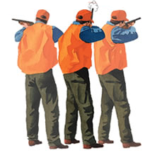
Shotgun Genome Sequencing
Complete genome copies
Fragmented genome chunks

Slide 7
Shotgun Genome Sequencing
Fragmented genome chunks
NOT REALLY DONE BY DUCK HUNTERS
Hydroshearing, sonication, enzymatic shearing
Notes:
Fragment sizes differ for different seq platforms.

Slide 8
Pre Next Generation Sequencing
Fragments were cloned:

Slide 9
Notes:
One tube per 2 sequences with Sanger and cloning. Not so bad if you only want 100 sequences. What if you want 1 million?

Slide 10
x millions
Notes:
One tube per 2 sequences with Sanger and cloning. Not so bad if you only want 100 sequences. What if you want 1 million?

Slide 11
x millions
Notes:
One tube per 2 sequences with Sanger and cloning. Not so bad if you only want 100 sequences. What if you want 1 million?

Slide 12
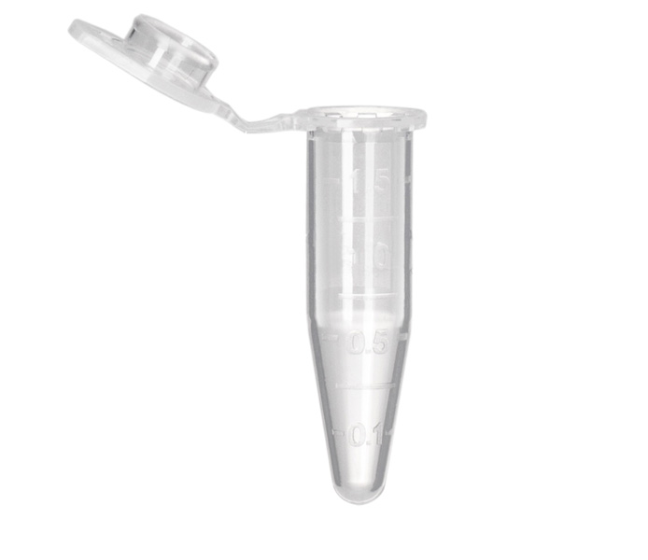
Sanger Sequencing Reactions
Template DNA
Known Primer (~20bp)
DNA Polymerase
Dideoxy Nucleotides
G
A
T
C
Regular Nucleotides
T
C
G
A
C
G
A
T
G
G
A
T
G
T
C
G
A
A
T
A
C
T
G
G
A
T
A
T
G
Labeled
Terminators
T
A
C
C
G
A
C
C
A
T
A
C
G

Slide 13
Sanger Sequencing
Primer
5’
T G C G C G G C C C A
A C G C G C C G G G T ? ? ? ? ? ? ? ? ? ? ? ? ? ? ?
3’
5’

Slide 14
Sanger Sequencing
Primer
5’
G T C T T G G G C T
T G C G C G G C C C A
A C G C G C C G G G T C A G A A C C C G A T C G C G
3’
5’

Slide 15
Sanger Sequencing
Primer
5’
G T C T T G G G C T A G C G C
T G C G C G G C C C A
A C G C G C C G G G T C A G A A C C C G A T C G C G
3’
5’
5’
21 bp
G T C T T G G G C T
T G C G C G G C C C A

Slide 16
Sanger Sequencing
Primer
5’
G T C T T G G G C T A
T G C G C G G C C C A
A C G C G C C G G G T C A G A A C C C G A T C G C G
3’
5’
5’
21 bp
G T C T T G G G C T
T G C G C G G C C C A
5’
26 bp
G T C T T G G G C T A G C G C
T G C G C G G C C C A

Slide 17
Sanger Sequencing
Primer
5’
G
T G C G C G G C C C A
A C G C G C C G G G T C A G A A C C C G A T C G C G
3’
5’
5’
21 bp
G T C T T G G G C T
T G C G C G G C C C A
5’
26 bp
G T C T T G G G C T A G C G C
T G C G C G G C C C A
5’
22 bp
G T C T T G G G C T A
T G C G C G G C C C A

Slide 18
Sanger Sequencing
Primer
5’
G T C T T G G G C
T G C G C G G C C C A
A C G C G C C G G G T C A G A A C C C G A T C G C G
3’
5’
5’
21 bp
G T C T T G G G C T
T G C G C G G C C C A
5’
26 bp
G T C T T G G G C T A G C G C
T G C G C G G C C C A
5’
22 bp
G T C T T G G G C T A
T G C G C G G C C C A
5’
12 bp
G
T G C G C G G C C C A

Slide 19
Sanger Sequencing
Primer
5’
G T C T T
T G C G C G G C C C A
A C G C G C C G G G T C A G A A C C C G A T C G C G
3’
5’
5’
21 bp
G T C T T G G G C T
T G C G C G G C C C A
5’
26 bp
G T C T T G G G C T A G C G C
T G C G C G G C C C A
5’
22 bp
G T C T T G G G C T A
T G C G C G G C C C A
5’
12 bp
G
T G C G C G G C C C A
5’
20 bp
G T C T T G G G C
T G C G C G G C C C A

Slide 20
Sanger Sequencing
A C G C G C C G G G T C A G A A C C C G A T C G C G
3’
5’
5’
21 bp
G T C T T G G G C T
T G C G C G G C C C A
5’
26 bp
G T C T T G G G C T A G C G C
T G C G C G G C C C A
5’
22 bp
G T C T T G G G C T A
T G C G C G G C C C A
5’
12 bp
G
T G C G C G G C C C A
5’
20 bp
G T C T T G G G C
T G C G C G G C C C A
5’
16 bp
G T C T T
T G C G C G G C C C A

Slide 21
Sanger Sequencing
A C G C G C C G G G T ? ? ? ? ? ? ? ? ? ? ? ? ? ? ?
3’
5’
5’
21 bp
? ? ? ? ? ? ? ? ? T
T G C G C G G C C C A
5’
26 bp
? ? ? ? ? ? ? ? ? ? ? ? ? ? C
T G C G C G G C C C A
5’
22 bp
? ? ? ? ? ? ? ? ? ? A
T G C G C G G C C C A
5’
12 bp
G
T G C G C G G C C C A
5’
20 bp
? ? ? ? ? ? ? ? C
T G C G C G G C C C A
5’
16 bp
? ? ? ? T
T G C G C G G C C C A
Notes:
Has to be done in a single tube per rxn.

Slide 22
Sanger Sequencing
Laser Reader
5’
5’
5’
5’
5’
5’
5’
5’
5’
5’
5’
20 bp
21 bp
19 bp
18 bp
13 bp
22 bp
15 bp
16 bp
14 bp
17 bp
G T C T T G G G C
12 bp
T G C G C G G C C C A
G T C T T G G G C T
T G C G C G G C C C A
G T C T T G G G
T G C G C G G C C C A
G T C T T G G
G T C T T G G G C T A
G T C T
T G C G C G G C C C A
T G C G C G G C C C A
G T
G T C T T
G T C T T G
G
T G C G C G G C C C A
T G C G C G G C C C A
T G C G C G G C C C A
T G C G C G G C C C A
T G C G C G G C C C A
T G C G C G G C C C A
G T C

Slide 23
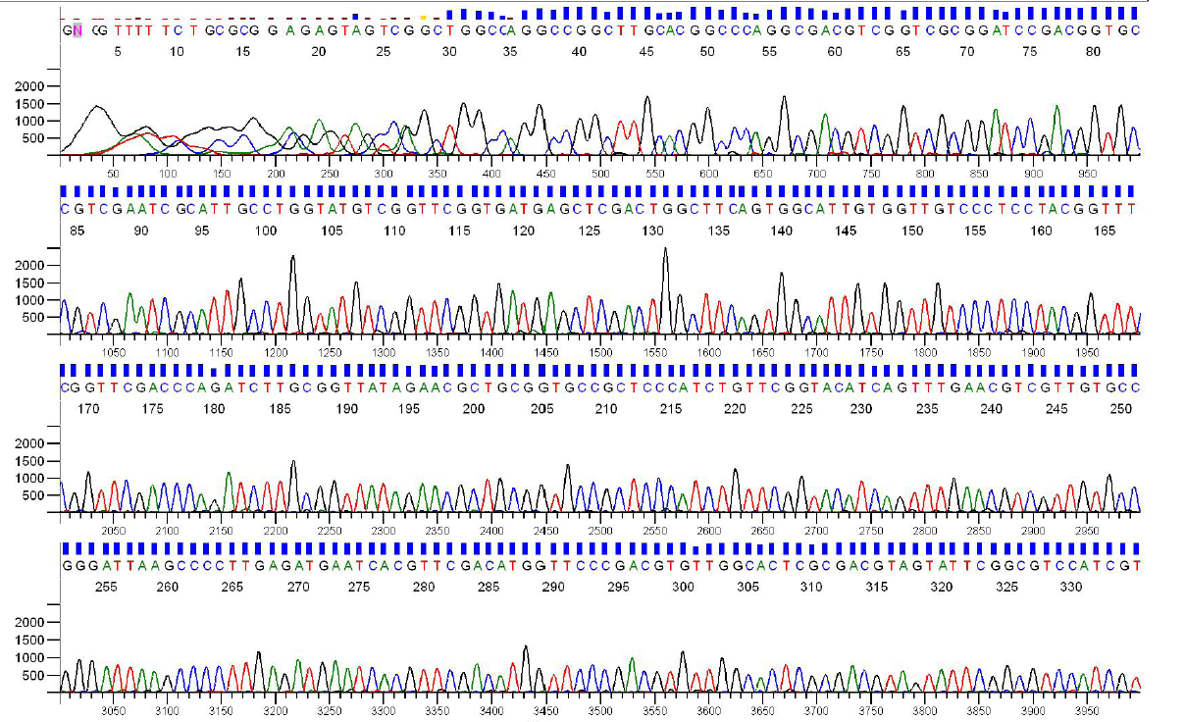
Sanger Sequencing Output
Each sequencing reaction gives us a chromatogram, usually ~600-1000 bp:

Slide 24
Sanger Throughput Limitations
Must have 1 colony picked for every 2 reactions
Must do 1 DNA prep for every 2 reactions
Must have 1 PCR tube for each reaction
Must have 1 gel lane for each reaction
AKA: Must have undergrad/entry-level labor!

Slide 25
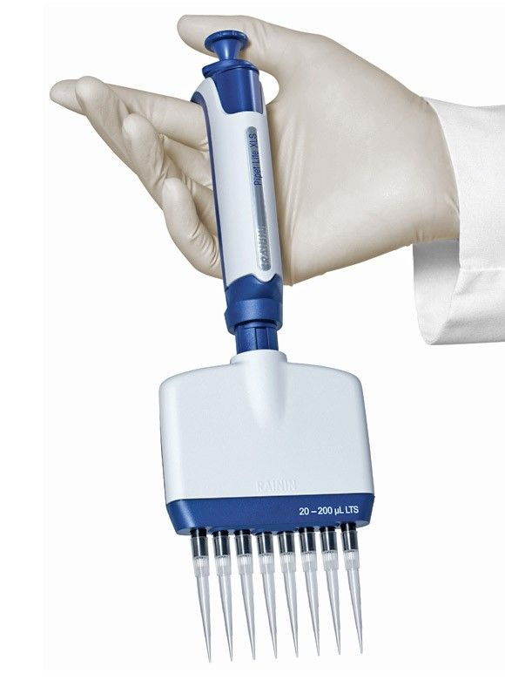
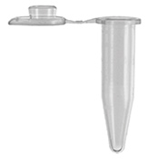
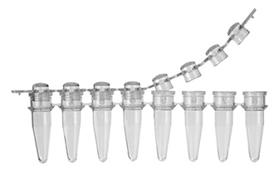

Slide 26
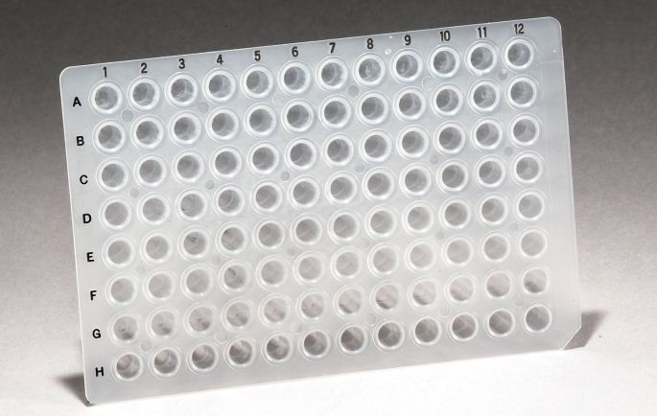
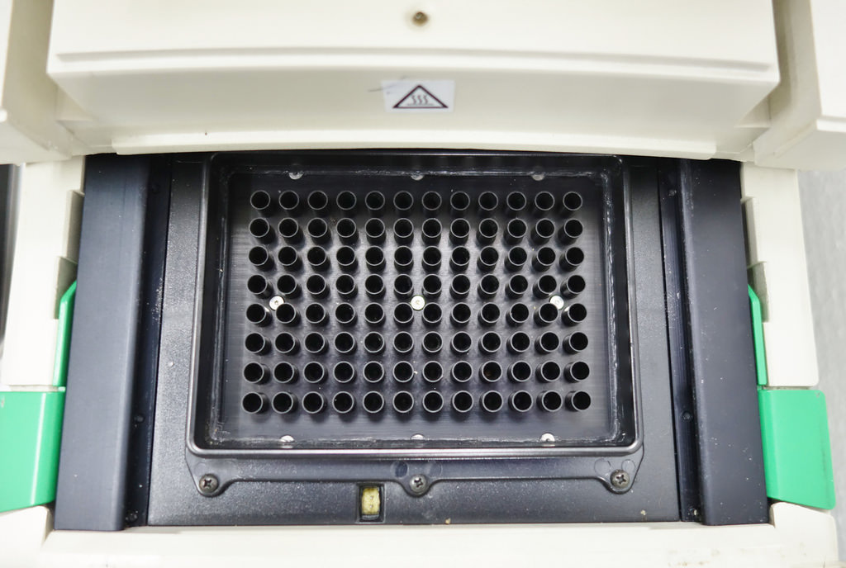
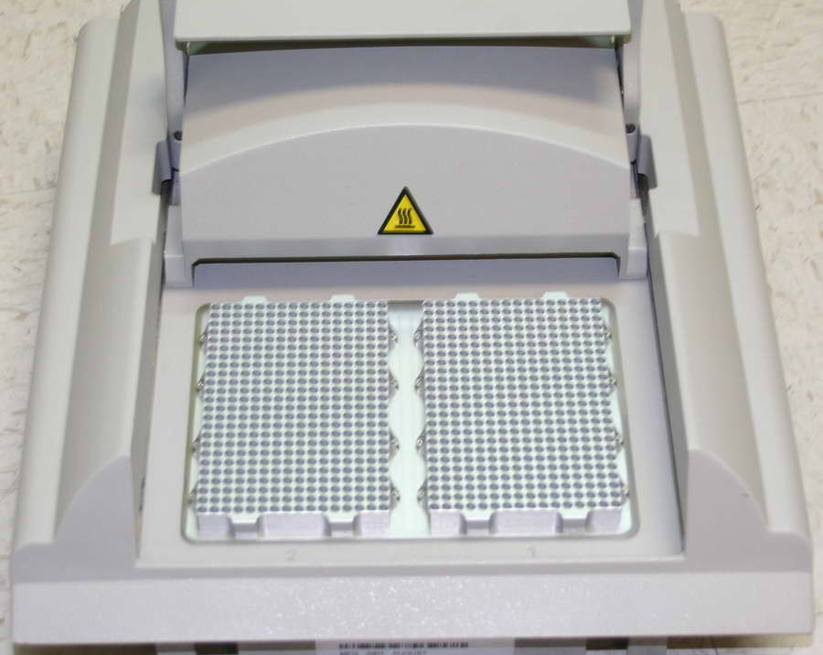
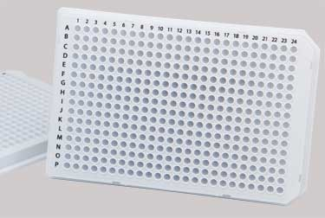

Slide 27
Colony Picking Robot

Slide 28
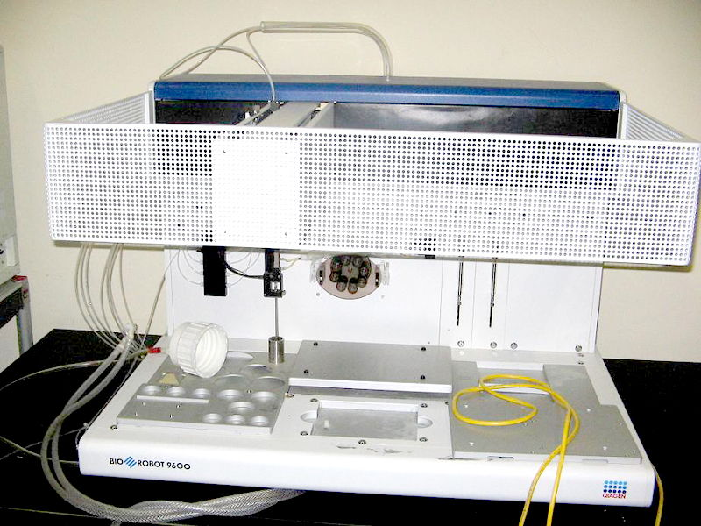

Slide 29
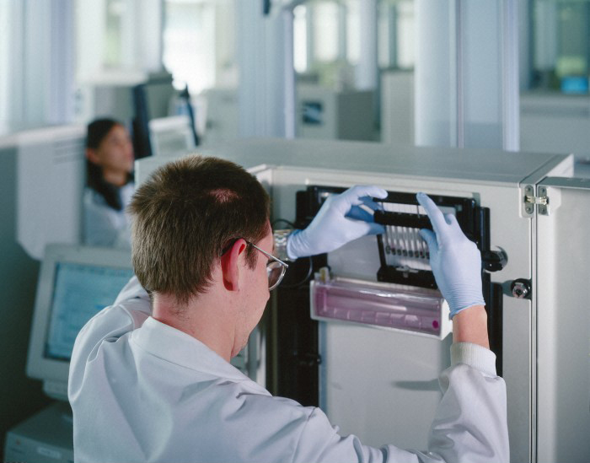

Slide 30
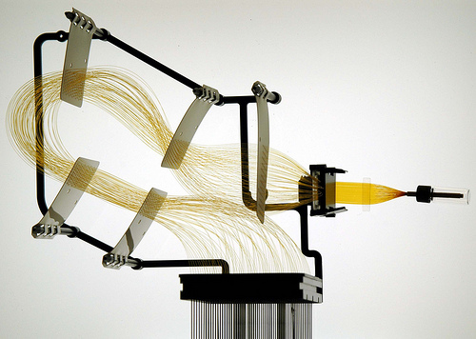
Capillary Arrays

Slide 31
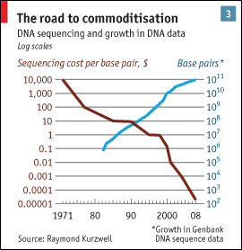
Sanger Throughput Limitations
Must have 1 colony picked for every 2 reactions
Must do 1 DNA prep for every 2 reactions
Must have 1 PCR tube for each reaction
Must have 1 gel lane for each reaction
from The Economist

Slide 32
Problem: How can we do way more reactions at once without having more tubes, thermocyclers, etc.?

Slide 33
Next generation sequencing
Massively parallel

Slide 34
Next generation sequencing

Slide 35
Shotgun sequencing by PGM/454
Genomic
Fragment
Adapters

Slide 36
Next generation sequencing

Slide 37
Shotgun sequencing by PGM/454
Bead/ISP
Adapter
Complement
Sequences
The idea is that each bead should be amplified
all over with a SINGLE library fragment.

Slide 38
Shotgun sequencing by PGM/454
Problem: How do I do PCR to amplify the fragments without having to use 1 tube for each reaction?

Slide 39
Shotgun sequencing by PGM/454

Slide 40
Shotgun sequencing by PGM/454

Slide 41
Shotgun sequencing by PGM/454

Slide 42
Shotgun sequencing by PGM/454
~3.5 µm for Ion Torrent, ~30 µm for 454

Slide 43
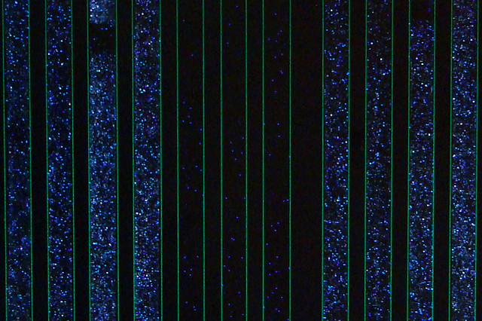
Raw 454 data
Only give polymerase one nucleotide at a time:
G
G
G
Primer
G
G
5’
G
T
T G C G C G G C C C A
C
T T
G G G
A C G C G C C G G G T C A G A A C C C G A T C G C G
3’
5’
If that nucleotide is incorporated, enzymes turn by-products into light:
1 2 3 4 5
The real power of this method is that it can take place in millions of tiny wells in a single plate at once.
T C A G T C A G T C A G

Slide 44
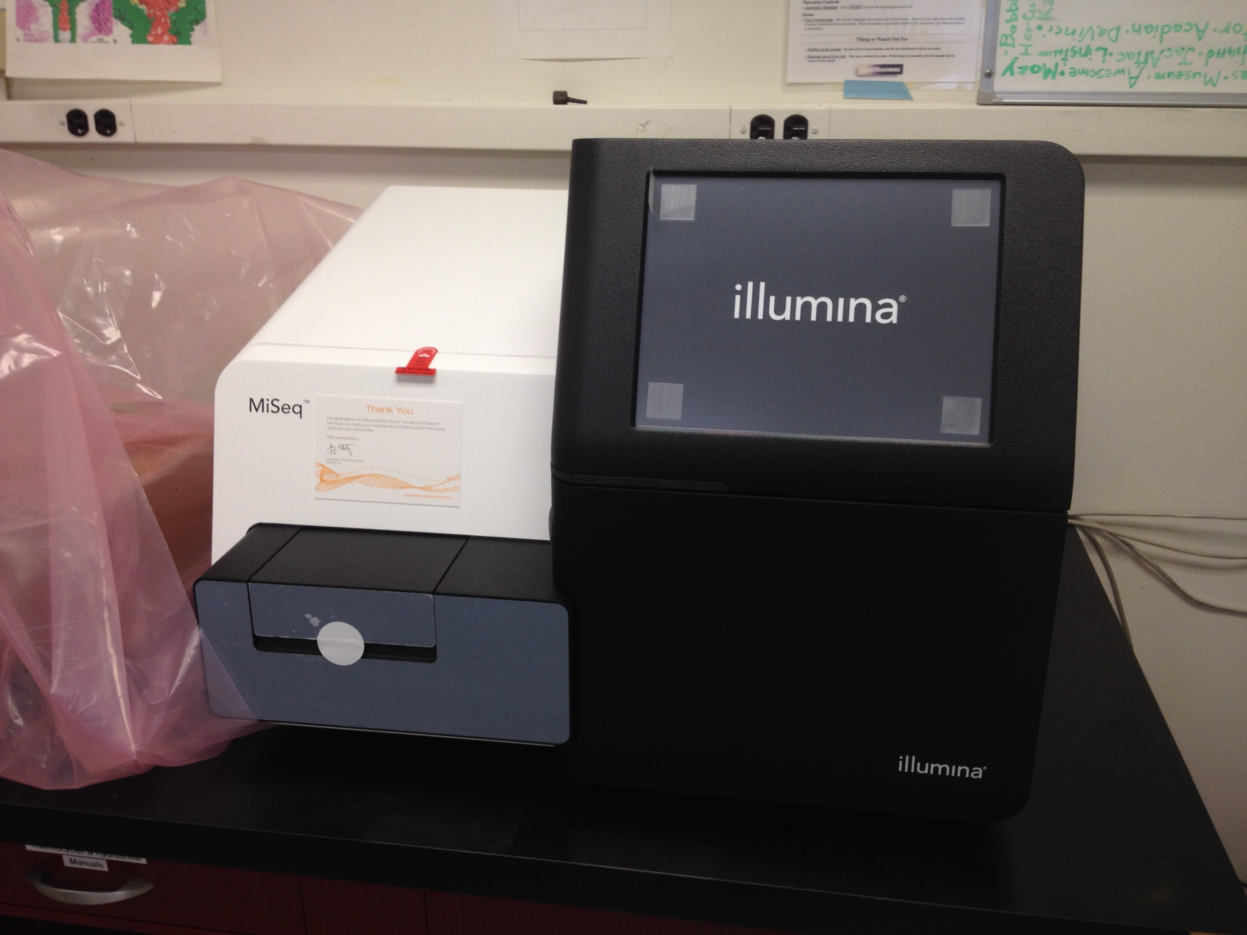
Illumina Sequencing

Slide 45
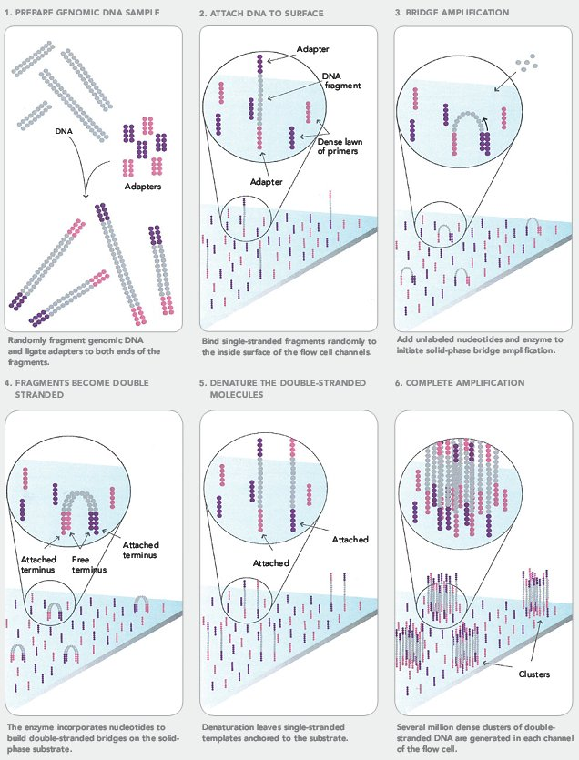
Illumina Sequencing

Slide 46
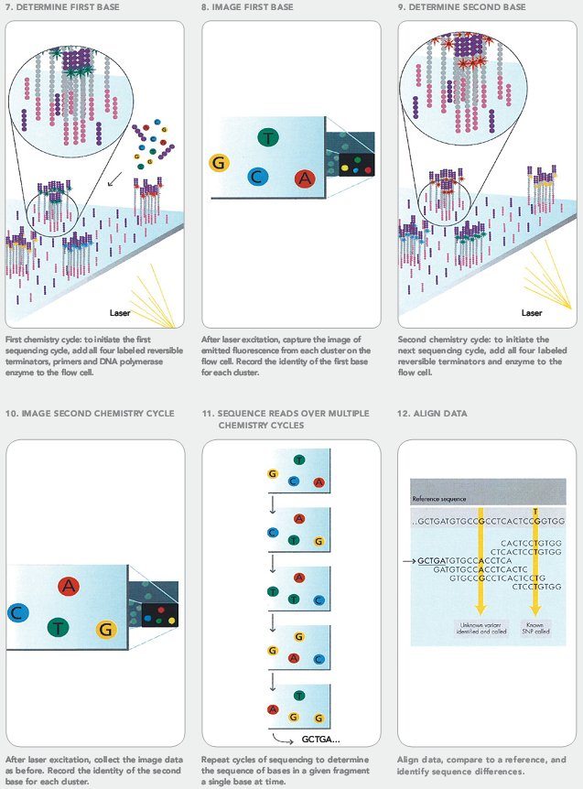
Illumina Sequencing

Slide 47
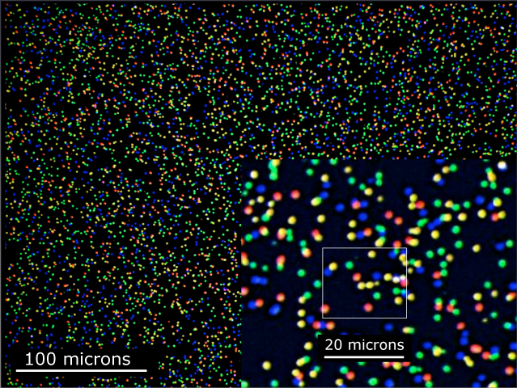
Illumina Sequencing

Slide 48
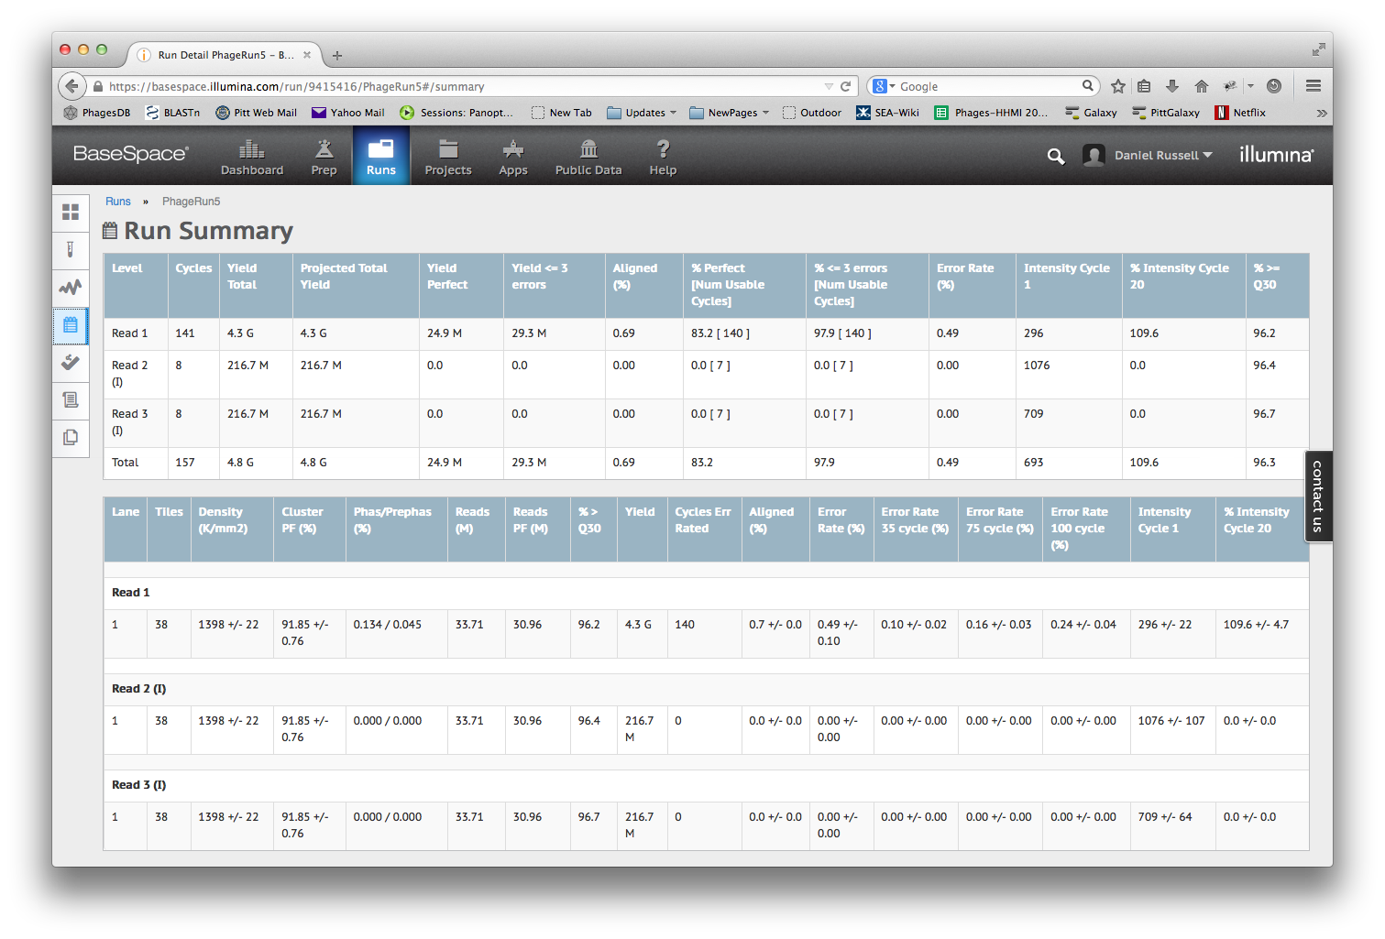

Slide 50
Next-Gen Sequencing
Take home message: Massively Parallel
We’re talking millions or billions of concurrent reads, but without separate tubes

Slide 51
Overview
Sequencing
Assembly

Slide 52
Method | Read Length
Sanger | 600-1000 bp
454 | 400-800 bp
Illumina | 75-300 bp
Ion Torrent | ~200 bp
PacBio/Nanopore | ~10,000 bp
But…
Phage Genome: ~5,000 to ~500,000 bp
Bacteria: Several million bp
Human: 3 billion bp

Slide 53
Assembly
17 bp
ATTGTTCCCACAGACCG
CGGCGAAGCATTGTTCC
ACCGTGTTTTCCGACCG
AGCTCGATGCCGGCGAAG
TTGTTCCCACAGACCGTG
TTTCCGACCGAAATGGC
ATGCCGGCGAAGCATTGT
ACAGACCGTGTTTCCCGA
TAATGCGACCTCGATGCC
AAGCATTGTTCCCACAG
TGTTTTCCGACCGAAAT
TGCCGGCGAAGCCTTGT
CCGACCGAAATGGCTCC
66 bp

Slide 54
Assembly
Consensus:
TAATGCGACCTCGATGCCGGCGAAGCATTGTTCCCACAGACCGTGTTTTCCGACCGAAATGGCTCC
ATTGTTCCCACAGACCG
CGGCGAAGCATTGTTCC
ACCGTGTTTTCCGACCG
AGCTCGATGCCGGCGAAG
TTGTTCCCACAGACCGTG
TTTCCGACCGAAATGGC
ATGCCGGCGAAGCATTGT
ACAGACCGTGTTTCCCGA
TAATGCGACCTCGATGCC
AAGCATTGTTCCCACAG
TGTTTTCCGACCGAAAT
TGCCGGCGAAGCCTTGT
CCGACCGAAATGGCTCC

Slide 55
Assembly
Consensus:
TAATGCGACCTCGATGCCGGCGAAGCATTGTTCCCACAGACCGTGTTTTCCGACCGAAATGGCTCC
ATTGTTCCCACAGACCG
CGGCGAAGCATTGTTCC
ACCGTGTTTTCCGACCG
AGCTCGATGCCGGCGAAG
TTGTTCCCACAGACCGTG
TTTCCGACCGAAATGGC
ATGCCGGCGAAGCATTGT
ACAGACCGTGTTTCCCGA
TAATGCGACCTCGATGCC
AAGCATTGTTCCCACAG
TGTTTTCCGACCGAAAT
TGCCGGCGAAGCCTTGT
CCGACCGAAATGGCTCC
Newbler

Slide 56
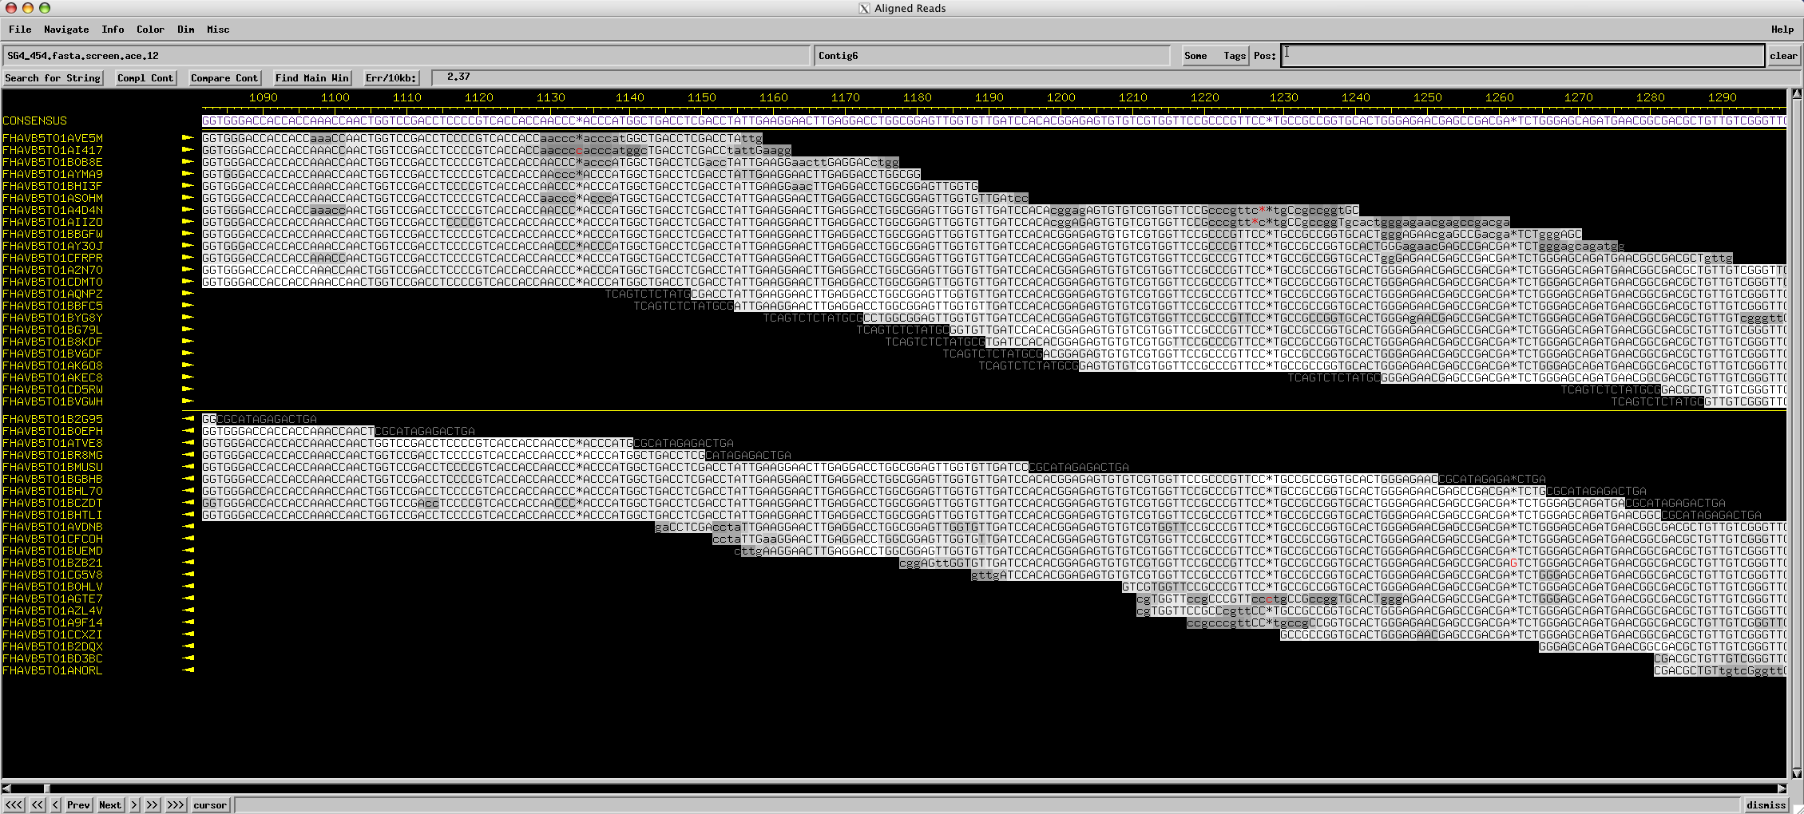
Assembly
Consed

Slide 57
Assembly
Using programs to find overlapping alignments in sequencing reads and build contigs.
The quality of an assembly depends on:
Program used
Type, quality, and length of individual reads
Number of reads used
Complexity of the genome

Slide 58
Finishing
Using a combination of programs and wet-bench experiments to close gaps, resolve weak areas, and ensure a high-quality extremely-low-error final genome sequence that is properly cut, oriented, and ready to annotate.
SEAphages aims for zero gaps and zero errors

Slide 59
From 1998 Genome Project Report
“DNA sequencing technology has improved dramatically since the genome project began. The amount of sequence produced each year is increasing steadily; individual centers are now producing tens of millions of base pairs of sequence annually…”

Slide 60
From 1998 Genome Project Report
“DNA sequencing technology has improved dramatically since the genome project began. The amount of sequence produced each year is increasing steadily; individual centers are now producing tens of millions of base pairs of sequence annually…”

Slide 61
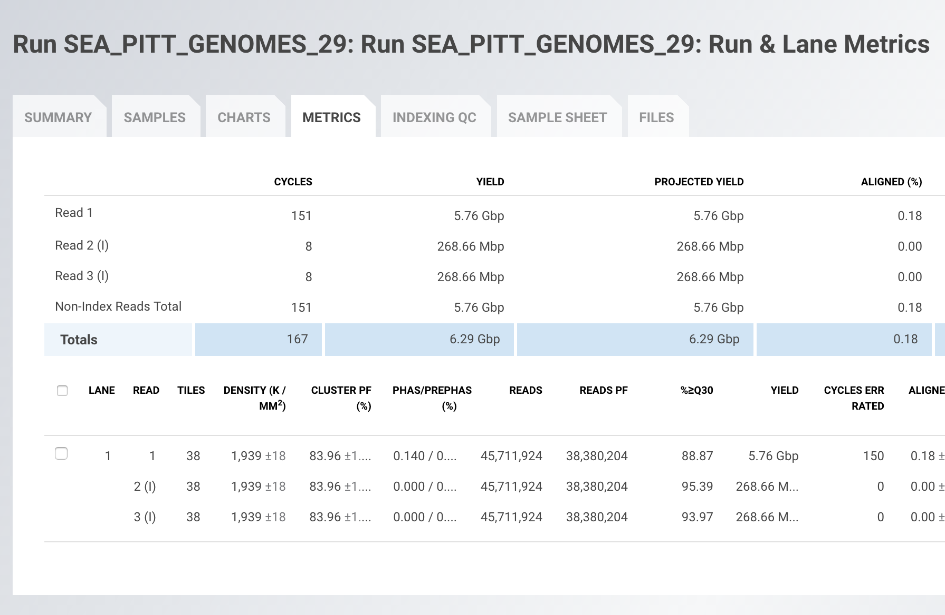
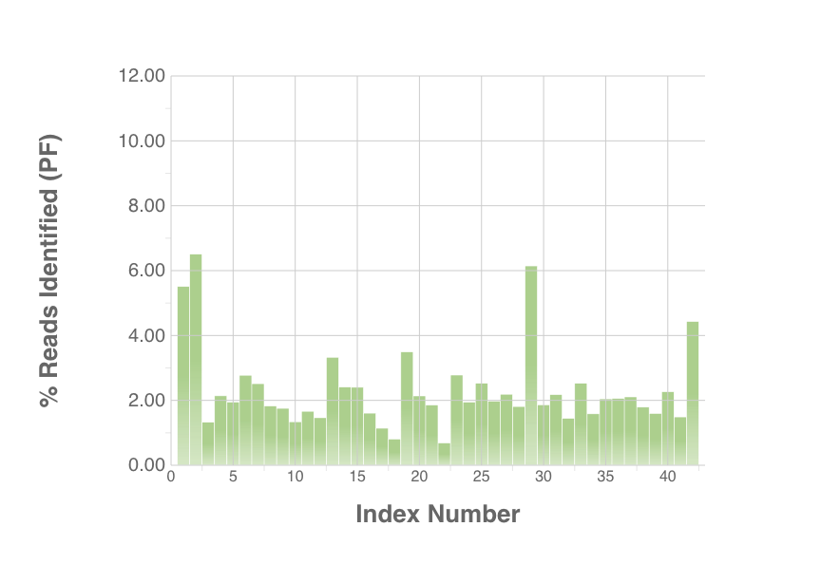
Becky Garlena
“Individual Beckys are now producing billions of base pairs of sequence twice a week…”

Slide 62
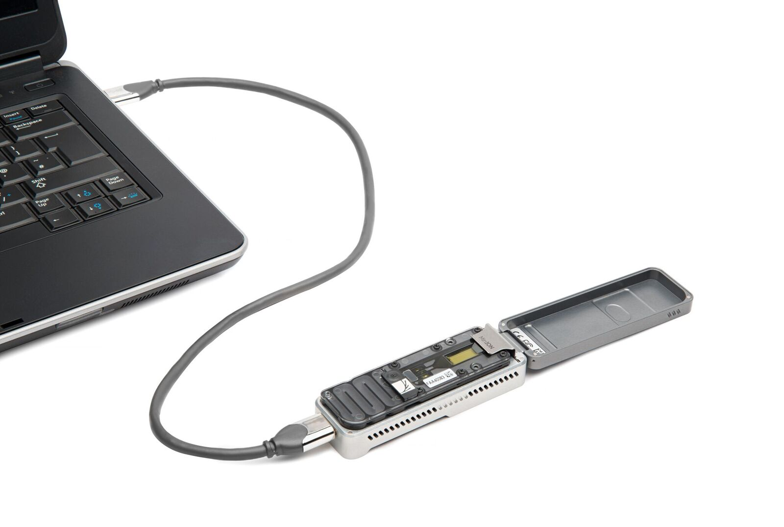

Slide 63
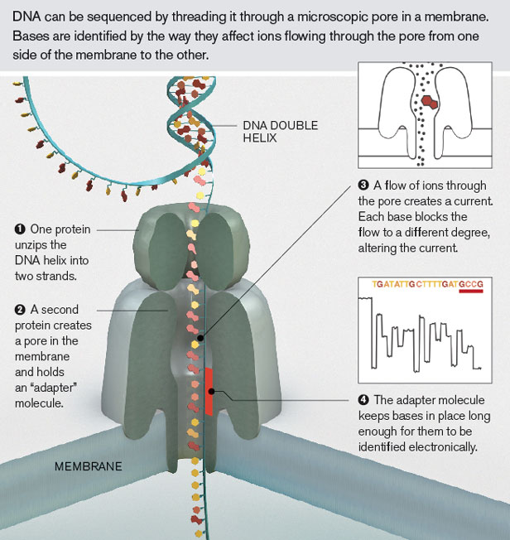
Oxford Nanopore

Slide 64
“The MinION has been used to successfully read … 100,000 base pairs during a single DNA capture, [which] has never been managed before using traditional sequencing techniques.
… but Oxford Nanopore has also introduced GridION [and] the company reckon that a 20-node GridION setup can sequence a complete human genome in just 15 minutes.”
—Wired

Slide 65
Pacific BioSciences sequencing

Slide 66
Pacific BioSciences sequencing (more detail)

Slide 67
Take home
Sequencing getting better faster than computers
Finishing is a prerequisite for annotation
Bioinformatics skills are very marketable

Slide 68
Assemblers, Contigs, N50, NG50
A nice description is in Niema Moshiri’ lecture at
https://www.youtube.com/watch?v=sdKKrC5jtPk&list=PLM_KIlU0WoXkR_MKrUDQPtKR2DNGAxaoi&index=2

Slide 69
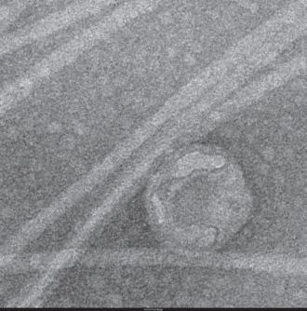
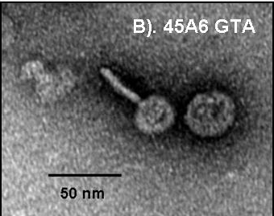
GTAs
Genetic transfer Agents
Are they under purifying selection?
Does this reveal function?

Slide 70
Purifying selection in GTA genes
dN/dS <1 for GTA genes has been used to infer selection for function
GTA genes
Lang AS, Zhaxybayeva O, Beatty JT. Nat Rev Microbiol. 2012 Jun 11;10(7):472-82
Lang, A.S. & Beatty, J.T. Trends in Microbiology , Vol.15, No.2 , 2006
Notes:
The ratio of non-synonymous-to-synonymous (dN/dS, or ω) codon substitution rates can be used as an indication of the selective pressure acting on a protein-coding gene. If a gene (or gene segment) is under purifying selection, non-synonymous mutations (that is, mutations resulting in a change of the encoded amino acid) will be selected against, resulting in ω < 1. In neutrally evolving proteins, synonymous and non-synonymous mutations will be fixed at approximately the same rate, resulting in ω = 1. Because different regions of a protein-coding gene may be under different selective constraints, codons can be divided into two categories: those with ω < 1 (yellow; the estimated ω is indicated on the bar) and those with ω fixed to 1 (green); the estimated proportion of codons in each category is given on the horizontal axis.

Slide 71
Figure 2: Nested levels of selection on gene content.
From: https://www.nature.com/articles/nrg3962 doi: 10.1038/nrg3962

Slide 72
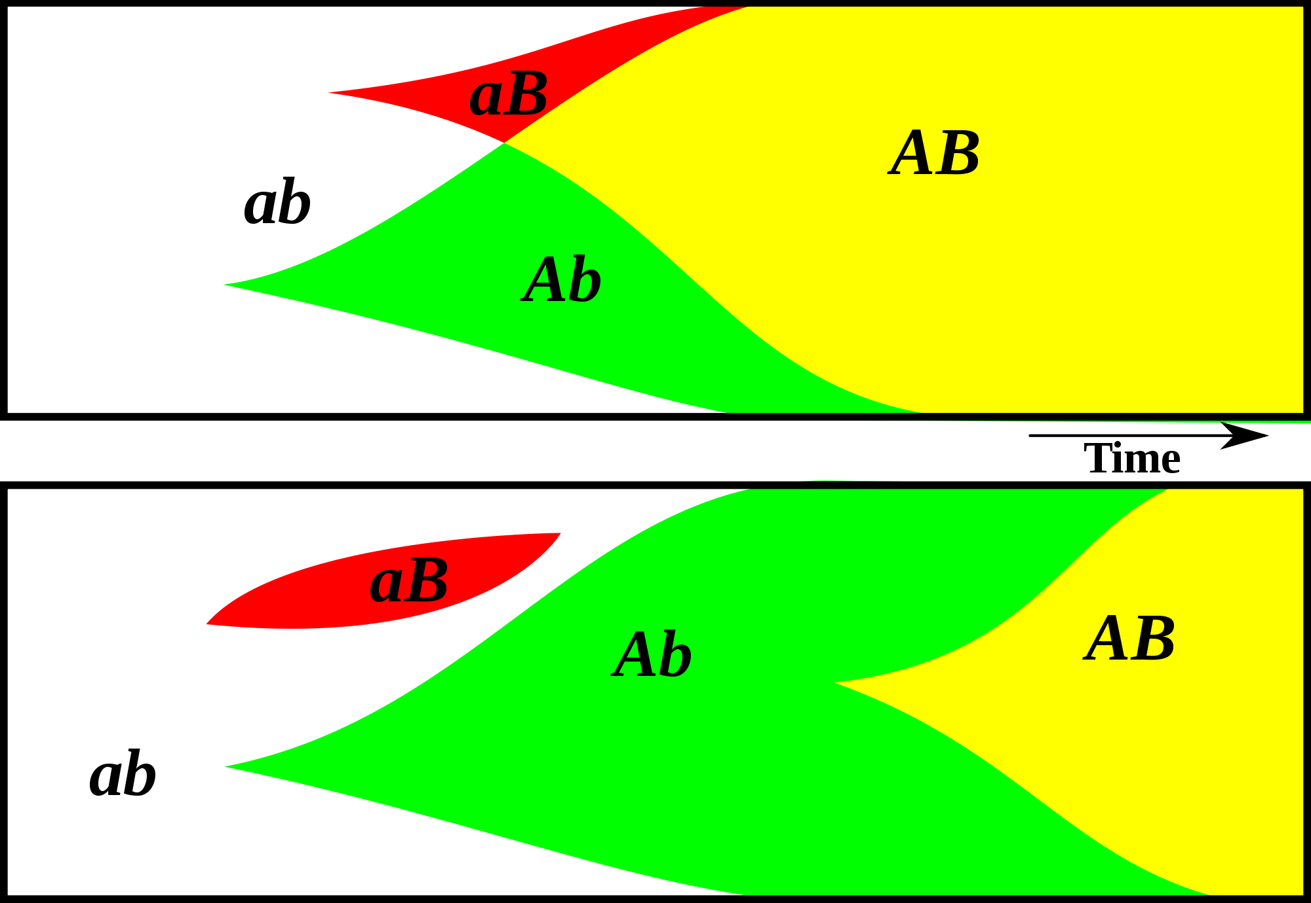
Gene Transfer, Sex, and Recombination:
Inventions do not need to be made sequentially
Gene transfer, followed by homologous or non-homologous recombination, allows inventions to be shared across the tree of life

Slide 73
GTAs cannot survive as selfish genetic elements, because
GTAs are too small to encode all GTA genes
The GTA+ cell dies upon release of the GTAs
At best one GTA- cell (that has a mutation in its GTA genes) can be converted to GTA+.
Recombination is beneficial to a group, because it prevents slightly deleterious mutations to be fixed along site beneficial ones, and it allows beneficial mutations that occurred in different cells to come together in a lineage. However, GTAs do not represent an evolutionary stable strategy.
GTA- cells can invade GTA+ population (the never lyse themselves, and the reap the benefits of recombination).
GTA+ cells can only invade a GTA- population, if the GTA+ cells manage somehow to restrict recombination to other GTA+ cells.
Why are GTAs around?
GTAs just represent decaying phages … But they are under purifying selection (however, see below).
The gene transfer they catalyze has some other benefits; Rosie Redfield (here) discusses the possibility that they might help transfer immunity against phages. (Can this be an evolutionary stable strategy?)

Slide 74
Purifying selection in E.coli ORFans
dN-dS < 0 for some ORFan E. coli clusters seems to suggest they are functional genes.
Gene groups | Number | dN-dS>0 | dN-dS<0 | dN-dS=0
E. coli ORFan clusters | 3773 | 944 (25%) | 1953 (52%) | 876 (23%)
Clusters of E.coli sequences found in Salmonella sp., Citrobacter sp. | 610 | 104 (17%) | 423(69%) | 83 (14%)
Clusters of E.coli sequences found in some Enterobacteriaceae only | 373 | 8 (2%) | 365 (98%) | 0 (0%)
Adapted after Yu, G. and Stoltzfus, A. Genome Biol Evol (2012) Vol. 4 1176-1187

Slide 75
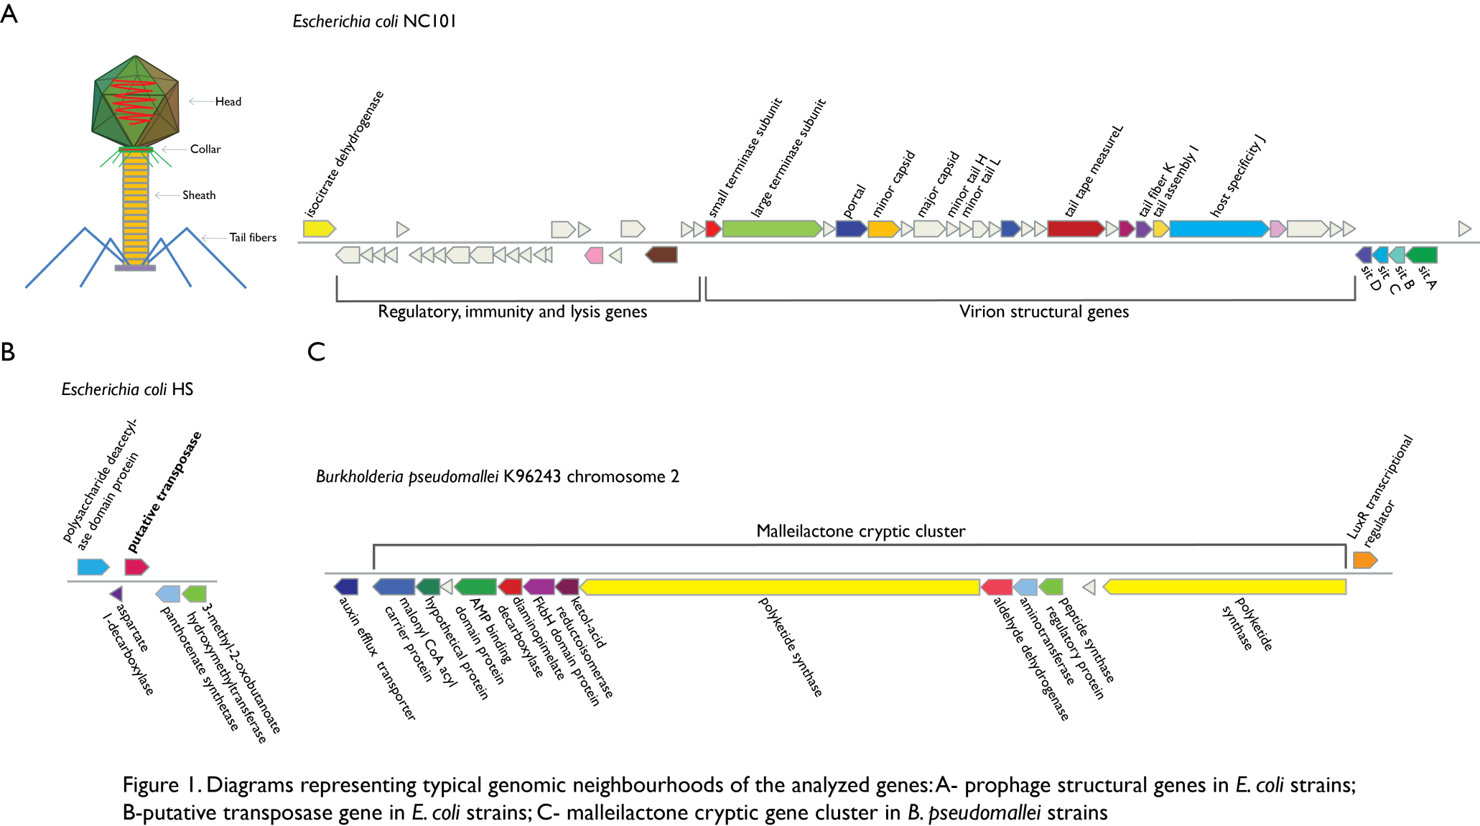
Vertically Inherited Genes Not Expressed for Function

Slide 76
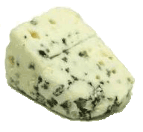
Trunk-of-my-car analogy: Hardly anything in there is the is the result of providing a selective advantage. Some items are removed quickly (purifying selection), some are useful under some conditions, but most things do not alter the fitness. See here for a published version.
Could some of the inferred purifying selection be due to the acquisition of novel detrimental characteristics (e.g., protein toxicity, HOPELESS MONSTERS)?

Slide 77
Counting Algorithm
Calculate number of different nucleotides/amino acids per MSA column (X)
Calculate number of nucleotides/amino acids substitutions (X-1)
Calculate number of synonymous changes
S=(N-1)nc-N
assuming N=(N-1)aa
X=2 1 nucleotide substitution
1 non-synonymous change
X=2 1 amino acid substitution

Slide 78
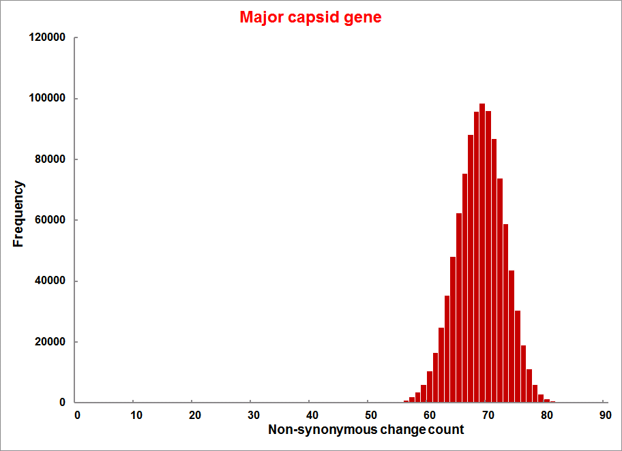
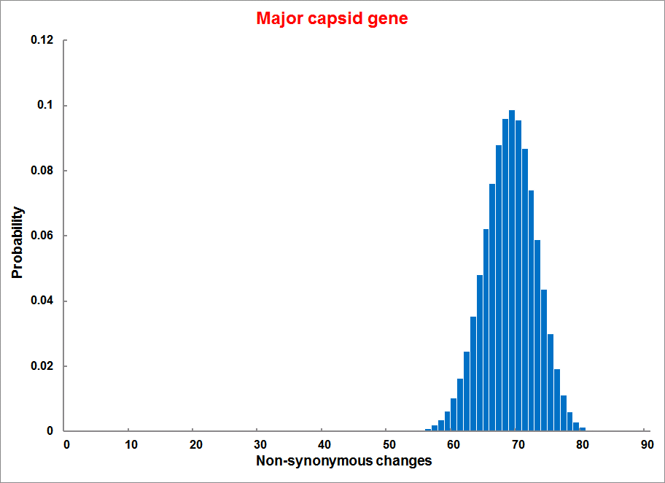
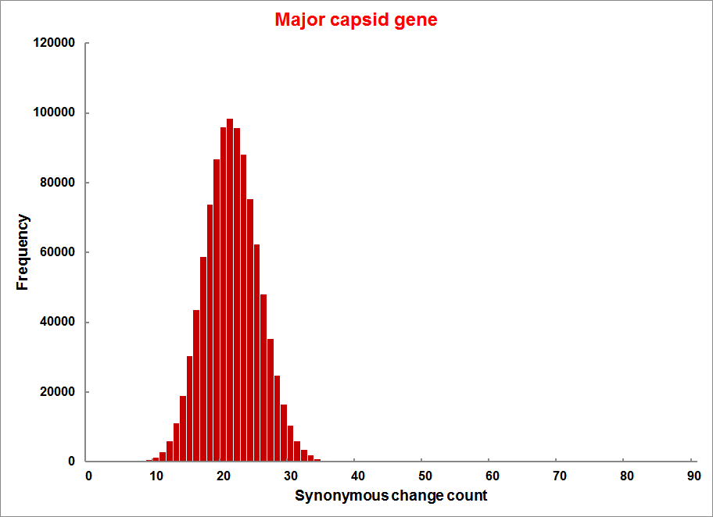
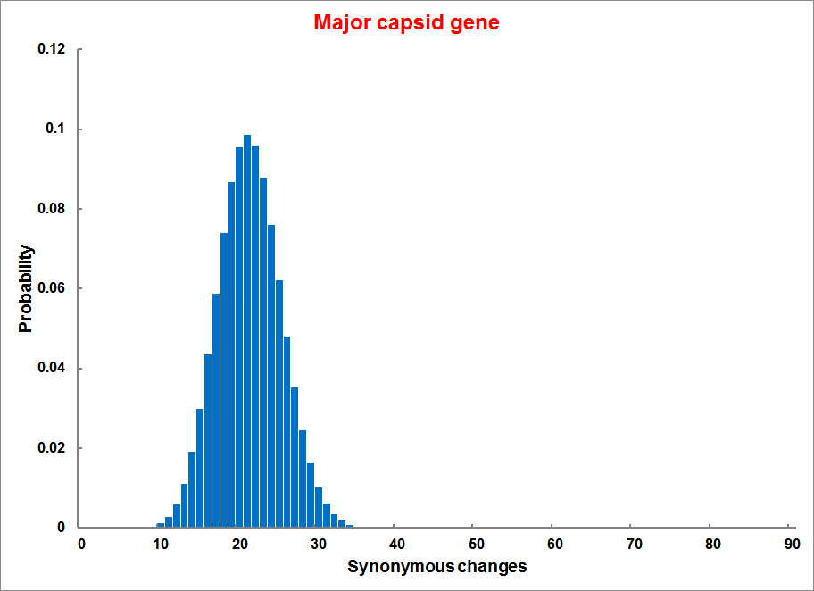
Evolution of Coding DNA Sequences Under a Neutral Model E. coli Prophage Genes
Count distribution from simulations
Probability distribution
n=90
Non-synonymous
n= 90
k= 24
p=0.763
P(≤24)=3.63E-23
Observed=24
P(≤24) < 10⁻⁶
n=90
Synonymous
n= 90
k= 66
p=0.2365
P(≥66)=3.22E-23
Observed=66
P(≥66) < 10⁻⁶

Slide 79
Evolution of Coding DNA Sequences Under a Neutral Model E. coli Prophage Genes
 |  | OBSERVED |  | SIMULATED |  | Dnapars | Simulated | Codeml
Gene | Alignment Length (bp) | Substitutions | Synonymous changes* | Substitutions | p-value synonymous (given *) | Minimum number of substitutions | dN/dS | dN/dS
Major capsid | 1023 | 90 | 66 | 90 | 3.23E-23 | 94 | 0.113 | 0.13142
Minor capsid C | 1329 | 81 | 59 | 81 | 1.98E-19 | 84 | 0.124 | 0.17704
Large terminase subunit | 1923 | 75 | 67 | 75 | 7.10E-35 | 82 | 0.035 | 0.03773
Small terminase subunit | 543 | 100 | 66 | 100 | 1.07E-19 | 101 | 0.156 | 0.25147
Portal | 1599 | 55 | 46 | 55 | 1.36E-21 | *64 | 0.057 | 0.08081
Protease | 1329 | 55 | 37 | 55 | 4.64E-11 | 55 | 0.162 | 0.24421
Minor tail H | 2565 | 260 | 168 | 260 | 1.81E-44 | 260 | 0.17 | 0.30928
Minor tail L | 696 | 30 | 26 | 30 | 1.30E-13 | 30 | 0.044 | 0.05004
Host specificity J | 3480 | 723 | 498 | 723 | 6.42E-149 | *773 | 0.137 | 0.17103
Tail fiber K | 741 | 41 | 28 | 41 | 1.06E-09 | 44 | 0.14 | 0.18354
Tail assembly I | 669 | 39 | 33 | 39 | 3.82E-15 | 40 | 0.064 | 0.07987
Tail tape measure protein | 2577 | 375 | 243 | 375 | 7.92E-64 | 378 | 0.169 | 0.27957
Values well under the p=0.01 threshold, suggesting rejection of the null hypothesis of neutral evolution of prophage sequences.

Slide 80
dN/dS < 1 is not sufficient evidence for the beneficial function of the encoded protein.
Prophages that have not been active as phages and are inherited vertically have a dN/dS below 1.
Purifying selection (dN/dS < 1) may occur because the gene product after the mutation is detrimental, not because the gene before mutation was beneficial.

Slide 81
HGT and the pangenome

Slide 82
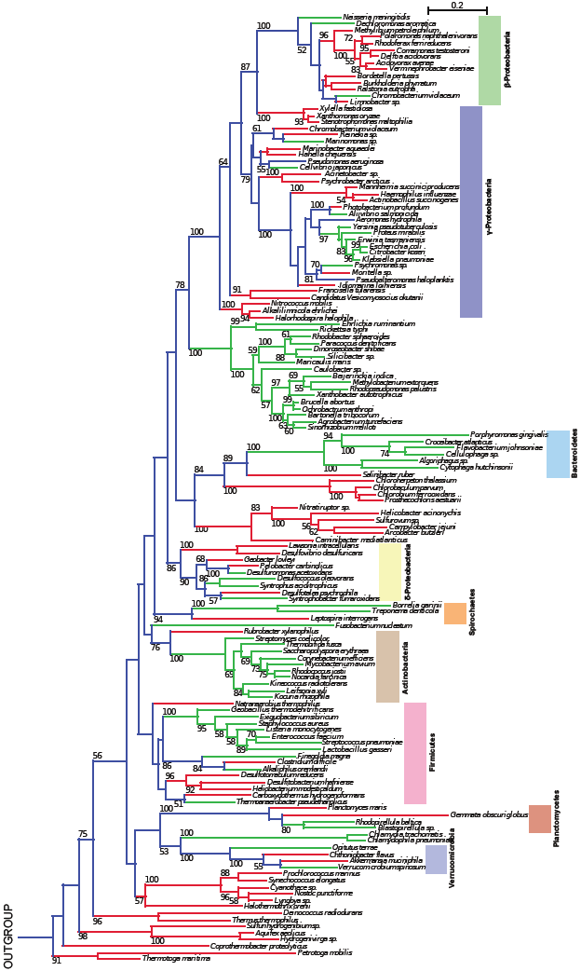
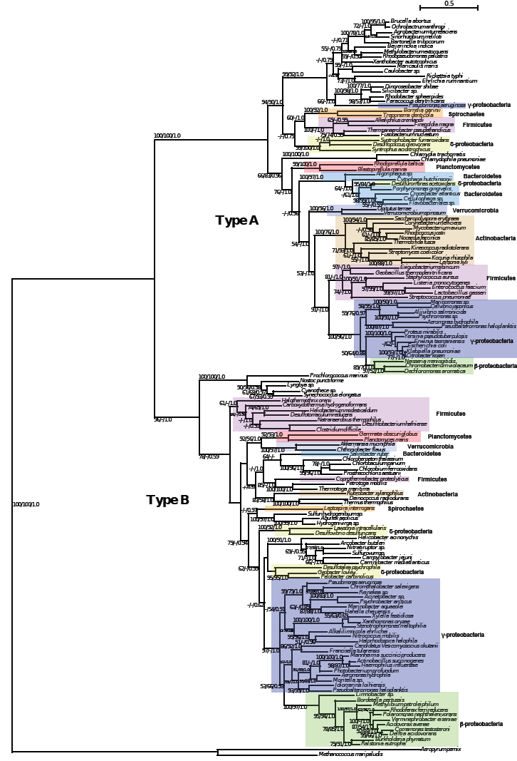
TyrRS
16S rRNA
Green -Type A
Red - Type B
Blue -Types A,B
Andam, Williams, Gogarten 2010 PNAS
Notes:
… a strong conflict with the organismal phylogeny as inferred from the 16S rRNA sequences is apparent.
The 16S rRNA tree shows the distribution of Types A and B.
For each of the two TyrRS groups, phylogenetic reconstruction resulted in trees similar to the ribosomal tree
Although the affiliation of members of a particular phylum does not exactly match that of the ribosomal tree, the overall phylogenetic structure for each bacterial TyrRS type is similar at the class and phylum levels (represented by the colored boxes).
The rRNA tree shows the distribution of Types A and B and the branches are color-coded, green branches – species with A, red branches with B. The internal branches are colored blue, indicating that the bacterial ancestor possessed both A and B. If this is indeed the case, then we have to infer a tremendous number of independent gene loss events that have occurred late in evolution (or the shallow nodes).

Slide 83
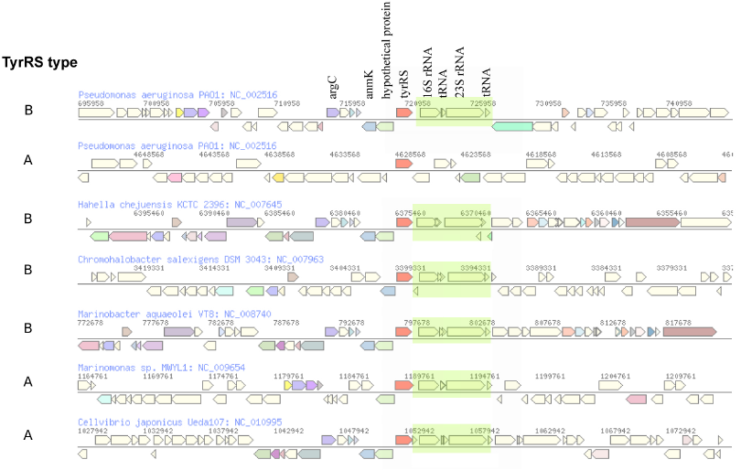
The genomic neighborhood of tyrRS in γ-proteobacteria
Andam, Williams, Gogarten 2010 PNAS
Notes:
similar neighboring gene identity and order for both tyrRS types A and B
The similarities in tyrRS region but differences in tyrRS type imply that transfer of tyrRS types among these genomes followed by homologous recombination. Although the two tyrRS types have low identity, homologous replacement with breakpoints in the neighboring genes may have facilitated the switching between TyrRS types. P. aeruginosa also carries tyrRS type A, but the genomic neighborhood of this gene does not show synteny with that of the tyrRS type A of other closely related taxa.
The finding of similar tyrRS gene neighborhoods in close relatives carrying either type A or type B provides evidence for the replacement of one form of tyrRS with another. Significantly, this rejects the differential loss hypothesis for these organisms. If the last common ancestor possessed both types of enzymes, we would expect the genes coding for each type of tyrRS to possess dissimilar genes flanking them.
The two TyrRS types are so divergent (approximately 28 % identity between the two Pseudomonas TyrRS types) that the possibility of homologous recombination within the TyrRS homeoalleles is unlikely. Consequently, in case of TyrRS homeoalleles, we expect that the unit of successful horizontal gene transfer includes at least the complete tyrRS gene.

Slide 84
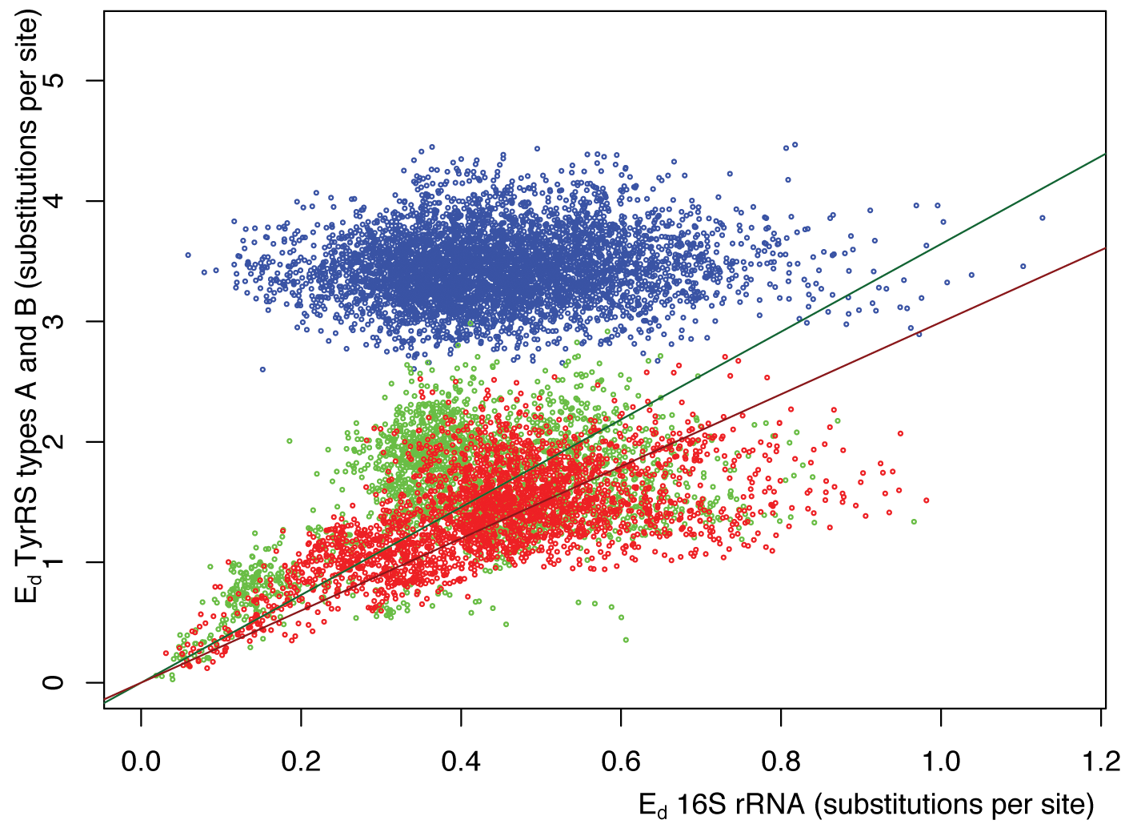
Pairwise distance between tyrRSs versus
pairwise distance of 16S rRNAs from the same genomes
Green -Type A tyrRS
Red - Type B tyrRS
Blue - Between the two types of tyrRS
Andam, Williams, Gogarten 2010 PNAS

Slide 85
Homeoalleles
Variants that have the same general function, but can have distinct characteristics.
Gene pool contains different homeoalleles, but individual strains and species usually contain only one of the alleles.
Can be brought together temporarily in a lineage through HGT
Andam, Williams, Gogarten 2010 PNAS
Notes:
The two TyrRS enzymes can be seen as variants similar to alleles in a population. Individual lines of descent possess one or the other of these variants, and in rare instances, they can possess both. We propose to call these variants homeoalleles. Like alleles, they have the same general function, but can have distinct characteristics. As is the case for homeologs in polypoids, homeoalleles cannot be considered orthologs, even though they are homologs with the same function. The line of descent has access to a gene pool that contains both TyrRS homeoalleles, whereas individual strains and species usually contain only one of the alleles. Genes in the accessible gene pool have different propensity to be swapped into an individual line of decent. Genes present in members of the same strain in the same environment likely have the highest propensity of being acquired, genes from organisms with similar regulatory promoter sequences and similar composition will be more frequently acquired than genes with less similar composition and promoters. Genes from divergent organisms will frequently fall in the latter category, and may contain sequence motifs incompatible with the genome organization of the recipient (36).
The two TyrRS types are so divergent (approximately 28 % identity between the two Pseudomonas TyrRS types) that the possibility of homologous recombination between the TyrRS homeoalleles is unlikely. Consequently, in case of TyrRS homeoalleles we expect that the unit of successful horizontal gene transfer includes at least the complete tyrRS gene. Homeoalelles can then be brought together temporarily in a lineage following horizontal transfer, but due to largely overlapping function, only one of the alleles is likely to survive in a lineage on the long run. The surviving allele may be selected due to an adaptive advantage under prevailing conditions.

Slide 86
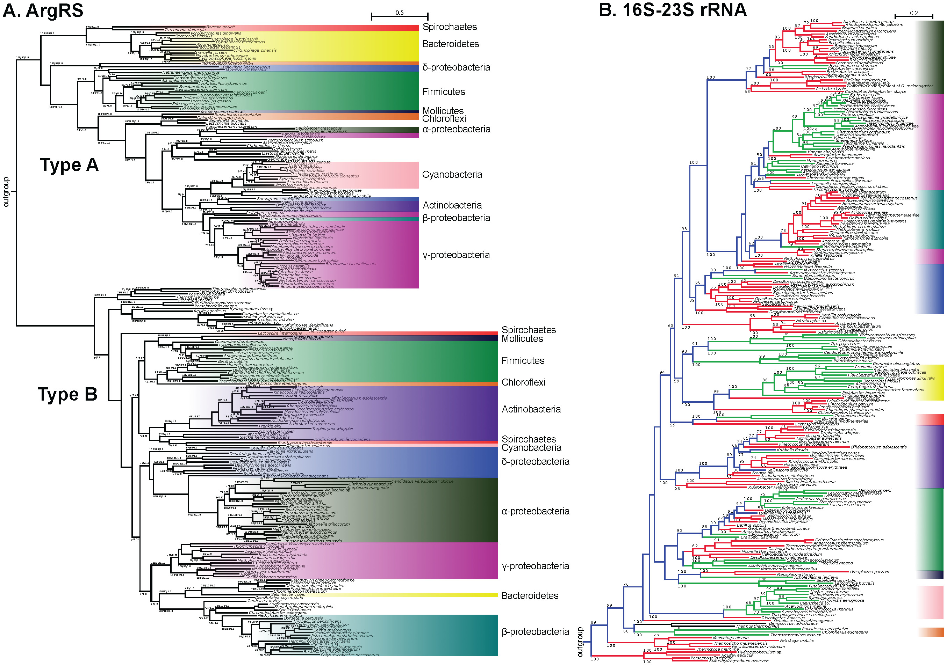

Slide 87
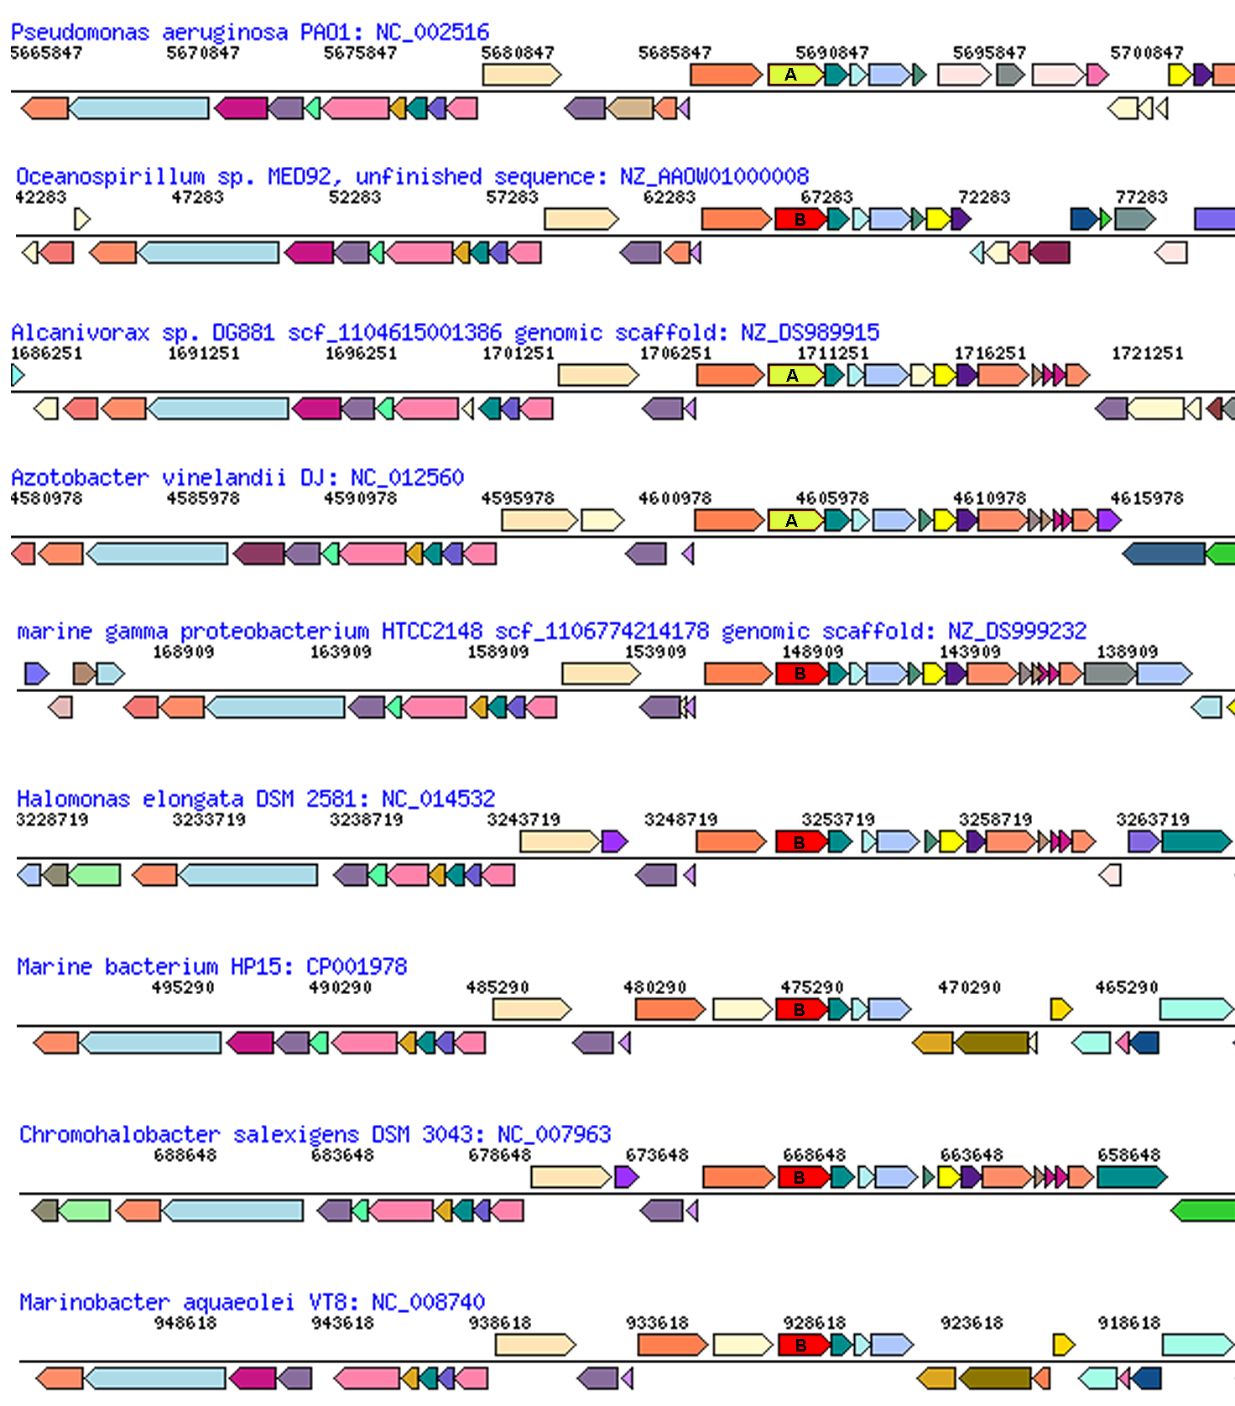
glutamate synthase
penicillin-bp
aroB
malic enz
ArgRS A&B
ArgRS synteny
between types in Pseudomonadales and Oceanospirillales
PilQ
PriA
HsIU

Slide 88
HGT and the pangenome
The fact that the phylogeny of a gene corresponds somewhat to the ribosomal RNA phylogeny does not support the notion that no HGT has occurred.
Accessory genes in the pangenome that are frequently transferred roughly follow the evolutionary history of the species, because the transfers occur more frequently between close relatatives.

