Slide 1
Notes on Computer Lab 8

Slide 2

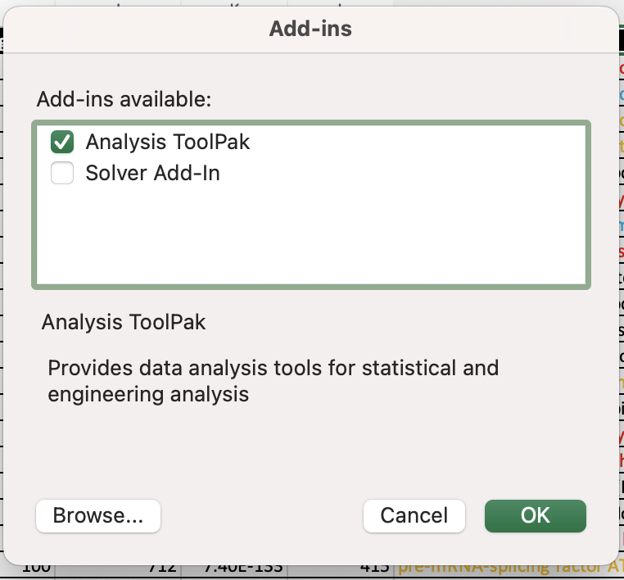
Histograms in Excel: use the Data Toolpak

Slide 3
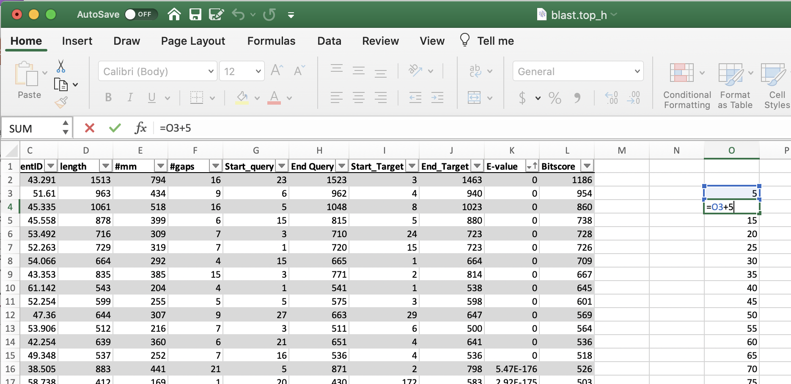
To get a nice-looking histogram, that also is easy to compare to other histograms, it is a good idea to add a column to the right that lists the bins in the histogram. As we want to get a histogram of % identity values (i.e. a depiction of how often did the %id values occur in the selected data) bins of 5% are ok.

Slide 4
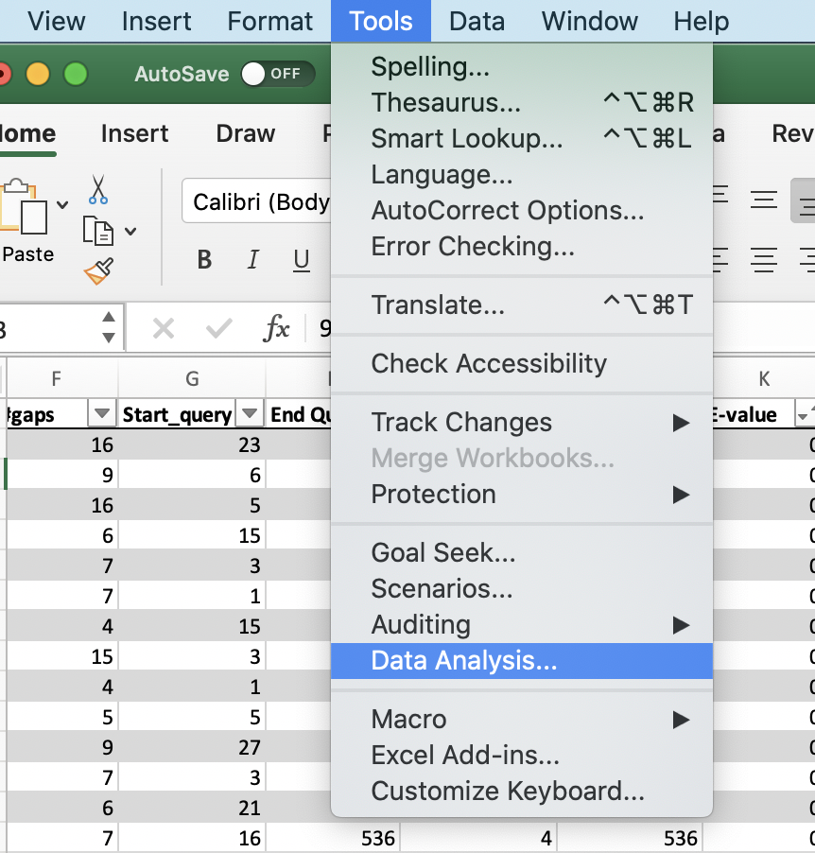
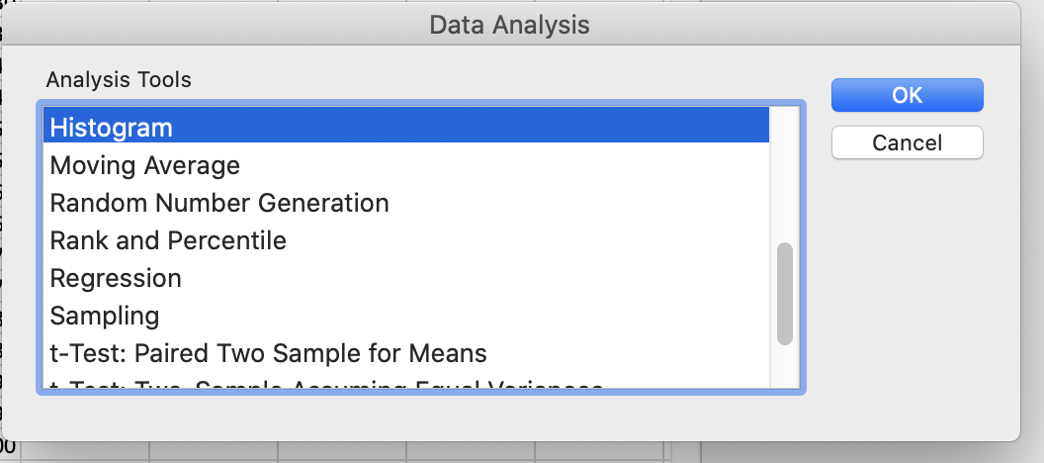
To get a nice histogram use the Data Analysis tool pak. It is part of the standard Excel distribution, but you might have to install it first.
Select tools, data analysis, histogram -- the default insert histogram is “ok” but you are stuch with the default bin sizes.

Slide 5
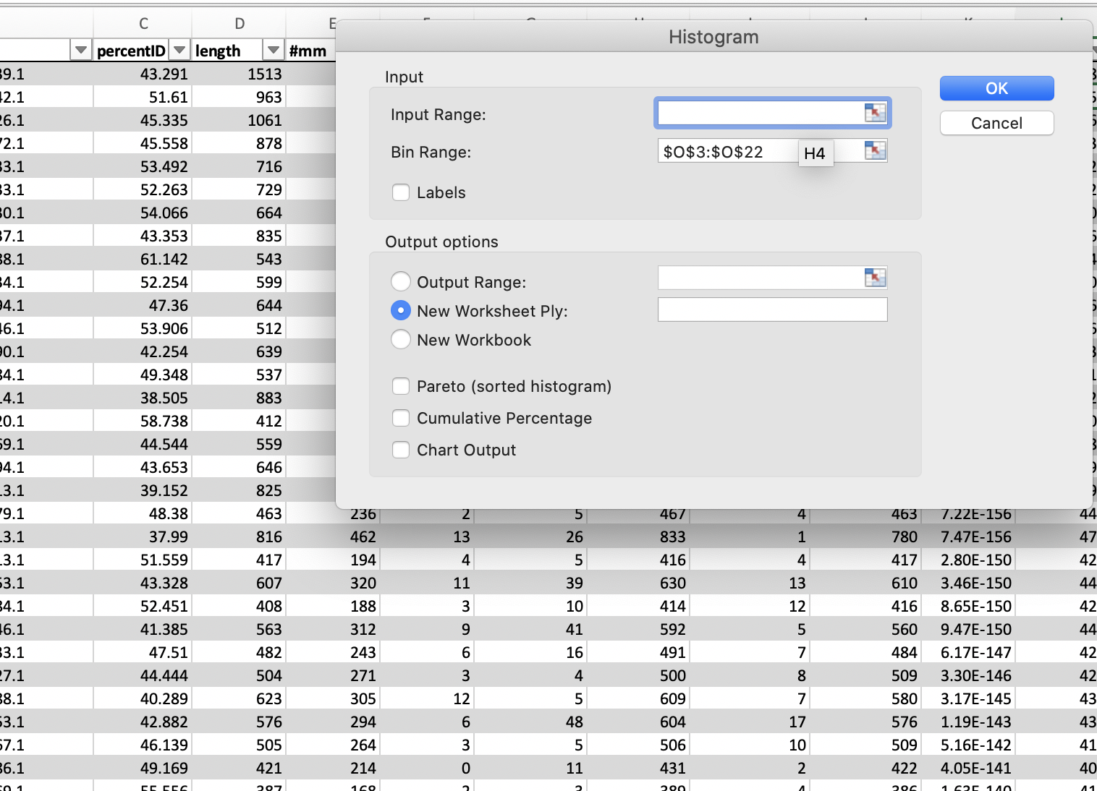
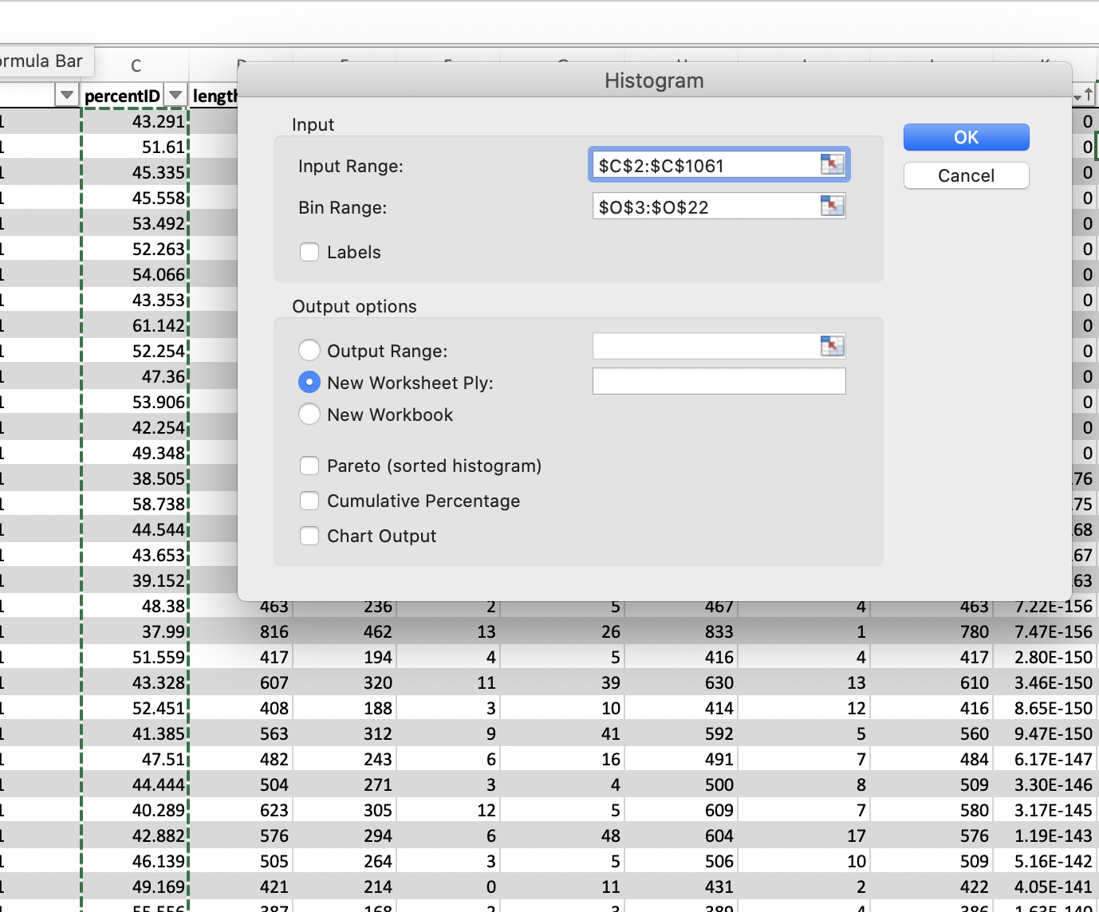
Click in the input range and select the data you want to analyze in a histogram, do the same for the bin range. (In my version, you cannot select a whole column.
select either everything, upto E-values of 1 e-7 or E-values > .5 or 1 or 10
click ok

Slide 6
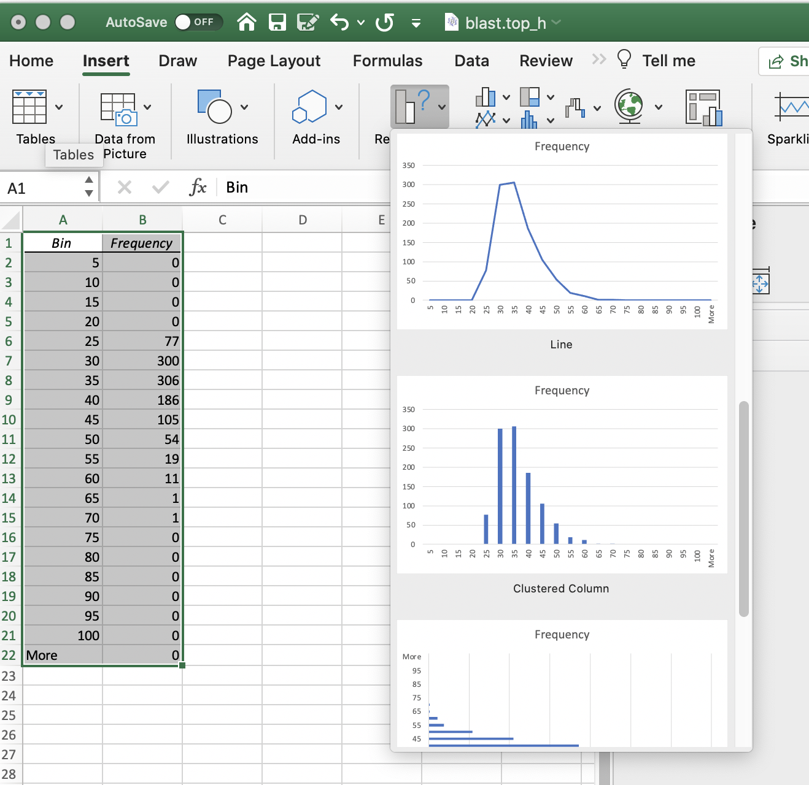
If you selected to place the result into a new worksheet, a table will be inserted in a new sheet.
The easiest is to select the table, and them insert a new graphic from recommended charts:

Slide 7
Percent ID is not an appropriate measure for the quality of a blast hit. The reason is that blast is doing only local alignments and the percent ID is expressed as a fraction of the length of the match.
If the match is 8aa long, a match 4 aa corresponds to 50% identity, but is hardly significant.

Slide 8
From the Borrelia-Haloferax comaparison
Histogram of % identity, different E-values
Logarithmic scale on Y-axis

Slide 9
Histograms of the number of matches illustrate the problem:
Add a new column to the spread sheet that gives the Number of identical aa per database match
= %ID/100 * Length [@percentID]/100*[@length]

Slide 10
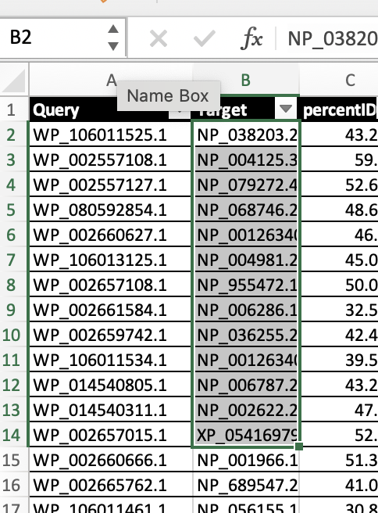
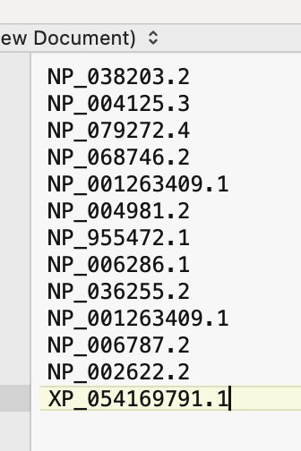
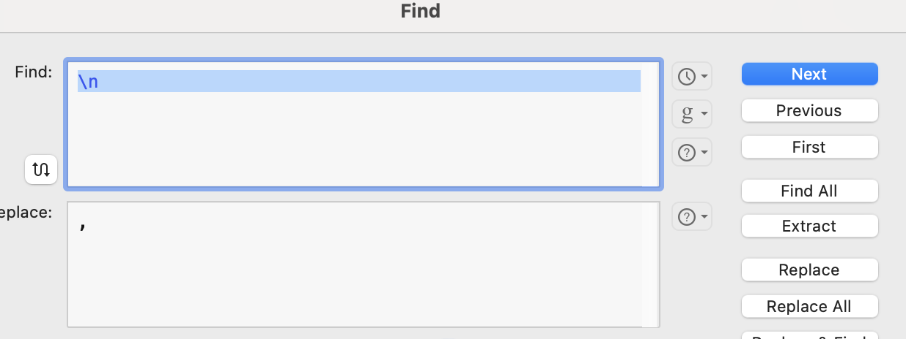
How to get annotation lines for the matches:
Copy the accession numbers from the blast output:
Paste into text editor:
Replace all \n with ,

Slide 11
How to get annotation lines for the matches:
Copy paste into the blastdbcmd:
blastdbcmd -entry NP_038203.2,NP_004125.3,NP_079272.4,NP_068746.2,NP_001263409.1,NP_004981.2,NP_955472.1,NP_006286.1,NP_036255.2,NP_001263409.1,NP_006787.2,NP_002622.2,XP_054169791.1 -db Homo_sapiens_protein.faa -outfmt %t
The –outfmt %t restricts the output to only the annotation line, without it you get all the sequences. (You could use a text editor to pull out the annotation lines.)
For more on the blastdbcmd type blastdbcmd –help at the command line

Slide 12
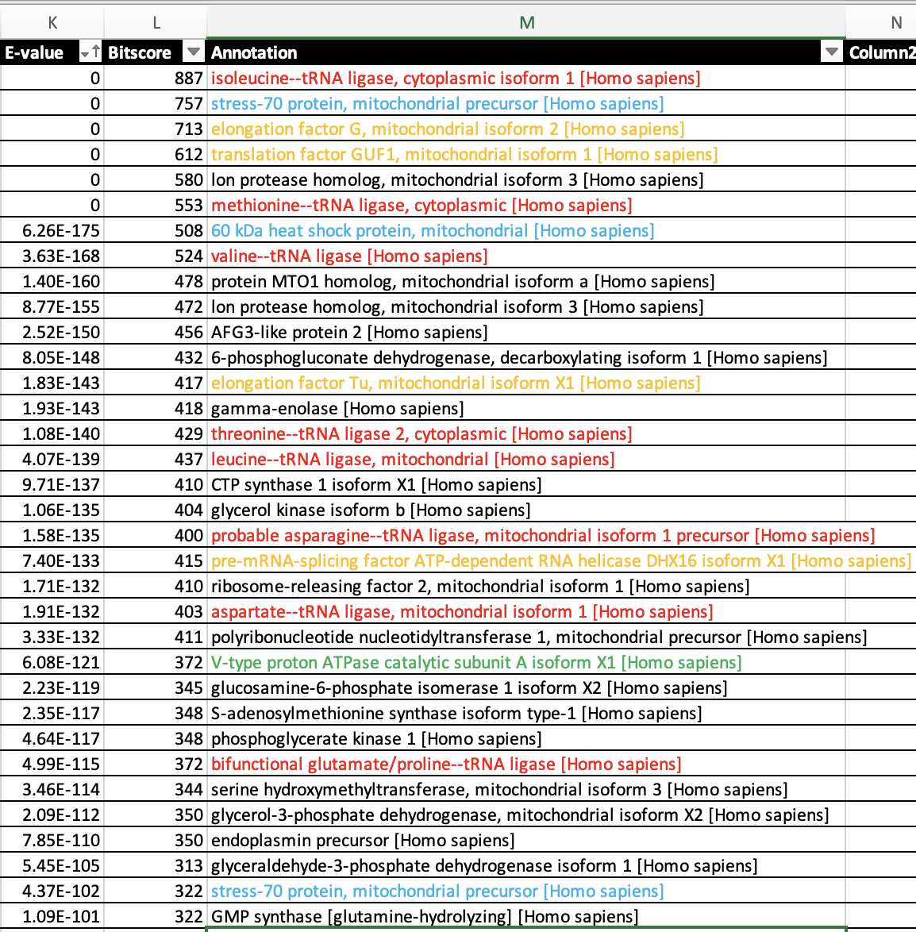
Top hits comparing Borrelia against human (as data-bank)
Note #1: Many aa RSs -- frequently transferred, often targeted by antibiotics.
Note #2: the vacuolar or Archaeal type A ATPase should not be present in a bacterium -- HGT happens.

Slide 13
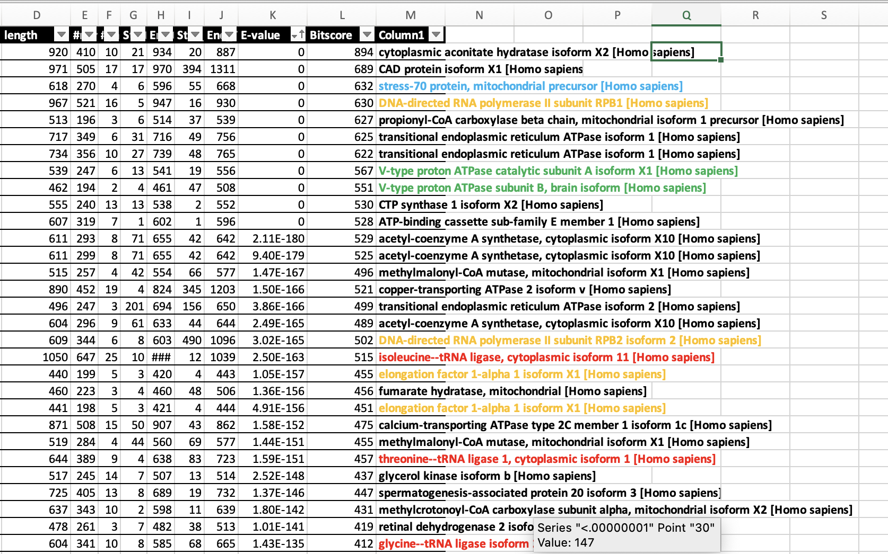
Top hits comparing Haloferax against
human (as data-bank)
Note #1: Many aa RSs -- frequently transferred, often targeted by antibiotics.

Slide 14
MCB 3421 – class 16 + 17
Phylogenies
and
Phylogenetic reconstruction

Slide 15
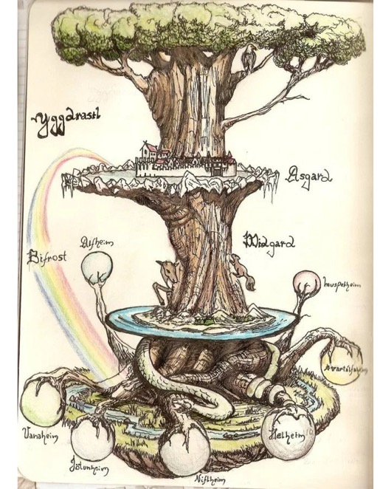
Trees have a long history in depicting evolutionary history, but also for depicting the diversity of life. (Note many Trees of Life depict the latter, and do not imply an evolutionary history)
The biblical tree of life
Yggdrasil
(North Mythology)
Mexican tree of life

Slide 16
What is in a tree?
Trees form molecular data are usually calculated as unrooted trees (at least they should be - if they are not, this is usually a mistake).
Trees have a branching pattern (also called the topology), and branch (split) lengths.
Often the branch lengths are ignored in depicting trees (these trees often are referred to as cladograms - note that cladograms should be considered rooted).
You can swap branches attached to a node, and in an unrooted you can depict the tree as rooted in any branch you like without changing the tree.

Slide 17
Trees often are rearranged and can become misleading to the non-expert:
The two trees are identical, the fact that one depicts humans on top does not reflect us being more advanced, it just is one of many possible ways to draw a tree.

Slide 18
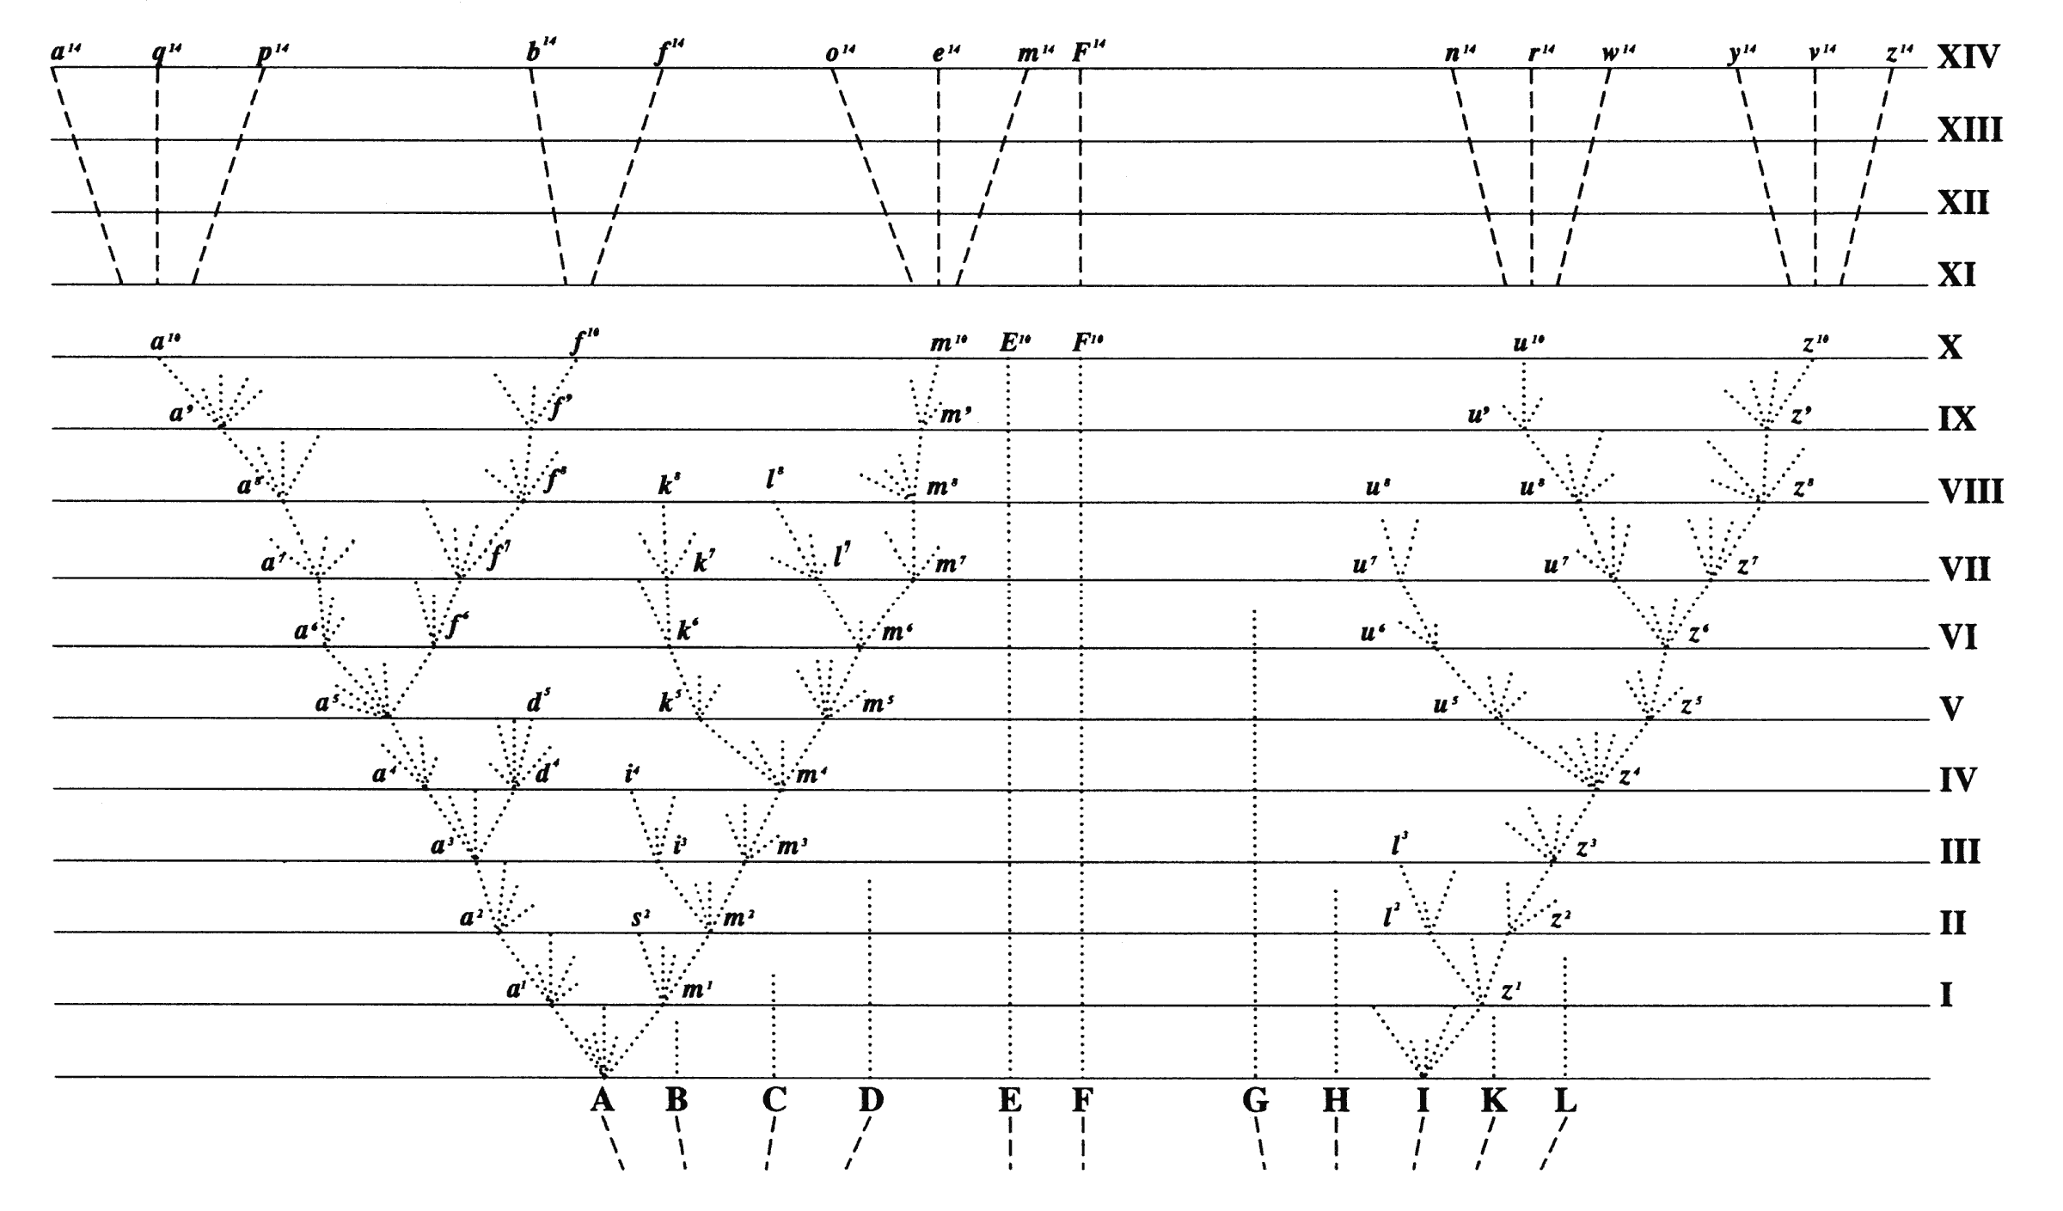
Following Darwin most biologist draw phylogenetic trees to that the present time is on top and the past at the bottom
Present
Past
Mathematicians often do it the other way around

Slide 19
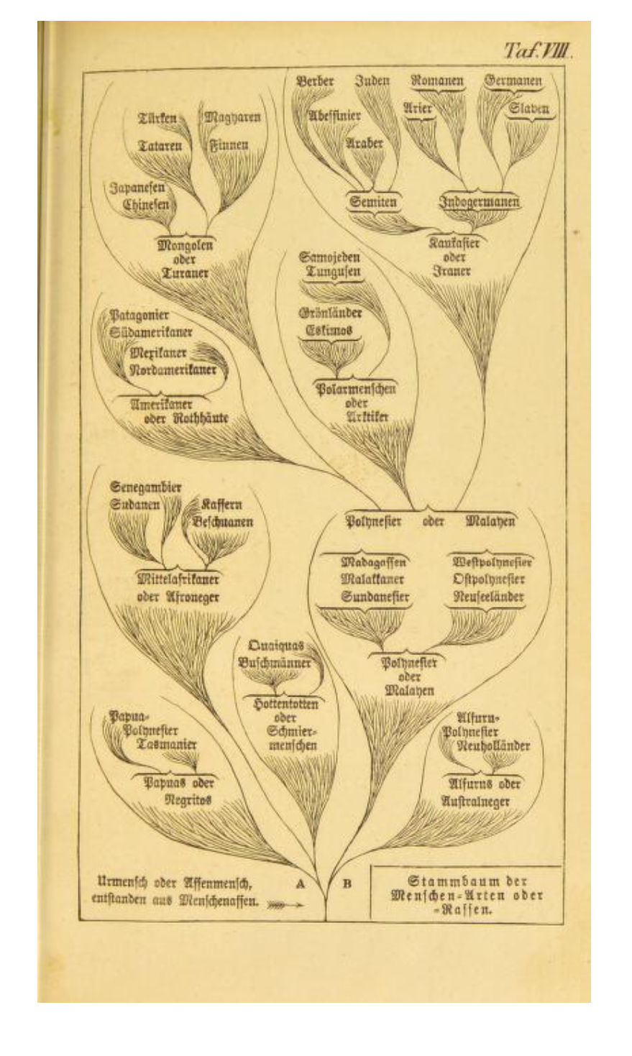
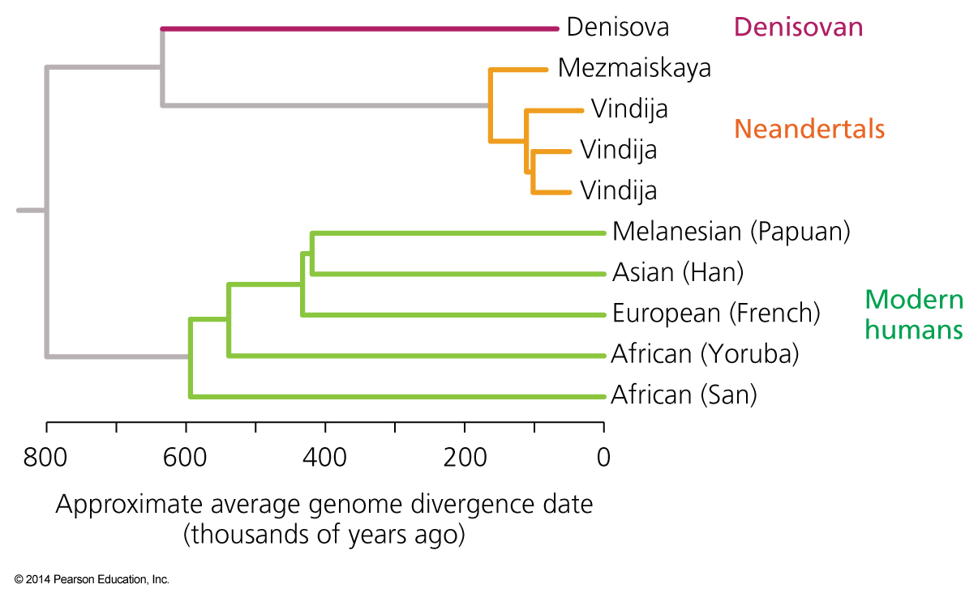
Orientation and branch length I
In case of a cladogram the leaves representing extant organisms should be at the same level,
i.e., not as in Haeckel’s trees.

Slide 20
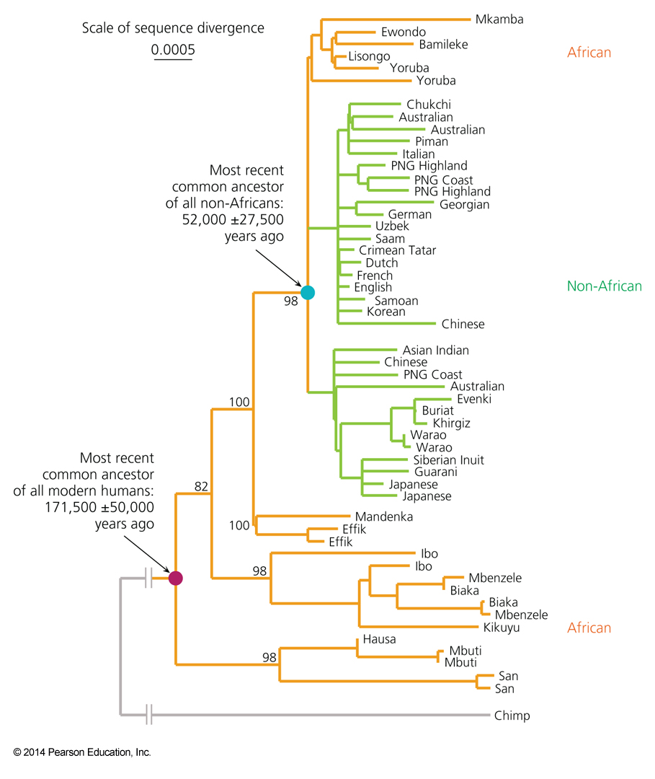
Orientation and branch length II
If you have branches scaled with the amount of change,
use them!

Slide 21
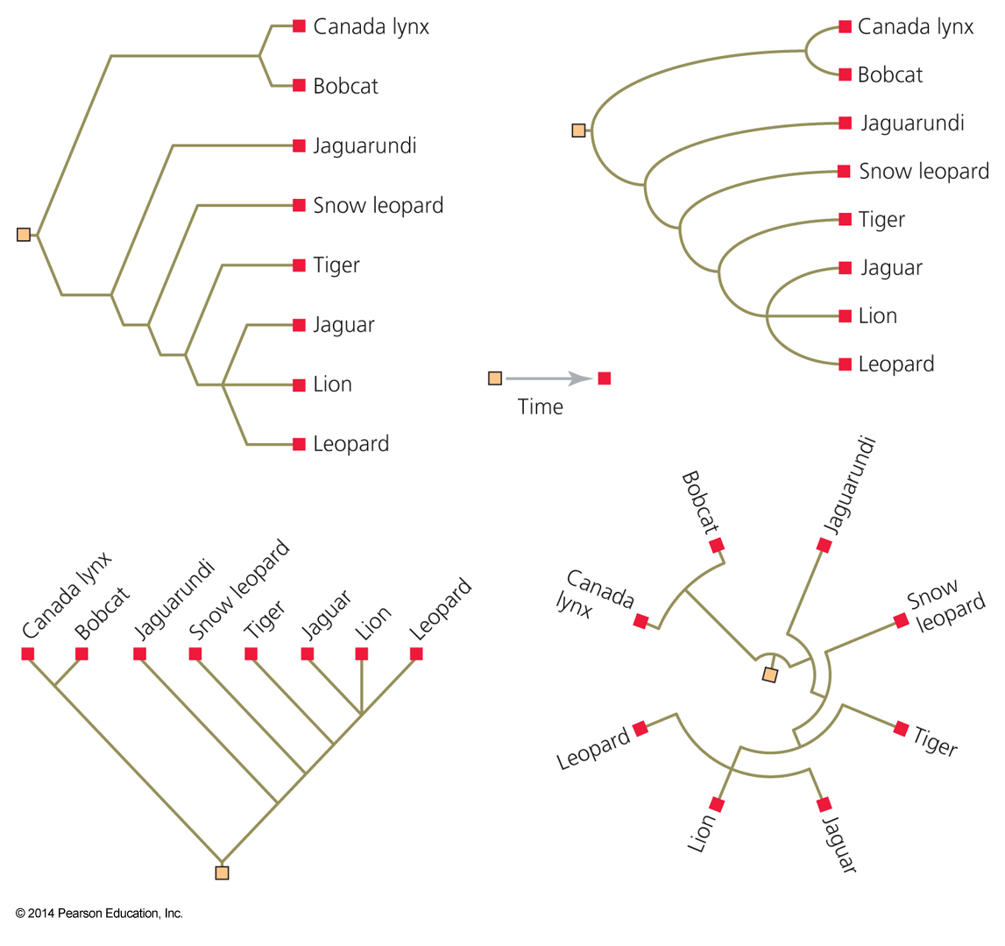
Trees can be depicted in many ways

Slide 22
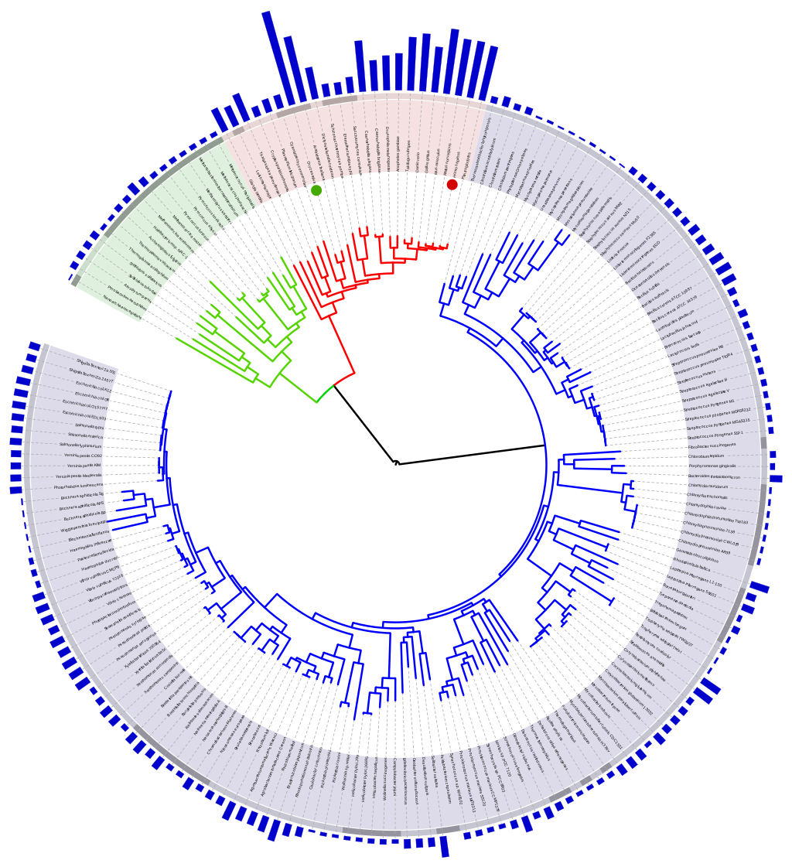
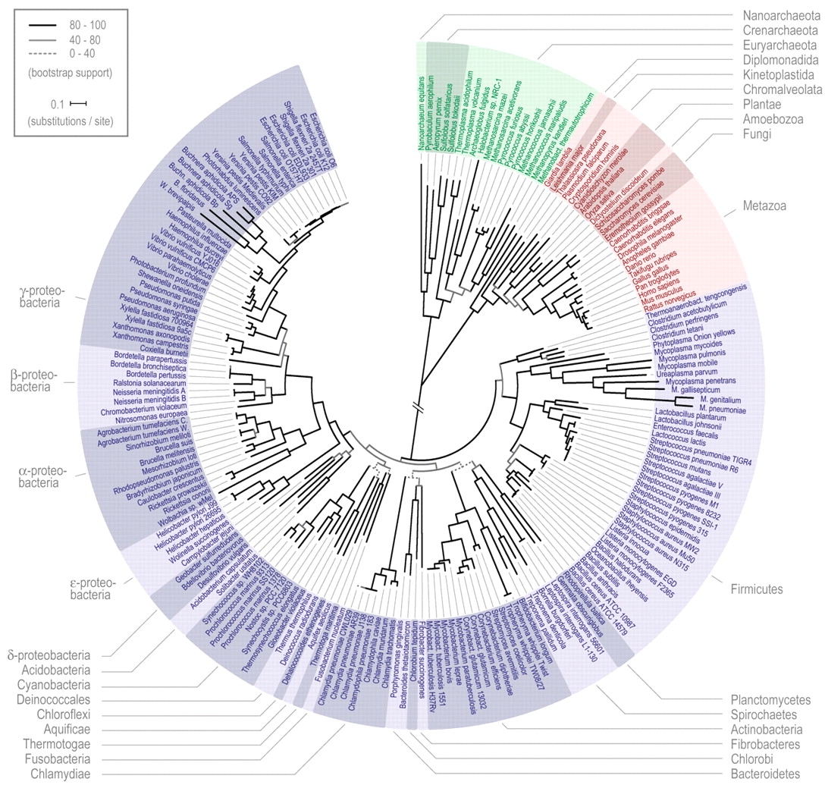
If you must break a long branch, provide information on how log this branch is (long branches are a problem).
Ciccarelli FD et al., Science. 2006 Mar 3;311(5765):1283-7.
doi: 10.1126/science.1123061.
Wikimedia commons

Slide 23
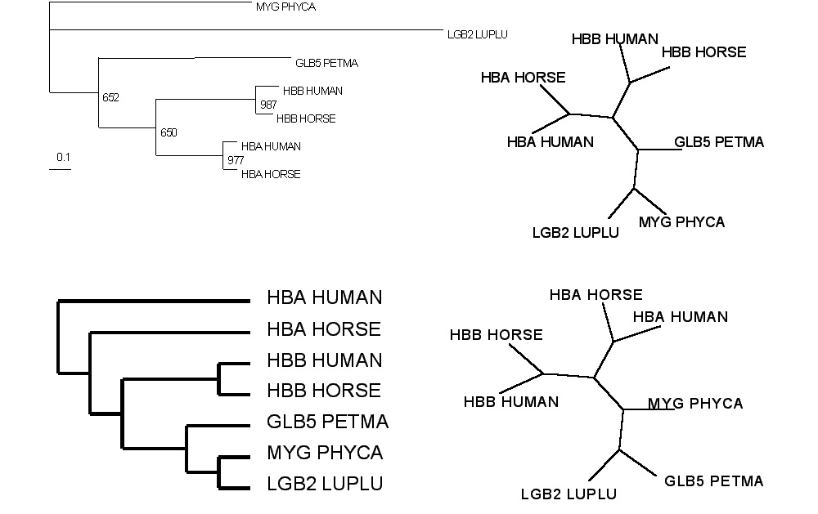
Test: Which of these trees is different when considering their unrooted topology?
More tests here

Slide 24
If you like tests on trees:
Science had an article on a
“The Tree-Thinking Challenge”, with a supplement that contained two quizzes on trees (with answers). We will do some of these in next week’s TBL class
E.g.:
On the basis of the tree on the left, is the frog more closely related to the fish or the human?
Does the tree on the right change your mind?

Slide 25
Trees in Newick or parenthesis format
Trees rooted on a node are usually considered as unrooted
Trees rooted on a branch are usually considered as rooted
((A, B), (C, D), E)
(((A, B), (C, D)), E)
Arbitrarily rooted in a node –
While displayed as rooted in a node, the tree should be considered as unrooted
Strictly bifurcating –
The root is located on the branch leading to E
More links here and here and here

Slide 26
Phylogenetic Reconstruction – Why?
A) Systematic classification of organisms
e.g.: Who were the first angiosperms? (i.e. where are the first angiosperms located relative to present day angiosperms?) Where in the tree of life is the last common ancestor located?
B) Evolution of molecules
e.g.: domain shuffling, reassignment of function, gene duplications, horizontal gene transfer, drug targets,
detection of genes that drive evolution of a species/population
(e.g. influenca virus)
C) Identification of organisms
e.g., phylotyping in microbiome samples,
origin of genes and viruses (e.g., HIV virus, recent ebola outbreak)

Slide 27
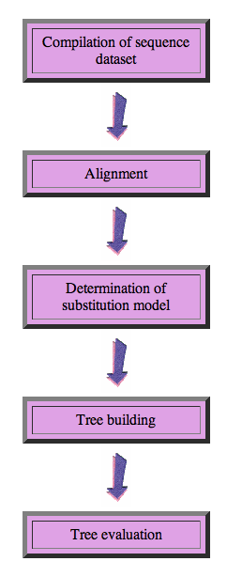
Steps of the phylogenetic analysis
Phylogenetic analysis is an inference of evolutionary relationships between organisms.
Phylogenetics tries to answer the question
“How did groups of organisms come into existence?”
Those relationships are usually represented by tree-like diagrams.
Note: the equation of biological evolution with a tree like process has limited validity at best.

Slide 28
Phylogenetic reconstruction - How
Distance analyses
  calculate pairwise distances
  (different distance measures, correction for multiple hits, correction for codon bias)
  make distance matrix (table of pairwise corrected distances)
  calculate tree from distance matrix
    i) using optimality criterion
    (e.g.: smallest error between distance matrix and distances in tree (very popular in people with a physics background),
    or use
    ii) algorithmic approaches (UPGMA or neighbor joining) – very fast, popular with students of Masatoshi Nei

Slide 29
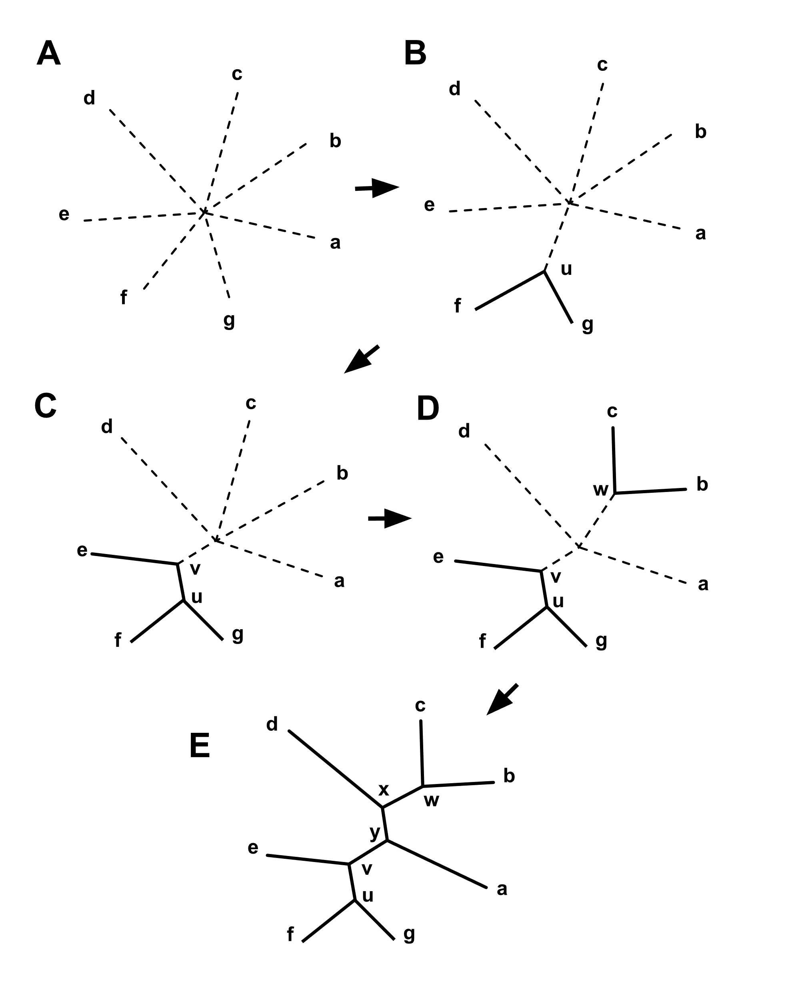
Algorithmic approaches (no global optimality criterion)
Principle of Neighbor Joining
From Wikipedia
UPGMA from Richard Edwards (here)
Wikipedia also has a good work through.

Slide 30
Phylogenetic reconstruction - How
Parsimony: Find the tree (or trees) that explains data with the smallest number of substitutions (aka as Occam’s razor).
Note: parsimony does poorly in the presence of short and long branches
Maximum Likelihood: Find the tree and model that make the dataset most probable.
Note: the probability of an individual data set is tiny. Usually a 0, followed by several 10000 zeros. -LogL values of 90000 are common.
Bayesian Approach: Find the tree and model that are most probable given the data and prior information.
Note: The Bayesian analysis and the biased random walk in parameter space use the likelihood (but not the maximum likelihood) associated with the points in in parameter space.

Slide 31
Else:
spectral analyses, like evolutionary parsimony, look only at patterns of substitutions,
Another way to categorize methods of phylogenetic reconstruction is to ask if they are using
an optimality criterion (e.g.: smallest error between distance matrix and distances in tree, least number of steps, highest probability), or
algorithmic approaches (UPGMA or neighbor joining)
Packages and programs available:
iqtree, MrBayes, PAUP*, phyml, raxml, PHYLIP, PAML, Tree-Puzzle, clustalw, PhyloGenie, HyPhy, seaview (GUI for PHYLIP and phyml)

Slide 32
Ockham’s Razor or the Parsimony Principle
In the words of Sir Isaac Newton:
“We are to admit no more causes of natural things than such as are both true and sufficient to explain their appearances.”
We prefer the phylogeny or cladogram that explains the observed characters (sequence or others) with the fewest number of changes.

