Slide 1
MCB 3421 – class 17
Phylogenies
and
Phylogenetic reconstruction
- part 2

Slide 2
Phylogenetic reconstruction - How
Distance matrix analysis (algorithmic or optimality criterion)
Parsimony: Find the tree (or trees) that explains data with the smallest number of substitutions (aka as Occam’s razor).
Note: parsimony does poorly in the presence of short and long branches
Maximum Likelihood: Find the tree and model that make the dataset most probable.
Note: the probability of an individual data set is tiny. Usually a 0, followed by several 10000 zeros. -LogL values of 90000 are common.
Bayesian Approach: Find the tree and model that are most probable given the data and prior information.
Note: The Bayesian analysis and the biased random walk in parameter space use the likelihood (but not the maximum likelihood) associated with the points in in parameter space.

Slide 3
Else:
spectral analyses, like evolutionary parsimony, look only at patterns of substitutions,
Another way to categorize methods of phylogenetic reconstruction is to ask if they are using
an optimality criterion (e.g.: smallest error between distance matrix and distances in tree, least number of steps, highest probability), or
algorithmic approaches (UPGMA or neighbor joining)
Packages and programs available:
iqtree, MrBayes, PAUP*, phyml, raxml, PHYLIP, PAML, Tree-Puzzle, clustalw, PhyloGenie, HyPhy, seaview (GUI for PHYLIP and phyml)

Slide 4
Ockham’s Razor or the Parsimony Principle
In the words of Sir Isaac Newton:
“We are to admit no more causes of natural things than such as are both true and sufficient to explain their appearances.”
We prefer the phylogeny or cladogram that explains the observed characters (sequence or others) with the fewest number of changes.

Slide 5
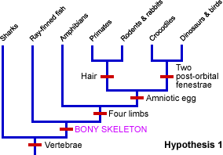
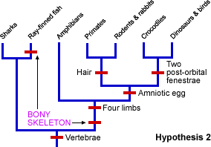
The parsimony approach also works for other characters. See below for the relation between sharks and bony fish:
From https://evolution.berkeley.edu/evolibrary/teach/index.php
This is pretty much equal to Willi Hennig’s cladistics. (The only difference is that parsimony does not insist on distinguishing between primitive and derived characters.)
Note, one can use ML for morphological characters!

Slide 6
Heuristic Searches
The most parsimonious tree or the maximum likely hood tree or the distance tree that fulfills some optimality criterion cannot be calculated directly from the data matrix (in contrast to the algorithmic approaches).
Given a tree the branch length (or number of steps) that optimize the criterion can be calculated.
To find the overall bet tree, the enormous tree spaced need to be explored.

Slide 7
Number of different trees and number of splits
Number of genomes [n] | Number of trees [2n-5]! / [2(n-3)(n-3)!] | Number of bipartitions [2^{(n-1)}-n-1]
4 | 3 | 3
6 | 105 | 25
8 | 10,395 | 119
10 | 2,075,025 | 501
13 | 1.37E + 10 | 4,082
20 | 2.22E + 20 | 5.24E + 05
50 | 2.84E + 74 | 5.63E + 14
This is for unrooted tree. A rooted tree with n-leaves has the same number of
different topologies as an unrooted tree with (n-1) leaves.

Slide 8
The
Long Branch Attraction (LBA)
artifact in phylogenetic reconstruction

Slide 9
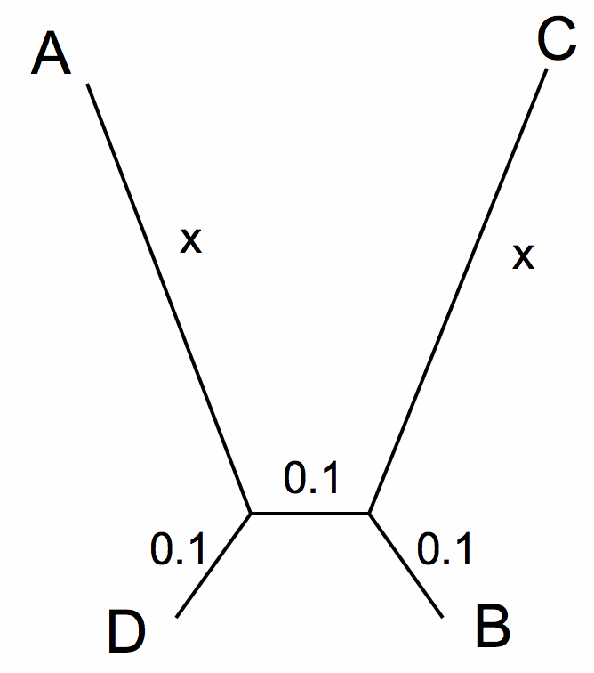
Long Branch Attraction (LBA) can be due to faster substitution rate in some branches, or due to long empty branches without any side branches
A
C
A B C D E F G H
A B C D E F G H
D
B
True Tree
LBA Tree
True Tree
LBA Tree

Slide 10
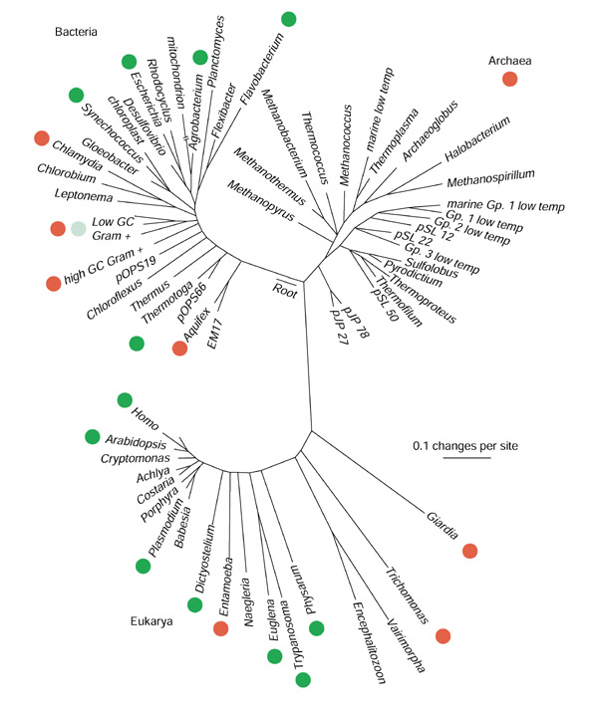
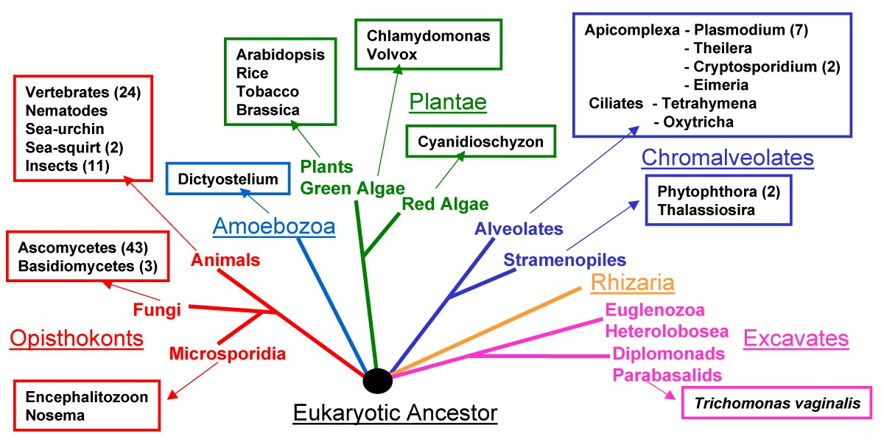
Example:
More recent protein based phylogeny
traditional
SSU rRNA
Protists without obvious mitochondria
From: https://figshare.com/articles/figure/Distribution_of_glutathione_mapped_onto_a_universal_tree_of_life_based_on_16S_rRNA_sequences/29286
Fungi that became parasites and
that lost their mitochondria

Slide 11
LBA
A
C
D
B
True Tree
LBA Tree
ProtPars
X

Slide 12
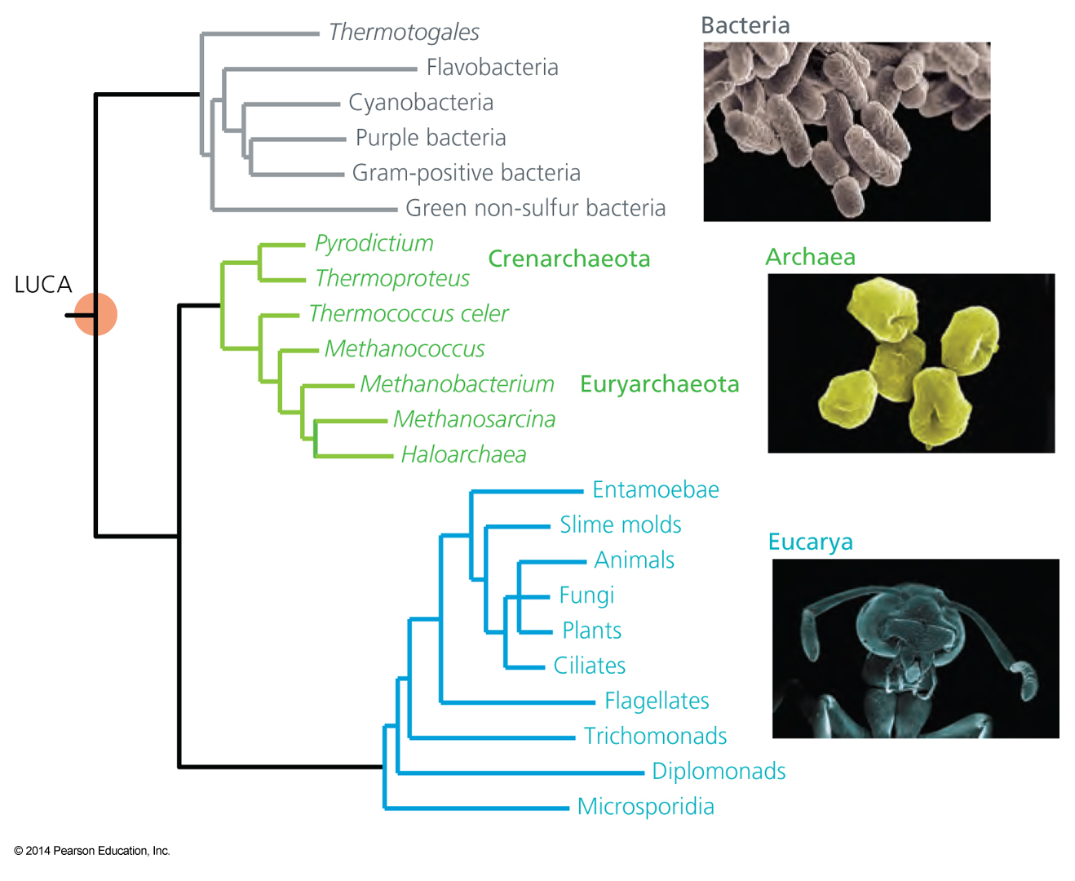
Example for a tree that likely reflects long branch attraction:
SSU rRNA phylogeny
Microsporidia and Diplomonads are parasites, and experienced many changes in their ribosomal RNA (long branches. More recent analysis of proteins from Microsporidia revealed them as derived from fungi https://en.wikipedia.org/wiki/Microsporidia
What is the long branch attracting the microsporidia?

Slide 13
Maximum Likelihood

Slide 14
Estimating Models and Model Parameters.
Likelihood: Probability of a dataset given a model and a set of parameter.
Maximum likelihood: maximum probability of drawing the sample actually obtained using the model parameters as variable. (This usually is a tiny number, thus usually one uses the negative logarithm).
This works great for finding the best fitting parameters,
AND
Maximum Likelihood Estimation (MLE) can be used to test if assuming a more complicated model is justified by the data

Slide 15
Example: Regression using Polynomials
When has one added too many parameters?
The fit undoubted increases with each parameter, but does this increase justify the additional parameter?
Notes:
The fit undoubted increases with each parameter, but does this increase justify the additional parameter?

Slide 16
One could use the maximum likelihood ratio test
Let L1 be the maximum value of the likelihood of the data without the additional assumption. In other words, L1 is the likelihood of the data with all the parameters unrestricted and maximum likelihood estimates substituted for these parameters.
Let L0 be the maximum value of the likelihood when the parameters are restricted (and reduced in number) based on the assumption. Assume k parameters were lost (i.e., L0 has k less parameters than L1).
Form the ratio λ=L0/L1. This ratio is always between 0 and 1 and the less likely the assumption is, the smaller λ will be. This can be quantified at a given confidence level as follows:
Calculate χ2=−2 ln λ. The smaller λ is, the larger χ2 will be.
We can tell when χ2 is significantly large by comparing it to the 100(1−α) percentile point of a Chi-Square distribution with degrees of freedom. χ2has an approximate Chi-Square distribution with k degrees of freedom and the approximation is usually good, even for small sample sizes.
The likelihood ratio test computes χ2 and rejects the assumption if χ2 is larger than a Chi-Square percentile with k degrees of freedom, where the percentile corresponds to the confidence level chosen by the analyst.
From: https://www.itl.nist.gov/div898/handbook/apr/section2/apr233.htm
Alternatives to the MLRT are the use of the Akaike information criterion or the Bayesian information criterion

Slide 17
Aside:
MLE is a sophisticated version of Ockham razor.
Ockham razor favors the explanation that can
explain an observation with the fewest
assumptions (the parsimony principle).
MLE favors the explanation under which the observation is most probable. (MLE becomes equivalent to parsimony, if all events are equally probable. Note: you can also apply different weights to the events that are counted in parsimony, or ignore some altogether, e.g., transversion parsimony.)

Slide 18
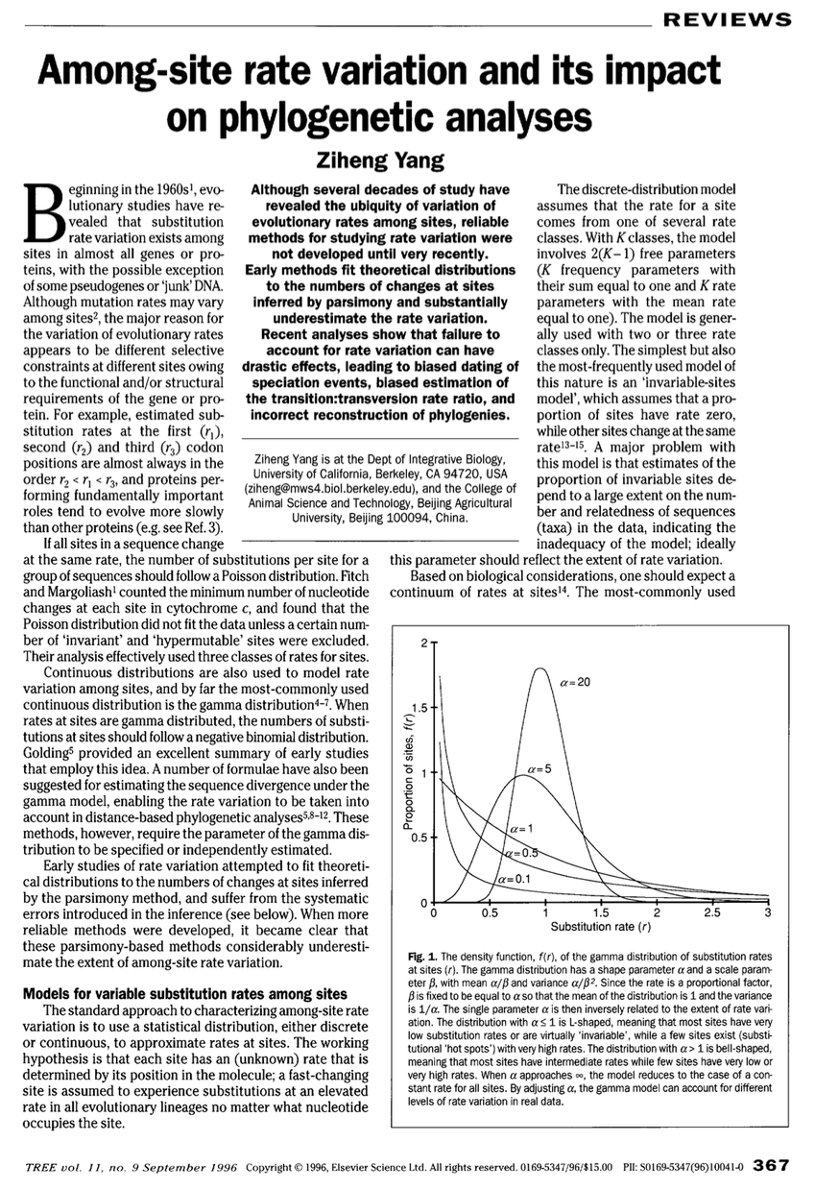
Aside on Correcting Distances all sites in an alignment are not created equal.
https://www.sciencedirect.com/science/article/pii/0169534796100410?via%3Dihub

Slide 19
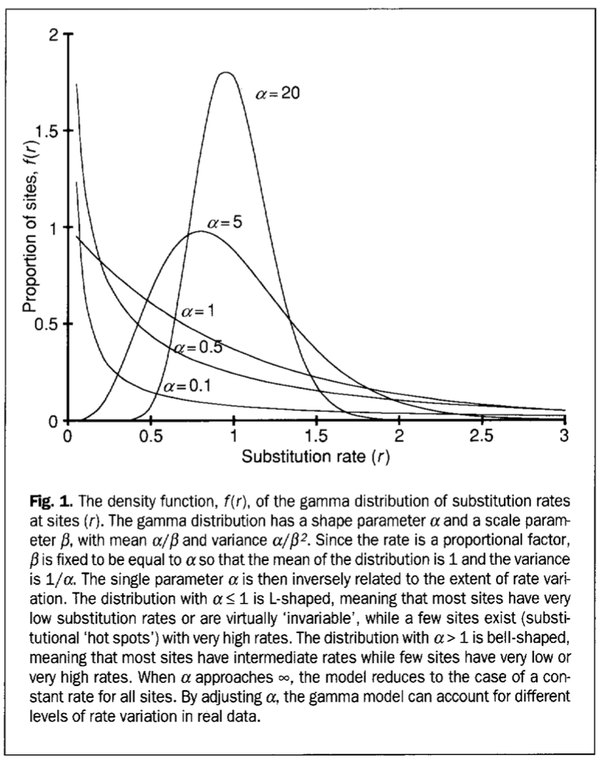
Aside on Correcting Distances
all sites in an alignment are not created equal.

Slide 20

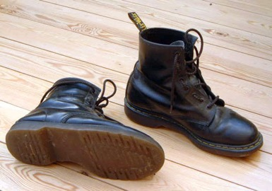
Non-Parametric Bootstrap:
Creating pseudo-samples (sampling with replacement, sample size n)
Doing the impossible Statistics on a single sample
Evaluation of pseudo-samples measures how much information in the original data support a conclusion.
Alternative to the non-parametric bootstrap:
Jacknife:
Creating pseudo-samples (sampling without replacement, sample size n/2)
Parametric Bootstrap:
Creating pseudo-samples through simulations using a model and parameters estimated from the data

Slide 21
Creating bootstrap or pseudo-samples through sampling alignment columns with replacement
From “Bootstrap and Rogue Identification Tests for Phylogenetic Analyses”
Molecular Biology and Evolution 35(1) DOI: 10.1093/molbev/msy118

Slide 22
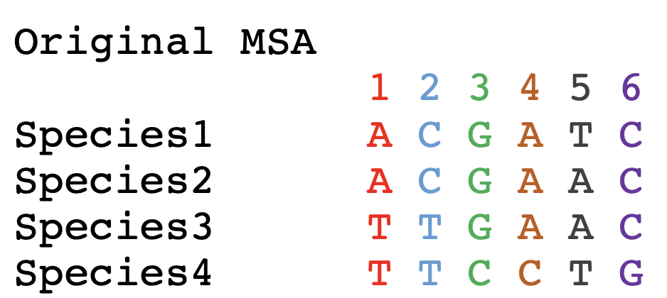
Bootstrapping example:

Slide 23
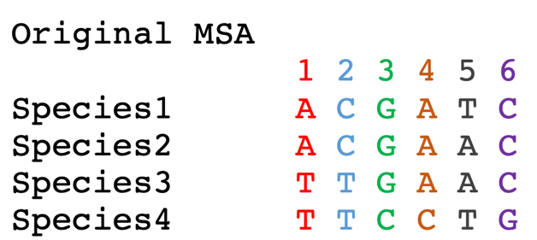
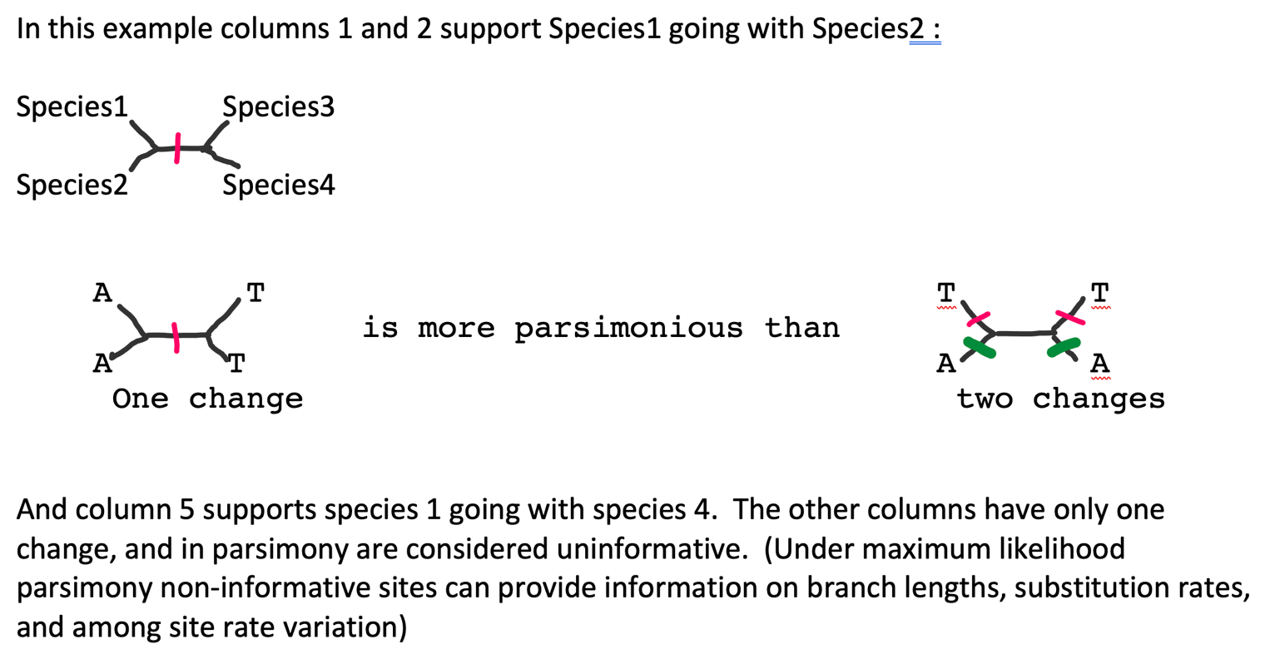
Parsimony informative sites

Slide 24
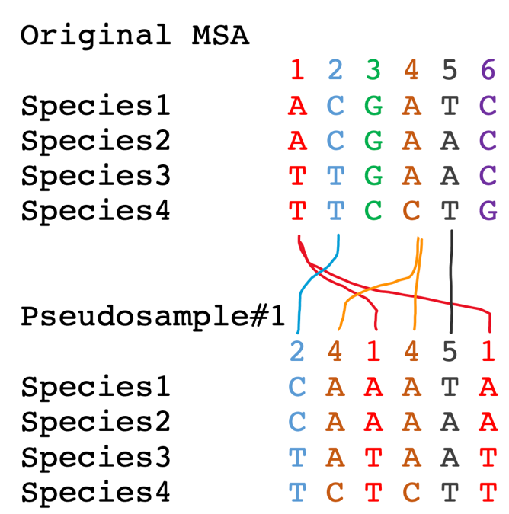
To sample with replacement for the alignment columns, we role six-sided dice six times. Assume you got the following numbers:
(2 4 1 4 5 1)
In this case column 3 and 6 did not make it into the pseudosample, and columns 1 and 4 made it twice.

Slide 25
Bootstrap Take Home Messages
If all pseudo-samples lead to the same conclusion (which then is said to have 100% bootstrap support), the original data set contained strong support for the conclusion
If only few pseudo-samples support a conclusion the original data do not strongly support the conclusion
Some consider 100-%bootstrap-support as analogous to a P-value.
Bootstrap support values are conservative
If a parameter value is estimated from the data, the bootstrap samples can be used to create confidence intervals (this is based on the finding that in cases where one can obtain many real samples, the real samples and the pseudo-samples show the same variance)

Slide 26
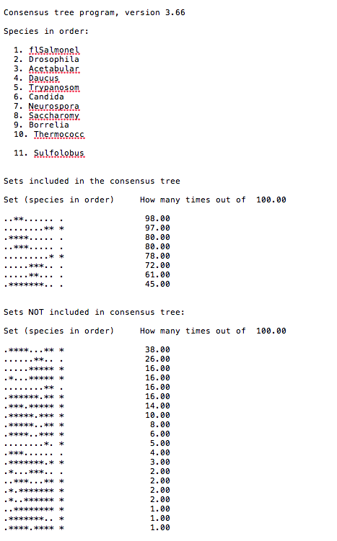
Output from consense

Slide 27
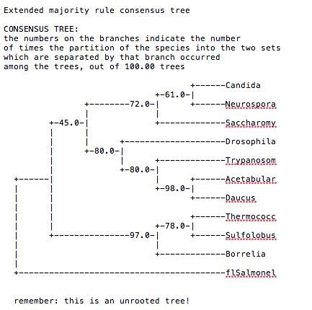
Output from consense

Slide 28
Why could a gene tree be different from the species tree?
Lack of resolution
Lineage sorting
Gene duplications/gene loss (paralogs/orthologs)
Gene transfer
Systematic artifacts (e.g., compositional bias and long branch attraction)

Slide 29
Trees – what might they mean?
Calculating a tree is comparatively easy, figuring out what it might mean is much more difficult.
If this is the probable organismal tree:
species A
species B
species C
species D
what could be the reason for obtaining this gene tree:
seq. from A
seq. from D
seq. from C
seq. from B

Slide 30
lack of resolution
seq. from A
seq. from D
seq. from C
seq. from B
e.g., 60% bootstrap support for bipartition (AD)(CB)

Slide 31
long branch attraction artifact
the two longest branches join together
seq. from A
seq. from D
seq. from C
seq. from B
e.g., 100% bootstrap support for bipartition (AD)(CB)
What could you do to investigate if this is a possible explanation?
use only slow positions,
use an algorithm that corrects for ASRV

Slide 32
Gene transfer
Organismal tree:
species A
species B
Gene Transfer
species C
species D
molecular tree:
seq. from A
seq. from D
seq. from C
speciation
seq. from B
gene transfer

Slide 33
Lineage Sorting
Organismal tree:
species A
species B
species C
Genes diverge and coexist in the
organismal lineage
species D
molecular tree:
seq. from A
seq. from D
seq. from C
seq. from B

Slide 34
Gene duplication
Organismal tree:
species A
species B
species C
gene duplication
species D
molecular tree:
seq. from A
seq. from B
seq. from C
seq. from D
seq.’ from B
seq.’ from C
gene duplication
seq.’ from D

Slide 35
Gene duplication
Organismal tree:
species A
species B
species C
gene duplication
species D
molecular tree:
seq. from A
with gene loss
seq. from D
seq.’ from B
seq.’ from C
gene duplication

Slide 36
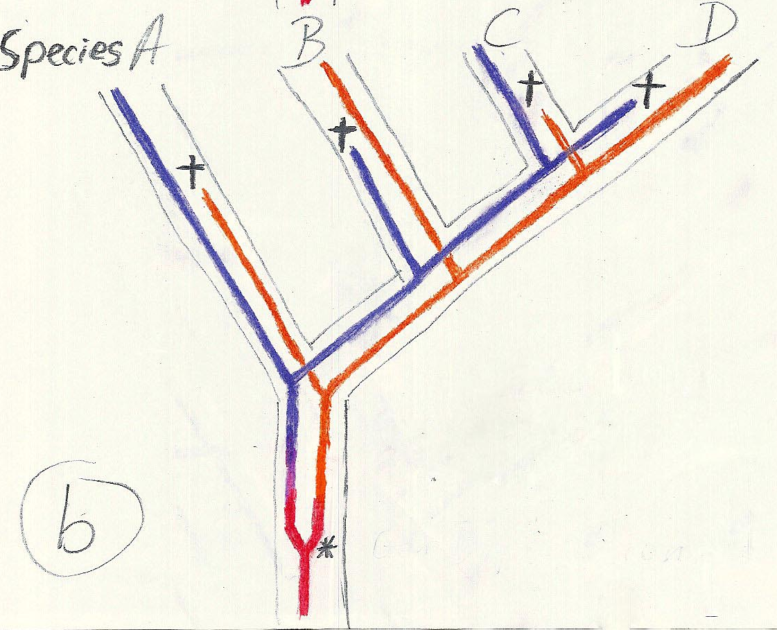
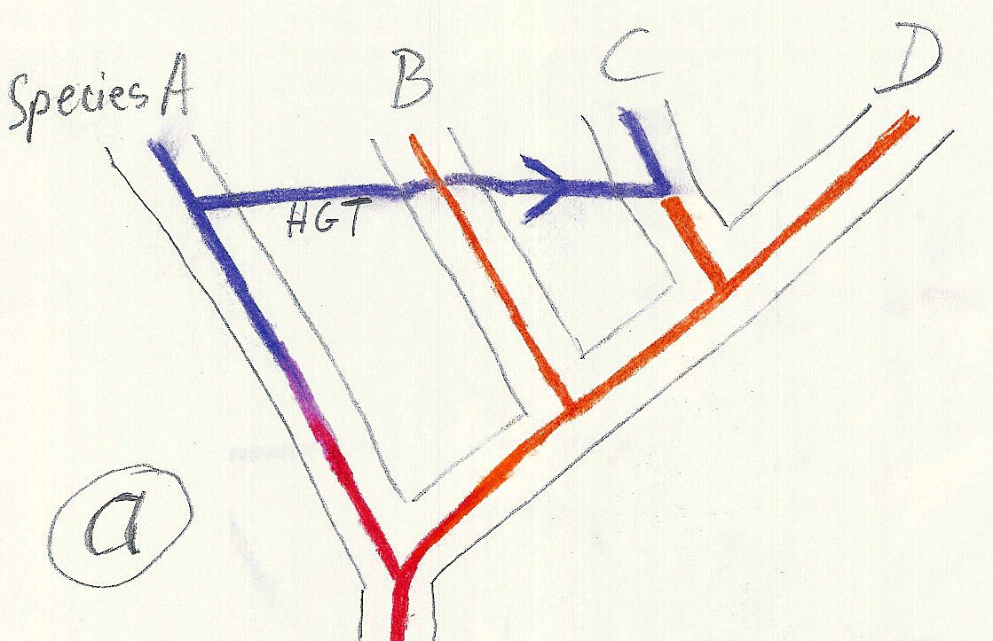
Gene duplication and gene transfer are equivalent explanations.
The more relatives of C are found that do not have the blue type of gene, the less likely is the duplication loss scenario
Ancient duplication followed by gene loss
Horizontal or lateral Gene
Note that scenario B involves many more individual events than A
1 HGT with
orthologous replacement
1 gene duplication followed by 4 independent gene loss events

Slide 37
The
Long Branch Attraction (LBA)
artifact in phylogenetic reconstruction

Slide 38
LBA can be due to faster substitution rate in some branches, or to long empty branches without any side branches
A
C
A B C D E F G H
A B C D E F G H
D
B
True Tree
LBA Tree
True Tree
LBA Tree

Slide 39
Example:
More recent protein based phylogeny
traditional
SSU rRNA
Protists without obvious mitochondria
From: https://figshare.com/articles/figure/Distribution_of_glutathione_mapped_onto_a_universal_tree_of_life_based_on_16S_rRNA_sequences/29286
Fungi that became parasites and
that lost their mitochondria

Slide 40
Parsimony: Find the tree (or trees) that explains data with the smallest number of substitutions (aka as Occam’s razor).
Note: parsimony does poorly in the presence of short and long branches
Maximum Likelihood: Find the tree and model that make the dataset most probable.
Note: the probability of an individual data set is tiny. Usually a 0, followed by several 10000 zeros. -LogL values of 90000 are common.
Bayesian Approach: Find the tree and model that are most probable given the data and prior information.
Note: The Bayesian analysis and the biased random walk in parameter space use the likelihood (but not the maximum likelihood) associated with the points in in parameter space.

Slide 41
The parsimony approach also works for other characters. See above for the relation between sharks and bony fish:
From https://evolution.berkeley.edu/evolibrary/teach/index.php
This is pretty much equal to Willi Hennig’s cladistics. (The only difference is that parsimony does not insist on distinguishing between primitive and derived characters.)
Note, one can use ML for morphological characters!

Slide 42
Parsimony: Find the tree (or trees) that explains data with the smallest number of substitutions (aka as Occam’s razor).
Note: parsimony does poorly in the presence of short and long branches
Maximum Likelihood: Find the tree and model that make the dataset most probable.
Note: the probability of an individual data set is tiny. Usually a 0, followed by several 10000 zeros. -LogL values of 90000 are common.
Bayesian Approach: Find the tree and model that are most probable given the data and prior information.
Note: The Bayesian analysis and the biased random walk in parameter space use the likelihood (but not the maximum likelihood) associated with the points in in parameter space.

Slide 43

Elliot Sober’s Gremlins
Observation: Loud noise in the attic
?
Hypothesis: gremlins in the attic playing bowling
Likelihood =
P(noise|gremlins in the attic)
What you would want to know (posterior probability):
P(gremlins in the attic|noise)
?
?

Slide 44
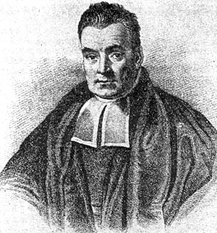
Bayes’ Theorem
Likelihood
describes how well the model predicts the data
P(data|model, I)
P(model|data, I) = P(model, I)
P(data,I)
Posterior
Probability
represents the degree
to which we believe a given model accurately describes the situation
given the available data and all of our prior information I
Prior
Probability
describes the degree to which we believe the model accurately describes reality
based on all of our prior information.
Normalizing
constant
Reverend Thomas Bayes (1702-1761)

Slide 45
Likelihood estimates do not take prior information into consideration:
e.g., if the result of three coin tosses is 3 times head, then the likelihood estimate for the frequency of having a head is 1 (3 out of 3 events) and the estimate for the frequency of having a head is zero.
The probability that both events (A and B) occur
Both sides expressed as conditional probability
If A is the model and B is the data, then
P(B|A) is the likelihood of model A
P(A|B) is the posterior probability of the model given the data.
P(A) is the considered the prior probability of the model.
P(B) often is treated as a normalizing constant.

Slide 46
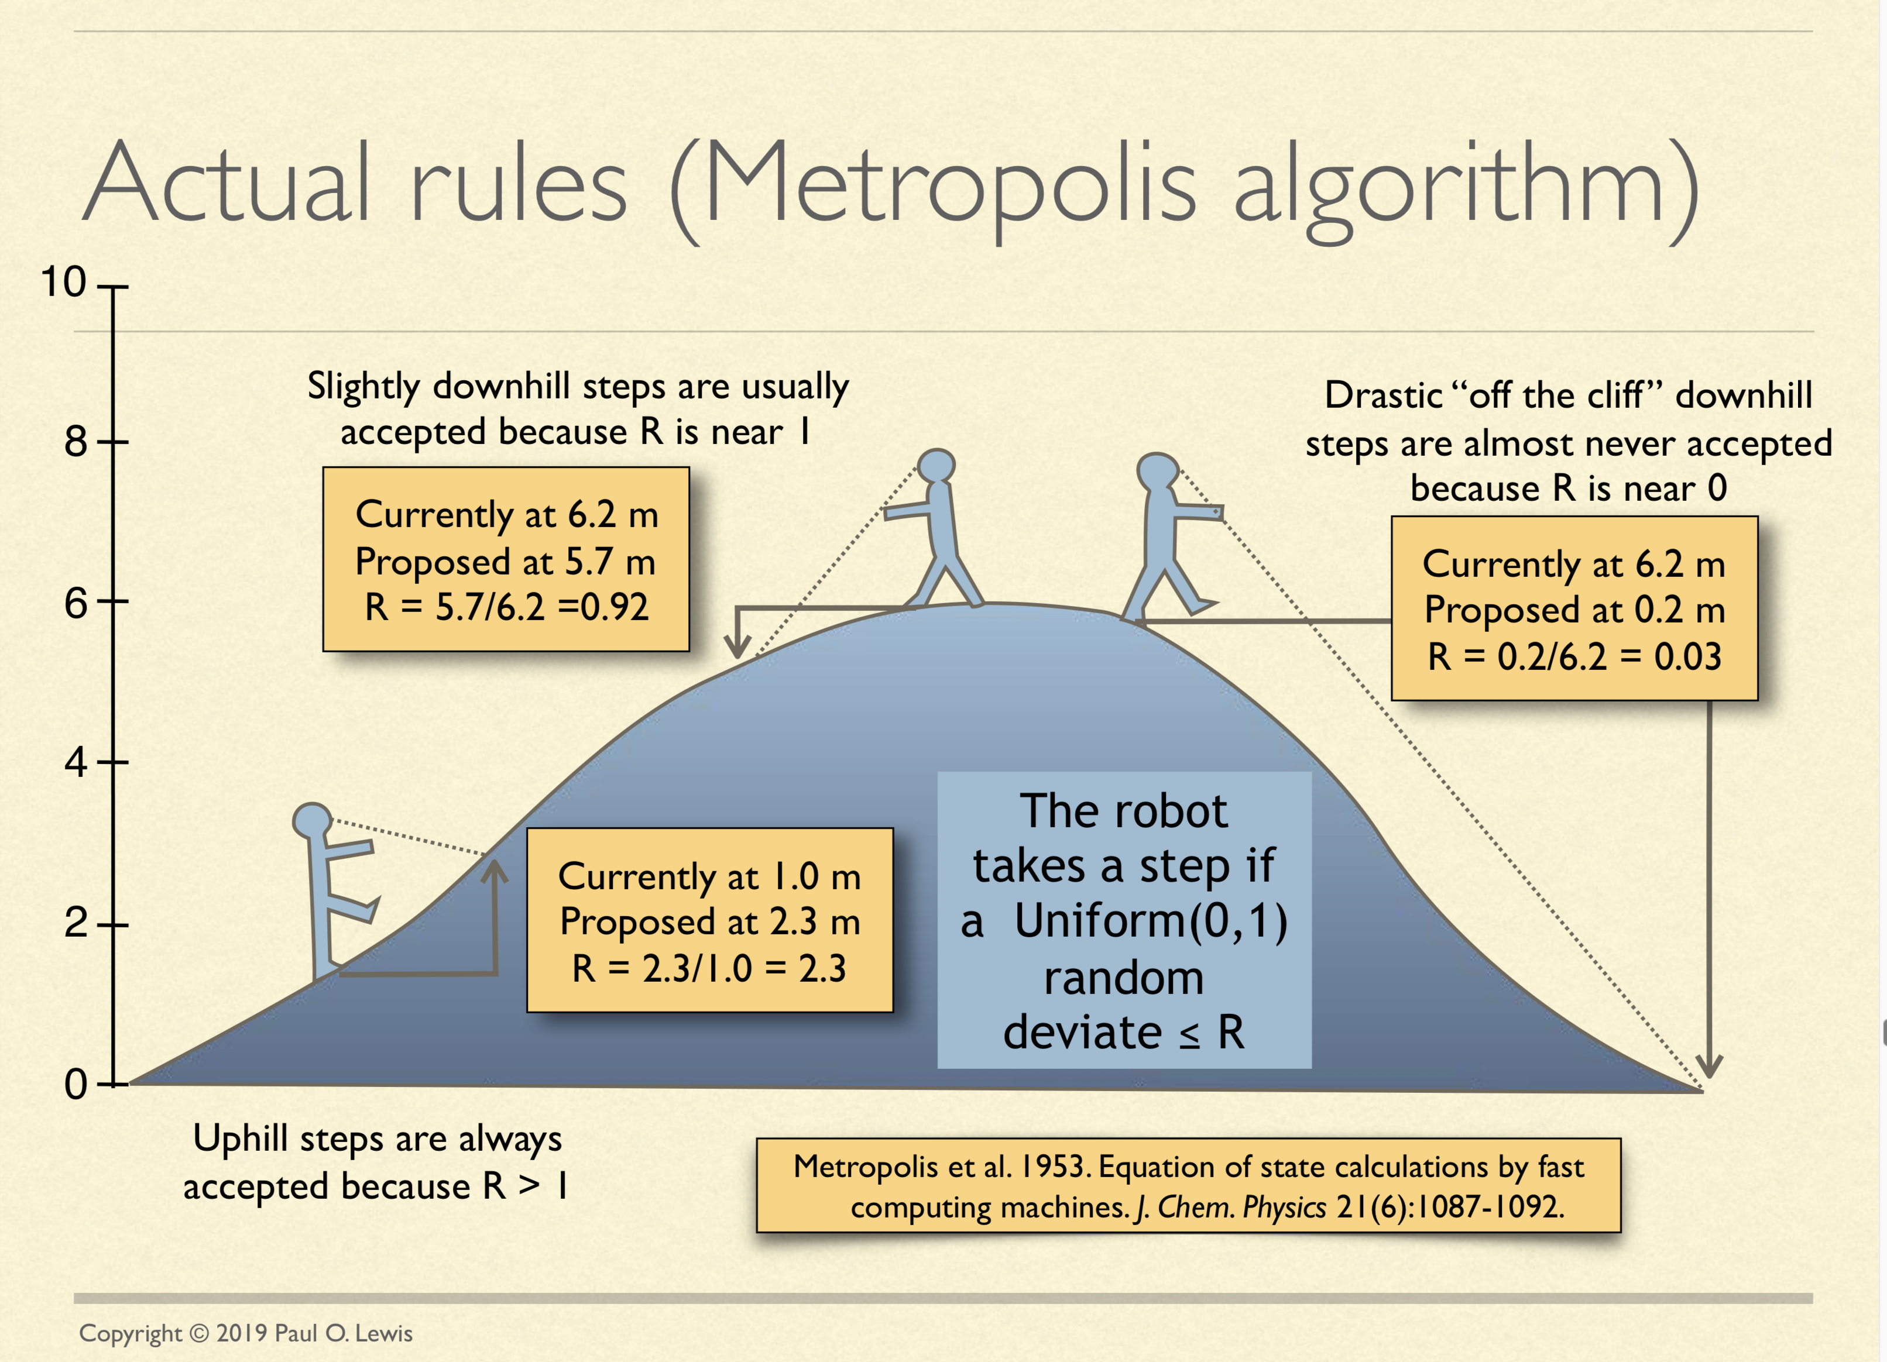
See: http://hydrodictyon.eeb.uconn.edu/people/plewis/downloads/wh2019/lewis-bayesian-part1.pdf

Slide 47
Estimating Bayesian Posterior Probabilities through biased sampling
Exploration of parameter space by sampling posterior probabilities (likelihoods) using a biased random walk through parameter space (Metropolis Hastings Coupled Monte Carlo Markov Chain or MC³)
Pick a set of parameters at random
Calculate the likelihood of the data / posterior probability for this set of parameters
Change one of the parameters by a little bit, recalculate the likelihood
If the posterior probability increased, use these parameter values as a starting point for the next parameter change (back to 3), if it gets worse calculate the ratio of the posterior probabilities and take these odds to accept or reject the new parameter as a starting point for the next step.
N_{i}
,where N_{i} - number of sampled parameter states (e.g. a particular clade) that you are interested in
N_{total} – total number of samples (has to be large)
P_{i} ≈
N_{total}

Slide 48
Alternative Approaches to Estimate
Posterior Probabilities
Bayesian Posterior Probability Mapping with MrBayes
(Huelsenbeck and Ronquist, 2001)
Problem:
Strimmer’s formula
L_{i}
p_{i}=
only considers 3 trees
(those that maximize the likelihood for
the three topologies)
L₁+L₂+L₃
Solution:
Exploration of the tree space by sampling trees using a biased random walk
(Implemented in MrBayes program)
Trees with higher likelihoods will be sampled more often
N_{i}
p_{i}≈
N_{total}
,where N_{i} - number of sampled trees of topology i, i=1,2,3
N_{total} – total number of sampled trees (has to be large)

Slide 49
Illustration of a biased random walk
Figures generated using MCRobot program (Paul Lewis, 2001)

Slide 50
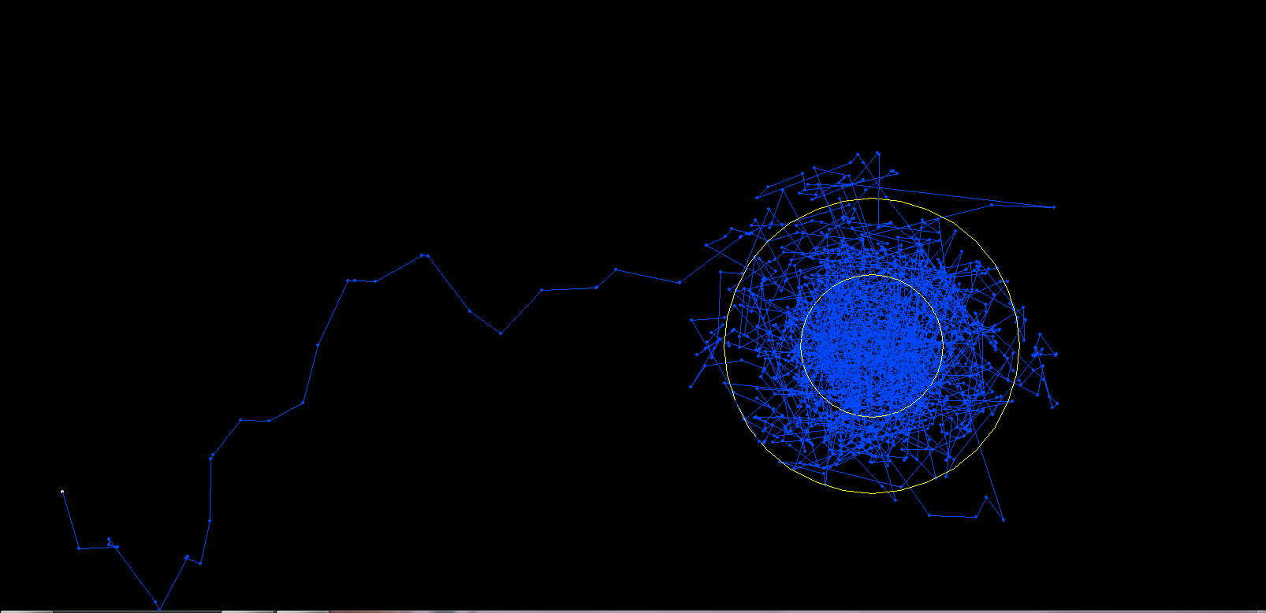
One needs to remove the burnin that is created, when the robot initially runs around in parameter space without seeing the probability landscape.

Slide 51
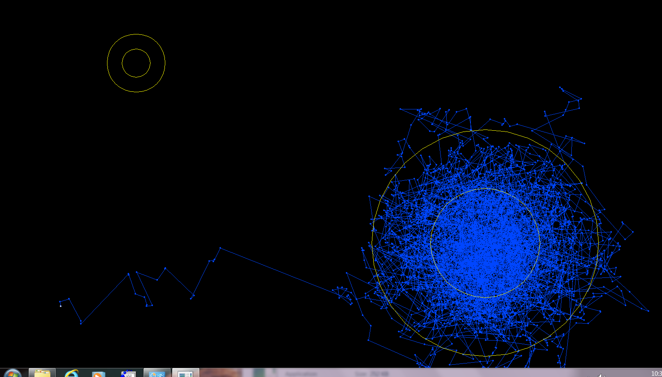
One complication is that the robot might be stuck on a local optimum.

Slide 52
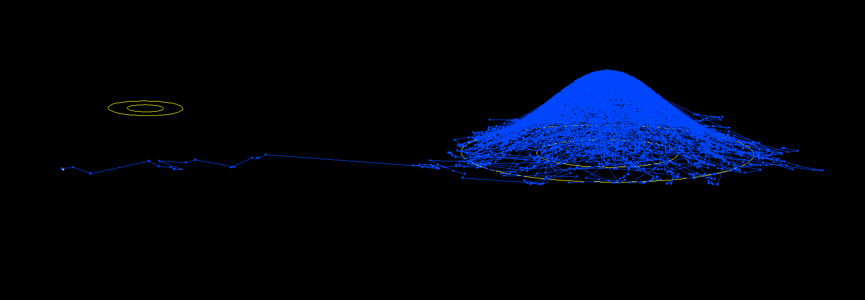
One complication is that the robot might be stuck on a local optimum. (Same as last slide but in sideview).

Slide 53
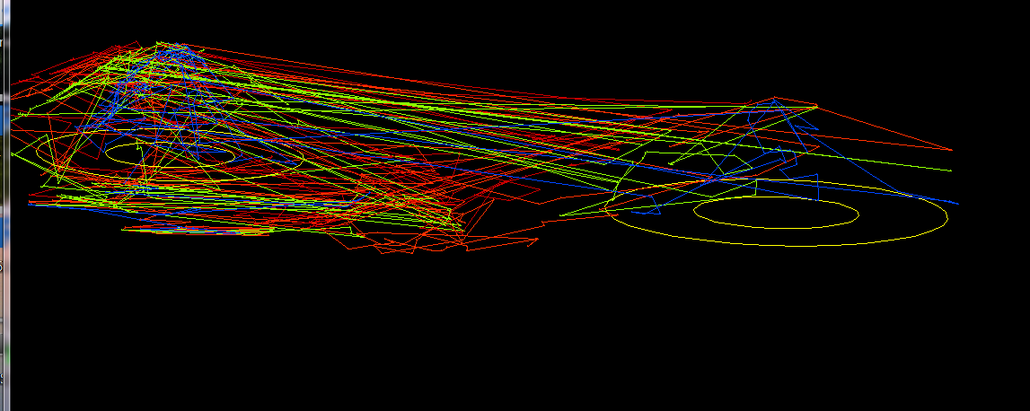
One solution is to run multiple chains, some of which “heated”, so that the probability landscape is melted down, and the robots move more easily away from the optimum. The different chains compare their sampled probability, and switch in case the heated chain is better.

Slide 54
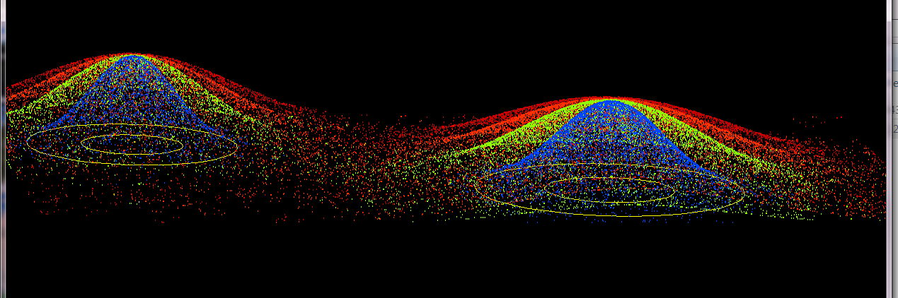
4 chains, same as previous, but many more generations, and the trajectory is not plotted, only the points visited by each of the four chains.

Slide 55
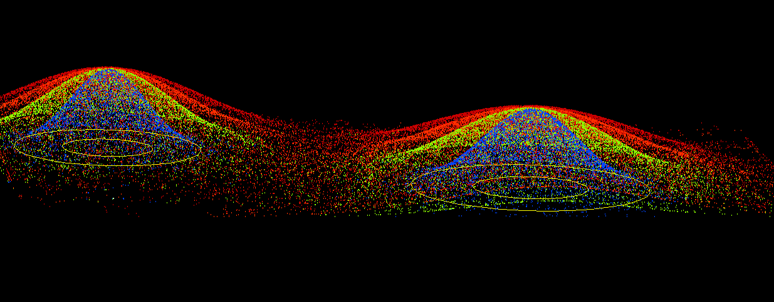
4 chains, same as previous, but even more generations

Slide 56
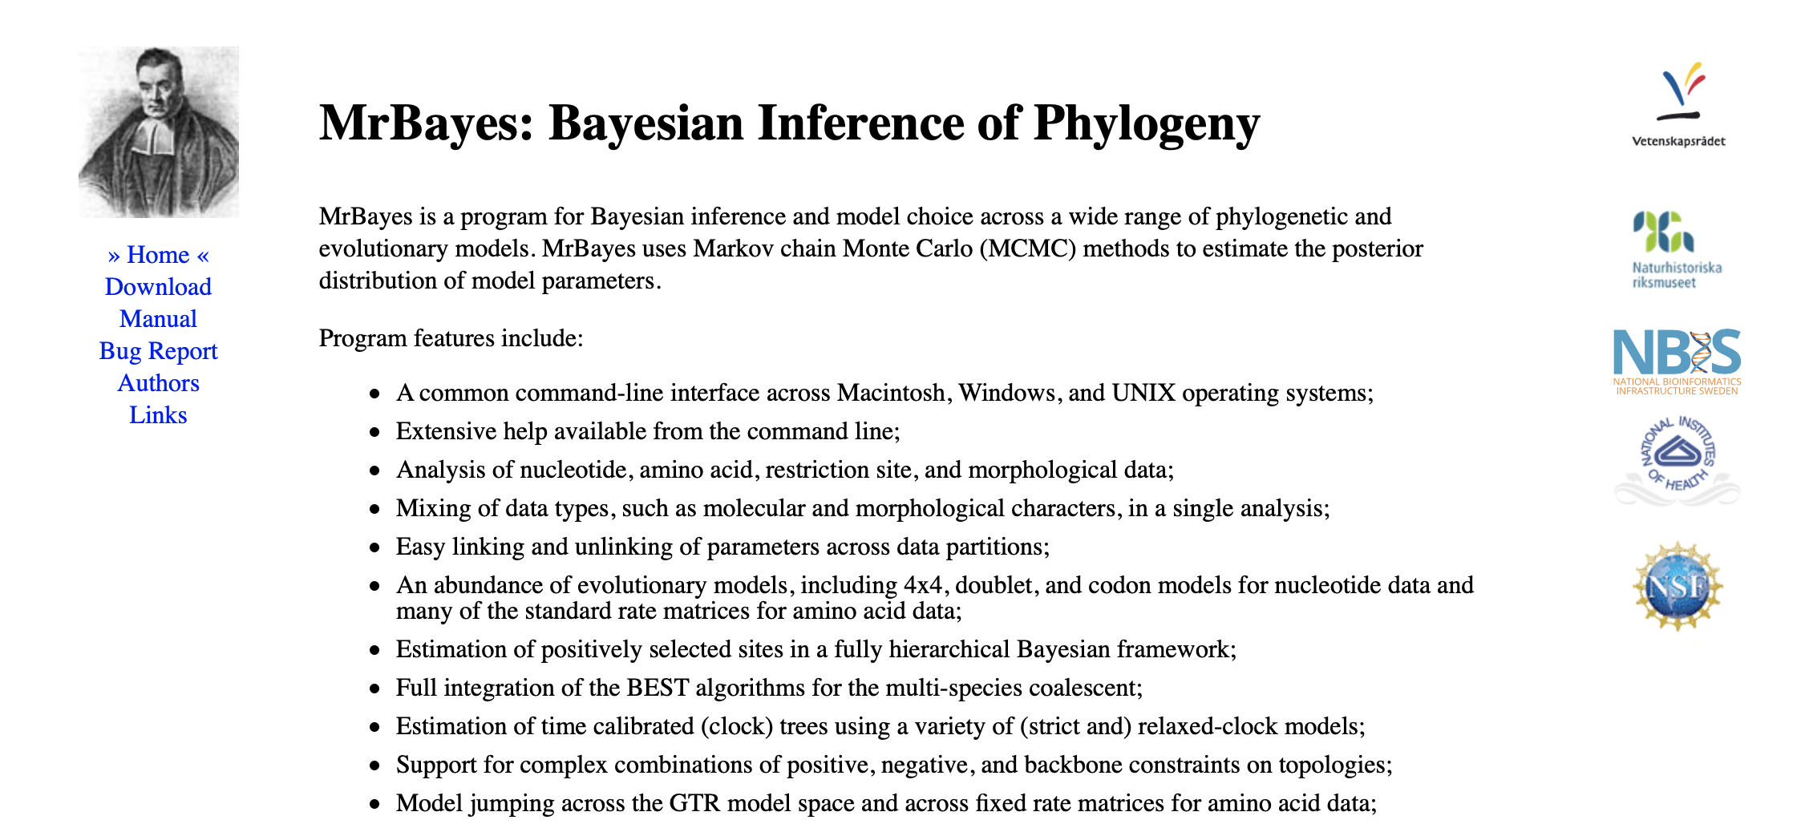

Slide 57
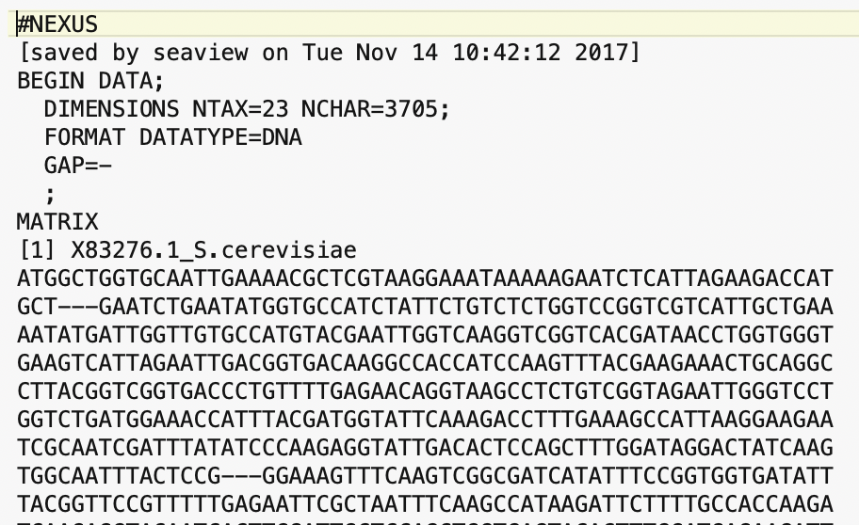
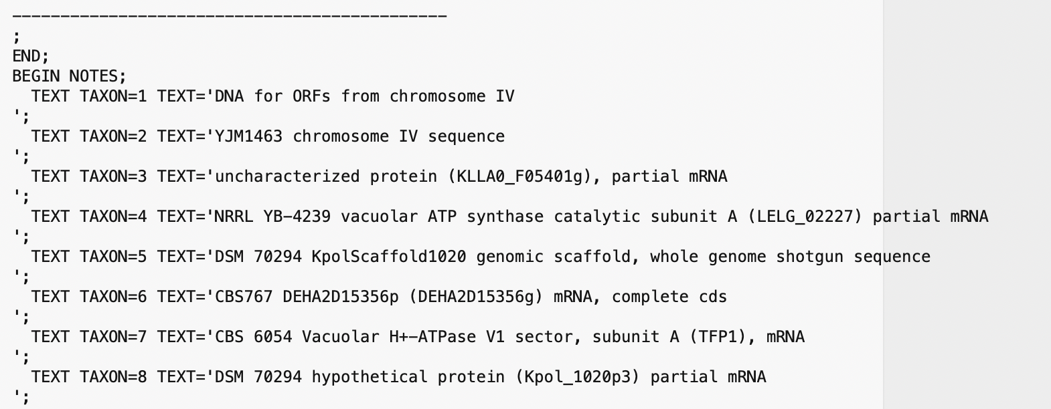
MrBayes reads Nexus files (can be generated from Seaview).
This retains partitioning data (e.g., into sites from exteins and inteins)
Nexus files can have command blocks at the end for different programs (PAUP or MrBayes)
Beginning of the file:
End of Data matrix, beginning of notes

Slide 58
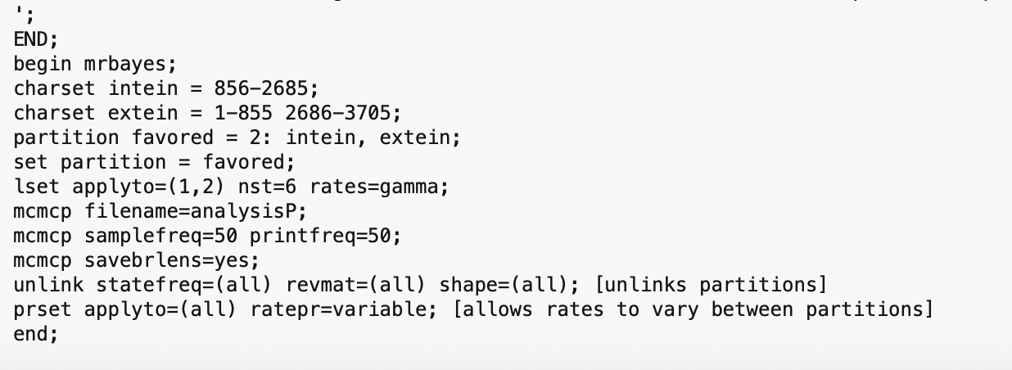
MrBayes block:
You need to consult the MrBayes manual at http://mrbayes.sourceforge.net/mb3.2_manual.pdf
to figure out the commands
Start mb -> execute Filename -> mcmc (starts the ”robot”)

Slide 59
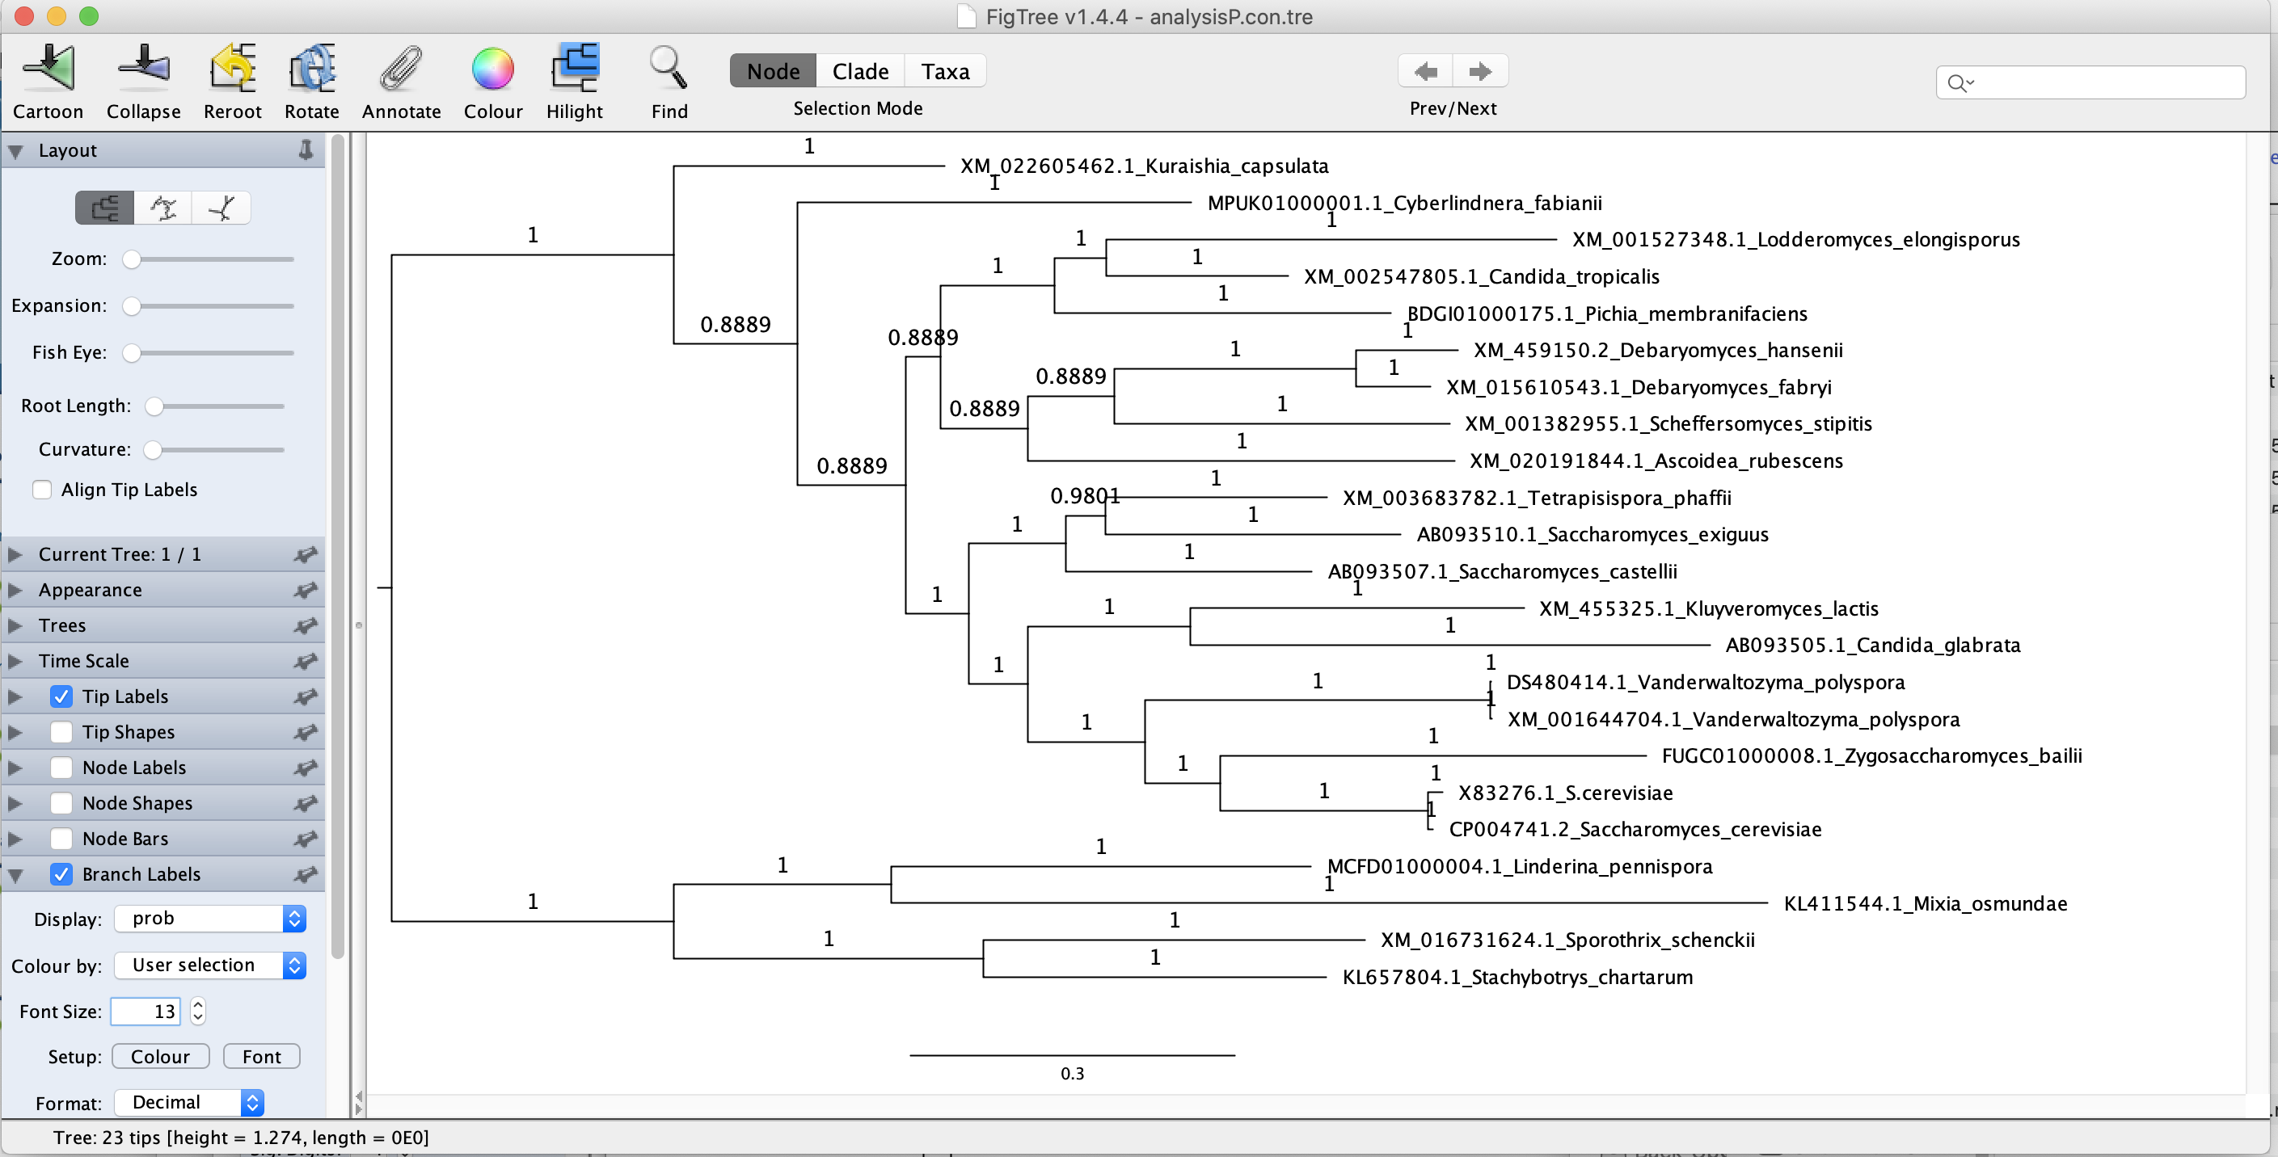
MrBayes creates a tree file (.t) that contains the trees sampled during the run.
This can be summarized into a consensus tree: (shown here in Figtree).

Slide 60
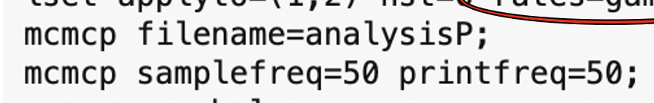
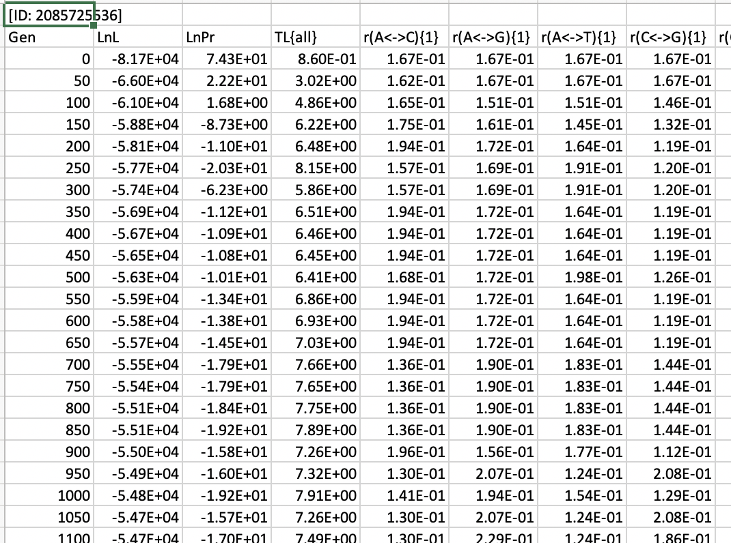
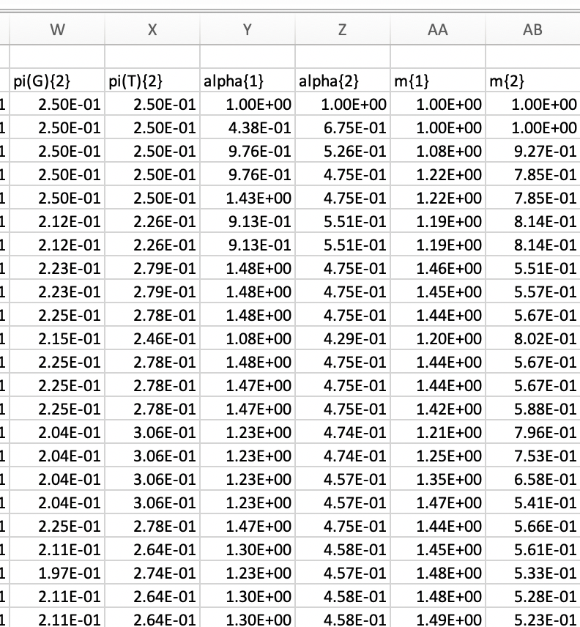
MrBayes also creates a parameter file (.b) that contains the parameters for the specified samples

Slide 61
Log Likelihood over generations
End Burnin

Slide 62
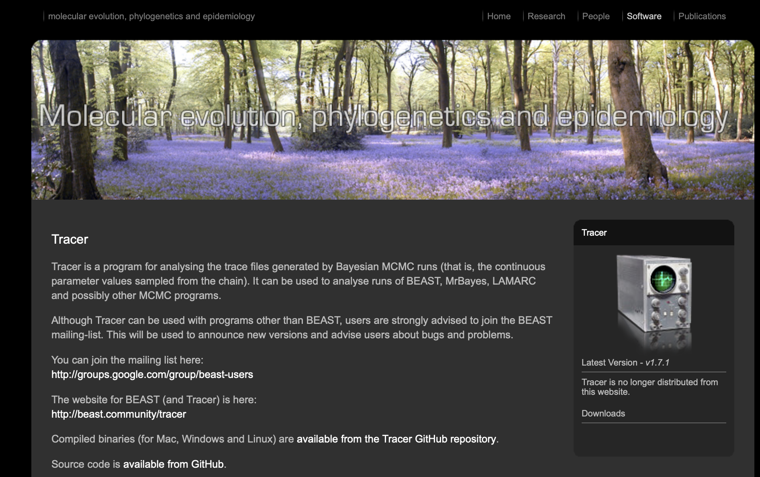
By default MrBayes is doing two parallel runs (with 4 chains each).
This allows to test convergence.
Tracer is a beautiful program that helps to analyze and visualize MCMCMC runs:
(much easier than in Excel)

Slide 63
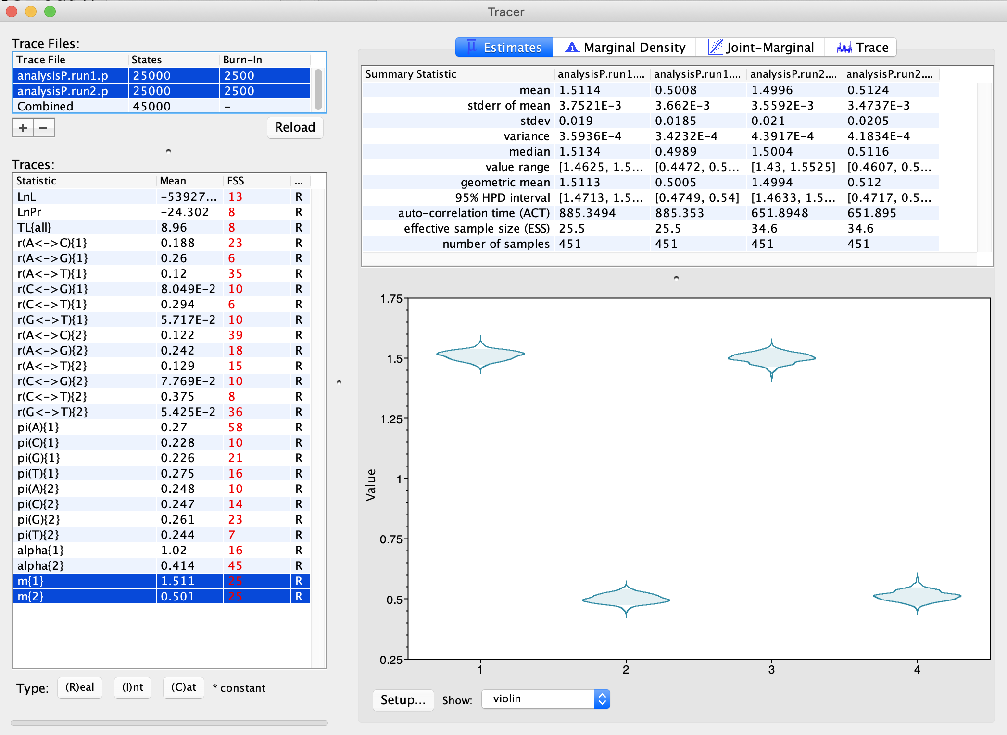
The relative substitution rates for the two partitions and the two runs.
As Violin plot:

Slide 64
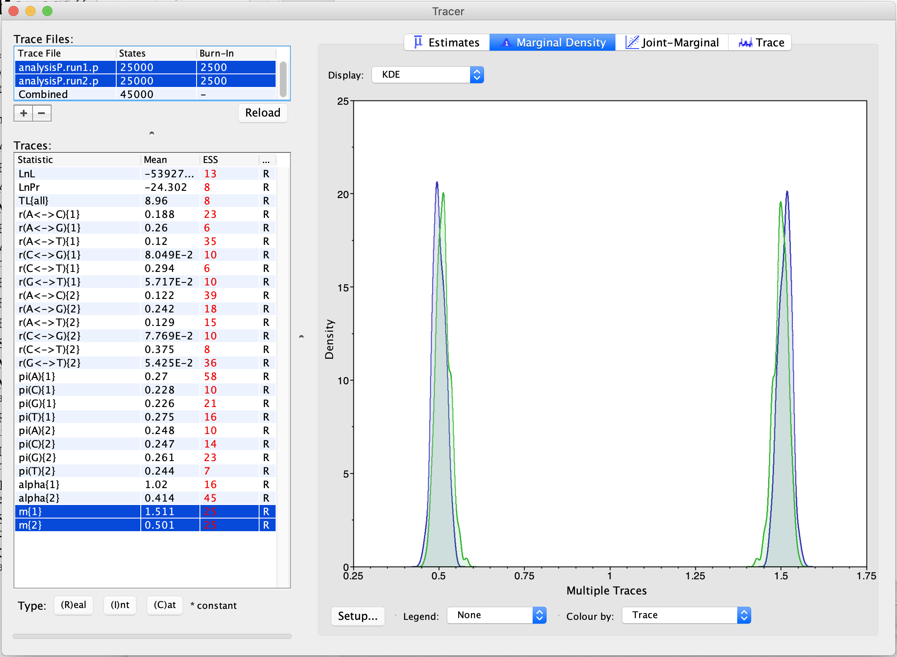
The relative substitution rates for the two partitions and the two runs.
As smoothed histogram:

Slide 65
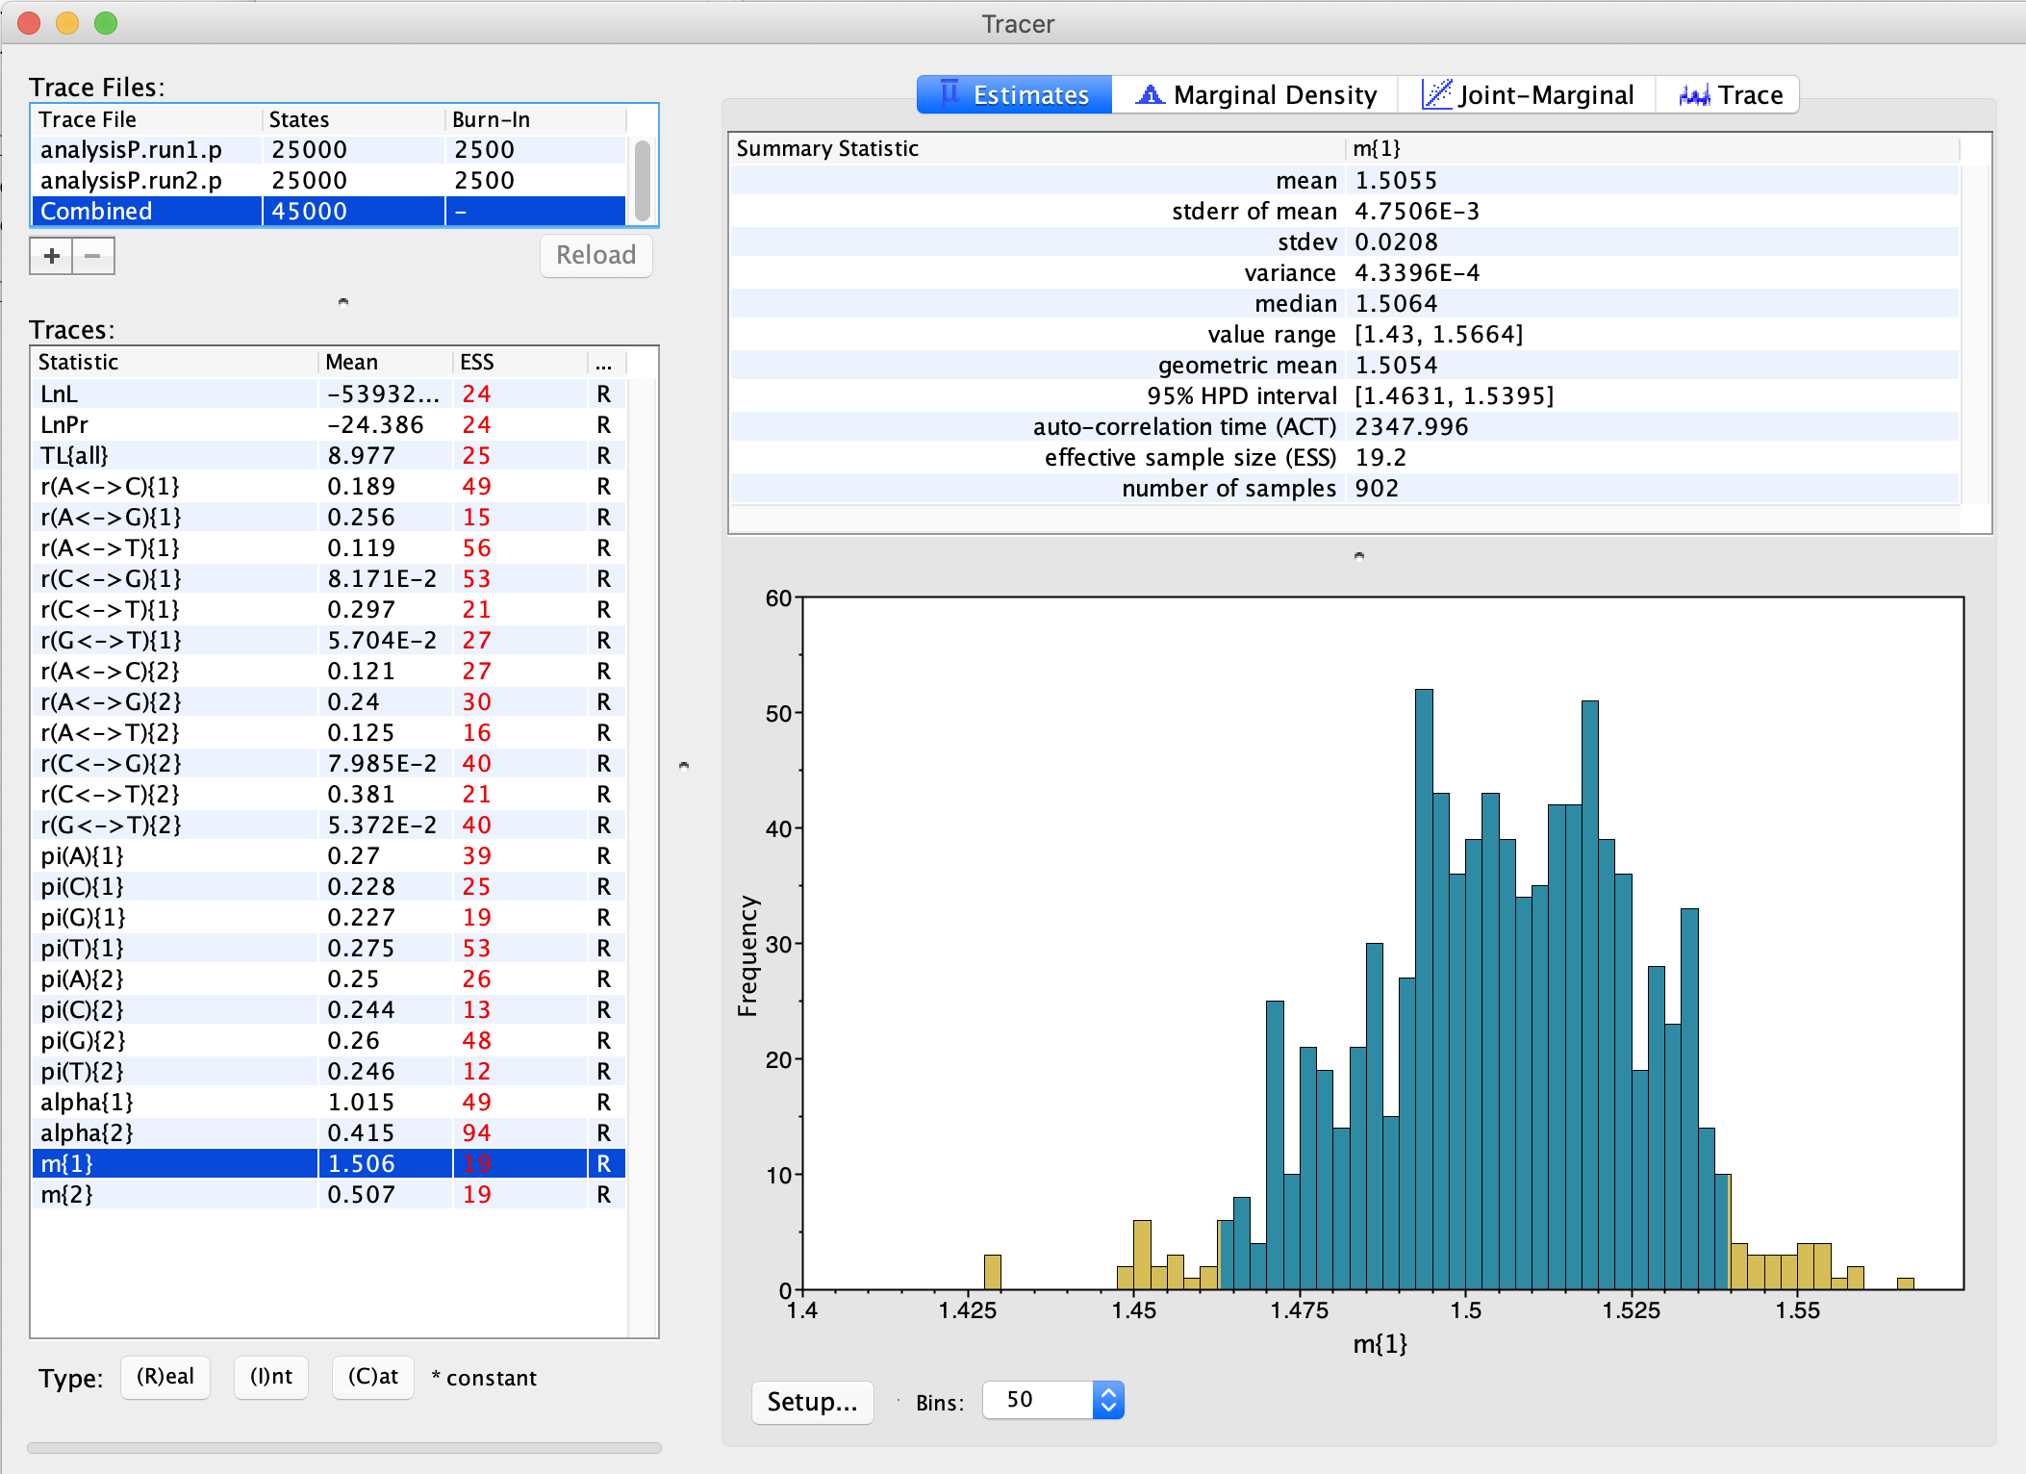
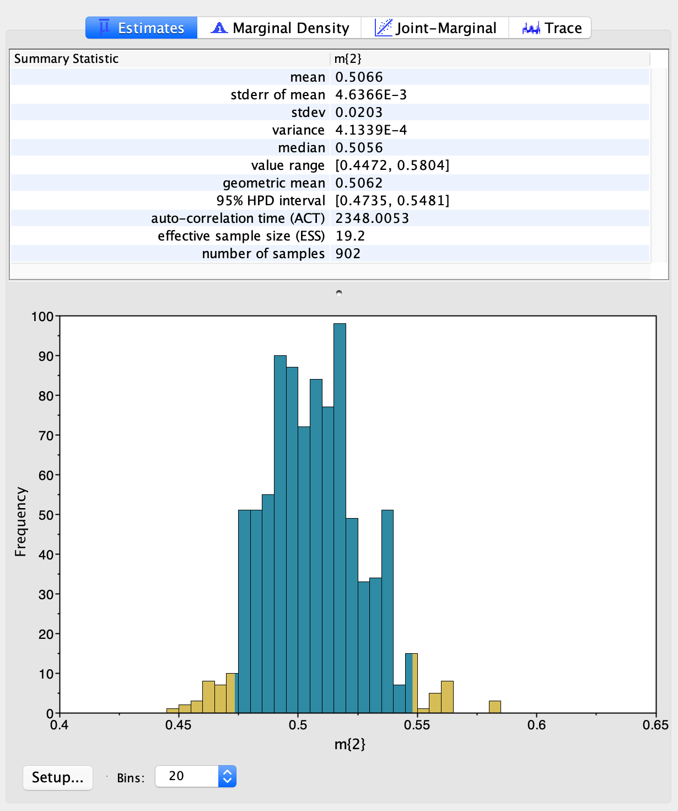
Distribution of relative substitution rate for the intein, versus the extein
=>

Slide 66
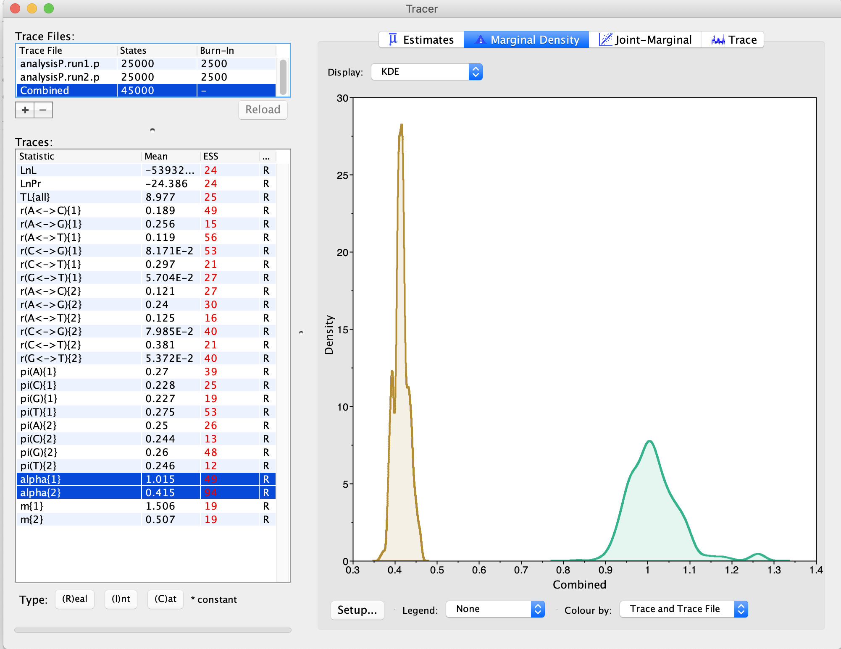
The shape parameter describing the Among Site Rate Variation (ASRV) for the two partitions:
Extein
Intein

Slide 67
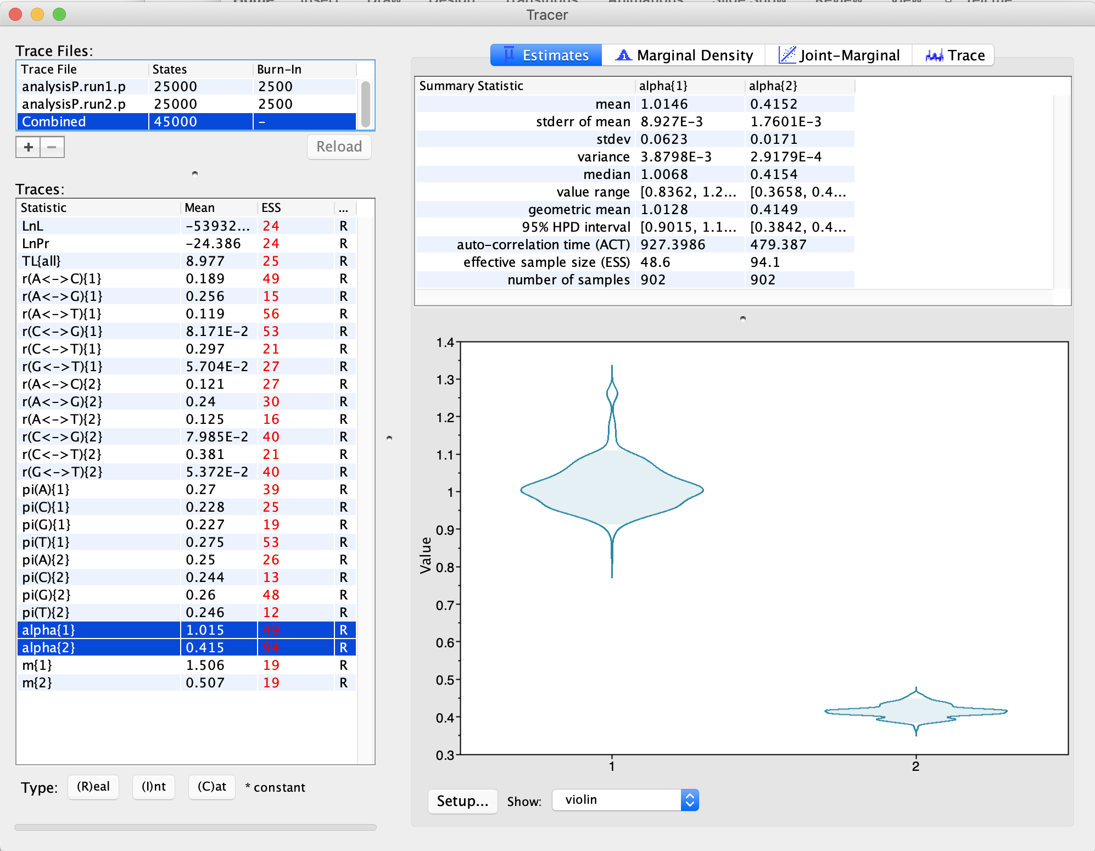
The shape parameter describing the Among Site Rate Variation (ASRV) for the two partitions:
Intein
Extein

Slide 68
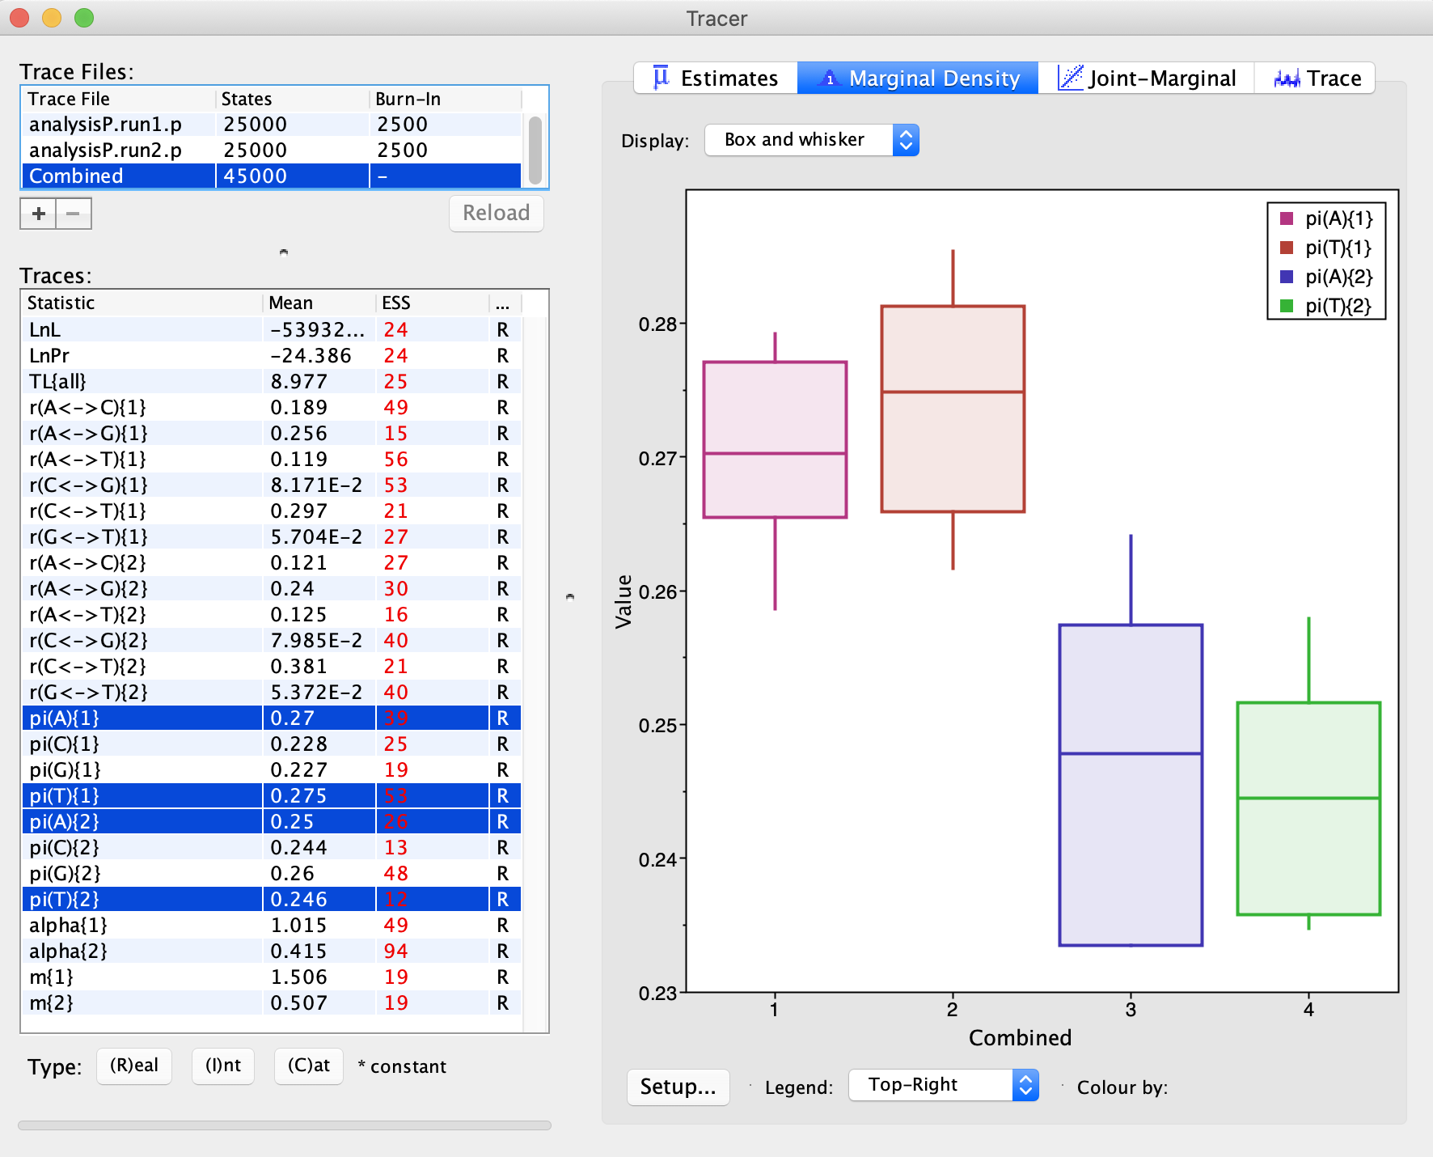
AT content is higher for the intein.
This also may reflect less selection, because mutations from GC pairs to AT pairs occur more frequently (mutational bias)
Intein
Extein

Slide 69
Bottomline:
Bayesian analyses make it easy to describe parameters governing the evolution of molecules
Intein have a less extreme ASRV compared to exteins
Inteins have a higher (three times) substitution rate
Tracer (or Excel) makes it easy to obtain 95% high probability intervals for parameter values.
Concerns with the analysis used as an example:
The example should have run much longer ...
If we suspect HGT of the intein, the datasets have been analyzed separately (and not linked to the same tree explored in the same

