Slide 1
MCB 3421 – class 17
Phylogenies
and
Phylogenetic reconstruction
- part 2

Slide 2
Phylogenetic reconstruction - How
Distance matrix analysis (algorithmic or optimality criterion)
Parsimony: Find the tree (or trees) that explains data with the smallest number of substitutions (aka as Occam’s razor).
Note: parsimony does poorly in the presence of short and long branches
Maximum Likelihood: Find the tree and model that make the dataset most probable.
Note: the probability of an individual data set is tiny. Usually a 0, followed by several 10000 zeros. -LogL values of 90000 are common.
Bayesian Approach: Find the tree and model that are most probable given the data and prior information.
Note: The Bayesian analysis and the biased random walk in parameter space use the likelihood (but not the maximum likelihood) associated with the points in in parameter space.

Slide 3
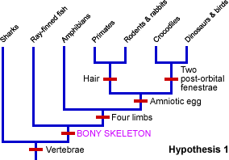
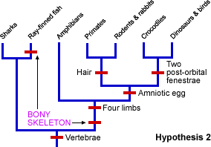
The parsimony approach also works for other characters. See below for the relation between sharks and bony fish:
From https://evolution.berkeley.edu/evolibrary/teach/index.php
This is pretty much equal to Willi Hennig’s cladistics. (The only difference is that parsimony does not insist on distinguishing between primitive and derived characters.)
Note, one can use ML for morphological characters!

Slide 4
Heuristic Searches
The most parsimonious tree or the maximum likely hood tree or the distance tree that fulfills some optimality criterion cannot be calculated directly from the data matrix (in contrast to the algorithmic approaches).
Given a tree the branch length (or number of steps) that optimize the criterion can be calculated.
To find the overall bet tree, the enormous tree spaced need to be explored.

Slide 5
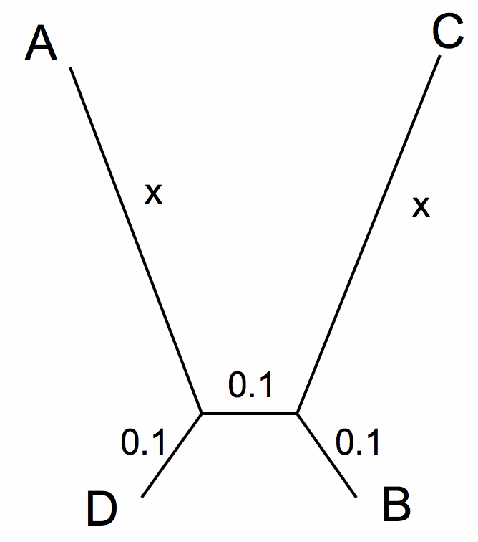
Long Branch Attraction (LBA) can be due to faster substitution rate in some branches, or due to long empty branches without any side branches
A
C
A B C D E F G H
A B C D E F G H
D
B
True Tree
LBA Tree
True Tree
LBA Tree

Slide 6
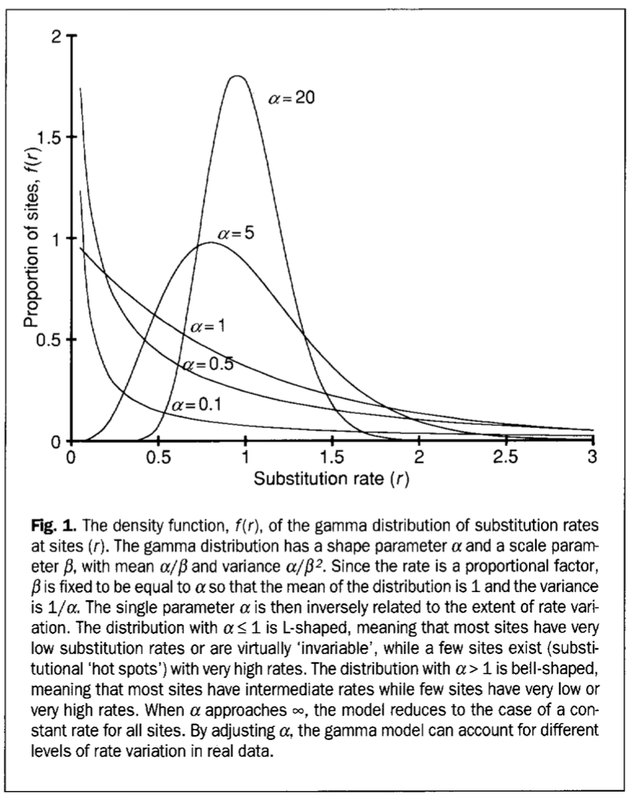
All alignment columns in an alignment are not created equal.

Slide 7

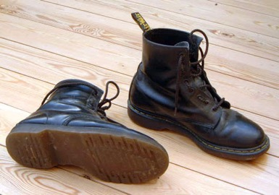
Non-Parametric Bootstrap:
Creating pseudo-samples (sampling with replacement, sample size n)
Doing the impossible Statistics on a single sample
Evaluation of pseudo-samples measures how much information in the original data support a conclusion.
Alternative to the non-parametric bootstrap:
Jacknife:
Creating pseudo-samples (sampling without replacement, sample size n/2)
Parametric Bootstrap:
Creating pseudo-samples through simulations using a model and parameters estimated from the data

Slide 8
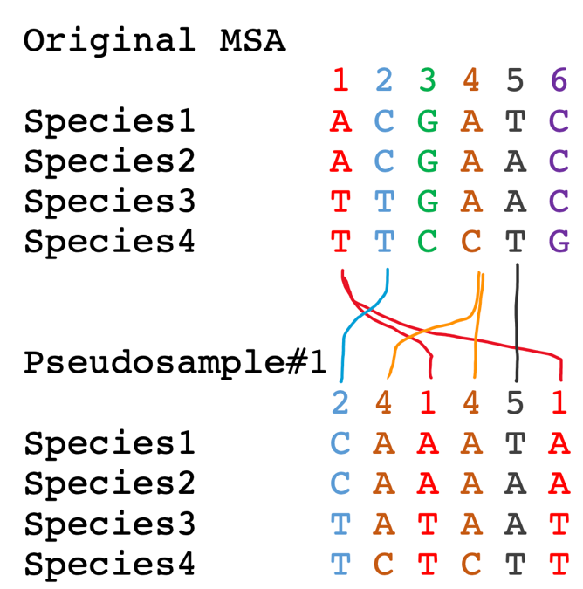
To sample with replacement for the alignment columns, we role six-sided dice six times. Assume you got the following numbers:
(2 4 1 4 5 1)
In this case column 3 and 6 did not make it into the pseudosample, and columns 1 and 4 made it twice.

Slide 9
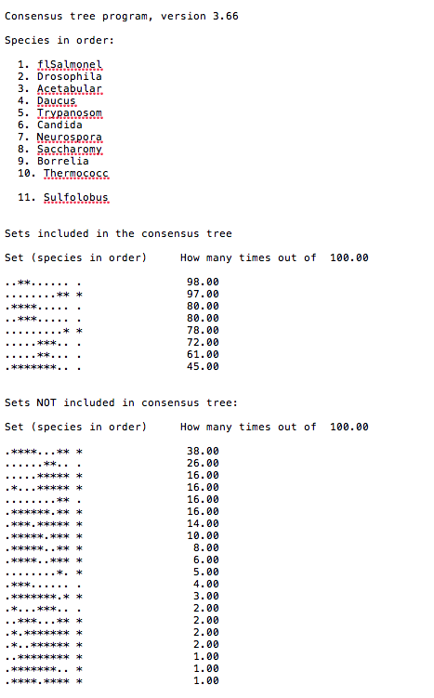
Output from consense

Slide 10
Why could a gene tree be different from the species tree?
Lack of resolution
Lineage sorting
Gene duplications/gene loss (paralogs/orthologs)
Gene transfer
Systematic artifacts (e.g., compositional bias and long branch attraction)

Slide 11
Trees – what might they mean?
Calculating a tree is comparatively easy, figuring out what it might mean is much more difficult.
If this is the probable organismal tree:
species A
species B
species C
species D
what could be the reason for obtaining this gene tree:
seq. from A
seq. from D
seq. from C
seq. from B

Slide 12
lack of resolution
seq. from A
seq. from D
seq. from C
seq. from B
e.g., 60% bootstrap support for bipartition (AD)(CB)

Slide 13
long branch attraction artifact
the two longest branches join together
seq. from A
seq. from D
seq. from C
seq. from B
e.g., 100% bootstrap support for bipartition (AD)(CB)
What could you do to investigate if this is a possible explanation?
use only slow positions,
use an algorithm that corrects for ASRV

Slide 14
Gene transfer
Organismal tree:
species A
species B
Gene Transfer
species C
species D
molecular tree:
seq. from A
seq. from D
seq. from C
speciation
seq. from B
gene transfer

Slide 15
Lineage Sorting
Organismal tree:
species A
species B
species C
Genes diverge and coexist in the
organismal lineage
species D
molecular tree:
seq. from A
seq. from D
seq. from C
seq. from B

Slide 16
Gene duplication
Organismal tree:
species A
species B
species C
gene duplication
species D
molecular tree:
seq. from A
seq. from B
seq. from C
seq. from D
seq.’ from B
seq.’ from C
gene duplication
seq.’ from D

Slide 17
Gene duplication
Organismal tree:
species A
species B
species C
gene duplication
species D
molecular tree:
seq. from A
with gene loss
seq. from D
seq.’ from B
seq.’ from C
gene duplication

Slide 18
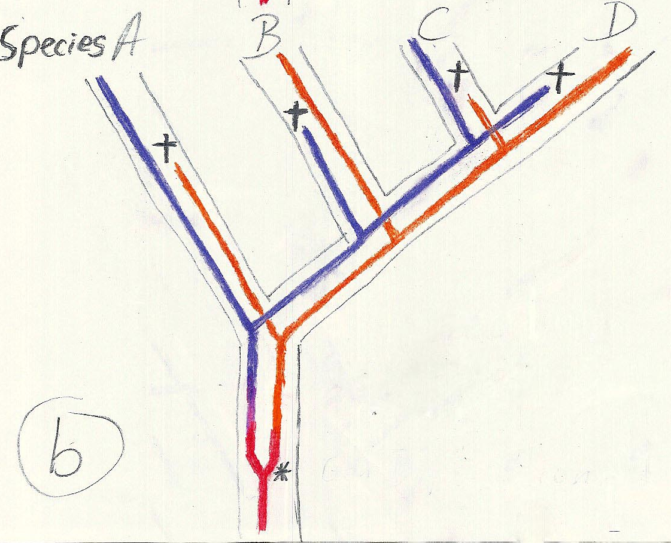
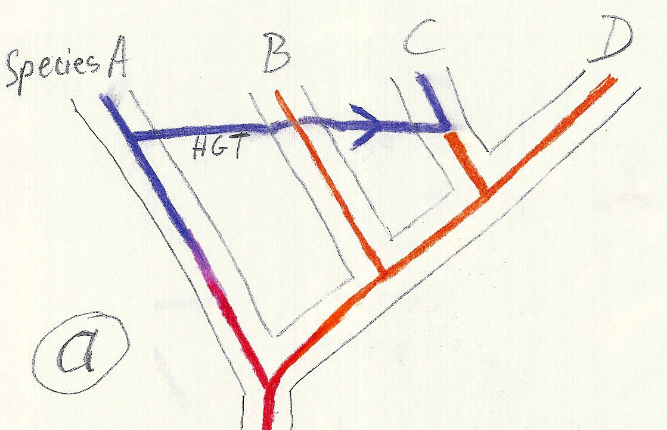
Gene duplication and gene transfer are equivalent explanations.
The more relatives of C are found that do not have the blue type of gene, the less likely is the duplication loss scenario
Ancient duplication followed by gene loss
Horizontal or lateral Gene
Note that scenario B involves many more individual events than A
1 HGT with
orthologous replacement
1 gene duplication followed by 4 independent gene loss events

Slide 19
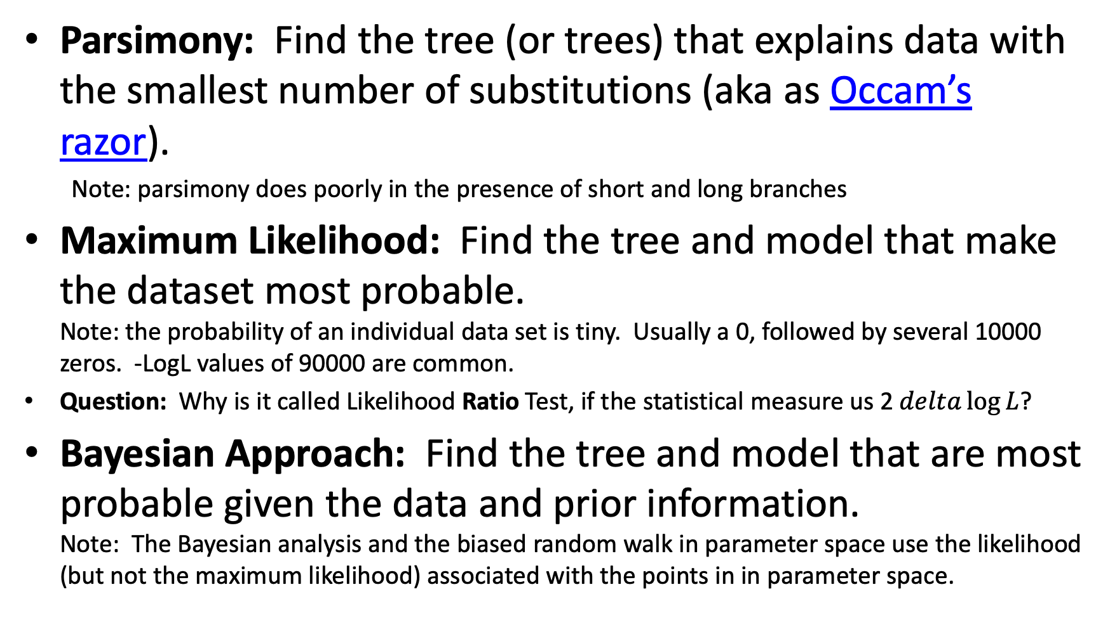
Parsimony: Find the tree (or trees) that explains data with the smallest number of substitutions (aka as Occam’s razor).
Note: parsimony does poorly in the presence of short and long branches
Maximum Likelihood: Find the tree and model that make the dataset most probable.
Note: the probability of an individual data set is tiny. Usually a 0, followed by several 10000 zeros. -LogL values of 90000 are common.
Question: Why is it called Likelihood Ratio Test, if the statistical measure us 2$delta\log{L}$?
Bayesian Approach: Find the tree and model that are most probable given the data and prior information.
Note: The Bayesian analysis and the biased random walk in parameter space use the likelihood (but not the maximum likelihood) associated with the points in in parameter space.

Slide 20

Elliot Sober’s Gremlins
Observation: Loud noise in the attic
?
Hypothesis: gremlins in the attic playing bowling
Likelihood =
P(noise|gremlins in the attic)
What you would want to know (posterior probability):
P(gremlins in the attic|noise)
?
?

Slide 21
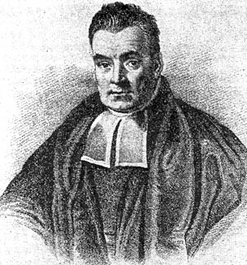
Bayes’ Theorem
Likelihood
describes how well the model predicts the data
P(data|model, I)
P(model|data, I) = P(model, I)
P(data,I)
Posterior
Probability
represents the degree
to which we believe a given model accurately describes the situation
given the available data and all of our prior information I
Prior
Probability
describes the degree to which we believe the model accurately describes reality
based on all of our prior information.
Normalizing
constant
Reverend Thomas Bayes (1702-1761)

Slide 22
Likelihood estimates do not take prior information into consideration:
e.g., if the result of three coin tosses is 3 times head, then the likelihood estimate for the frequency of having a head is 1 (3 out of 3 events) and the estimate for the frequency of having a head is zero.
The probability that both events (A and B) occur
Both sides expressed as conditional probability
If A is the model and B is the data, then
P(B|A) is the likelihood of model A
P(A|B) is the posterior probability of the model given the data.
P(A) is the considered the prior probability of the model.
P(B) often is treated as a normalizing constant.

Slide 23
Likelihood estimates do not take prior information into consideration:
e.g., if the result of three coin tosses is 3 times head, then the likelihood estimate for the frequency of having a head is 1 (3 out of 3 events) and the estimate for the frequency of having a head is zero.
The probability that both events (A and B) occur
Both sides expressed as conditional probability
If A is the model and B is the data, then
P(B|A) is the likelihood of model A
P(A|B) is the posterior probability of the model given the data.
P(A) is the considered the prior probability of the model.
P(B) often is treated as a normalizing constant.

Slide 24
Likelihood estimates do not take prior information into consideration:
e.g., if the result of three coin tosses is 3 times head, then the likelihood estimate for the frequency of having a head is 1 (3 out of 3 events) and the estimate for the frequency of having a head is zero.
The probability that both events (A and B) occur
Both sides expressed as conditional probability
If A is the model and B is the data, then
P(B|A) is the likelihood of model A
P(A|B) is the posterior probability of the model given the data.
P(A) is the considered the prior probability of the model.
P(B) often is treated as a normalizing constant.

Slide 25
Likelihood estimates do not take prior information into consideration:
e.g., if the result of three coin tosses is 3 times head, then the likelihood estimate for the frequency of having a head is 1 (3 out of 3 events) and the estimate for the frequency of having a head is zero.
The probability that both events (A and B) occur
Both sides expressed as conditional probability
If A is the model and B is the data, then
P(B|A) is the likelihood of model A
P(A|B) is the posterior probability of the model given the data.
P(A) is the considered the prior probability of the model.
P(B) often is treated as a normalizing constant.

Slide 26
Estimating Bayesian Posterior Probabilities through biased sampling
Exploration of parameter space by sampling posterior probabilities (likelihoods) using a biased random walk through parameter space (Metropolis Hastings Coupled Monte Carlo Markov Chain or MC³)
Pick a set of parameters at random
Calculate the likelihood of the data / posterior probability for this set of parameters
Change one of the parameters by a little bit, recalculate the likelihood
If the posterior probability increased, use these parameter values as a starting point for the next parameter change (back to 3), if it gets worse calculate the ratio of the posterior probabilities and take these odds to accept or reject the new parameter as a starting point for the next step.
According to Metropolis Hastings:
N_{i}
,where N_{i} - number of sampled parameter states (e.g. a particular clade) that you are interested in
N_{total} – total number of samples (has to be large)
P_{i} ≈
N_{total}
if I -> infinity

Slide 27
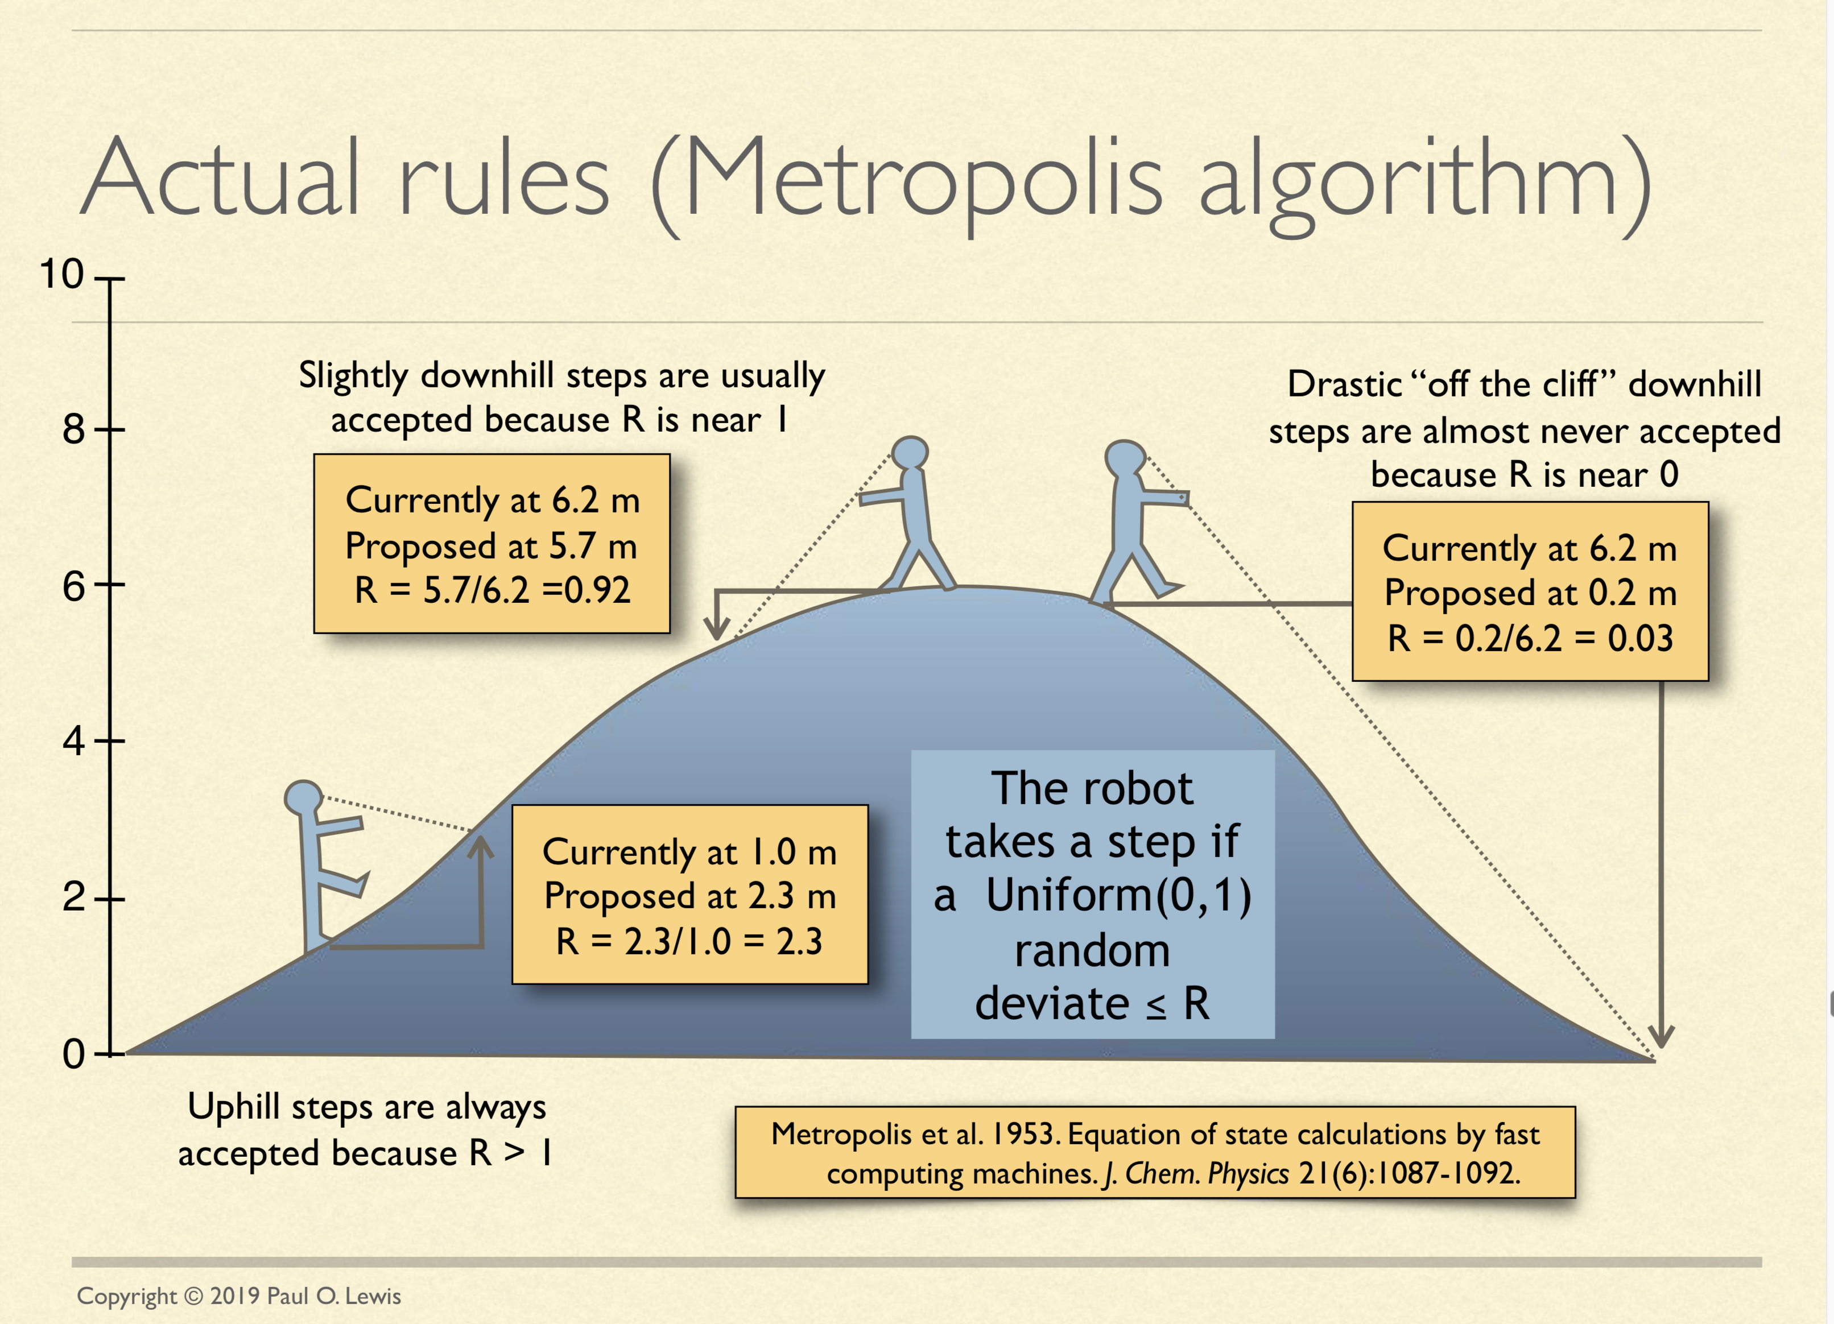
See: http://hydrodictyon.eeb.uconn.edu/people/plewis/downloads/wh2019/lewis-bayesian-part1.pdf

Slide 28
Alternative Approaches to Estimate
Posterior Probabilities
Bayesian Posterior Probability Mapping with MrBayes
(Huelsenbeck and Ronquist, 2001)
Problem:
Strimmer’s formula
L_{i}
p_{i}=
only considers 3 trees
(those that maximize the likelihood for
the three topologies)
L₁+L₂+L₃
Solution:
Exploration of the tree space by sampling trees using a biased random walk
(Implemented in MrBayes program)
Trees with higher likelihoods will be sampled more often
N_{i}
p_{i}≈
N_{total}
,where N_{i} - number of sampled trees of topology i, i=1,2,3
N_{total} – total number of sampled trees (has to be large)

Slide 29
Illustration of a biased random walk
Figures generated using MCRobot program (Paul Lewis, 2001)

Slide 30
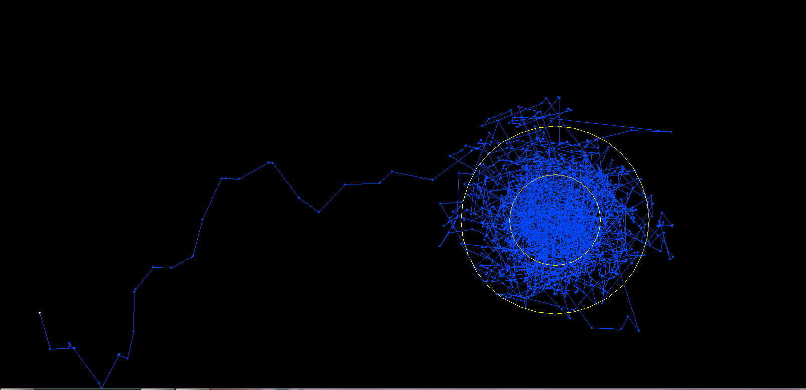
One needs to remove the burnin that is created, when the robot initially runs around in parameter space without seeing the probability landscape.

Slide 31
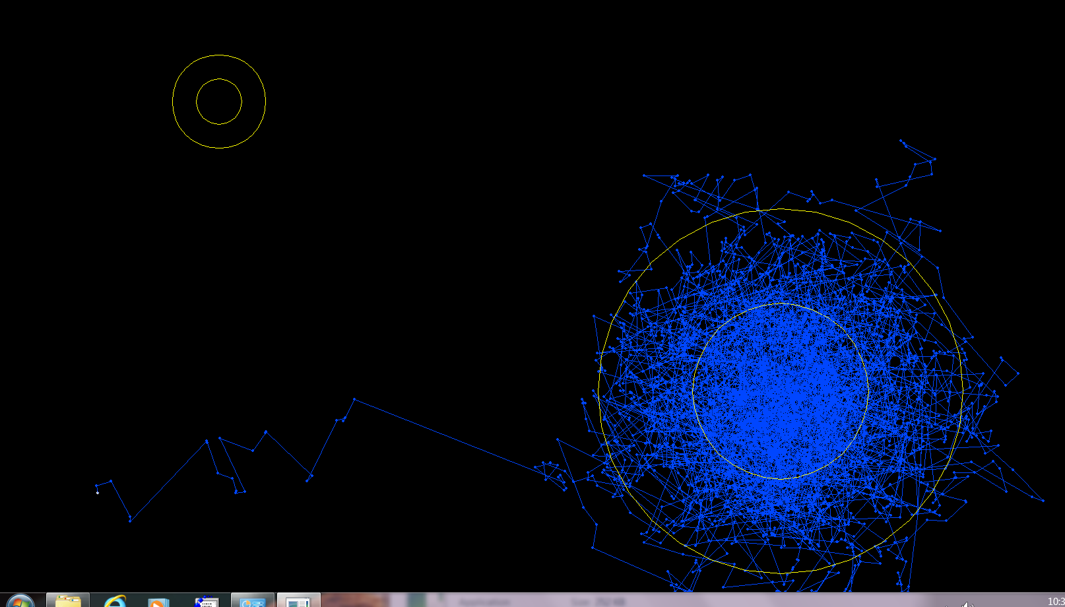
One complication is that the robot might be stuck on a local optimum.

Slide 32
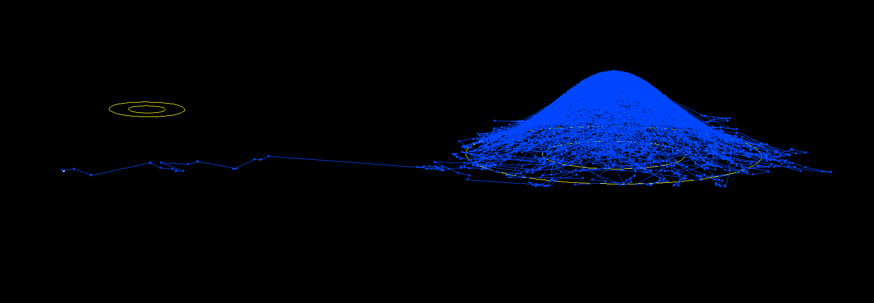
One complication is that the robot might be stuck on a local optimum. (Same as last slide but in sideview).

Slide 33
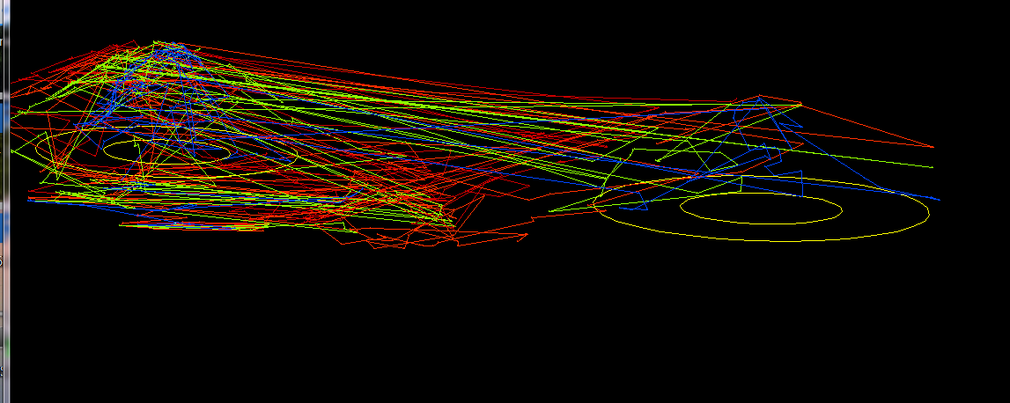
One solution is to run multiple chains, some of which “heated”, so that the probability landscape is melted down, and the robots move more easily away from the optimum. The different chains compare their sampled probability, and switch in case the heated chain is better.

Slide 34
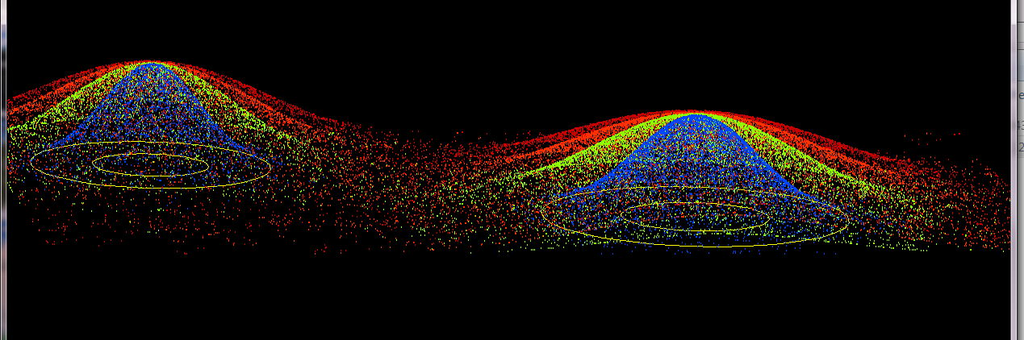
4 chains, same as previous, but many more generations, and the trajectory is not plotted, only the points visited by each of the four chains.

Slide 35
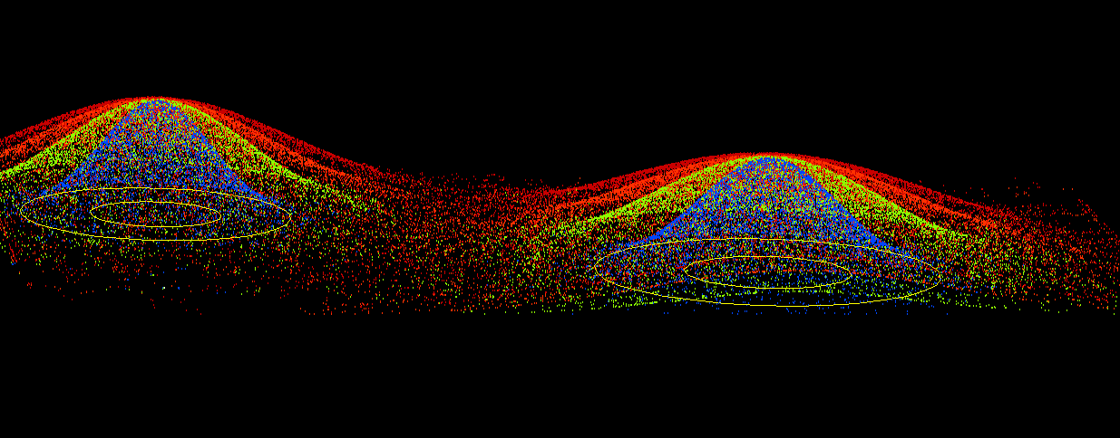
4 chains, same as previous, but even more generations

Slide 36
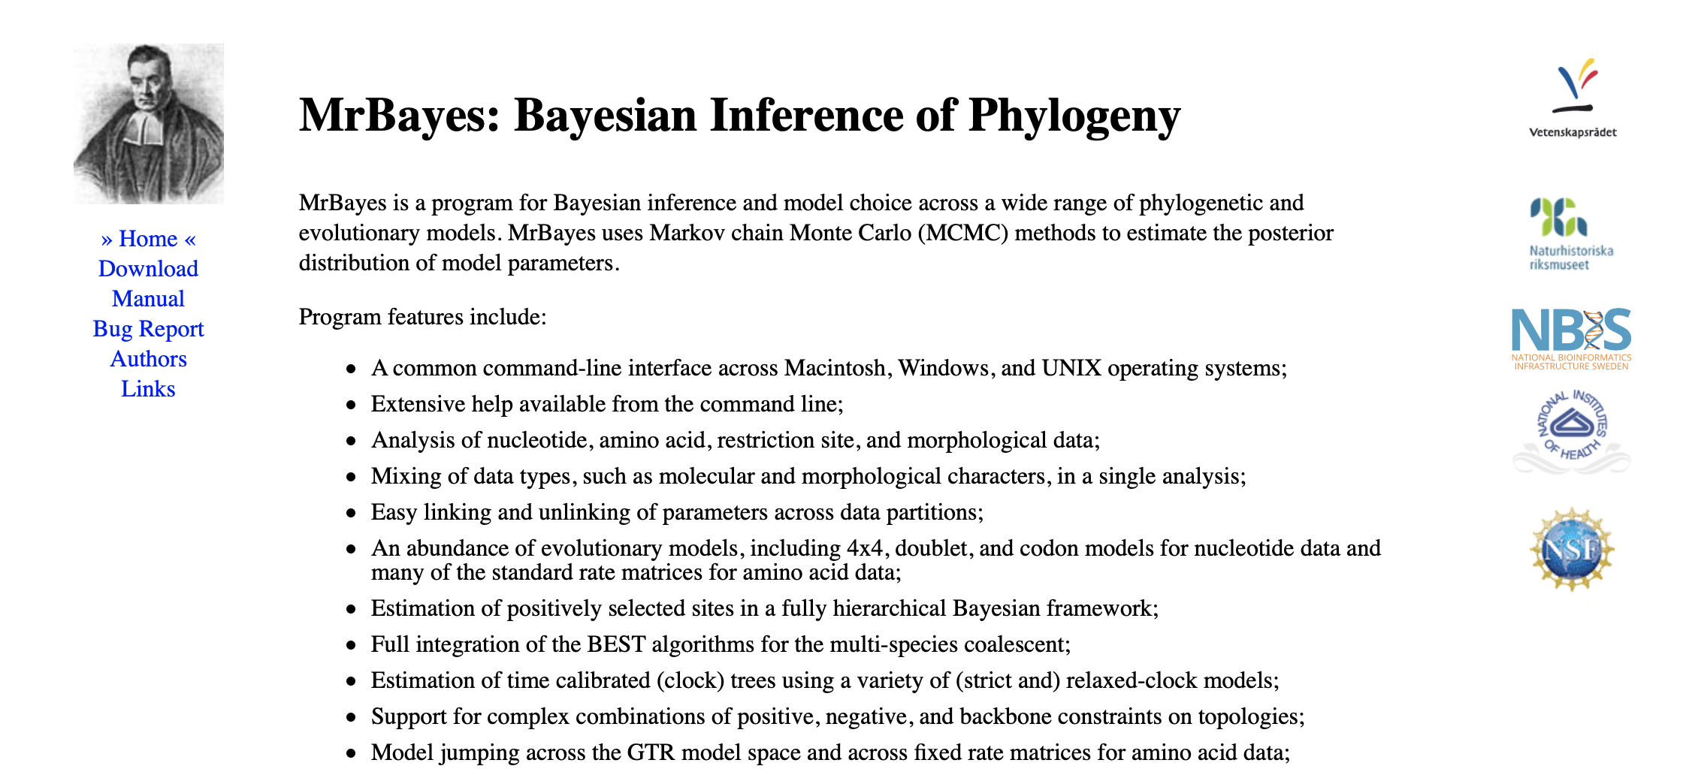

Slide 37
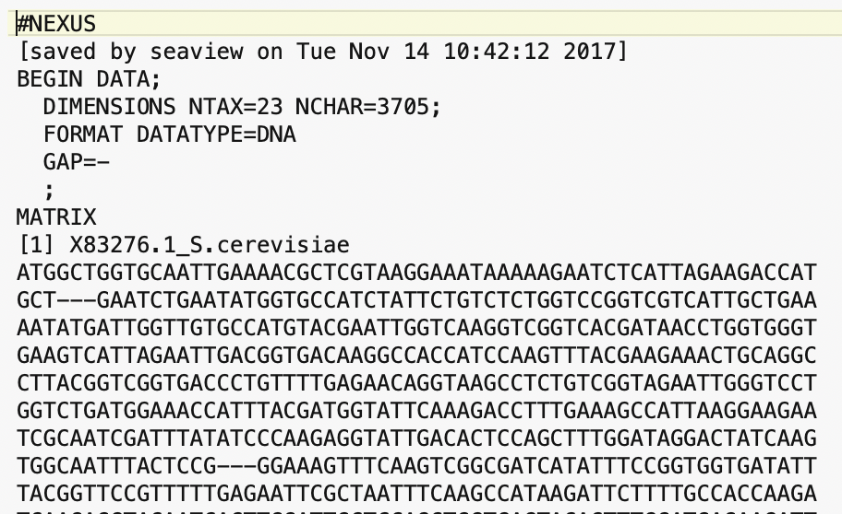
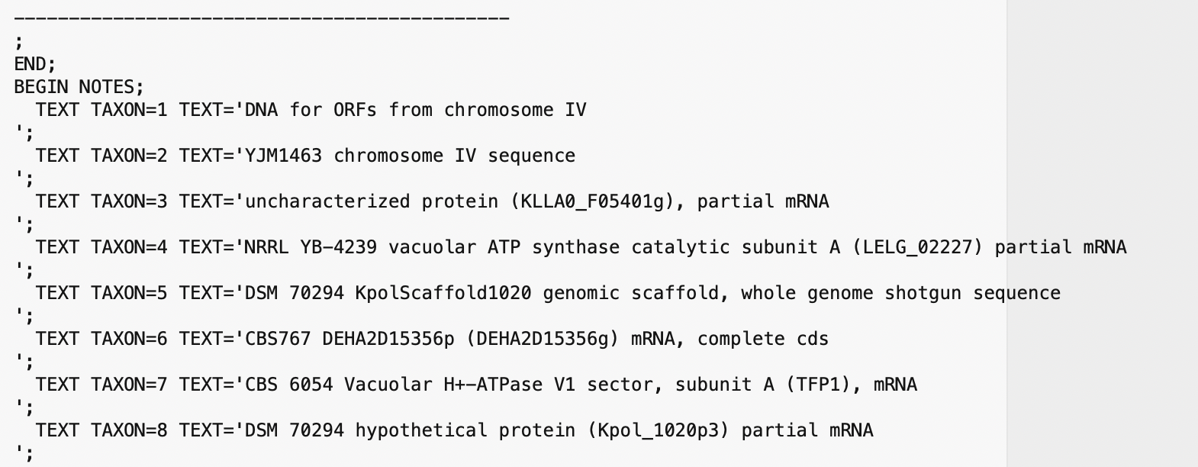
MrBayes reads Nexus files (can be generated from Seaview).
This retains partitioning data (e.g., into sites from exteins and inteins)
Nexus files can have command blocks at the end for different programs (PAUP or MrBayes)
Beginning of the file:
End of Data matrix, beginning of notes

Slide 38
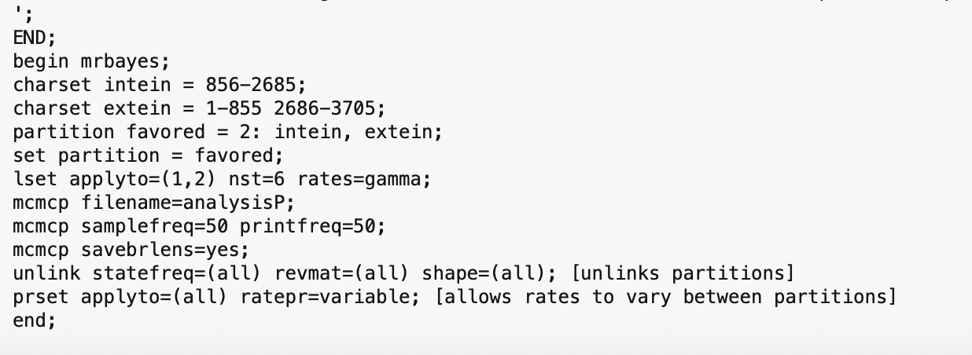
MrBayes block:
You need to consult the MrBayes manual at http://mrbayes.sourceforge.net/mb3.2_manual.pdf
to figure out the commands
Start mb -> execute Filename -> mcmc (starts the ”robot”)

Slide 39
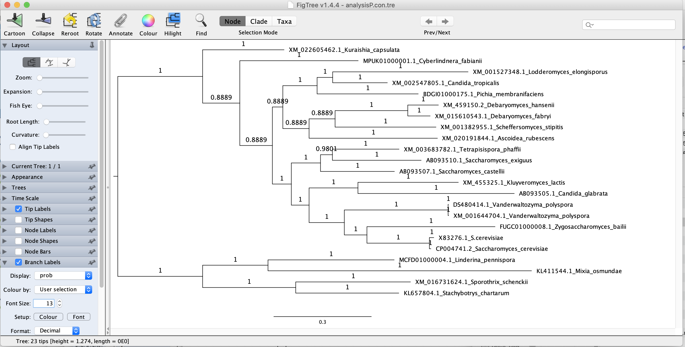
MrBayes creates a tree file (.t) that contains the trees sampled during the run.
This can be summarized into a consensus tree: (shown here in Figtree).

Slide 40
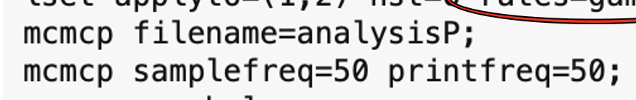
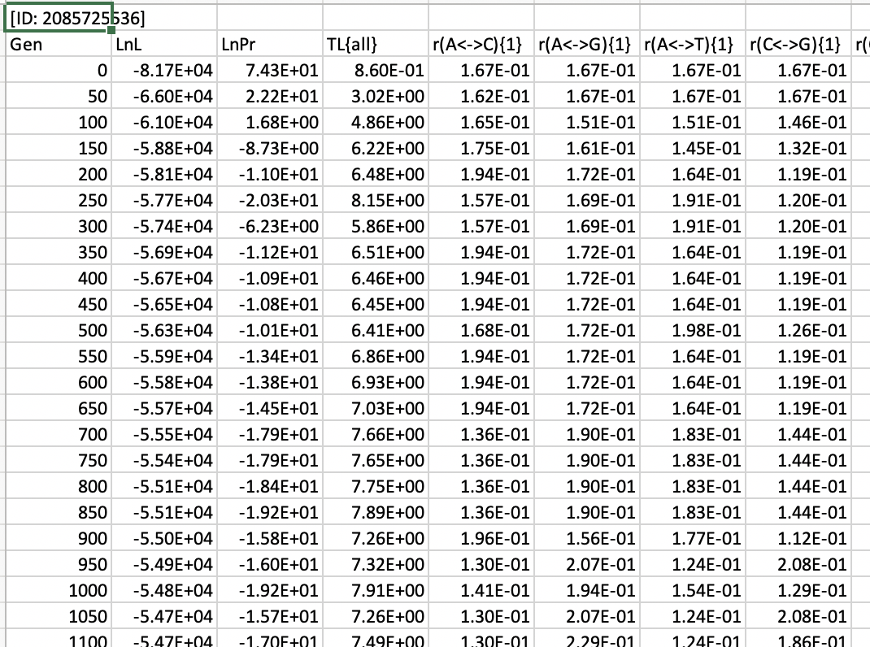
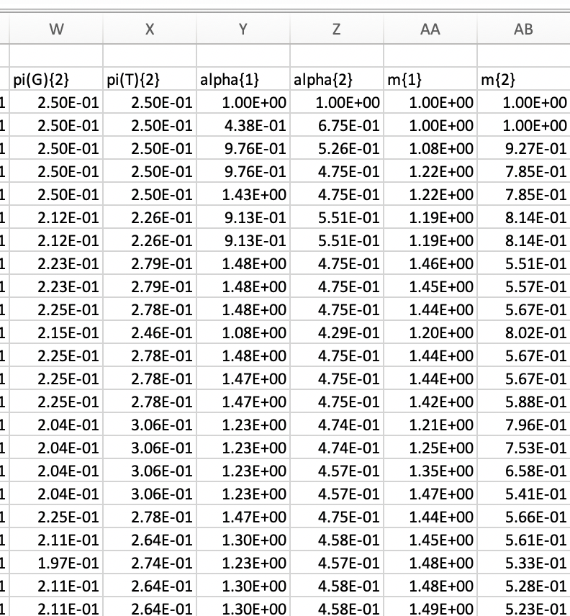
MrBayes also creates a parameter file (.p) that contains the parameters for the specified samples

Slide 41
Log Likelihood over generations
End Burnin

Slide 42
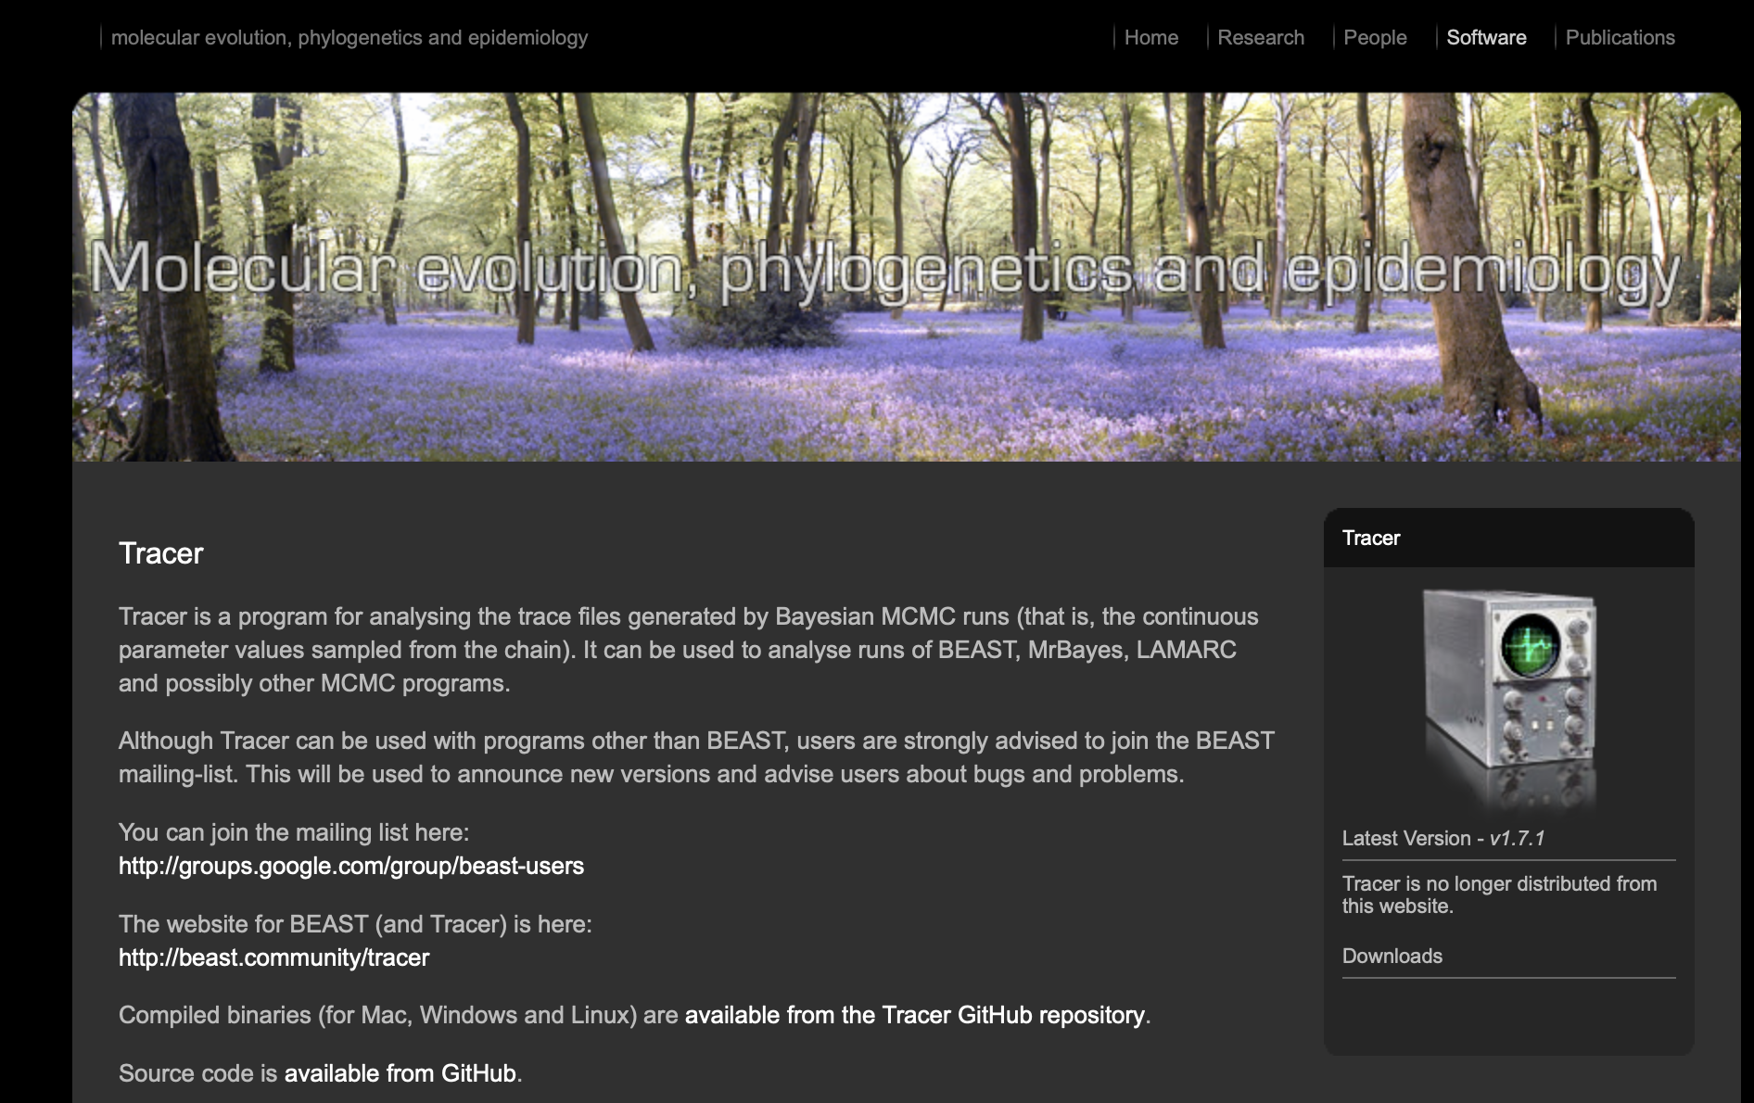
By default MrBayes is doing two parallel runs (with 4 chains each).
This allows to test convergence.
Tracer is a beautiful program that helps to analyze and visualize MCMCMC runs:
(much easier than in Excel)

Slide 43
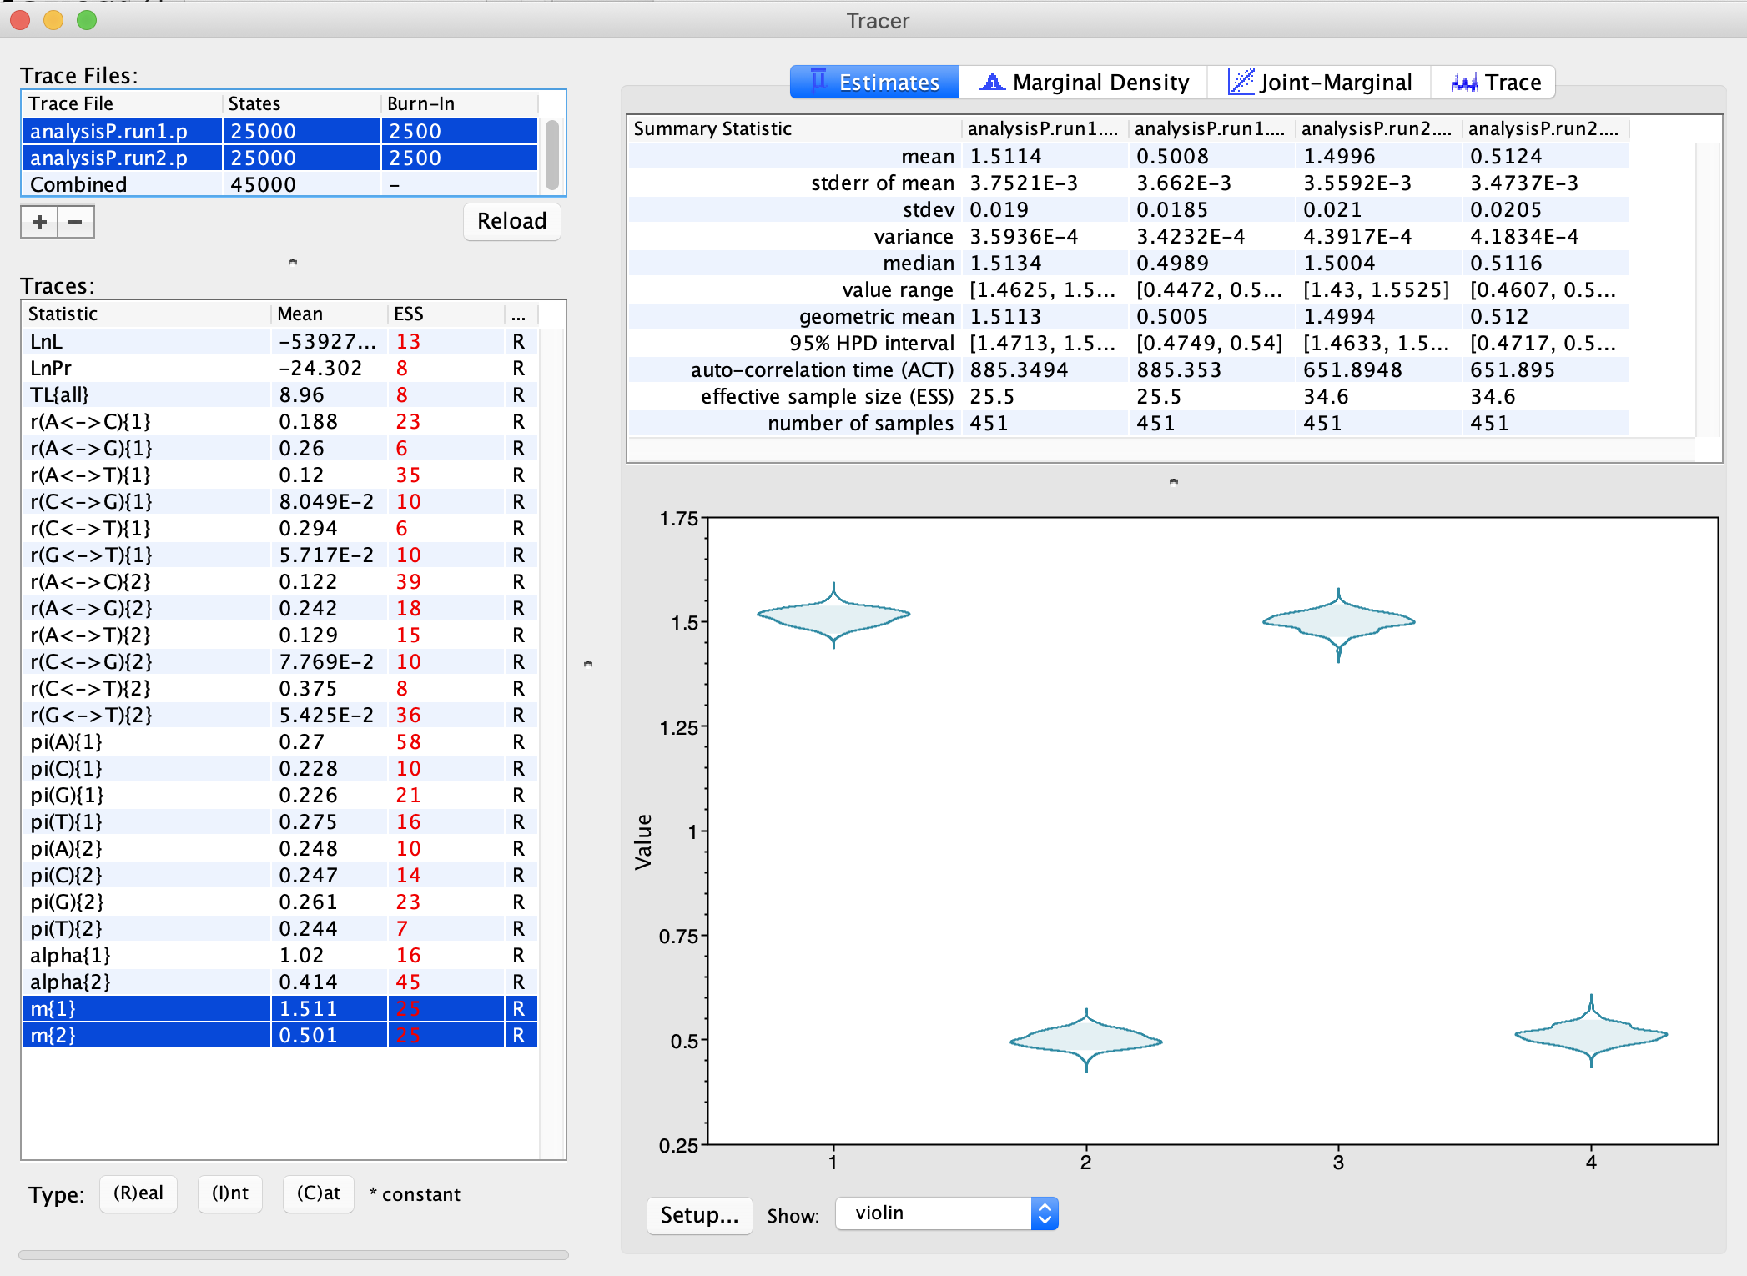
The relative substitution rates for the two partitions and the two runs.
As Violin plot:

Slide 44
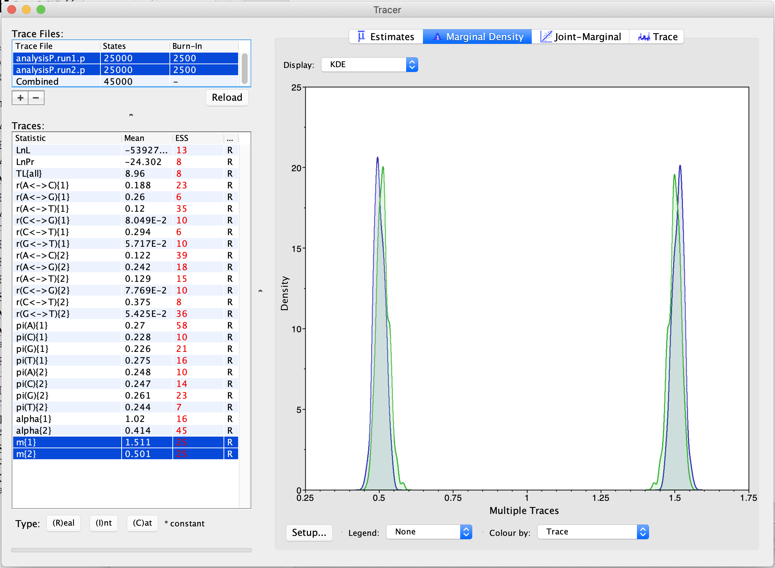
The relative substitution rates for the two partitions and the two runs.
As smoothed histogram:

Slide 45
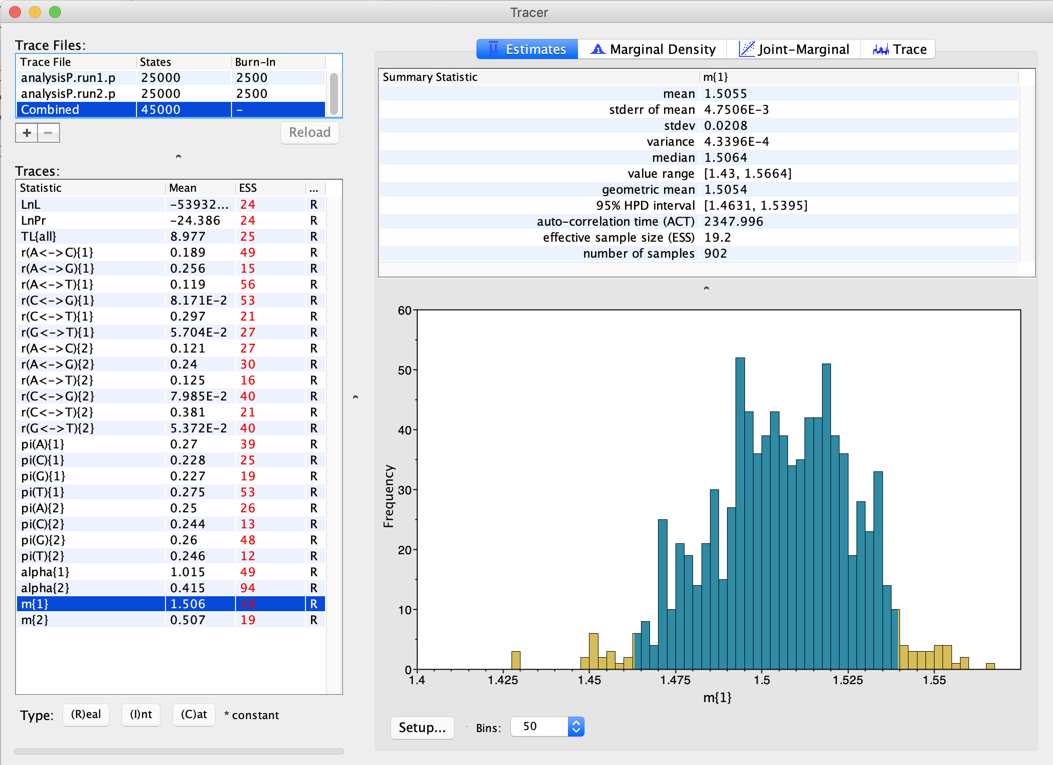
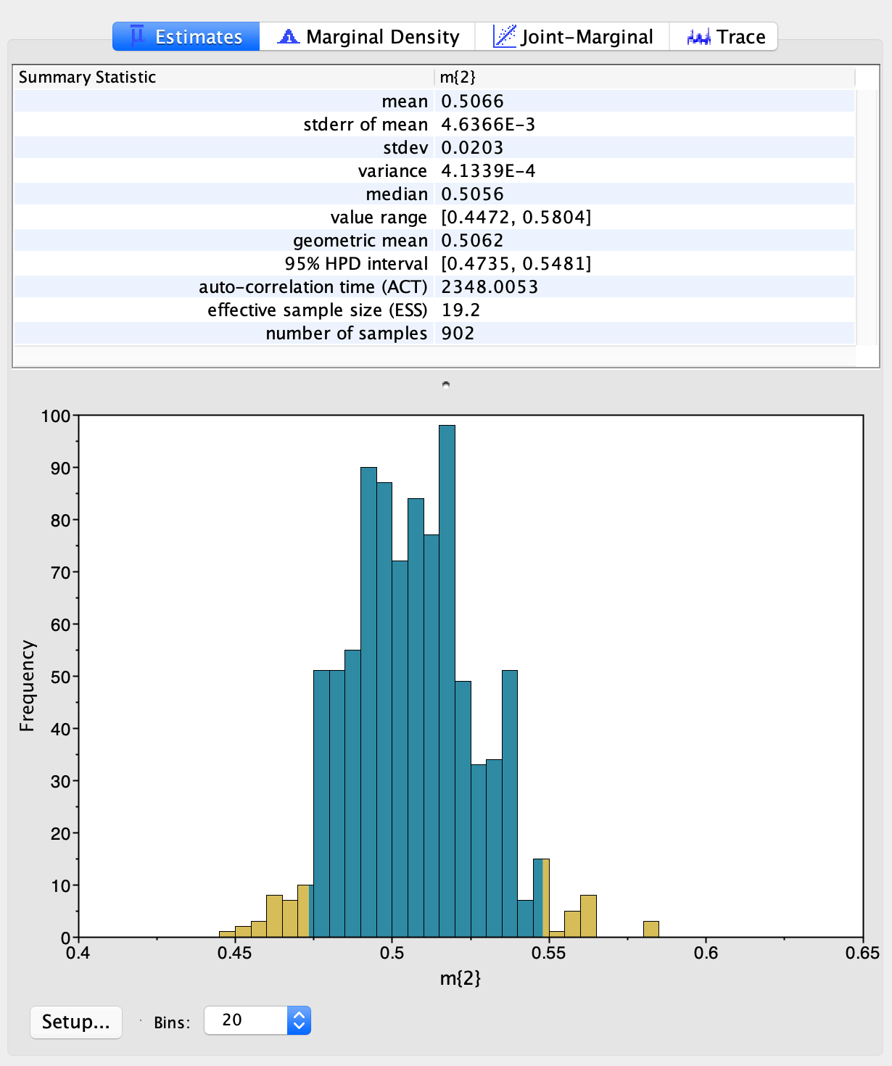
Distribution of relative substitution rate for the intein, versus the extein
=>

Slide 46
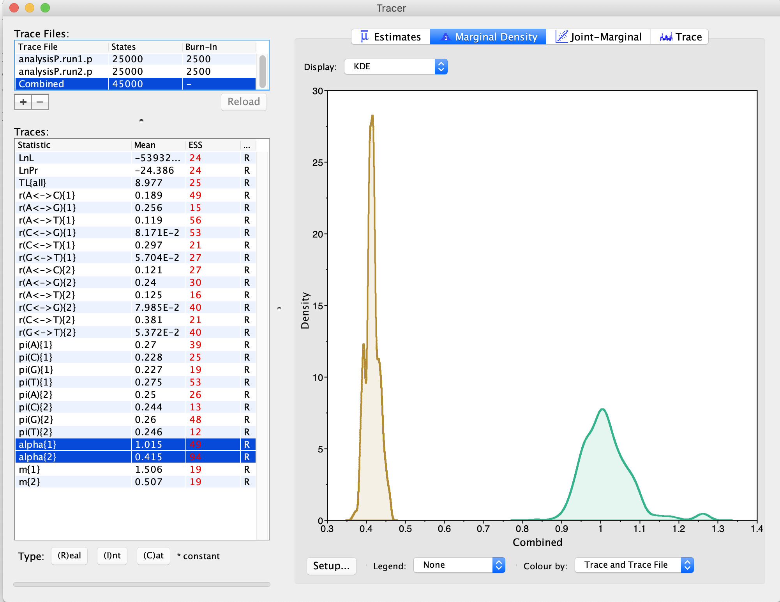
The shape parameter describing the Among Site Rate Variation (ASRV) for the two partitions:
Extein
Intein

Slide 47
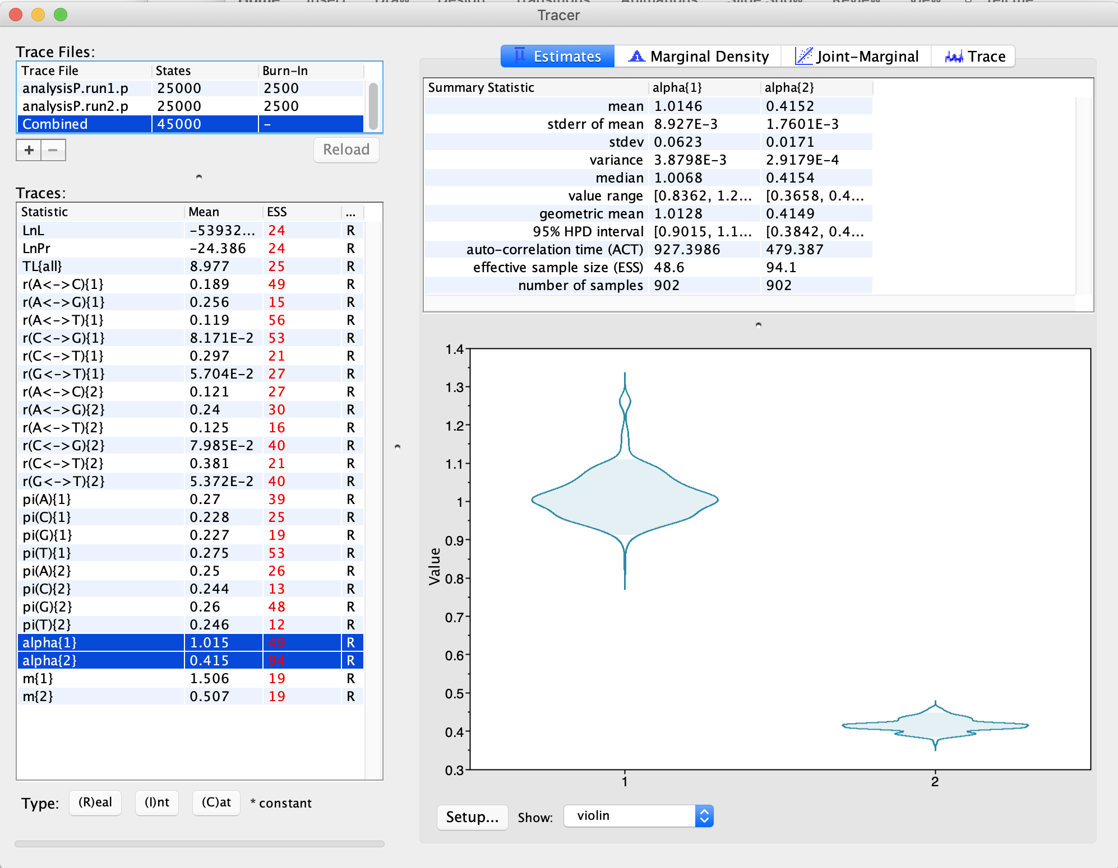
The shape parameter describing the Among Site Rate Variation (ASRV) for the two partitions:
Intein
Extein

Slide 48
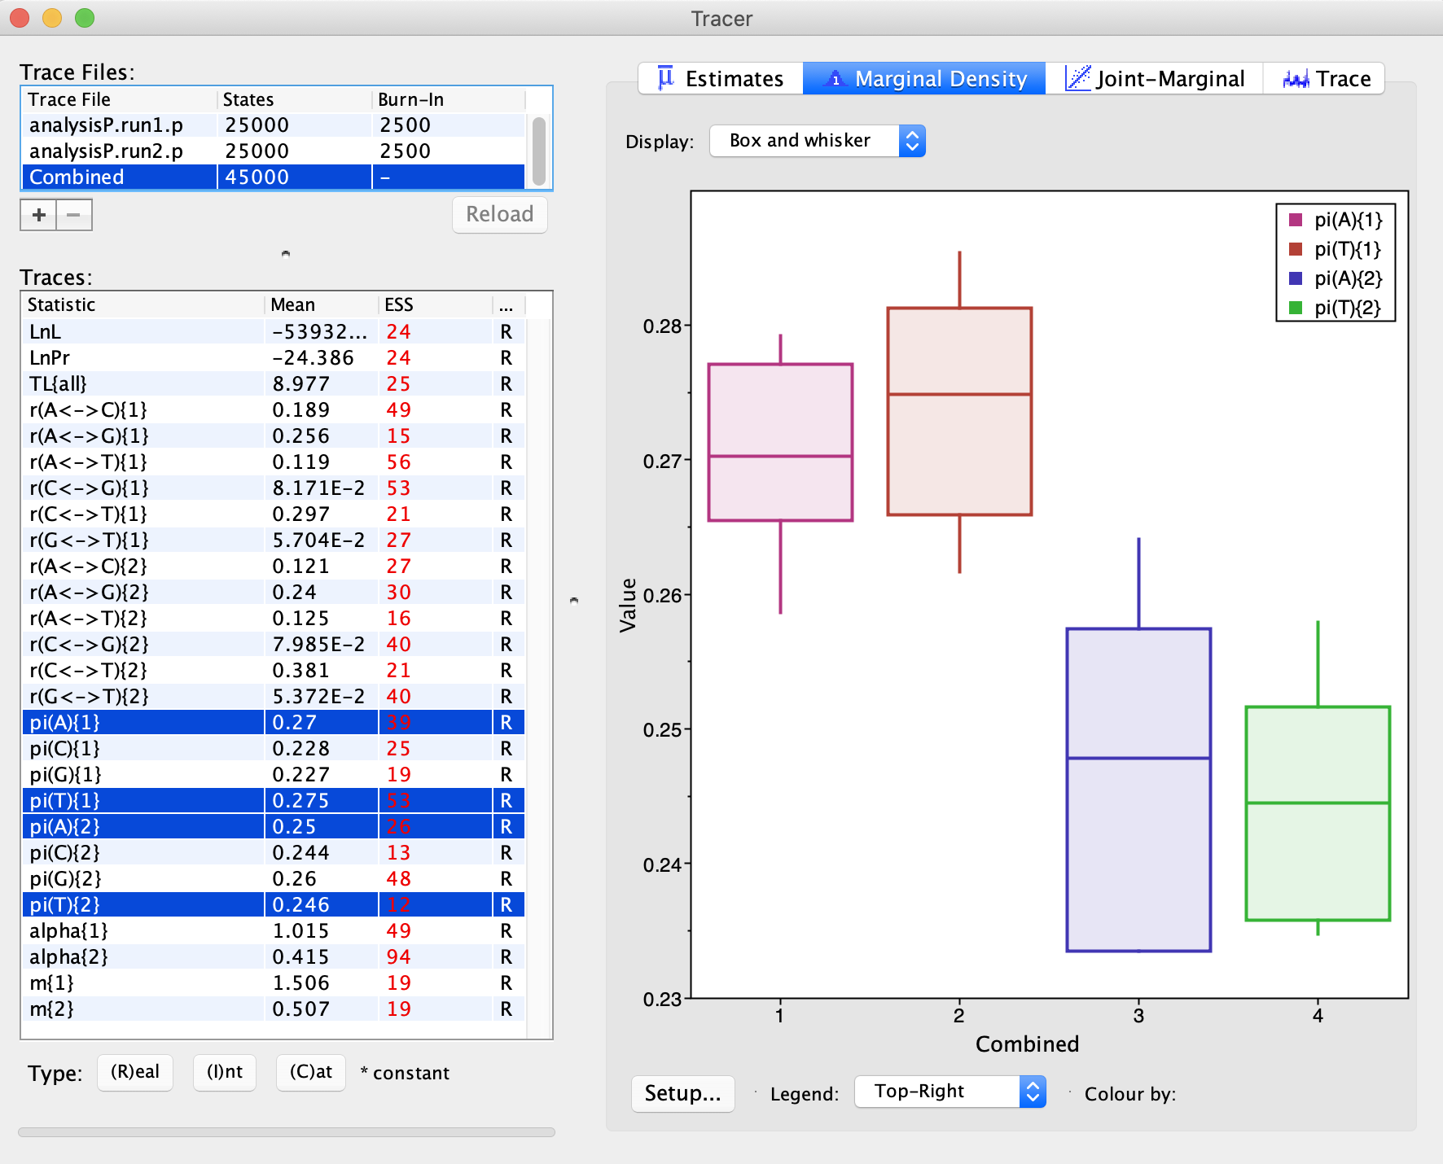
AT content is higher for the intein.
This also may reflect less selection, because mutations from GC pairs to AT pairs occur more frequently (mutational bias)
Intein
Extein

Slide 49
Bottomline:
Bayesian analyses make it easy to describe parameters governing the evolution of molecules
Intein have a less extreme ASRV compared to exteins
Inteins have a higher (three times) substitution rate
Tracer (or Excel) makes it easy to obtain 95% high probability intervals for parameter values.
Concerns with the analysis used as an example:
The example should have run much longer ...
If we suspect HGT of the intein, the datasets have been analyzed separately (and not linked to the same tree explored in the same

Slide 50
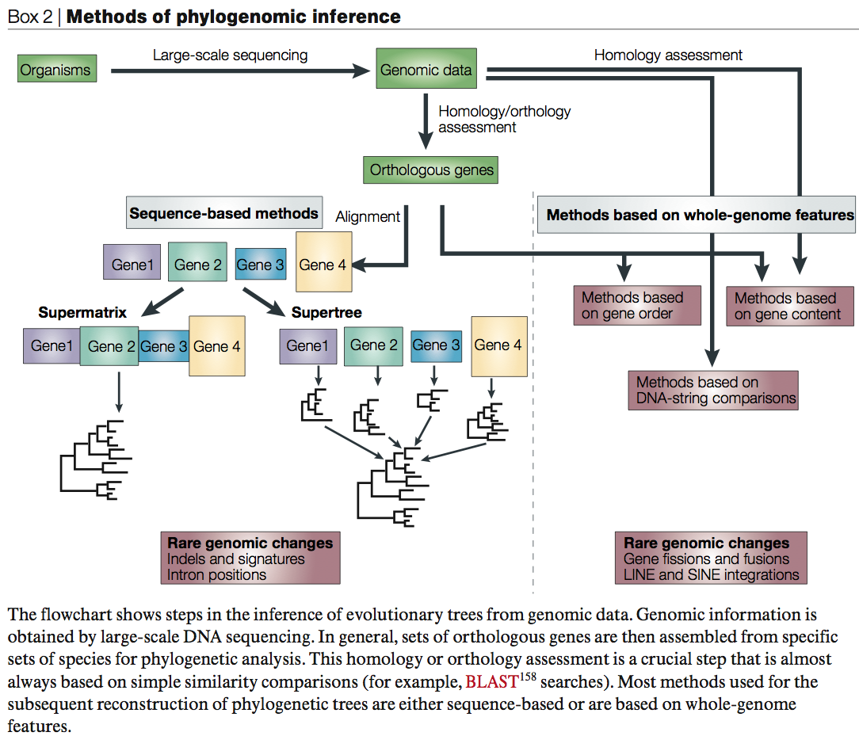
From Gen Tree to Genome Phylogeny
From:
Delsuc F, Brinkmann H, Philippe H.
Phylogenomics and the reconstruction of the tree of life.
Nat Rev Genet. 2005 May;6(5):361-75.

Slide 51
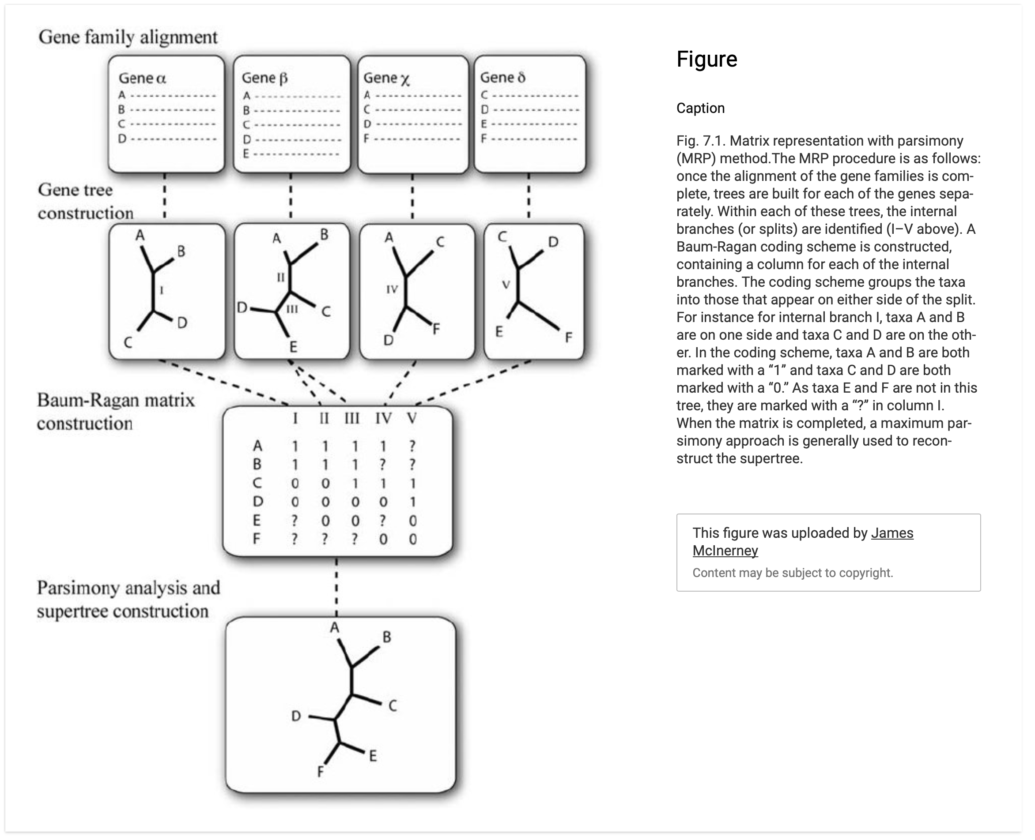
Supertree using
Matrix Representation
using Parsimony (MRB)
https://www.researchgate.net/profile/James-Mcinerney-2

Slide 52
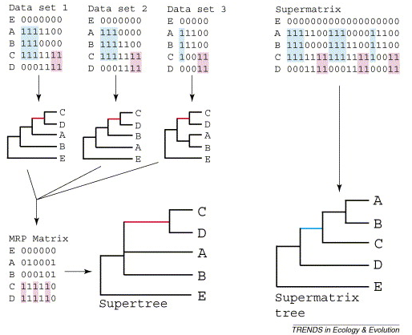
Supertree vs. Supermatrix
From:
Alan de Queiroz John Gatesy:
The supermatrix approach to systematics
Trends Ecol Evol. 2007 Jan;22(1):34-41
Schematic of MRP supertree (left) and parsimony supermatrix (right) approaches to the analysis of three data sets. Clade C+D is supported by all three separate data sets, but not by the supermatrix. Synapomorphies for clade C+D are highlighted in pink. Clade A+B+C is not supported by separate analyses of the three data sets, but is supported by the supermatrix. Synapomorphies for clade A+B+C are highlighted in blue. E is the outgroup used to root the tree.

Slide 53
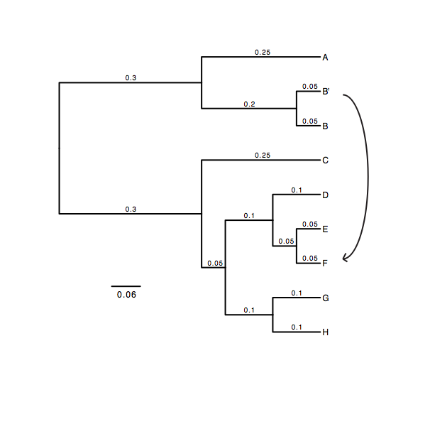
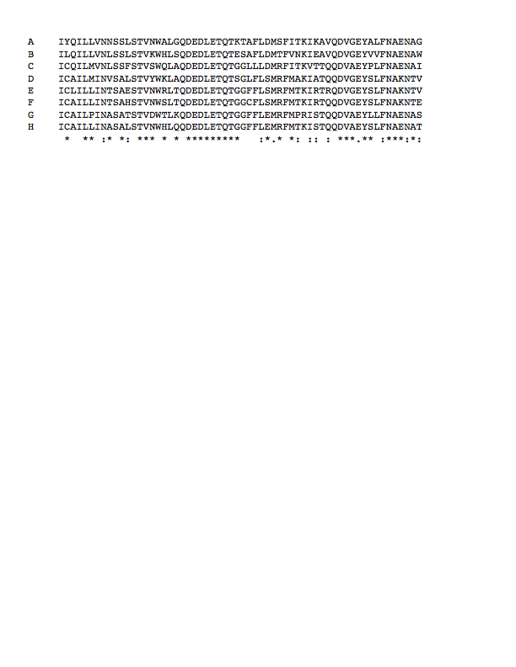
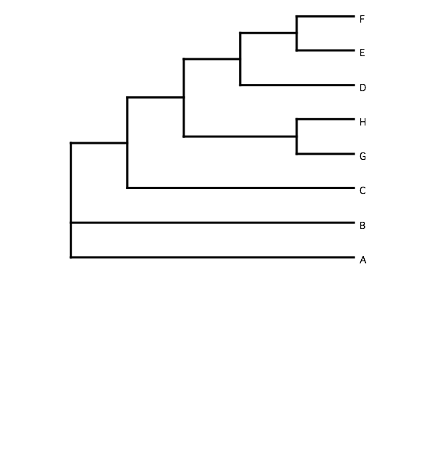
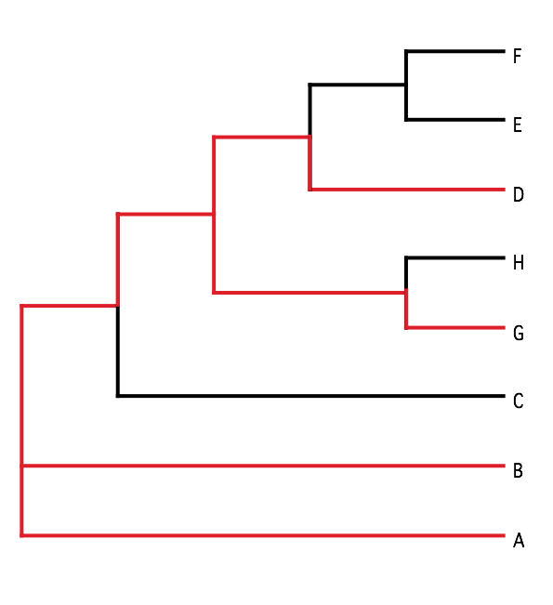
B) Generate 100 datasets using Evolver with certain amount of HGTs
A) Template tree
C) Calculate 1 tree using the concatenated dataset or 100 individual trees
D) Calculate Quartet based tree using Quartet Suite
Repeated 100 times…

Slide 54
Supermatrix versus
Quartet based Supertree
inset: simulated phylogeny

Slide 55
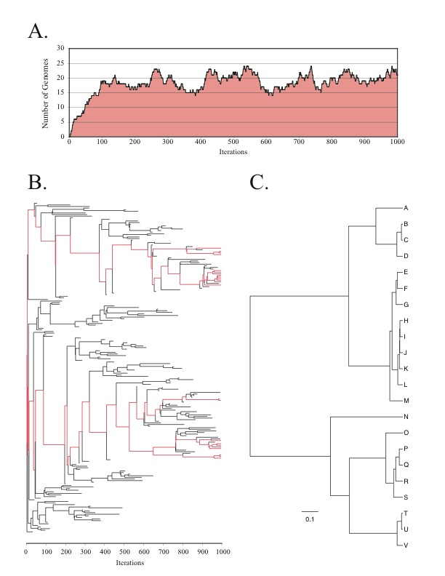
Note : Using same genome seed random number will reproduce same genome history
From: Lapierre P, Lasek-Nesselquist E, and Gogarten JP (2012)
The impact of HGT on phylogenomic reconstruction methods
Brief Bioinform [first published online August 20, 2012] doi:10.1093/bib/bbs050

Slide 56
HGT EvolSimulator Results

Slide 58

With little phylogenetic information (very divergent sequences, or very similar ones), one needs to concatenate sequences to make use of the information present in very dilute form in the individual datasets.
The problem is that the analysis becomes sensitive to HGT. A gene acquired from outside the group under analysis will pull the recipient towards the base of the phylogeny.
In case individual gene trees are well resolved, supertree approaches are much more robust towards HGT.
Odysseus vor Scilla und Charybdis
Johann Heinrich Füssli

