Slide 1
MCB 3421 – class 20
Intro to population genetics

Slide 2
Population Genetics
Drift versus Selection
A) In a population of infinite size in which allele frequencies follow a differential equation a mutation with a selective advantage will be fixed

Slide 3
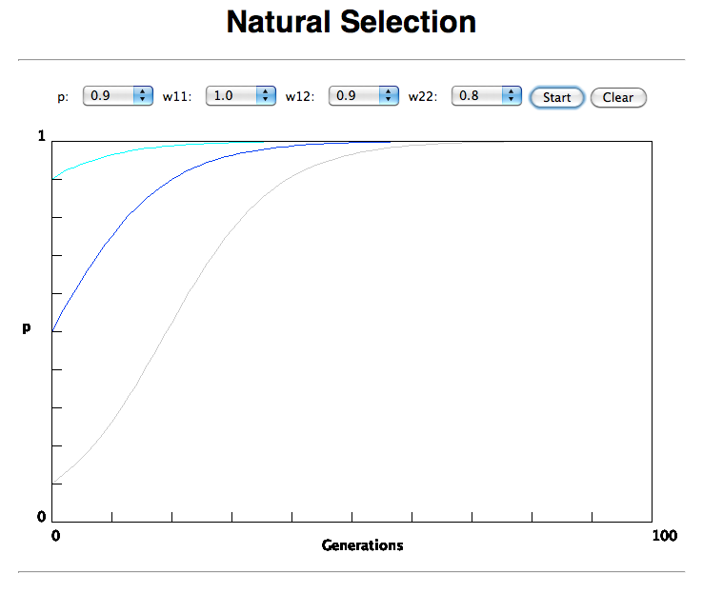

Slide 4
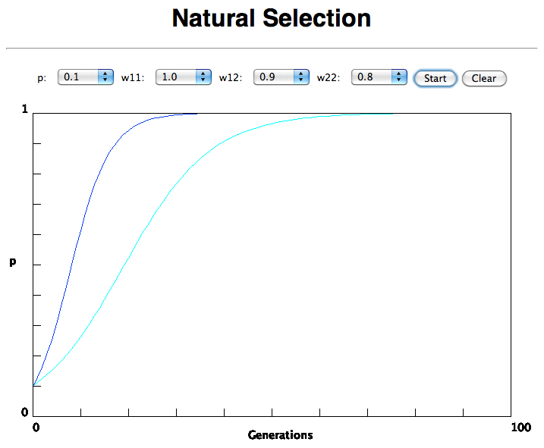
In the deterministic model, the time till fixation depends on the selective advantage, but fixation is guaranteed.

Slide 5
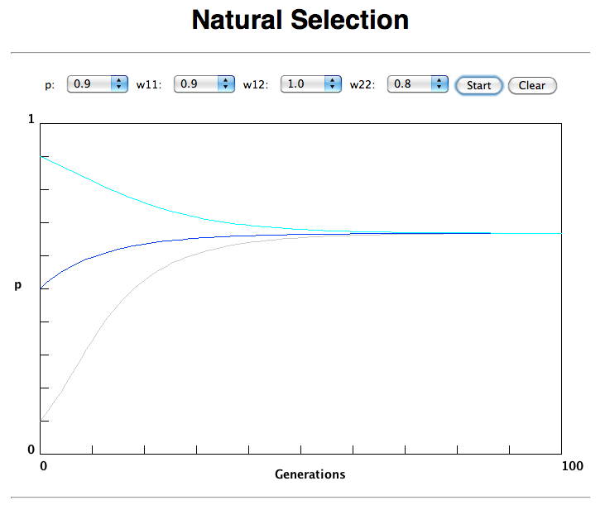
Only in case the heterozygote has an advantage (=balancing selection) do both alleles coexist in a population.

Slide 6
(Kimura’s) Neutral theory:
The vast majority of observed sequence differences between members of a population are neutral (or close to neutral). These differences can be fixed in the population through random genetic drift. Some mutations are strongly counter selected (this is why there are patterns of conserved residues). Only very seldom is a mutation under positive selection.
The neutral theory does not say that all evolution is neutral and everything is only due to to genetic drift.

Slide 7
Modern synthesis:
Evolution occurs within populations where the fittest organisms have a selective advantage. Over time the advantageous genes become fixed in a population and the population gradually changes.
Why is this not a contradiction to the theory of neutral evolution. (which says what ?)

Slide 8
Nearly Neutral theory:
Even synonymous mutations do not lead to random composition but to codon bias.
Small negative selection might be sufficient to produce the observed codon usage bias.

Slide 9
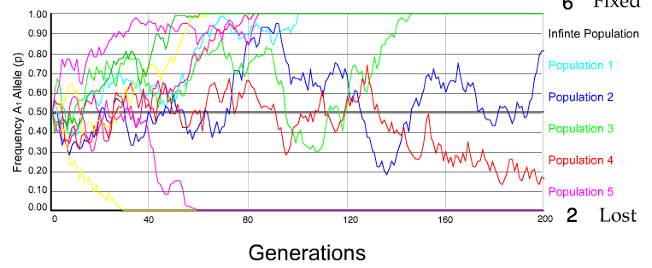
Genetic Drift: The law of the Gutter:
N=50 s=0
10 replicates

Slide 10
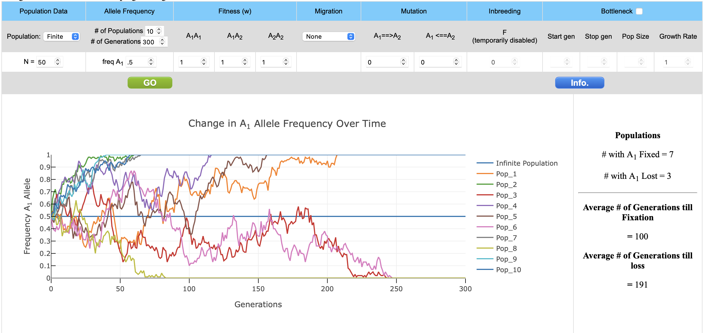

Slide 11
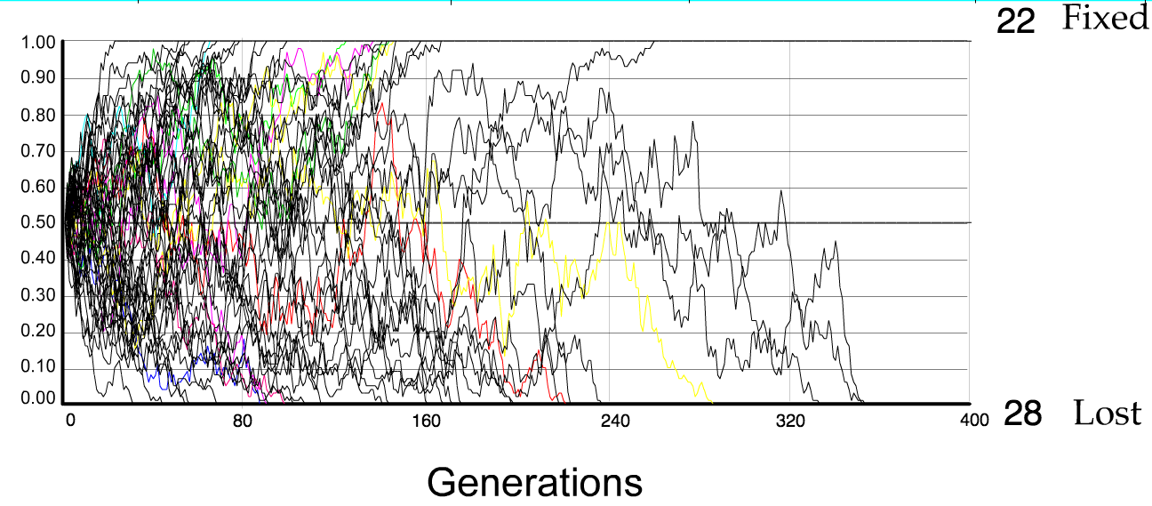
N=50 s=0
50 replicates

Slide 12
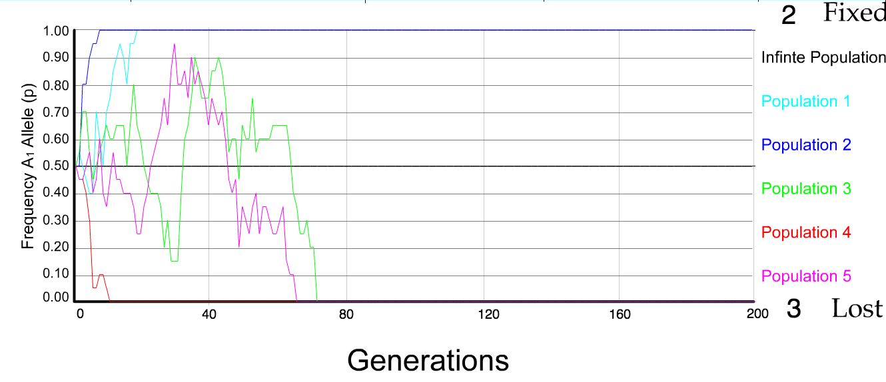
N=10 s=0
5 replicates

Slide 13
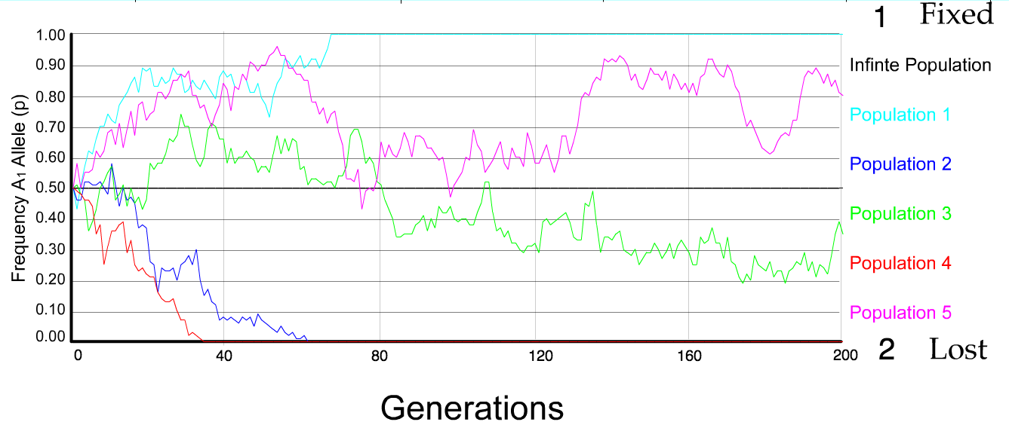
N=50 s=0
5 replicates

Slide 14
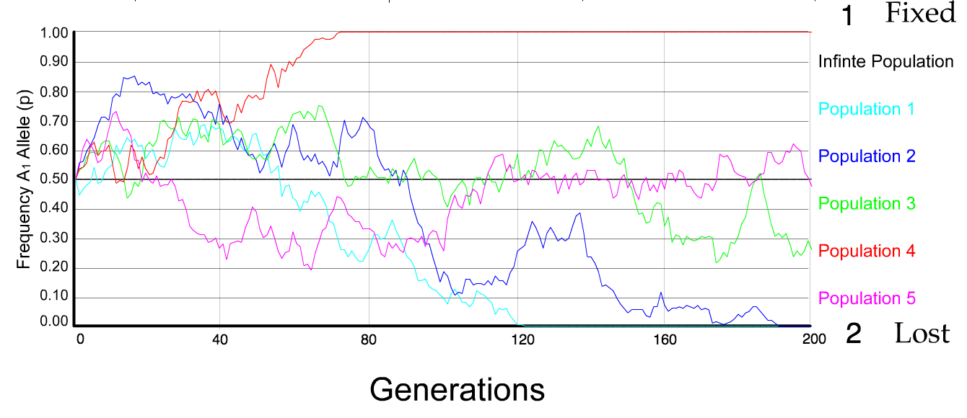
N=100 s=0
5 replicates

Slide 15
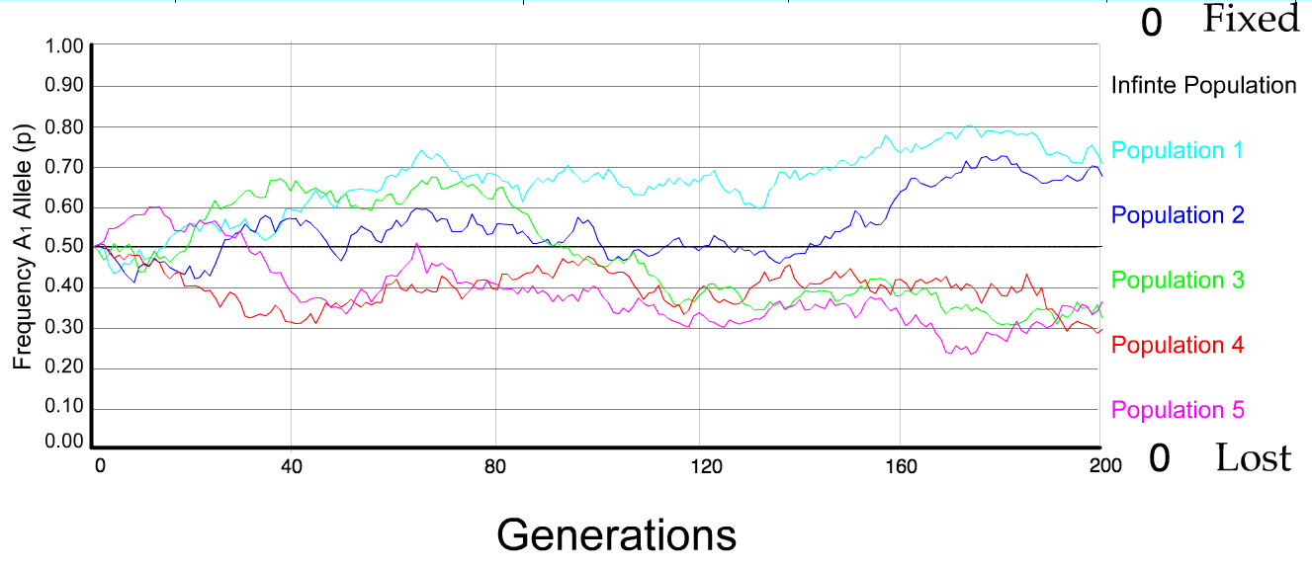
N=500 s=0
5 replicates

Slide 16
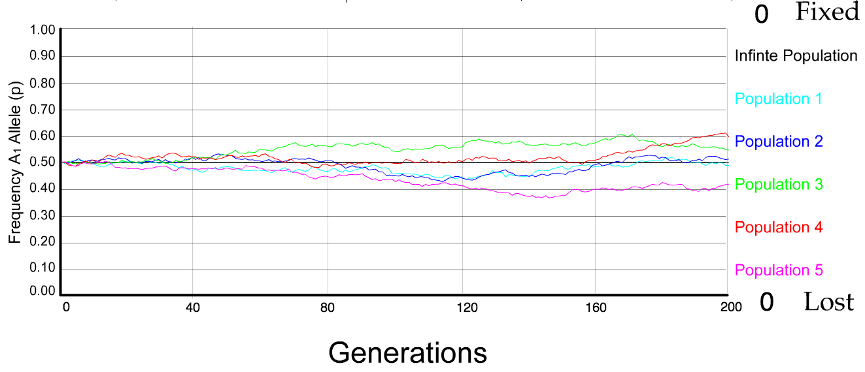
N=5000 s=0
5 replicates

Slide 17
s=0 -- neutral mutation
The probability of fixation, P, is equal to frequency of allele in population. Mutation rate (per gene/per unit of time) = u ;
freq. with which allele is generated in diploid population size N =u*2N
Probability of fixation for each allele = 1/(2N)
Substitution rate =
frequency with which new alleles are generated * Probability of fixation= u*2N *1/(2N) = u = Mutation rate
Therefore: If f s=0, the substitution rate is independent of population size, and equal to the mutation rate !!!! (NOTE: Mutation unequal Substitution! ) This is the reason that there is hope that the molecular clock might sometimes work.
Fixation time due to drift alone:
t_{av}=4*N_{e} generations (N_{e}=effective population size; For n discrete generations N_{e}= n/(1/N₁+1/N₂+…..1/N_{n})

Slide 18
s>0
Time till fixation on average:
t_{av}= (2/s) ln (2N) generations (how come that this is also true for mutations with negative “s” ! discuss among yourselves)
N=10⁴,
s=0: average time to fixation: 40.000 generations s=0.01: average time to fixation: 1.900 generations
N=10⁶,
s=0: average time to fixation: 4*10⁶ generations s=0.01: average time to fixation: 2900 generations
N=10¹¹ (100 billion – size of the Prochlorococcus population),
s=0: average time to fixation: 2*10¹¹ generations (about .5 billion years) s=0.01: average time to fixation: 5200 generations (about 14 years)
Probability of fixation, P, is approximately equal to 2s; e.g., if selective advantage s = 1% then P = 2%

Slide 19
Positive selection (s>0)
A new allele (mutant) confers some increase in the fitness of the organism
Selection acts to favour this allele
Also called adaptive selection or Darwinian selection.
NOTE: Fitness = ability to survive and reproduce
Modified from from www.tcd.ie/Genetics/staff/Aoife/GE3026/GE3026_1+2.ppt

Slide 20
Random Genetic Drift
Selection
100
advantageous
Allele frequency
disadvantageous
0
Modified from from www.tcd.ie/Genetics/staff/Aoife/GE3026/GE3026_1+2.ppt

Slide 21
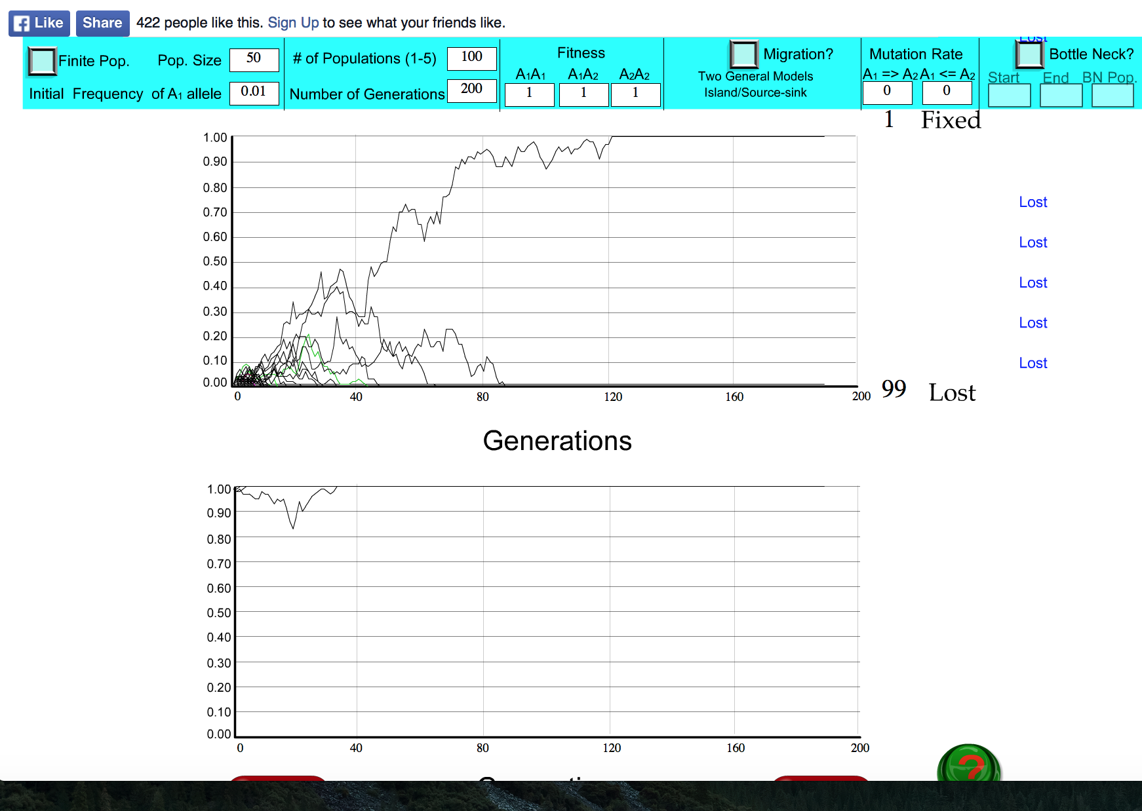
s=0

Slide 22
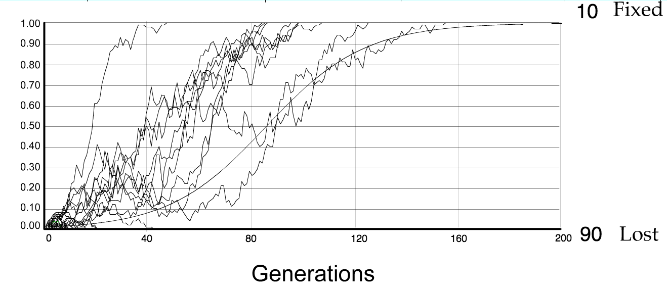
For advantageous mutations:
Probability of fixation, P, is approximately equal to 2s;
e.g., if selective advantage s = 5% then P = 10%
tav=2/s*log2N generations = 40*log100= 80

Slide 23
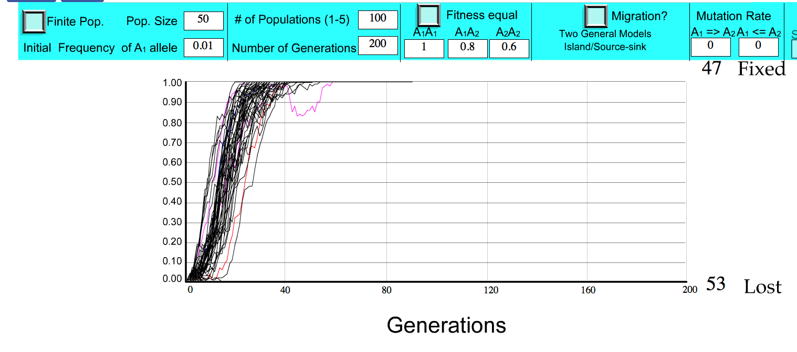
S=.2 => shorter fixation time.

Slide 24
Advantageous allele
Herbicide resistance gene in nightshade plant
Modified from from www.tcd.ie/Genetics/staff/Aoife/GE3026/GE3026_1+2.ppt

Slide 25
selection versus drift
The larger the population the longer it takes for an allele to become fixed.
Note: Even though an allele conveys a strong selective advantage of 10%, the allele has a rather large chance to go extinct.
Note#2: Fixation is faster under selection than under drift.
Question: Can you think of genes that have a higher fixation probability? (Hint: HGT)

Slide 26
Negative selection (s<0)
A new allele (mutant) confers some decrease in the fitness of the organism
Selection acts to remove this allele
Also called purifying selection
Modified from from www.tcd.ie/Genetics/staff/Aoife/GE3026/GE3026_1+2.ppt

Slide 27
Deleterious allele
Human breast cancer gene, BRCA2
5% of breast cancer cases are familial
Mutations in BRCA2 account for 20% of familial cases
Normal (wild type) allele
Mutant allele
(Montreal 440
Family)
Stop codon
4 base pair deletion
Causes frameshift
Modified from from www.tcd.ie/Genetics/staff/Aoife/GE3026/GE3026_1+2.ppt

Slide 28
Neutral mutations
Neither advantageous nor disadvantageous
Invisible to selection (no selection)
Frequency subject to ‘drift’ in the population
Random drift – random changes of allele frequency in small populations

