Slide 1
MCB 3421 – class 21
dN/dS
selective sweeps
introgression
human evolution

Slide 2
Neutral mutations
Neither advantageous nor disadvantageous
Invisible to selection (no selection)
Frequency subject to ‘drift’ in the population
Random drift – random changes of allele frequency in small populations

Slide 3
Types of Mutation-Substitution
Replacement of one nucleotide by another
Synonymous (Doesn’t change amino acid)
  Rate sometimes indicated by Ks
  Rate sometimes indicated by d_{s}
Non-Synonymous (Changes Amino Acid)
  Rate sometimes indicated by Ka
  Rate sometimes indicated by d_{n}
(this and the following 4 slides are from
mentor.lscf.ucsb.edu/course/ spring/eemb102/lecture/Lecture7.ppt)

Slide 4
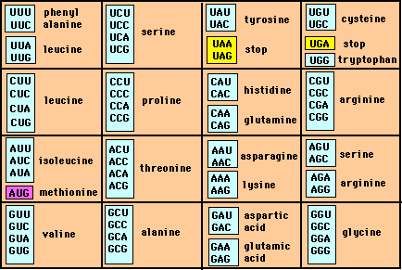
Genetic Code – Note degeneracy of 1st vs 2nd vs 3rd position sites

Slide 5
Genetic Code
Four-fold degenerate site – Any substitution is synonymous
From: mentor.lscf.ucsb.edu/course/spring/eemb102/lecture/Lecture7.ppt

Slide 6
Genetic Code
Two-fold degenerate site – Some substitutions synonymous, some
non-synonymous
From: mentor.lscf.ucsb.edu/course/spring/eemb102/lecture/Lecture7.ppt

Slide 7
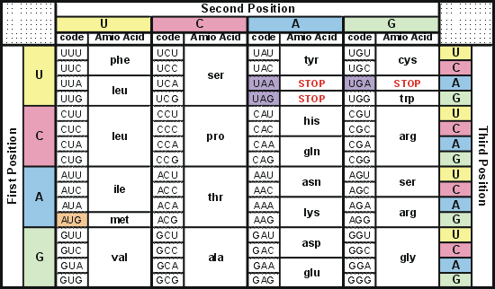
Degeneracy of 1st vs 2nd vs 3rd position sites results in 25.5% synonymous changes and 74.5% non synonymous changes (Yang&Nielsen,1998).
Genetic Code
Notes:
An inspection of the genetic code table suggests most changes at the first position are nonsynonymous, all changes at the second codon position are nonsynonymous and only some changes at the third position are synonymous. As a result we do not expect to see equal proportions of synonymous and nonsynonymous mutations even if there is no selection at protein level. Indeed, if mutations from any one nucleotide to any other occur at the same rate , we expect 25.5% of mutations to be synonymous and 74.5% mutations to be nonsynonymous.

Slide 8
Measuring Selection on Genes
Null hypothesis = neutral evolution
Under neutral evolution, synonymous changes should accumulate at a rate equal to mutation rate
Under neutral evolution, amino acid substitutions should also accumulate at a rate equal to the mutation rate
From: mentor.lscf.ucsb.edu/course/spring/eemb102/lecture/Lecture7.ppt

Slide 9
Counting #s/#a
Ser Ser Ser Ser Ser
Species1 TGA TGC TGT TGT TGT
Ser Ser Ser Ser Ala
Species2 TGT TGT TGT TGT GGT
#s = 2 sites
#a = 1 site
#a/#s=0.5
To assess selection pressures one needs to calculate the rates (Ka, Ks), i.e. the occurring substitutions as a fraction of the possible syn. and nonsyn. substitutions.
Things get more complicated, if one wants to take transition transversion ratios and codon bias into account. See
chapter 4 in Nei and Kumar, Molecular Evolution and Phylogenetics.
Modified from: mentor.lscf.ucsb.edu/course/spring/eemb102/lecture/Lecture7.ppt

Slide 10
Testing for selection using dN/dS ratio
dN/dS ratio (aka Ka/Ks or ω (omega) ratio) where
dN = number of non-synonymous substitutions / number of all possible non-synonymous substitutions
dS =number of synonymous substitutions / number of all possible synonymous substitutions
dN/dS >1 positive, Darwinian selection
dN/dS =1 neutral evolution This usually is the null hypothesis!
dN/dS <1 negative, purifying selection
Notes:
The synonymous and non-synonymous rates dN and dS are defined as the numbers of synonymous and nonsynonymous substitutions per site. The ratio of the two rates omega=dN/dS then measures selective pressure at the protein level. If selection level has no effect on fitness, nonsynonymous mutations will be fixed at the same rate as synonymous mutations so that dN=dS and omega=1. If nonsynonymous mutations are deleterious purifying selection will reduce their fixation rate so that dN<dS and omega<1. If nonsynonymous mutations are favored by Darwinian selection, they will be fixed at a higher rate than synonymous mutations resulting in dN>dS and omega>1.

Slide 11
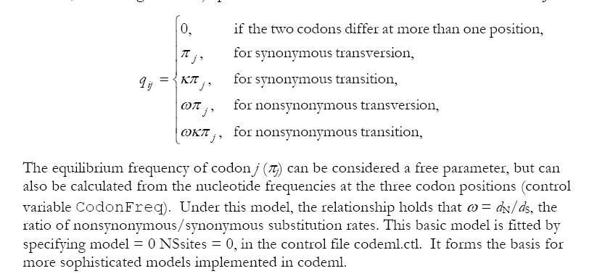
PAML (codeml) the basic model

Slide 12
dambe
Two programs worked well for me to align nucleotide sequences based on the amino acid alignment,
One is DAMBE (only for windows). This is a handy program for a lot of things, including reading a lot of different formats, calculating phylogenies, it even runs codeml (from PAML) for you.
The procedure is not straight forward, but is well described on the help pages. After installing DAMBE go to HELP -> general HELP -> sequences -> align nucleotide sequences based on …->
If you follow the instructions to the letter, it works fine.
DAMBE also calculates Ka and Ks distances from codon based aligned sequences.

Slide 13
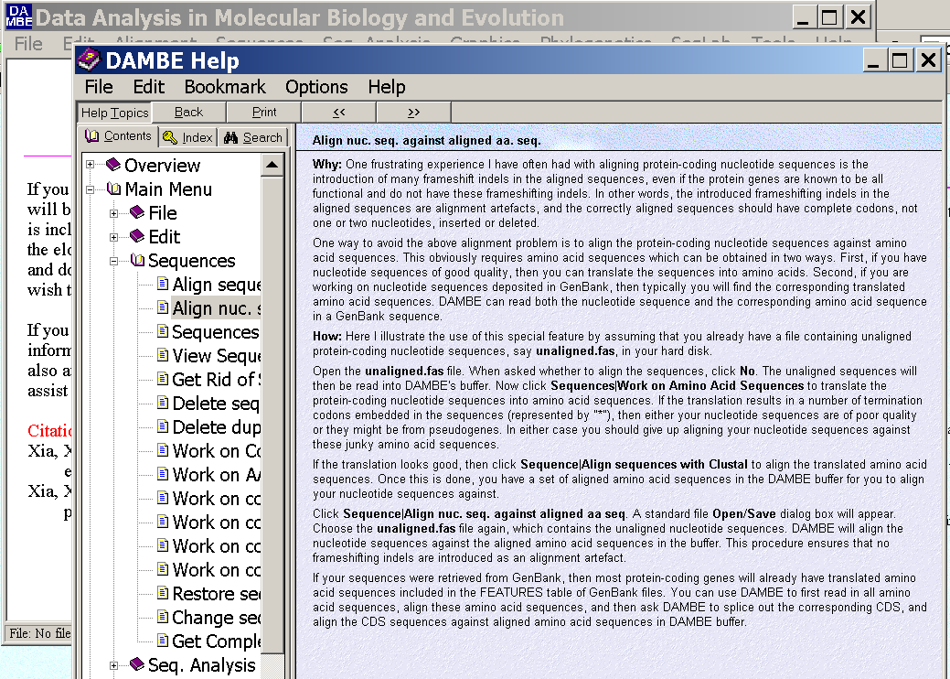
dambe (cont)

Slide 14
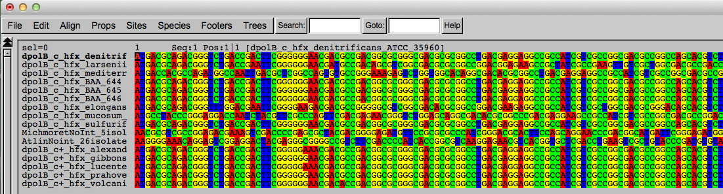
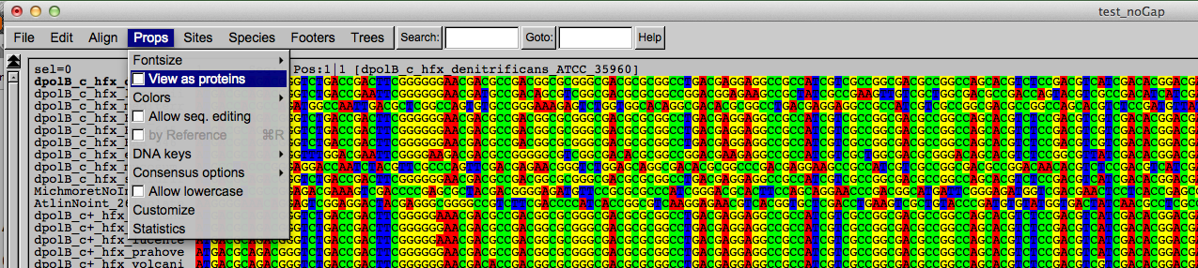
Codon based alignments in Seaview
Load nucleotide sequences (no gaps in sequences, sequence starts with nucleotide corresponding to 1st codon position)
Select view as proteins

Slide 15
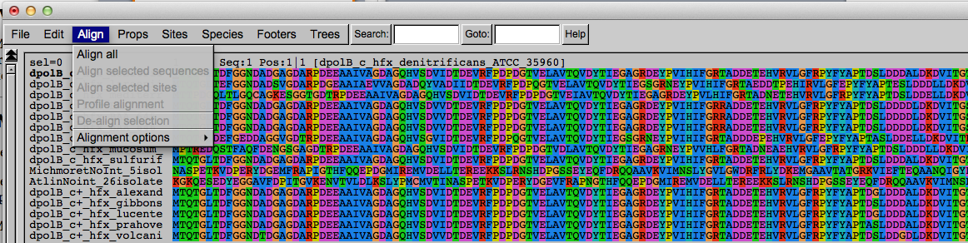
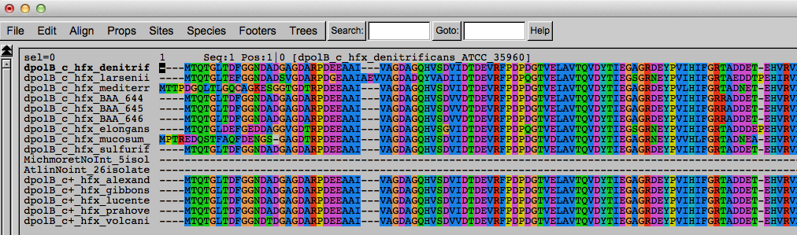
Codon based alignments in Seaview
With the protein sequences displayed, align sequences
Select view as nucleotides

Slide 16
PAML (codeml) the basic model

Slide 17

sites versus branches
You can determine omega for the whole dataset; however, usually not all sites in a sequence are under selection all the time.
PAML (and other programs) allow to either determine omega for each site over the whole tree, ,
or determine omega for each branch for the whole sequence,
.
It would be great to do both, i.e., conclude codon 176 in the vacuolar ATPases was under positive selection during the evolution of modern humans – alas, a single site often does not provide much statistics. PAML does provide a branch site model.

Slide 18
Sites model(s)
have been shown to work great in few instances.
The most celebrated case is the influenza virus HA gene.
A talk by Walter Fitch (slides and sound) on the evolution of
this molecule is here .
This article by Yang et al, 2000 gives more background on ml approaches to measure omega.
The dataset used by Yang et al is here: flu_data.paup .

Slide 19
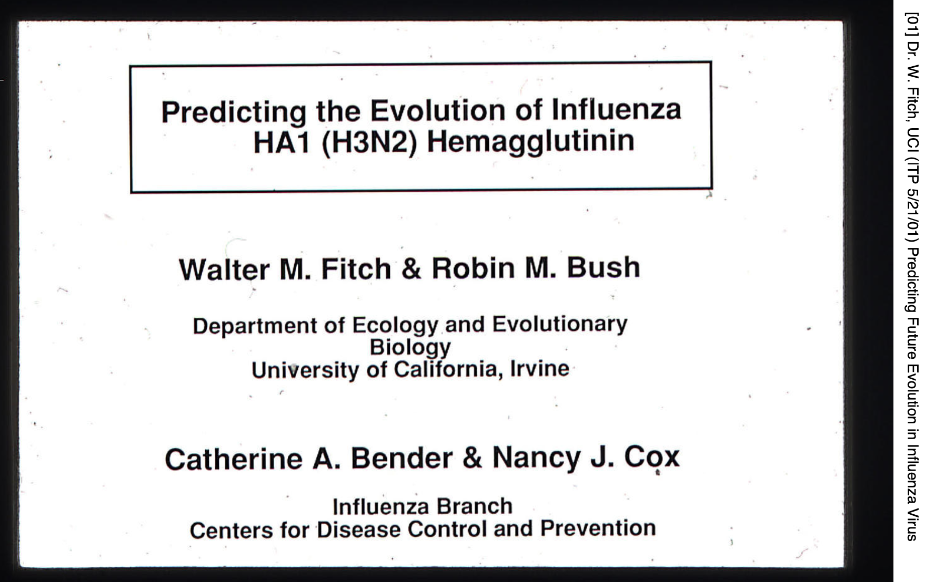
Slides from Walter Fitch’s talk

Slide 20
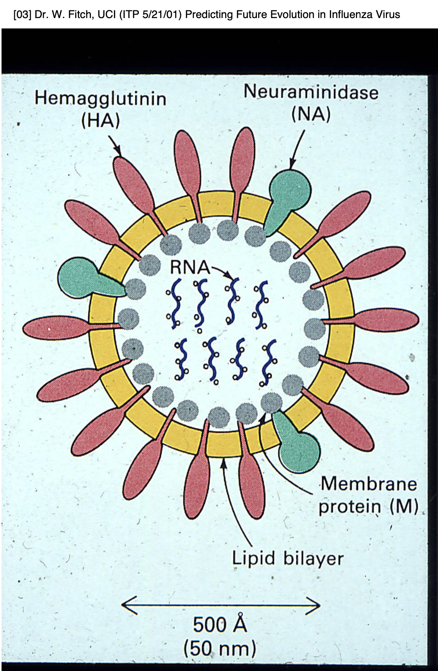
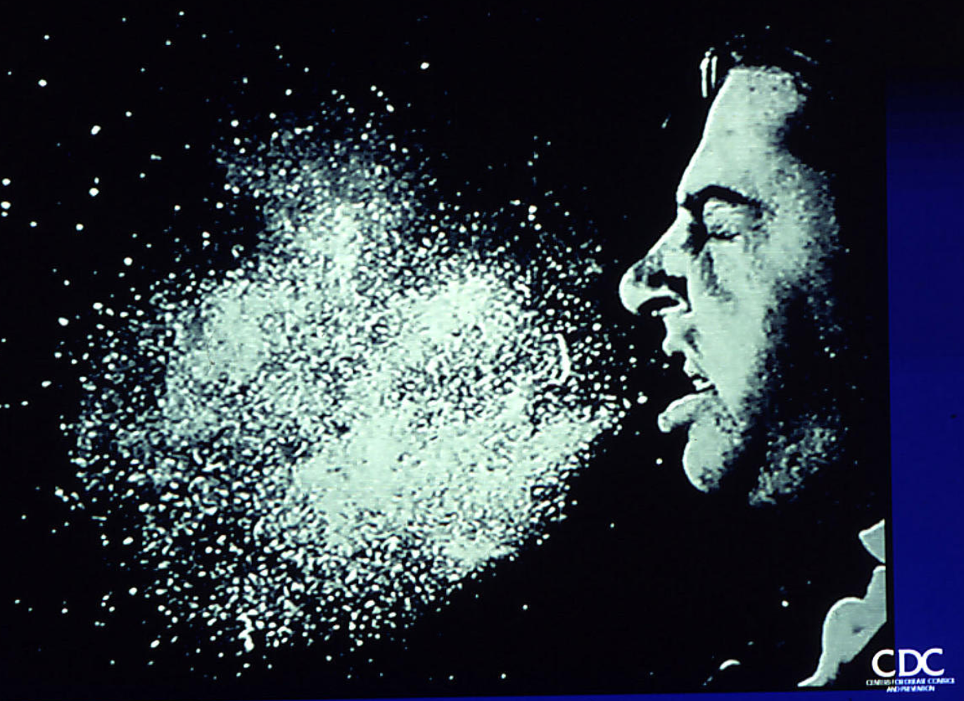

Slide 21
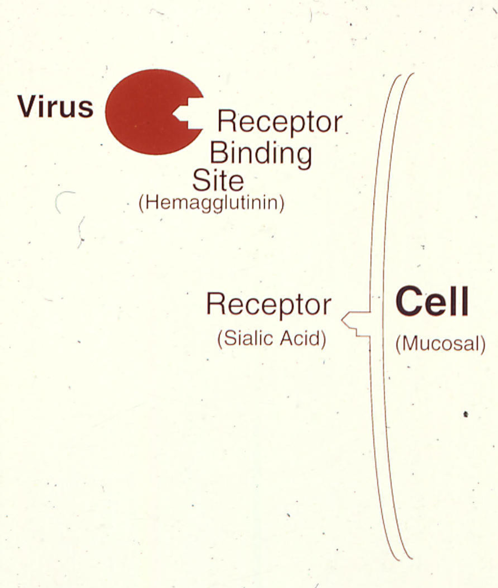
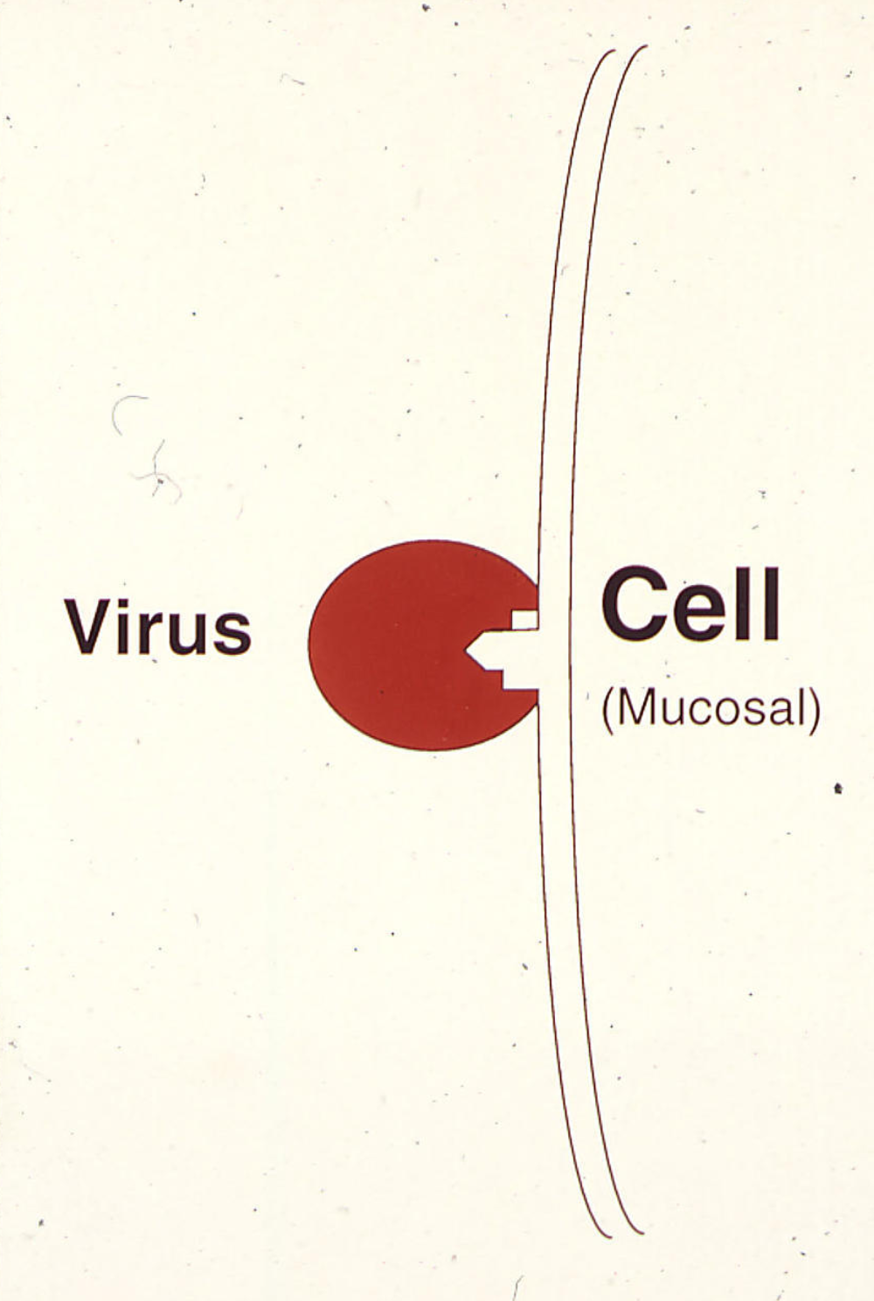

Slide 23
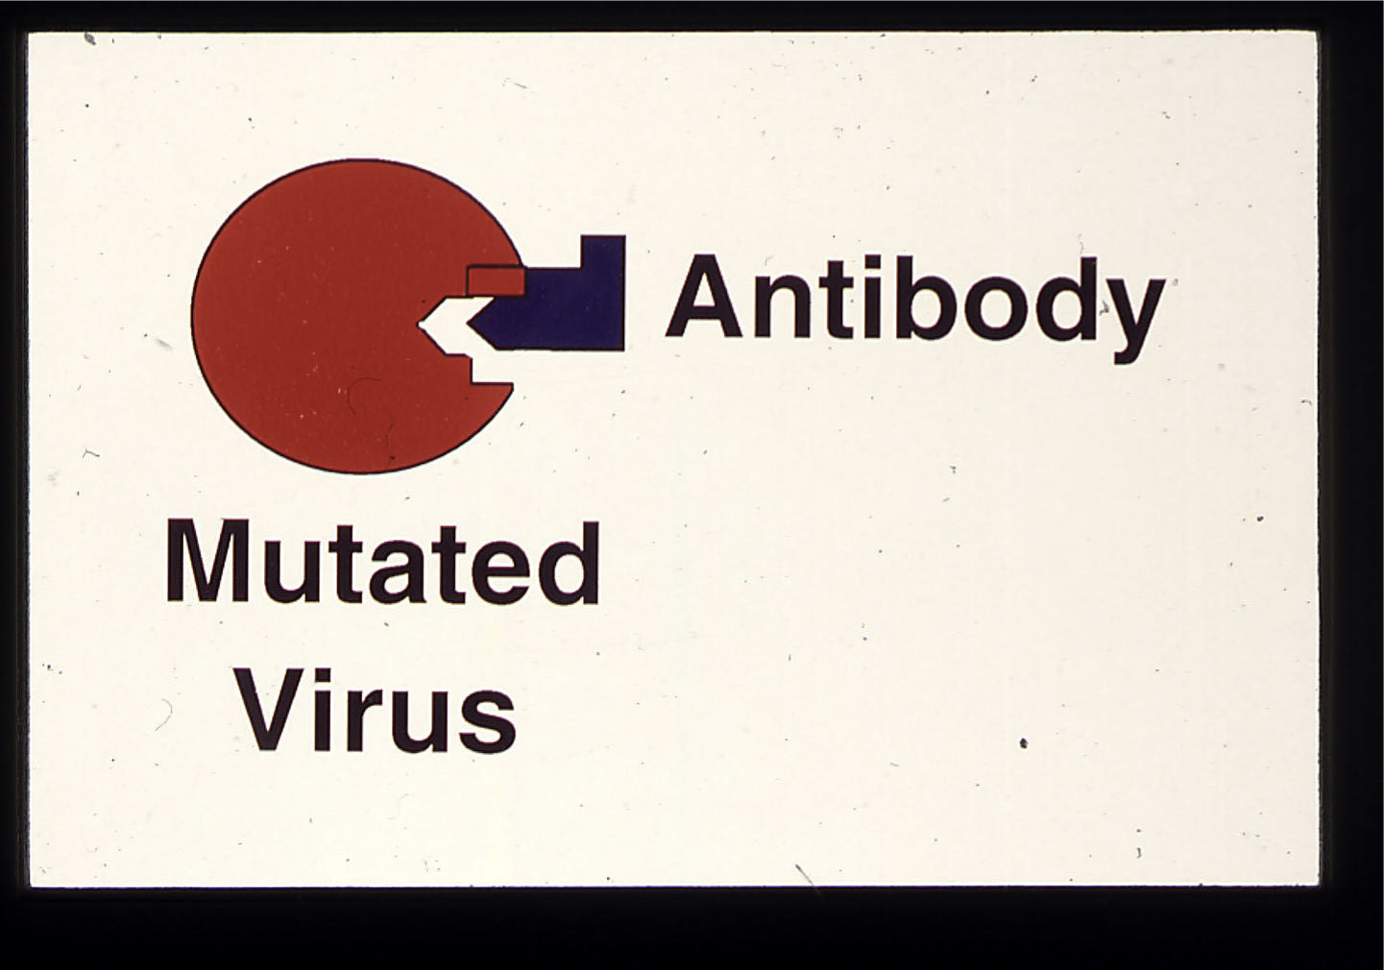

Slide 24
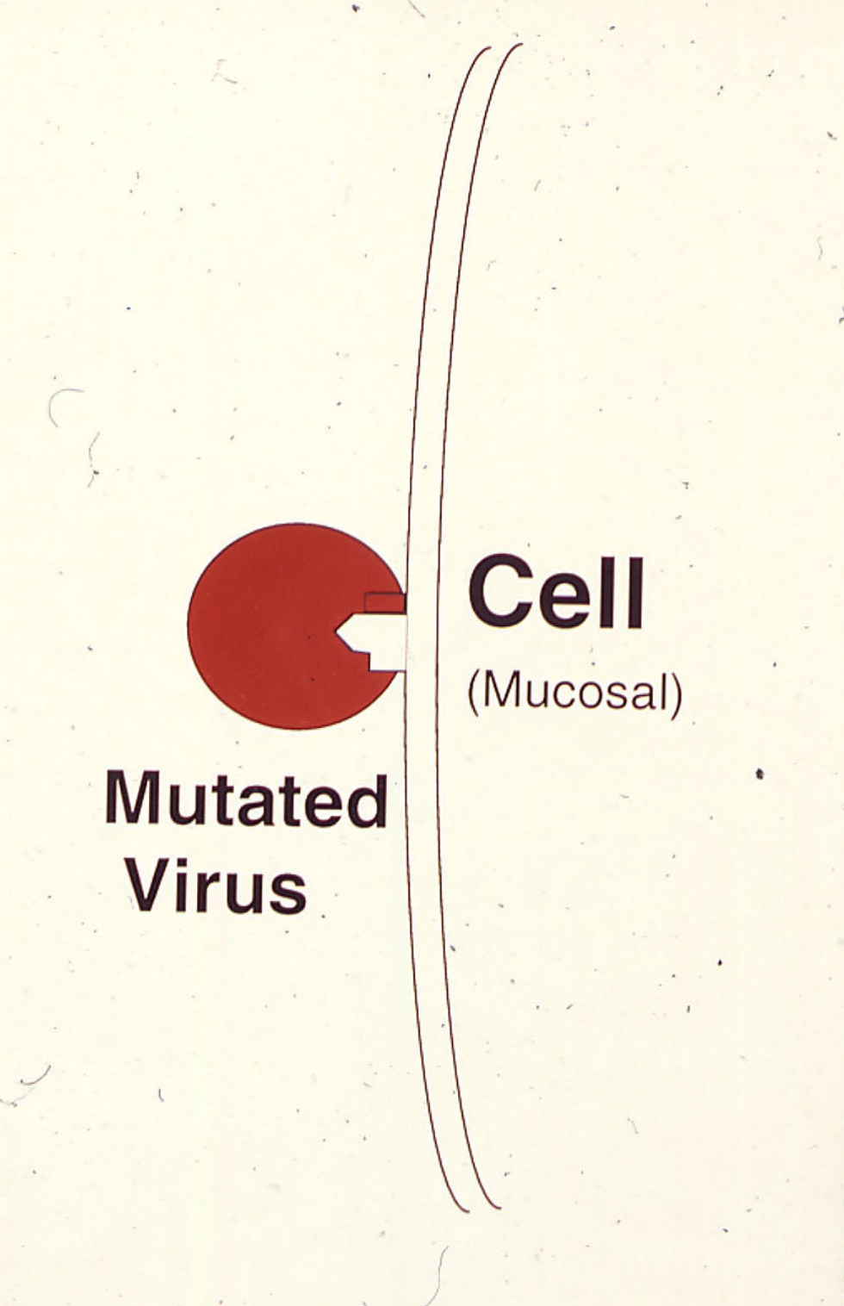
Positive or
Darwinian or
diversifying selection
of the mutated virus

Slide 25
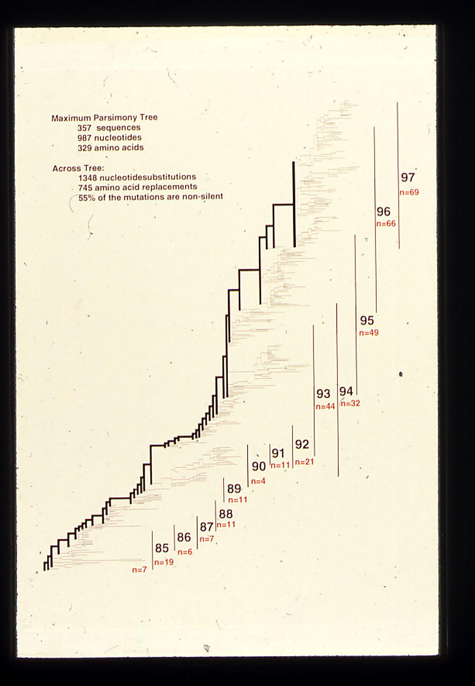
Parsimony phylogeny of influenza HA gene

Slide 26
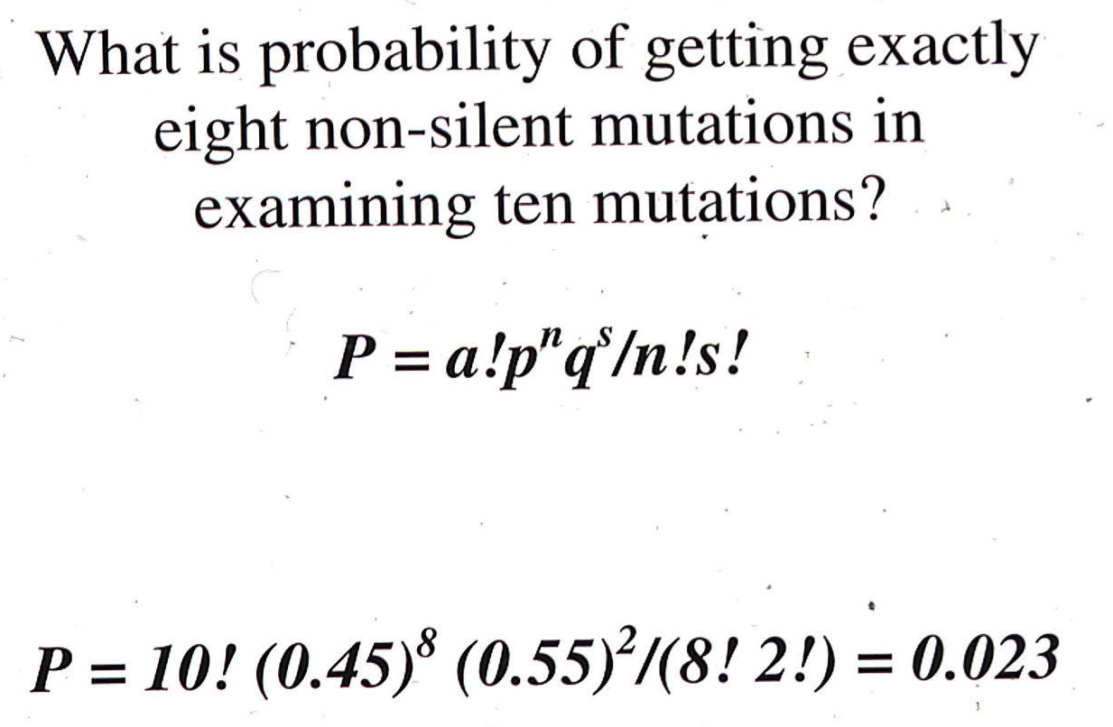
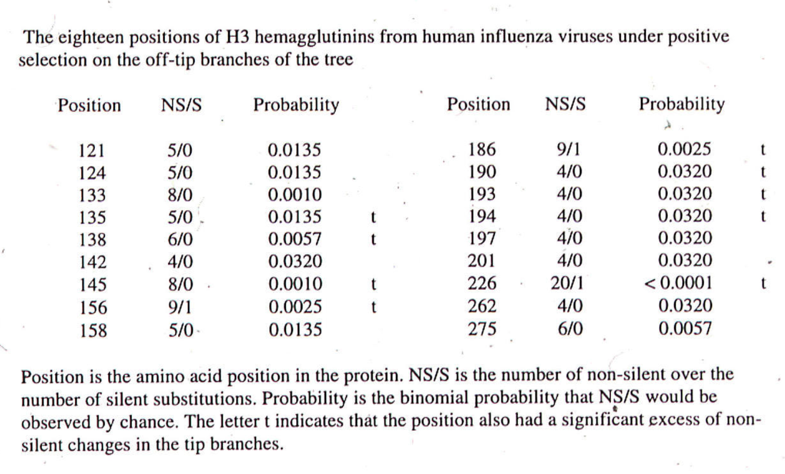

Slide 27
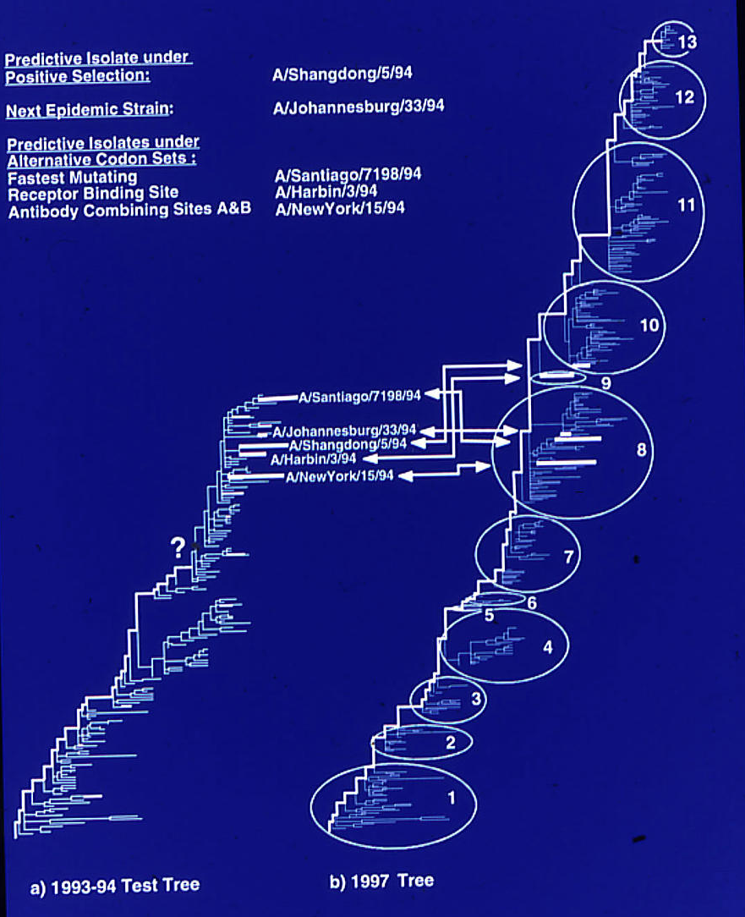

Slide 28
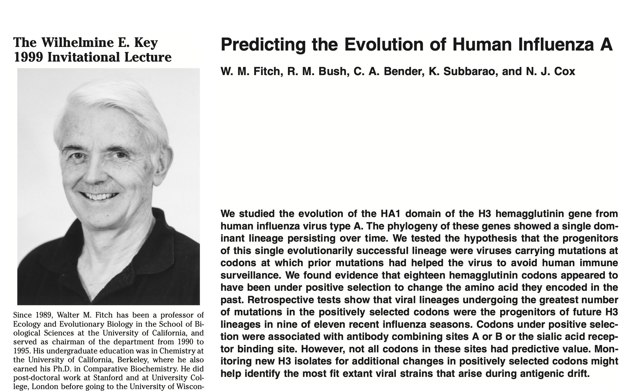
More here:

Slide 29
sites model in MrBayes
The MrBayes block in a nexus file might look something like this:
begin mrbayes;
set autoclose=yes;
lset nst=2 rates=gamma nucmodel=codon omegavar=Ny98;
mcmcp samplefreq=500 printfreq=500;
mcmc ngen=500000;
sump burnin=500;
sumt burnin=500;
end;
This article by Yang et al, 2000 gives more background on ml approaches to measure omega.
The dataset used by Yang et al is here: flu_data.paup .

Slide 30
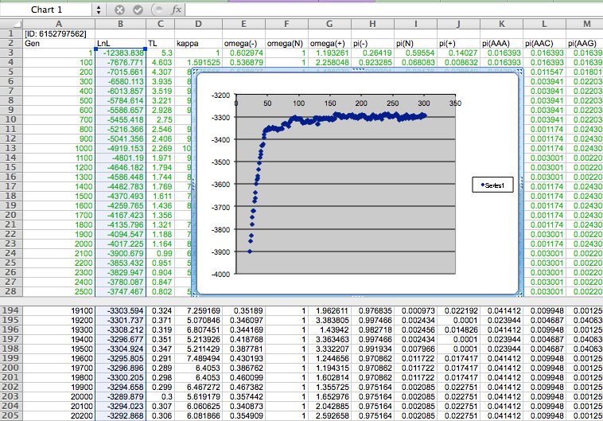

Slide 31
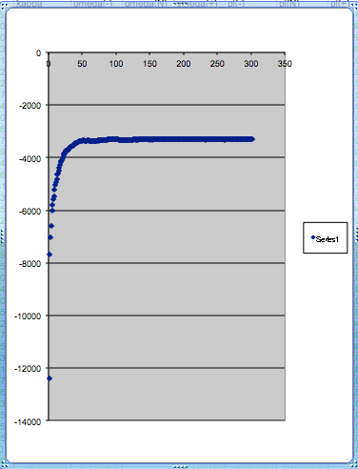
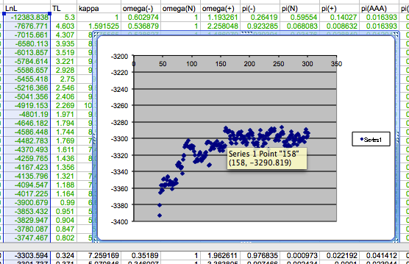
plot LogL to determine which samples to ignore
the same after rescaling the y-axis

Slide 32
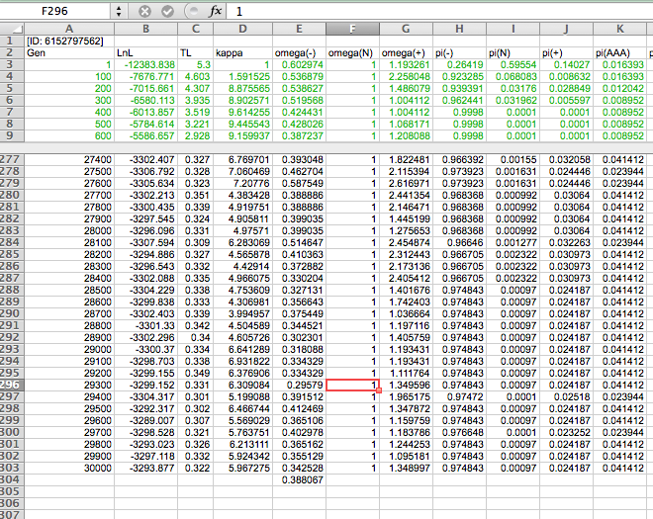

Slide 33
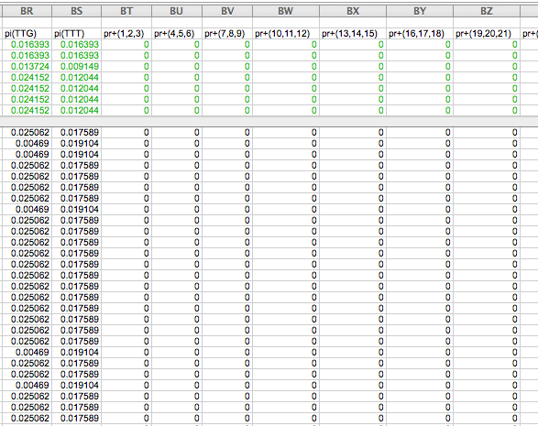

Slide 34
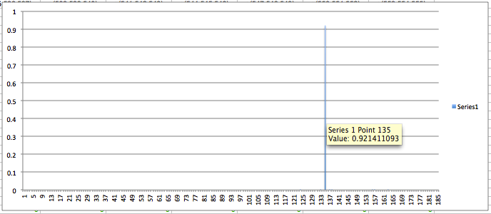
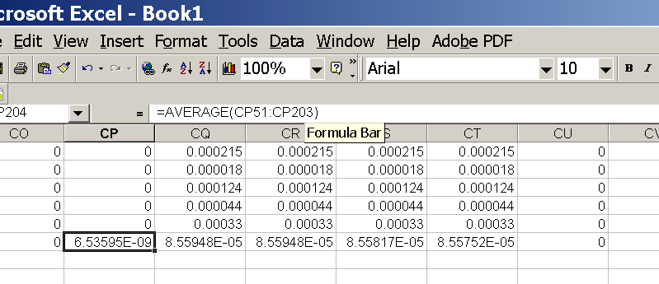
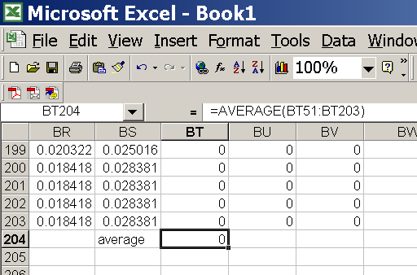
for each codon calculate the the average probability
copy paste formula
plot row
enter formula

Slide 35
Other ways to detect positive selection
Selective sweeps -> fewer alleles present in population (lower heterogeneity between alleles)
-> neighboring genes sweeped along (linkage disequilibrium)
(see below for possible contributions from archaic Humans for example)
Repeated episodes of positive selection -> high dN
(works well for repeated positive – aka diversifying – selection; e.g. virus interaction with the immune system)
A COMMON PROBLEM IS DUE TO UNRELIABLY ALIGNED SEQUENCES, which result in high dN.
Genes that are decaying, or that are pseudogenes already, have a dN/dS close to 1. Adding questionable alignments to this, one can easily arrive at dN/dS > 1.

Slide 36
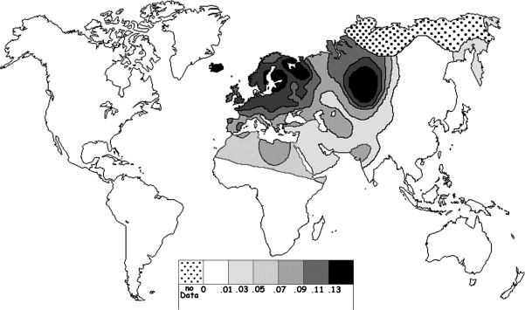
Fig. 1 Current world-wide frequency distribution of CCR5-Δ32 allele frequencies. Only the frequencies of Native populations have been evidenced in Americas, Asia, Africa and Oceania. Map redrawn and modified principally from <ce:cross-ref refid="bib5"> B...
Eric Faure , Manuela Royer-Carenzi
Is the European spatial distribution of the HIV-1-resistant CCR5-Δ32 allele formed by a breakdown of the pathocenosis due to the historical Roman expansion?
Infection, Genetics and Evolution, Volume 8, Issue 6, 2008, 864 - 874
http://dx.doi.org/10.1016/j.meegid.2008.08.007

Slide 37
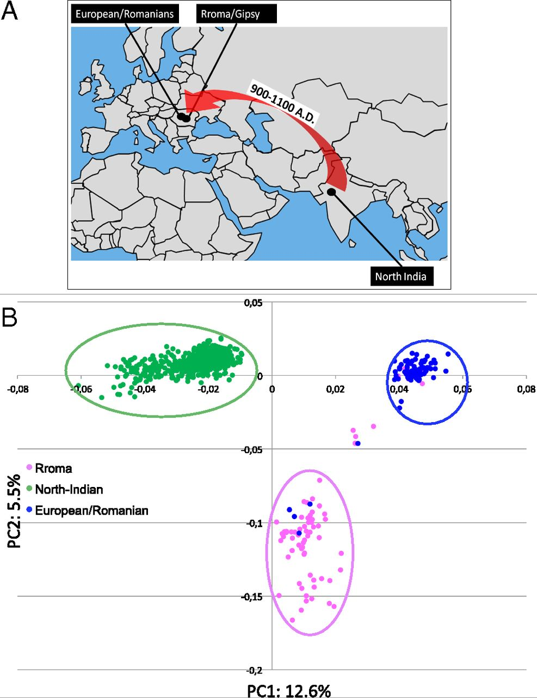
Geographic origin of the three populations studied.
196,524 SNPs
-> PCA
Hafid Laayouni et al. PNAS 2014;111:2668-2673
©2014 by National Academy of Sciences
Notes:
Geographic origin of the three populations studied. (A) European/Romanians and Rroma/Gipsy share the same location, even if the origin of the latter is in North India. (B) Plot of the populations under analysis according to the coordinates to the two main eigenvectors of smartpca (Eigensoft) analysis, in which each dot represents an individual. Individuals within the circles and the same color have been considered for the study; those of different colors represent false population allocation and those intermediate represent admixed individuals. ROM, nongypsy Romanians; INDI, individuals from North India; GYP, Rroma/Gypsies living in Romania.

Slide 38
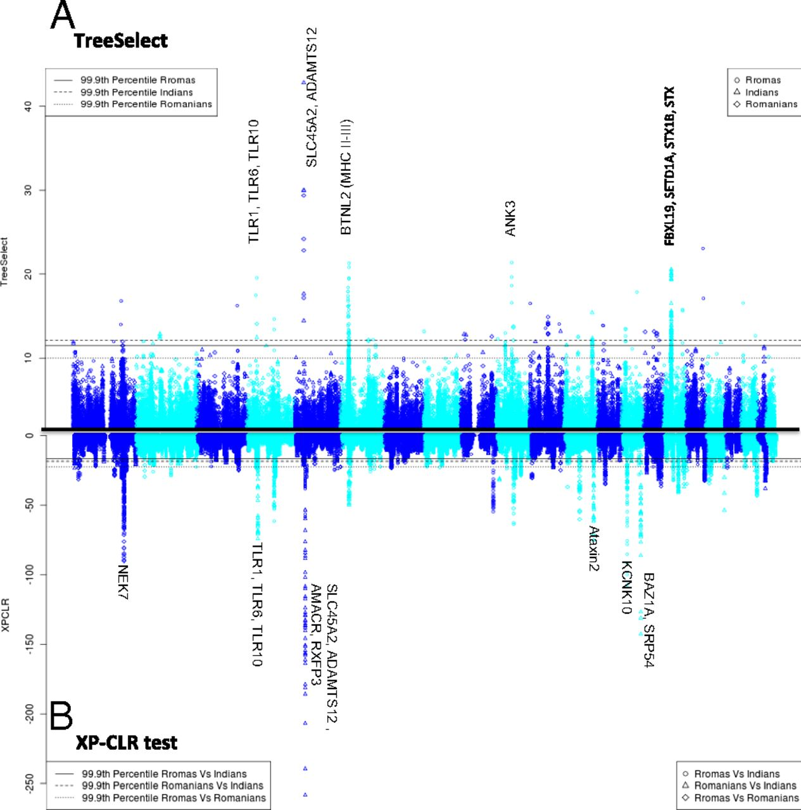
Manhattan plot of results of selection tests in Rroma, Romanians, and Indians using TreeSelect statistic (A) and XP-CLR statistic (B).
SNP frequencies within and between populations
selective sweeps detected through linkage disequilibrium
Laayouni H et al. PNAS 2014;111:2668-2673
Convergent evolution in European and Rroma populations reveals pressure exerted by plague on Toll-like receptors.
©2014 by National Academy of Sciences
Notes:
Manhattan plot of results of selection tests in Rroma, Romanians, and Indians using TreeSelect statistic (A) and XP-CLR statistic (B). Chromosomes ordered from chromosome 1 to chromosome 22.

Slide 39
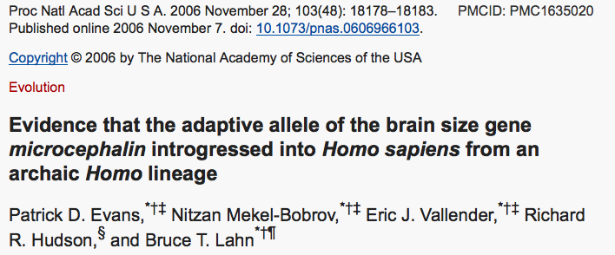
Genes involved in brain development (mutations lead to microencephaly).
Divergent version (alleles) of the wildtype allele exist, with rather uneven frequencies in different human populations.

Slide 40
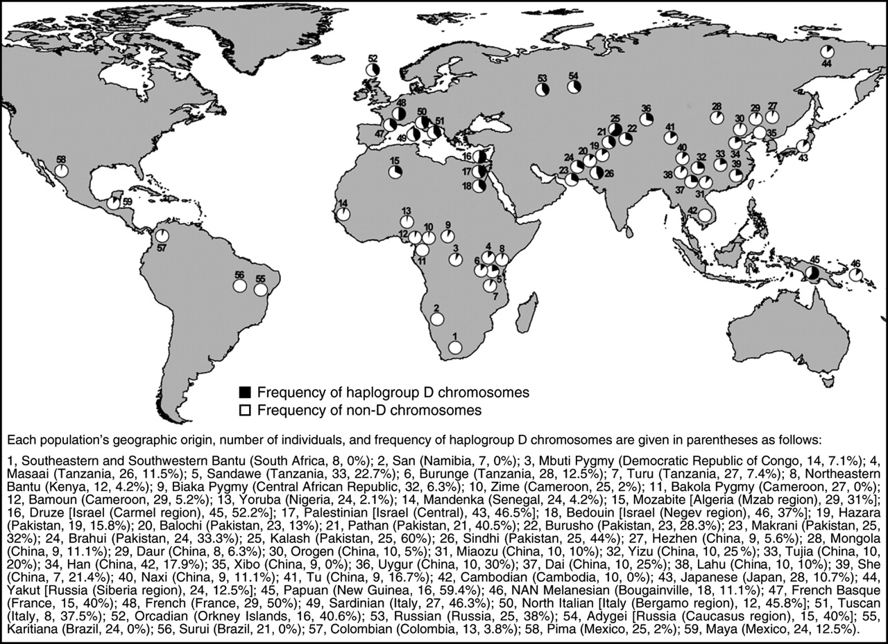
https://science.sciencemag.org/content/309/5741/1720.long
Variant arose about
5800 years ago

Slide 41
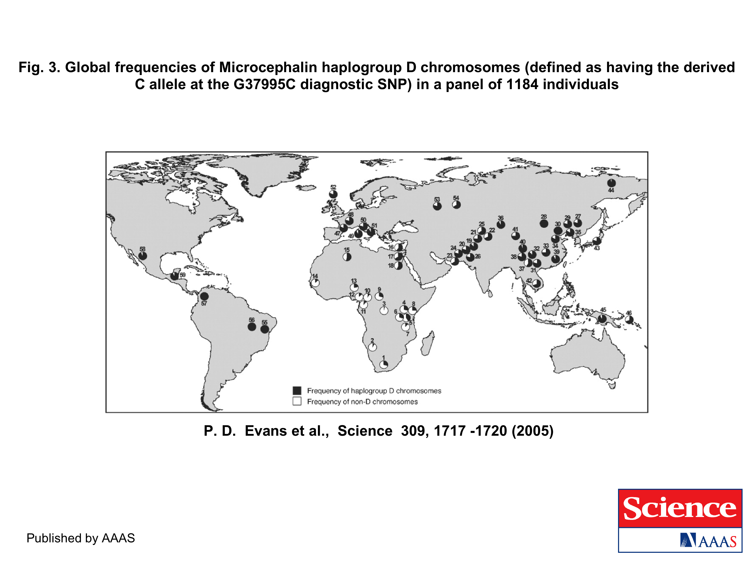
https://science.sciencemag.org/content/309/5741/1717.long
The age of haplogroup D was found to be ~37,000 years

Slide 42
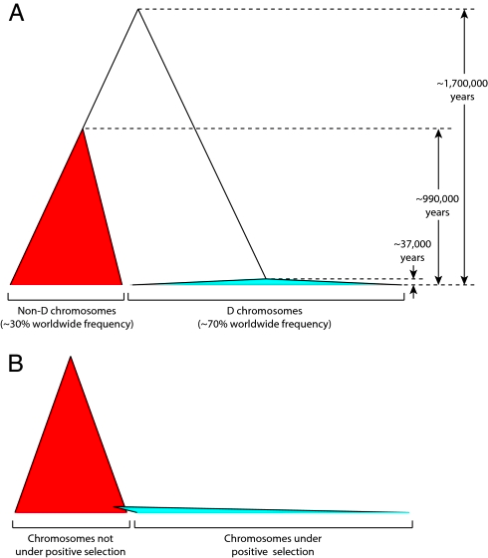

Slide 43
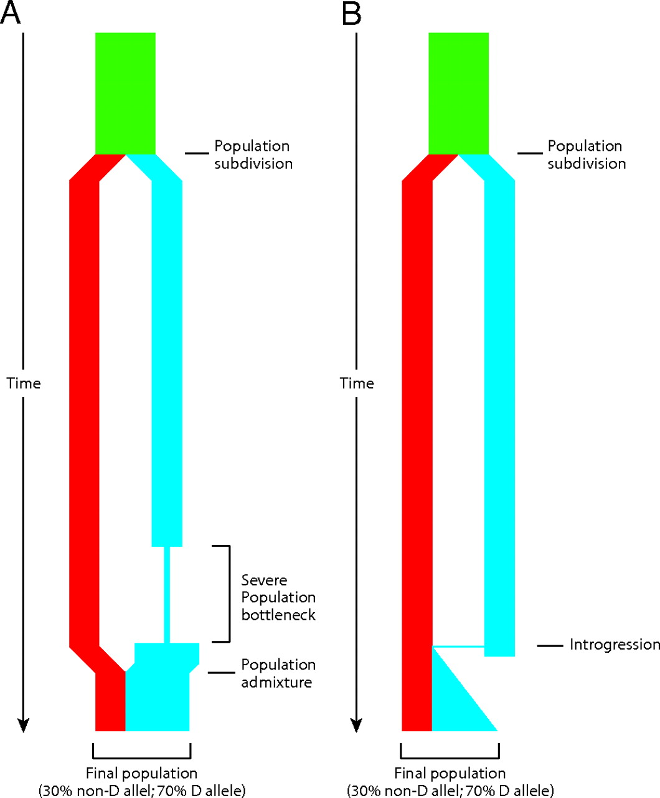

Schematic depiction of two demographic scenarios compatible with the observed genealogy of the microcephalin locus.
Patrick D. Evans et al. PNAS 2006;103:48:18178-18183
©2006 by National Academy of Sciences
Notes:
Schematic depiction of two demographic scenarios compatible with the observed genealogy of the microcephalin locus. In both scenarios, an ancestral population, depicted in green, was subdivided into two reproductively isolated populations. One population, depicted in red, fixes the non-D allele, whereas the other population, depicted in blue, fixes the D allele. (A) In the first scenario, the blue population went through a severe bottleneck that dramatically reduced genetic diversity. It then expanded and merged with the other population. (B) In the second scenario, a rare interbreeding event occurred between the two populations, bringing a copy of the D allele from the blue into the red population. This copy subsequently amplified to high frequency under positive selective pressure. The first scenario depends on demography only and does not require selection. This scenario should therefore affect all sites in the genome. The second scenario requires the action of positive selection on the introgressed allele and is therefore not expected to have a genome-wide effect. The observation that the genealogy of microcephalin is not representative of the genome is consistent with the second scenario.

Slide 44
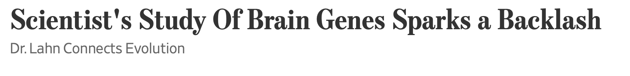
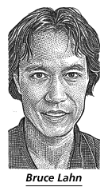
From the WSJ
... told his audience was that genetic changes over the past several thousand years might be linked to brain size and intelligence. He flashed maps that showed the changes had taken hold and spread widely in Europe, Asia and the Americas, but weren't common in sub-Saharan Africa.
Web sites and magazines promoting white "racialism" quickly seized on Dr. Lahn's suggestive scientific snapshot.
The university's patent office is also having second thoughts. Its director, Alan Thomas, says his office is dropping a patent application filed last year that would cover using Dr. Lahn's work as a DNA-based intelligence test. "We really don't want to end up on the front page...for doing eugenics," Mr. Thomas says.
More recently, Dr. Lahn says he was moved when a student asked him whether some knowledge might not be worth having. It is a notion to which he has been warming.
https://www.wsj.com/articles/SB115040765329081636

Slide 45
More on gene flow in human populations

Slide 46
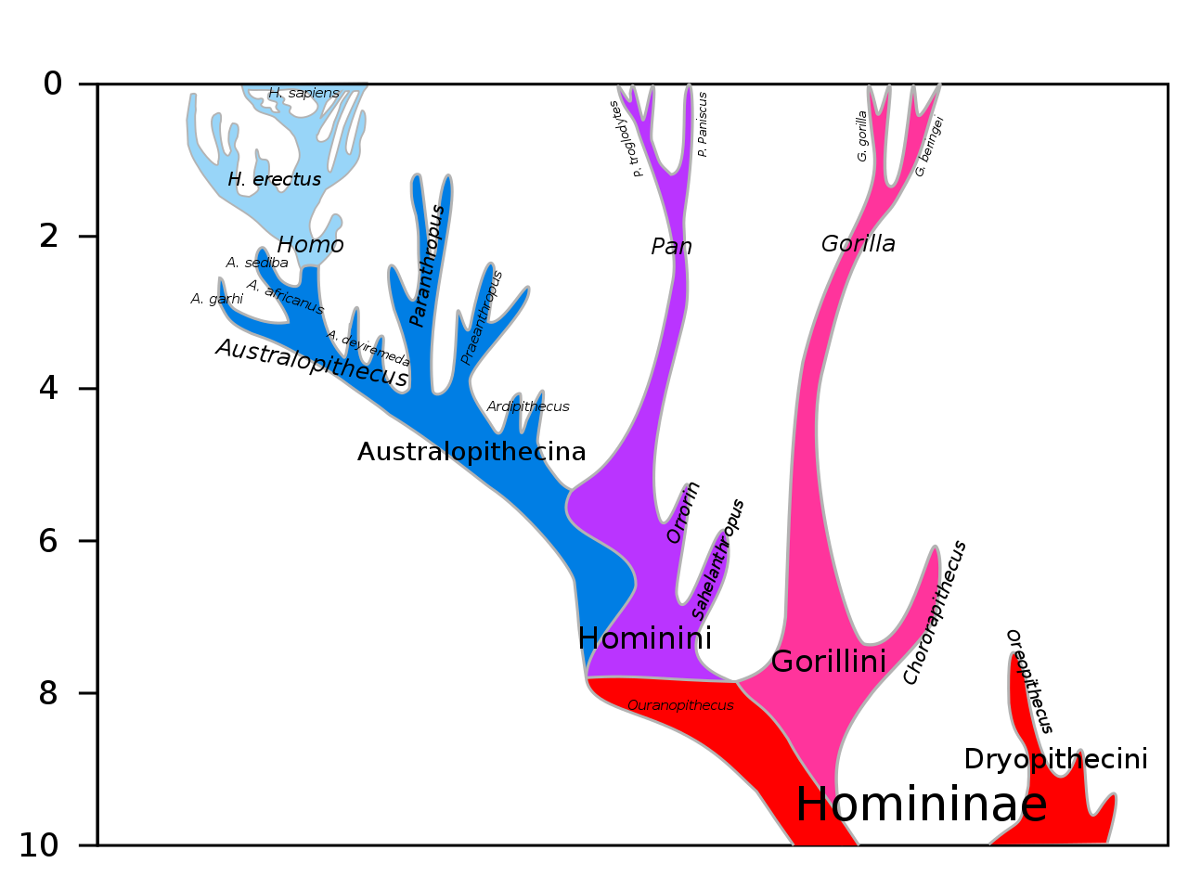
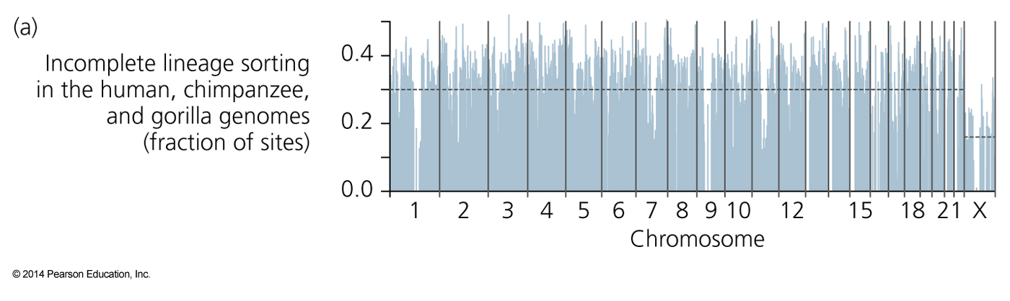
Lineage sorting and extended/complex speciation
Fig. 20.6
For a large fraction of genes, the human sequences are not closer to the chimpanzee homologues. The fraction is smaller for the X chromosome.
https://upload.wikimedia.org/wikipedia/commons/3/3e/Hominini_lineage.svg

Slide 47
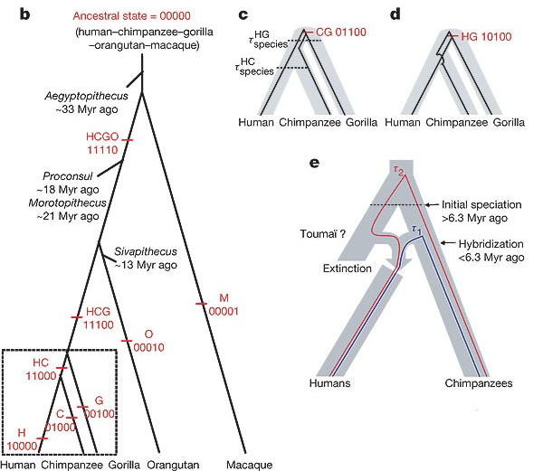
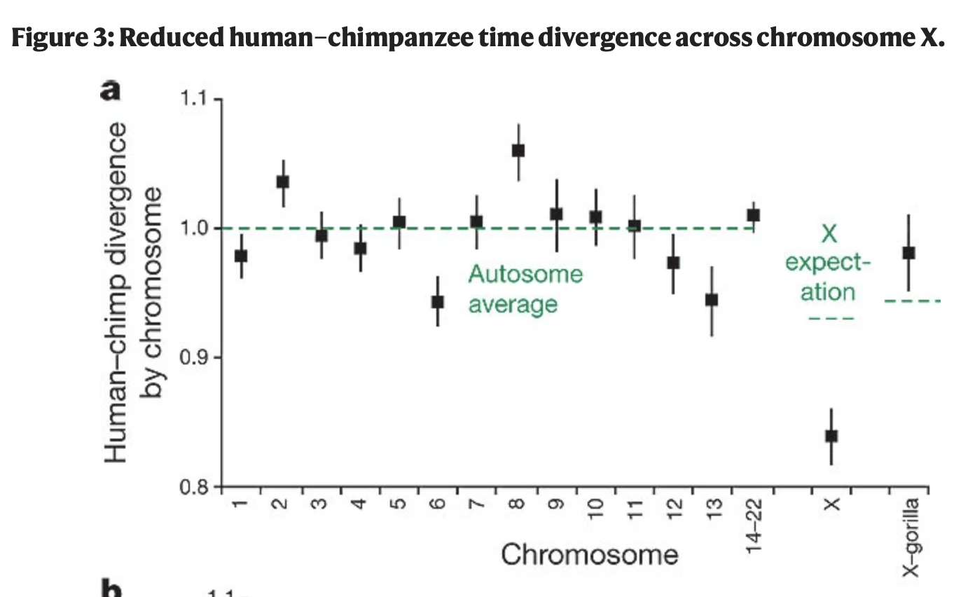
Lineage sorting and extended/complex speciation (cont.)
Patterson Net al., Nature. 2006 441(7097):1103-8. doi: 10.1038/nature04789.

Slide 48
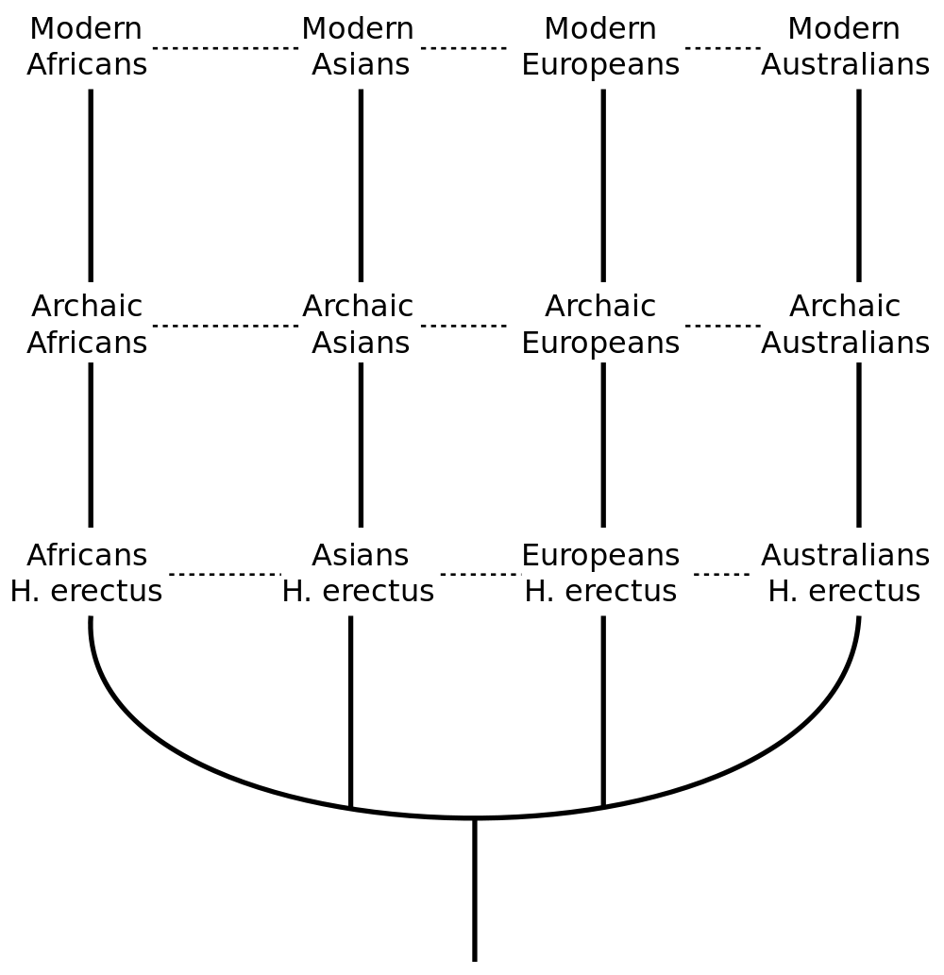
The traditional (pre-genomics) multiregional hypothesis
From http://en.wikipedia.org/wiki/Multiregional_Evolution

Slide 49
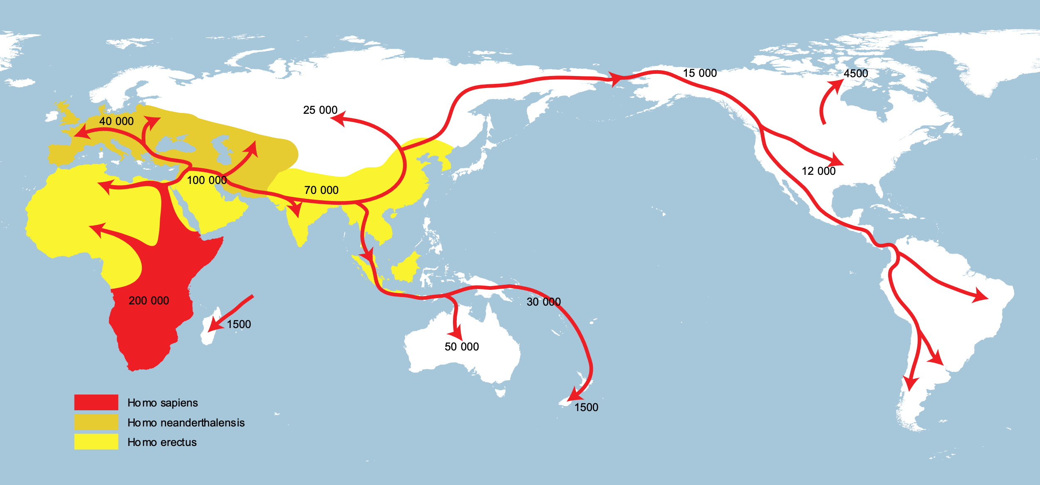
Out of Africa Hypothesis (supported by mitochondrial DNA)
From https://en.wikipedia.org/wiki/Recent_African_origin_of_modern_humans

Slide 50
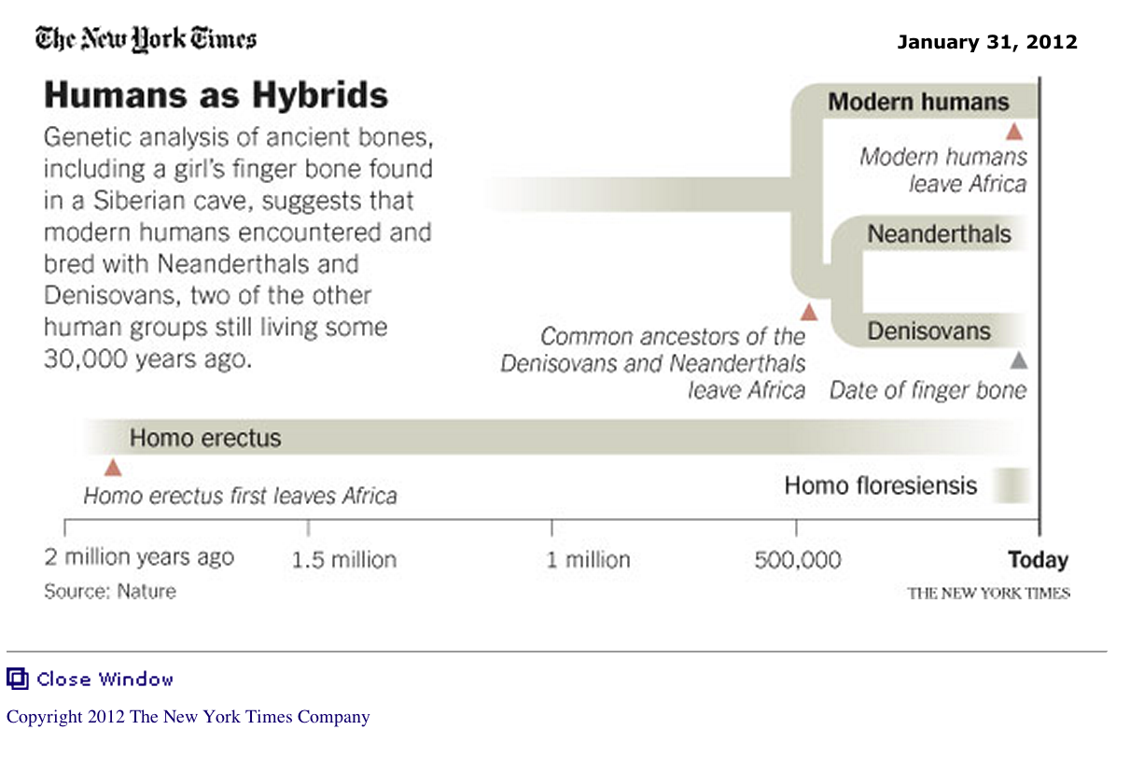
From: http://www.nytimes.com/2012/01/31/science/gains-in-dna-are-speeding-research-into-human-origins.html?_r=1

Slide 51

The Denisovan genome was sequenced from the distal manual phalanx fragment (replica depicted) found in the Denisova cave.^{[16]}
Thilo Parg / Wikimedia Commons
„Lizenz: CC BY-SA 3.0“

Slide 52
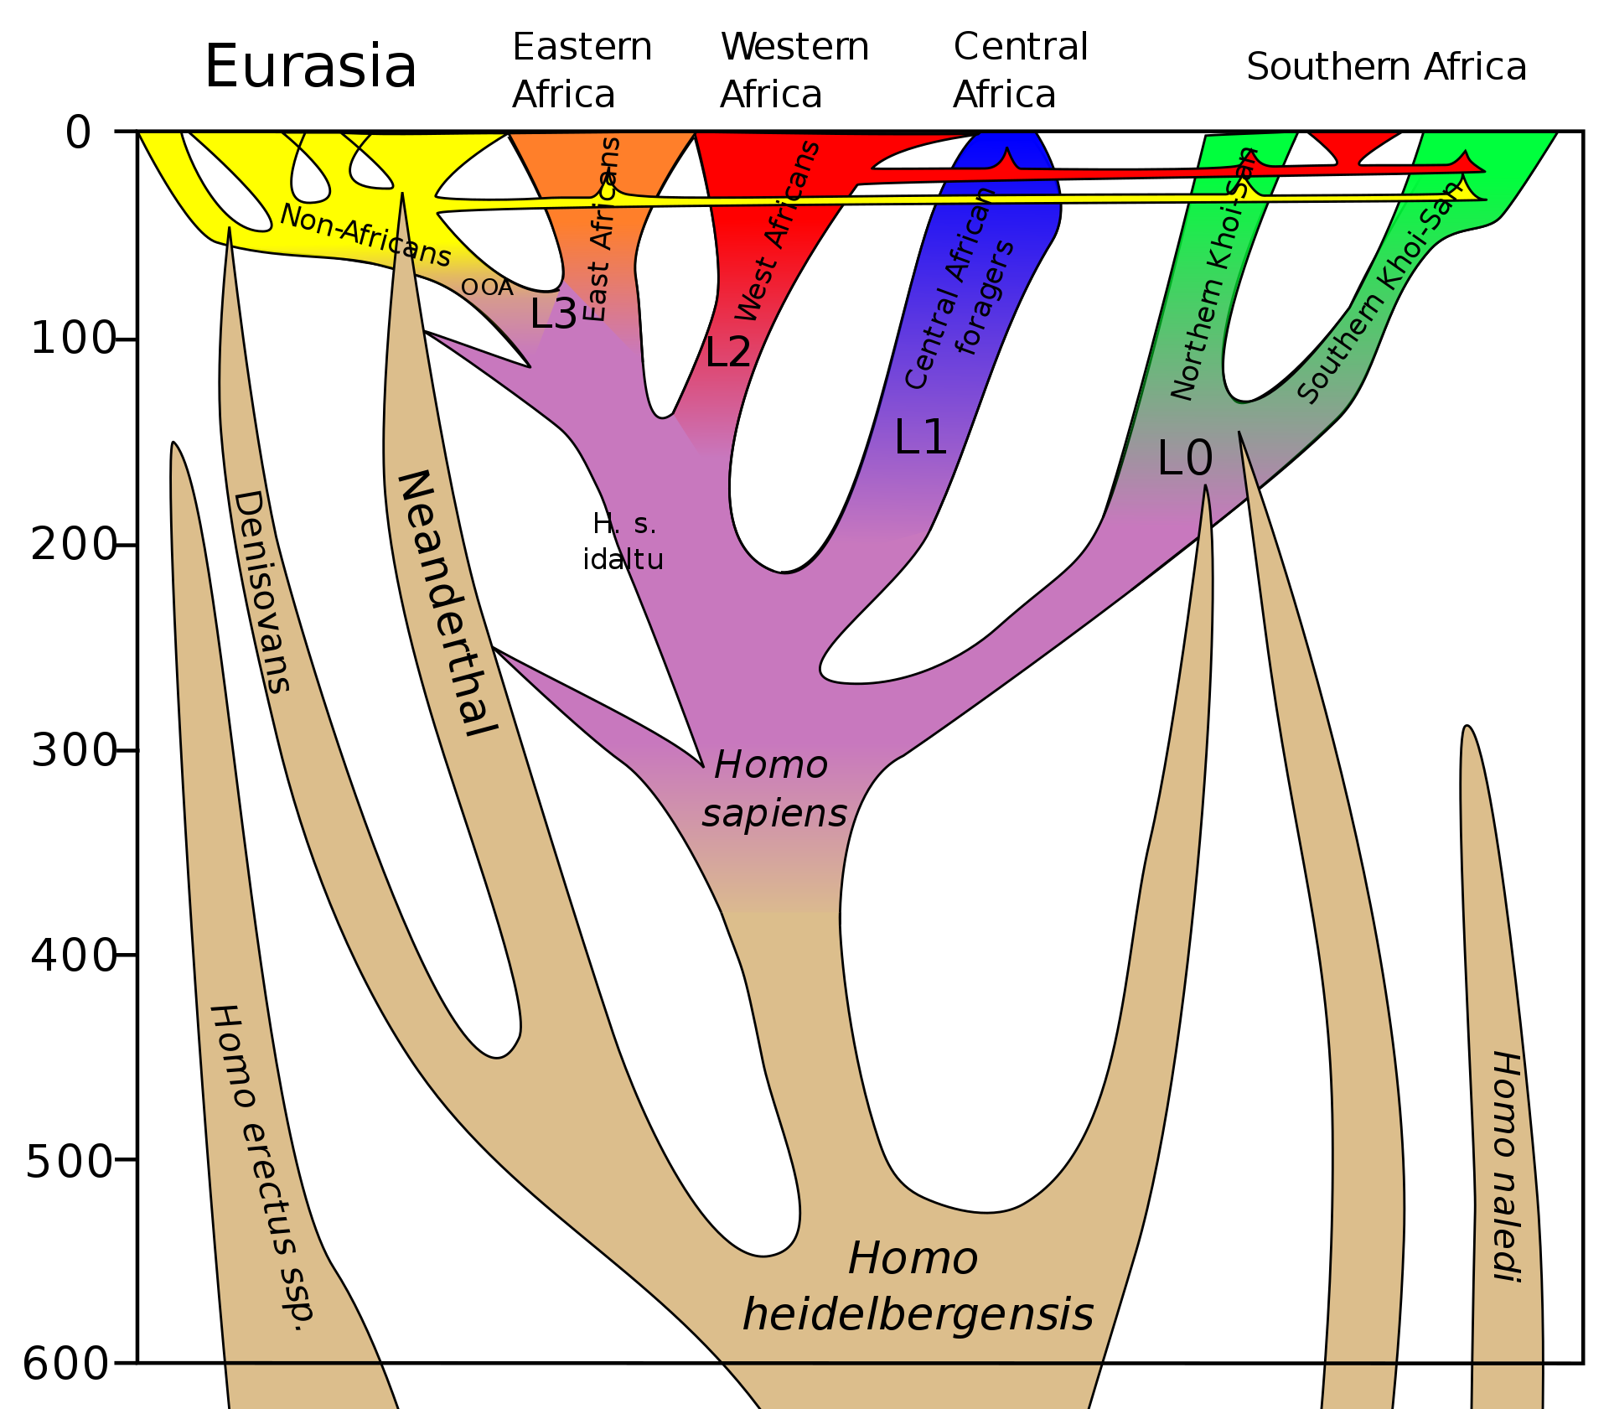
From Wikipedia
Dbachmann CC BY-SA 4.0
A model of the phylogeny of H. sapiens over the last 600,000 years (vertical axis). The horizontal axis represents geographic location; the vertical axis represents time in thousands of years ago.^{[1]} Homo heidelbergensis is shown as diverging into Neanderthals, Denisovans and H. sapiens. With the expansion of H. sapiens after 200 kya, Neanderthals, Denisovans and unspecified archaic African hominins are displayed as again subsumed into the H. sapiens lineage. Possible admixture events involving certain modern populations in Africa are also shown.

Slide 53
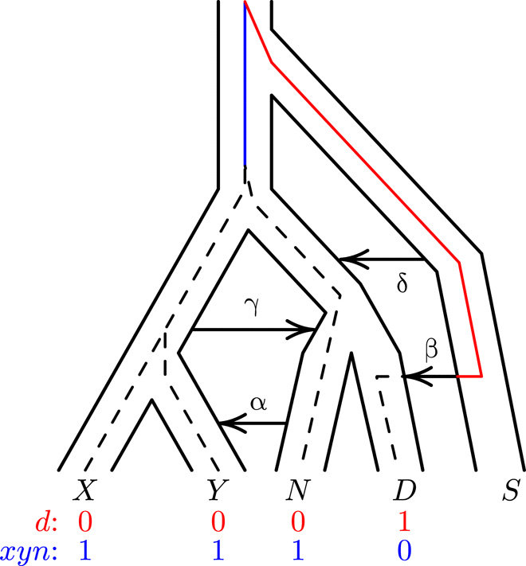

Fig. 1 A population network including four episodes of gene flow, with an embedded gene genealogy.
Alan R. Rogers et al. Sci Adv 2020;6:eaay5483
Copyright © 2020 The Authors, some rights reserved; exclusive licensee American Association for the Advancement of Science. No claim to original U.S. Government Works. Distributed under a Creative Commons Attribution NonCommercial License 4.0 (CC BY-NC).
Notes:
A population network including four episodes of gene flow, with an embedded gene genealogy. Upper case letters (X, Y, N, D, and S) represent populations (Africa, Europe, Neanderthal, Denisovan, and superarchaic). Greek letters label episodes of admixture. d and xyn illustrate two nucleotide site patterns, in which 0 and 1 represent the ancestral and derived alleles. A mutation on the red branch would generate site pattern d. One on the blue branch would generate xyn. For simplicity, this figure refers to Neanderthals with a single letter. Elsewhere, we use two letters to distinguish between the Altai and Vindija Neanderthals.

Slide 54
From Wikipedia: https://en.wikipedia.org/wiki/Denisovan

Slide 55
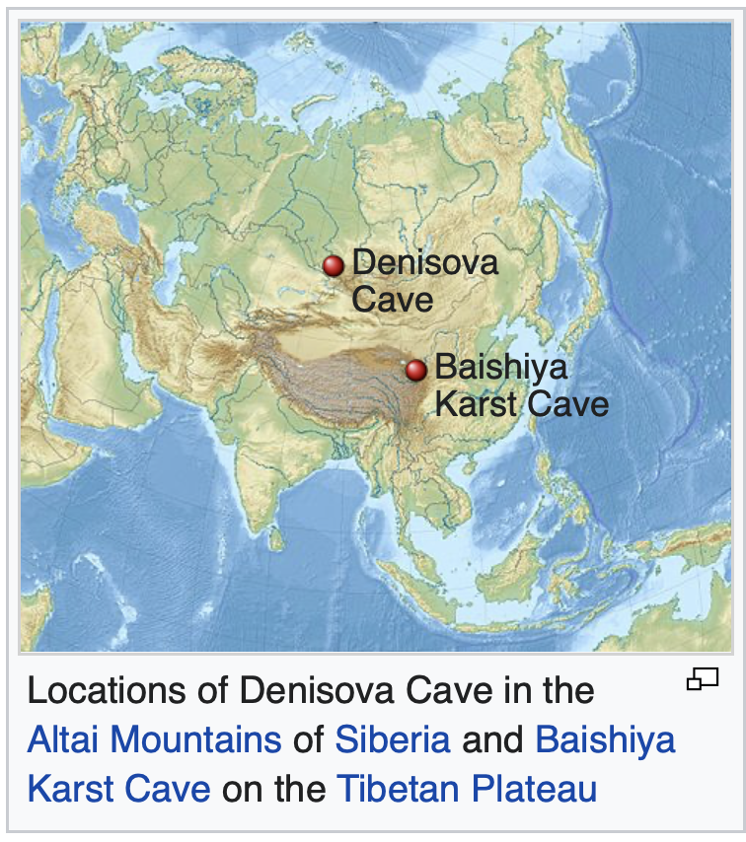
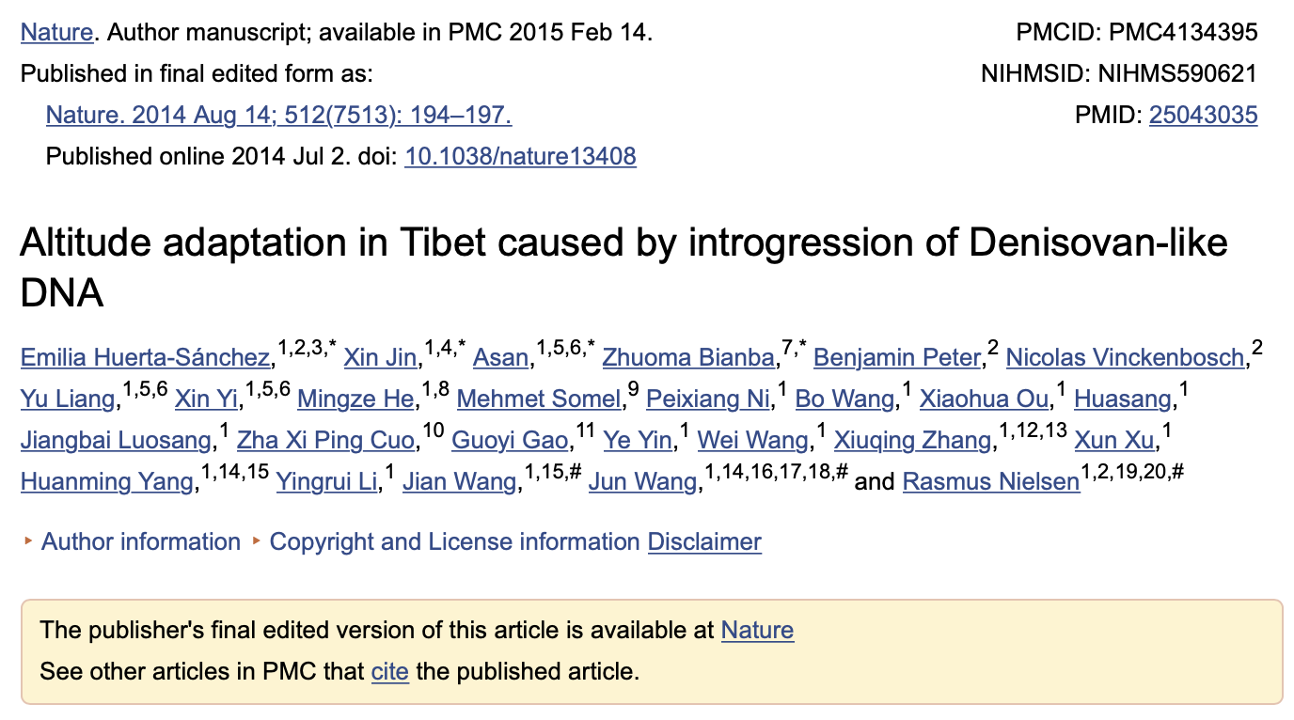
From Wikipedia: https://en.wikipedia.org/wiki/Denisovan

Slide 56
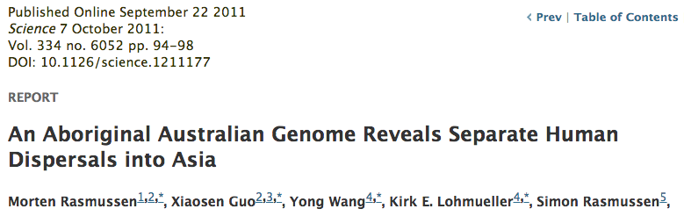


Slide 57

Did the Denisovans Cross Wallace's Line?
Science 18 October 2013:
vol. 342 no. 6156 321-323
Ancient migrations.
The proportions of Denisovan DNA in modern human populations are shown as red in pie charts, relative to New Guinea and Australian Aborigines (3). Wallace's Line (8) is formed by the powerful Indonesian flow-through current (blue arrows) and marks the limit of the Sunda shelf and Eurasian placental mammals.

