Slide 1
Transduction and Gene Transfer Agents dN/dS <1 - A positive contribution to fitness?
MCB3421 2023 class 23

Slide 2
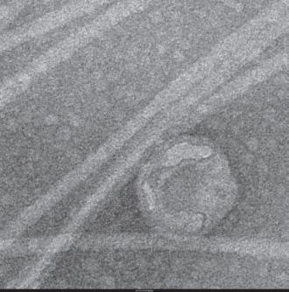
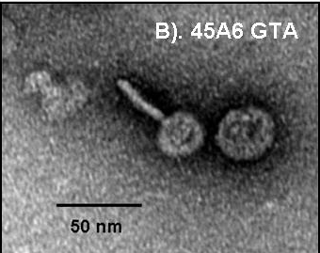
GTA
Genetic transfer Agents

Slide 3
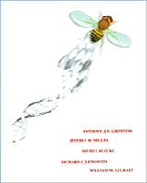
Phage and Horizontal gene Transfer
From:
An Introduction to Genetic Analysis. 7th edition.
Griffiths AJF, Miller JH, Suzuki DT, et al.
New York: W. H. Freeman; 2000.
The mechanism of generalized transduction. In reality, only a very small minority of phage progeny (1 in 10,000) carries donor genes.

Slide 4
Phage and Horizontal gene Transfer
From:
An Introduction to Genetic Analysis. 7th edition.
Griffiths AJF, Miller JH, Suzuki DT, et al.
New York: W. H. Freeman; 2000.
Specialized transduction mechanism in phage λ. (a) A lysogenic bacterial culture can produce normal λ or, rarely, an abnormal particle, λdgal, which is the transducing particle. (b) Transducing by the mixed lysate can produce gal⁺ transductants by the coincorporation of λdgal and a λ wild type.

Slide 5
Gene(tic) Transfer Agents: Defective phage, no longer recognize their own DNA
From:
Andrew S. Lang, Olga Zhaxybayeva, and J. Thomas Beatty: Gene transfer agents: phage-like elements of genetic exchange. Nat Rev Microbiol. 2012 Jun 11; 10(7): 472–482.
https://www.ncbi.nlm.nih.gov/pmc/articles/PMC3626599/
GTA
Lysogenic phage
Notes:
a | The genes encoding the gene transfer agent (GTA) particles are located on the host chromosome, and their expression leads to the production of GTA particles (black). GTA genes have never been found to excise from the genome as part of GTA production. Random DNA segments from the producing cell are packaged in the particles (blue particle heads), and only the occasional particle contains GTA genes (red particle head). For all genetically characterized GTAs, the amount of DNA packaged is insufficient to encode the phage-like structure (as indicated by the small heads). It is presumed that GTAs require lysis (dashed line) for release from cells. b | In the production of transducing phages, phage or prophage genes within the host genome are expressed, resulting in the production of phage particles (black) and replication of the phage genome (not shown). Packaging of the complete phage genome then occurs (orange phage heads), with occasional packaging of non-phage DNA (blue phage head). Note that this is an over simplification and some transducing phage particles can contain both phage and cellular genomic DNA. Tailed phage structures require lysis to be released from cells.

Slide 6
Gene Transfer Agents: Defective phage, no longer recognize their own DNA
From:
Andrew S. Lang, Olga Zhaxybayeva, and J. Thomas Beatty: Gene transfer agents: phage-like elements of genetic exchange. Nat Rev Microbiol. 2012 Jun 11; 10(7): 472–482.
https://www.ncbi.nlm.nih.gov/pmc/articles/PMC3626599/
The heads of GTAs are smaller than necessary to pack all of the genes encoding the GTA
Notes:
a | Rhodobacter capsulatus gene transfer agents (RcGTAs)³⁰. b | Dd1 particles from Desulfovibrio desulfuricans⁴⁸. c | Virus of Serpulina hyodysenteriae (VSH 1) particles in Brachyspira hyodysenteriae⁵⁰. d | A voltae transfer agent (VTA) particle in Methanococcus voltae⁶⁷. Parts a,c and d are reproduced, with permission, from (respectively) REF. 30 © (1979) Elsevier; REF. 50 © (1997) American Society for Microbiology; and REF. 67© (1999) Society for General Microbiology. Part b is modified, with permission, from REF. 48 © (1987) US National Academy of Sciences.

Slide 7
Rhodobacter capsulatus
GTA discovered in 1974
Resemble prophage (see next slide)
Regulated quorum sensing system
RcGTA like gene clusters shown in many
α-proteobacteria, suggesting vertical transmission began around the time of the split of the groups of alphaproteobacteria.

Slide 8
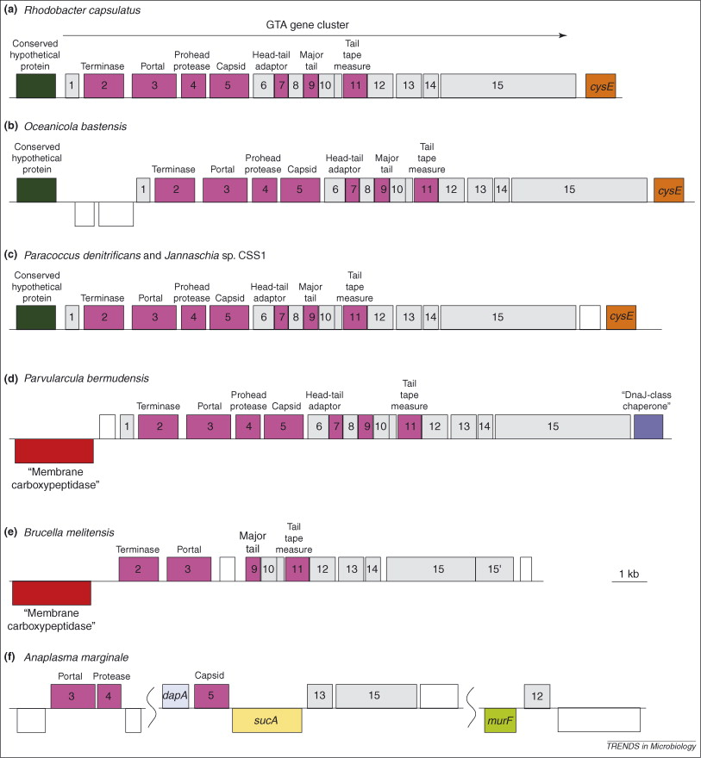
GTA Origin and Evolution
The conserved gene neighborhoods suggests vertical inheritance in α-proteobacterial lineages
Lang, A.S. & Beatty, J.T. Trends in Microbiology , Vol.15, No.2 , 2006
Notes:
Syntenic arrangement is valid only for Rhodobacterales
Widespread presence of RcGTA clusters, pattern of RcGTA-gene like distribution in these species and the results of phylogenetic analyses in these species suggest a prokaryotic ancestor of all alpha-proteobacteria contained RcGTA-like genes.

Slide 9
Purifying selection in GTA genes
dN/dS <1 for GTA genes has been used to infer selection for function
GTA genes
Lang AS, Zhaxybayeva O, Beatty JT. Nat Rev Microbiol. 2012 Jun 11;10(7):472-82
Lang, A.S. & Beatty, J.T. Trends in Microbiology , Vol.15, No.2 , 2006
Notes:
The ratio of non-synonymous-to-synonymous (dN/dS, or ω) codon substitution rates can be used as an indication of the selective pressure acting on a protein-coding gene. If a gene (or gene segment) is under purifying selection, non-synonymous mutations (that is, mutations resulting in a change of the encoded amino acid) will be selected against, resulting in ω < 1. In neutrally evolving proteins, synonymous and non-synonymous mutations will be fixed at approximately the same rate, resulting in ω = 1. Because different regions of a protein-coding gene may be under different selective constraints, codons can be divided into two categories: those with ω < 1 (yellow; the estimated ω is indicated on the bar) and those with ω fixed to 1 (green); the estimated proportion of codons in each category is given on the horizontal axis.

Slide 10
Purifying selection provides evidence that a gene is doing something positive (as in making a positive contribution to fitness)
?

Slide 11
Figure 2: Nested levels of selection on gene content.
From: https://www.nature.com/articles/nrg3962 doi: 10.1038/nrg3962

Slide 12
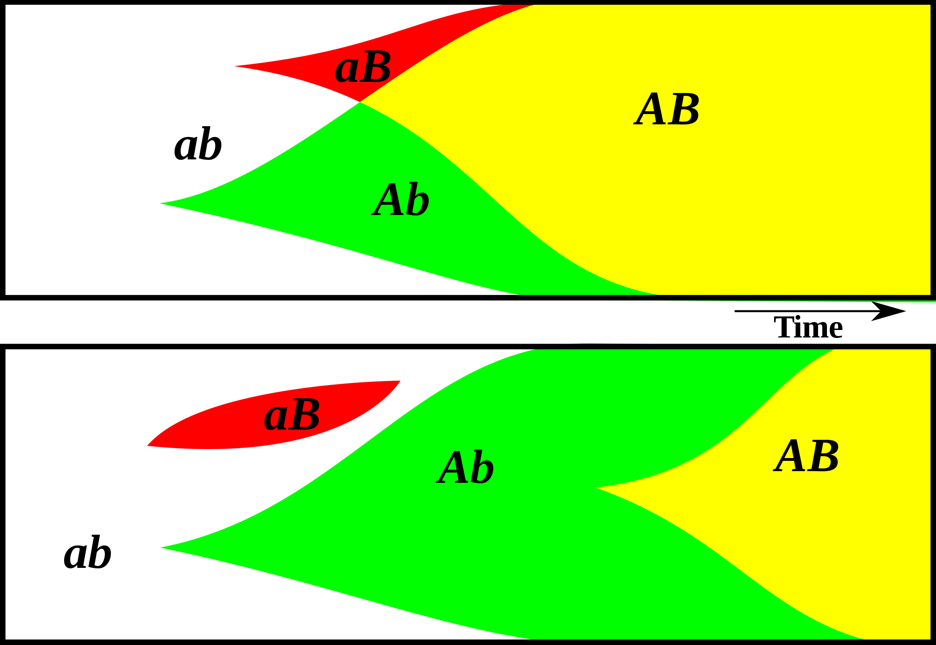
Gene Transfer, Sex, and Recombination:
Inventions do not need to be made sequentially
Gene transfer, followed by homologous or non-homologous recombination, allows inventions to be shared across the tree of life

Slide 13
GTAs cannot survive as selfish genetic elements, because
GTAs are too small to encode all GTA genes
The GTA+ cell dies upon release of the GTAs
At best one GTA- cell (that has a mutation in its GTA can be converted to GTA+.
Recombination is beneficial to a group, because it prevents slightly deleterious mutations to be fixed along site beneficial ones, and it allows beneficial mutations that occurred in different cells to come together in a lineage. However, GTAs do not represent an evolutionary stable strategy.
GTA- cells can invade GTA+ population (the never lyse themselves, and the reap the benefits of recombination).
GTA+ cells can only invade a GTA- population, if the GTA+ cells manage somehow to restrict recombination to other GTA+ cells.
Why are GTAs around?
GTAs just represent decaying phages … But they are under purifying selection (or not, see below); and they persist in lineages.
The gene transfer they catalyze has some other benefits; Rosie Redfield (here) discusses the possibility that they might help transfer immunity against phages. (Can this be an evolutionary stable strategy?)

Slide 14
While recombination is great for the populations, GTAs cannot be selected for this.
GTA+ cell dies when GTAs are produced. Head is too small to transfer all the GTA genes. No selection as selfish genetic element! No group selection, because GTA- cells would invade
GTA as a bacterial vaccination program:
If a cell is infected by a phage, the GTAs are induced, and many of them will package fragments of phage DNA. These introduced into a recipient can lead to incorporation of the phage into the CRISPR array (without the recipient ever having experiences the phage.
Idea from Sanna Koskiniemi from Uppsala University, via Rosie Redfield’s blog

Slide 15
Purifying selection in E.coli ORFans
dN-dS < 0 for some ORFan E. coli clusters seems to suggest they are functional genes.
Gene groups | Number | dN-dS>0 | dN-dS<0 | dN-dS=0
E. coli ORFan clusters | 3773 | 944 (25%) | 1953 (52%) | 876 (23%)
Clusters of E.coli sequences found in Salmonella sp., Citrobacter sp. | 610 | 104 (17%) | 423(69%) | 83 (14%)
Clusters of E.coli sequences found in some Enterobacteriaceae only | 373 | 8 (2%) | 365 (98%) | 0 (0%)
Adapted after Yu, G. and Stoltzfus, A. Genome Biol Evol (2012) Vol. 4 1176-1187

Slide 16
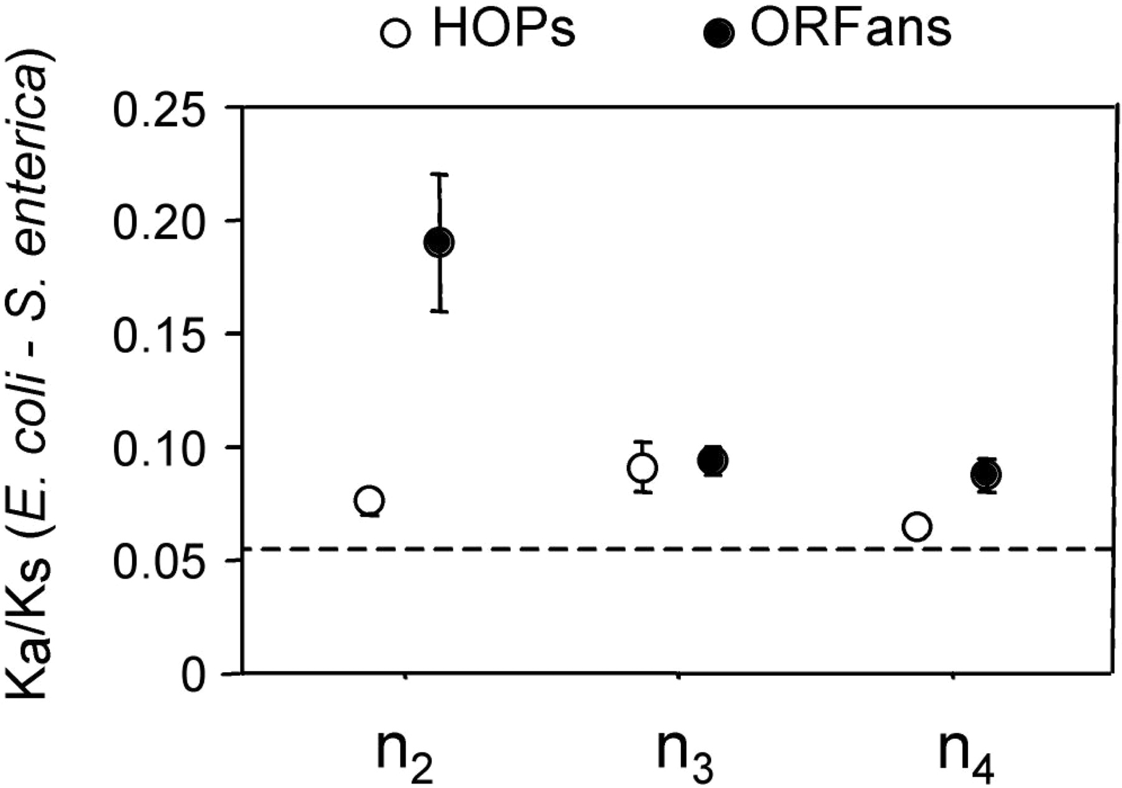
Vincent Daubin and Howard Ochman: Bacterial Genomes as New Gene Homes: The Genealogy of ORFans in E. coli. Genome Research 14:1036-1042, 2004
The ratio of non-synonymous to synonymous substitutions for genes found only in the E.coli - Salmonella clade is lower than 1, but larger than for more widely distributed genes.
Increasing phylogenetic depth
Fig. 3 from Vincent Daubin and Howard Ochman, Genome Research 14:1036-1042, 2004

Slide 17
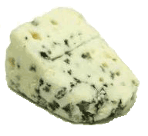
Trunk-of-my-car analogy: Hardly anything in there is the is the result of providing a selective advantage. Some items are removed quickly (purifying selection), some are useful under some conditions, but most things do not alter the fitness. See here for a published version.
Could some of the inferred purifying selection be due to the acquisition of novel detrimental characteristics (e.g., protein toxicity, HOPELESS MONSTERS)?

Slide 18
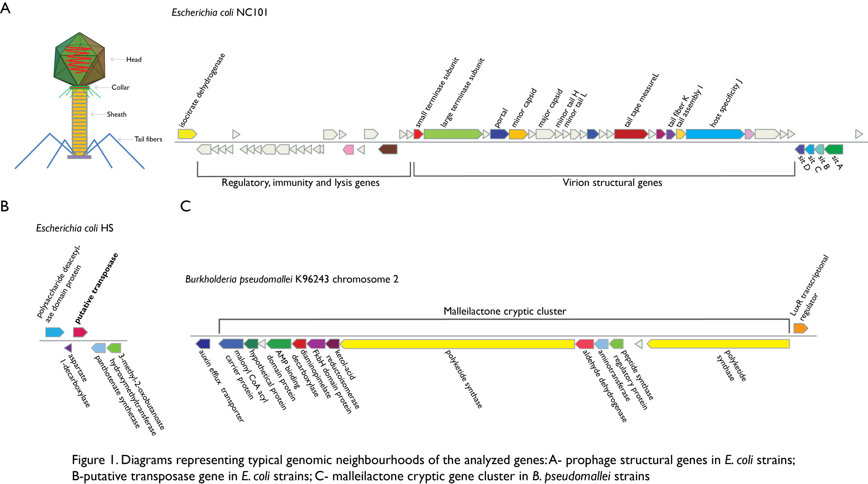
Vertically Inherited Genes Not Expressed for Function

Slide 19
Counting Algorithm
Calculate number of different nucleotides/amino acids per MSA column (X)
Calculate number of nucleotides/amino acids substitutions (X-1)
Calculate number of synonymous changes nucl changes – aa changes
X=2 1 nucleotide substitution
1 non-synonymous change
X=2 1 amino acid substitution

Slide 20
Simulation Algorithm
Calculate MSA nucleotide frequencies (%A,%T,%G,%C)
Introduce a given number of random substitutions ( at any position) based on inferred base frequencies
Compare translated mutated codon with the initial translated codon and count synonymous and non-synonymous substitutions

Slide 21
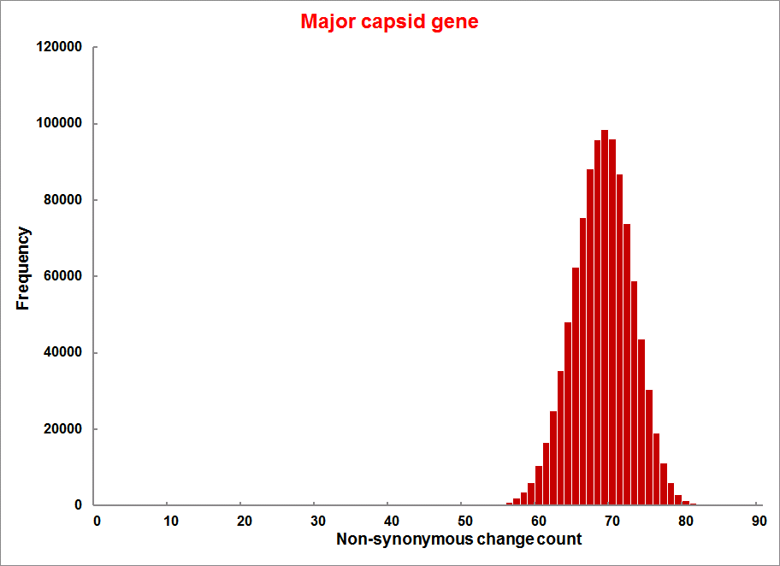
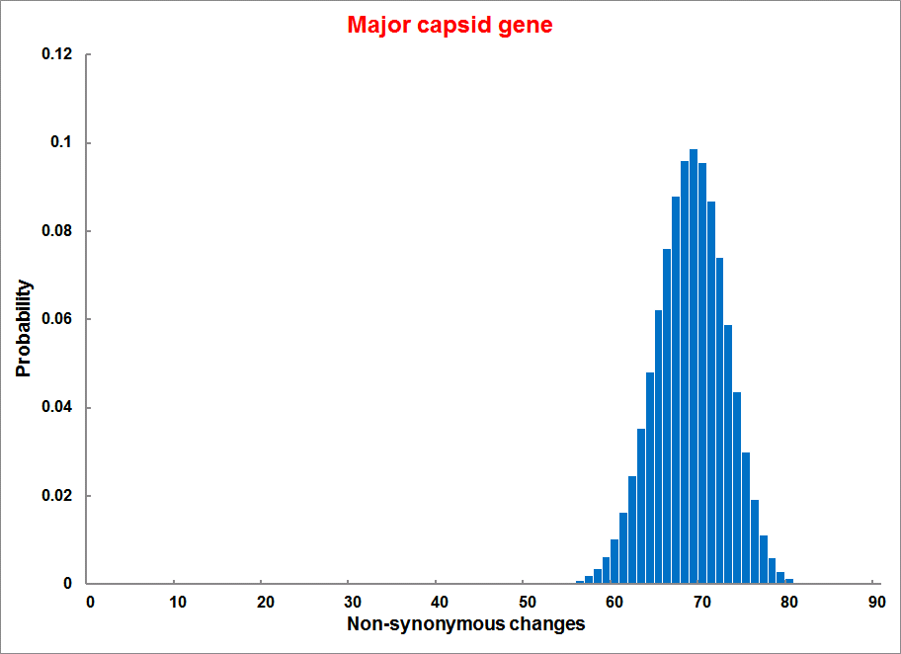
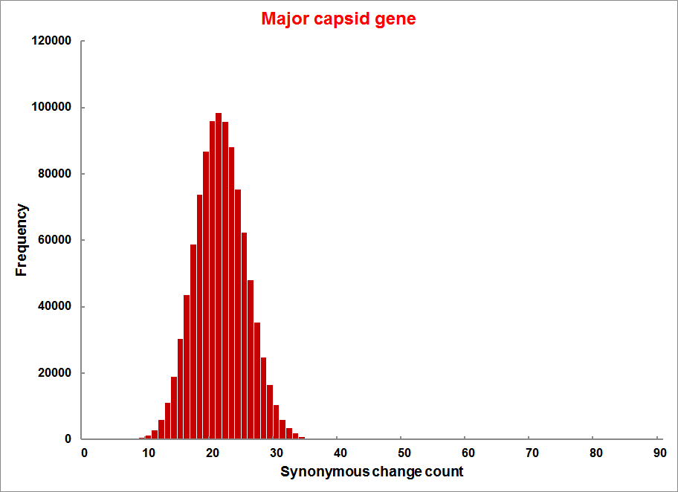
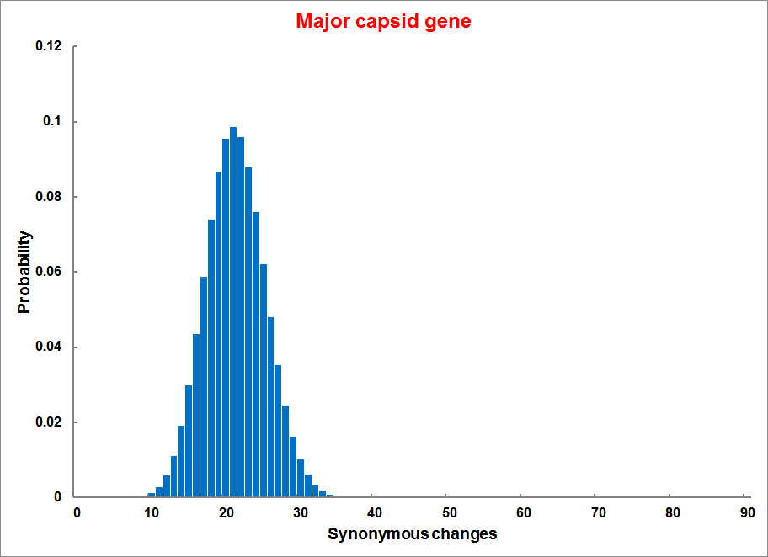
Evolution of Coding DNA Sequences Under a Neutral Model E. coli Prophage Genes
Count distribution from simulations
Probability distribution
n=90
Non-synonymous
n= 90
k= 24
p=0.763
P(≤24)=3.63E-23
Observed=24
P(≤24) < 10⁻⁶
n=90
Synonymous
n= 90
k= 66
p=0.2365
P(≥66)=3.22E-23
Observed=66
P(≥66) < 10⁻⁶

Slide 22
Evolution of Coding DNA Sequences Under a Neutral Model E. coli Prophage Genes
 |  | OBSERVED |  | SIMULATED |  | Dnapars | Simulated | Codeml
Gene | Alignment Length (bp) | Substitutions | Synonymous changes* | Substitutions | p-value synonymous (given *) | Minimum number of substitutions | dN/dS | dN/dS
Major capsid | 1023 | 90 | 66 | 90 | 3.23E-23 | 94 | 0.113 | 0.13142
Minor capsid C | 1329 | 81 | 59 | 81 | 1.98E-19 | 84 | 0.124 | 0.17704
Large terminase subunit | 1923 | 75 | 67 | 75 | 7.10E-35 | 82 | 0.035 | 0.03773
Small terminase subunit | 543 | 100 | 66 | 100 | 1.07E-19 | 101 | 0.156 | 0.25147
Portal | 1599 | 55 | 46 | 55 | 1.36E-21 | *64 | 0.057 | 0.08081
Protease | 1329 | 55 | 37 | 55 | 4.64E-11 | 55 | 0.162 | 0.24421
Minor tail H | 2565 | 260 | 168 | 260 | 1.81E-44 | 260 | 0.17 | 0.30928
Minor tail L | 696 | 30 | 26 | 30 | 1.30E-13 | 30 | 0.044 | 0.05004
Host specificity J | 3480 | 723 | 498 | 723 | 6.42E-149 | *773 | 0.137 | 0.17103
Tail fiber K | 741 | 41 | 28 | 41 | 1.06E-09 | 44 | 0.14 | 0.18354
Tail assembly I | 669 | 39 | 33 | 39 | 3.82E-15 | 40 | 0.064 | 0.07987
Tail tape measure protein | 2577 | 375 | 243 | 375 | 7.92E-64 | 378 | 0.169 | 0.27957
Values well under the p=0.01 threshold, suggesting rejection of the null hypothesis of neutral evolution of prophage sequences.

Slide 23
dN/dS < 1 is not sufficient evidence for the beneficial function of the encoded protein.
Prophages that have not been active as phages and are inherited vertically have a dN/dS below 1.
A dN/dS of this size may be due to the encoded protein turning bad after some mutations.

Slide 24
S
S
A genes contribution to fitness before a mutation
0
0
S
S
A genes contribution to fitness after a mutation
0
0
dN/dS >1 because before a disabeling non-synonymous mutation happened the gene made a positive contribution.
dN/dS >1 because after the non-synonymous mutation the mutated gene makes a negative contribution to fitness.
After the mutation the organisms is less fit.

