Slide 1
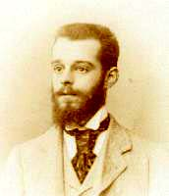
Félix d'Hérelle (1873 –1949) was a French-Canadian microbiologist
High schools in Paris
At 16 biked through western Europe
At 17 traveled through South America.
Continued his travels through Europe, including Turkey, attended lectures at the University of Bonn (Germany)
At 20, got married in Turkey to Marie (15 Years old).
In 1893, joined the French military for a 4-year tour of duty. His military record lists desertion in November 1894.
At age 24 (1897) moved to Canada with wife and daughter.
Grant to study the fermentation and distillation of maple syrup to schnapps.
Bacteriologist at the General Hospital in Guatemala City. (Malaria and infectious diseases. Side projects fungal infections of Coffee plants and make whiskey from bananas
In 1907, he, his wife and 2 daughters moved to a sisal plantation near Mérida, Yucatán. In 1909 established a method to produce sisal schnapps
Stopped a locust plague at the plantation using their own diseases. He extracted pathogenic bacteria from the locust guts.
in 1911, moved to Paris, worked (unpaid) at the Institute Pasteur.
Excerpts from Wikipedia and https://www.ncbi.nlm.nih.gov/pmc/articles/PMC5221746/

Slide 2
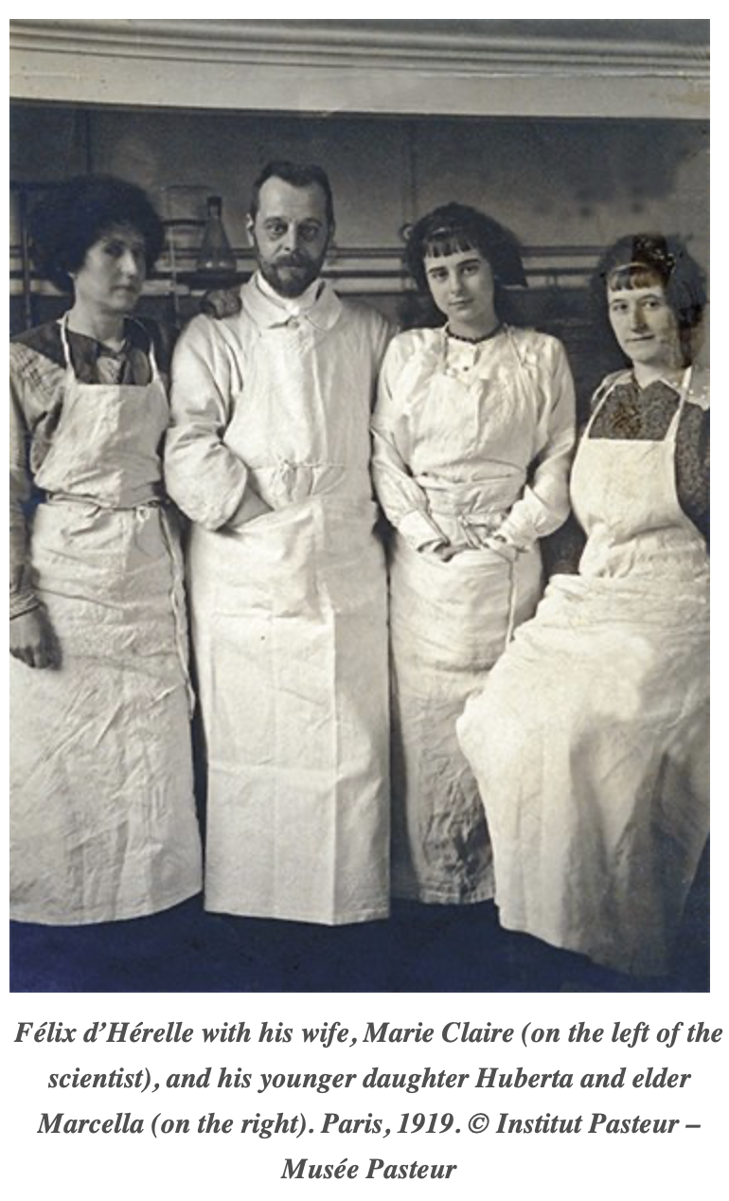
Félix d'Hérelle in France

Slide 3
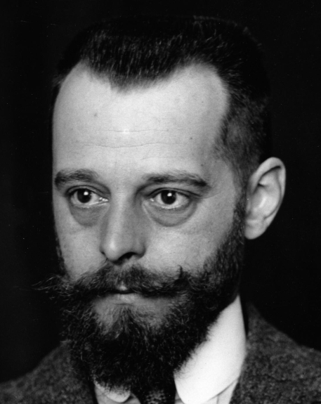
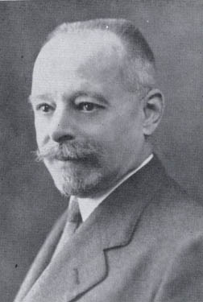
Félix d'Hérelle (1873 –1949) was a French-Canadian microbiologist
In 1917 announced the discovery of an invisible, antagonistic microbe of the dysentery bacillus.
In early 1919 isolated phages from chicken feces, successfully treating a plague of chicken typhus with them.
August 1919 treated human dysentery using phage therapy ...
Work on phages in India and the US (Yale, 1928 to 1933).
In 1934 moved to Tbilisi, Georgia to work with George Eliava, founder of the Tbilisi Institute (George Eliava Institute of Bacteriophage, Microbiology and Virology).
His book, "The Bacteriophage and the Phenomenon of Recovery," written in Tbilisi was dedicated to Comrade Stalin.
George Eliava and Lavrenty Beria (head of Stalin’s secret police) were in love with the same woman, George Eliava and denounced as an enemy of the people. D'Herelle escaped and never returned to Tbilisi.
Excerpts from Wikipedia and https://www.ncbi.nlm.nih.gov/pmc/articles/PMC5221746/
Images from https://www.cdnmedhall.ca/laureates/felixdherelle and https://en.citizendium.org/wiki/Félix_d%27Hérelle/Citable_Version

Slide 4
Phage are an alternative to antibiotics.
Problems include the need of extensive purification and for effective treatment an individualized phage cocktail is necessary.
On successful target are mycobacteria (Actinobacteria)
PhagesDB is a databank of annotated and draft genomes of Actinophage.
One tool to visually compare phage genomes (in addition to dotplots, sequence alignments and phylogenetic trees) is Phamerator.

Slide 5
Phamerator works better under Chrome.

Slide 6
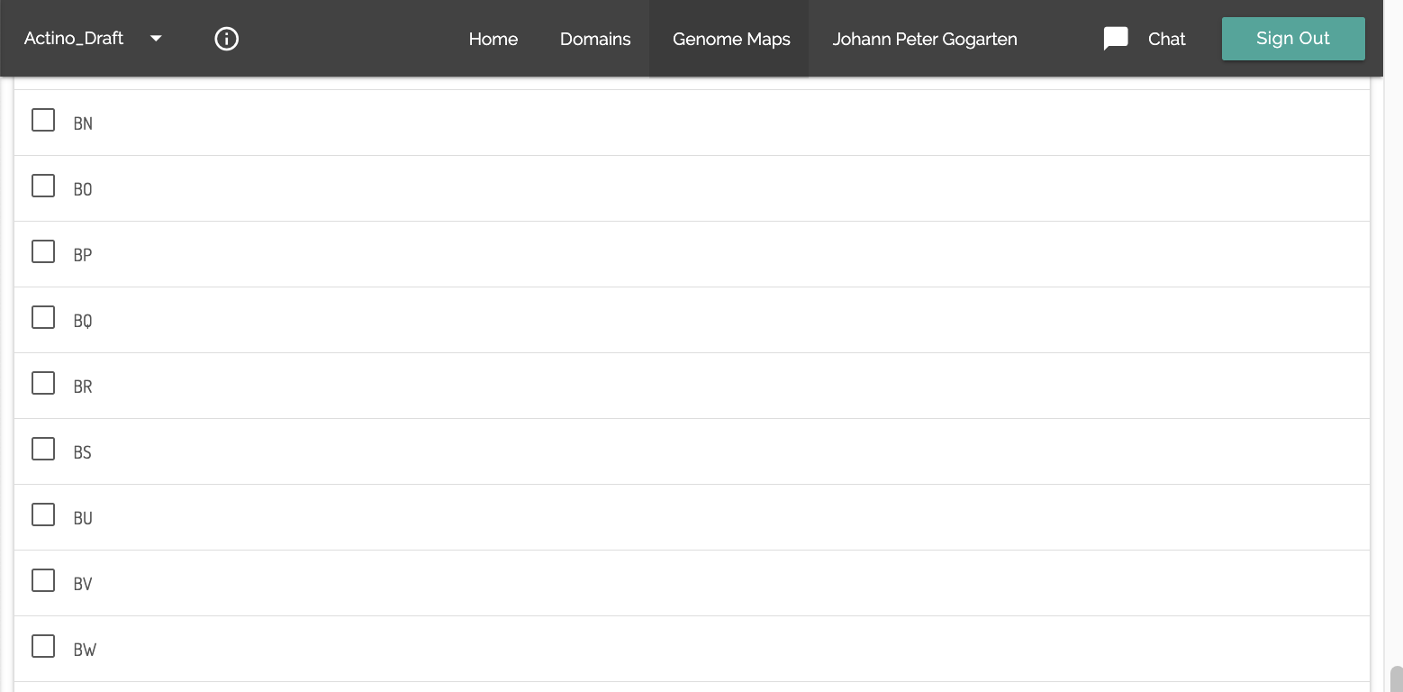
To select phages, click on the line that has the name of the subcluster.
Do not place a check mark! Usually, you do not want to select all the phages in a subcluster.

Slide 7
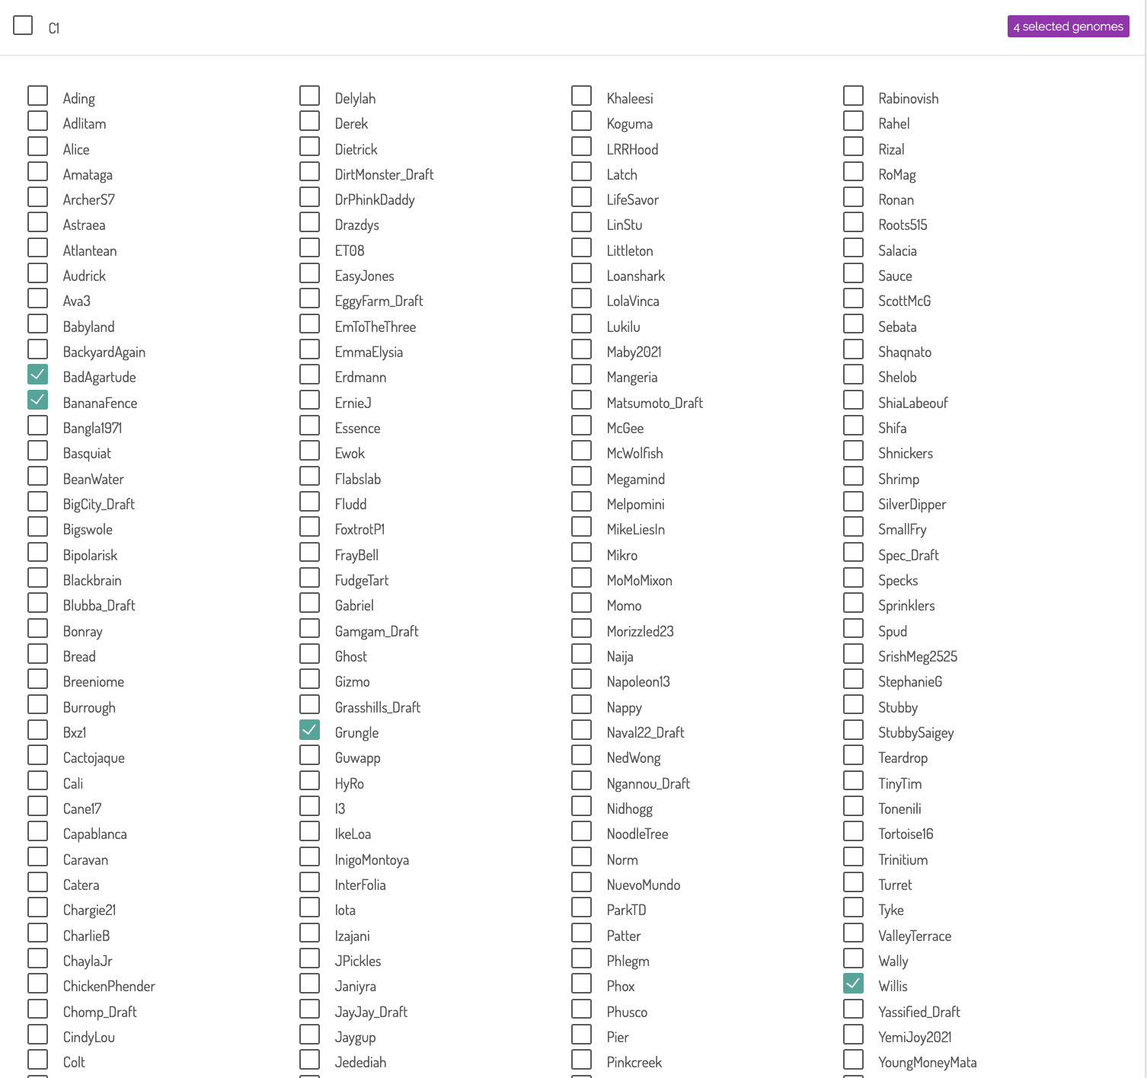
Then place checkmarks infront of the phages you want to analyze.

Slide 8
To see the header, you need to scroll back to the top or use the menu

Slide 9
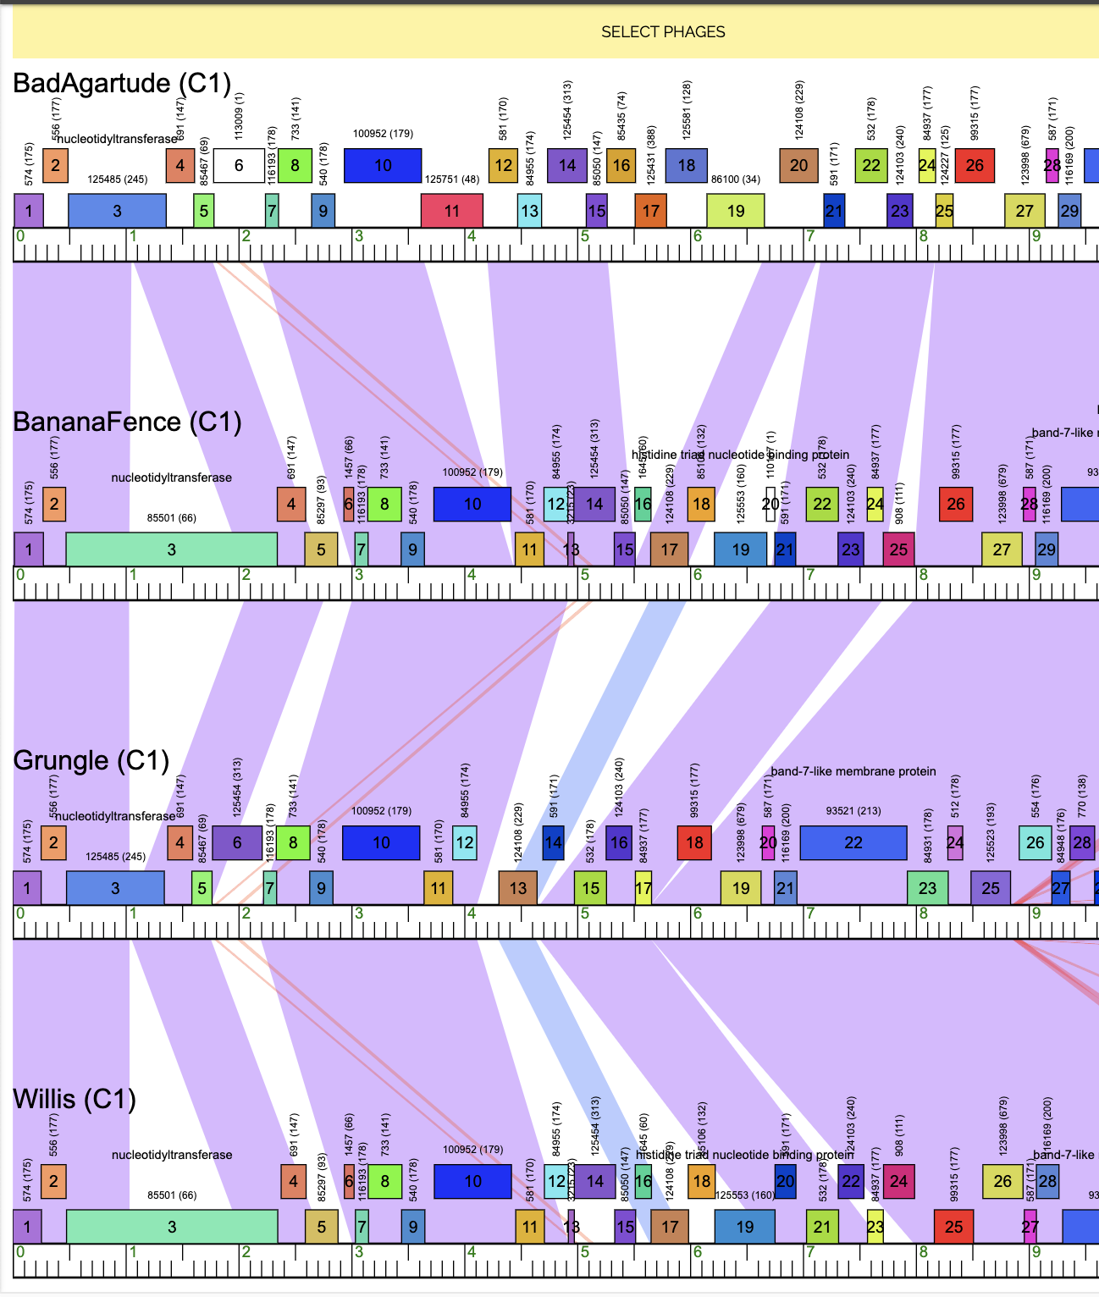
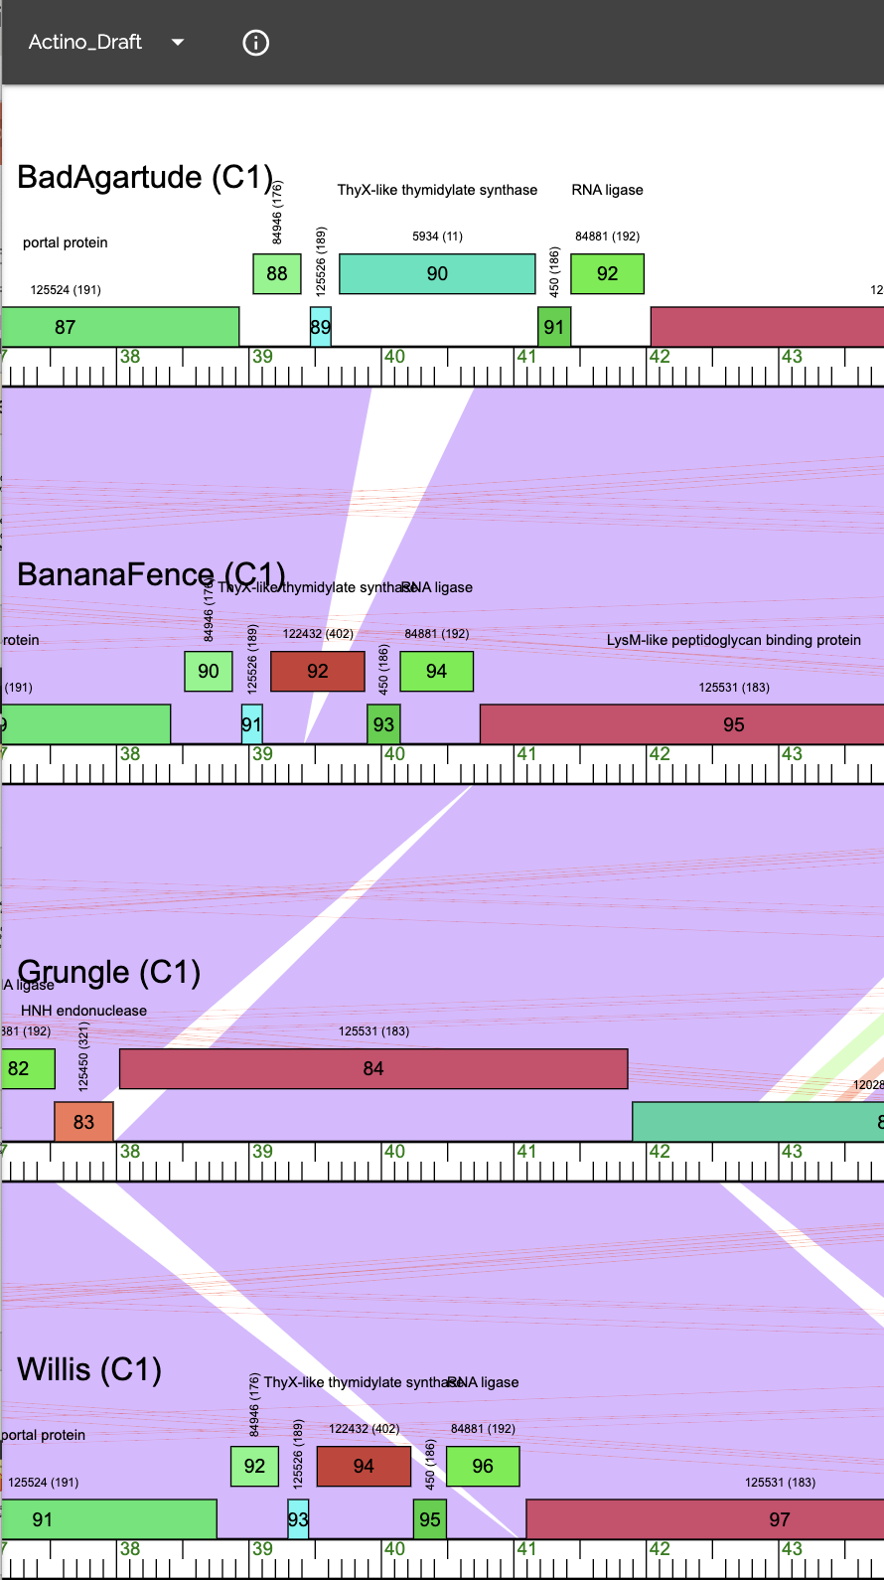

Slide 10
