Slide 1
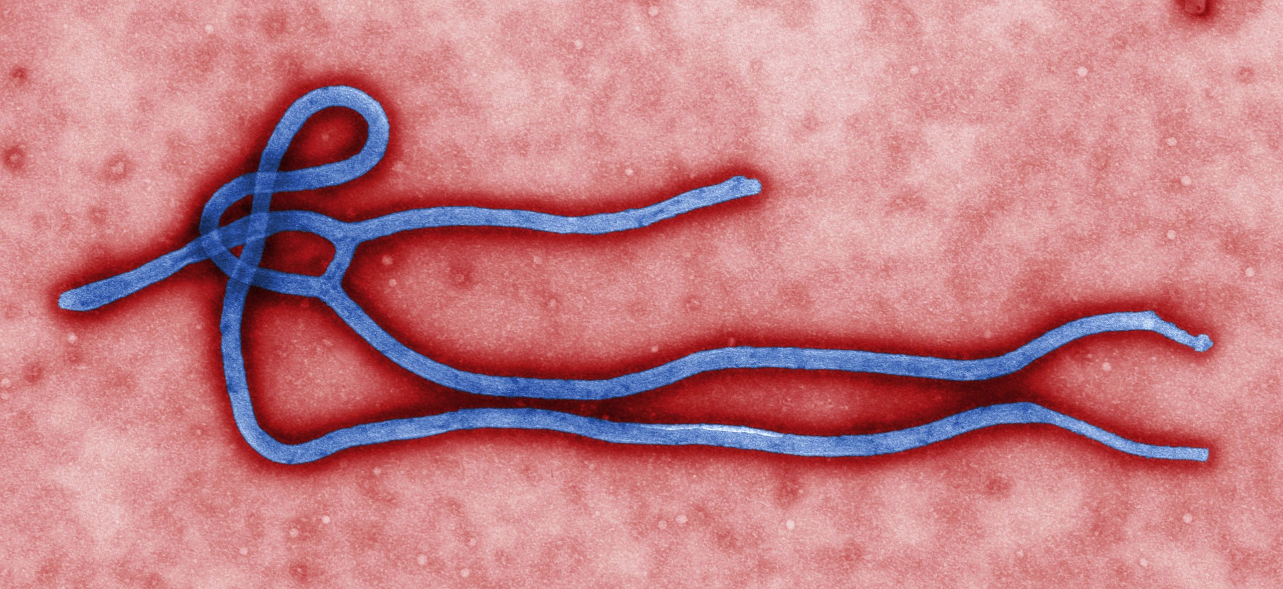
Molecular Evolution and Ebola
from http://en.wikipedia.org/wiki/Ebolavirus
phylogenetics in today’s research

Slide 2
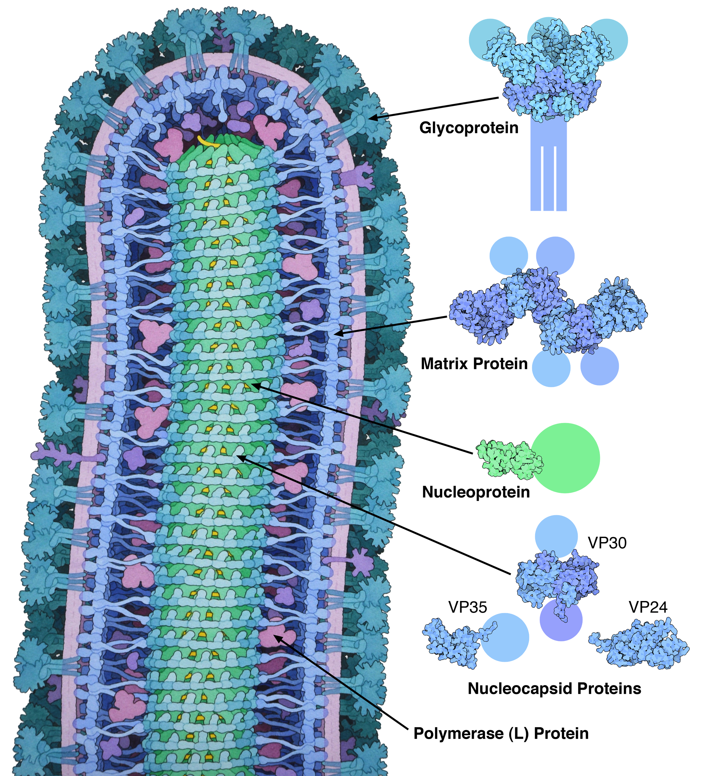
Cross-sectional drawing of the Ebola virus particle, with structures of the major proteins shown and labeled at the side. Pale circles represent domains too flexible to be observed in the experimental structure. Drawn by David Goodsell from PDB files 3csy, 4ldd, 4qb0, 3vne, 3fke, and 2i8b.
From: https://en.wikipedia.org/wiki/Zaire_ebolavirus
Also see https://en.wikipedia.org/wiki/Marburg_virus

Slide 3
Ebola hemorrhagic fever
Ebola viruses (related to Marburg virus)
Single (negative-sense) stranded RNA virus
Disease of humans and other primates
(chimpanzees and antelopes in the Tai forest regularly die of Ebola)
Natural reservoir bats (?)
Believed to be transferred to humans through bush meat. (gorilla, chimpanzee, antelope, fruit bats)

Slide 4
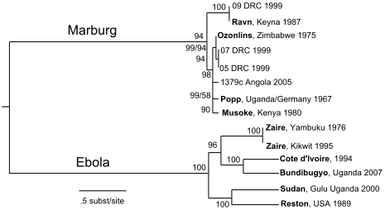
Ebola phylogeny
From: http://en.wikipedia.org/wiki/Ebolavirus

Slide 5
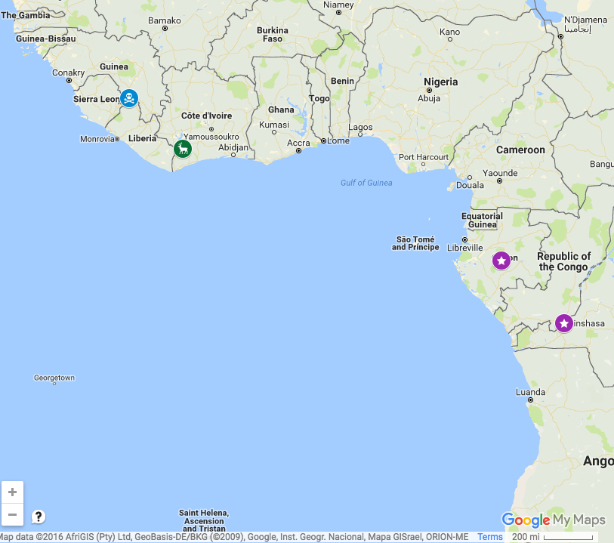
Google
Map
Patient zero
Tai National Park
Congo, DRC,
Gabon

Slide 6
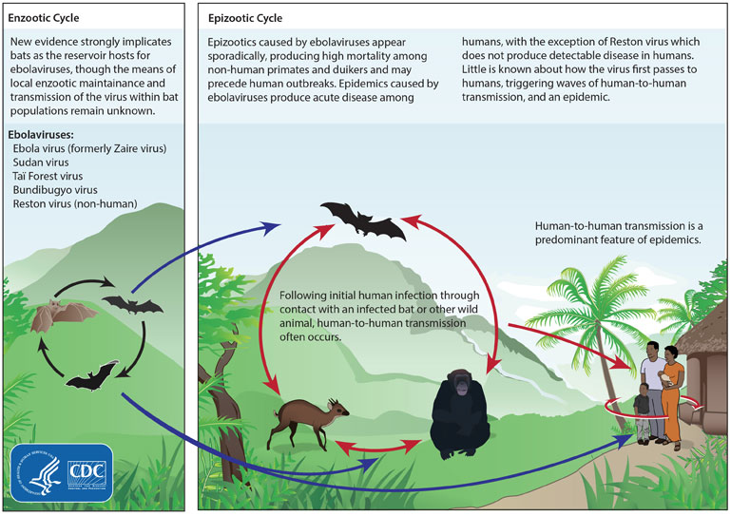
Ebola life cycle
Via: http://en.wikipedia.org/wiki/Ebolavirus

Slide 7
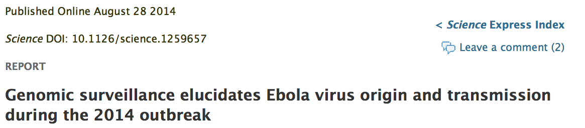
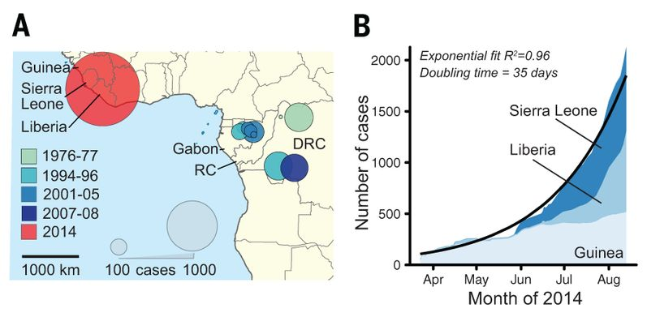
From: http://www.sciencemag.org/content/early/2014/08/27/science.1259657.full
In memoriam: Tragically, five co-authors, who contributed greatly to public health and research efforts in Sierra Leone, contracted EVD in the course of their work and lost their battle with the disease before this manuscript could be published. We wish to honor their memory.

Slide 8
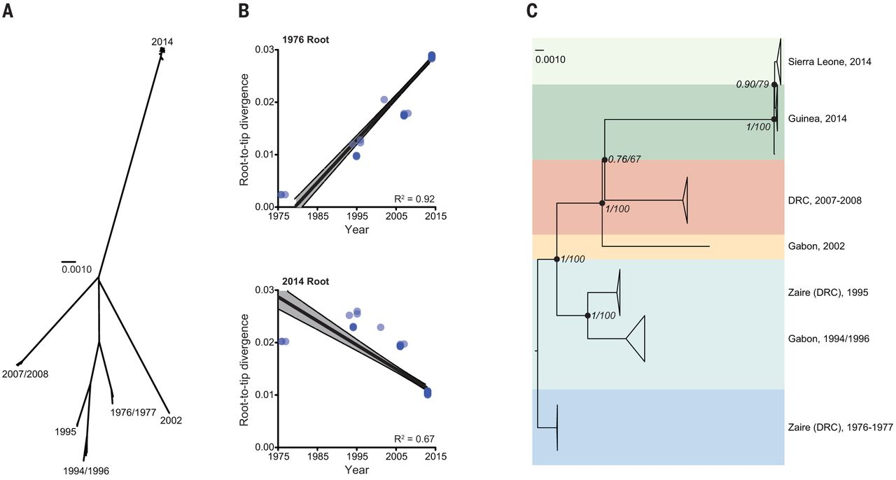

Fig. 2 Relationship between outbreaks.(A) Unrooted phylogenetic tree of EBOV samples; each major clade corresponds to a distinct outbreak (scale bar = nucleotide substitutions/site).
S K Gire et al. Science 2014;science.1259657
Published by AAAS
Notes:
Relationship between outbreaks.(A) Unrooted phylogenetic tree of EBOV samples; each major clade corresponds to a distinct outbreak (scale bar = nucleotide substitutions/site). (B) Root-to-tip distance correlates better with sample date when rooting on the 1976 branch (R² = 0.92, top) than on the 2014 branch (R² = 0.67, bottom). (C) Temporally rooted tree from (A).

Slide 9
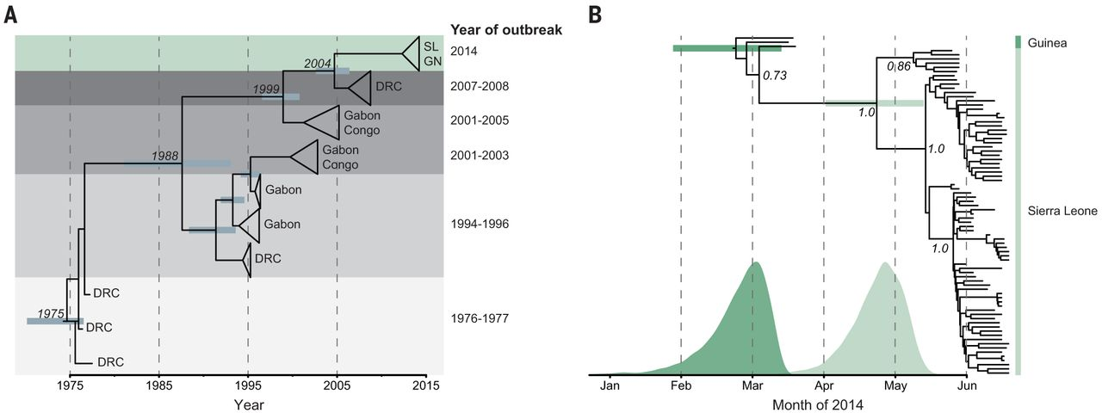
Fig. 3 Molecular dating of the 2014 outbreak.(A) BEAST dating of the separation of the 2014 lineage from Middle African lineages (SL = Sierra Leone; GN = Guinea; DRC = Democratic Republic of Congo; tMRCA: Sep 2004, 95% HPD: Oct 2002 - May 2006).
S K Gire et al. Science 2014;science.1259657
Published by AAAS
Notes:
Molecular dating of the 2014 outbreak.(A) BEAST dating of the separation of the 2014 lineage from Middle African lineages (SL = Sierra Leone; GN = Guinea; DRC = Democratic Republic of Congo; tMRCA: Sep 2004, 95% HPD: Oct 2002 - May 2006). (B) BEAST dating of the tMRCA of the 2014 West African outbreak (tMRCA: Feb 23, 95% HPD: Jan 27 - Mar 14) and the tMRCA of the Sierra Leone lineages (tMRCA: Apr 23, 95% HPD: Apr 2 - May 13); probability distributions for both 2014 divergence events overlayed below. Posterior support for major nodes is shown.

Slide 10
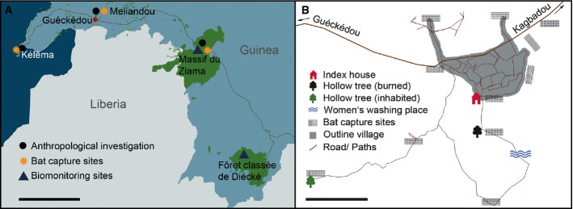
Sampling and investigation locations
In southeastern Guinea (Sierra Leone, Guinea, and Liberia are visible);
scale bar stands for 50 km.
In and around the index village, Meliandou; scale bar stands for 100 m.
From:
Investigating the zoonotic origin of the West African Ebola epidemic
EMBO Mol Med. 2015 Jan; 7(1): 17–23.
Published online 2014 Dec 30. doi: 10.15252/emmm.201404792

Slide 11
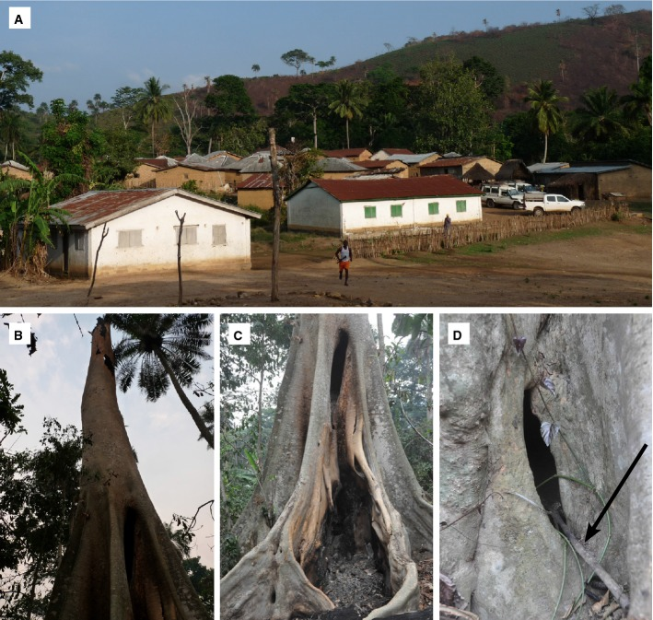
Investigating the zoonotic origin of the West African Ebola epidemic
EMBO Mol Med. 2015 Jan; 7(1): 17–23.
Published online 2014 Dec 30. doi: 10.15252/emmm.201404792
Meliandou and the burnt tree that housed a bat colonyA The village of Meliandou.
B–D The burnt hollow tree; in (D), the arrow points at a stick, most probably left there by children.

Slide 12
Conclusions
Genetic similarity across the sequenced 2014 samples suggests a single transmission from the natural reservoir, likely an insectivorous bat, followed by human-to-human transmission during the outbreak.
First 12 patients in Sierra Leone attended the funeral of an EVD case from Guinea.
Most infected by multiple “divergent” lineages.
Substitution rate is roughly twice as high within the 2014 outbreak as between outbreaks.

