Slide 1
MCB3421
class 24
Introns Early vs Introns late
Figtree

Slide 2

Figtree developed by the same group that developed tracer
Reads trees in a variety of different formats (including Newick)
Re-root, flip branches, subtree
color, branch and node labels
Draws trees as trees, stars, and circular diagrams

Slide 3
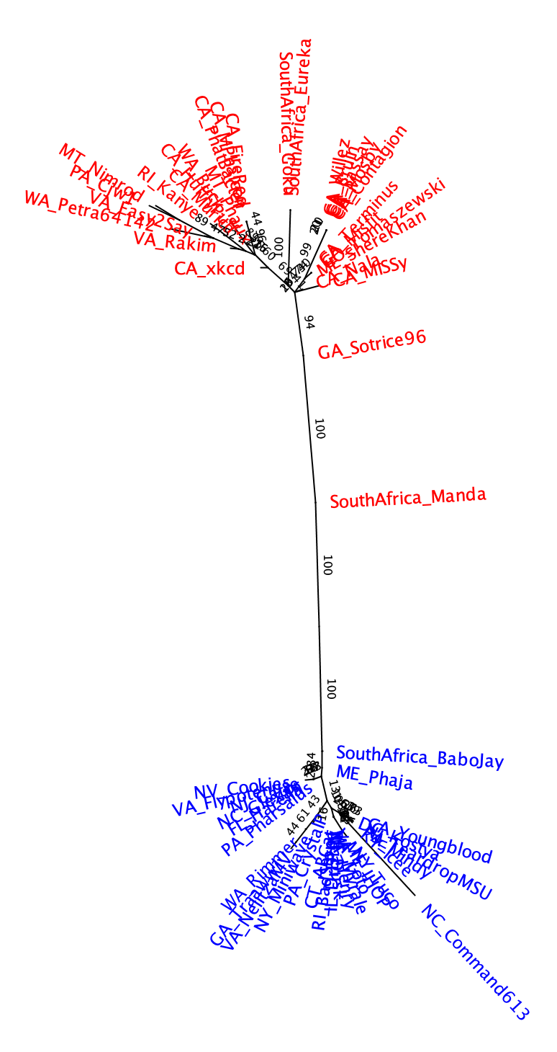
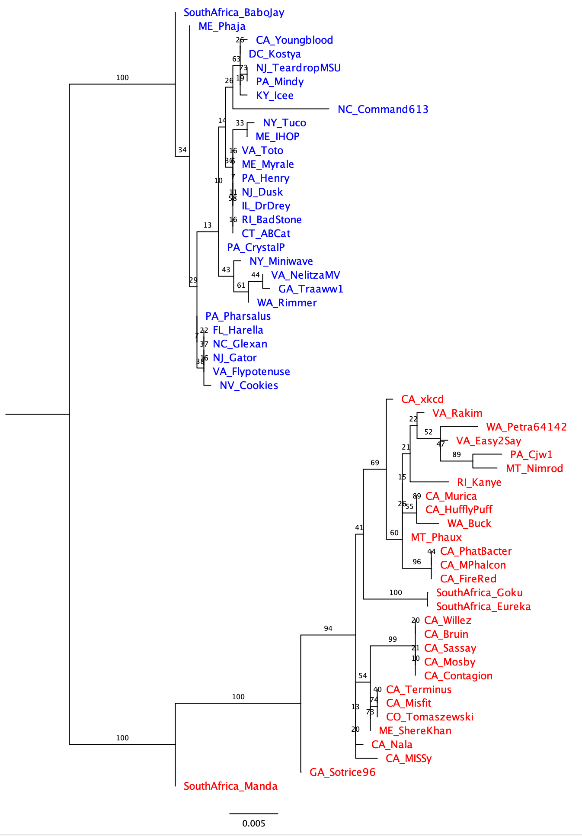
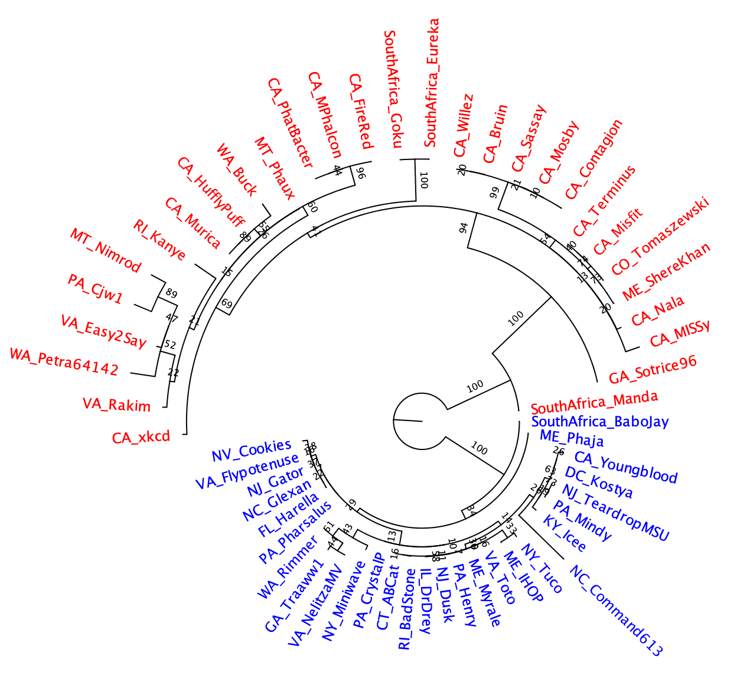
Different ways to draw the tree
Given that the tree does not have an outgroup, the branch at the root is strange!

Slide 4
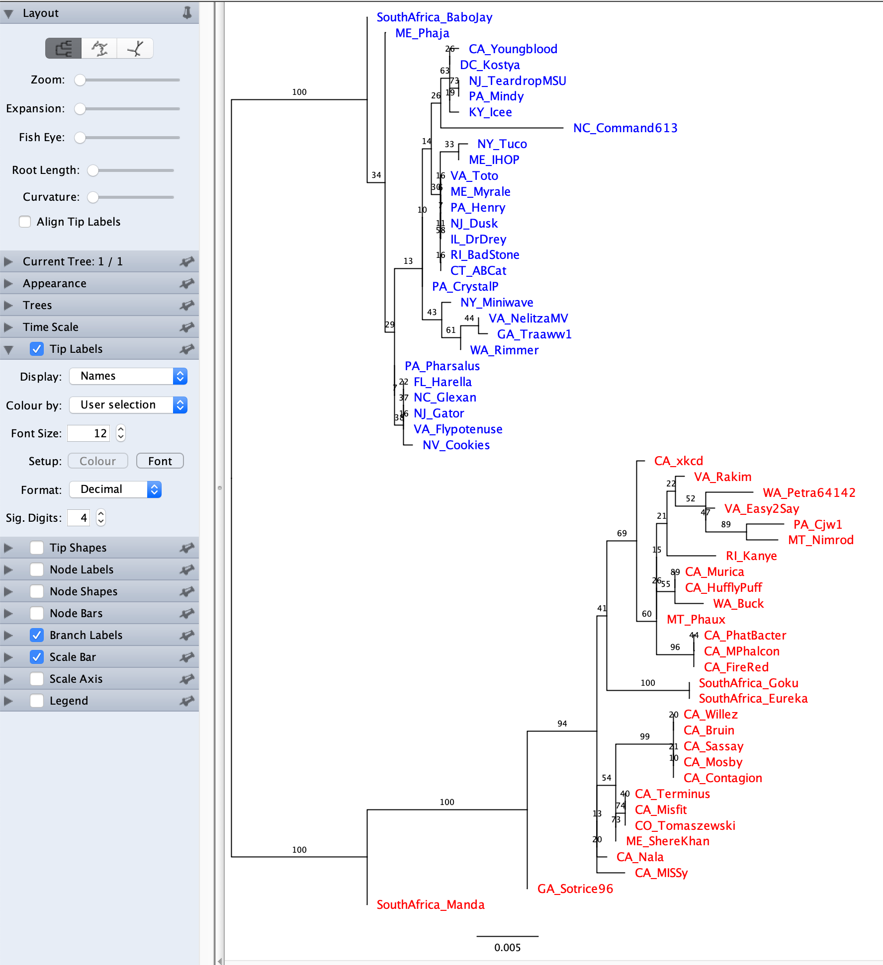
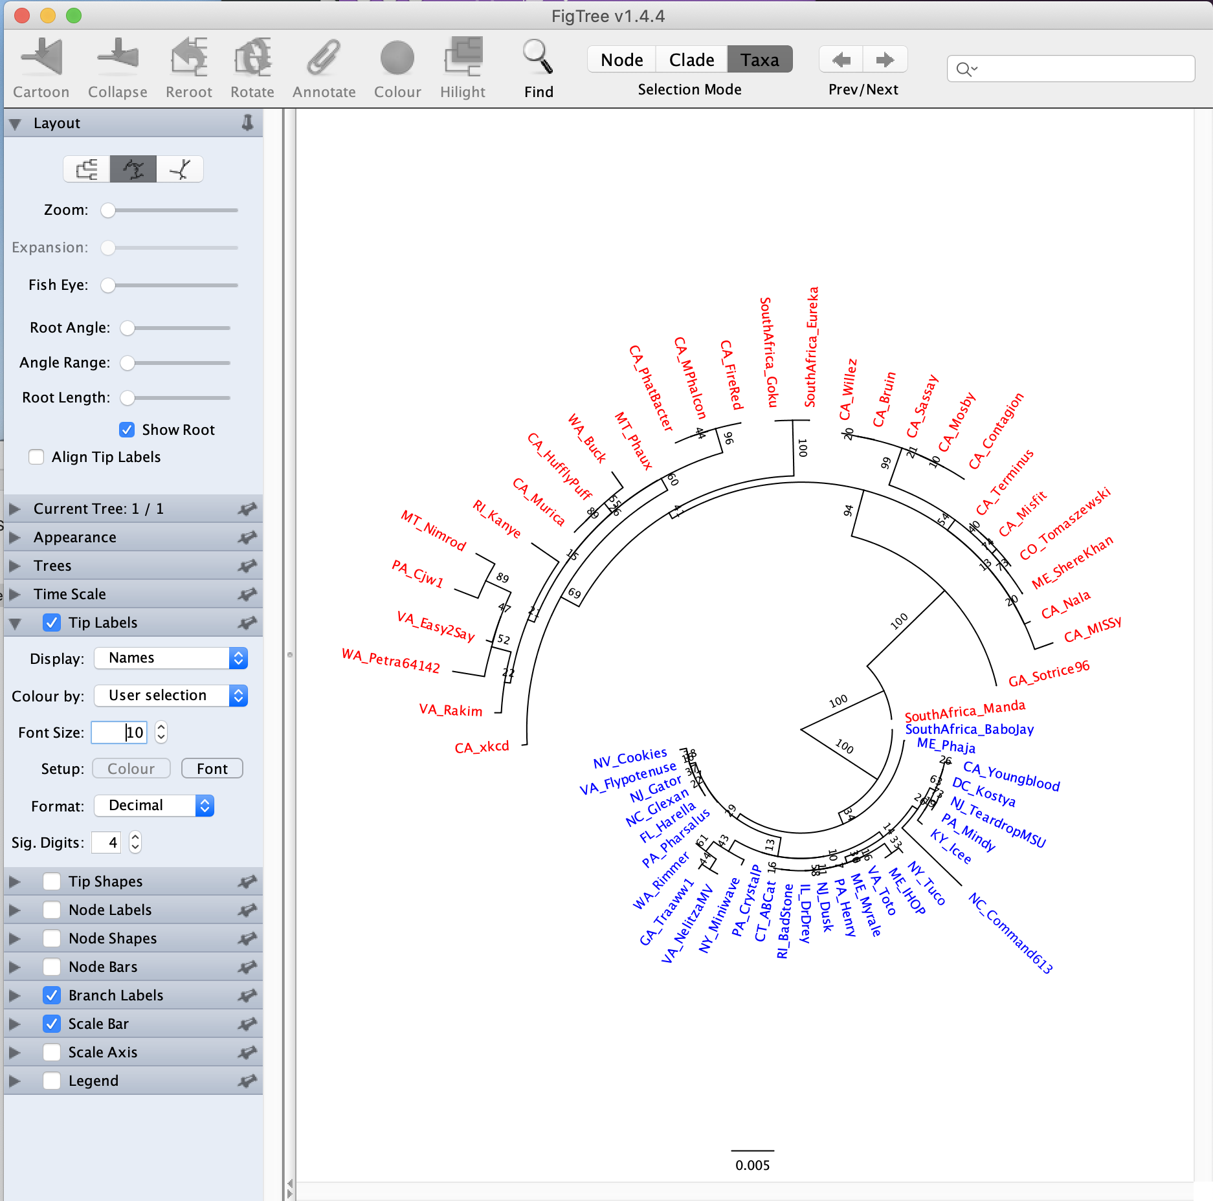
moving the toot length lever to the left helps

Slide 5
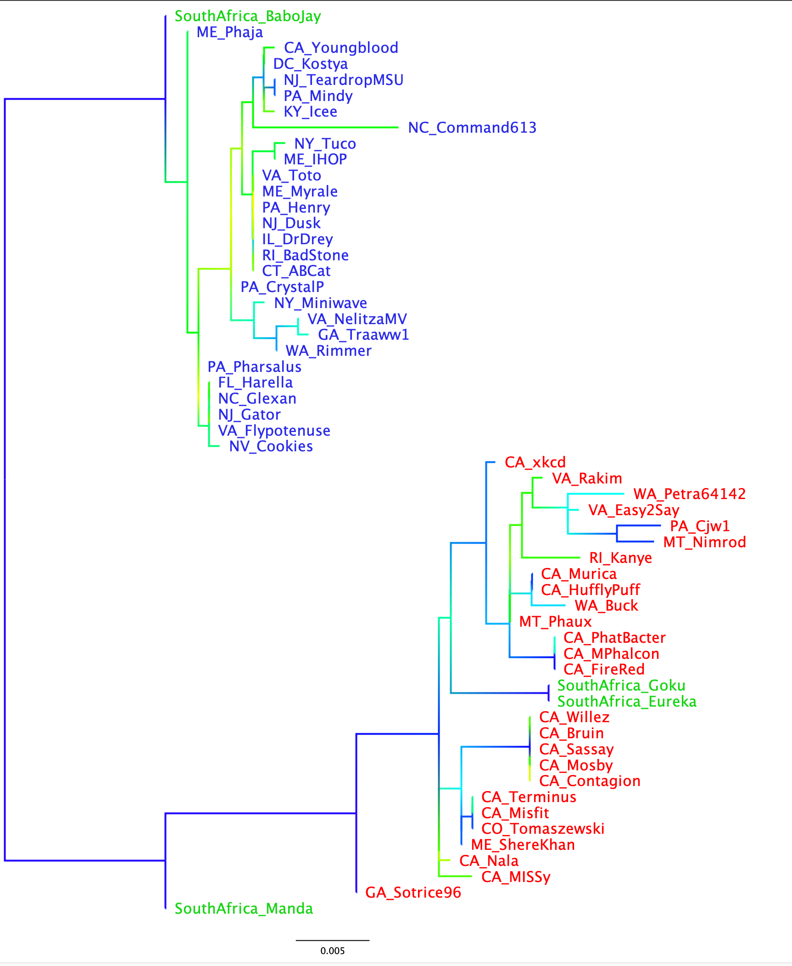
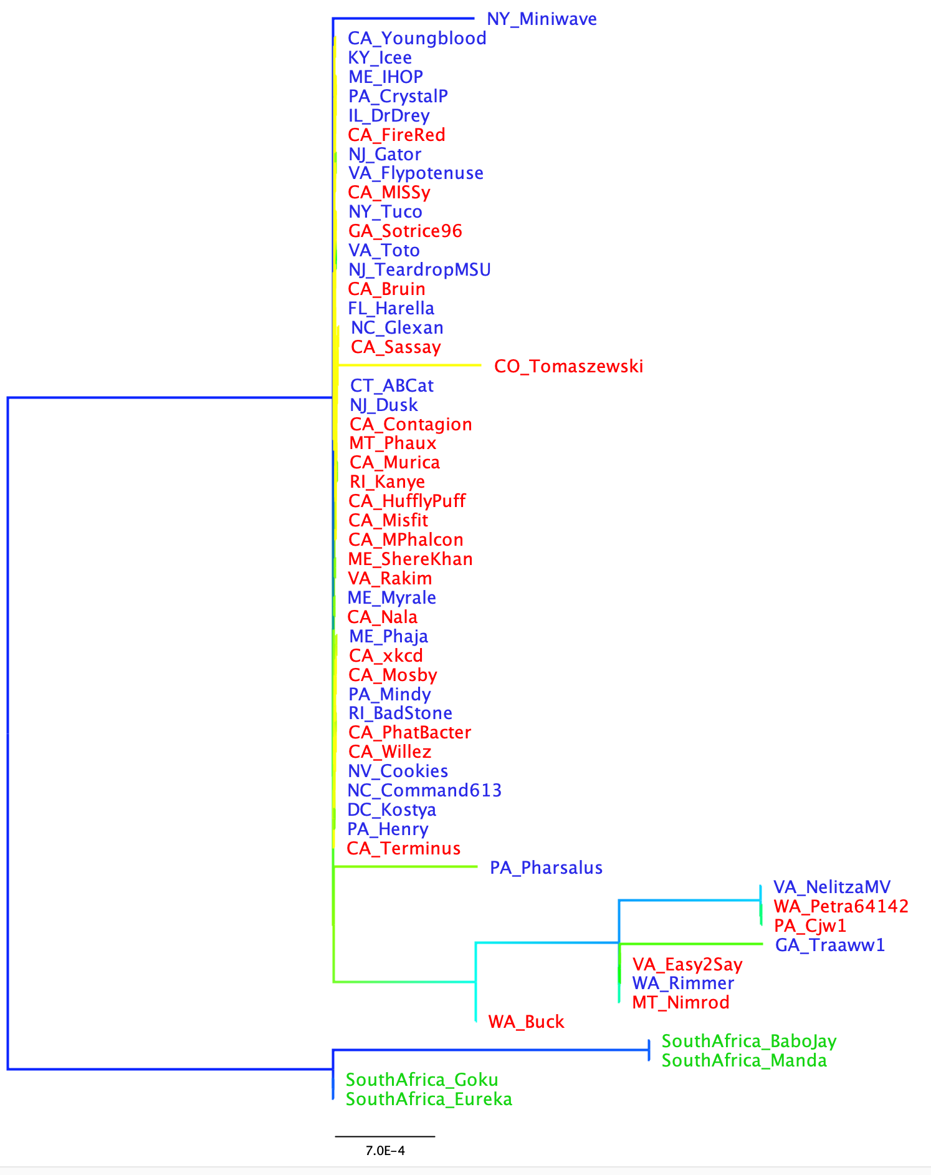
If you have multiple gene trees from the same set (or subset) of species, and the leaves have the same names, the colors carry over to the new tree you open
Branches gradient colored according to support value
Extein
-> the clans defined by the extein tree are not reflected in the intein phylogeny. The intein was transferred several times between the red and green clans. Note the nearly identical intein between red and green leaves.
Intein

Slide 6
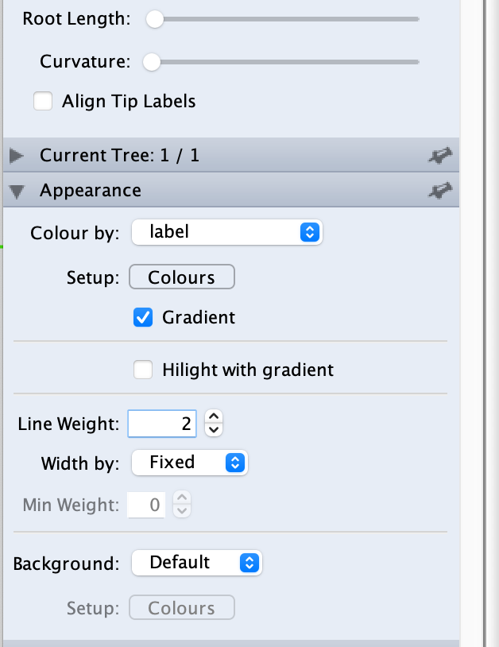
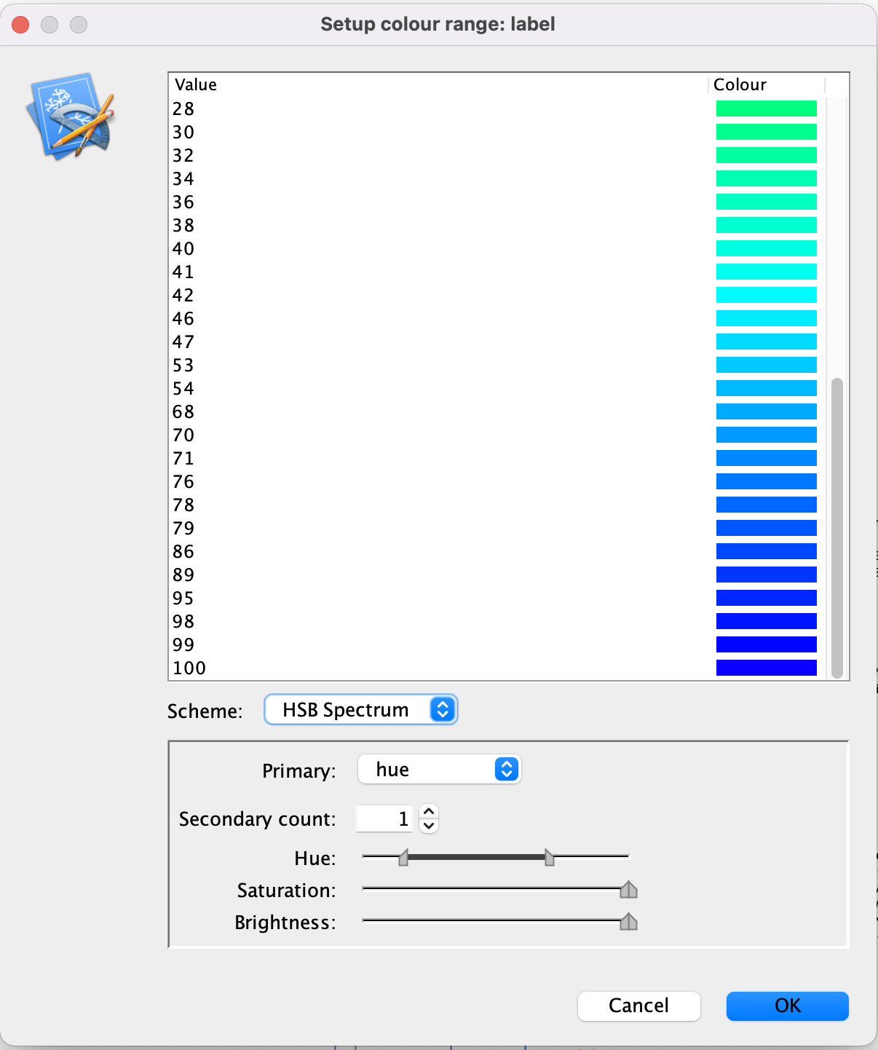

Slide 7
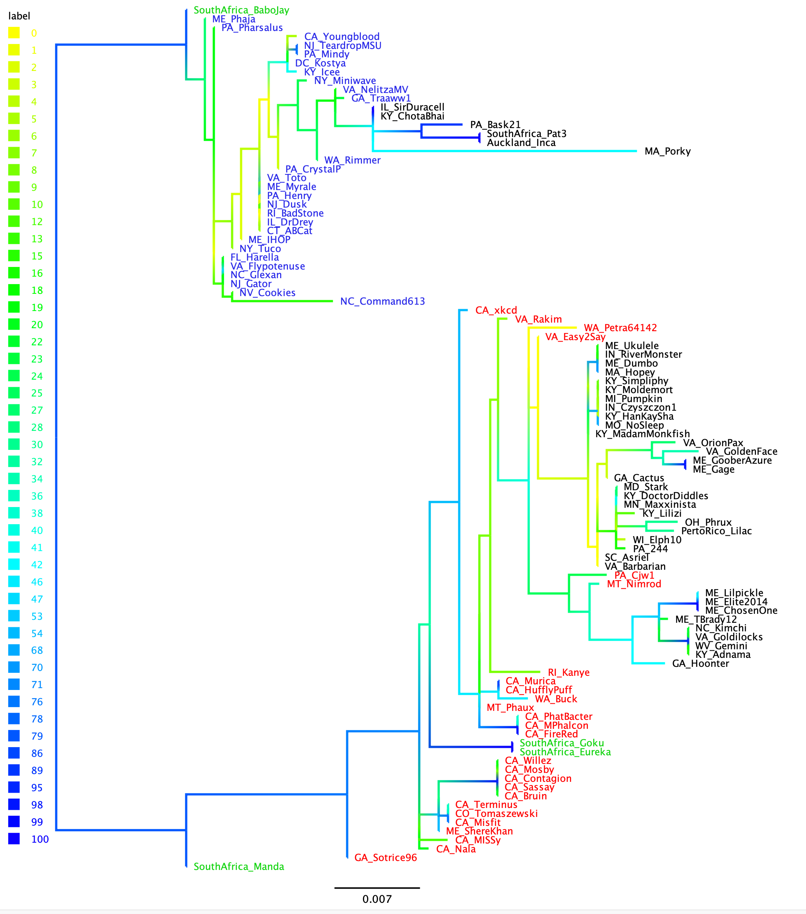

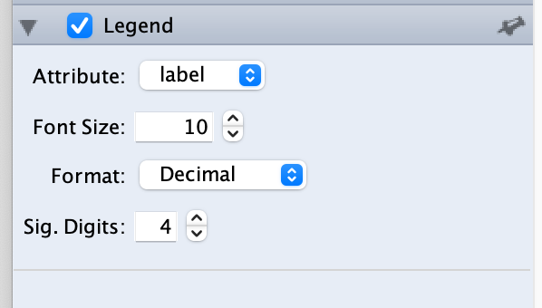
Phylogeny of Exteins in terminases
of Actinophage cluster E
no Intein
clade 1
clade 2

Slide 8
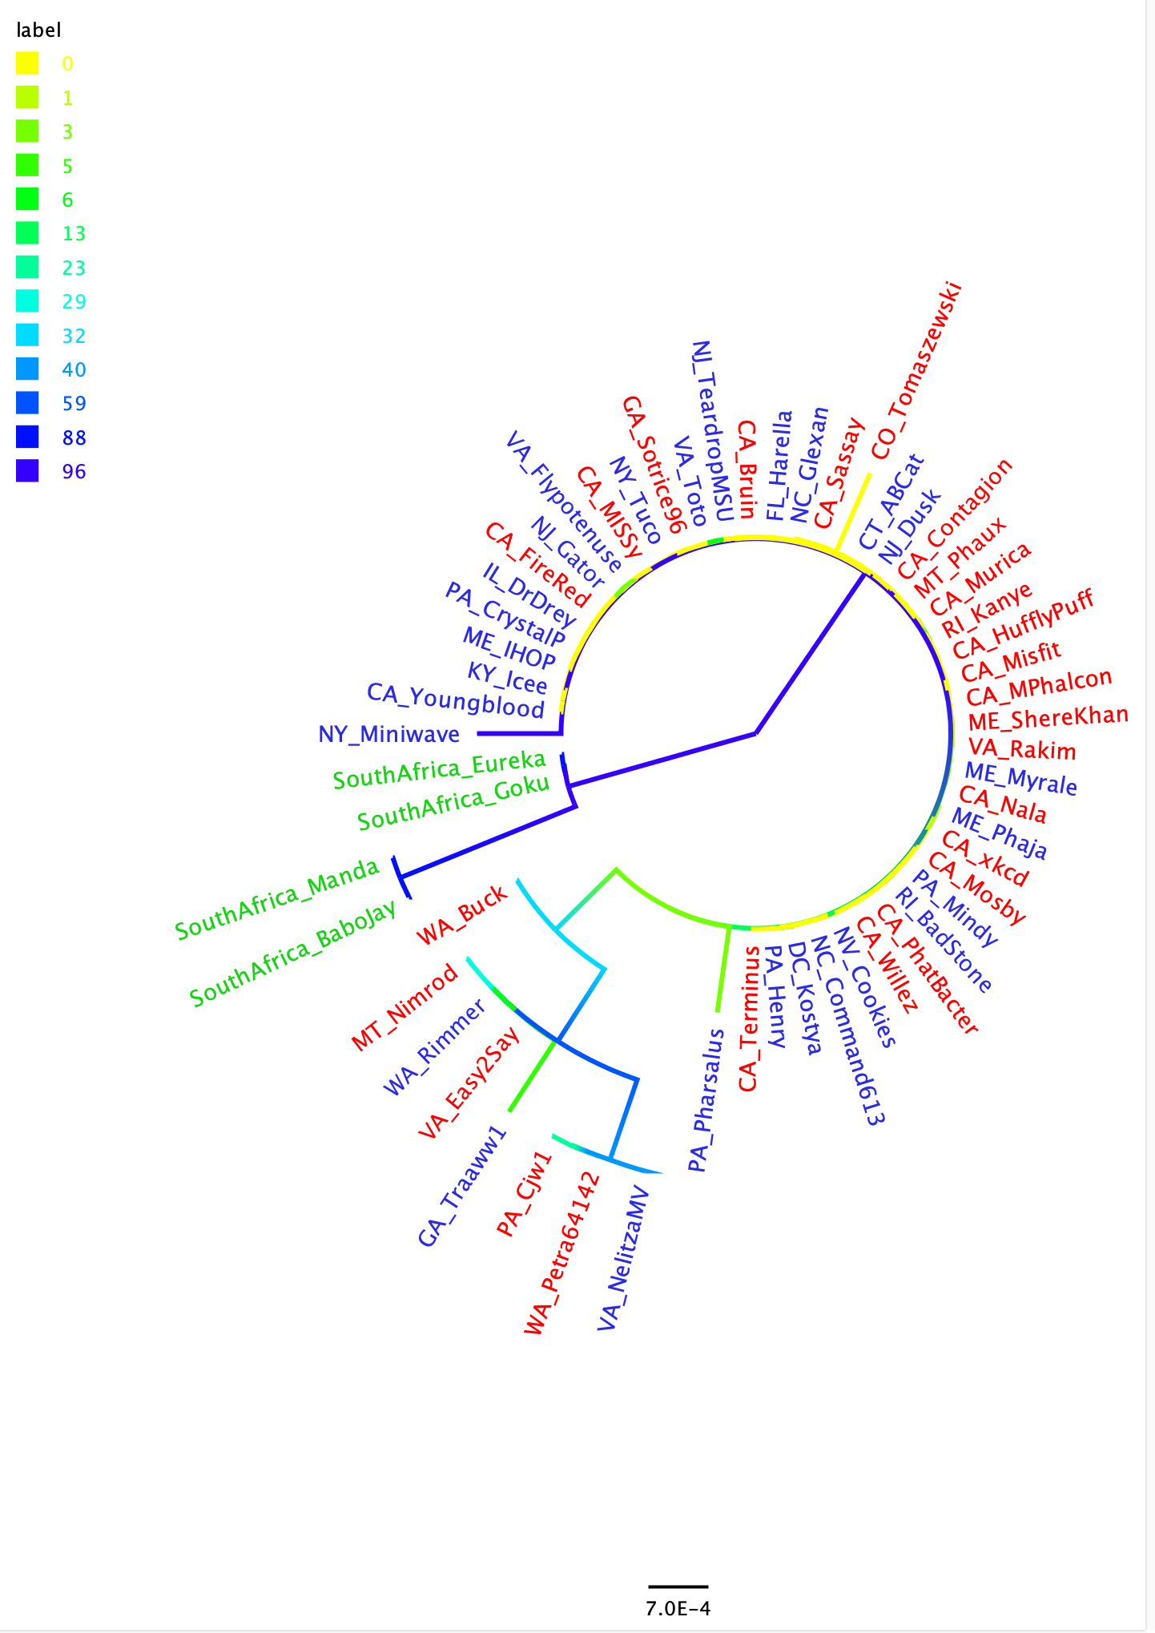
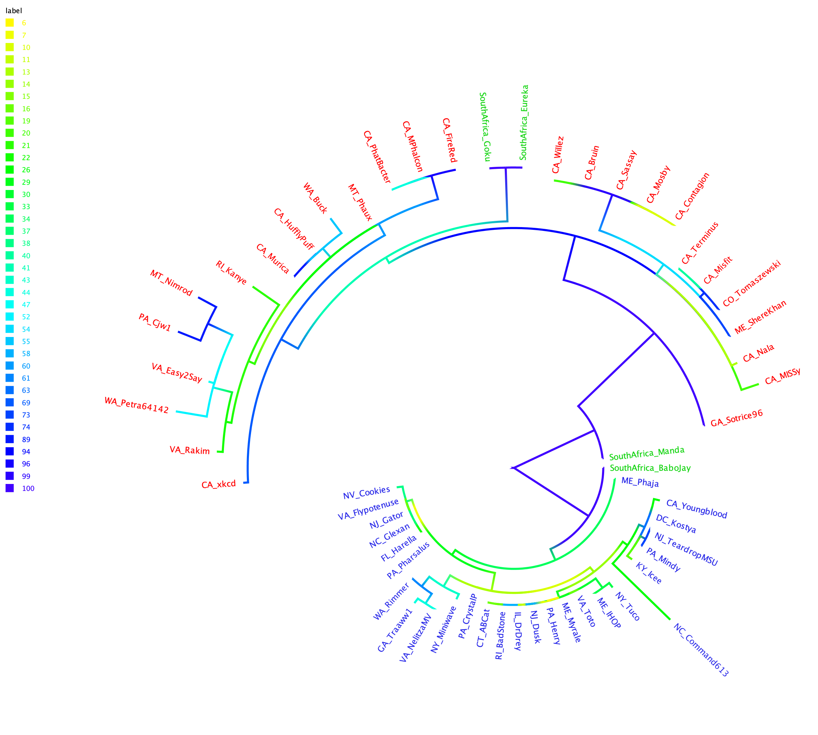

Slide 9
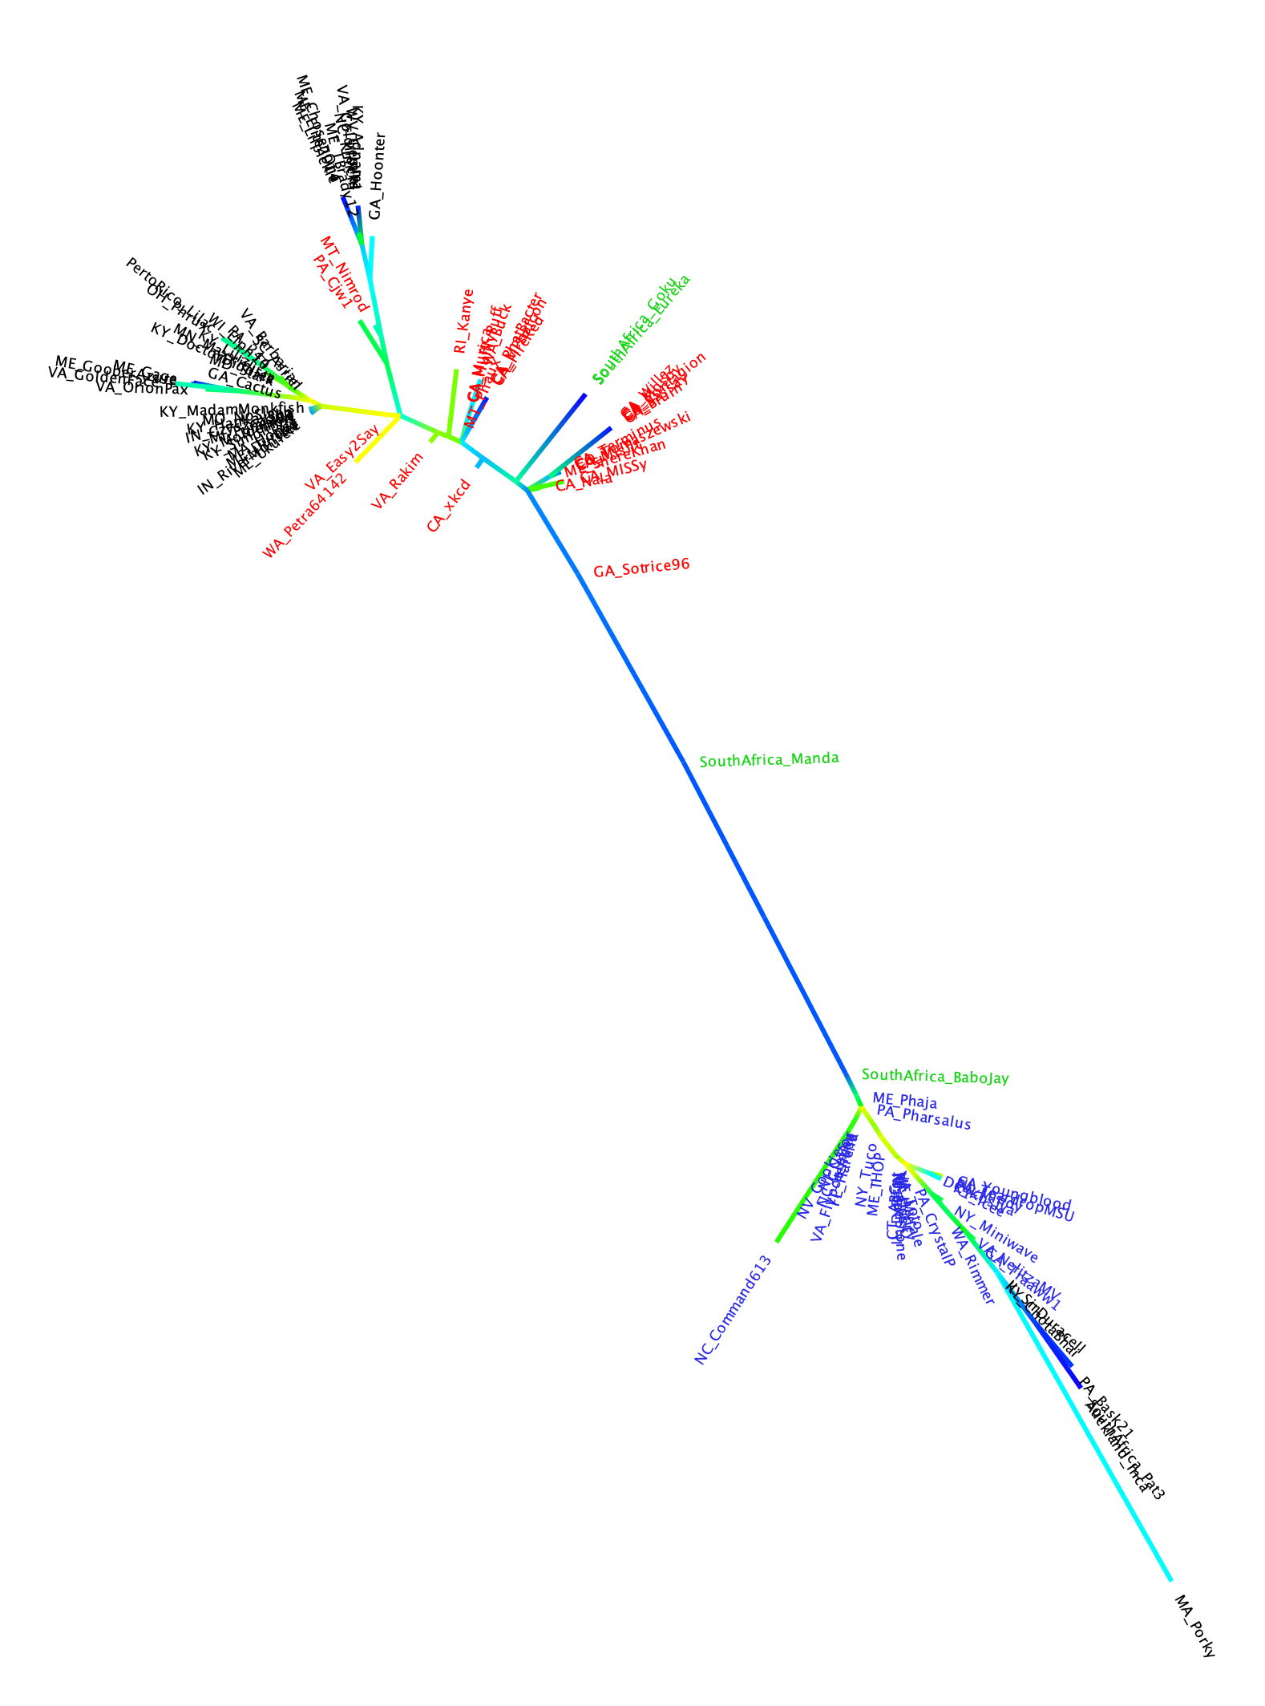
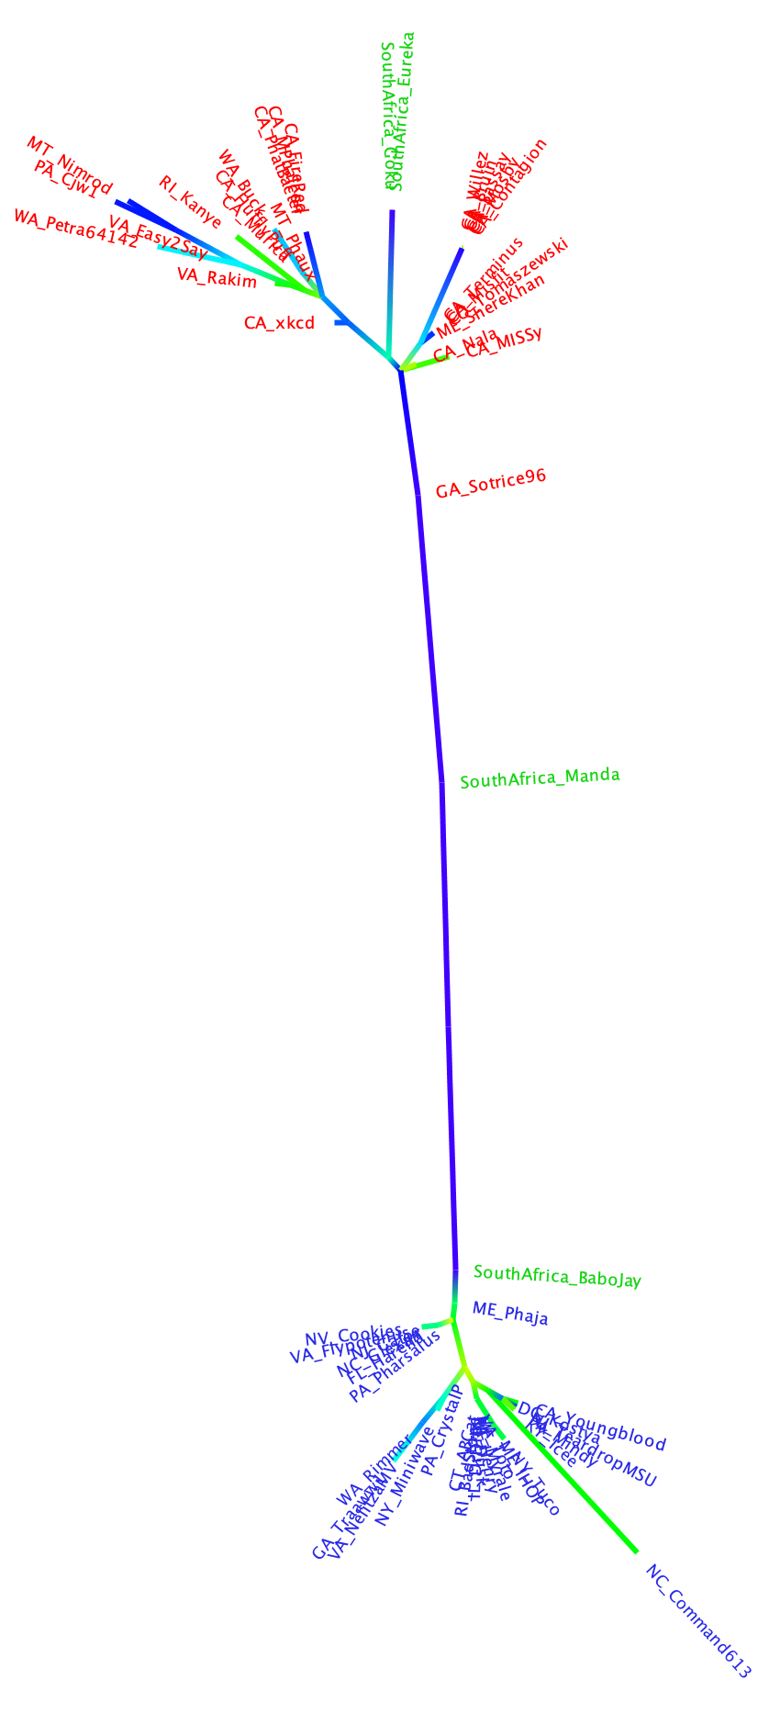
exteins
intein
containing exteins

Slide 10
Homeoalleles
Variants that have the same general function, but can have distinct characteristics.
Gene pool contains different homeoalleles, but individual strains and species usually contain only one of the alleles.
Can be brought together temporarily in a lineage through HGT
Andam, Williams, Gogarten 2010 PNAS
Notes:
The two TyrRS enzymes can be seen as variants similar to alleles in a population. Individual lines of descent possess one or the other of these variants, and in rare instances, they can possess both. We propose to call these variants homeoalleles. Like alleles, they have the same general function, but can have distinct characteristics. As is the case for homeologs in polypoids, homeoalleles cannot be considered orthologs, even though they are homologs with the same function. The line of descent has access to a gene pool that contains both TyrRS homeoalleles, whereas individual strains and species usually contain only one of the alleles. Genes in the accessible gene pool have different propensity to be swapped into an individual line of decent. Genes present in members of the same strain in the same environment likely have the highest propensity of being acquired, genes from organisms with similar regulatory promoter sequences and similar composition will be more frequently acquired than genes with less similar composition and promoters. Genes from divergent organisms will frequently fall in the latter category, and may contain sequence motifs incompatible with the genome organization of the recipient (36).
The two TyrRS types are so divergent (approximately 28 % identity between the two Pseudomonas TyrRS types) that the possibility of homologous recombination between the TyrRS homeoalleles is unlikely. Consequently, in case of TyrRS homeoalleles we expect that the unit of successful horizontal gene transfer includes at least the complete tyrRS gene. Homeoalelles can then be brought together temporarily in a lineage following horizontal transfer, but due to largely overlapping function, only one of the alleles is likely to survive in a lineage on the long run. The surviving allele may be selected due to an adaptive advantage under prevailing conditions.

Slide 11
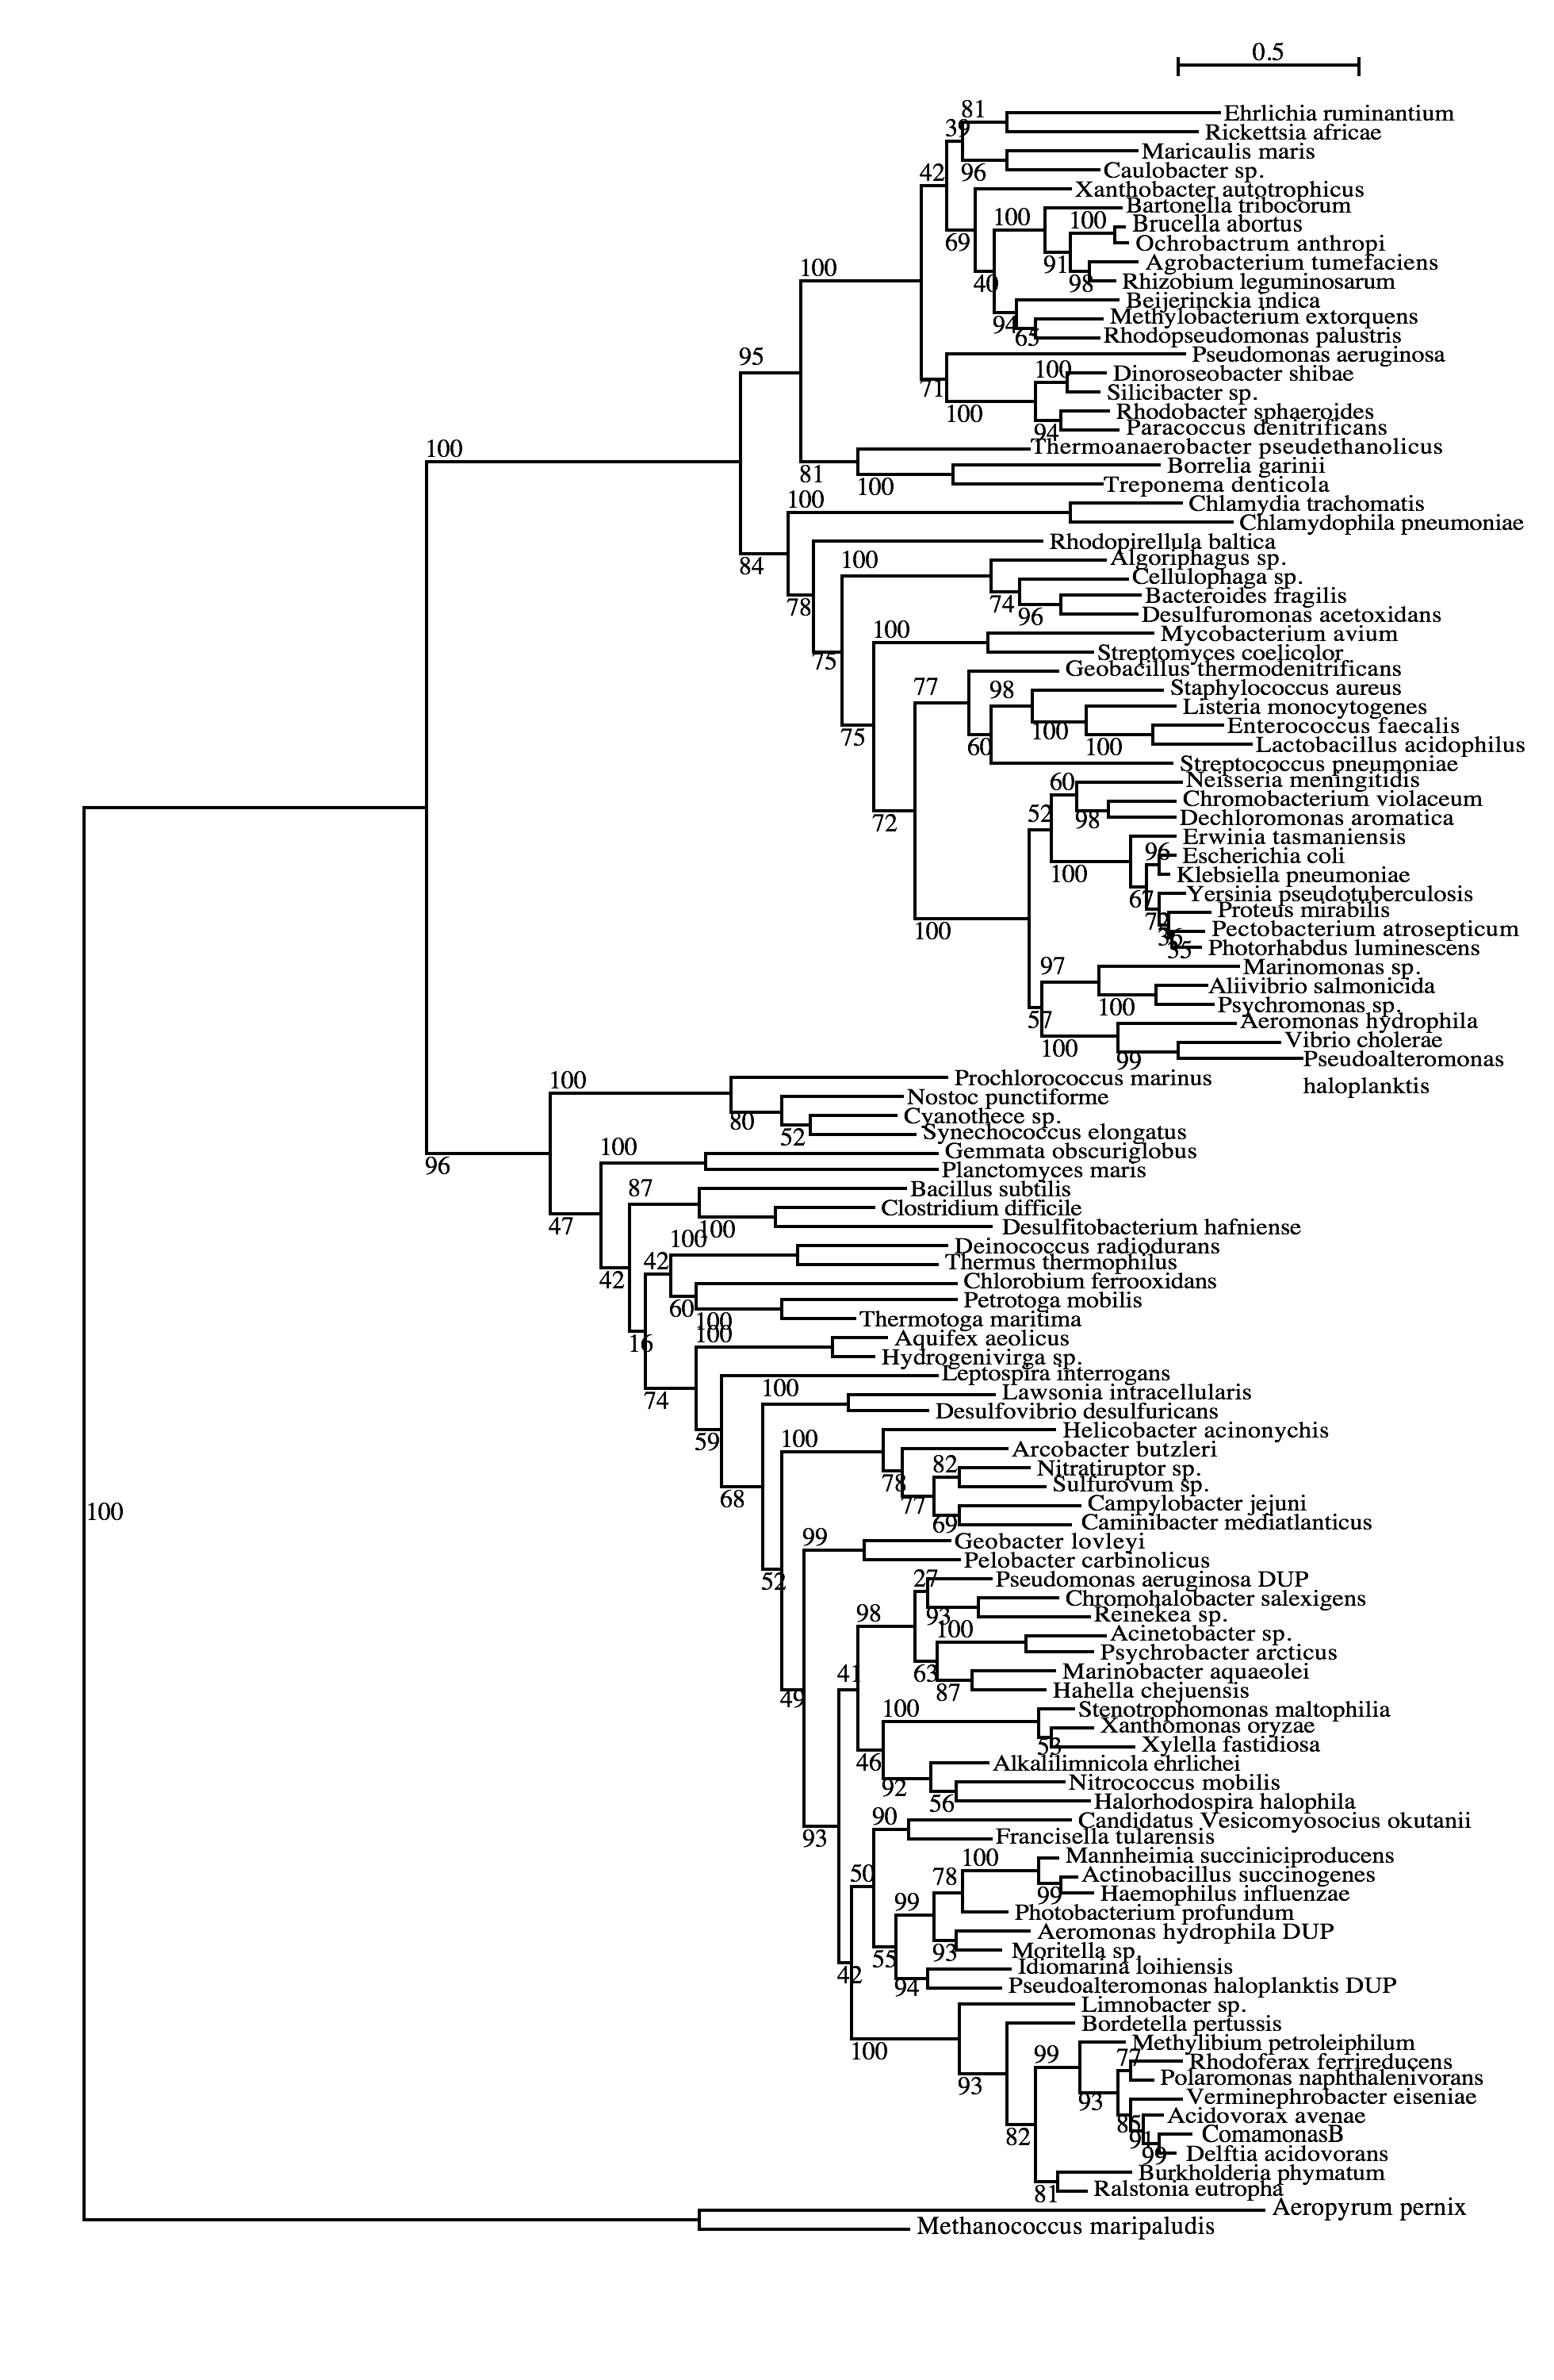
Tyrosyl-tRNA synthetase
Planctomycetes
Firmicutes
Spirochetes
δ-Proteobacteria
γ-Proteobacteria
β-Proteobacteria
Andam, Williams, Gogarten 2010 PNAS
Notes:
There are 3 species (same strain) here that have duplicates found in both subtrees – Pseudomonas aeruginosa PA01, Aeromonas hydrophila ATCC7966 and Pseudoalteromonas haloplanktis TAC125. All three are from complete genome sequences and I checked the papers that published the description of each genome. For Pseudomonas PA01 genome, the authors stated that its large genome size (6.3M bp) was a result of gene duplication, with 50% more paralogous groups than predicted (Stover et al. 2000). However, they didn’t say anything about which genes might have been duplicated. Aeromonas ATCC7966 has more tRNAs (128) than other sequenced genomes and many of these were a result of tandem duplication (Seshadri et al 2006). So does this suggest that their synthetases might have been duplicated as well? They have also found many protein-coding genes that are paralogous. Lastly, the Pseudoaltermonas TAC125 has two chromosomes but all tRNAs are found in only one of them (Medigue et al. 2005). They also found a high number of tRNA genes (106), similar to other vibrios. What I found interesting in their paper is that when they compared its genes with homologs with other related bacteria, the authors found high similarity with Shewanella and Vibrio (which are found in the top part of our tree) and also with Idiomarina and Photobacterium (found in bottom part of our tree). I wonder if some other genes of Pseudoalteromonas also show the same pattern like this? That is, if its other genes that were duplicated also split into two groups?

Slide 12
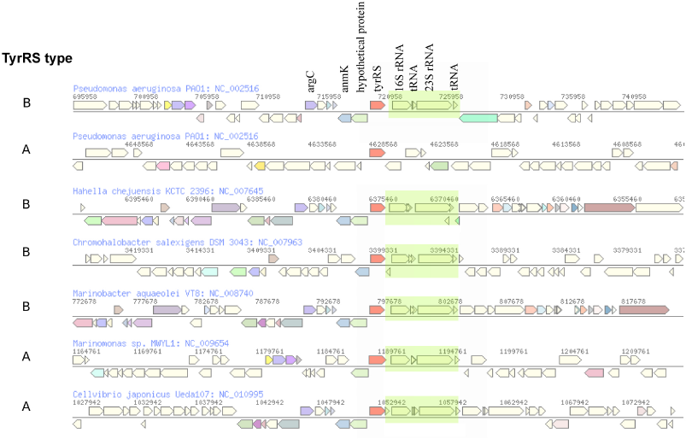
The genomic neighborhood of tyrRS in γ-proteobacteria
Andam, Williams, Gogarten 2010 PNAS
Notes:
similar neighboring gene identity and order for both tyrRS types A and B
The similarities in tyrRS region but differences in tyrRS type imply that transfer of tyrRS types among these genomes followed by homologous recombination. Although the two tyrRS types have low identity, homologous replacement with breakpoints in the neighboring genes may have facilitated the switching between TyrRS types. P. aeruginosa also carries tyrRS type A, but the genomic neighborhood of this gene does not show synteny with that of the tyrRS type A of other closely related taxa.
The finding of similar tyrRS gene neighborhoods in close relatives carrying either type A or type B provides evidence for the replacement of one form of tyrRS with another. Significantly, this rejects the differential loss hypothesis for these organisms. If the last common ancestor possessed both types of enzymes, we would expect the genes coding for each type of tyrRS to possess dissimilar genes flanking them.
The two TyrRS types are so divergent (approximately 28 % identity between the two Pseudomonas TyrRS types) that the possibility of homologous recombination within the TyrRS homeoalleles is unlikely. Consequently, in case of TyrRS homeoalleles, we expect that the unit of successful horizontal gene transfer includes at least the complete tyrRS gene.

Slide 13
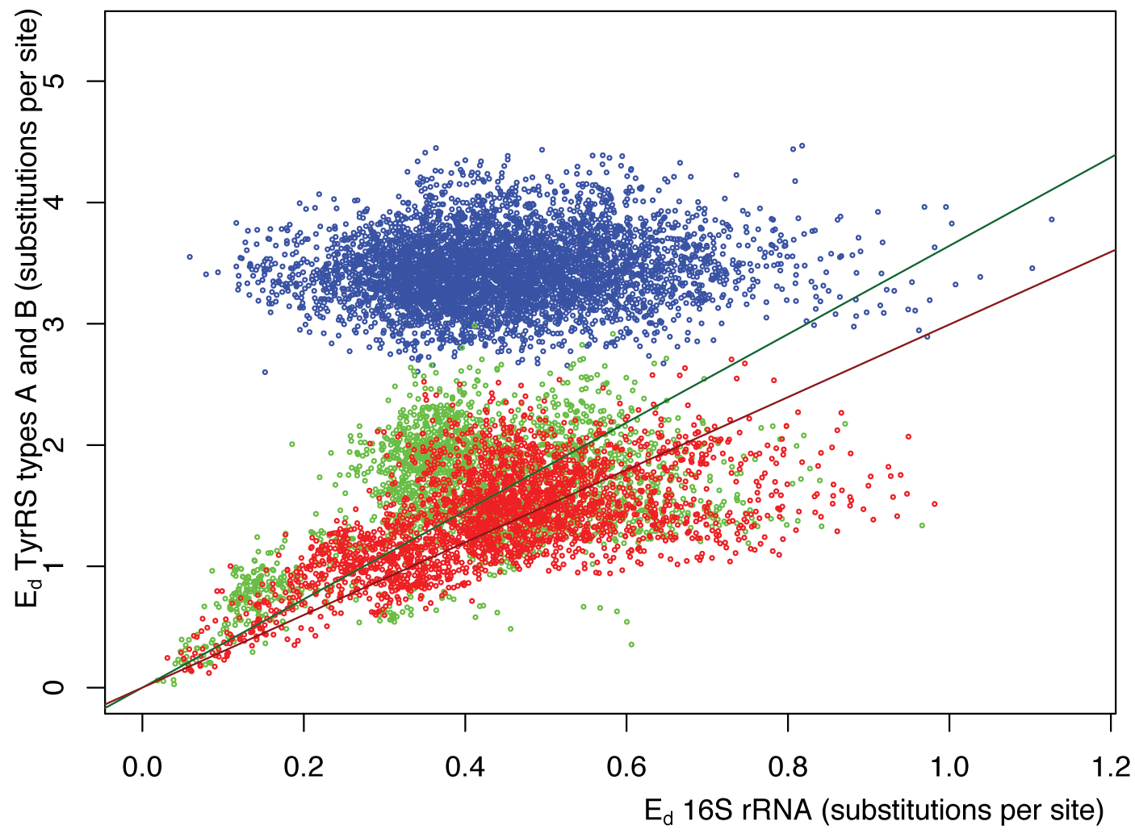
Pairwise distance between tyrRSs versus
pairwise distance of 16S rRNAs from the same genomes
Green -Type A tyrRS
Red - Type B tyrRS
Blue - Between the two types of tyrRS
Andam, Williams, Gogarten 2010 PNAS

Slide 14
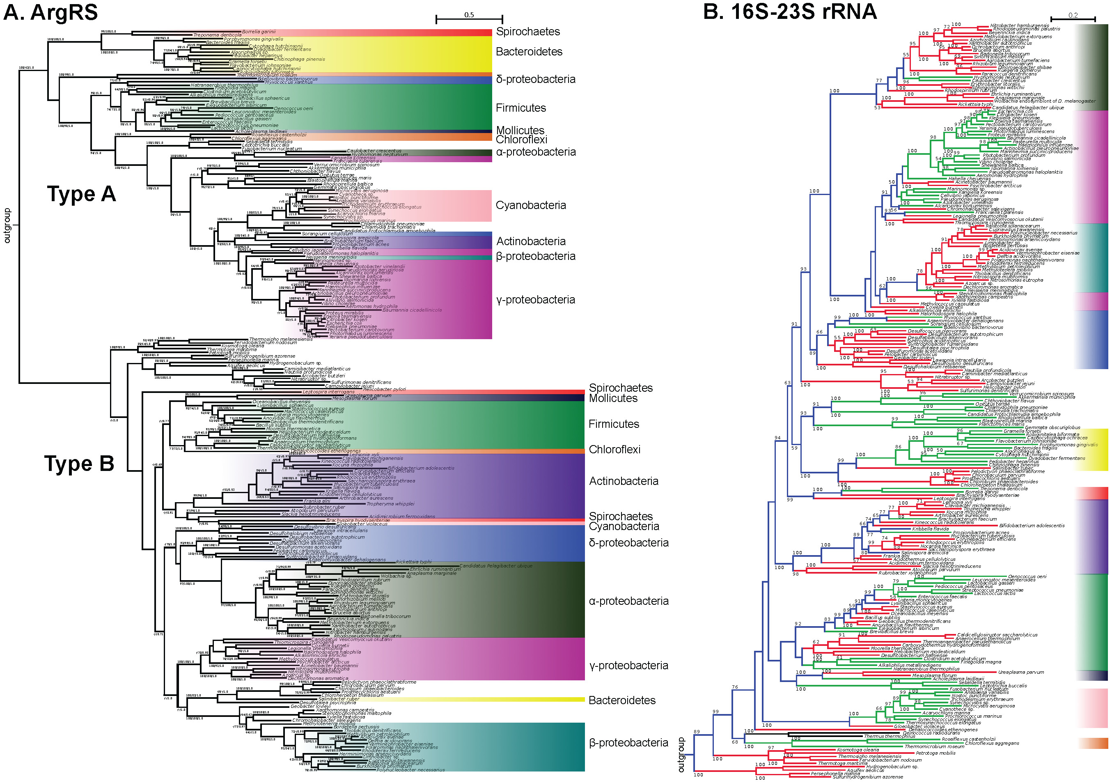

Slide 15
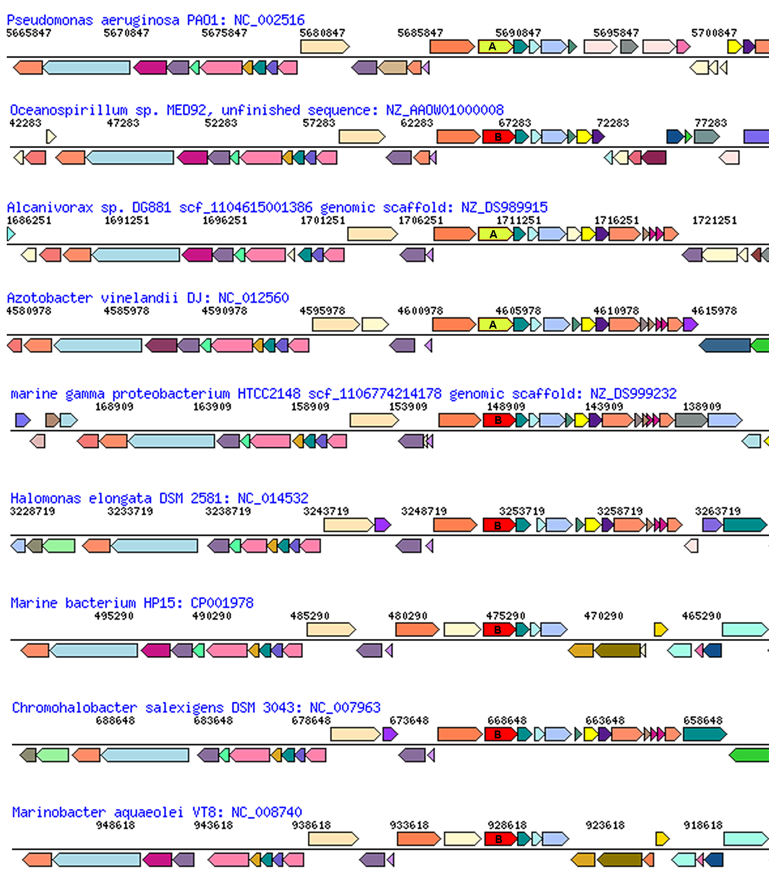
glutamate
synthase
penicillin-bp
ArgRS synteny
between types in Pseudomonadales and Oceanospirillales
aroB
malic enz
ArgRS A&B
PilQ
PriA
HsIU
Pseudomonadales

Slide 16
Homeoalleles
Variants that have the same general function, but can have distinct characteristics.
Gene pool contains different homeoalleles, but individual strains and species usually contain only one of the alleles.
Can be brought together temporarily in a lineage through HGT
Andam, Williams, Gogarten 2010 PNAS
Notes:
The two TyrRS enzymes can be seen as variants similar to alleles in a population. Individual lines of descent possess one or the other of these variants, and in rare instances, they can possess both. We propose to call these variants homeoalleles. Like alleles, they have the same general function, but can have distinct characteristics. As is the case for homeologs in polypoids, homeoalleles cannot be considered orthologs, even though they are homologs with the same function. The line of descent has access to a gene pool that contains both TyrRS homeoalleles, whereas individual strains and species usually contain only one of the alleles. Genes in the accessible gene pool have different propensity to be swapped into an individual line of decent. Genes present in members of the same strain in the same environment likely have the highest propensity of being acquired, genes from organisms with similar regulatory promoter sequences and similar composition will be more frequently acquired than genes with less similar composition and promoters. Genes from divergent organisms will frequently fall in the latter category, and may contain sequence motifs incompatible with the genome organization of the recipient (36).
The two TyrRS types are so divergent (approximately 28 % identity between the two Pseudomonas TyrRS types) that the possibility of homologous recombination between the TyrRS homeoalleles is unlikely. Consequently, in case of TyrRS homeoalleles we expect that the unit of successful horizontal gene transfer includes at least the complete tyrRS gene. Homeoalelles can then be brought together temporarily in a lineage following horizontal transfer, but due to largely overlapping function, only one of the alleles is likely to survive in a lineage on the long run. The surviving allele may be selected due to an adaptive advantage under prevailing conditions.

Slide 17
Terminology
Typically, the term pangenome is used to describe the gene content of a related taxonomic group, like a species or genus, family or phylum.
Sometimes it refers to a broader set like the entire contents of a gut,
but this is usually referred to (and should be referred to) as a meta-genome and considered a separate phenomenon.
Edwards-Venn cogwheel
A.W.F. Edwards 1998

Slide 18
Aside on disputes in terminology:
Two definitions for the term microbiome:
Micro-biome: a biome occupied by microorganisms (the skin can be considered a biome, for large organisms, the tundra is an example for a biome)
Microb-i-ome: the summary of -omics information obtained for a microbial community.
It seems #1 has won, see Jonathan Eisen’s discussion here.
Bottomline: The characterization of a micro-biome goes beyond a catalog of species (the microbiota), and certainly beyond the enumerations of 16S rRNA OTUs present in an environment; it includes the interactions between organisms, defining guilds (groups of organisms with similar roles in a biome), placing organisms into guilds, and characterizing the ecological parameters that define the niche. In addition, the microbiome is also populated by phages, other viruses, and eukaryotes. Catalogs of 16S rRNA OTUs and metagenome sequencing are an important first step, but alone they are insufficient to define of fully describe a microbiome.

Slide 19
The pangenome as a shared genetic resource
The homeoalleles provide an example for the pangenome providing a shared genetic recourse. (The different aaRS types provide resistance to antibiotics produced by competitors – switching to another type can provide a selective advantage.)
Another example are weakly selected functions (wsf) – genes or gene clusters that are only used under some conditions, e.g. a complex sugar in the environment. In the absence of the sugar, the genes will decay and may be lost from most genomes, only to be shared between members if the sugar becomes available again.
Jeffrey Lawrence and John Roth suggested that this sharing can drive operon formation (here and here)!
Edwards-Venn cogwheel
A.W.F. Edwards 1998

Slide 20
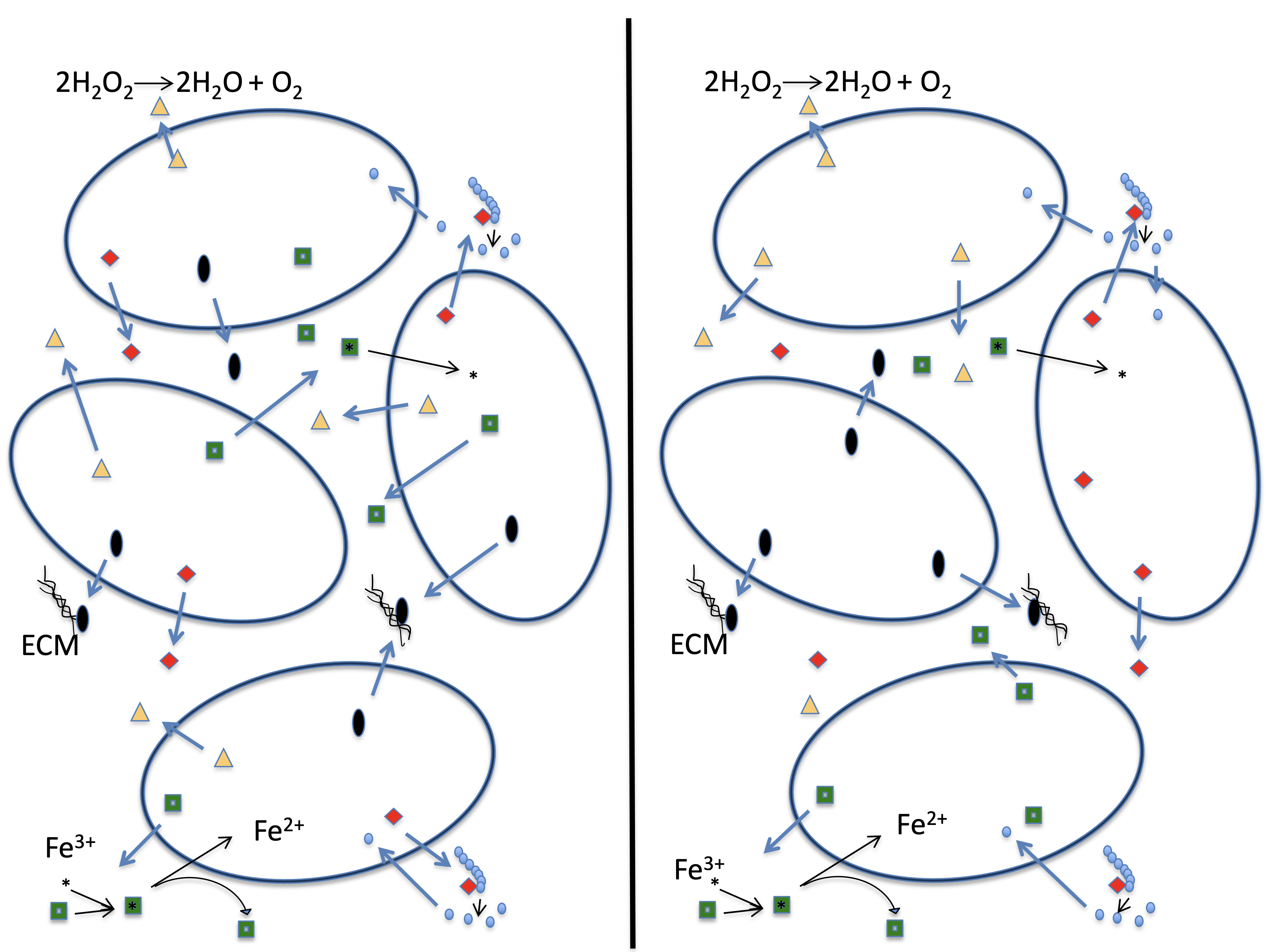
The pangenome as a shared genetic resource
Another important group of genes among the accessory pool are genes that are involved in cheating (an individual relies on its neighbors to provide the function), or the division of labor (aka mutual cheating). This is the subject of the Strong Black Queen Hypothesis.
A.W.F. Edwards 1998
Edwards-Venn cogwheel

Slide 21
HGT as a force creating new pathways

Slide 22
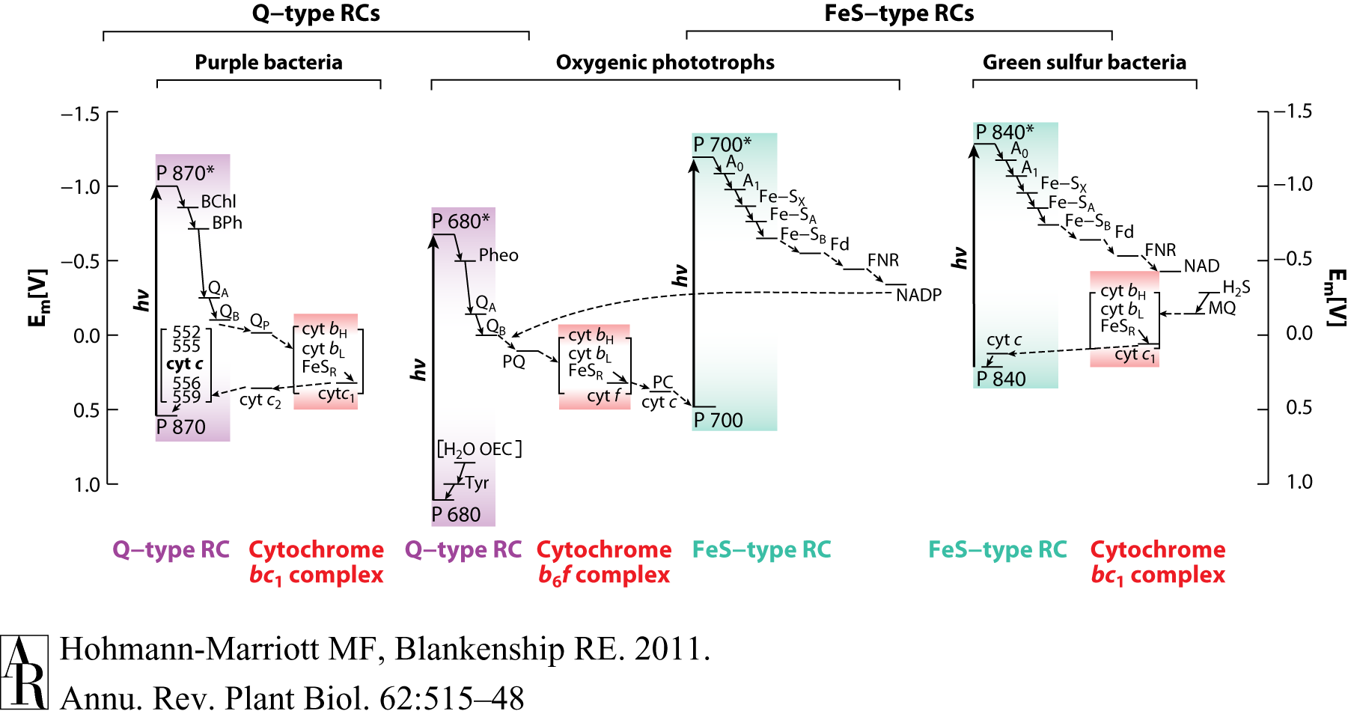
HGT as a force creating new pathways – Example 2
Oxygen producing photosynthesis

Slide 23
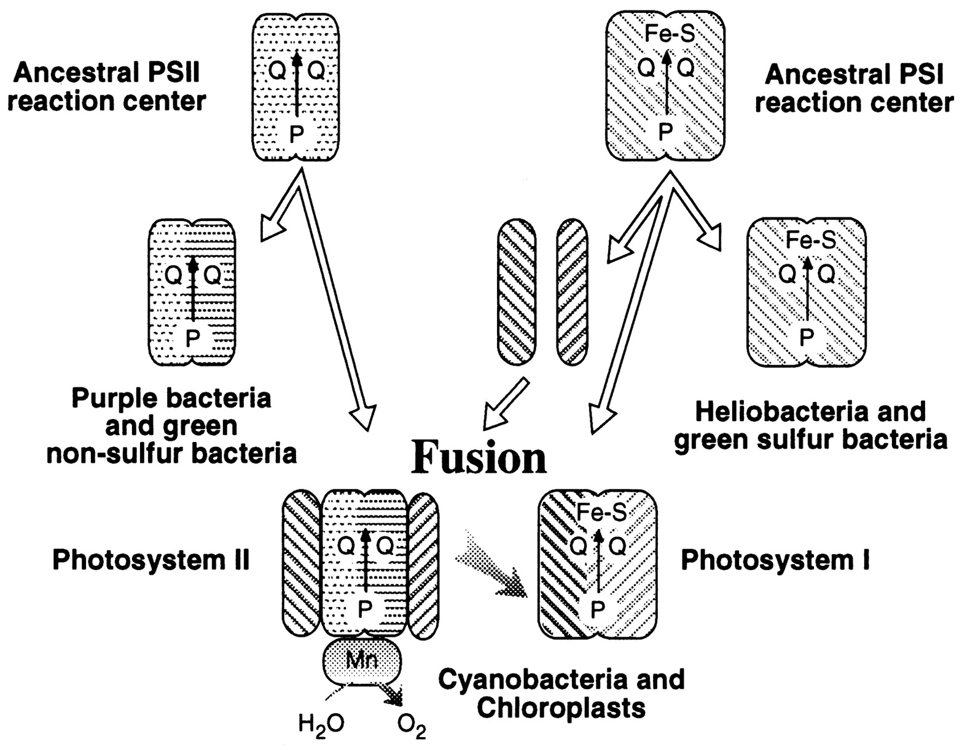
A heterologous fusion model for the evolution of oxygenic photosynthesis based on phylogenetic analysis.
Xiong J et al. PNAS 1998;95:14851-14856
©1998 by National Academy of Sciences
Notes:
A heterologous fusion model for the evolution of oxygenic photosynthesis based on phylogenetic analysis. Details of the model are provided in the text.

Slide 24
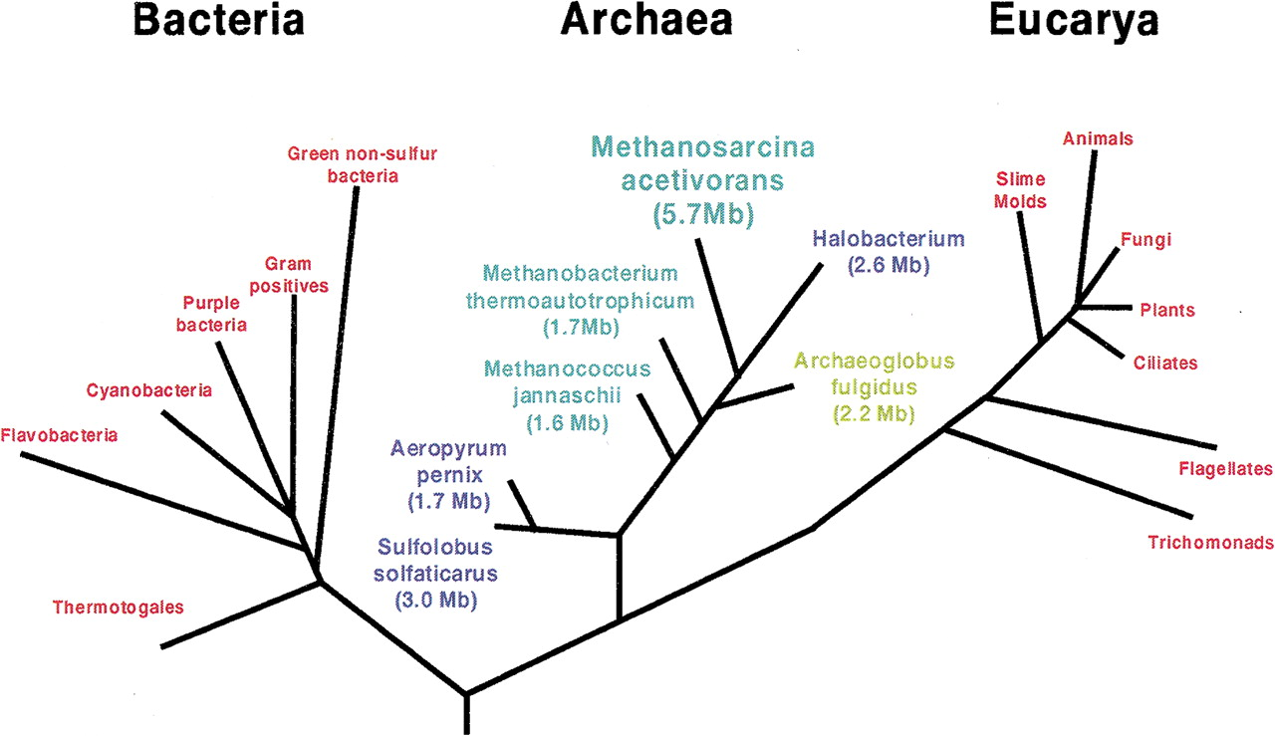
HGT as a force creating new pathways – Example I
Acetoclastic Methanogenesis
Thermo-
plasmatales
Pyrococci
Modified from: Galagan et al., 2002

Slide 25
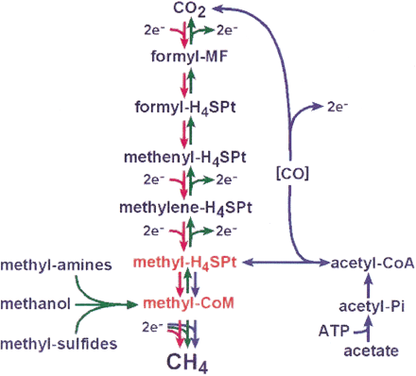
Methanogenesis
Unique to subset of Archaea
Energy production via reduction of multiple carbon substrates to CH₄
900 Million metric tons of biogenic methane produced annually.
Over 66% of biogenic methane is produced from acetate, mostly by Methanosarcina genera.
From: Galagan et al., 2002
Fournier and Gogarten (2008) Evolution of Acetoclastic Methanogenesis in Methanosarcina via Horizontal Gene Transfer from Cellulolytic Clostridia. J. Bacteriol. 190(3):1124-7

Slide 26
Methanogenesis
CODH complex:
reversible Acetyl-CoA synthesis
Acetoclastic methanogenesis-
specific pathway:
acetate kinase (AckA) and
phosphotransacetylase (Pta)
From: Galagan et al., 2002

Slide 27
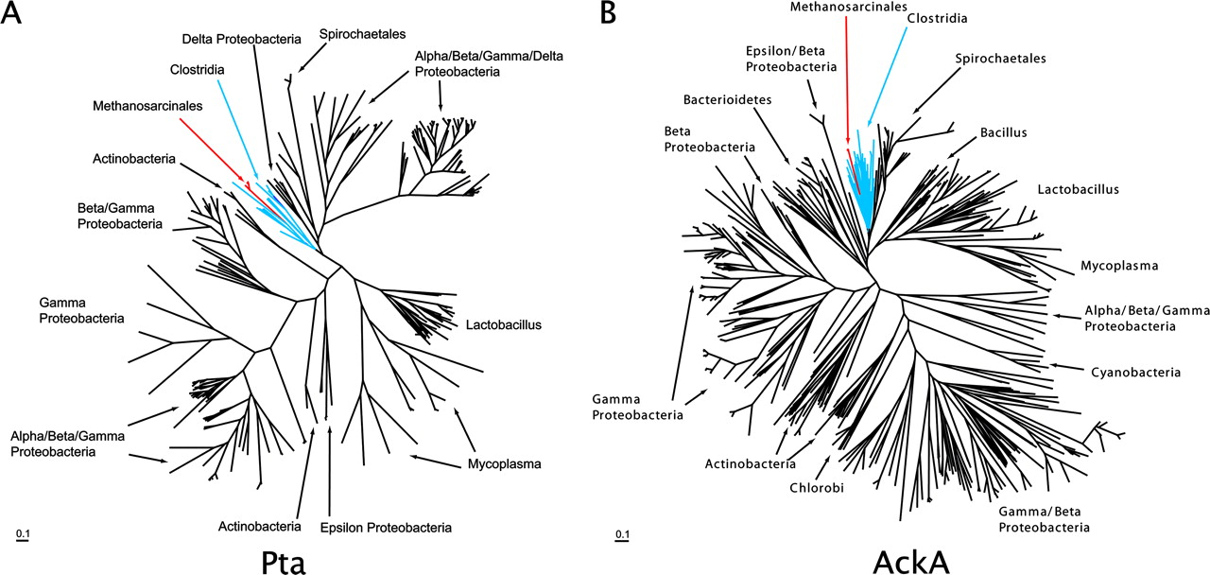
Maximum likelihood phylogenetic trees of Pta and AckA homologs. Homologs found in Methanosarcina are red and in both cases are found in a monophyletic group corresponding to the Clostridia (blue) ... .

Slide 28
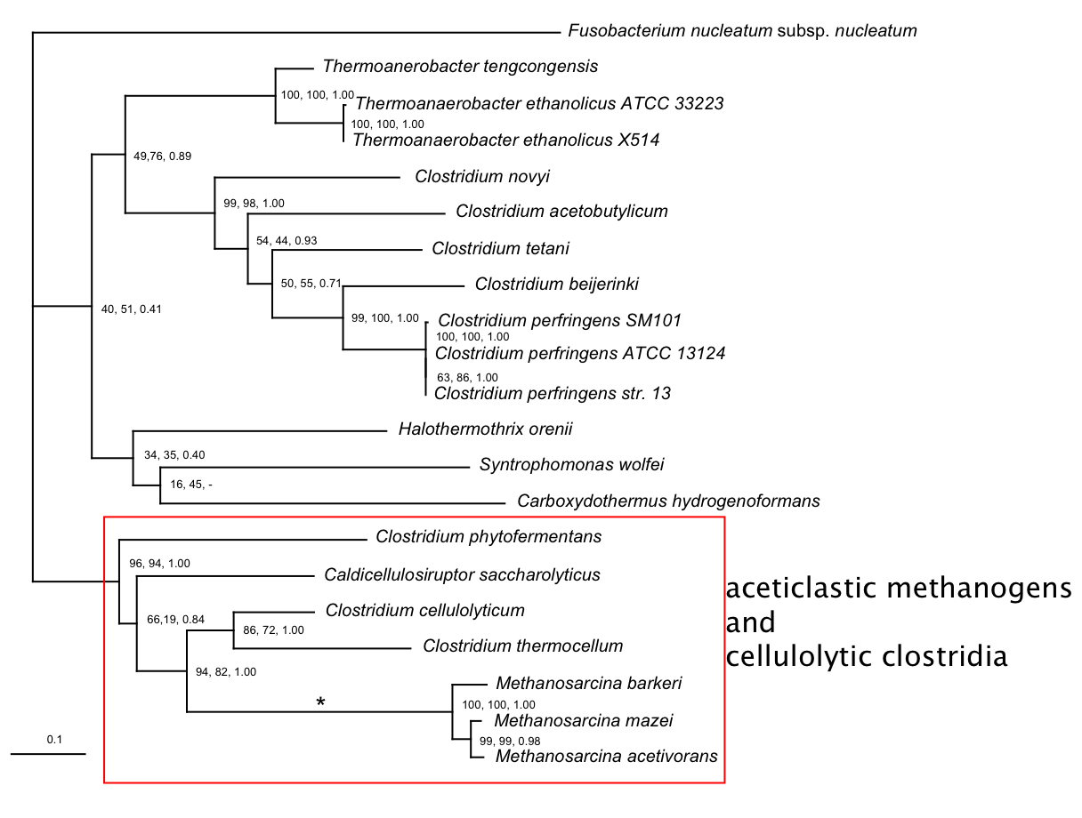
Phosphotransacetylase (Pta)
Modified form Fournier and Gogarten (2008) Evolution of Acetoclastic Methanogenesis in Methanosarcina via Horizontal Gene Transfer from Cellulolytic Clostridia. J. Bacteriol. 190(3):1124-7
acetoclastic Methanosarcina and cellulolytic clostridia

Slide 29
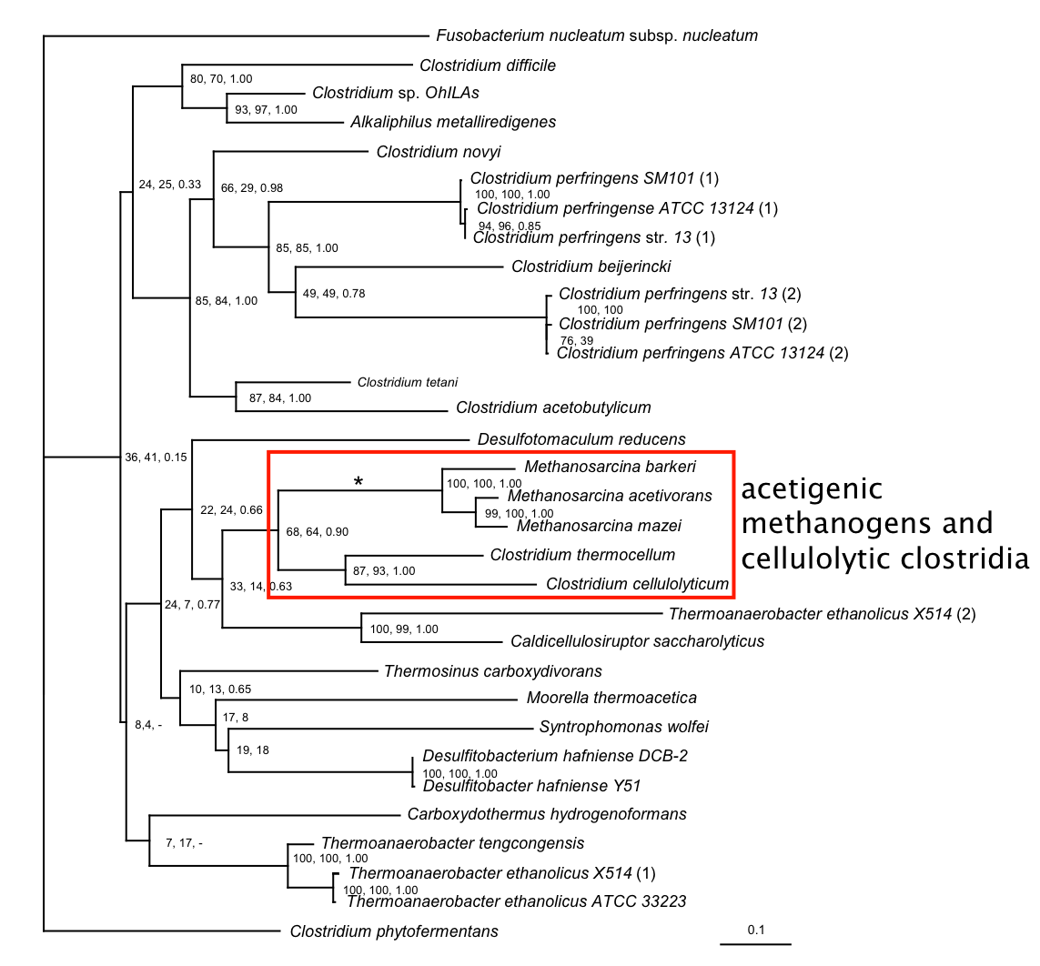
acetate kinase (AckA)
acetoclastic methonogens and cellulolytic clostridia
Modified form Fournier and Gogarten (2008) Evolution of Acetoclastic Methanogenesis in Methanosarcina via Horizontal Gene Transfer from Cellulolytic Clostridia. J. Bacteriol. 190(3):1124-7

Slide 30
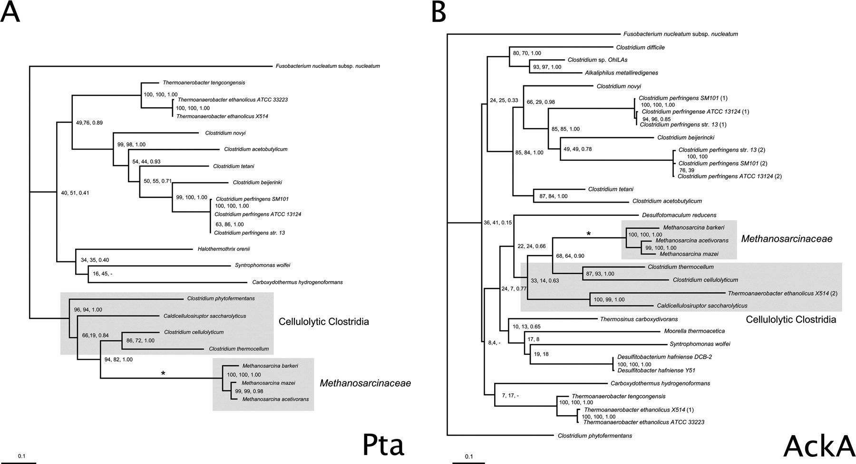
Consensus trees of Pta and AckA homologs within the Clostridia. Branches in which there were postulated horizontal gene transfers to Methanosarcina are indicated by an asterisk. Homologs from the firmicute F. nucleatum were used as outgroups to root the trees. The numbers associated with each clade indicate bootstrap values for maximum likelihood and neighbor joining and the posterior probability from Bayesian inference, respectively. Sequence alignment was ...

Slide 31
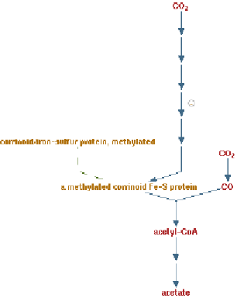
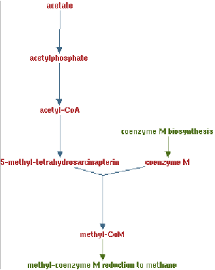
Clostridia acetigenic pathway
Methanosarcina
acetoclastic pathway
AckA
HGT
PtaA
PtaA
AckA
Figures drawn with Metacyc (www.metacyc.org)

Slide 32
HGT as a force creating new pathways – Example 3
Acetyl-CoA Assimilation: Methylaspartate Cycle
Acetate
Alcohols
Polyhydroxybutyrate
Fatty acids
acetyl-CoA
Lysine, leucine
oxaloacetate
citrate
malate
isocitrate
CO
2
fumarate
acetyl-CoA
2-oxoglutarate
Poly-γ -glutamate
succinate
glutamate
Proteins
glyoxylate
γ-Glutamylcystein
succinyl-CoA
methylaspartate
CO
Osmoadaptation
2
propionyl-CoA
mesaconate
3-methylmalyl-CoA
mesaconyl-CoA
Khomyakova, Bükmez, Thomas, Erb, Berg, Science, 2011

Slide 33
Comparison of different anaplerotic pathways
acetyl-CoA
acetyl-CoA
acetyl-CoA
acetyl-CoA
crotonyl-CoA
oxaloacetate
citrate
oxaloacetate
citrate
CO
2
malate
isocitrate
acetyl-CoA
ethylmalonyl-CoA
CO
2
fumarate
acetyl-CoA
2-oxoglutarate
malate
isocitrate
methylsuccinyl-CoA
glyoxylate
succinate
glutamate
CO
2
mesaconyl-CoA
glyoxylate
2-oxoglutarate
3-methylmalyl-CoA
succinyl-CoA
methylaspartate
fumarate
CO
propionyl-CoA
glyoxylate
2
propionyl-CoA
mesaconate
CO
2
CO
2
acetyl-CoA
succinate
succinyl-CoA
3-methylmalyl-CoA
mesaconyl-CoA
succinyl-CoA
malate
Citric acid cycle and
Glyoxylate cycle
Ethylmalonyl-CoA
pathway
Methylaspartate cycle
Bacteria, Eukarya and some Archaea
α-Proteobacteria, streptomycetes
haloarchaea

Slide 34
HGT as a force creating new pathways – Example 3
Acetyl-CoA Assimilation: methylaspartate cycle
Haloarchaea
Haloarcula marismortui,
Natrialba magadii
Glutamate fermentation,
Bacteria
Propionate assimilation
Acetate
assimilation, Bacteria
Khomyakova, Bükmez, Thomas, Erb, Berg, Science, 2011

Slide 35
Introns

Slide 36
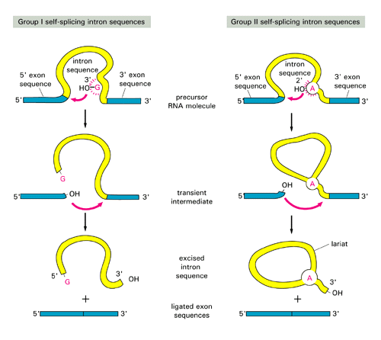

Slide 37
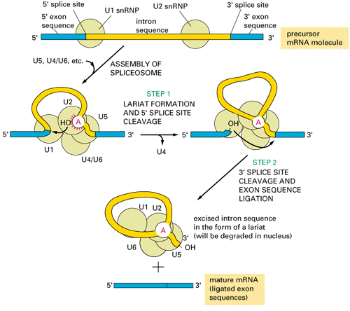

Slide 38
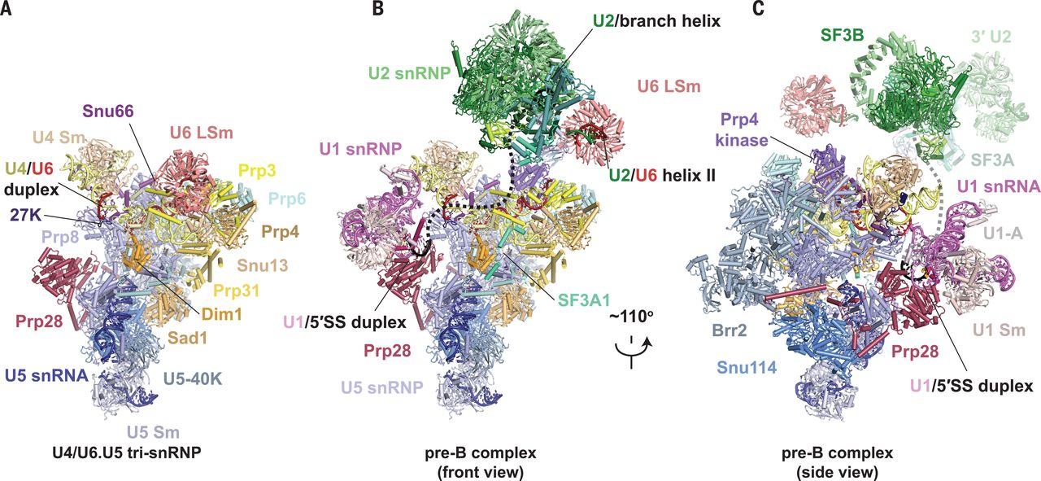

Fig. 1 Structures of human tri-snRNP and pre–B complex.
Clément Charenton et al. Science 2019;364:362-367
Copyright © 2019 The Authors, some rights reserved; exclusive licensee American Association for the Advancement of Science. No claim to original U.S. Government Works
Notes:
Structures of human tri-snRNP and pre–B complex. (A) Overview of human U4/U6.U5 tri-snRNP. (B and C) Overview of the human U1.U2.U4/U6.U5 pre–B complex in two orientations. The black dashed line represents the theoretical path of the pre-mRNA intron.

Slide 39
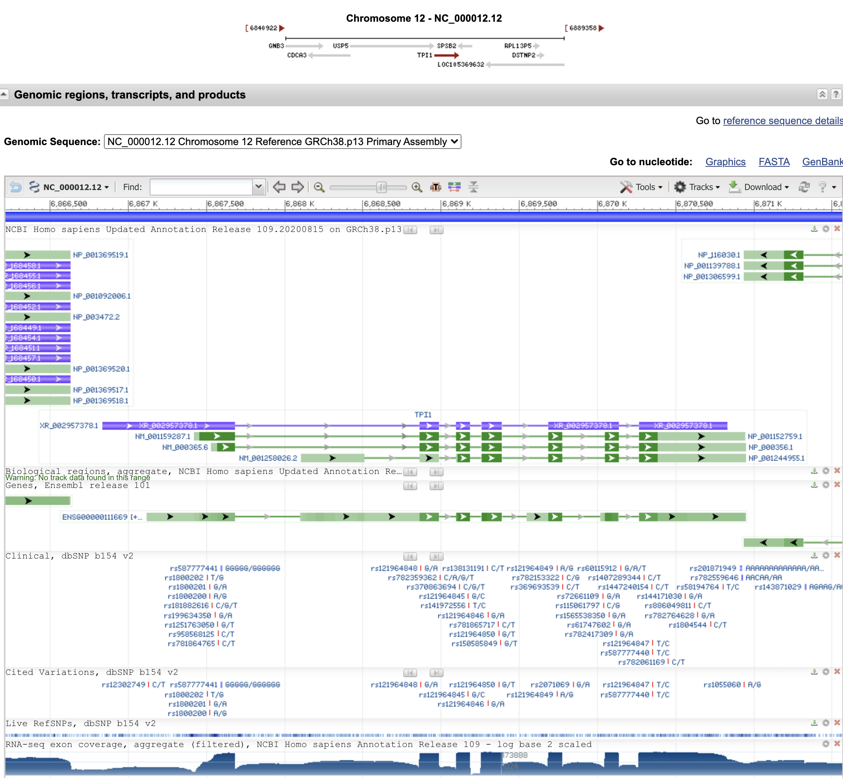
The human tpi1 gene in NCBI

Slide 40
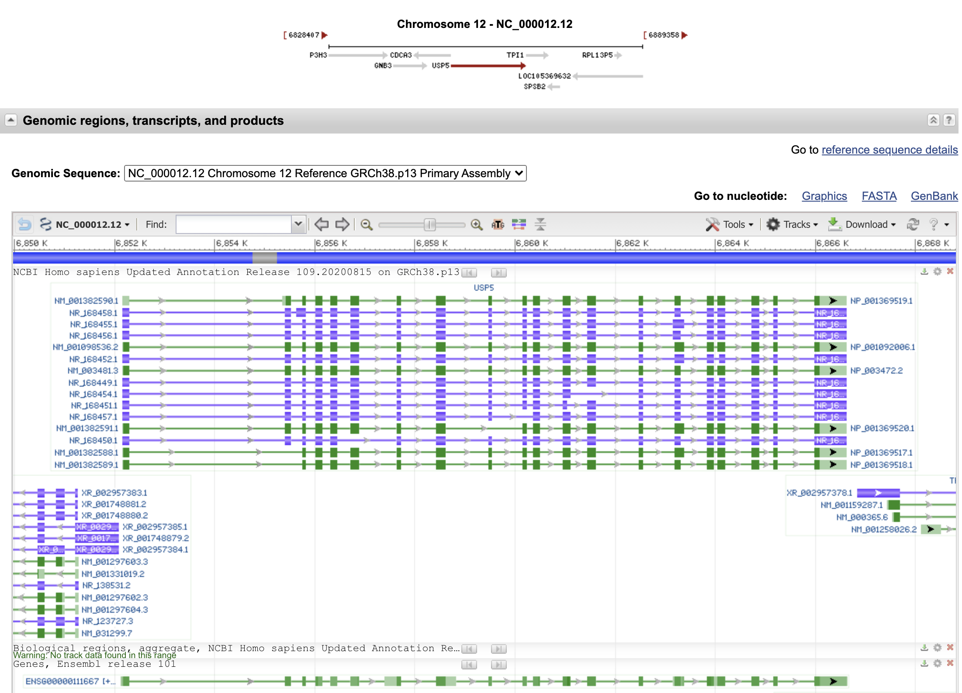
The neighboring gene,
ubiquitin specific peptidase 5,
is perhaps more typical:

Slide 41
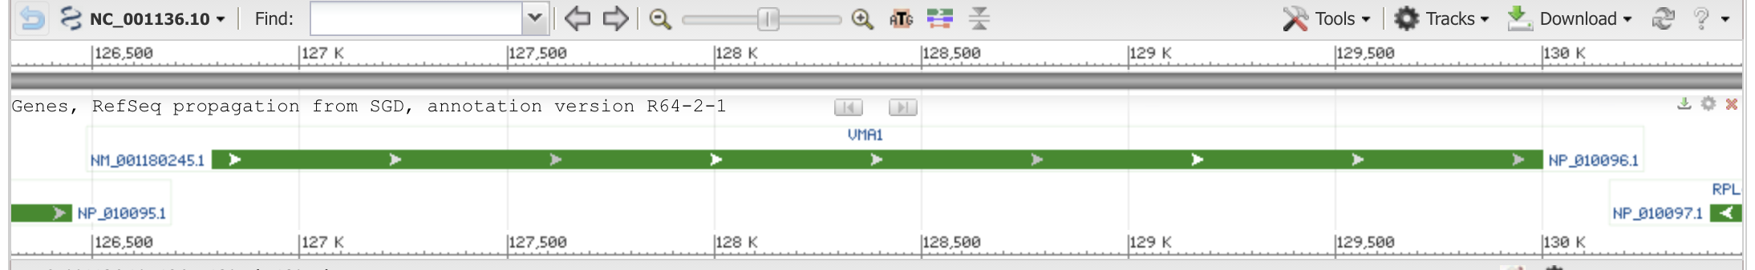
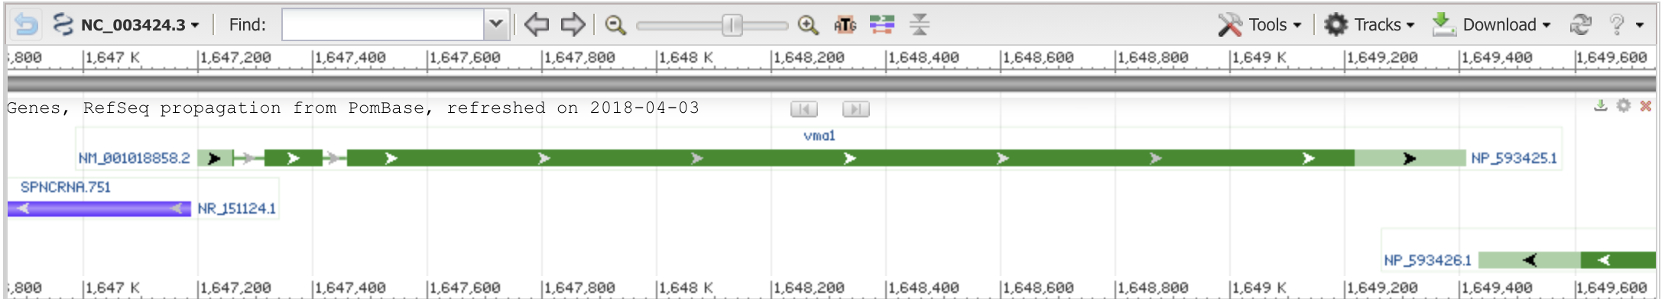
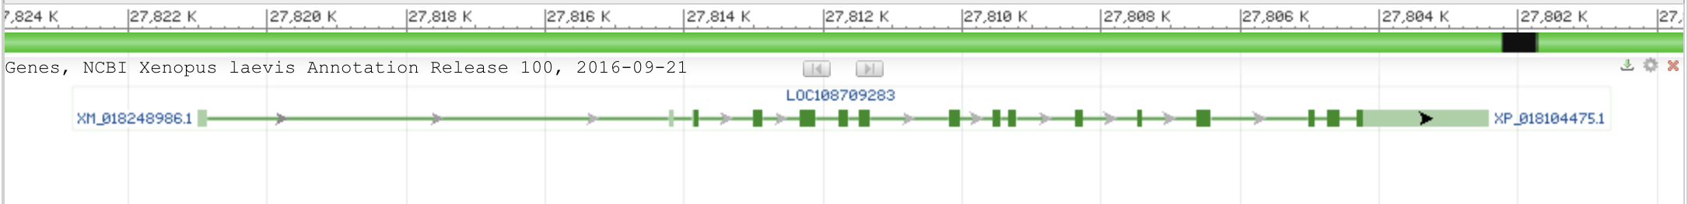
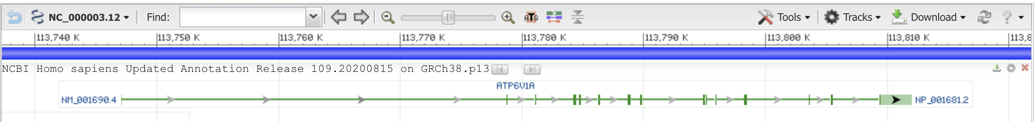
vma1 genes
Saccharomyces cerevisiae S288C
Schizosaccharomyces pombe
Xenopus laevis (African clawed frog)
(one of two paralogs)
Homo sapiens (human)

Slide 42
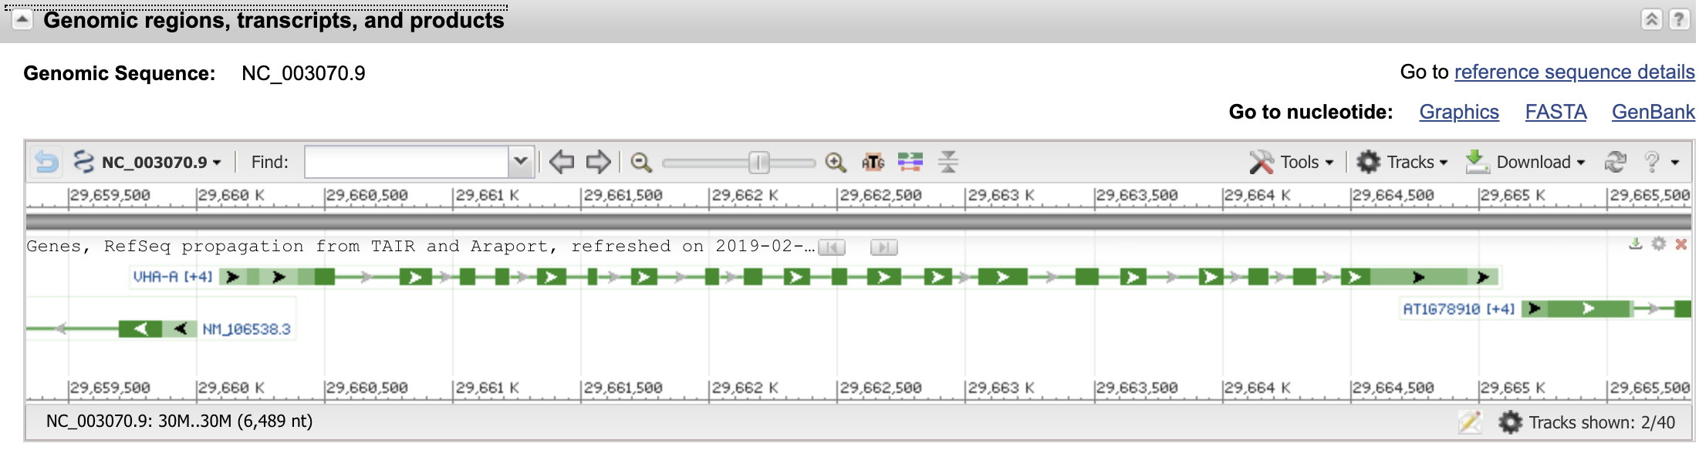
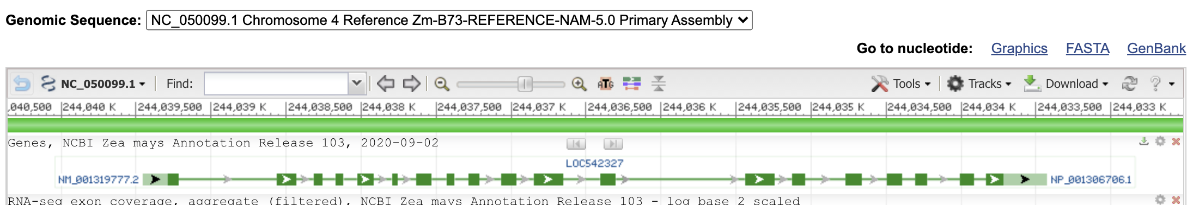
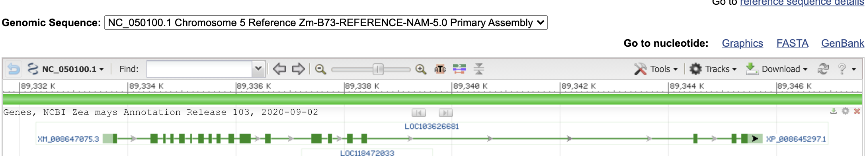
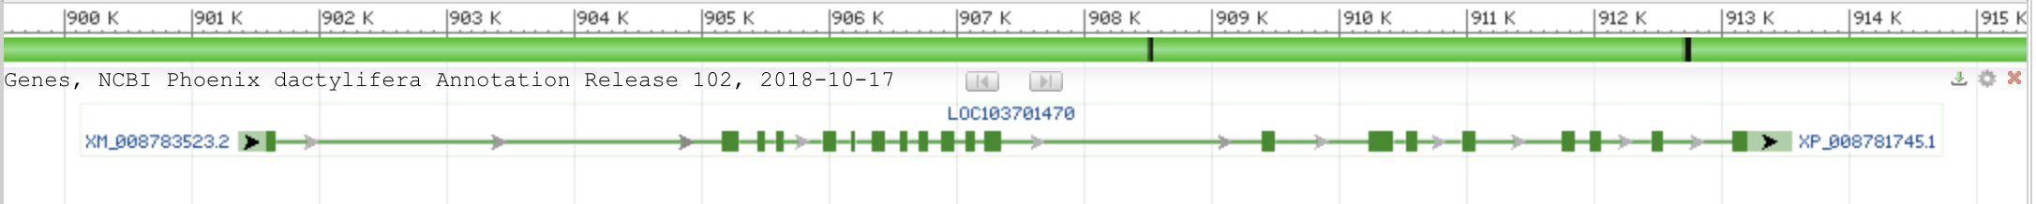
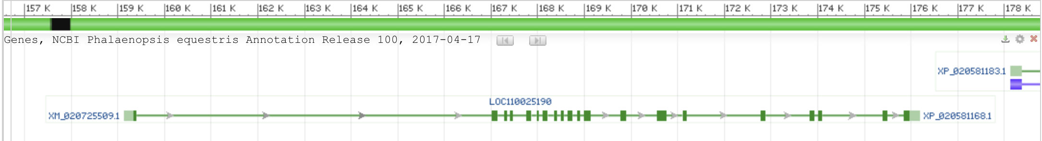
vma1 genes
Arabidopsis thaliana (thale cress)
Zea mays chromosome 4
Zea mays chromosome 5
Phoenix dactylifera (date palm)
Phalaenopsis equestris (orchid)

Slide 43
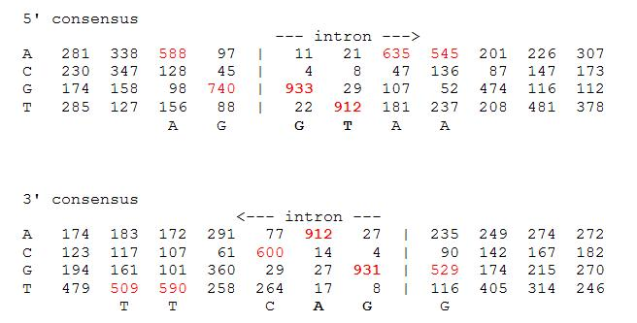
Splice site consensus in Arabidopsis thaliana

Slide 44
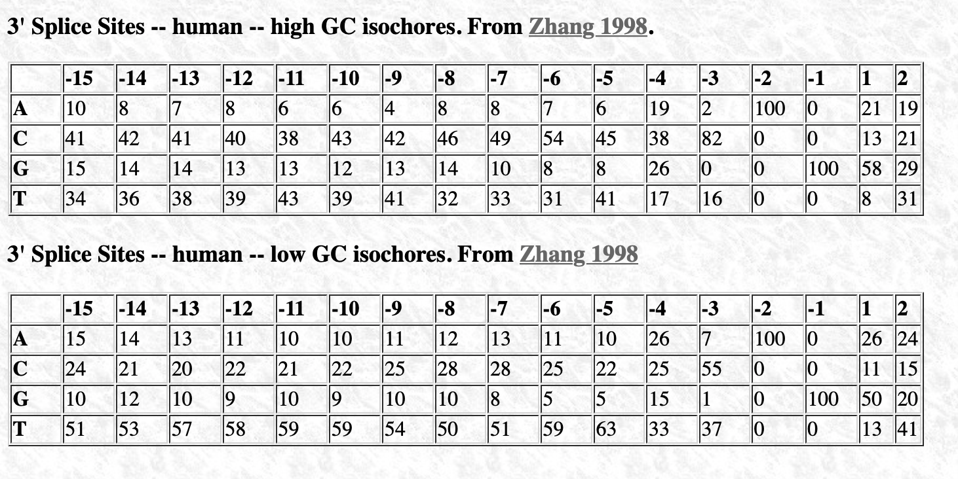
Splice site consensus humans
C A G || G T
From: http://science.umd.edu/labs/mount/RNAinfo/matrices.html https://pubmed.ncbi.nlm.nih.gov/9536098/

Slide 45
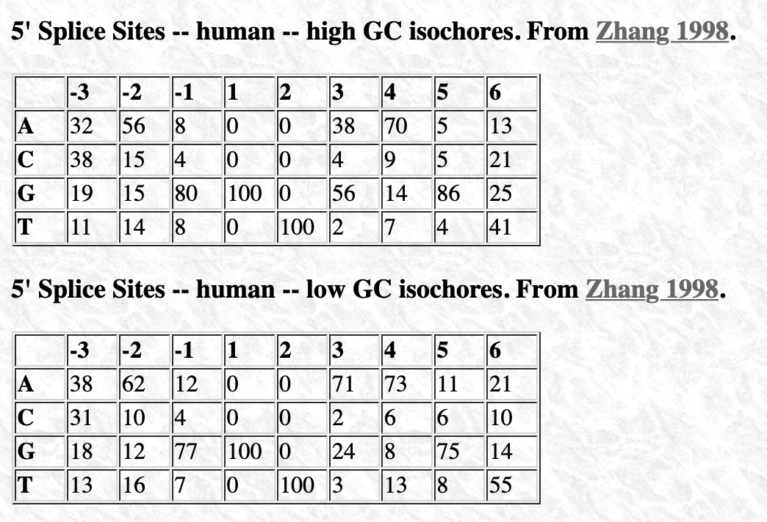
Splice site consensus humans
A G || G T
From: http://science.umd.edu/labs/mount/RNAinfo/matrices.html https://pubmed.ncbi.nlm.nih.gov/9536098/

Slide 46
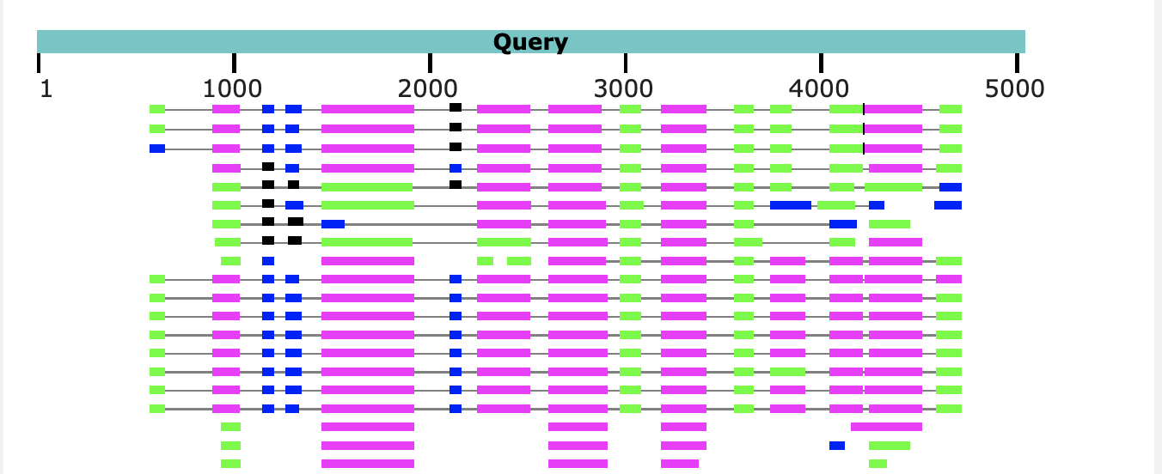
Predicting Intron and Exon sequences using computational approaches remains problematic.
The best way approach is to compare a cDNA or EST to the genome.
The second best is to compare the genome sequence to a protein databank.
The parts of the query that does not have matches corresponds to introns.
Note the large number of introns present in Arabidopsis, which is a plant with a very small genome. In other organisms the introns are even larger.

Slide 47
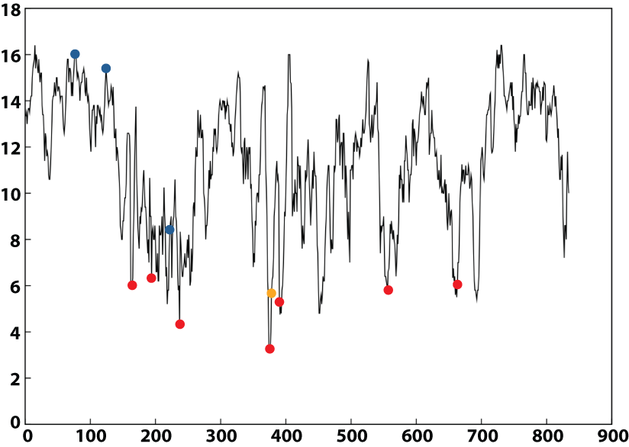

Ribonucleotide Reductase
Intein
Group I Introns
Group II Introns

Slide 48

From:
Intron positions correlate with module boundaries in ancient proteins
Sandro Jose de Souza, Manyuan Long, Lloyd Schoenbach, Scott William Roy, and Walter Gilbert
https://www.pnas.org/content/93/25/14632
Named after Mitiko Gō

Slide 49


From:
Correlation of DNA exonic regions with protein structural units in haemoglobin
Mitiko Gō
Nature volume 291, pages90–92(1981)
beta SU from 4N8T Go domains colored
F1
F2
F3
F4

Slide 50


Slide 51


Slide 52

Nonsense-mediated mRNA decay (NMD) pathway
/
/
From:
https://en.wikipedia.org/wiki/Nonsense-mediated_decay
More details at https://en.wikipedia.org/wiki/MRNA_surveillance

Slide 53

From: How do proteins gain new domains?
(a) Gene fusion. The noncoding region between two genes is modified so that the exons of the first gene become spliced with the second. (most common in animals)
(b) Exon extension. The noncoding region following an exon becomes part of the exon and codes for a new domain.
(c) Exon recombination. The exons of two genes become directly joined.
(d) Intron recombination. An exon from one gene is inserted into the intron of another. (rare Less than 10%)
(e) Retroposition. A retrotransposon sequence (RT, purple) mediates the copying of itself and a neighboring gene region via an mRNA intermediate, followed by insertion into another gene. (Rare (?) Gained domain encoded by a single exon).
/
Data from https://www.ncbi.nlm.nih.gov/pmc/articles/PMC2926785/

Slide 54
Other possible benefits of introns
Alternative Splicing
Exon shuffling
If splicing is skipped the intron sequence can become a novel exon.

Slide 55


Possible benefits of having intein
Exon shuffling
Genes for the IgG heavy chain
51x27x6x5 = 41,310 different combinations
Genes for the IgG light chain
40x 5 = 200 different combinations
If the assembly of the light and heavy chain one region V (D) J are joined together 8,262,000 different antibodies can be produced through exon shuffling.
In the maturation of B cells additional mutations further increase diversity.
From: https://www.ncbi.nlm.nih.gov/books/NBK26860/

Slide 56
Introns early
Introns late
Self splicing RNAs are an example for catalytic RNA that could have been present in RNA world.
There is little reason to assume that the RNA world was not plagued by self-splicing parasites.
Neighboring Introns are more frequently in same phase than expected by chance (but not by much ☺)
Spliceosomal introns are present in deep branching eukaryotes
Introns frequently are found in linker regions (see Go plots)
Exon shuffling can create a large number of different catalytic sites (see the maturation of the immune system)
The nonsense mediated decay pathway exists in plants, animals and fungi. This pathway relies on tagging Exon Junction Complexes, i.e. the widespread presence of spliceosomal introns.
Mapping individual introns onto organismal evolutionary history shows that many introns inserted into the sites where they are found presently more recently.
Intron preference for linker region could be the result of selection (they do less harm here than in tightly packed domains.
Exon shuffling in the maturation of the adaptive immune system is a modern trait of vertebrates.
Even if some introns are ancient, this does not prove that they played a role in assembling the now existing protein families.
In the recent evolution (in the presence of many large introns), recombination in introns (exon shuffling appears to be rare – gene fusions are more common)

Slide 57
Predicting Open Reading Frames
GeneMark uses hidden Markov models and can be trained using training sets
-- works for pro- and eukaryotes and metagenomes
-- GenemarkS is the “standard to gene calling in viruses and prokaryotes
Glimmer was developed for prokaryotes,
-- a related software (GlimmerHMM) was developed for eukaryotes
Keep in mind that ab initio approaches work less well than those based on homology.
Popular are
PROKKA (described here)
RAST
Both rely on homology and already annotated similar genomes.
The cycle of identifying essential genes (aatRNAsynthases, DNA and RNA polymerases, ATPsynthases), and using these to train gene prediction software seems to work well.

