Slide 1
MCB3421
class 25
Introns Early vs Introns late (cont)
Emboss – theoretical isoelectric point

Slide 2
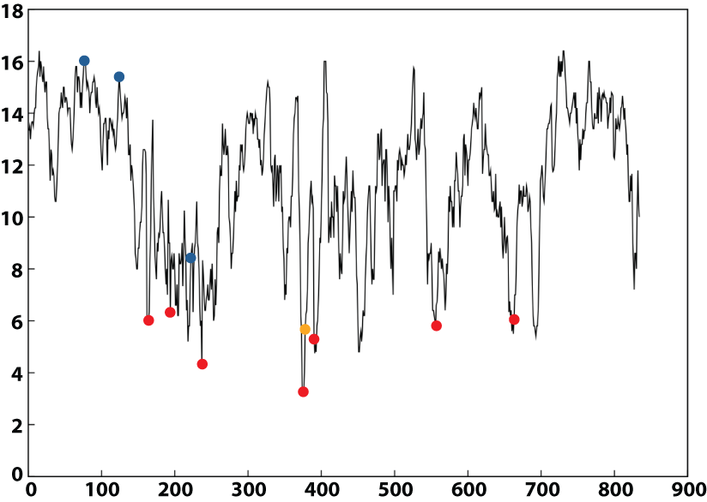

Ribonucleotide Reductase
Intein
Group I Introns
Group II Introns

Slide 3
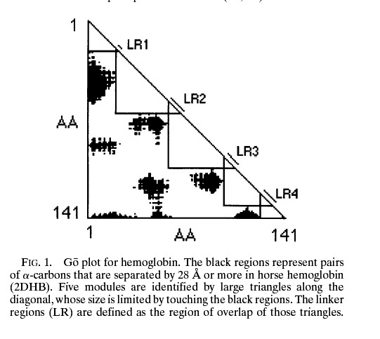
From:
Intron positions correlate with module boundaries in ancient proteins
Sandro Jose de Souza, Manyuan Long, Lloyd Schoenbach, Scott William Roy, and Walter Gilbert
https://www.pnas.org/content/93/25/14632
Named after Mitiko Gō

Slide 4
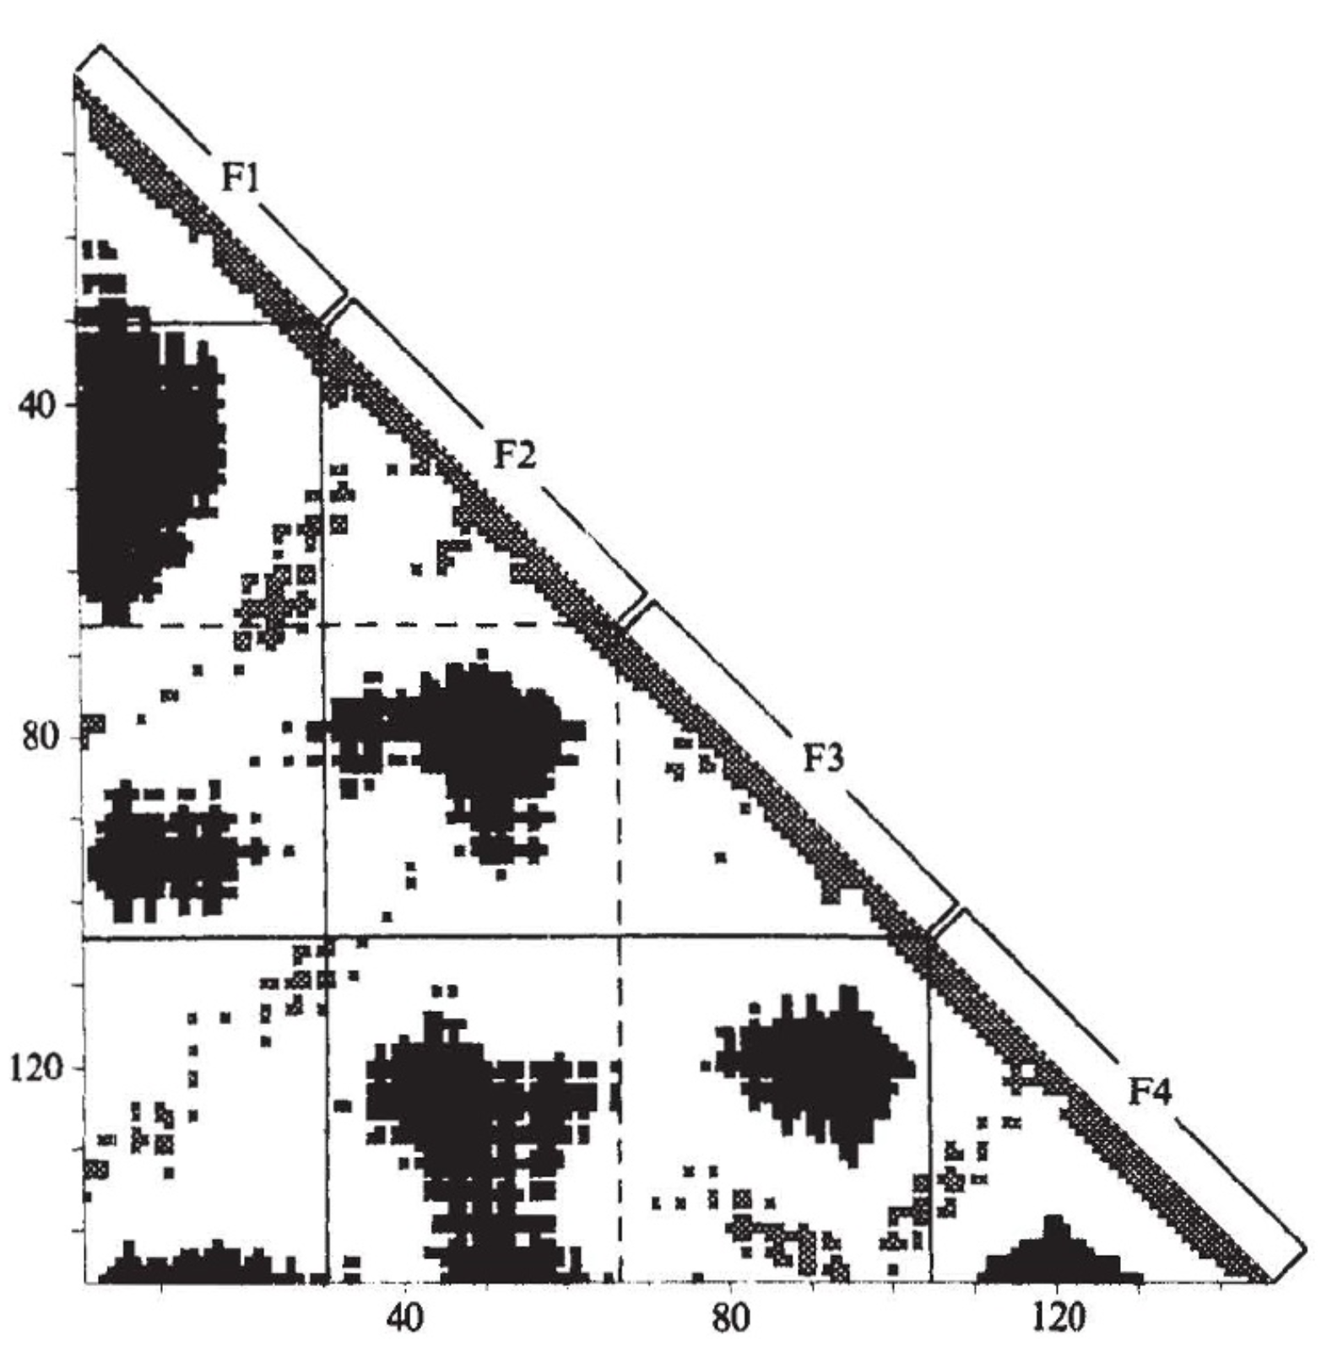
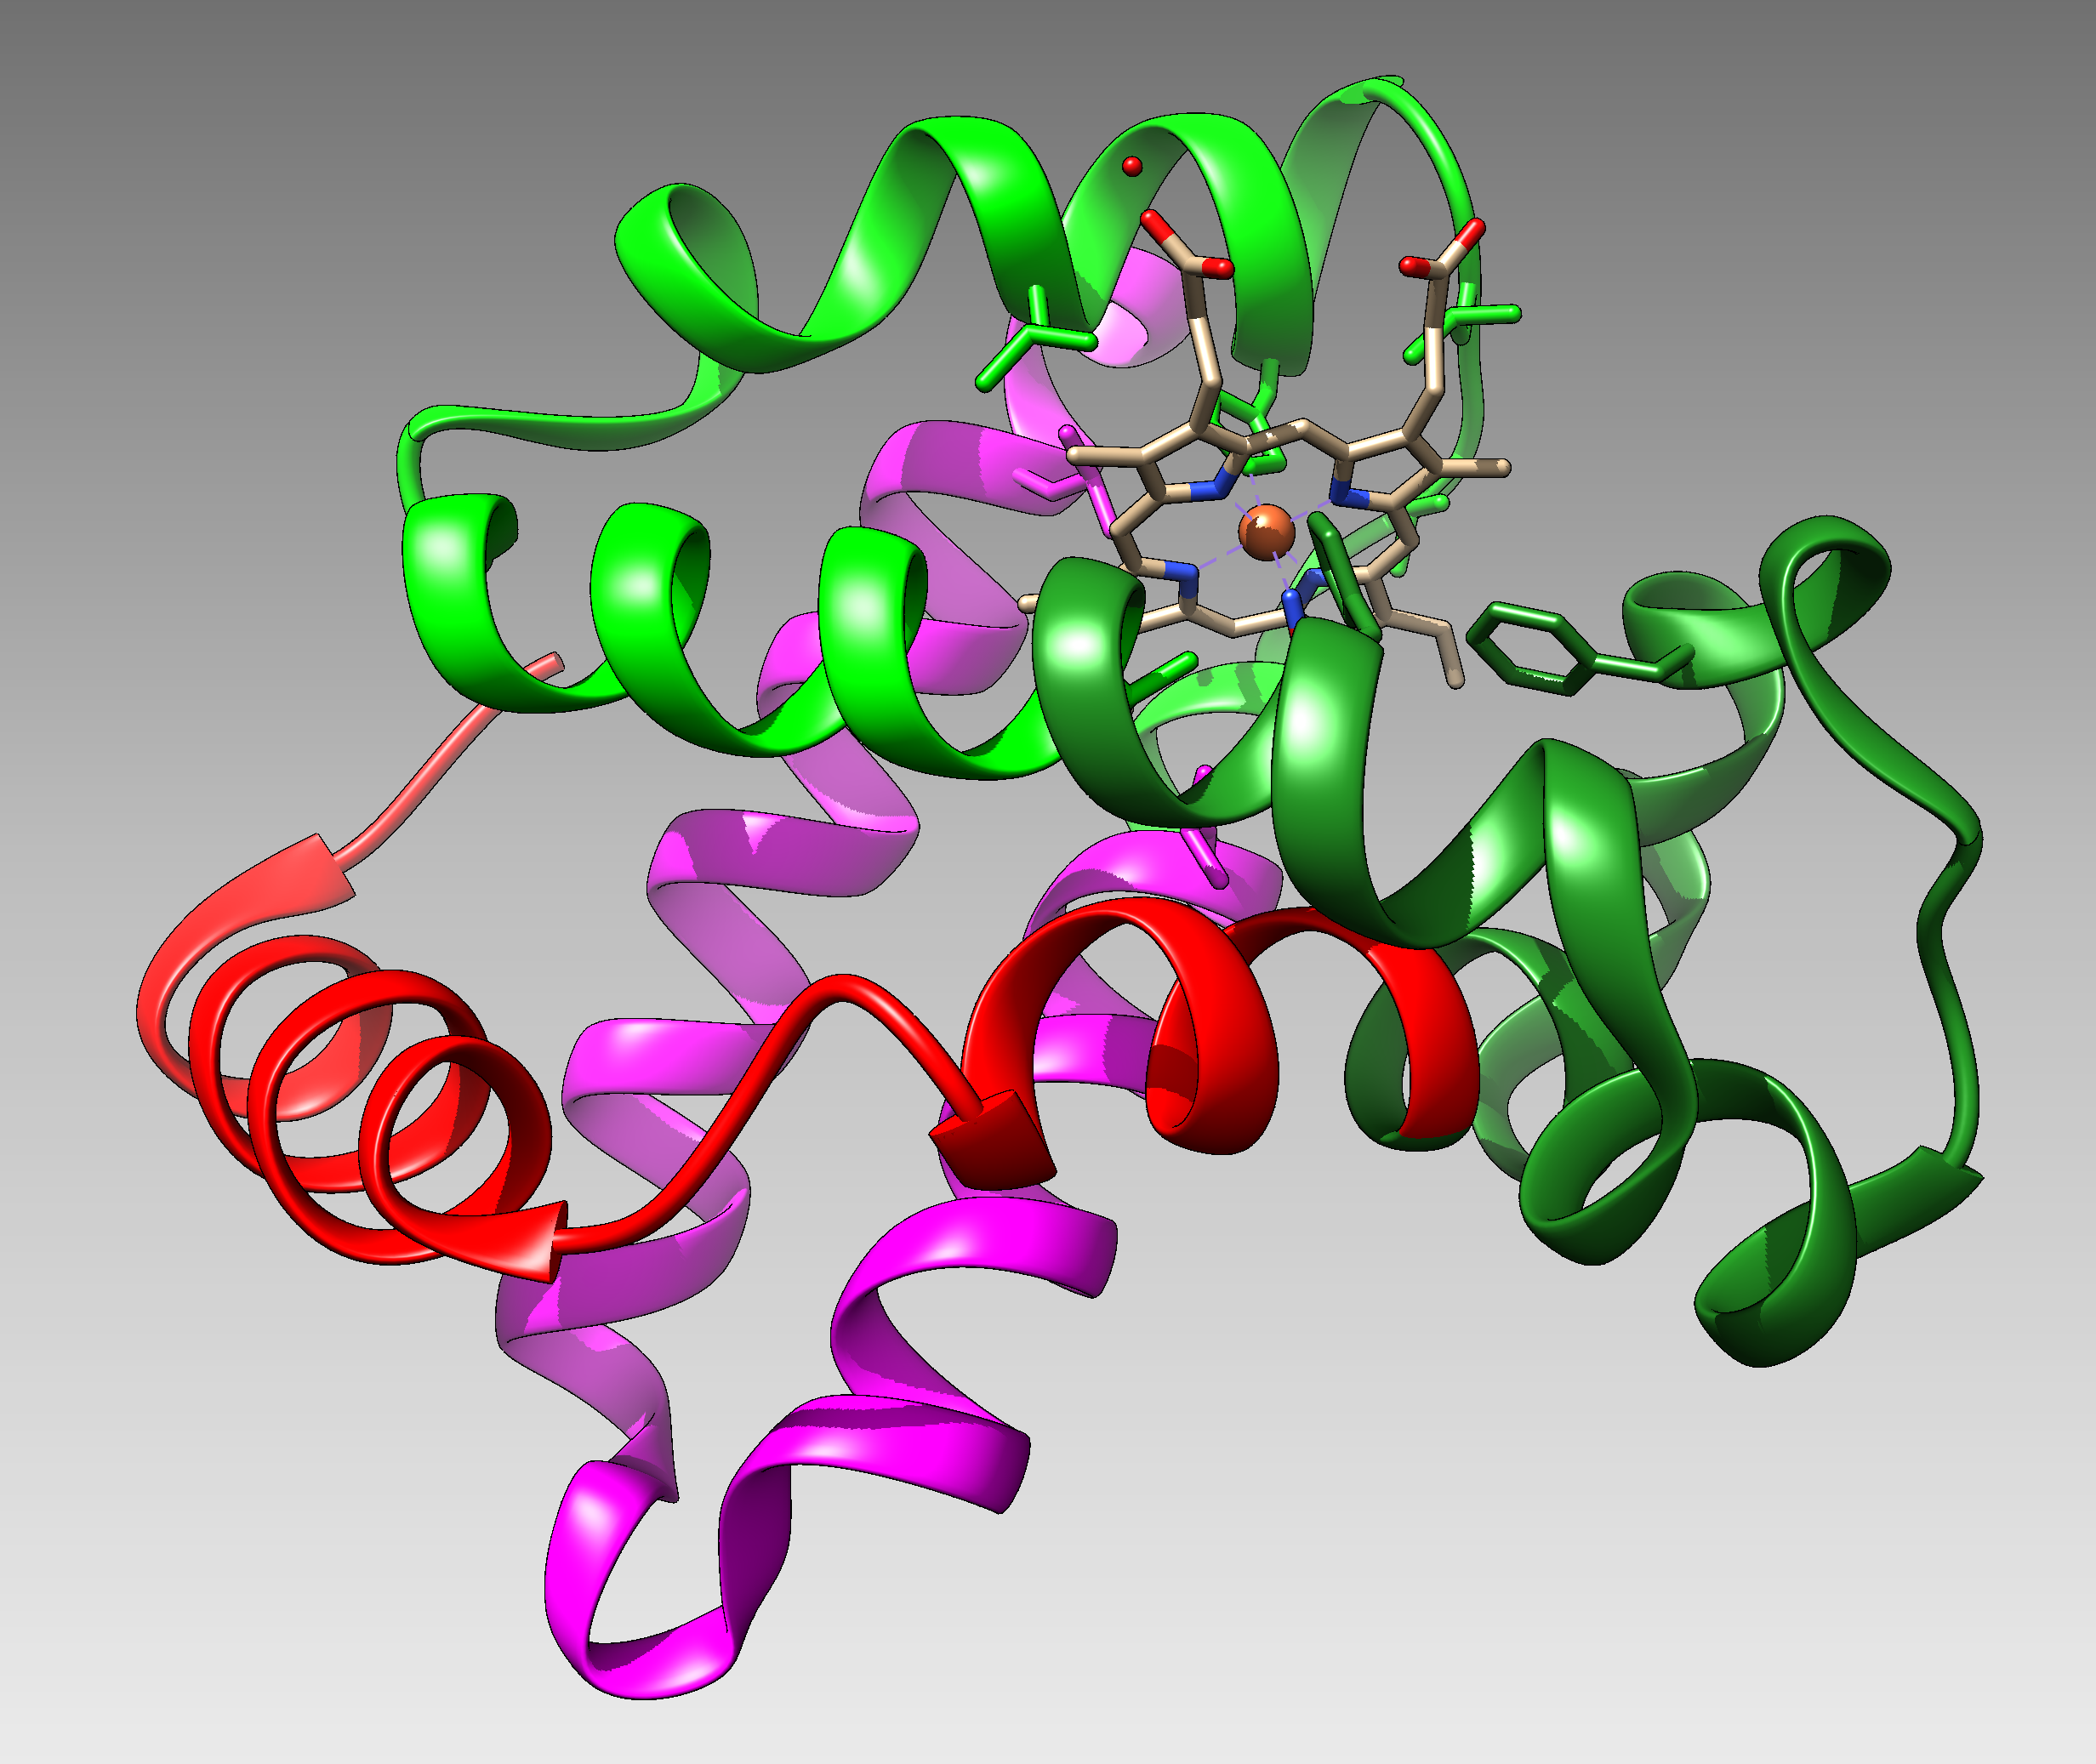
From:
Correlation of DNA exonic regions with protein structural units in haemoglobin
Mitiko Gō
Nature volume 291, pages90–92(1981)
beta SU from 4N8T Go domains colored
F1
F2
F3
F4

Slide 5
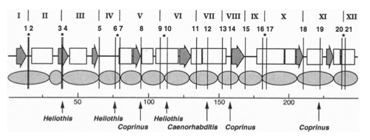

Slide 6
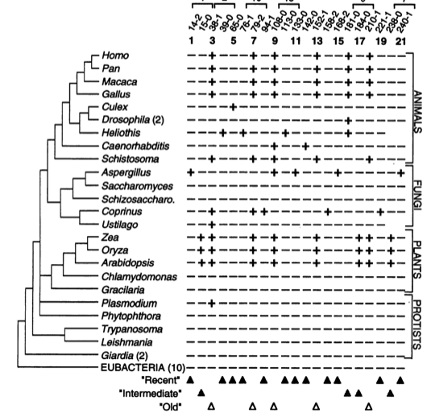

Slide 7
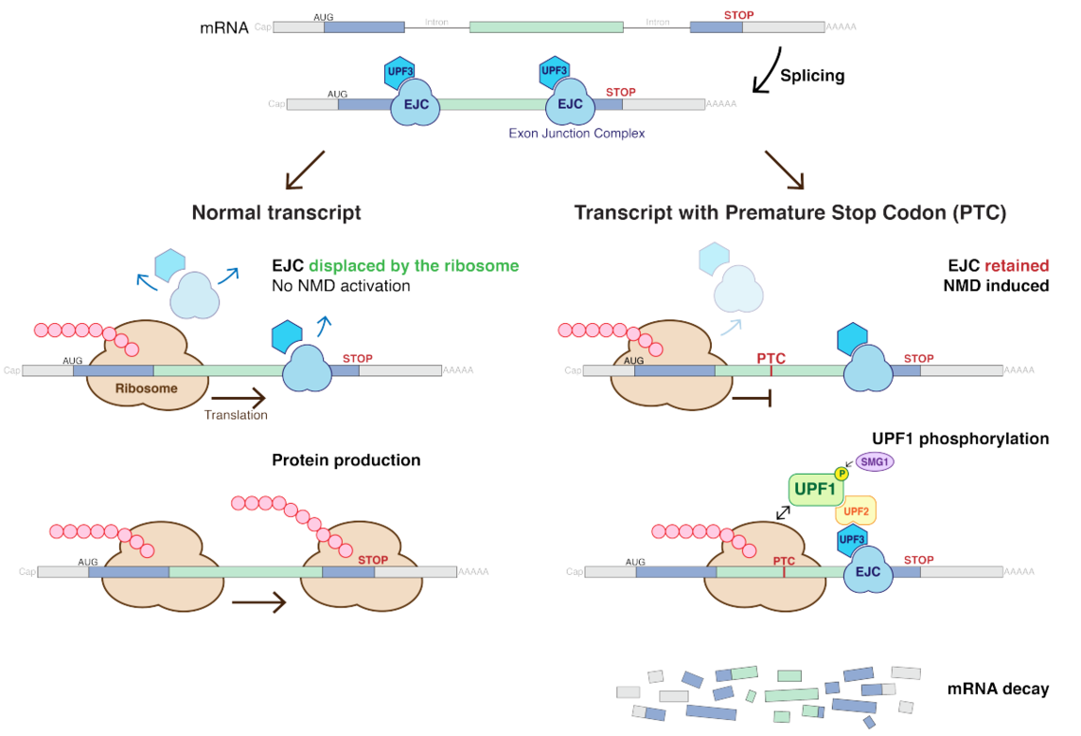
Nonsense-mediated mRNA decay (NMD) pathway
/
/
From:
https://en.wikipedia.org/wiki/Nonsense-mediated_decay
More details at https://en.wikipedia.org/wiki/MRNA_surveillance

Slide 8
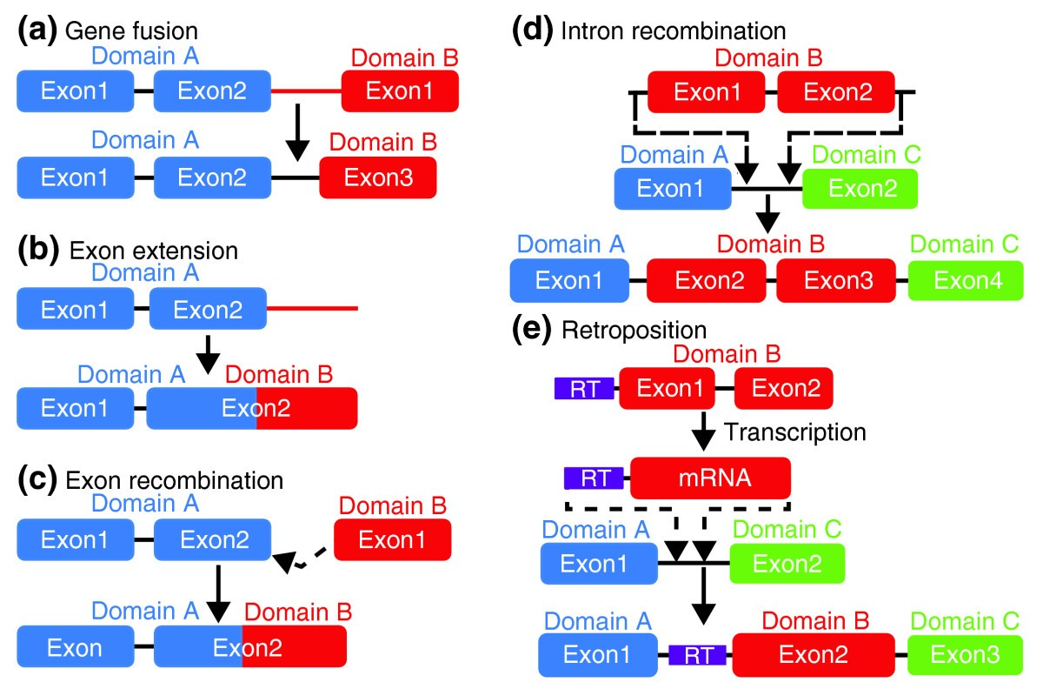
From: How do proteins gain new domains?
(a) Gene fusion. The noncoding region between two genes is modified so that the exons of the first gene become spliced with the second. (most common in animals)
(b) Exon extension. The noncoding region following an exon becomes part of the exon and codes for a new domain.
(c) Exon recombination. The exons of two genes become directly joined.
(d) Intron recombination. An exon from one gene is inserted into the intron of another. (rare Less than 10%)
(e) Retroposition. A retrotransposon sequence (RT, purple) mediates the copying of itself and a neighboring gene region via an mRNA intermediate, followed by insertion into another gene. (Rare (?) Gained domain encoded by a single exon).
/
Data from https://www.ncbi.nlm.nih.gov/pmc/articles/PMC2926785/

Slide 9
Other possible benefits of introns
Alternative Splicing
Exon shuffling
If splicing is skipped the intron sequence can become a novel exon.

Slide 10
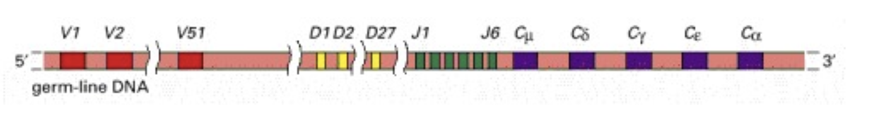
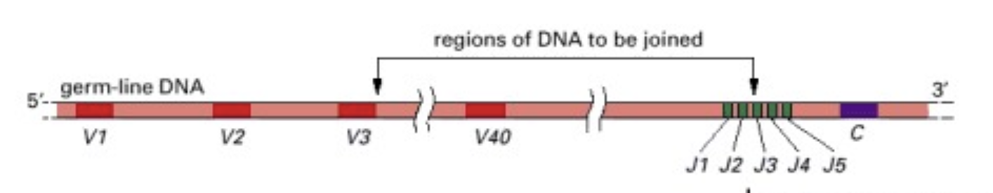
Possible benefits of having intein
Exon shuffling
Genes for the IgG heavy chain
51x27x6x5 = 41,310 different combinations
Genes for the IgG light chain
40x 5 = 200 different combinations
If the assembly of the light and heavy chain one region V (D) J are joined together 8,262,000 different antibodies can be produced through exon shuffling.
In the maturation of B cells additional mutations further increase diversity.
From: https://www.ncbi.nlm.nih.gov/books/NBK26860/

Slide 11
Introns early
Introns late
Self splicing RNAs are an example for catalytic RNA that could have been present in RNA world.
There is little reason to assume that the RNA world was not plagued by self-splicing parasites.
Neighboring Introns are more frequently in same phase than expected by chance (but not by much ☺)
Spliceosomal introns are present in deep branching eukaryotes
Introns frequently are found in linker regions (see Go plots)
Exon shuffling can create a large number of different catalytic sites (see the maturation of the immune system)
The nonsense mediated decay pathway exists in plants, animals and fungi. This pathway relies on tagging Exon Junction Complexes, i.e. the widespread presence of spliceosomal introns.
Mapping individual introns onto organismal evolutionary history shows that many introns inserted into the sites where they are found presently more recently.
Slight intron preference for linker regions could be the result of selection (they do less harm here than in tightly packed domains.
Exon shuffling in the maturation of the adaptive immune system is a modern trait of vertebrates.
Even if some introns are ancient, this does not prove that they played a role in assembling the now existing protein families.
In the recent evolution (in the presence of many large introns), recombination in introns (exon shuffling appears to be rare – gene fusions are more common)
Neighboring introns often are not in same phase of the open reading frame (recombination in the introns and alternative splicing then would results in frameshift mutations).

Slide 12
Predicting Open Reading Frames
GeneMark uses hidden Markov models and can be trained using training sets
-- works for pro- and eukaryotes and metagenomes
-- GenemarkS is the “standard to gene calling in viruses and prokaryotes
Glimmer was developed for prokaryotes,
-- a related software (GlimmerHMM) was developed for eukaryotes
Keep in mind that ab initio approaches work less well than those based on homology.
Popular are
PROKKA (described here)
RAST
Both rely on homology and already annotated similar genomes.
The cycle of identifying essential genes (aatRNAsynthases, DNA and RNA polymerases, ATPsynthases), and using these to train gene prediction software seems to work well.

Slide 13
Strategies for extreme halophily
Exclude salts, balance with other osmotically active substances.
Balance external Na⁺ Cl⁻ with internal K⁺ Cl⁻
  This leads to very high internal K⁺ concentration (> 5M)
  At this ionic strength, the reach of a charge on a protein does not reach very far.
  To compensate, proteins in organisms following the salt in strategy have many
  negative charges.
  Consequently, most proteins have an acidic isoelectric point.

Slide 14
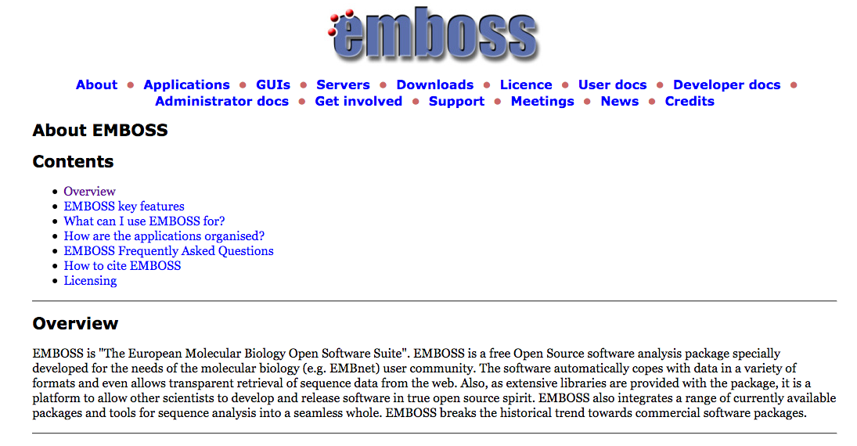

Slide 15
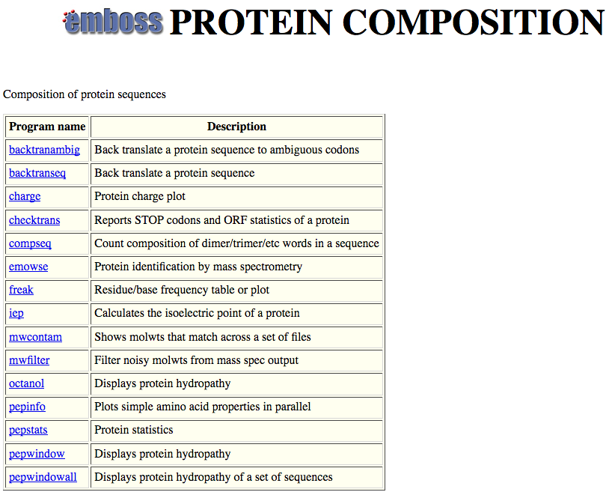

Slide 16
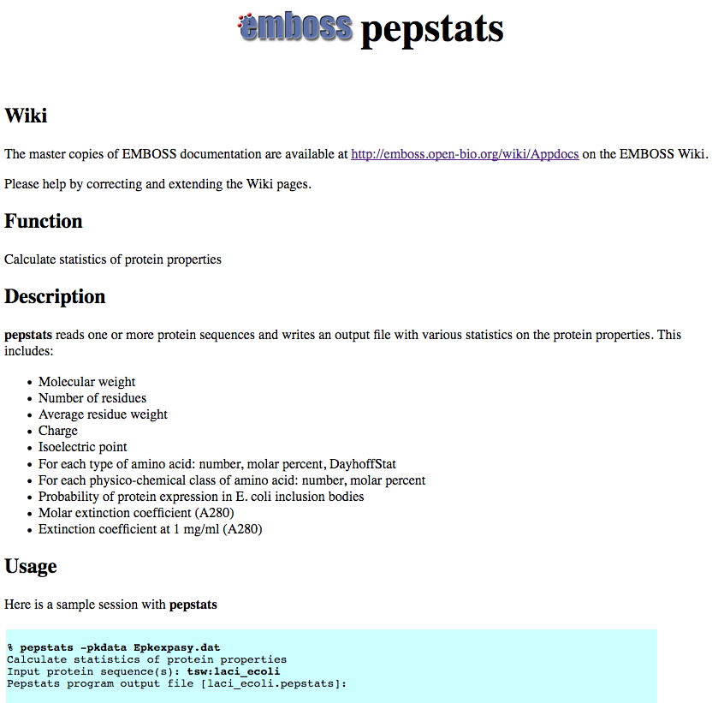

Slide 17
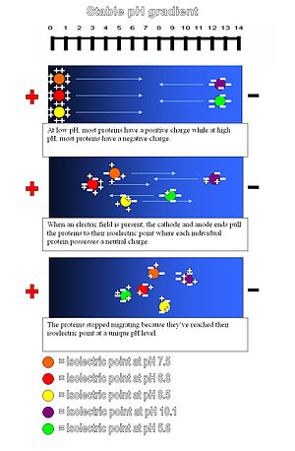
Isoelectric point (pI) of a protein:
The pH at which the net charge of the protein is zero.
This can be experimentally determined using isoelectric focusing gels (Figure).
Theoretical pI is calculated from the pKs of the individual amino acids.

Slide 18
PEPSTATS of QAY18538.1 from 1 to 580
Molecular weight = 64213.14 Residues = 580
Average Residue Weight = 110.712 Charge = -74.0
Isoelectric Point = 3.9355
A280 Molar Extinction Coefficients = 21890 (reduced) 22140 (cystine bridges)
A280 Extinction Coefficients 1mg/ml = 0.341 (reduced) 0.345 (cystine bridges)
Probability of expression in inclusion bodies = 0.979
Residue Number Mole% DayhoffStat
A = Ala 46 7.931 0.922
B = Asx 0 0.000 0.000
C = Cys 4 0.690 0.238
D = Asp 81 13.966 2.539
/.../
Property Residues Number Mole%
Tiny (A+C+G+S+T) 157 27.069
Small (A+B+C+D+G+N+P+S+T+V) 328 56.552
Aliphatic (A+I+L+V) 169 29.138
Aromatic (F+H+W+Y) 38 6.552
Non-polar (A+C+F+G+I+L+M+P+V+W+Y) 267 46.034
Polar (D+E+H+K+N+Q+R+S+T+Z) 313 53.966
Charged (B+D+E+H+K+R+Z) 196 33.793
Basic (H+K+R) 63 10.862
Acidic (B+D+E+Z) 133 22.931

Slide 19
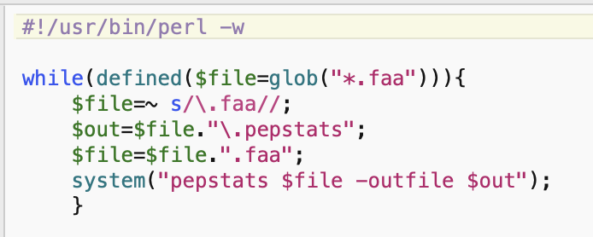
run_pepstats.pl

Slide 20
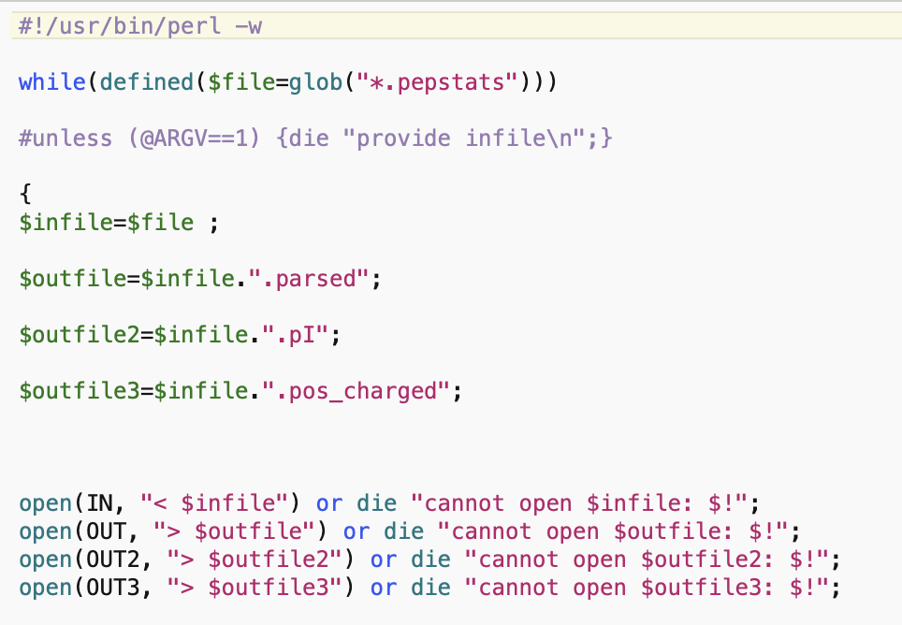
parse_pepstats.pl

Slide 21
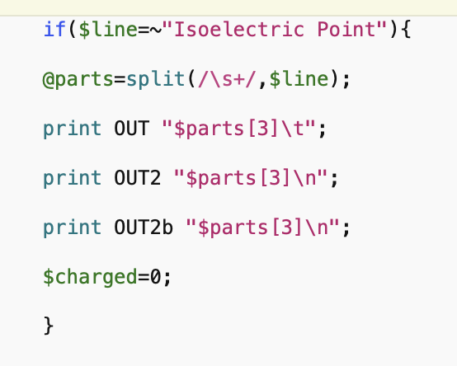
parse_pepstats_mod.pl

Slide 22
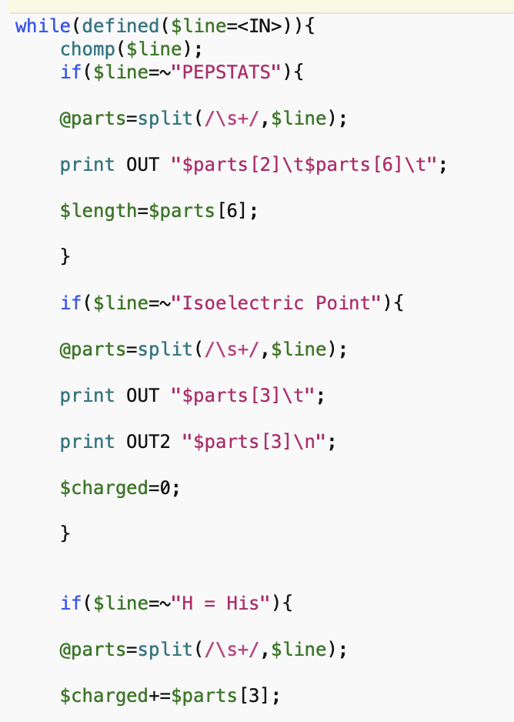
parse_pepstats.pl

Slide 23
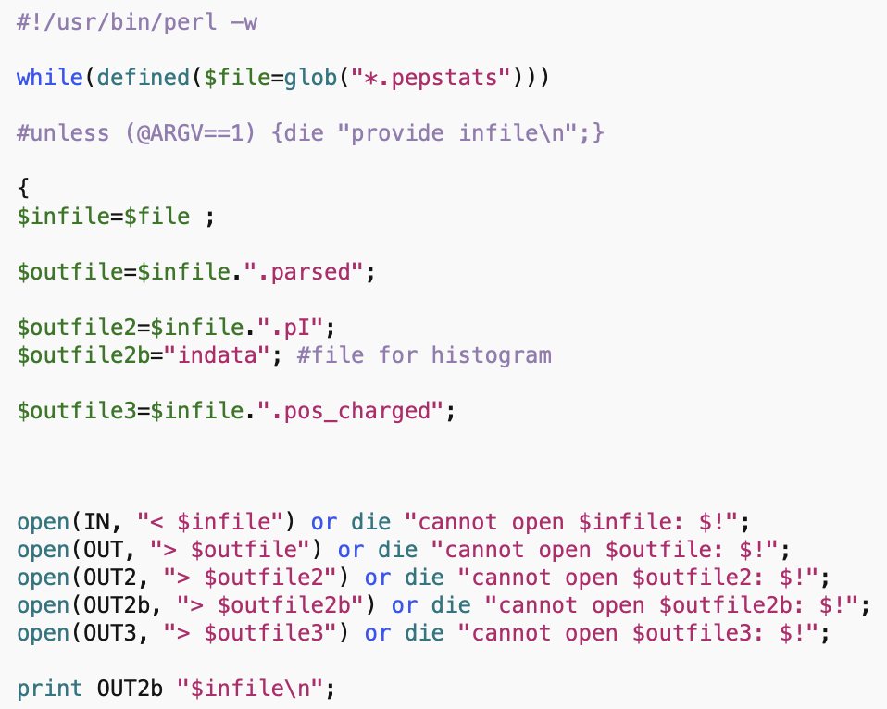
parse_pepstats_mod.pl

Slide 24
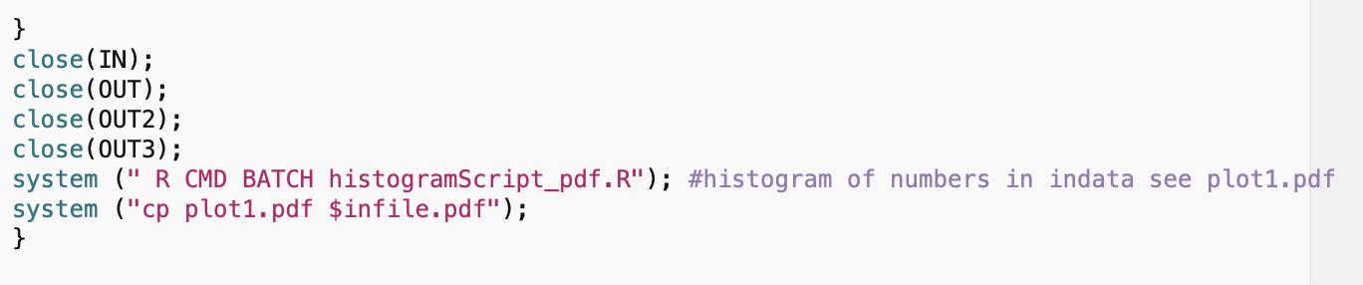
parse_pepstats_mod.pl

Slide 25
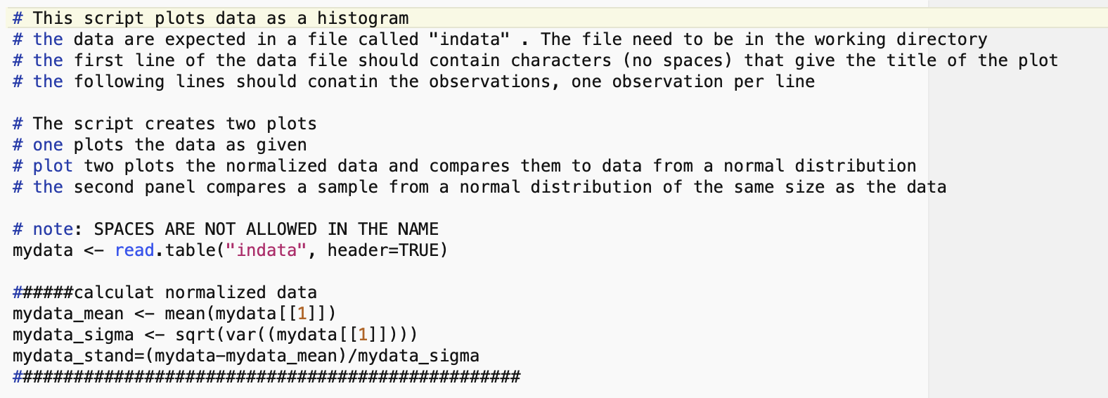
histogramScript_pdf.R

Slide 26
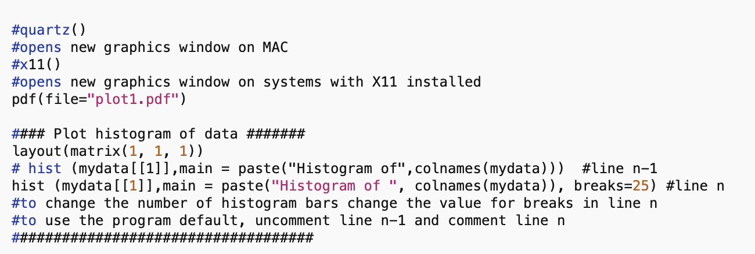
histogramScript_pdf.R

Slide 27
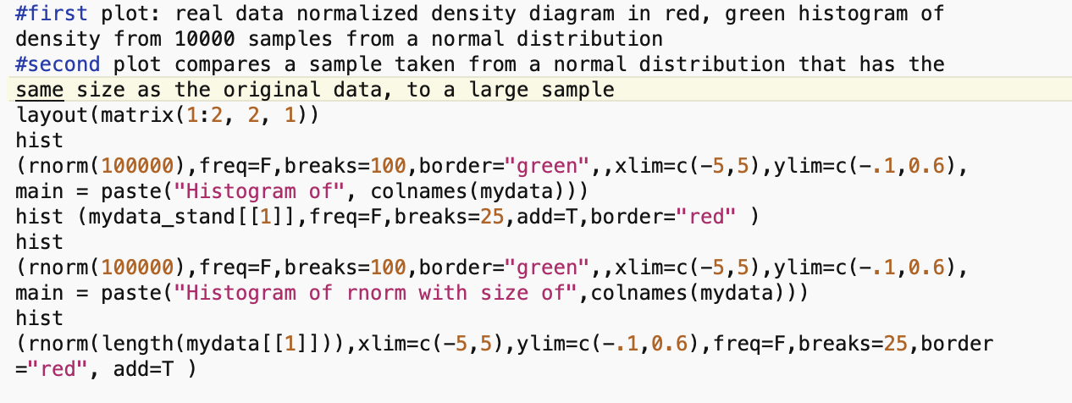
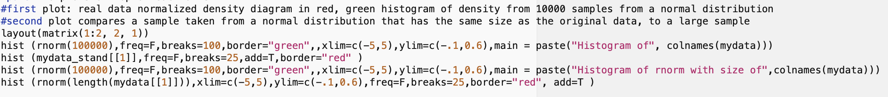
histogramScript_pdf.R

Slide 28
pH at which protein has no charge

Slide 29
positive charge at
neutral pH
negative charge at neutral pH
pH at which protein has no charge

Slide 30
DNA, cell wall & membrane bound proteins
pH at which protein has no charge

Slide 31
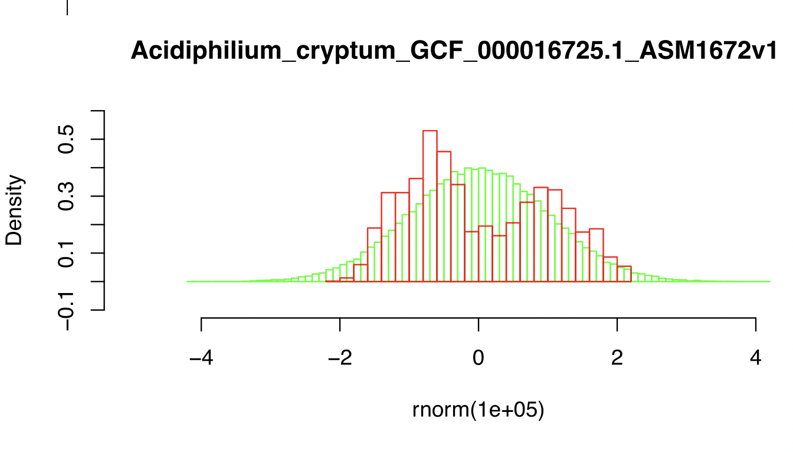

Slide 32
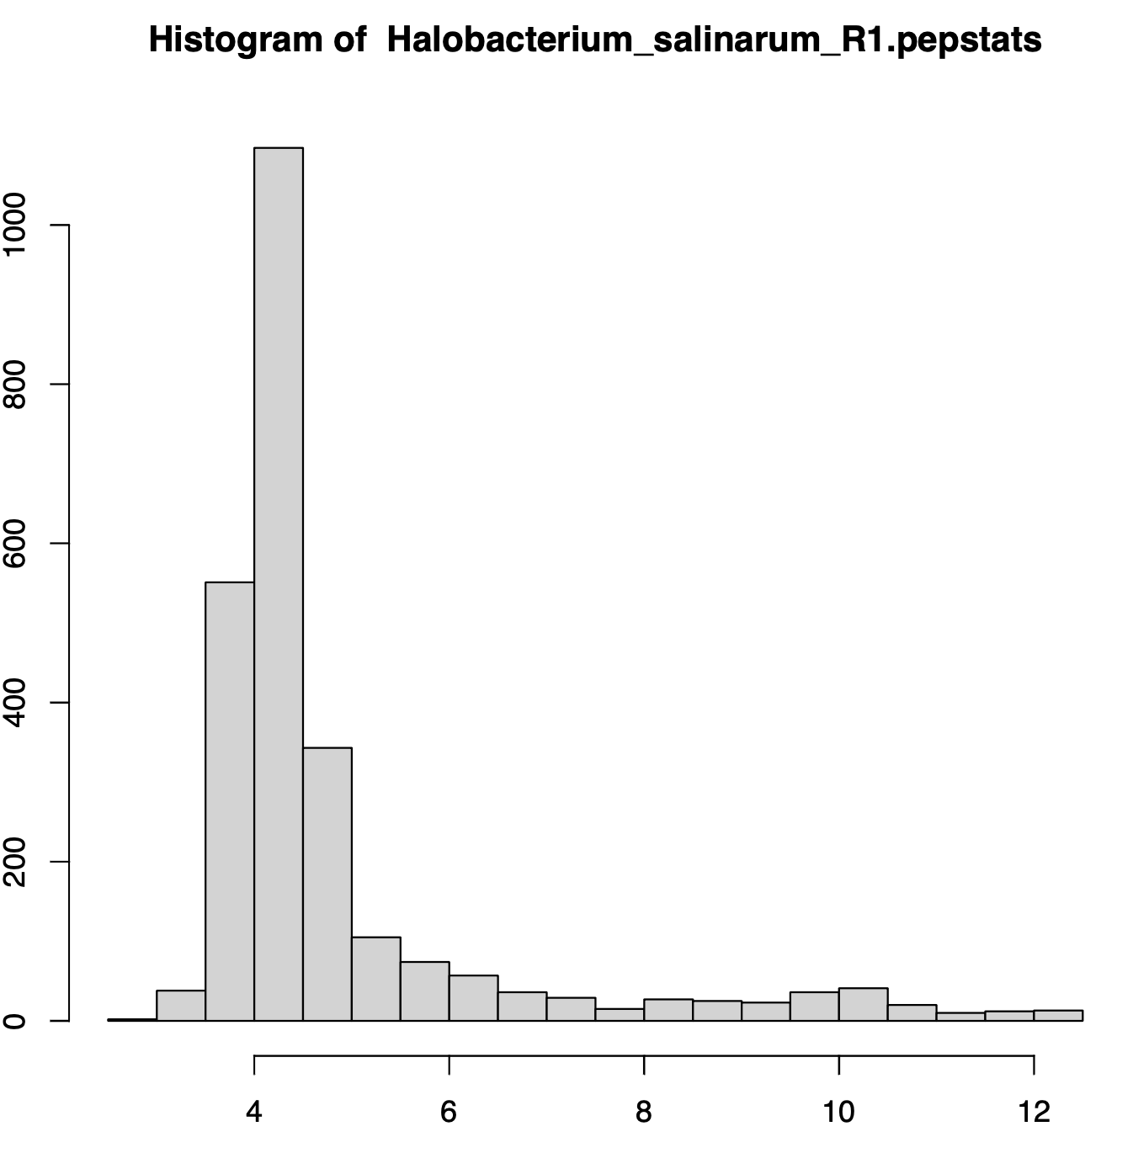
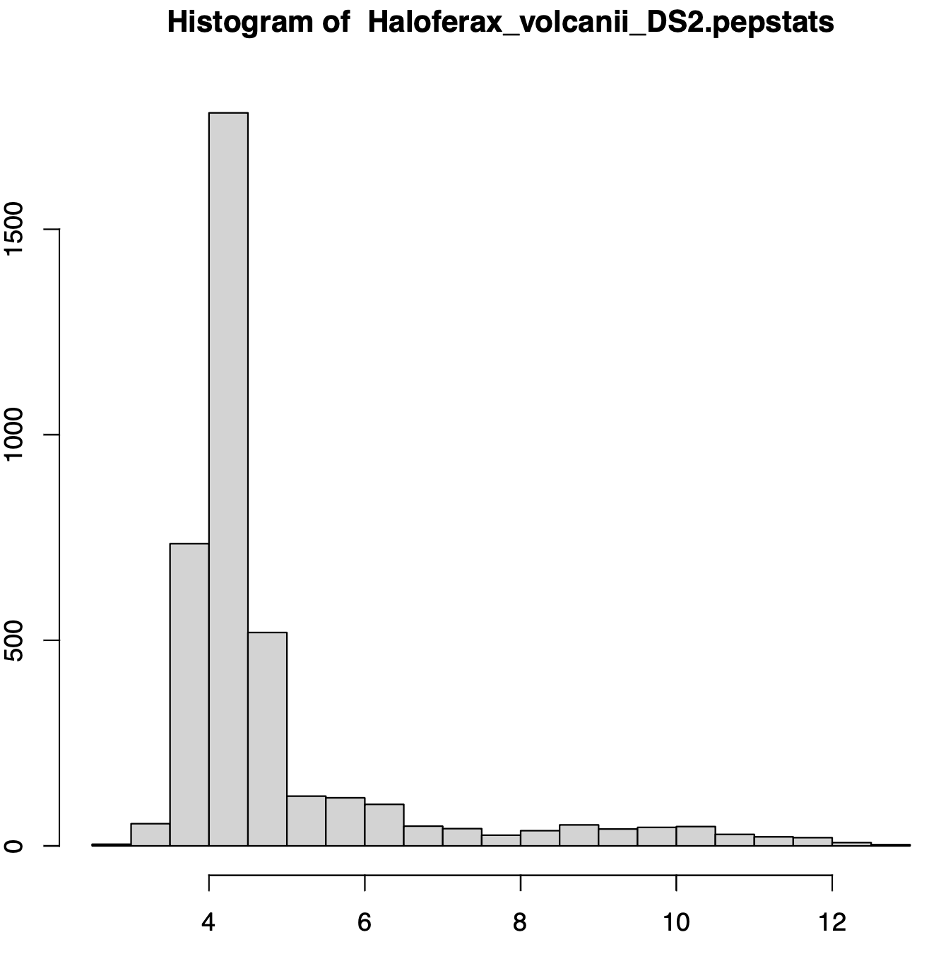
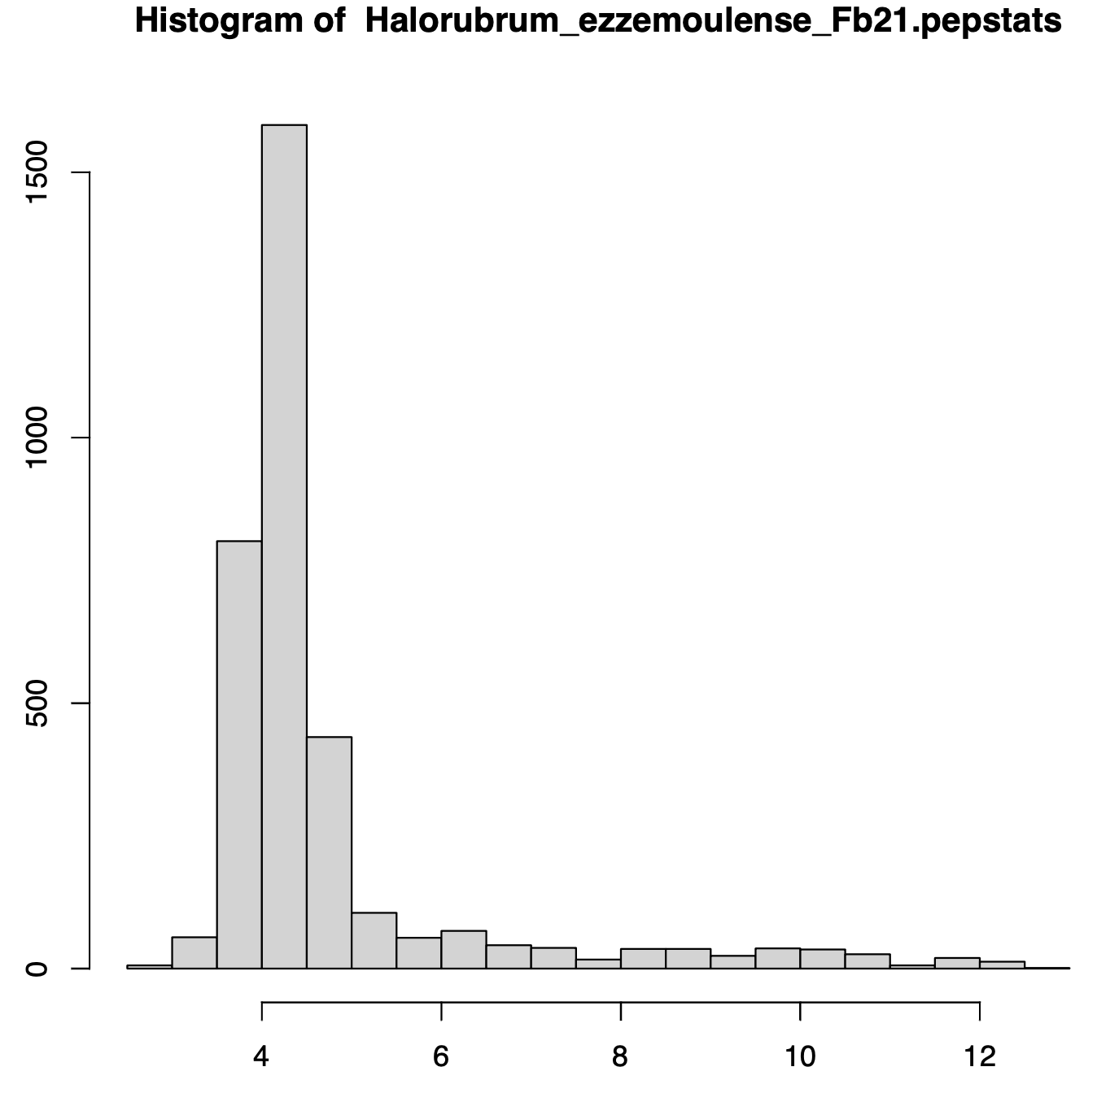
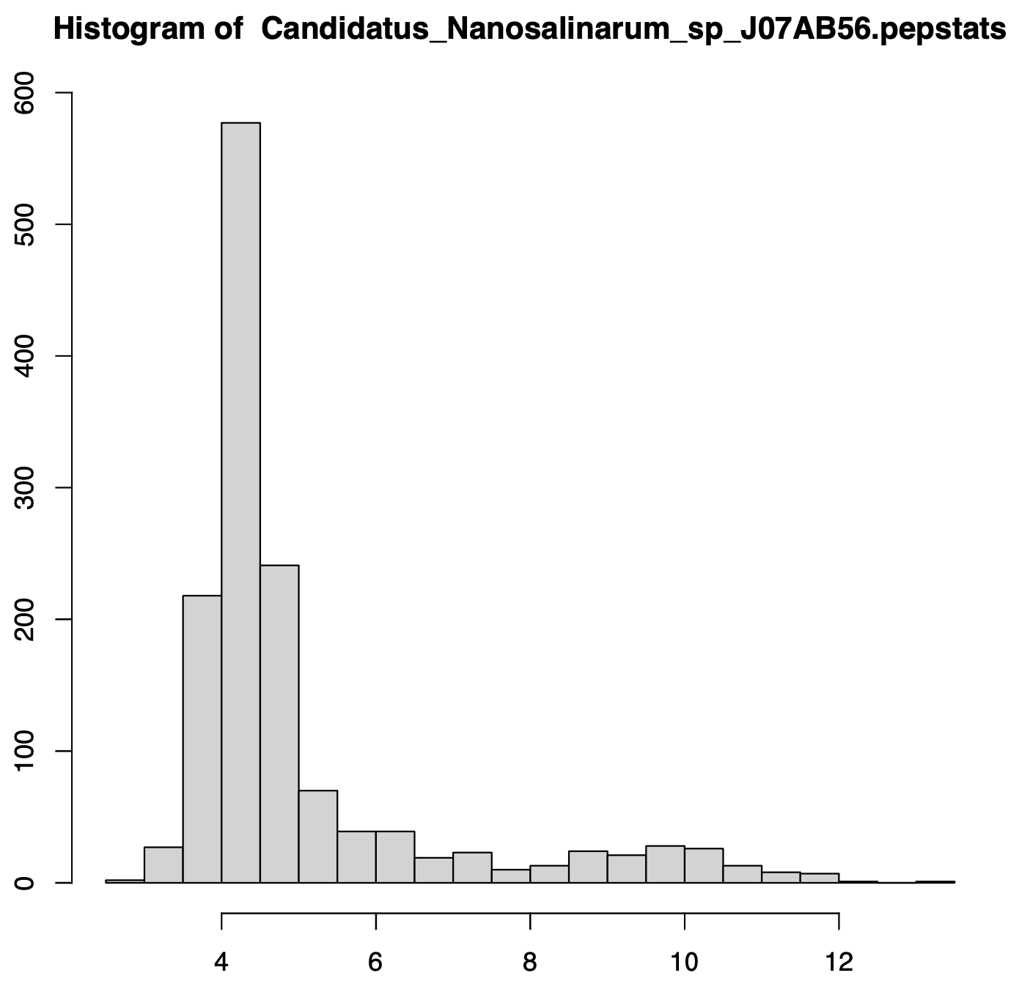
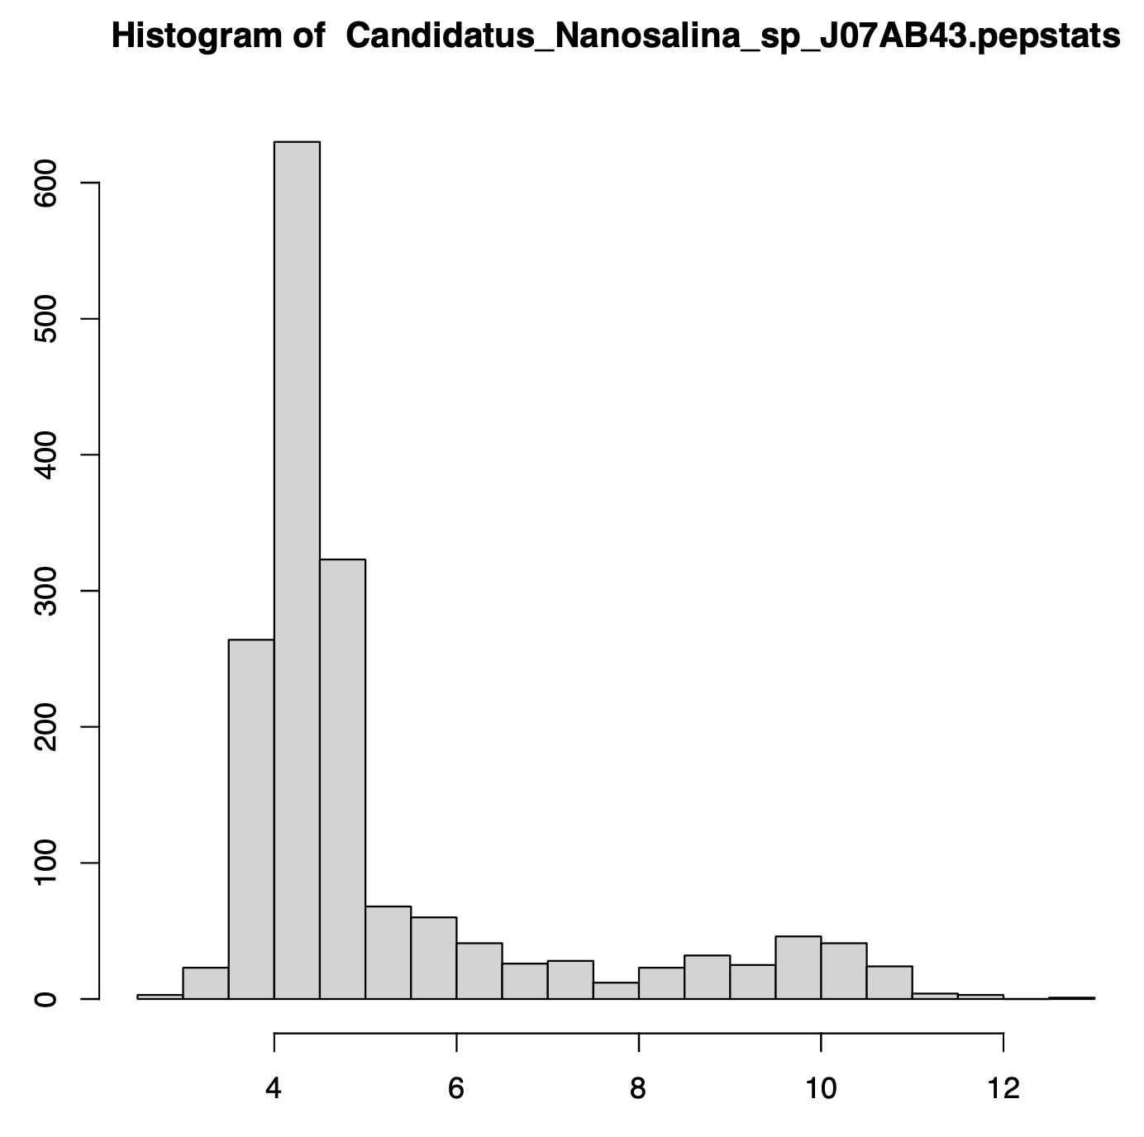

Slide 33
Green: Normal distribution with 100,000 samples
Red: Actual theoretical IEP data
Green: Normal distribution with 100,000 samples
Red: Normal distribution with same number of samples as real data

Slide 34
DNA, cell wall & membrane bound proteins
pH at which protein has no charge
What does this say about the cytoplasmic pH in Thermoplasma (a thermoacidophile, some measurements had suggested an acidic cytoplasmic pH)?
compare https://pubmed.ncbi.nlm.nih.gov/12804/ and
https://www.ncbi.nlm.nih.gov/pmc/articles/PMC214861/

Slide 35
Histogram of theoretical isoelectric points of Thermplasmatales proteins
What does this say about the cytoplasmic pH in Thermoplasma (a thermoacidophile, some measurements had suggested an acidic cytoplasmic pH)?
compare https://pubmed.ncbi.nlm.nih.gov/12804/ and
https://www.ncbi.nlm.nih.gov/pmc/articles/PMC214861/
pH at which protein has no charge

Slide 36
pH at which protein has no charge

Slide 37
Histogram of theoretical isoelectric points of Saccharomyces proteins
DNA, cell wall & membrane bound proteins
pH at which protein has no charge

Slide 38
Strategies for extreme halophily
Exclude salts, balance with other osmotically active substances.
Balance external Na⁺ Cl⁻ with internal K⁺ Cl⁻
This leads to very high internal K⁺ concentration (> 5M)
At this ionic strength, the reach of a charge on a protein does not reach very far.
To compensate, proteins in organisms following the salt in strategy have many negative charges.
Consequently, most proteins have an acidic isoelectric point.

Slide 39
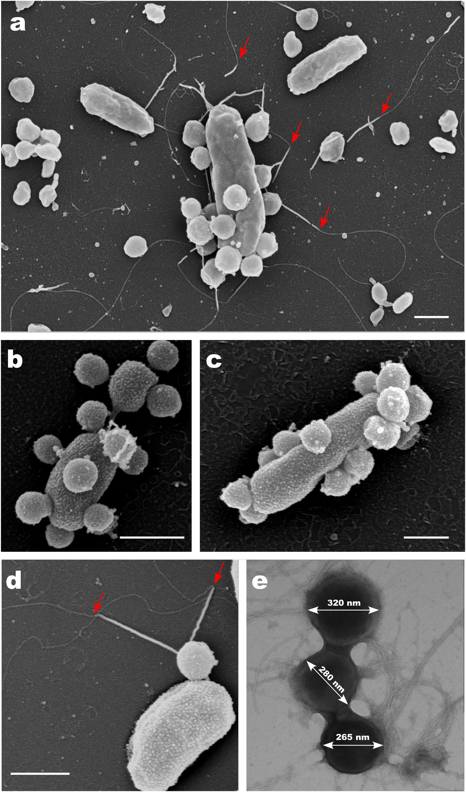
Nanohaloarchaea are ectosymbionts of Haloarchaea
The phylogenetic position of Nanohaloarchaea is uncertain. The have small genomes, experience high substitution rates and have the same compositional bias as Haloarchaea. Today most often they are considered part of a superphylum of small divergent archaea (DPANN), but this may be an artifact due to high substitution rates. On the other hand, housekeeping genes tend to group them with Haloarchaea, but this may reflect gene transfer or compositional bias.
From: Symbiosis between nanohaloarchaeon and
haloarchaeon is based on utilization of different
polysaccharides
https://doi.org/10.1073/pnas.2007232117

Slide 41
Histogram of theoretical isoelectric points of Haloferax proteins
Salt in strategy
At neutral pH most proteins with negative charge
pH at which protein has no charge

Slide 44

Do the SET survey!
(from https://www.reddit.com/r/school_memes/ )

Slide 45

Reminder
Be Nice !
Do the SETs !
Columbia from https://en.wikipedia.org/wiki/Uncle_Sam

Slide 46
Constructive Neutral Evolution with special emphasis on Inteins

Slide 47
Genetic Drift: the fixation of a selectively neutral or nearly neutral mutation in a population
The smaller a population, the more slightly deleterious mutations can be fixed due to genetic drift.

Slide 48
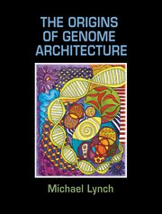
Michael Lynch
The Origins of Genome Architecture
Argues that most features in eukaryotic genomes arose because populations of eukaryotic organism (larger cell size) were much smaller than for prokaryotes.
This includes introns, the proliferation of repetitive elements, mRNA editing, gene duplications and the emergence of protein-protein interactions turning proteins to become parts of complicated multi subunit complexes.
The book is available through the UConn library online (but reading it in a browser is rather tedious).

Slide 49
Note: The percentage of coding DNA is small in animals and plants, the amount of intergenic and intron DNA increases.
Aside: an ongoing debate on the functionality of intergenic DNA continues. See the discussion of the encode project here and here).
The onion test is a good exercise for those thinking that most intergenic DNA has important functions in animals and especially humans.

Slide 50
Cord scrambling as example for the directionality that may be present in random mutations
From Arlin Stolzfus, Biol. Direct.
https:/ /biologydirect.biomedcentral.com/articles/10.1186/1745-6150-7-35
Increase in complexity can be due to drift not better function (at least initially to the contrary).

Slide 51
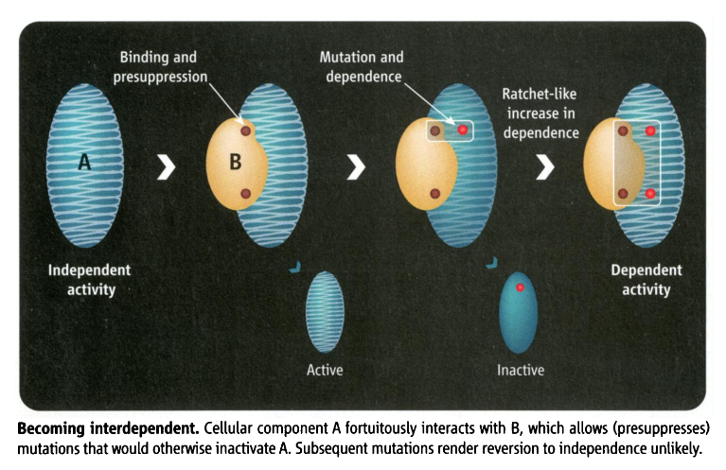
Mutations can have a directing force
Constructive neutral evolution:
Random interactions between macromolecules lower the overall free energy, leading to more stability, allowing for destabilizing mutations to occur. The mutated macromolecule remains stable and active, as long as the binding partner is present.
From: Irremediable Complexity?
Author(s): Michael W. Gray, Julius Lukeš, John M. Archibald, Patrick J. Keeling and W. Ford Doolittle
Source: Science, New Series, Vol. 330, No. 6006 (12 November 2010), pp. 920-921

Slide 52
Constructive Neutral Evolution
An organism acquires neutral or only slightly deleterious mutations or traits.
Other mutations or events compensate (or pre-supress) for deleterious effect.
The reversal of the mutation is improbable (there are more ways to scramble things than to unscramble them).
The presence of these compensating processes becomes a necessity to achieve the original function.
At no point along the process did the mutations or events increase the fitness of the organism (which does not say that the complex feature later may evolve useful functions).
The outcome is a complex process that requires cooperation between different components to fulfill the same function as the original process.
CNE occurs more frequently in organisms with small effective populations (See Michael Lynch’s “Evolution of genome architecture”)

Slide 53
CNE Examples (may be)
Interactions between macromolecules
Multisubunit homomers -> heteromers (histones, tubulins, ATP synthase, proteasome)
Large protein-RNA complexes (Spliceosome, Ribosome)
Split Inteins / Spliceosomal Introns
Subfunctionalization (maintaining duplicated genes)
RNA editing
Alternative splicing
? Fixation of introns/inteins in a population
(mobile genetic elements have their own agenda, and their fixation can be driven by the fitness advantage to themselves)

Slide 54
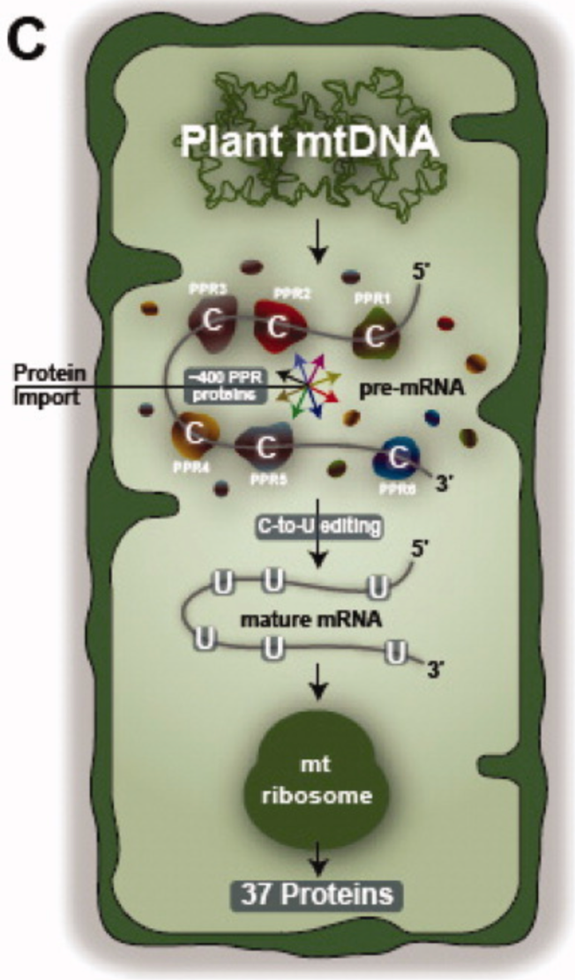
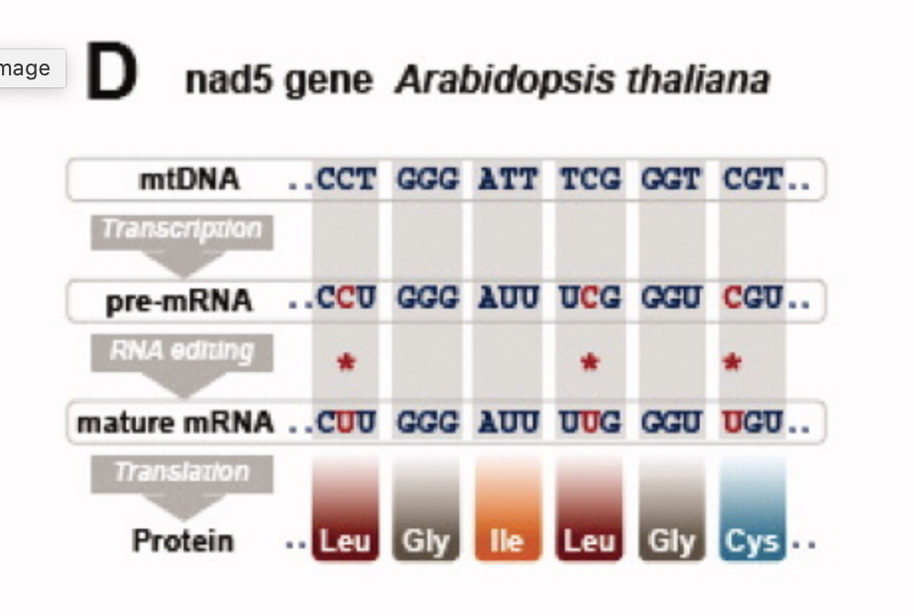
From: https://iubmb.onlinelibrary.wiley.com/doi/full/10.1002/iub.489

Slide 55
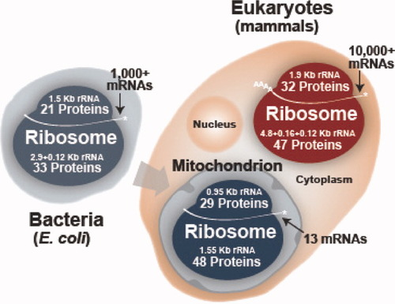
From: https://iubmb.onlinelibrary.wiley.com/doi/full/10.1002/iub.489

Slide 56
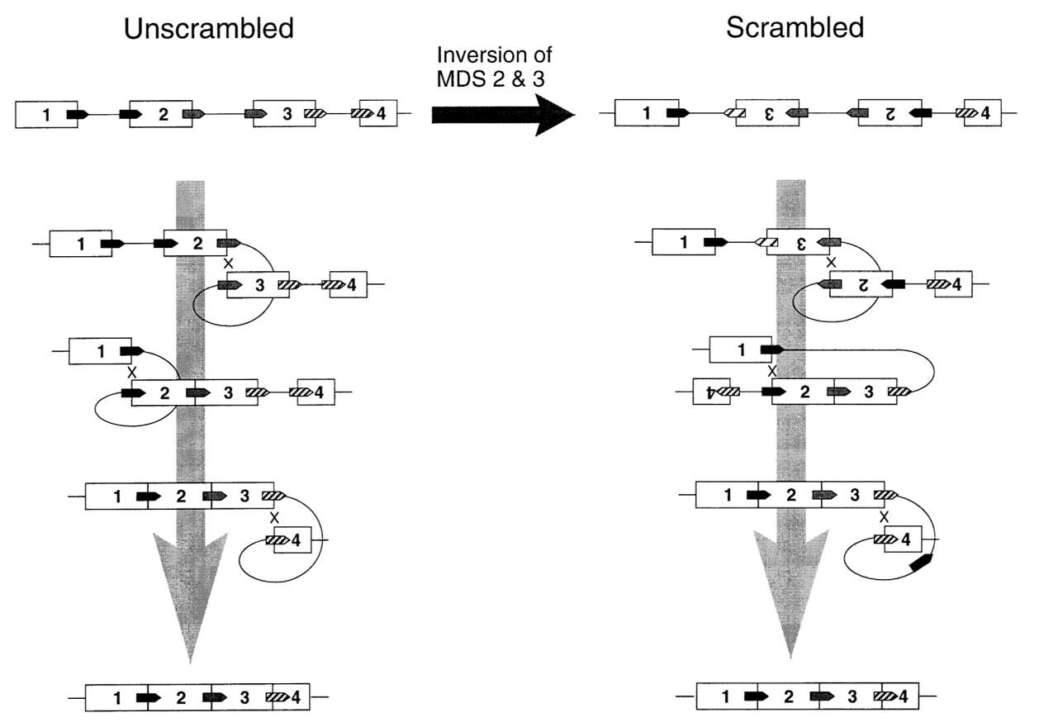
Gene Unscrambling in Ciliates
Micro to Macro Nucleus
From: Arlin Stoltzfus
On the Possibility of Constructive
Neutral Evolution
https://link.springer.com/article/10.1007%2FPL00006540
See also
https://www.pnas.org/content/97/7/3298

Slide 57
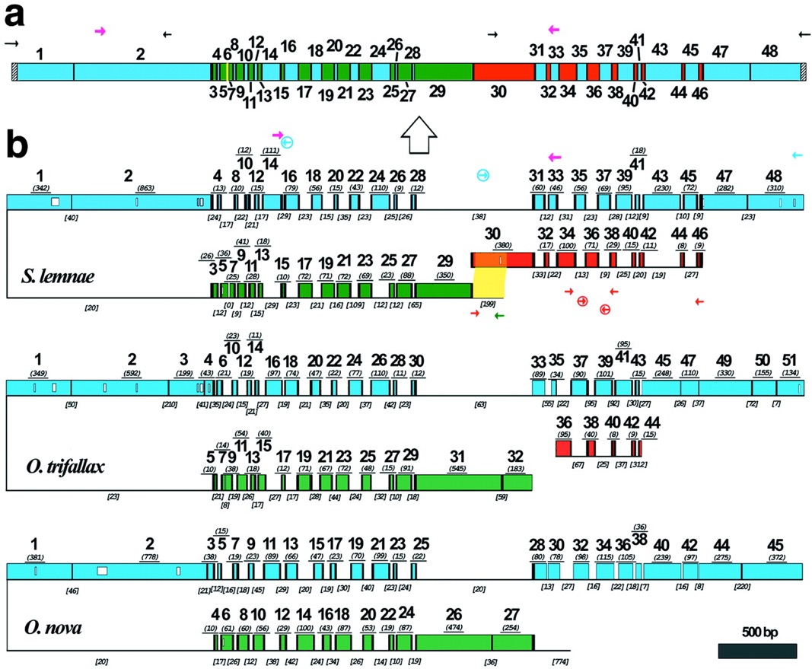
Gene Unscrambling in Ciliates
Micro to Macro Nucleus -- DNA polymerase α gene in hypotrichous ciliates
Evolution and assembly of an extremely
scrambled gene
Laura F. Landweber, Tai-Chih Kuo, and
Edward A. Curtis
From:
https://www.pnas.org/content/97/7/3298

Slide 58
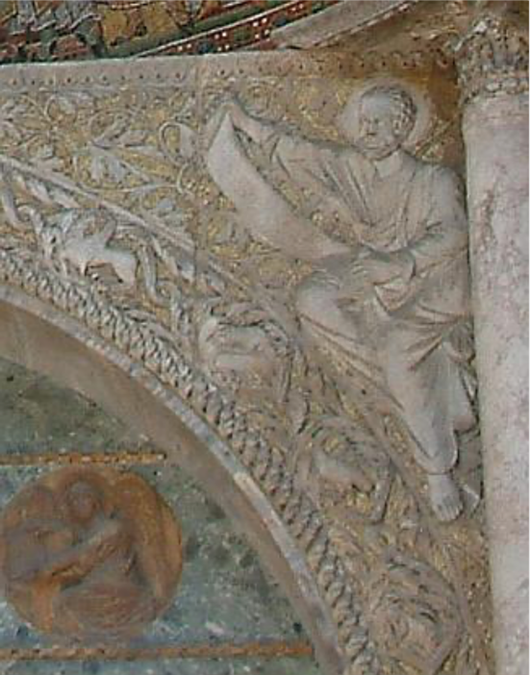
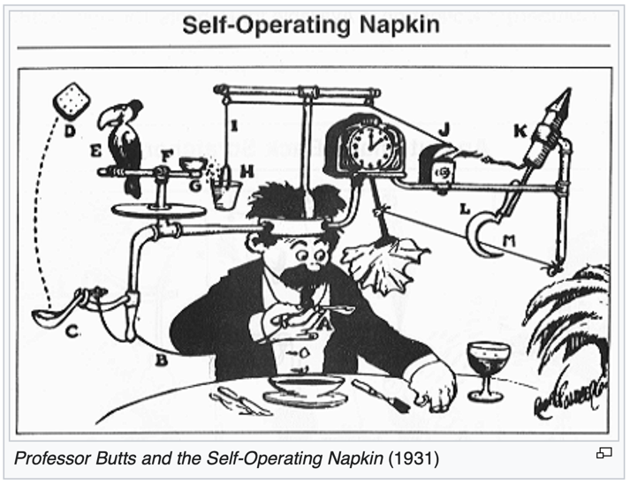
Related Concepts
Increased complexity in small populations
Subfunctionalization to maintain gene duplications (also here)
The Spandrels of San Marco (Gould & Lewontin)
Biological Rube Goldberg machines.

Slide 59
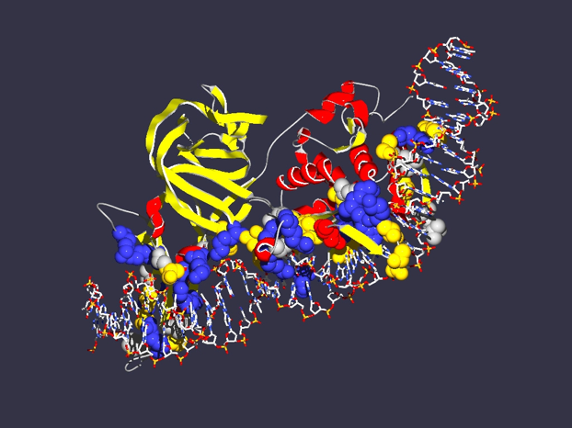
In case of inteins the co-evolution of genes results in
Mutualism between splicing and homing endonuclease domain
Commensalism between host protein and intein without HE domain
Parasitism between host protein and intein with HE
Encoding
1LWS
Extein = Host Protein
Intein Splicing Domain
Structure from Moure et al. (2002)
Nat.Struct.Biol. 9: 764-770
Homing Endonuclease (HE)
domain

Slide 60
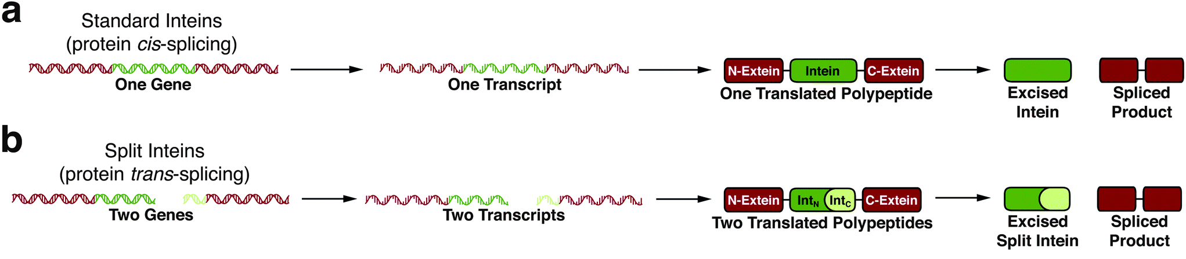
From: Inteins: nature's gift to protein chemists
Neel H. Shah and Tom W. Muir
DOI: 10.1039/C3SC52951G

Slide 61
Split inteins as an example for CNE
Transcribed
and translated
Functional replicative
DNA polymerase III
dnaE
dnaE
cis splicing
(difficult to revert, because no complete cDNA present)
dnaE1
Non-covalent inter-actions between N and C intein
trans splicing
dnaE2
Gene encoding extein
extein
Gene encoding splicing domains
Intein splicing domains
Gene encoding homing endonuclease domain
Intein homing endonuclease domains

Slide 62
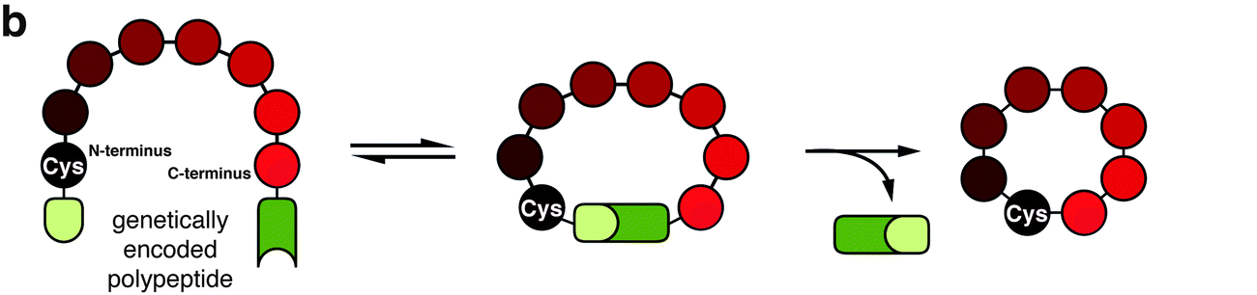
From: Inteins: nature's gift to protein chemists
Neel H. Shah and Tom W. Muir
DOI: 10.1039/C3SC52951G

