Slide 1
Lecture 26
Discussion of Lab 13 and
Constructive neutral evolution
Notes:
b discussion and

Slide 2

Reminder
Be Nice !
Do the SETs
Columbia from https://en.wikipedia.org/wiki/Uncle_Sam

Slide 3
DNA, cell wall & membrane bound proteins
pH at which protein has no charge
Thermo-acidophiles have the same bimodal distribution as other bacteria.
No indication that these organisms have a more acidic intracellular pH.
Notes:
Aside on Thermoplasma intein splicing of A-subunit expressed in E.coli https://www.ncbi.nlm.nih.gov/pmc/articles/PMC60005/?tool=pubmed .

Slide 4
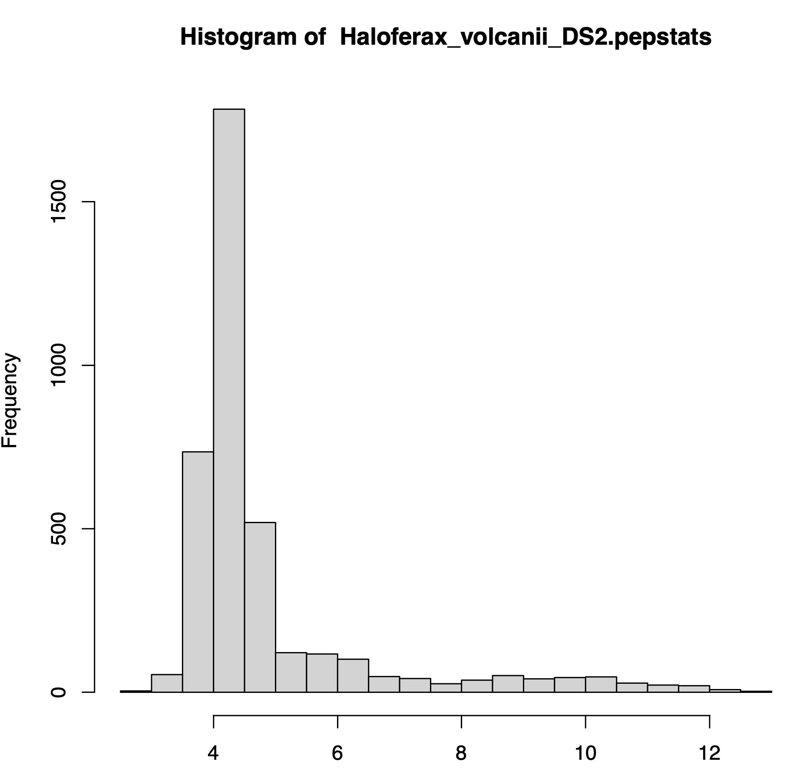
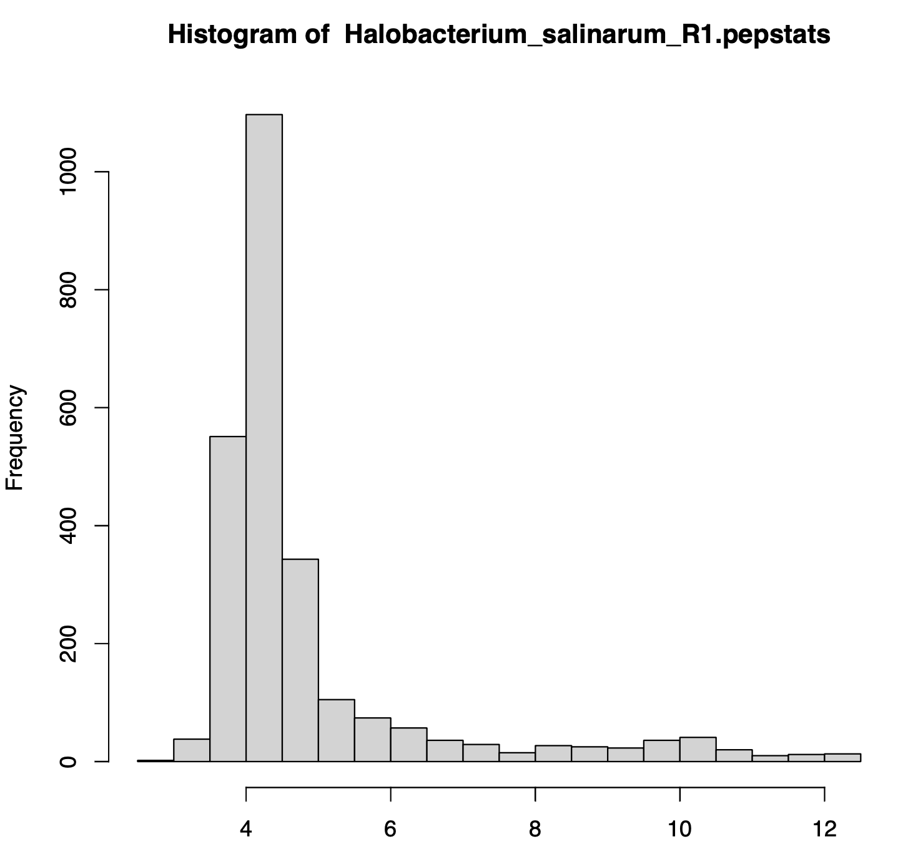
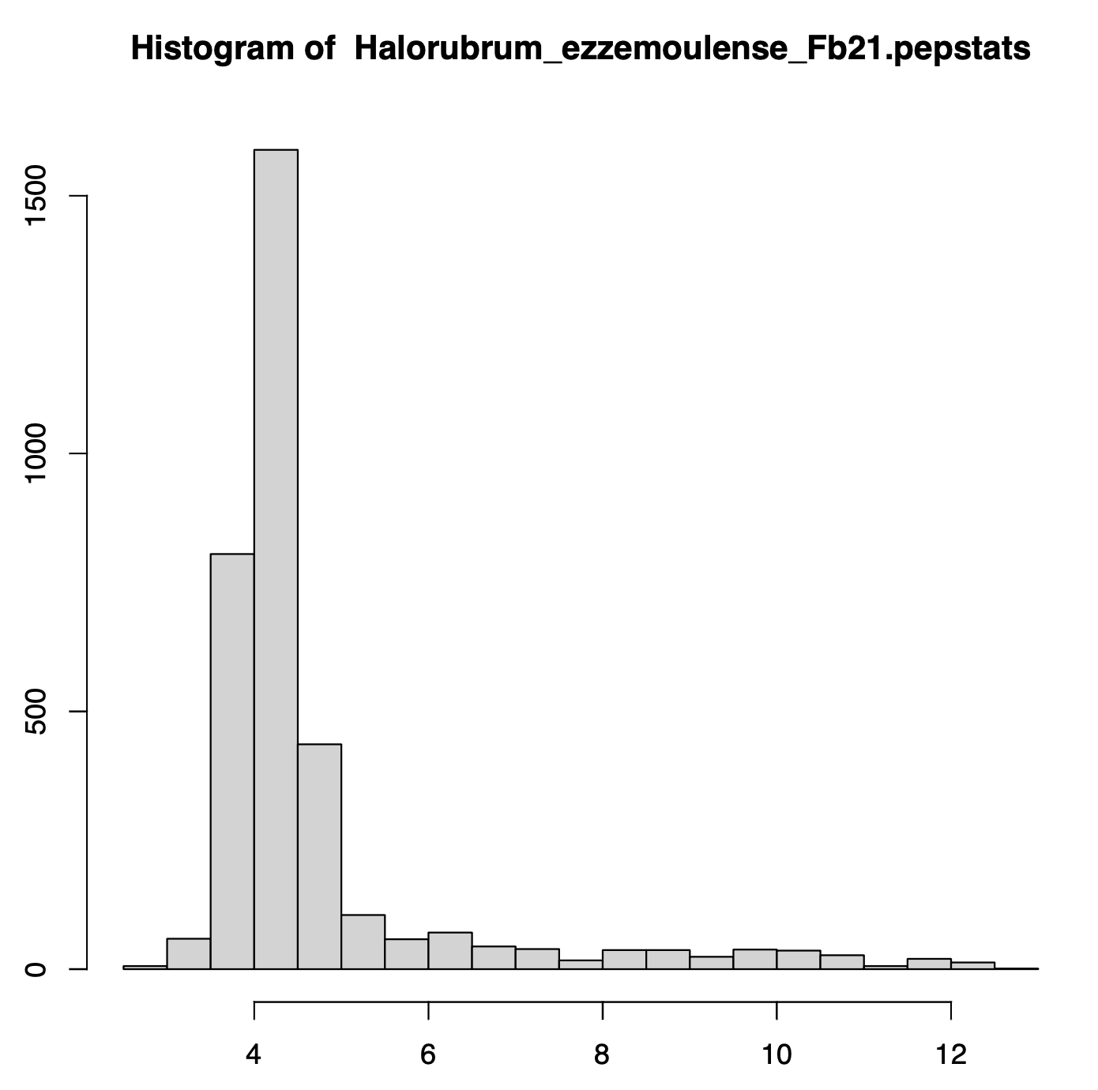
Salt-in strategists -- Haloarchaea
Haloferax_volcanii_DS2
Halobacterium_salinarum_R1
Halorubrum_ezzemoulense_Fb21

Slide 5
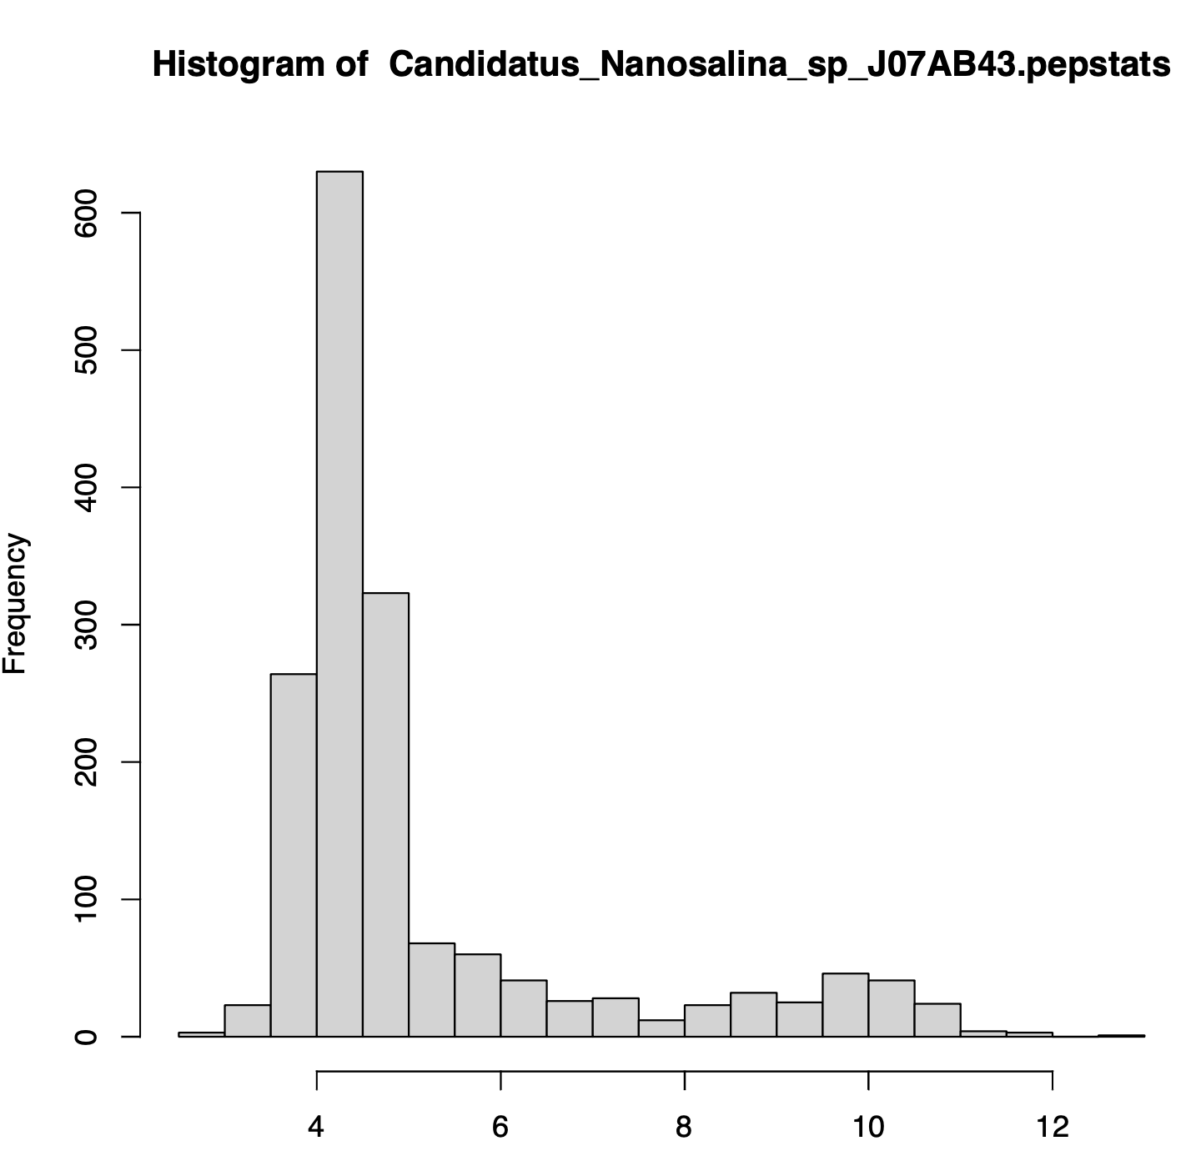
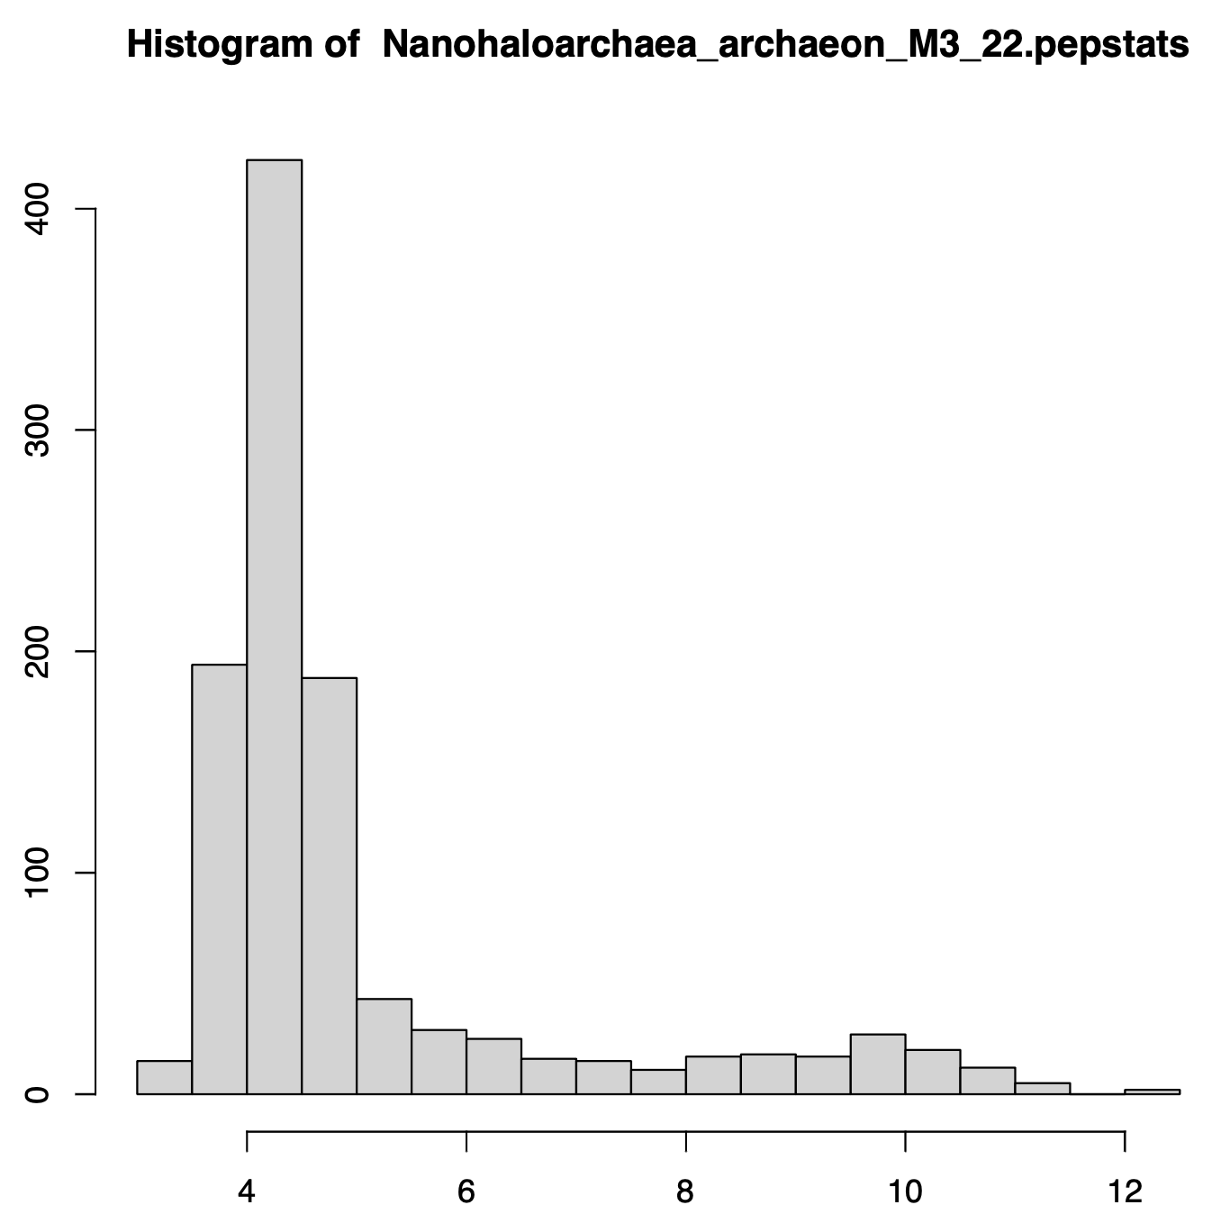
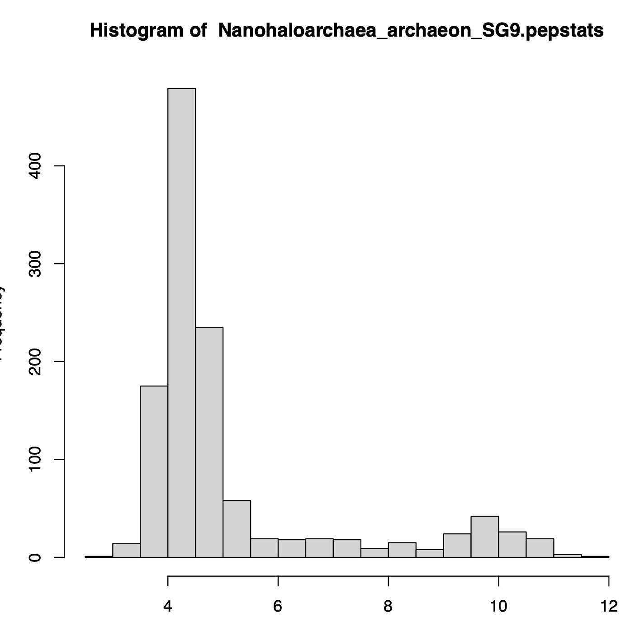
Salt-in strategists -- Nanohaloarchaea
Candidatus_Nanosalina_sp_J07AB43
Nanohaloarchaea_archaeon_M3_22
Nanohaloarchaea_archaeon_SG9

Slide 6
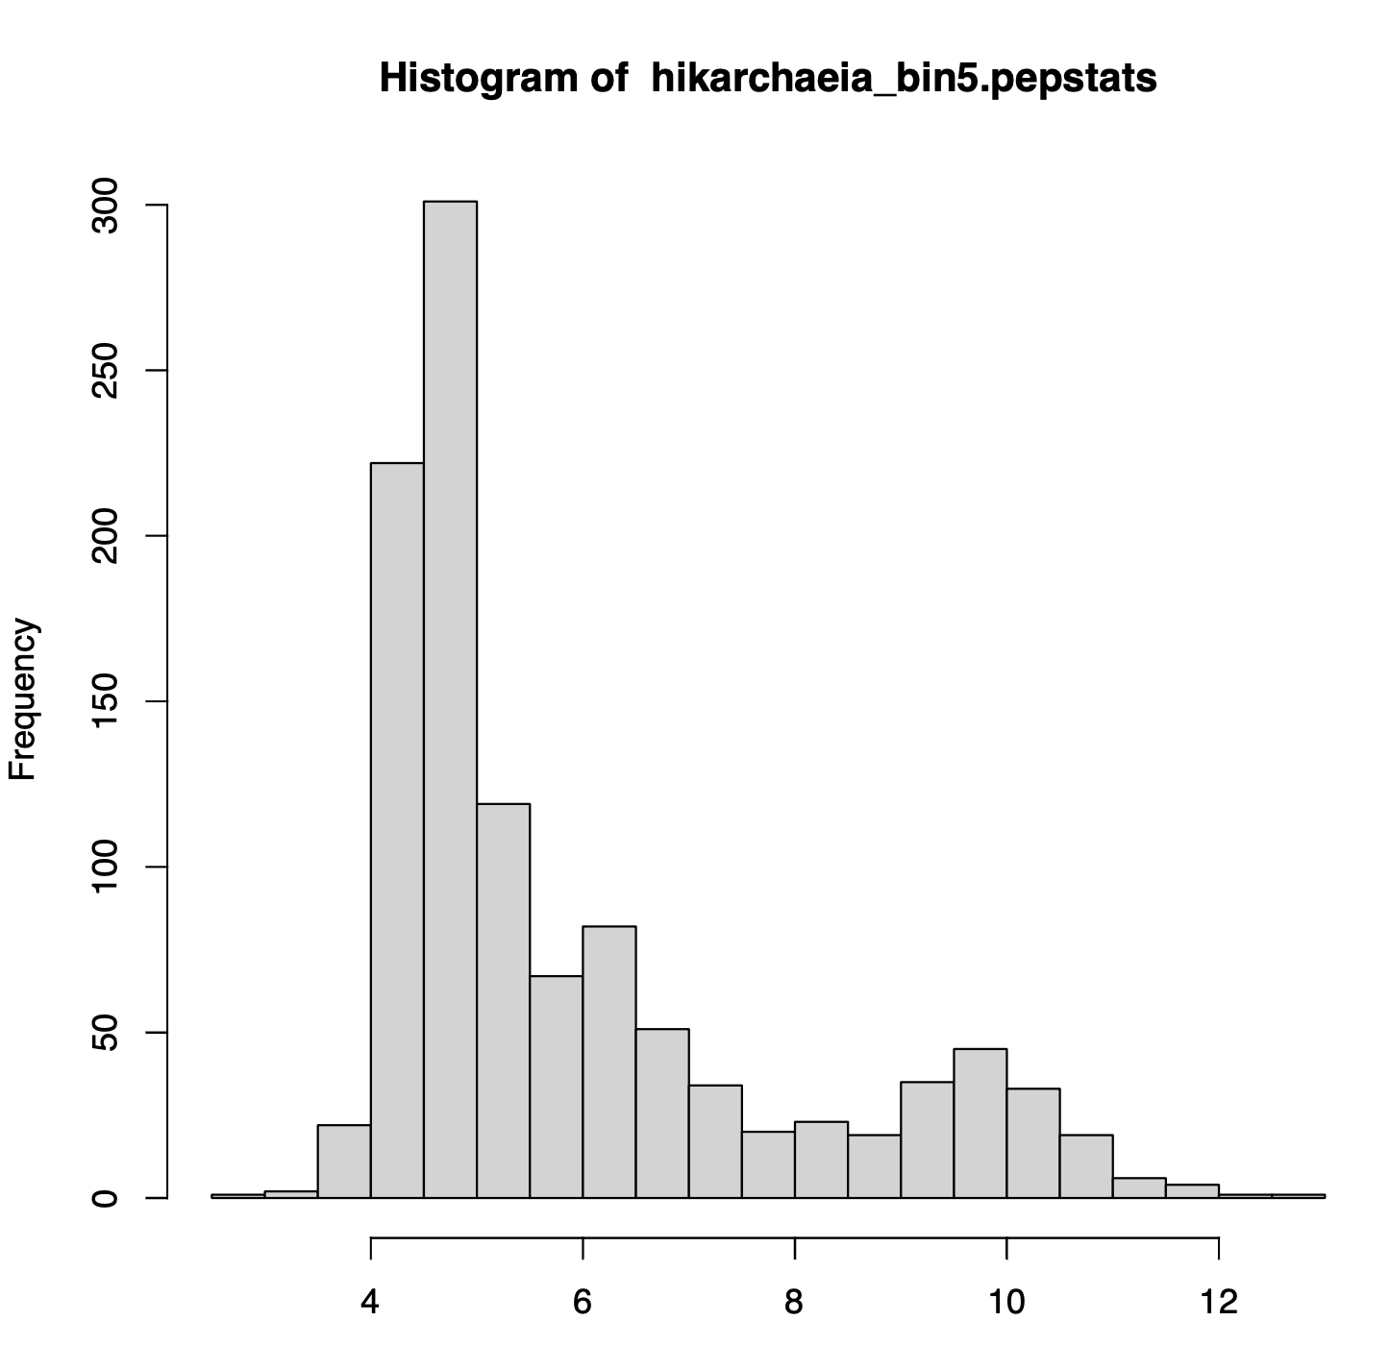
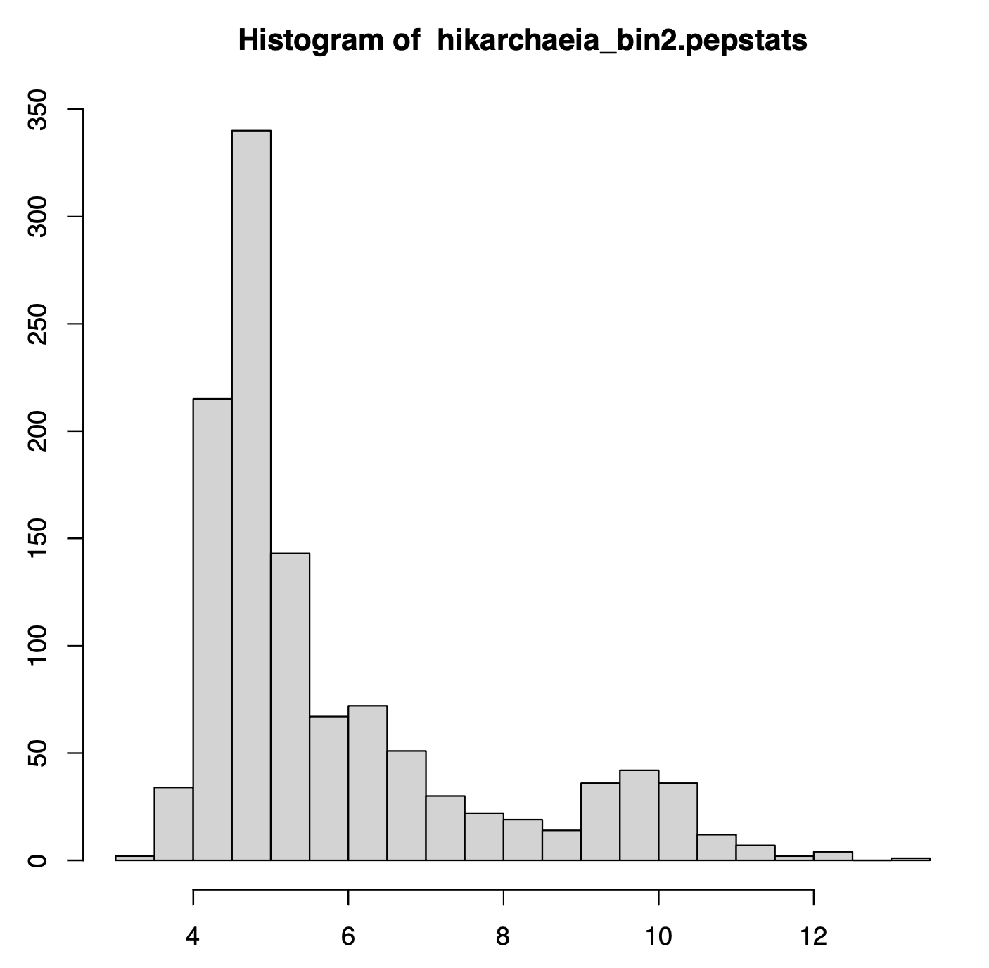
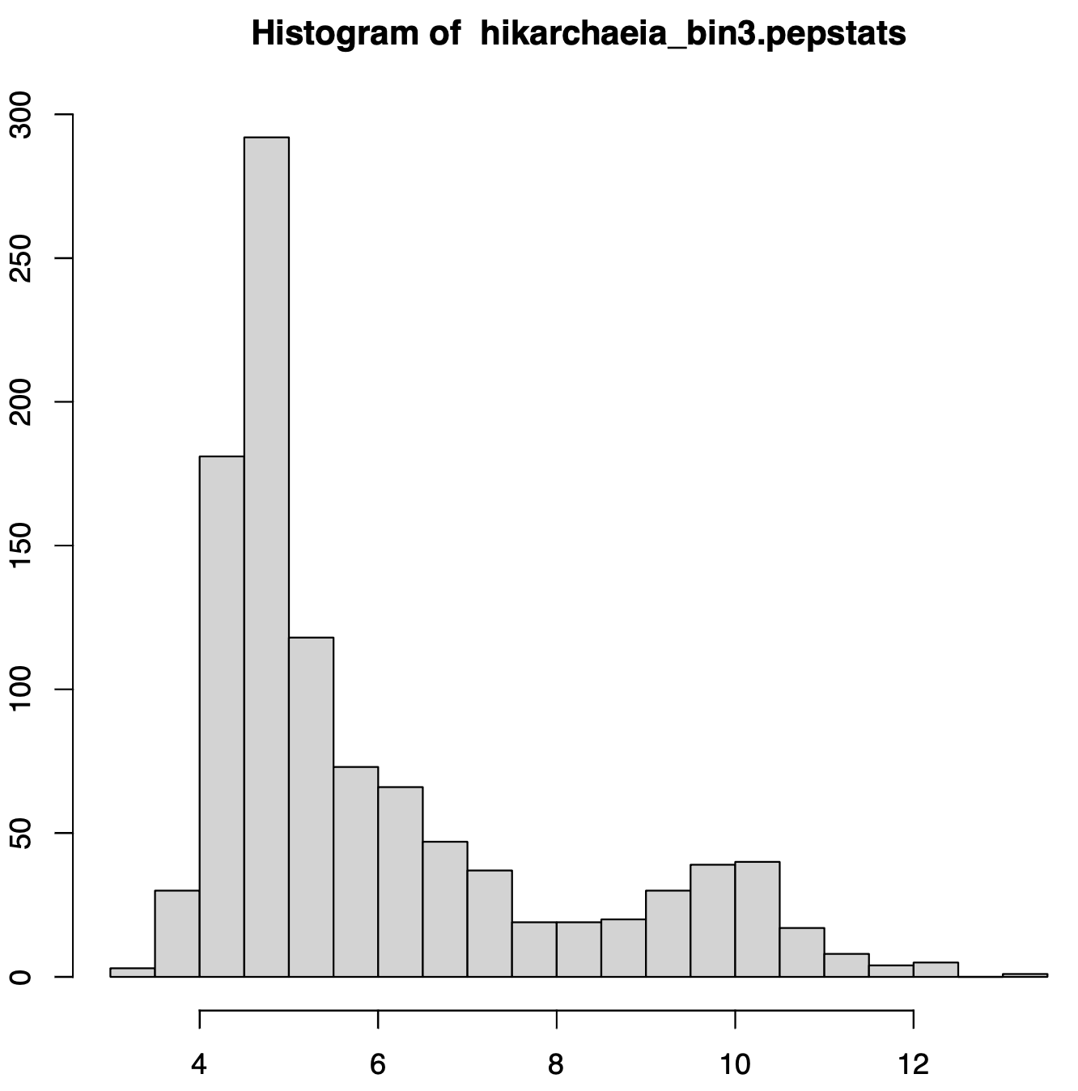
Salt-in strategists ? –
Hikarchaeia or Group IV Marine Archaea
hikarchaeia_bin5
hikarchaeia_bin3
hikarchaeia_bin2
Likely phylogenetic sister group of the Haloarchaea – proteome appears to reflect salt in strategy

Slide 7
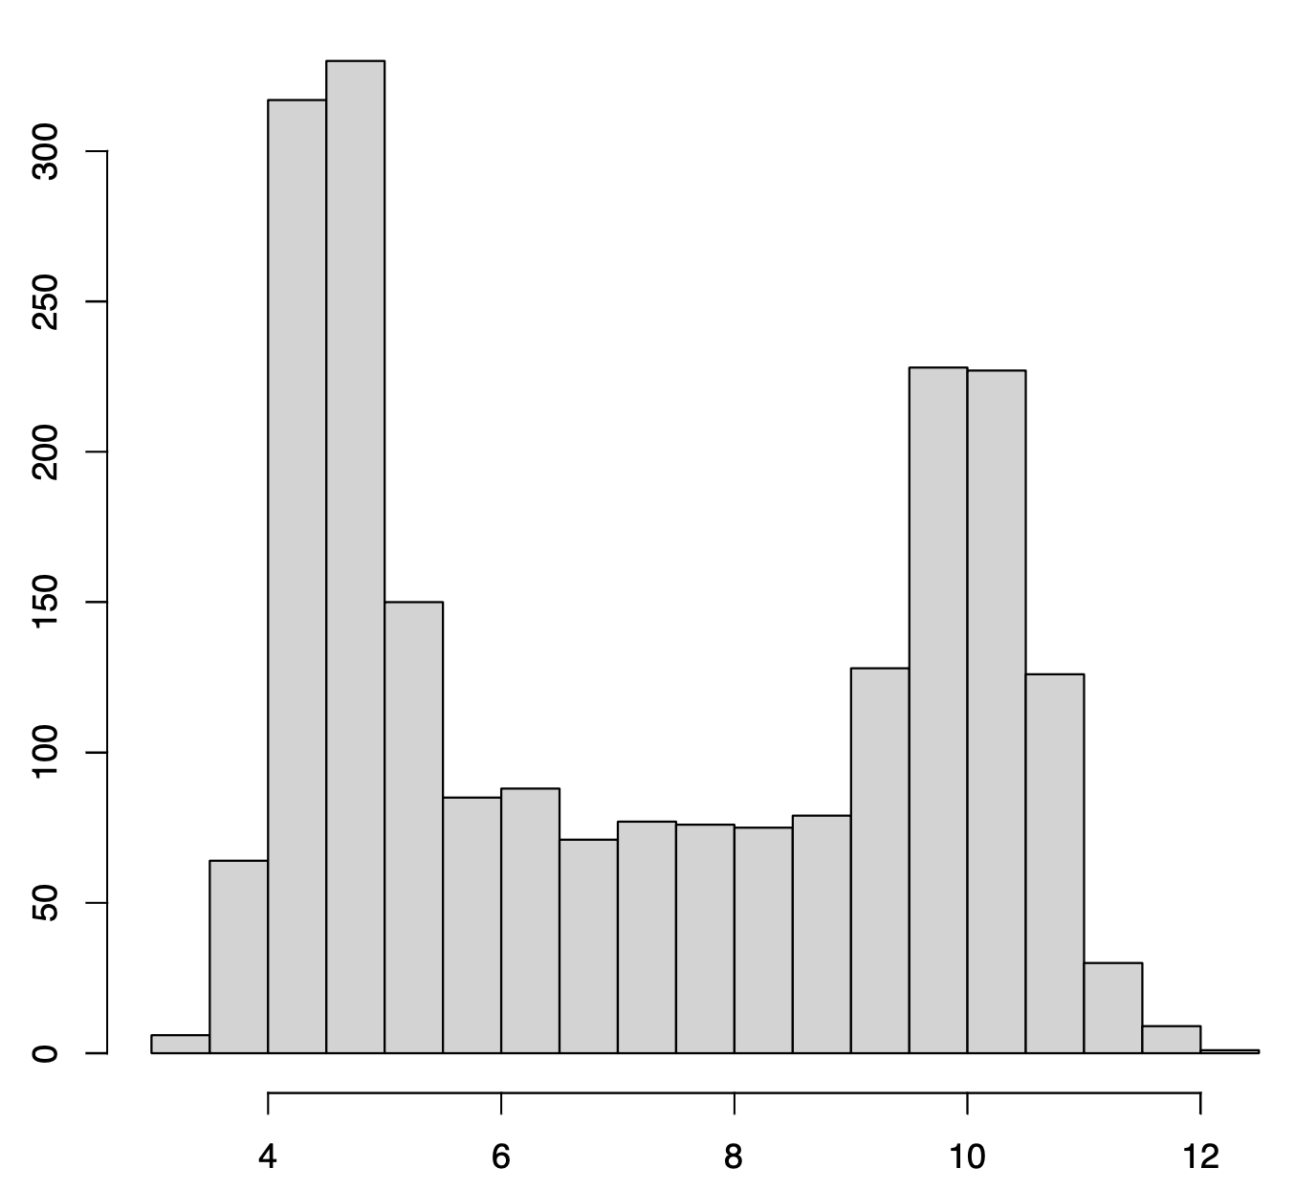
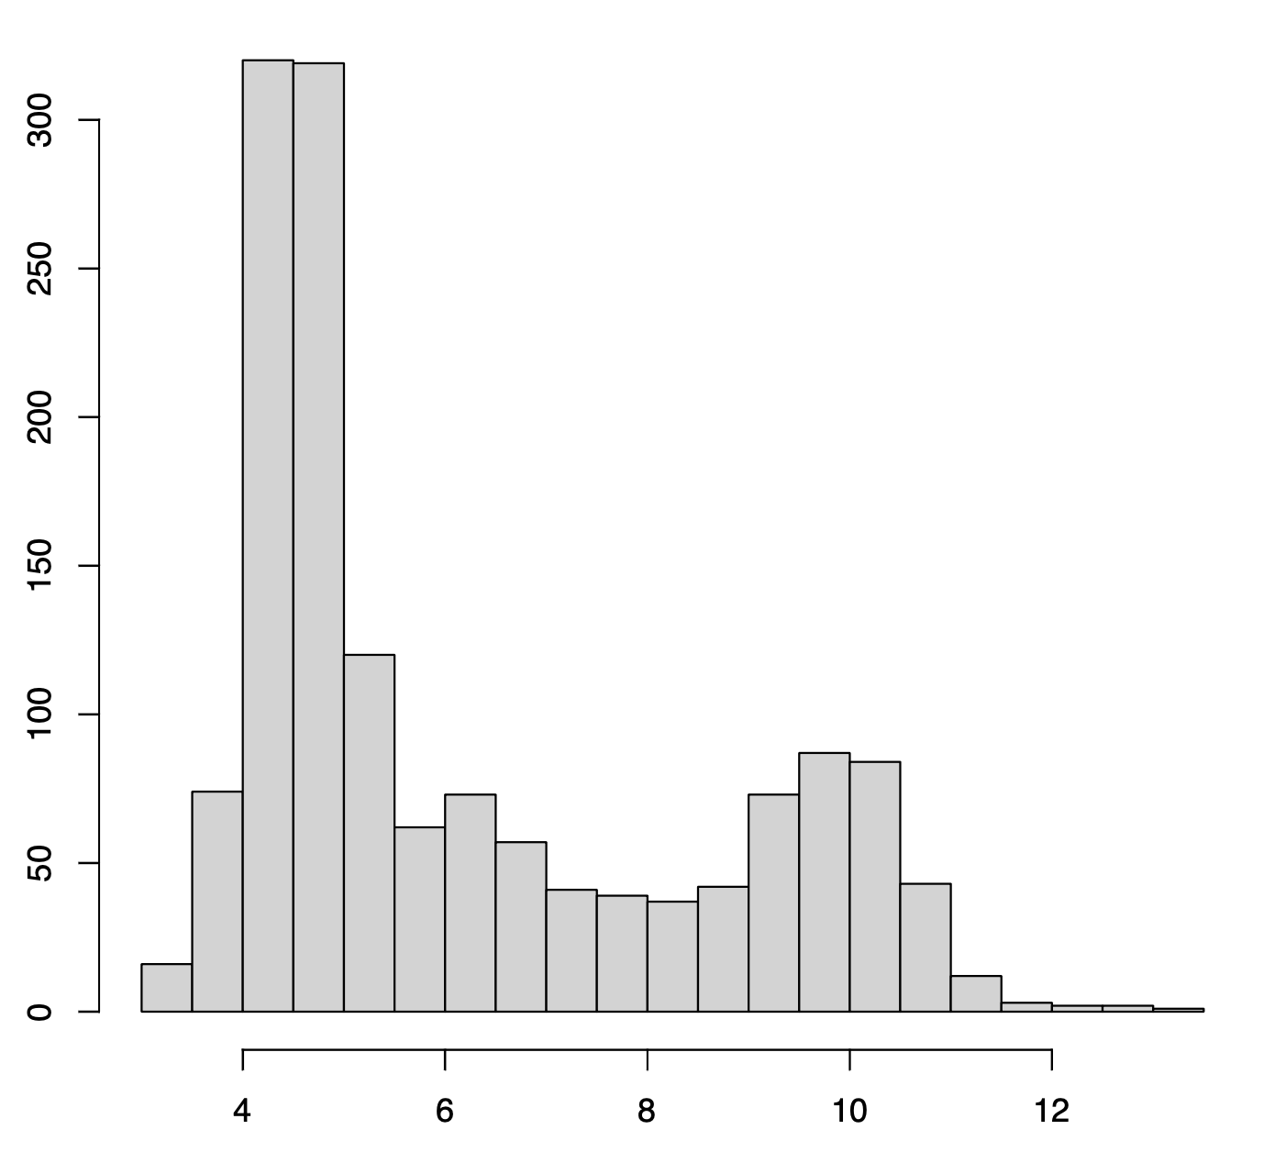
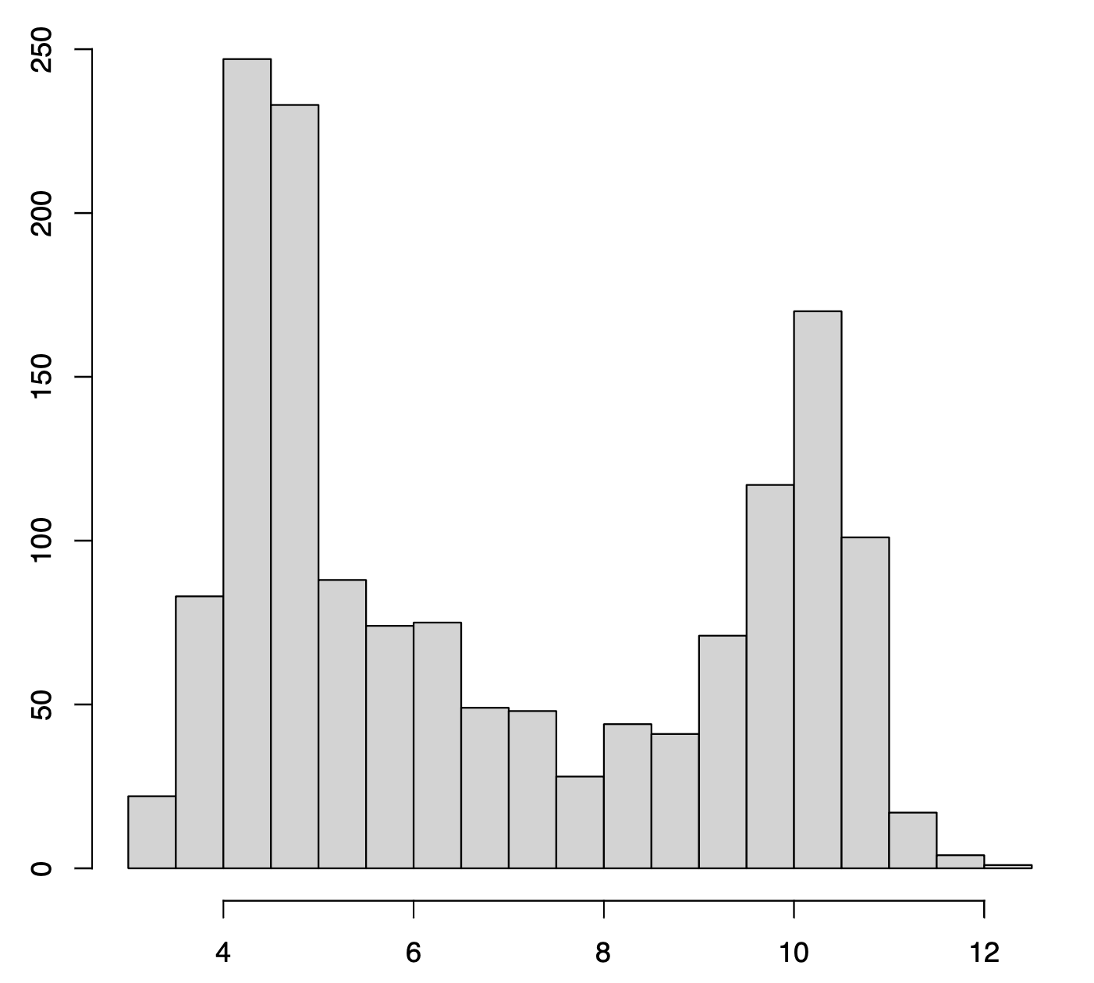
Methanonatronarchaeia --
Previously suggested sistergroup to the Haloarchaea
Methanonatronarchaeia_archaeon_
GCA_003555005.1
Methanonatronarchaeum
thermophilum_GCF_002153915
Ca_Methanohalarchaeum_thermophilum_
HMET1

Slide 8
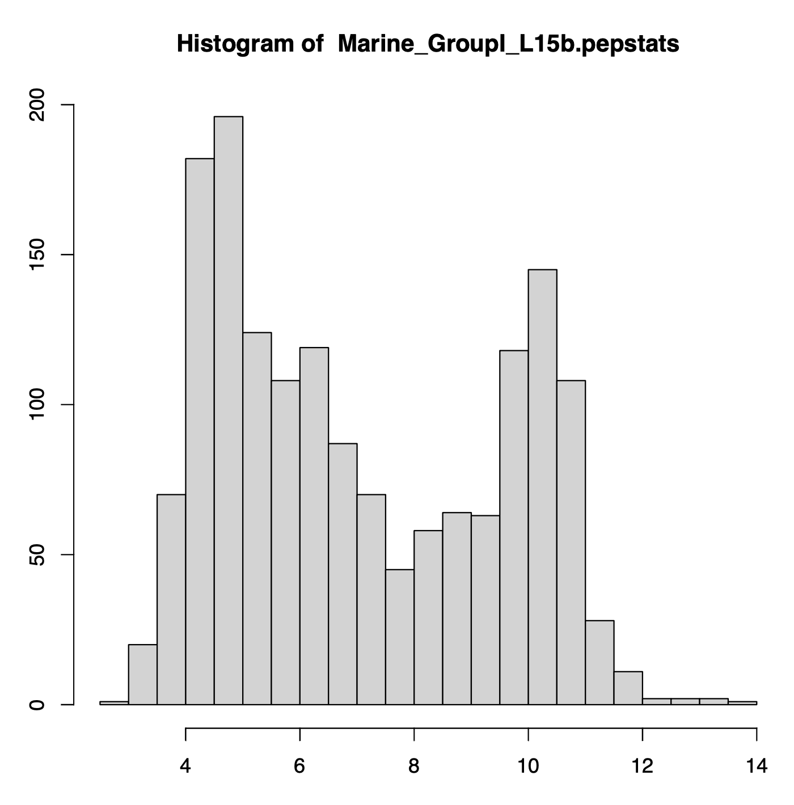
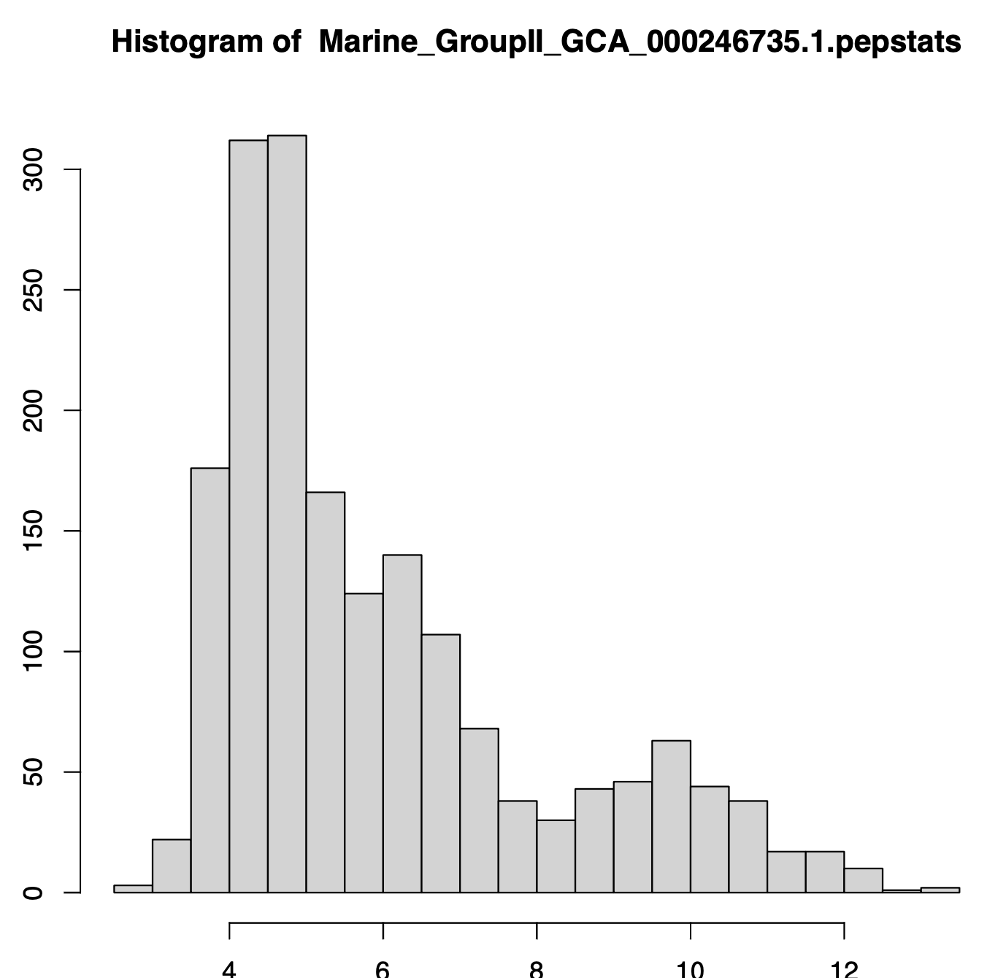
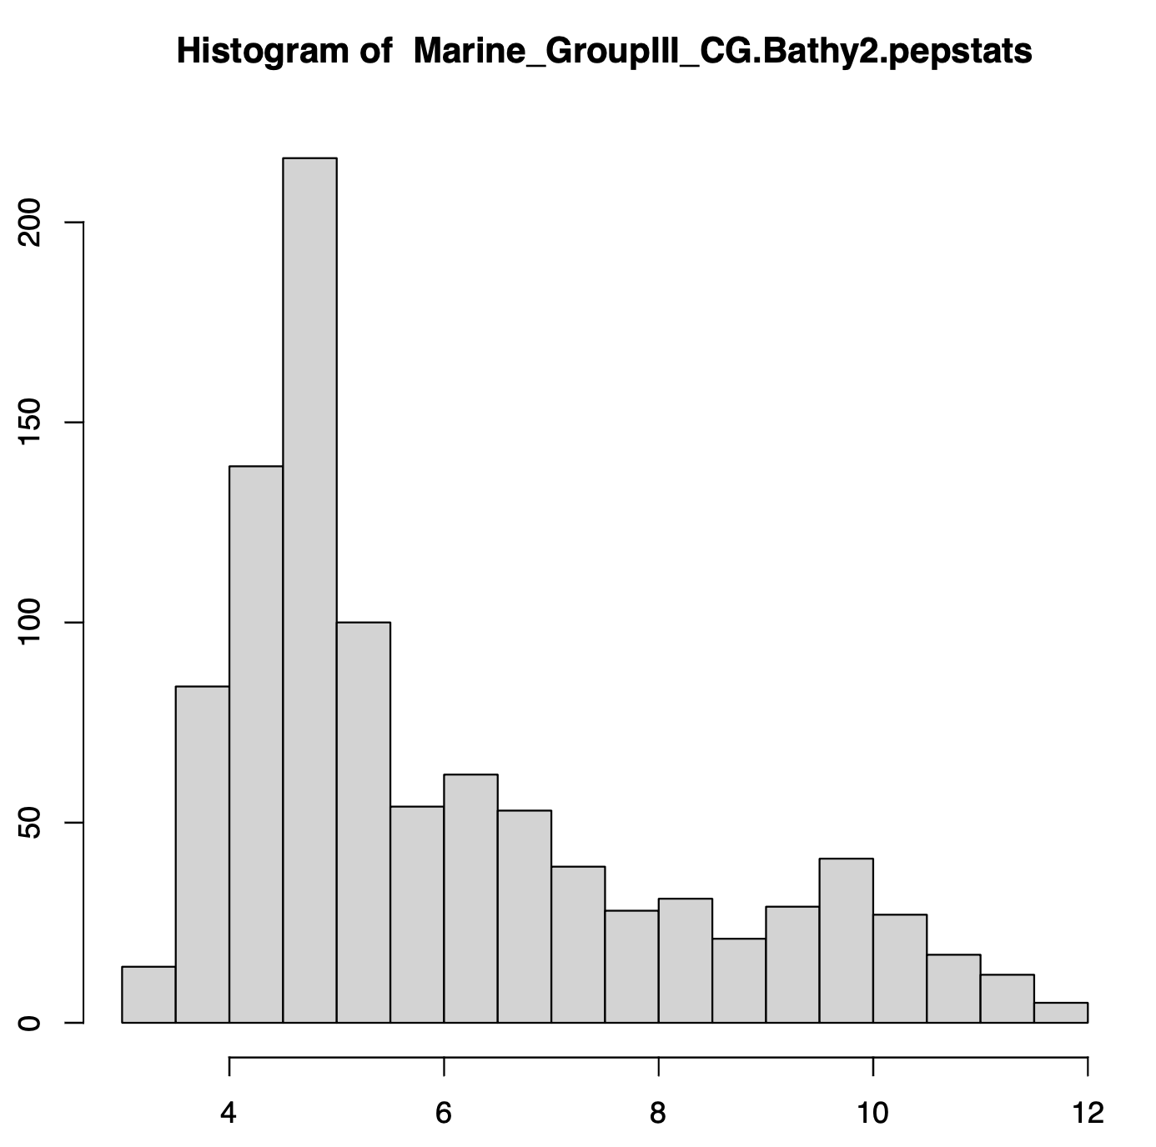
Other marine archaea

Slide 9
Some bacteria evolved a salt-in strategy
Gene transfer and convergent evolution

Slide 10
Not all Halophiles have a salt-in signature

Slide 11
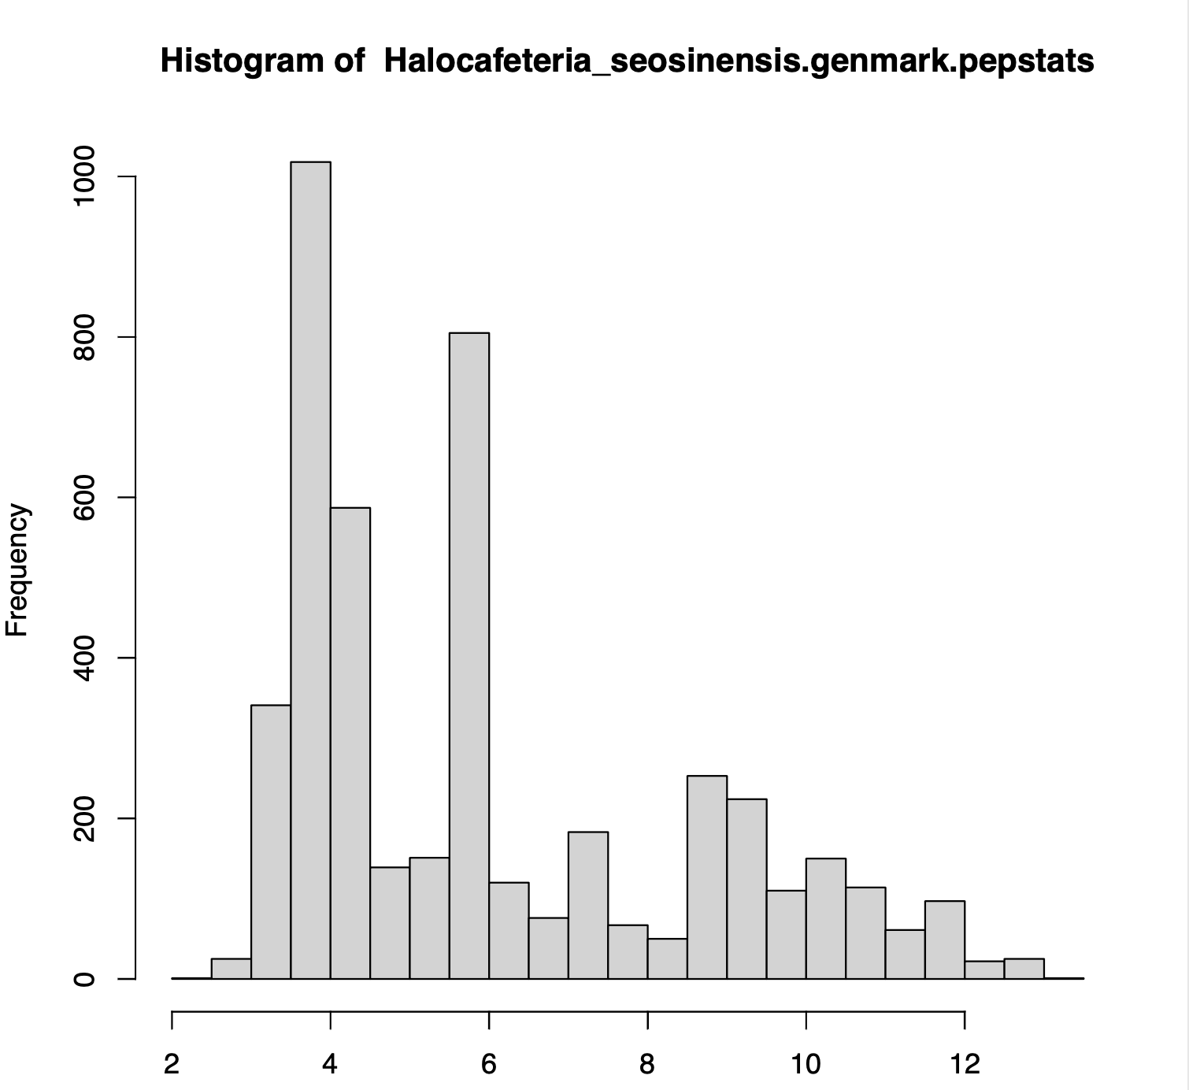
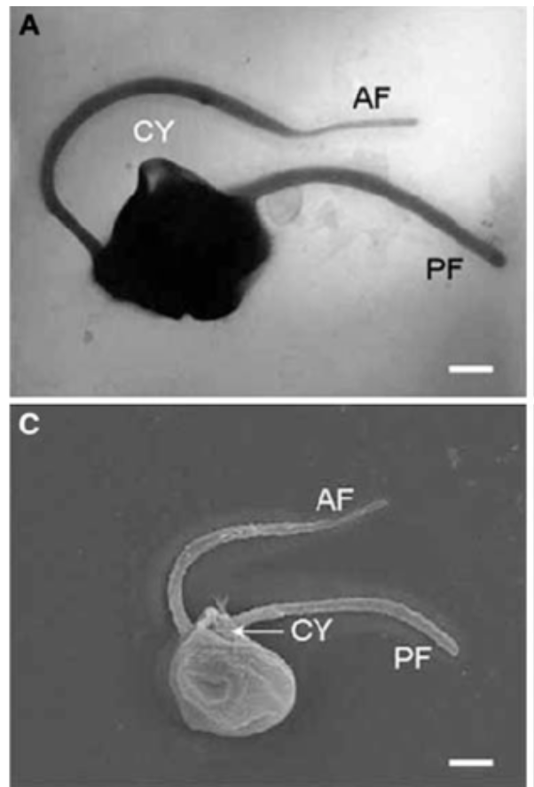
Halocafeteria – needs more work
(halophilic eukaryotes – stramenopiles)
from 2021
From:
https://www.researchgate.net/figure/Halocafeteria-seosinensis-electron-micrographs-a-Transmission-electron-micrograph-Whole_fig1_6912913

Slide 12
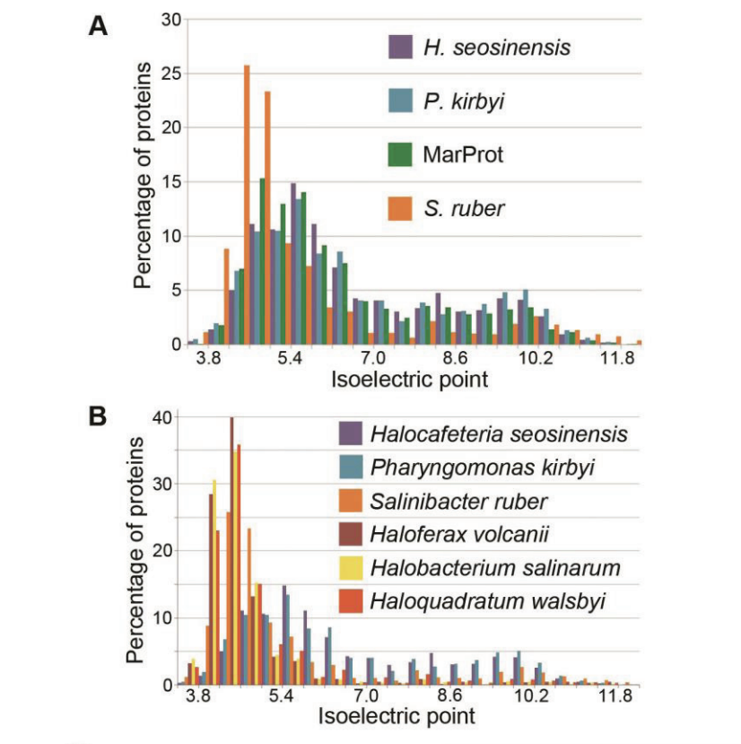
Halocafeteria – needs more work
From https://dalspace.library.dal.ca/handle/10222/73554
Tommy Harding’s PhD thesis --
The proteome is not readily available.

Slide 13
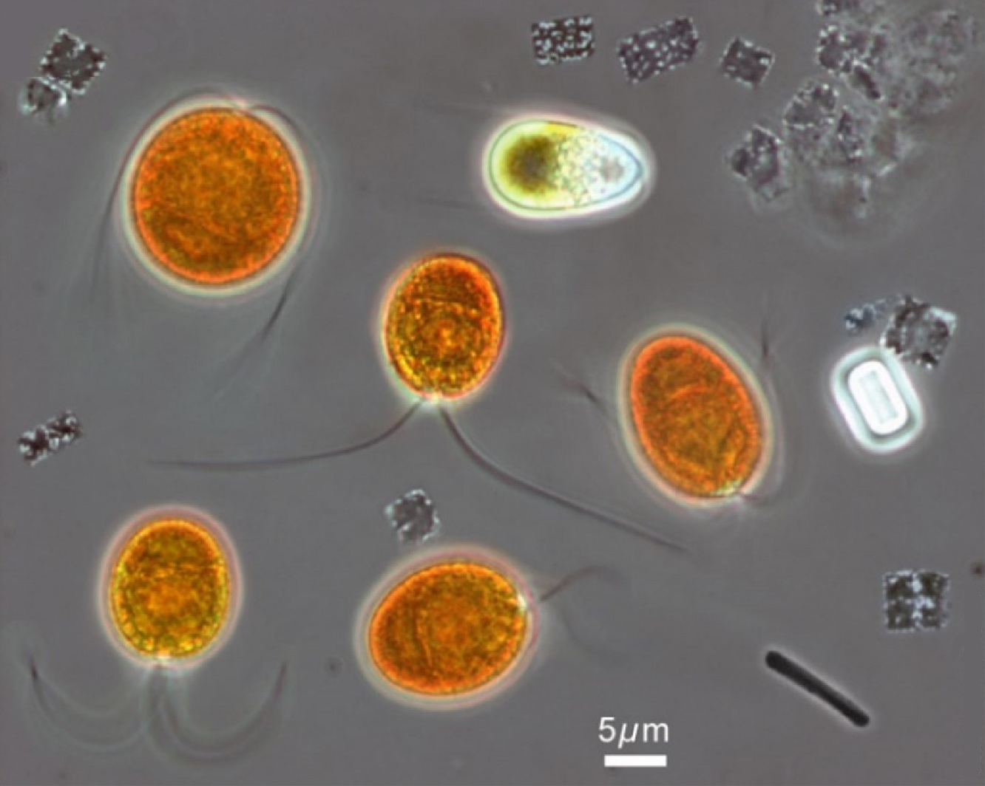
Dunaliella salina –not a salt-in strategist.
green algae – looks red because of beta carotene
From:
https://commons.wikimedia.org/wiki/File:Microorganisms_from_the_hypersaline_Lake_Tyrrell.jpg

Slide 14
Constructive Neutral Evolution and
The evolution of genome architecture

Slide 15
Genetic Drift: the fixation of a selectively neutral or nearly neutral mutation in a population.
The smaller a population, the more slightly deleterious mutations can be fixed due to genetic drift.

Slide 16
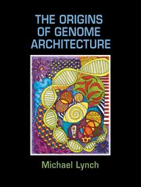
Michael Lynch
The Origins of Genome Architecture
Argues that most features in eukaryotic genomes arose because populations of eukaryotic organism (larger cell size) were much smaller than for prokaryotes.
This includes introns, the proliferation of repetitive elements, mRNA editing, gene duplications and the emergence of protein-protein interactions turning proteins to become parts of complicated multi subunit complexes.

Slide 17
Note: The percentage of coding DNA is small in animals and plants, the amount of intergenic and intron DNA increases.
Aside: an ongoing debate on the functionality of intergenic DNA continues. See the discussion of the encode project here and here).
The onion test is a good exercise for those thinking that most intergenic DNA has important functions in animals and especially humans.

Slide 18
Cord scrambling as example for the directionality that may be present in random mutations
From Arlin Stolzfus, Biol. Direct.
https:/ /biologydirect.biomedcentral.com/articles/10.1186/1745-6150-7-35
Increase in complexity can be due to drift, and not better functionality.
Mutations do not always provide small changes in fitness on which selection acts. Mutations themselves can provide a driving force towards complexity.
And some mutations can create large jumps in evolution (e.g., genome mutations)

Slide 19
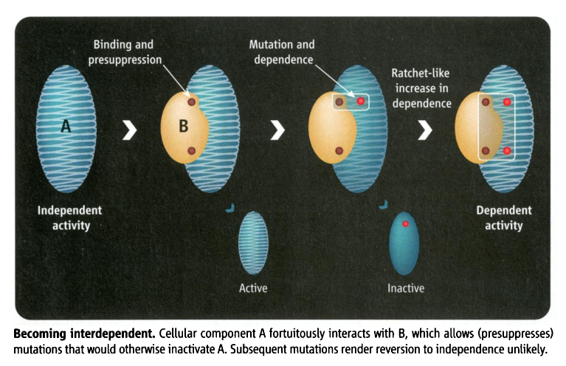
Slightly deleterious mutations can have a directing force toward complexity
Constructive neutral evolution:
Random interactions between macromolecules lower the overall free energy, leading to more stability, allowing for destabilizing mutations to occur. The mutated macromolecule remains stable and active, as long as the binding partner is present.
From: Irremediable Complexity?
Author(s): Michael W. Gray, Julius Lukeš, John M. Archibald, Patrick J. Keeling and W. Ford Doolittle
Source: Science, New Series, Vol. 330, No. 6006 (12 November 2010), pp. 920-921

Slide 20
Constructive Neutral Evolution
An organism acquires neutral or only slightly deleterious mutations or traits.
Other mutations or events compensate (or pre-suppress) for deleterious effect.
The reversal of the mutation is improbable (there are more ways to scramble things than to unscramble them).
The presence of these compensating processes becomes a necessity to achieve the original function.
At no point along the process did the mutations or events increase the fitness of the organism (which does not say that the complex feature later may evolve useful functions).
The outcome is a complex process that requires cooperation between different components to fulfill the same function as the original process.
CNE occurs more frequently in organisms with small effective populations (See Michael Lynch’s “Evolution of genome architecture”)

Slide 21
CNE Examples (may be)
Interactions between macromolecules
Multisubunit homomers -> heteromers (histones, tubulins, ATP synthase, proteasome)
Large protein-RNA complexes (Spliceosome, Ribosome)
Split Inteins
Subfunctionalization (maintaining duplicated genes)
RNA editing
Alternative splicing
? Fixation of introns/inteins in a population
(mobile genetic elements have their own agenda, and their fixation can be driven by the fitness advantage to themselves)

Slide 22
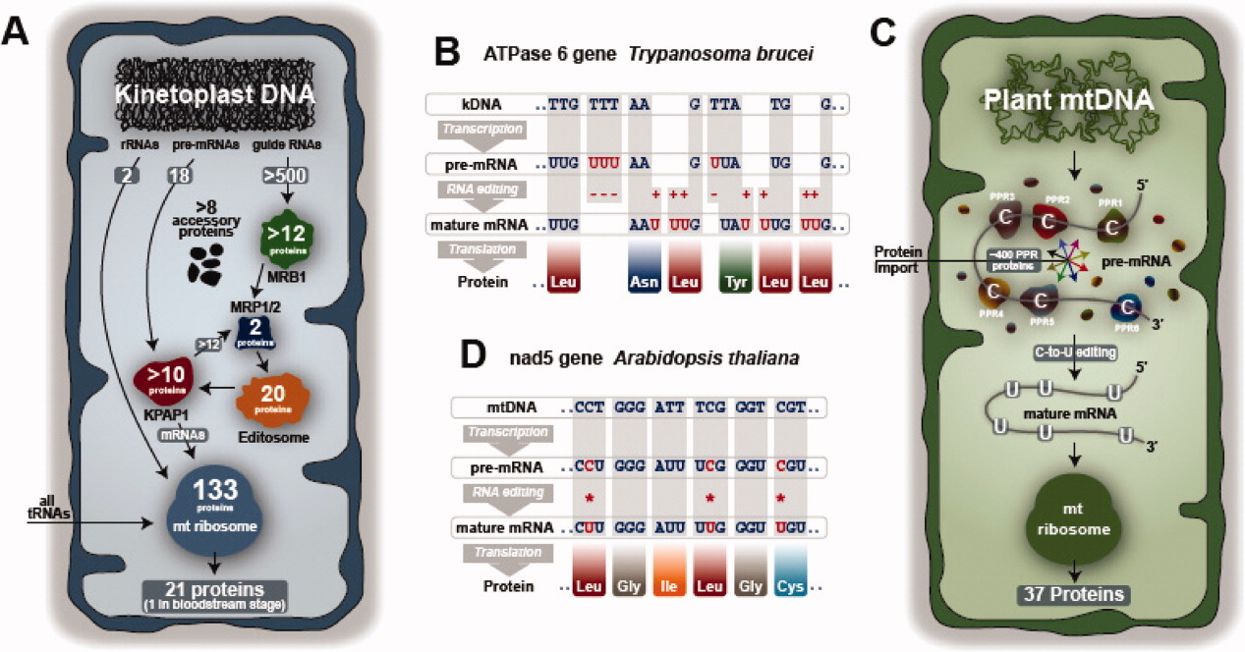
From: https://iubmb.onlinelibrary.wiley.com/doi/full/10.1002/iub.489
From: https://iubmb.onlinelibrary.wiley.com/doi/full/10.1002/iub.489

Slide 23
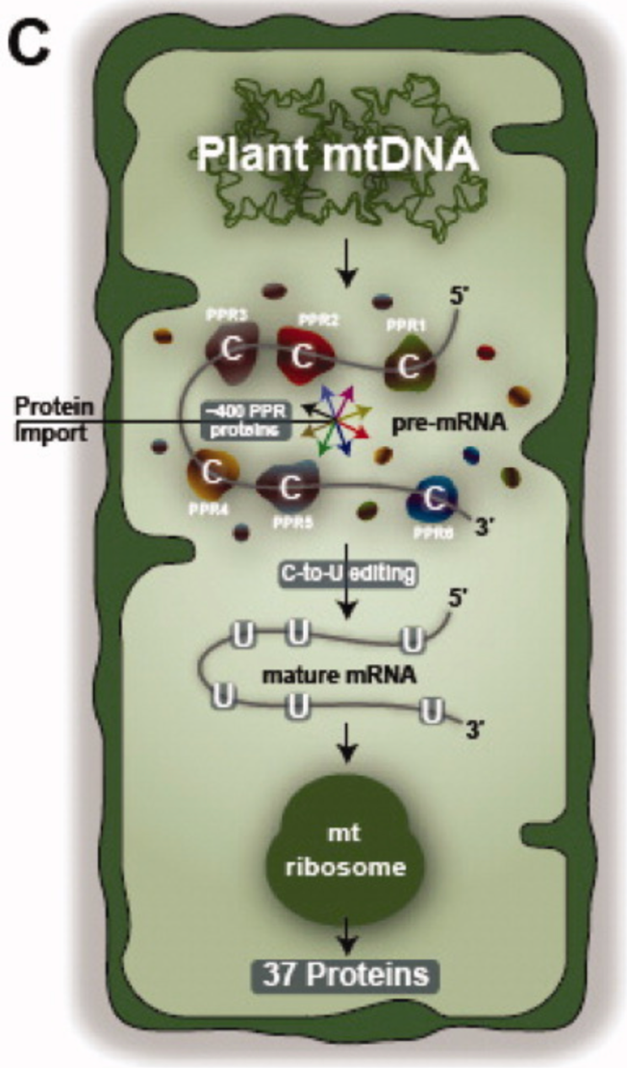
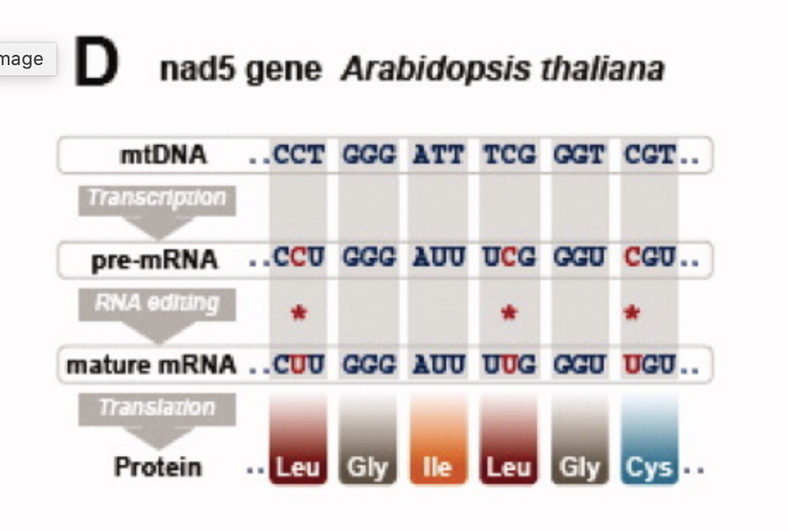
From: https://iubmb.onlinelibrary.wiley.com/doi/full/10.1002/iub.489

Slide 24
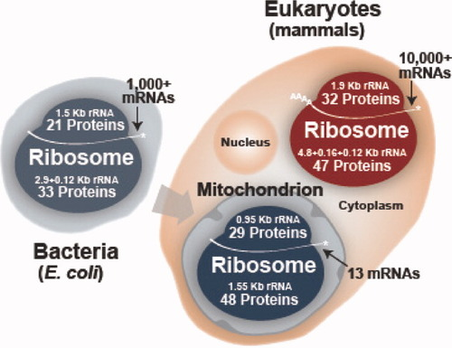
From: https://iubmb.onlinelibrary.wiley.com/doi/full/10.1002/iub.489

Slide 25
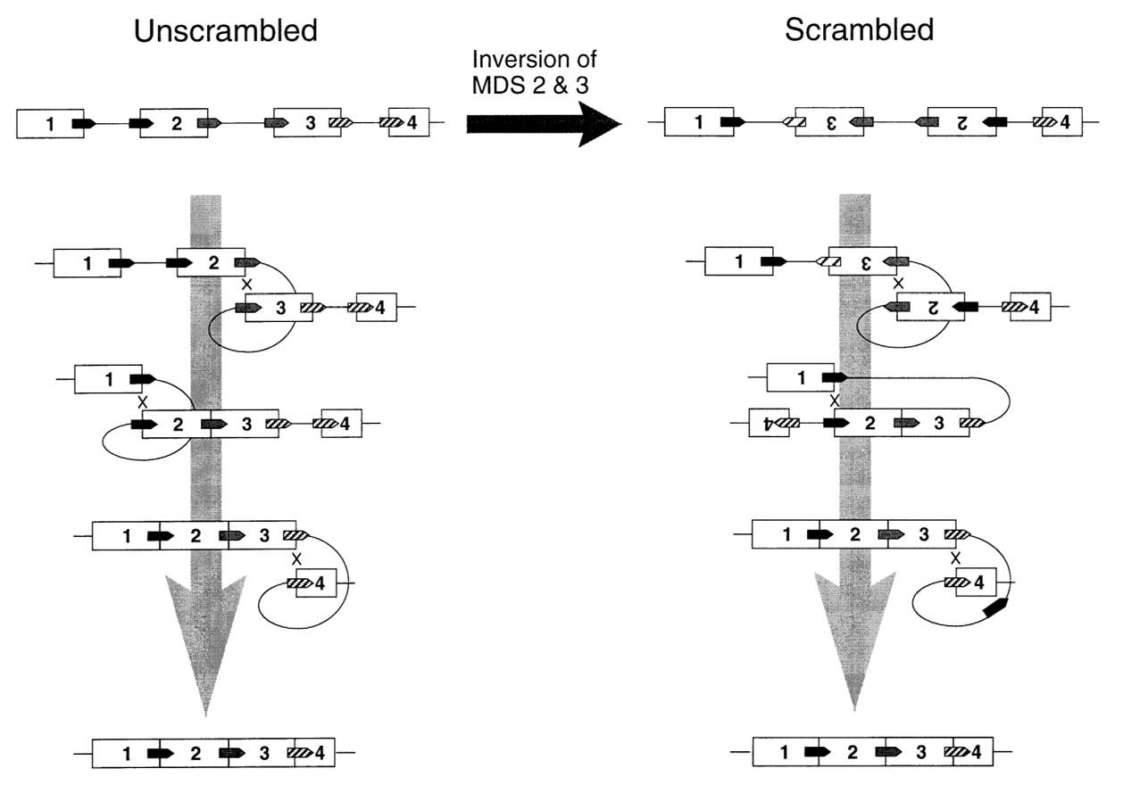
Gene Unscrambling in Ciliates
Micro to Macro Nucleus
From: Arlin Stoltzfus
On the Possibility of Constructive
Neutral Evolution
https://link.springer.com/article/10.1007%2FPL00006540
See also
https://www.pnas.org/content/97/7/3298

Slide 26
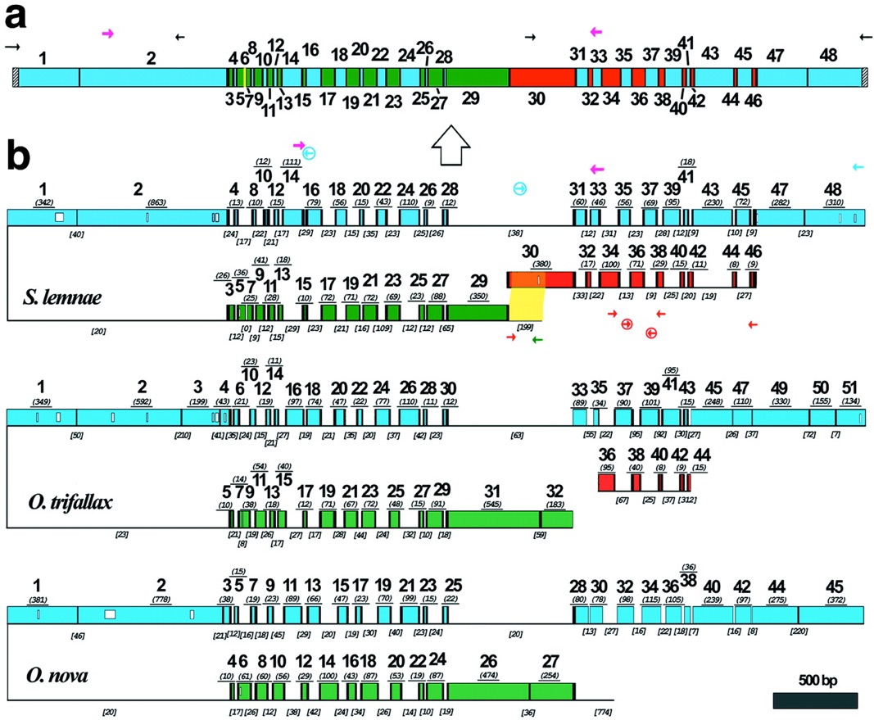
Gene Unscrambling in Ciliates
Micro to Macro Nucleus -- DNA polymerase α gene in hypotrichous ciliates
Evolution and assembly of an extremely
scrambled gene
Laura F. Landweber, Tai-Chih Kuo, and
Edward A. Curtis
From:
https://www.pnas.org/content/97/7/3298
Notes:
(a) A schematic map of the macronuclear DNA-polymerase α gene of S. lemnae. The 48 MDS are shown as colored boxes. Green and blue MDSs are both present on the major locus, but in opposite orientation. Red MDSs are derived from the minor locus. The yellow MDS is missing. Pointer sequences are indicated by black vertical bars, telomeres by hatched bars. PCR primers indicated by small arrows; degenerate primers, in magenta, were based on an alignment of this gene in 10 hypotrich species (33). The macronuclear copy is derived from the micronuclear copy (large arrow). (b) A schematic alignment of the micronuclear genes encoding the large catalytic subunit of DNA-polymerase α in S. lemnae, O. trifallax (7), and O. nova (6), with MDSs aligned based on predicted amino acid sequences; open boxes within MDSs indicate gaps in alignment. MDSs are drawn to scale with the length (excluding pointer sequences when available) underlined in italics and parentheses. Green and blue MDSs are encoded on opposite strands of the major locus, indicated by the inversion. Red MDSs are derived from the minor locus. Black vertical bars indicate pointers. IESs are indicated by thin lines, not to scale, but IES length is given in italics and brackets. IES-specific primers are circled. The yellow highlighted region indicates 193/199 bp overlap between the IES that marks the 5′ end of the major locus and MDS 30 in the minor locus of S. lemnae.

Slide 27
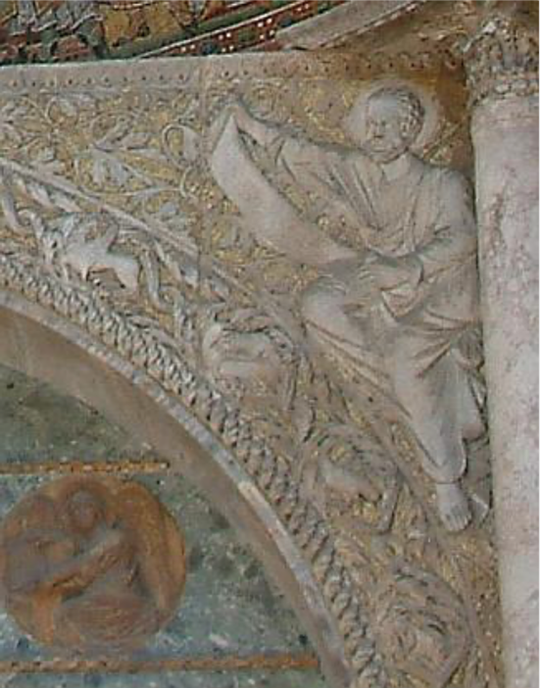
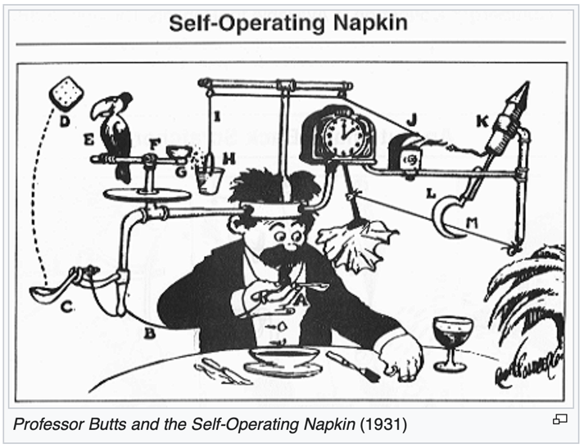
Related Concepts
Increased complexity in small populations
Subfunctionalization to maintain gene duplications (also here)
The Spandrels of San Marco (Gould & Lewontin)
Biological Rube Goldberg machines.

Slide 28
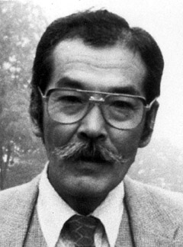
Duplications and Evolution
Ohno postulated that gene duplication plays a major role in evolution
Small scale duplications (SSD)
Whole genome duplications (WGD)
Polyploid: nucleus contains three or more copies of each chromosome
Autopolyploid: formed within a single species
Diploids AA and A’A’ Polyploid AAA’A’
Allopolyploid: formed from more than one species
Diploids AA and BB Polyploid AABB
Susumu Ohno 1970
Evolution by gene duplication
1R and 2R hypothesis
“Junk DNA” 1972
Slide from Chris Pires

Slide 29
Type of gene duplications:
tandem repeats
duplication via transposition (esp. retro transposition) (selfish genetic elements, but other genes as well (see the work from Craig Nelson’s lab)
Whole genome, chromosome, or chromosome arm duplications
In the lineage to vertebrates two whole genome duplications occurred (the exact placement is uncertain, because other duplications occurred as well). As a consequence many regulatory genes (e.g. the hox gene cluster) are now present in at least 4 copies per genome. Many think that this allowed for a more differentiated development)
In fish* three rounds of whole genome duplications occurred
(*Teleostei = bony fish; the largest group of fish, but it does not include the sistergroup to the tetrapods (Lungfish or Dipnoe)
Most crop plants are polyploid (auto- or allopolyploid) => can lead to instant speciation in a hybridzone.

Slide 30
The Fate of Duplicated Genes
Neofunctionalization
gene paralog 1
gene duplication
gene 1
gene paralog 2
paralog two picks up new function
Does happen only very rarely, it at all.

Slide 31
The Fate of Duplicated Genes
B) Pseudogenization
gene paralog 1
one paralog keep the original function
gene duplication
gene 1
gene paralog 2
one paralog accumulates mutations and looses function
Occurs most frequently

Slide 32
The Fate of Duplicated Genes
Subfunctionalization
Initially this is slightly deleterious, because an additional gene
needs to be maintained
gene paralog 1
gene duplication
gene 1
gene paralog 2
The gene has a a function
(e.g., an ATP synthase subunit expressed in all organs, or in all organs of a plant)
The two paralogs divide the functional space
(e.g. one paralog is expressed in liver cells, the other in all other organs, or in case of plants one expressed only in anthers, the other in roots, the third in stomata)
The main pathway paralogs are maintained in a genome.

Slide 33
Question:
A correlation between genome size and organismal complexity seems to exist (although, see the onion).
However, does this prove that the longer and more frequent intron, and most of the non-coding DNA plays a role in this complexity that is adaptive?
Or is it more likely that drift allowed for these features (intron proliferation and size increase), and that the increased complexity was then used in some instances to provide adaptive features.

Slide 34
Benefits of introns
Alternative Splicing
Exon shuffling
If splicing is skipped the intron sequence can become a novel exon.
Nonsense-mediated mRNA decay (NMD) pathway

Slide 35
Inteins, aka Protein Introns
Bars on the periphery give numbers per genome, ranging from 1 to 19.
Only genomes with at least one intein included.
From: Inteins: nature's gift to protein chemists
Neel H. Shah and Tom W. Muir
DOI: 10.1039/C3SC52951G

Slide 36
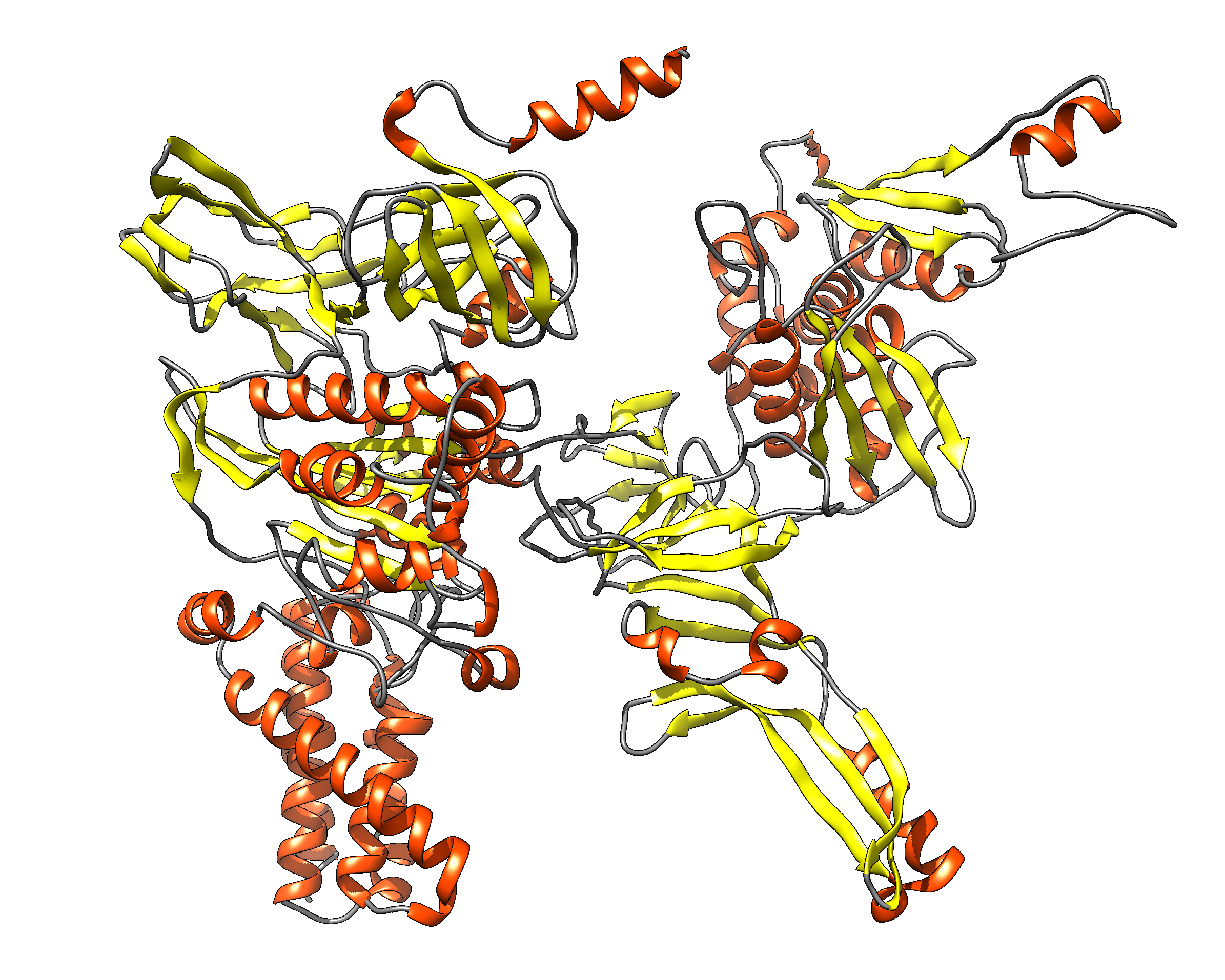
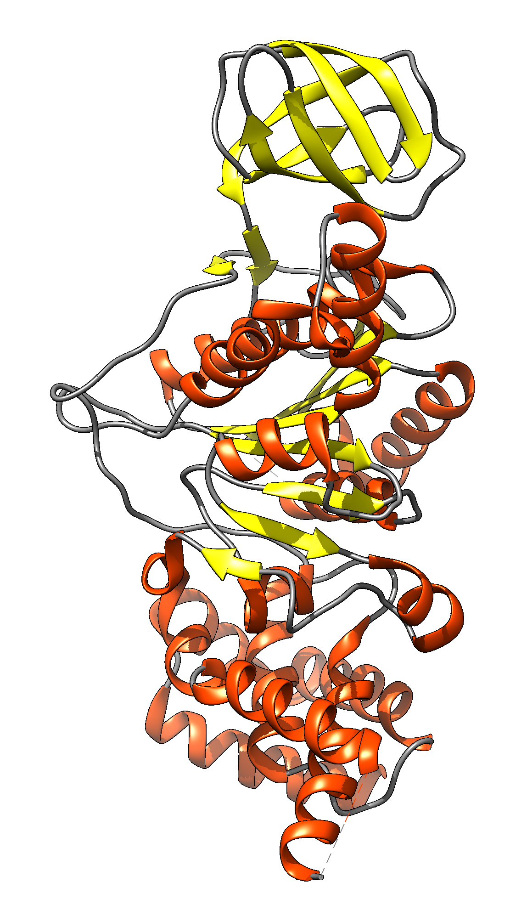
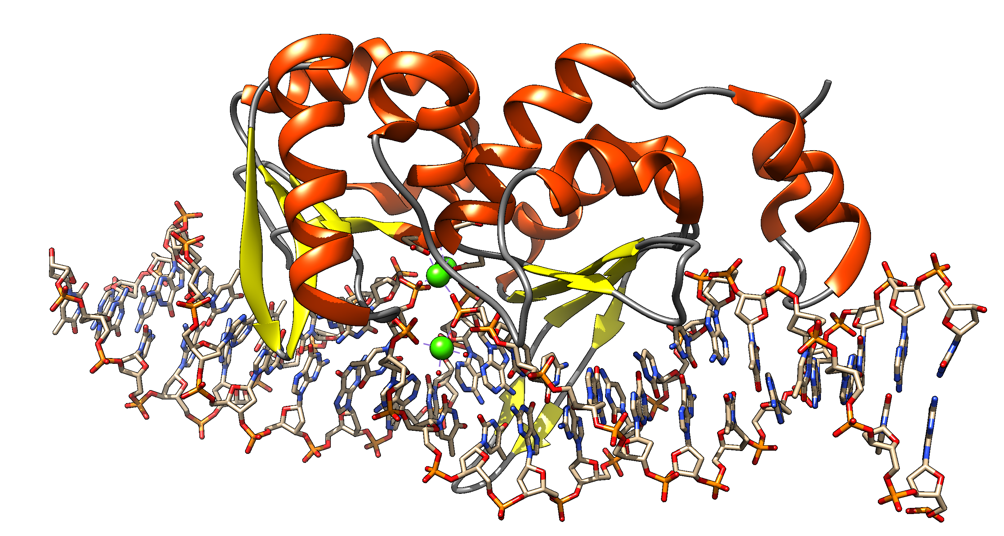
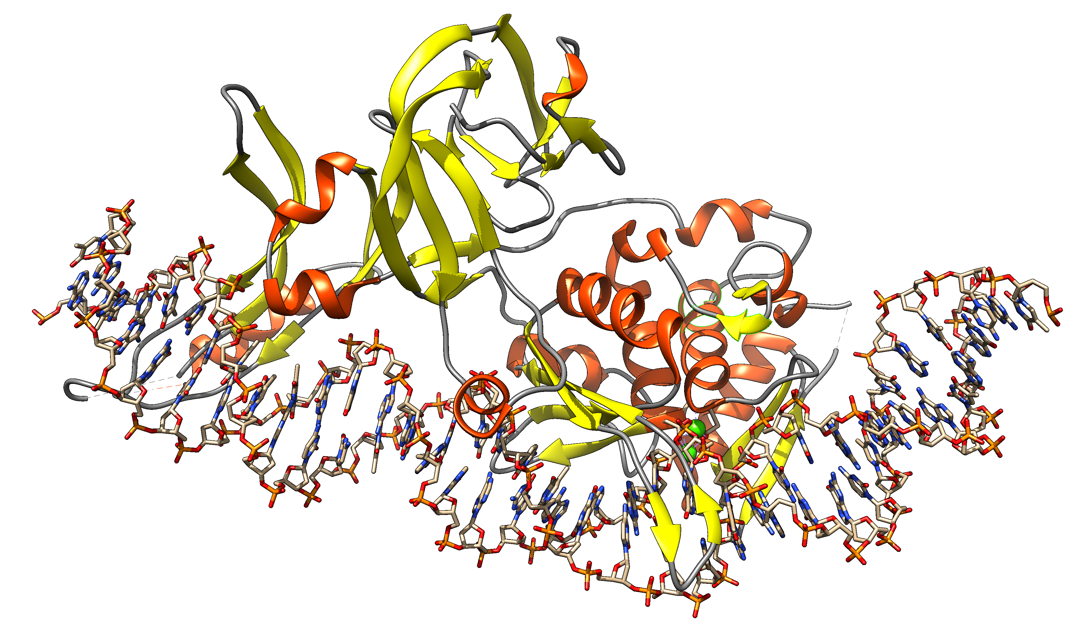
Group I Intron
Intein
Exon: Intron: ORF on Intron
Extein: Intein Splicing Domain: HE domain:
DNA
transcription
transcription
mRNA
or
rRNA
translation
splicing
Exon
Intron with ORF
translation
alpha fold prediction
of Sce vma1 gene product
splicing
Protein
Homing Endonuclease
1LWS.pdb
functional protein
functional protein
Intein with HE and
Splicing domain
Notes:
Structures F-ATPase chain A, SceI, https://alphafold.ebi.ac.uk/entry/P38078 and 1LWS

Slide 37
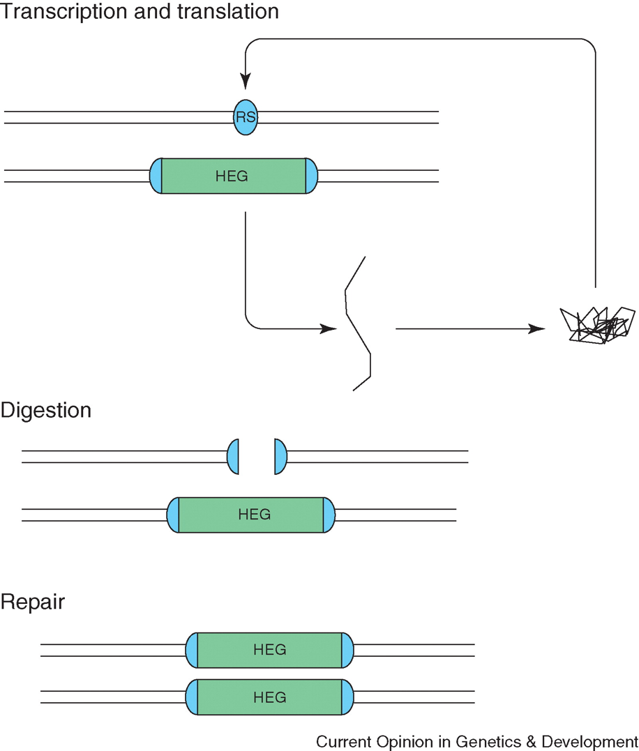



Homing and Homing Endonucleases in Inteins
Self Splicing
Domain
Homing Endonuclease
Domain
Homing Endonuclease
Recognition Site

Slide 38
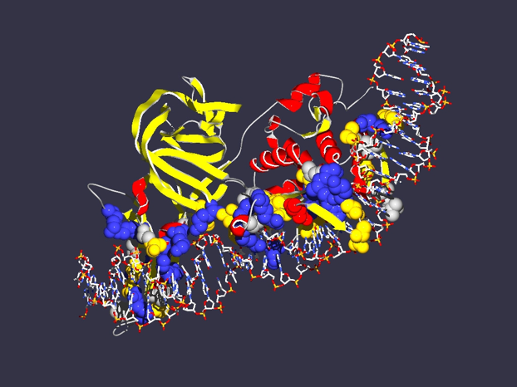
In case of inteins the co-evolution of genes results in
Mutualism between splicing and homing endonuclease domain
Commensalism between host protein and intein without HE domain
Parasitism between host protein and intein with HE
Encoding
1LWS
Extein = Host Protein
Intein Splicing Domain
Structure from Moure et al. (2002)
Nat.Struct.Biol. 9: 764-770
Homing Endonuclease (HE)
domain

Slide 39
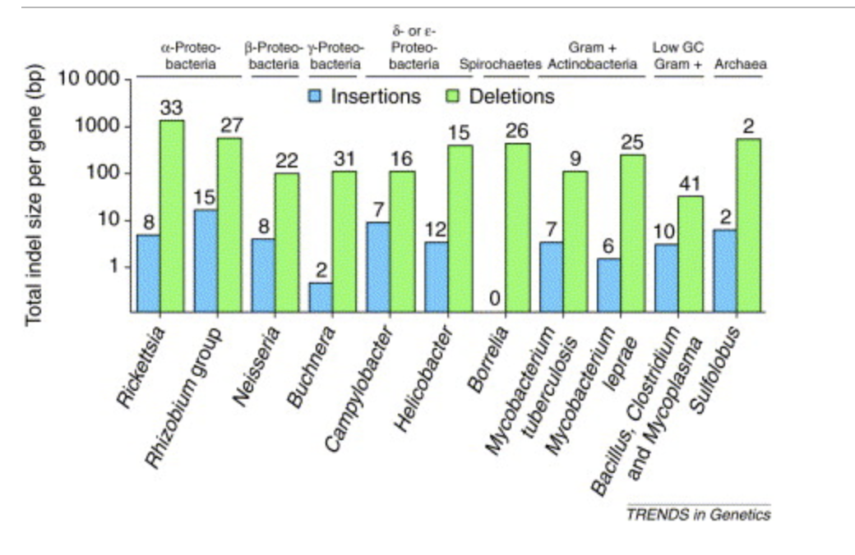
Deletion pressure in bacteria
Small deletions help to get rid of selfish genetic elements, molecular parasites, and redundancy due to duplicated genes. E.g., in a Restriction Modification System, a first deletion might inactivate the restriction activity, leaving behind an orphan methylase, which subsequently can decay without harm to the organisms.
This piece wise deletion does not work in case of inteins. As soon as the self splicing domain is impacted, the host protein becomes dysfunctional. One way to get rid of an intein is recombination with an intein free allele (but this works efficiently only after the the Homing Endonuclease is inactivated).
Deletions and insertions in pseudogenes from
https://doi.org/10.1016/S0168-9525(01)02447-7

Slide 40
Split inteins as an example for CNE
Transcribed
and translated
Functional replicative
DNA polymerase III
dnaE
dnaE
cis splicing
(difficult to revert, because no complete cDNA present)
dnaE1
Non-covalent inter-actions between N and C intein
trans splicing
dnaE2
Gene encoding extein
extein
Gene encoding splicing domains
Intein splicing domains
Gene encoding homing endonuclease domain
Intein homing endonuclease domains

Slide 41
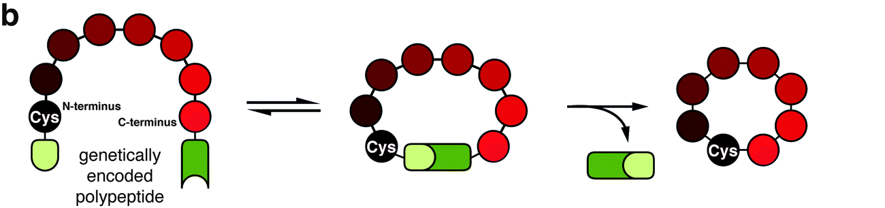
From: Inteins: nature's gift to protein chemists
Neel H. Shah and Tom W. Muir
DOI: 10.1039/C3SC52951G

