Slide 1
MCB 3421 – class 10
The transitive property of homology
Blast searches via the commandline
The fossil record for early life
LUCA and the early heavy bombardment of Earth

Slide 2
Recommendation following the somewhat difficult use of filezilla and the absence of a decent text editor.
If you use the class laptops, always check out the same laptop.
Set yourself up as a user
Then, if you use filezilla’s connection manager, filezilla will retain your settings.
Also, if you use Microsoft office 365, the links in the instructions work, and you can type in your answers. (And if you save your document on OneDrive, you have version control.)
Can you as a student download Microsoft office for free?

Slide 3
If A is a homolog of B & B is a homolog of C
A
B
B
C
then
A
B
C
B
C
A
A
C
B
either
or
or

Slide 4
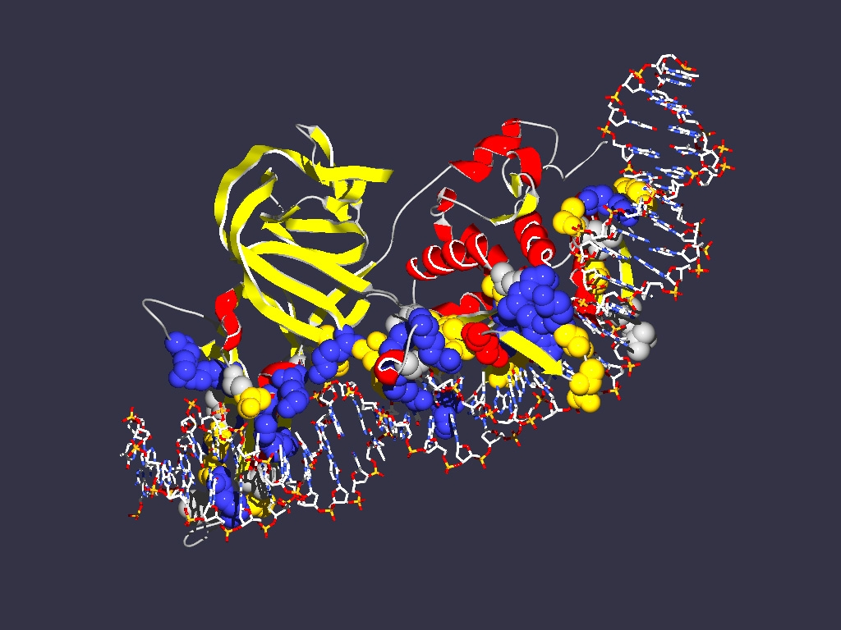
The transitive property of homology
”Exceptions”
A or B or C are not one, but several entities lumped together
Example:
Encoding
1LWS
Extein = Host Protein
Intein Splicing Domain
Homing Endonuclease (HE)
domain
Each component can have its own homologs

Slide 5
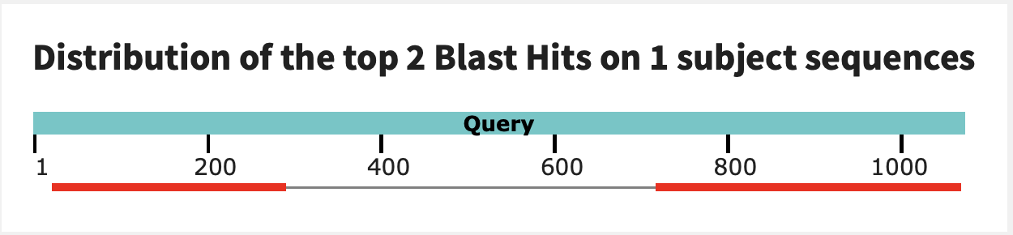
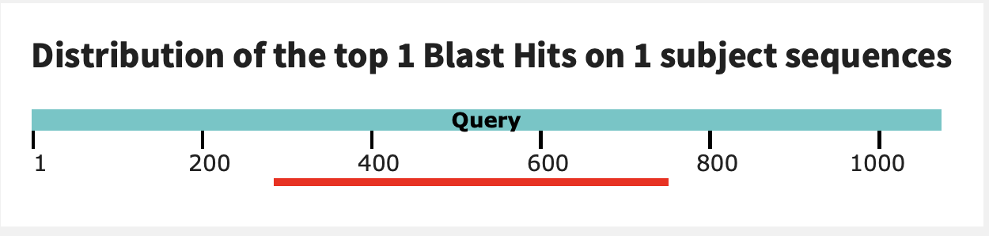
Exception to the transitive property of homology
In a pairwise blast search multiple components in the query might be revealed as follows:
Query: GI 6320016 (V-ATPase a-SU from Yeast)
6320016 (V‐ATPase A‐SU from Yeast)
GI 1303679 (V‐ATPase A‐SU from Acetabularia)
GI 1303679 (V‐ATPase A‐SU from Acetabularia)
Homolog 1:
GI 1303679 (V‐ATPase A‐SU from Acetabularia)
V-ATPase a-SU from Acetabularia
Homolog 2:
HO-endonuclease from Yeast

Slide 6
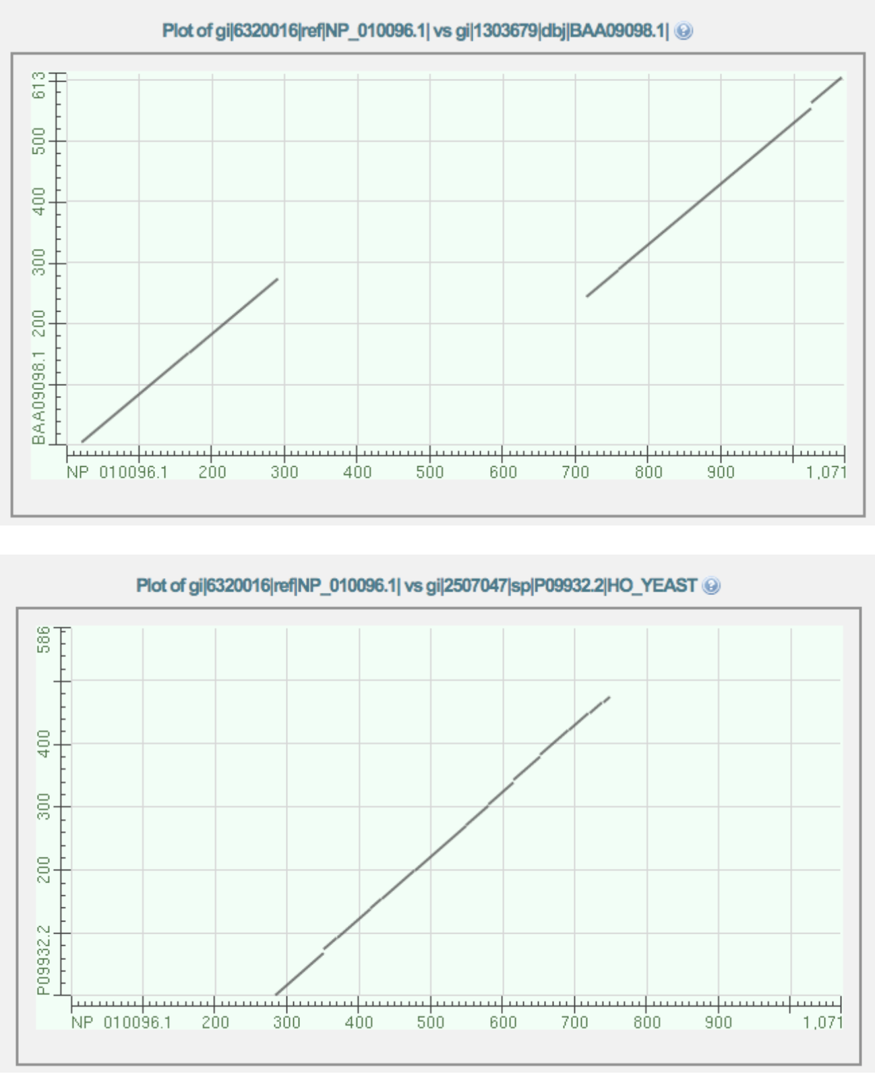
While homology is a transitive property, the parts of a protein (or DNA) that are homologous need to be the same. E.g. 6320016 (V‐ATPase A‐SU from Yeast) is homologous to 1303679 (V‐ATPase A‐SU from Acetabularia) and to 2507047 (mating type switching endonuclease from yeast), but different parts of 6320016 give rise to this homology.

Slide 7
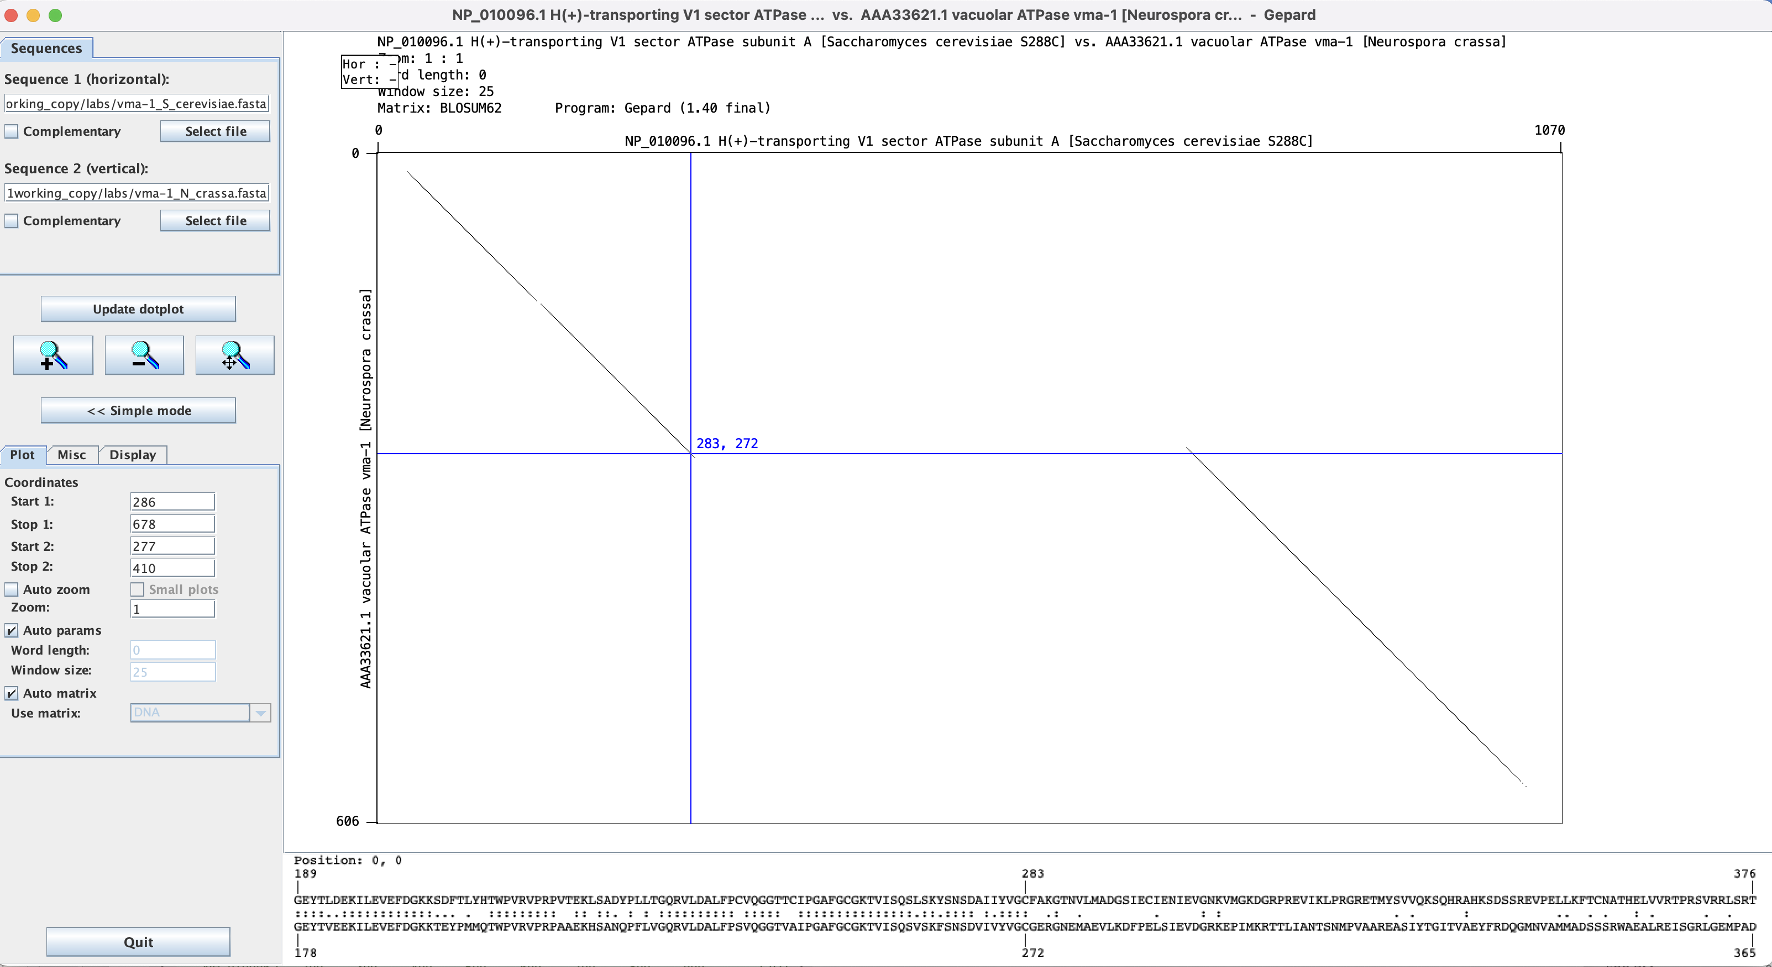
Dotplot in Gephard: Yeast vs Neurosora V-ATPase A-subunit.
Note: while the match ends at position 283, the diagonal extends a little beyond this. The first aa of the intein is the C

Slide 8
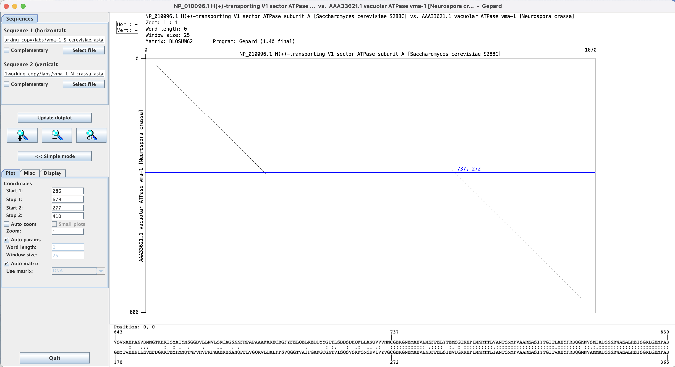
The last aa of the inteins are HN

Slide 9
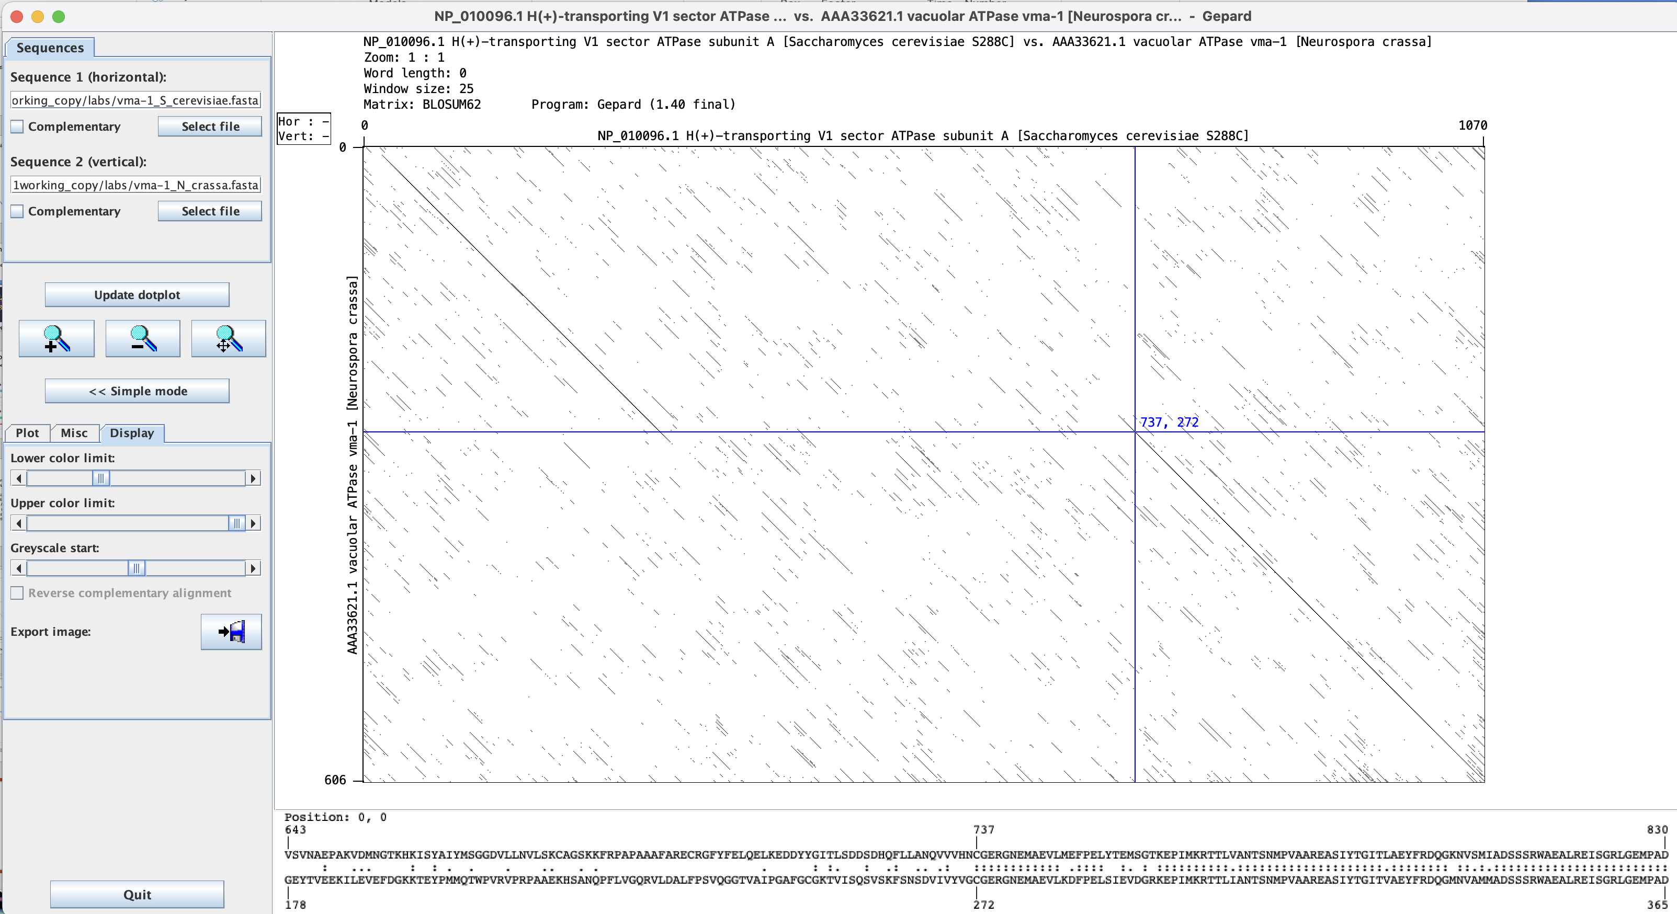
Adjusting which windows to display.

Slide 10

Distant View of Atake in Evening Shower
from: http://archive.artsmia.org/art-of-asia/explore/explore-collection-ukiyo-e-rain.cfm.html

Slide 11
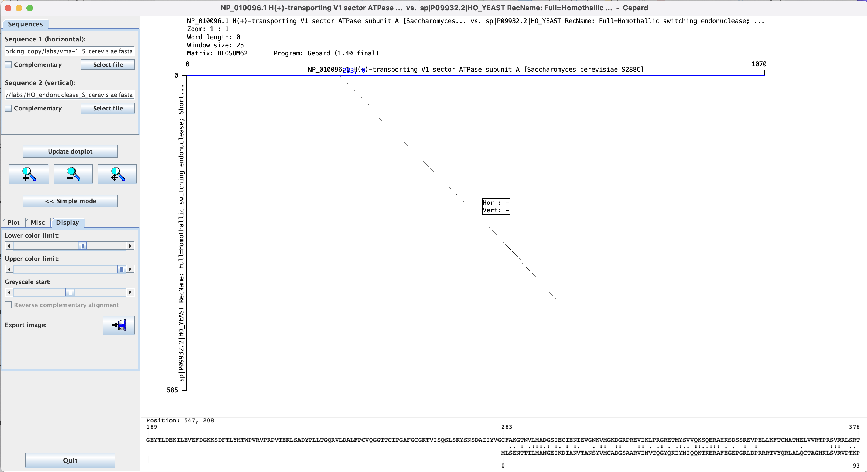
This works moderately well for divergent sequences – one could increase the window size and decrease the lower color limit

Slide 12
characters at the end of lines
File tranfers from Windows to UNIX and return:
End of Line characters are a problem. Under Windows DO NOT use notepad, it does not understand UNIX newline symbols ‘\n’.
Best write your programs under UNIX using vi or vim (or any other editor you are comfortable with)
2nd best is to use a text editor like bbedit (very nice and free program for UNIX). Like vi and vim it provides context dependent coloring.
3rd best is to remove end of line symbols in a UNIX editor or use sed (Stream EDitor) after you transferred the file:
sed s/.$// name_of_WINDOWS_infile > name_of_UNIX_outfile (This replaces the last non letter character before the eol ($) with nothing)
Some versions of office allow to save files as UNIX textfiles, but ...
A related problem is encountered by Mac users. Many older text editors will use MAC carriage returns at the end of the line. Most unix programs will not be able to handle these. In a terminal window you could use the following command to convert your file:
tr ’\r' ’\n' < name_of_the_Mac_file > name_of_the_unix_file
The EoL confusion is very inconvenient, but there really is no easy solution, tough luck; and you better know about this in case something goes wrong.

Slide 13
Formatting a custom database
Format sequence data into Fasta format
Example of Fasta format:
>sequence 1
AAATGCTTAAAAA
>sequence 2
AAATTGCTAAAAGA
Convert Fasta to Blast format by using makeblastdb program from command-line:
makeblastdb -in proteins.faa -dbtype prot -parse_seqids
(formatdb.log is a file where the results are logged from the formatting operation)
by Bob Friedman

Slide 14
How to get help: command -h
bash-4.2$ makeblastdb -h
USAGE
makeblastdb [-h] [-help] [-in input_file] [-input_type type]
-dbtype molecule_type [-title database_title] [-parse_seqids]
[-hash_index] [-mask_data mask_data_files] [-mask_id mask_algo_ids]
[-mask_desc mask_algo_descriptions] [-gi_mask]
[-gi_mask_name gi_based_mask_names] [-out database_name]
[-max_file_sz number_of_bytes] [-logfile File_Name] [-taxid TaxID]
[-taxid_map TaxIDMapFile] [-version]
DESCRIPTION
Application to create BLAST databases, version 2.7.1+
Use '-help' to print detailed descriptions of command line arguments

Slide 15
Searching a custom database:
blastp -query query_protein.faa -db proteins.faa -out blast.txt -outfmt 6
-outfmt 6 specifies a tabular output format.
The default e-value cut-off is 10 (i.e. at the bottom of the list you expect about 10 false positives). To reduce the size of the output file you can set the e value cut-off to 0.0001 (you would probably not have any false positives).
You would add -evalue 0.0001 to the above command.
The output will be written to a text file called blast.txt.
The file query_protein.faa can contain one or many sequences in fasta format. If the file has more than one sequences a blast search will be done for every sequence. However, all the output goes into the same file.

Slide 16
How to get help: command -h
bash-4.2$ blastp -h
USAGE
blastp [-h] [-help] [-import_search_strategy filename]
[-export_search_strategy filename] [-task task_name] [-db database_name]
[-dbsize num_letters] [-gilist filename] [-seqidlist filename]
[-negative_gilist filename] [-negative_seqidlist filename]
[-entrez_query entrez_query] [-db_soft_mask filtering_algorithm]
[-db_hard_mask filtering_algorithm] [-subject subject_input_file]
[-subject_loc range] [-query input_file] [-out output_file]
[-evalue evalue] [-word_size int_value] [-gapopen open_penalty]
[-gapextend extend_penalty] [-qcov_hsp_perc float_value]
[-max_hsps int_value] [-xdrop_ungap float_value] [-xdrop_gap float_value]
[-xdrop_gap_final float_value] [-searchsp int_value]
[-sum_stats bool_value] [-seg SEG_options] [-soft_masking soft_masking]
[-matrix matrix_name] [-threshold float_value] [-culling_limit int_value]
[-best_hit_overhang float_value] [-best_hit_score_edge float_value]
[-window_size int_value] [-lcase_masking] [-query_loc range]
[-parse_deflines] [-outfmt format] [-show_gis]
[-num_descriptions int_value] [-num_alignments int_value]
[-line_length line_length] [-html] [-max_target_seqs num_sequences]
[-num_threads int_value] [-ungapped] [-remote] [-comp_based_stats compo]
[-use_sw_tback] [-version]
DESCRIPTION
Protein-Protein BLAST 2.7.1+
Use '-help' to print detailed descriptions of command line arguments

Slide 17
From blast –help: (goes over several pages)
*** Formatting options
-outfmt <String>
alignment view options:
0 = Pairwise,
1 = Query-anchored showing identities,
2 = Query-anchored no identities,
3 = Flat query-anchored showing identities,
4 = Flat query-anchored no identities,
5 = BLAST XML,
6 = Tabular,
7 = Tabular with comment lines,
8 = Seqalign (Text ASN.1),
9 = Seqalign (Binary ASN.1),
10 = Comma-separated values,
11 = BLAST archive (ASN.1),
12 = Seqalign (JSON),
13 = Multiple-file BLAST JSON,
14 = Multiple-file BLAST XML2,
15 = Single-file BLAST JSON,
16 = Single-file BLAST XML2,
18 = Organism Report

Slide 18
From blast –help: (continued)
Options 6, 7 and 10 can be additionally configured to produce
a custom format specified by space delimited format specifiers.
The supported format specifiers are:
qseqid means Query Seq-id
qgi means Query GI
qacc means Query accesion
qaccver means Query accesion.version
qlen means Query sequence length
sseqid means Subject Seq-id
sallseqid means All subject Seq-id(s), separated by a ';'
sgi means Subject GI
sallgi means All subject GIs
sacc means Subject accession
saccver means Subject accession.version
sallacc means All subject accessions
slen means Subject sequence length
qstart means Start of alignment in query
qend means End of alignment in query
sstart means Start of alignment in subject
send means End of alignment in subject
qseq means Aligned part of query sequence
sseq means Aligned part of subject sequence
evalue means Expect value
bitscore means Bit score
score means Raw score
length means Alignment length
pident means Percentage of identical matches
nident means Number of identical matches
mismatch means Number of mismatches
positive means Number of positive-scoring matches
gapopen means Number of gap openings
gaps means Total number of gaps
ppos means Percentage of positive-scoring matches
frames means Query and subject frames separated by a '/'
qframe means Query frame
sframe means Subject frame
btop means Blast traceback operations (BTOP)
staxid means Subject Taxonomy ID
ssciname means Subject Scientific Name
scomname means Subject Common Name
sblastname means Subject Blast Name
sskingdom means Subject Super Kingdom
staxids means unique Subject Taxonomy ID(s), separated by a ';'
(in numerical order)
sscinames means unique Subject Scientific Name(s), separated by a ';'
scomnames means unique Subject Common Name(s), separated by a ';'
sblastnames means unique Subject Blast Name(s), separated by a ';'
(in alphabetical order)
sskingdoms means unique Subject Super Kingdom(s), separated by a ';'
(in alphabetical order)
stitle means Subject Title
salltitles means All Subject Title(s), separated by a '<>'
sstrand means Subject Strand
qcovs means Query Coverage Per Subject
qcovhsp means Query Coverage Per HSP
qcovus means Query Coverage Per Unique Subject (blastn only)

Slide 19
When not provided, the default value is:
'qaccver saccver pident length mismatch gapopen qstart qend sstart send
evalue bitscore', which is equivalent to the keyword 'std'
Default = `0'
Query accession_number.version
Subject accession_number.version
% identity
Alignment length
Number of mismatches
Number of gap openings
Start of alignment in query
End of alignment in query
Start of alignment in subject
End of alignment in subject
Expect value
Bit score

Slide 20
Default tabular output (–outfmt 6): (gene 10 from bacteriophage Zhengyi against actinophagedb)
Zhengyi 94287_EugeneKrabs_Draft_10 99.463 745 4 0 1 745 1 745 0.0 1544
Zhengyi 311157_Unphazed_10 85.542 747 106 1 1 745 1 747 0.0 1338
Zhengyi 325083_Xitlalli_Draft_10 85.906 745 103 1 3 745 4 748 0.0 1337
Zhengyi 15244_ArMaWen_10 85.542 747 106 1 1 745 1 747 0.0 1337
Zhengyi 169244_LilyLou_11 85.408 747 107 1 1 745 1 747 0.0 1335
Zhengyi 288178_Stormbreaker_Draft_10 85.638 745 105 1 3 745 4 748 0.0 1332
Zhengyi 35842_BlueRugrat_Draft_10 85.599 743 105 1 5 745 3 745 0.0 1330
Zhengyi 301381_TinyTimothy_10 84.688 738 105 2 8 745 4 733 0.0 1288
Zhengyi 319351_Wesak_10 84.553 738 106 2 8 745 4 733 0.0 1285
Zhengyi 233484_Phogo_10 81.392 747 129 4 1 745 1 739 0.0 1245
Zhengyi 5978_Alex44_10 81.258 747 130 4 1 745 1 739 0.0 1243
Zhengyi 219502_Pabst_Draft_11 75.963 753 165 7 3 745 4 750 0.0 1155
Zhengyi 5386_Akoni_10 60.881 772 242 11 5 745 7 749 0.0 889
Zhengyi 16330_Ashton_10 60.881 772 242 11 5 745 7 749 0.0 889
Zhengyi 6996_AloeVera_Draft_10 61.061 773 239 12 5 745 4 746 0.0 889
Zhengyi 307288_Truong_10 60.931 773 240 12 5 745 7 749 0.0 887
Zhengyi 97649_Fede_Draft_10 61.282 749 269 13 5 745 4 739 0.0 879
Zhengyi 17656_Atraxi_Draft_10 60.610 754 261 12 5 745 4 734 0.0 874
Zhengyi 184880_Mazun_Draft_10 60.898 757 248 15 7 745 6 732 0.0 870
Zhengyi 234940_PhriedRice_10 60.956 753 254 13 7 745 6 732 0.0 867
Zhengyi 234112_Phractured_10 60.956 753 254 13 7 745 6 732 0.0 867
Zhengyi 229391_Phedro_10 60.956 753 254 13 7 745 6 732 0.0 867
Zhengyi 228522_Pharky_10 60.956 753 254 13 7 745 6 732 0.0 867
Zhengyi 14465_Arete_11 37.517 757 416 19 3 745 13 726 1.30e-133 414
Zhengyi 45652_Burro_10 37.813 759 403 21 7 745 15 724 3.58e-130 405
Zhengyi 13154_Araxxi_10 36.842 760 413 21 5 745 14 725 2.12e-124 390
Zhengyi 307086_Troy_42 26.267 750 406 35 6 721 2 638 1.45e-33 139
Zhengyi 265199_SamW_42 26.267 750 406 35 6 721 2 638 1.45e-33 139
Zhengyi 164472_Lederberg_42 26.267 750 406 35 6 721 2 638 1.45e-33 139
Often looks strange, because some entries run into the next tab – making the font smaller, or loading it into excel helps.

Slide 21
Default tabular output (–outfmt 7): gene all proteins in Hfx. volcanii genome against a nanohaloarchaeal genome (strain SG9)
# Query: WP_004040797.1 hypothetical protein [Haloferax volcanii]
# Database: SG9.faa
# Fields: query acc.ver, subject acc.ver, % identity, alignment length, mismatches, gap opens, q. start, q. end, s. start, s. end, evalue, bit score
# 11 hits found
WP_004040797.1 AOV94602.1 45.000 20 11 0 66 85 1240 1259 0.14 26.6
WP_004040797.1 AOV95267.1 27.273 66 38 3 25 84 354 415 0.37 25.4
WP_004040797.1 AOV94348.1 50.000 14 7 0 104 117 44 57 2.8 22.7
WP_004040797.1 AOV94453.1 25.000 60 43 1 57 116 352 409 3.2 22.7
WP_004040797.1 AOV94962.1 27.869 61 42 2 15 73 547 607 3.2 22.3
WP_004040797.1 AOV94961.1 20.909 110 75 3 10 117 8 107 4.0 21.9
WP_004040797.1 AOV94654.1 66.667 15 5 0 82 96 314 328 6.7 21.6
WP_004040797.1 AOV94708.1 37.500 24 15 0 62 85 8 31 6.9 21.6
WP_004040797.1 AOV94738.1 41.935 31 18 0 30 60 487 517 7.9 21.2
WP_004040797.1 AOV94984.1 37.143 35 20 1 27 59 722 756 8.7 21.2
WP_004040797.1 AOV94472.1 28.235 85 57 1 6 86 142 226 9.4 21.2
# BLASTP 2.7.1+
# Query: WP_004040798.1 hypothetical protein [Haloferax volcanii]
# Database: SG9.faa
# Fields: query acc.ver, subject acc.ver, % identity, alignment length, mismatches, gap opens, q. start, q. end, s. start, s. end, evalue, bit score
# 2 hits found
WP_004040798.1 AOV95137.1 28.889 45 32 0 7 51 15 59 0.23 25.8
WP_004040798.1 AOV95296.1 50.000 14 7 0 125 138 243 256 6.7 22.3
# BLASTP 2.7.1+
# Query: WP_004040800.1 hypothetical protein [Haloferax volcanii]
# Database: SG9.faa
# Fields: query acc.ver, subject acc.ver, % identity, alignment length, mismatches, gap opens, q. start, q. end, s. start, s. end, evalue, bit score
# 13 hits found
WP_004040800.1 AOV94411.1 30.645 62 42 1 247 307 18 79 0.83 26.2
...
Continues for all ~4000 genes in the Haloferax volcanii genome.

Slide 22
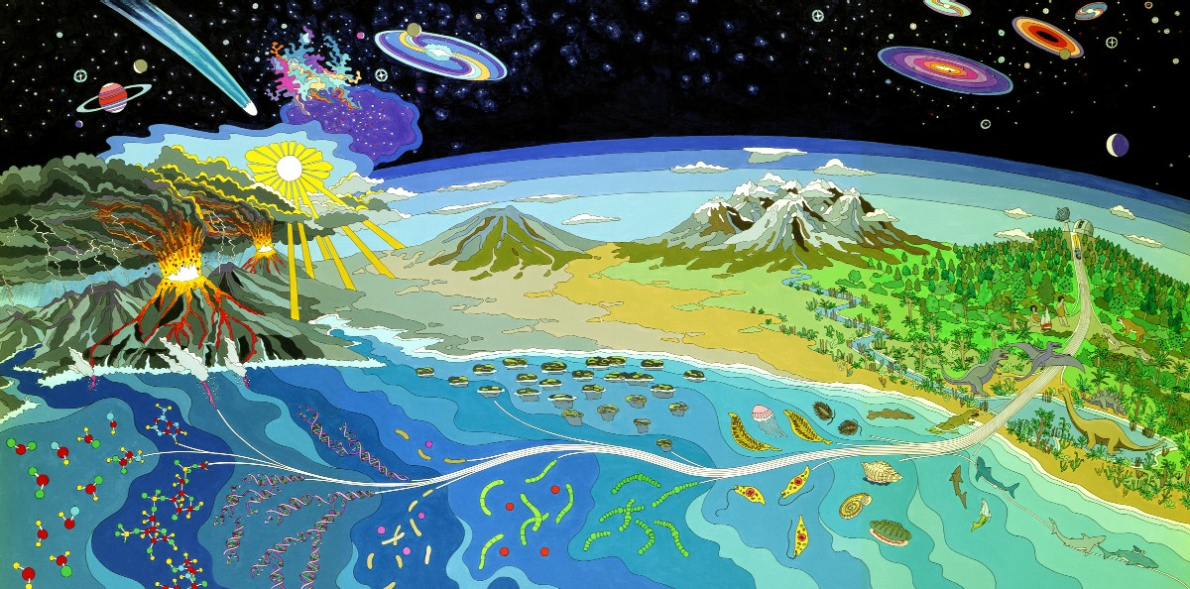
Mural at NASA Ames Research Center
The record for early life

Slide 23
With the insistence of NSF and NIH that articles reporting on funded research are accessible by the public within a year after publication, many recent articles are available to everyone.
Exceptions are review articles and commentaries and particularly annoying, older articles in Science (e.g., Bill Schopf’s article on 3.5 billion-year-old* cyanobacterial fossils.
* Names and abbreviations for large numbers are a problem. Most European countries denote 10⁹ as a milliard and 10¹² as billion. This is known as a the short (UK and US) and long scale respectively. From Wikipedia:
For example, Bulgarian, Catalan, Croatian, Czech, Danish, Dutch, Finnish, French, Georgian, German, Hebrew (Asia), Hungarian, Italian, Norwegian, Polish, Portuguese, Romanian, Russian, Serbian, Slovak, Slovenian, Spanish, Swedish, Turkish and Ukrainian — use milliard (or a related word) for the short scale billion, and billion (or a related word) for the long scale billion.
I try to use the term Giga Year Before Present as less ambiguous.

Slide 24
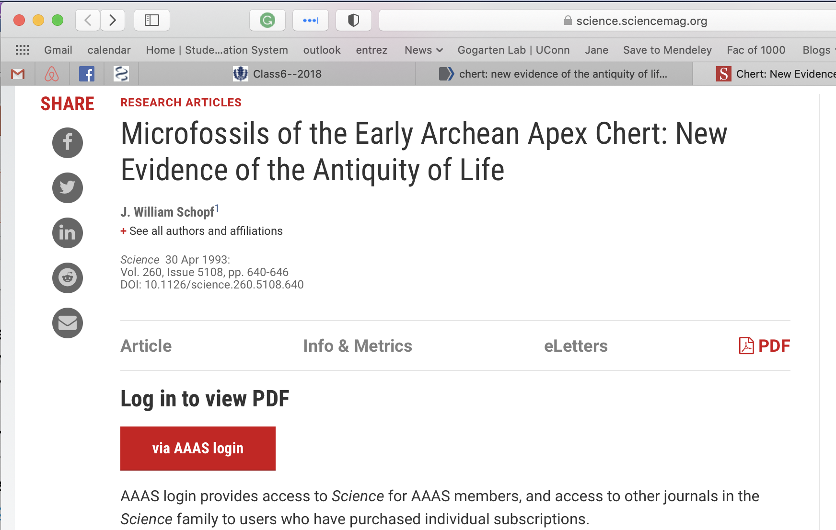

Slide 25
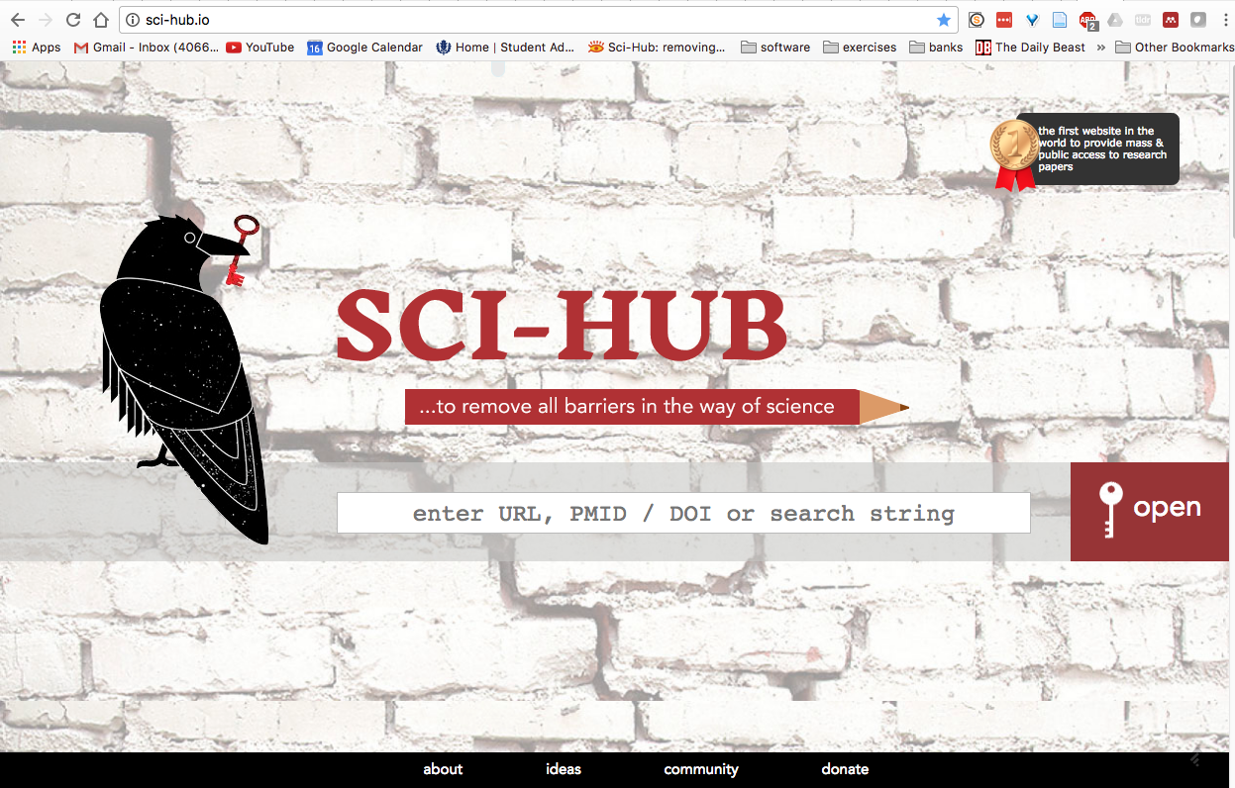
The web’s solution to open access:
Paste DOI here

Slide 26
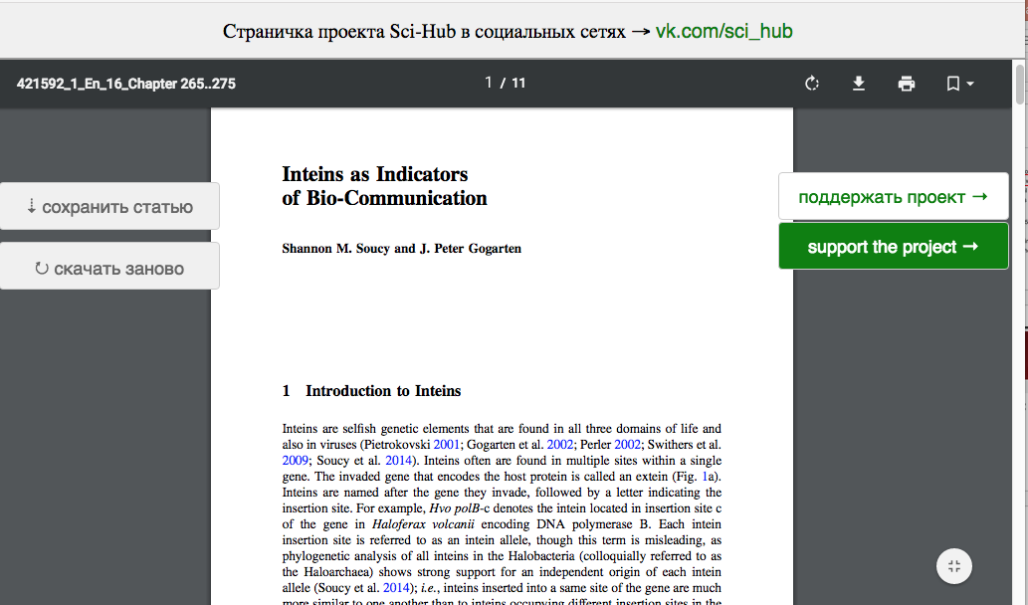
SCI-HUB
Even obscure and very recent Book Chapters are retrieved. This was posted before the authors had received their pdf!

Slide 27
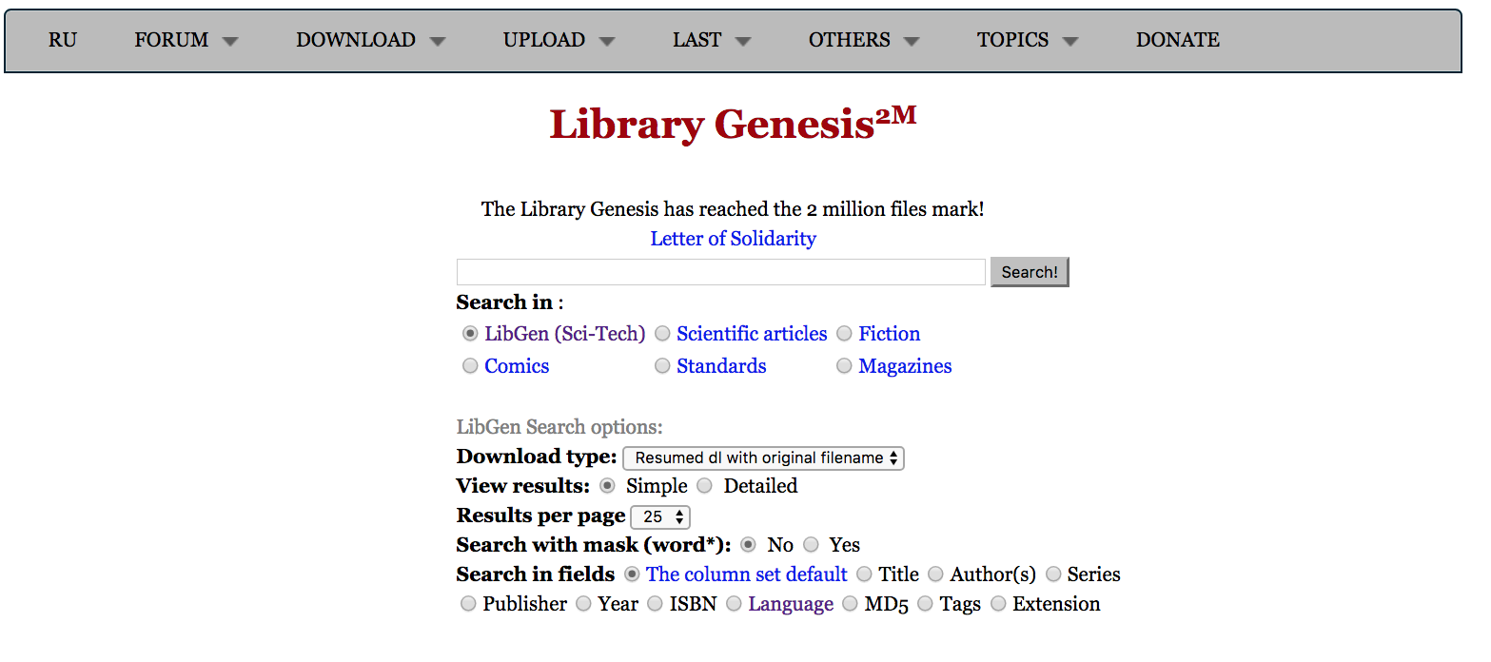
Companion site to SCI-HUB

Slide 28
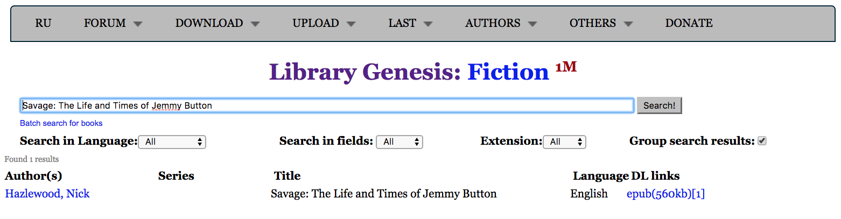
Jemmy Button was a native American “abducted” by Captain FitzRoy (bought for a button, hence the name) to England to be civilized. He, together with a missionary and other Fuegians were returned to Tierra del Fuego on the same trip that also brought Charles Darwin to the Galapagos.

Slide 29

to download click here

Slide 30
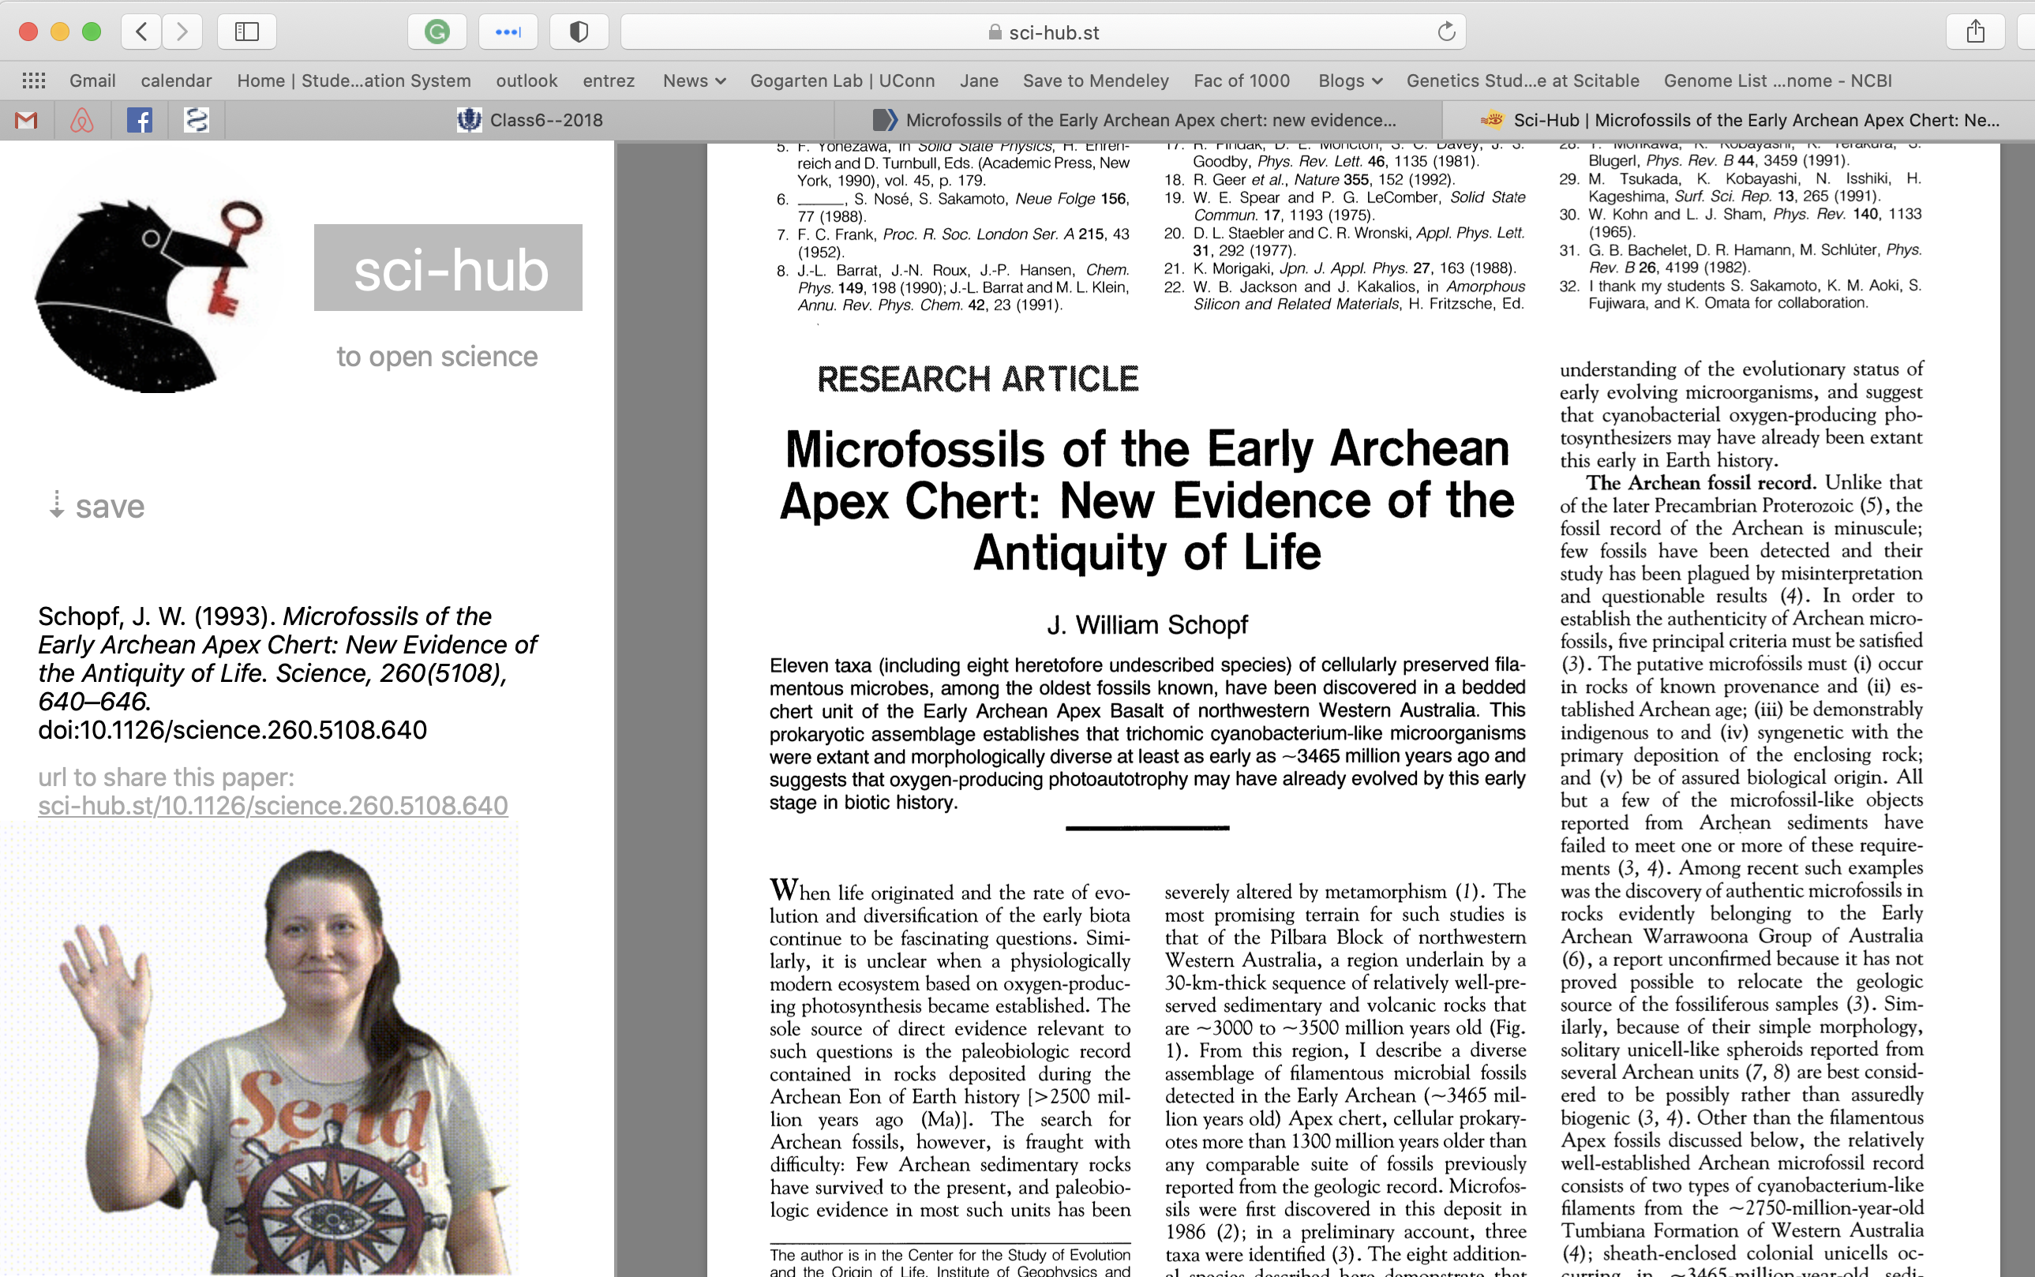

Slide 31
How old is life on Earth?
The Earth is about 4.6 Ga old, but no crustal rocks has survived from that time. The oldest rocks are no older than 4.0 Ga. But zircon crystals dated to 4.4 billion years BP are found in rocks. They are considered evidence for Earth's crust having had formed and being in contact with water already 4.4 billion years GaBP (here and here)
Biological Signature Evidence (examples): Oldest geological evidence for life - 3.8 Ga ago - is based on ¹³C discrimination (carbon derived from living systems often have lower delta ¹³C values than inorganic carbonates) [here]. The rocks are from Akilia island off the coast of Greenland, and severely altered by metamorphism. However, recently the evidence for that was reassessed.
3.7 billion year of rocks from the Isua formation in Greenland contain structures described as stromatholites. here in NYT, report in Nature
The amount of carbon in the Issua formation (and its discrimination against agains 13C) is interpreted by Minik Rosing to indicate a highly productive biosphere.
3.7GA old fossils from marine hydrothermal vent systems (Dodd et al 2017)
Morphological Fossil Evidence: For about a decade the oldest microfossils were considered to be about 3.5 Ga old (see here). The fossils (as interpreted by Bill Schopf) look like "modern" Cyanobacteria. Compare the time to to molecular trees of life: Is this a problem? However, the evidence for these fossils was questioned.
3.2Ga old filamentous fossils, probably of thermophilic chemotrophic prokaryotes (Rasmussen, 2000)
1.8Ga old fossils from Gunflint formation: iron-loving bacteria and cyanobacteria

Slide 32
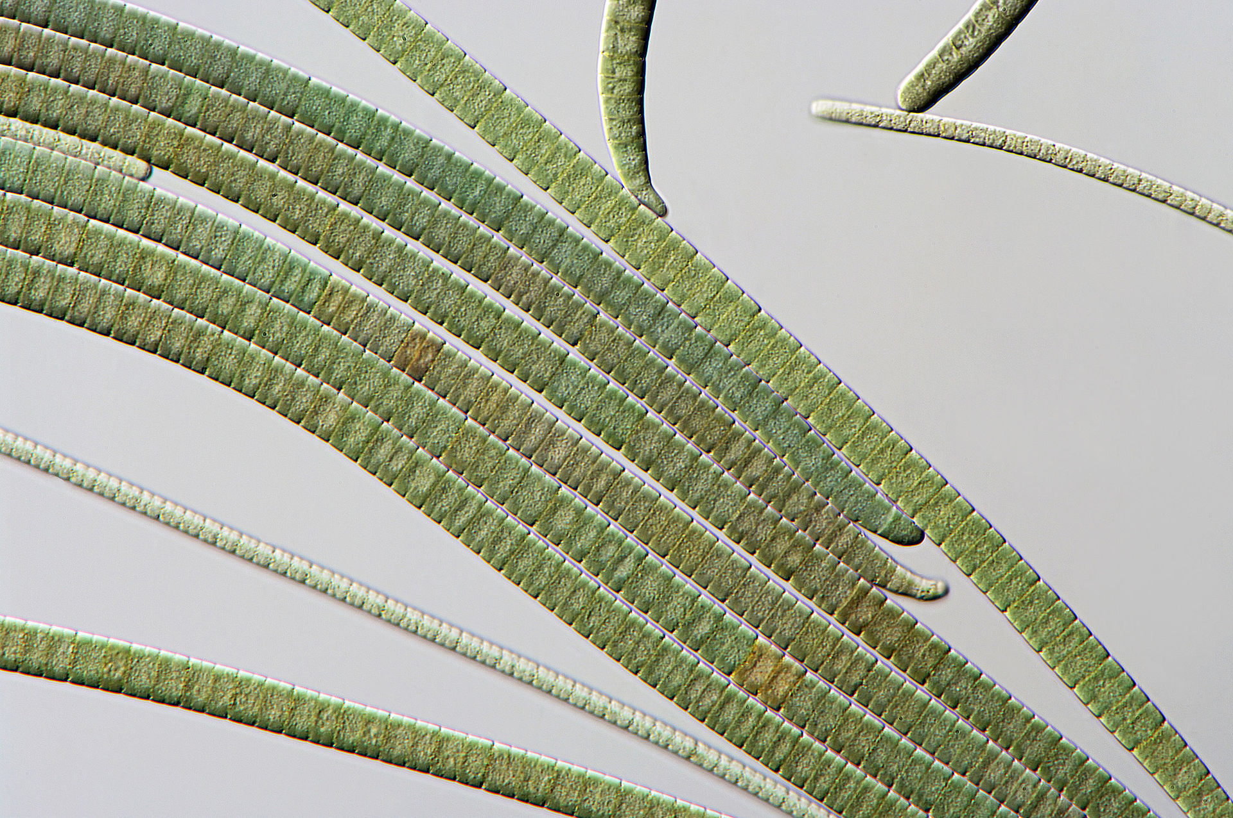
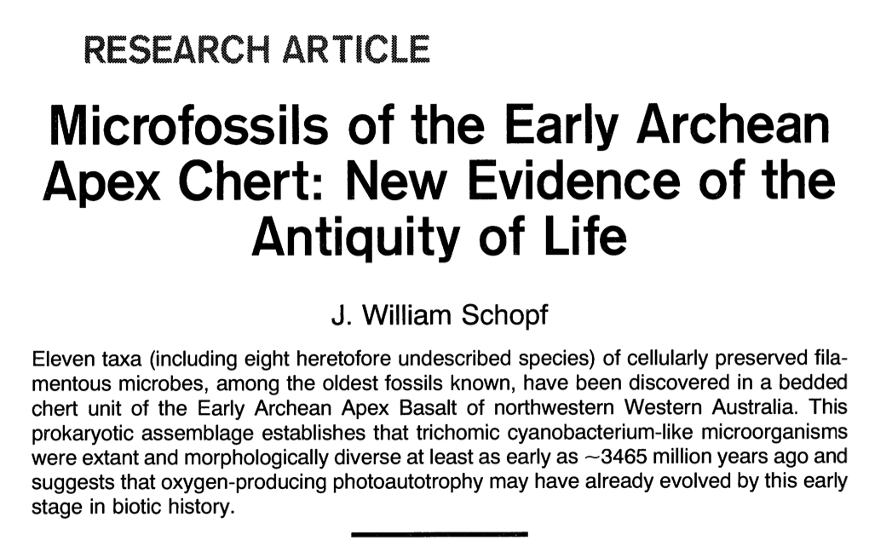
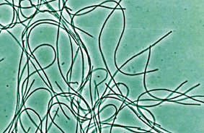
Oscillatoria (a cyanobacterium)
Chloroflexus (green non-sulfur bacteria)
Cyanobacteria-like: Bill Schopf and others most of the time considered them cyanobacteria, especially when other wrote about the finding; however, there are non-oxygen producing filamentous photosynthetic bacteria with a very similar morphology

Slide 33
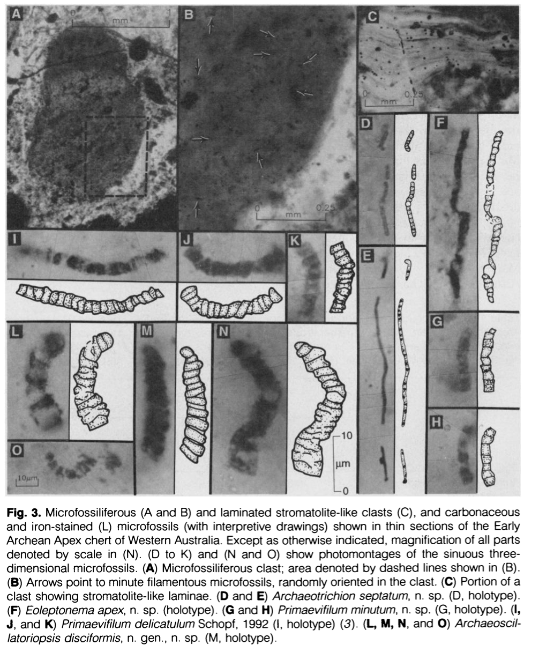
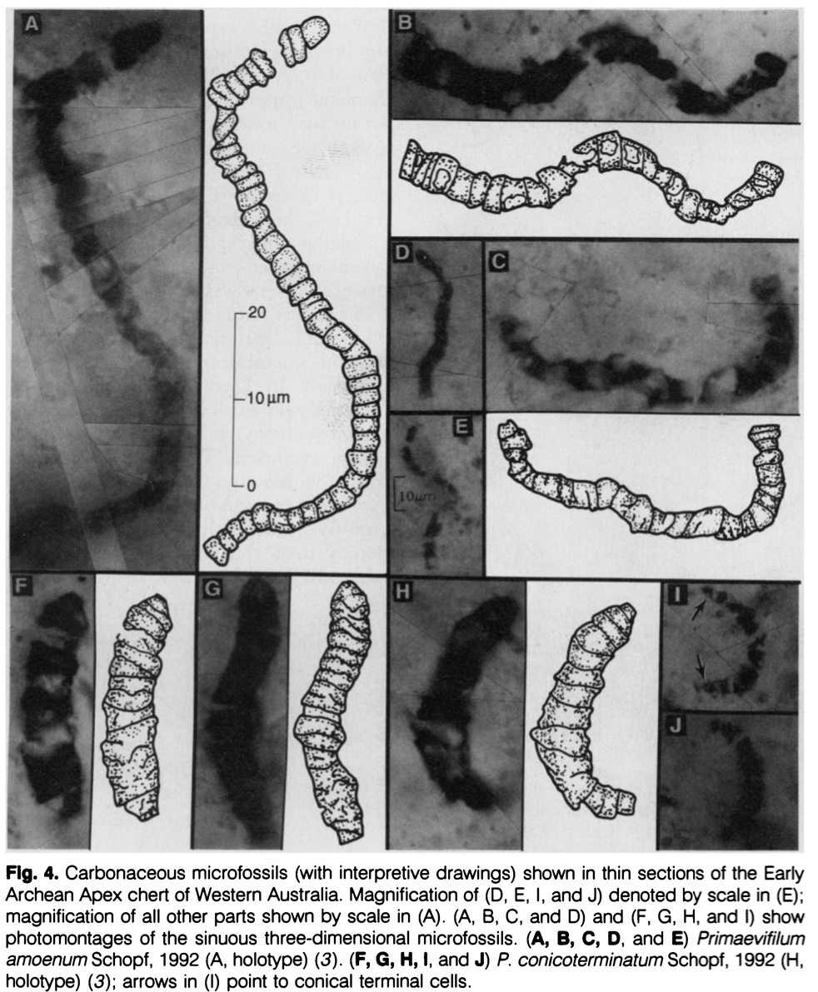

Slide 34
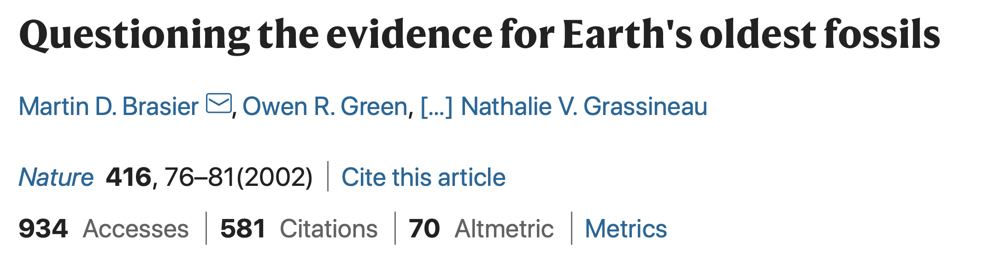

Slide 35
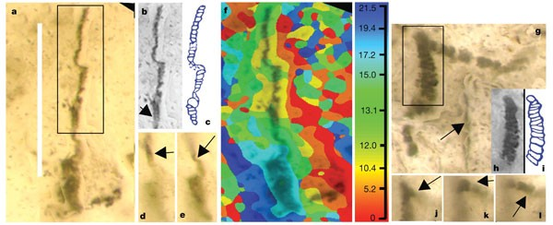
a, New image of putative beggiatoan Eoleptonema apex Holotype (ref. 3), combining the most sharply focused images from successive focal planes; b, c, digital image and interpretative sketch in the style of ref. 3 that omits the lower structure; d, e, new single image frames showing continuity of original and newly imaged structures. f, Topographic map showing computer-selected focal planes (plus scale in µm) of a; g, new image of putative cyanobacterium Archaeoscillatoriopsis disciformis Holotype (ref. 3) showing rhombic ghost (arrow); h, i, digital image and interpretative sketch in the style of ref. 3 that omits the lower structure and side branch; j, k, l, new single image frames showing continuity of original and newly imaged structure. Scale bar, 40 µm.

Slide 36
Mural at NASA Ames Research Center
Darwin’s Coral of Life, tree shape, and indications for early extinctions due to increased environmental temperature.

Slide 37
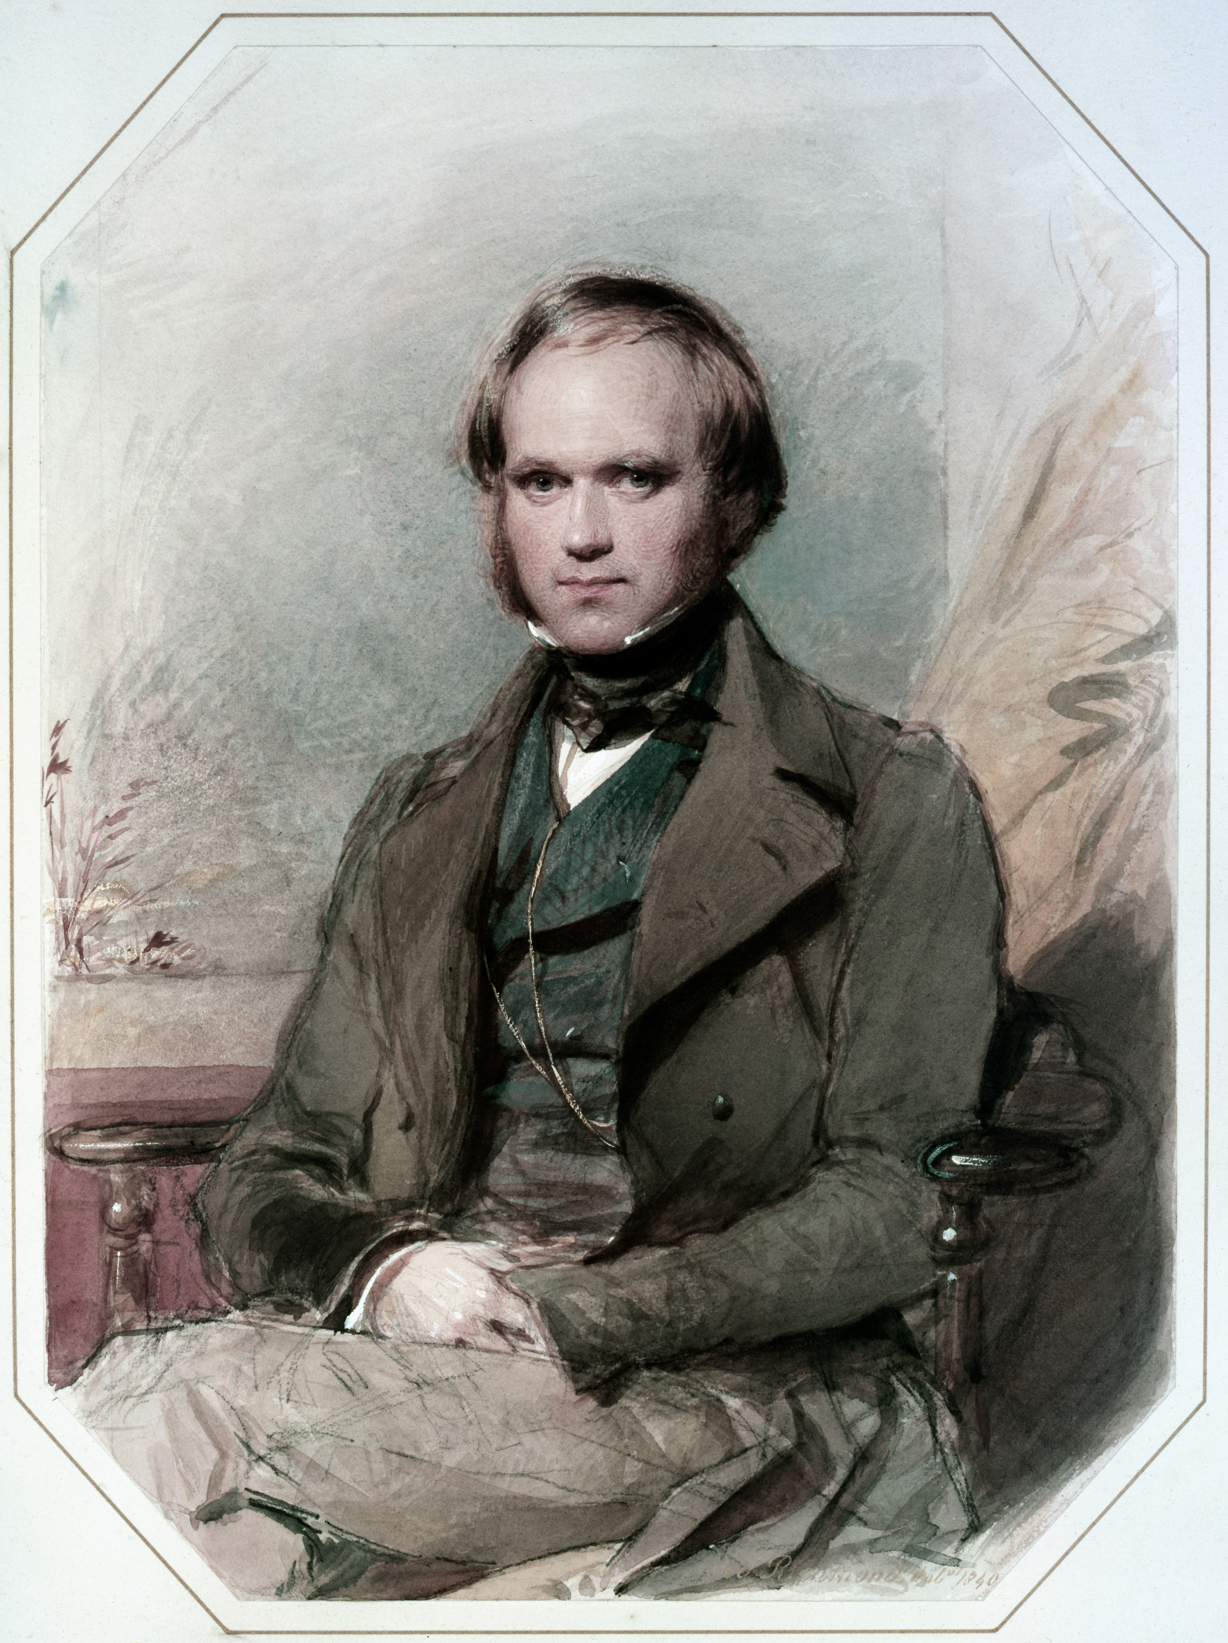
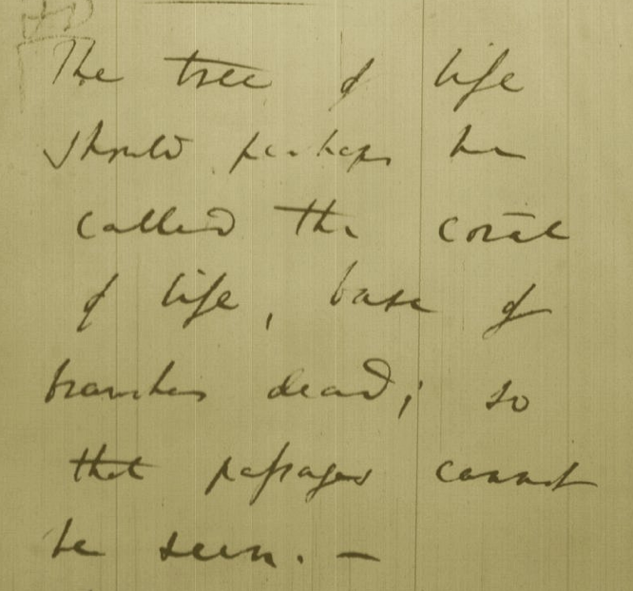
Tree, Web, or Coral of Life?
“The tree of life should perhaps be called the coral of life, base of branches dead”
Charles Darwin
painted by George Richmond in the late 1830
Page B26 from Charles Darwin’s (1809-1882) notebook (1837/38)

Slide 38
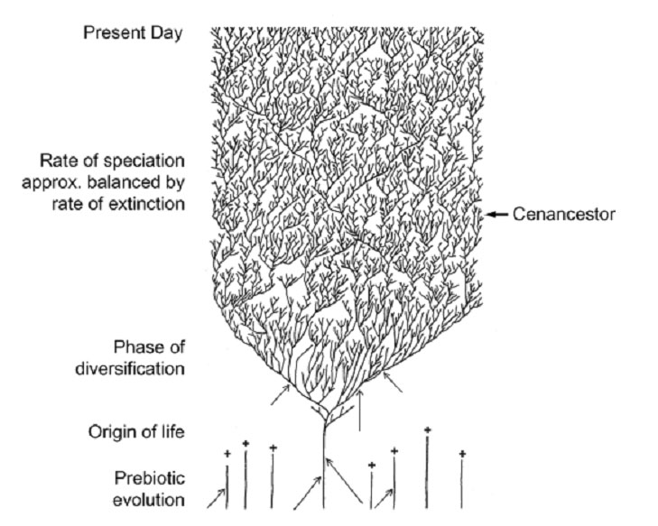
The Coral of Life (Darwin)
ZHAXYBAYEVA and GOGARTEN (2004):
Cladogenesis, Coalescence and the Evolution of the Three Domains of Life.
Trends in Genetics 20 (4): 182- 187
Notes:
The “Coral of Life” and the transfer of characters from now extinct into surviving lineages

Slide 39
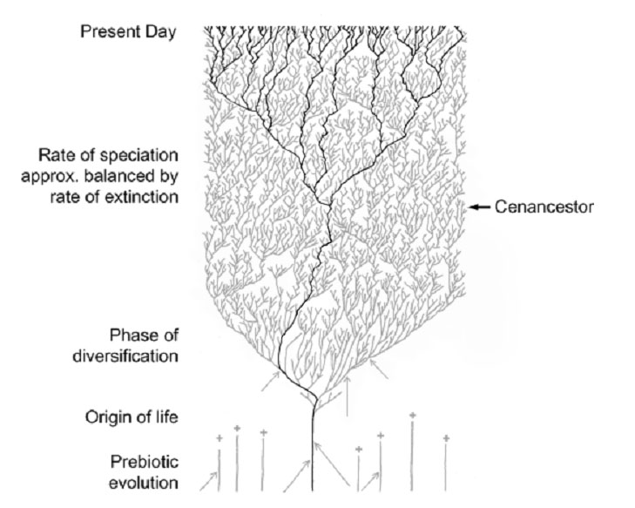
The Coral of Life (Darwin)
ZHAXYBAYEVA and GOGARTEN (2004):
Cladogenesis, Coalescence and the Evolution of the Three Domains of Life.
Trends in Genetics 20 (4): 182- 187
Notes:
The “Coral of Life” and the transfer of characters from now extinct into surviving lineages

Slide 40
The Coral of Life (Darwin)
ZHAXYBAYEVA and GOGARTEN (2004):
Cladogenesis, Coalescence and the Evolution of the Three Domains of Life.
Trends in Genetics 20 (4): 182- 187
Notes:
The “Coral of Life” and the transfer of characters from now extinct into surviving lineages

Slide 41
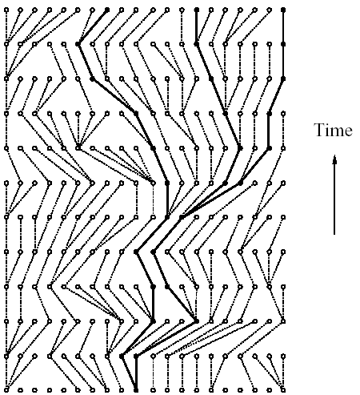
Coalescence – the process of tracing lineages backwards in time to their common ancestors. Every two extant lineages coalesce to their most recent common ancestor. Eventually, all lineages coalesce to the cenancestor.
t/2
(Kingman,
1982)
Illustration is from J. Felsenstein, “Inferring Phylogenies”, Sinauer, 2003

Slide 42
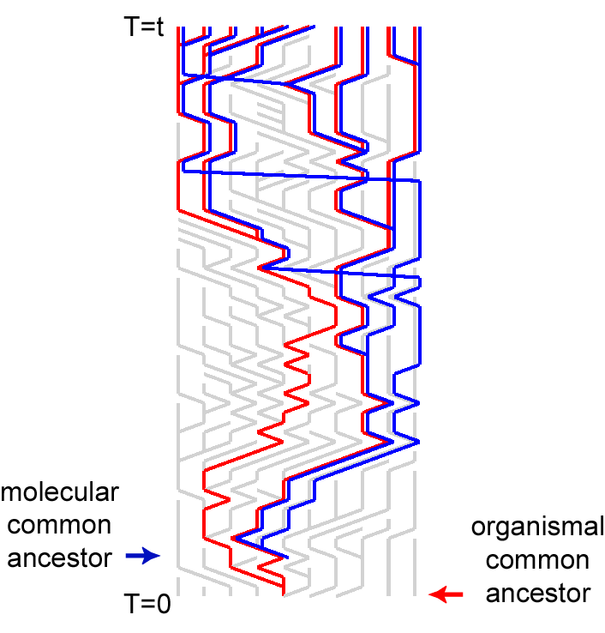
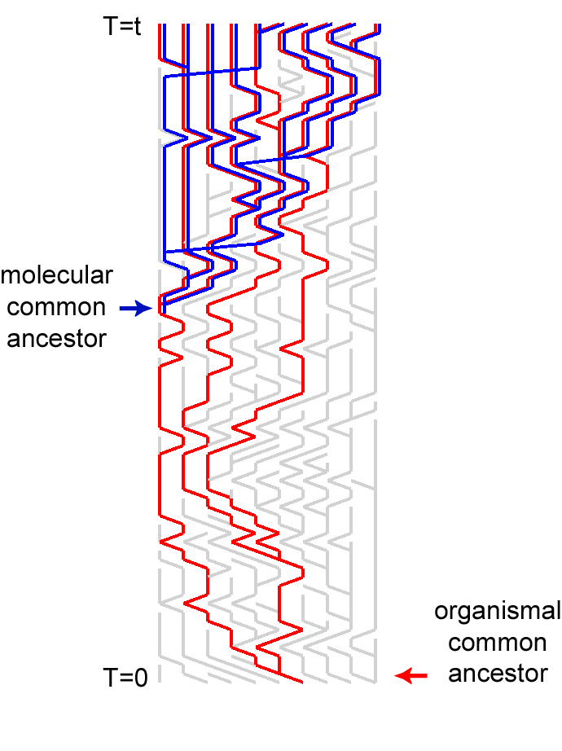
Simulations of organismal evolution by coalescence
One extinction and one speciation event per generation
Horizontal transfer event once in 10 generations
RED: organismal lineages (no HGT)
BLUE: molecular lineages (with HGT)
GRAY: extinct lineages
RESULTS:
Most recent common ancestors are different for organismal and molecular phylogenies
Different coalescence times
Long coalescence of the last two lineages

Slide 43
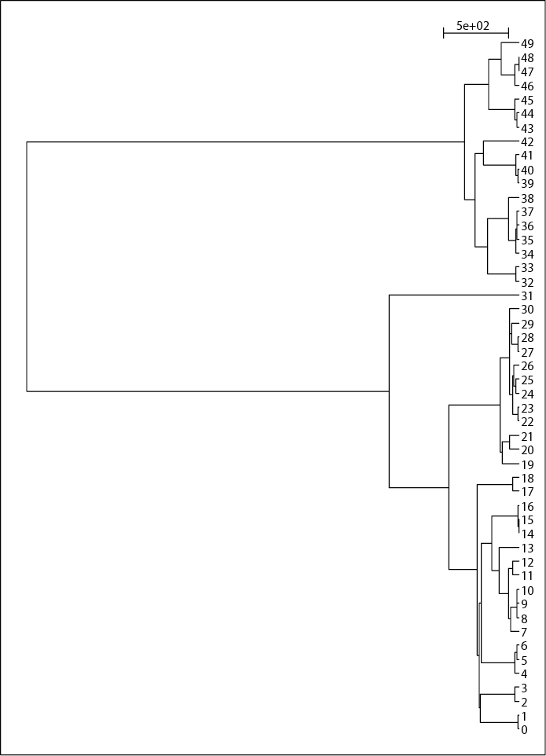
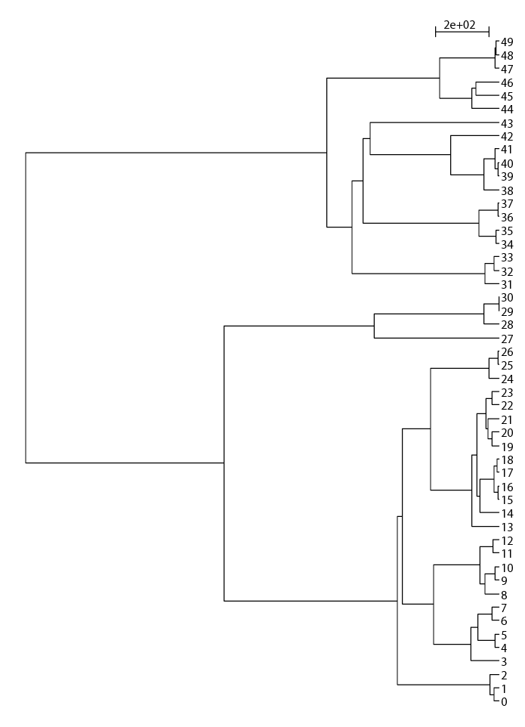
EXTANT LINEAGES FOR THE SIMULATIONS OF 50 LINEAGES

Slide 44
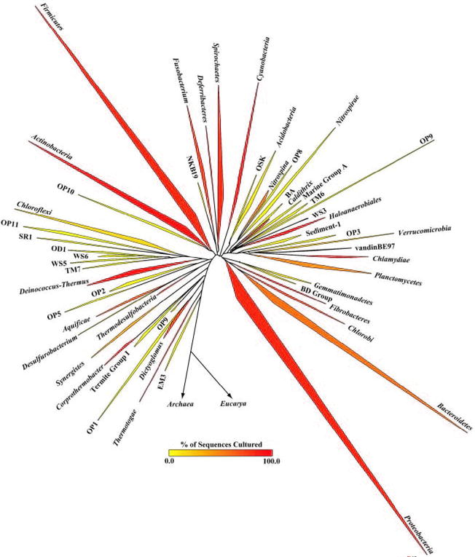
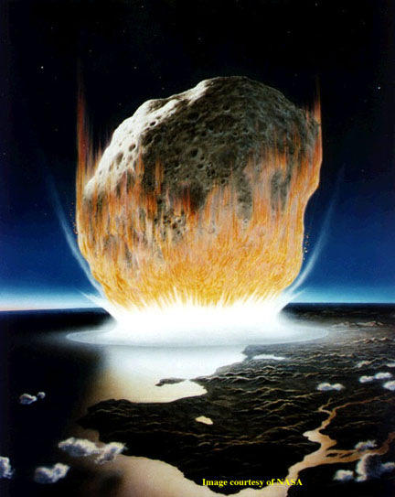
The deviation from the “long branches at the base” pattern could be due to
under sampling
an actual radiation
  due to an invention that was not transferred
  following a mass extinction
Bacterial 16SrRNA based phylogeny (from P. D. Schloss and J. Handelsman, Microbiology and Molecular Biology Reviews, December 2004.)

Slide 45
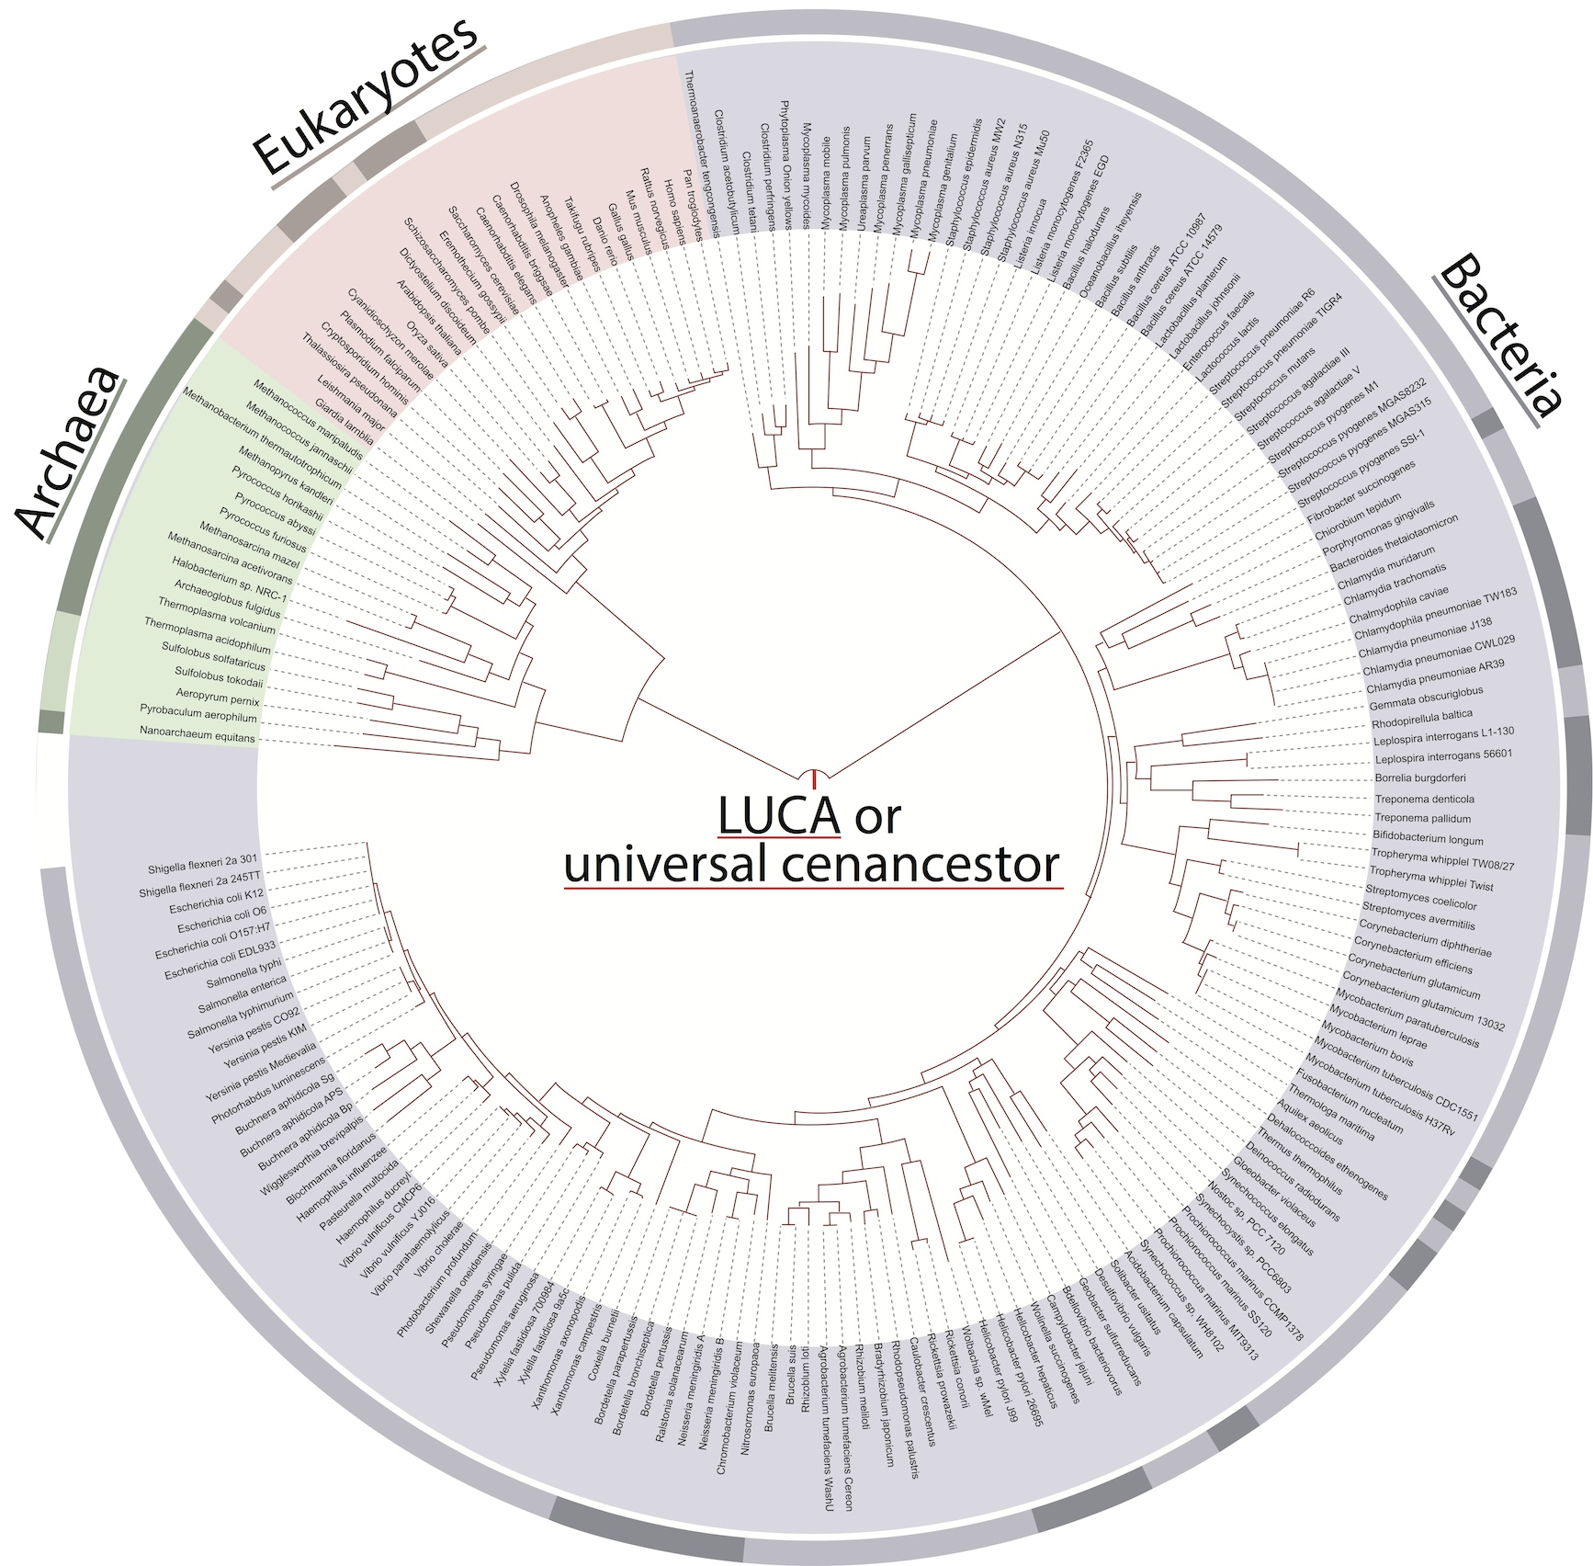
Molecular Phylogenies ➔
Lonely Ancestors
Noteworthy:
Tree topology averaged over many genes (mainly ribosomal proteins).
No reticulations.
Branches do not reflect time.
Only extant organisms and their lucky ancestors are includes
From: http://itol.embl.de/
iTol The interactive Tree of Life
Ciccarelli et al, Science. 2006 311 :1283-7
Notes:
Tree of 1 % as example.

Slide 46
EXTANT LINEAGES FOR THE SIMULATIONS OF 50 LINEAGES

Slide 47
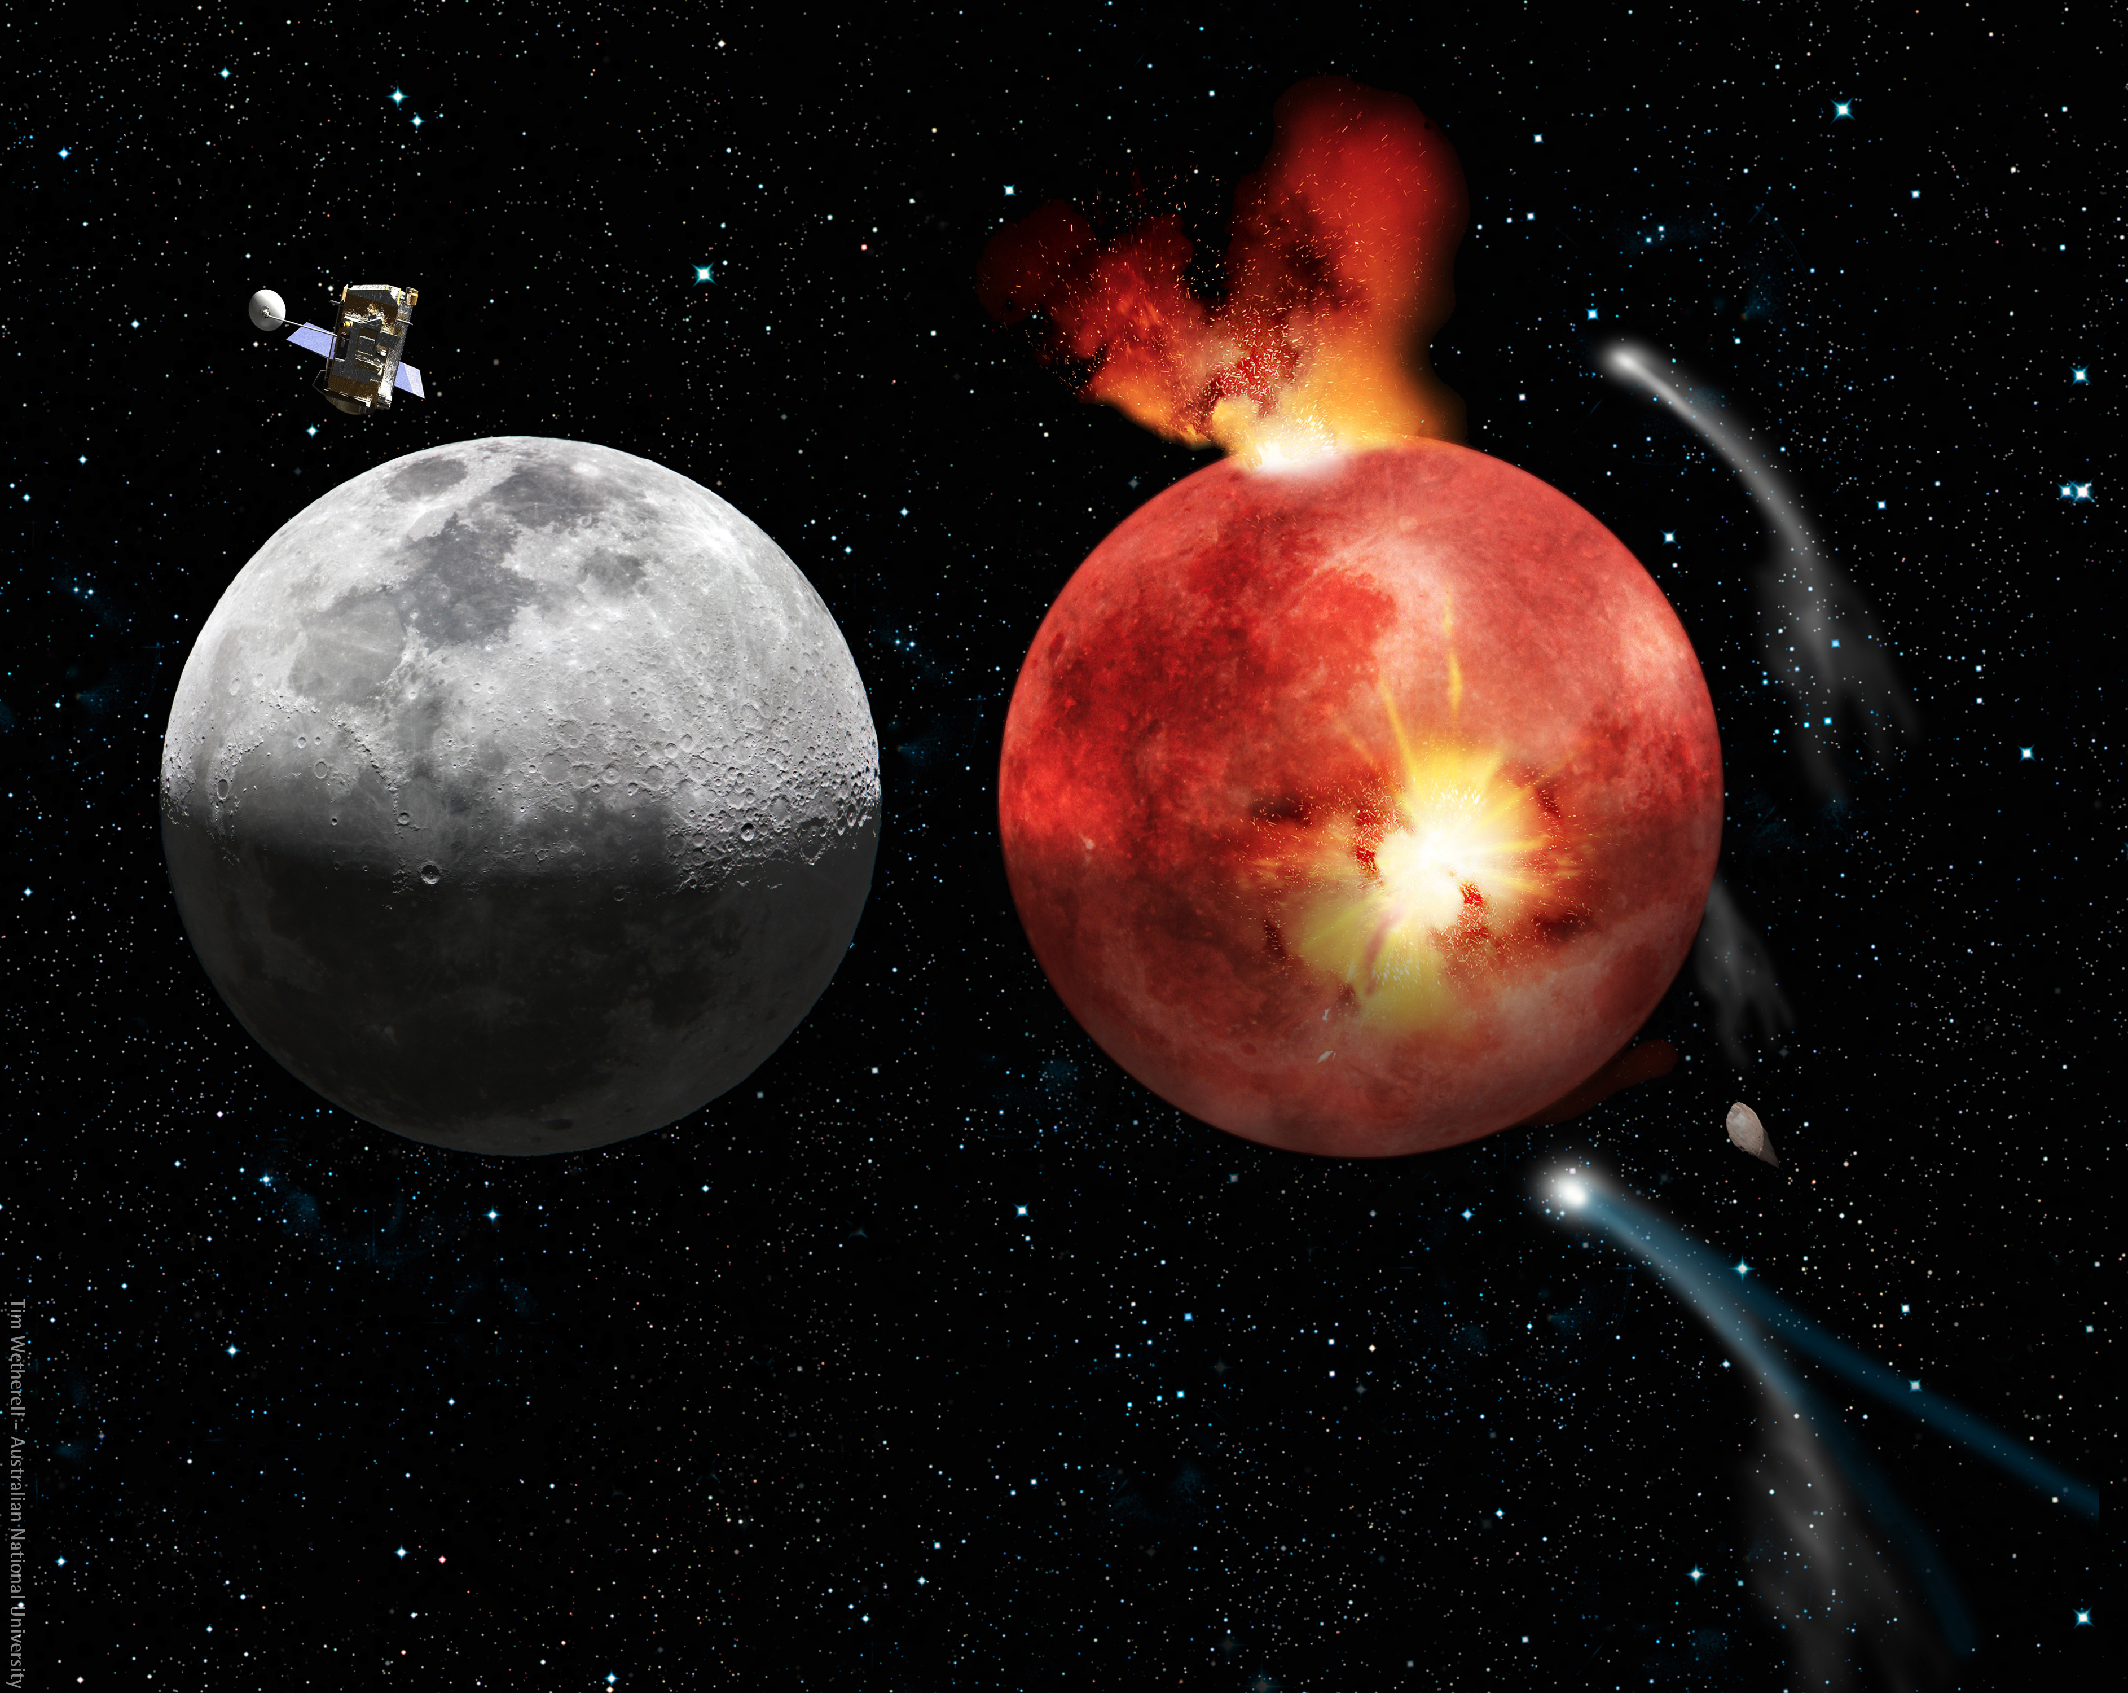
Lunar Cataclysm and Today
The cratering record of the moon
From: http://en.wikipedia.org/wiki/Late_Heavy_Bombardment

Slide 48
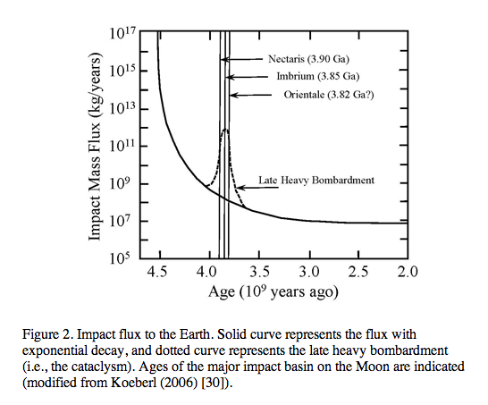
From: http://www.origin-life.gr.jp/3603/3603055/3603055.html
Alternative: tail of early heavy bombardment; however, see Marchi et al.
Nature 511:578-82 2014 for an update on the early impact history.

Slide 49
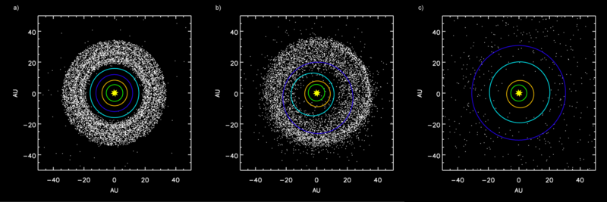
Simulation showing the outer planets and the Kuiper belt:
a) Before Jupiter–Saturn 2:1 resonance.
b) Scattering of Kuiper belt objects into the Solar System after the orbital shift of Neptune.
c) After ejection of Kuiper belt bodies by Jupiter.
From: http://en.wikipedia.org/wiki/Late_Heavy_Bombardment

Slide 50
Early Earth
Early Earth was spinning at a much faster rate: according to computer models, Earth had a six-hour day 4.5 billion years ago! Since then, with the help of our Moon, Earth has been slowing down and our days have been getting longer.
... the Moon was even closer to Earth. Billions of years ago, the Moon was 10 times closer and tides were 1000 times higher. Scientists believe that these extreme tides occurred once every three hours because the Earth was spinning more rapidly. The tides eroded the coastal areas, adding minerals to the oceans.
From: the Lunar Planetary Institute https://www.lpi.usra.edu/education/explore/marvelMoon/background/moon-influence/

Slide 51
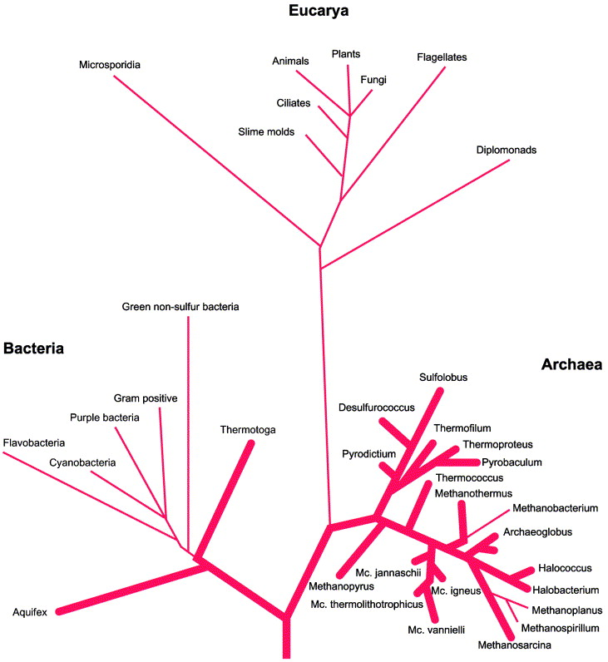
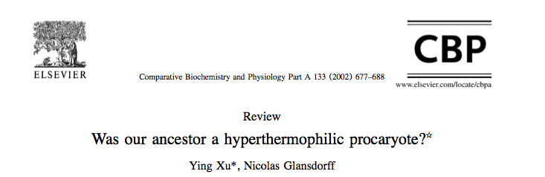
Fig. 3. The classical SSUrRNA distance tree, presented as rooted in the bacterial branch. Bold lines indicate extreme hyperthermophiles. From Stetter (1996).

Slide 52
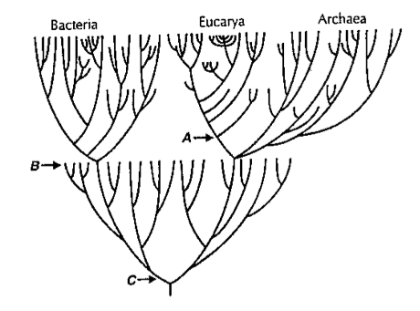
Near frustration of early life
From: Gogarten-Boekels M, Hilario E, Gogarten JP. Orig Life Evol Biosph. 1995 Jun;25(1-3):251-64. The effects of heavy meteorite bombardment on the early evolution
—the emergence of the three domains of life.

Slide 53
LUCA (located on the “bacterial branch”) was less thermophilic than the ancestor of the bacterial and archaeal domains
Boussau, B, Blanquart, S, Necsulea, A, Lartillot, N and Gouy, M (2008). Parallel adaptations to high temperatures in the Archaean eon. Nature 456(7224): 942-945
Reconstruction of ancestral protein and rRNA sequences
Based on IVYWREL and rRNA stem G+C content LUCA was less thermophilic than the domain ancestors.
Galtier, N, Tourasse, N and Gouy, M (1999).
A nonhyperthermophilic common ancestor to extant life forms. Science 283(5399): 220-221.8
rRNA 60°C80°C
IVYWREL (corrected for GC content) 20°C70°C

Slide 54
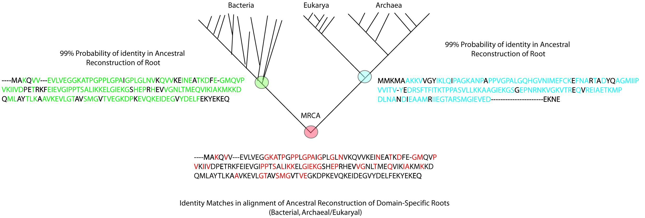
Compositional Stratigraphy
Fournier GP, Gogarten JP. 2007. Signature of a primitive genetic code in ancient protein lineages. J Mol Evol. 65(4):425-436
“We perform a compositional analysis of ribosomal proteins and ATPase subunits in bacterial and archaeal lineages, using conserved positions that came and remained under purifying selection before and up to the most recent common ancestor. An observable shift in amino acid usage at these conserved positions likely provides an untapped window into the history of protein sequence space, allowing events of genetic code expansion to be identified.”

Slide 55
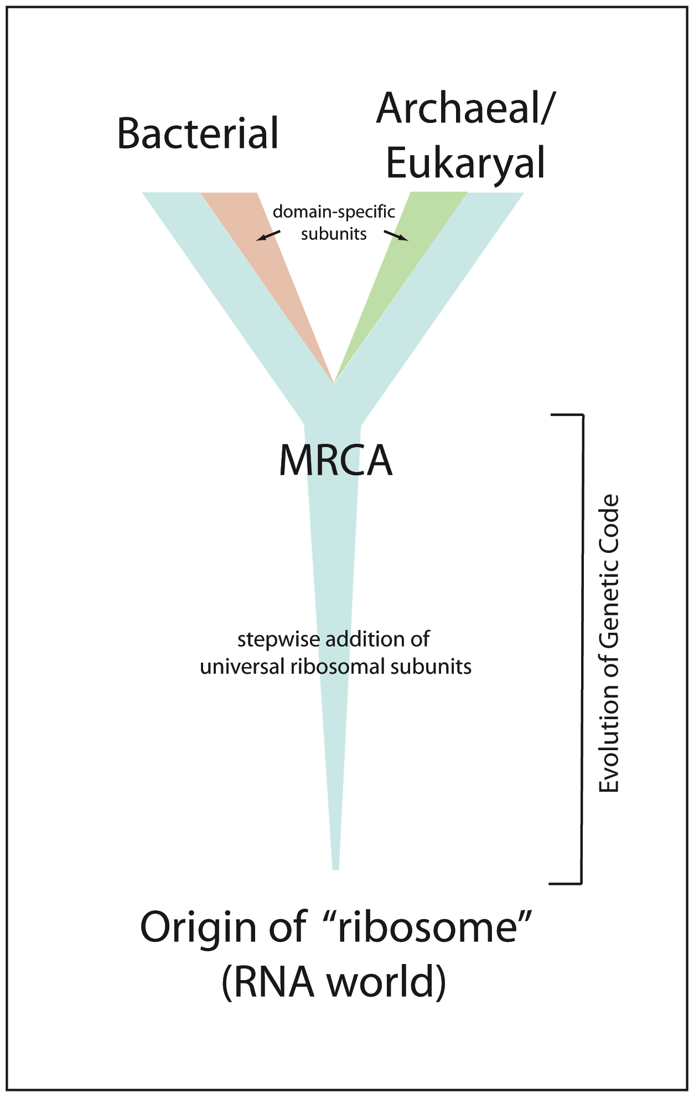
Evolution of the Ribosome
“Core” of ribosome consists of RNA + subset of ribosomal proteins universally conserved in all life (~29 proteins) (Harris et al., 2003)
Likely coevolved with genetic code within an RNA world (Wolf & Koonin, 2007)

Slide 56
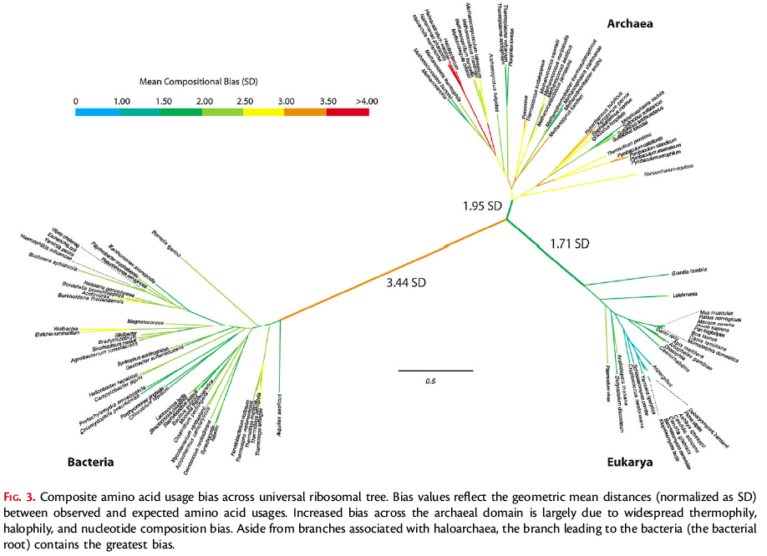
Rooting the Ribosomal Tree of Life using an Echo from the Early Expansion of the Genetic Code
(Fournier and Gogarten, MBE 2010)
Notes:
Central branch not IVYWREL biased

Slide 57
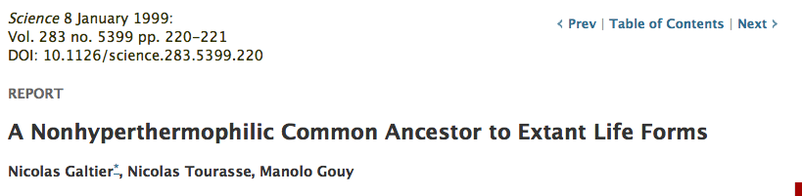

Slide 58
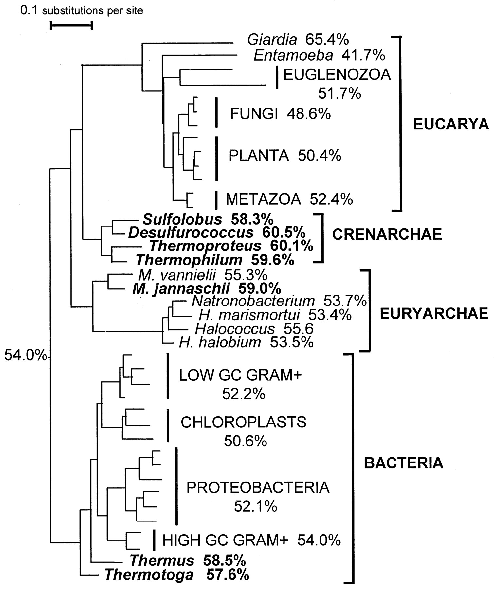
Maximum likelihood tree reconstructed from 40 LSU rRNA sequences (17). G+C contents of (groups of) sequences are given next to taxon names. The inferred ancestral G+C content appears next to the root. Two hundred topologies obtained by rearranging an initial neighbor-joining tree were evaluated. The monophyly of Bacteria, Eucarya, Crenarchaea, Euryarchaea, Euglenozoa, animals, green plants, fungi, high-GC Gram-positive bacteria, low-GC Gram-positive bacteria, proteobacteria, and chloroplasts was kept in all trees, but the remaining branching orders were randomly shuffled; 1409 complete, unambiguously aligned sites were used. The names of thermophilic species are in boldface.M, Methanococcus; H,Halobacterium.

Slide 59
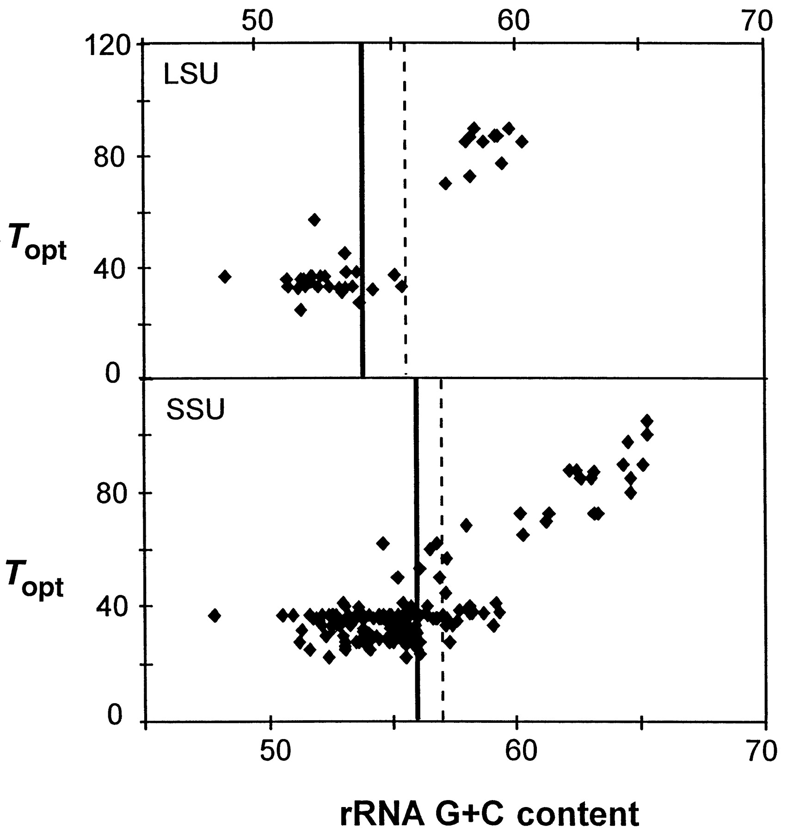
Figure 2 Correlation between optimal growth temperature and rRNA G+C content in prokaryotes.

Slide 60
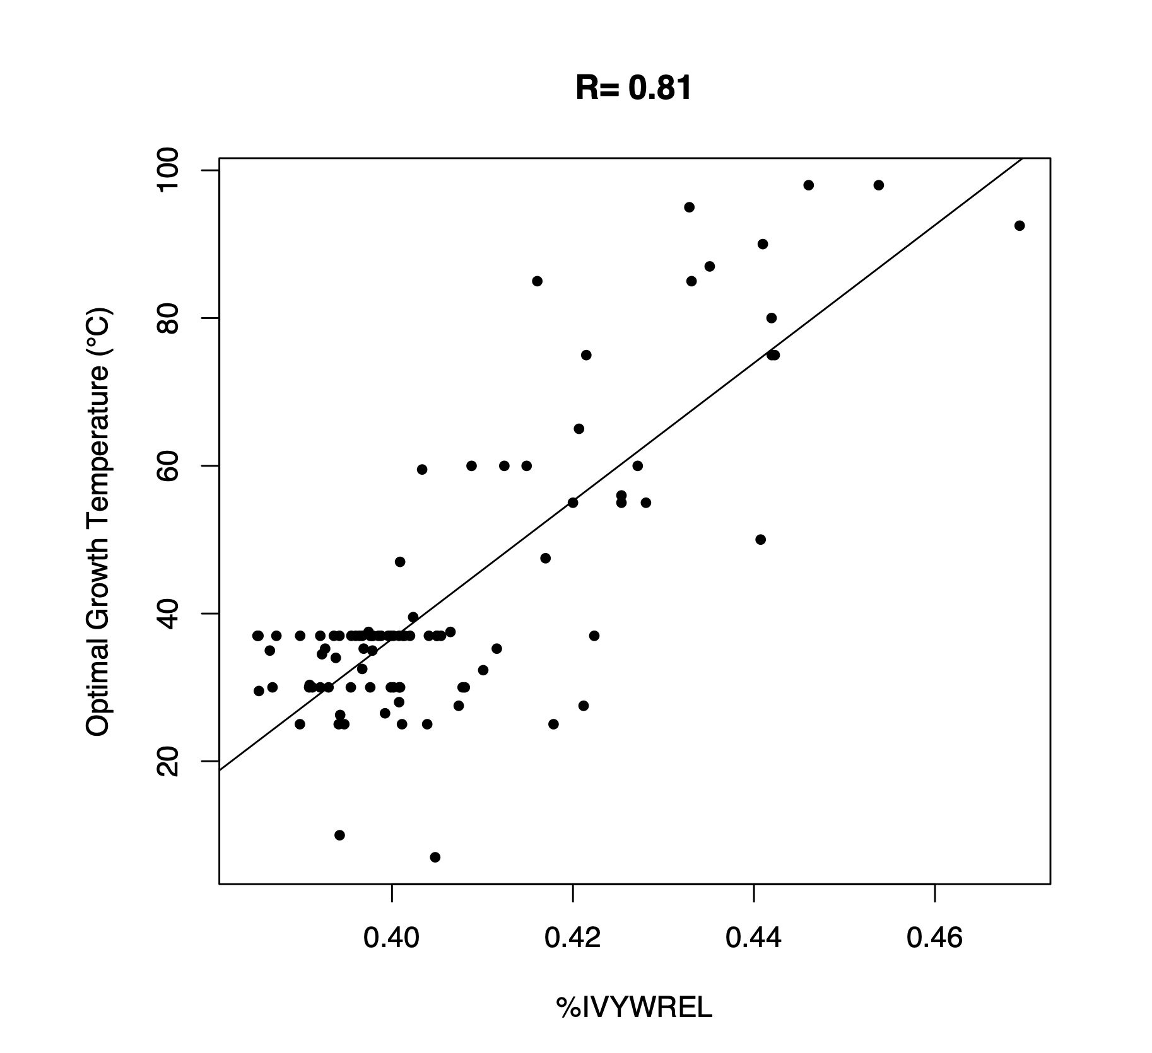
Optimal Growth Temperature
versus
amino acid composition
From: B. Boussau et al. Nature 000, 1-4 (2008) doi:10.1038/nature07393

Slide 61
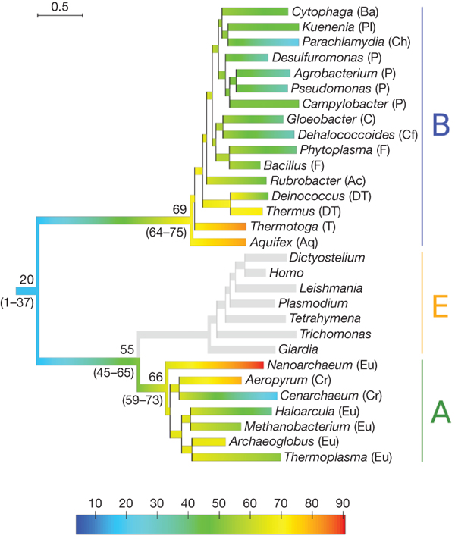

Evolution of thermophily over the tree of life.
B Boussau et al. Nature 000, 1-4 (2008) doi:10.1038/nature07393

Slide 62
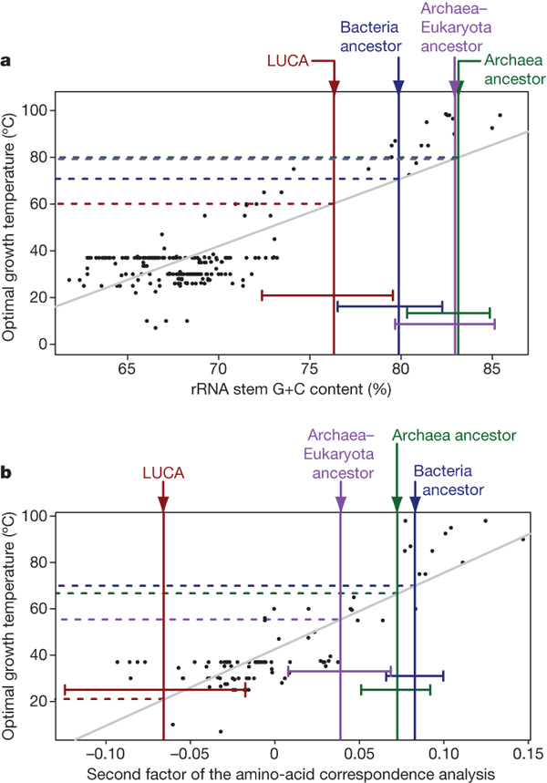
Correlations between sequence compositions and OGT,
and estimates of key ancestral compositions.
B Boussau et al. Nature 000, 1-4 (2008) doi:10.1038/nature07393

Slide 63
Conclusion
Tree shape and amino acid composition of ancestral sequences suggest a bottleneck due to increased environmental temperature at the base of the bacterial and archaeal domains.
Studies of horizontal gene transfers of aaRSs (e.g., rare form of SerRS) suggest that more than two lineages passed through this bottleneck.
See https://link.springer.com/article/10.1007%2Fs11084-011-9261-2
and https://www.ncbi.nlm.nih.gov/pmc/articles/PMC2873001/

Slide 64
The Coral of Life (Darwin)
ZHAXYBAYEVA and GOGARTEN (2004):
Cladogenesis, Coalescence and the Evolution of the Three Domains of Life.
Trends in Genetics 20 (4): 182- 187

