Slide 1
Class 12
Photosynthesis in the Tree/Net of Life
Notes on computer lab
Willie Hennig and cladistics

Slide 2
Take-home exam #4 will be posted today.
It will be due next week Monday at 11am.
If you have saved it, please send me the chimerax session file with the alphafold predicted structure, and the name of the sequence analyzed.

Slide 3
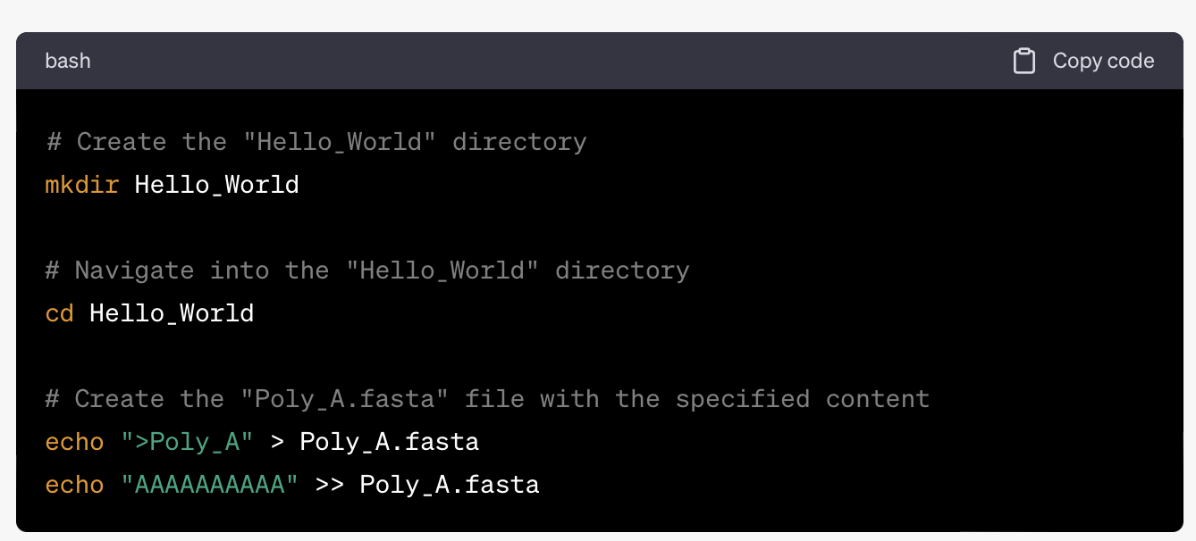
Question in takehome exam #3:
This may require some extra googling for finagling with chatgpt, but please do your best.
In Unix please write a short bit of code (i.e. a series of command line commands) that would create a new directory named "Hello_World" then enter that directory and create a .fasta file called "Poly_A" using the same name as a header and containing the sequence
ChatGPT:
# Create the "Hello_World" directory
mkdir Hello_World
# Navigate into the "Hello_World" directory
cd Hello_World
# Create the "Poly_A.fasta" file with the specified
# content
echo ">Poly_A" > Poly_A.fasta
echo "AAAAAAAAAA" >> Poly_A.fasta
And chatGPT provides many explanations: →

Slide 4
Let me break down what each command does:
mkdir Hello_World: This command creates a new directory named "Hello_World."
cd Hello_World: It changes the current working directory to "Hello_World," so you're now inside that directory.
echo ">Poly_A" > Poly_A.fasta: This command uses the echo command to create a new file named "Poly_A.fasta" and adds the header ">Poly_A" to it. The > operator is used to redirect the output of echo into the "Poly_A.fasta" file. If the file already exists, this will overwrite its content.
echo "AAAAAAAAAA" >> Poly_A.fasta: This appends the sequence "AAAAAAAAAA" to the "Poly_A.fasta" file using the >> operator. If the file does not exist, it will be created.
After running these commands, you'll have a "Hello_World" directory containing the "Poly_A.fasta" file with the specified header and sequence.

Slide 5
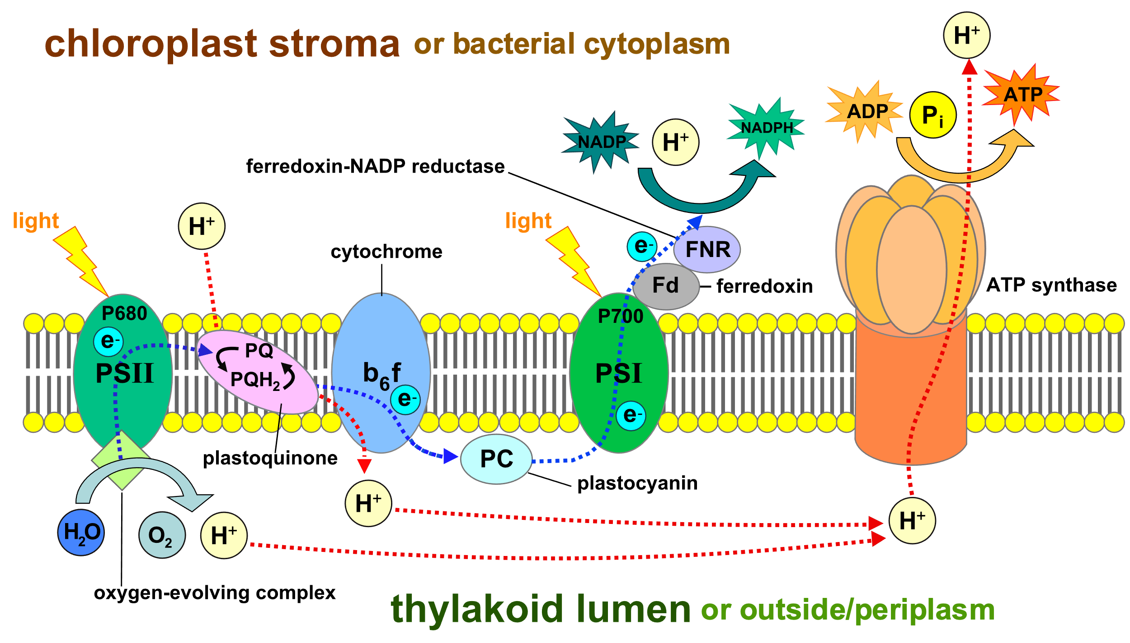

Slide 6
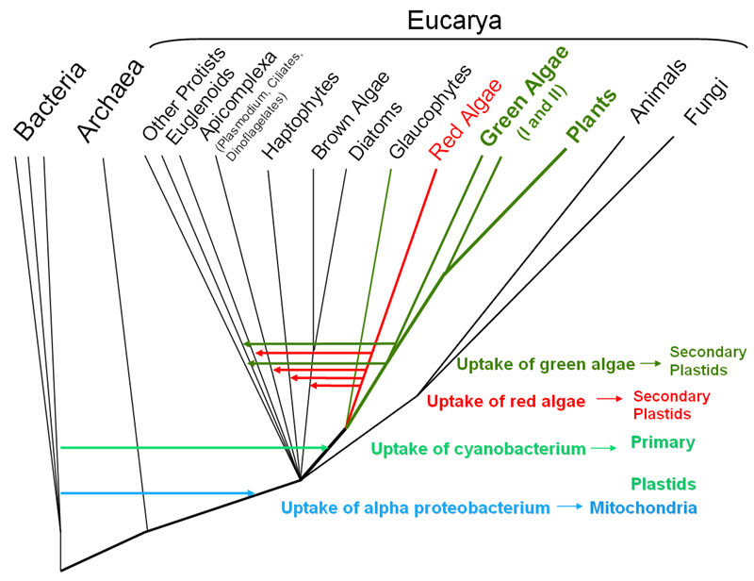
From: http://6e.plantphys.net/topic01.02.html

Slide 7
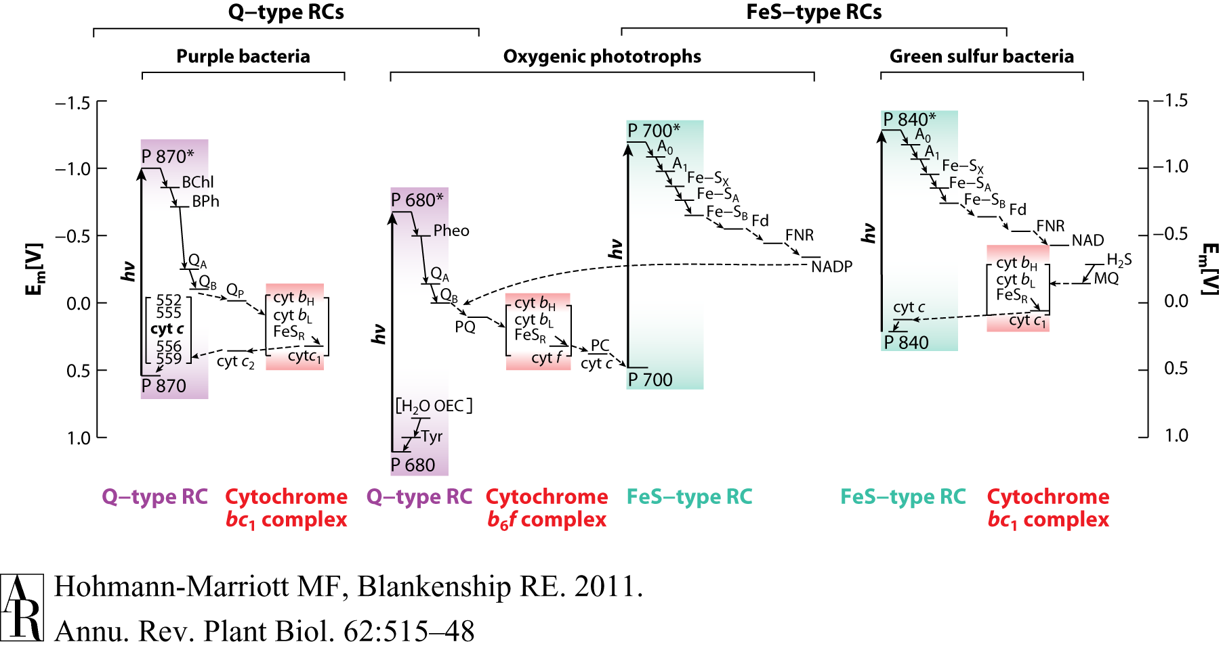
HGT as a force creating new pathways – Example 1
Oxygen producing photosynthesis

Slide 8
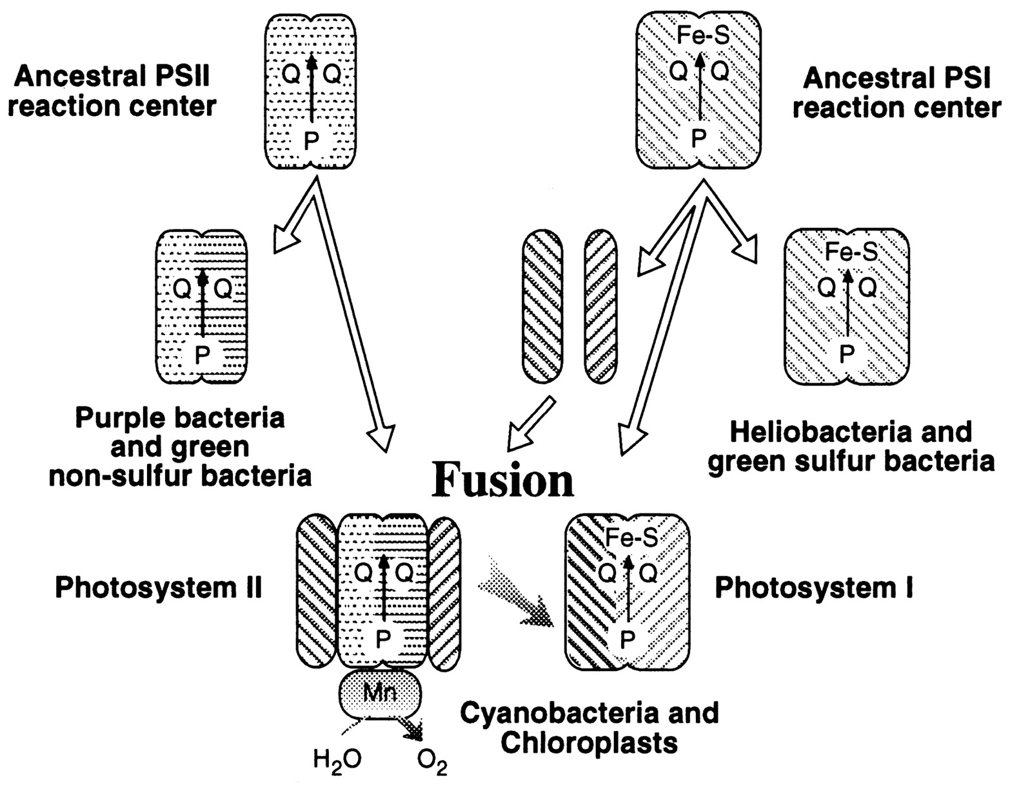
A heterologous fusion model for the evolution of oxygenic photosynthesis based on phylogenetic analysis.
Xiong J et al. PNAS 1998;95:14851-14856
©1998 by National Academy of Sciences
Notes:
A heterologous fusion model for the evolution of oxygenic photosynthesis based on phylogenetic analysis. Details of the model are provided in the text.

Slide 9
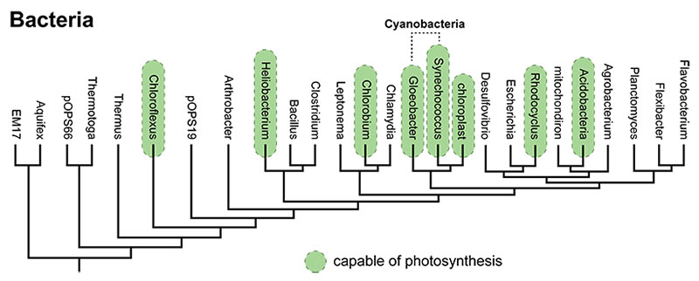
All photosynthetic pathways, including those of the Cyanobacteria, are quite similar. This suggests that they all evolved from a common ancestral pathway — in other words, that they are homologous. However, all the different bacteria that photosynthesize are rather distantly related to one another. The genes coding for photosynthetic pathways seem homologous, but the lineages bearing them are not closely related enough for a common ancestor to have passed the pathways on to all of them. What's the explanation for this apparent paradox? Horizontal transfer.
From: https://evolution.berkeley.edu/evolibrary/news/170503_cyanobacteria

Slide 10
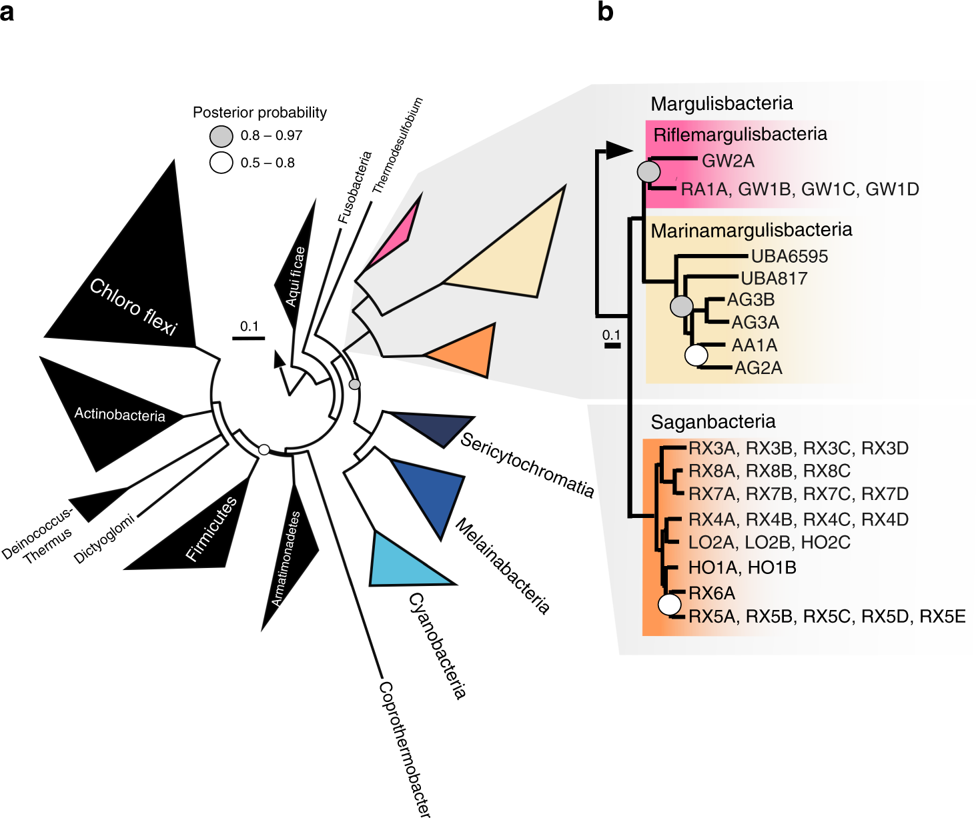
The ancestor of all these groups may have been an anaerobe in which fermentation and H₂metabolism were central metabolic features. The ability to use O₂ as a terminal electron acceptor must have been subsequently acquired by these lineages.
From: https://www.nature.com/articles/s41467-018-08246-y

Slide 11
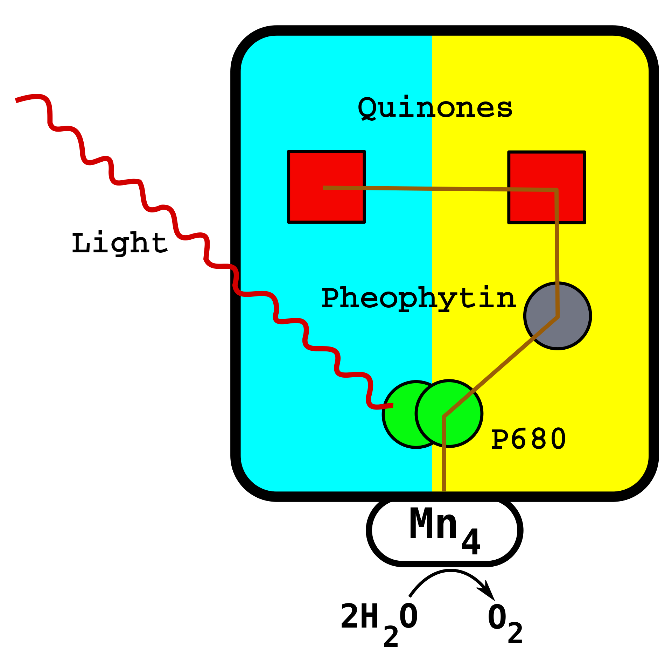
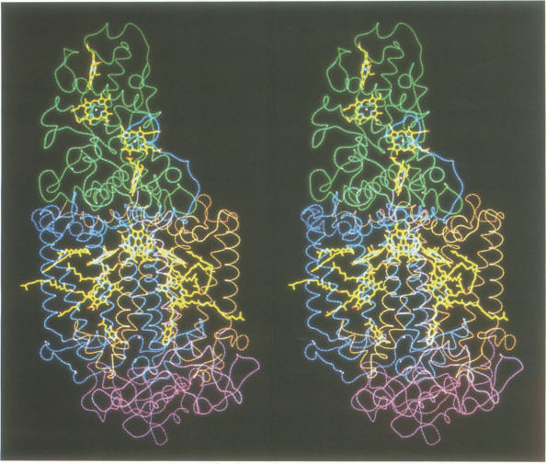
From Wikipedia (left) and J Deisenhofer and H Michel’s Nobel lecture

Slide 12
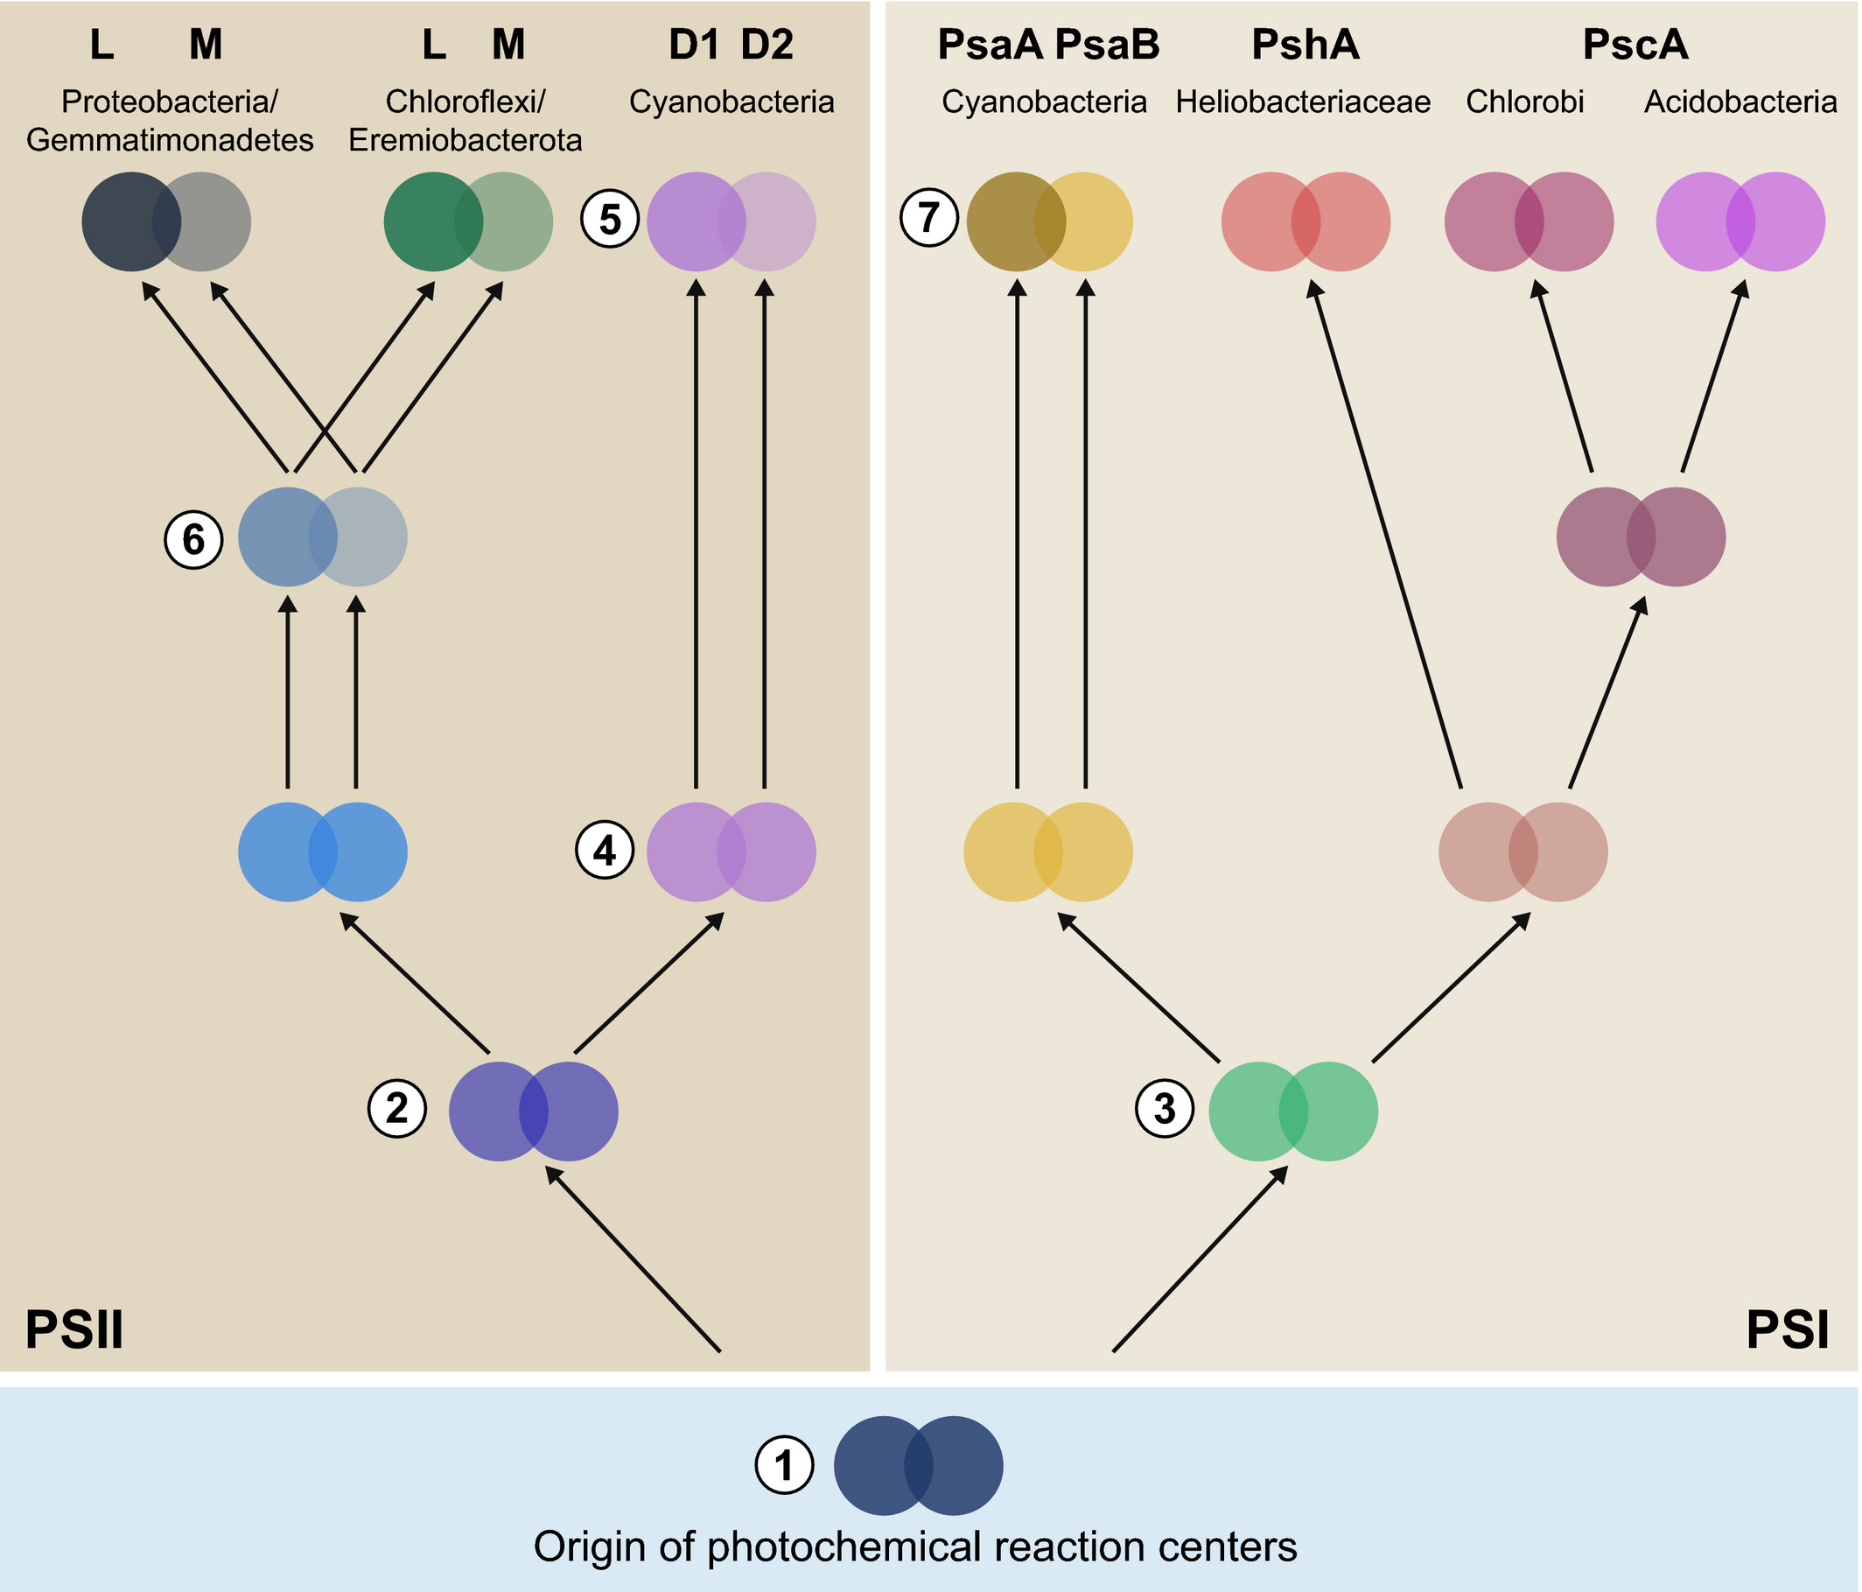
Schematic representation of the evolutionary relationships of reaction center proteins based on molecular phylogenies.
Comment: It is curious that the duplication and divergence between the two reaction center proteins is inferred to have happened three times independently. A more ancient duplication followed by gene conversion seems a more parsimonious explanation.

Slide 13
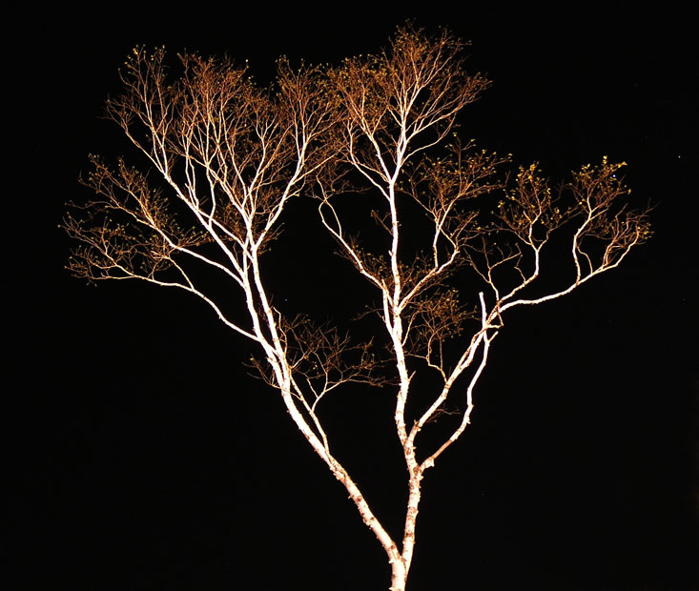
Cladistics
A Natural Taxonomy
Eukaryotes
Bacteria
Archaea
Cenancestor
(aka LUCA or MRCA)

Slide 14
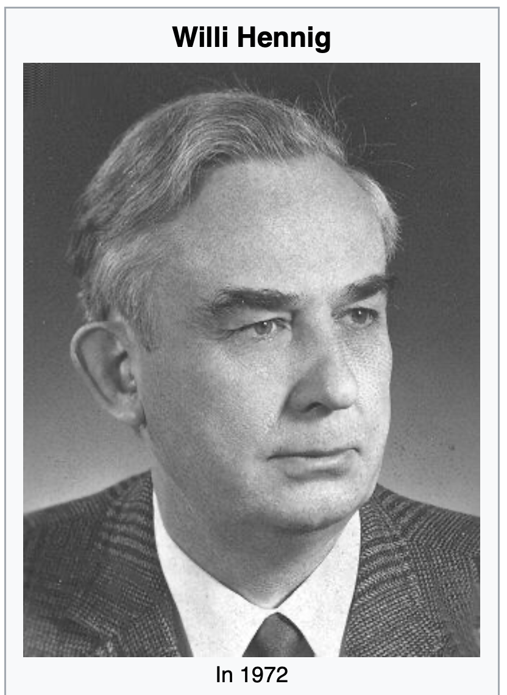
Willi Hennig was the founder of a systematic system based on shared ancestry (aka cladistics).
His area of expertise were insect.
Wings, halteres, hardened fore-wings, the ability to fold wing back, no wings, mouth parts, development includes a pupae ... are excellent characters to classify organisms.
From Wikipedia: https://en.wikipedia.org/wiki/Willi_Hennig

Slide 15
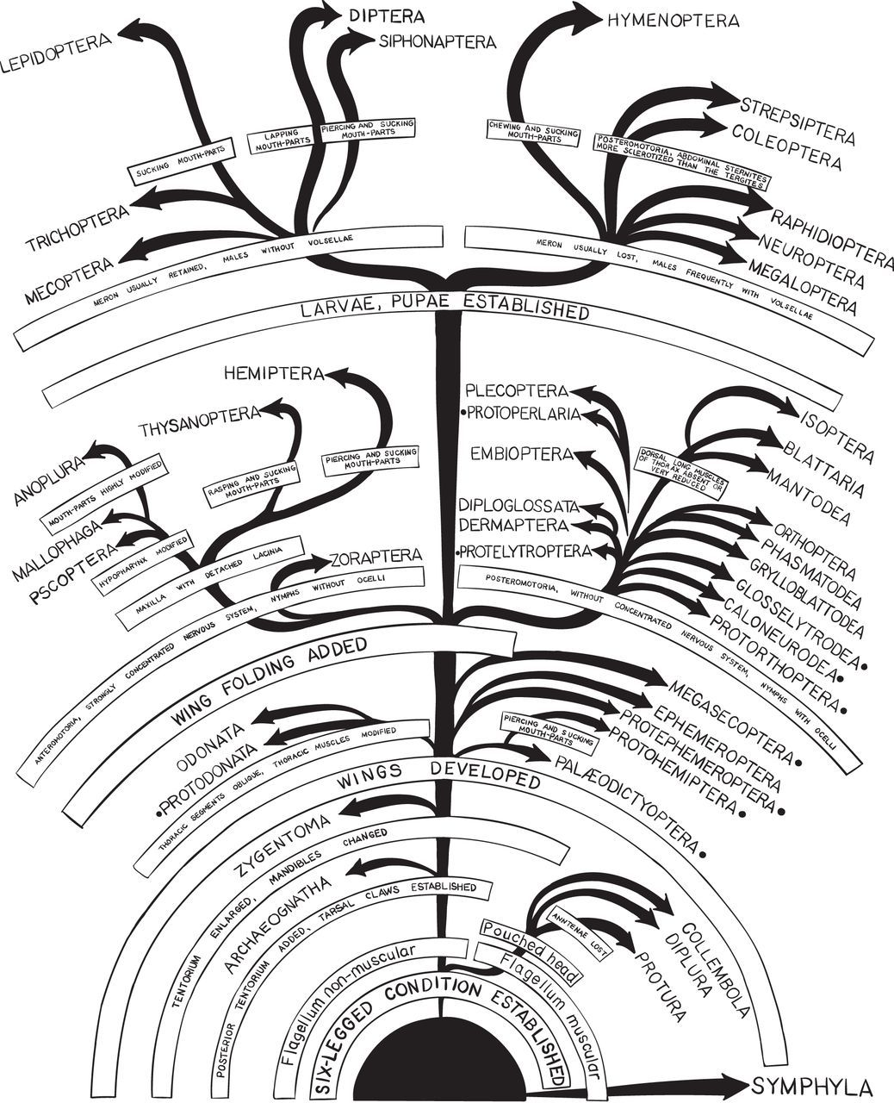
Insect taxonomy based on shared derived characters.
From: https://royalsocietypublishing.org/doi/10.1098/rsif.2016.0363

Slide 16
C C C c c
B B b b b
A a a a a
I
II
III
IV
V
D -> d
C -> c
B -> b
A -> a

Slide 17
C C C c c
B B b b b
A a a a a
I
II
III
IV
V
D -> d
Shared derived characters (aka synapomorphies) define monophyletic groups
C -> c
B -> b
A -> a

Slide 18
D D D D d
C C C c c
B B b b b
I
II
III
IV
V
D -> d
Shared primitive characters (aka symplesiomorphies) define paraphyletic groups
C -> c
B -> b
A -> a

Slide 19
D D D D d
C C C c c
B B b b b
A a a a a
I
II
III
IV
V
D -> d
Derived characters
that are not shared
(as the autapomorphy d) do not provide phylogenetic information.
C -> c
(question: If one
would know that A is primitive, would this provide useful phylogenetic information?
B -> b
A -> a

Slide 20
Terminology
The goal of cladistics is to have a natural taxonomic system that is based on shared ancestry. Every group is defined by an ancestor that only is an ancestor to this group.
In molecular phylogenies, we usually cannot distinguish between derived and primitive characters. Most phylogenetic reconstruction results in unrooted trees, as if you look at the tree from the top, and you do not know where the stem is.
The tip of the branches often are called leaves or Operational Taxonomic Units.
In a phylogenetic tree the line connecting two nodes is know as a split or bipartition. If one removes the line, the leaves fall into two groups.
In a rooted tree, each node defines the descendants as a clade. In unrooted trees a group connected to a single node is called a clan.

Slide 21
Terminology for trees
The term cladogram refers to a strictly bifurcating diagram, where each clade is defined by a common ancestor that only gives rise to members of this clade. I.e., a clade is monophyletic (derived from one ancestor) as opposed to a polyphyletic group (derived from many ancestors). Note: you need to know where the root is! If one does not know the root, but one wants to denote a group that groups together, one can use the term clan.
Branches in cladograms are not scaled with respect to time or substation events
A clade is recognized and defined by shared derived characters (= synapomorphies). Shared primitive characters (= sympleisiomorphies , alternativie spelling is symplesiomorphies) do not define a clade. (See in example drawing ala Hennig).
To use these terms you need to have polarized characters; for most molecular characters you don't know which state is primitive and which is derived (exceptions: ?).

Slide 22
Trees often are rearranged and can become misleading to the non-expert:
The two trees are identical, the fact that one depicts humans on top does not reflect us being more advanced, it just is one of many possible ways to draw a tree.

Slide 23
Terminology
Related terms:
autapomorphy = a derived character that is only present in one group; an autapomorphic character does not tell us anything about the relationship of the group that has this character ot other groups.
homoplasy = a derived character that was derived twice independently (convergent evolution). Note that the characters in question might still be homologous (e.g. a position in a sequence alignment, frontlimbs turned into wings in birds and bats).
paraphyletic = a taxonomic group that is defined by a common ancestor, however, the common ancestor of this group also has decendants that do not belong to this taxonomic group. Many systematists despise paraphyletic groups (and consider them to be polyphyletic). Examples for paraphyletic groups are reptiles and protists. Many consider the archaea to be paraphyletic as well.
holophyletic = same as above, but the common ancestor gave rise only to members of the group.

Slide 24
Terminology
Branches, splits, bipartitions
Leaves, or OTUs (operational taxonomic units)
In a rooted tree: clades (else clans)
Mono-, Para-, polyphyletic groups, cladists and a natural taxonomy
The term cladogram refers to a strictly bifurcating diagram, where each clade is defined by a common ancestor that only gives rise to members of this clade. I.e., a clade is monophyletic (derived from one ancestor) as opposed to a polyphyletic group (derived from many ancestors). (Note: you need to know where the root is! If one does not know the root, but one wants to denote a group that groups together, one can use the term clan)
A clade is recognized and defined by shared derived characters (= synapomorphies). Shared primitive characters (= sympleisiomorphies , alternativie spelling is symplesiomorphies) do not define a clade. (See in example drawing ala Hennig).
To use these terms you need to have polarized characters; for most molecular characters you don't know which state is primitive and which is derived (exceptions:....).

Slide 25
Complications and Controversies
According to Hennig:
Shared derived characters define monophyletic groups
Shared primitive characters define paraphyletic groups
homoplasies – characters that evolved independently define polyphyletic groups
According to Ernst Ashlock (and Ernst Mayr and others)
Both, shared derived characters and shared primitive characters define monophyletic groups – they go back to a common ancestor, and they deserve a name (e.g., prokaryotes, reptiles)
Shared derived characters define holophyletic groups
Homoplasies - define polyphyletic groups

Slide 26
Which characters define which groups:
Shared primitive
Characters
Shared Derived
Characters
Homoplasies
According to
Hennig
Polyphyletic
Paraphyletic
Monophyletic
According to
Ashlock
Polyphyletic
Holophyletic
Monophyletic

Slide 27
Why Fish don’t exist
According to Willi Hennig (a view accepted by most taxonomist that do not need to teach undergraduate students)
  reptiles,
  fish,
  protists,
  algae,
  green algae,
  prokaryotes,
  and many others
are not proper taxonomic groups, because the ancestor of these groups was also ancestor to organisms that are not part of this group.

Slide 28

Why Fish don’t exist
Link to an npr interview
David Starr Jordan on Wikipedia
Taxonomist, eugenicist,
first president of Stanford,
and possible murdered of Jane Stanford
You tube video of virtual event with Lulu Miller
Link to book

Slide 29
Why might it be correct to say that “Fish don’t exist”?
The distinction between holophyletic and monophyletic that Mayr and Ashlock propose abandons a taxonomy based on natural groups.
Discuss the advantages and disadvantages of a strict cladistic approach that does not allow groups based on symplesiomorphies (shared primitive characters).
List a few groups of organisms that represent paraphyletic groups
Note: Willi Henning’s cladistics is at odds with Ernst Mayr’s understanding of taxonomic groups.

Slide 30
Why Fish don’t exist
According to Willi Hennig (a view accepted by most taxonomist that do not need to teach undergraduate students)
  reptiles,
  fish,
  protists,
  algae,
  green algae,
  prokaryotes,
  and many others
are not proper taxonomic groups, because the ancestor of these groups was also ancestor to organisms that are not part of this group.
Which groups derive from the same ancestors?

Slide 31
Why Fish don’t exist
According to Willi Hennig (a view accepted by most taxonomist that do not need to teach undergraduate students)
  reptiles,
  fish,
  protists,
  algae,
  green algae,
  prokaryotes,
  and many others
are not proper taxonomic groups, because the ancestor of these groups was also ancestor to organisms that are not part of this group.
Which groups derive from the same ancestors?
Fish are not a monophyletic group, because their ancestor is also ancestor to the tetrapods
Prokaryotes are not a monophyletic group, because their ancestor is also ancestor to the Eukaryotes

Slide 32
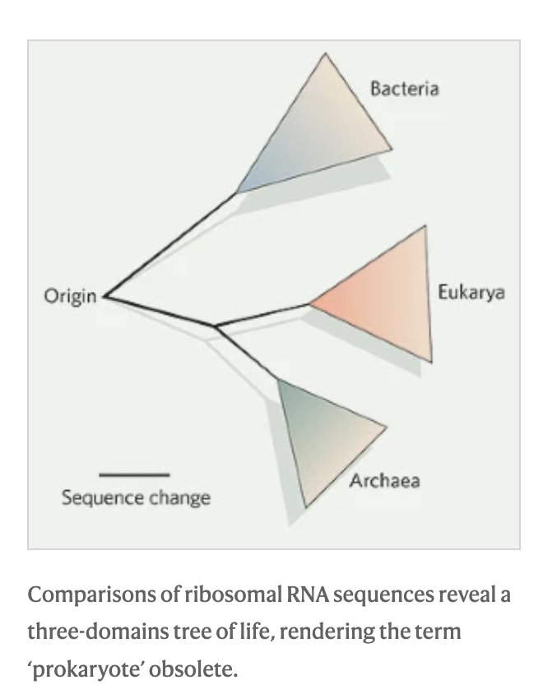
Norman R. Pace:
Time for a change, Nature volume 441, page289 (2006)
Argues that the term prokaryote is obsolete, because it denotes a paraphyletic group.
Prokaryotes
In an ironic twist, the recent discovery and sequencing of new archaeal species, reveals that the Archaea themselves likely are a paraphyletic group ->

Slide 33
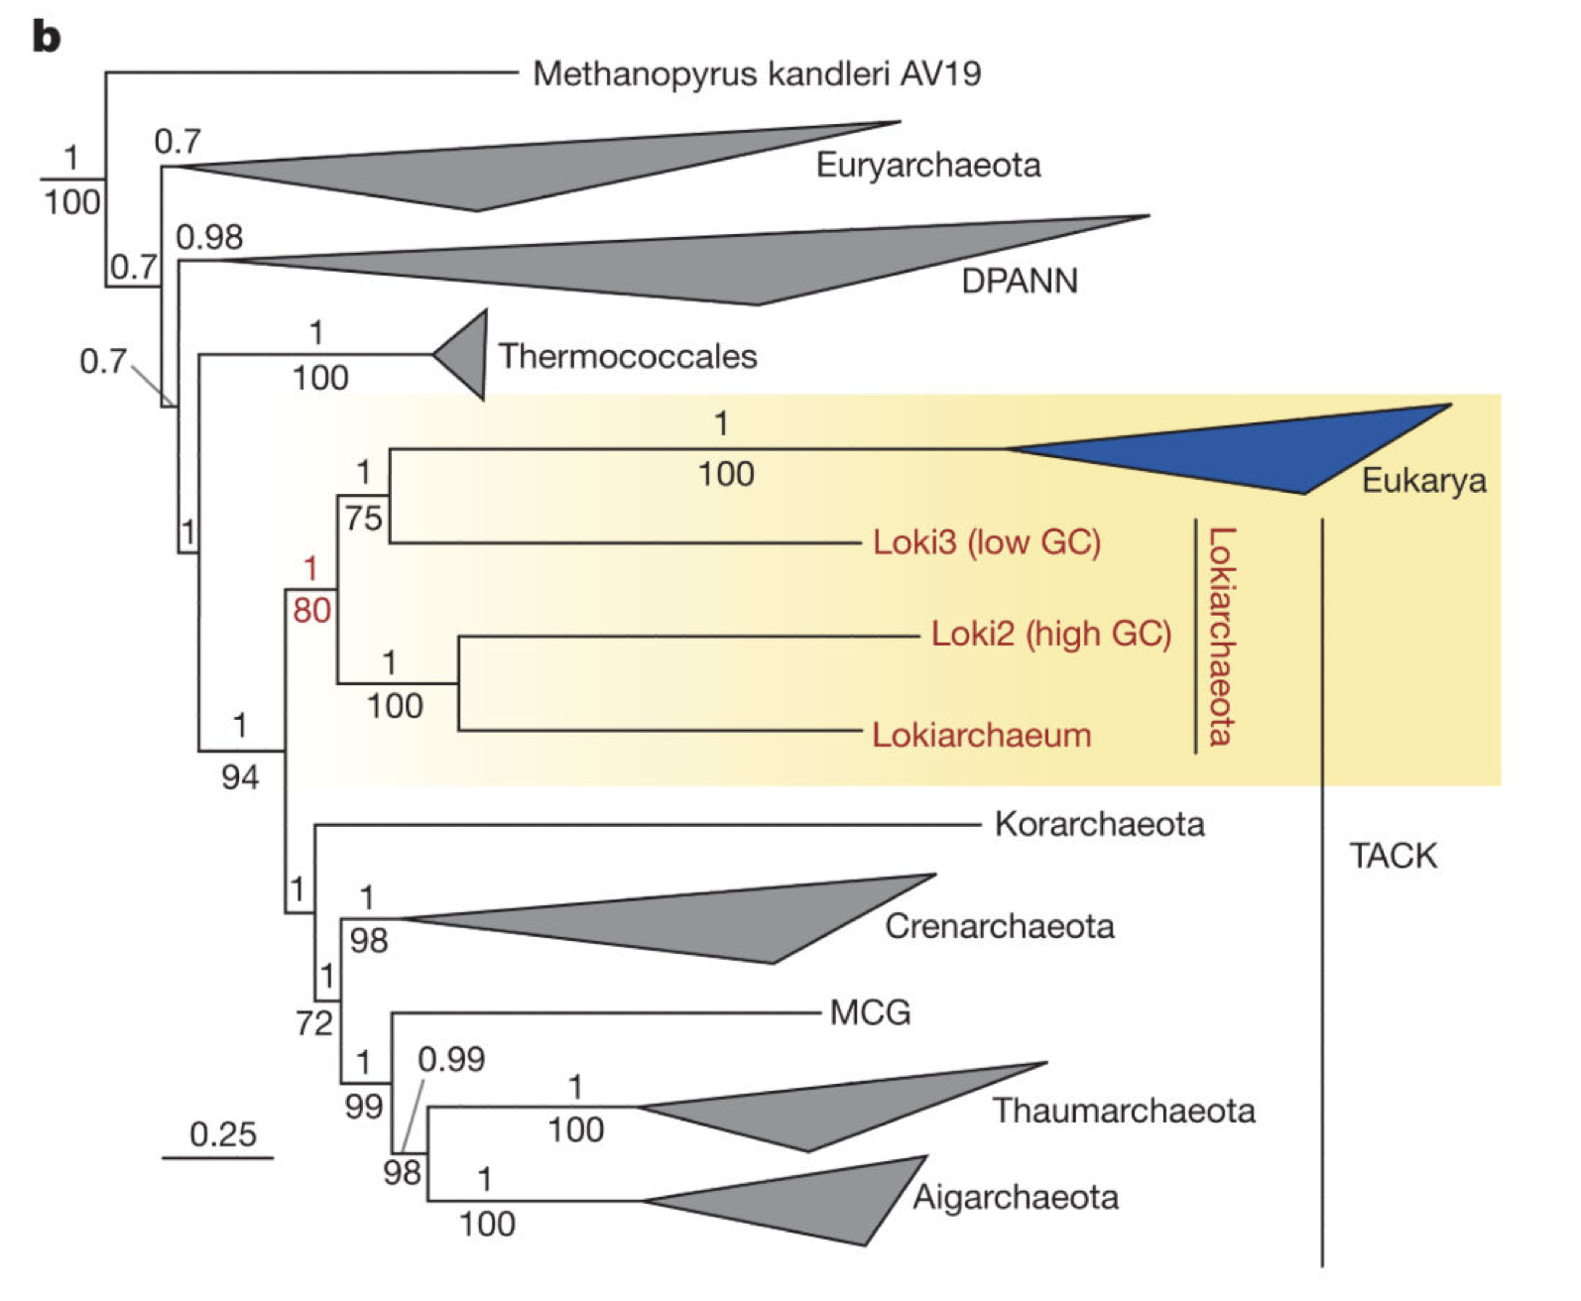
Prokaryotes
Archaea
The recent discovery and sequencing of archaeal species, reveals that the Archaea themselves likely are a paraphyletic group.
E.g., Spang et al. Complex archaea that bridge the gap between prokaryotes and eukaryotes Nature. 2015 May 14; 521(7551): 173–179. doi:10.1038/nature14447.
However, see Da Cunha et al., Asgard archaea do not close the debate about the universal tree of life topology, PLoS Genet 14(3): e1007215. https://doi.org/10.1371/ journal.pgen.1007215

Slide 34
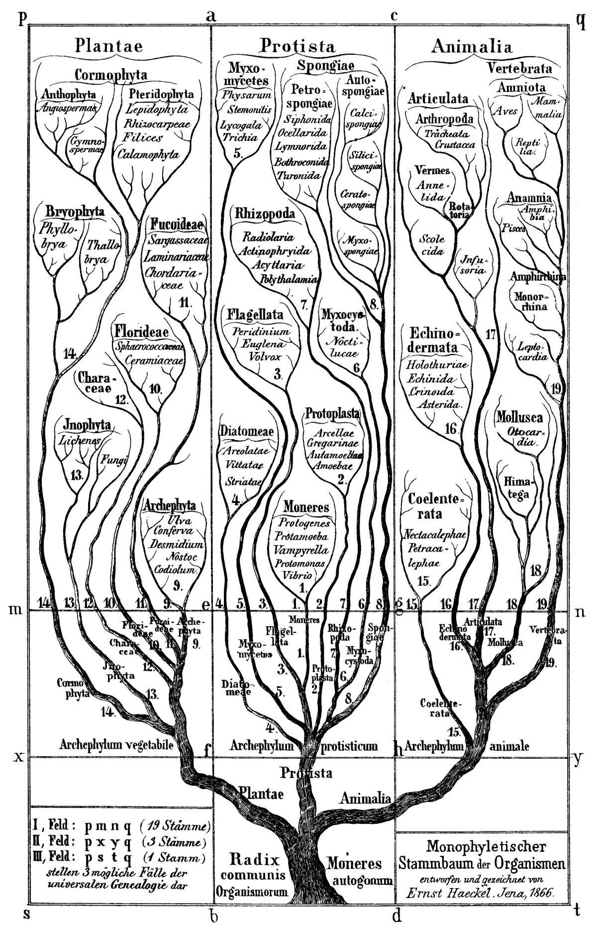
Discussion:
What might be misleading about some of the images depicting evolution?
E.g., Ernst Haeckel’s famous tree.

Slide 35
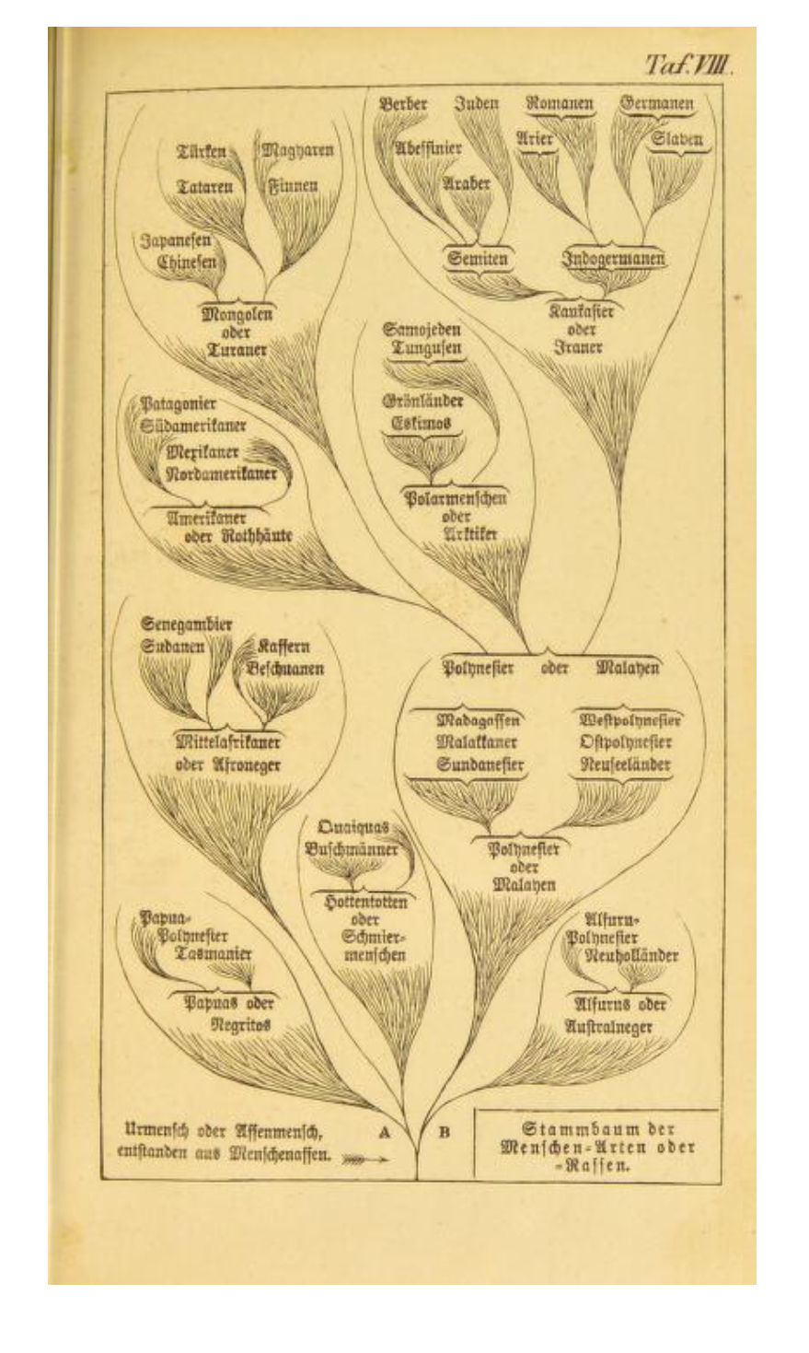
These biases become even more painfully obvious in Haeckel’s depictions of human evolution.
Ernst Haeckel 1868 Stem-tree of human species and races.
Native Americans
Japanese
Germanic
The point of this and the following slides is not that Ernst Haeckel was a racist (he was, and so were most other scientists at the time, including Charles Darwin); rather they are to illustrate the arbitrariness in which leaves sometimes are arranged in cladograms.
Adapted from: Robert J. Richards, The tragic sense of life, Ernst Haeckel and the struggle over evolutionary thought, University of Chicago Press 2008

Slide 36
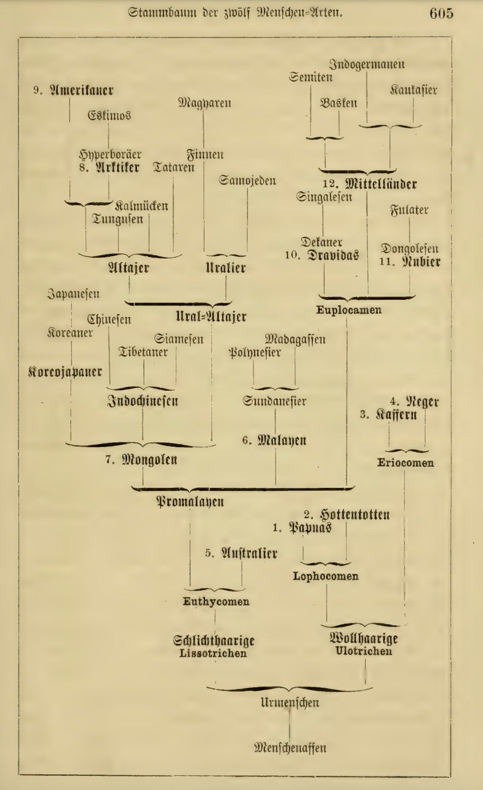
Due to Karl May (popular German author) the idea of the “noble savage” had become popular in Germany and associated mainly with native Americans.
Native Americans
Japanese
Germanic
Ernst Haeckel 1870-79: Stem-tree of human species and races. (2nd to 7th edition of Natürliche Schöpfungsgeschichte)

Slide 37
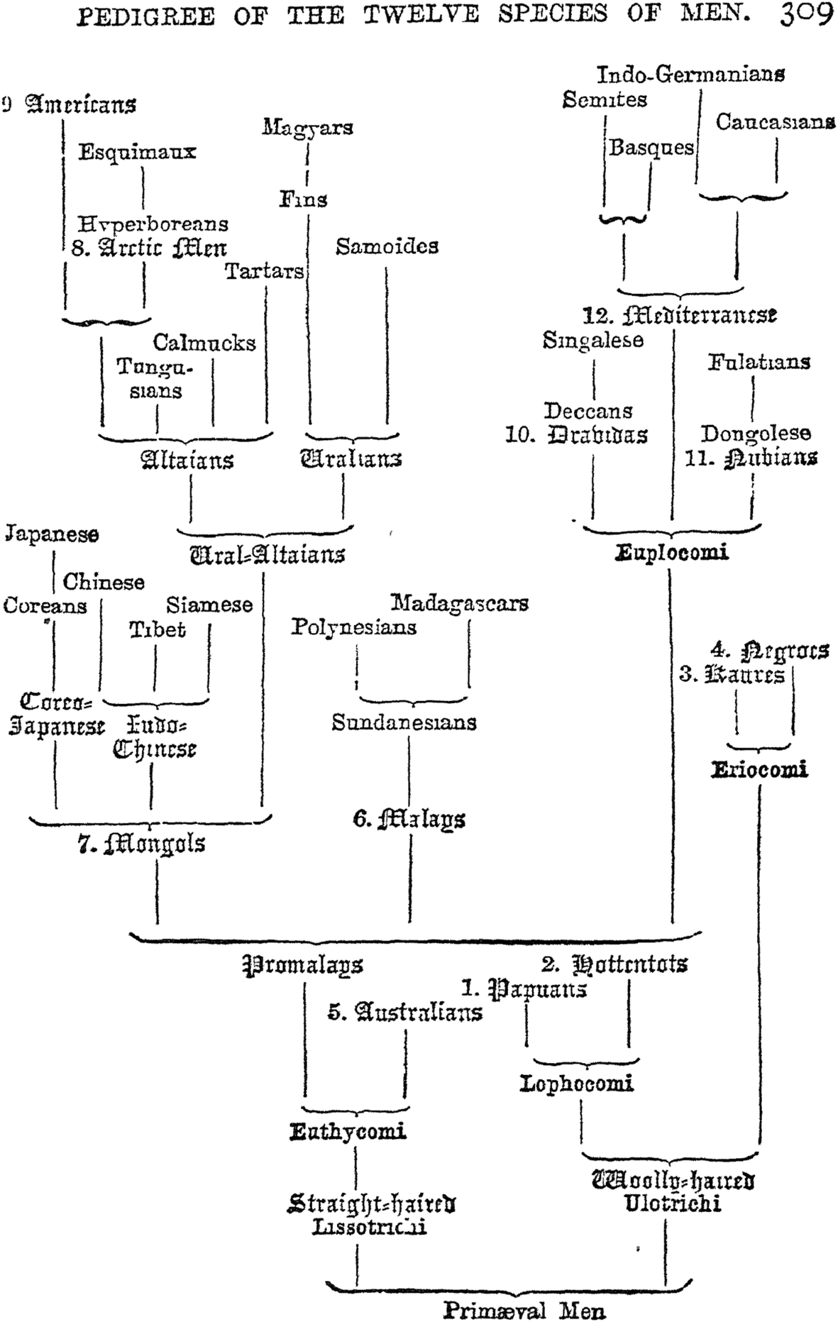
Due to Karl May the idea of the “noble savage” had become popular in Germany and associated mainly with native Americans
Ernst Haeckel 1870-79 Stem-tree of human species and races. (2nd to 7th edition of Natürliche Schöppfungsgeschichte)
Native Americans
Japanese
Germanic

Slide 38
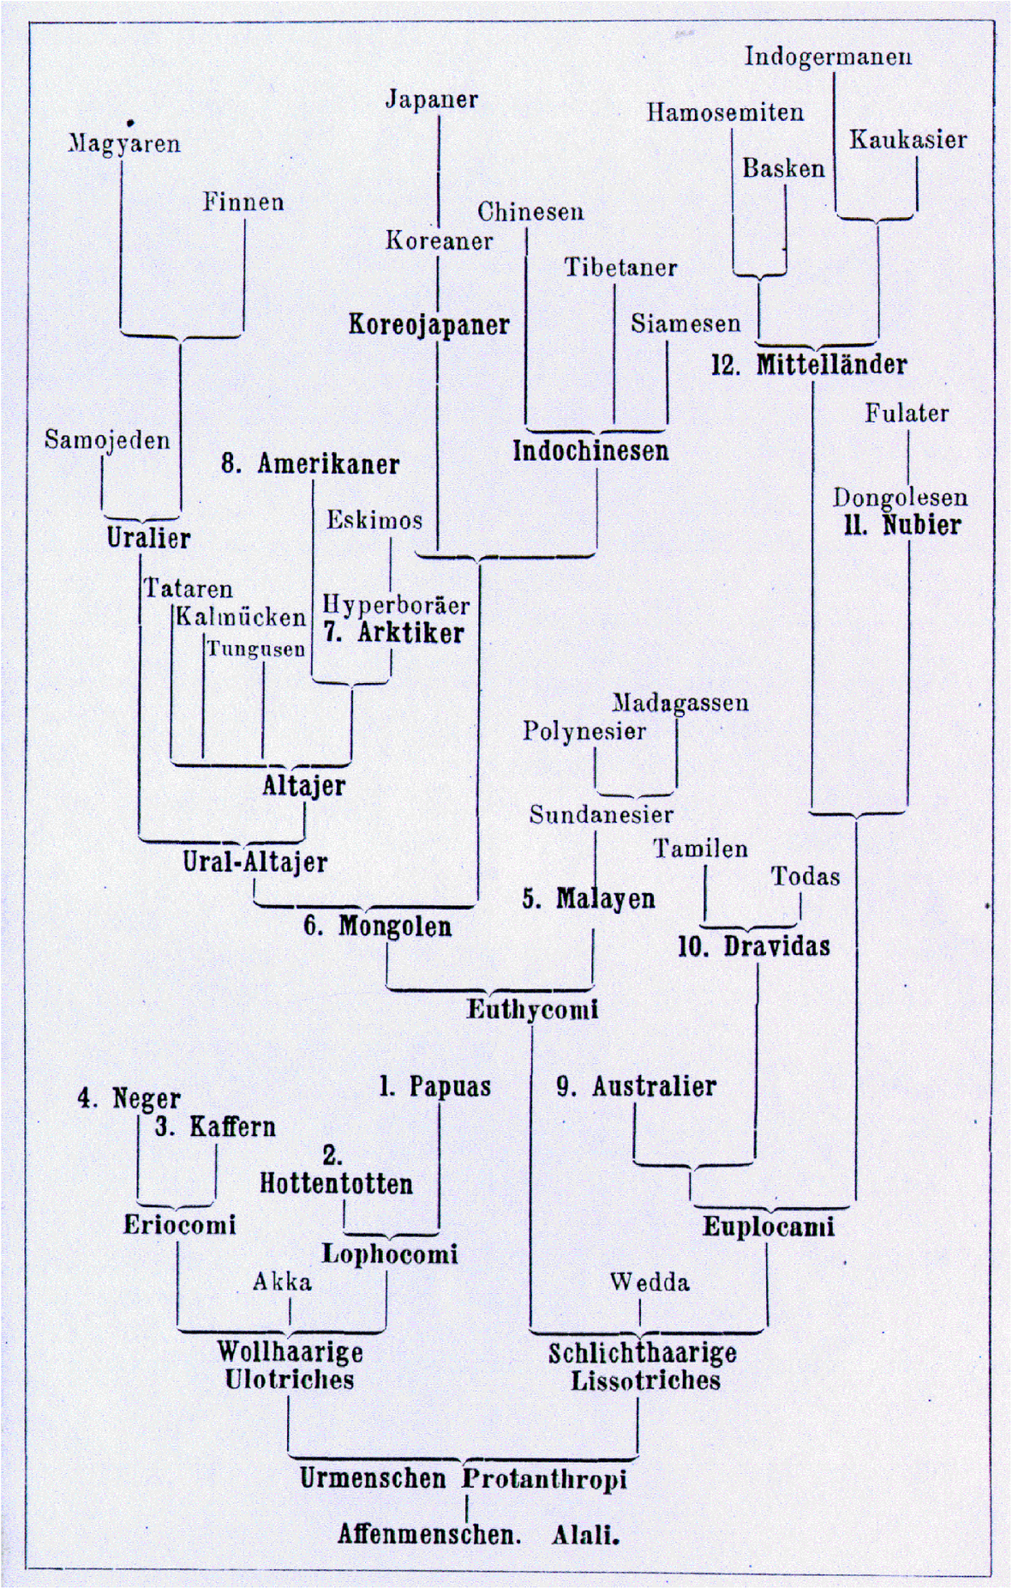
Buffalo Bill Western Shows depicted native Americans as savages killing innocent families had become popular entertainment in Europe.
Also, Haeckel’s books were translated into Japanese in 1882 and 1889.
Native Americans
Japanese
Germanic
The History of Creation, 8th (+) edition 1889-1920

Slide 39
Trees in Newick or parenthesis format
Trees rooted on a node (basal trifurcation) are usually considered as unrooted
Trees rooted on a branch are usually considered as rooted
((A, B), (C, D), E)
(((A, B), (C, D)), E)
Arbitrarily rooted in a node –
While displayed as rooted in a node, the tree should be considered as unrooted
Strictly bifurcating –
The root is located on the branch leading to E
More links here and here and here

Slide 40
What is in a tree?
Trees form molecular data are usually calculated as unrooted trees (at least they should be - if they are not this is usually a mistake).
To root a tree you either can assume a molecular clock (substitutions occur at a constant rate, again this assumption is usually not warranted and needs to be tested),
or you can use an outgroup (i.e. something that you know forms the deepest branch), or you need to be able to decide, which state of a character is primitive – this might work for wings, but usually not for A, G, T, and Cs.
For example, to root a phylogeny of birds, you could use the homologous characters from a reptile as outgroup; to find the root in a tree depicting the relations between different human mitochondria, you could use the mitochondria from chimpanzees or from Neanderthals as an outgroup; to root a phylogeny of alpha hemoglobins you could use a beta hemoglobin sequence, or a myoglobin sequence as outgroup.
What could be the outgroup for the Tree-of-Life?
Trees have a branching pattern (also called the topology), and branch lengths.
Often the branch lengths are ignored in depicting trees (these trees often are referred to as cladograms - note that cladograms should be considered rooted).
You can swap branches attached to a node, and in an unrooted you can depict the tree as rooted in any branch you like without changing the tree.

