Slide 1
From Lab 4 you should have
The amino acid sequence of the gene that encodes the putative intein
A homolog of the gene that does not contain the intein.
Let me know, if you failed in obtaining this. The reasons may be
  this is not an intein
  there are so many intein containing homologs that the matches without the intein are not listed in the blast search.
The phamily or phamilies to which the intein containing and intein free genes belong
based on the size of the gene, the plus and minus intein genes may be classified into different phams

Slide 2
Recap:
Margaret Belle (Oakley) Dayhoff
started the field now known as bioinformatics.
She was fearless - she aligned ancient paralogs, used them to reconstruct phylogenies, and realized that these could be used to learn about early evolution.
created the first nucleotide and protein data banks
calculated the first log/odds matrices (PAM) to score alignments
Used these to classify aa into groups that are frequently substituting for one another
invented the the single letter amino acid code

Slide 3
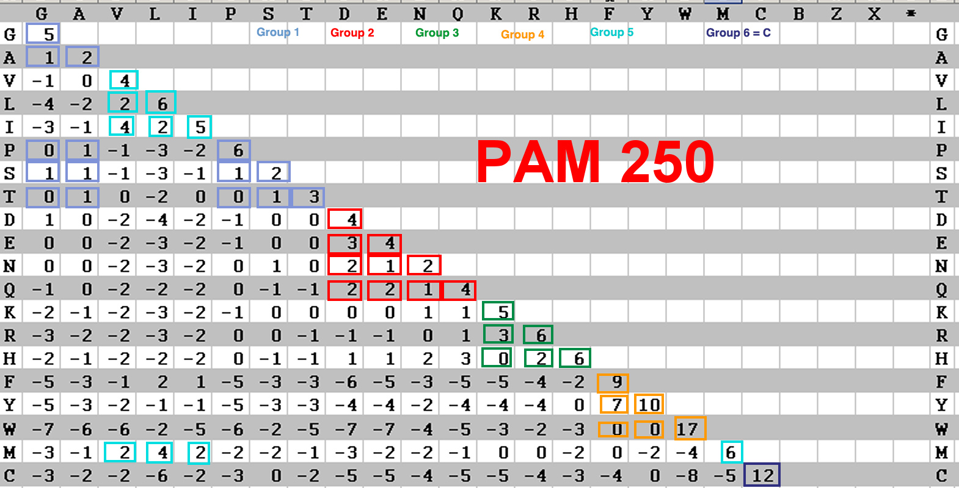
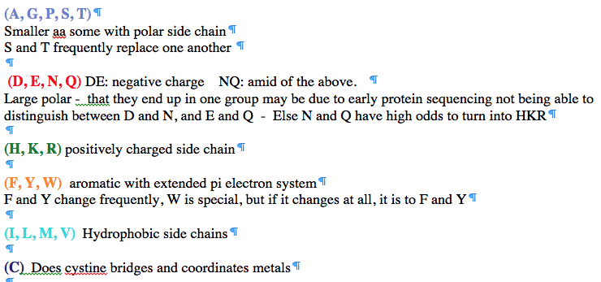
PAM 250 log (odds) matrix
Notes:
Dayhoff recoding

Slide 4
Selecting Scoring Matrices
Choose a matrix appropriate to the suspected degree of sequence identity between the query and its target sequences
PAM: empirically derived for close relatives
BLOSUM: empirically derived for distant relatives
4

Slide 5
Intro to Statistics
MCB 3421 2021
Class 8

Slide 6
False Positives (probability of)
The probability of have the observed outcome under the null hypothesis
(the drug doesn’t make a difference, the sequences aren’t related, the target sites are not particularly conserved …)
Example: Sequence similarity between two sequences.
How to measure what is expected under the null hypothesis?
Possibility 1: Randomize one or both of the sequences.
Possibility 2: Compare one of the sequences against a databank. (Assuming the databank has mainly unrelated sequences)
Possibility 3: Use a formula for the distribution that is based on a model or that fit observations.

Slide 7
Distribution under null hypothesis from randomized sequences
Calculate alignment score for actual sequences
Calculate expectation under null hypothesis
randomize (scramble) one (or both) of the sequences and calculate the alignment score for the randomized sequences.
repeat the last step at least 100 times (usually 1000)
describe distribution of randomized alignment scores
Calculate the probability of the score for actual sequences under the null hypothesis, i.e., Is the score obtained for the real sequences significantly better than the score for the randomized sequences?
Lipman and Pearson (1984) Rapid and Sensitive Protein Similarity Searches, Science 227(4693):1435-41, DOI: 10.1126/science.2983426

Slide 8
z -score
MEAN
Alignment Score
Actual Sequences
z Score = 4.1
STDDEV

Slide 9
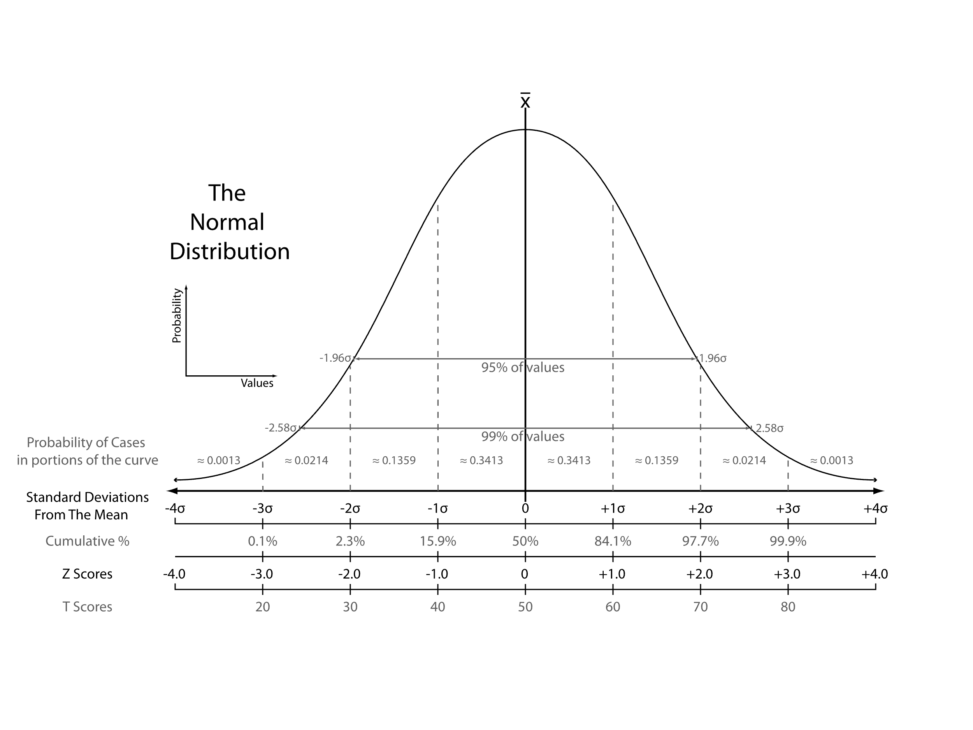
z -score
From: https://en.wikipedia.org/wiki/Standard_score
Notes:
Distinction between probability and probability density

Slide 10
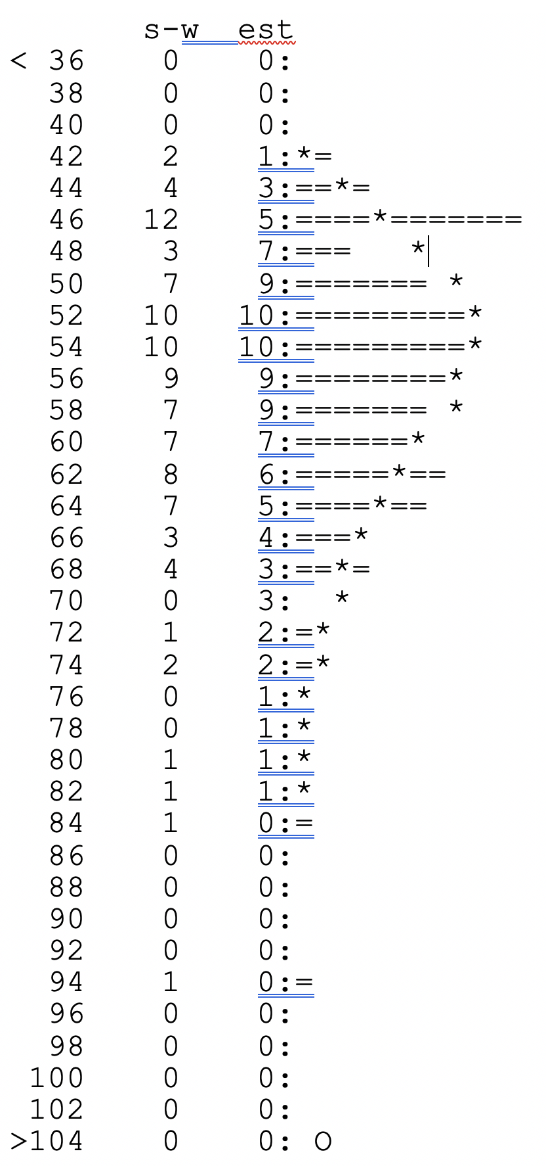
Using a probability distribution
Modern PRSS
43400 residues in 100 sequences,
BLOSUM50 matrix, gap penalties: -12,-2
unshuffled s-w score: 269;
shuffled score range: 43 - 96
Lambda: 0.13635 K: 0.0055017;
P(269)= 1.9668e-13
For 100 sequences,
a score >=269 is expected 1.97e-11 times
Notes:
e stabds for engineering format not Eulers number!

Slide 11
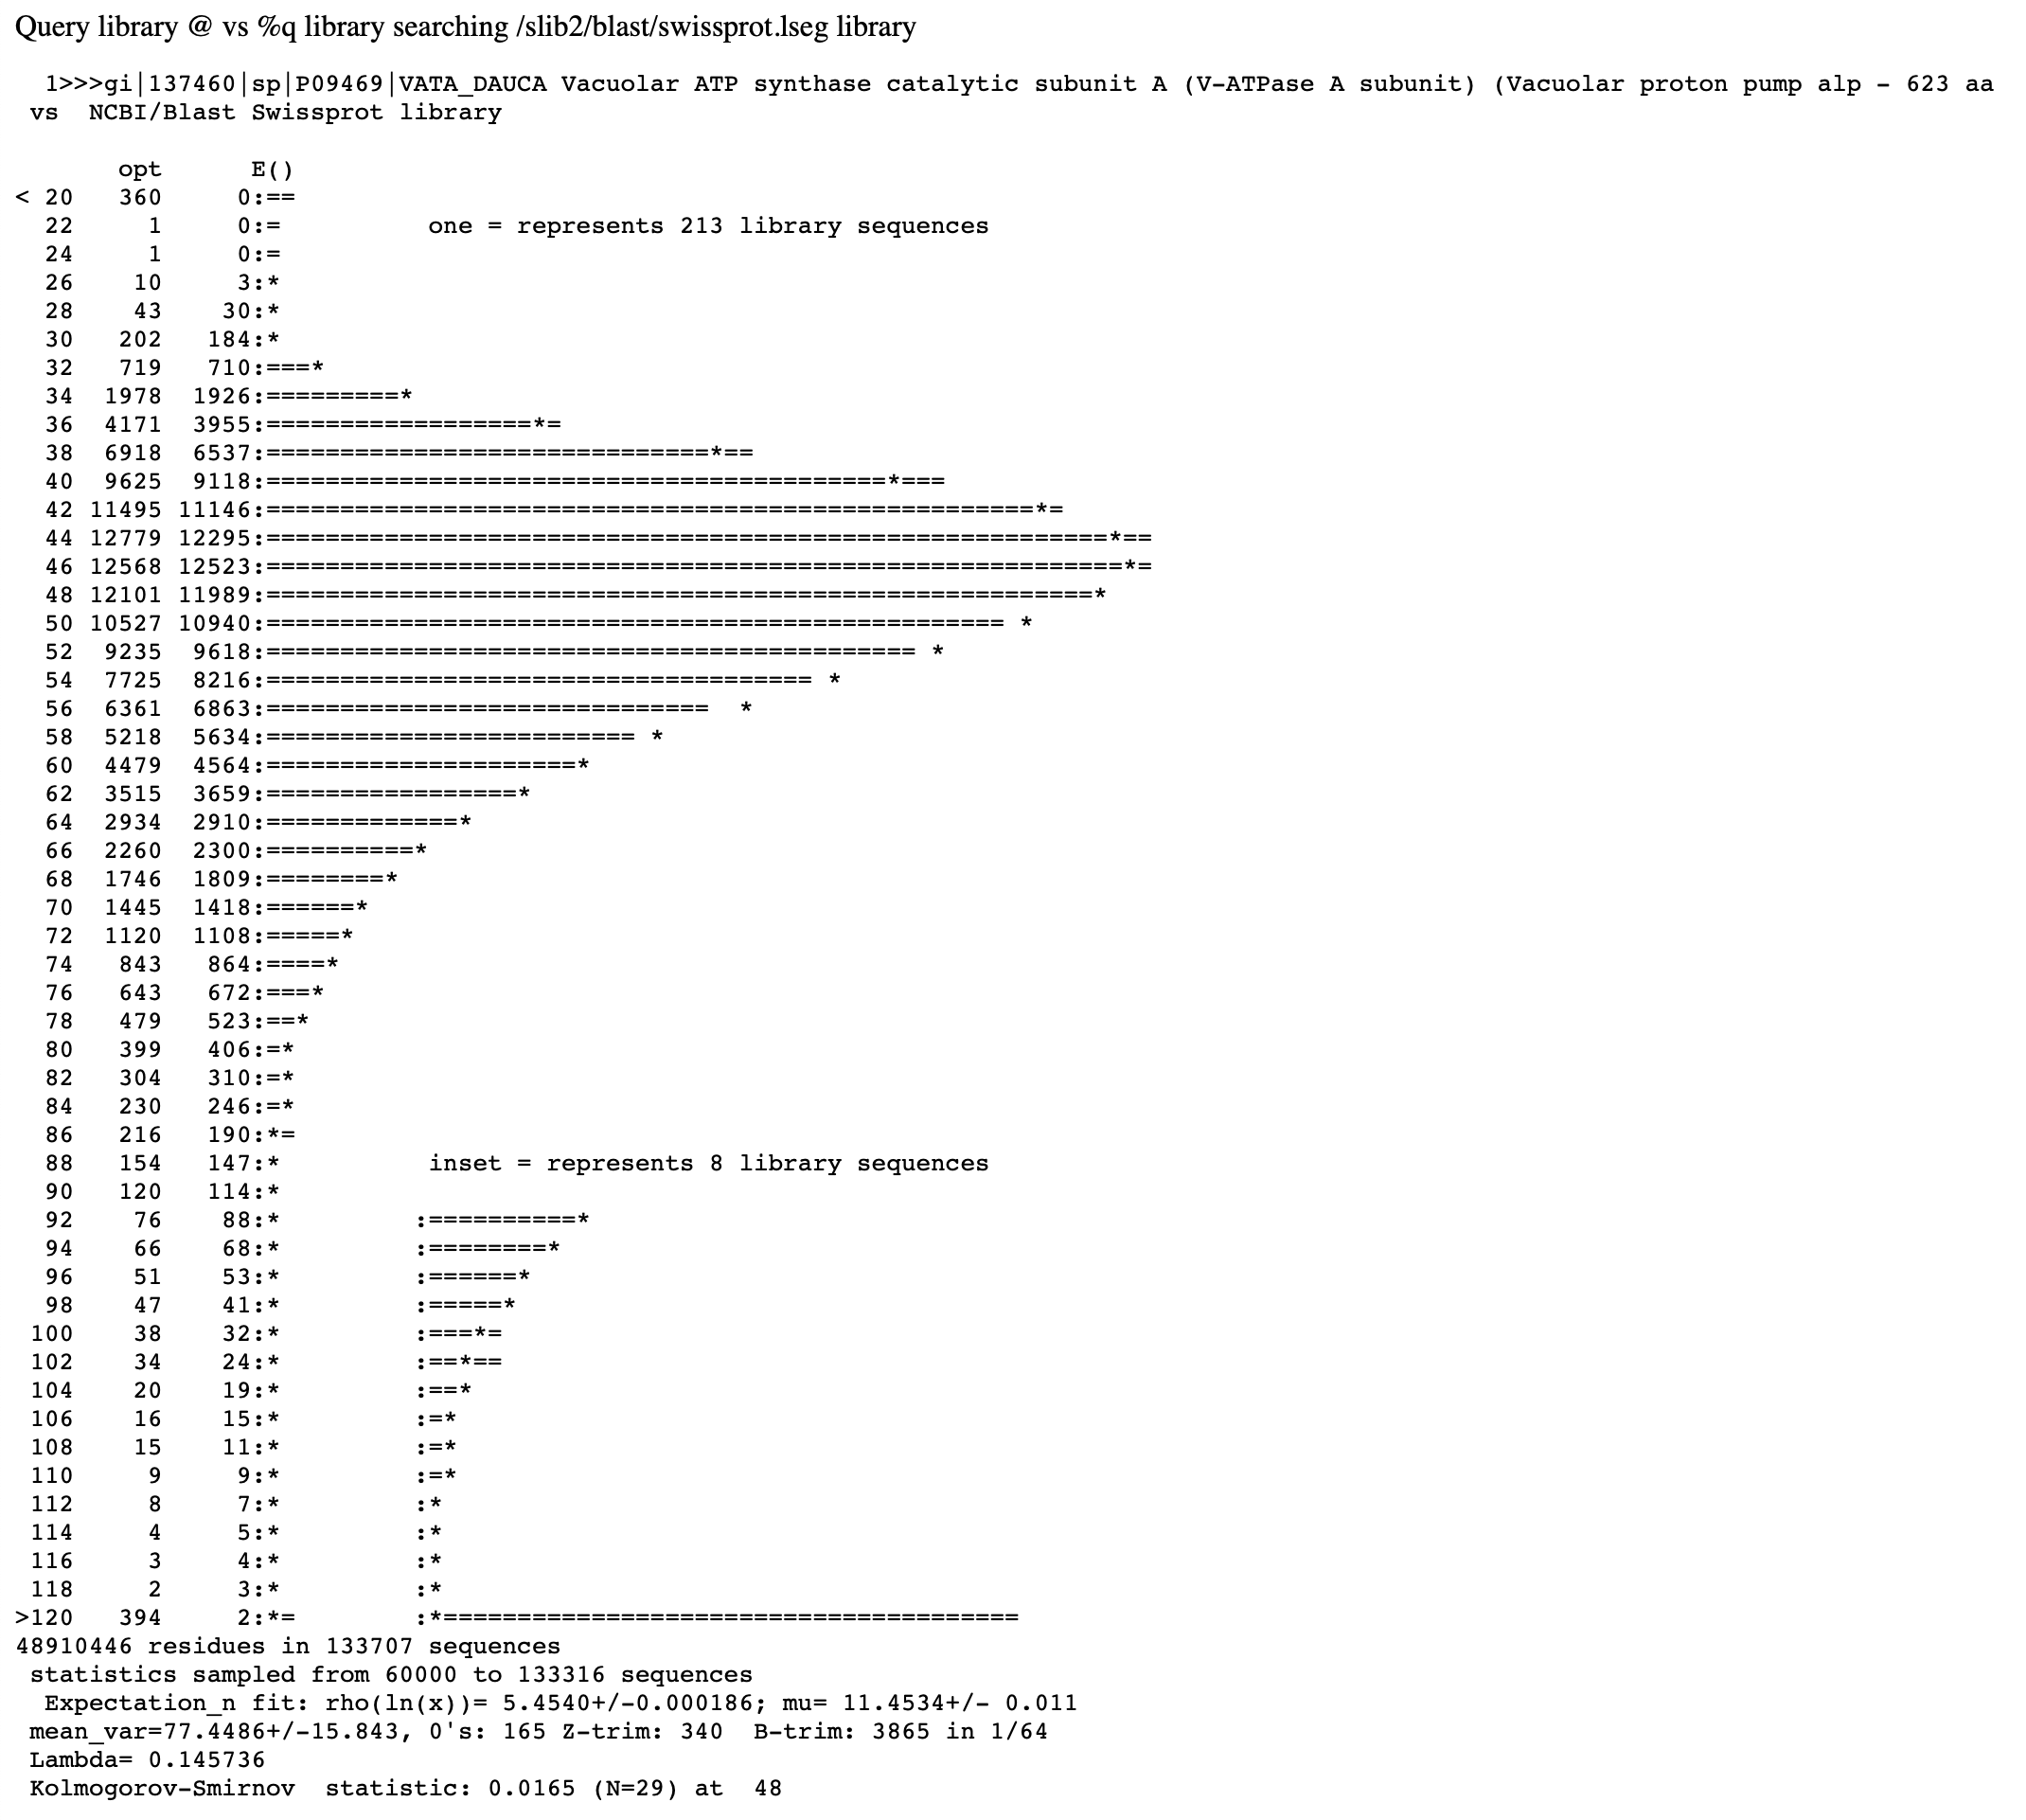
FASTA databank search
(Distribution under H₀ is estimated from the data, i.e. all scores against the databank sequences)

Slide 12
False Positives versus False Negatives
If a databank search with a sequence is considered a search a ”homology search” (significant similar complex sequence are homologs), then
False Positives: non-homologous sequences that are reported as similar (these are very well estimated by E-values)
False Negatives: homologous sequences that are not reported as similar (there are many, but the number is unknown)
Aside:
E-values give the expected number of matches with an alignment score this good or better due to chance alone (no shared ancestry, no convergent evolution)
P-values give the probability of to find a match of this quality or better due to chance alone (no shared ancestry, no convergent evolution).
The P value is equal to the probability that the null hypothesis (similarity is due to chance alone) is true. This probability is also known as the significance level at which the null hypothesis can be rejected.
P values are [0,1], E-values are [0,infinity).

Slide 13
P-Hacking
You should define a testable hypothesis before you select the data to analyze.
The interactive selection of which data to include or exclude is known as P-hacking – you try out different things until you det the expected result.
For example, the question if a government formed by democrats (or republicans) is significantly beneficial to the economy.
This depends on which level of government you include, and which measures for the economy you use.
An interactive P-hacking scheme on this question is at
https://projects.fivethirtyeight.com/p-hacking/
Also see https://fivethirtyeight.com/features/science-isnt-broken/#part1

Slide 14
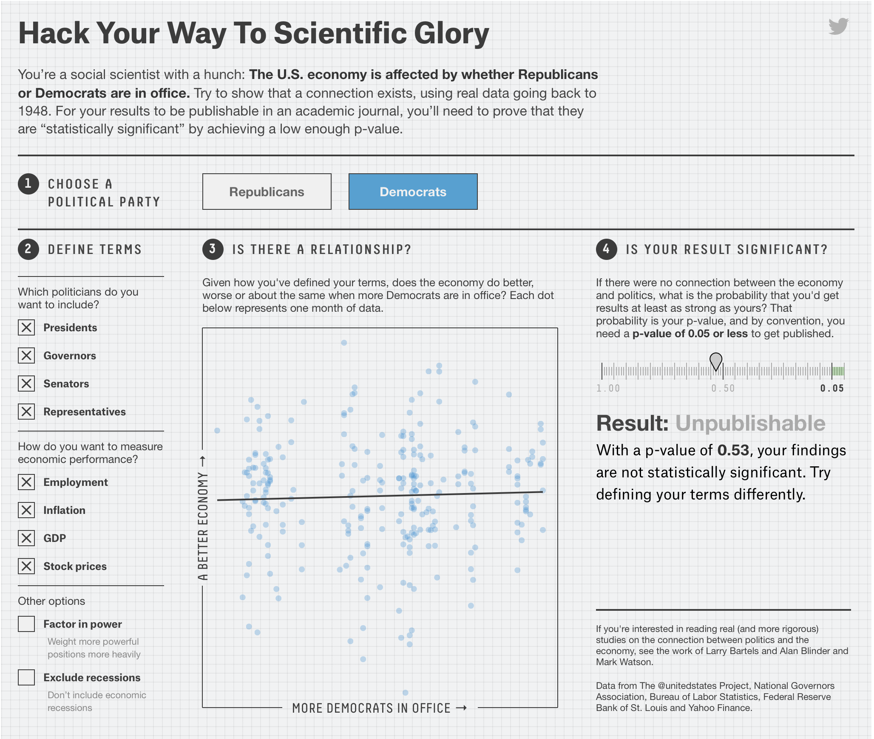
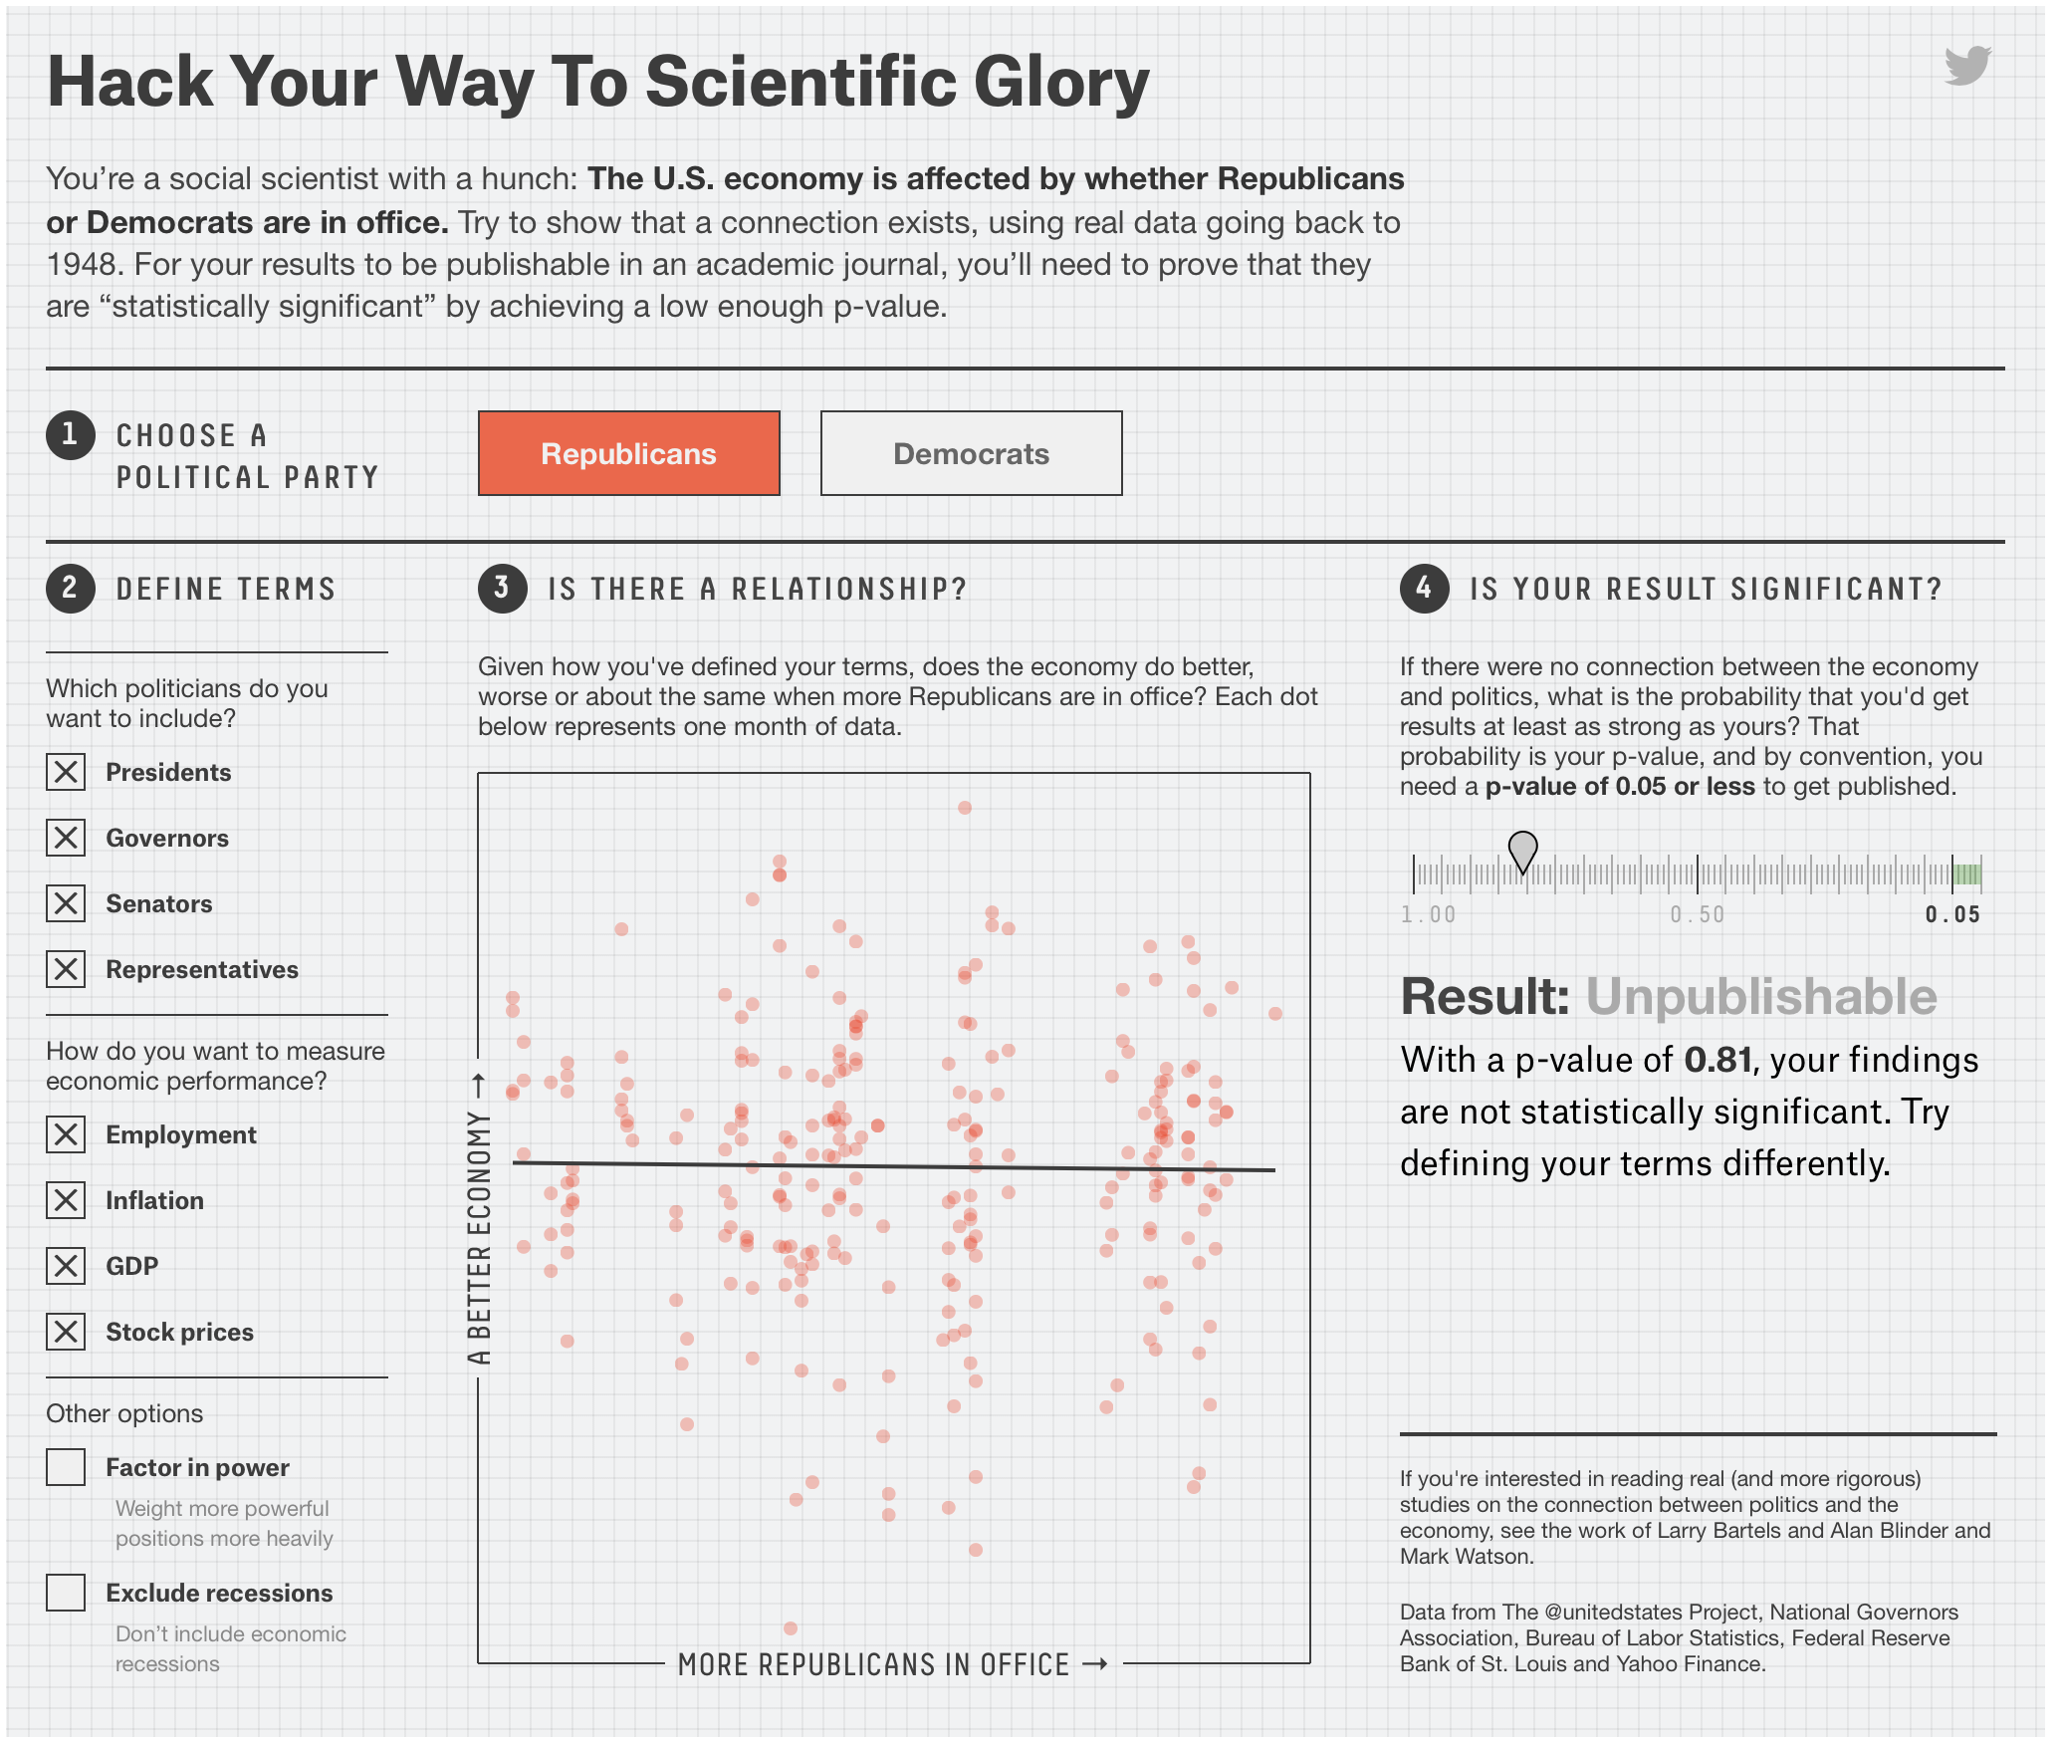
Using all the data does not give significant results

Slide 15
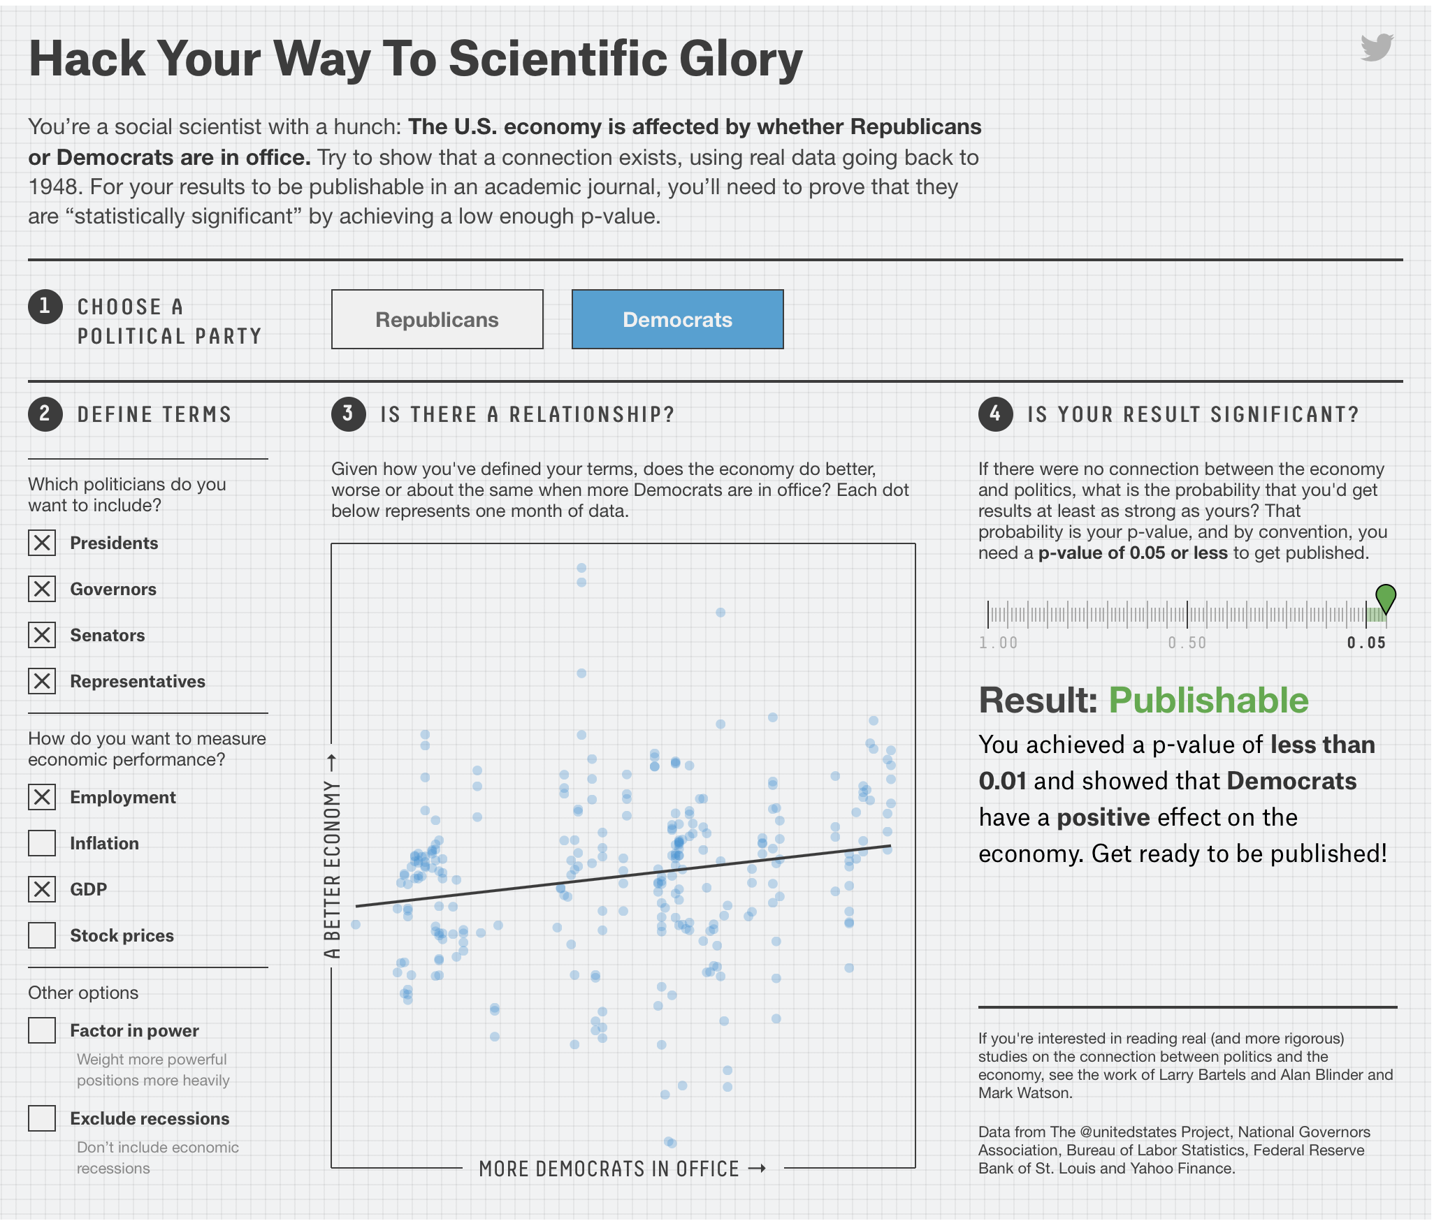
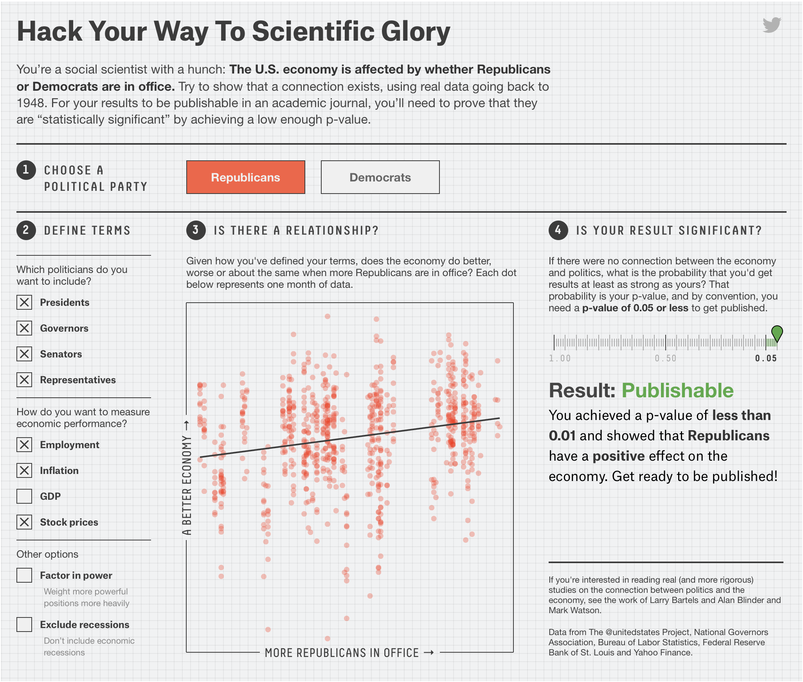
But with minor modification:

Slide 16
Data Dredging aka Fishing Expeditions
If you do 100 experiments, you expect to find one experiment that is significant at the 1% level due to chance alone.
(P-value = The probability to find something under the null hypothesis or due to chance alone.)
If in 100 experiments you do not want to have a false positive with a probability of 1%, then you need to correct the P-value for the individual test.
Question: What is the Null Hypothesis that is tested by the P (orE-) value of a databank search?

Slide 17
Types of Error in a Databank Search
False positives: The number of false positives are estimated in the E-value. The P-value or significance value gives the probability that a positive identification is made in error (same as with drug tests).
Danger: avoid fishing expeditions. If you do 100 tests on random data, you expect one to be positive at the 1% significance level.
You could apply the Bonferroni correction:
The significance level for the individual test is calculated through dividing the overall desired significance level by the number of parallel tests.
The null-hypothesis of the overall test is that None of the individual tests is significantly different from chance. (The opposite of none being "at least one")
False negatives: Homologous sequences in the databank that are not recognized as such. If there are only 12000 different protein families, on average a sequence should have (size of the databank)/12000 matches. In other words, the number of false negatives is probably very large.

Slide 18
When do you need a correction for multiple tests?
Expression studies, where you test all possible transcripts simultaneously
Test all genes in a genome against a database of pathogenicity genes

Slide 19
One Person
One Person
doing
doing
one test
N=1000 tests
Without correction
Probability for a false positive
in single test
P<0.01
Probability for a false positive
in single test
P<0.01
Overall probability
for a false positive
P<10
Overall probability
for a false positive
P<0.01
With Bonferroni correction
Probability for a false positive
in single test
P<0.01/N=0.00001
Overall probability
for a false positive
P<0.01

Slide 20
When do you need a correction for multiple tests?
Expression studies, where you test all possible transcripts simultaneously
Test all genes in a genome against a database of pathogenicity genes
If you, your class, or collaborators do the repeated tests, it is obvious that one should apply a correction for multiple tests!
Problem: What happens if people do not know about the other tests being performed?

Slide 21
One Person
1000 People
doing
doing
one test
N=1 test each
Without correction
Probability for a false positive
in single test
P<0.01
Overall probability
for a false positive
P<10
Probability for a false positive
in single test
P<0.01
Result:
990 people have an insignificant finding and conclude this was a good idea, while it lasted.
10 people have a significant result with P < 0.01
1 person has a a significant result with P < 0.001
They conclude that this is an important and exciting result providing significant support to an important hypothesis.
=> News Headline!
Overall probability
for a false positive
P<0.01

Slide 22
Verbal overshadowing is the phenomenon, where giving a verbal description of a face (or other complex stimuli) impairs recognition of that face or stimuli first reported by Schooler and Englster-Schooler (1990). The effects are observed across multiple domains of cognition that are known to rely on non-verbal knowledge and perceptual expertise, such as memory. Memory has been known to be influenced by language. Seminal work by Carmichael and collaborators (1932) demonstrated that labels attached to, or associated with, non-verbal forms during memory encoding can affect the way the forms were subsequently reproduced. Because of this, memory performance that relies on reportable aspects of memory that encode visual forms should be vulnerable to the effects of verbalization.
From Wikipedia https://en.wikipedia.org/wiki/Decline_effect
https://en.wikipedia.org/wiki/Verbal_overshadowing
See: Article in New Yorker at https://www.newyorker.com/magazine/2010/12/13/the-truth-wears-off

Slide 23
The Decline Effect
Other examples
second generation anti-psychotic drugs
connection between symmetry and sexual preference of female birds in nature
The “truth wears off” because:
regression toward the mean
publication bias
novel drugs might have a stronger placebo effect
Study designs maybe biased *.

Slide 24
From: Methodological Flaws, Conflicts of Interest, and Scientific Fallacies: Implications for the Evaluation of Antidepressants’ Efficacy and Harm
Front. Psychiatry, 07 December 2017
Sec. Public Mental Health
Volume 8 - 2017 | https://doi.org/10.3389/fpsyt.2017.00275
Conclusion: The strong reliance on industry-funded research results in an uncritical approval of antidepressants. Due to several flaws such as publication and reporting bias, unblinding of outcome assessors, concealment and recoding of serious adverse events, the efficacy of antidepressants is systematically overestimated, and harm is systematically underestimated. Therefore, I conclude that antidepressants are largely ineffective and potentially harmful.

Slide 25
What can one do to prevent the scientific enterprise to report false results on a regular basis?

Slide 26
What can one do to prevent the scientific enterprise to report false results on a regular basis?
A) metastudies, e.g., Initial severity and antidepressant benefits: A meta-analysis of data submitted to the Food and Drug Administration
Authors
Irving Kirsch, Brett J Deacon, Tania B Huedo-Medina, Alan Scoboria, Thomas J Moore, Blair T Johnson
B) Don’t turn every dietary study with P<.05 into a headline
C) use higher significant cut-offs
D) publish results that do not have a significant outcome.

Slide 27
BLAST = Basic Local Alignment Search Tool
meaning: Blast does not align the whole query sequence to the target sequence in the database, but only provides local matches.

Slide 28
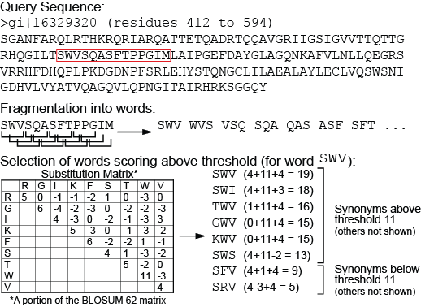
BLAST Phase 1: Segmenting the query sequence; scoring potential word matches--compile
BLAST:
  Segments the query sequence into pieces (“words”)
    Default word length: 3 amino acids or 11 nucleic acids
  Creates a list of synonyms and their scores for comparing query words to target words
    Uses scoring matrix to calculate scores for synonyms that might be found in the database
  Saves the scores (and synonyms) exceeding a given threshold T
28

Slide 29
BLAST Phase 2: Scanning the database
BLAST
  Scans the database for matches to the word list with acceptable T values
  Requires two matches (“hits”) within the target sequence
  Sets aside sequences with matches above T for further analysis
Words
SWI
PGI
…………..SWITEASFSPPGIM…..
Possible match from the database
29

Slide 30
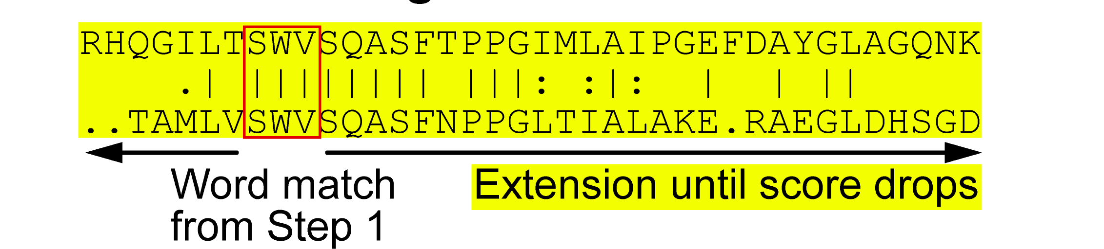
BLAST Phase 3: Extending the hits
BLAST
  Searches 5’ and 3’ of the word hit on both the query and target sequence
  Adds up the score for sequence identity or similarity until value exceeds S
  Alignment is dropped from subsequent analyses if value never exceeds S
30

Slide 31
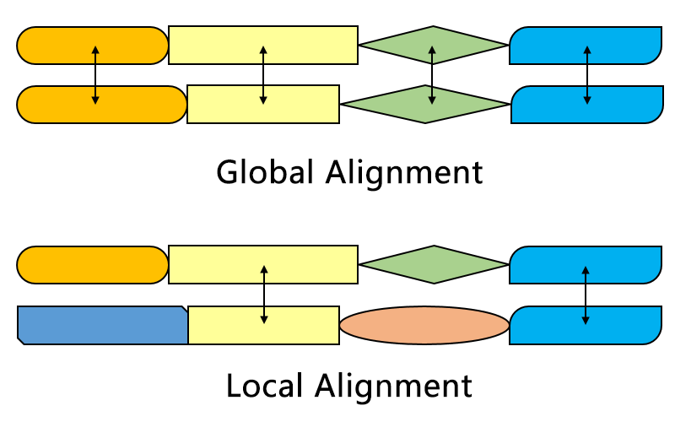
Aligning sequences is part of many analytical pipelines
Alignments can be local or global
local: e.g. blast finds stretches of similar sequences
global: two (or more) sequences are aligned from beginning to end (e.g. in fasta databank searches)
From https://en.wikipedia.org/wiki/Smith–Waterman_algorithm#/media/File:Alignment-Comparison-En.png

Slide 32
Types of Blast searching
blastp compares an amino acid query sequence against a protein sequence database
blastn compares a nucleotide query sequence against a nucleotide sequence database
blastx compares the six-frame conceptual protein translation products of a nucleotide query sequence against a protein sequence database
tblastn compares a protein query sequence against a nucleotide sequence database translated in six reading frames
tblastx compares the six-frame translations of a nucleotide query sequence against the six-frame translations of a nucleotide sequence database.
by Bob Friedman

Slide 33
blastn
Nucleotide Query
Nucleotide databank
Protein Query
Protein databank
e.g., finding ribosomal RNA sequences in a genome (after turning the genome into a databank

Slide 34
Nucleotide Query
Nucleotide databank
blastp
Protein Query
Protein databank
e.g., finding homologs to a particular protein in a databank or genome

Slide 35
blastn and blastp searches using the same gene as query
 | Nucleotide Query | Protein Query
Flowering plants | 1417 | 2055
Other green plants (minus flowering plants) | 36 | 708
Red algae | 7 | 42
Opisthokonts (animals and fungi) | 2479 | >5000
Primates | 5 | 152
Thermoplasmatales | 9 | 117
Cyanobacteria | 0 | 326
The first 6 searches target organisms that posses the vacuolar/archaeal type ATPase, the cyanobacteria only have the more divergent F-ATPase

Slide 36
Nucleotide Query
Nucleotide databank
blastx
Protein Query
Protein databank
e.g., check if anything with homologs is encoded in a nucleotide sequence

Slide 37
Nucleotide Query
Nucleotide databank
6 frame translation
tblastn
Protein Query
Protein databank
e.g., check if homologs to a protein of interests are encoded in a genome.
This works great to find pseudogenes such as decaying transposases or retroviral reverse transcriptases in a genome.
This works to detect pseudogenes (where there isn’t a contiguous open reading frame), and it works with Position Specific Scoring Matrices.

Slide 38
Nucleotide Query
Nucleotide databank
tblastx
6 frame translation
Protein Query
Protein databank
e.g., check if homologs to a protein of interests are encoded in a genome.
This works great to find pseudogenes such as decaying transposases or retroviral reverse transcriptases in a genome.
This works to detect pseudogenes (where there isn’t a contiguous open reading frame), and it works with Position Specific Scoring Matrices.

Slide 39
fasta: an alternative to blast
slower
better alignments between query and database sequences.
An example output is here

Slide 40
remainder of sides moved to class 9

