Slide 1
Alignments, UNIX, blast via the command line
MCB 3421 2023
Class 9

Slide 2
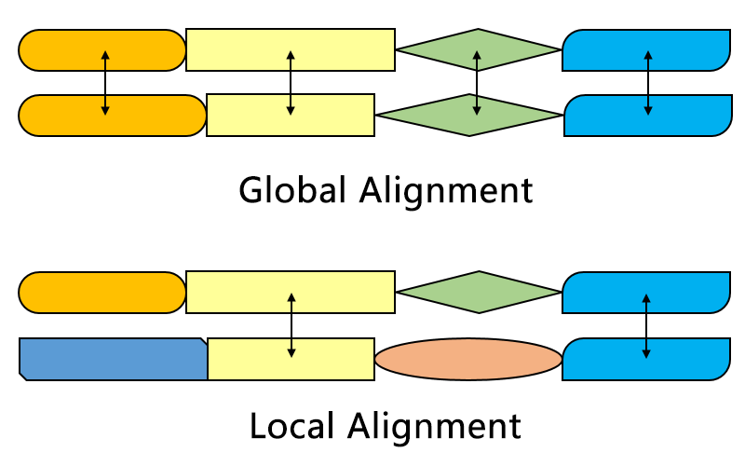
Aligning sequences is part of many analytical pipelines
Alignments can be local or global
local: e.g. blast finds stretches of similar sequences
global: two (or more) sequences are aligned from beginning to end (e.g. in fasta databank searches)
From https://en.wikipedia.org/wiki/Smith–Waterman_algorithm#/media/File:Alignment-Comparison-En.png

Slide 3
fasta: an alternative to blast
slower
better alignments between query and database sequences.
An example output is here
BLAST: local alignments
FASTA: global alignments

Slide 4

dotplot
The easiest way (provided the program runs on your computer) to align two sequences is to use a dotplot or gepard.
In realistic implementations a window of 5 to 20 nucleotides or amino acids is slid along one of the axes (i.e., sequences) and compared to every possible window on the other axis (sequence).
The dot intensity can be adjusted to reflect the percent identity (or similarity) in the two windows.
Example of a dotplot comparison of a protein with 13 repeated domians compared against itself

Slide 5
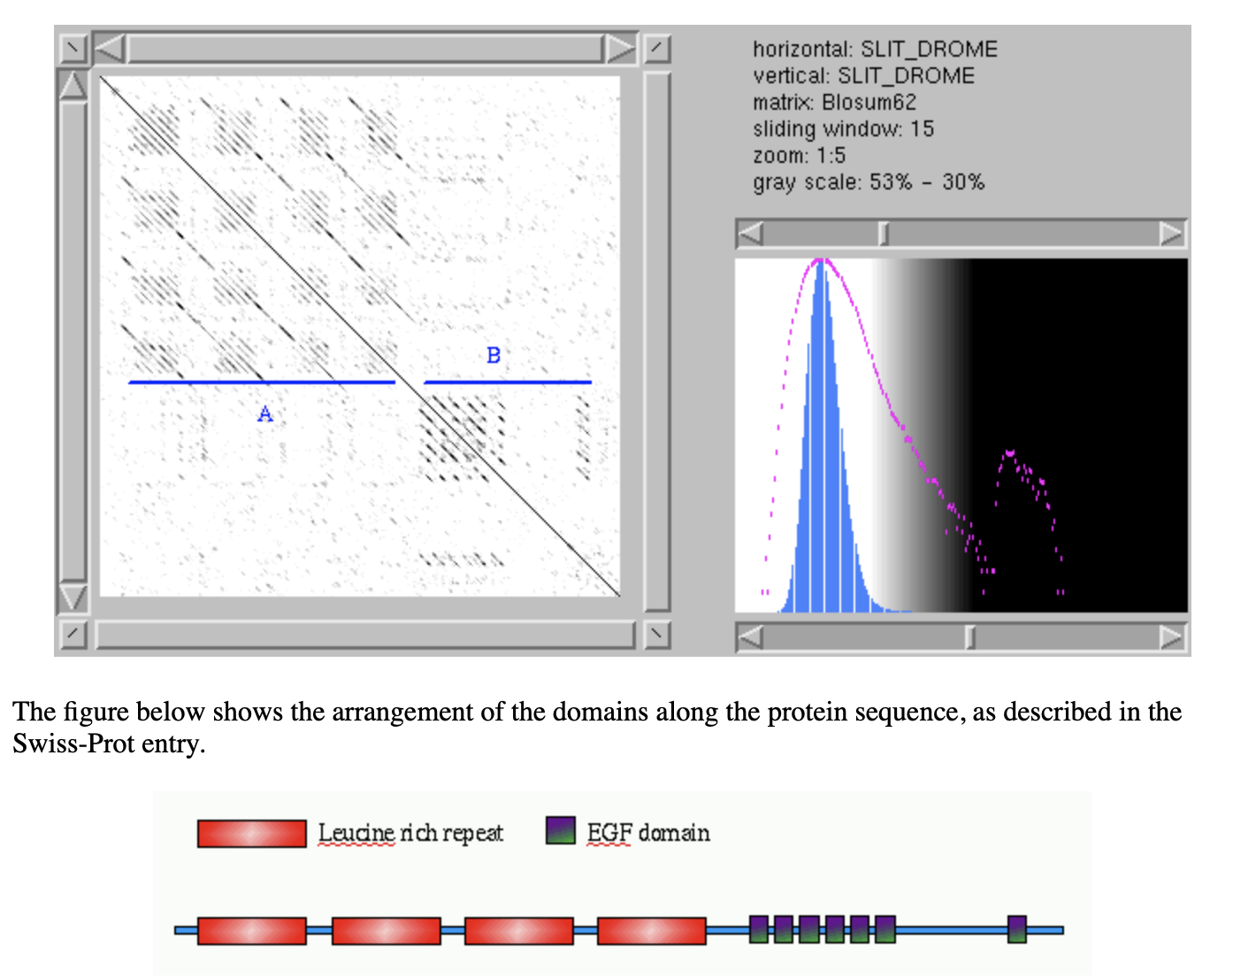
Alignment of a protein against itself consisting of multiple repeted domains
from: https://myhits.sib.swiss/util/dotlet/doc/repeats.html

Slide 6

dotplots can also be used to compare a DNA sequence (in the three forward reading frames) against a protein:
gene encoding the V-ATPases A SU in Arabidopsis
protein sequence of the
V-ATPases A SU in Arabidopsis

Slide 7
Blast databases
EST - Expression Sequence Tags; cDNA
wgs – whole genome shotgun reads
Reference genome sequences
NR - non-redundant DNA or amino acid sequence database
NT - NR database excluding EST, STS, GSS, HTGS
PDB - DNA or amino acid sequences accompanied by 3d structures
STS - Sequence Tagged Sites; short genomic markers for mapping
Swissprot - well-annotated amino-acid sequences
Refseq_select – proteins/mRNAs encoded by well characterized transcripts
env_nr - Metagenomic proteins
SRA – sequence read archive
wgs – whole genome shotgun sequences
At the EBI:
Uniref90 / Uniref50 – data base that clusters sequences more than 90 or 50 % identical and represents each cluster by a single representative sequence
Great to assemble sequences to calculate profiles.
by Bob Friedman

Slide 8
Custom databases
Custom databases can include private sequence data, non-redundant gene sets based on genomic locations, merging of genetic data from specific organisms
It’s also faster to search only the sequence data that is necessary
Can search against sequences with custom names

Slide 9
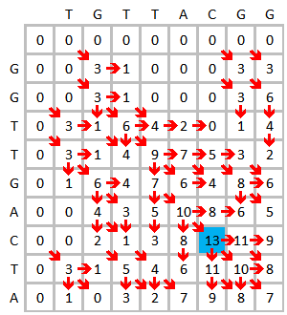
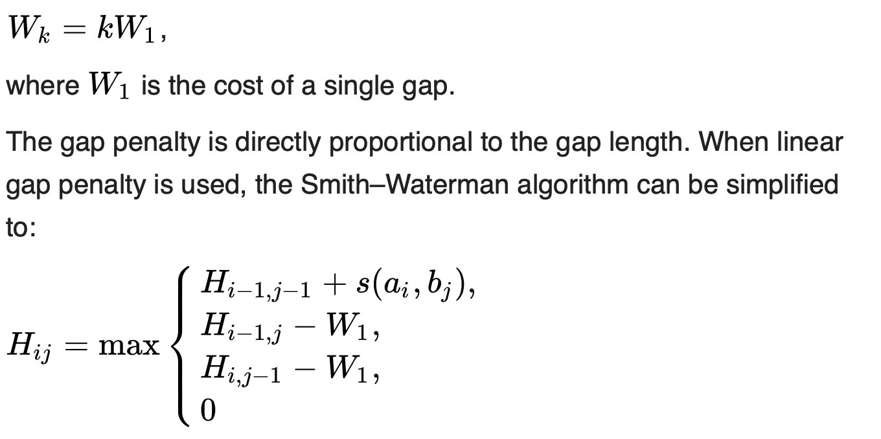
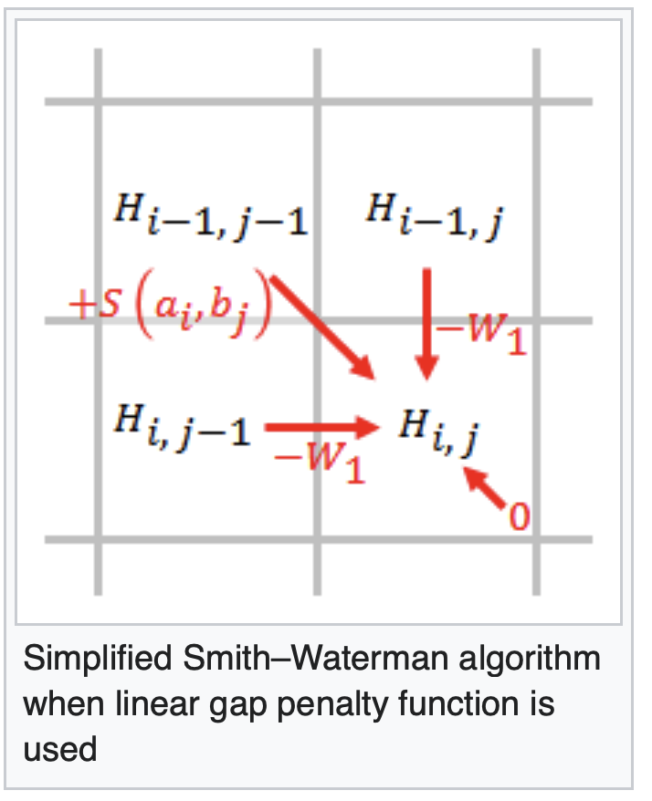
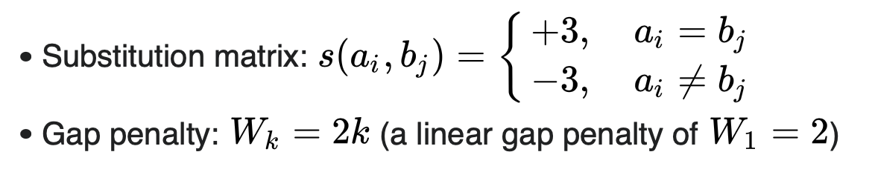
Optimal alignments
For pairwise (this has been extended to three sequences) dynamic programming algorithms have been developed that guarantee to find an optimal alignment (given a scoring matrix and gap penalties) (and you can use shuffling to assess significance of the score)
The most famous of these are the Needleman Wunsch and the Smith Waterman algorithms.
Wikipedia has a good description of the Smith–Waterman algorithm
You write down the sequences on the two axes, and starting at the upper left fill in the maximum score for each field
Assuming a linear gap penalty:

Slide 10
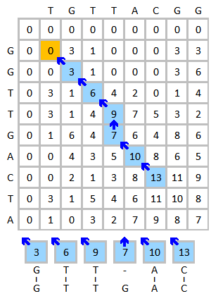
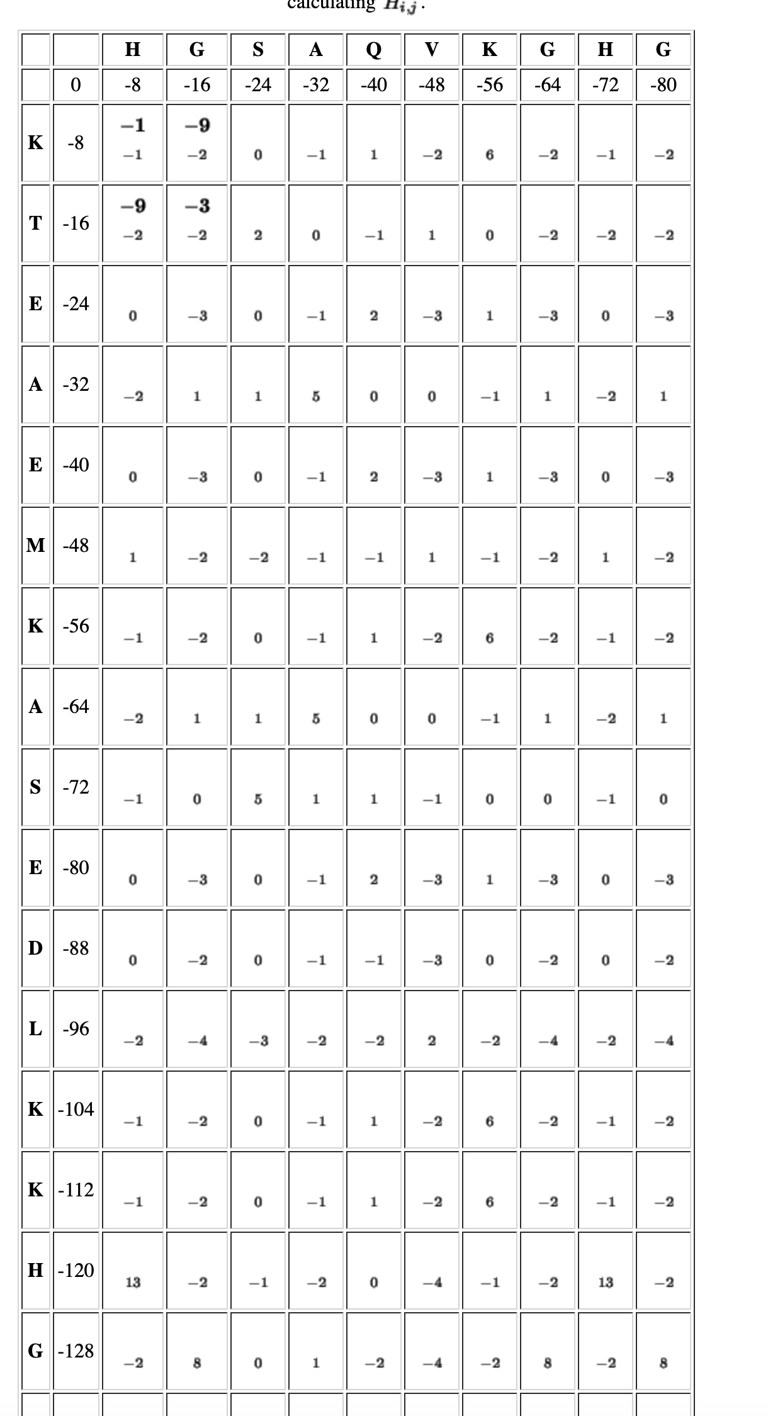
Trace back from the highest number to zero.
The Needleman-Wunsch algorithm differs in that it allows for cells to have
negative scores. A step by step version is here or more readable here

Slide 11
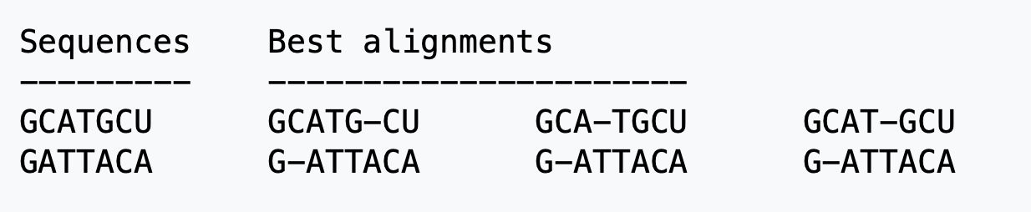
Both algorithms are guaranteed to give you an optimum score; however, usually the report a single alignment; however, usually there are different alignment with the same score. E.g.:
From: https://en.wikipedia.org/wiki/Needleman–Wunsch_algorithm

Slide 12
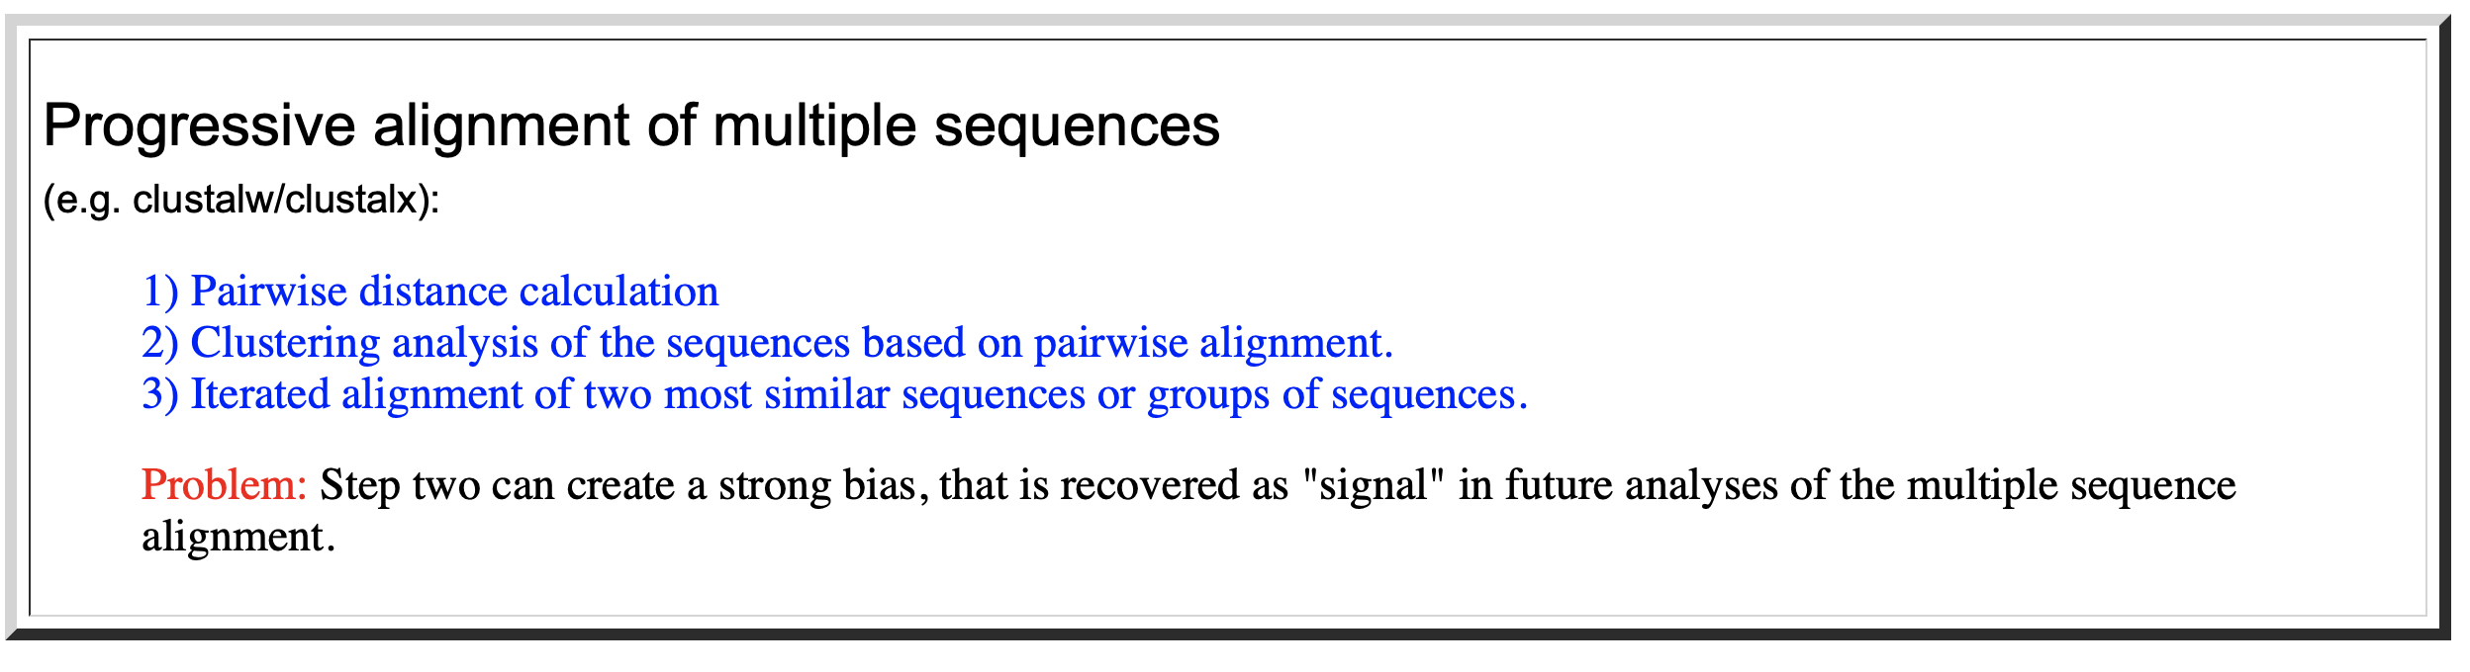
Multiple Sequence Alignments (MSAs)
clustalx (the same as clustalw with a GUI) is a frequently used progressive alignment algorithm*.
Gives excellent alignments that usually are very similar to alignments based on protein structures.
It works better, the more sequences are included.
Often not acceptable as a start point to build molecular phylogenies!
* the first effective multiple sequence alignment program was developed by Feng and Doolittle

Slide 13
The second step (the clustering analysis of the sequences) is most important. The relationships found here will create a serious bias in the final alignment. The better the guide tree, the better the final alignment. One can load a guide tree into clustal. This tree will then be used instead of the neighbor joining tree calculated by clustalw as a default. (The guide tree needs to be in normal parenthesis notation WITH branch lengths).

Slide 14
Other alignment programs:
MUSCLE is the current alignment program of choice. It is thought to give better alignments compared to clustal, it is faster and works with larger datasets. The program is available through a webserver at the ebi, and as a command line program to download here, and already installed on Xanadu.
Developed by gentleman scientist Robert Edgar. The paper on muscle has been citer over 31000 times
MUSCLE also is one option to use in the SEAVIEW GUI program

Slide 15
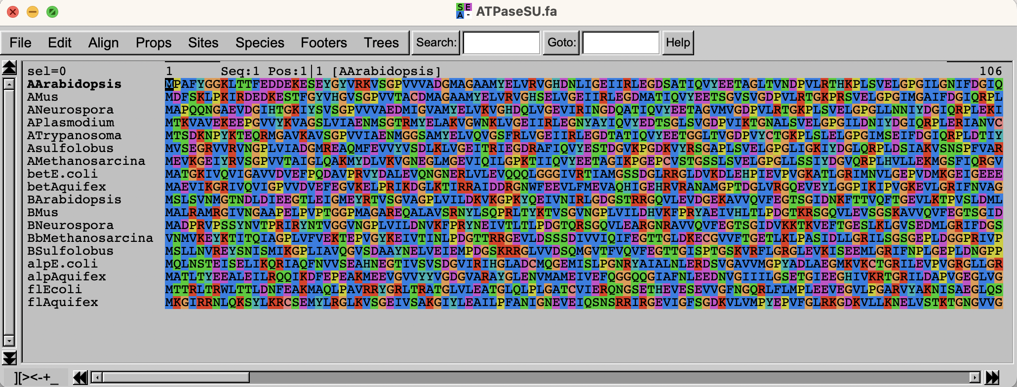
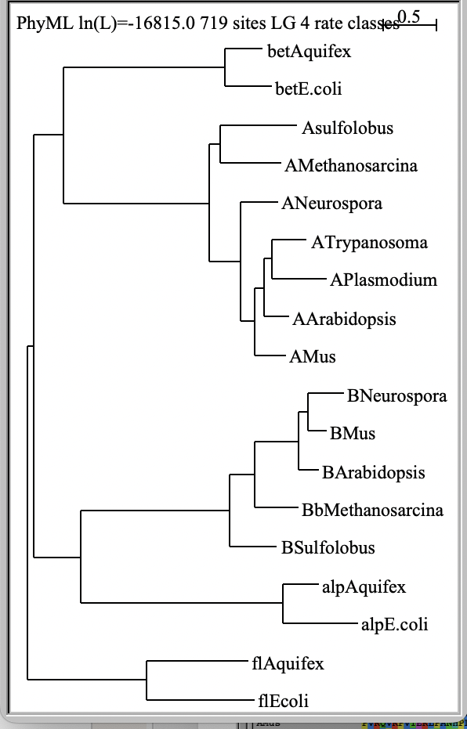
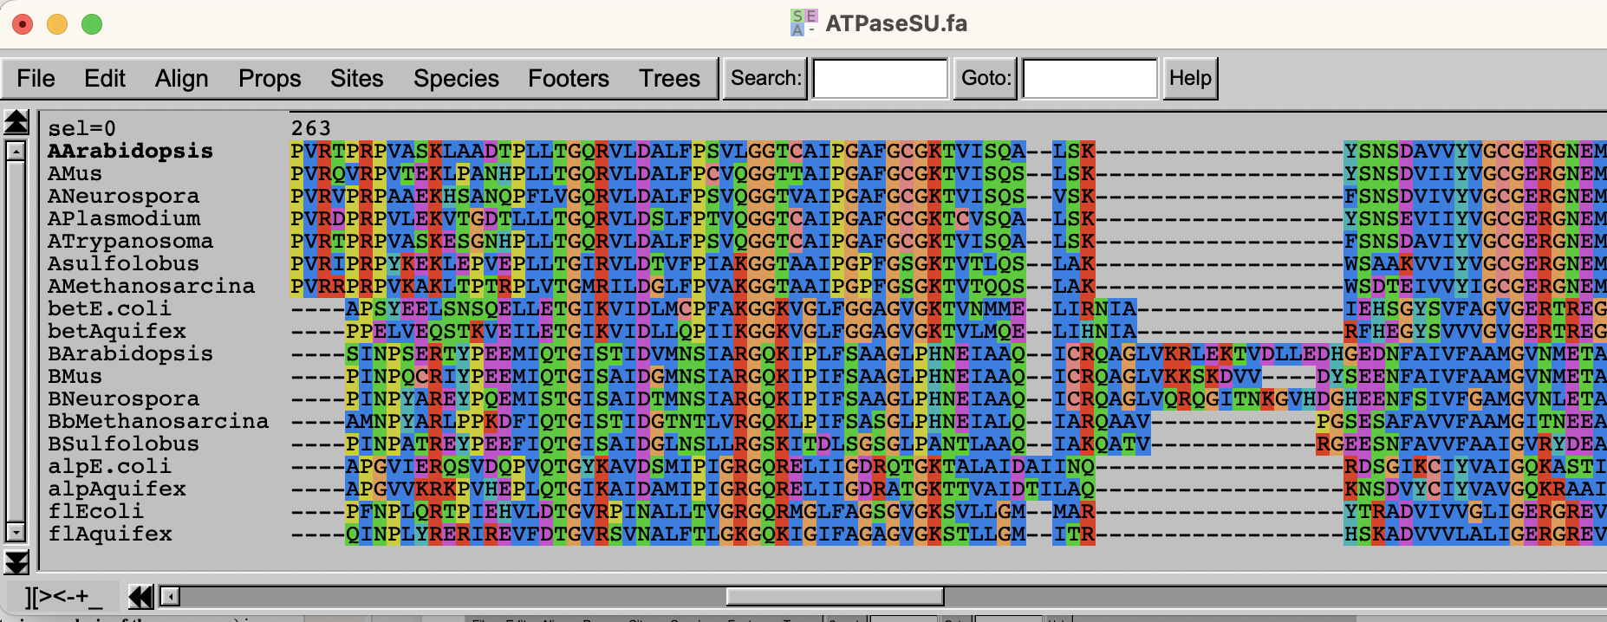
Seaview
aligns sequences
translates nucleotide sequences
reconstructs phylogenetic trees

Slide 16
Statalign – trees without MSAs
If your sequences are not very similar, and if you are not able to generate a trustworthy multiple sequence alignment, you can calculate distance trees based on pairwise alignments only.
The best program for this purpose is statalign from Jeff Thorne (Thorne JL, Kishino H (1992) Freeing phylogenies from artifacts of alignment. Mol Bio Evol 9:1148-1162). It runs under standard UNIX. It's only worth your effort if you are getting gray hairs because of a data set you cannot reliably align. Very out of fashion these days.

Slide 17
Prank
Most multiple sequence alignment programs produce alignments that are pleasing to the human eye by placing only a few large gaps into the sequences.
However, for many applications it is better to align a particular amino acid to gaps in the other sequences, if one is not certain about the homology of the position. The programs that introduce more gaps are at present underutilized. An example is PRANK (a web version of PRANK is part of the guidance 2 server to determine reliably aligned sites).

Slide 18
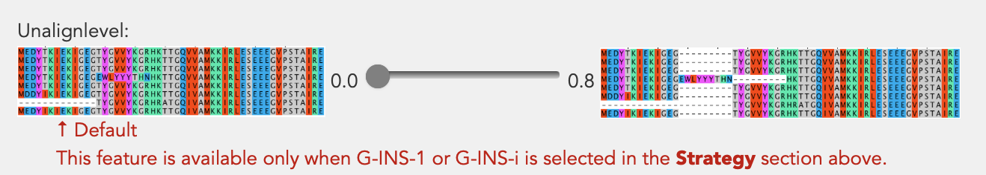
MAFFT
(this seems currently the best program, if one wants to align divergent sequences)
A collection of alignment programs with different options.
Options exist for sequences that are homologous over their entire length, or those that consist of multiple domains and may contain long gaps (missing domains) in some sequences.
Another option (currently in testing) is to force or not force alignment of divergent regions. An unalign level of .9 seems a good choice to avoid downstream artifacts

Slide 19
MAFFT
Available online, but only with very limited numbers of iterations.
Command line versions are available for different operating systems.
If you use the web interface at https://mafft.cbrc.jp/alignment/server/ ,
it tells which command it used – you can copy this and then use it on Xanadu
or your own computer from the commandline, and increase the number of iterations.
Commands might be the following:
mafft --globalpair --maxiterate 1000 all.fasta > output_alignment.fasta
mafft --globalpair --unalignlevel 0.8 --leavegappyregion --maxiterate 1000 all.fasta > more_iterations_alignlevel0.8.fasta
The manual is at https://mafft.cbrc.jp/alignment/software/manual/manual.html

Slide 20
SATè
A program that combines phylogenetic reconstruction and multiple sequence alignment: SATe.
SATé is a software package for inferring a sequence alignment and phylogenetic tree. The iterative algorithm involves repeated alignment and tree searching operations. The original data set is divided into smaller subproblems by a tree-based decomposition. These subproblems are aligned and further merged for phylogenetic tree inference.

Slide 21
Recommendations
If you need to use MSA in your work, my current recommendation is to use muscle, and test if an alignment calculated with PRANK or MAFFT gives similar results. Also, if you use less than 100 sequences, try SATe2.
(The time needed for computation is very different!).
Note: in some instances none of the automated procedures gives satisfactory results and modifying alignments by hand is the only option.

Slide 22
Manual Alignments
In some instances, none of the automated procedures gives satisfactory results and modifying alignments by hand is the only option.
Jalview remains a popular option. Advantages are the PCA analysis of the sequence alignment, and the integration of the different display windows.
Seaview is similar, it has a nice GUI and uses has more sophisticated alignment (muscle, clustalo) and phylogenetic reconstruction programs.

Slide 23
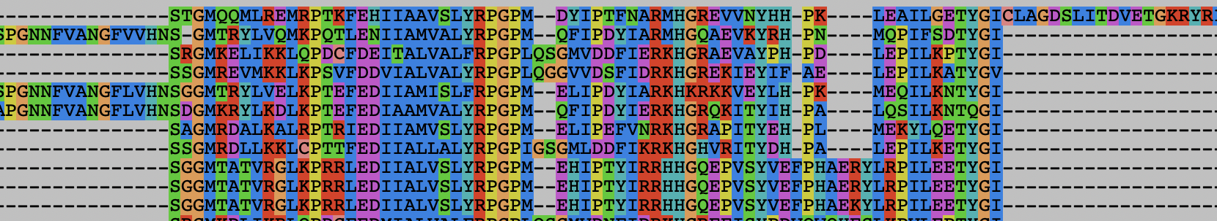
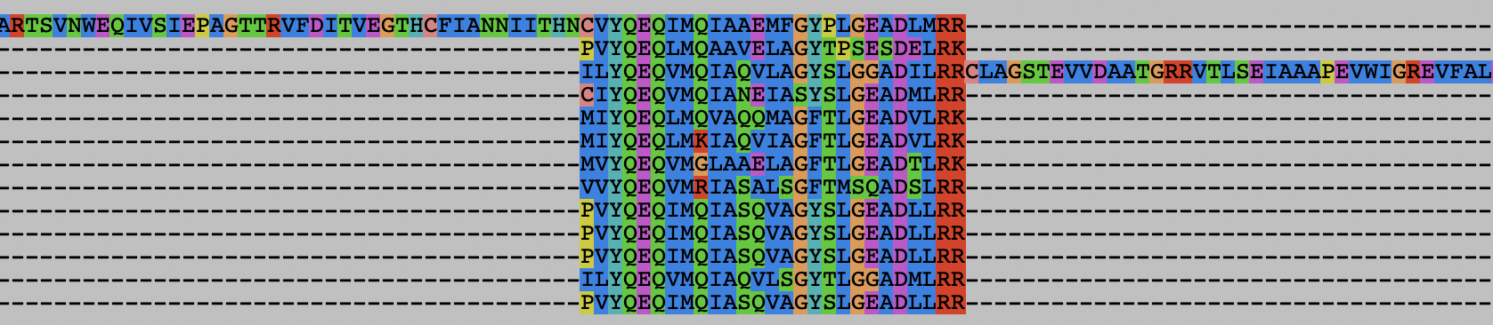
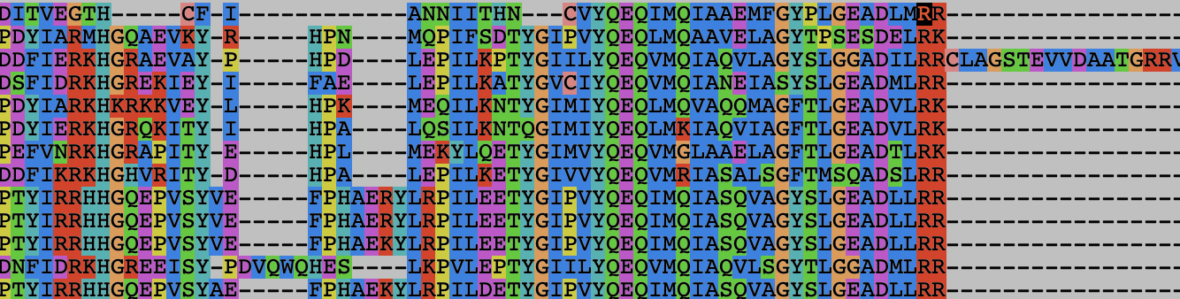
E.g., a gene invaded by inteins inserted into different locations
Intein 2
Extein
Intein 1
Intein 2
Extein
Intein 3
Muscle aligns the 2nd intein to the 1st intein mushes part of the extein with the intein sequence :

Slide 24
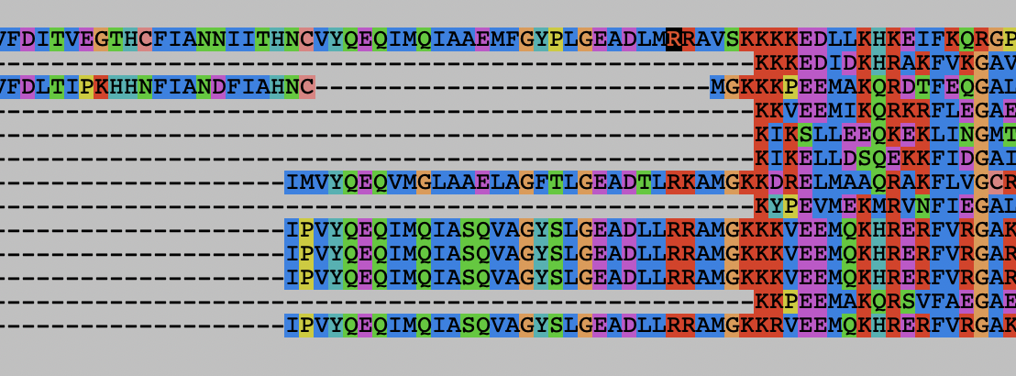
E.g., a gene invaded by inteins inserted into different locations
Intein 2
Extein
Intein 3
Intein 2
Extein
Intein 1
clustelo also aligns the 1st and 2nd intein and misses the small block of extein for several sequences :

Slide 25
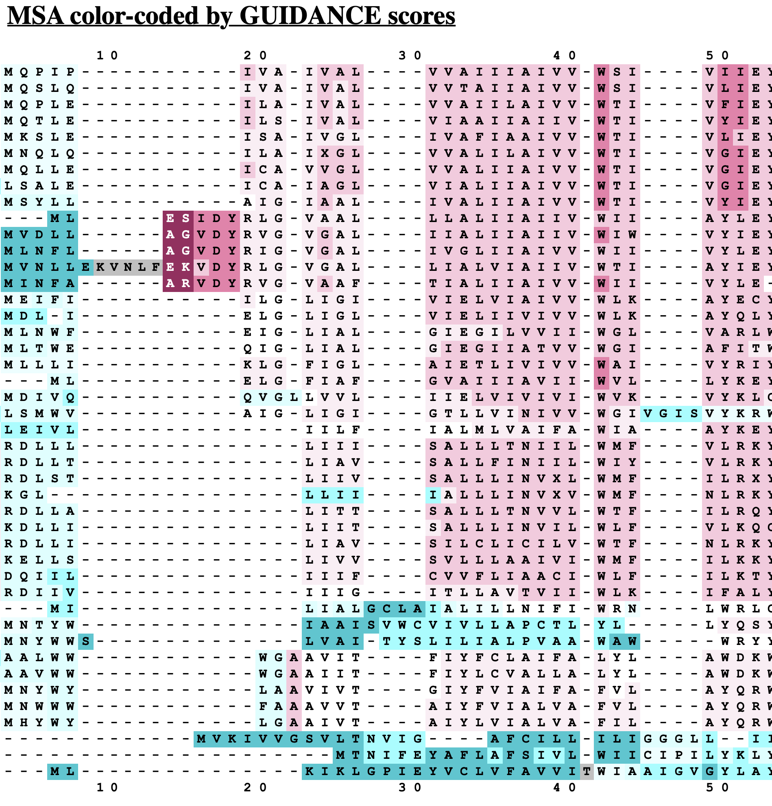
The question if one should use only reliably aligned sequences, or all sequences remains under debate. Many think that using all of the sequences will inform on substitution patterns and thus generate more reliable models.
Also, variable regions that cannot be aligned between divergent sequences, will help to resolve relationships closer to the tips.
One approach to remove ambiguous alignment
positions is GBLOCK (implemented in seaview
(see above, web server is here), another is guidance
from Tal Pupko's lab at TAU (I like this one, because It
allows to remove positions from poorly aligned individual
sequences, not only complete columns).

Slide 26
Command Line
The favored operating system flavor in computational biology is UNIX/LINUX.
The command line is similar to DOS.
Some of the frequently used commands are here
MacOsX runs on top of UNIX
pwd
ls
ls –l
chmod
chmod a+x blastall.sh
chmod 755 *.sh
cd
cd ..
cd $HOME
passwd
ps
ps aux
rm
more
cat
vi (text editor)
ssh
sftp
For windows an “ok” ssh program is putty.
UConn also has a site license for the ssh program from ssh.com

Slide 27
The bioinformatics cluster at UConn is called Xanadu. You will get a student account on that cluster.
Info on hardware is at https://health.uconn.edu/high-performance-computing/resources/
A rather lengthy introduction is at https://bioinformatics.uconn.edu/resources-and-events/tutorials-2/xanadu/
The main thing to keep in mind is that the cluster has one head node (which is the node where you end up when you establish a connection to the cluster via ssh.
All computational work should be done on a compute node, or via a shell script submitted to the compute queue.
NEVER RUN ANALYSES ON THE HEADNODE!

Slide 28
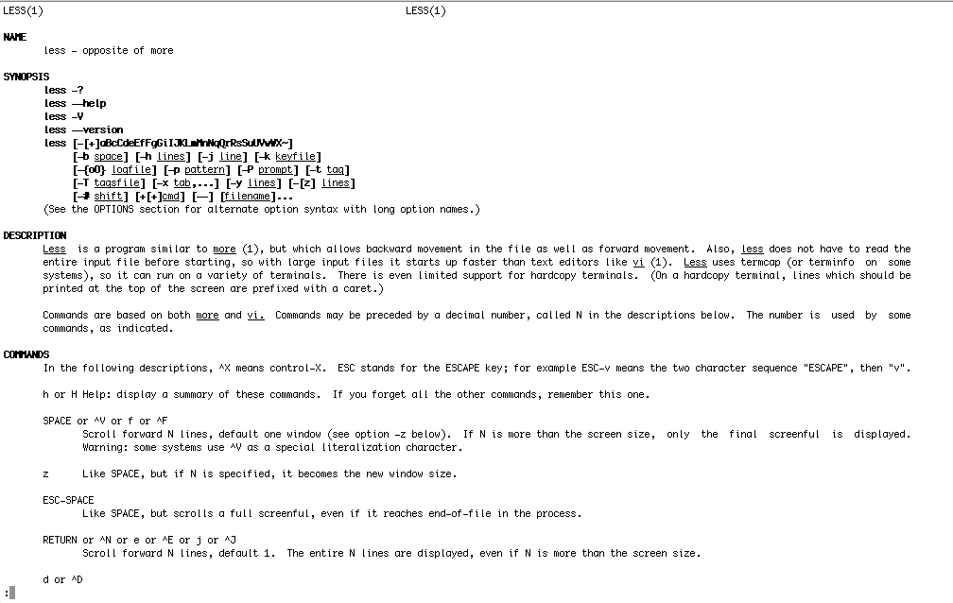
How to get help on unix commands: man command

Slide 29
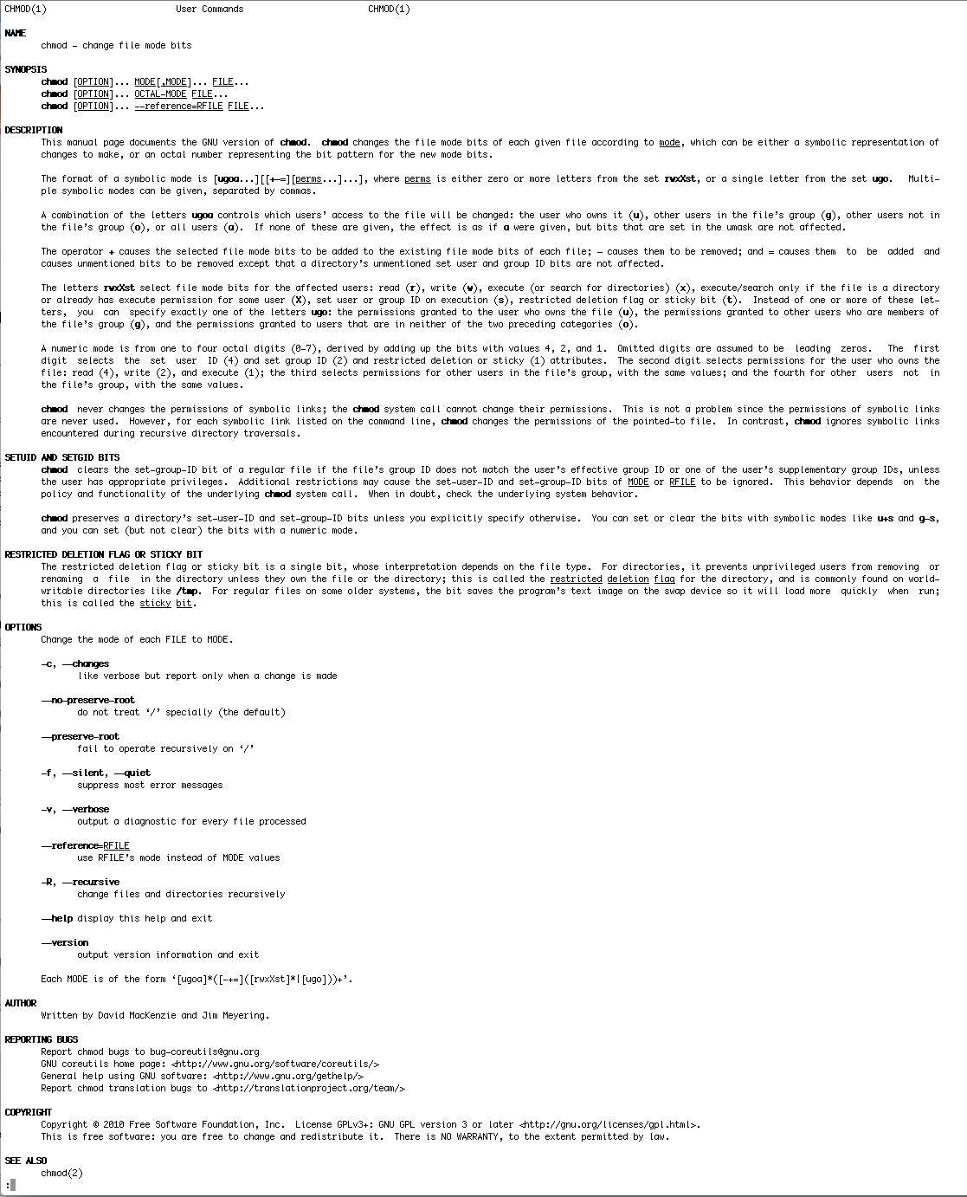
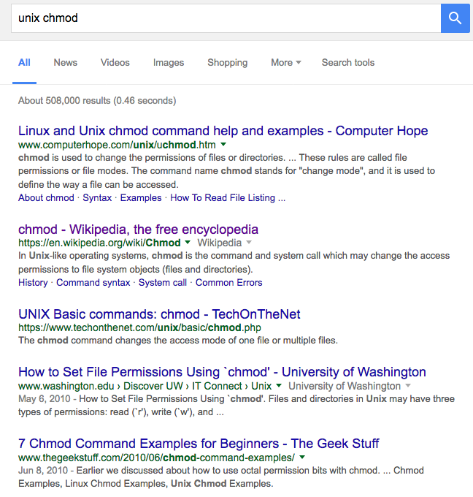
How to get help:
man command
man usually gives too much information,
google is a great alternative.

Slide 30
UNIX
Basic UNIX commands
ls, cd, chmod, cp, rm, mkdir, more (or) less, cat, ps, kill -9
A brief listing is here
chmod is a particular pain in the ... .
Under unix every file has an owner and the owner, his group and everyone else have permissions to read, write and/or execute the file (or they don’t). If you want to see which permissions are currently assigned to your files, type ls -l at the command prompt.
chmod a+x *.pl gives everyone execute permission for all files that end with .pl the * is a wildcard. (warning don't ever use rm in conjunction with *)
For more on chmod type ”man chmod” or see here.
(In the OsX GUI you can control click at a file, select info, and then change permissions). Most file transfer programs (Filezilla) allow you to use a GUI to change file permissions on a server (in filezilla: right click).

Slide 31
Unix - command line interface
If you tried to execute a command, and you made a mistake, for example, you mistyped a file name, you can recall the last command using the up arrow (down arrow for more recent).
If you are tired typing long filenames, you can use the tab key to complete the line, provided there is only one way to complete the line. E.g: cd /Desktop could be replaced by cd /D<tab>
If there are two or more choices you hear a boing, if you hit <tab> again, you get a list of choices.
If you want to become more familiar with the unix command line, the code-academy has a good introduction at
https://www.codecademy.com/courses/learn-the-command-line

Slide 32
characters at the end of lines
File tranfers from Windows to UNIX and return:
End of Line characters are a problem. Under Windows DO NOT use notepad, it does not understand UNIX newline symbols ‘\n’.
Best write your programs under UNIX using vi or vim (or any other editor you are comfortable with)
2nd best is to use a text editor like bbedit (very nice and free program for UNIX). Like vi and vim it provides context dependent coloring.
3rd best is to remove end of line symbols in a UNIX editor or use sed (Stream EDitor) after you transferred the file:
sed s/.$// name_of_WINDOWS_infile > name_of_UNIX_outfile (This replaces the last non letter character before the eol ($) with nothing)
Some versions of office allow to save files as UNIX textfiles, but ...
A related problem is encountered by Mac users. Many older text editors will use MAC carriage returns at the end of the line. Most unix programs will not be able to handle these. In a terminal window you could use the following command to convert your file:
tr ’\r' ’\n' < name_of_the_Mac_file > name_of_the_unix_file
The EoL confusion is very inconvenient, but there really is no easy solution, tough luck; and you better know about this in case something goes wrong.

Slide 33
Special characters:
\n #newline
\t #tab

Slide 34
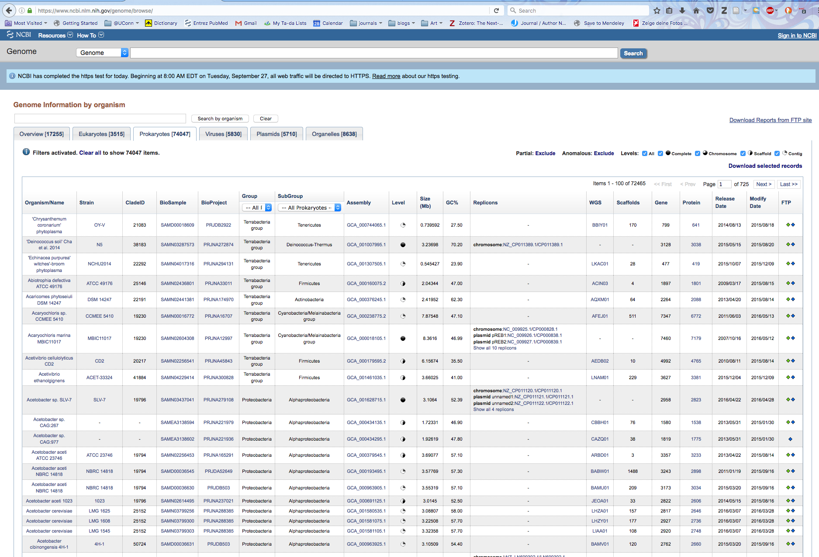
Browsing and retrieving genomes from the NCBI

Slide 35
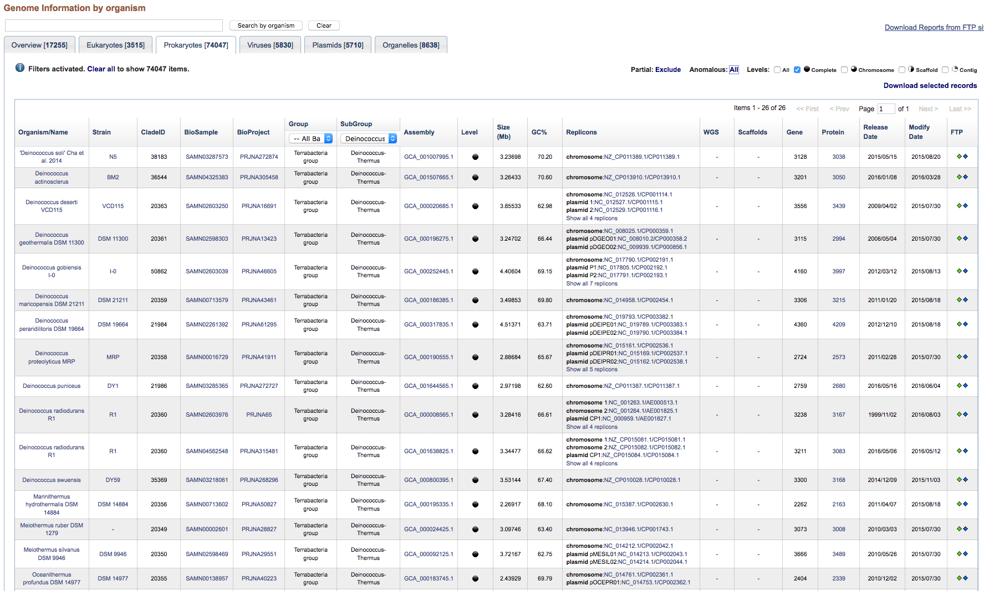
Genome browser at NCBI https://www.ncbi.nlm.nih.gov/genome/browse/

Slide 36
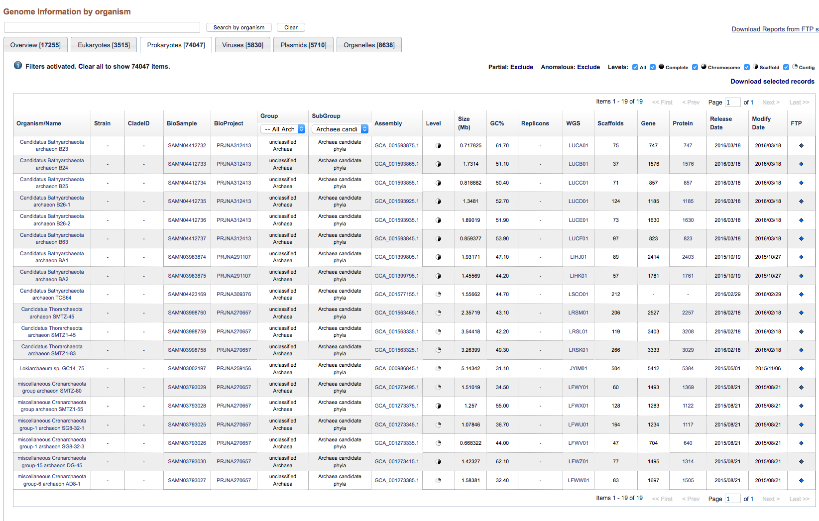

Slide 37
Formatting a custom database
Format sequence data into Fasta format
Example of Fasta format:
>sequence 1
AAATGCTTAAAAA
>sequence 2
AAATTGCTAAAAGA
Convert Fasta to Blast format by using makeblastdb program from command-line:
makeblastdb -in proteins.faa -dbtype prot -parse_seqids
(formatdb.log is a file where the results are logged from the formatting operation)
by Bob Friedman

Slide 38
Searching a custom database:
blastp -query query_protein.faa -db proteins.faa -out blast.txt -outfmt 6
-outfmt 6 specifies a tabular output format.
The default e-value cut-off is 10 (i.e. at the bottom of the list you expect about 10 false positives). To reduce the size of the output file you can set the e value cut-off to 0.0001 (you would probably not have any false positives).
You would add -evalue 0.0001 to the above command.
The output will be written to a text file called blast.txt.
The file query_protein.faa can contain one or many sequences in fasta format. If the file has more than one sequences a blast search will be done for every sequence. However, all the output goes into the same file.

Slide 39
How to get help: command -h
bash-4.2$ blastp -h
USAGE
blastp [-h] [-help] [-import_search_strategy filename]
[-export_search_strategy filename] [-task task_name] [-db database_name]
[-dbsize num_letters] [-gilist filename] [-seqidlist filename]
[-negative_gilist filename] [-negative_seqidlist filename]
[-entrez_query entrez_query] [-db_soft_mask filtering_algorithm]
[-db_hard_mask filtering_algorithm] [-subject subject_input_file]
[-subject_loc range] [-query input_file] [-out output_file]
[-evalue evalue] [-word_size int_value] [-gapopen open_penalty]
[-gapextend extend_penalty] [-qcov_hsp_perc float_value]
[-max_hsps int_value] [-xdrop_ungap float_value] [-xdrop_gap float_value]
[-xdrop_gap_final float_value] [-searchsp int_value]
[-sum_stats bool_value] [-seg SEG_options] [-soft_masking soft_masking]
[-matrix matrix_name] [-threshold float_value] [-culling_limit int_value]
[-best_hit_overhang float_value] [-best_hit_score_edge float_value]
[-window_size int_value] [-lcase_masking] [-query_loc range]
[-parse_deflines] [-outfmt format] [-show_gis]
[-num_descriptions int_value] [-num_alignments int_value]
[-line_length line_length] [-html] [-max_target_seqs num_sequences]
[-num_threads int_value] [-ungapped] [-remote] [-comp_based_stats compo]
[-use_sw_tback] [-version]
DESCRIPTION
Protein-Protein BLAST 2.7.1+
Use '-help' to print detailed descriptions of command line arguments

Slide 40
From blast –help: (goes over several pages)
*** Formatting options
-outfmt <String>
alignment view options:
0 = Pairwise,
1 = Query-anchored showing identities,
2 = Query-anchored no identities,
3 = Flat query-anchored showing identities,
4 = Flat query-anchored no identities,
5 = BLAST XML,
6 = Tabular,
7 = Tabular with comment lines,
8 = Seqalign (Text ASN.1),
9 = Seqalign (Binary ASN.1),
10 = Comma-separated values,
11 = BLAST archive (ASN.1),
12 = Seqalign (JSON),
13 = Multiple-file BLAST JSON,
14 = Multiple-file BLAST XML2,
15 = Single-file BLAST JSON,
16 = Single-file BLAST XML2,
18 = Organism Report

Slide 41
From blast –help: (continued)
Options 6, 7 and 10 can be additionally configured to produce
a custom format specified by space delimited format specifiers.
The supported format specifiers are:
qseqid means Query Seq-id
qgi means Query GI
qacc means Query accesion
qaccver means Query accesion.version
qlen means Query sequence length
sseqid means Subject Seq-id
sallseqid means All subject Seq-id(s), separated by a ';'
sgi means Subject GI
sallgi means All subject GIs
sacc means Subject accession
saccver means Subject accession.version
sallacc means All subject accessions
slen means Subject sequence length
qstart means Start of alignment in query
qend means End of alignment in query
sstart means Start of alignment in subject
send means End of alignment in subject
qseq means Aligned part of query sequence
sseq means Aligned part of subject sequence
evalue means Expect value
bitscore means Bit score
score means Raw score
length means Alignment length
pident means Percentage of identical matches
nident means Number of identical matches
mismatch means Number of mismatches
positive means Number of positive-scoring matches
gapopen means Number of gap openings
gaps means Total number of gaps
ppos means Percentage of positive-scoring matches
frames means Query and subject frames separated by a '/'
qframe means Query frame
sframe means Subject frame
btop means Blast traceback operations (BTOP)
staxid means Subject Taxonomy ID
ssciname means Subject Scientific Name
scomname means Subject Common Name
sblastname means Subject Blast Name
sskingdom means Subject Super Kingdom
staxids means unique Subject Taxonomy ID(s), separated by a ';'
(in numerical order)
sscinames means unique Subject Scientific Name(s), separated by a ';'
scomnames means unique Subject Common Name(s), separated by a ';'
sblastnames means unique Subject Blast Name(s), separated by a ';'
(in alphabetical order)
sskingdoms means unique Subject Super Kingdom(s), separated by a ';'
(in alphabetical order)
stitle means Subject Title
salltitles means All Subject Title(s), separated by a '<>'
sstrand means Subject Strand
qcovs means Query Coverage Per Subject
qcovhsp means Query Coverage Per HSP
qcovus means Query Coverage Per Unique Subject (blastn only)

Slide 42
When not provided, the default value is:
'qaccver saccver pident length mismatch gapopen qstart qend sstart send
evalue bitscore', which is equivalent to the keyword 'std'
Default = `0'
Query accession_number.version
Subject accession_number.version
% identity
Alignment length
Number of mismatches
Number of gap openings
Start of alignment in query
End of alignment in query
Start of alignment in subject
End of alignment in subject
Expect value
Bit score

Slide 43
How to get help: command -h
bash-4.2$ makeblastdb -h
USAGE
makeblastdb [-h] [-help] [-in input_file] [-input_type type]
-dbtype molecule_type [-title database_title] [-parse_seqids]
[-hash_index] [-mask_data mask_data_files] [-mask_id mask_algo_ids]
[-mask_desc mask_algo_descriptions] [-gi_mask]
[-gi_mask_name gi_based_mask_names] [-out database_name]
[-max_file_sz number_of_bytes] [-logfile File_Name] [-taxid TaxID]
[-taxid_map TaxIDMapFile] [-version]
DESCRIPTION
Application to create BLAST databases, version 2.7.1+
Use '-help' to print detailed descriptions of command line arguments

Slide 44
Default tabular output (–outfmt 6): (gene 10 from bacteriophage Zhengyi against actinophagedb)
Zhengyi 94287_EugeneKrabs_Draft_10 99.463 745 4 0 1 745 1 745 0.0 1544
Zhengyi 311157_Unphazed_10 85.542 747 106 1 1 745 1 747 0.0 1338
Zhengyi 325083_Xitlalli_Draft_10 85.906 745 103 1 3 745 4 748 0.0 1337
Zhengyi 15244_ArMaWen_10 85.542 747 106 1 1 745 1 747 0.0 1337
Zhengyi 169244_LilyLou_11 85.408 747 107 1 1 745 1 747 0.0 1335
Zhengyi 288178_Stormbreaker_Draft_10 85.638 745 105 1 3 745 4 748 0.0 1332
Zhengyi 35842_BlueRugrat_Draft_10 85.599 743 105 1 5 745 3 745 0.0 1330
Zhengyi 301381_TinyTimothy_10 84.688 738 105 2 8 745 4 733 0.0 1288
Zhengyi 319351_Wesak_10 84.553 738 106 2 8 745 4 733 0.0 1285
Zhengyi 233484_Phogo_10 81.392 747 129 4 1 745 1 739 0.0 1245
Zhengyi 5978_Alex44_10 81.258 747 130 4 1 745 1 739 0.0 1243
Zhengyi 219502_Pabst_Draft_11 75.963 753 165 7 3 745 4 750 0.0 1155
Zhengyi 5386_Akoni_10 60.881 772 242 11 5 745 7 749 0.0 889
Zhengyi 16330_Ashton_10 60.881 772 242 11 5 745 7 749 0.0 889
Zhengyi 6996_AloeVera_Draft_10 61.061 773 239 12 5 745 4 746 0.0 889
Zhengyi 307288_Truong_10 60.931 773 240 12 5 745 7 749 0.0 887
Zhengyi 97649_Fede_Draft_10 61.282 749 269 13 5 745 4 739 0.0 879
Zhengyi 17656_Atraxi_Draft_10 60.610 754 261 12 5 745 4 734 0.0 874
Zhengyi 184880_Mazun_Draft_10 60.898 757 248 15 7 745 6 732 0.0 870
Zhengyi 234940_PhriedRice_10 60.956 753 254 13 7 745 6 732 0.0 867
Zhengyi 234112_Phractured_10 60.956 753 254 13 7 745 6 732 0.0 867
Zhengyi 229391_Phedro_10 60.956 753 254 13 7 745 6 732 0.0 867
Zhengyi 228522_Pharky_10 60.956 753 254 13 7 745 6 732 0.0 867
Zhengyi 14465_Arete_11 37.517 757 416 19 3 745 13 726 1.30e-133 414
Zhengyi 45652_Burro_10 37.813 759 403 21 7 745 15 724 3.58e-130 405
Zhengyi 13154_Araxxi_10 36.842 760 413 21 5 745 14 725 2.12e-124 390
Zhengyi 307086_Troy_42 26.267 750 406 35 6 721 2 638 1.45e-33 139
Zhengyi 265199_SamW_42 26.267 750 406 35 6 721 2 638 1.45e-33 139
Zhengyi 164472_Lederberg_42 26.267 750 406 35 6 721 2 638 1.45e-33 139
Often looks strange, because some entries run into the next tab – making the font smaller, or loading it into excel helps.

Slide 45
Default tabular output (–outfmt 7): gene all proteins in Hfx. volcanii genome against a nanohaloarchaeal genome (strain SG9)
# Query: WP_004040797.1 hypothetical protein [Haloferax volcanii]
# Database: SG9.faa
# Fields: query acc.ver, subject acc.ver, % identity, alignment length, mismatches, gap opens, q. start, q. end, s. start, s. end, evalue, bit score
# 11 hits found
WP_004040797.1 AOV94602.1 45.000 20 11 0 66 85 1240 1259 0.14 26.6
WP_004040797.1 AOV95267.1 27.273 66 38 3 25 84 354 415 0.37 25.4
WP_004040797.1 AOV94348.1 50.000 14 7 0 104 117 44 57 2.8 22.7
WP_004040797.1 AOV94453.1 25.000 60 43 1 57 116 352 409 3.2 22.7
WP_004040797.1 AOV94962.1 27.869 61 42 2 15 73 547 607 3.2 22.3
WP_004040797.1 AOV94961.1 20.909 110 75 3 10 117 8 107 4.0 21.9
WP_004040797.1 AOV94654.1 66.667 15 5 0 82 96 314 328 6.7 21.6
WP_004040797.1 AOV94708.1 37.500 24 15 0 62 85 8 31 6.9 21.6
WP_004040797.1 AOV94738.1 41.935 31 18 0 30 60 487 517 7.9 21.2
WP_004040797.1 AOV94984.1 37.143 35 20 1 27 59 722 756 8.7 21.2
WP_004040797.1 AOV94472.1 28.235 85 57 1 6 86 142 226 9.4 21.2
# BLASTP 2.7.1+
# Query: WP_004040798.1 hypothetical protein [Haloferax volcanii]
# Database: SG9.faa
# Fields: query acc.ver, subject acc.ver, % identity, alignment length, mismatches, gap opens, q. start, q. end, s. start, s. end, evalue, bit score
# 2 hits found
WP_004040798.1 AOV95137.1 28.889 45 32 0 7 51 15 59 0.23 25.8
WP_004040798.1 AOV95296.1 50.000 14 7 0 125 138 243 256 6.7 22.3
# BLASTP 2.7.1+
# Query: WP_004040800.1 hypothetical protein [Haloferax volcanii]
# Database: SG9.faa
# Fields: query acc.ver, subject acc.ver, % identity, alignment length, mismatches, gap opens, q. start, q. end, s. start, s. end, evalue, bit score
# 13 hits found
WP_004040800.1 AOV94411.1 30.645 62 42 1 247 307 18 79 0.83 26.2
...
Continues for all ~4000 genes in the Haloferax volcanii genome.

Slide 46
To move files between local PC and server:
For windows machines:
install Filezilla client for transfer and putty as terminal.
For Macintosh computers:
install Filezilla (client!) from https://filezilla-project.org/
Filezilla also allows you to change file permissions and to create new directories.
To establish a command line connection via ssh (secure shell):
For windows machines:
Use PuTTY to establish an ssh connection
There are more user-friendly programs (e.g., Bitvise SSH Client); however, UConn’s bioinformatics cluster Xanadu uses different nodes for file transfer and ssh connections, thus the programs with more bells and whistles that assume the same address for both don’t help much, and mainly create confusion.
For Macintosh computers:
Use the terminal program that is part of the operating system (in the Applications/Utilities folder)

