Slide 1
Notebooks are due Friday!
Take home exam is due on Friday!
Midterm is next Wednesday 11.15am in TLS 301
(in class, closed book)

Slide 2
MCB 3423 – class 11
Strand bias
Gene plots
Origin of replication
cumulative GC skew
Architecture imparting sequences

Slide 3
GCBias in a window (G-C/(G+C))

Slide 4
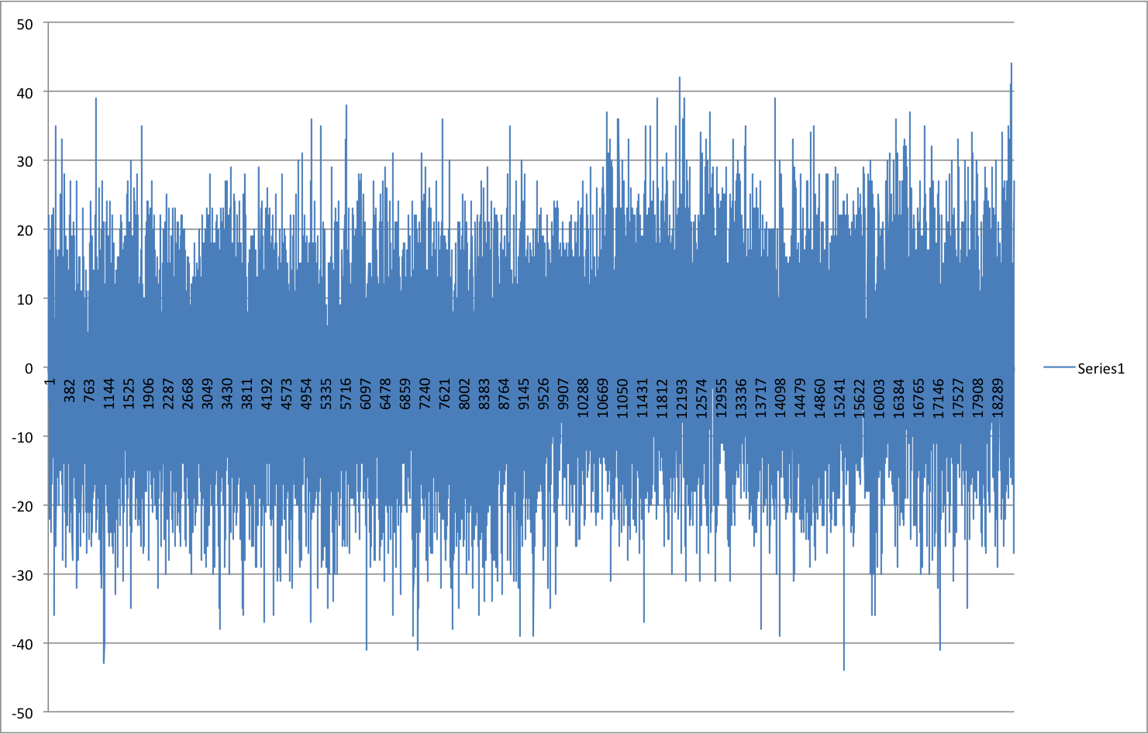
Window=100 , printed every 100

Slide 5
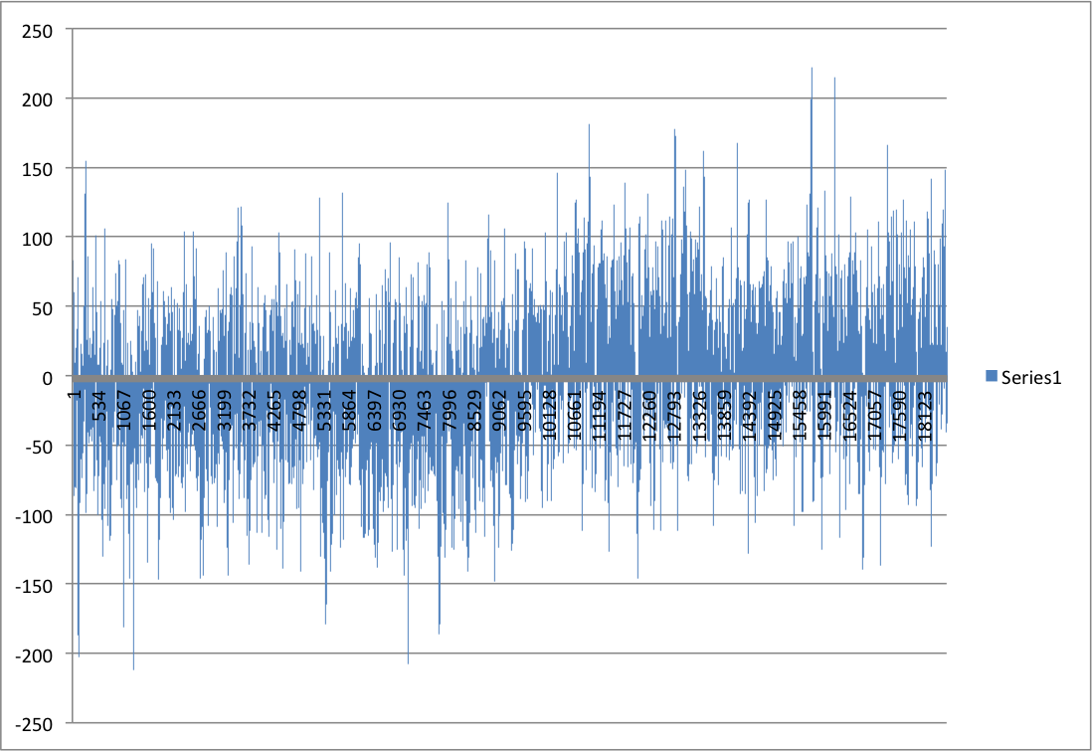
Window=1000 , printed every 100

Slide 6
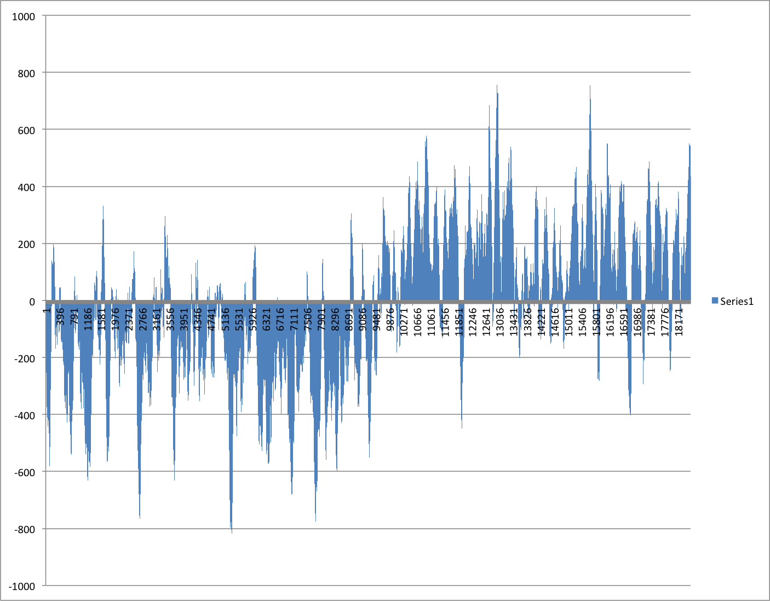
Window=10000 , printed every 100

Slide 7
Cumulative GCSkew
SUM(C-G) measured along the genome from the Origen of Replication (ORI)

Slide 8
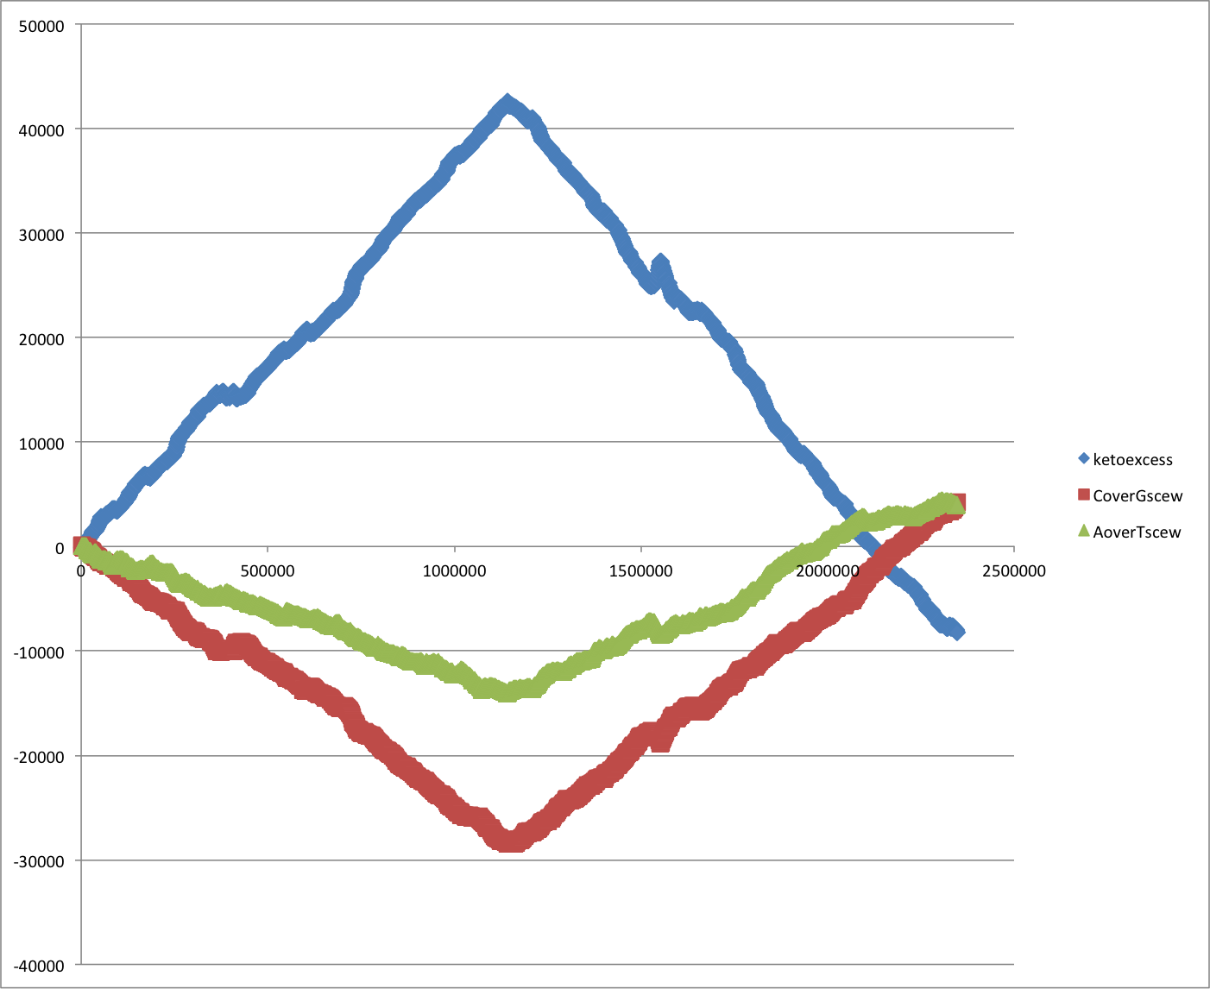
Cumulative Strand Bias in Thermus themophilus SG0

Slide 9
Types of Nucleobases
Symbol^{[17]} | Description | Bases represented
A | adenine | A |  |  |  | 1
C | cytosine |  | C
G | guanine |  |  | G
T | thymine |  |  |  | T
U | uracil |  |  |  | U
W | weak | A |  |  | T | 2
S | strong |  | C | G
M | amino | A | C
K | keto |  |  | G | T
R | purine | A |  | G
Y | pyrimidine |  | C |  | T
B | not A (B comes after A) |  | C | G | T | 3
D | not C (D comes after C) | A |  | G | T
H | not G (H comes after G) | A | C |  | T
V | not T (V comes after T and U) | A | C | G
N | any base (not a gap) | A | C | G | T | 4
From: https://en.wikipedia.org/wiki/Nucleotide

Slide 10
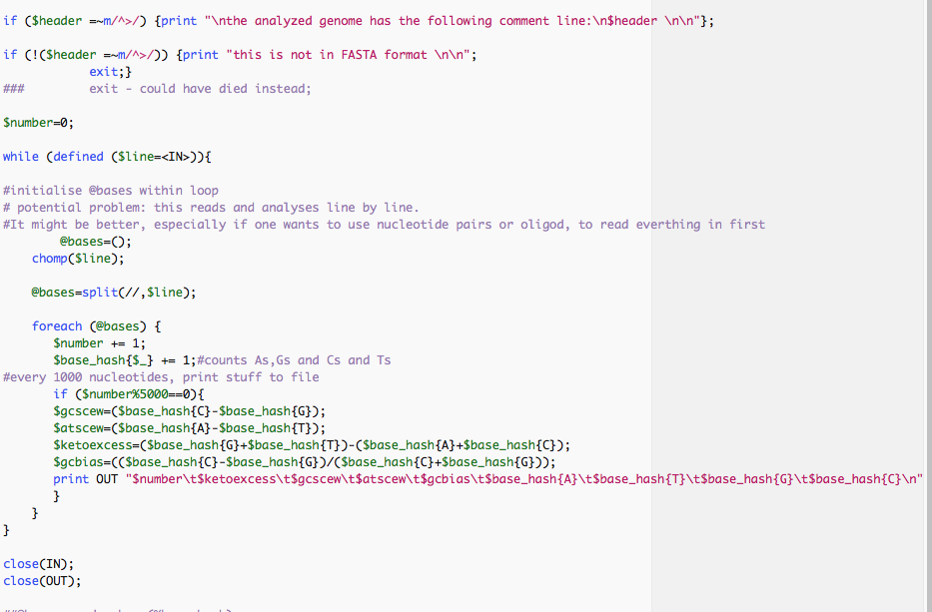
Part of script to calculate cumulative GC bias
Hashes are cool ☺

Slide 11
Cumulative Tetramer bias for Thermus thermophilus SG0
The same can be done with oligonucleotide bias (how often does an oligonucleotide occur on one strand minus occurrence on the other strand)

Slide 12
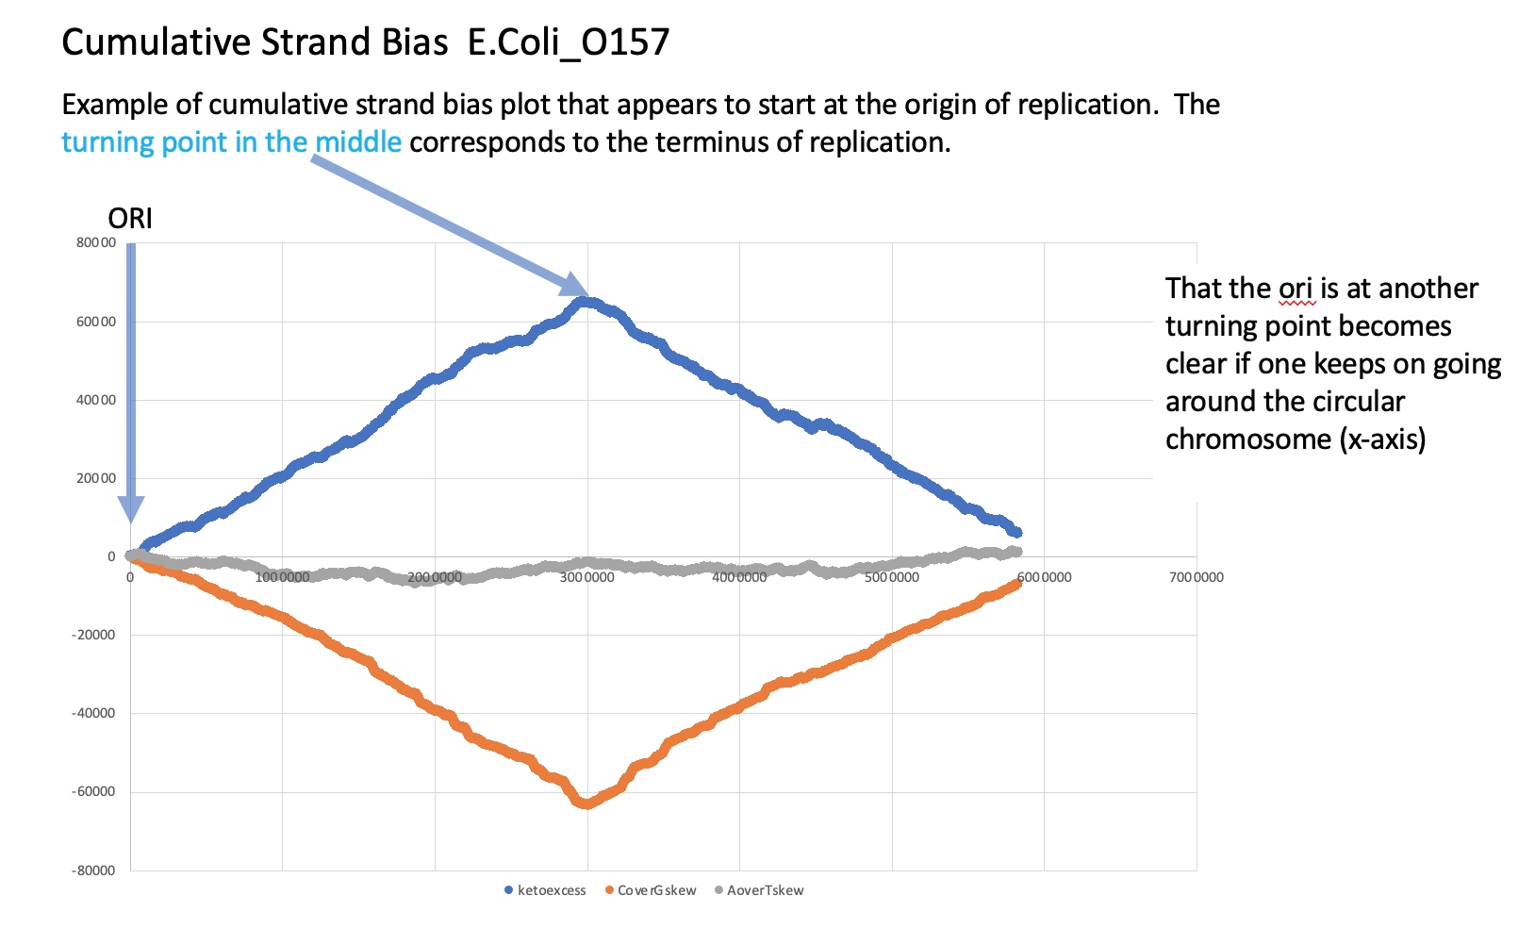

Slide 13
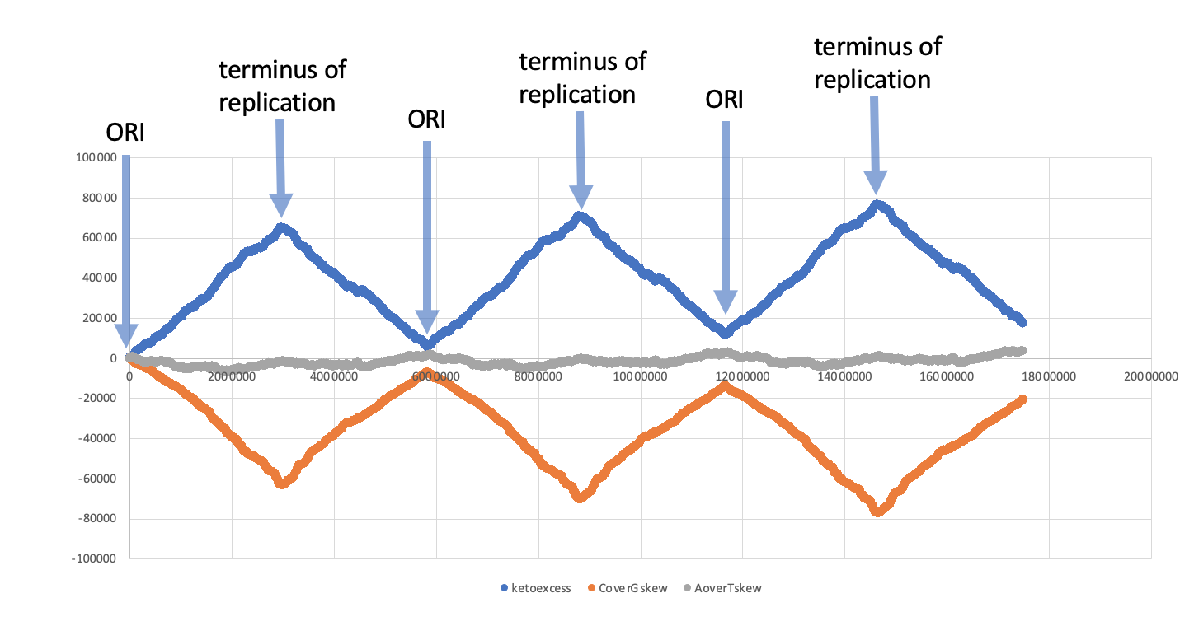
Cumulative Strand Bias E.Coli_O157 – going around the chromosome 3 times

Slide 14
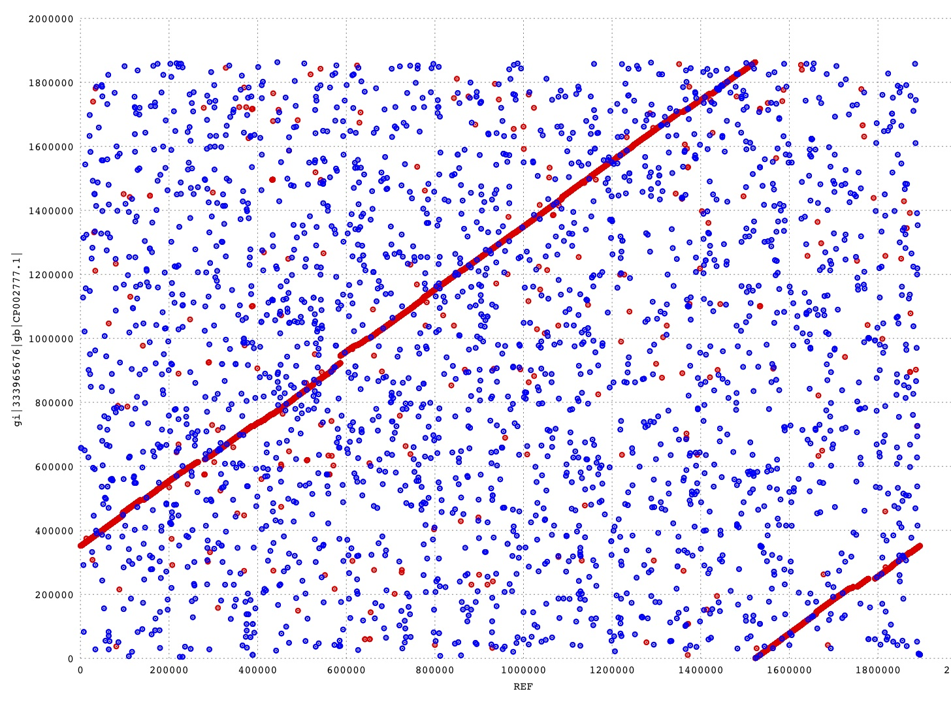
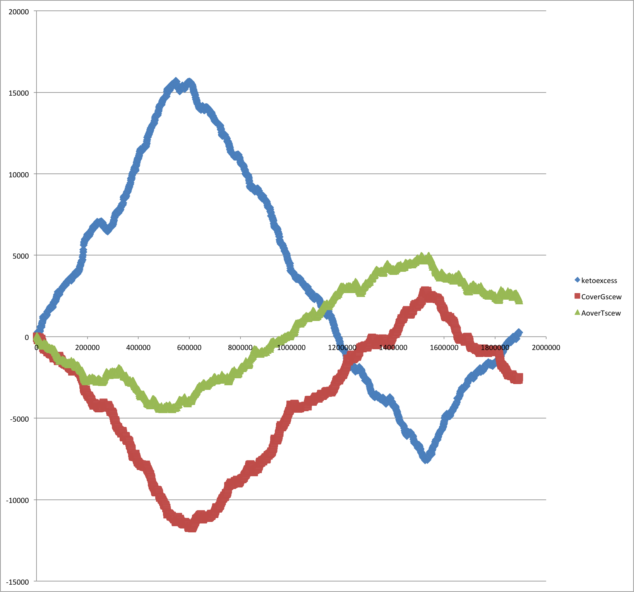
“Usually”, files of bacterial genomes start with the origin of replication, and the direction is chosen so that the first encoded protein is DnaA (chromosomal replication initiator protein). Sometimes things go wrong, or unspoken rules are ignored.
Cumulative Strand Bias HB27
Mummer Plot: HB27 versus SG0

Slide 15
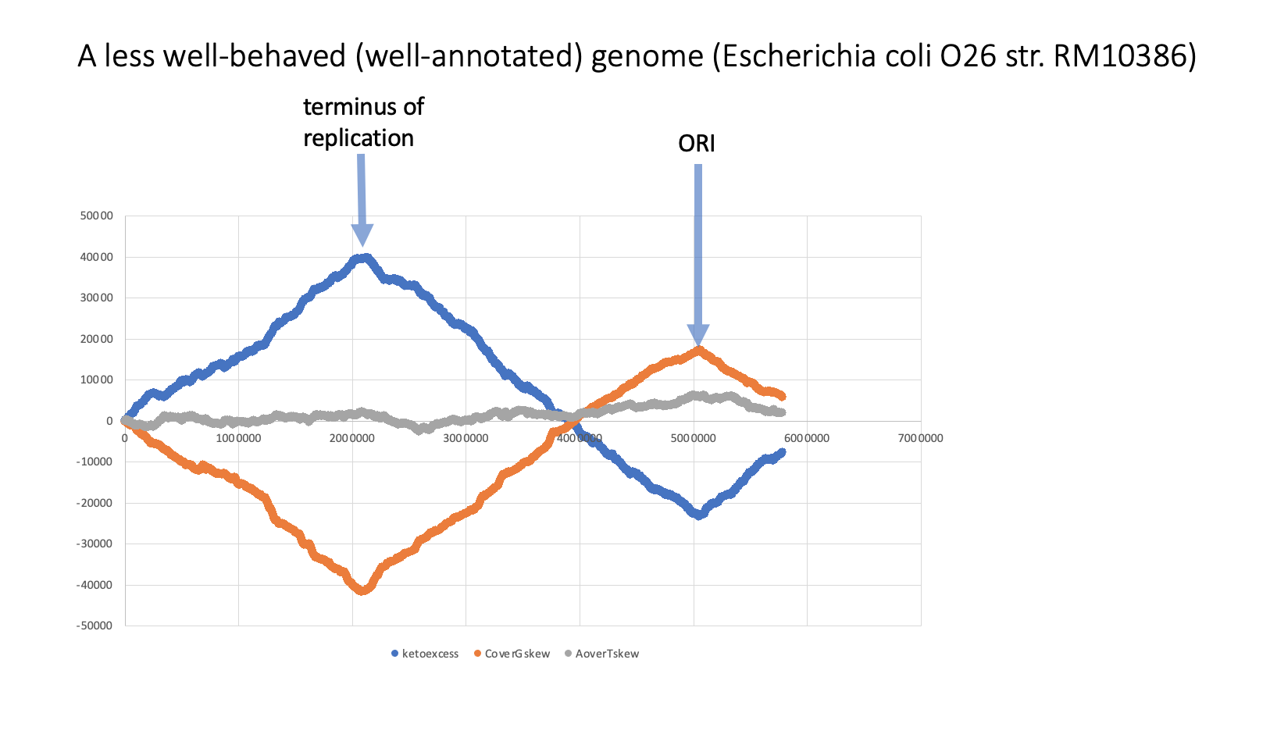

Slide 16
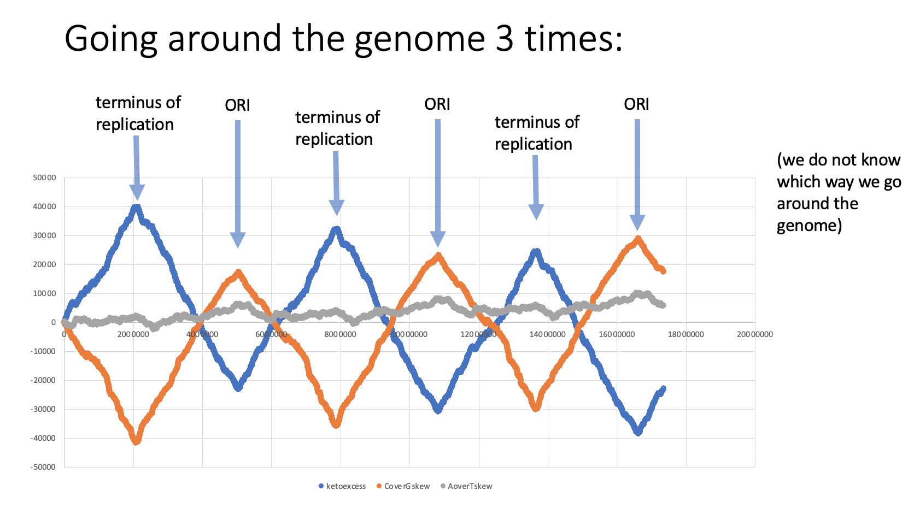

Slide 17
CDS GCA_003112225.1 Primary Assembly chromosome CP028126.1 5006615 5008018 - AWJ57195.1 chromosomal replication initiator protein DnaA I3U_28625 1404 467
Note: if DnaA is encoded on the plus or the minus strand.
(gepard and mummer compare both strands, but this helps to get the direction right)

Slide 18
From Feature table of
Aeromonas caviae R25-6
CDS with_protein GCF_003294855.1
Primary Assembly chromosome
NZ_CP025705.1 1355282 1356652 +
WP_039040645.1 WP_039040645.1
chromosomal replication initiator protein DnaA
C1C92_RS06430 1371 456

Slide 19
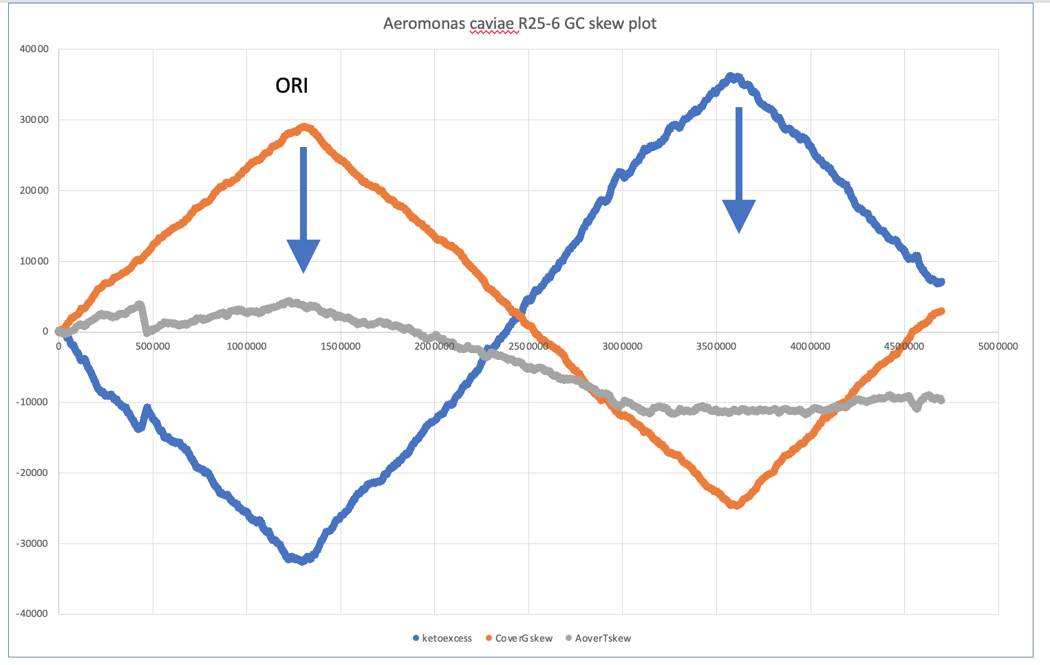
ORI

Slide 20
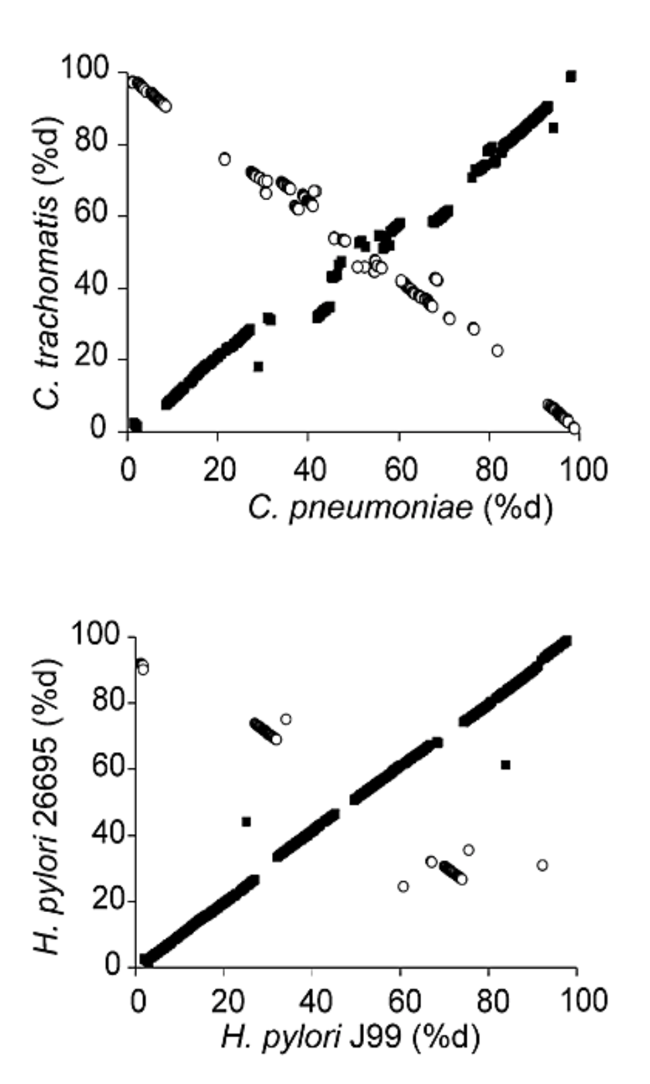
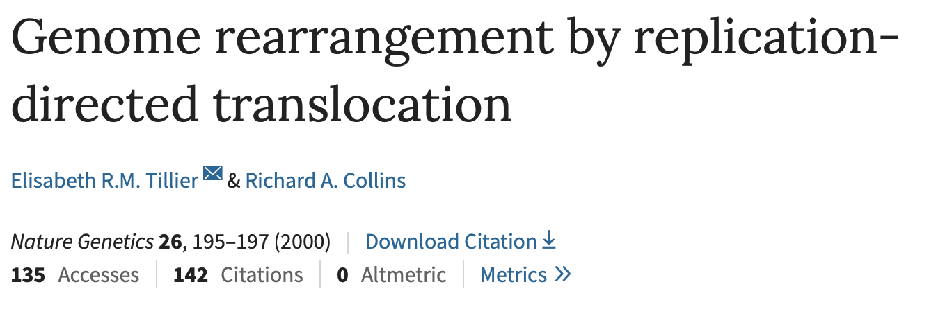
From:

Slide 21
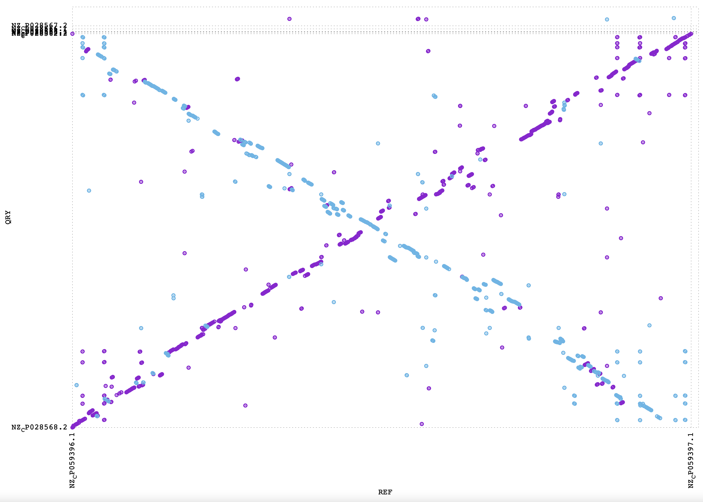
A. hydophila WCHAH045096
Aeromonas veronii HM21

Slide 22
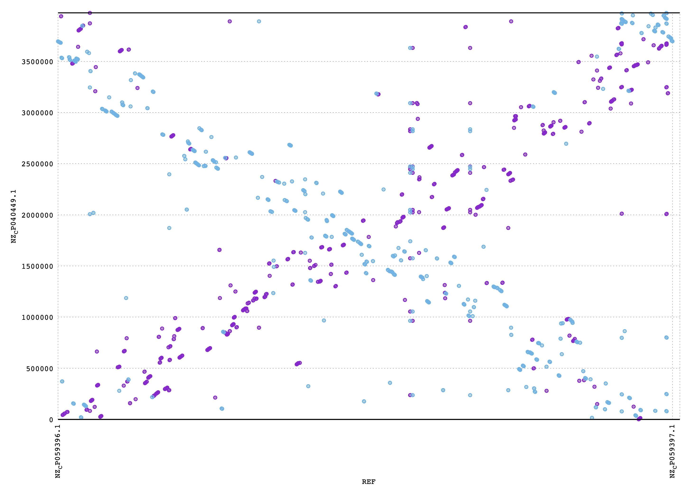
Aeromonas simiae A6
Aeromonas veronii HM21

Slide 23
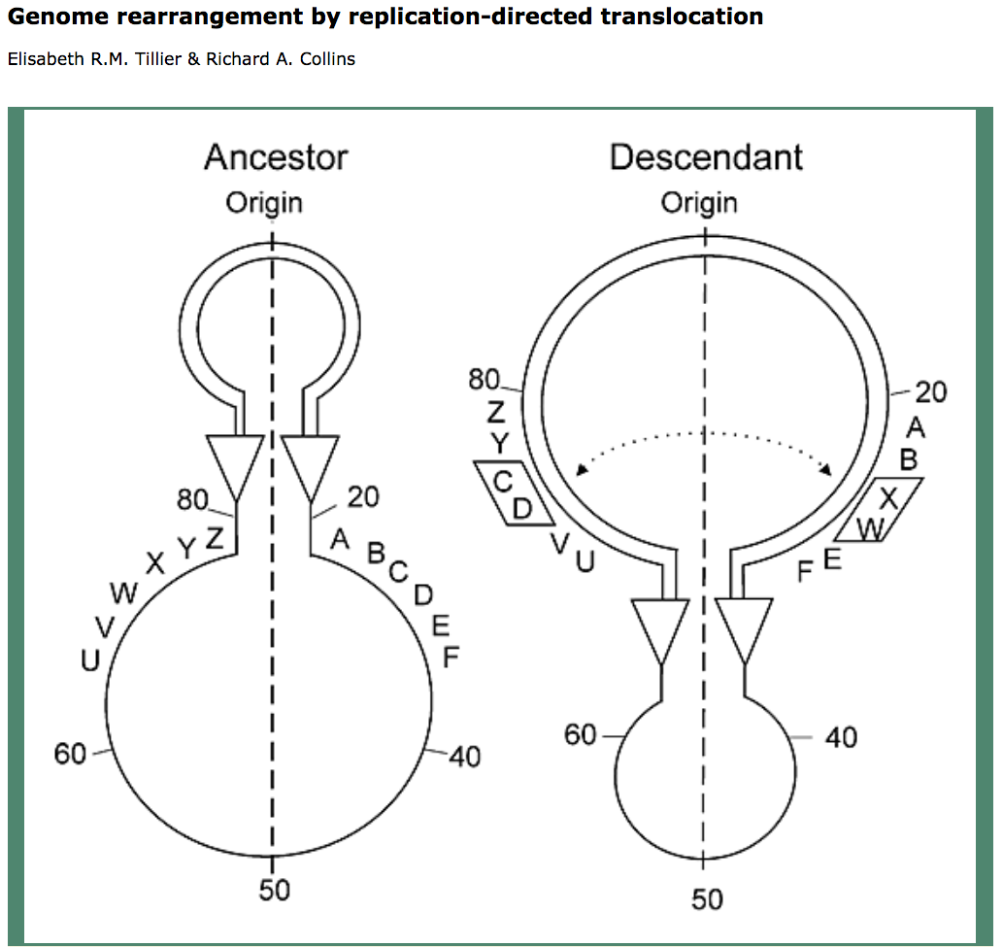
Two Reasons for Recombination Patterns in Microbial genomes:
A) Recombination events occur at the time of replication
Figure 2. Rearrangement of gene order by translocation of genes across the replication axis.
A hypothetical ancestral gene order is indicated (left). After passage of the replication forks (triangles), genes C and D have exchanged positions with W and X by translocation across the replication axis (vertical dashed line) in the descendant genome. For simplicity, the diagram shows a reciprocal translocation that might occur in a single round of replication through two reciprocal recombination events. The diagram does not specify a mechanism for the translocation of genes, which may also occur in several steps as a series of recombination events in separate rounds of replication through intermediate genome organizations. The two replication forks are proposed to be across the replication axis and physically close together, promoting translocation of sequences at the forks. Numbers indicate the percentage of distance from the origin.

Slide 24
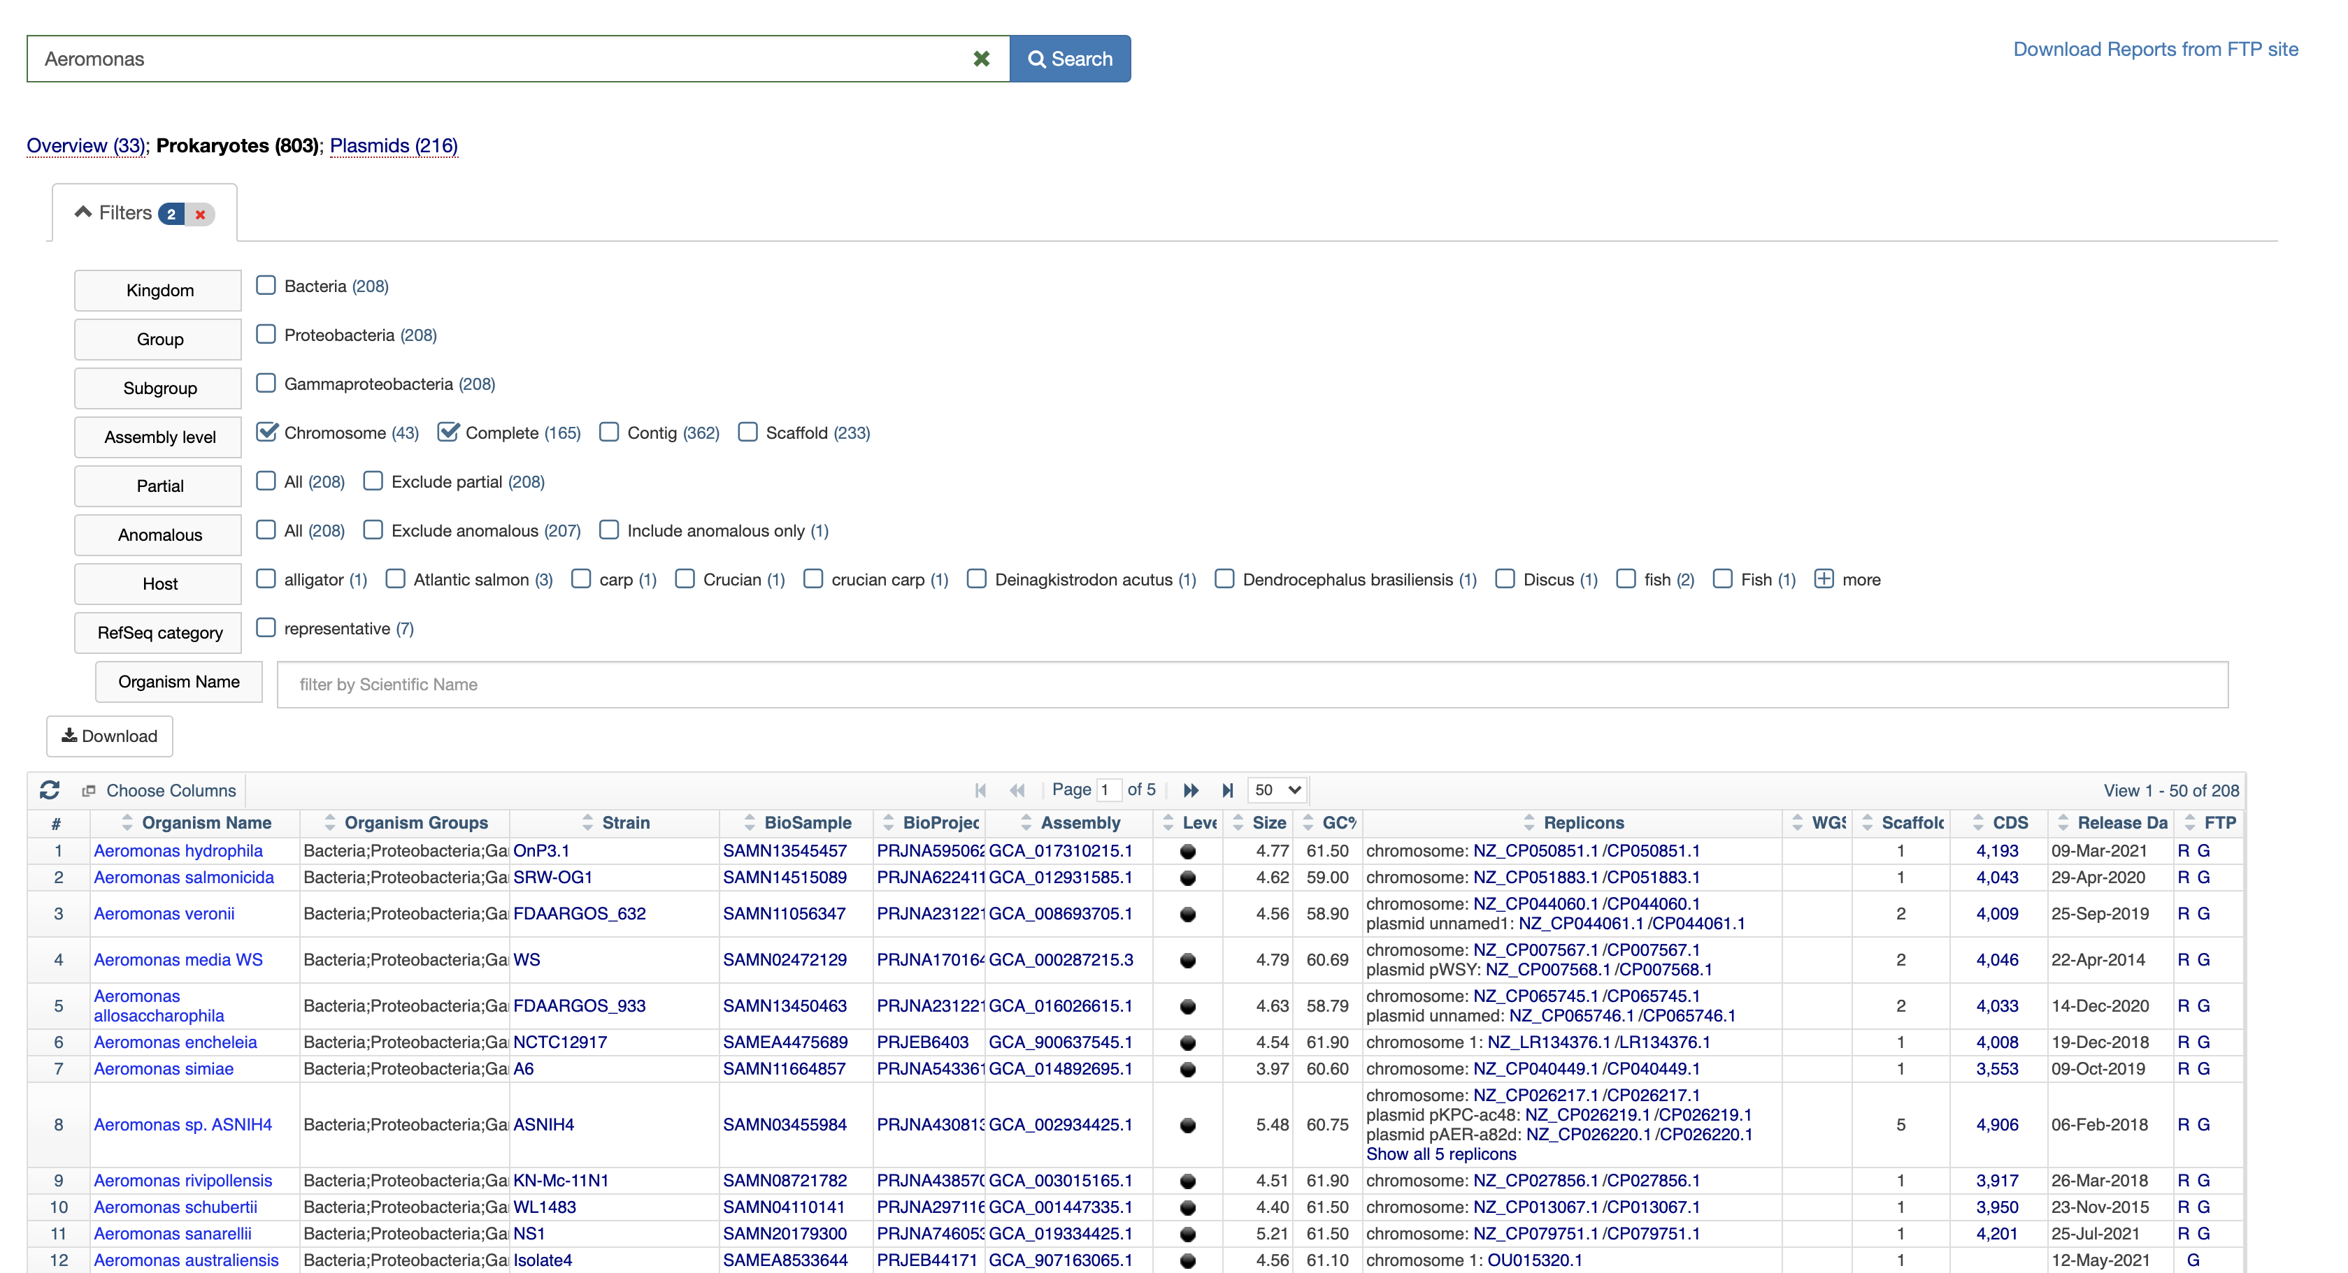
Many genomes are available at the NCBI https://www.ncbi.nlm.nih.gov/genome/browse#!/overview/

Slide 25
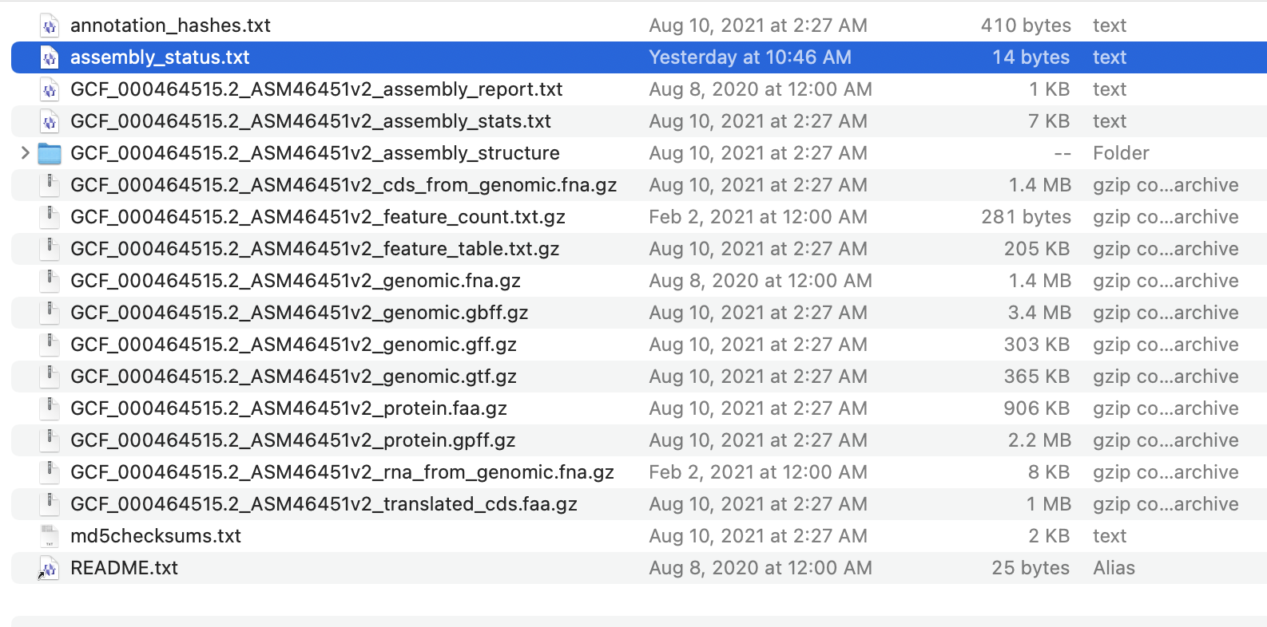
You can open the link in finder, or an FTP program (use guest)
All coding sequences
Genome feature table
The nucleotide sequence
All encoded proteins

Slide 26
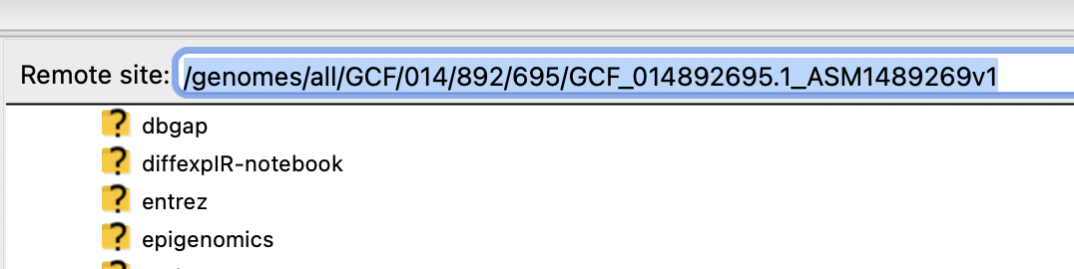
There are different ways to download the files:
via the finder (under OS X) Open Finder under “Go” select Serer > copy paste the link under “R”, in the window that opens select anonymous.
Using Filezilla: Connect to ftp.ncbi.nlm.nih.gov login type anonymous. Then copy the R link (right click) from the microbial
browser and paste it into the address field – delete everything before genome:
C) ssh to Xanadu, go to a compute node, and the use the copy url command.
To get the address, copy the R link (right click) to the clipboard, paste it behind curl -O
E.g., curl -O ftp://ftp.ncbi.nlm.nih.gov/genomes/all/GCF/002/850/695/GCF_002850695.3_ASM285069v3/
Then complete the line with
GCF_002850695.3_ASM285069v3_protein.faa.gz (for all the encoded proteins in a multiple fasta file
GCF_002850695.3_ASM285069v3_genomic.fna.gz (for the nucleotide sequence of genome +plasmids
GCF_002850695.3_ASM285069v3_feature_table.txt.gz (for the feature table)
The commands to execute would be
curl -O ftp://ftp.ncbi.nlm.nih.gov/genomes/all/GCF/002/850/695/GCF_002850695.3_ASM285069v3/GCF_002850695.3_ASM285069v3_protein.faa.gz
curl -O ftp://ftp.ncbi.nlm.nih.gov/genomes/all/GCF/002/850/695/GCF_002850695.3_ASM285069v3/GCF_002850695.3_ASM285069v3_genomic.fna.gz
curl -O ftp://ftp.ncbi.nlm.nih.gov/genomes/all/GCF/002/850/695/GCF_002850695.3_ASM285069v3/GCF_002850695.3_ASM285069v3_feature_table.txt.gz
Once you have the files you need to uncompress them using
gunzip GCF_002850695.3_ASM285069v3_protein.faa.gz or using a wild card gunzip *.gz

Slide 27
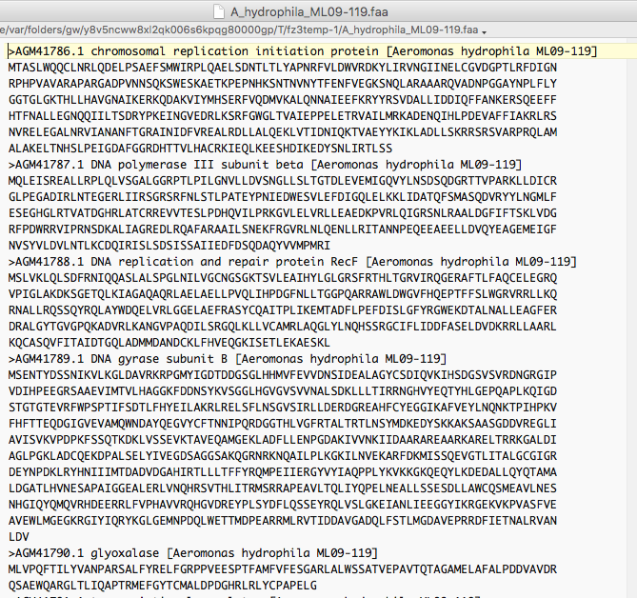
Typical multiple sequence fasta file

Slide 28
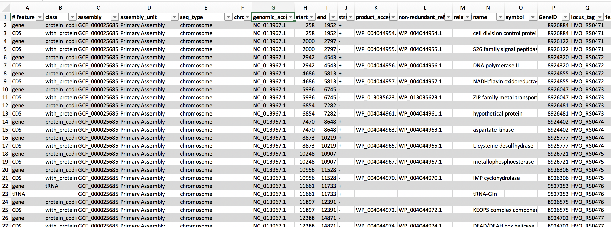
Feature table

Slide 29
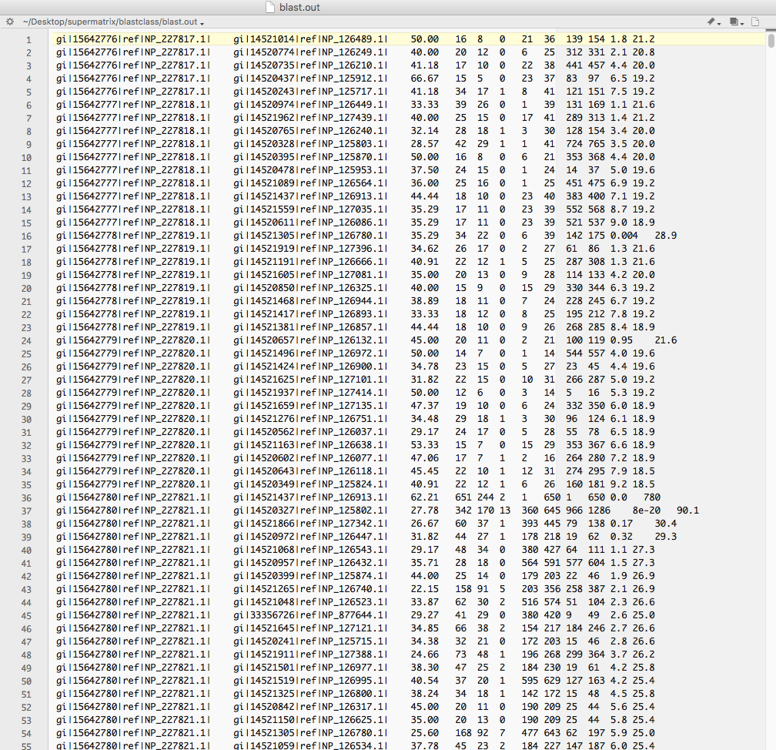
Blast output in tabular form looks like this

Slide 30
There are several different approaches to map a best scoring blast hits to a location in the genome.
One approach is to link databank tables.
A simple alternative is to reannotate the annotation lines so that they start with the location in the genome.

Slide 31
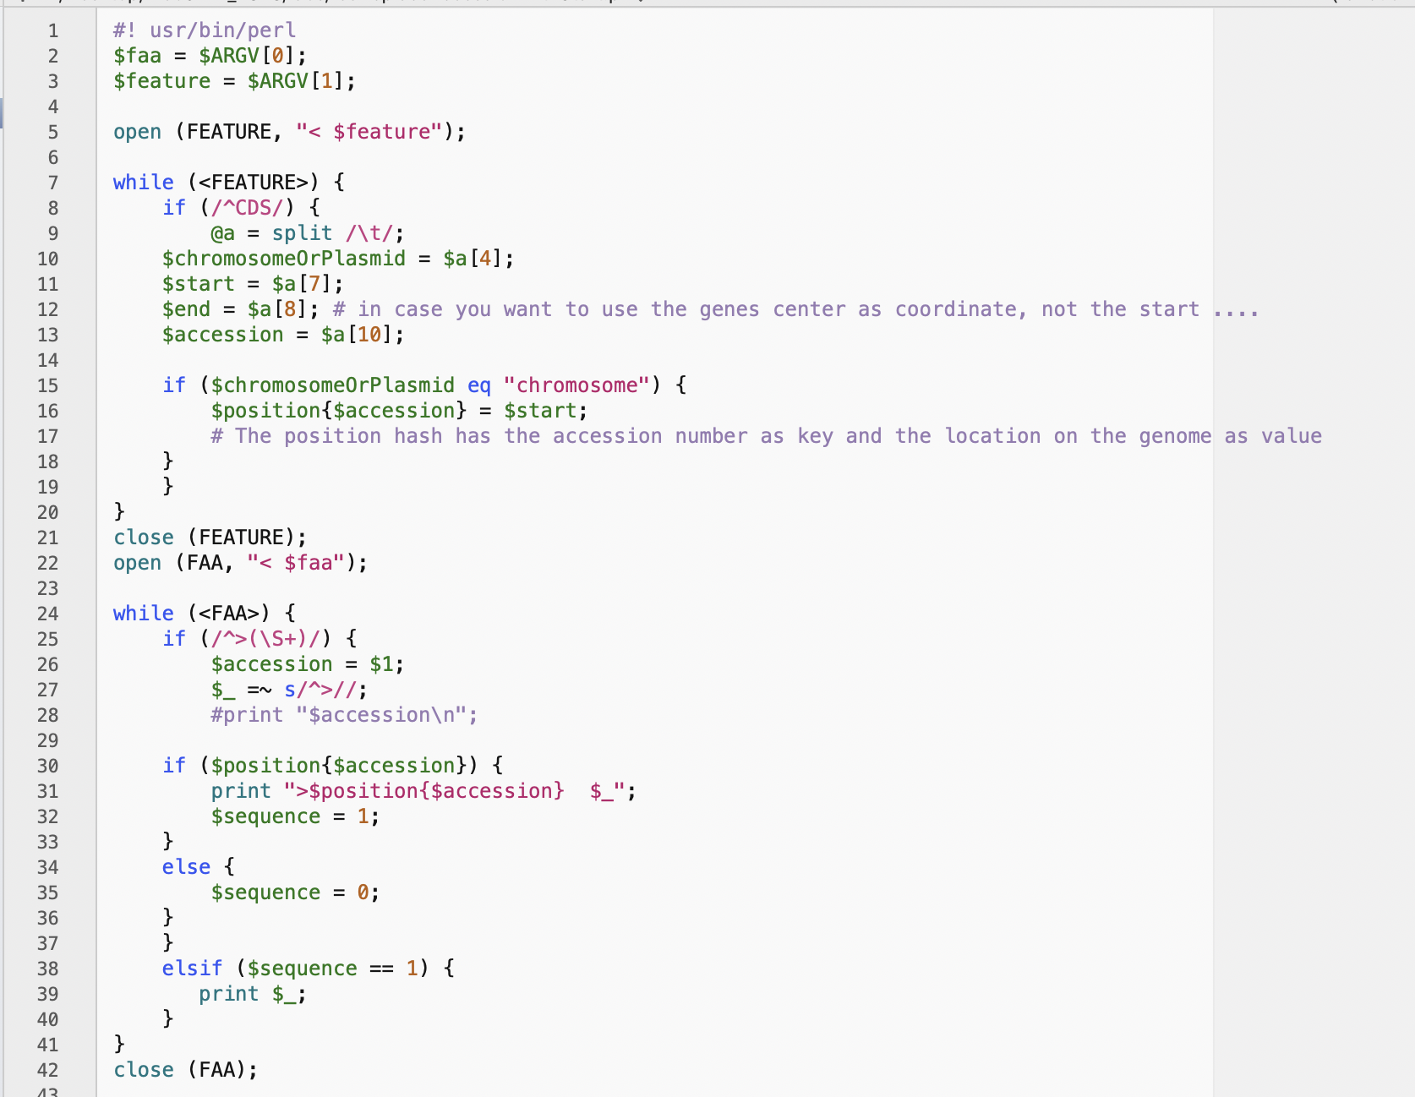
faaReplace AccessionWithStart.pl

Slide 32
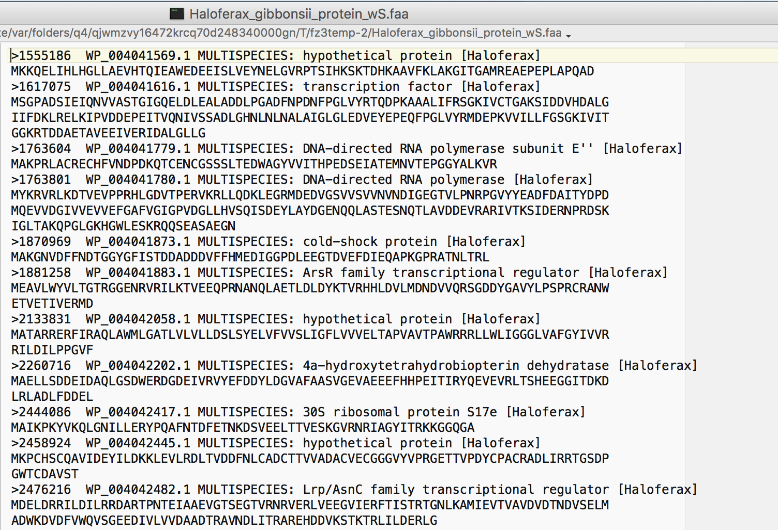
Genome fasta file with location in genome

Slide 33
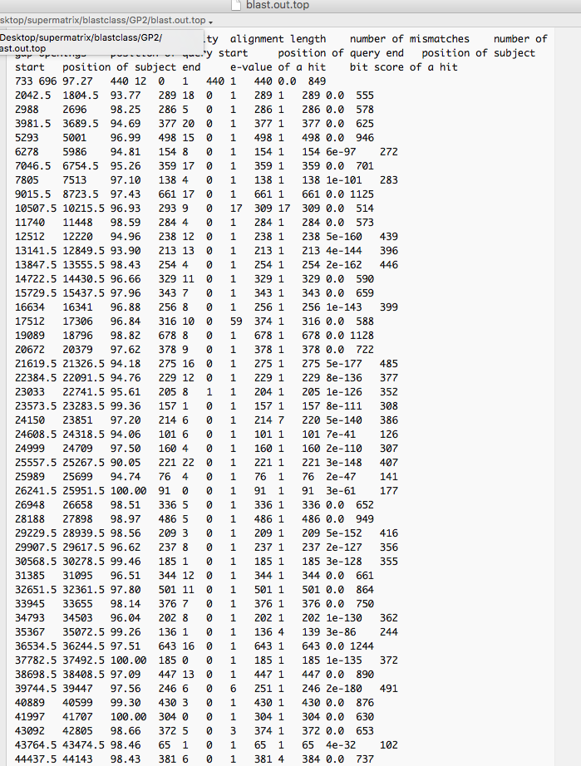
Top scoring hits only
GI replaced with number

Slide 34
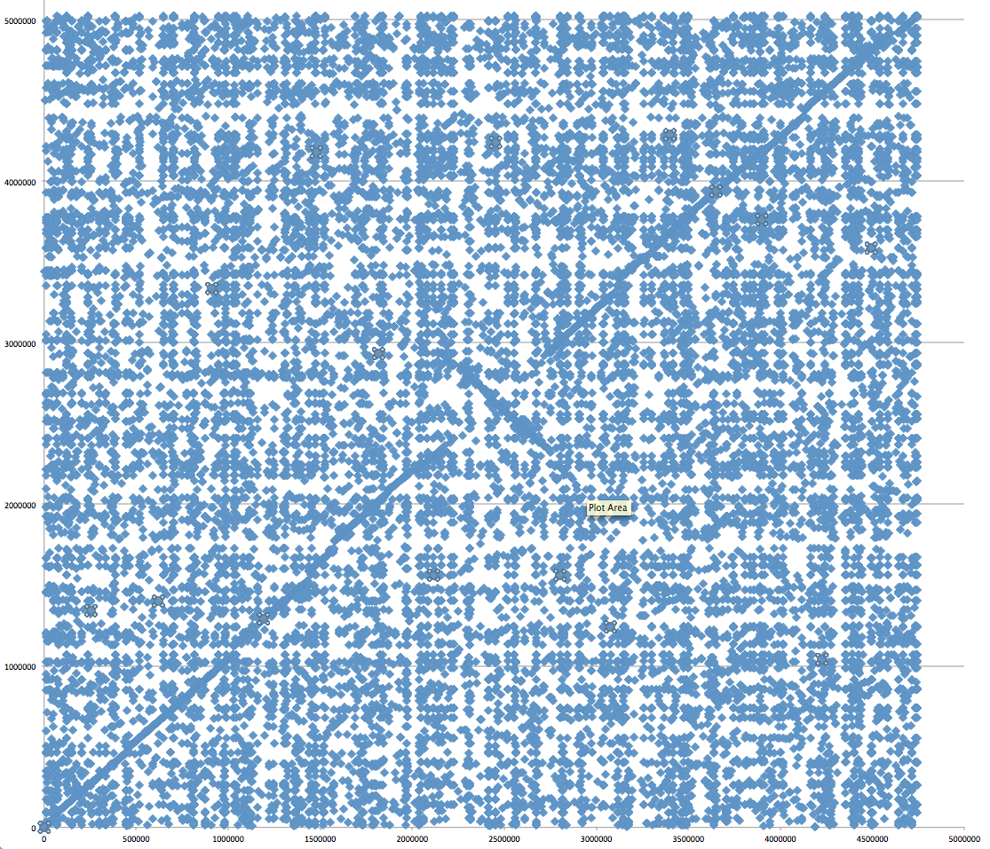
Aeromonas_hydrophila_ATCC_7966_uid58617 versus Aeromonas_hydrophila_ML09_119_uid205540/
Evalue cut off: 10^-4
To only plot the top scoring hits use extract_lines.pl -->

Slide 35
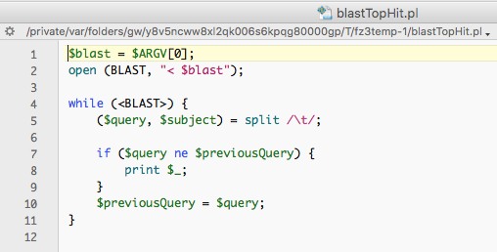

Slide 36
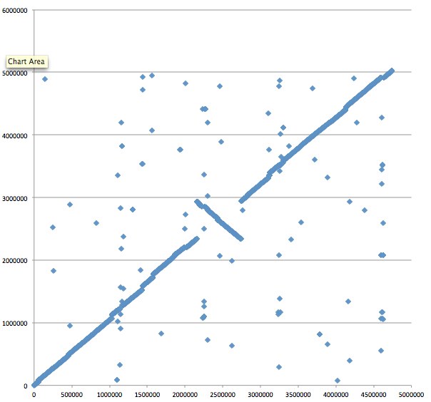
Aeromonas_hydrophila_ATCC_7966_uid58617 versus Aeromonas_hydrophila_ML09_119_uid205540/
E-value cut off: 10^-4
Top-scoring hits only

Slide 37
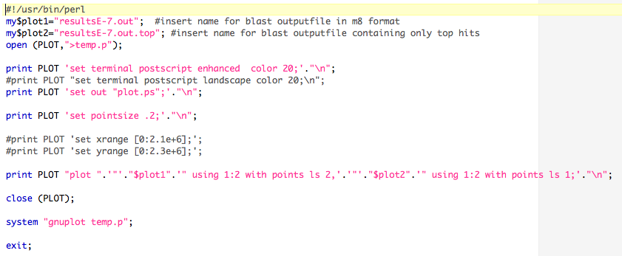
Plot blast.out and blast.out.top

Slide 38
Aeromonas_hydrophila_ATCC_7966_uid58617 versus Aeromonas_hydrophila_ML09_119_uid205540/
Same with Gnuplot

Slide 39
Aeromonas_hydrophila_ML09_119_uid205540 versus Aeromonas_salmonicida A449
Notes:
About 26 recombination events equidistant to the ORI

Slide 40
Aeromonas_veronii B565 versus Aeromonas_hydrophila_ML09_119_uid205540

Slide 41
Two Reasons for Recombination Patterns in Microbial genomes:
A) Recombination events occur at the time of replication
Figure 2. Rearrangement of gene order by translocation of genes across the replication axis.
A hypothetical ancestral gene order is indicated (left). After passage of the replication forks (triangles), genes C and D have exchanged positions with W and X by translocation across the replication axis (vertical dashed line) in the descendant genome. For simplicity, the diagram shows a reciprocal translocation that might occur in a single round of replication through two reciprocal recombination events. The diagram does not specify a mechanism for the translocation of genes, which may also occur in several steps as a series of recombination events in separate rounds of replication through intermediate genome organizations. The two replication forks are proposed to be across the replication axis and physically close together, promoting translocation of sequences at the forks. Numbers indicate the percentage of distance from the origin.

Slide 42
From:

Slide 43
Two Reasons for Recombination Patterns in Microbial genomes:
B) Recombination events that do not occur in a symmetric fashion between the two arms result in misplaced Genome Architecture IMparting Sequences (AIMS)
dnaA boxes
one way signals for the replication fork, ter sites , tus binding

Slide 44
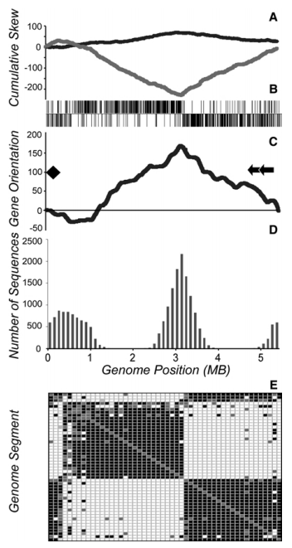
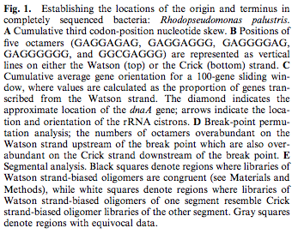
Selection for Chromosome Architecture in Bacteria

Slide 45
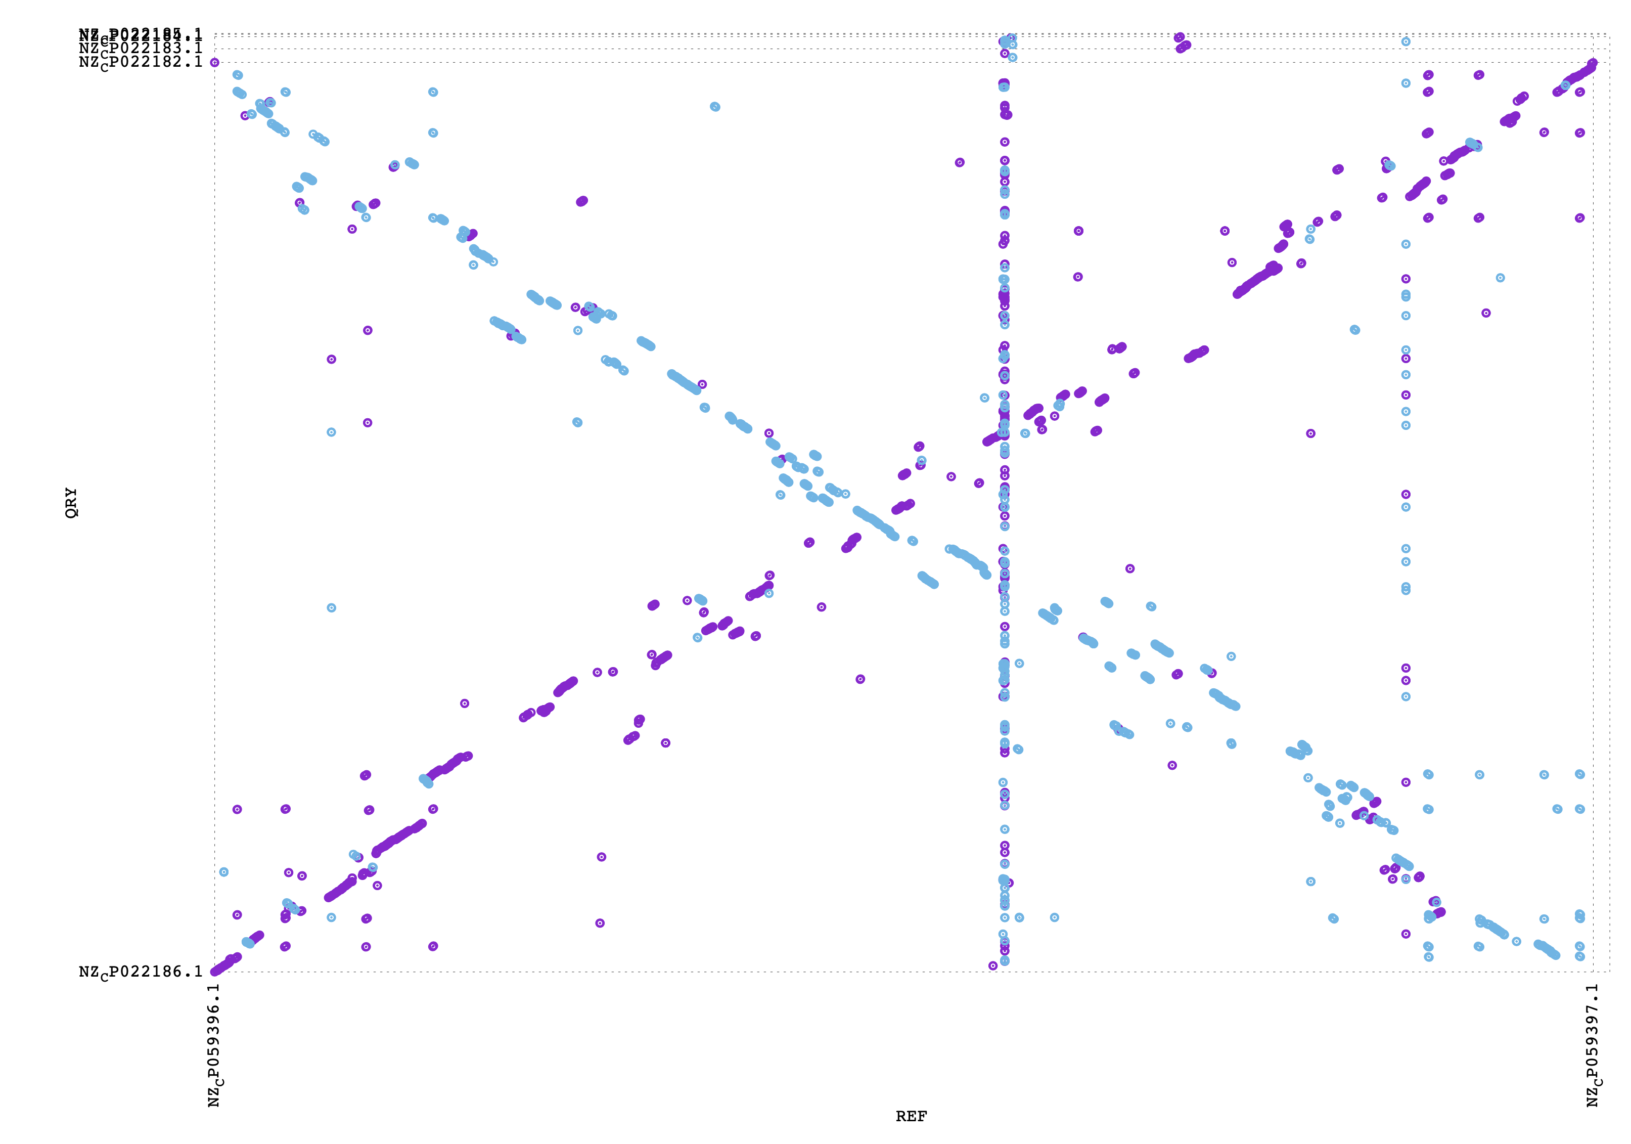
Food for thought- What might have happened here?
Aeromonas salmonicida S68
Aeromonas veronii HM21

Slide 46
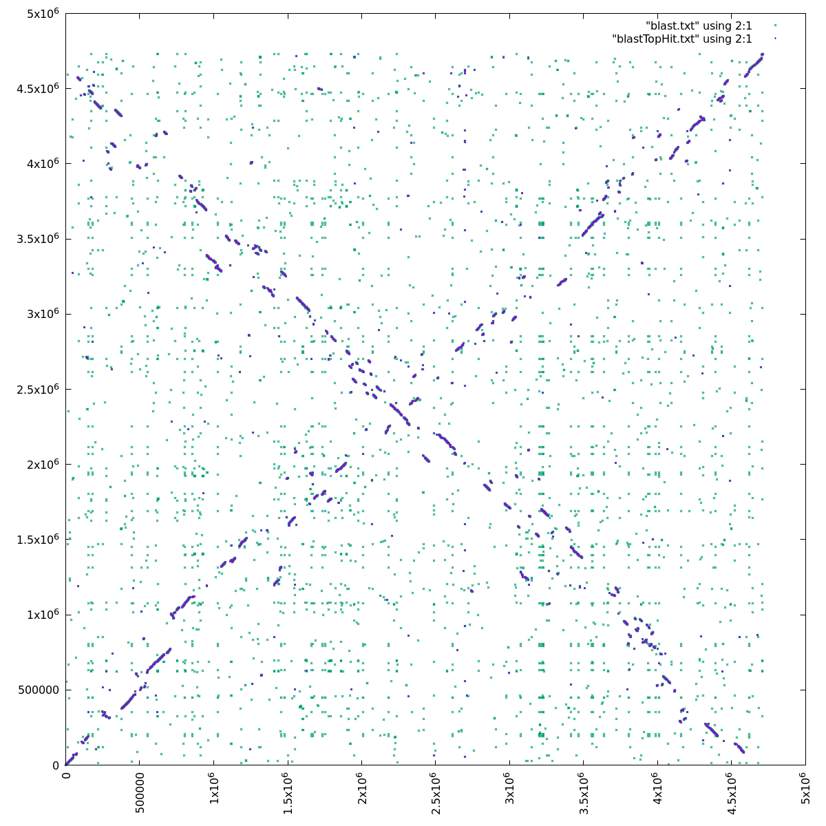
Gene Plot:
green e-value below 10⁻³⁰
blue top scoring blast hits.
Aeromonas salmonicida S68
Aeromonas veronii HM21

Slide 47
Food for thought- What might have happened here?
Gene plot
ORI

Slide 48
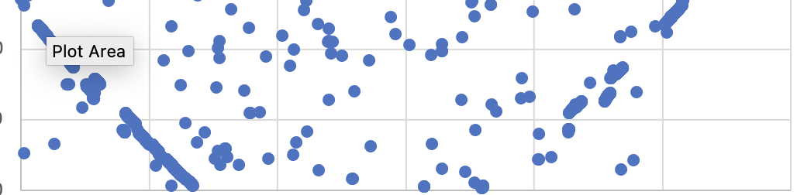
Gene plot
Aeromonas caviae, R25-6

Slide 49
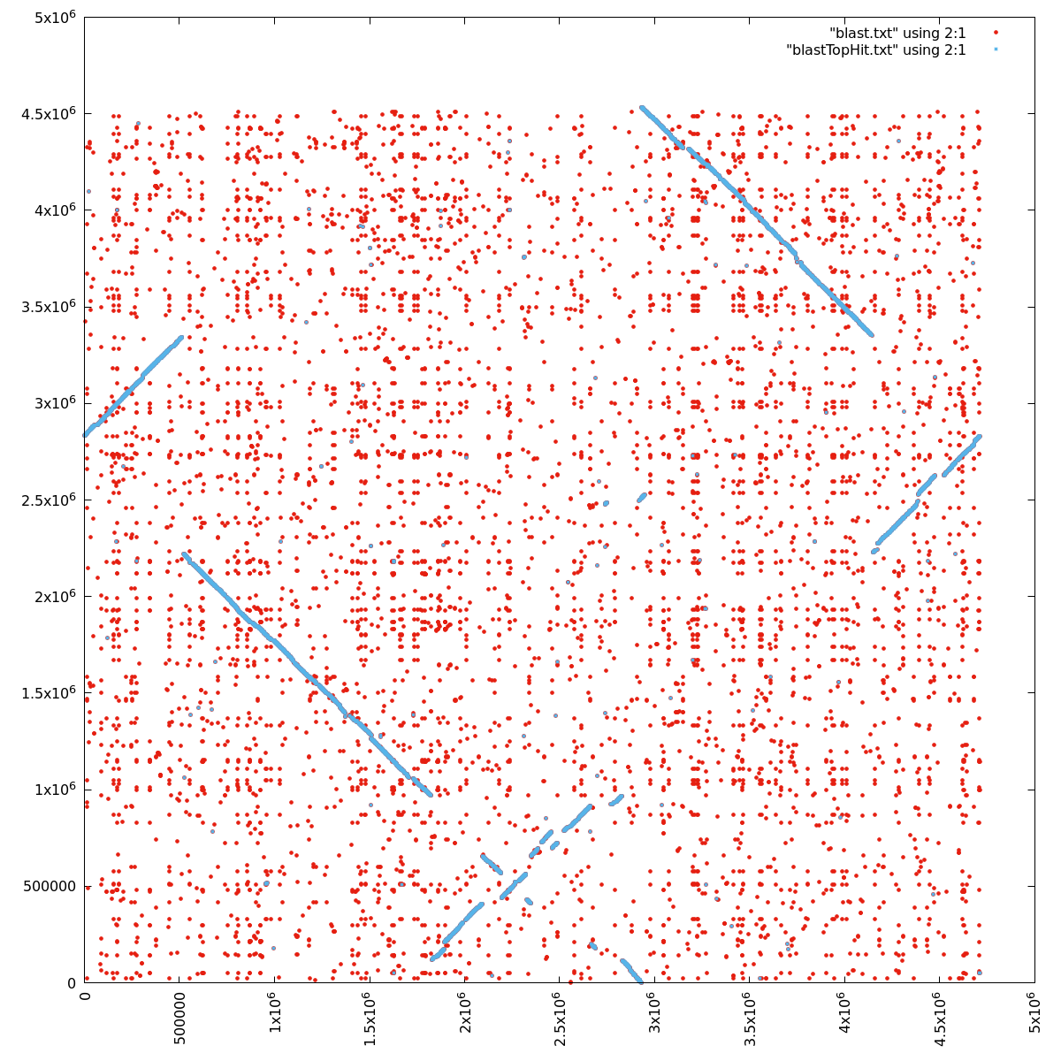
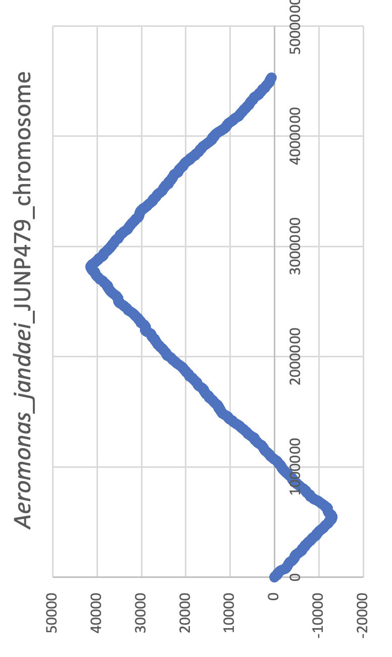
Origin
Origin
Terminus
Origin
A. jandaei JUNP479
Terminus
A. veronii HM21

Slide 50
Origin
Origin
Terminus
Origin
A. jandaei JUNP479
Terminus
A. veronii HM21

Slide 51
Origin
Origin
Terminus
A. jandaei JUNP479
Terminus
A. veronii HM21

Slide 52
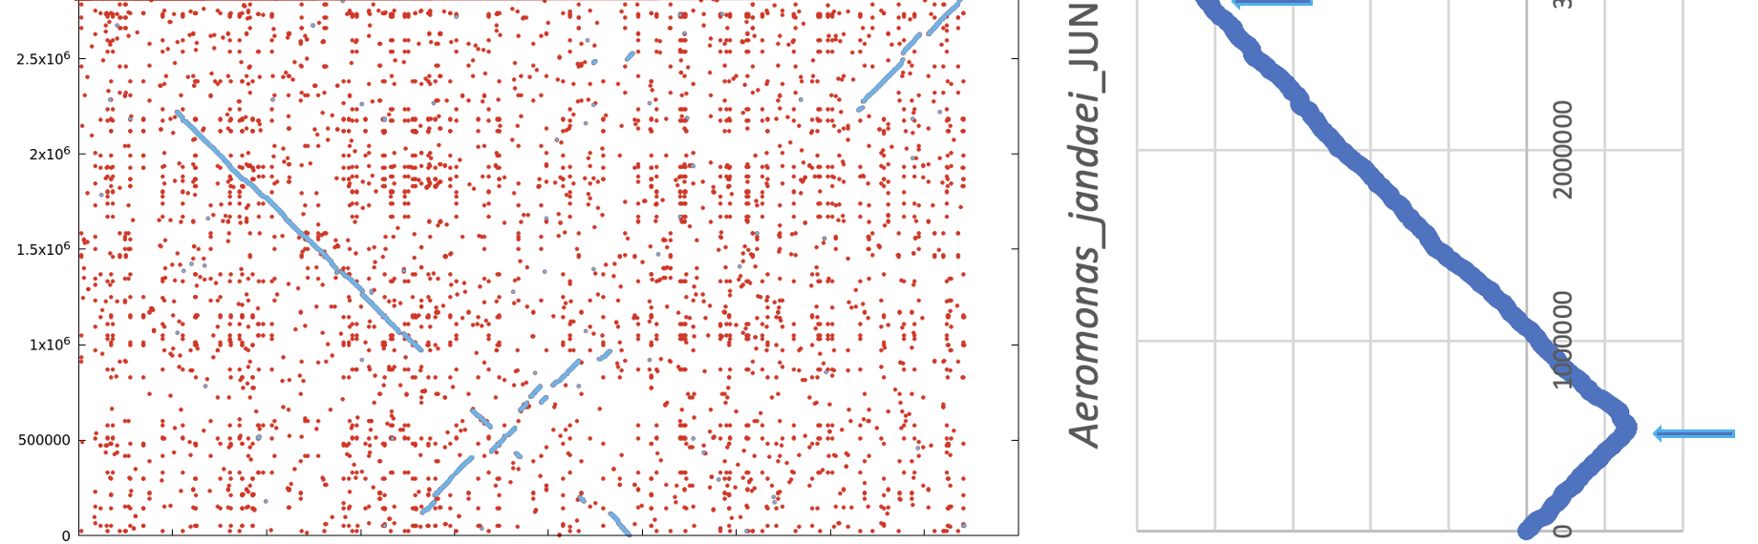
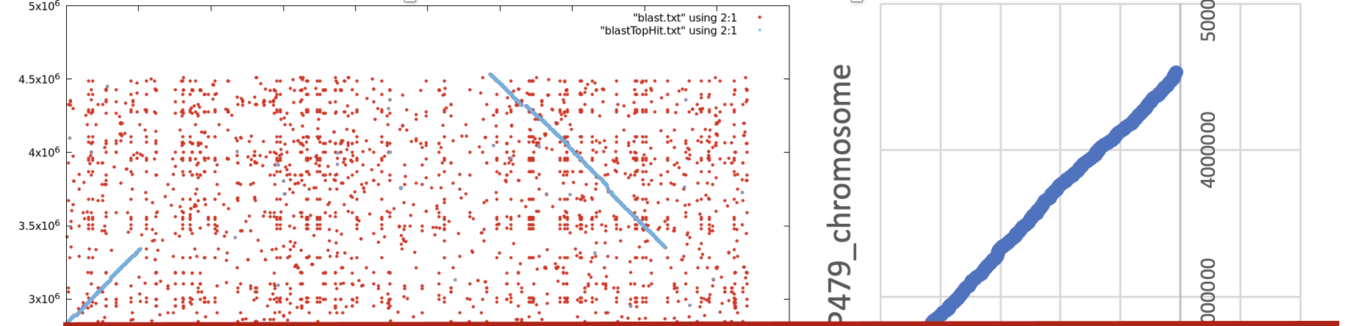
Origin
Origin
Terminus
Origin
A. jandaei JUNP479
Terminus
Origin
A. veronii HM21

Slide 53
Inferring Recombination Events from Dot -, Gene, or Mummer Plots

Slide 54
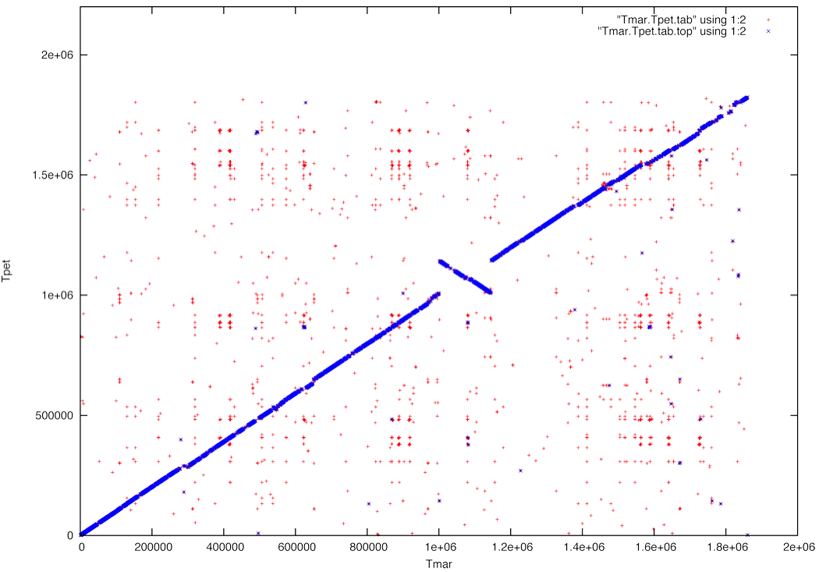
2
3
X axis
1
#3
3
2
2
#2
#1
1
y axis
1
3
1
2
3
#1 Identify and label syntenic fragments and their direction in the axes. For each axis draw a circular representation.

Slide 55
2
3
X axis
1
#3
3
2
2
#2
#1
1
X axis
1
3
1
2
3
#2 Draw in the recombination events that convert the genome on the X-axis into the one on the Y axis.

Slide 56
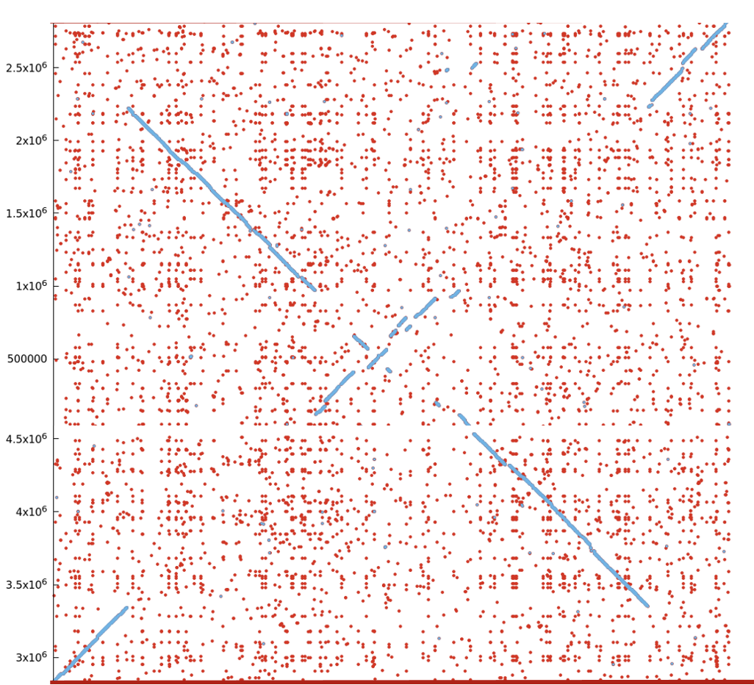
3
5
2
4
X axis
2
1
5
3
3
4
2
4
Y axis
1
1
5
1
3
4
5
2

Slide 57
3
5
2
4
X axis
2
1
5
3
3
4
2
4
Y axis
1
1
5
1
3
4
5
2

