Slide 1
Slide 8

Slide 2
Slide 15 class 6

Slide 3
Mutationism versus Modern Synthesis
Natural Selection versus Mutualism
MCB 3421_2023 Class 14

Slide 4
What is needed for evolution to occur?
(Note, this is different from stating that this is all that occurs in evolution)
Offspring similar* but not identical to parents
More offspring than necessary
Competition for resources, mates => survival of the fittest.
Note: the differences need to be inherited.

Slide 5
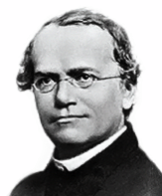
Mendelian genetics and Mutationism
Gene as unit of inheritance
Mutations cause difference in phenotype
Hugo de Vries, Carl Correns, and William Bateson
Richard Goldschmidt's hopeful monsters (1940)
Gregor Johann Mendel

Slide 6
Mutationists
Replaced Darwin’s concept of blended inheritance and fluctuations (which were shown not to be inherited) with inherited mutations.
For the most part the geneticists in the early 1900s did not doubt the process of natural selection as described by Darwin, but they saw the creative force in the mutations.
(From Arlin’s entry on mutationsm in Wikkipedia: )
“.. the mutationists saw evolution as a two-step process of the chance occurrence of a mutation, followed by its persistence or elimination (selection).
The mutationists denied that selection is creative, and they gave mutation a certain measure of control over the course of evolution.”

Slide 7
Claims of the Modern Synthesis
Mutations create variation.
The individual mutation is not important.
An unlimited supply in variation is present in the population.
Selection is what causes evolution by natural selection.
Mutationists believed Mendelian genetics is incompatible with Darwin’s theory of natural selection. (See Arlin Stoltzfus’ Mutationism Myth, which debunks this claim. The proponents of the modern synthesis did not want to “stand on the shoulders of giants”.)
Julian Huxley invented the term, when he produced his book, Evolution: The Modern Synthesis (1942). Other major figures in the modern synthesis include Ronald A. Fisher, Theodosius Dobzhansky, John B.S. “Jack” Haldane, Sewall Wright, Edmond B. Ford, Ernst Mayr, Bernhard Rensch, Sergei Chetverikov, George Gaylord Simpson, and G. Ledyard Stebbins.

Slide 8
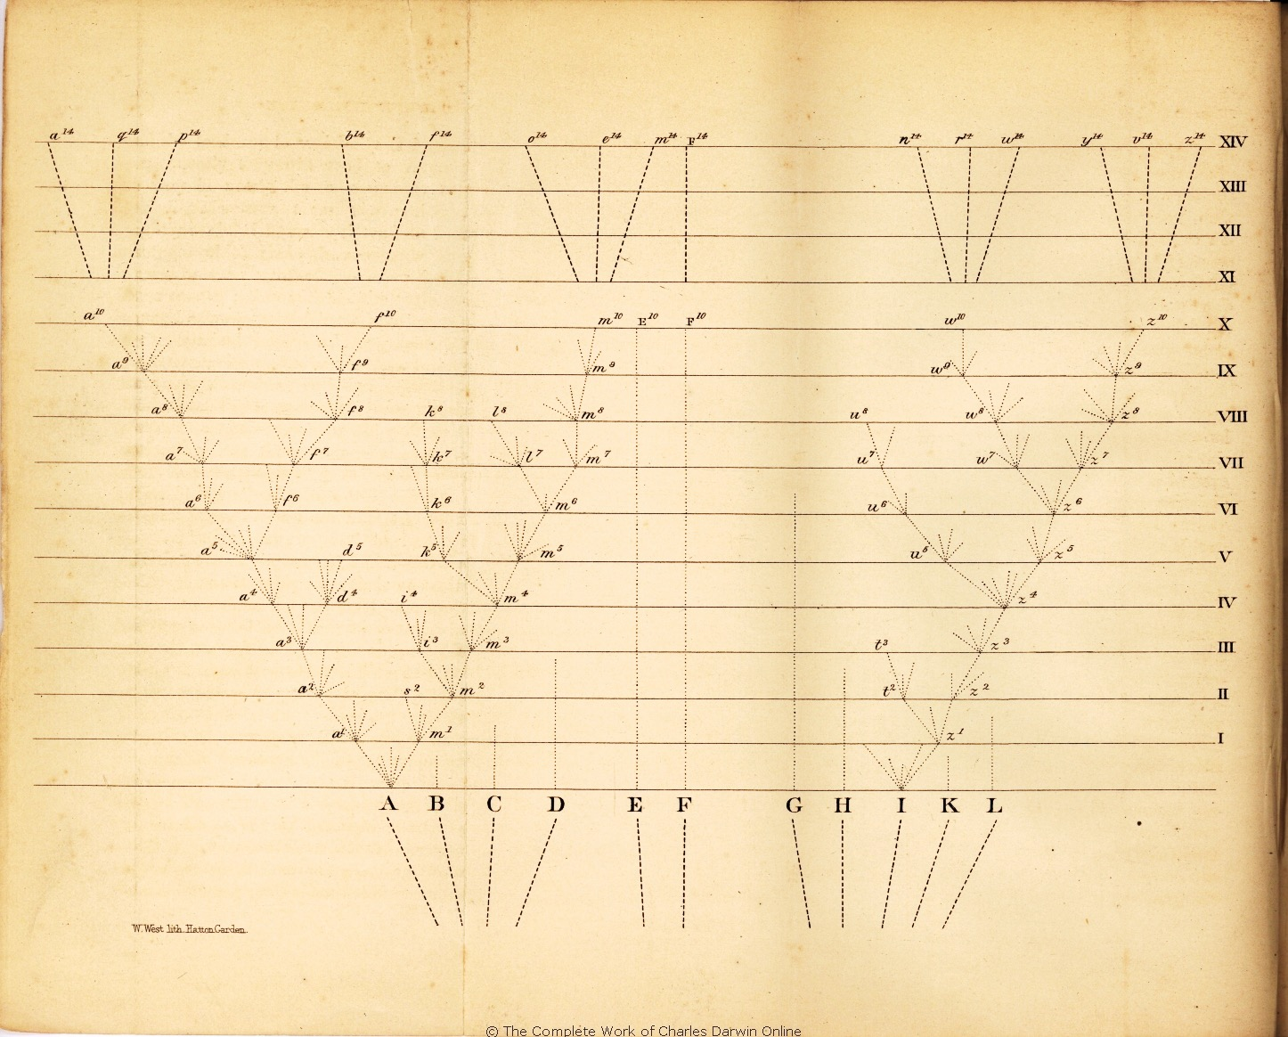
Darwinian Evolution- a slow and gradual process
In Darwin’s description evolution by natural selection was a slow and gradual process based on small inheritable variation.
However, note that his aim was to establish
that the “common view of the immutability
of species” was wrong.
“That natural selection
will always act with
extreme slowness,
I fully admit.”
Darwin saw fluctuations
as a source for variation

Slide 9
Alternatives and add-ons to evolution by natural selection acting on gradual changes
Horizontal gene transfer and recombination
Polyploidization (angiosperm and vertebrate evolution) see here and here
Fusion and cooperation of organisms
(Kefir, lichen, also the eukaryotic cell, cooperation in microbial populations and communities)
Evolution of the holobiont (host + symbionts)
Random genetic drift
Gratuitous complexity
Selfish genes (who/what is the subject of evolution?)
Parasitism, altruism, gene transfer agents
Mutationism, hopeful monsters (see also Richard Goldschmidt)
Targeted mutations (?), genetic memory (?) (see Foster's and Hall's reviews on directed/adaptive mutations; see here for a counterpoint)

Slide 10
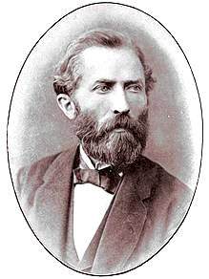
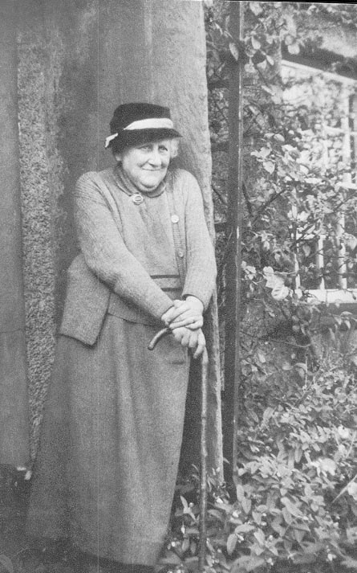
Heinrich Anton de Bary
“Die Erscheinung der Symbiose”
(Strausbourg, 1879)
Parasitism/Antagonism
Commensalism
Mutualism
Lichenism/Symbiogenesis
Beatrix Potter
Was not allowed to present her 1897 paper on lichen symbionts to the Royal Academy of Sciences due to her gender
(an apology was issued on the 100 year anniversary of the event)

Slide 11
Symbiosis (from Wikipedia)
Symbiosis (from Greek συμβίωσις "living together", from σύν "together" and βίωσις "living") is any type of a close and long-term biological interaction between two different biological organisms, be it mutualistic, commensalistic, or parasitic. The organisms, each termed a symbiont, may be of the same or of different species. In 1879, Heinrich Anton de Bary defined it as "the living together of unlike organisms".
The term was subject to a century-long debate about whether it should specifically denote mutualism, as in lichens; biologists have now abandoned that restriction.
According to this definition,
all parasites that live closely with their host are symbionts!
Wikipedia is not infallible, but among most scientists this is accepted – but apparently not by all.
What might be the reason for the popularity of the more encompassing definition?

Slide 12
Examples of mutualistic symbiosis
(Endo)symbiotic nitrogen-fixing bacteria in Alder (Frankia) and related trees, in Leguminosae (Rhizobium), in Gunera (Nostoc)
Lichen: symbioses between fungi and eukaryotic algae or cyanobacteria
Mycorrhiza in plants: fungi take over the role of root hairs
Microbiota in the gut of animals (digestions of cellulose and other compounds, vitamin biosynthesis, production of group specific smell, synthesis of essential amino acids (especially in sap eating insects)
Microorganisms in the rhizosphere of plants (provide nutrients and water).
?Communication between neighboring plants (the wood wide web)?

Slide 13
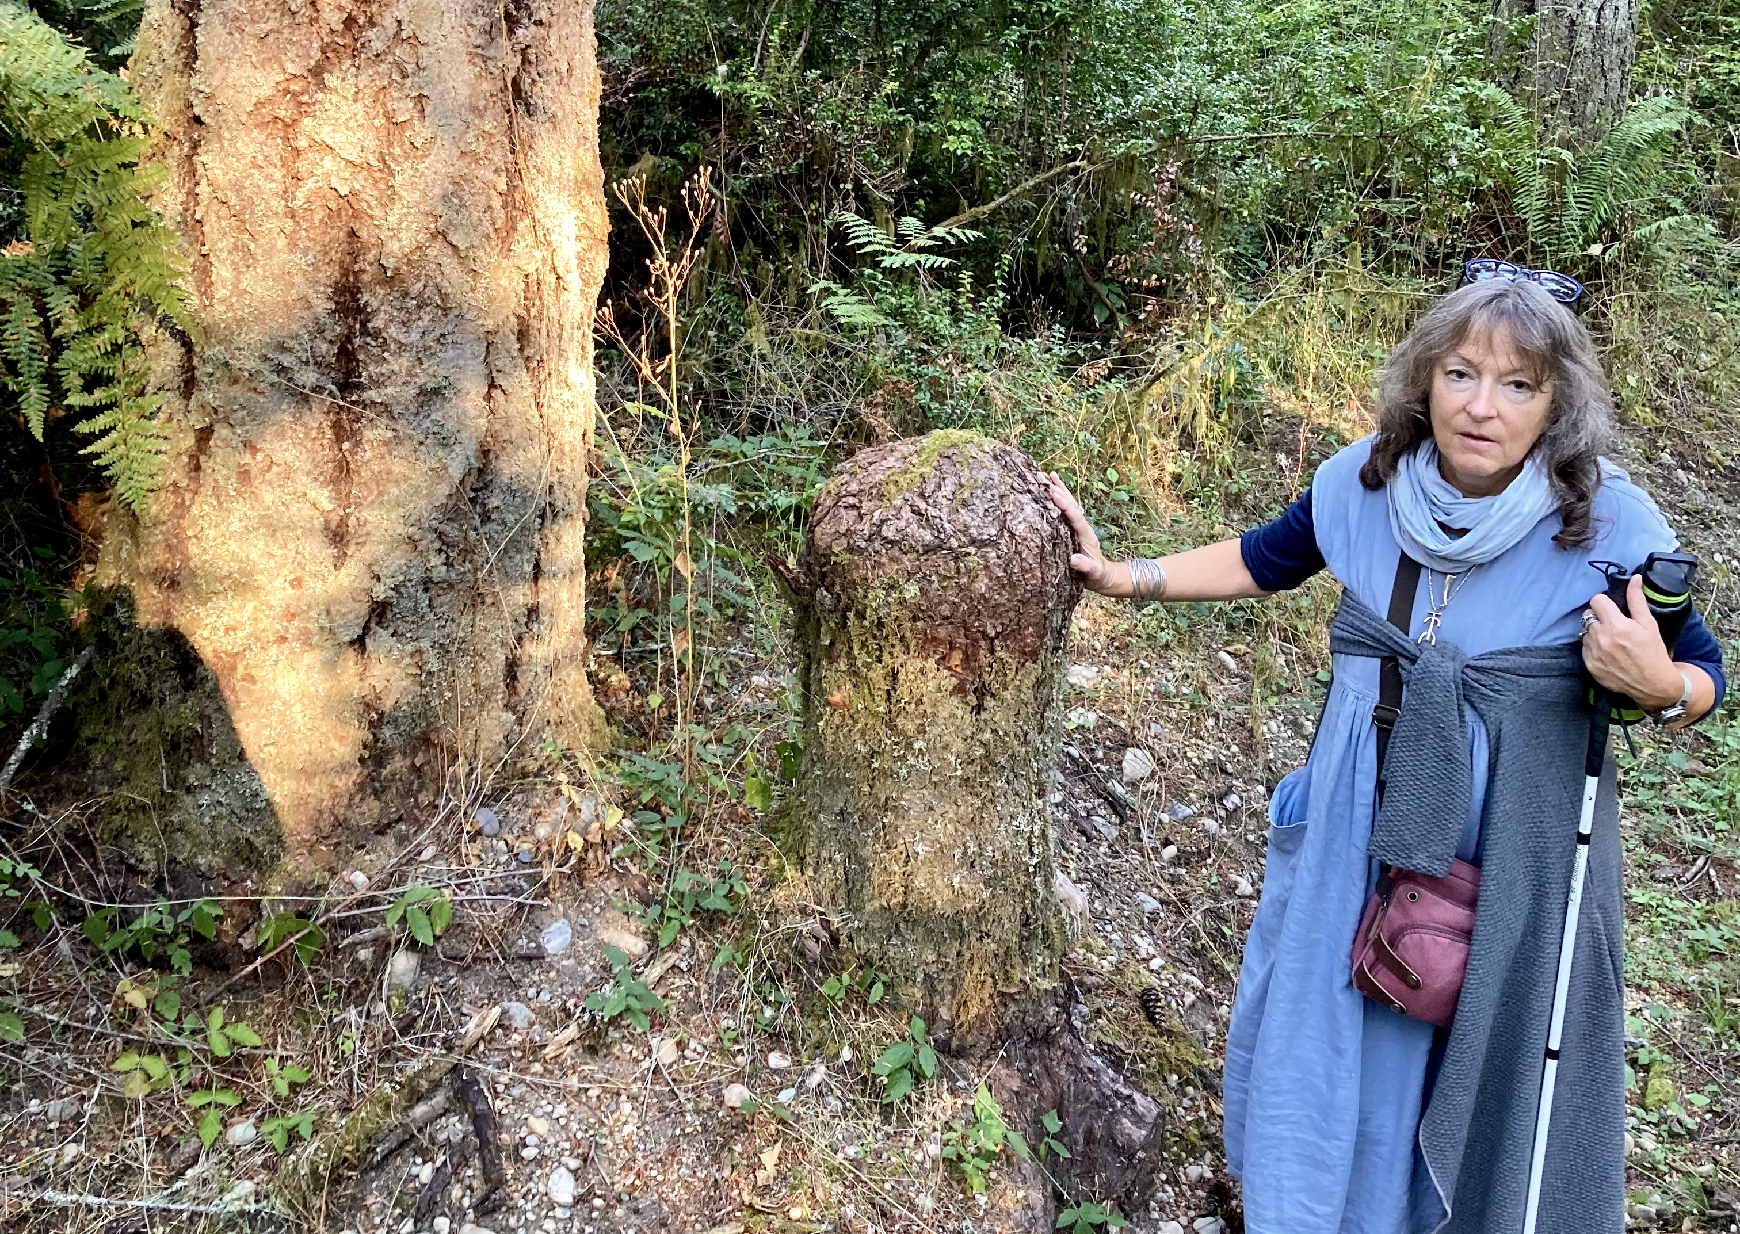
Aid from neighboring trees, reserves and effective wound healing, or two stems from the same tree?
Tree stump on Vashon island (near Seattle, Washington). The stump’s
surface has been completely overgrown by new bark.
Example of the
wood wide web?
See here for a critical assessment.

Slide 14
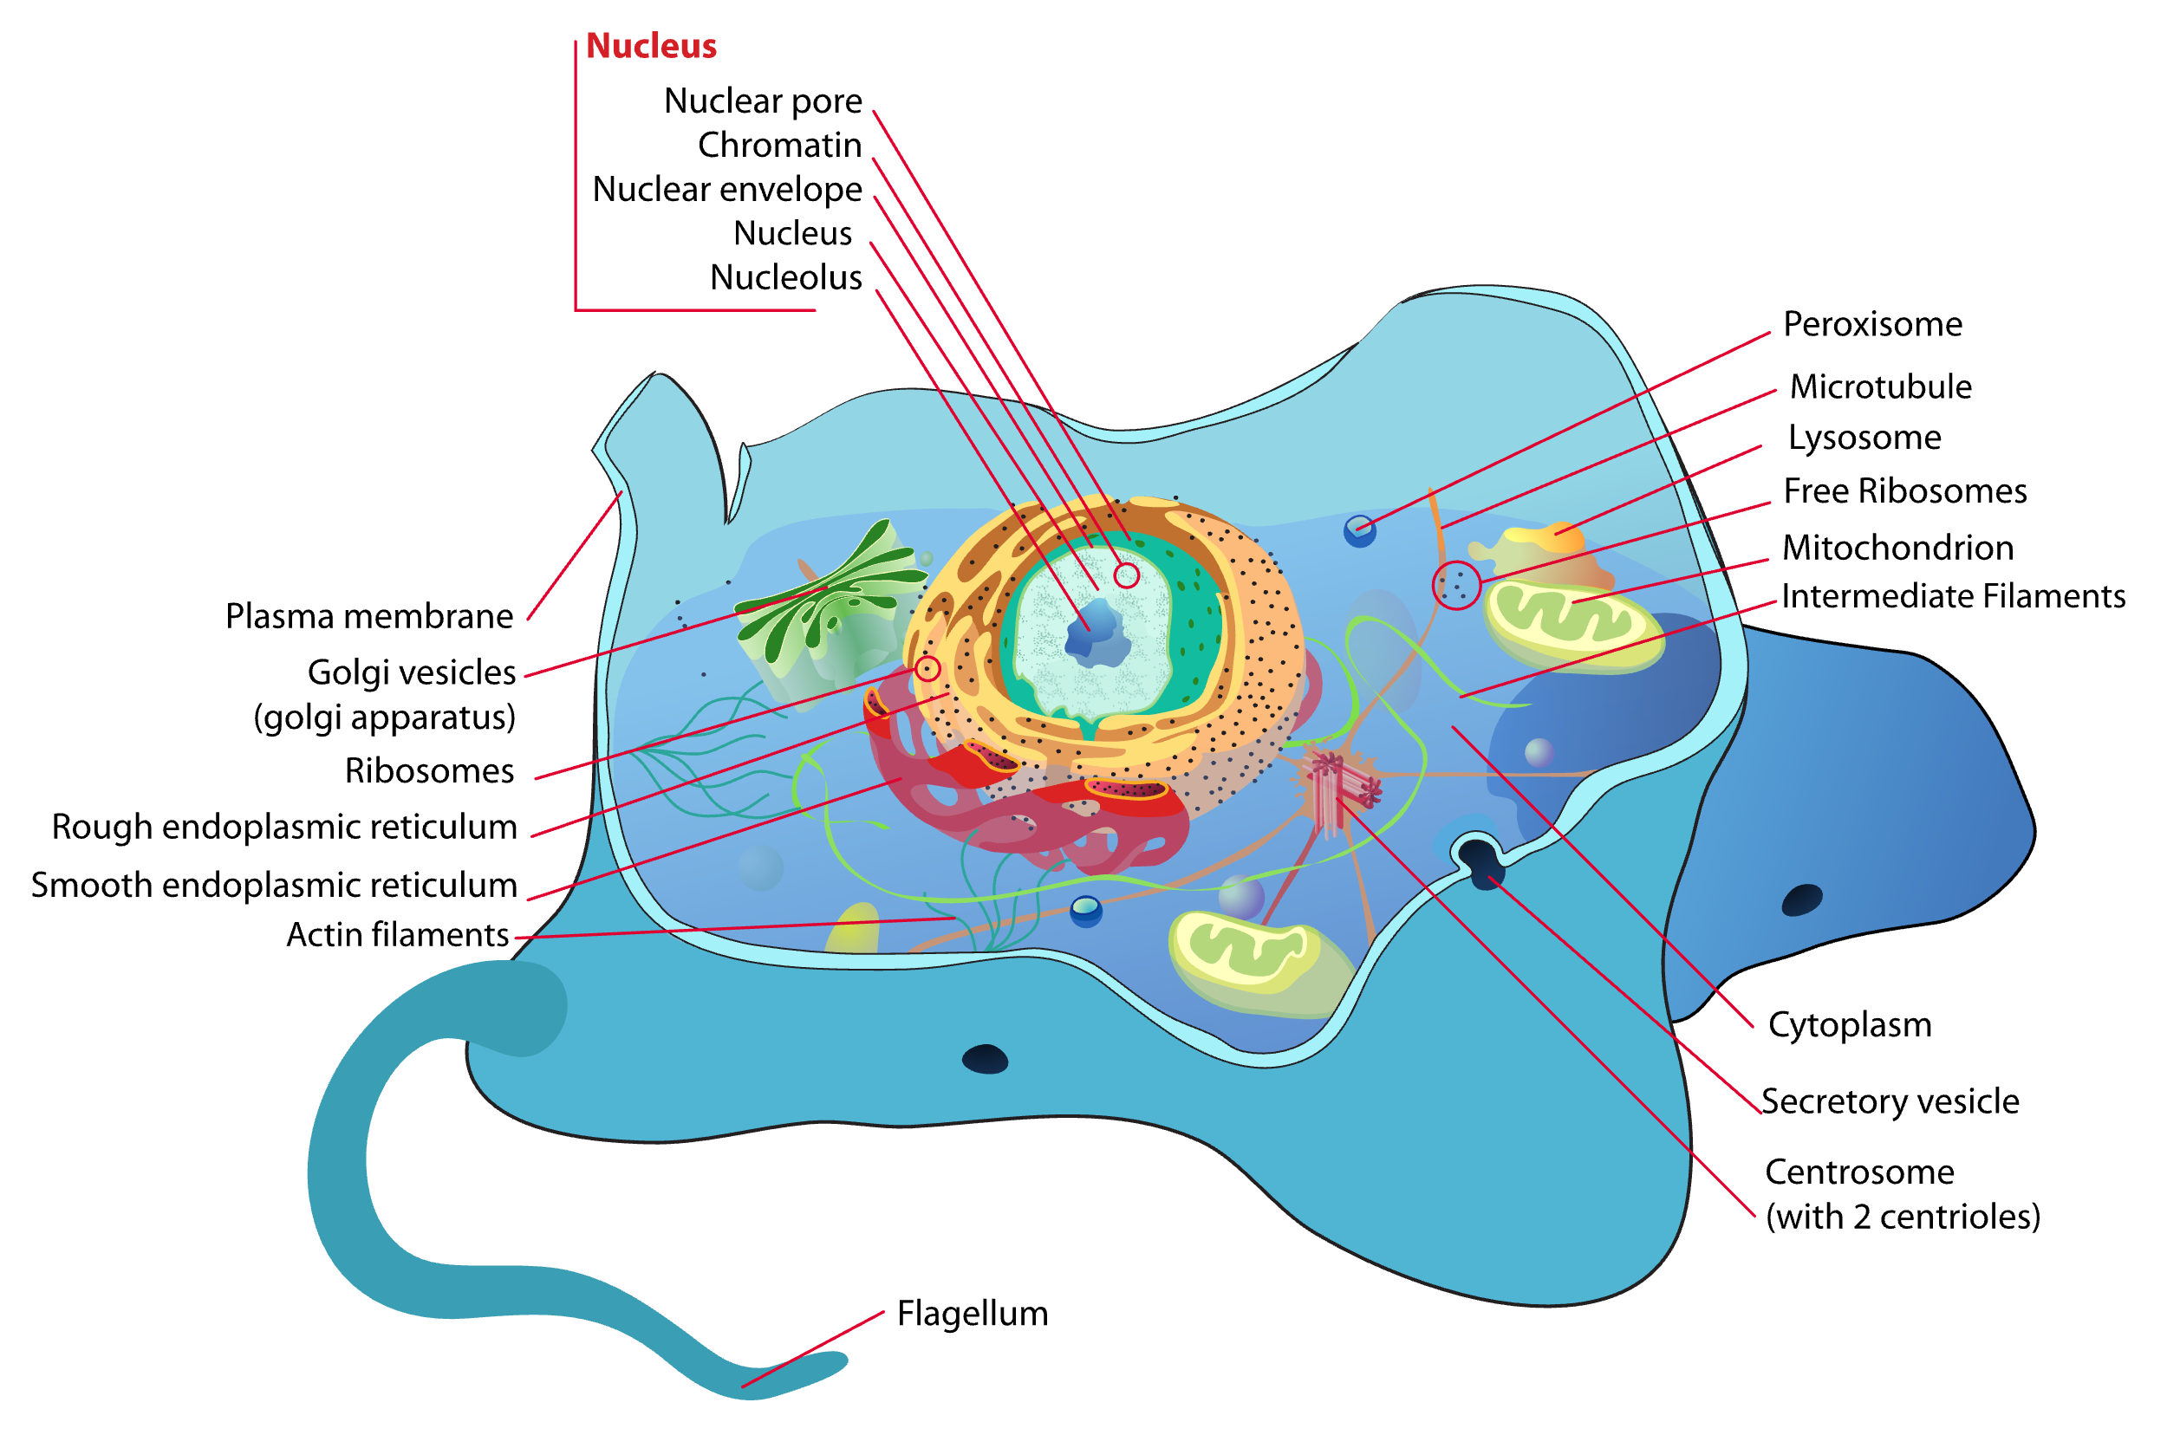
The Eukaryotic Cell
Animal Cell
Eukaryote. (2023, March 2).
In Wikipedia.https://en.wikipedia.org/wiki/Eukaryote

Slide 15
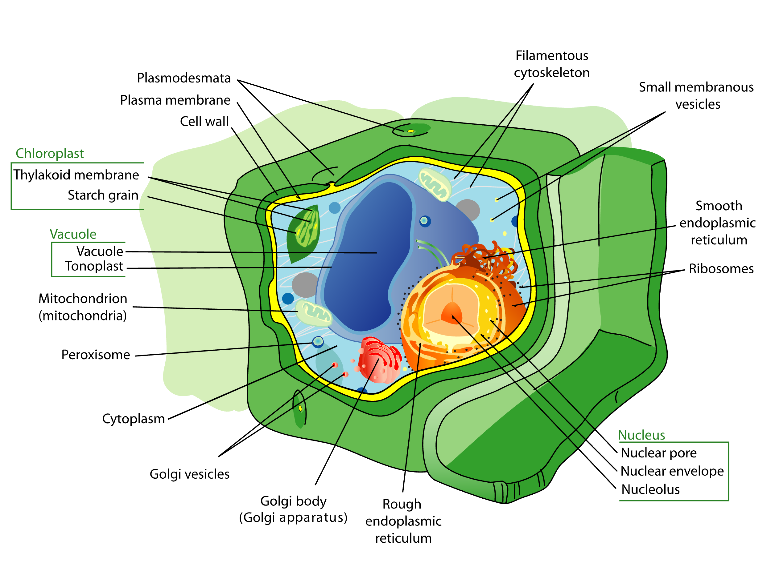
The Eukaryotic Cell
Plant cell
Eukaryote. (2023, March 2).
In Wikipedia. https://en.wikipedia.org/wiki/Eukaryote

Slide 16
The Eukaryotic Cell
Plant cell
Where is DNA located ?
Eukaryote. (2023, March 2).
In Wikipedia. https://en.wikipedia.org/wiki/Eukaryote

Slide 17
Not all viruses remain parasites.
Viruses have coevolved with their hosts over long periods of time. And many have made important contributions to their host. E.g.:
Syncytin in the human placenta
PolyDNA “viruses” on parasitic wasps
Viruses as weapons against competitors

Slide 18
Human endogenous retroviruses
Human endogenous retroviruses (HERV) proviruses comprise a significant part of the human genome, with approximately 98,000 ERV elements and fragments making up 5–8%.^{[1]} According to a study published in 2005, no HERVs capable of replication had been identified in the human germline; all appeared to be defective, containing major deletions or nonsense mutations. This is because most HERVs are merely traces of original viruses, having first integrated millions of years ago.

Slide 19
The role of the syncytium in the placenta
… a syncytium without any extracellular spaces between cells in order to limit the exchange of migratory immune cells between the developing embryo and the body of the mother (something an epithelium will not do sufficiently, as certain blood cells are specialized to be able to insert themselves between adjacent epithelial cells). The fusion of the cells is apparently caused by viral fusion proteins from endosymbiotic endogenous retrovirus (ERV).^{[5]} An immunoevasive action was the initial normal behavior of the viral protein, in order to avail for the virus to spread to other cells by simply merging them with the infected one. It is believed that the ancestors of modern viviparous mammals evolved after an infection by this virus, enabling the fetus to better resist the immune system of the mother.^{[6]}
From Wikipedia

Slide 20
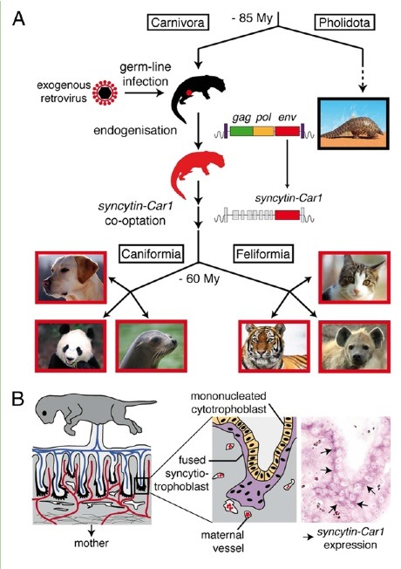
Viruses in Evolution of development
Carl Zimmer on “the loom”
“The big picture that’s now emerging is quite amazing. Viruses have rained down on mammals, and on at least six occasions, they’ve gotten snagged in their hosts and started carrying out the same function: building placentas.”
Links:
http://en.wikipedia.org/wiki/ERVWE1
http://blogs.discovermagazine.com/loom/2012/02/14/mammals-made-by-viruses/#.UTNwZSvfaIN

Slide 21
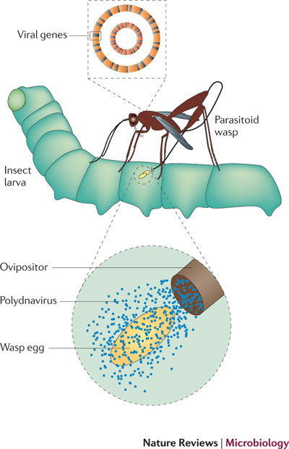
Many parasitoid wasps lay their eggs inside a living insect larva. When a female wasp deposits her eggs inside a lepitdopteran caterpillar, she also deposits her symbiogenic polydnavirus virions, which only express wasp genes. These genes are expressed in the caterpillar, where they prevent the encapsulation process that would otherwise wall off and kill the wasp egg.
More in
Marilyn J. Roossinck and Edelio R. Bazán
Annual Review of Virology 2017

Slide 22
Many bacteria carry a viral genome (green) integrated into their own genome (blue). These lysogenic viruses remain dormant and render the host bacteria immune to lytic forms of the virus. If the lysogenic virus excises from the genome, it can reproduce rapidly, producing thousands of progeny and leading to the death of the host cell. This releases the viruses into the extracellular environment, where they can kill competing bacteria (red) that are not lysogenic for the virus.
This is similar to the viruses that the Europeans carried with them that killed most of the native Americans and largely destroyed their culture, even before they had personal contact.
For the intentional use of viruses as bioweapon see https://en.wikipedia.org/wiki/Siege_of_Fort_Pitt
Marilyn J. Roossinck

Slide 23
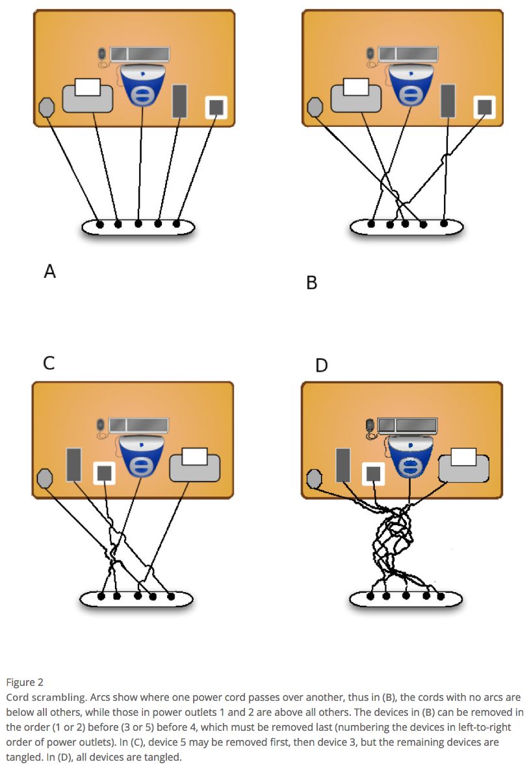
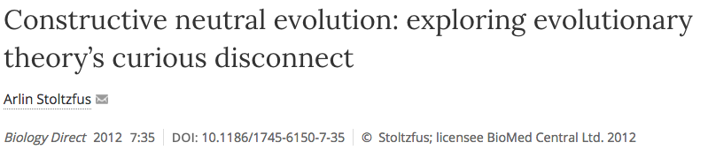
Mutations can have a directing force (A)
Arlin’s example of computer cables
From:

Slide 24
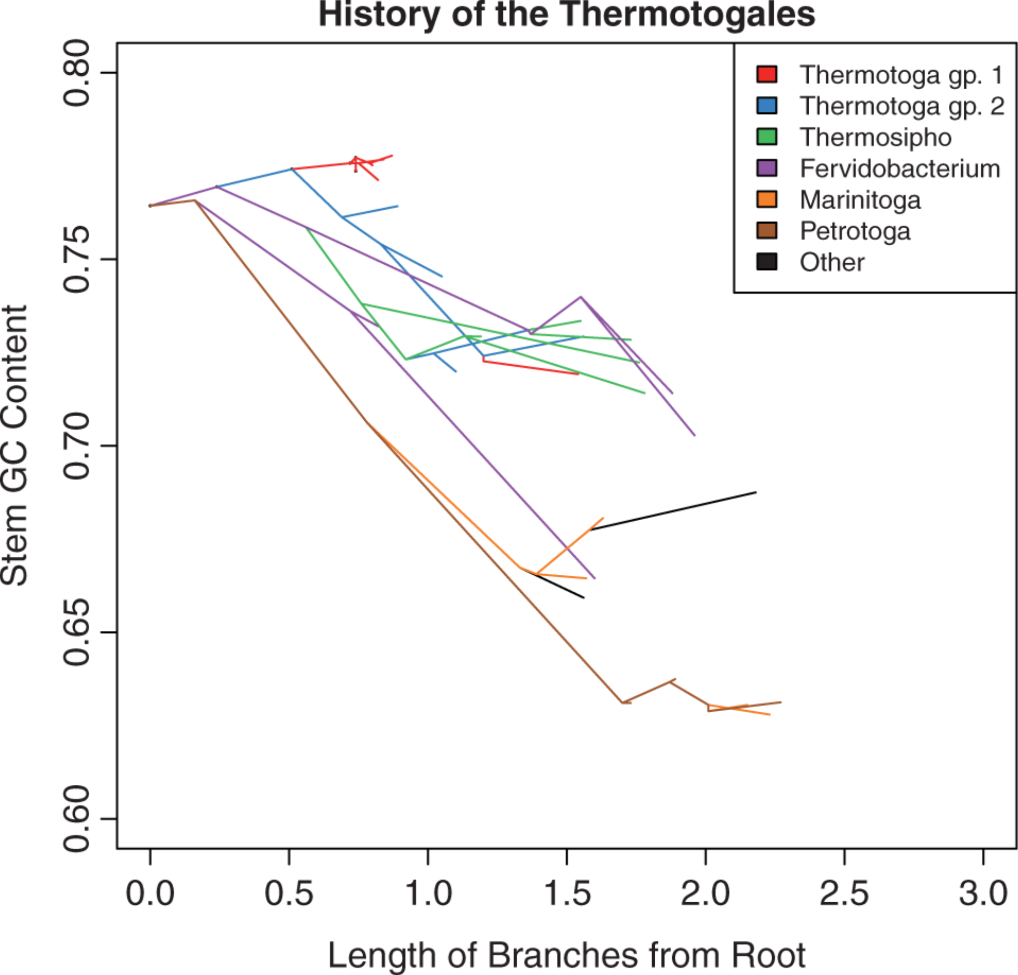
Mutations can have a directing force (B)
Mutations bias temperature adaptation towards lower temperature:
From: Anna G. Green Kristen S. Swithers Jan F. Gogarten Johann Peter Gogarten
Reconstruction of Ancestral 16S rRNA Reveals Mutation Bias in the Evolution of Optimal Growth Temperature in the Thermotogae Phylum
Mol Biol Evol. 2013;30(11):2463-2474. doi:10.1093/molbev/mst145

Slide 25
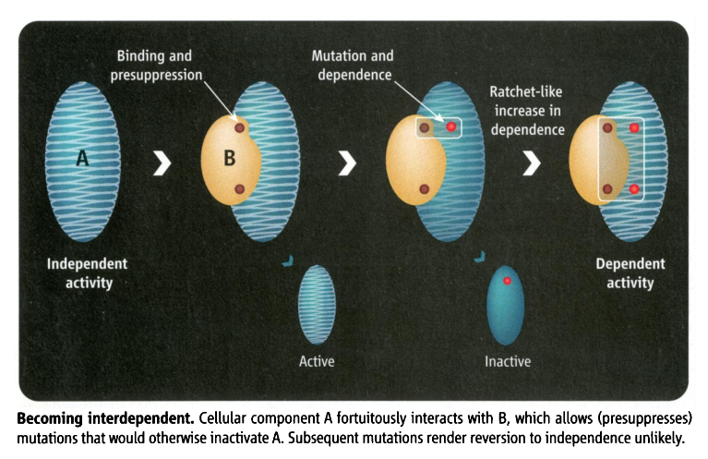
Mutations can have a directing force (C)
Constructive neutral evolution:
Random interactions between macromolecules lower the overall free energy, leading to more stability, allowing for destabilizing mutations to occur. The mutated macromolecule remains stable and active, as long as the binding partner is present.
From: Irremediable Complexity?
Author(s): Michael W. Gray, Julius Lukeš, John M. Archibald, Patrick J. Keeling and W.
Ford Doolittle
Source: Science, New Series, Vol. 330, No. 6006 (12 November 2010), pp. 920-921

Slide 26
Natural Selection and Mutual Aid

Slide 27
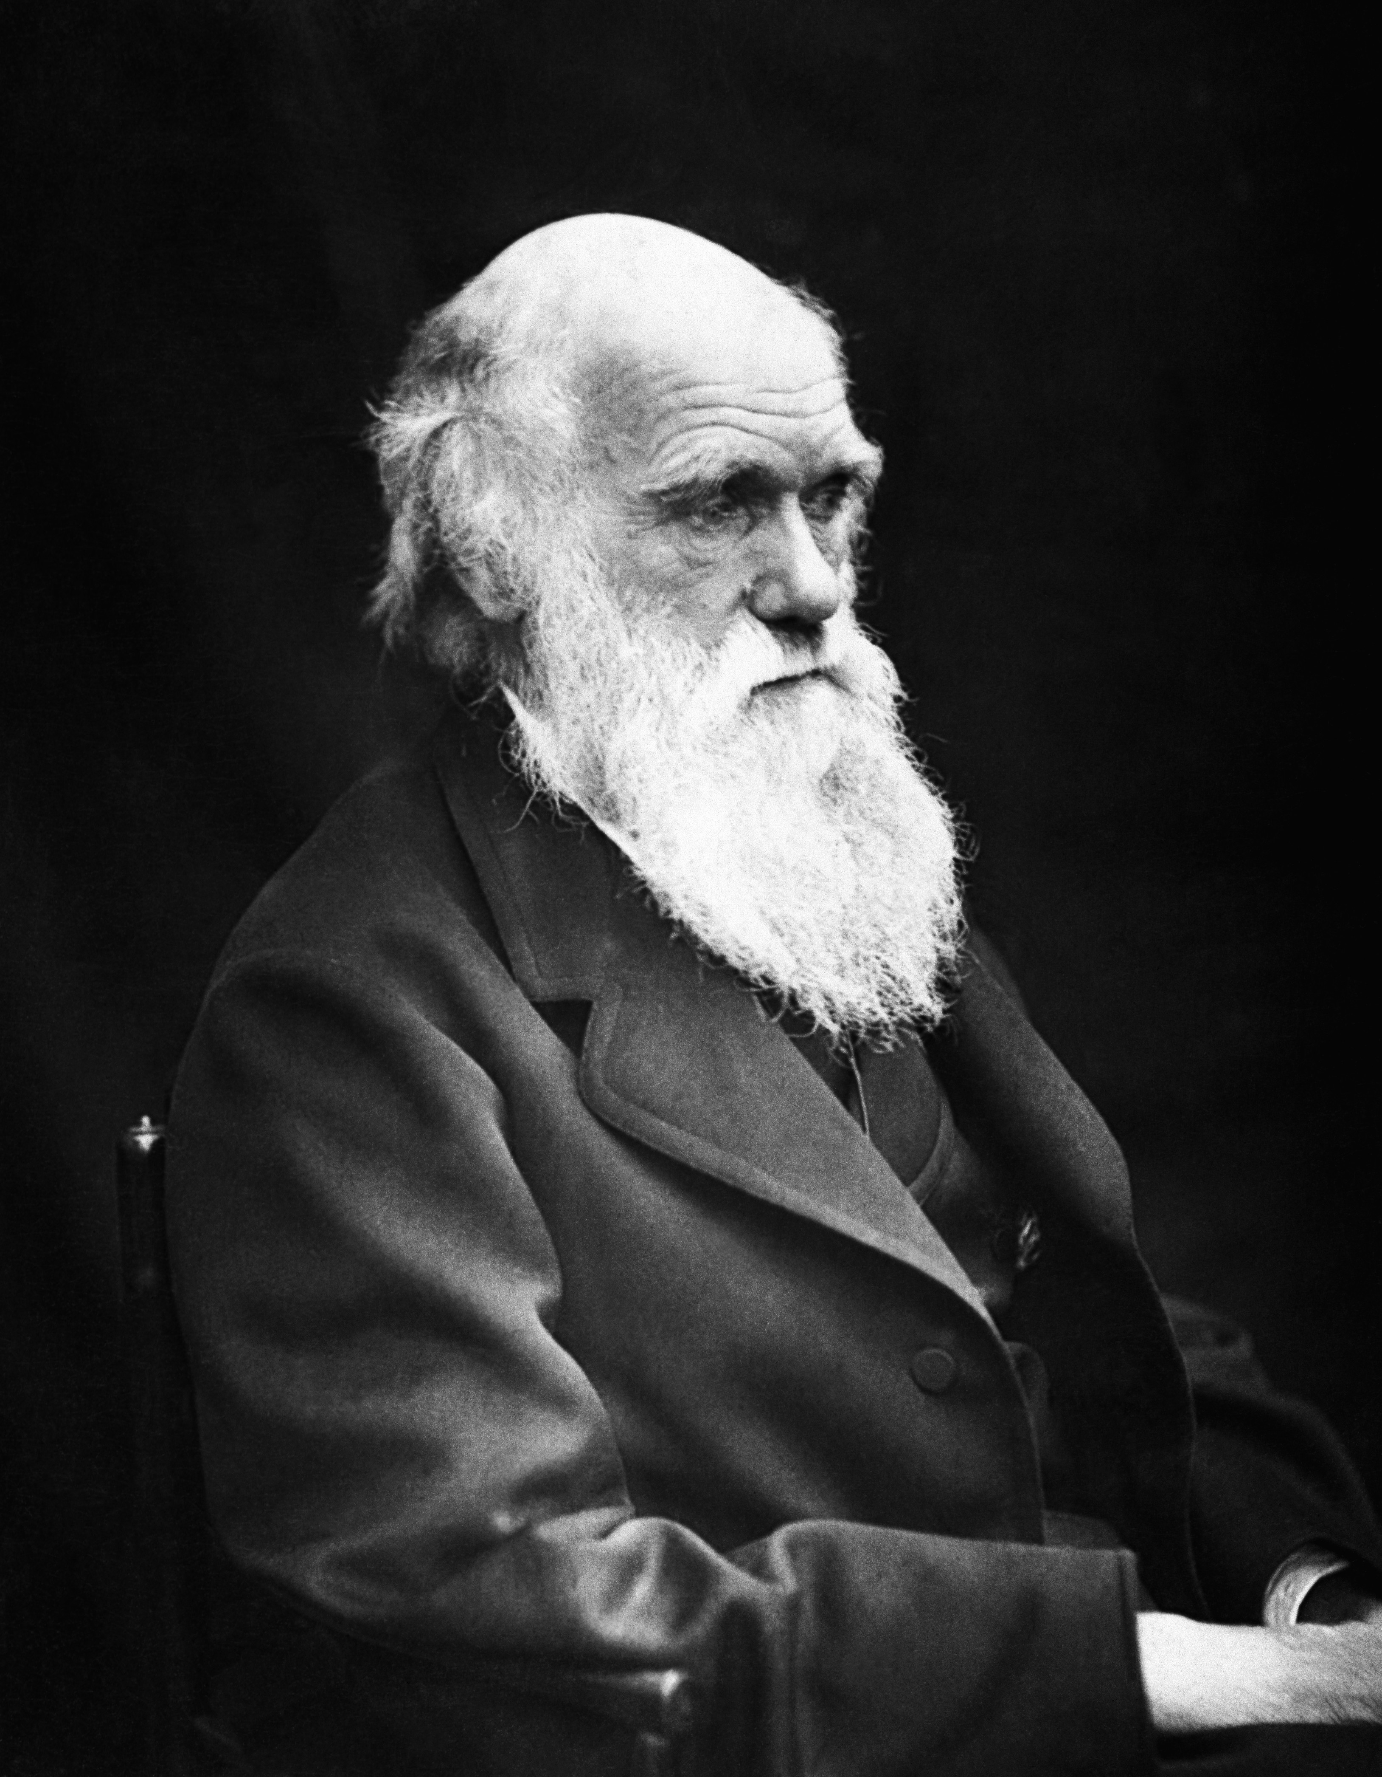
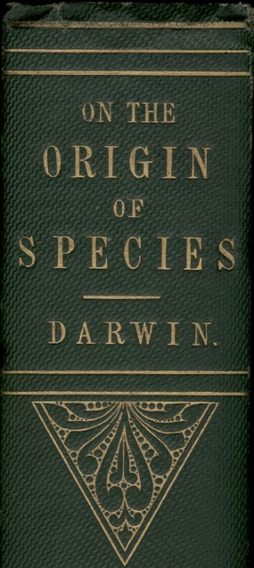
Darwinian Evolution – Natural Selection
…., if there be, owing to the high geometrical powers of increase of each species, at some age, season, or year, a severe struggle for life, and this certainly cannot be disputed; then, considering the infinite complexity of the relations of all organic beings to each other and to their conditions of existence, causing an infinite diversity in structure, constitution, and habits, to be advantageous to them, I think it would be a most extraordinary fact if no variation ever had occurred useful to each being's own welfare, in the same way as so many variations have occurred useful to man. But if variations useful to any organic being do occur, assuredly individuals thus characterised will have the best chance of being preserved in the struggle for life; and from the strong principle of inheritance they will tend to produce offspring similarly characterised. This principle of preservation, I have called, for the sake of brevity, Natural Selection.
Charles Darwin
Photo by J. Cameron, 1869

Slide 28
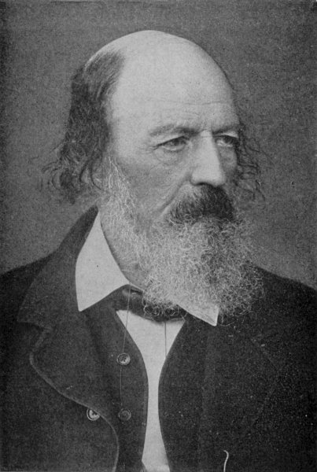
Nature, red in tooth and claw
Are God and Nature then at strife,
That Nature lends such evil dreams?
So careful of the type she seems,
So careless of the single life;
That I, considering everywhere
Her secret meaning in her deeds,
And finding that of fifty seeds
She often brings but one to bear,
Canto 56
Who trusted God was love indeed
And love Creation's final law
Tho' Nature, red in tooth and claw
With ravine, shriek'd against his creed
From: Alfred Lord Tennyson's In Memoriam A. H. H., 1850 (published before Darwin's Origin of species)

Slide 29
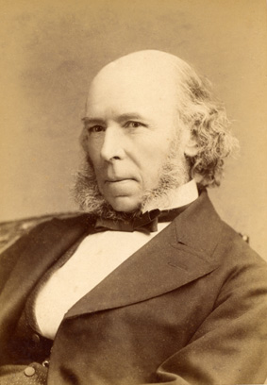
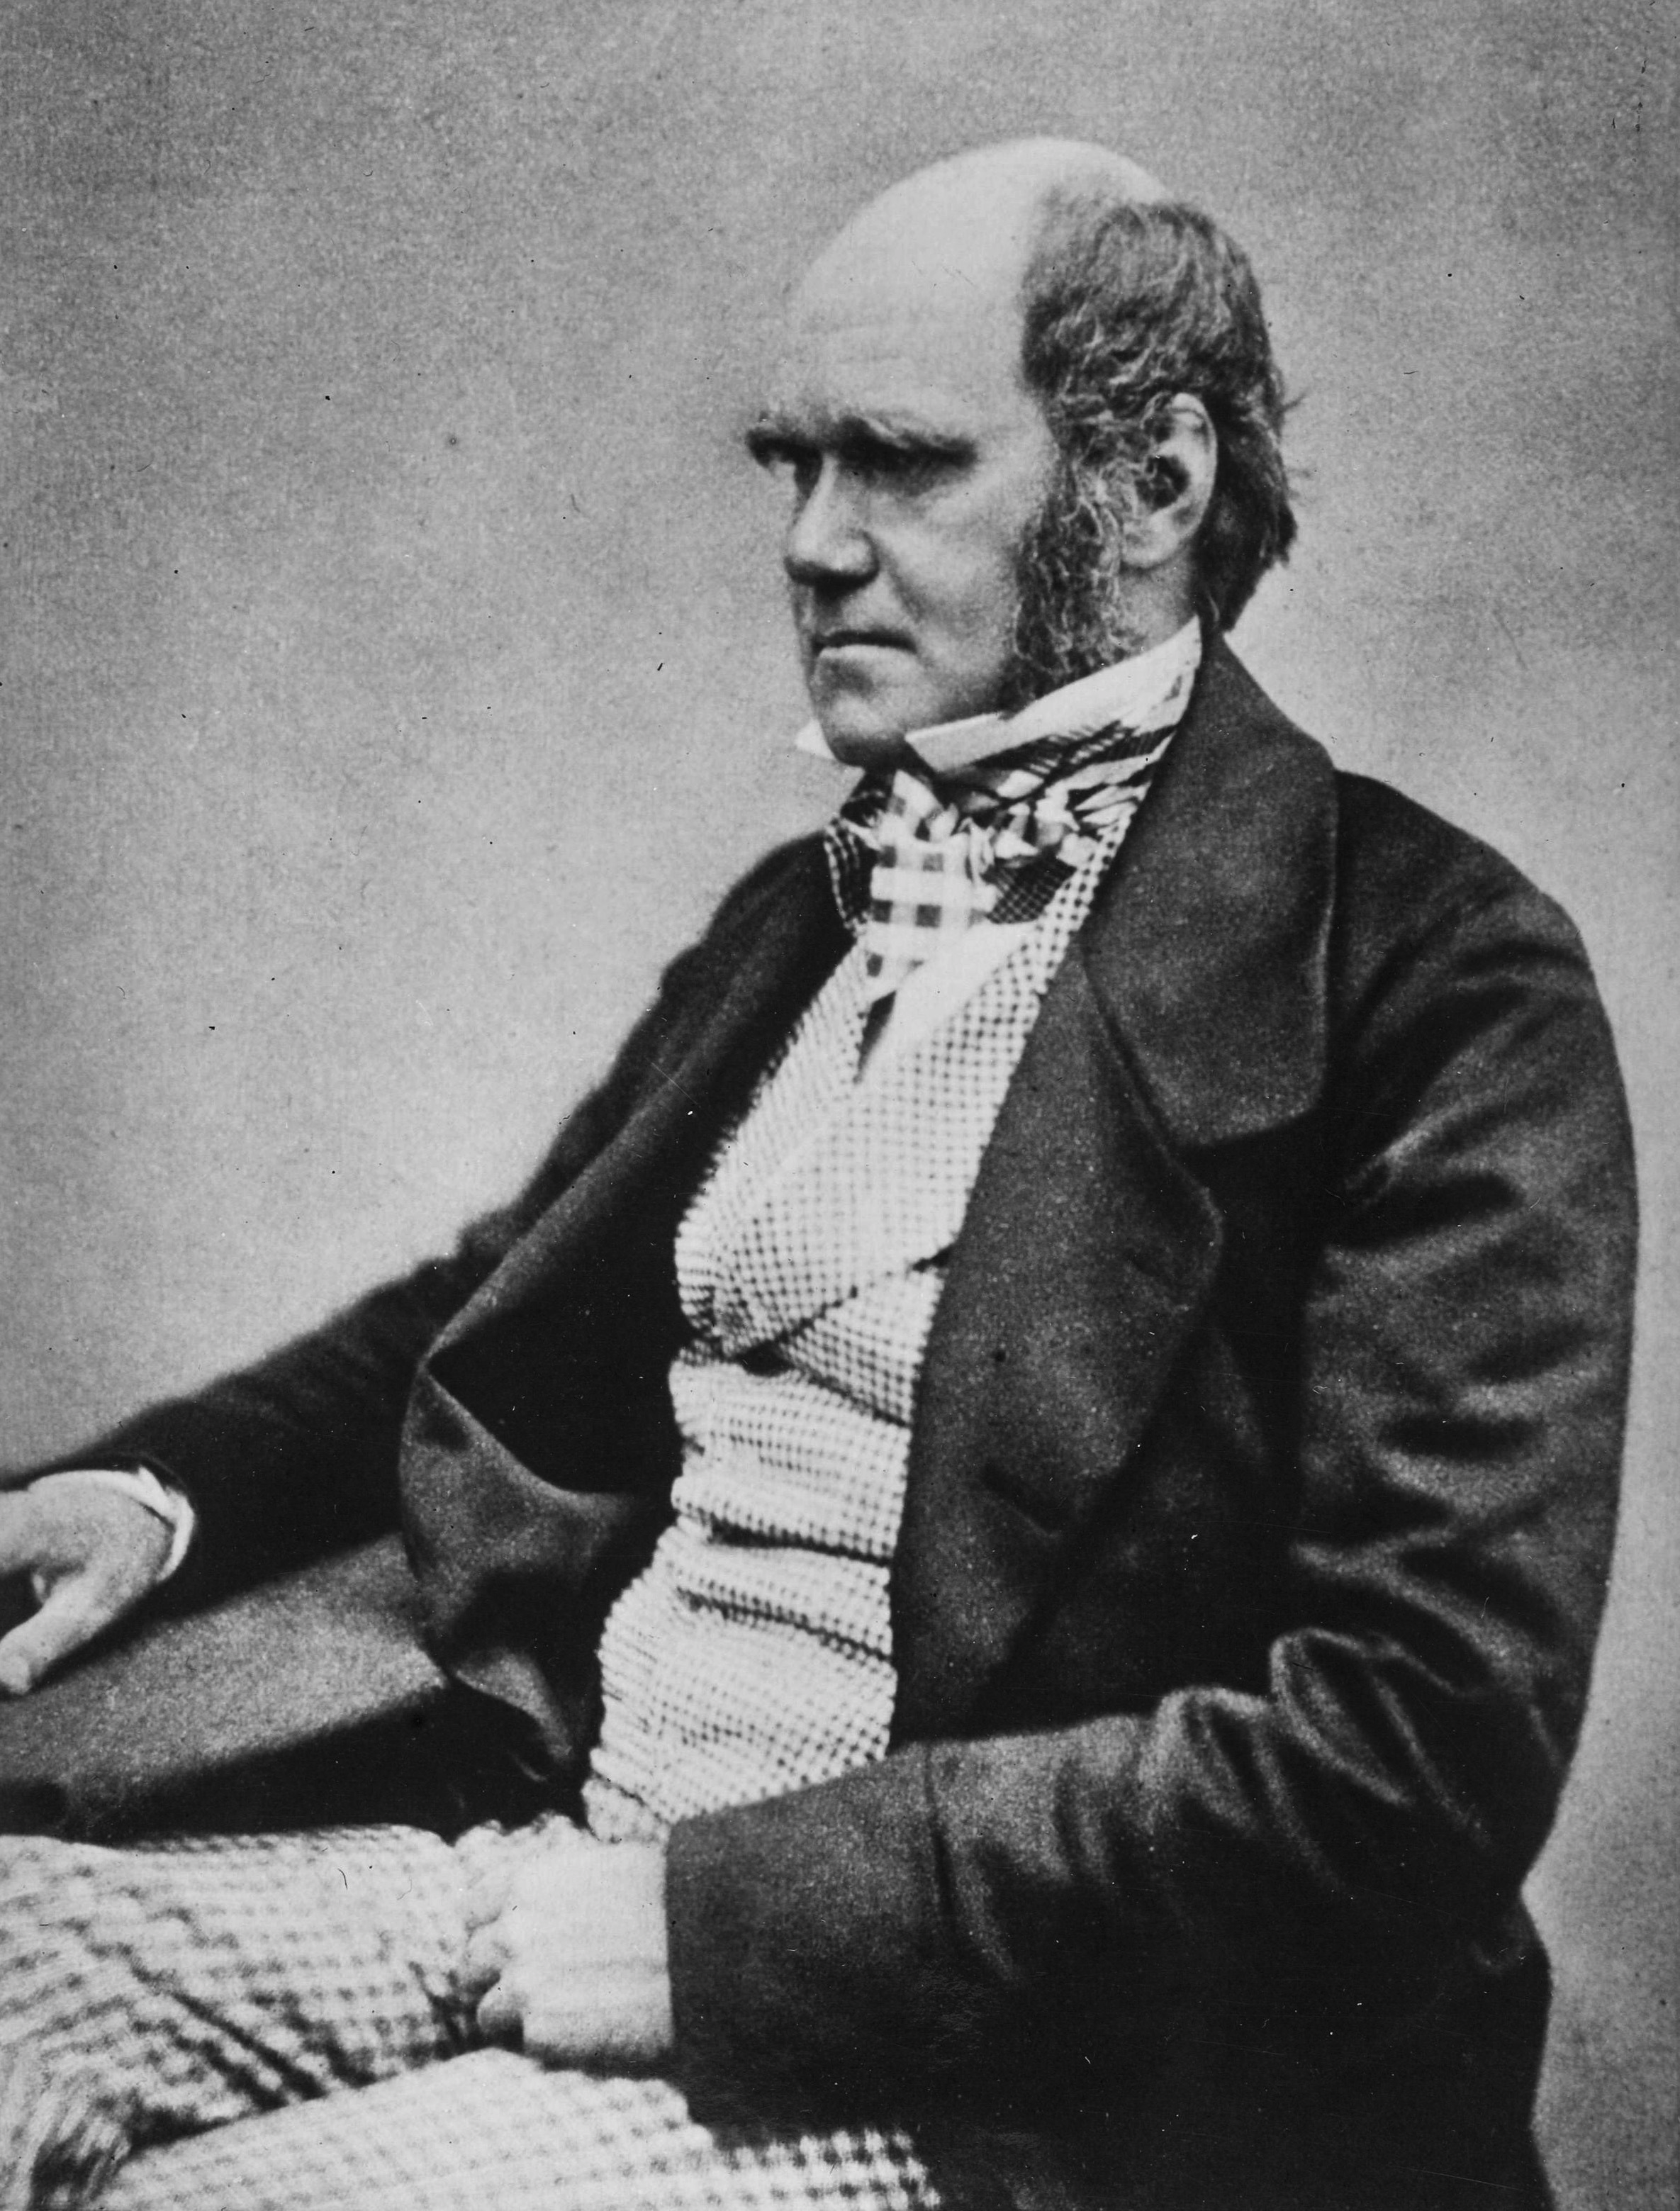
Social Darwinism and Eugenics
(Spencer, Malthus, Galton)
Herbert Spencer in his Principles of Biology of 1864 wrote: 'This survival of the fittest, which I have here sought to express in mechanical terms, is that which Mr. Darwin has called "natural selection", or the preservation of favoured races in the struggle for life.'
Charles Darwin in The Descent of Man, and Selection in Relation to Sex (1882): 'Thus the weak members of civilized societies propagate their kind. No one who has attended to the breeding of domestic animals will doubt that this must be highly injurious to the race of man. It is surprising how soon a want of care, or care wrongly directed, leads to the degeneration of a domestic race; but excepting in the case of man himself, hardly any one is so ignorant as to allow his worst animals to breed. … but there appears to be at least one check in steady action, namely that the weaker and inferior members of society do not marry so freely as the sound …
Charles Robert Darwin, aged 45 in 1854
Images from Wikipedia

Slide 30
From: http://darwin-online.org.uk/content/frameset?pageseq=157&itemID=F955&viewtype=side

Slide 31
Darwin was an ardent abolitionist, (e.g. here) but …
From: http://darwin-online.org.uk/content/frameset?pageseq=229&itemID=F937.1&viewtype=side

Slide 32
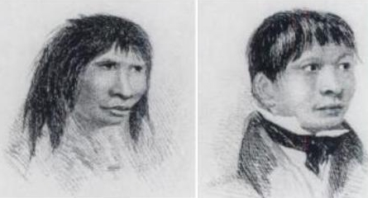
Aside on Jemmy Button:
Darwin was on the beagle when Captain Fitzroy returned Jemmy Button to his native Tierra del Fuego (or Fireland).
Jemmy Button had been abducted to England on the previous voyage of the Beagle under Captain Fitzroy, and under Fitzroy’s tutelage received education in England.
Two views of Jemmy Button from FitzRoy's Narrative (1839)
via Wikipedia
Reading assignment for Wednesday:
https://www.darwinproject.ac.uk/orundellico-jemmy-button

Slide 33
Some of the early Darwinists were worse racists.
For example, Ernst Haeckel writes in his HISTORY OF CREATION
At the lowest stage of human mental development are the Australians, some tribes of the Polynesians, and the Bushmen, Hottentots, and some of the Negro tribes … Nothing, however, is perhaps more remarkable in this respect, than that some of the wildest tribes in southern Asia and eastern Africa have no trace whatever of the first foundations of all human civilization, of family life, and marriage. They live together in herds, like apes, generally climbing on trees and eating fruits; they do not know of fire, and use stones and clubs as weapons, just like the higher apes. All attempts to introduce civilization among these, and many of the other tribes of the lowest human species, have hitherto been of no avail; it is impossible to implant human culture where the requisite soil, namely, the perfecting of the brain, is wanting. Not one of these tribes has ever been ennobled by civilization; it rather accelerates their extinction. They have barely risen above the lowest stage of transition from man-like apes to ape-like men, a stage which the progenitors of the higher human species had already passed through thousands of years ago.

Slide 34
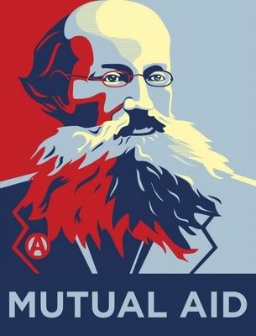
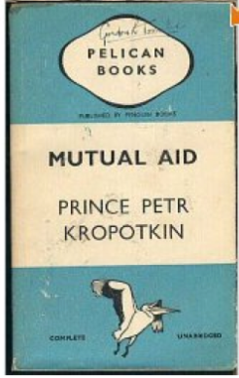
Prince Pyotr Alexeyevich Kropotkin
Mutual Aid: A Factor of Evolution
Russian Anarchist; organized geographical survey expedition to Siberia and Manchuria; spent most of his life in Switzerland, France (Paris commune), and England; returned to Russia after the 1917 revolution, but did not like the Bolsheviks and spoke out against authoritarian socialism.
Chapters written 1890-96
Critique of the "Struggle for Existence".
Raises the question
"Who are the fittest?"

Slide 35
From Mutual aid: a factor of evolution - Peter Kropotkin
… I saw animal life struggling in Northern Asia. They made me realize at an early date the overwhelming importance in Nature of what Darwin described as "the natural checks to over-multiplication," in comparison to the struggle between individuals of the same species for the means of subsistence, which may go on here and there, to some limited extent, but never attains the importance of the former. Paucity of life, under-population -- not over-population -- being the distinctive feature …
… besides the law of Mutual Struggle there is in Nature the law of Mutual Aid, which, for the success of the struggle for life, and especially for the progressive evolution of the species, is far more important than the law of mutual contest.
... Darwin himself was not fully aware of the generality of the factor … And at the very beginning of his memorable work he insisted upon the term being taken in its "large and metaphorical sense including dependence of one being on another, and including (which is more important) not only the life of the individual, but success in leaving progeny."1

Slide 36
From Mutual aid: a factor of evolution - Peter Kropotkin
… Nay, on the very pages just mentioned, amidst data disproving the narrow Malthusian conception of struggle, the old Malthusian leaven reappeared -- namely, in Darwin's remarks as to the alleged inconveniences of maintaining the "weak in mind and body" in our civilized societies (ch. v). As if thousands of weak-bodied and infirm poets, scientists, inventors, and reformers, together with other thousands of so-called "fools" and "weak-minded enthusiasts," were not the most precious weapons used by humanity in its struggle for existence by intellectual and moral arms, which Darwin himself emphasized in those same chapters of Descent of Man.

Slide 37
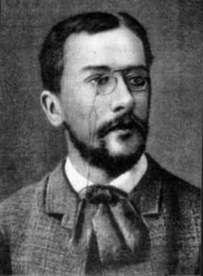
Symbiogenesis
Konstantin Mereschkowski:
The nature and origins of chromatophores in the plant kingdom (1905)
The Theory of Two Plasms as the Basis of Symbiogenesis (1909)
Natural selection cannot create novelty.
→ Acquisition and inheritance of microbes
(see also Lynn Margulis' theory of serial endosybiosis)

Slide 38
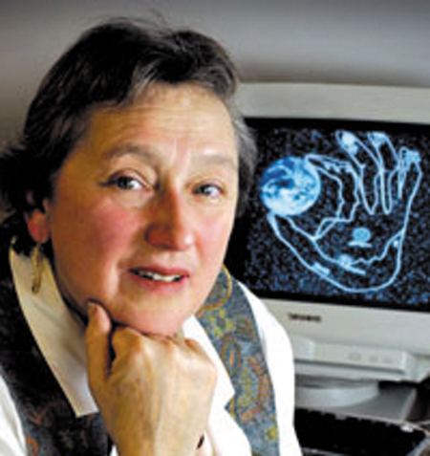
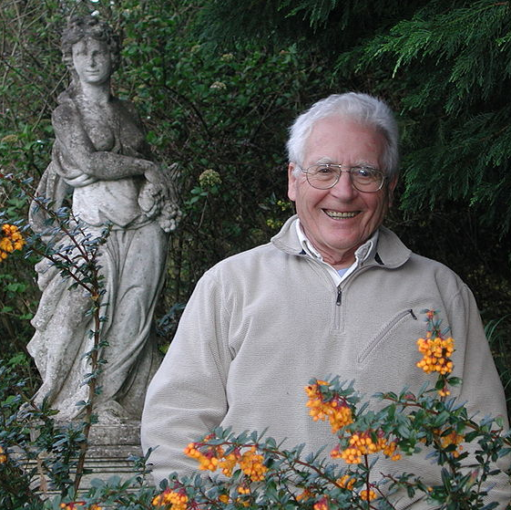
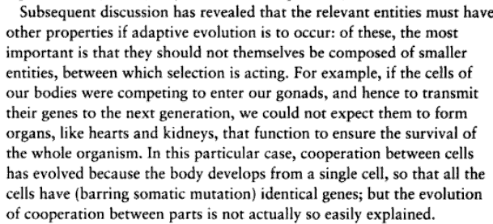
Gaia Hypothesis
Lynn Margulis, James Lovelock
Ecosystems (including the whole biosphere) can be seen as super organisms with their own homeostatic mechanisms.
Problems:
A single organisms cannot evolve by natural selection.
Both positive and negative feed back loops exist in the biosphere.
John Maynard Smith in Connie Barlow's "From Gaia to Selfish gene":
Images from Wikipedia

Slide 39
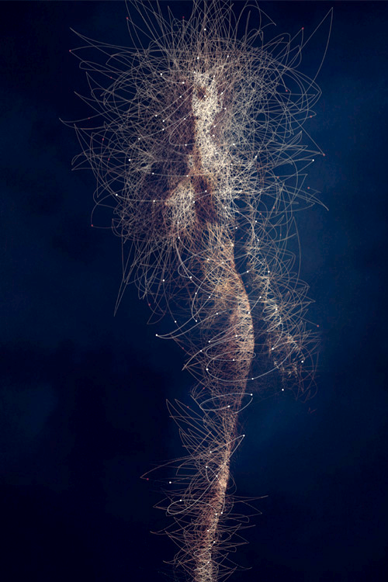
Holobiont and Evolution
Holobiont = Host plus all its Symbionts
In science symbiont is usually defined as living together, i.e. the term includes mutualistic, commensal and parasitic interactions.
The fitness of the Holobiont is the arbiter of selection.
The Hologenome Theory of Evolution
Image: BODY MICROBES, by Bruno Vergauwen.

Slide 40
Mutual aid
Discussion
Is the concept of mutual aid in conflict with Darwin’s theory of evolution by natural selection?
Or only in conflict with social Darwinists?
Is it the result of seeing the struggle for survival as a struggle with the environment, and not with members of the same species? (=> Group Selection)

Slide 41
Follow up questions on mutual aid
Discussion
mutual aid in the bacterial world – rule or exception?
Example: distributed metabolic pathways ammonium to nitrite to nitrate
Is there a difference between cooperation, mutualism and cheating?

Slide 42
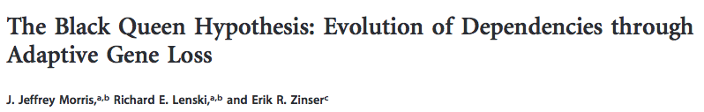
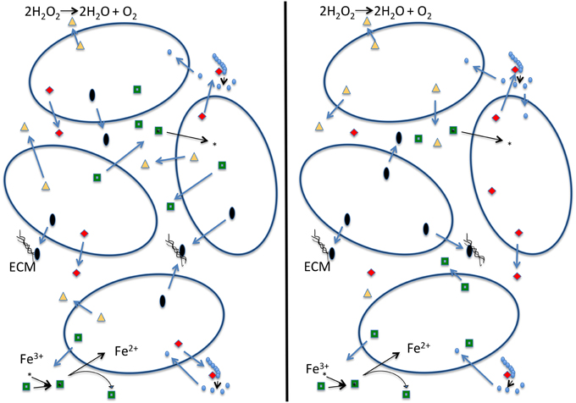
The Black Queen Hypothesis
doi: 10.1128/mBio.00036-12
23 March 2012
mBio vol. 3 no. 2 e00036-12
explains the emergence of collaboration between microbes through the loss of genes encoding common goods (leaky products). E.g.:
Start - After selection for small streamlined genomes
Cells with identical genomes Cells are mutually dependent
The name refers to the game of Hearts, where the usual strategy is to avoid hearts and the queen of spades (in analogy to get rid of as many genes encoding leaky functions as possible - cheating).
The alternative is to get all hearts and the Black Queen (corresponding to the maintaining the keystone genome).

Slide 43
Discussion
Is the concept of mutual aid in conflict with Darwin’s theory of evolution by natural selection, or only in conflict with social Darwinists?

