Slide 1
Mutual aid
Discussion
Is the concept of mutual aid in conflict with Darwin’s theory of evolution by natural selection?
Or only in conflict with social Darwinists?

Slide 2
From Mutual aid: a factor of evolution - Peter Kropotkin
… I saw animal life struggling in Northern Asia. They made me realize at an early date the overwhelming importance in Nature of what Darwin described as "the natural checks to over-multiplication," in comparison to the struggle between individuals of the same species for the means of subsistence, which may go on here and there, to some limited extent, but never attains the importance of the former. Paucity of life, under-population -- not over-population -- being the distinctive feature …
… besides the law of Mutual Struggle there is in Nature the law of Mutual Aid, which, for the success of the struggle for life, and especially for the progressive evolution of the species, is far more important than the law of mutual contest.
... Darwin himself was not fully aware of the generality of the factor … And at the very beginning of his memorable work he insisted upon the term being taken in its "large and metaphorical sense including dependence of one being on another, and including (which is more important) not only the life of the individual, but success in leaving progeny."1

Slide 3
Mutual aid
Discussion
Is the concept of mutual aid in conflict with Darwin’s theory of evolution by natural selection?
Or only in conflict with social Darwinists?
The different emphasis seems to be due to seeing the struggle for survival as a struggle with the environment, and not with members of the same species. (=> Group Selection)

Slide 4
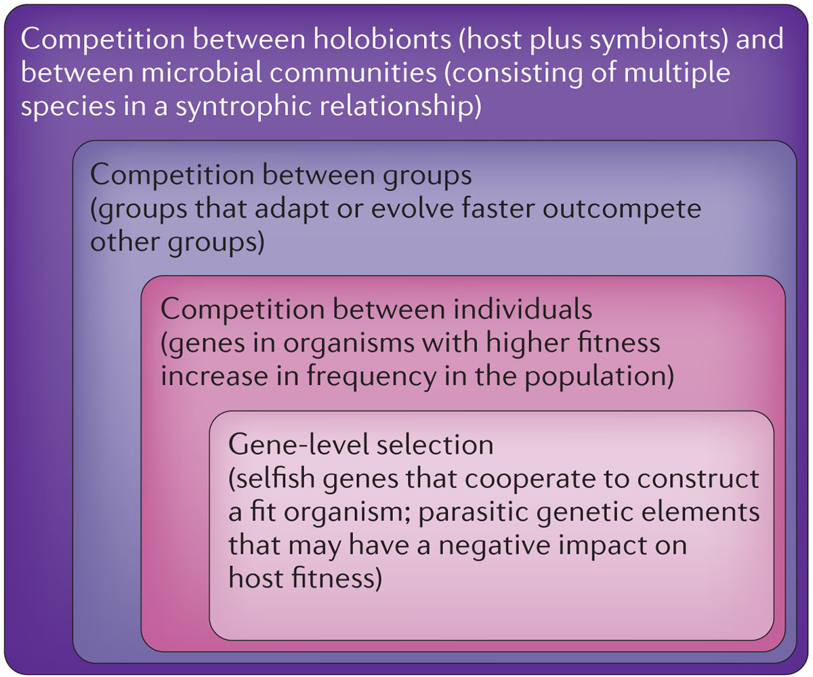
Levels of Selection
Notes:
Soucy SM, Huang J, Gogarten JP (2015)
Horizontal gene transfer: building the web of life.
Nature Reviews in Genetics 16, 472–482. doi: 10.1038/nrg3962

Slide 5
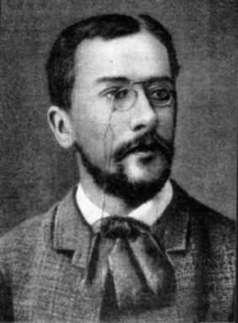
Symbiogenesis
Konstantin Mereschkowski:
The nature and origins of chromatophores in the plant kingdom (1905)
The Theory of Two Plasms as the Basis of Symbiogenesis (1909)
Natural selection cannot create novelty.
→ Acquisition and inheritance of microbes
(see also Lynn Margulis' theory of serial endosybiosis)

Slide 6
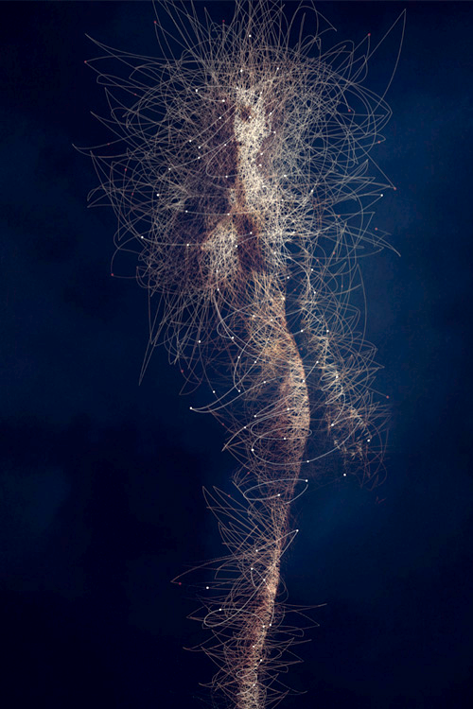
Holobiont and Evolution
Holobiont = Host plus all its Symbionts
In science symbiont is usually defined as living together, i.e. the term includes mutualistic, commensal and parasitic interactions.
The fitness of the Holobiont is the arbiter of selection.
The Hologenome Theory of Evolution
Image: BODY MICROBES, by Bruno Vergauwen.

Slide 7
Follow up questions on mutual aid
Discussion
mutual aid in the bacterial world – rule or exception?
Example: distributed metabolic pathways ammonium to nitrite to nitrate
Is there a difference between cooperation, mutualism and cheating?

Slide 8
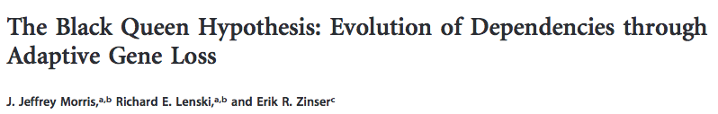
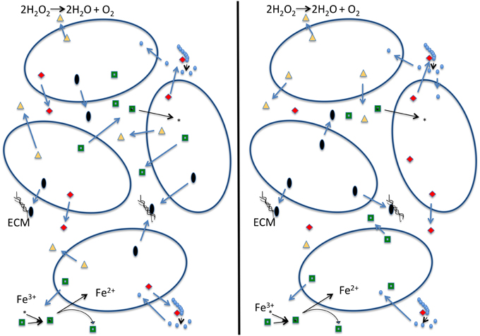
The Black Queen Hypothesis
doi: 10.1128/mBio.00036-12
23 March 2012
mBio vol. 3 no. 2 e00036-12
explains the emergence of collaboration between microbes through the loss of genes encoding common goods (leaky products). E.g.:
Start - After selection for small streamlined genomes
Cells with identical genomes Cells are mutually dependent
The name refers to the game of Hearts, where the usual strategy is to avoid hearts and the queen of spades (in analogy to get rid of as many genes encoding leaky functions as possible - cheating).
The alternative is to get all hearts and the Black Queen (corresponding to the maintaining the keystone genome).

Slide 9
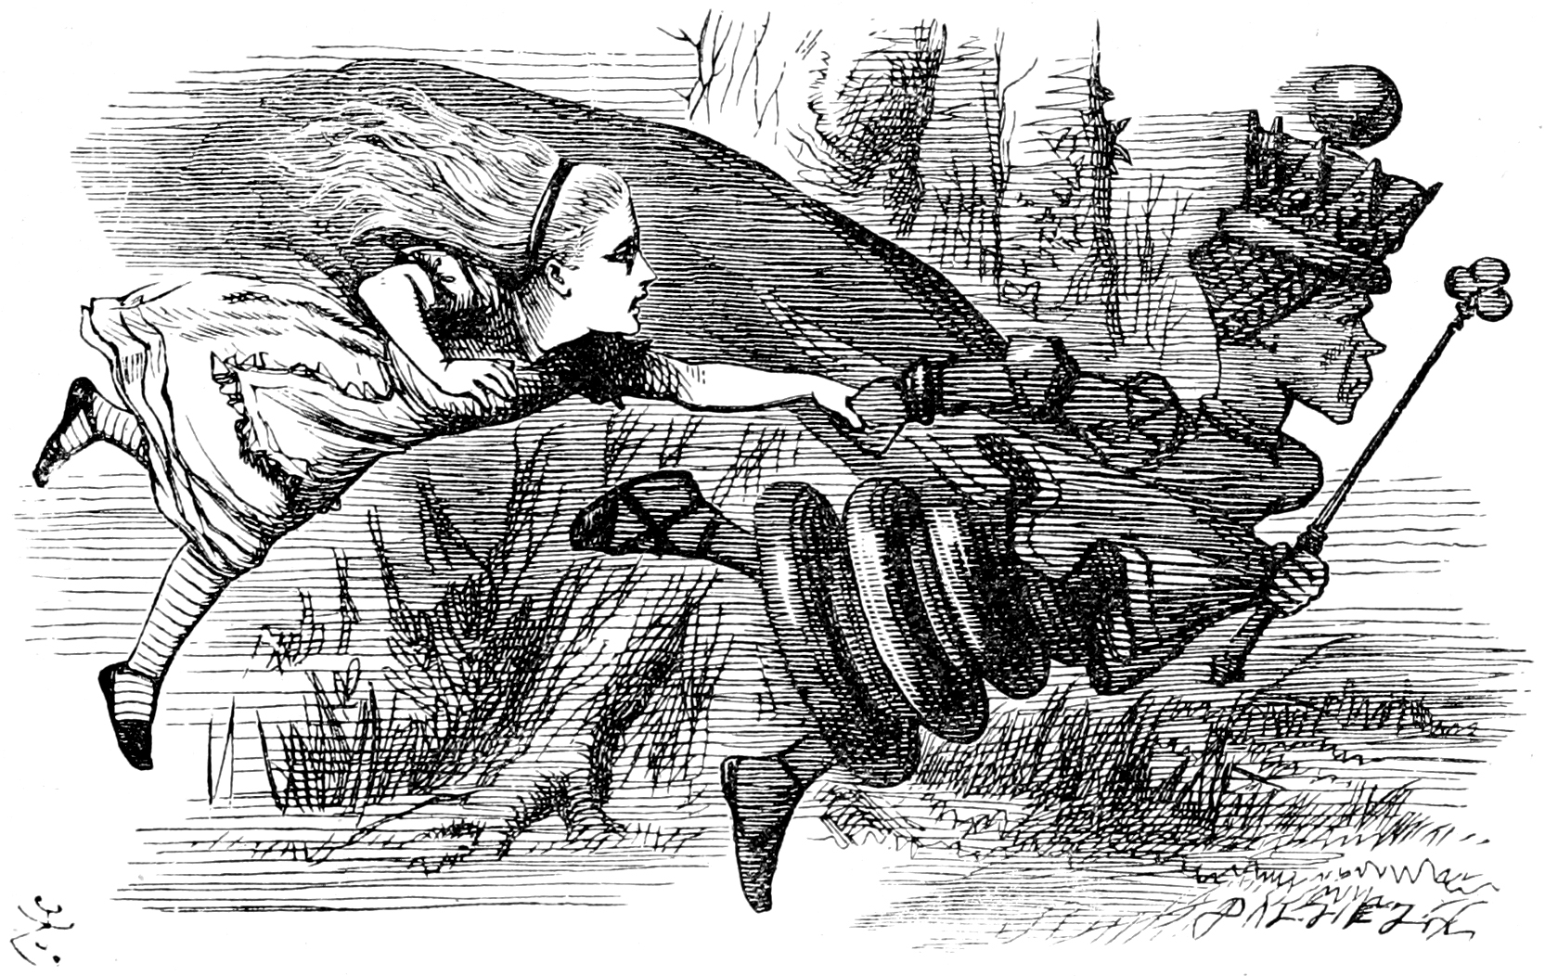
The Red Queen* hypothesis
A Species must constantly evolve in order to survive while pitted against ever-evolving competing species.
Edwards-Venn cogwheel
* In analogy to to the Red Queen from Lewis Carroll’s Through the Looking-Glass, who states that "it takes all the running you can do, to keep in the same place"

Slide 10
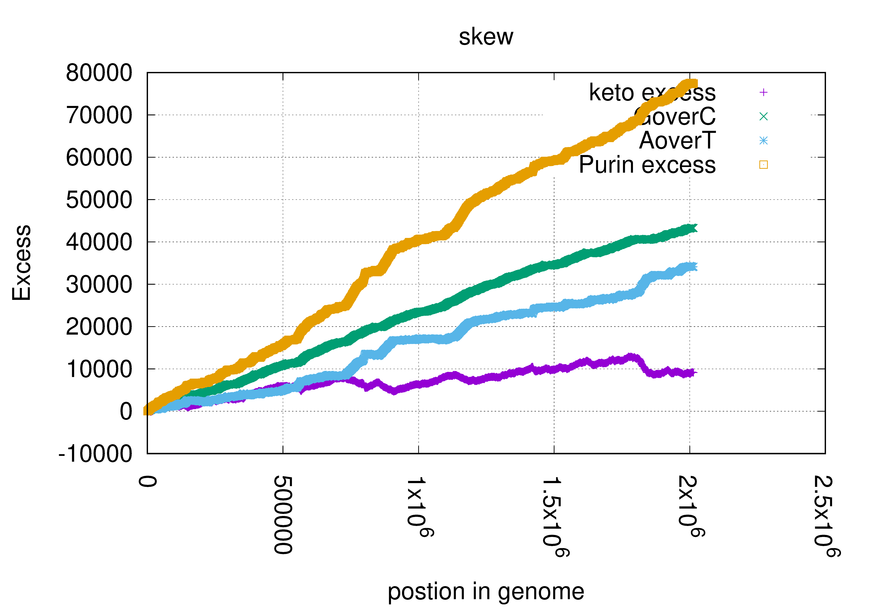
Supposedly: Streptococcus pyogenes strain MGAS10786 chromosome, complete genome
What went wrong, if anything?
Is this a strange genome?
?????

Slide 11
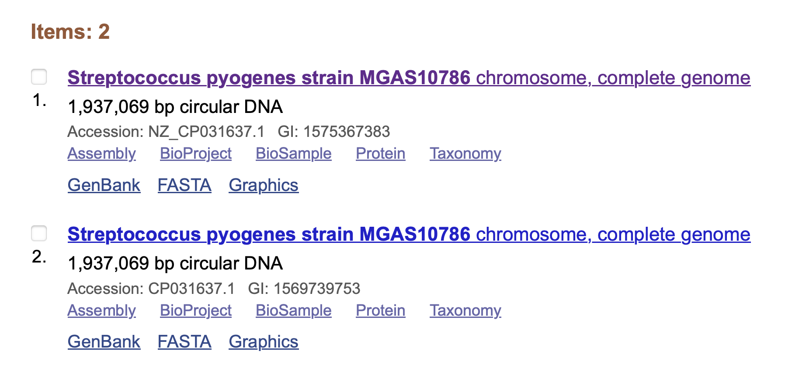
Two versions at NCBI (refseq and genbank)

Slide 12
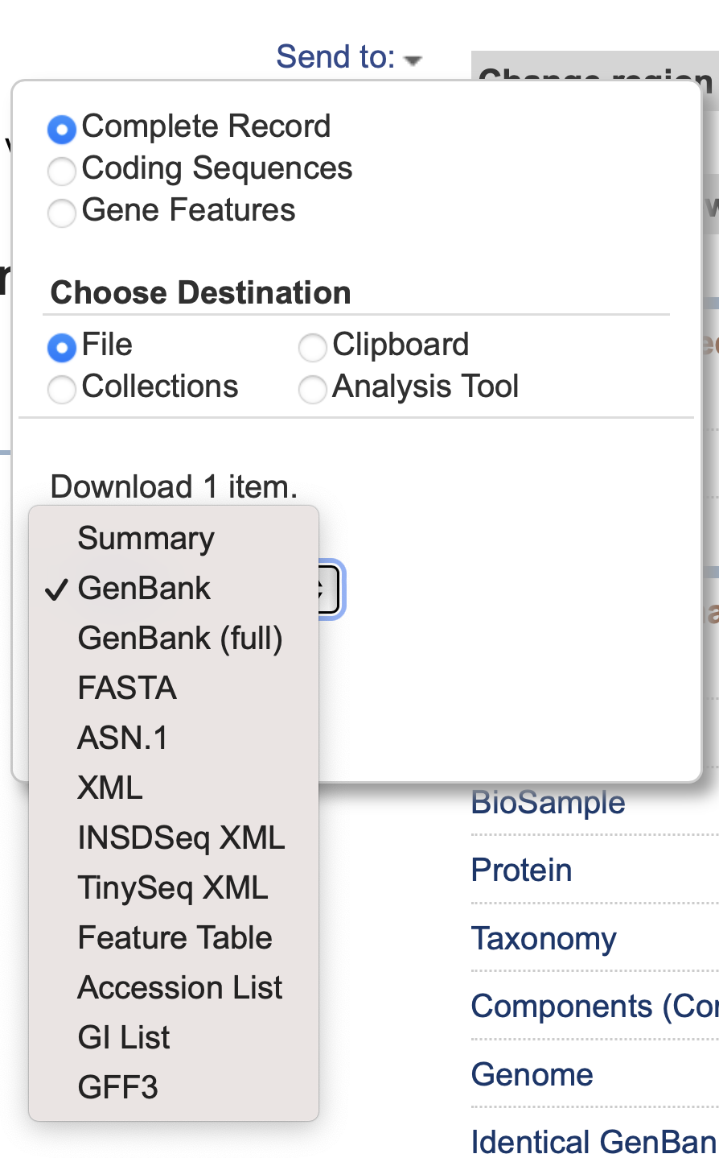
To get the complete genome

Slide 13
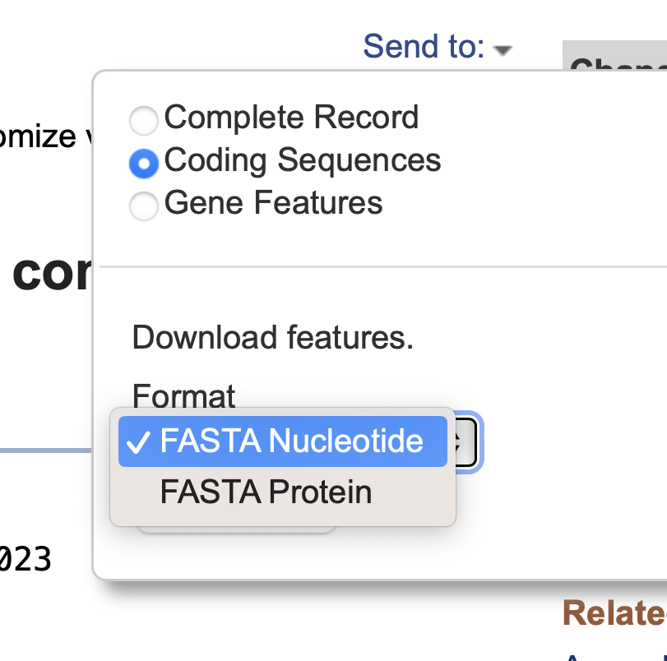
This retrieves the coding sequences only not the DNA of the chromosome
As most of the cds are on the leading strand, the bias increases continuously.

Slide 14
Watson and Crick strands
|
Terminus
Watson and Crick strands change bias at origin and terminus of replication.
To a large part this is due to the preponderance of transcription of genes occurring on the leading strand (both DNA and RNA are synthesized from 5’ to 3’)
In contrast the coding sequences switch from Watson to Crick strand, and thus always hav ethe same bias.
ori
|
3’
3’

Slide 15
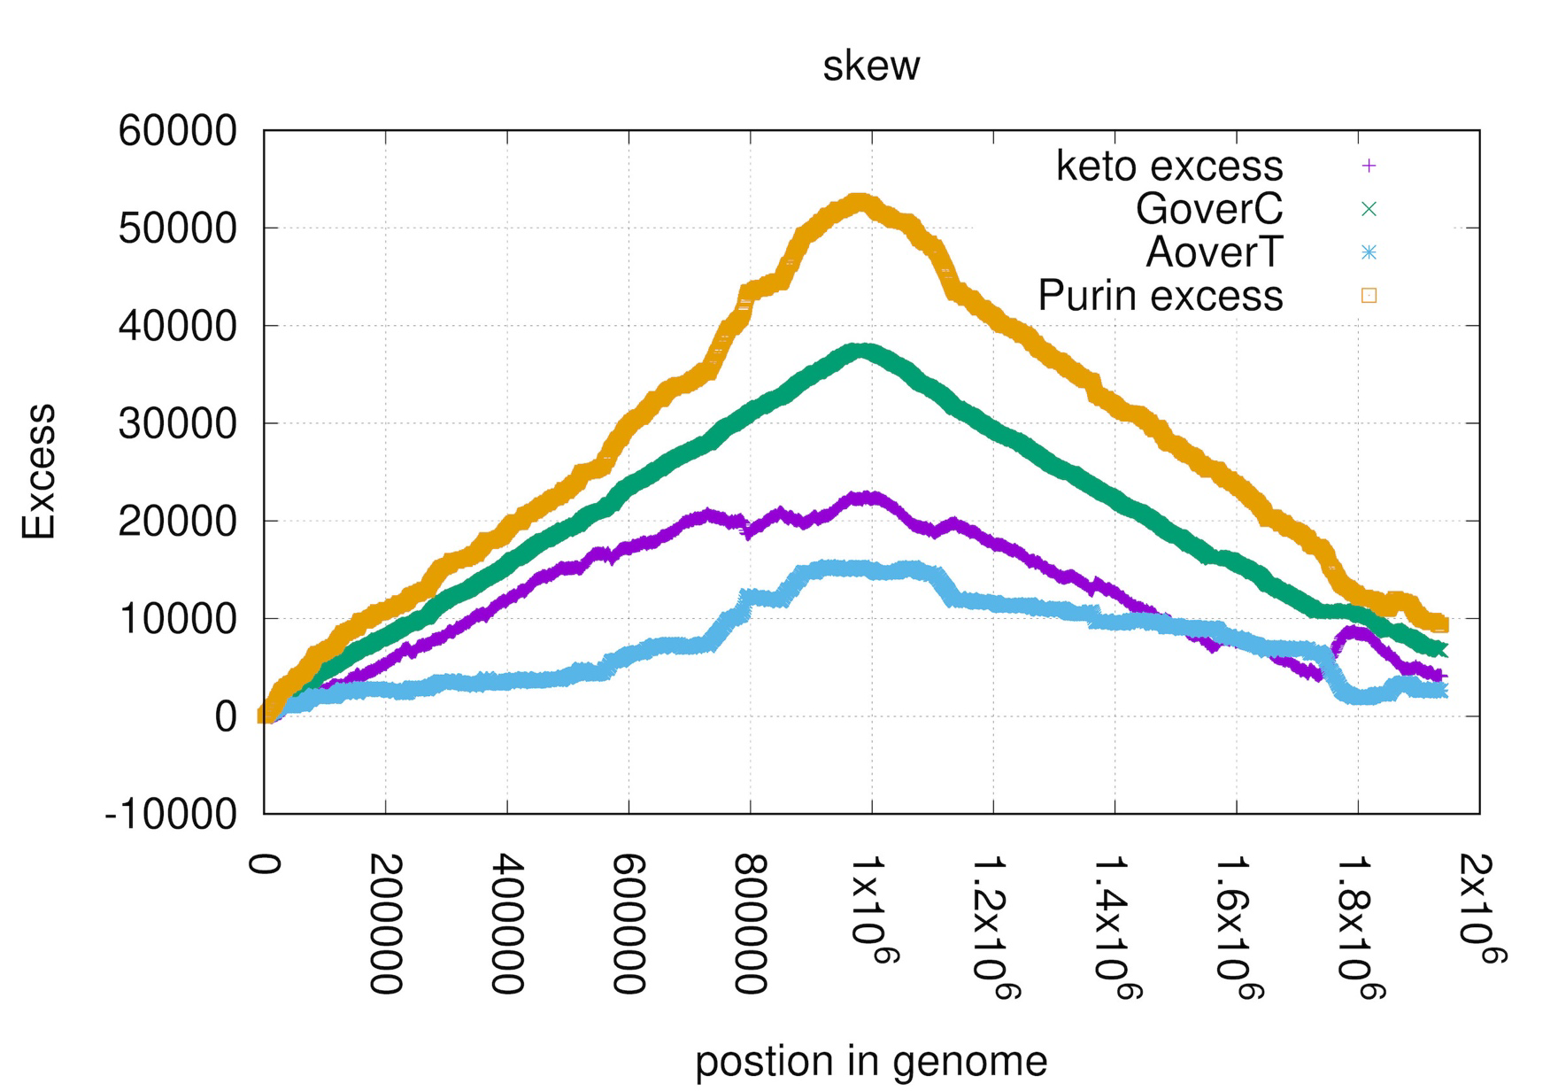
Streptococcus pyogenes strain MGAS10786 chromosome, complete genome

Slide 16
Class 13
Gene and genome duplications
Dotplots

Slide 17
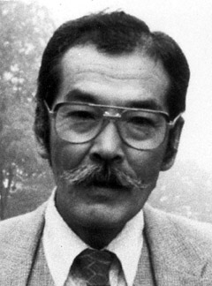
Duplications and Evolution
Ohno postulated that gene duplication plays a major role in evolution
Small scale duplications (SSD)
Whole genome duplications (WGD)
Polyploid: nucleus contains three or more copies of each chromosome
Autopolyploid: formed within a single species
Diploids AA and A’A’ Polyploid AAA’A’
Allopolyploid: formed from more than one species
Diploids AA and BB Polyploid AABB
Susumu Ohno 1970
Evolution by gene duplication
1R and 2R hypothesis
“Junk DNA” 1972
Slide from Chris Pires

Slide 18
Type of gene duplications:
tandem repeats
duplication via transposition (esp. retro transposition) (selfish genetic elements, but other genes as well; see the work from Craig Nelson’s lab)
Whole genome, chromosome, or chromosome arm duplications
In the lineage to vertebrates two whole genome duplications occurred (the exact placement is uncertain, because other duplications occurred as well). As a consequence, many regulatory genes (e.g. the hox gene cluster) are now present in at least 4 copies per genome. Many think that this allowed for a more differentiated development)
In fish* three rounds of whole genome duplications occurred
(*Teleostei = bony fish; the largest group of fish, but it does not include the sistergroup to the tetrapods (Lungfish or Dipnoe)
Most crop plants are polyploid (auto- or allopolyploid) => can lead to instant speciation in a hybridzone.

Slide 19
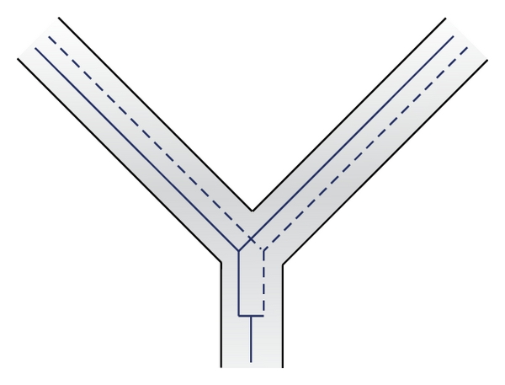
Autochtonous gene duplication.
Can occur through duplication of part of a chromosome, or through an mRNA intermediate (the new gene loses its introns)

Slide 20
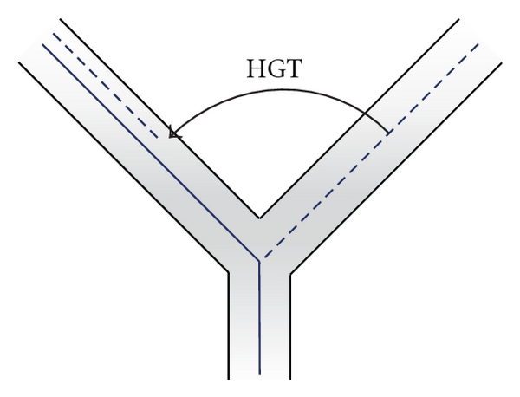
Gene family expansion through gene transfer. In one lineage the gene might have acquired a slightly different function, e.g., a malic acid dehydrogenase might have acquired reactivity toward lactic acid.
The recipient lineage than has both, a lactic and a malic acid dehydrogenase.
Most common in bacteria

Slide 21
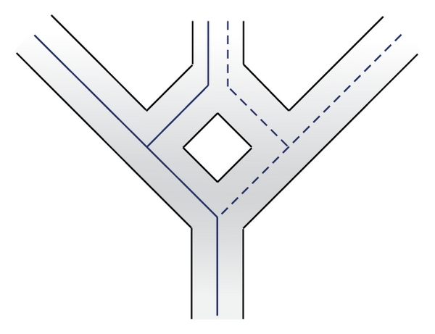
Aneupolyploidization.
Genomes from two related lineages fuse, all genes are duplicated. Occurs frequently in plants (instant speciation, the hybrids can not cross with the parents, because they have different sets of chromosomes.

Slide 22
Gene and genome duplication versus
Horizontal Gene Transfer
Gene family expansion through horizontal gene transfer –
the most common process in prokaryotes
Gene duplication through lineage fusion
Very common in plants, but also in animals
Autochtonous gene/genome
duplication are rare
in prokaryotes

Slide 23
Fate of Duplicated genes

Slide 24
Fate of Duplicated genes
gene silencing -> decay -- the most common fate, loss of function
Pseudogenization
gene paralog 1
one paralog keep the original function
gene duplication
gene 1
gene paralog 2
one paralog accumulates mutations and looses function
Occurs most frequently

Slide 25
Fate of Duplicated genes
gene silencing -> decay -- the most common fate, loss of function
subfunctionalization -- the two daughter genes from the duplication divide the functions of the parent gene, for example, via tissue specific expression – in plants many genes for proton pumps targeted to the plasma membrane exist, they all have the same function, but they are expressed in root hairs, in stamen, ..., in human the mitochondrial F-ATPase alpha subunit (encoded in the nucleus) has an isoform that is only expressed in the liver; this is the most common way for a gene to be maintained in a genome following a duplication.

Slide 26
The Fate of Duplicated Genes
Subfunctionalization
gene paralog 1
gene duplication
gene 1
gene paralog 2
The gene has a a function
(e.g., an ATP synthase subunit expressed in all organs, or in all organs of a plant)
The two paralogs divide the functional space
(e.g. one paralog is expressed in liver cells, the other in all other organs, or in case of plants one expressed only in anthers, the other in roots, the third in stomata)
Occurs often, This is the main pathway paralogs are maintained in a genome.

Slide 27
Fate of Duplicated genes
gene silencing -> decay -- the most common fate, loss of function
subfunctionalization -- the two daughter genes from the duplication divide the functions of the parent gene, for example, via tissue specific expression – in plants many genes for proton pumps targeted to the plasma membrane exist, they all have the same function, but they are expressed in root hairs, in stamen, ..., in human the mitochondrial F-ATPase alpha subunit (encoded in the nucleus) has an isoform that is only expressed in the liver; this is the most common way for a gene to be maintained in a genome following a duplication.
neofunctionalization -- one of the genes picks up a new function that the parent gene did not have.

Slide 28
The Fate of Duplicated Genes
Neofunctionalization
gene paralog 1
gene duplication
gene 1
gene paralog 2
paralog two picks up new function
Does happen only very rarely, it at all.

Slide 29
Question:
It seems that gene duplications followed by gene loss play not a big role in evolution. Conway and Lynch suggest that these duplications play a major role in biodiversity in erecting post mating hybridization barriers. How does this work?

Slide 30



Post mating hybridization barrier (hybrid infertility) through duplication followed by loss of function
Parent Populations
Subpopulation a
In 50% of the cases
the two sub populations
will lose the function in different copies
duplicated gene
before loss of function
Subpopulation b

Slide 31


F1
F2
Chr1+
Chr1 -
Chr2+
2+
1+
Chr2-
1+
0 +
Hybrid will have two functional genes in different locations
In 25% the F2 will not have a functional gene.
In case 100 genes were initially duplicated.
50 will be differentially fixed, and for each of
these the chance of being completely lost is 25%.
The chance the none of the 50 genes is lost is 0.75⁵⁰= 6x10⁻⁷

Slide 32
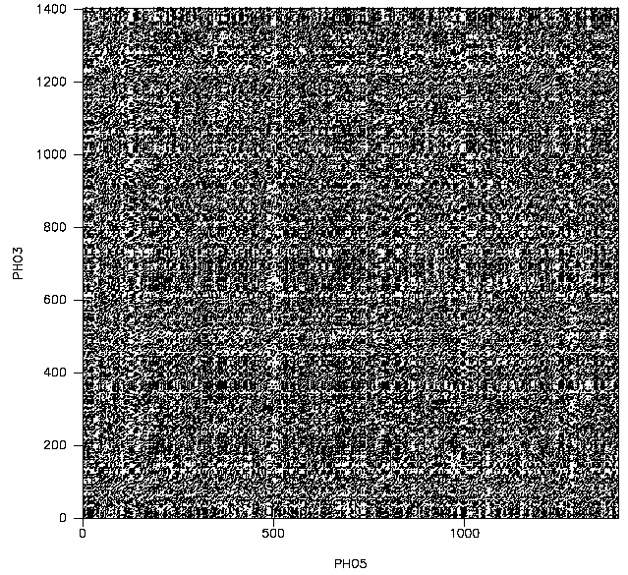
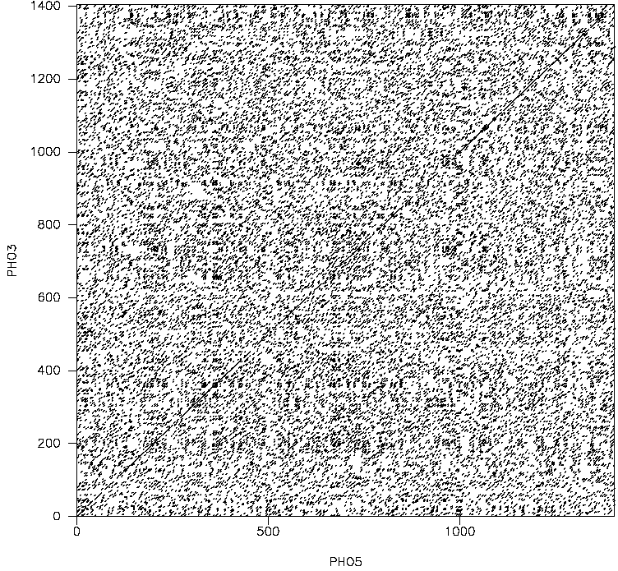
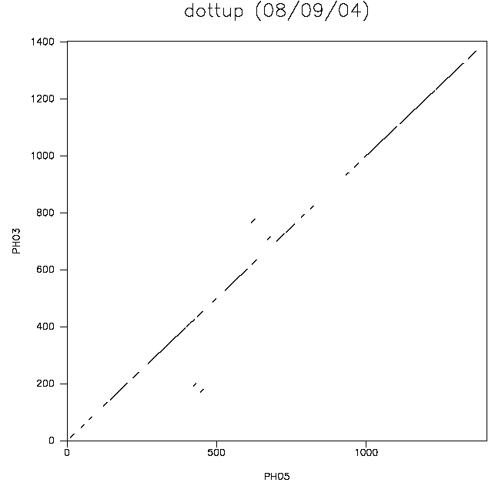
Dotplot with Word Matches
With nucleic sequences, each residue is expected every 4 positions on average
  Single letter-based dot plot not very informative
Can set up dot plots to display only word (multiple letter) matches
  Words correspond to a diagonal of dots in the letter-based dot plot
Ex: alignment of PHO5 and PHO3 coding sequences, with different word sizes
  larger the word size, higher the stringency of match
Word size = 2
Word size = 3
Word size = 10

Slide 33
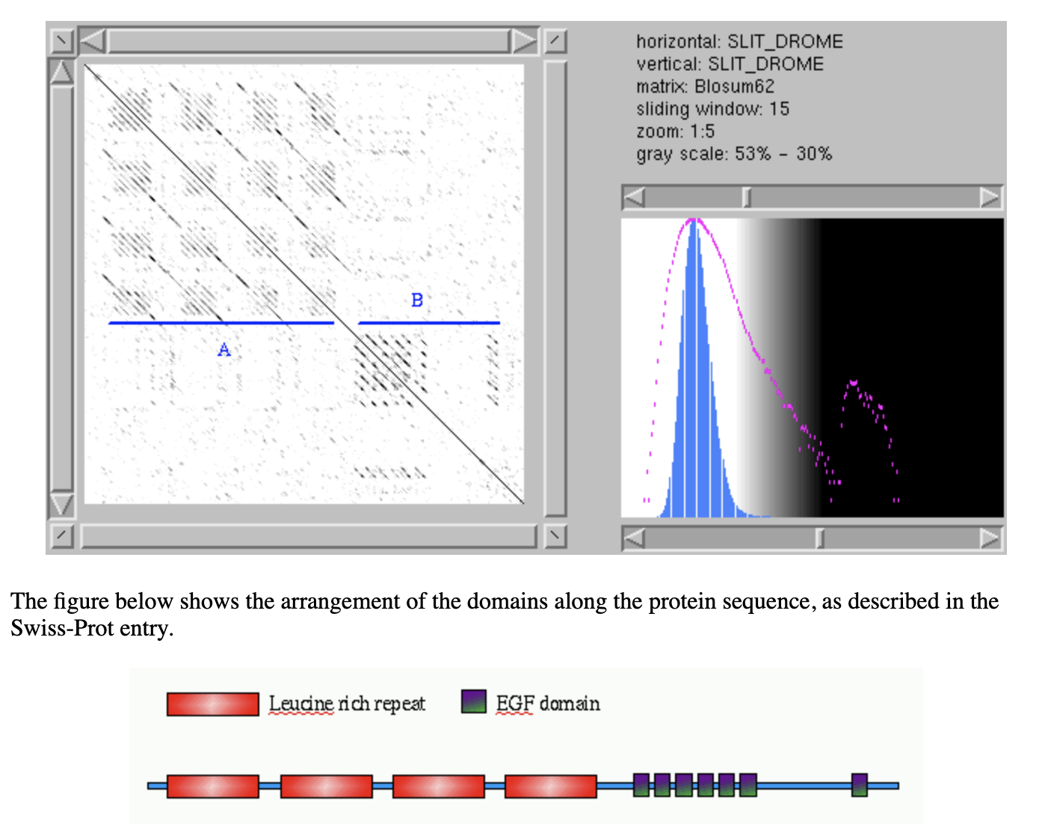
Alignment of a protein against itself consisting of multiple repeted domains
from: https://myhits.sib.swiss/util/dotlet/doc/repeats.html

Slide 34
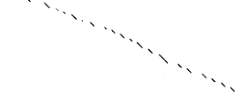
dotplots can also be used to compare a DNA sequence (in the three forward reading frames) against a protein:
gene encoding the V-ATPases A SU in Arabidopsis
protein sequence of the
V-ATPases A SU in Arabidopsis

Slide 35
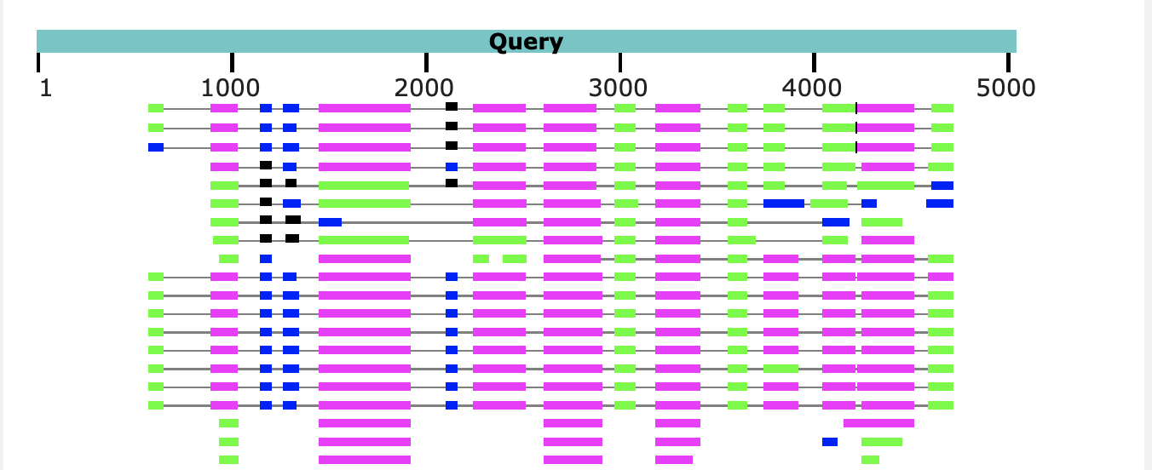
A similar result is obtained using blastx, with the gene sequence as query:
The parts of the query that does not have matches corresponds to introns.
Note the large number of introns present in Arabidopsis, which is a plant with a very small genome. In other organisms the introns are even larger.

Slide 36
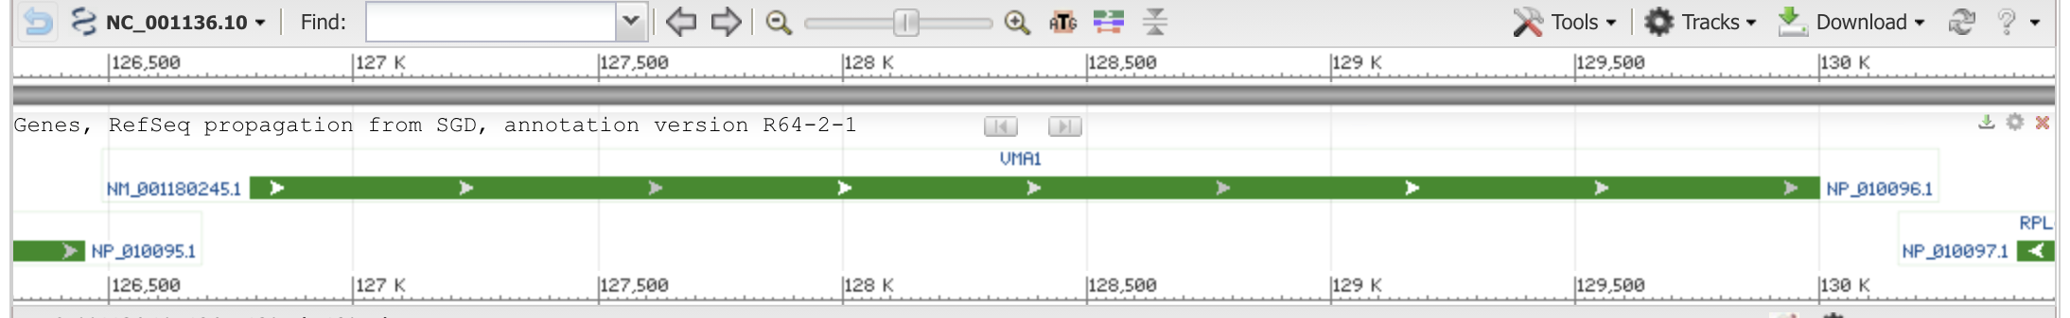
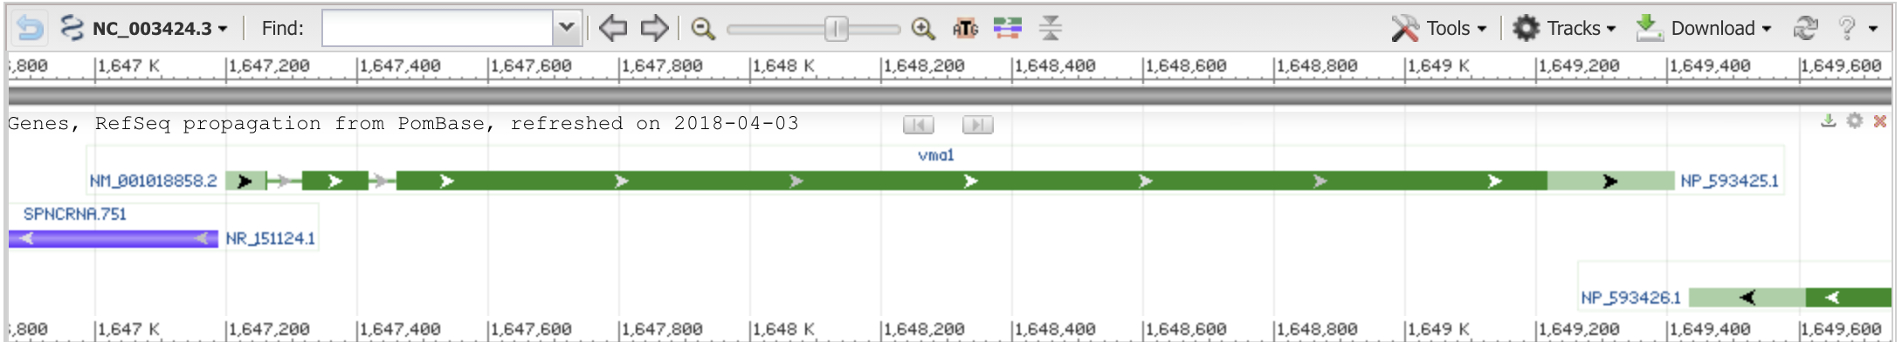
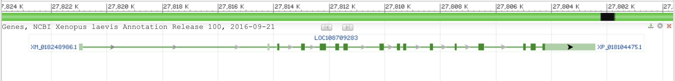
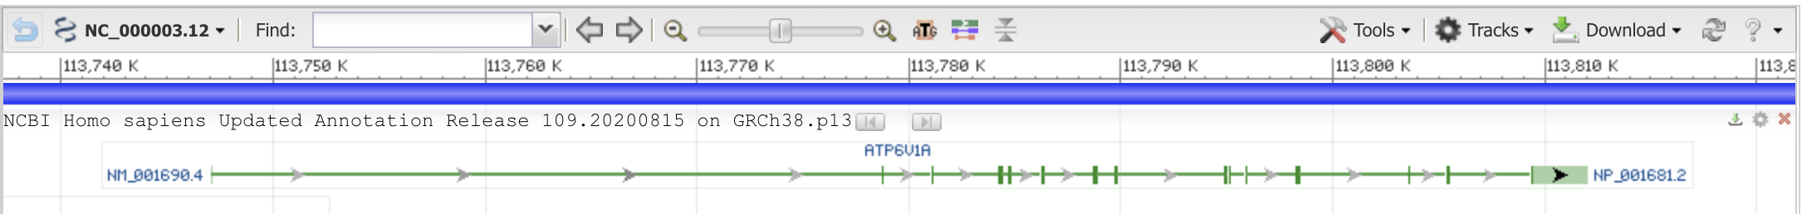
vma1 genes (encoding the vacuolar ATPase catalytic subunit)
Saccharomyces cerevisiae S288C
(1 exon)
Schizosaccharomyces pombe
(3 exons)
Xenopus laevis (African clawed frog)
(one of two paralogs)
~16 exons
Homo sapiens (human)
~15 exons

Slide 37
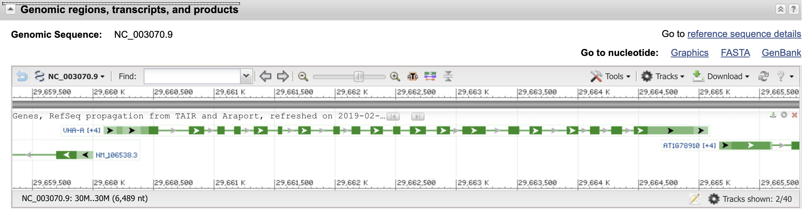
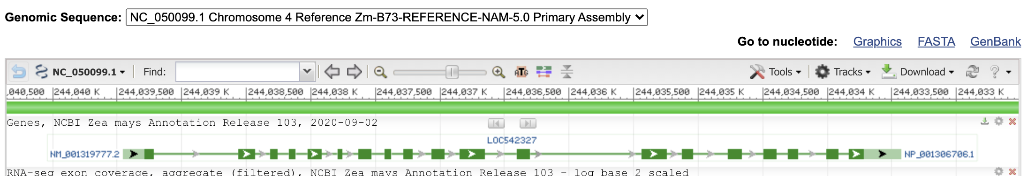
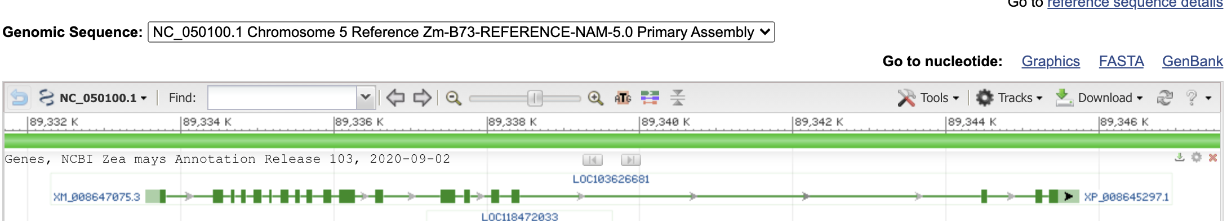
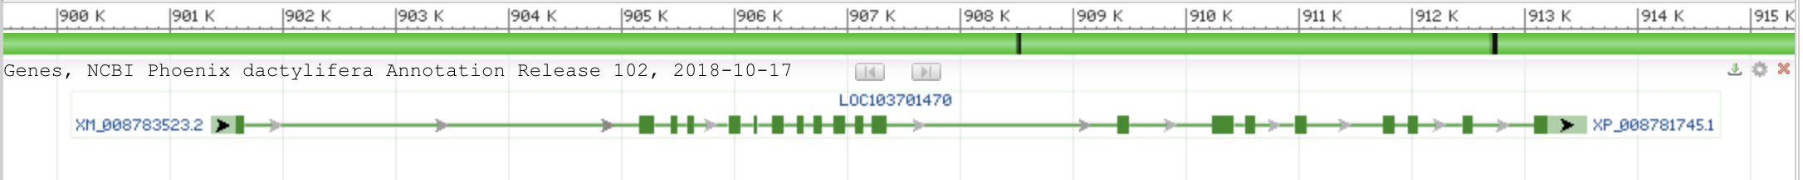
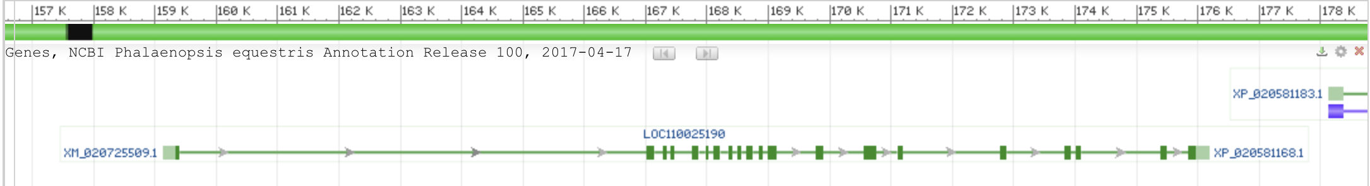
vma1 genes
Arabidopsis thaliana (thale cress)
Zea mays chromosome 4
Zea mays chromosome 5
Phoenix dactylifera (date palm)
Phalaenopsis equestris (orchid)

Slide 38
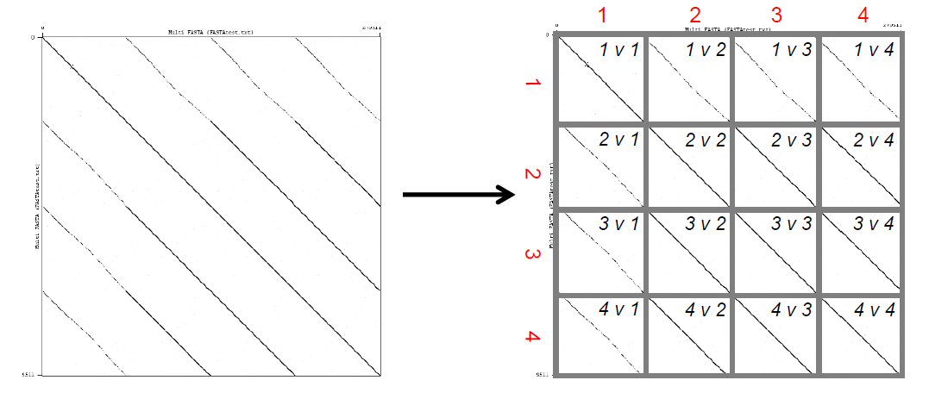
Multiple fasta file (containing 4 genomes) compared against itself.
using GENOME PAIR RAPID DOTTER (GEPARD)
From: Kapinos, A., Torres, C., Freise, A., McClory, S., Cornely, K. (2020). Using Dotplots for Comparative Genomic Analysis. HHMI Science Education Alliance (SEA) Faculty Group, QUBES Educational Resources. doi:10.25334/RR9F-HD75

Slide 39
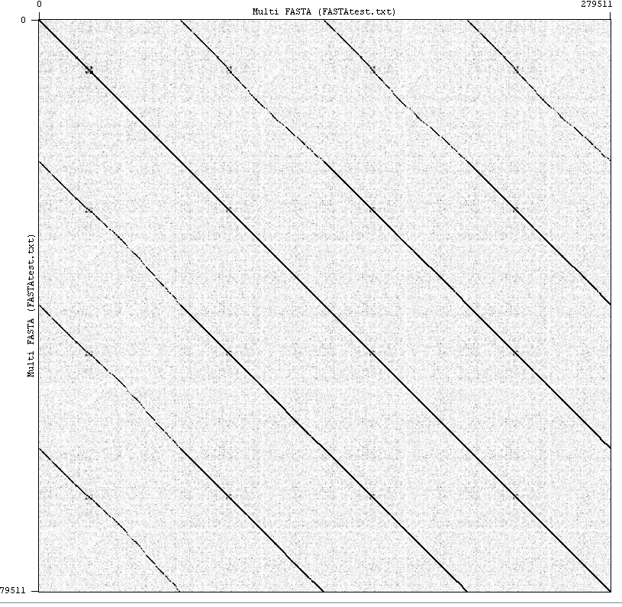
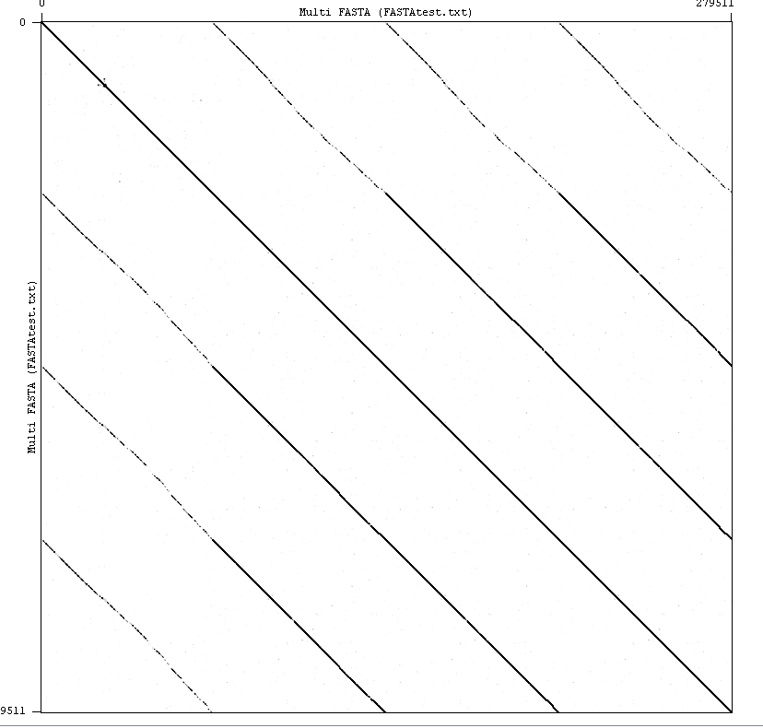
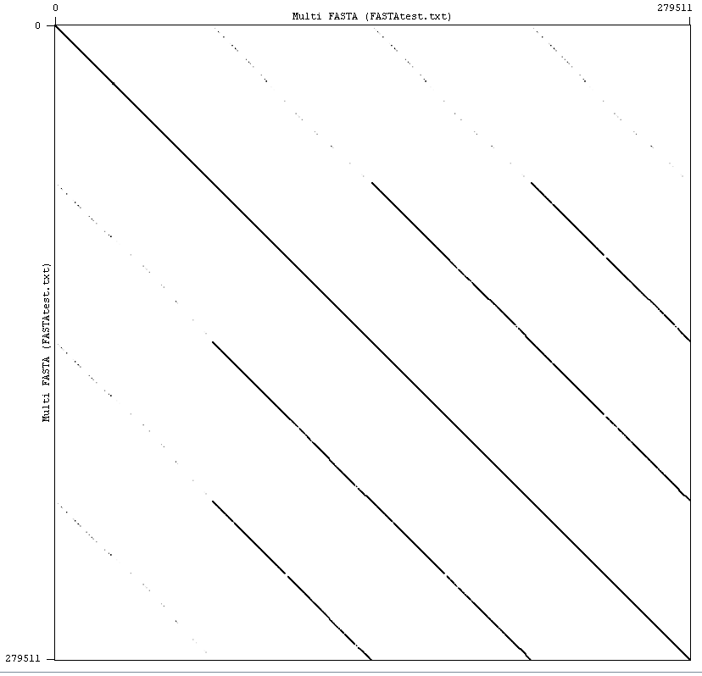
Word size = 10
Word size = 15
Word size = 40
Comparing 4 phage genomes (multiple fasta file) against themselves using gepard
From: Kapinos, A., Torres, C., Freise, A., McClory, S., Cornely, K. (2020). Using Dotplots for Comparative Genomic Analysis. HHMI Science Education Alliance (SEA) Faculty Group, QUBES Educational Resources. doi:10.25334/RR9F-HD75

Slide 40
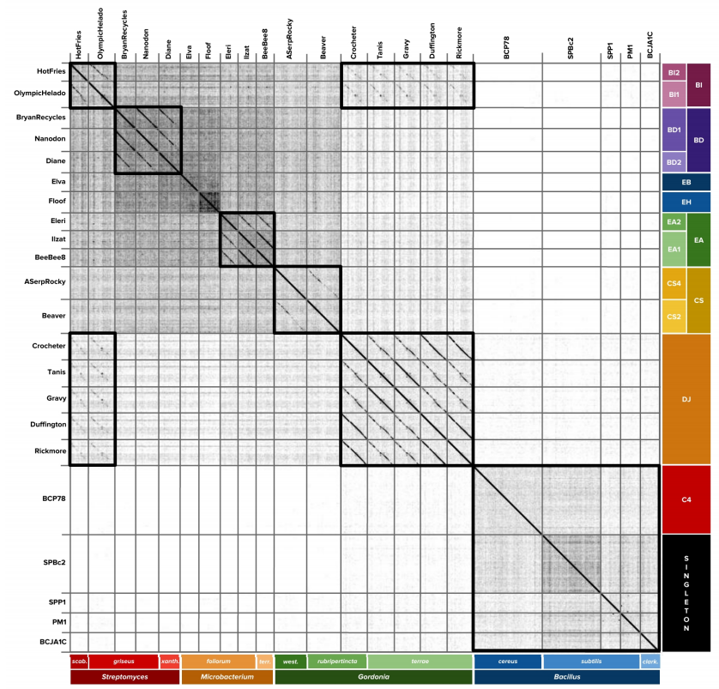
Dotplot Comparison of Nucleotide Similarity Among 22 Siphoviridae Phages
Nucleotide sequences of 22 Siphoviridae were compiled into a single file in FASTA format. Phages were selected from a variety of different clusters and subclusters infecting different host species. Hosts belonged to one of four bacterial genera, comprising two distinct phyla. Dotplots were created using the Genome Pair Rapid Dotter (GEPARD) platform and manually annotated to highlight regions of nucleotide similarity. In general, phages exhibited the highest degree of nucleotide similarity with other phages belonging to the same cluster or infecting the same host. Overall, phage nucleotide similarity tended to be broadly organized based on host phyla, with Bacillus phages exhibiting little similarity to Actinobacteriophages (phages infecting Streptomyces, Microbacterium, and Gordonia hosts).
Kapinos A, Remijas L, Torres C et al. Stability and host specificity of phages Zorp and Tanis for use in phage therapies [version 1; not peer reviewed]. F1000Research 2019, 8:1110 (poster) (https://doi.org/10.7490/f1000research.1117059.1)
From: Kapinos, A., Torres, C., Freise, A., McClory, S., Cornely, K. (2020). Using Dotplots for Comparative Genomic Analysis. HHMI Science Education Alliance (SEA) Faculty Group, QUBES Educational Resources. doi:10.25334/RR9F-HD75

