Slide 1
MCB3421 2023
Class 2
Basics of Molecular Biology
Intro to Protein Structure

Slide 2
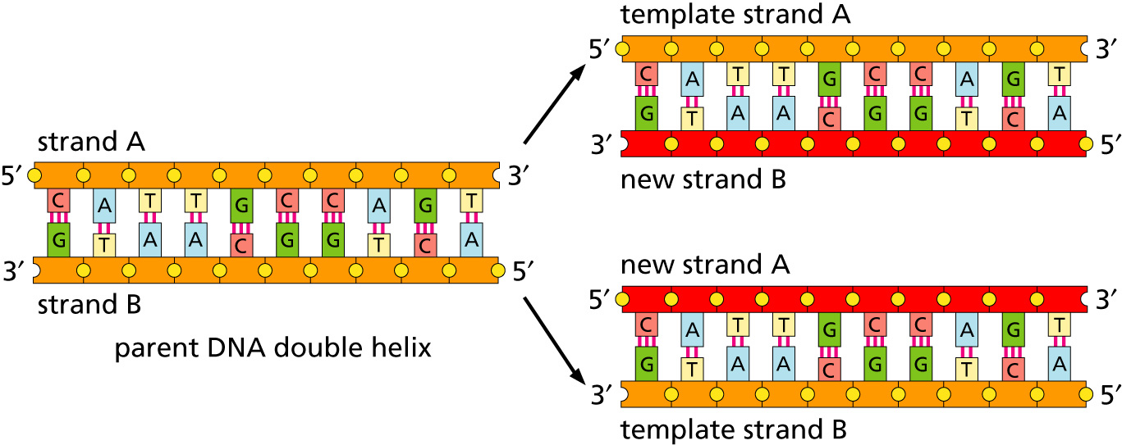
Replication
lagging and leading strand - strand bias
see Drew Barry’s animation at https://www.youtube.com/watch?v=7Hk9jct2ozY at 2.30 minutes

Slide 3
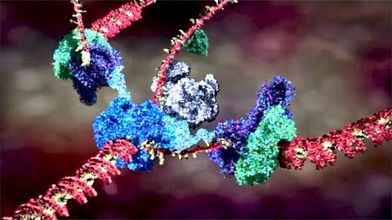
Replication
https://www.youtube.com/embed/X_tYrnv_o6A?start=60
Start at 1 minute stop at 2 minutes
Drew Berry

Slide 4
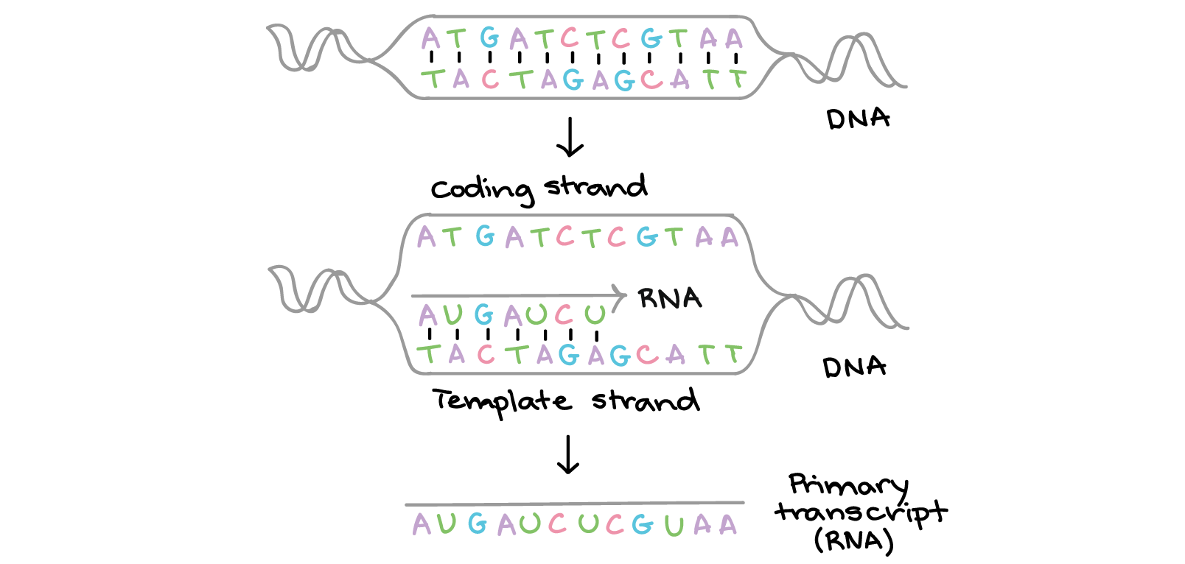
Transcription
Khan Academy, www.khanacademy.org

Slide 5
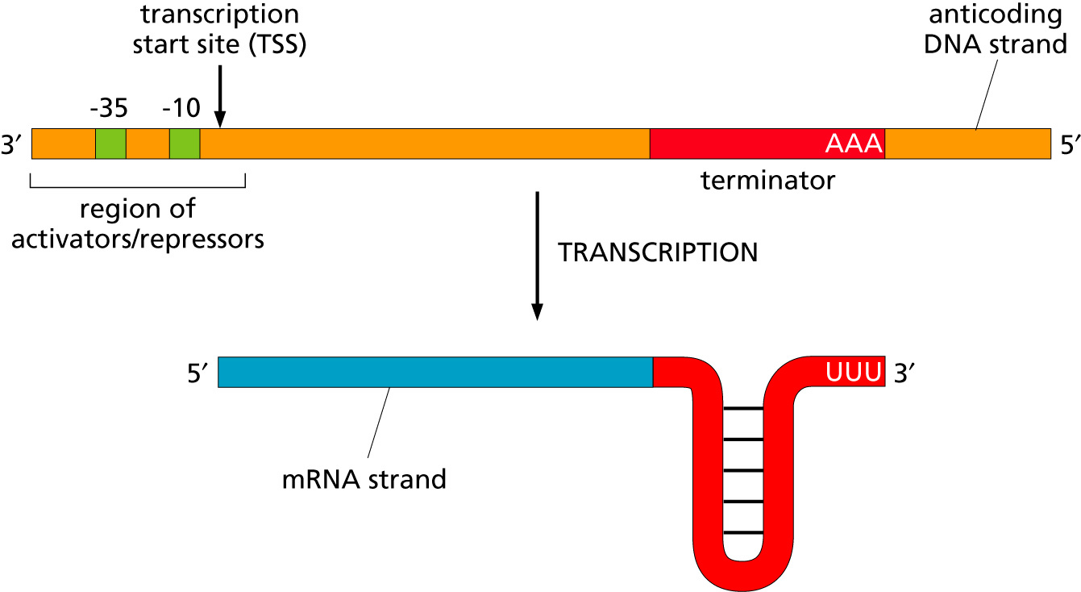
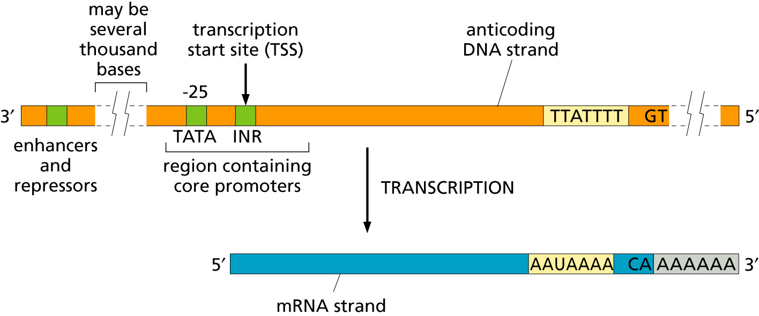
Transcription
Bacteria
Eukaryotes

Slide 6
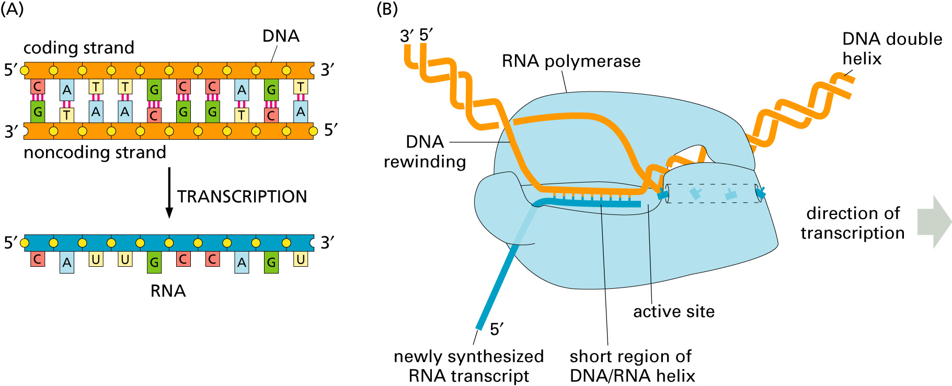
Transcription

Slide 7
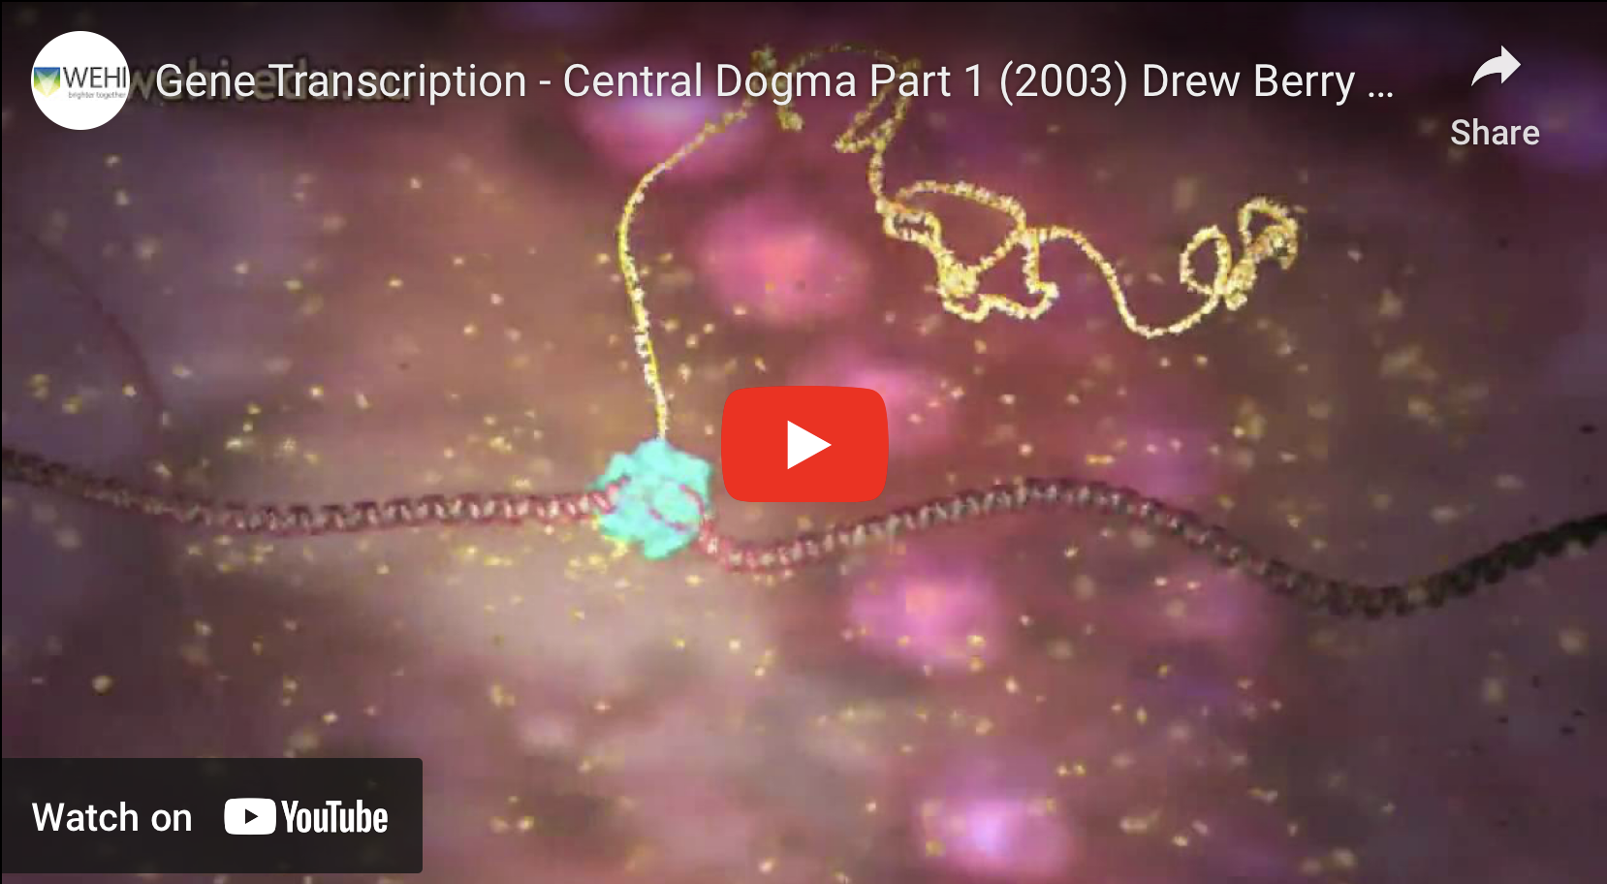
https://www.youtube.com/watch?v=xSQybiea2AA
Drew Berry

Slide 8
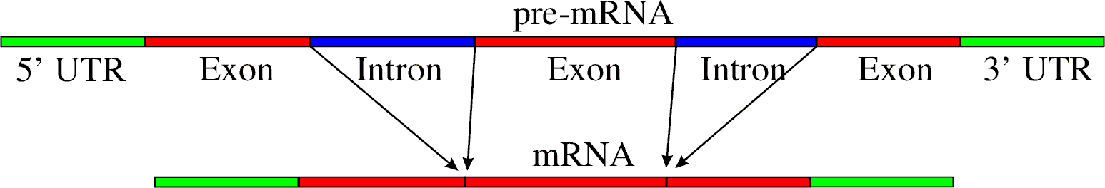
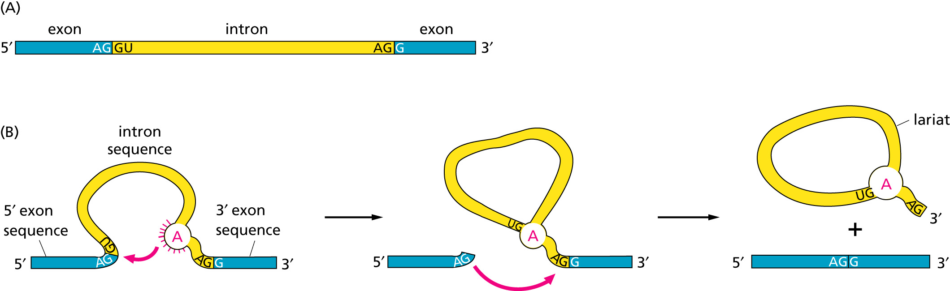
RNA processing
Simple illustration of a pre-mRNA, with introns (top). After the introns have been removed via splicing, the mature mRNA sequence is ready for translation (bottom).
Intron types
RNA can be the catalyst

Slide 9
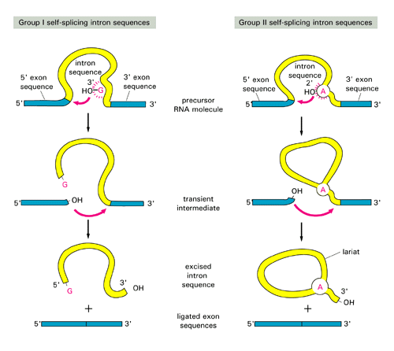
Self-splicing introns in Archaea and Bacteria (also in mitochondria and plastids)

Slide 10
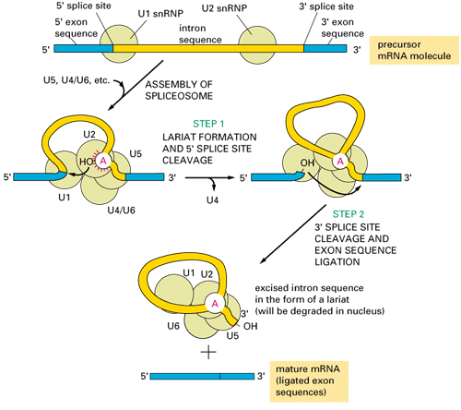
Spliceosomal Introns in Eukaryotes
Splicing occurs in the nucleus

Slide 11
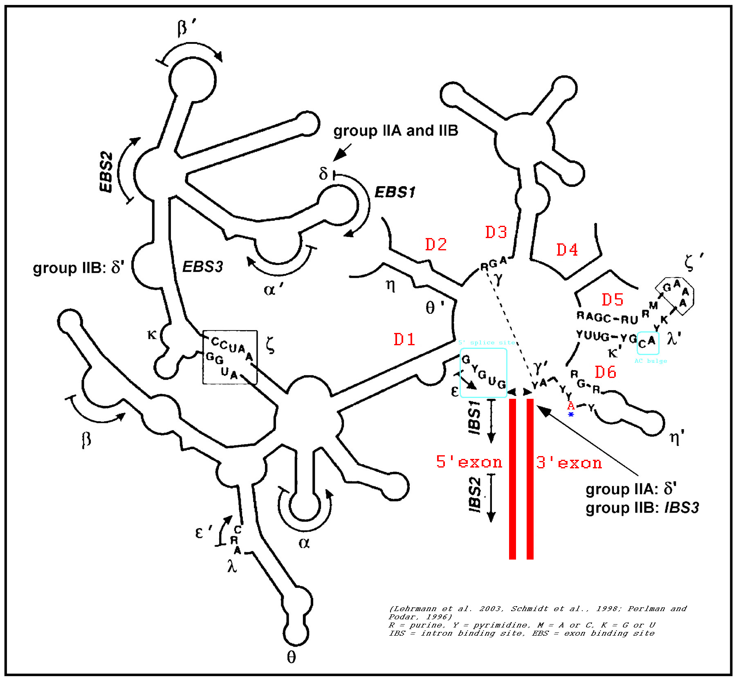
Group II intron

Slide 12
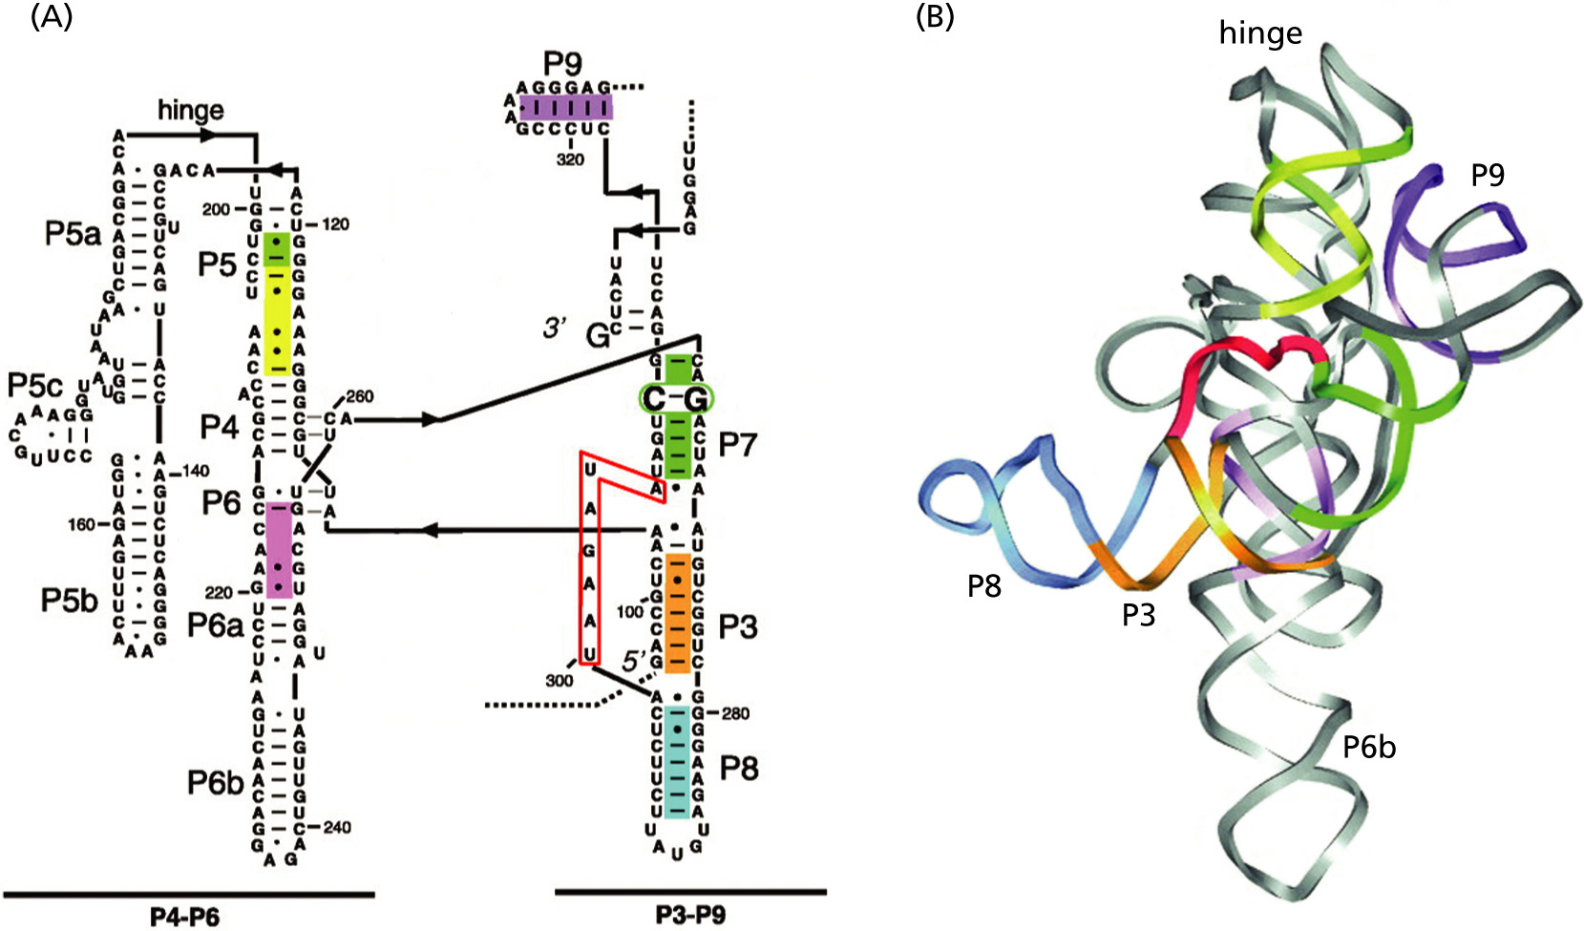
Self-splicing introns

Slide 13
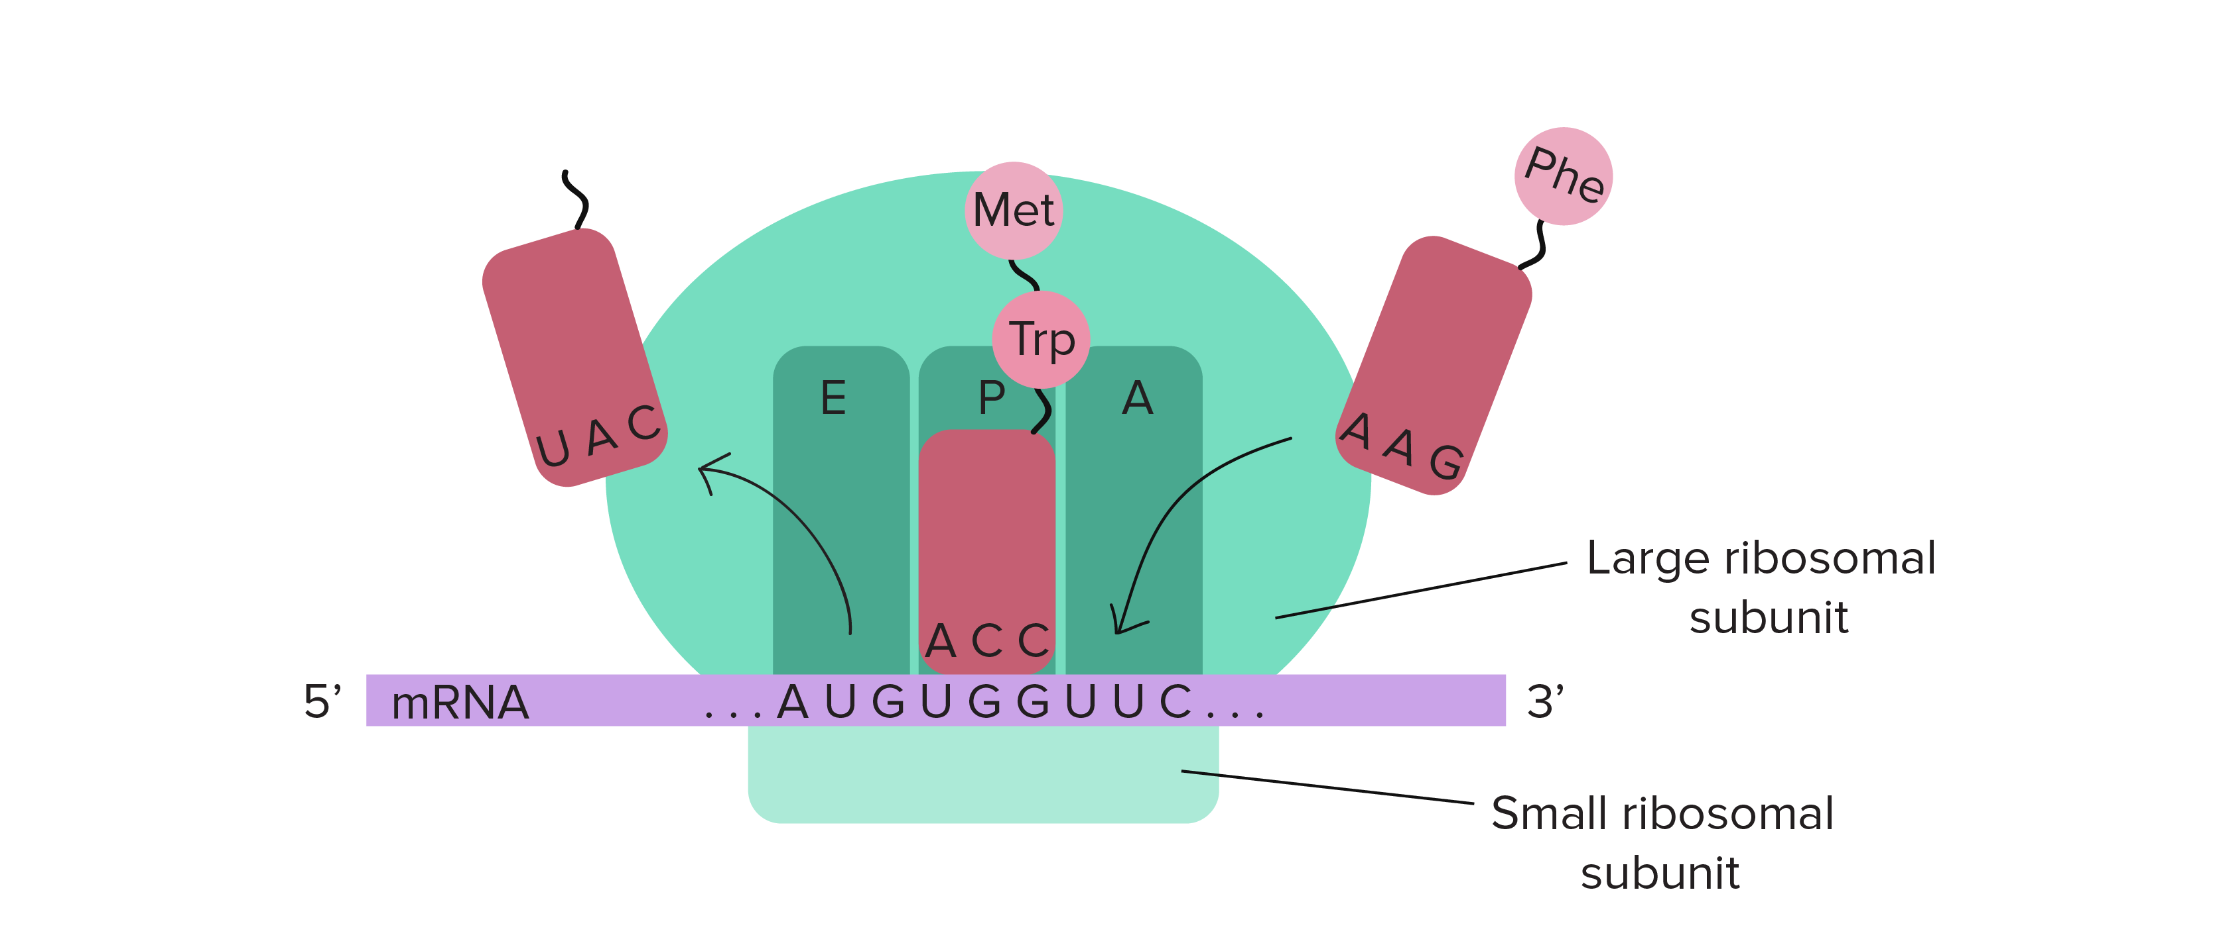
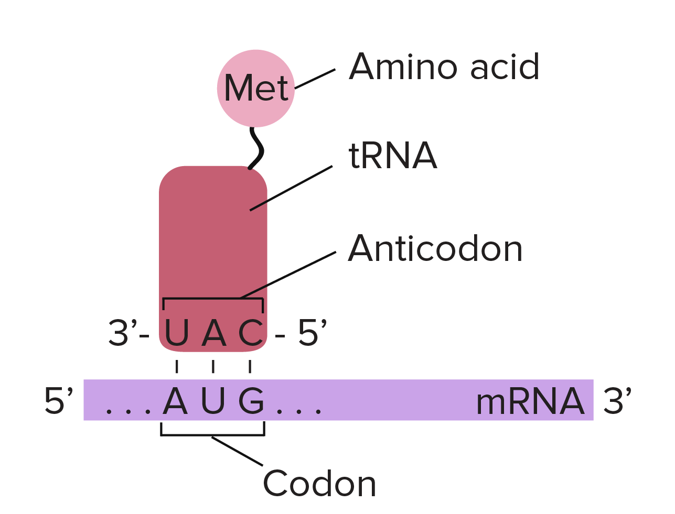
Translation

Slide 14
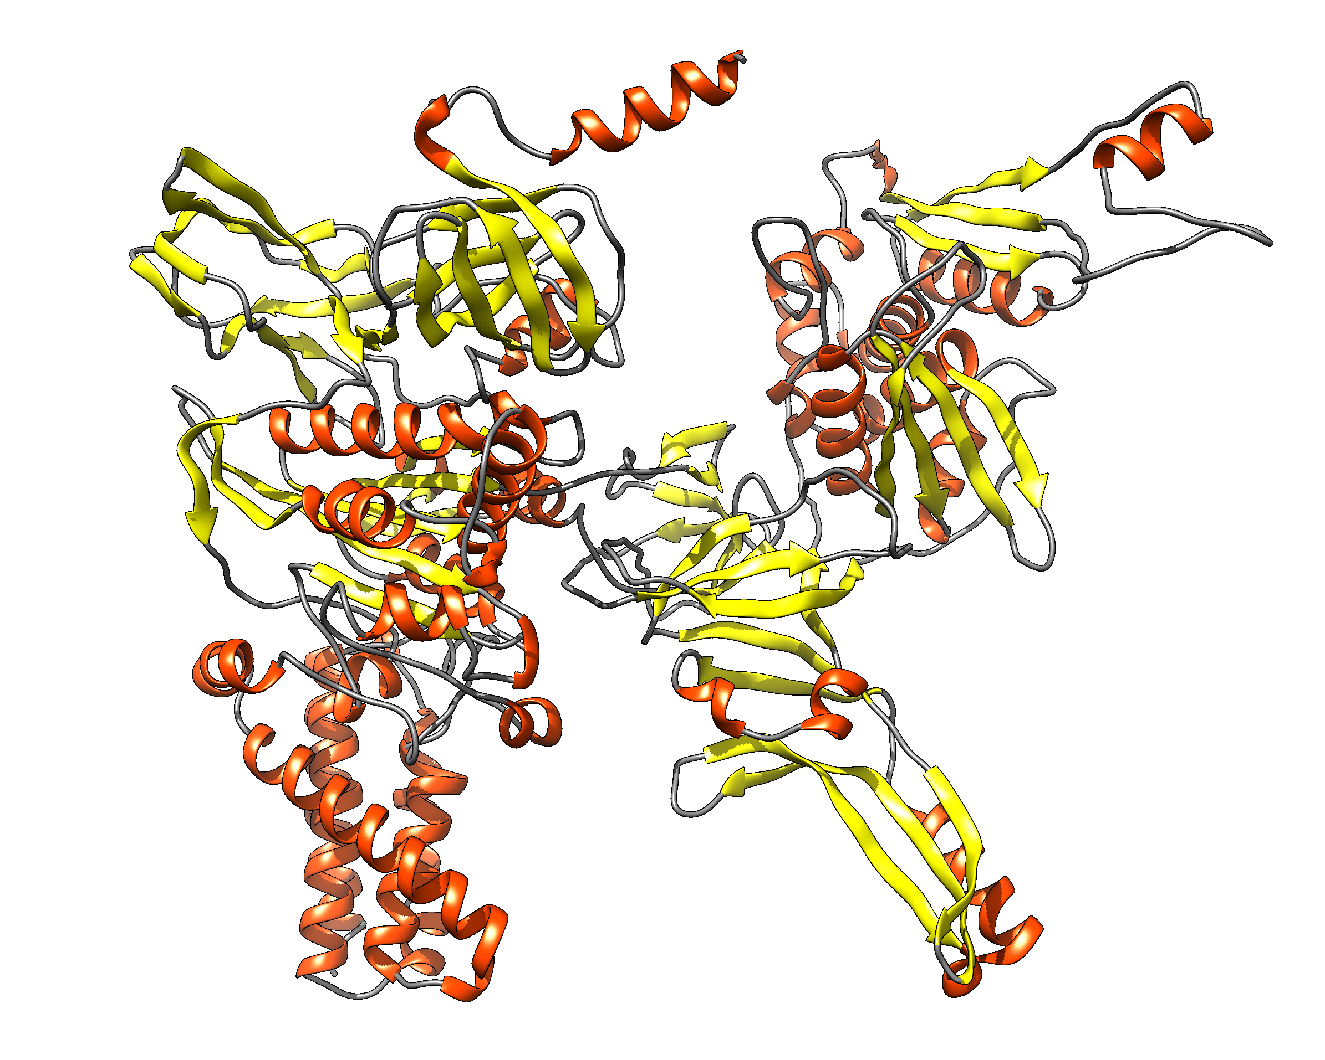
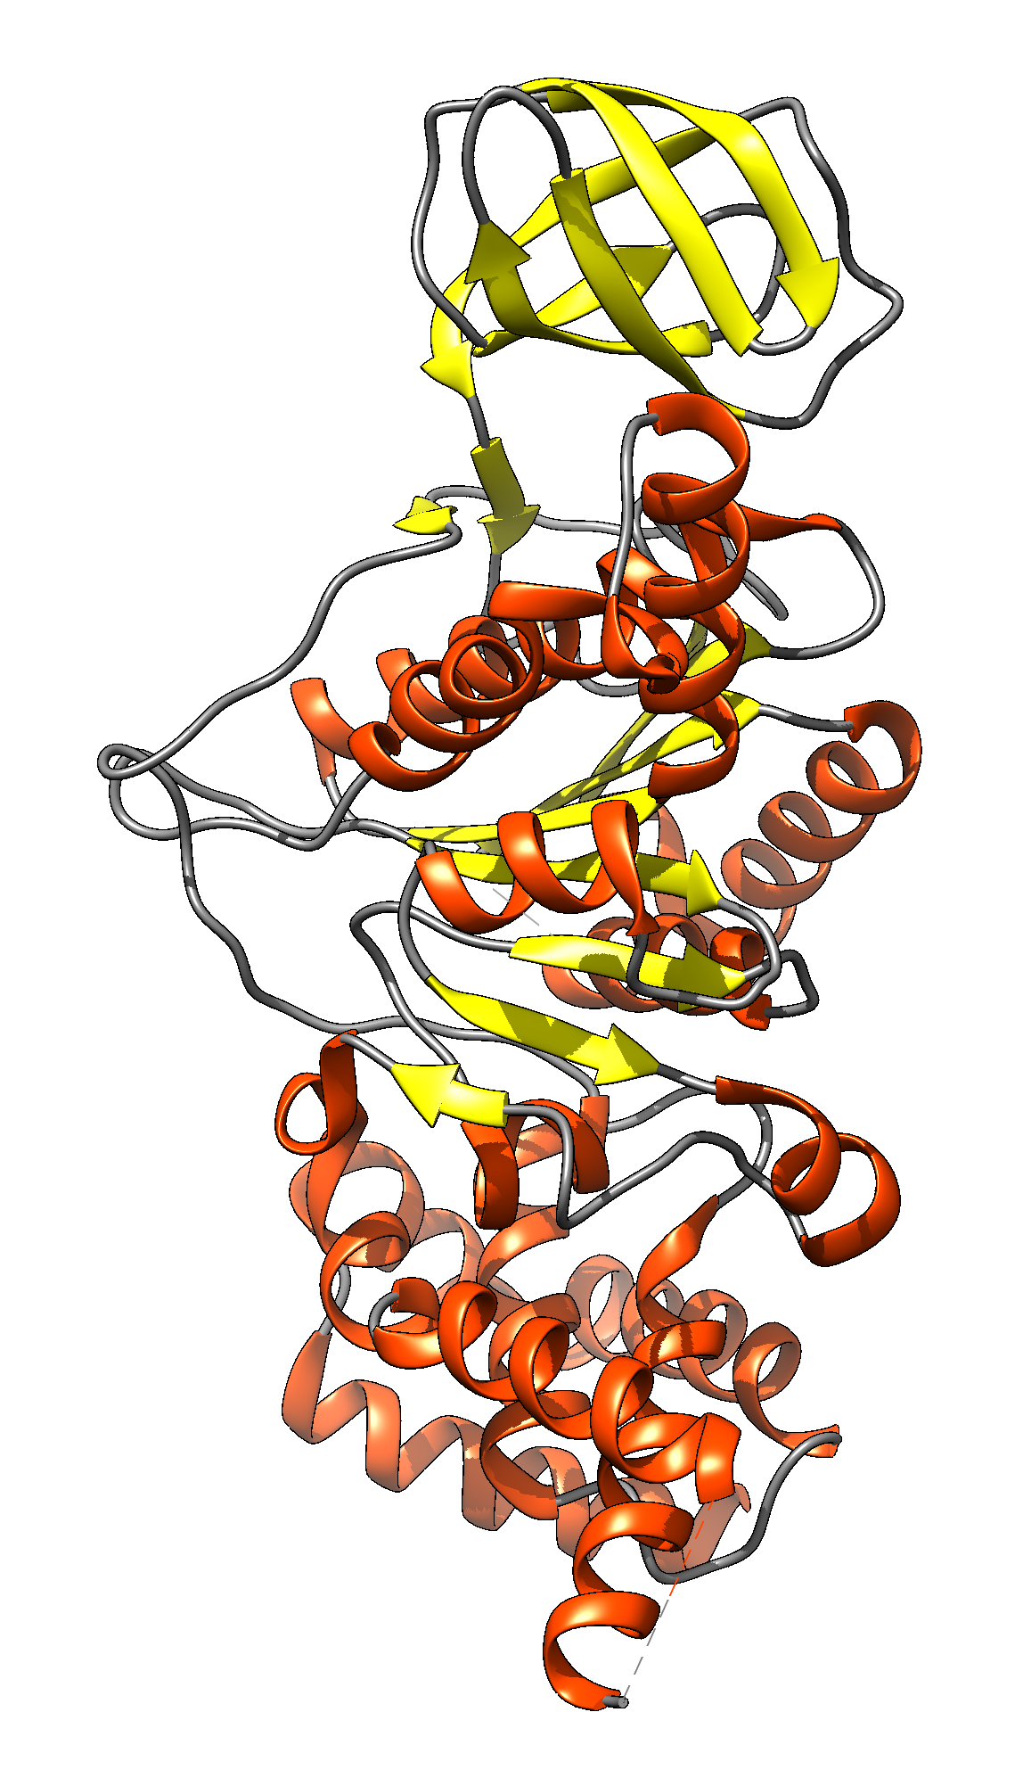
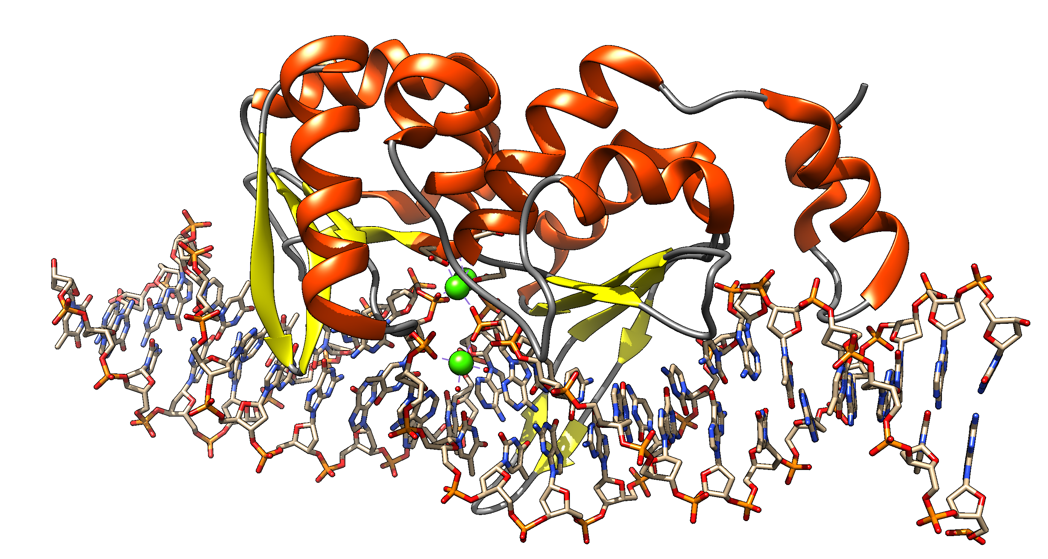
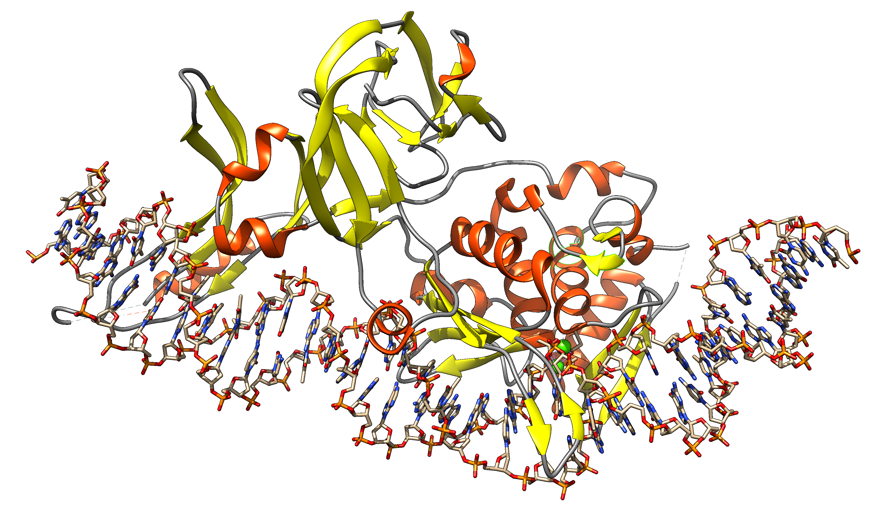
Group I Intron
Intein
Exon: Intron: ORF on Intron
Extein: Intein Splicing Domain: HE domain:
DNA
transcription
transcription
mRNA
or
rRNA
translation
splicing
Exon
Intron with ORF
translation
alpha fold prediction
of Sce vma1 gene product
splicing
Protein
Homing Endonuclease
1LWS.pdb
functional protein
functional protein
Intein with HE and
Splicing domain
Notes:
Structures F-ATPase chain A, SceI, https://alphafold.ebi.ac.uk/entry/P38078 and 1LWS

Slide 15
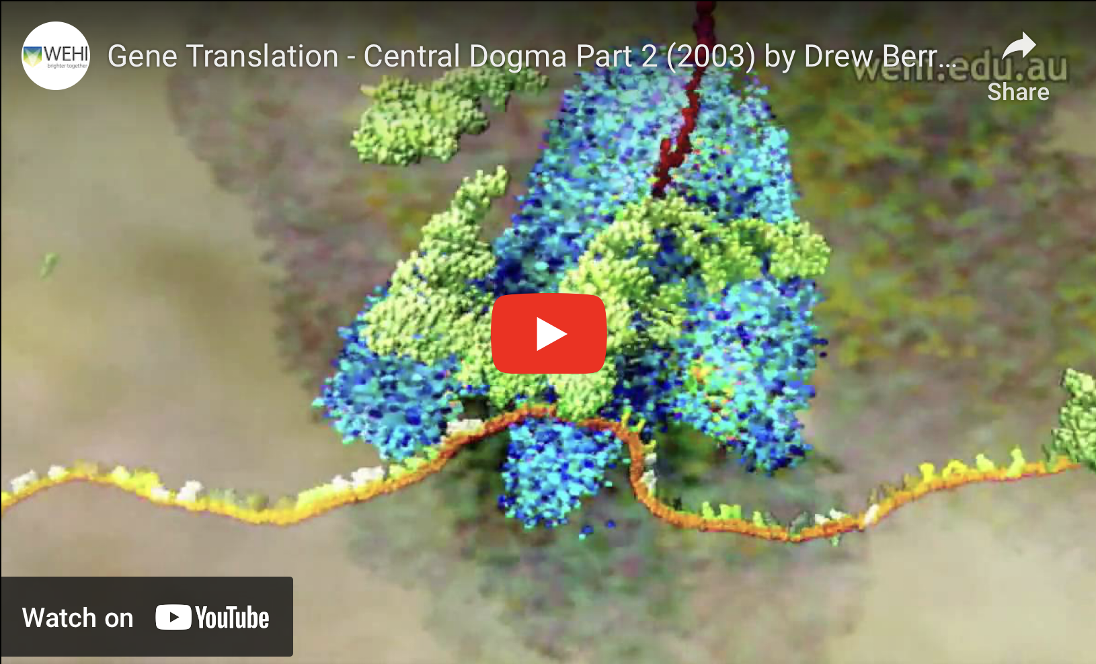
https://www.youtube.com/watch?v=WkI_Vbwn14g
Drew Berry

Slide 16
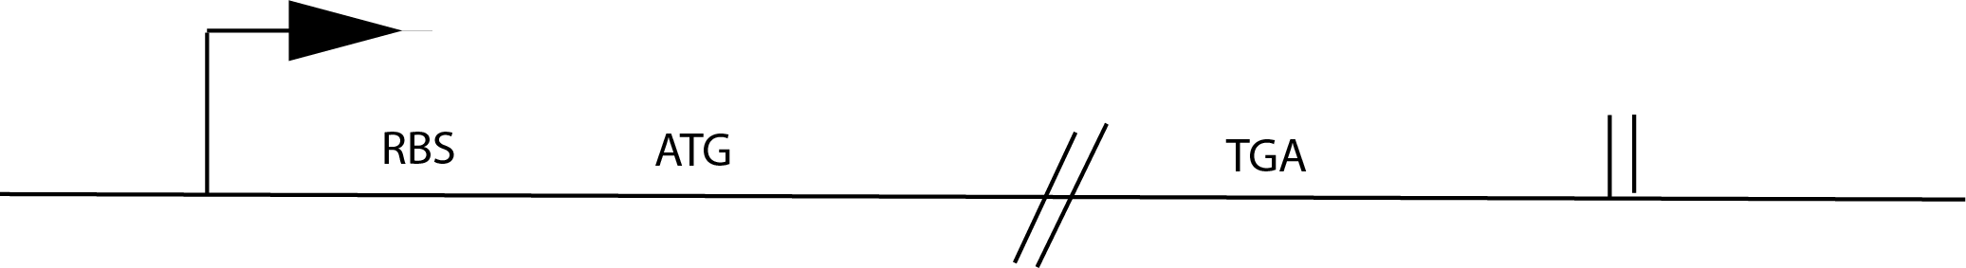
Prokarotic Gene Organization

Slide 17
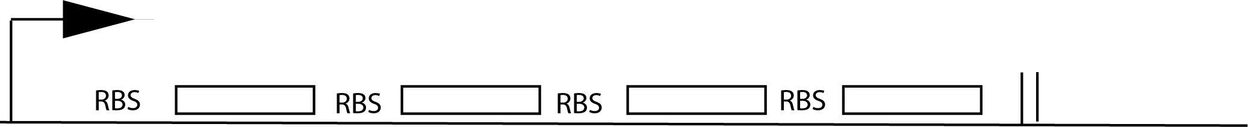
Operon Organization

Slide 18
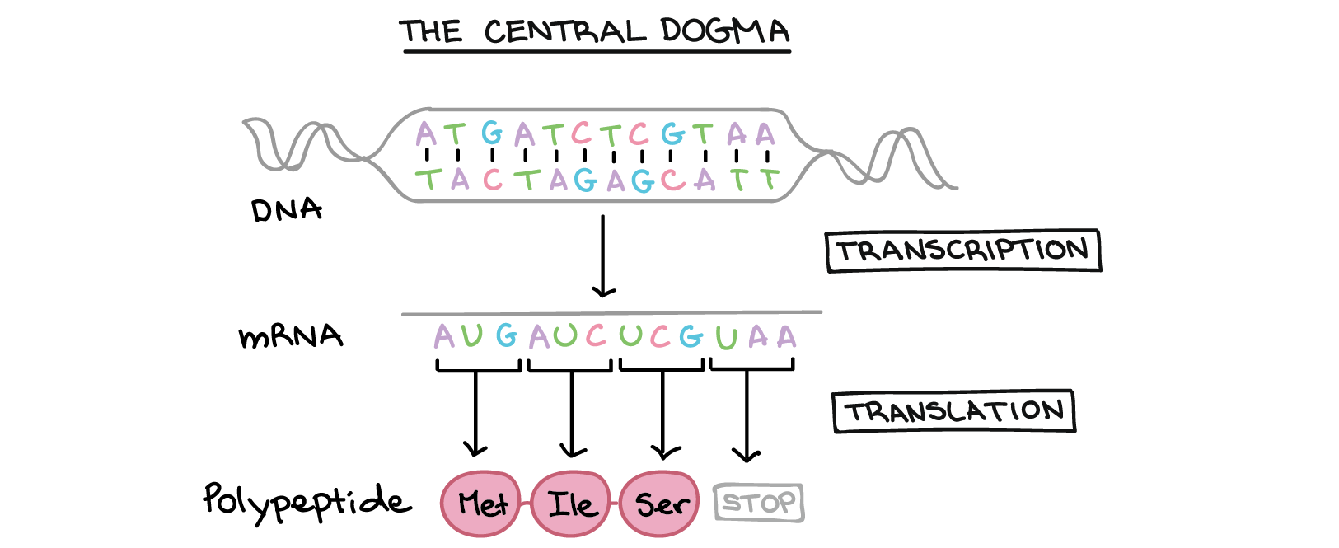
The central dogma
Why might this be wrong or incomplete
Khan Academy, www.khanacademy.org

Slide 19
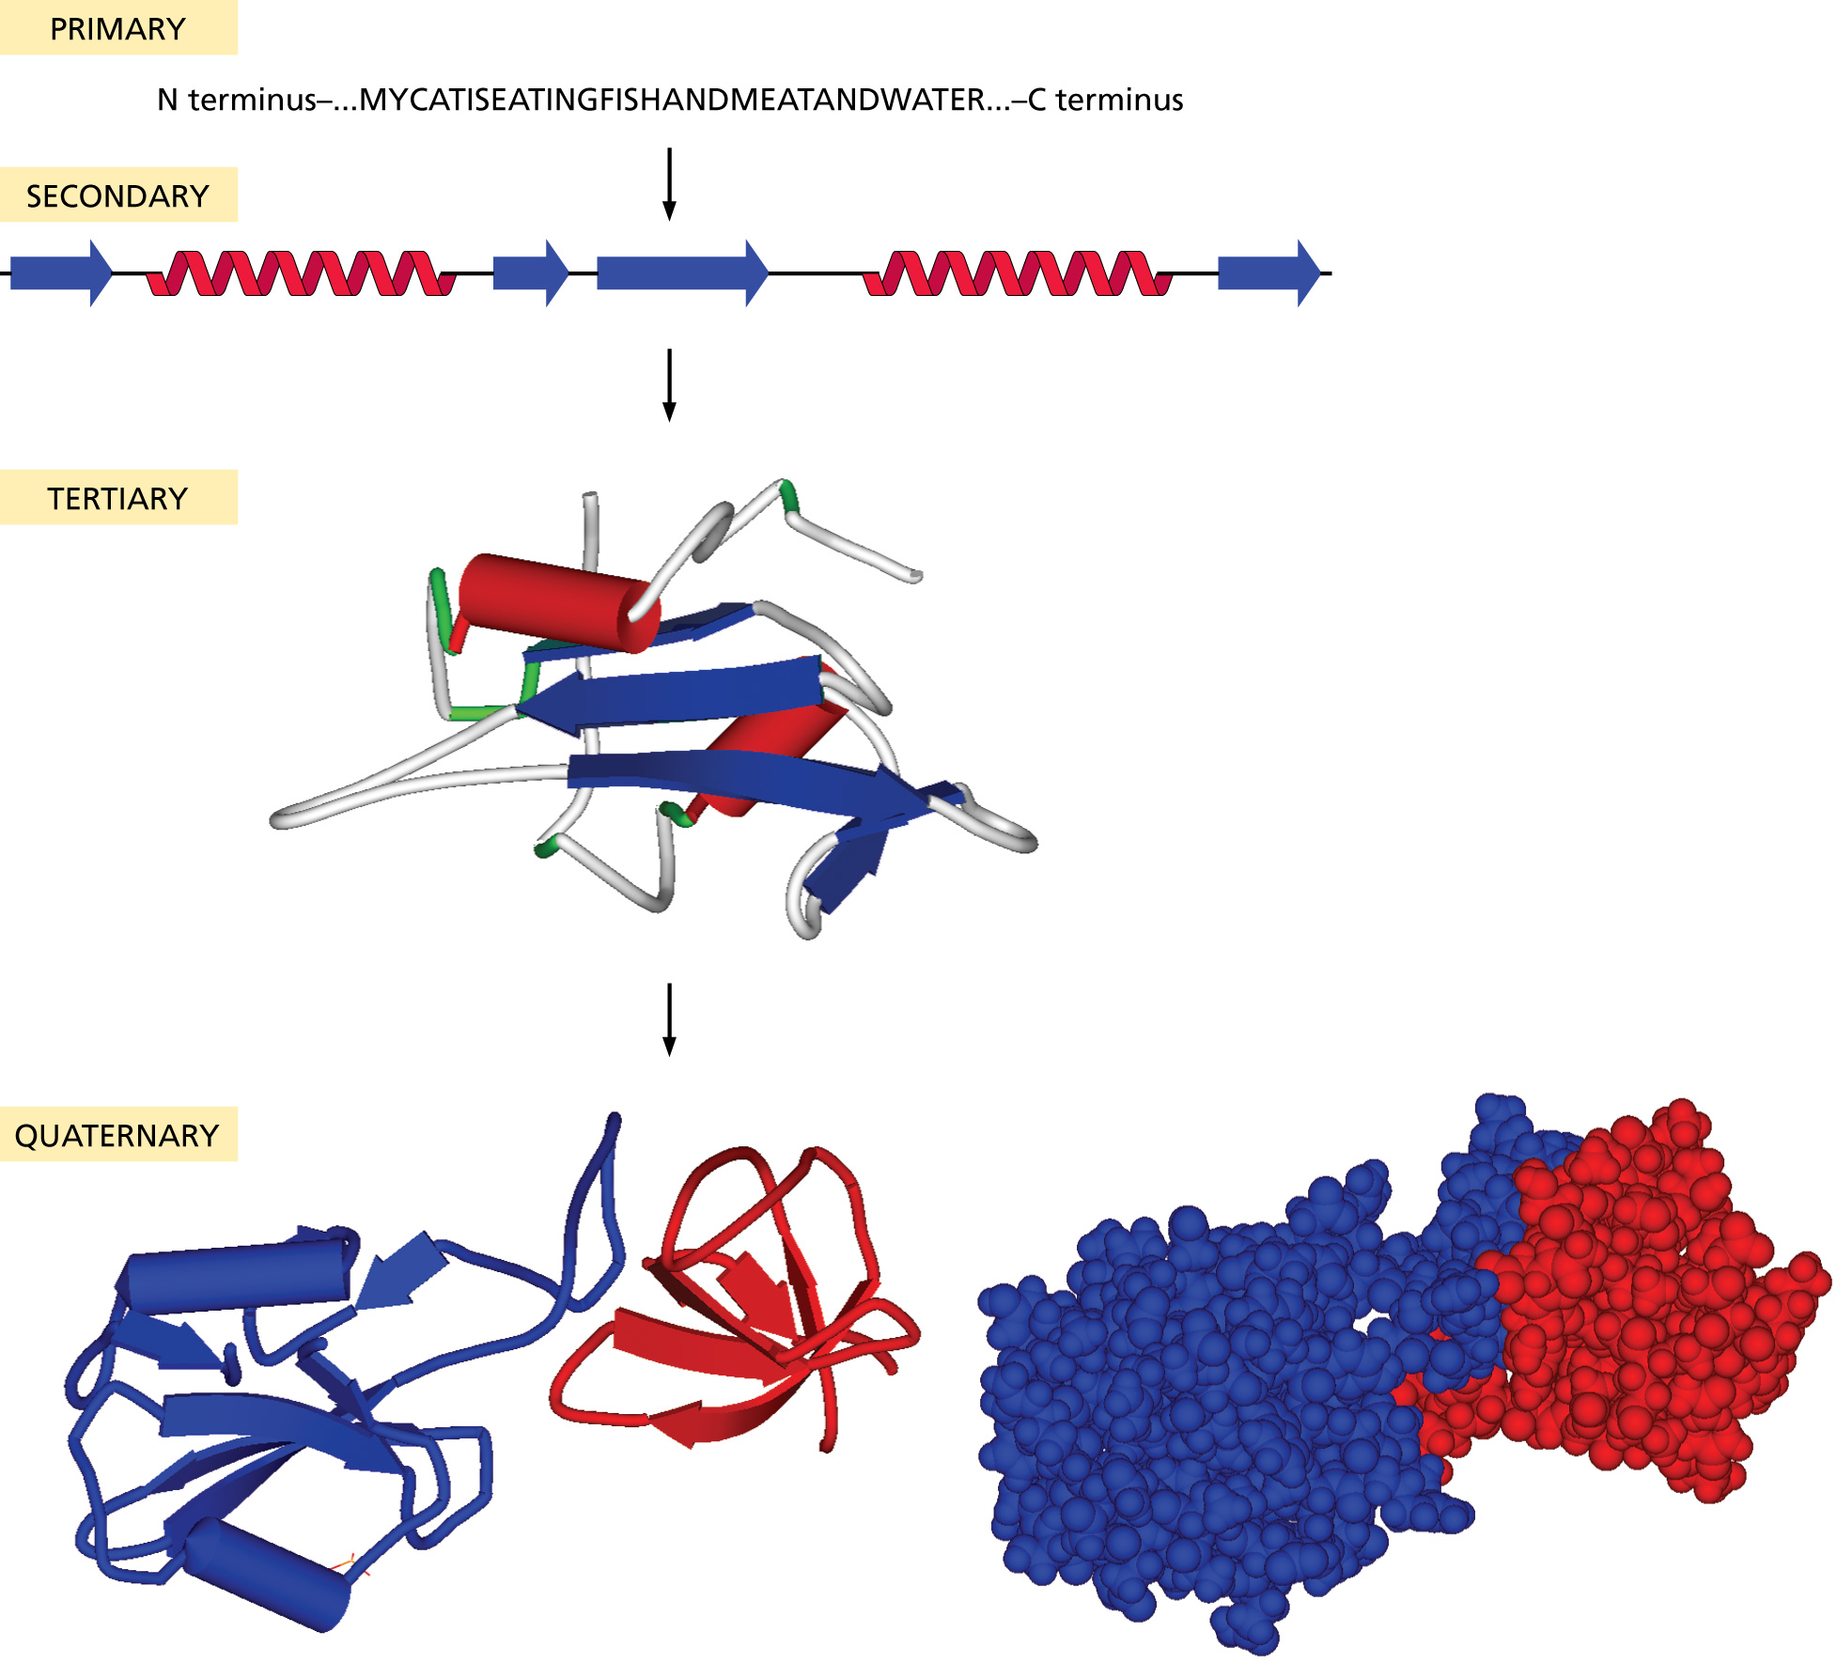
Protein structure:

Slide 20
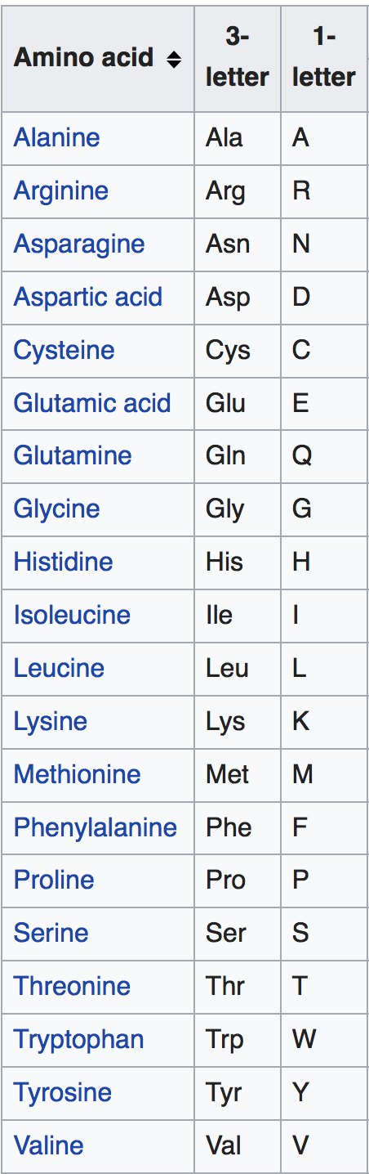
Primary structure
20 typical amino acids from the
primary sequence of a protein:
The sequence is written from the
amino to the carboxy terminal

Slide 21
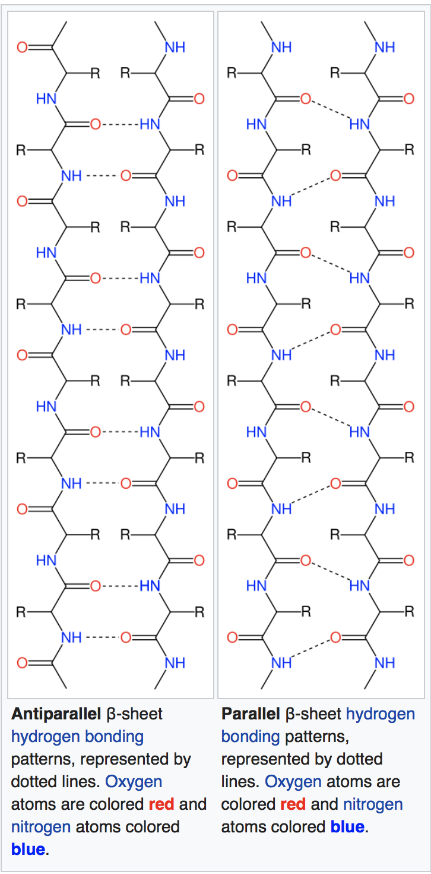
Important secondary structure elements (local folds)
Beta sheets
Often depicted
as yellow arrows
From Wikipedia
https://en.wikipedia.org/wiki/Beta_sheet
https://en.wikipedia.org/wiki/Beta_barrel

Slide 22
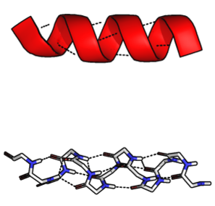
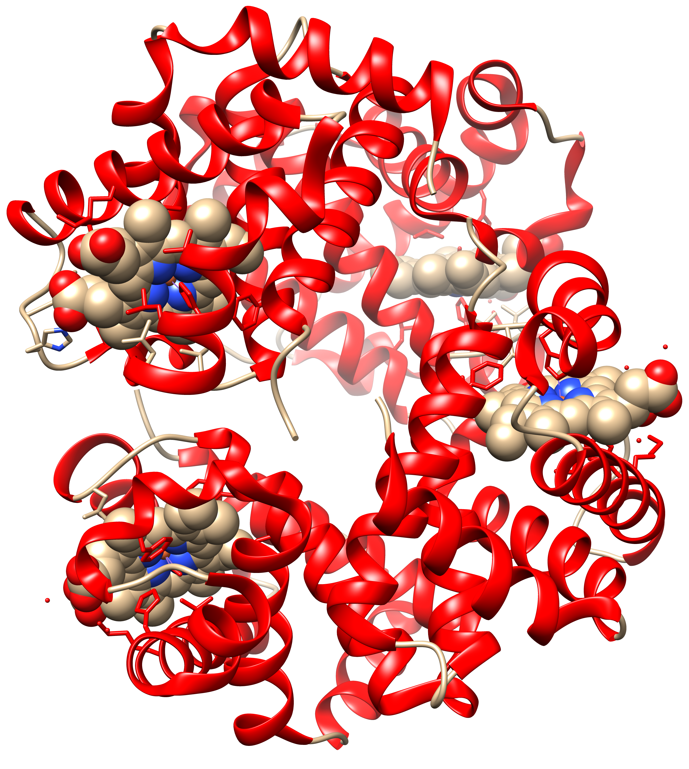
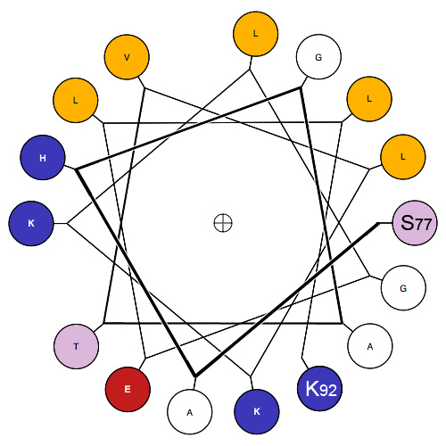
Important secondary structure elements (local folds)
Alpha Helices
Often depicted as red spirals
1GZX.pdb
Modified from Wikipedia
https://en.wikipedia.org/wiki/Alpha_helix
https://en.wikipedia.org/wiki/Hemoglobin

Slide 23
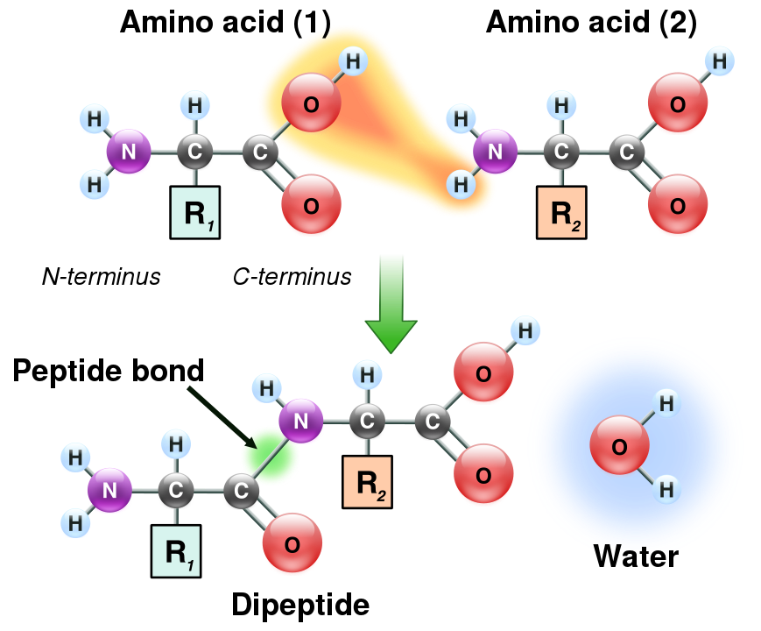
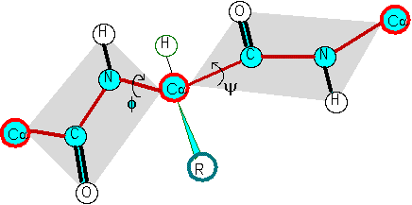
The Phi and Psi angles associated with each alpha carbon along the peptide chain
Formation of a peptide bond
φ
ψ
Illustration of the peptide plane (gray area) and φ-ψ angles. The red line formed by the repeating -Cα-C-N-Cα- is the backbone of the peptide chain.
From:
https://en.wikipedia.org/wiki/Peptide_bond

Slide 24
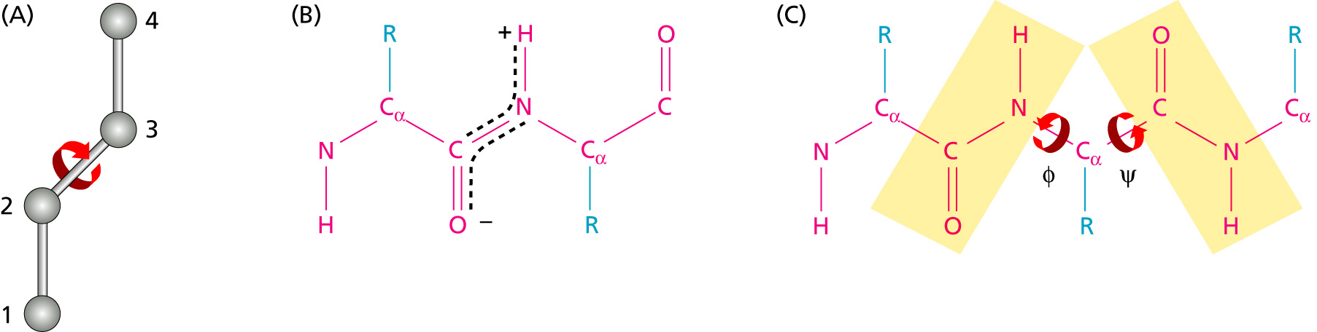
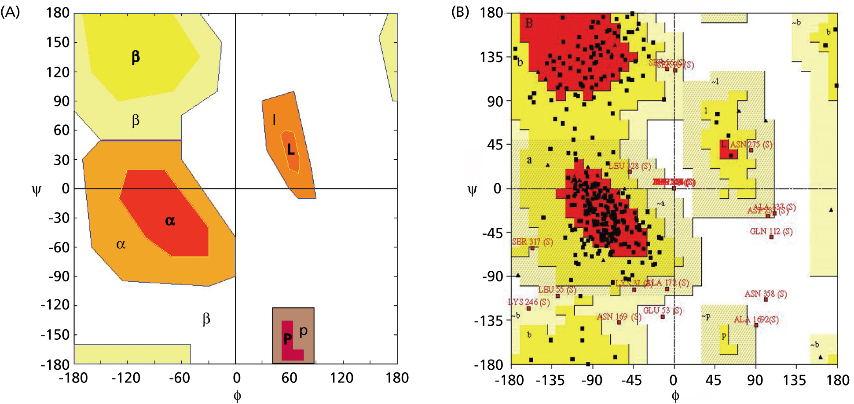
Angles in the protein backbone

Slide 25
UCSF’s Chimera
Free and powerful program to work with protein structures
Steep and long learning curve
(command line and/or menu driven)
Available for free at http://www.rbvi.ucsf.edu/chimera/
Many tutorials are available on the program’s webpage and on youtube.

Slide 26
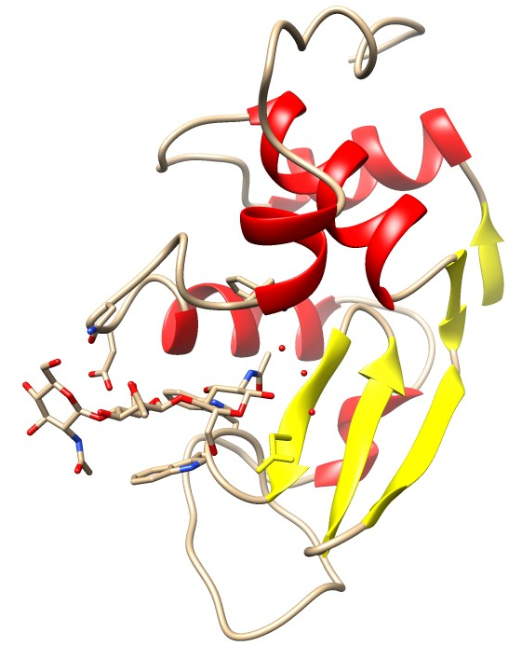
Lysozyme
Cleaves the sugar backbone on the cell wall of bacteria (which leads to exploding bacteria).
Present in tears, salvia, egg white, …
The N-acetylglucosamine (NAG) trimer is an inhibitor that binds to the catalytic site

