Slide 1
MCB 3421 Class 4 2023
Discussion of Lab
ATP binding sites –
Shared Ancestry versus Convergent Evolution
The RNA World

Slide 2
Some answered the questions: Can you determine which chain, via (Select > chain), does not have an ATP or ATP analog bound?
with chain G (the gamma subunit) -- this is technically correct. However, we were studying the 6 subunits in the head group, and one of the three beta subunits has an empty ATP binding site.
The expected answer was
CHAIN E: BETA(E) (E for Empty)
(one could have obtained this answer by hovering the mouse pointer over the subunit without the ATP (which at this point might have been visible as space filling balls). The label that pops up gives the aa one points at followed by the chain. Or one could look at the pdb file (or you could have consulted the answer you gave to the previous question).

Slide 3
For the answer to "Make a guess as to how much ATP are synthesized in the human body per day" some had very low guesses. The answers on the web and in the literature are slightly different, But all in the range of about the bodyweight.
or:
or from Wikipedia:

Slide 4
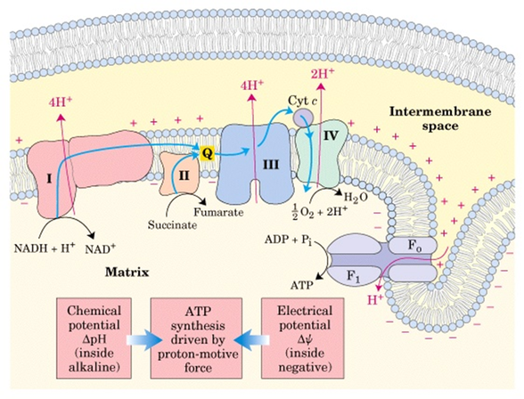
Chemiosmotic coupling
https://microbiochem.weebly.com/uploads/2/8/8/2/28824147/9076073.png?588
From:
https://microbiochem.weebly.com/chemiosmotic-coupling-hypothesis.html

Slide 5
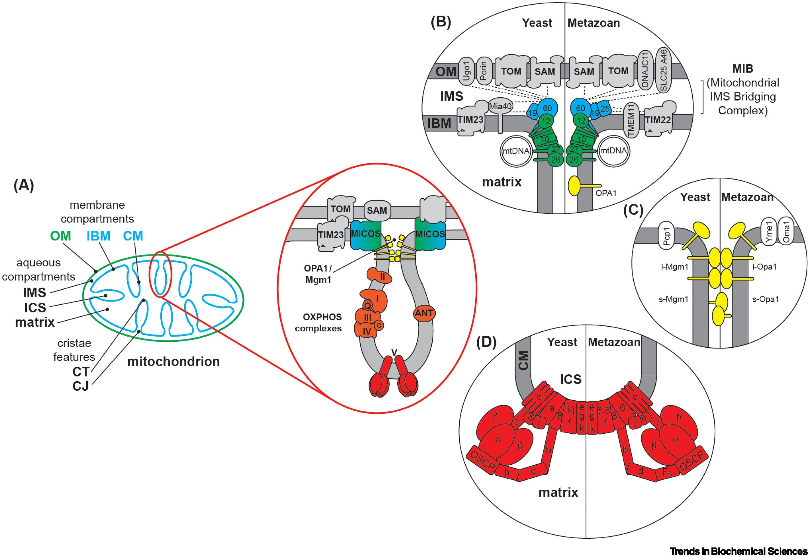
From: Mitochondrial compartmentalization: emerging themes in structure and function.
Joseph C. Iovine, Steven M. Claypool, Nathan N. Alder
Trends in Biochemical Sciences
DOI: 10.1016/j.tibs.2021.06.003

Slide 6
BetaTP and alphaTP from 1bmf.pdb

Slide 7
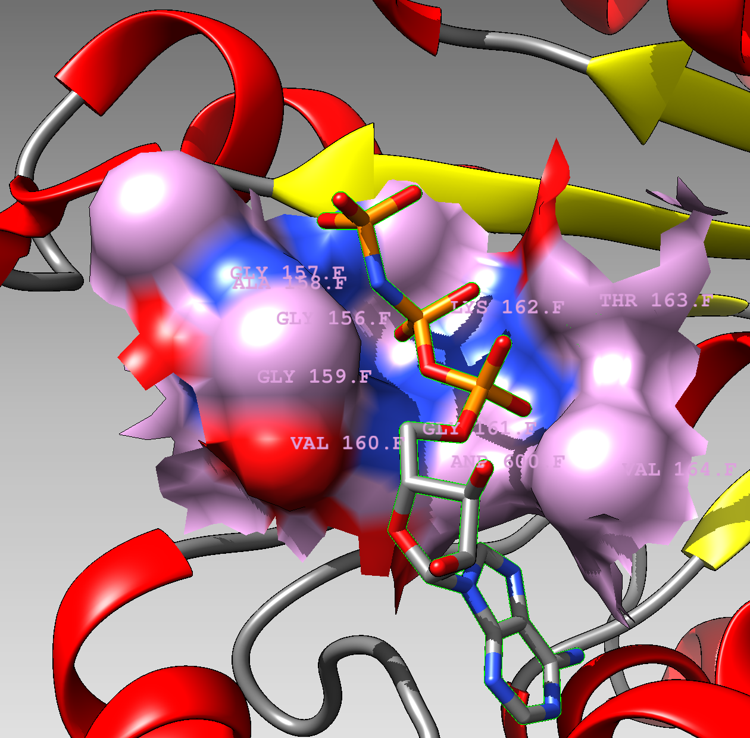
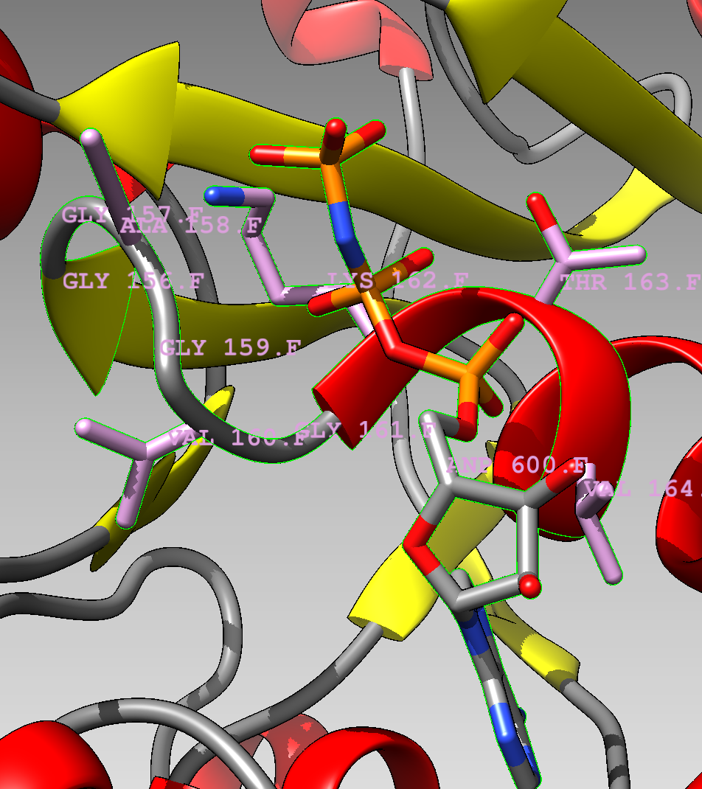

Slide 9
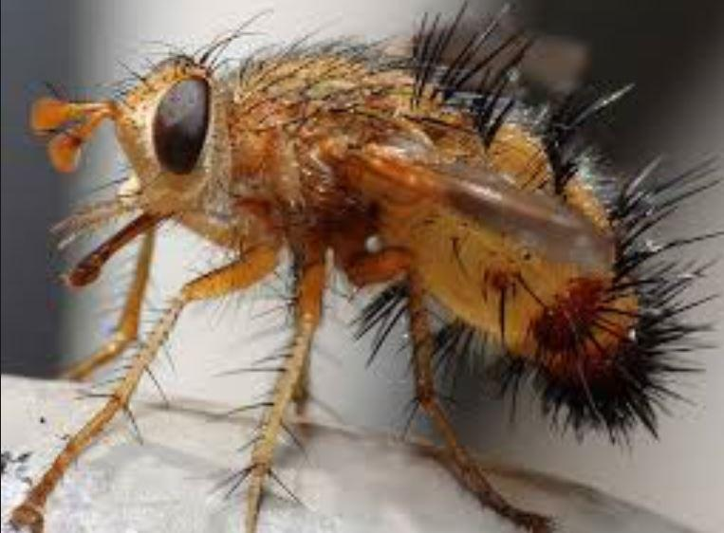
Name: SHH – sonic hedgehog Location: Chromosome 7 Length: 12,288 bases Role: Codes for a signalling protein crucial for determining the placement of limbs and organs in the developing embryo
Site of action: The embryo
https://www.theguardian.com/science/2011/oct/26/sonic-hedgehog-gene
From https://twitter.com/KirkMMaxey/status/577886323912015872

Slide 10
The most common fold in proteins is the Rossmann fold occurring in most nucleotide binding proteins. Examples are the V-/F-/A-ATPases, helicases, P-type ATPases, myosin ….
At the core of the fold is a beta alpha beta fold, and the presence of the so-called Walker motifs.
(From http://proteopedia.org/wiki/index.php/Rossmann_fold)

Slide 11
It is conceivable that all the Rossmann fold domains are homologous, but the beta alpha beta arrangement is rather simple, and one cannot exclude the possibility of convergent evolution (i.e., the Rossmann fold in ATP synthases, might not have common shared ancestry with the Rossmann fold in P-type ATPases, ABC transporters, or the NADH binding 3-phosphoglycerate dehydrogenase)
“The basic nucleus of the βαβ fold is about 30 residues. In many proteins that do not share any significant sequence homology, there exists an extensive tertiary structural homology beyond this 30 residue segment, particularly in specific domains that bind dinucleotides. Therefore, the probability that this type of extensive structural homology evolved independently is very low. Thus, most likely βαβ fold represents an ancient structure that left its vestige in numerous proteins. Certainly, this conclusion does not exclude the possibility of independent convergent evolution.” From http://proteopedia.org/wiki/index.php/Rossmann_fold

Slide 12
GRASP ATP binding site
A second unrelated ATP binding domain is the GRASP domain. Examples are D alanin – D-Alanin ligase, glutathione synthetase, carbamoyl phosphate synthetase and many other enzymes that use the energy from ATP to ligate two substrates.

Slide 13
GRASP ATP binding sites

Slide 14
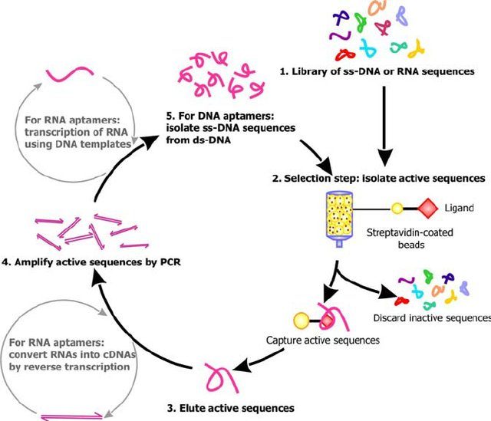
SELEX

Slide 15
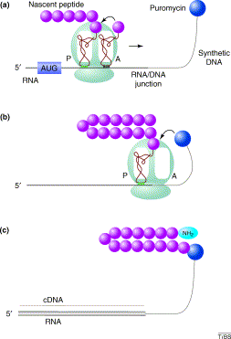
RNA display
from https://www.sciencedirect.com/science/article/pii/S0968000403000367

Slide 16
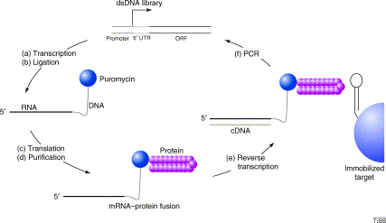
from https://www.sciencedirect.com/science/article/pii/S0968000403000367

Slide 17
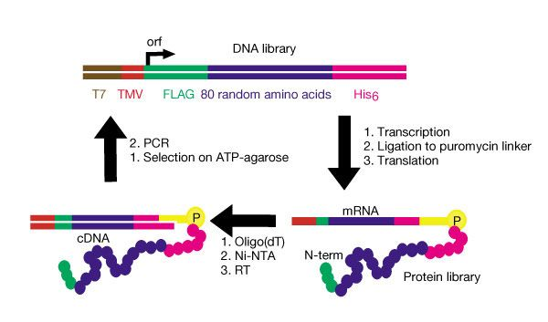
Keefe and Szostak’s description
Four distinct ATP binding peptides isolated.
”estimate that roughly 1 in 10¹¹ of all random-sequence proteins have ATP-binding activity comparable to the proteins isolated in this study”
from https://www.nature.com/articles/35070613

Slide 18
One of these in vitro selected peptides was crystalized by Lo Surdo, P., Walsh, M.A., Sollazzo, M.
From: https://www.nature.com/articles/nsmb745

Slide 19
GRASP ATP from the D-alanin D-alanine ligase

Slide 20
Rossman fold
ATPase beta SU
1BMF.pdb

Slide 21
In vitro selected peptide
1UW1.pdb

Slide 22
Convergent evolution of ATP binding sites did not lead to a similar arrangement of secondary structures building blocks.
ATP GRASP Rossmann fold In vitro evolved peptide

Slide 23
Rossmann, ATP GRASP, in vitro evolution
The Rossmann and GRASP domains evolved through natural selection.
Using an approach similar to the selection of substrate binding aptamers (RNA) in the selex approach (co-invented by former UConn undergraduate Larry Gold), Keefe and Szostak used Puromycin to link the synthesized protein to the encoding DNA. (aka RNA display)

Slide 24
The tangled tree of life
or
How to depict evolutionary history?

Slide 25
If you want to learn more about the recent upheaval of tree thinking with respect to evolution see the book by David Quamann:
The Tangled Tree,
A Radical New History of Life
and
Soucy SM, Huang J, Gogarten JP (2015) Horizontal gene transfer: building the web of life. Nature Reviews in Genetics 16, 472–482. doi: 10.1038/nrg3962

Slide 26
One of the “the four horsemen” of the gene-transfer apocalypse: William Martin, Jeffrey Lawrence, Peter Gogarten and Ford Doolittle.
The debate is ongoing as to who is Pestilence, War, Famine, and Death.
Painting by Viktor Vasnetsov 1887, via Wikipedia

Slide 27
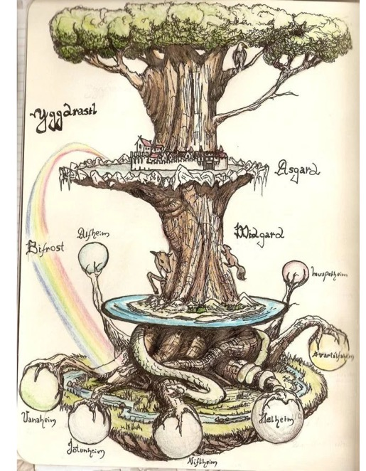
Trees have a long history in depicting evolutionary history, but also for depicting the diversity of life. (Note, many Trees of Life depict the latter, and do not imply an evolutionary history)
The biblical tree of life
Yggdrasil (North Mythology)
Mexican tree of life

Slide 28
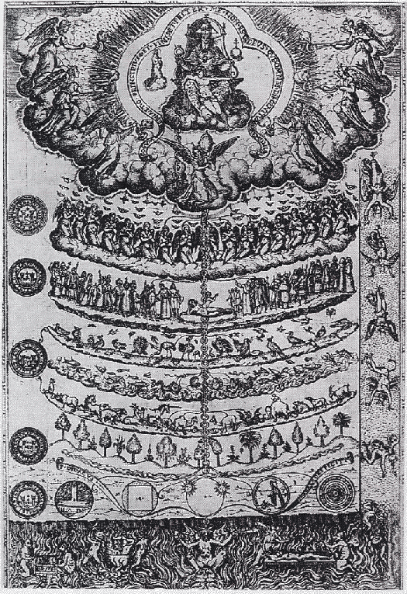
Scala Naturae
Being
God
Realm of Being
Angels
Demons
Man
1579 drawing of the Great Chain of Being from Didacus Valades, Rhetorica Christiana. Source Wikipedia
Animals
Realm of Becoming
Plants
Minerals
Non-being

Slide 29
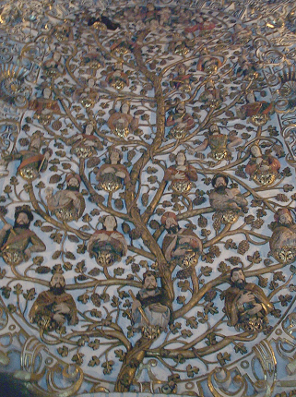
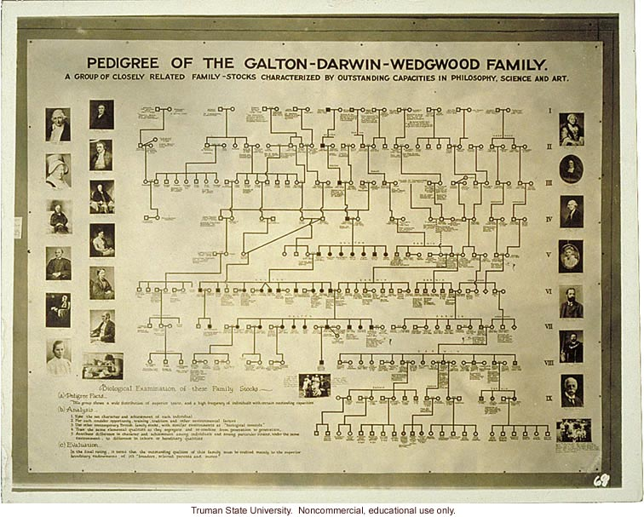
Family Trees, Genealogies, Pedigrees
Genealogy (Church Ceiling, Santo Domingo, Oaxaca)
Charles Darwin's Family "Tree"

Slide 30
Family Tree
Species tree
Species split at time moves forward
Each individual has two parents.
Tree branches, as one goes back in time
Tree branches as one moves forward in time
Past
Past
Present
Present

Slide 31
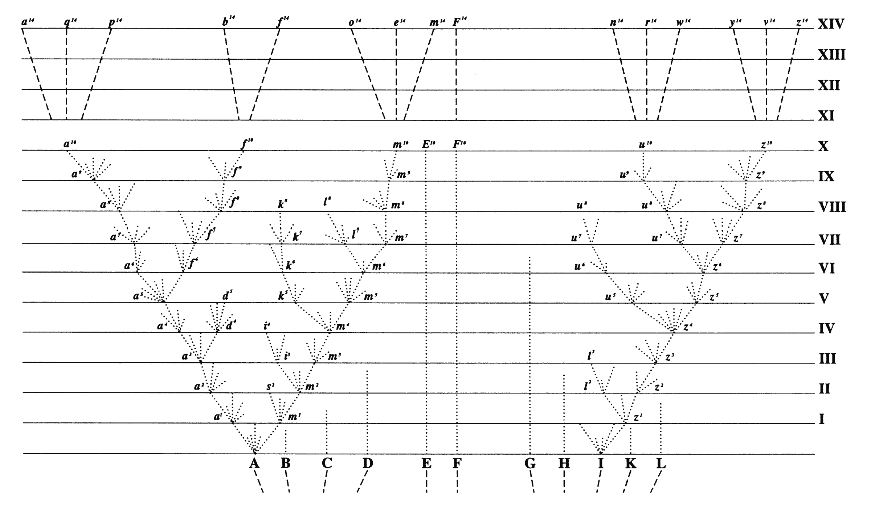
Following Darwin most biologist draw phylogenetic trees to that the present time is on top and the past at the bottom
Present
Past
Mathematicians often do it the other way around

Slide 32
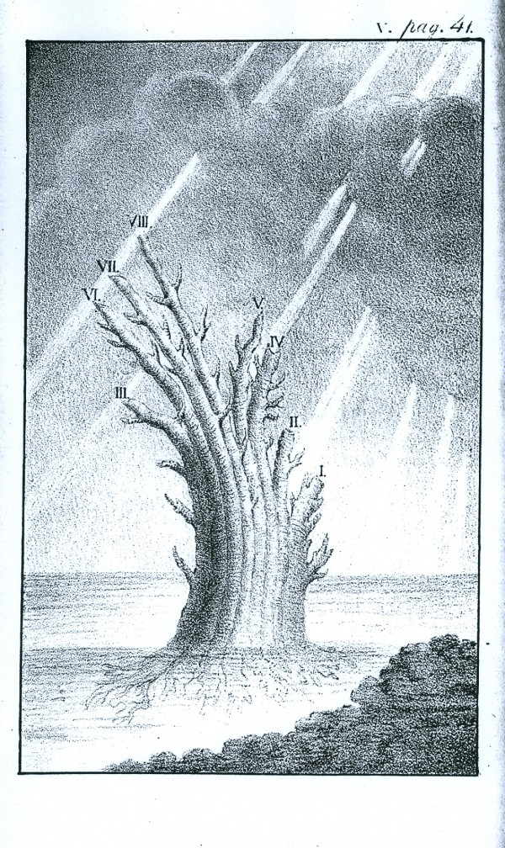
Russian naturalist Peter Simon Pallas (1766): "But the system of organic bodies is best of all represented by an image of a tree which immediately from the root would lead forth out of the most simple plants and animals a double, variously contiguous animal and vegetable trunk; the ﬁrst of which would proceed from mollusks to ﬁshes, with a large side branch of insects sent out between these, hence to amphibians and at the farthest tip it would sustain the quadrupeds, but below the quadrupeds it would put forth birds as an equally large side branch.” (translation from Latin by E. N. Genovese, from J. David Archibald: "Edward Hitchcock’s Pre-Darwinian (1840) ‘Tree of Life’" Journal of the History of Biology (2009) 42:561–592)
Tree of animal life, Depiction of the tree proposed by Peter Simon Pallas, from Carl Edward von Eichwald's Zoologia specialis (1829). (From: Mark A. Ragan: "Trees and networks before and after Darwin", Biol Direct. 2009 Nov 16;4:43.)

Slide 33
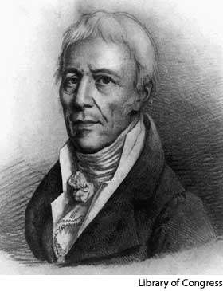
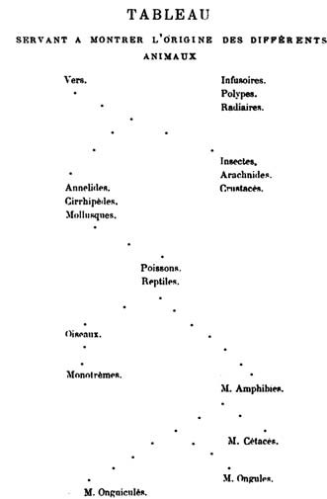
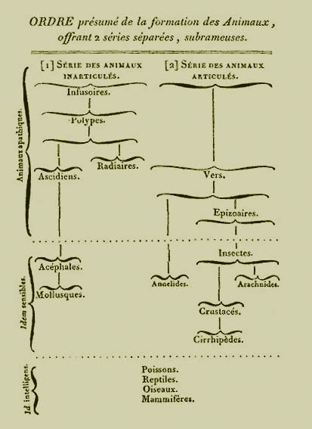
Jean-Baptiste Lamarck
Tree from 1809
Tree-like classification from 1815

Slide 34
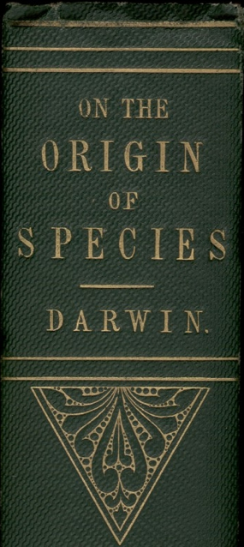
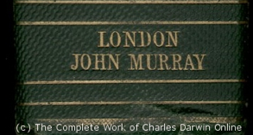
“As buds give rise by growth to fresh buds, and these, if vigorous, branch out and overtop on all sides many a feebler branch, so by generation I believe it has been with the great Tree of Life, which fills with its dead and broken branches the crust of the earth, and covers the surface with its ever-branching and beautiful ramifications.”
Charles Darwin in “On the Origin of Species by Means of Natural Selection or the Preservation of Favoured Races in the Struggle for Life”, p 162 ff, London, John Murray, 1859

Slide 35
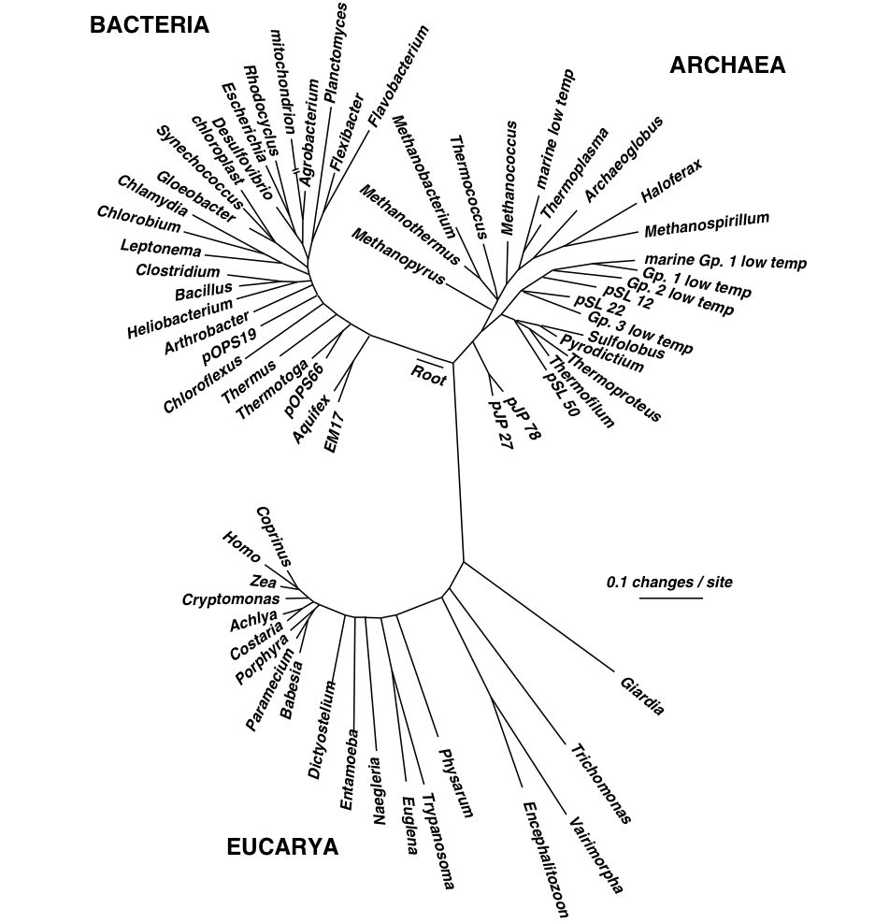
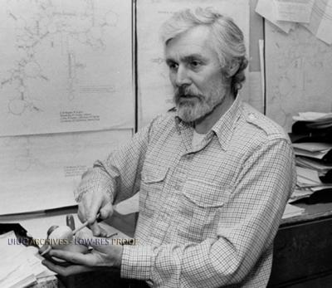
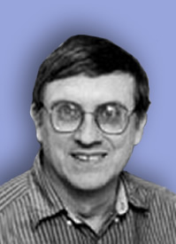
Small Subunit Ribosomal RNA based Tree of Life.
Carl Woese
George Fox
Notes:
1977

Slide 36
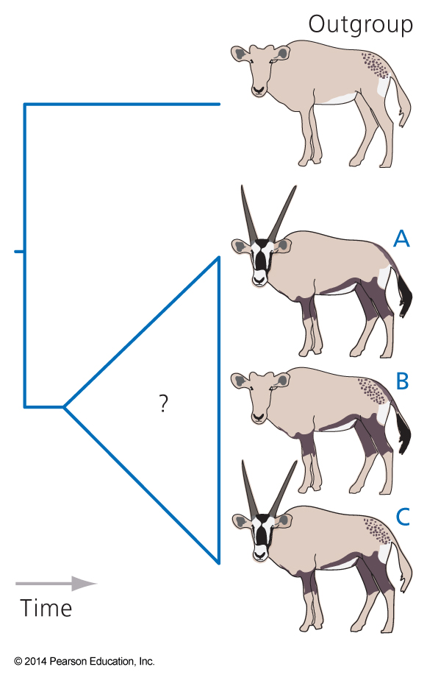
How to root a tree?
Using polarized characters (i.e., derived and primitive characters). For many characters, especially molecular characters (e.g., a nucleotide position in a gene) this is not possible.
Using an Outgroup: Include one or more organisms that are related but outside of the group one wants to study. E.g., for a tree of birds, one could use crocodiles as outgroup.
Fig. 4.12

Slide 37
Catalytic subunits
Non catalytic subunits
Archaea
Eukarya
Bacteria
Bacteria
Archaea
Eukarya
speciation
time
gene duplication
Gogarten et al, 1989, PNAS 86, 17, 6661–6665 http://www.pnas.org/content/113/32/E4654.full.pdf?with-ds=yes
Notes:
Rooting the Tree of Life by an ancient Gene Duplicaiton

Slide 38
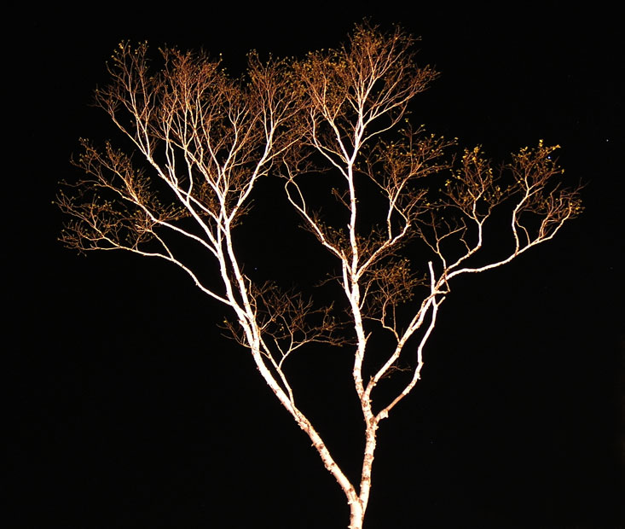
The Tree of Life according to SSU ribosomal RNA (+)
strictly bifurcating
no reticulation
only extant lineages
based on a single molecular phylogeny
branch length is not proportional to time
Eukaryotes
Bacteria
Archaea
PHYLOGENY: from Greek phylon, race or class, and -geneia, born.
“the origin and evolution of a set of organisms, usually of a species” (Wikipedia);
Cenancestor (aka MRCA or LUCA) as placed by ancient duplicated genes (ATPases, Signal recognition particles, EF)
The “Root”
Notes:
Tree in Halifax – Image from Olga Zhaxybayeva – used as illustration for the ribosomal tree of life
? What about life without ribosomes? What other possibilities are there to root the tree of life?

Slide 39
What could one use to root the tree of life that contains all living organisms?

Slide 40
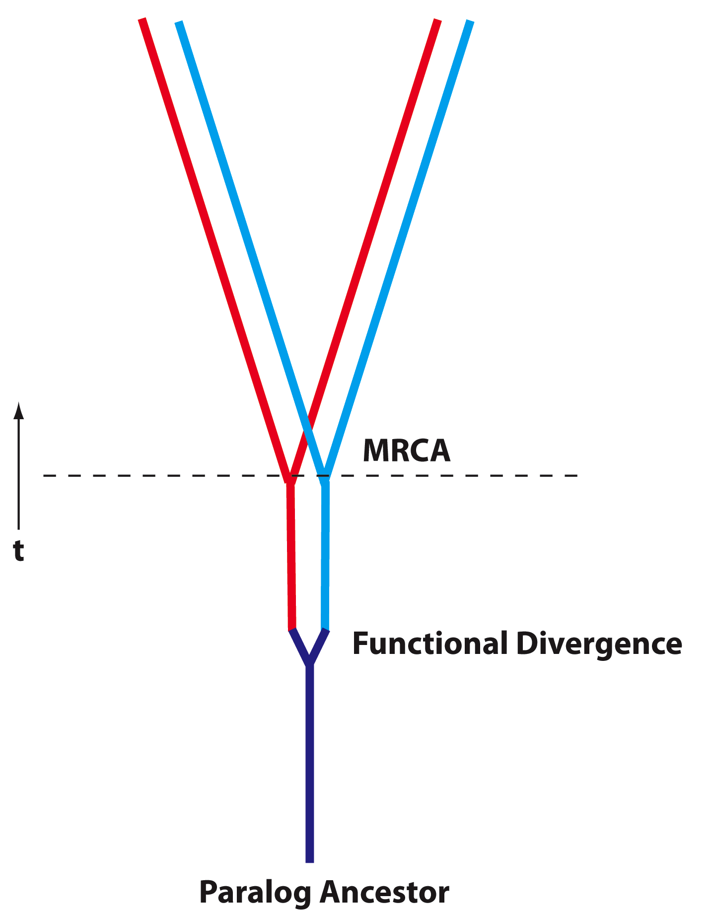
Deep Paralogs (Paralog: homologs that evolved through a gene duplication)
Gene families evolve by duplication, gene transfer and divergence
For ancient proteins, some of these divergences occurred before the divergence of the three domains of life (MRCA, aka Last Universal Common Ancestor LUCA);
Determining function of paralog ancestors could elucidate primordial physiology… however, lack of time machine prevents direct experimental observation.
In some special cases, can be inferred using amino acid composition…

Slide 41
Other ancient duplicated genes used to root the tree of life:
Elongation factors (play a role in ribosomal protein synthesis)
Signal recognitions factors (bind to membrane proteins during their synthesis at the ribosome and direct them to the membrane)
Aminoacyl tRNA synthetases (they charge the tRNAs with the correct amino acid). These enzymes fall into two groups of homologs.
Lactic and malic acid dehydrogenase.

Slide 42
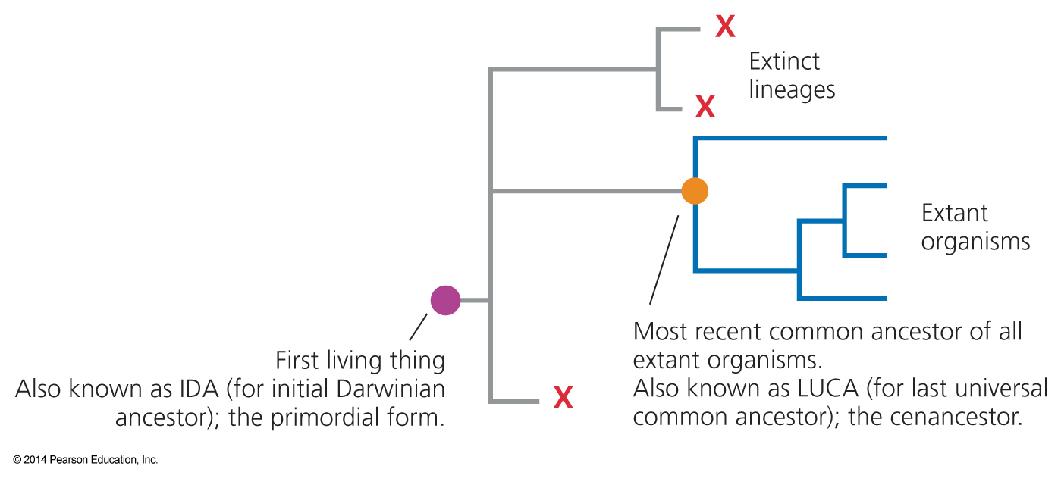
Based on the ancient duplicated genes,
The Last Universal Common Ancestor (aka LUCA or cenancestor) had
energized membranes
ribosomal template directed protein biosynthesis
used 20 different amino acids
This is very different from the first living thing.
Fig. 17.1

Slide 43
The early evolution of life:
Why is the RNA-world assumed to be an early stage in Life’s history?
What problem is solved by assuming a progenote phase of life?
(progenote: organisms existing before a strict linkage between geno- and phenotype – genes frequently transferred between entities)

Slide 44
The RNA World and the Central Dogma

Slide 45
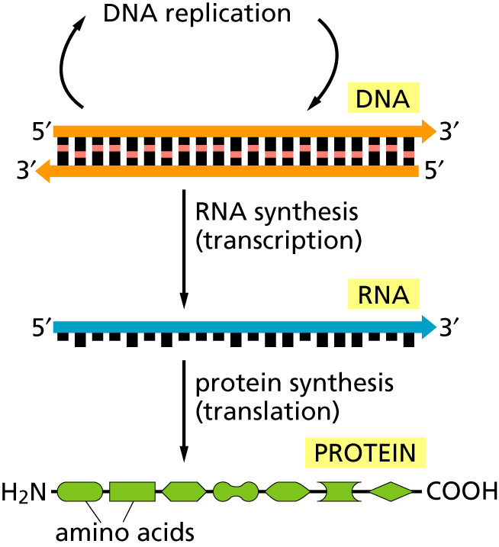
The central dogma
Why might this be wrong or incomplete
Notes:
Reverse transcriptase
Also, proteins can modify a DNA sequence – however, they never back translate a protein into RNA or DNA

Slide 46
Why might the central dogma as depicted in the last slide be wrong or incomplete

Slide 47
Why might the central dogma as depicted in the last slide be wrong or incomplete
Many viruses (e.g., HIV, HERVs) possess a reverse transcriptase that can transcript RNA back into DNA. HIV: Human Immunodeficiency Virus HERV: Human endogenous retroviruses (For SciFi on HERVs see Darwin’s Radio)
In Eukaryotes, many gene duplications occur through an RNA intermediate (see work from Craig Nelson’s lab (here and here)

Slide 48
Why might the central dogma as depicted in the last slide be wrong or incomplete
Proteins can modify DNA sequences, e.g., homing endonucleases, mismatch repair enzymes; however, these do not back translate a protein sequence into a nucleotide sequence.

Slide 49
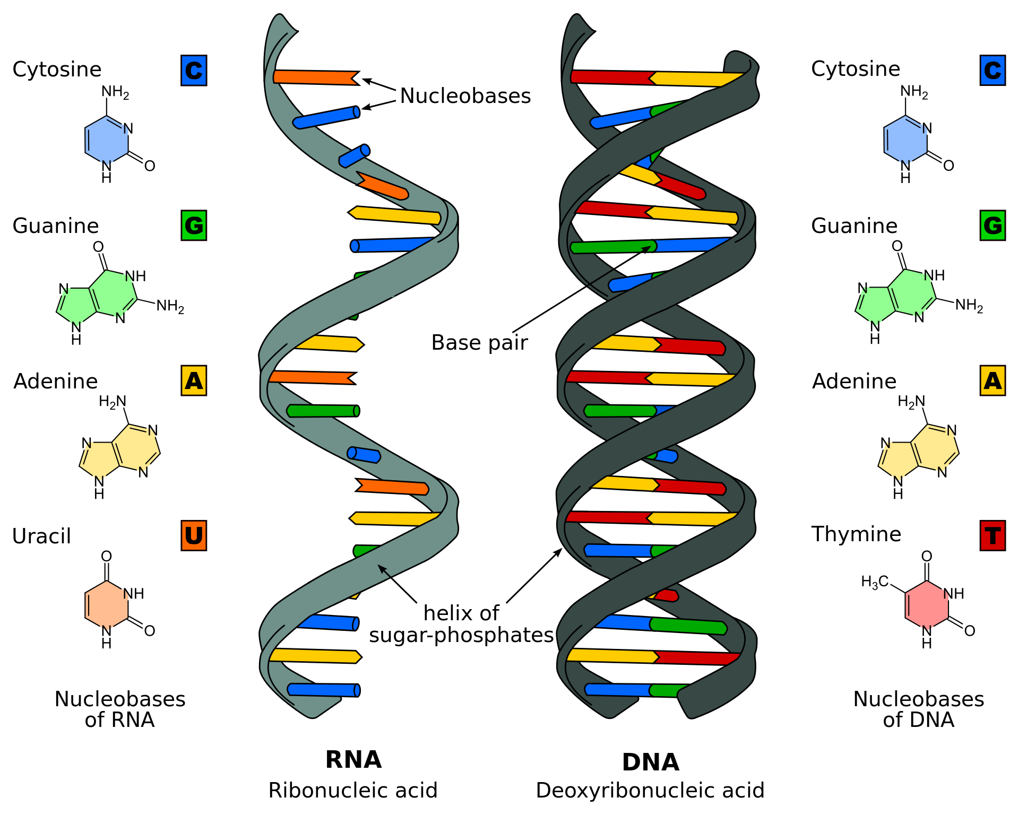
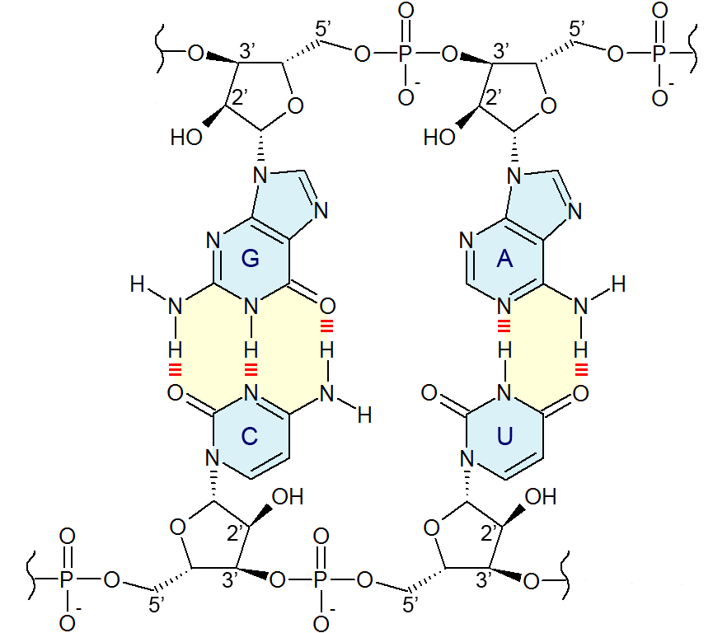
Base pairing in RNA Note the OH group at C2of the ribose
A comparison of RNA (left) with DNA (right), showing the helices and nucleobases each employs
From Wikipedia

Slide 50
The RNA world concept
Today RNA usually is an intermediate between information storage (DNA) and catalytic action/structures (protein)
The RNA world hypothesis says that early in life RNA was fulfilling both functions: information storage (as in today’s RNA viruses – SARS1&2, HIV) and catalytic activity.

Slide 51
RNA enzymes:

Slide 52
Ribosome

Slide 53
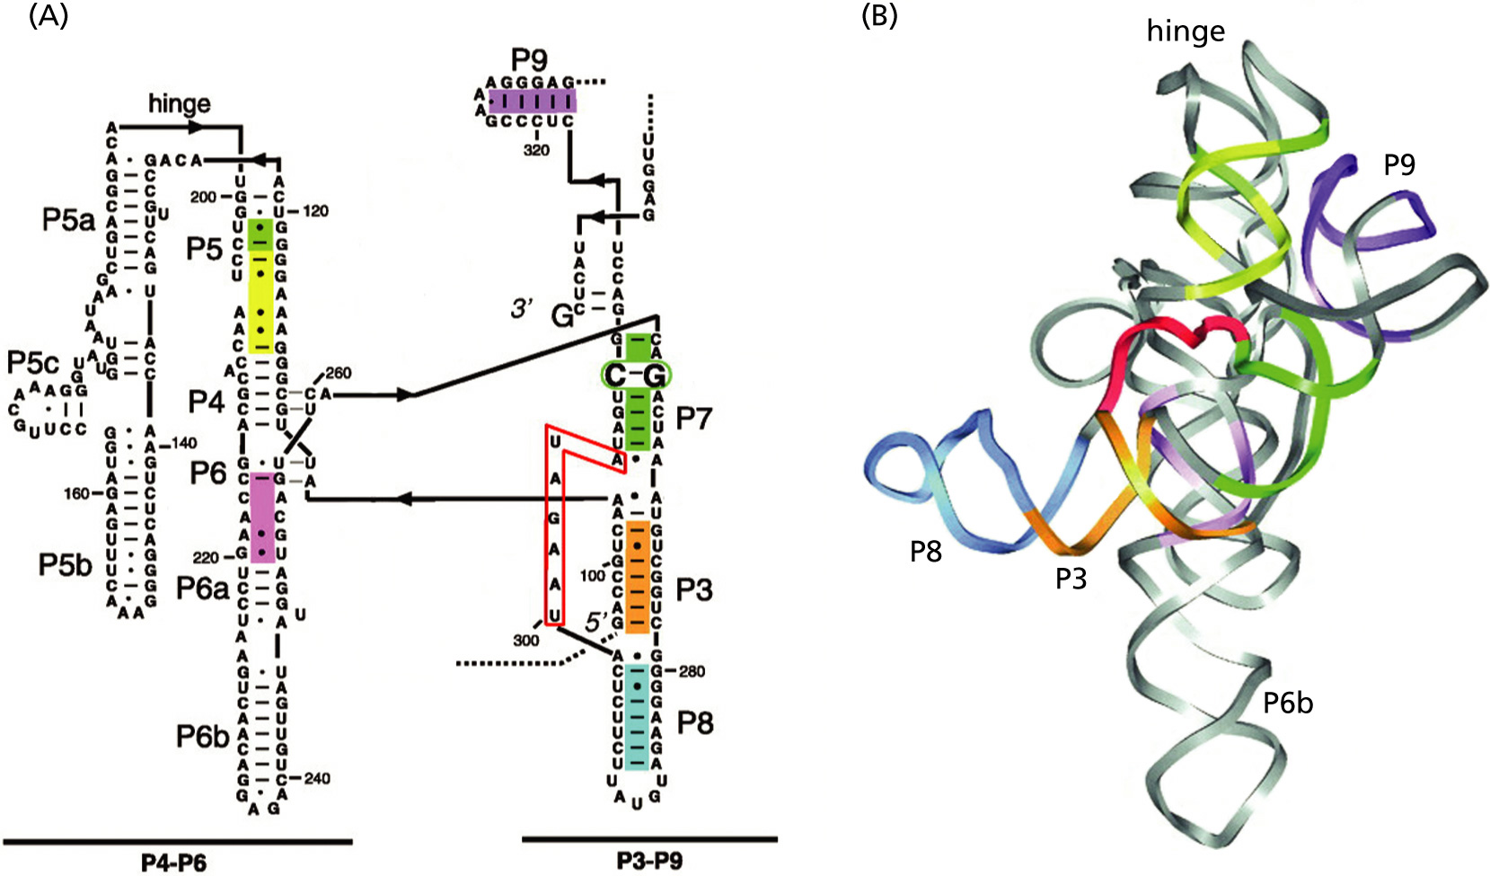
Self-splicing introns

Slide 54
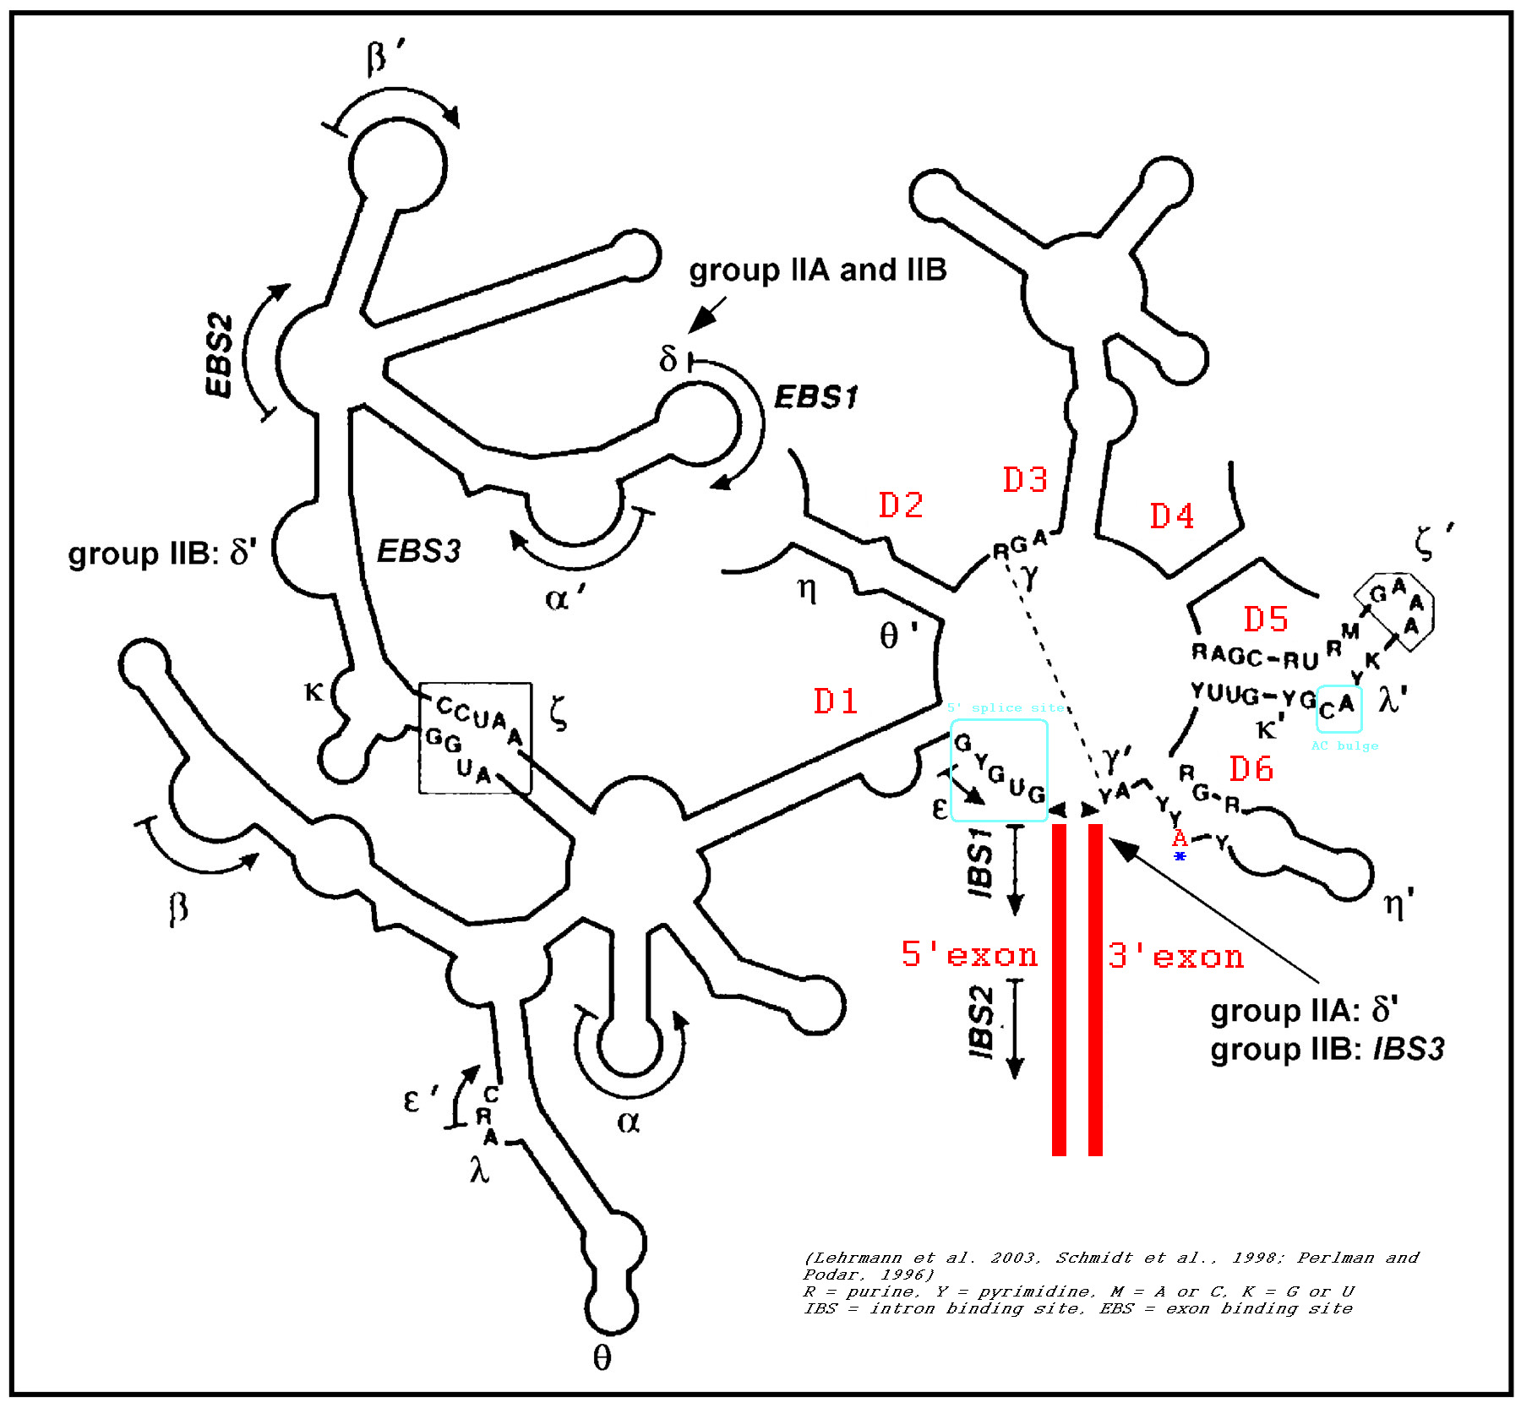
Group II intron

Slide 55
Pro-RNA world
RNA connects Information Storage (DNA) and catalysis (Protein) One could envision the DNA and protein polymers added to the RNA world
RNA can be genetic material
RNA can be an enzyme
Many cofactors are ribonucleotides, which has been interpreted as a remnant from the RNA world

Slide 56
Can you name some cofactors that might be remnants from the RNA world?

Slide 57
Can you name some cofactors that might be remnants from the RNA world?
ATP
Nicotinamide adenine dinucleotide phosphate (NADP⁺)
NAD⁺
Flavin Mono Nucleotide
acetyl-CoA
FADH
coenzyme F420 (in methanogenesis)

Slide 58
Contra-RNA world
RNA is reactive and instable (DNA is more stable – the OH group on C2 is rather reactive)
RNA catalysts are slow
RNA is not a likely product of prebiotic synthesis The first self replicating RNA would need plenty of activated nucleotides. Even small contaminations with the stereoisomer kills replication.
The primordial soup would have been too diluted -> primordial pizza (sandwich) reactants bound to surface

Slide 59
