Slide 1
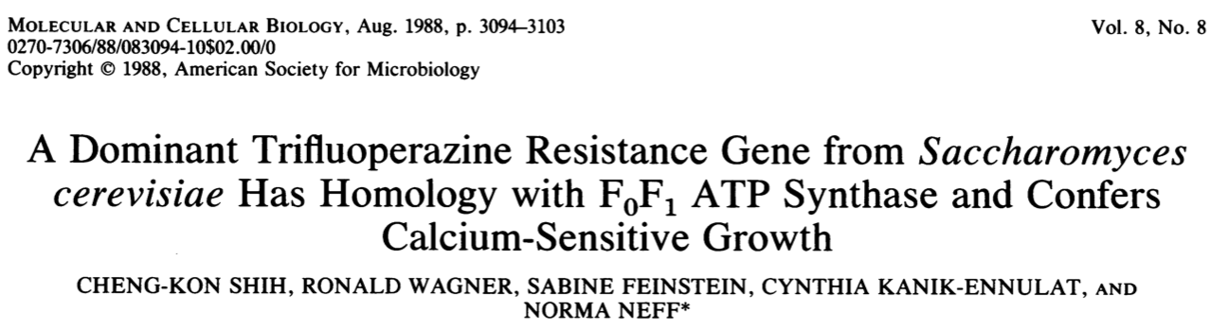
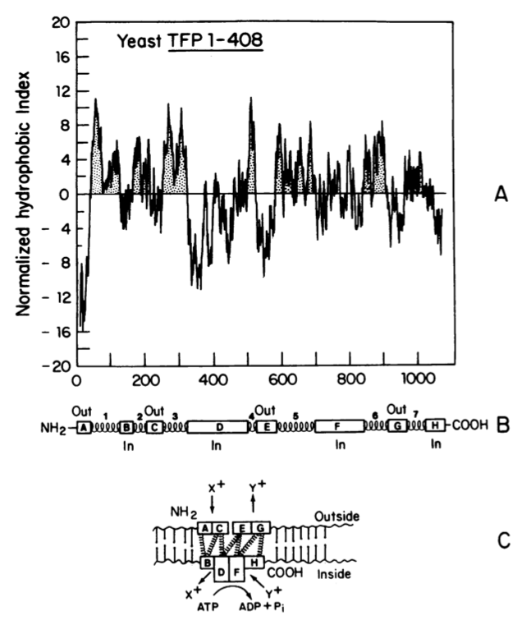
First published intein sequence, but not recognized as such.
(vacuolar ATPases catalytic subunit is not an integral membrane protein)

Slide 2
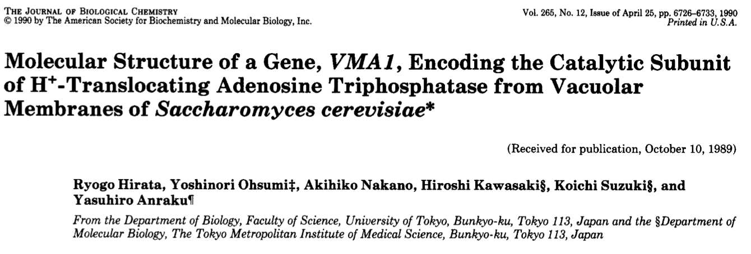
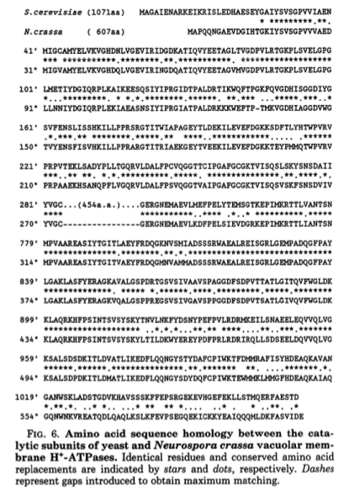
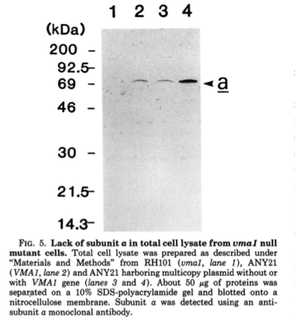
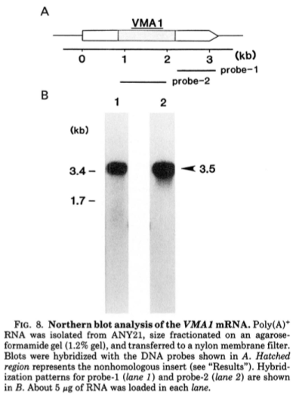
Notes:
In 1989

Slide 3
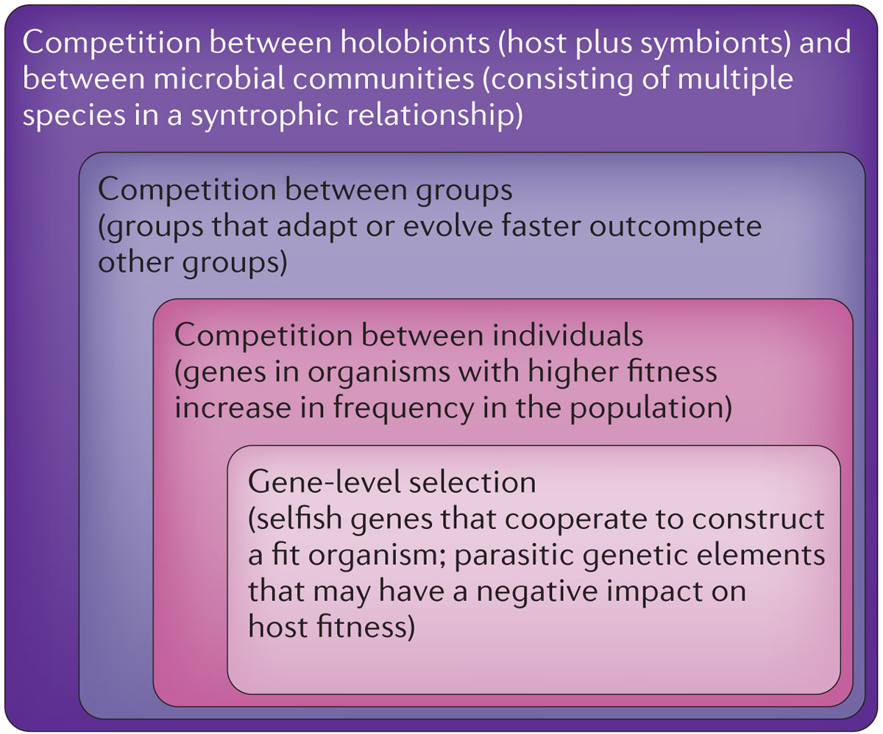
Levels of Selection
Notes:
Soucy SM, Huang J, Gogarten JP (2015)
Horizontal gene transfer: building the web of life.
Nature Reviews in Genetics 16, 472–482. doi: 10.1038/nrg3962

Slide 4
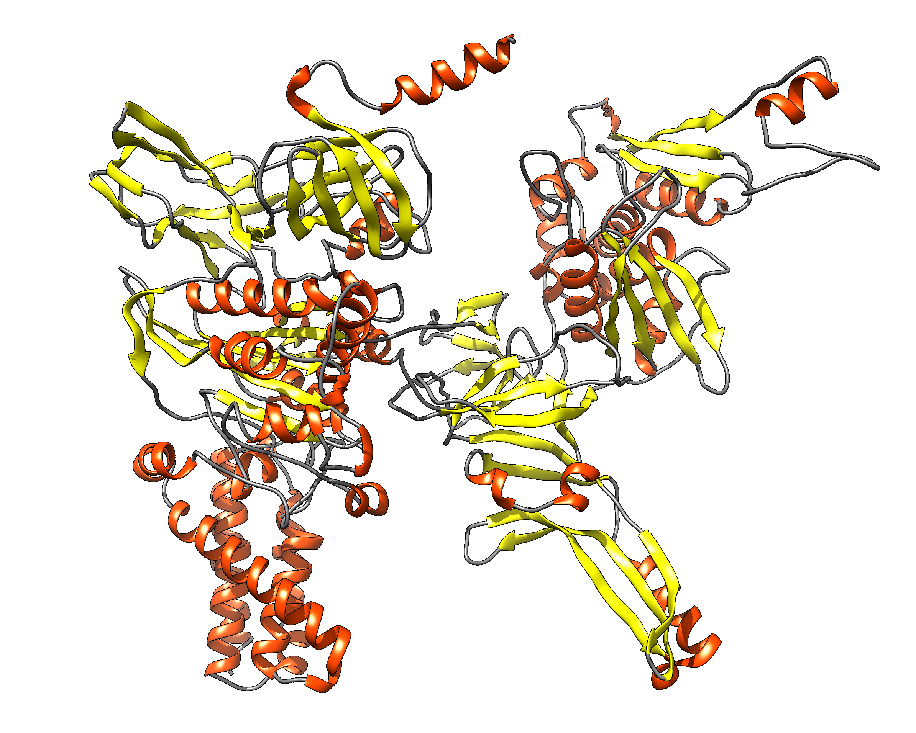
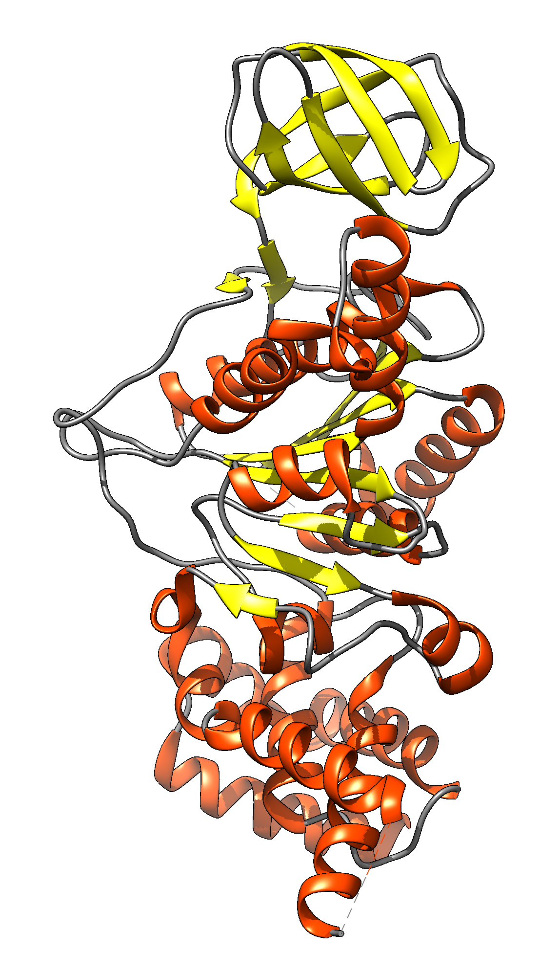
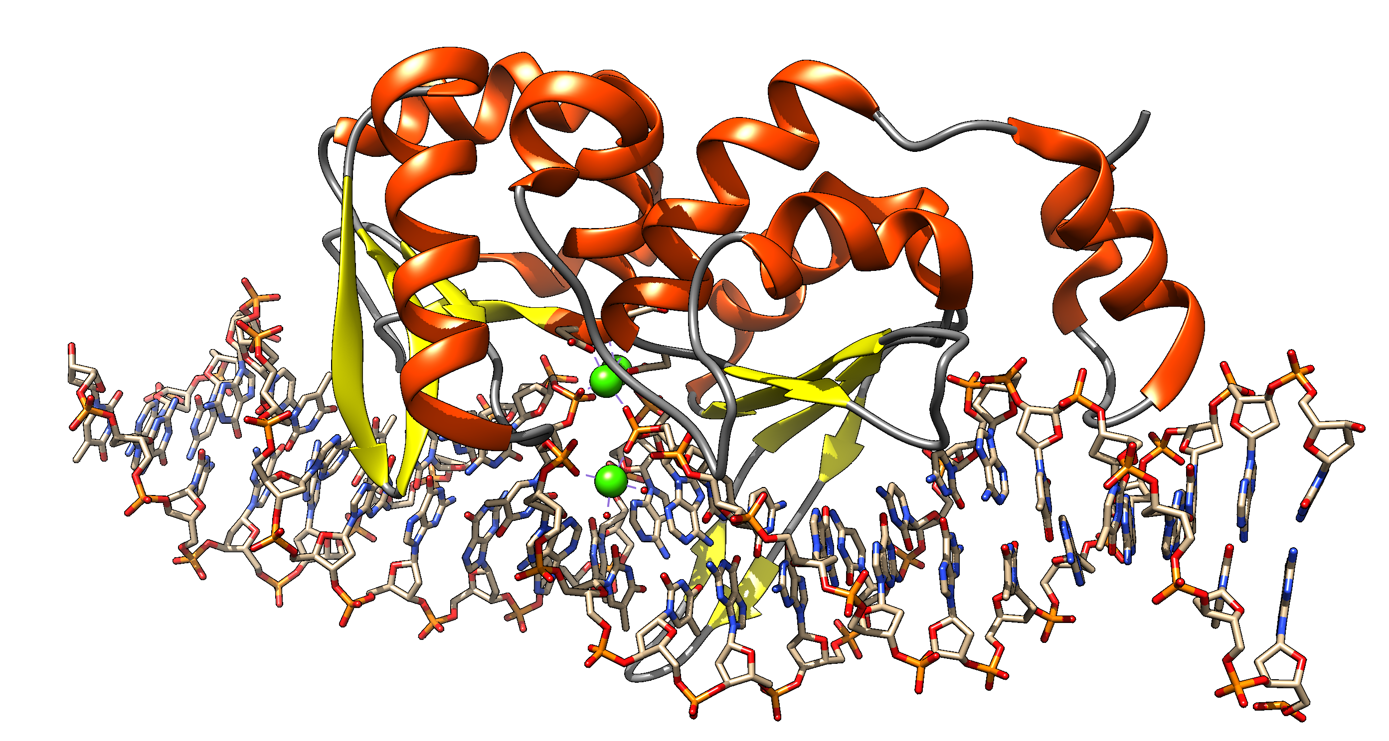
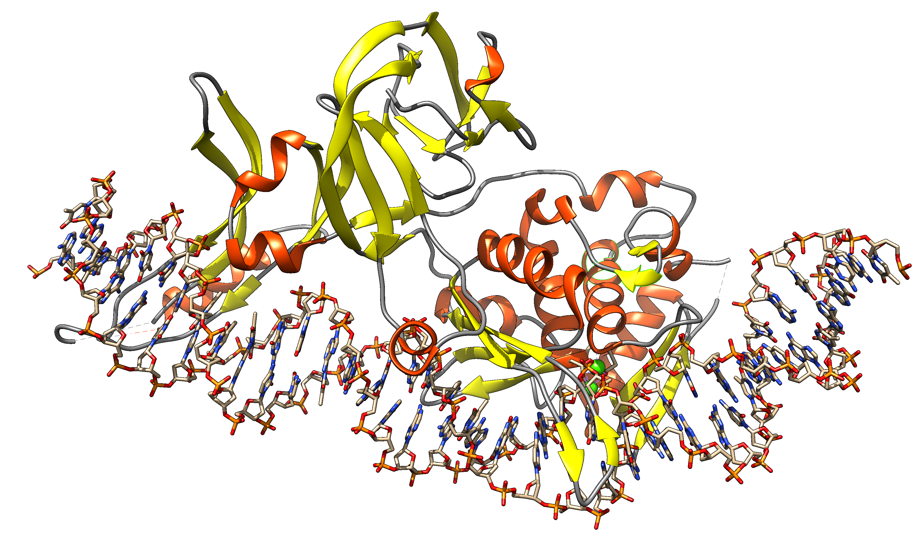
Group I Intron
Intein
Exon: Intron: ORF on Intron
Extein: Intein Splicing Domain: HE domain:
DNA
transcription
transcription
mRNA
or
rRNA
translation
splicing
Exon
Intron with ORF
translation
alpha fold prediction
of Sce vma1 gene product
splicing
Protein
Homing Endonuclease
1LWS.pdb
functional protein
functional protein
Intein with HE and
Splicing domain
Notes:
Structures F-ATPase chain A, SceI, https://alphafold.ebi.ac.uk/entry/P38078 and 1LWS

Slide 5
Inteins (molecular fleas):
Self-Splicing Protein Mobile Elements
DNA
Intein Self-Splicing Domains
Auto catalytic splicing reaction removes the intein from the host protein
Intein Homing Endonuclease Domain
Recognizes unoccupied intein insertion
sites (IIS) and disrupts the sequence with a
double strand break
Extein
Host protein
RNA
Protein
Notes:
Inteins: protein splicing mobile genetic elements
2 domains HEN domain makes a DSB at the Intein Insertion site (IIS) splicing domains – auto-catalytic splicing reaction- reinstating a functional protein
Found in all three domains of life in the most conserved positions of slowly evolving genes,
Notably: polymerases, topoisomerases, helicases and other genes related to nucleotide metabolism

Slide 6
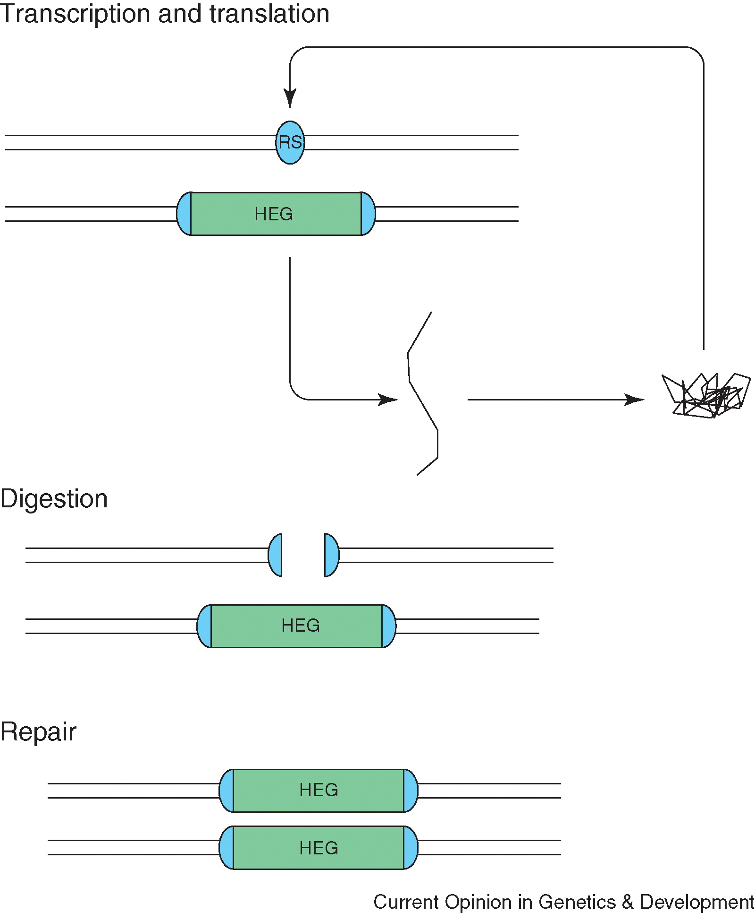


Intein Homing
Intein = Intervening Protein sequence
= “protein intron”
Modified from
Self Splicing
Domain
Homing Endonuclaease
Domain

Slide 7
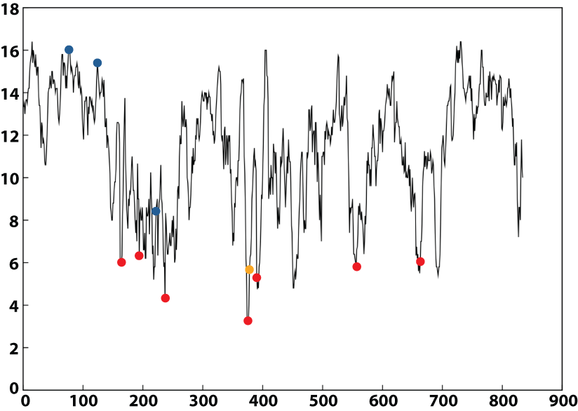

Ribonucleotide Reductase
Intein
Group I Introns
Group II Introns

Slide 8
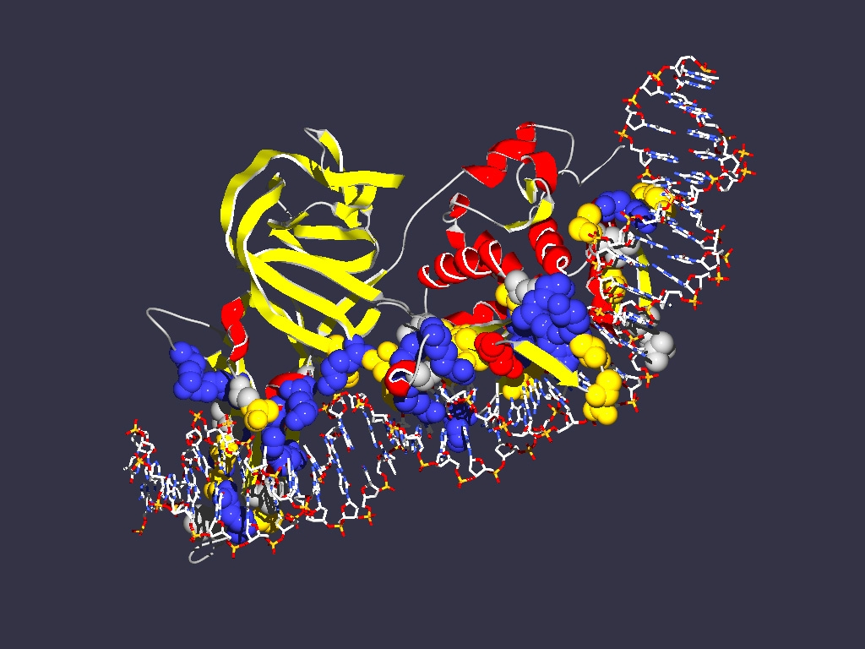
In case of inteins the co-evolution of genes results in
Mutualism between splicing and homing endonuclease domain
Commensalism between host protein and intein without HE domain
Parasitism between host protein and intein with HE
Encoding
1LWS
Extein = Host Protein
Intein Splicing Domain
Structure from Moure et al. (2002)
Nat.Struct.Biol. 9: 764-770
Homing Endonuclease (HE)
domain

Slide 9
How can inteins with functional homing endonuclease survive on the long run?
Homing cycle
Coexistence of the three forms (preditor prey with three partners, in an intransitive fitness relationship)
Diverse environment with regions that select for the intein, and those that don’t

Slide 10
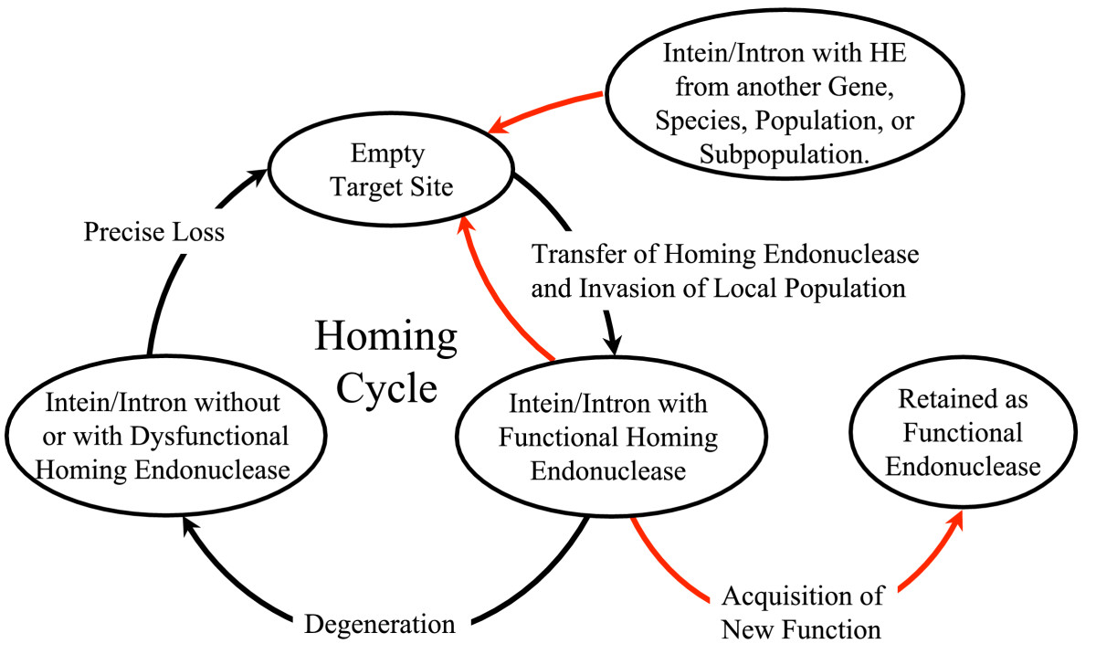
Homing cycle of a parasitic genetic element (modified from [3, 13]). Recent findings suggest that due to complex population structure the cycle might not operate in synchrony in different subpopulations. The red arrows indicate the trajectory of the functioning HE and the black arrows the fate of the host gene. The precise loss can occur through recombination with an intein or intron free allele, or, in case of introns, through recombination with a reverse transcript of the spliced mRNA [39, 40].

Slide 11
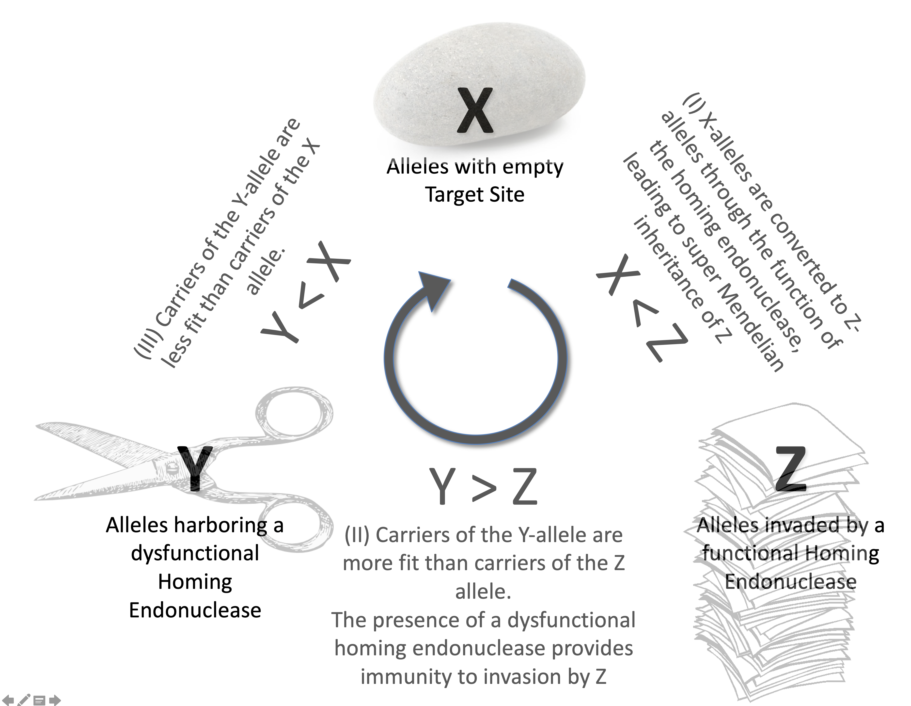
Coexistence of the three forms
A Molecular Rock-Paper-Scissors game
Simulations using difference-equations in populations of limited size
Barzel et al. BMC Evolutionary Biology 2011 11:324 doi:10.1186/1471-2148-11-324

Slide 12

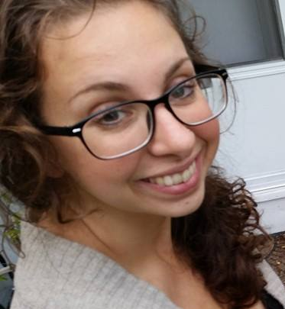
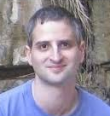
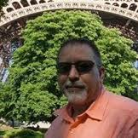
Inteins have a high fitness cost for the host organism.
Competition Experiment between Intein + and Intein – strains (otherwise isogenic)
From: Impact of a homing intein on recombination frequency and organismal fitness. Naor et al.
doi: 10.1073/pnas.1606416113
Dr. Adit Naor
Tel Aviv Univ / Stanford
Dr. Shannon Soucy
UConn / Dartmouth
Dr. Uri Gophna
Tel Aviv Univ
Dr. Thane Papke
UConn

Slide 13
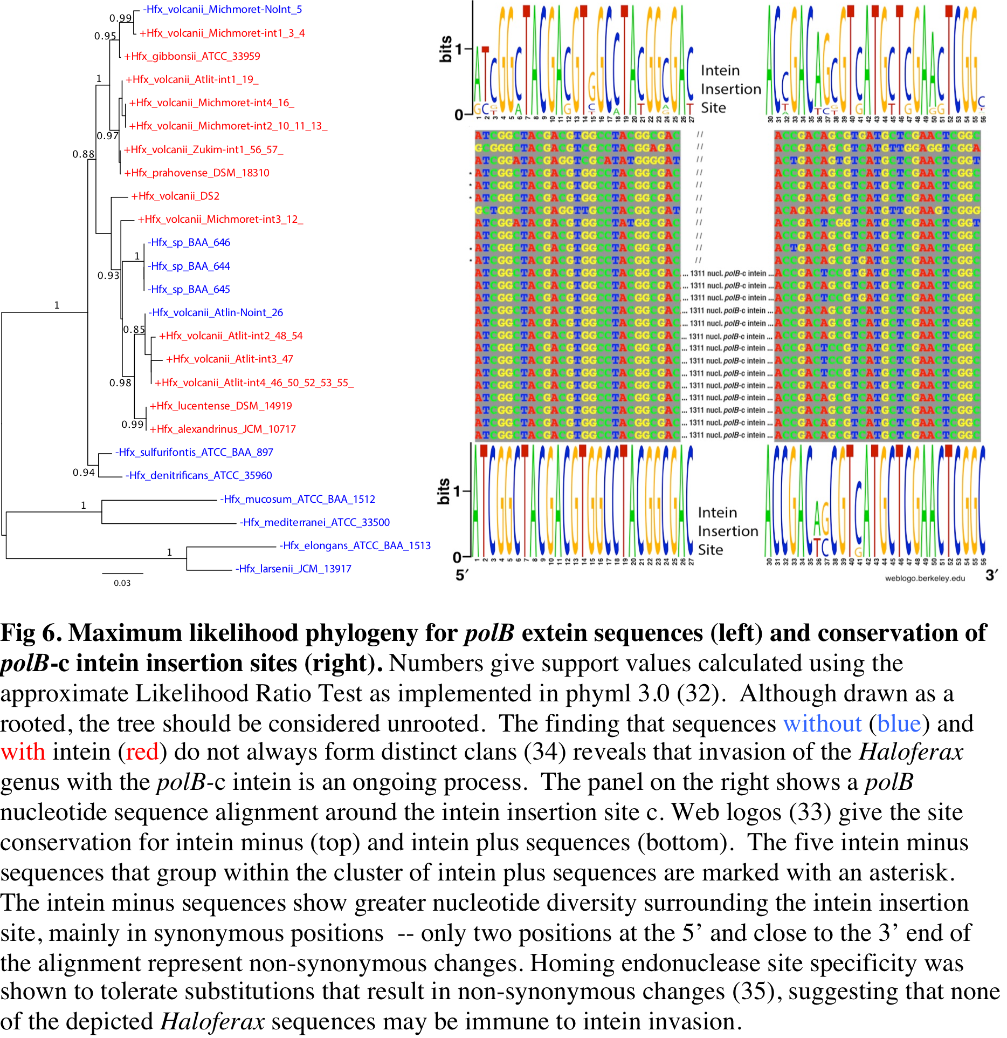
Notes:
From: Naor A, Altman-Price N, Soucy SM, Green AG, Mitiagin Y, Turgeman I, |
Davidovich N, Gogarten JP*, Gophna U* (2016)
The impact of a homing intein on recombination frequency and organismal fitness.
PNAS 113 (32): E4654–E4661 doi:10.1073/pnas.1606416113

Slide 14
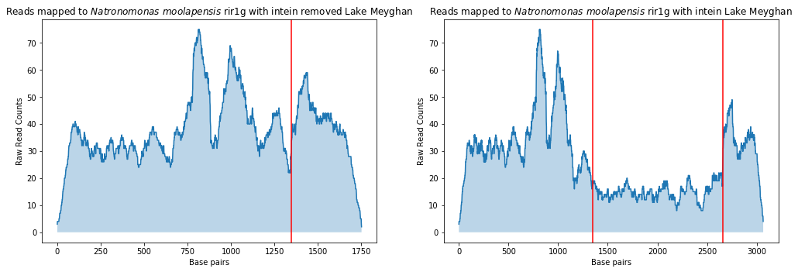
Frequency of reads mapped to Natronomonas moolapensis rir1g
Metagenomic reads from Lake Meyghan* mapped back to reference sequences with and without the intein.
Intein was artificially removed, to intact insertion site.
Red lines indicate intein boundaries, sharp decrease in coverage when intein removed.
*Naghoni, A. et al. Microbial diversity in the hypersaline Lake Meyghan, Iran. Sci. Rep. 7, (2017).

Slide 15
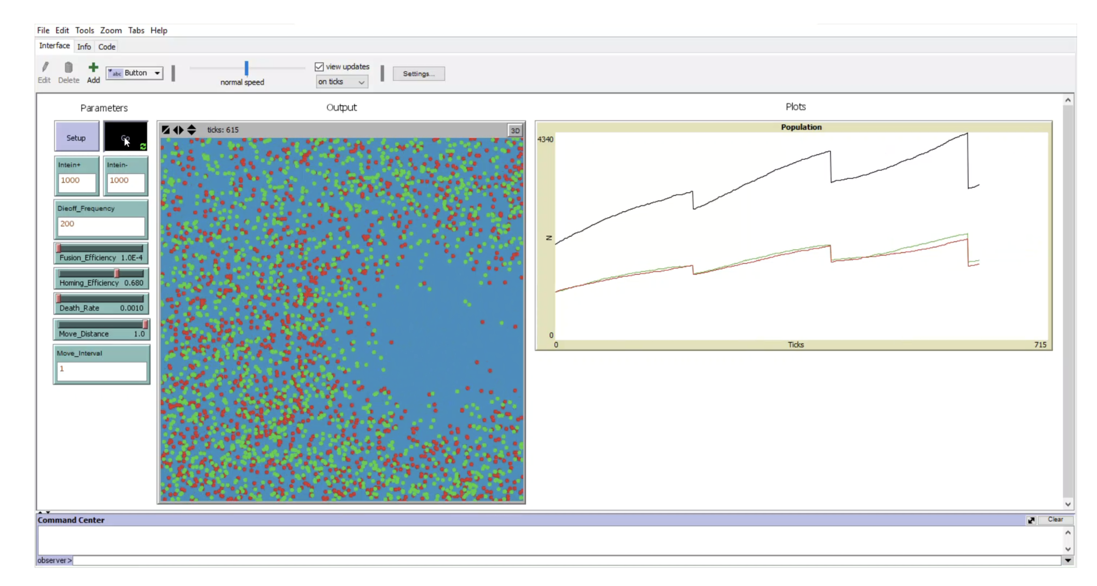
Simulation: Homogeneous Environment with localized random extinctions
Agent based modeling using NetLogo

Slide 16
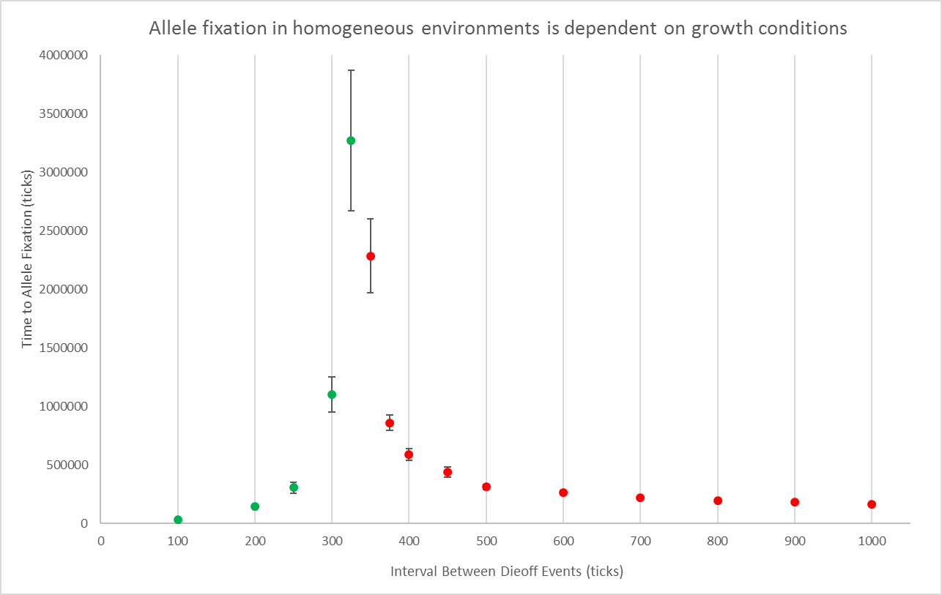

Slide 17
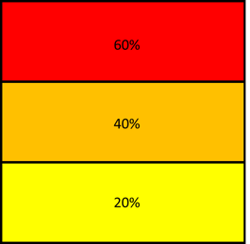
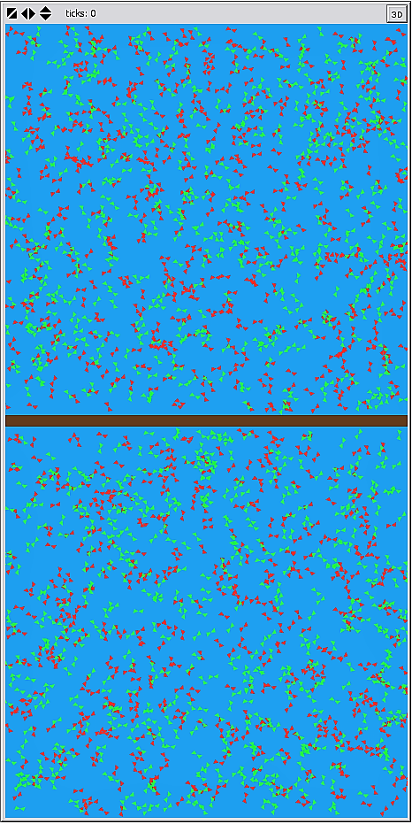
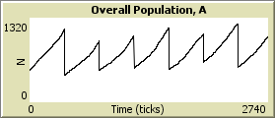
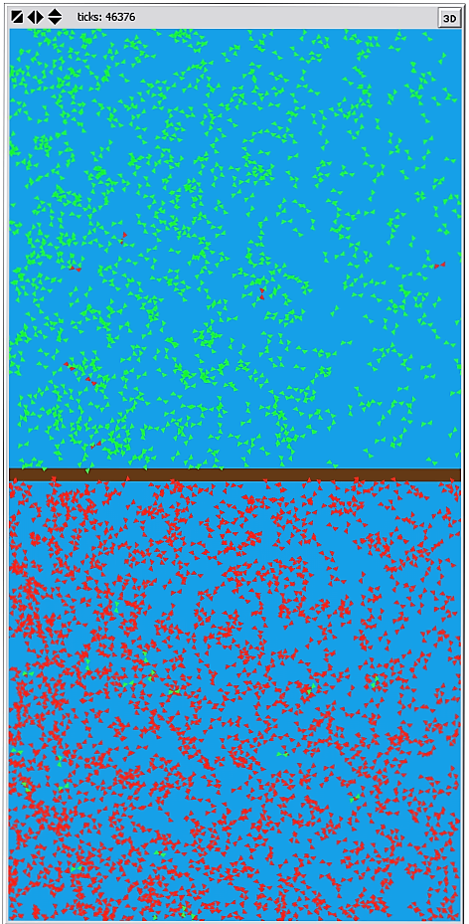
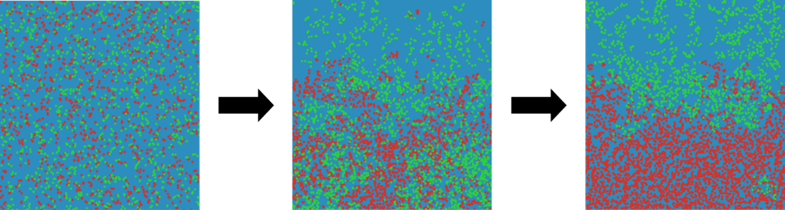
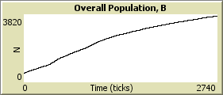
Changing conditions (temporal and/or spatial) can facilitate the long-term coexistence of homing endonucleases with empty target sites
Two environments with
different frequencies of local
extinction events
Environment with a gradient in efficiency of local extinction events
A
Population held in exponential phase
A
B
B
Population enters stationary phase
Close to stationary phase: Inteins transmission continues, increasing the frequency of the invaded allele
During active growth: Due to fitness cost of the intein, the frequency of the noninvaded allele increases

Slide 18
Simulation of a two-compartment system (each of the compartments is homogenous) using iterations.
In each discrete generation 10% of the population dies in compartment 2, and .1% move between compartments. Without death the carrying capacity is 2 in each compartment.
A heterogeneous environment can lead to long-term stable coexistence of invaded and uninvaded genes
Sum of Intein minus cells
Sum of Intein invaded cells (in both compartments)

Slide 19
How can inteins with functional homing endonuclease survive on the long run?
Homing cycle
Coexistence of the three forms (preditor prey with three partners, in an intransitive fitness relationship)
Diverse environment with regions that select for the intein, and those that don’t
They picked up a function that increases the fitness of the host (emergency shut off, if conditions are bad – e.g., salt, temperature, redox potential; mating type switching endonuclease, weapon against competitors).

Slide 20
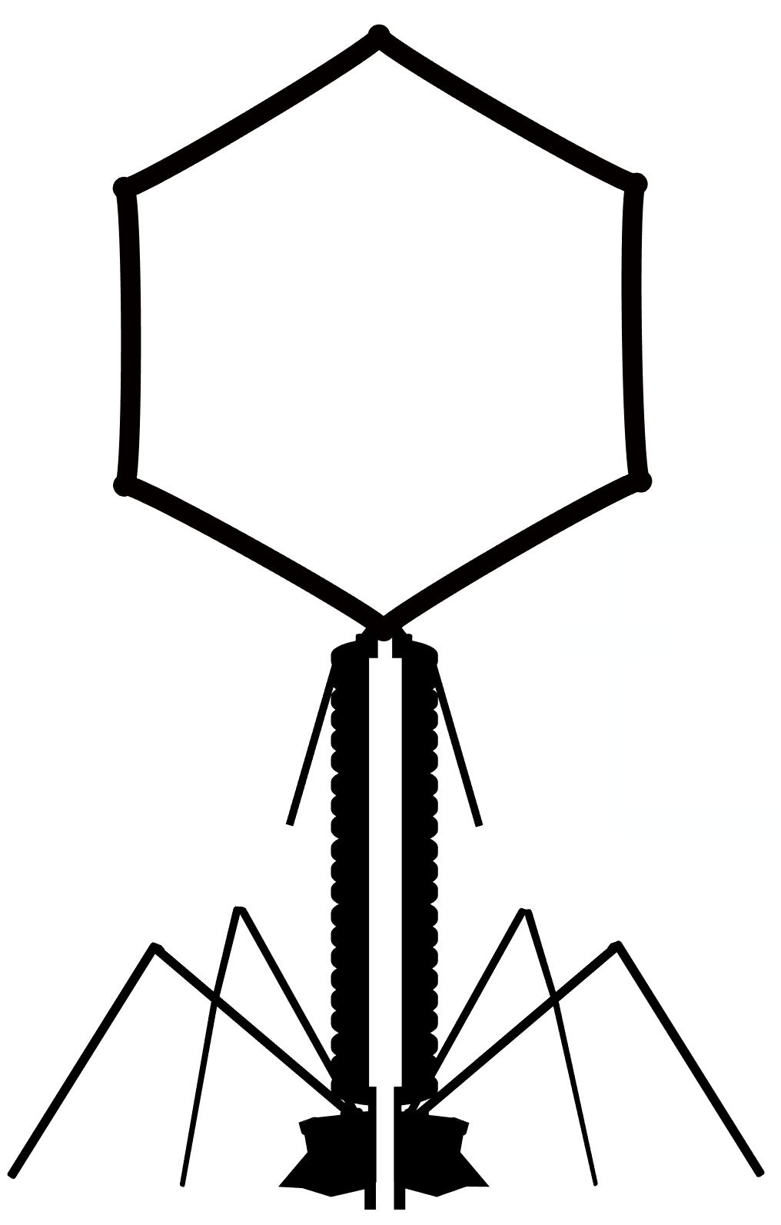

Phage with Intein
Phage w/o Intein
Bacterial Cell
x
Intein

Slide 21
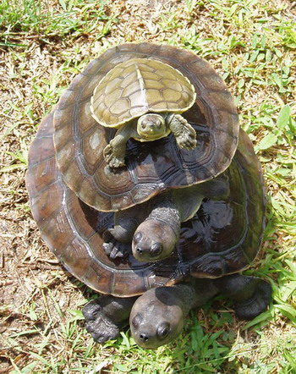
Infinite Regress
After a lecture on the structure of the solar system, the cosmologist William James was accosted by a little old lady.
"Your theory that the sun is the centre of the solar system, and the earth is a ball which rotates around it has a very convincing ring to it, Mr. James, but it's wrong. I've got a better theory," said the little old lady.
"And what is that, madam?" inquired James politely.
"That we live on a crust of earth which is on the back of a giant turtle."
Not wishing to demolish this absurd little theory by bringing to bear the masses of scientific evidence he had at his command, James decided to gently dissuade his opponent by making her see some of the inadequacies of her position.
"If your theory is correct, madam," he asked, "what does this turtle stand on?"
"You're a very clever man, Mr. James, and that's a very good question," replied the little old lady, "but I have an answer to it. And it's this: The first turtle stands on the back of a second, far larger, turtle, who stands directly under him."
"But what does this second turtle stand on?" persisted James patiently.
To this, the little old lady crowed triumphantly,
"It's no use, Mr. James—it's turtles all the way down.”
From Ross, John R. (1967). Constraints on variables in syntax (Doctoral dissertation). MIT. hdl:1721.1/15166.
via https://en.wikipedia.org/wiki/Turtles_all_the_way_down

Slide 22
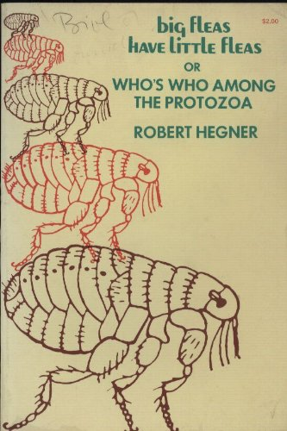
Siphonaptera
Great fleas have little fleas upon their backs to bite 'em,
And little fleas have lesser fleas, and so ad infinitum.
And the great fleas themselves, in turn, have greater fleas to go on ;
While these again have greater still, and greater still, and so on.
From: Augustus De Morgan’s poem Siphonaptera (1872)
via https://en.wikipedia.org/wiki/Siphonaptera_(poem)

Slide 23
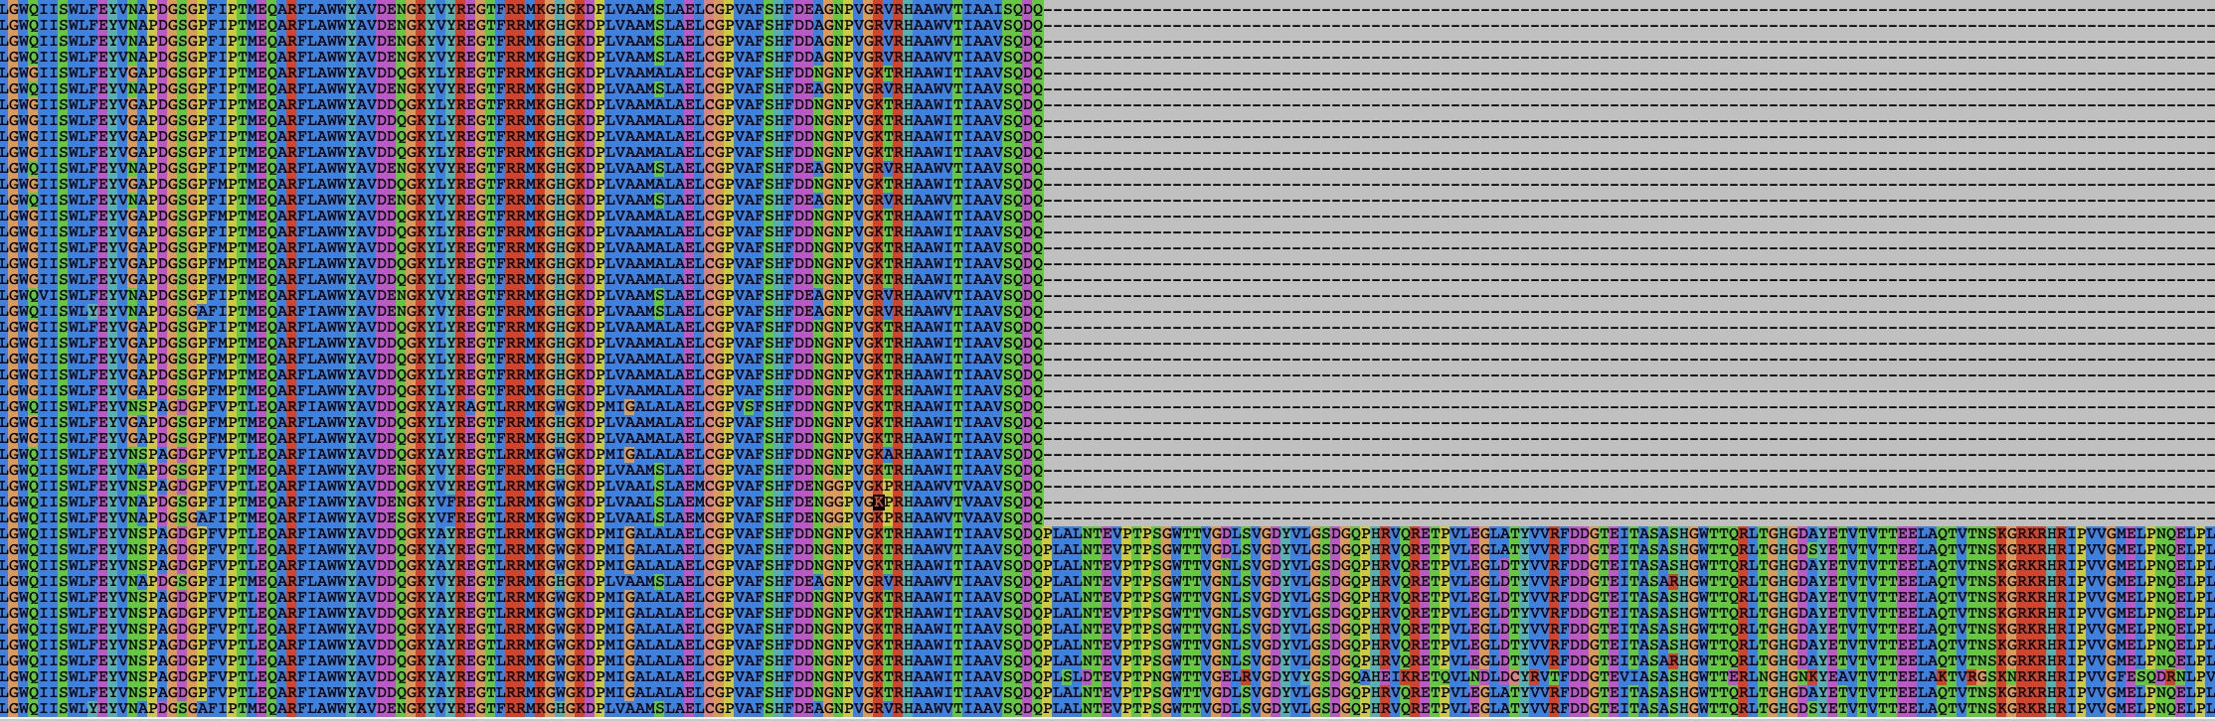
Terminase Subunits from Actinobacteriophages Cluster A1
Alignment of protein sequences
N-Extein
Intein

Slide 24
Phage Assembly
From: Corynne L. Dedeo, Gino Cingolani, and Carolyn M. Teschke:
Portal Protein: The Orchestrator of Capsid Assembly for the dsDNA Tailed Bacteriophages and Herpesviruses
Annual Review of Virology 2019
Notes:
Terminase plays a crucial role in packaging DNA into the phage head. It’s subunits form a complex with the Portal proteins, it provides energy to pump DNA into the head, and contains a nuclease the cleaves the DNA, when the head is full – communicated through conformation changes of the portal protein and interaction with the ATP driven DNA pump.
.

Slide 25
Exteins and their inteins from homologous terminase subunits in the A1 cluster
Extein

Slide 26
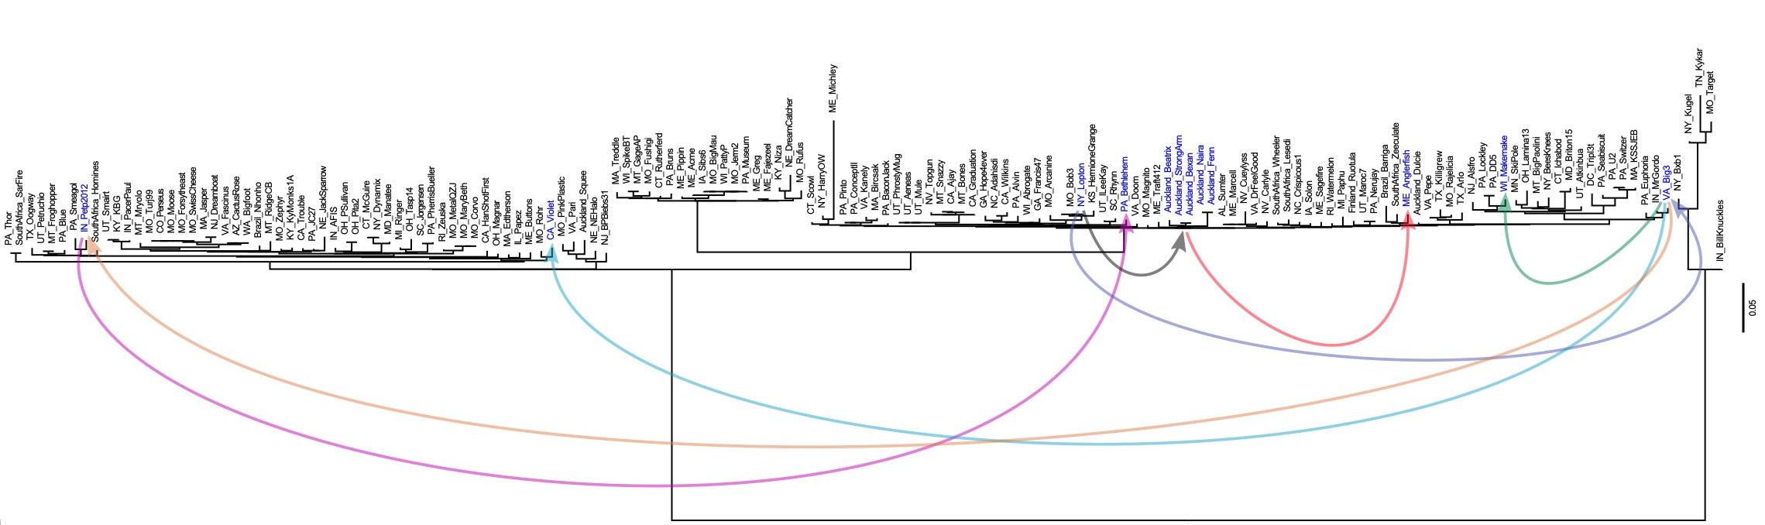
Reconciliation between extein and intein trees
This is one of many equally parsimonious reconciliations (allowing for transfer, duplication and loss).
Note that the Auckland cluster requires only one intein acquisition at the base.

Slide 27
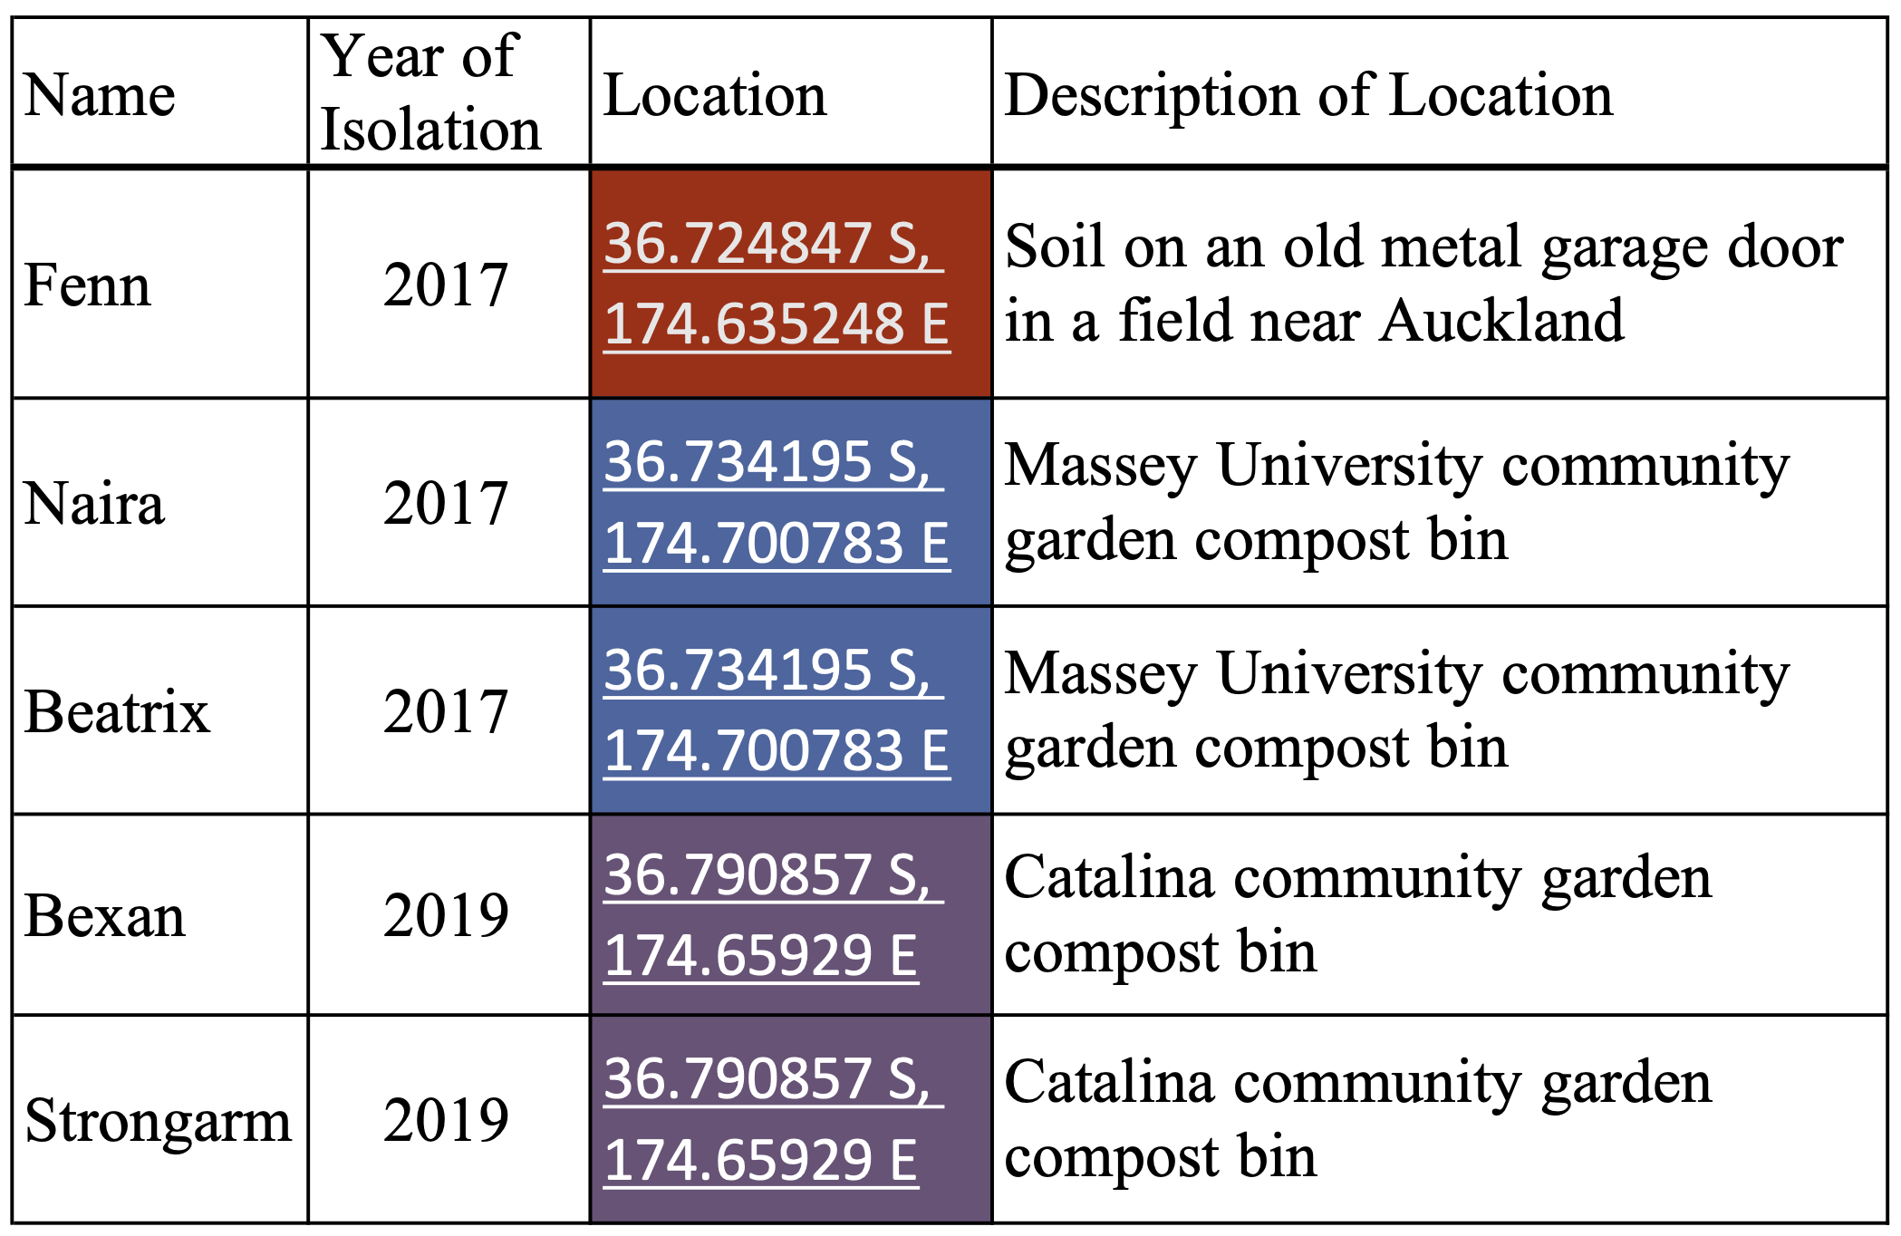
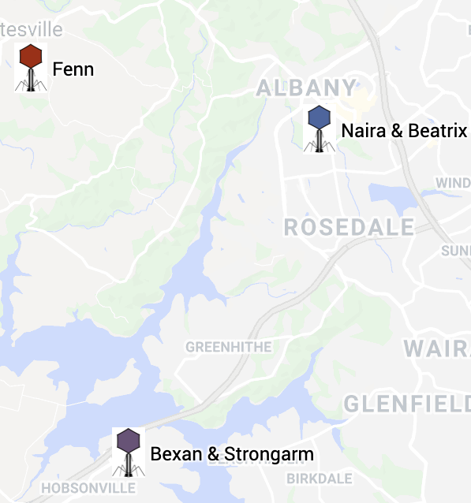
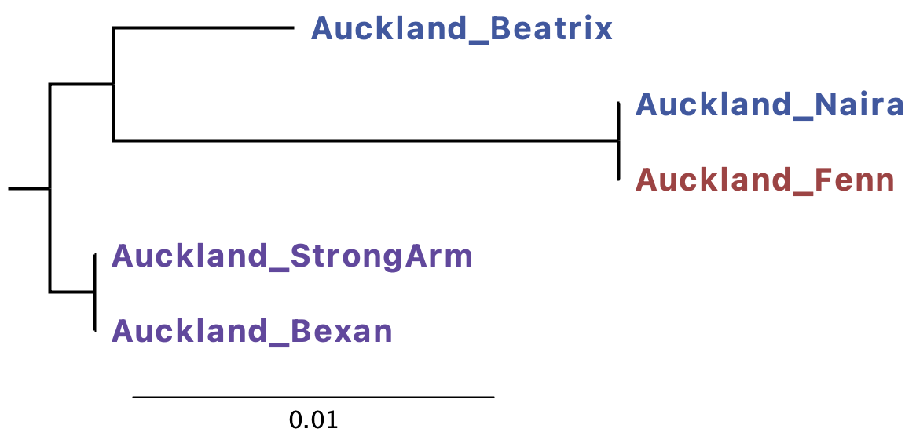
The A1 Phages from the Auckland area
 | Number of sites | Number of sequences | Number of Polymorphic sites (only SNPs) | Watterson’s Theta
Extein | 1689 | 5 | 31 | 0.0088
Intein | 1023 | 5 | 0 | 0
Phylogeny based on extein sequences (topology is the same if the whole genomes are used):
Notes:
Bexan and Strongarm differ by one nucleotide and a 128 nucleotide indel (Bexan has a deletion that fuses two neighboring minor tail proteins into a single larger ORF)

Slide 28
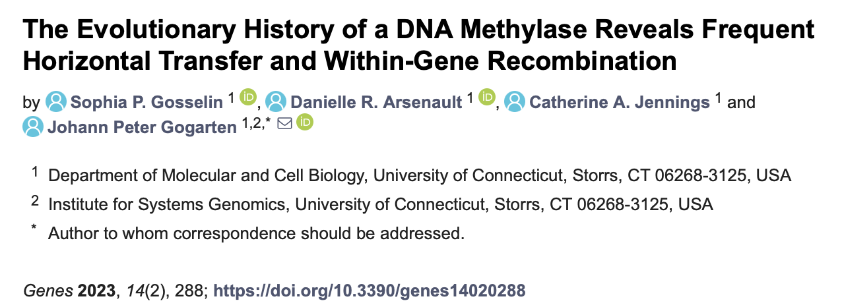

Slide 29
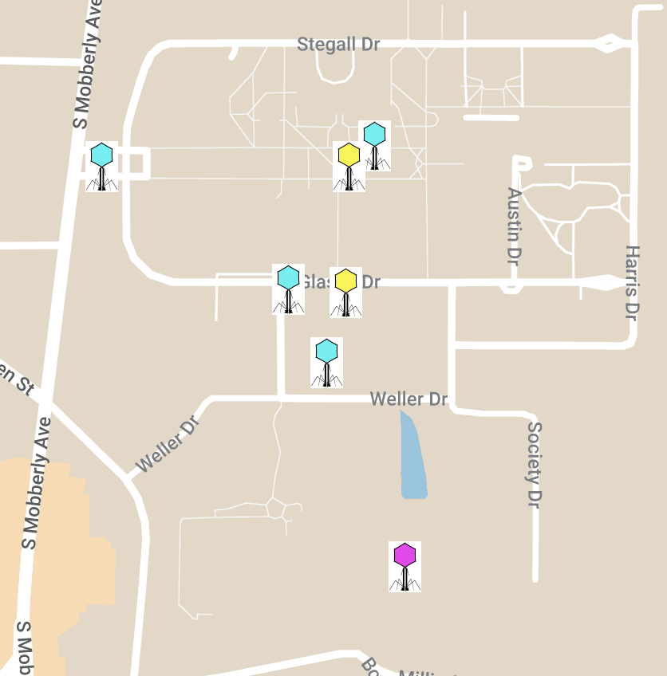
Methylase Extein Phylogeny
Notes:
Cactusjack LeTourneau University 2018 32.4654 N,94.7273 W
Glaske LeTourneau University 2017 32.46555 N,94.72777 W
Phalm LeTourneau University 2018 32.466944 N,94.730278 W
StressBall LeTourneau University 2018 32.464719 N,94.727251 W
Megiddo LeTourneau University 2018 32.4624 N,94.7262 W
KilKor LeTourneau University 2018 32.4655 N,94.727 W
Willsammy LeTourneau University 2016 32.466944 N,94.726944 W

Slide 30
Phylogeny of an Actinophage Methylase Family
Exteins
Inteins
Max 13% sequence divergence
Max 0% sequence divergence
Notes:
Cactusjack LeTourneau University 2018 32.4654 N,94.7273 W
Glaske LeTourneau University 2017 32.46555 N,94.72777 W
Phalm LeTourneau University 2018 32.466944 N,94.730278 W
StressBall LeTourneau University 2018 32.464719 N,94.727251 W
Megiddo LeTourneau University 2018 32.4624 N,94.7262 W
KilKor LeTourneau University 2018 32.4655 N,94.727 W
Willsammy LeTourneau University 2016 32.466944 N,94.726944 W

