Slide 1
MCB 3421
Class 6 2023
The tangled tree of life
or
How to depict evolutionary history?

Slide 2
If you want to learn more about
the recent upheaval of tree thinking with respect to evolution see the book by David Quamann:
The Tangled Tree,
A Radical New History of Life
and
Soucy SM, Huang J, Gogarten JP (2015)
Horizontal gene transfer: building the web of life.
Nature Reviews in Genetics 16, 472–482. doi: 10.1038/nrg3962

Slide 3
One of the “the four horsemen” of the gene-transfer apocalypse: William Martin, Jeffrey Lawrence, Peter Gogarten and Ford Doolittle.
The debate is ongoing as to who is
Pestilence, War, Famine, and Death.
Painting by Viktor Vasnetsov 1887, via Wikipedia

Slide 4
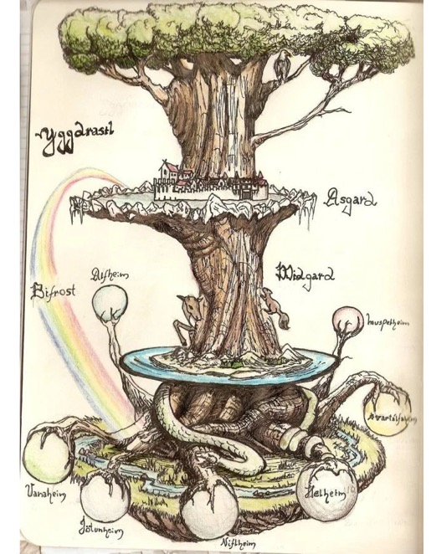
Trees have a long history in depicting evolutionary history, but also for depicting the diversity of life.
(Note, many Trees of Life depict the latter, and do not imply an evolutionary history)
The biblical tree of life
Yggdrasil
(North Mythology)
Mexican tree of life

Slide 5
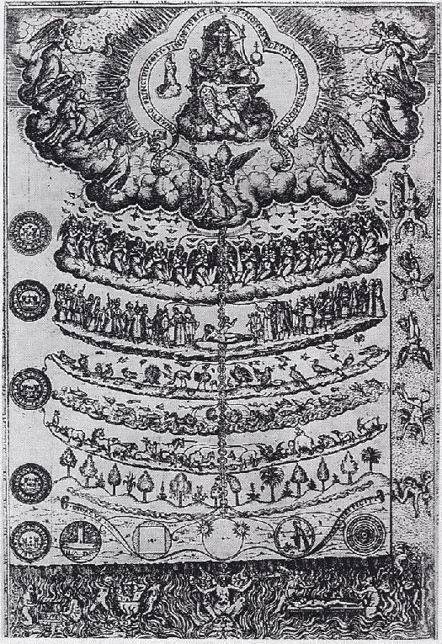
Scala Naturae
Being
God
Realm of Being
Angels
Demons
Man
1579 drawing of the Great Chain of Being from
Didacus Valades, Rhetorica Christiana. Source Wikipedia
Animals
Realm of Becoming
Plants
Minerals
Non-being

Slide 6
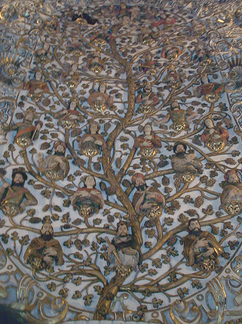
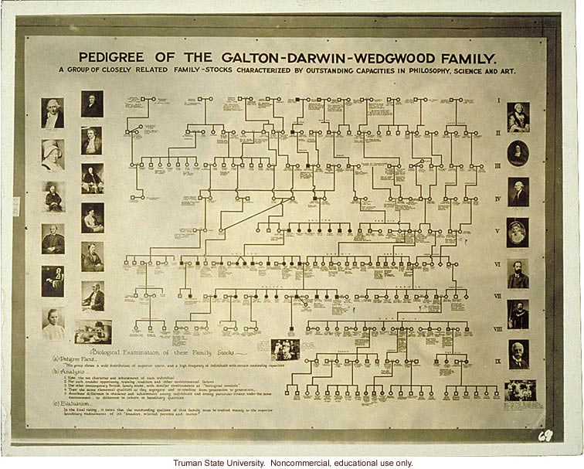
Family Trees, Genealogies, Pedigrees
Genealogy
(Church Ceiling,
Santo Domingo,
Oaxaca)
Charles Darwin's Family "Tree"

Slide 7
Family Tree
Species tree
Species split at time moves forward
Each individual has two parents.
Tree branches, as one goes back in time
Tree branches as one moves forward in time
Past
Past
Present
Present

Slide 8
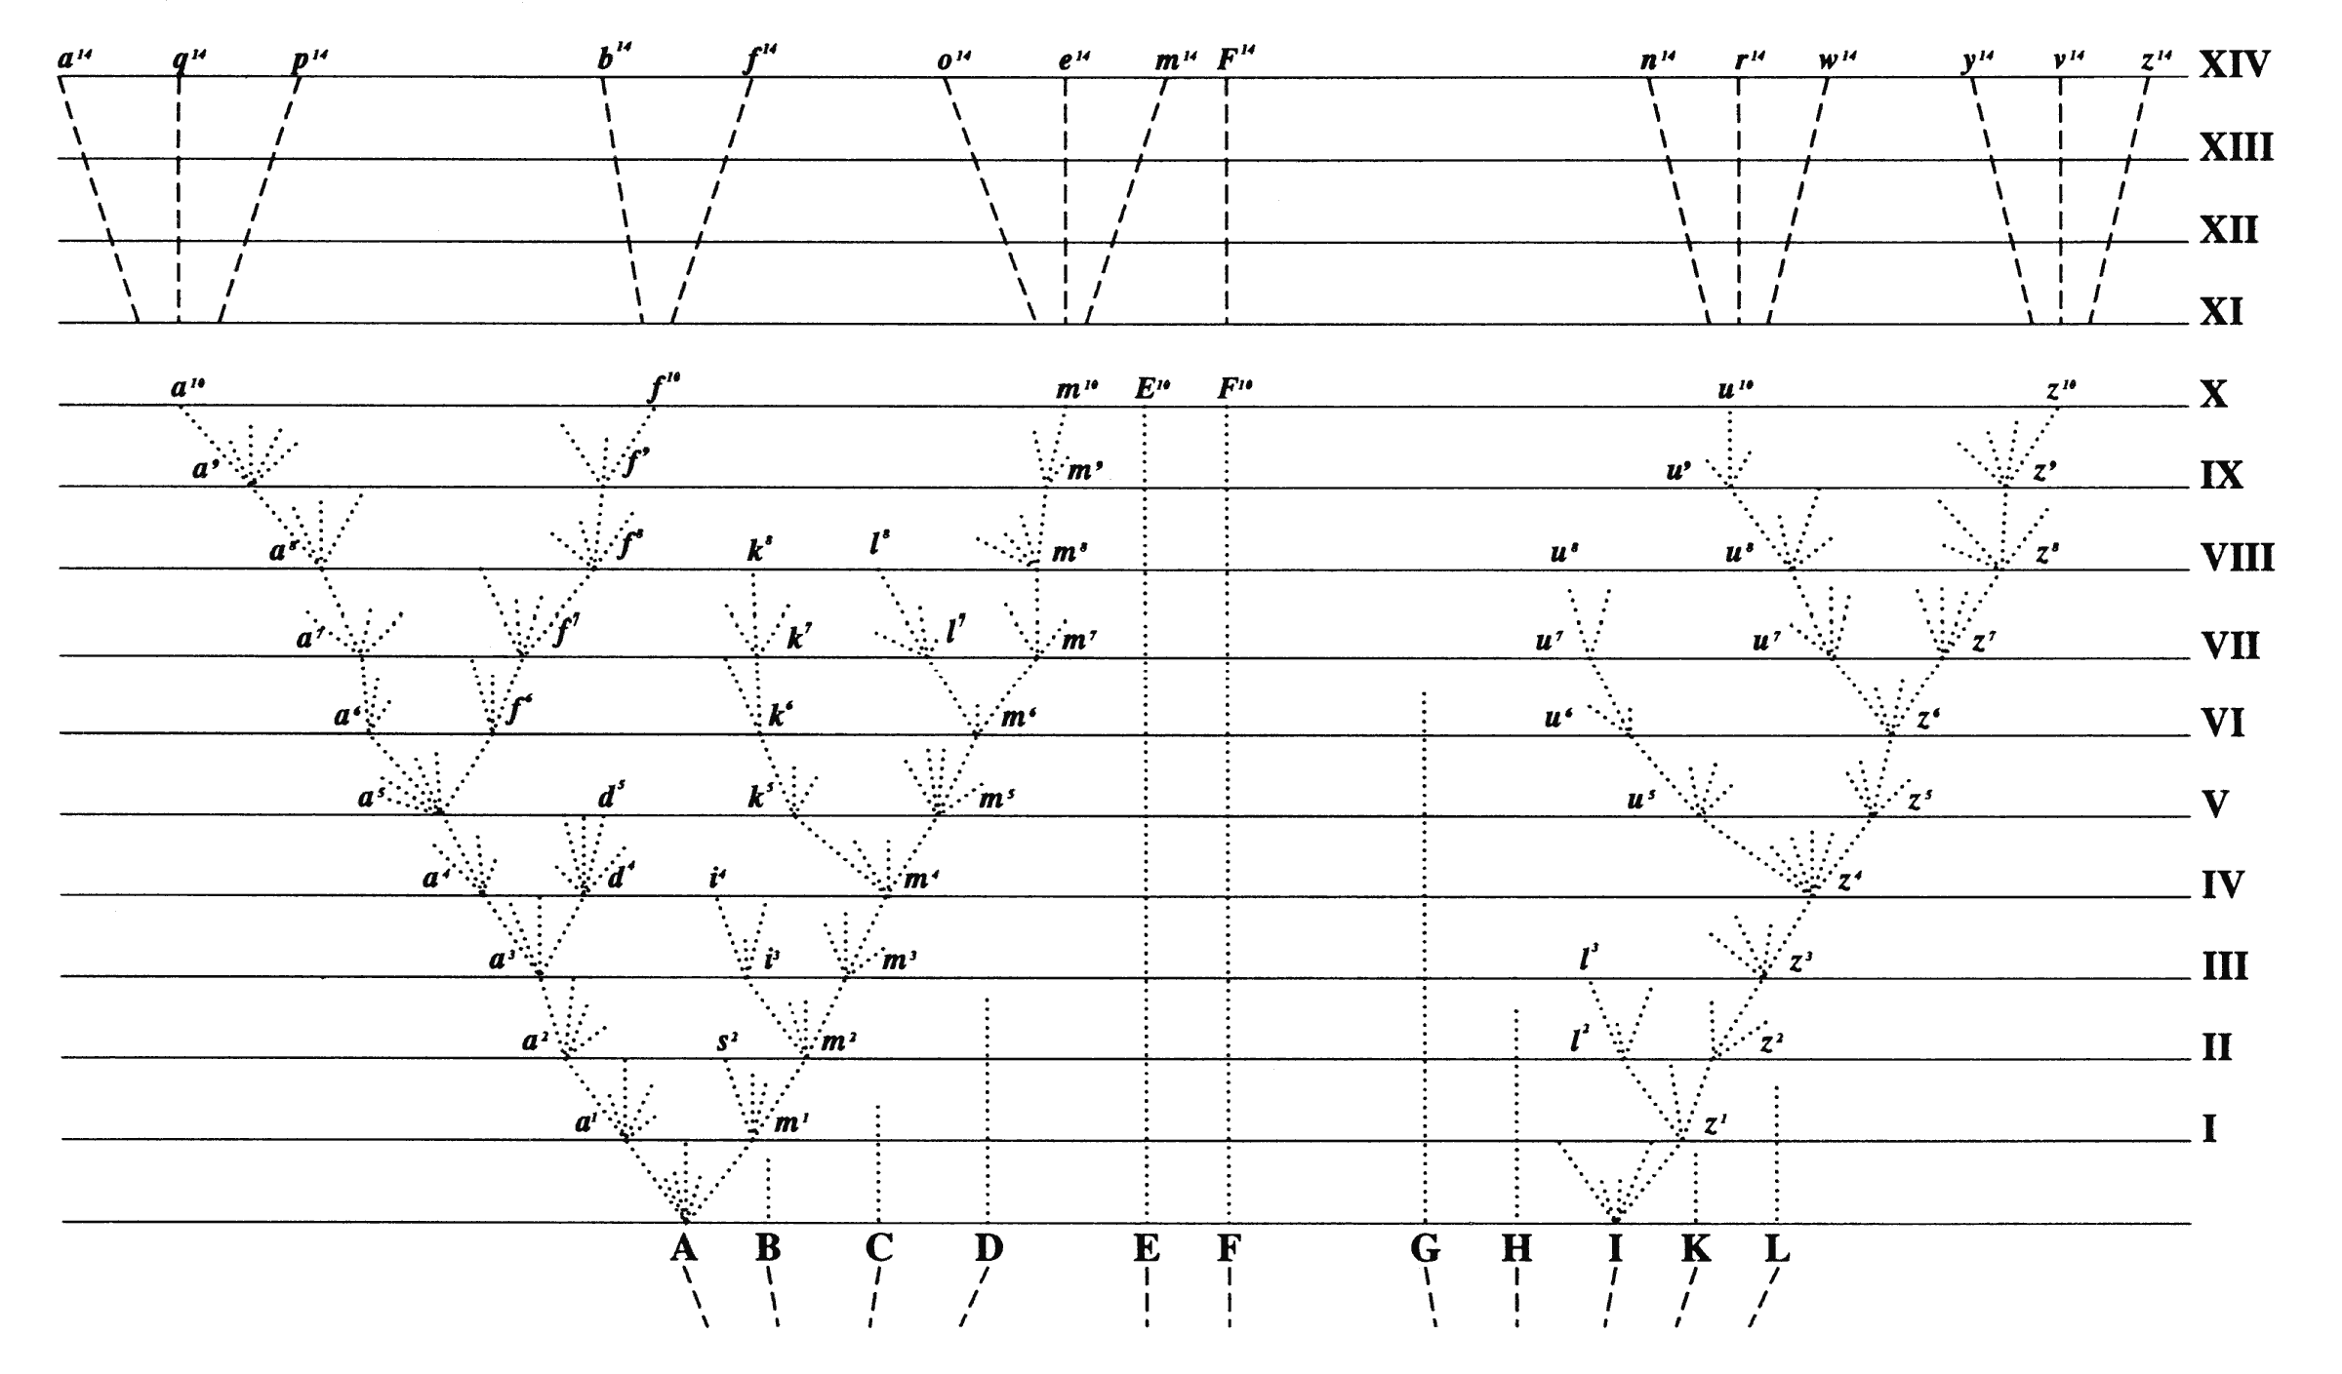
Following Darwin most biologist draw phylogenetic trees to that the present time is on top and the past at the bottom
Present
Past
Mathematicians often do it the other way around

Slide 9
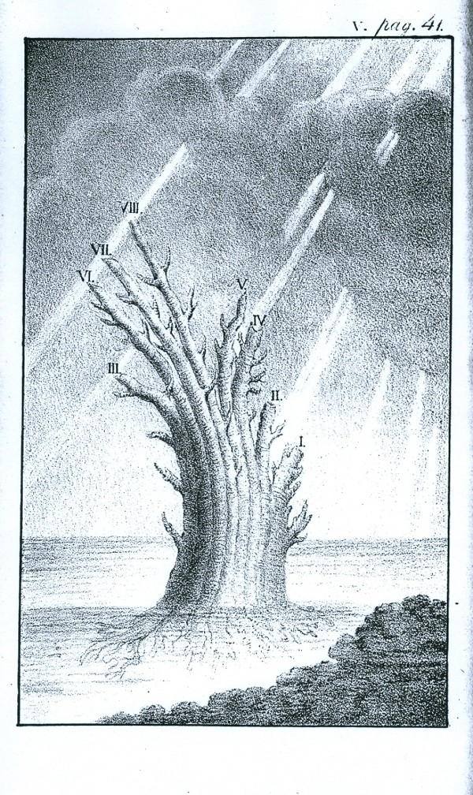
Russian naturalist Peter Simon Pallas (1766): "But the system of organic bodies is best of all represented by an image of a tree which immediately from the root would lead forth out of the most simple plants and animals a double, variously contiguous animal and vegetable trunk; the ﬁrst of which would proceed from mollusks to ﬁshes, with a large side branch of insects sent out between these, hence to amphibians and at the farthest tip it would sustain the quadrupeds, but below the quadrupeds it would put forth birds as an equally large side branch.”
(translation from Latin by E. N. Genovese,
from J. David Archibald: "Edward Hitchcock’s Pre-Darwinian (1840) ‘Tree of Life’" Journal of the History of Biology (2009) 42:561–592)
Tree of animal life, Depiction of the tree proposed
by Peter Simon Pallas, from Carl Edward von Eichwald's Zoologia specialis (1829). (From: Mark A. Ragan: "Trees and networks before and after Darwin", Biol Direct. 2009 Nov 16;4:43.)

Slide 10
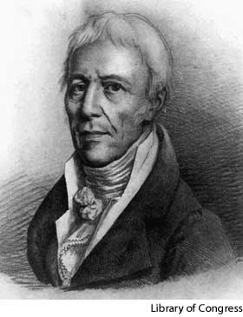
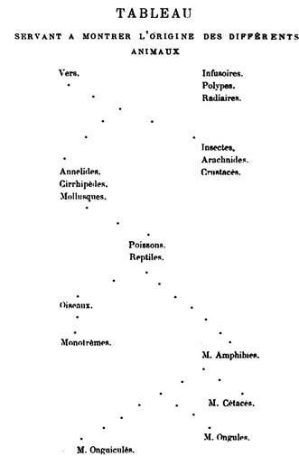
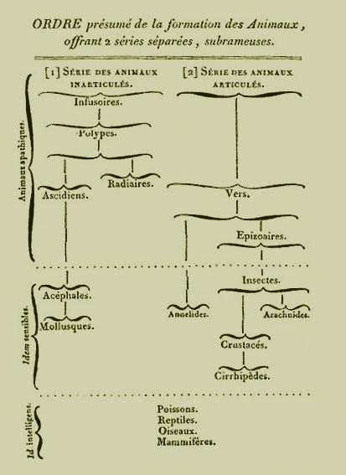
Jean-Baptiste Lamarck
Tree from 1809
Tree-like classification
from 1815

Slide 11
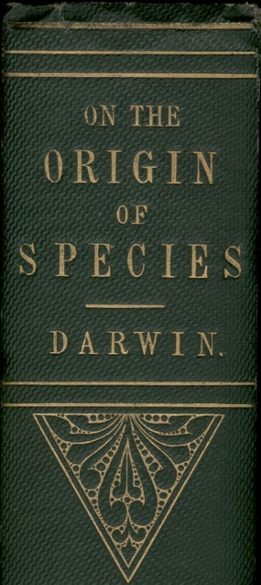
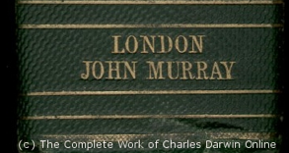
“As buds give rise by growth to fresh buds, and these, if vigorous, branch out and overtop on all sides many a feebler branch, so by generation I believe it has been with the great Tree of Life, which fills with its dead and broken branches the crust of the earth, and covers the surface with its ever-branching and beautiful ramifications.”
Charles Darwin in
“On the Origin of Species by Means of Natural Selection or the Preservation of Favoured Races in the Struggle for Life”,
p 162 ff, London, John Murray, 1859

Slide 12
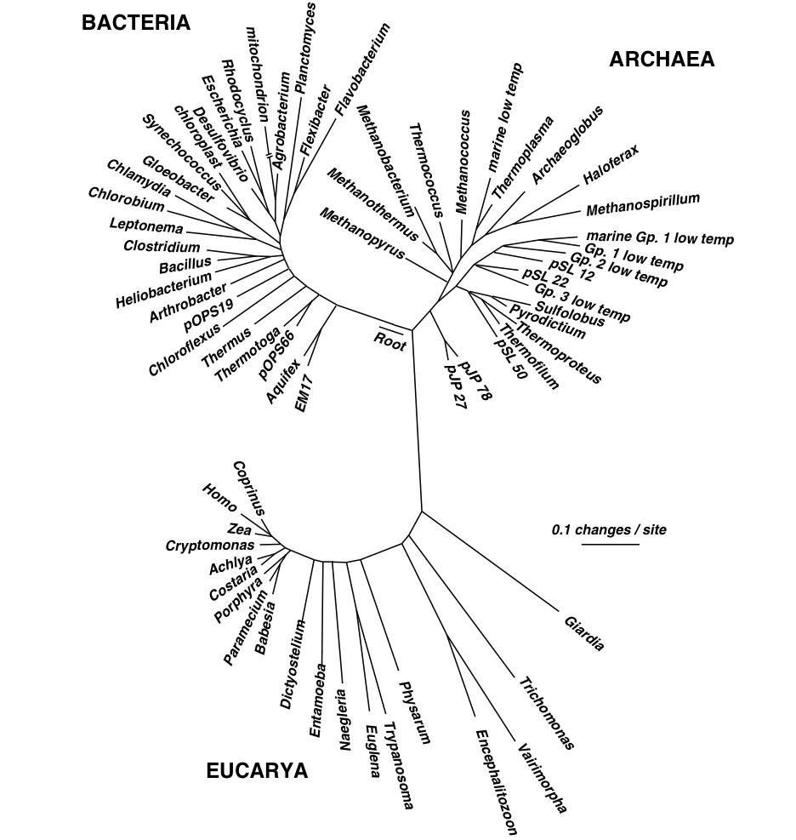
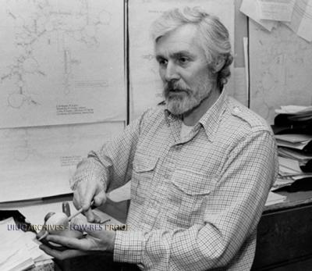
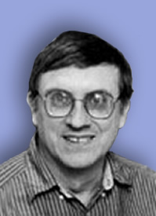
Small Subunit Ribosomal RNA based Tree of Life.
Carl Woese
George Fox
Notes:
1977

Slide 13
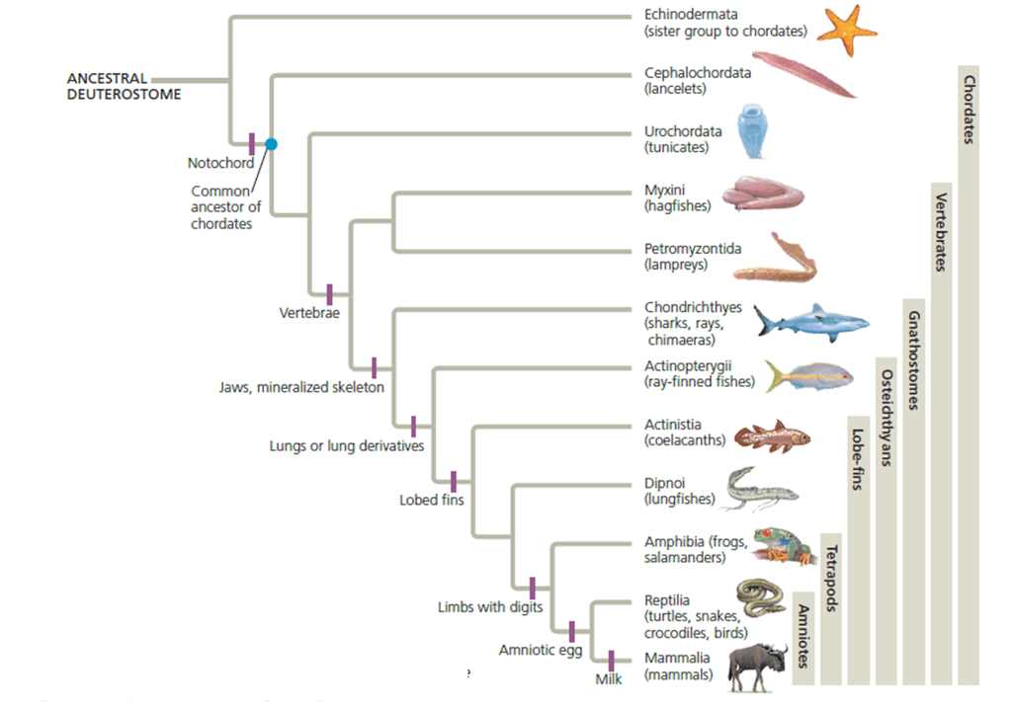
How to root a tree?
Using polarized characters (i.e., derived and primitive characters). For many characters, especially molecular characters (e.g., a nucleotide position in a gene) this is not possible.
Using an Outgroup: Include one or more organisms that are related but outside of the group one wants to study. E.g., for a tree of birds, one could use crocodiles as outgroup.
From: https://www.chegg.com/homework-help/questions-and-answers/outgroup-tree--echinodermata-b-mammalia-c-ancestral-deuterostomes-d-urochordata-q85102920

Slide 14
Catalytic subunits
Non catalytic subunits
Archaea
Eukarya
Bacteria
Bacteria
Archaea
Eukarya
speciation
time
gene duplication
Gogarten et al, 1989, PNAS 86, 17, 6661–6665
http://www.pnas.org/content/113/32/E4654.full.pdf?with-ds=yes
Notes:
Rooting the Tree of Life by an ancient Gene Duplicaiton

Slide 15
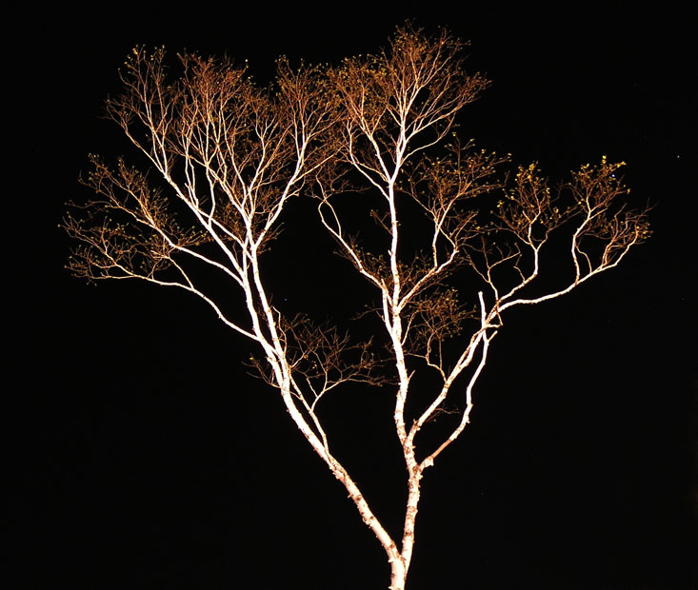
The Tree of Life according to SSU ribosomal RNA (+)
strictly bifurcating
no reticulation
only extant lineages
based on a single molecular phylogeny
branch length is not proportional to time
Eukaryotes
Bacteria
Archaea
PHYLOGENY: from Greek phylon, race or class, and -geneia, born.
“the origin and evolution of a set of organisms, usually of a species” (Wikipedia);
Cenancestor
(aka MRCA or LUCA)
as placed by ancient duplicated genes (ATPases, Signal recognition particles, EF)
The “Root”
Notes:
Tree in Halifax – Image from Olga Zhaxybayeva – used as illustration for the ribosomal tree of life
? What about life without ribosomes? What other possibilities are there to root the tree of life?

Slide 16
What could one use to root the tree of life that contains all living organisms?

Slide 17
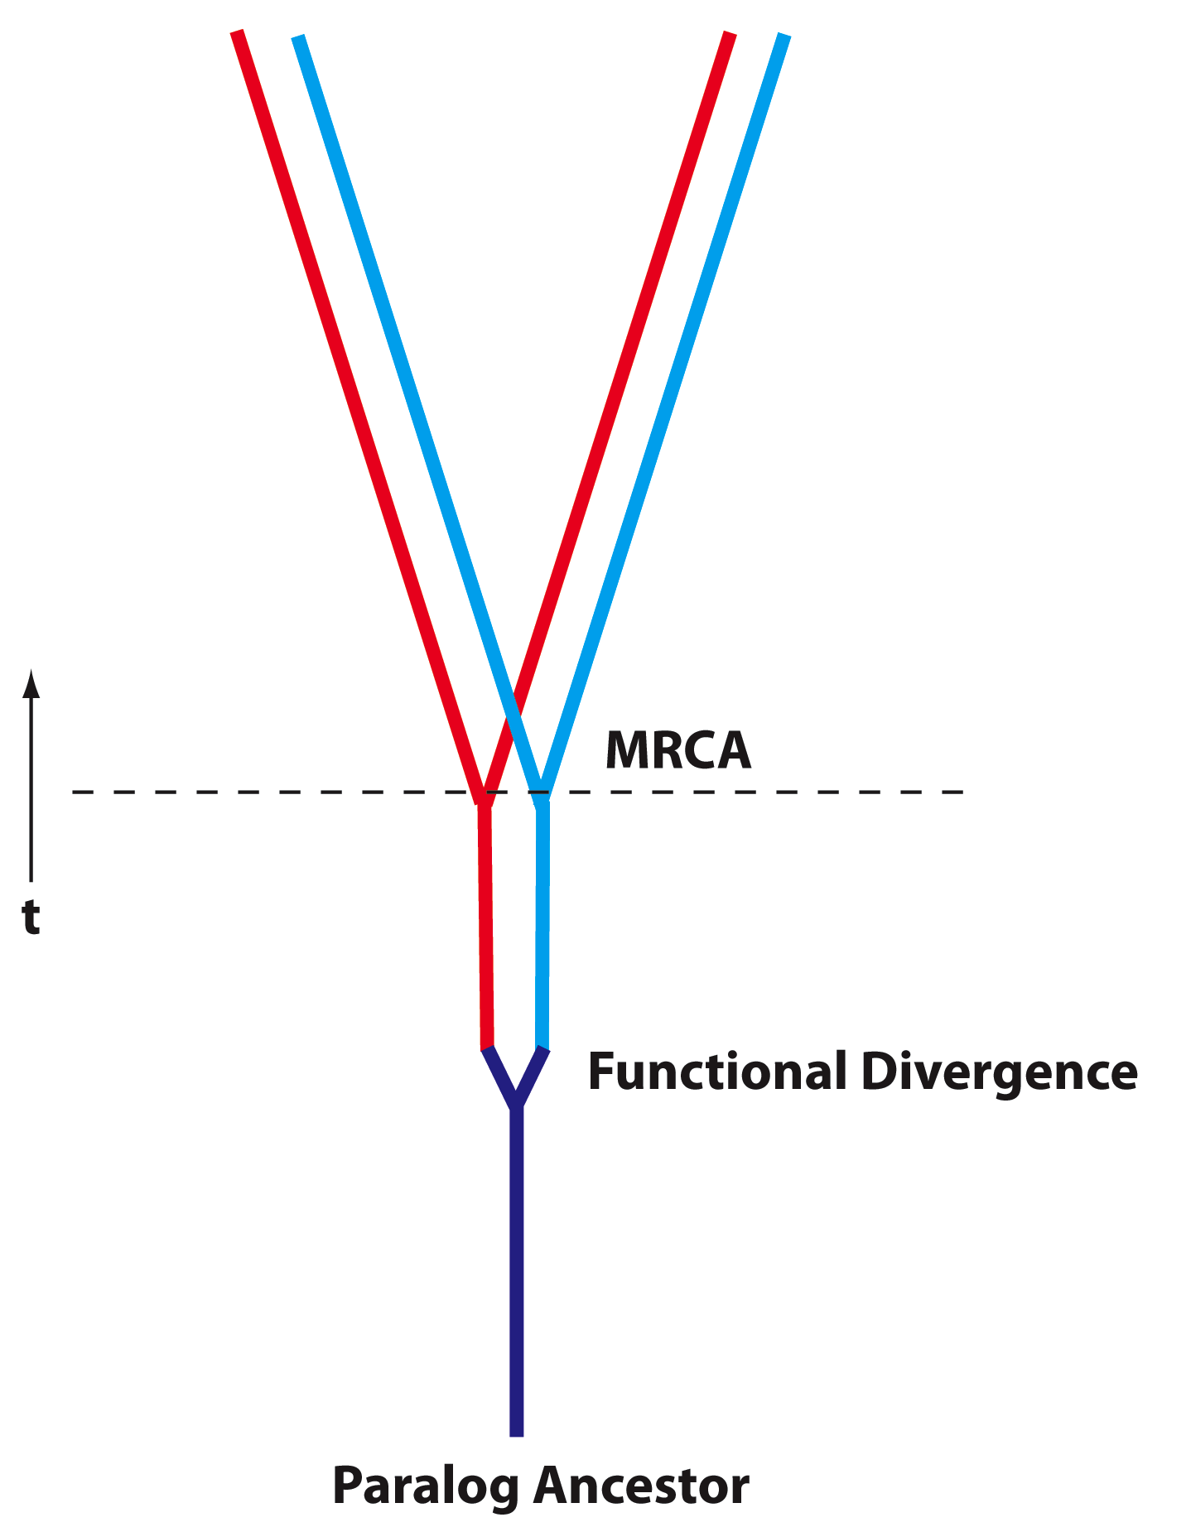
Deep Paralogs
(Paralog: homologs that evolved through a gene duplication)
Gene families evolve by duplication, gene transfer and divergence
For ancient proteins, some of these divergences occurred before the divergence of the three domains of life (MRCA, aka Last Universal Common Ancestor LUCA);
Determining function of paralog ancestors could elucidate primordial physiology… however, lack of time machine prevents direct experimental observation.
In some special cases, can be inferred using amino acid composition…

Slide 18
Other ancient duplicated genes used to root the tree of life:
Elongation factors (play a role in ribosomal protein synthesis)
Signal recognitions factors (bind to membrane proteins during their synthesis at the ribosome and direct them to the membrane)
Aminoacyl tRNA synthetases (they charge the tRNAs with the correct amino acid). These enzymes fall into two groups of homologs.
Lactic and malic acid dehydrogenase.

Slide 19
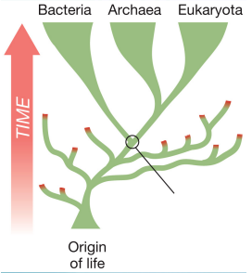
Based on the ancient duplicated genes,
The Last Universal Common Ancestor (aka LUCA or cenancestor) had
energized membranes
ribosomal template directed protein biosynthesis
used 20 different amino acids
This is very different from the first living thing.

Slide 20
The early evolution of life:
Why is the RNA-world assumed to be an early stage in Life’s history?
What problem is solved by assuming a progenote phase of life?
(progenote: organisms existing before a strict linkage between geno- and phenotype – genes frequently transferred between entities)

Slide 21
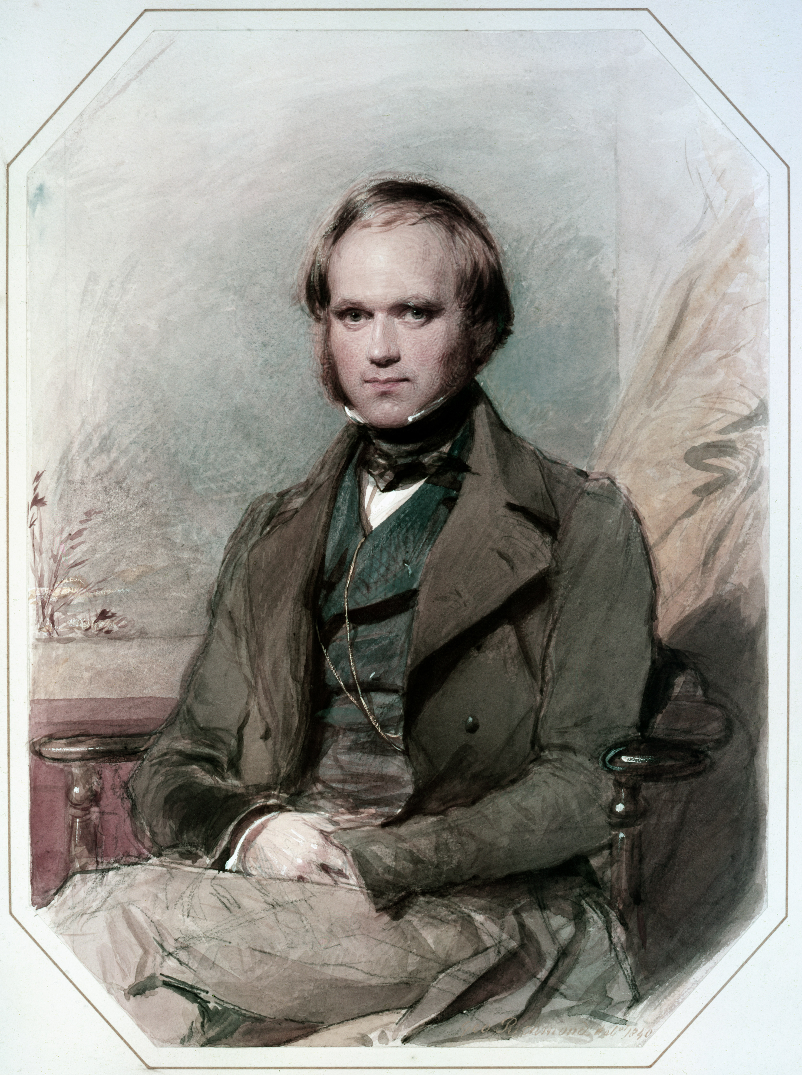
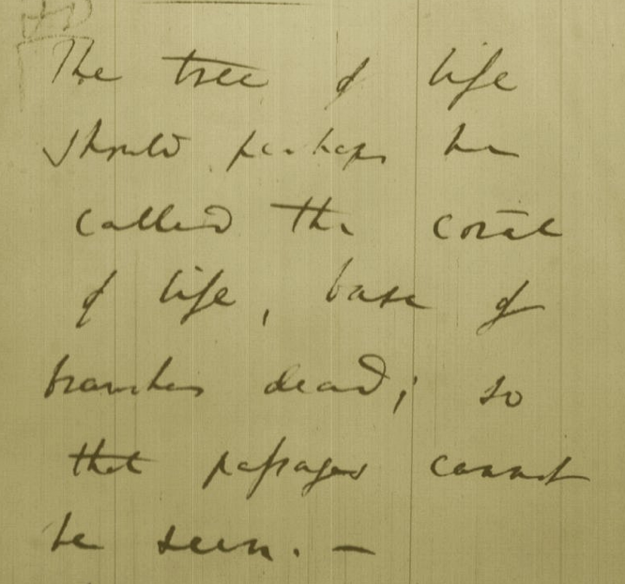
Tree, Web, or Coral of Life?
“The tree of life should perhaps be called the coral of life, base of branches dead”
Charles Darwin
painted by George Richmond in the late 1830
Page B26 from Charles Darwin’s (1809-1882) notebook (1837/38)

Slide 22
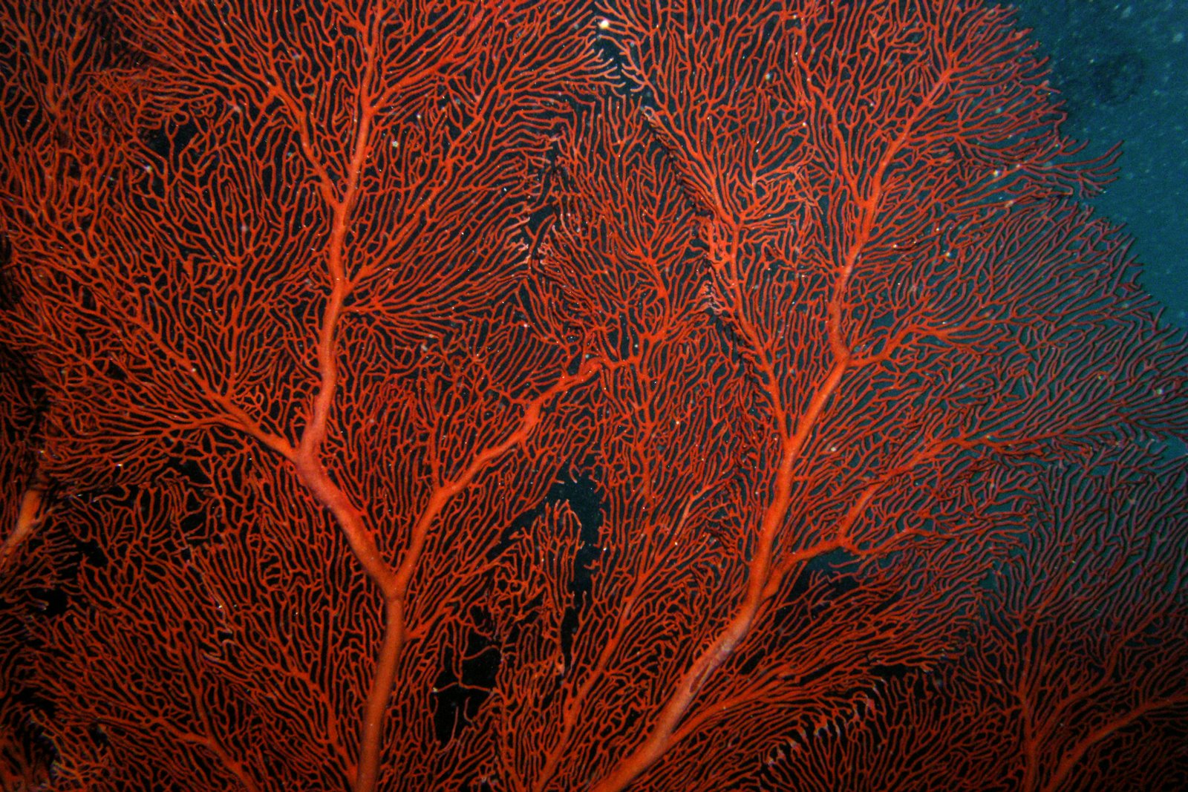
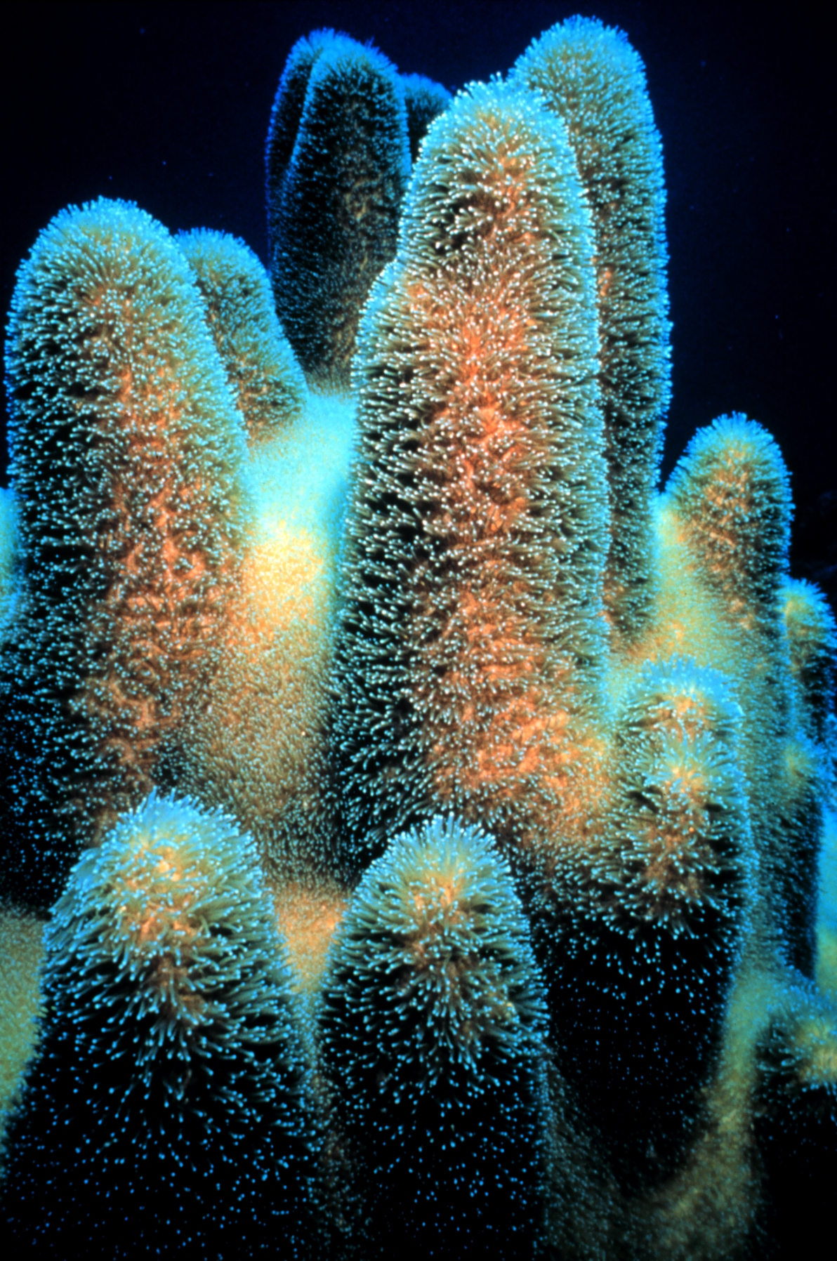
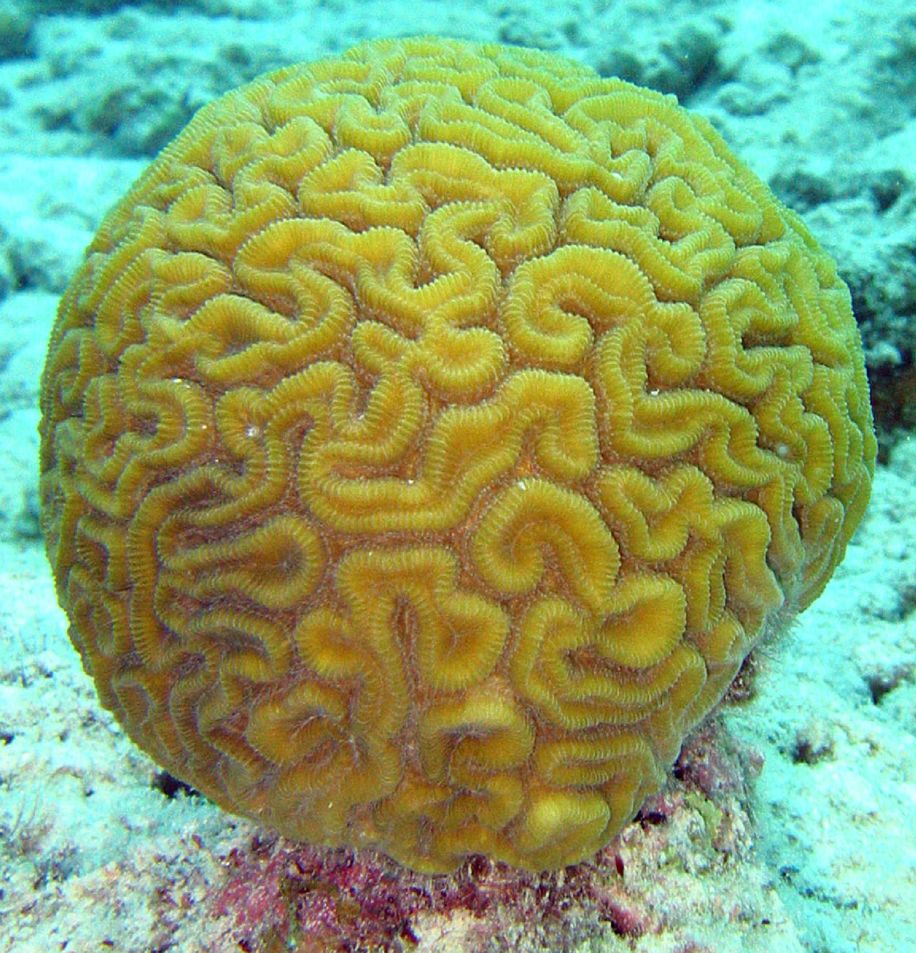
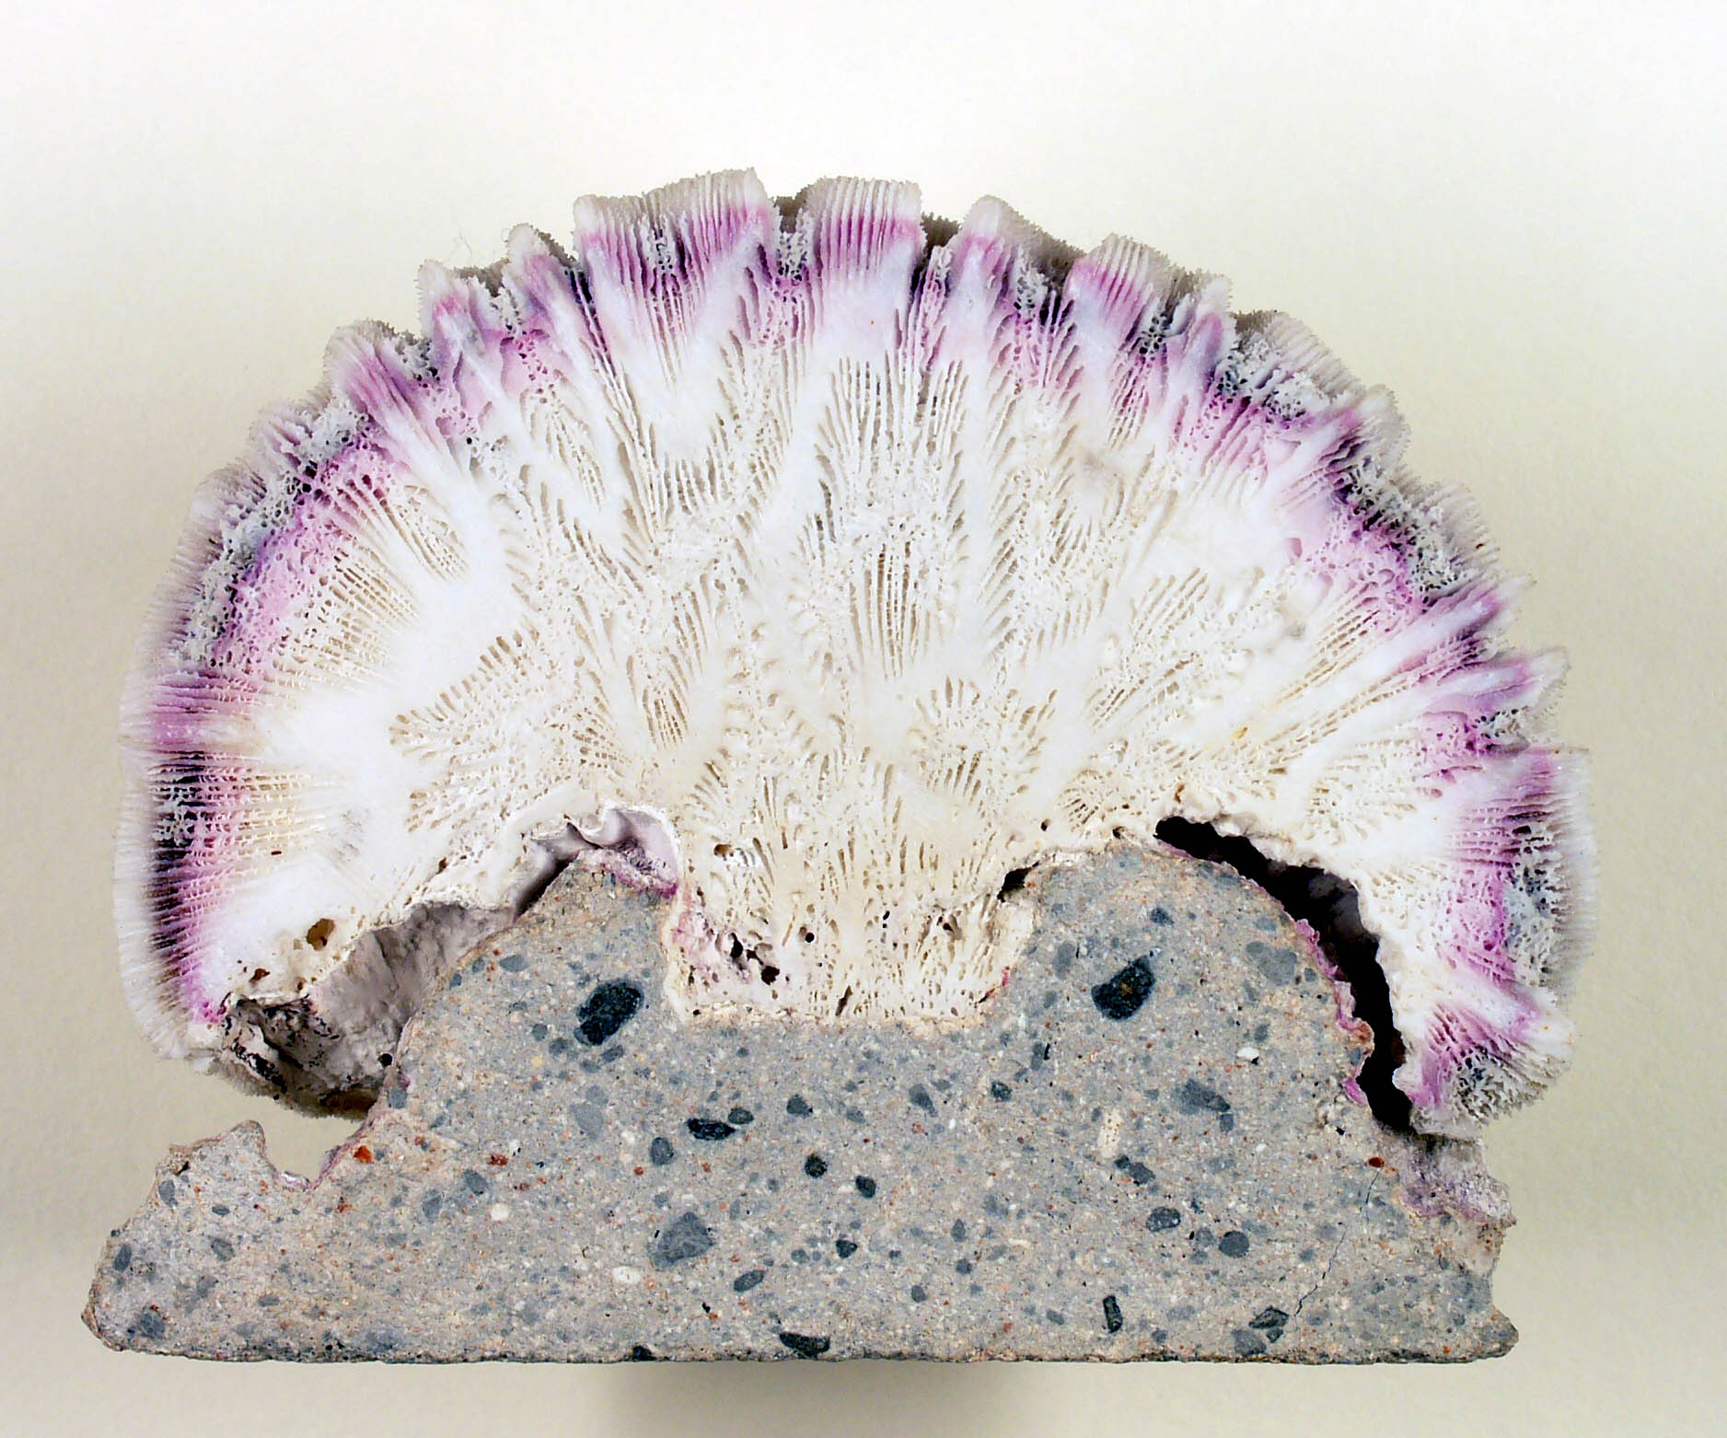
Which Type of Coral?

Slide 23
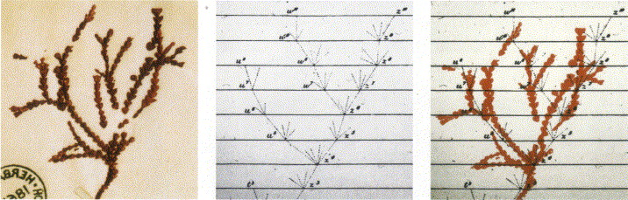
Darwin’s coral was a red algae
(Bossea orbignyana)
The captivating coral. According to the ideas of Horst Bredekamp, parts of the diagram in Darwin's origin of species (centre) more or less directly reflect the branching properties of a specimen Darwin collected himself.
From Florian Maderspacher:
“The captivating coral--the origins of early evolutionary imagery.”
Curr Biol 16: R476-8 2006
Notes:
A specimen in Darwin’s herbarium labeled as coral, actually is a red algae.

Slide 24
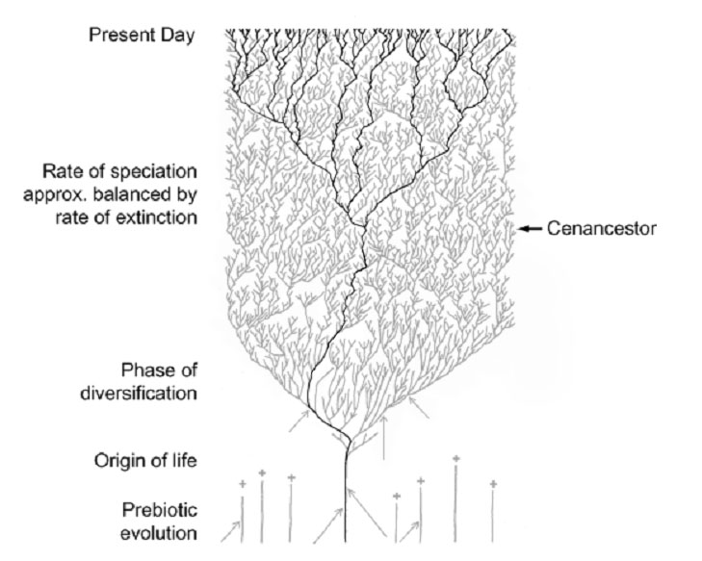
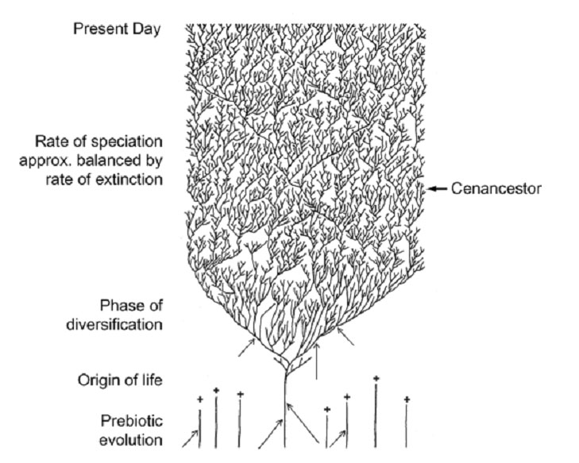
The Coral of Life (Darwin)
Notes:
The “Coral of Life” and the transfer of characters from now extinct into surviving lineages

Slide 25
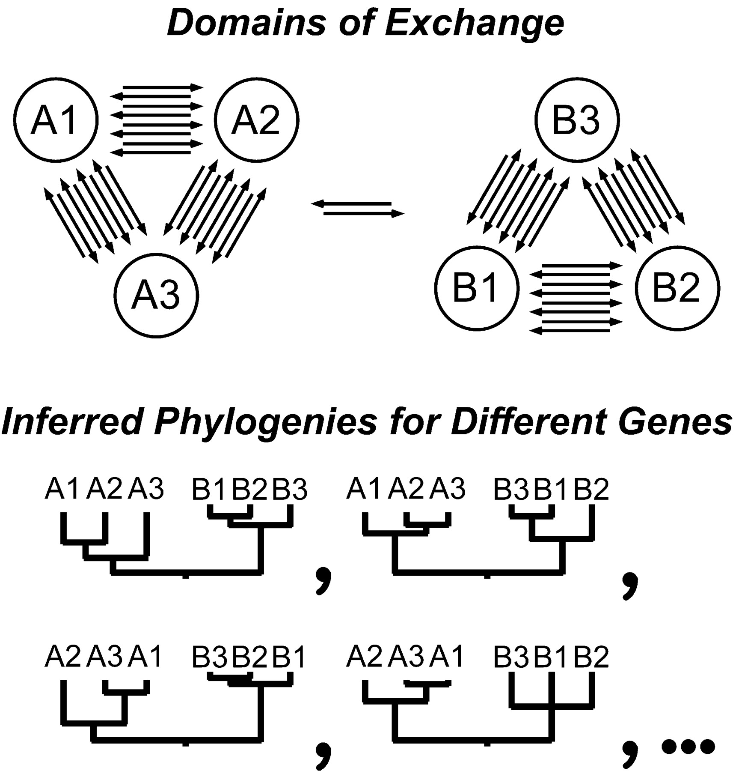

HGT can generate reproducible patterns in molecular phylogenies.
Gogarten, J.P., Doolittle, W.F., Lawrence, J.G., Mol. Biol. Evol. 2002 19:2226-2238.

Slide 26
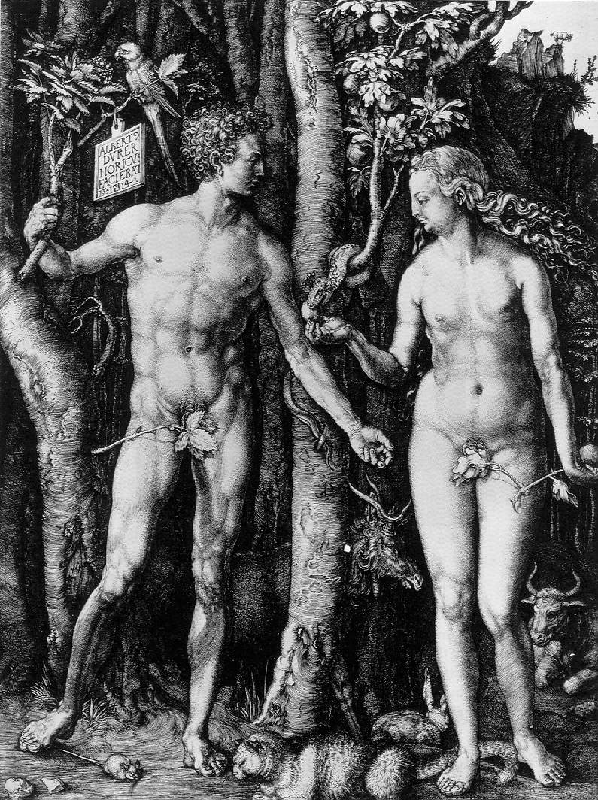
Y chromosome
Adam
Mitochondrial
Eve
Lived
approximately
40,000 years ago
Lived
166,000-249,000
years ago
>250,000
Thomson, R. et al. (2000) Proc Natl Acad Sci U S A 97, 7360-5
Underhill, P.A. et al. (2000) Nat Genet 26, 358-61
Mendez et al. (2013) American Journal of Human Genetics 92 (3): 454.
Cann, R.L. et al. (1987) Nature 325, 31-6
Vigilant, L. et al. (1991) Science 253, 1503-7
Albrecht Dürer, The Fall of Man, 1504
Adam and Eve never met ☹
The same is true for ancestral rRNAs, EF, ATPases!

Slide 27
The Coral of Life (Darwin)
Notes:
The “Coral of Life” and the transfer of characters from now extinct into surviving lineages

Slide 28
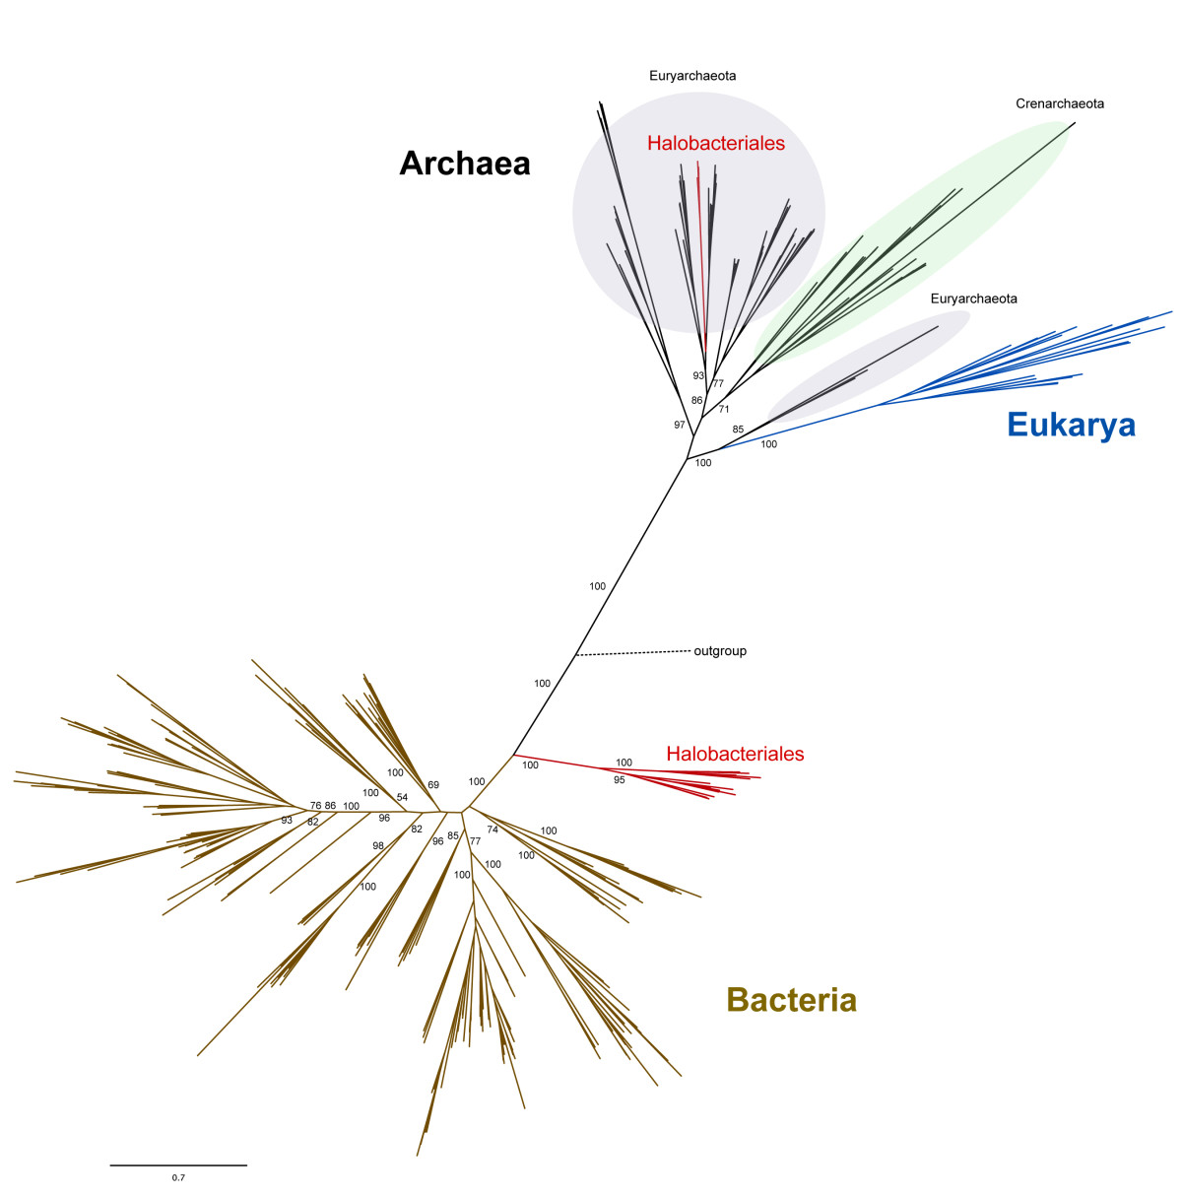
leucyl-tRNA synthetase
phylogeny
Ancient origin of the divergent forms of leucyl-tRNA synthetases in the Halobacteriales
Cheryl P Andam, Timothy J Harlow, R Thane Papke and
J Peter Gogarten
BMC Evolutionary Biology 12:85

Slide 29
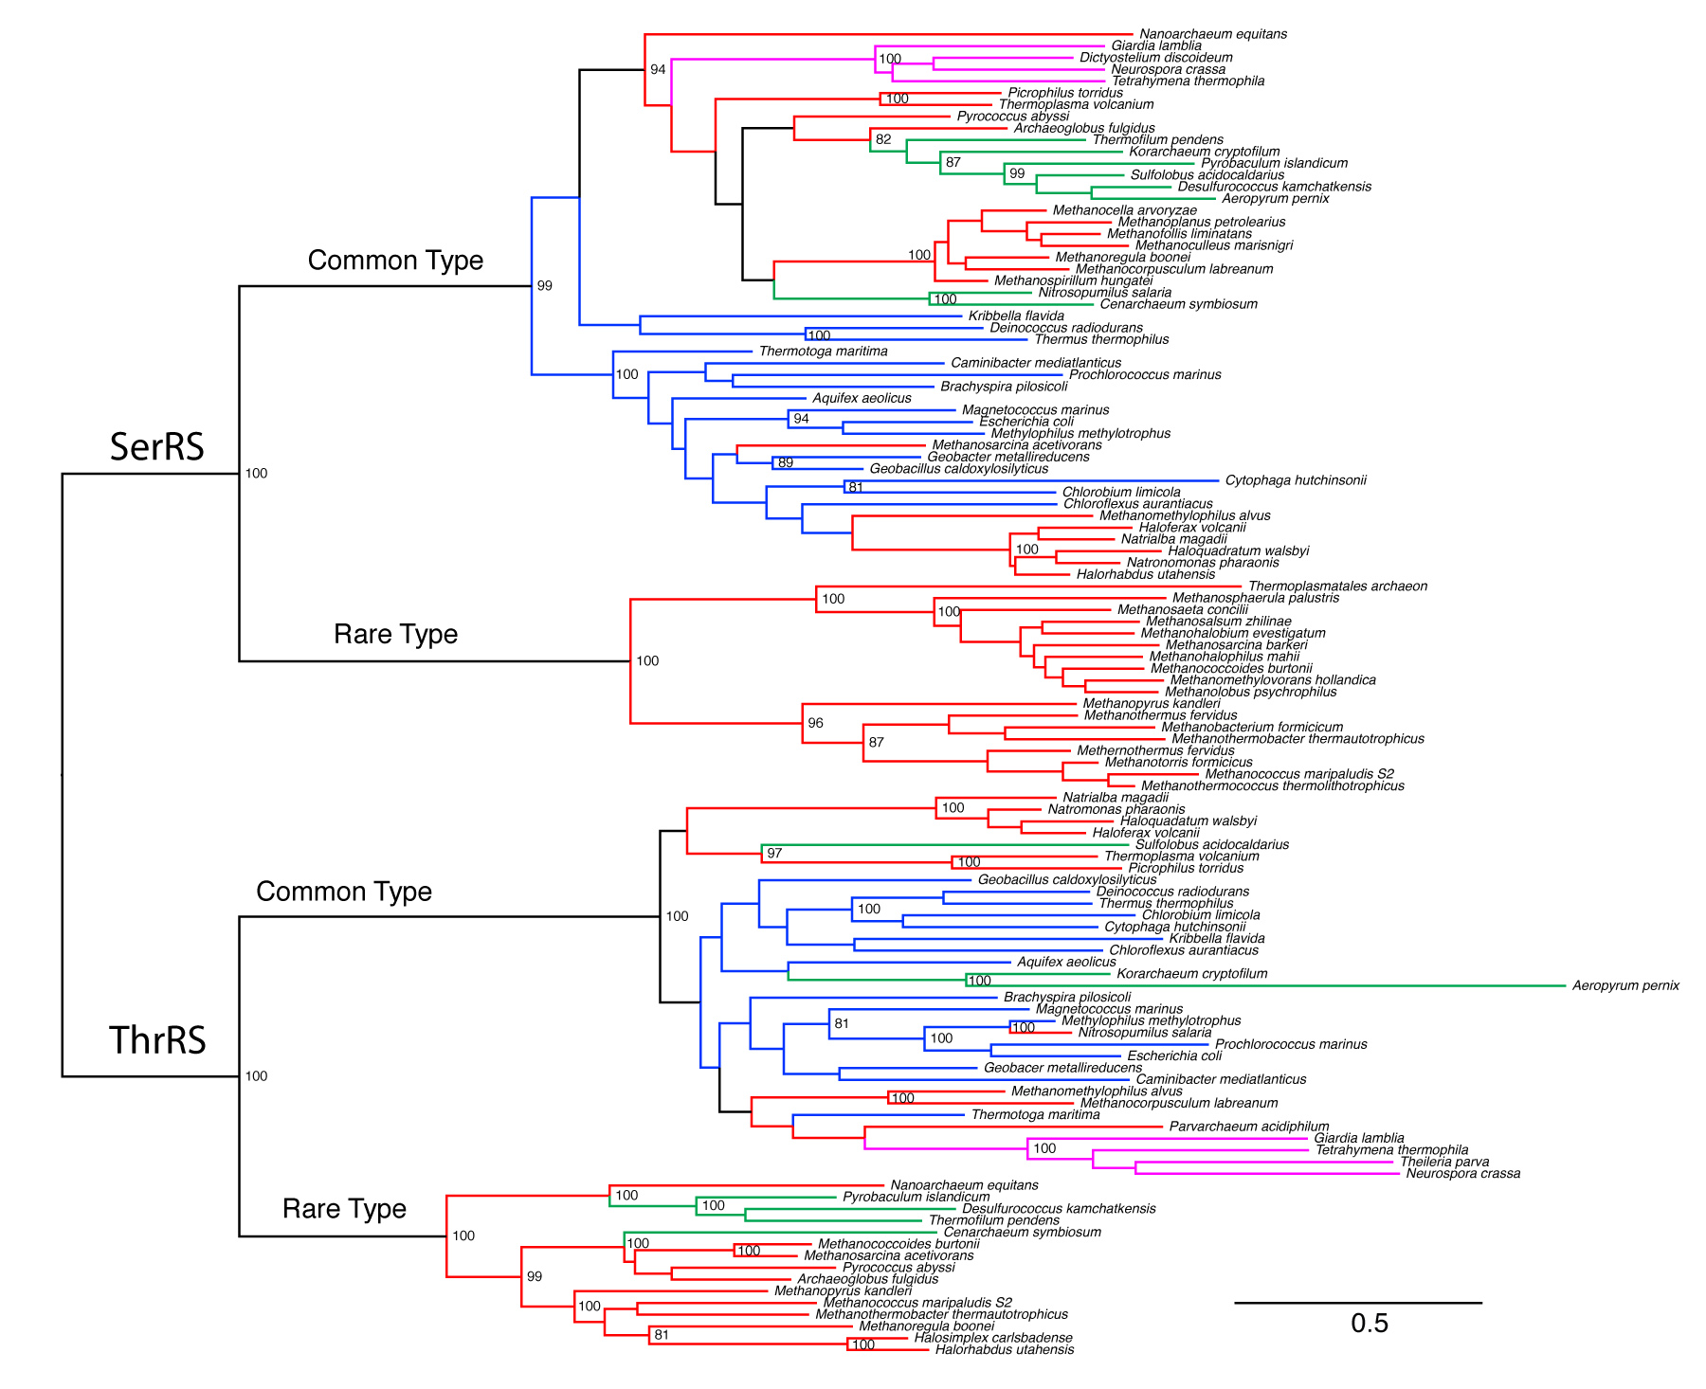
thrRS and serRS phylogeny
Eukaryotes
Crenarchaeota
Euryachaeota
Bacteria
Alignment with PRANK and SATé, tree with phyml (WAG, gamma +I)

Slide 30
Gene Transfer and Phylogenetic Reconstruction: Friends or Foes?
Popular view
Gene transfer is a disruptive force in phylogenetic reconstruction.
New view
Events of ancient gene transfer are valuable tools for reconstructing organismal phylogeny.

Slide 31
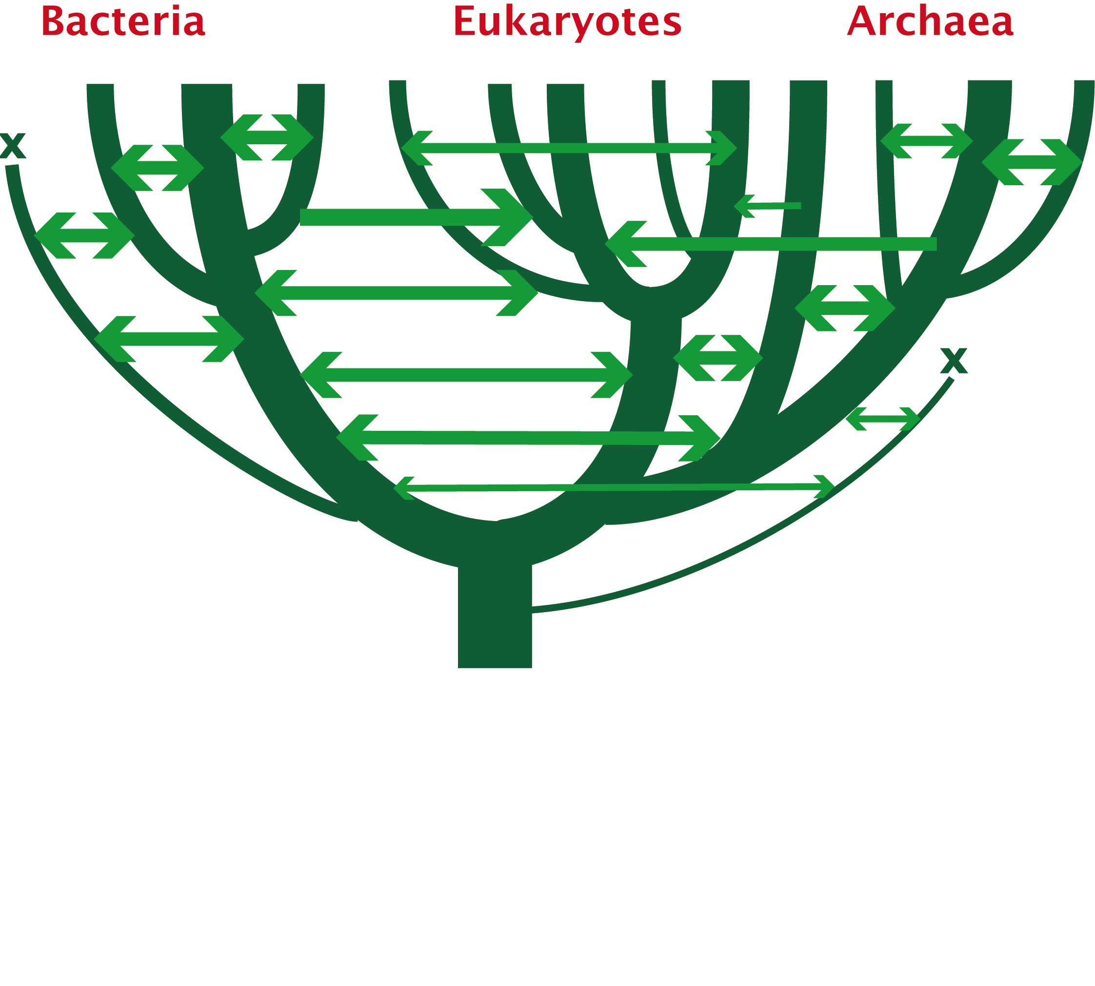
1. Any ancient gene transfer to the ancestor of a major lineage implicitly marks the recipient and descendents as a natural group.
2. The donor must exist at the same time or earlier than the recipient.
Ancient HGTs

Slide 32
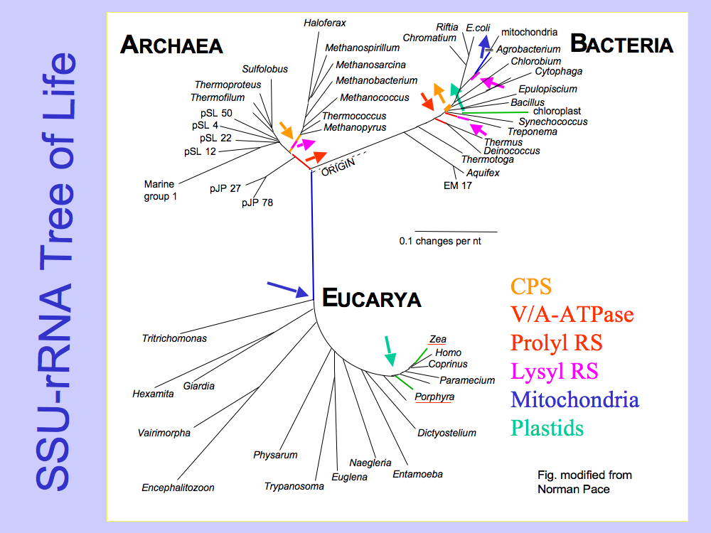
Small subunit ribosomal RNA (16S) based tree of life.
Carl Woese, George Fox, and many others.

Slide 33
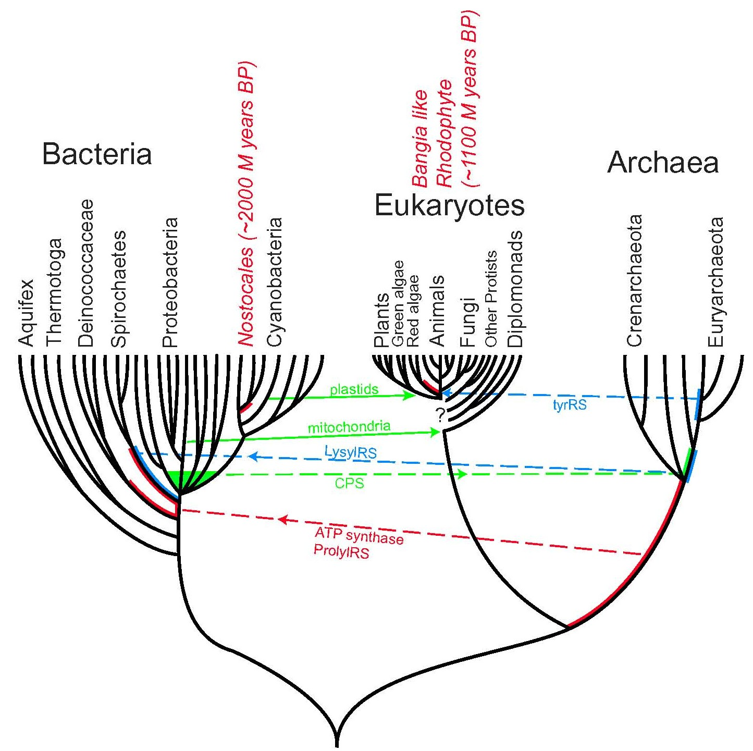
Presence of a transferred gene is a shared derived character that can be useful in systematics.
Gene “ping-pong” between different lineages can be used to build correlations between different parts
of the tree/net of life.
Notes:
Gene ping pong
Fossil record for the early evolution is sparse -- gene transfer allows to use marker from one group also for other groups
Tyrosyl tRNA synthetase

Slide 34
Gene transfer as a tool to correlate evolutionary events and define clades
Bacterial and archaeal groups had already diverged into different families and genera, before the major eukaryotic kingdoms diverged:
  Animals – Fungi diverge after split of Haloarchaea into lineages that contain Halobacterium and Haloarcula, respectively.
  Archaeplastida (glaucocystophytes, red-, and green algae) diverge after Chlamydiae split into lineages containing Chlamydia and Parachlamydia, respectively.

Slide 35
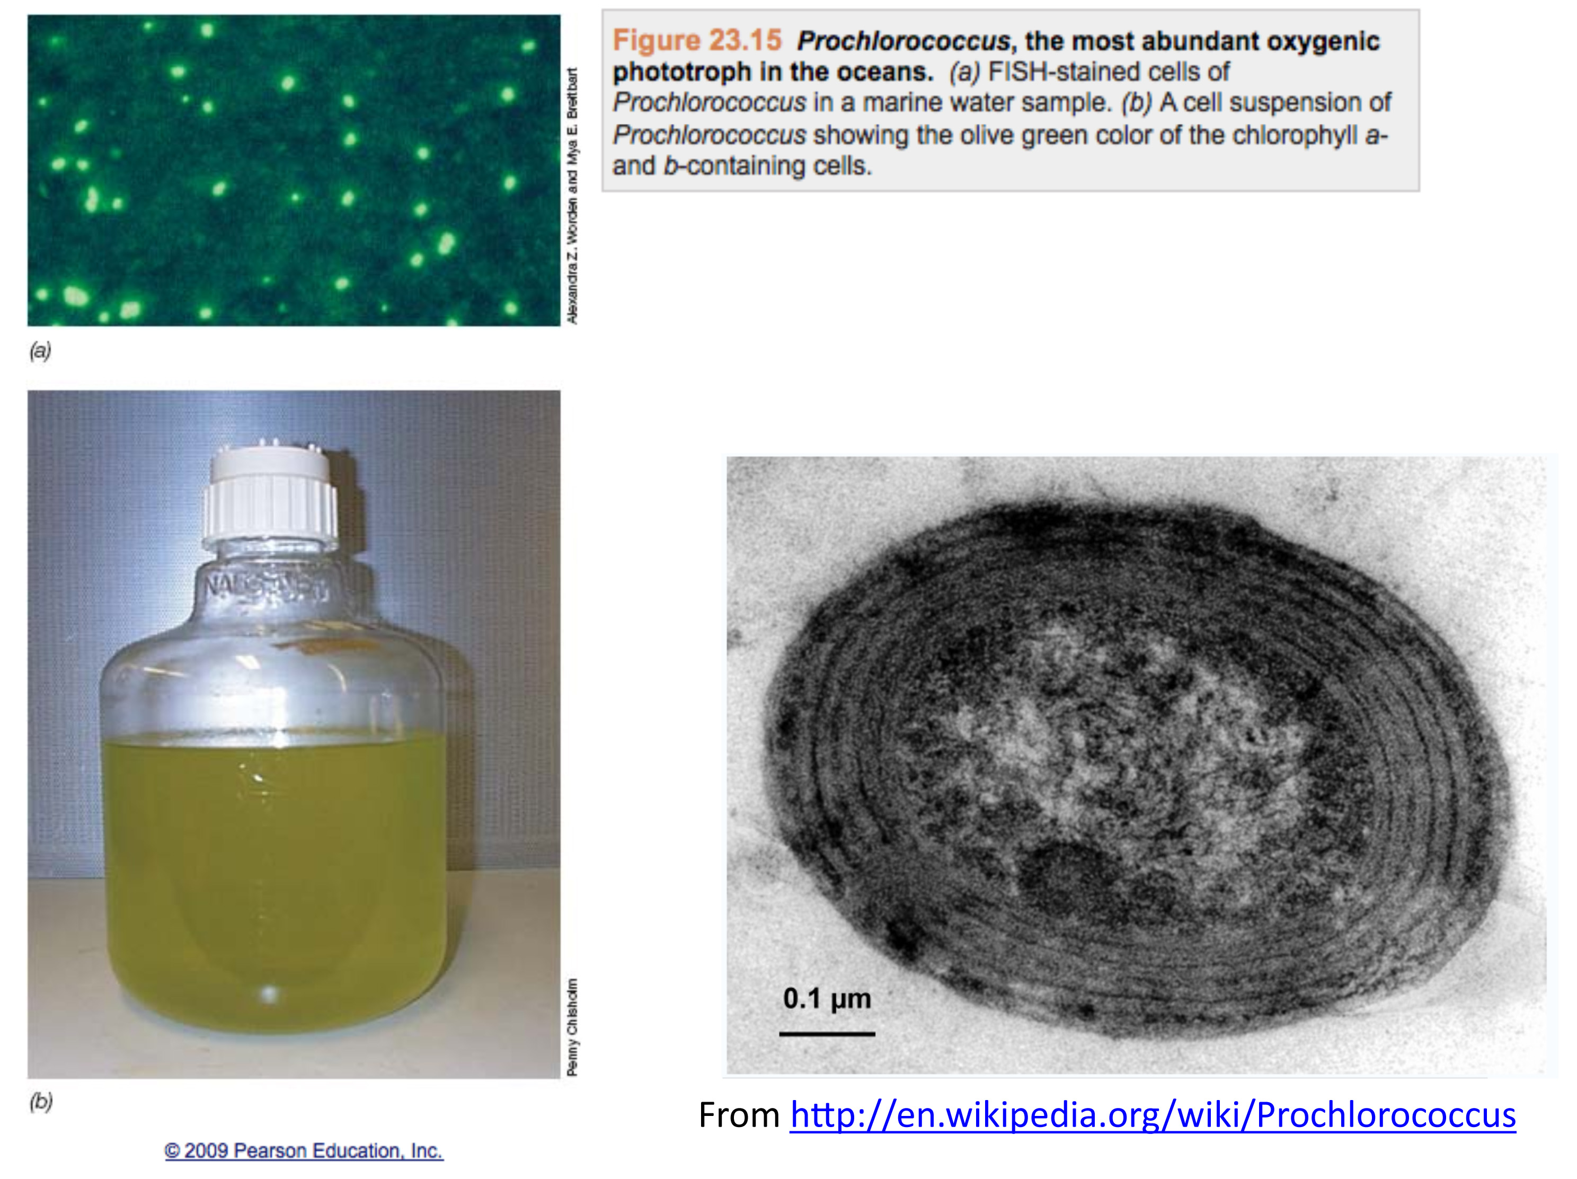

Slide 36
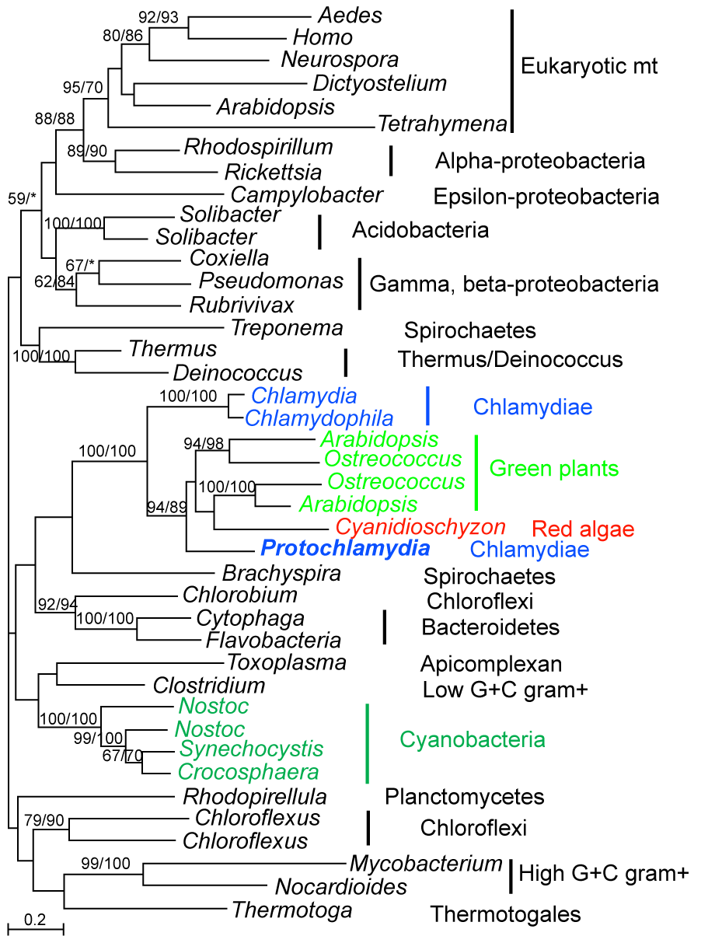
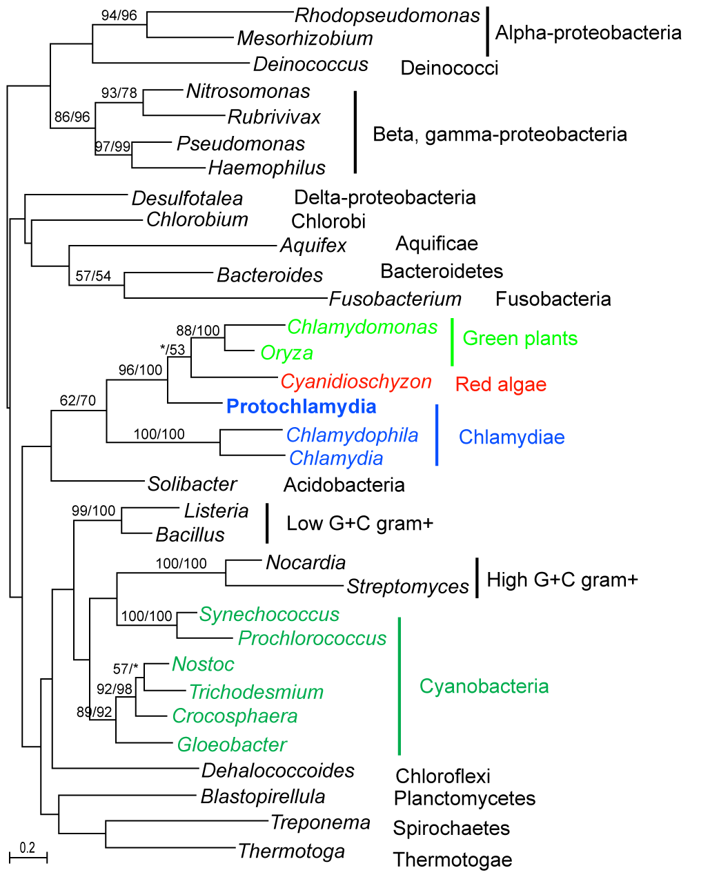
Chlamydial-type genes in red algae and plants are often specifically associated with Protochlamydia (Parachlamydia)
Huang and Gogarten 2007, Genome Biol 8:R99
Beta-ketoacyl-ACP synthase (fabF)
4-diphosphocytidyl-2-C-methyl-D-erythritol kinase (ispE)

Slide 37
Red Algal and Green Plant Genes of Chlamydial Origin
Consistent phylogenetic signal links
Chlamydiae, red algae and green plants.
modified from
Huang and Gogarten 2007, Genome Biol 8:R99
Additional genes reported in
Becker B, Hoef-Emden K, Melkonian M.
BMC Evol Biol. 2008 Jul 15;8:203.
Moustafa A, Reyes-Prieto A, Bhattacharya D..
PLoS ONE. 2008 May 21;3(5):e2205.
Notes:
mention signalP

Slide 38
ThrRS Phylogeny – γ-Proteobacteria
Outgroup (β-Proteobacteria)
Enterobacteriales
Xantho- and
Pseudomonadales
HTCC5015
marine γ-proteobacterium
(Sargasso Sea)
Oceanospirillales
high light
low light
Notes:
Grouping of prochlorococcus with planctonic marine open ocean gamma suggest that the transfer took place in the open ocean environment, before the divergence of the different prochlorococci, and after the divergence from Synecchococci, the other group of small marine cyanobacteria.

Slide 39
The Coral of Life (Darwin)
Notes:
The “Coral of Life” and the transfer of characters from now extinct into surviving lineages

Slide 40
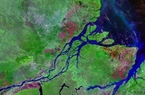
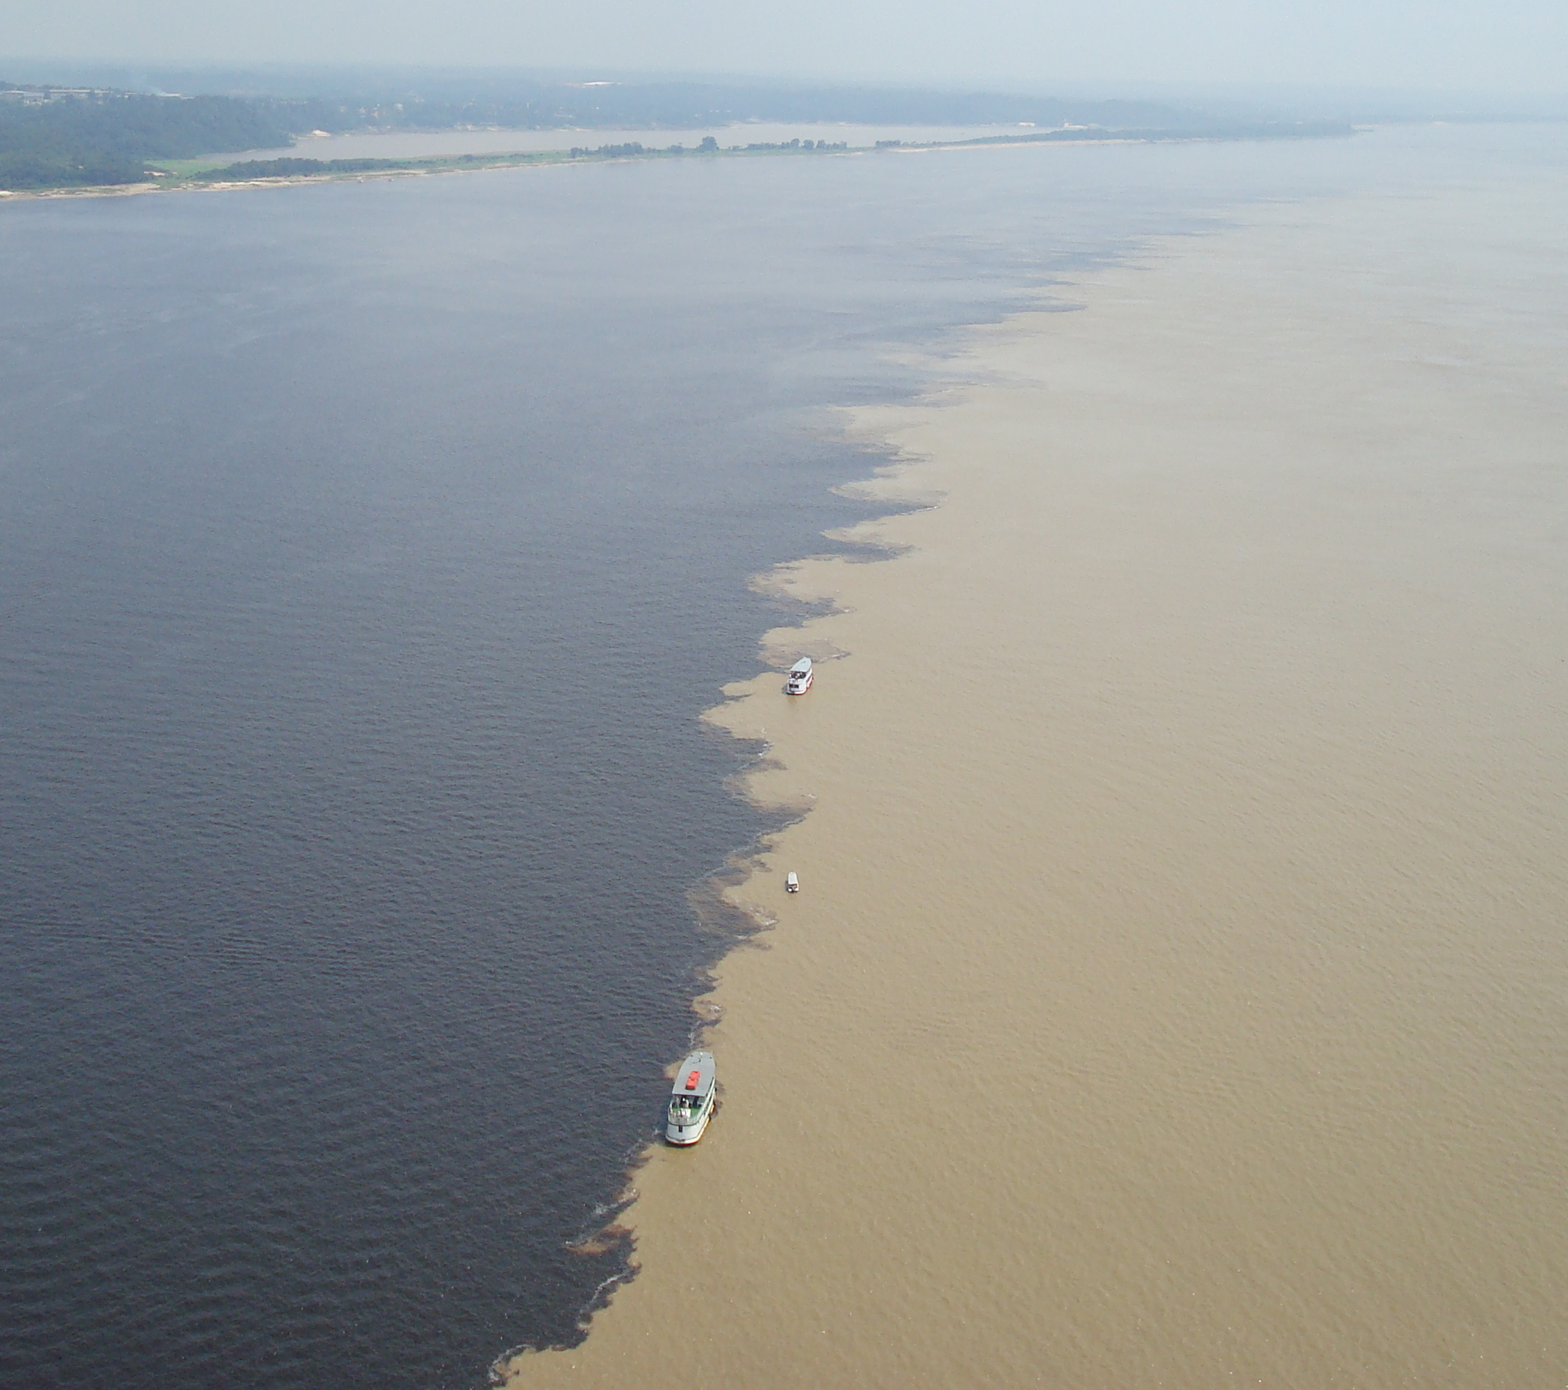
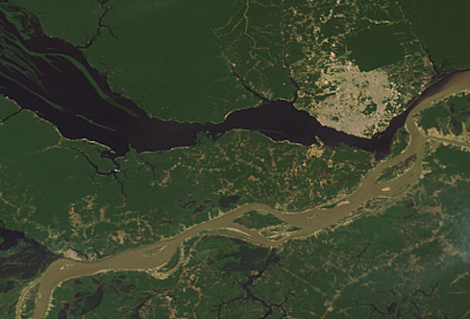
The Watershed of Life
Jonathan Eisen in his Tree of Life Blog on
"Top Five Metaphors Charles Darwin Considered"
http://phylogenomics.blogspot.com/2008/06/top-five-metaphors-darwin-considered.html
http://www.southcom.mil/appssc/files/Blogs/633600980055909252.jpg
Meeting of the meeting of Solimões and Negro rivers at Origin of the Amazon

Slide 41
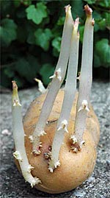
THE POTATO OF LIFE
Bacteria
Archaea
Eukaryotes
Successive independent crystallization of the three domains of life from a population of pre-cells
extinct
lineage
Glansdorff N, Xu Y, Labedan B: The Last Universal Common Ancestor: emergence, constitution and genetic legacy of an elusive forerunner.
Biol Direct 2008, 3:29.
Kandler O (1994) The early diversification of life. In Early Life on Earth, Nobel Symposium, vol. 84, pp. 152-509: Columbia Univ. Press.
Woese CR (2002) On the evolution of cells. PNAS 99: 8742-7
photo from www.sonnentaler.net
This is just included, because it is cute. The three cellular lineage almost certainly did not separate in the progenote stage symbolized here as the potato.

Slide 42
The Rhizome of Life (Didier Raoult)
See opinion piece in
https://www.thelancet.com/journals/lancet/article/PIIS0140-6736(09)61958-9/fulltext

Slide 43
See https://phylogenomics.blogspot.com/2008/06/top-five-metaphors-darwin-considered.html for more

