Slide 1
MCB 3421 2024
Class 7
Databanks, Entrez and the history of Genbank;
BLAST,
Intro to Statistics

Slide 2
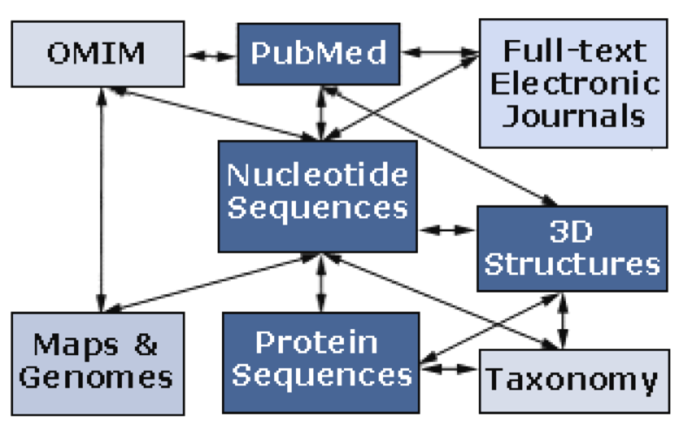
Databanks at the NCBI
NCBI (National Center for Biotechnology Information) is a home for many public biological databases (see diagram below). All of the databases are interlinked, and they all have common search and retrieval system - Entrez.
Very old connection diagram:
A list of the different databases in ENTREZ is here

Slide 3
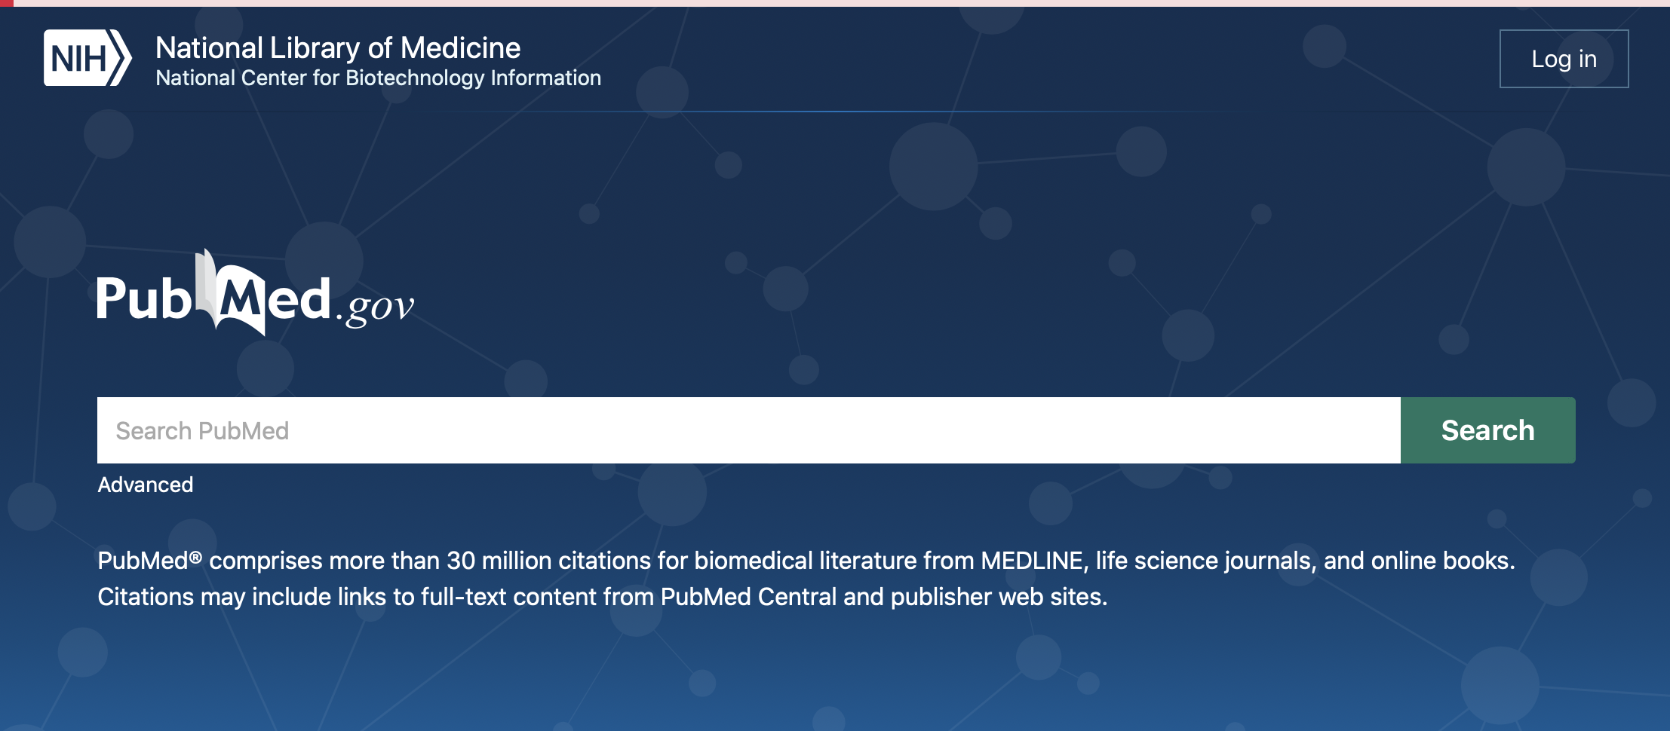
To get from the new pubmed interface to an interface that includes all databanks click on the NIH link

Slide 4
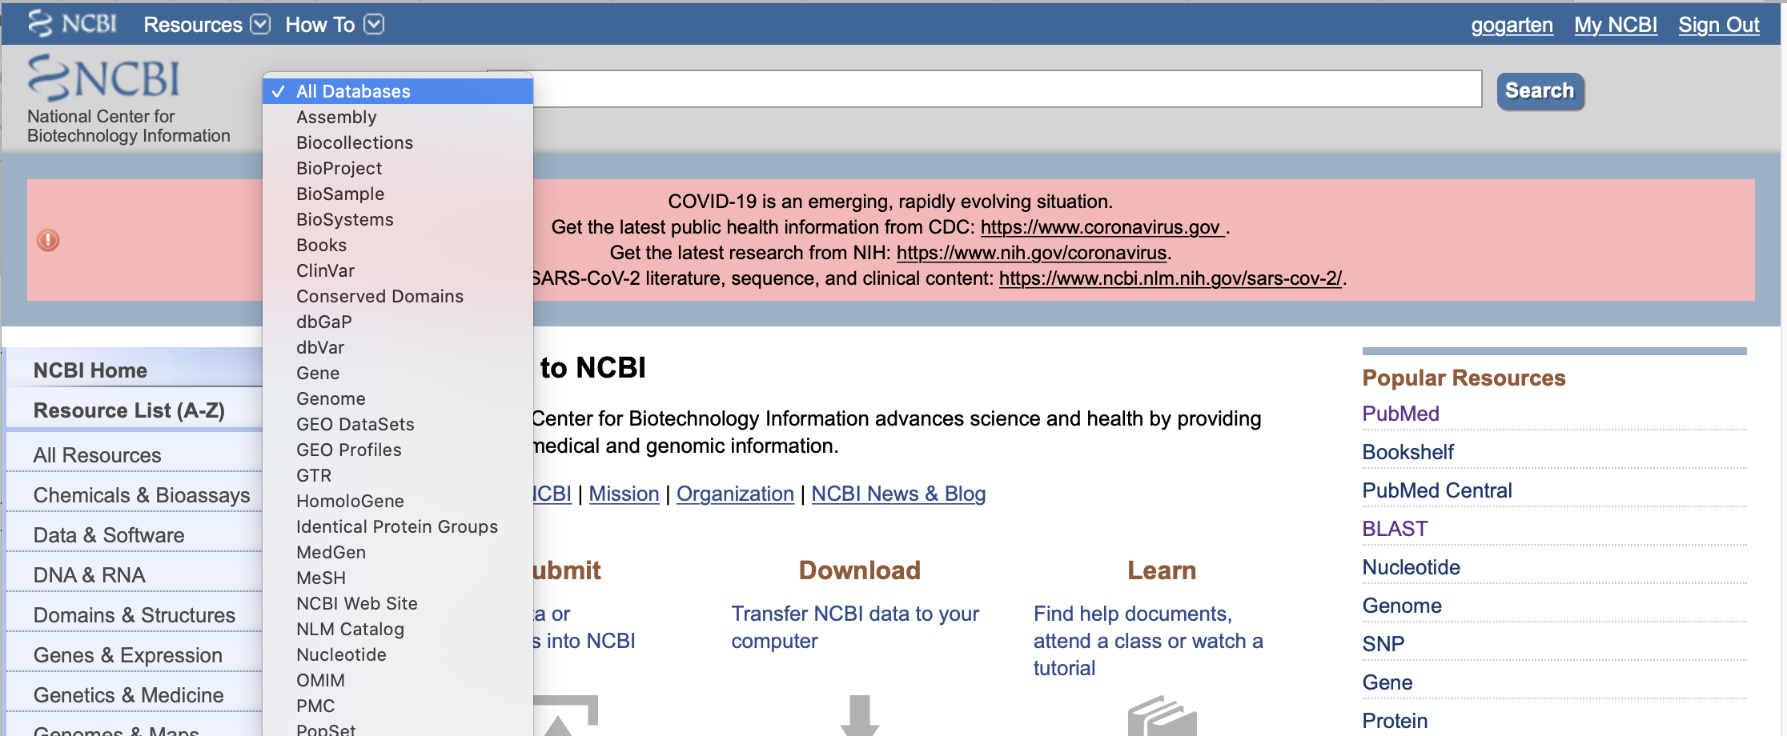
This allows to search either individual or all databases simultaneously.
For example, if you search for a particular protein that is listed with the “accession” A3C58_00620

Slide 5
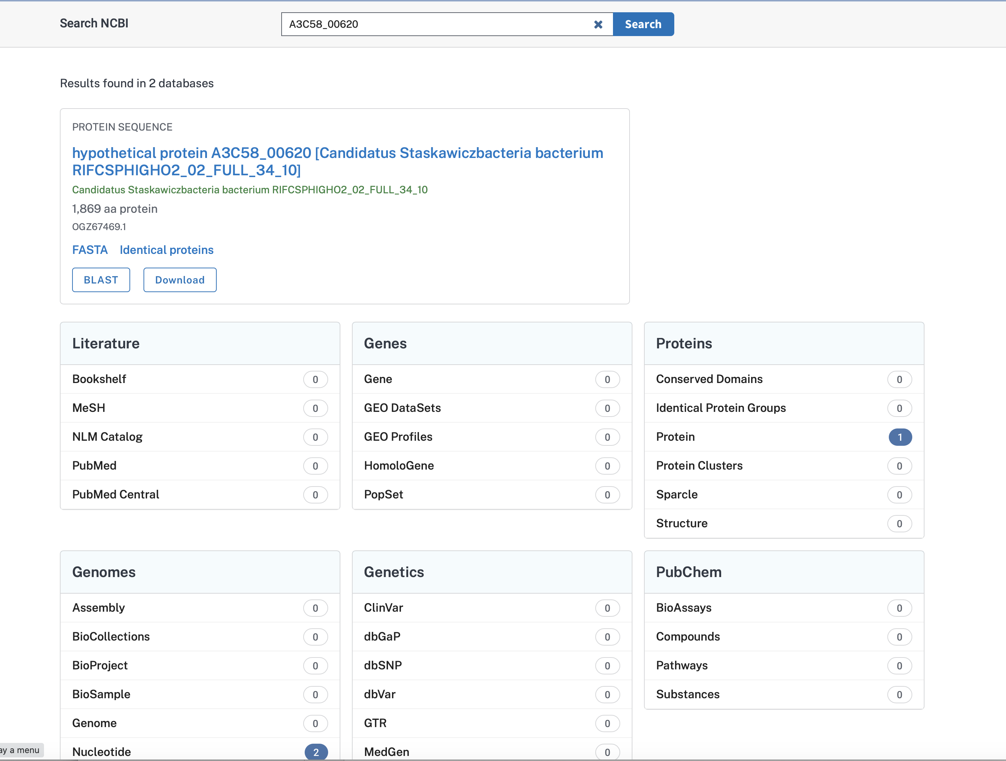
One match in protein databank, and two in genomes (which have the number in the annotation)
Clicking the link gets you to a listing of the entries, and another click gets you to the sequence.

Slide 6
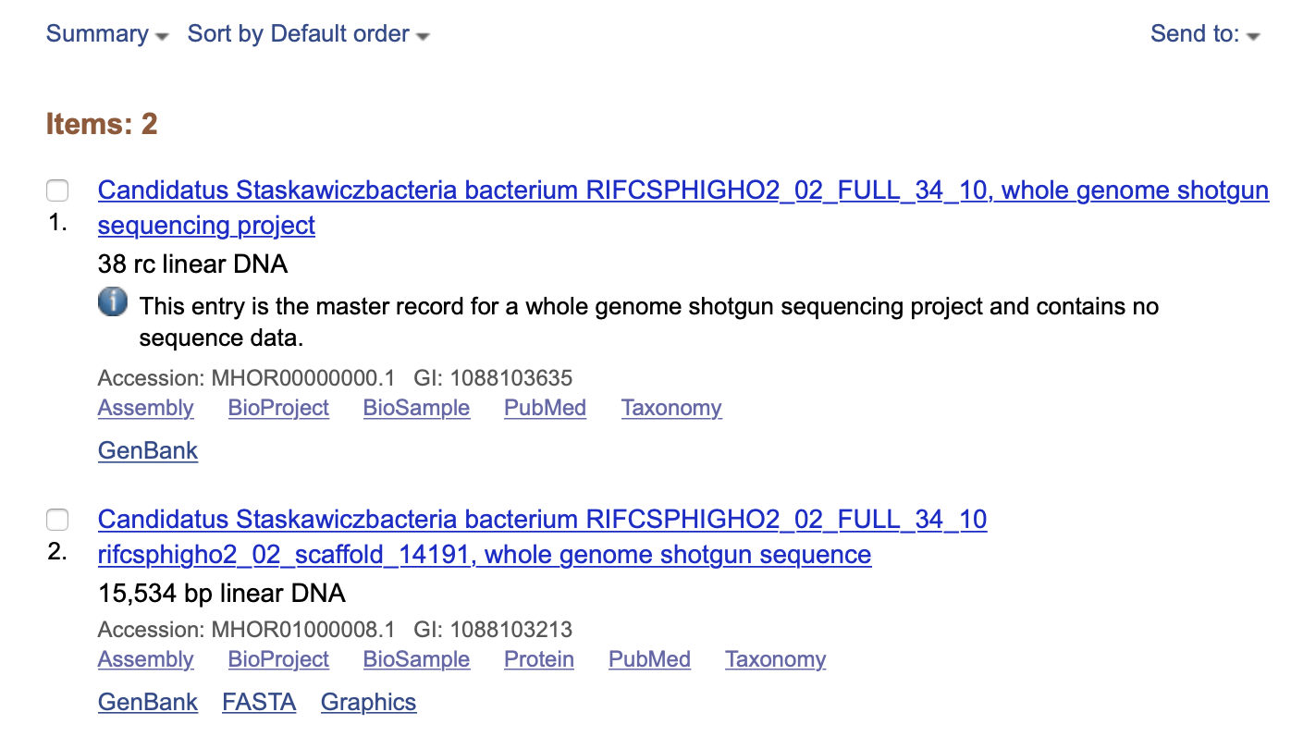
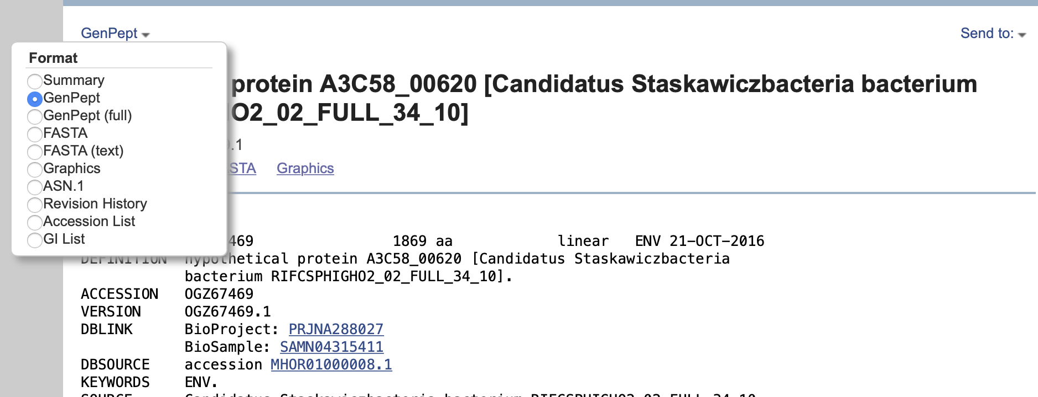
You also can send item to file or a clipboard for later use

Slide 7
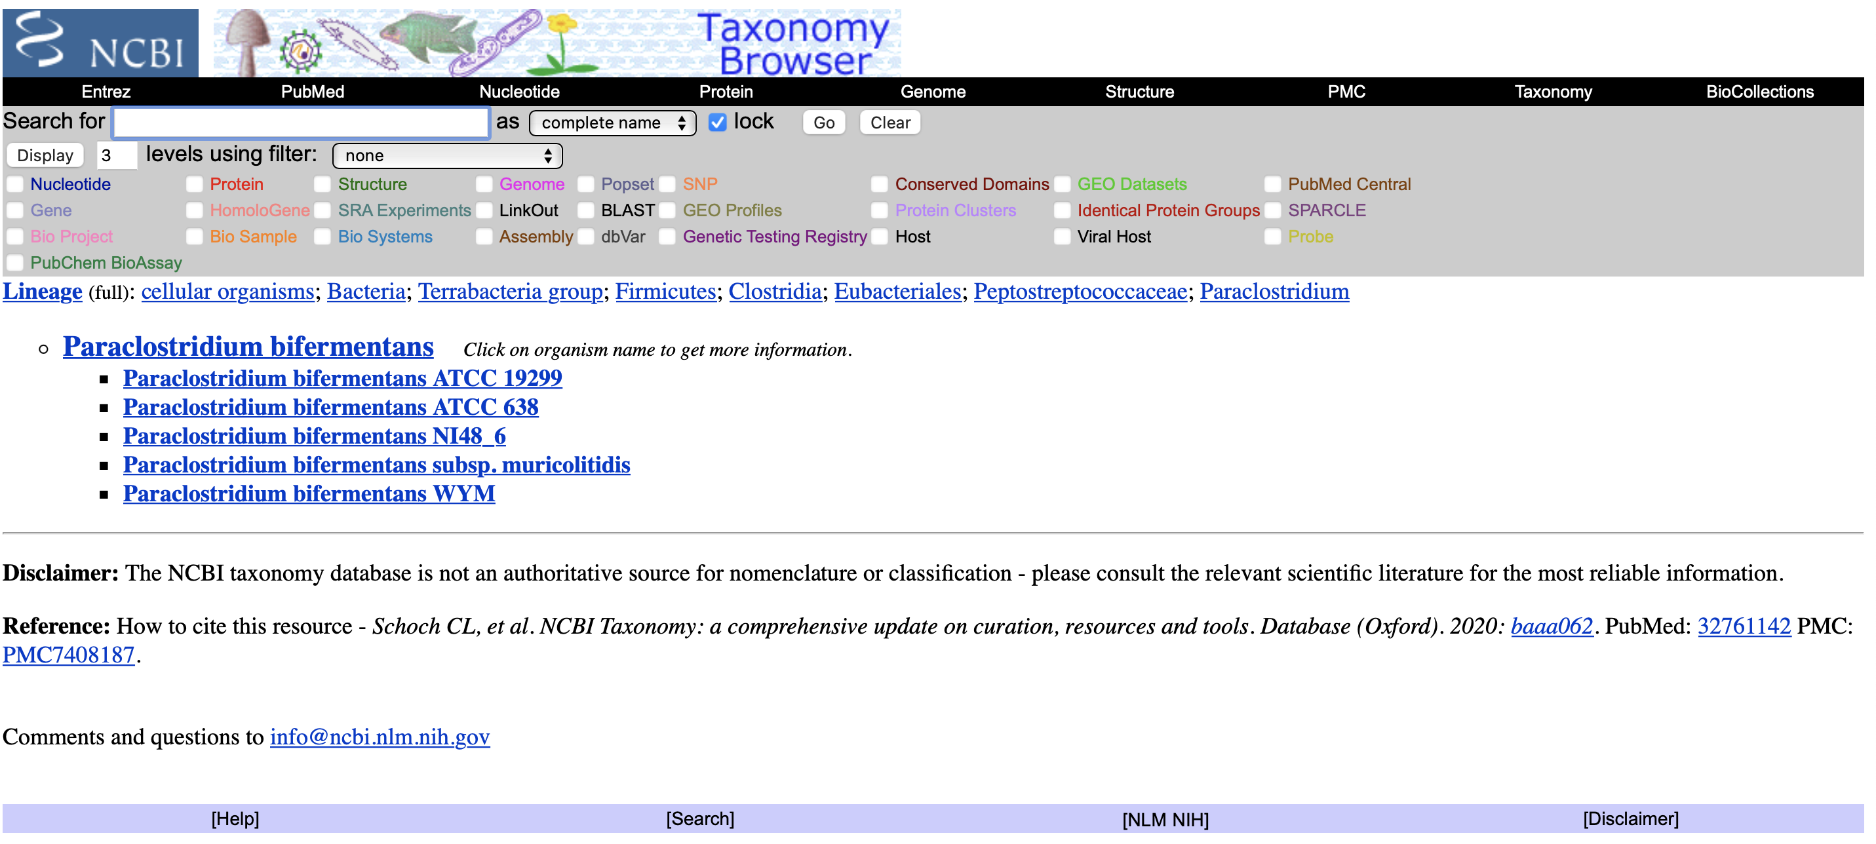
If you want to know more about the organism, you could use the taxonomy databank

Slide 8
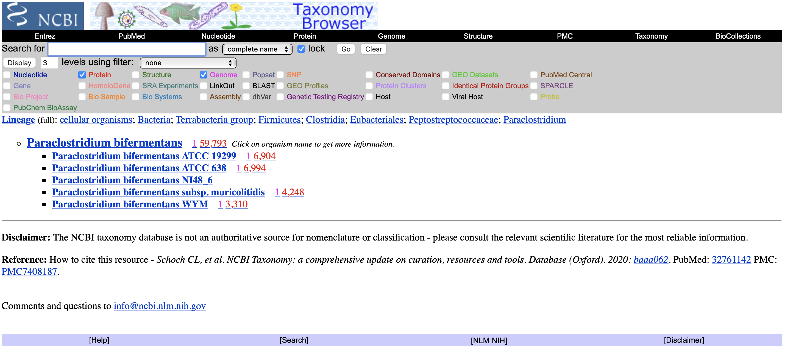
If you want to download all genomes or all proteins from the respective databanks, select items in the header

Slide 9
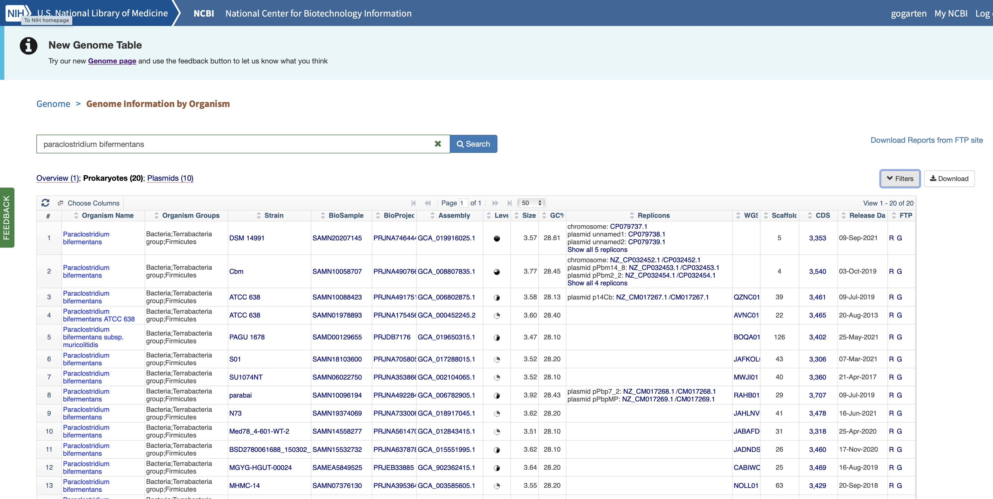
For genomes, the NCBI’s genome browser is a more straight-forward resource:

Slide 10
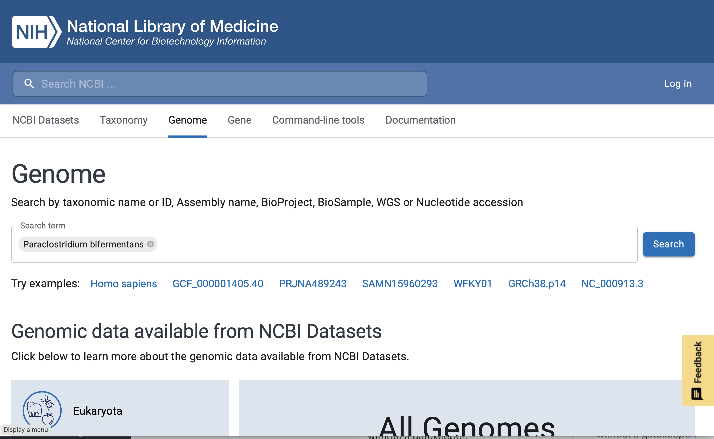
The New Genome Interface

Slide 11
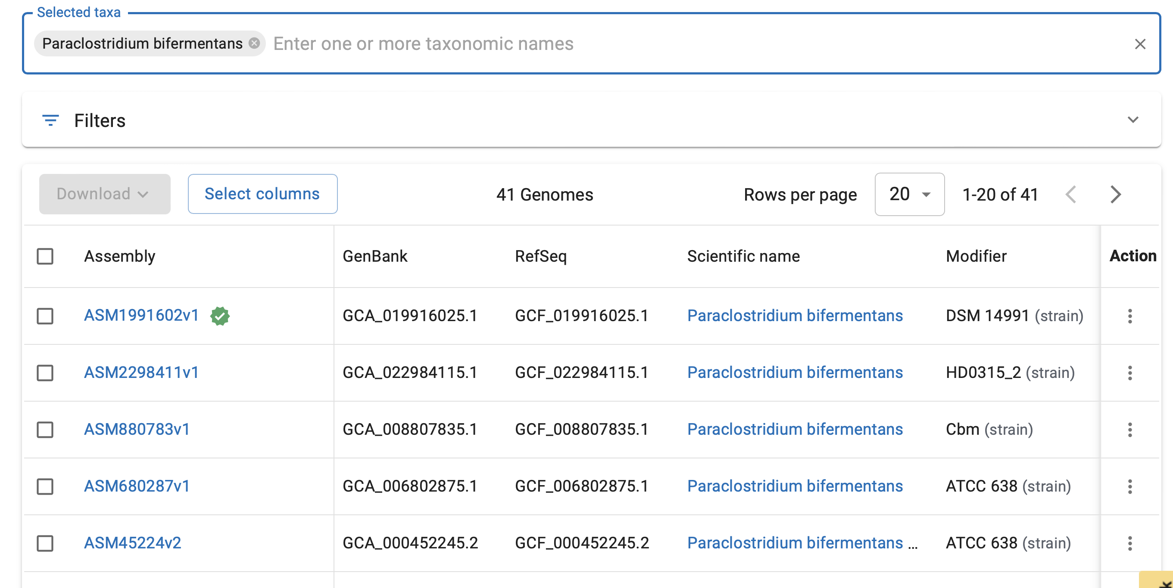
Warning: The subsequent steps do not work with the Safari Browser

Slide 12
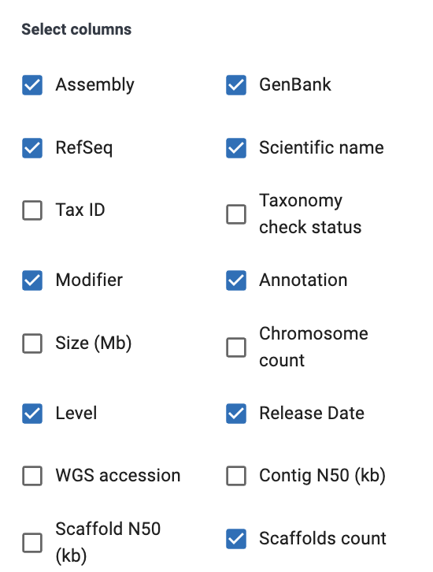
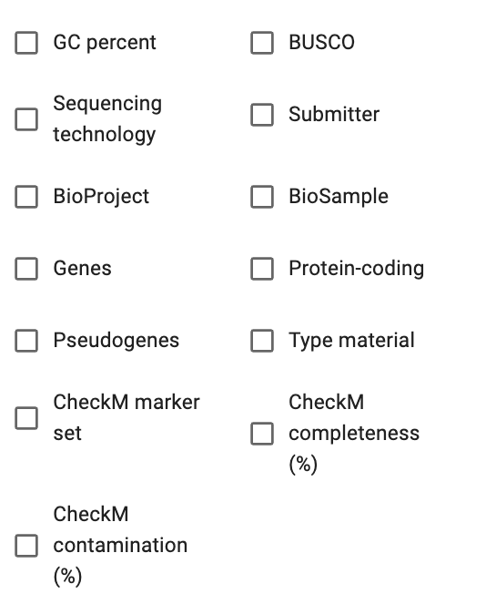
You can select different columns

Slide 13
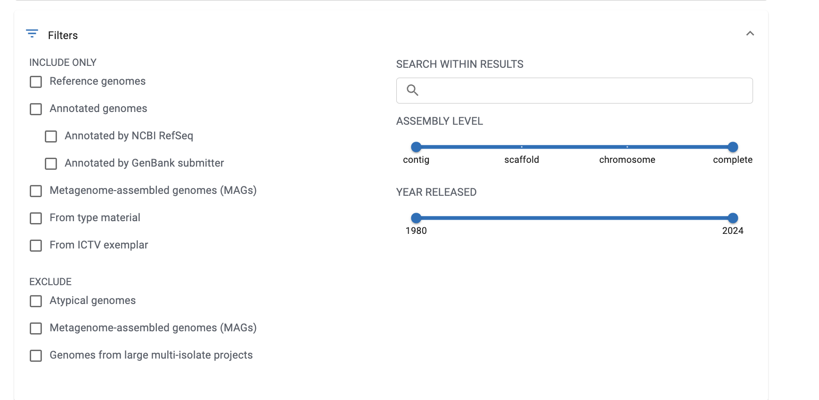
And you can apply filters

Slide 14
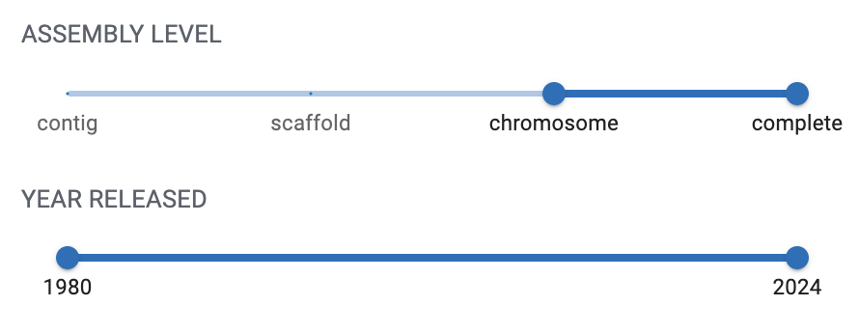
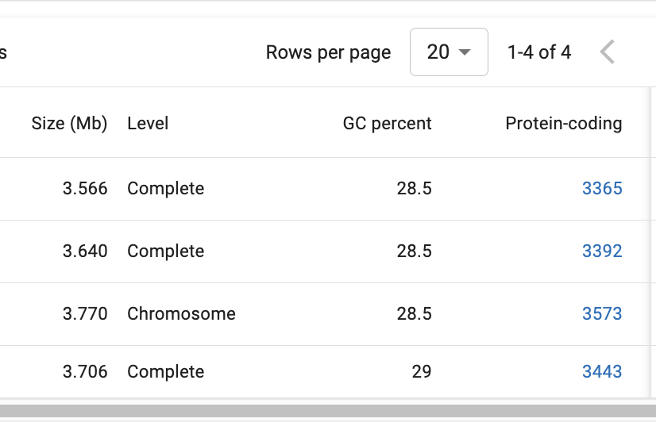
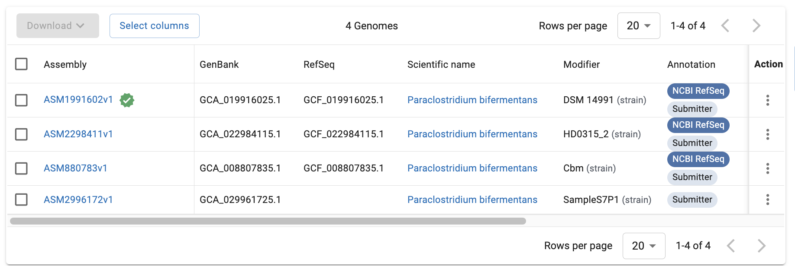

Slide 15
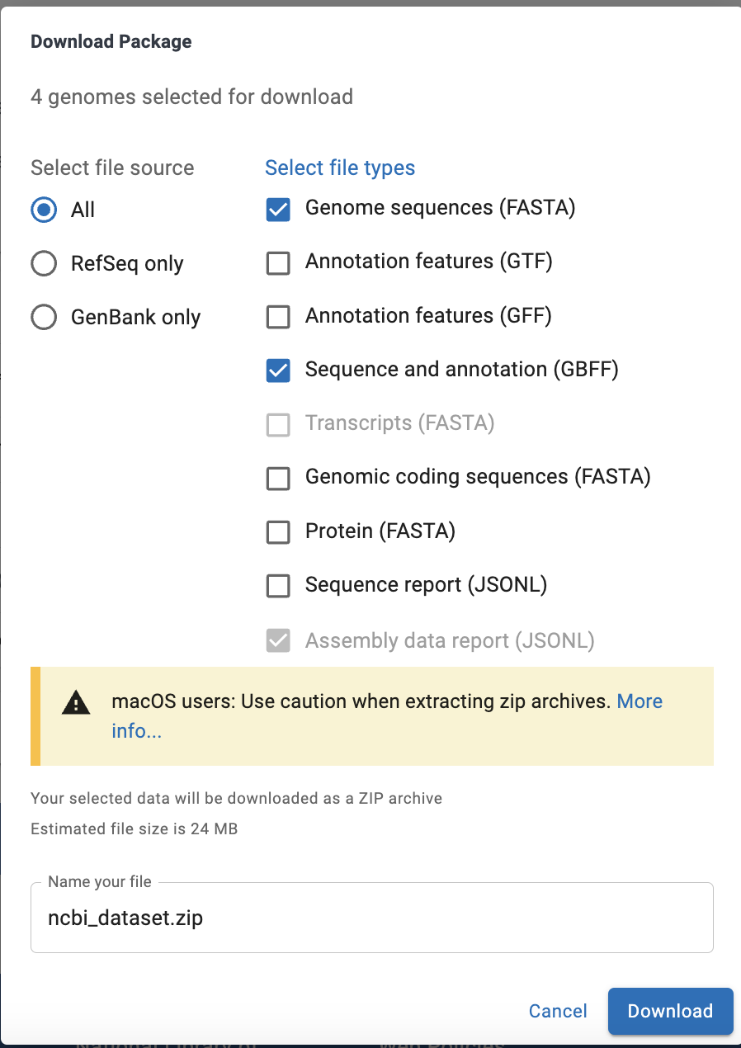
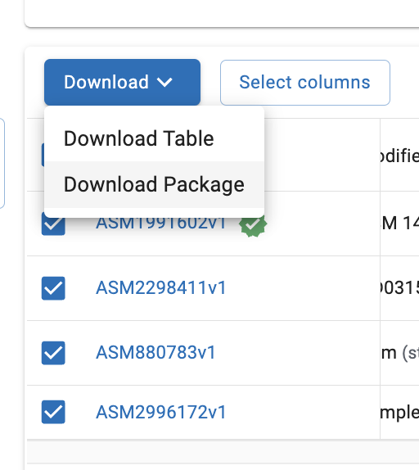
Refseq files are created by the NCBI, and presumably more uniformly annotated (sometimes they have uniform misannotations, e.g., genes invaded by an intein are annotated not by the hostname, but by the endonuclease).
Genbank files are annotated by the submitter. Every refseq file also has corresponding genebank file but not vice versa.

Slide 16
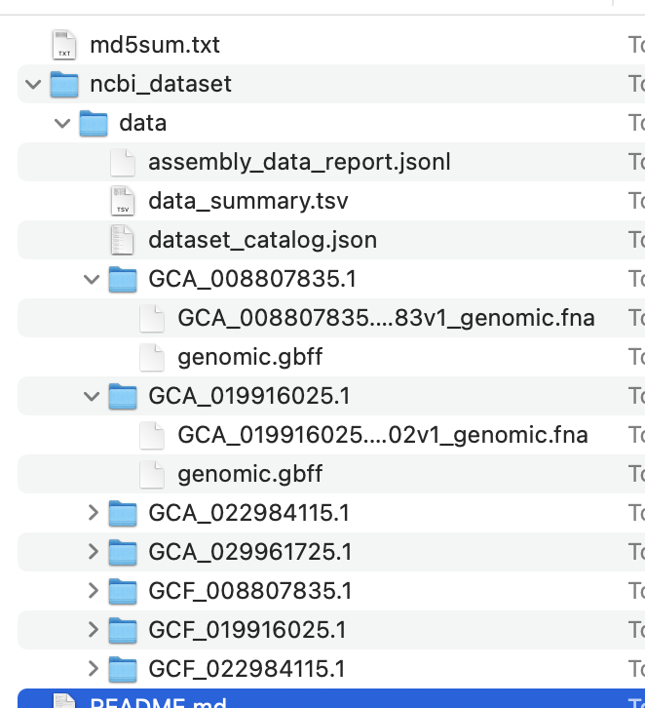
From the readme.md file:
### I still can't find my data, can you help?
We have identified a bug affecting Mac Safari users. When downloading data from the NCBI Datasets web interface, you may see only this README file after the download has completed (while other files appear to be missing).
As a workaround to prevent this issue from recurring, we recommend disabling automatic zip archive extraction in Safari until Apple releases a bug fix.
For more information, visit:
https://www.ncbi.nlm.nih.gov/datasets/docs/reference-docs/mac-zip-bug/

Slide 17
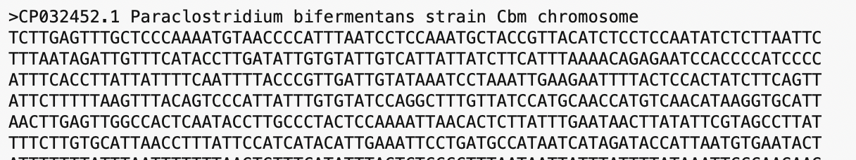
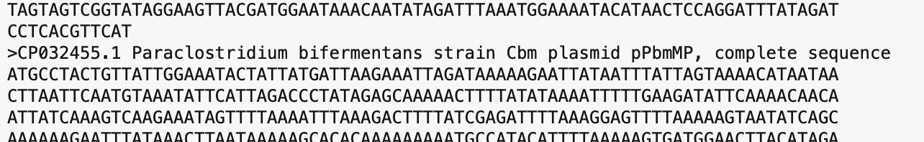
The selected genomes were requested in fasta format.
Usually, the files contain multiple sequences. Each starting with a “>”
The first annotation line is the first line in the file.
Followed by the sequence.
The second annotation line also begins with >. This can be recognized because the the > is preceded by a new line symbol (\n)

Slide 18
Distinctions between Databanks
Supervised databanks with gatekeeper. Examples: Swissprot Refseq (at NCBI) PhagesDB Entries are checked for accuracy. + more reliable annotations (but still not great) -- frequently out of date | Repositories without gatekeeper. Examples: GenBank EMBL TrEMBL Everything is accepted. + everything is available -- many duplicates -- poor reliability of annotations

Slide 19
Problem with Ownership
One problem in maintaining databanks (supervised and unsupervised) is "ownership" of sequences, which in many data banks prevents a continuous update of sequences. Even if errors are detected, they are not easily removed form the databank.
Example 1: Jordan Konisky’s K⁺ pump (putative P-type ATPase) in Methanococcus voltae.
Example 2: ATP synthase operons in E.coli see Fig.1 in
http://mic.microbiologyresearch.org/content/journal/micro/10.1099/mic.0.033811-0#tab2
Example 3: Even species names are often wrongly assigned (see slides and/or manuscript)

Slide 20
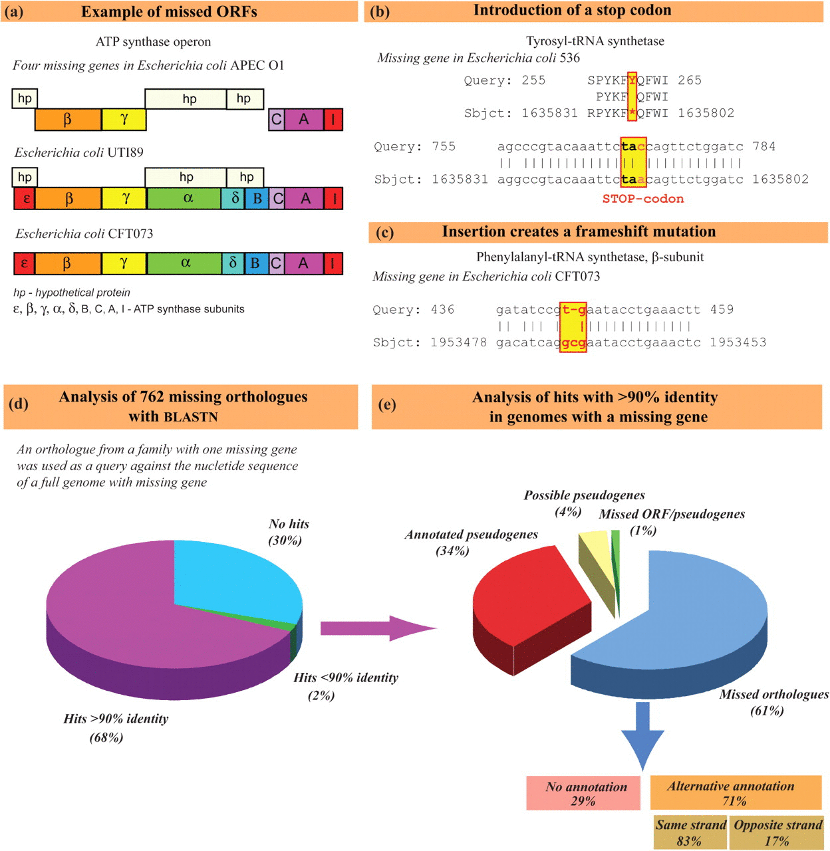
The hypothetical proteins in APEC01 have now become part of a conserved hypothetical protein family – they are found in many other E. coli.

Slide 21
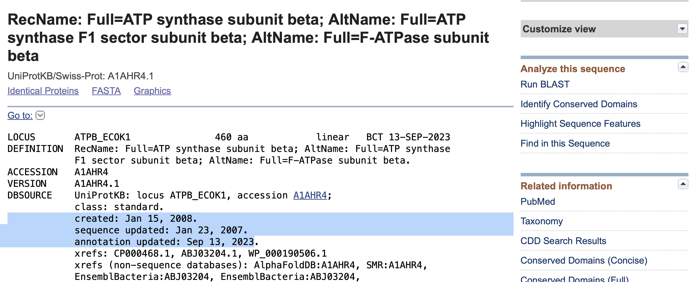

Slide 22
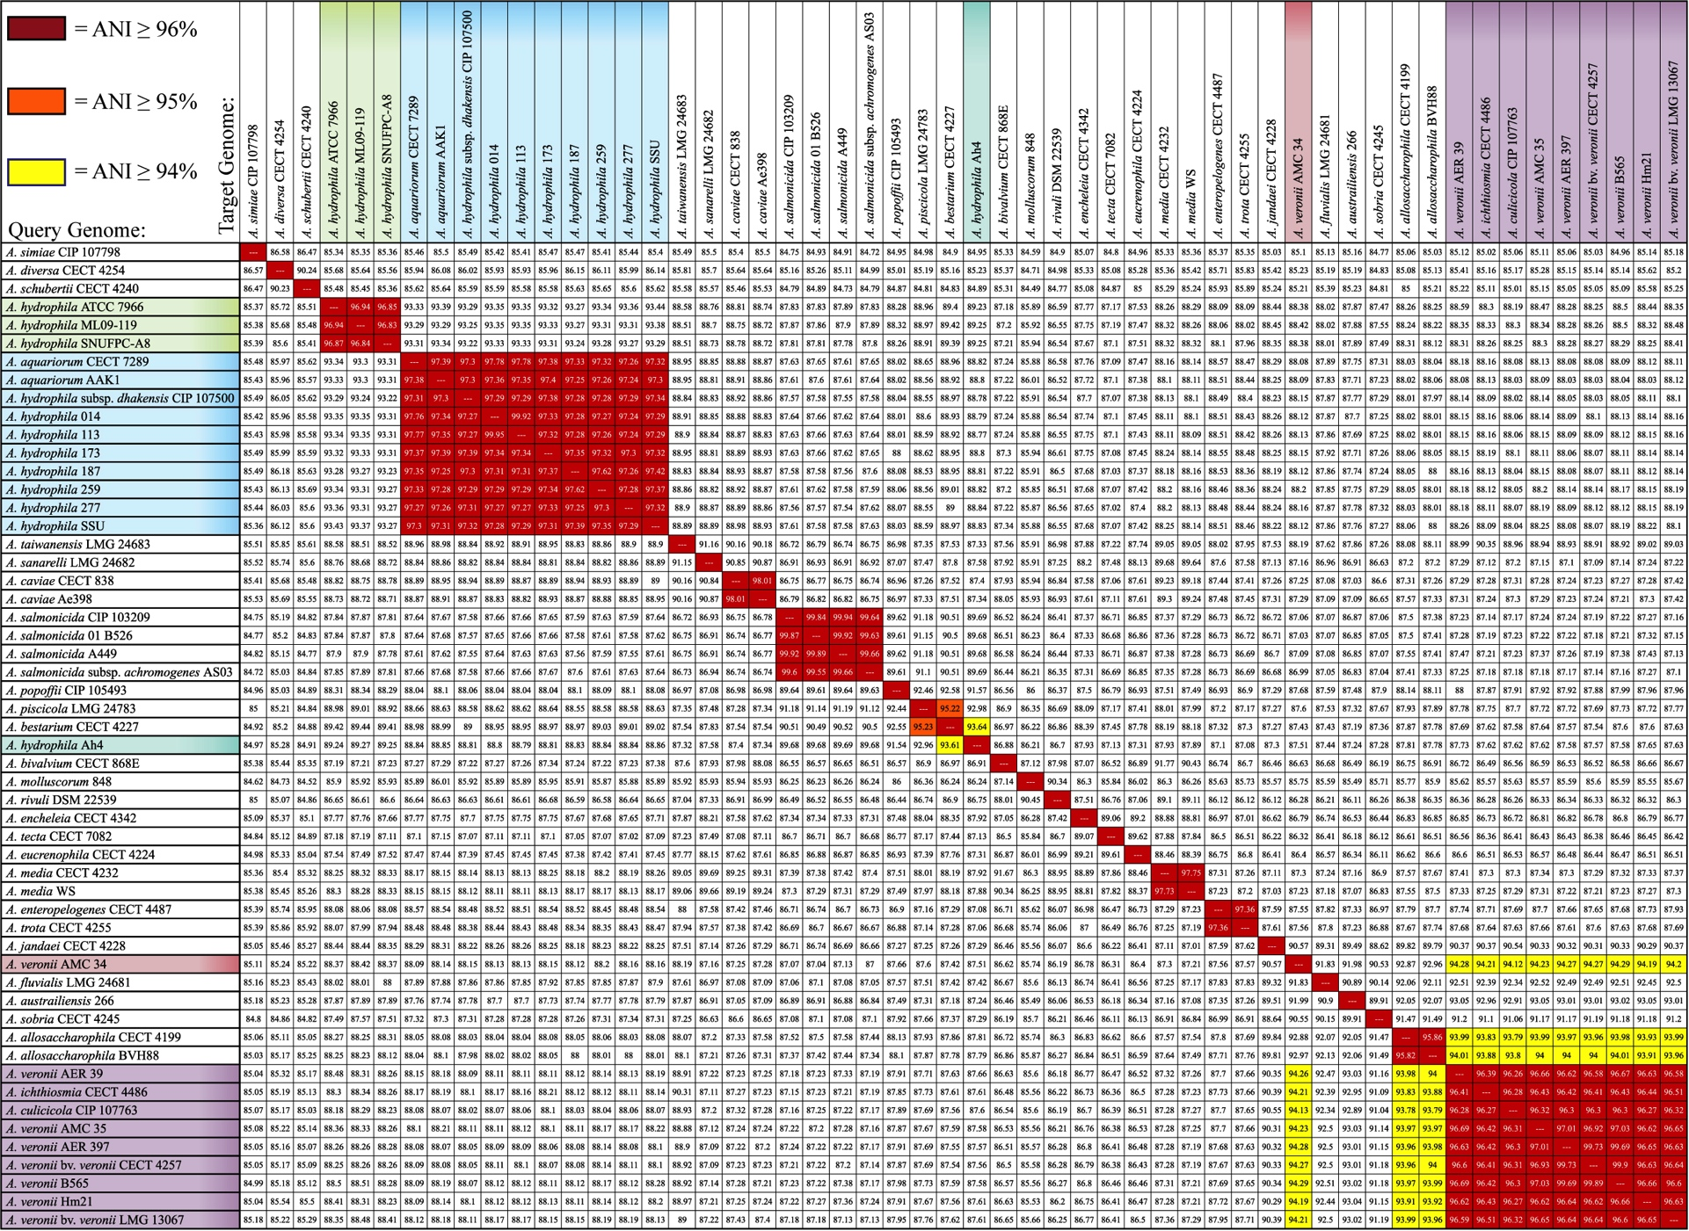
Average Nucleotide Identity (mANI)
A. hydrophila
A. aquariorum/
dhakensis
A. caviae
A. salmonicida
A. piscicola / bestarium /hydrophila AH4
A. media
A. enteropelogenes / trota
A. allosaccharophila
A. veronii
Using JSpecies (Richter and Rosselló-Móra, 2009, PNAS 106: 19126–19131)

Slide 23
Genbank
Founded in 1982 at the Los Alamos National Laboratory
Initially managed at Stanford in conjunction with the BIOSCI/Bionet news groups
1989-92 transition to the NCBI on the east coast
One precursor was Margaret Dayhoff’s Atlas of Protein Sequence and Structure
In 1987 genbank fit onto a few 360 KB floppy disks.
Genbank uses a flat file database format (see http://en.wikipedia.org/wiki/Flat_file_database)
NCBI does not use a relational databank (as in Oracle, peoplesoft)
NCBI stores data in ASN.1 format (http://en.wikipedia.org/wiki/Abstract_Syntax_Notation_One),
which allows to hardwire crosslinks to other data banks, and makes retrieval of related information fast.
NCBI’s sample record (http://www.ncbi.nlm.nih.gov/Sitemap/samplerecord.html) contains links to most the fields used in the gbk flatfile.

Slide 24
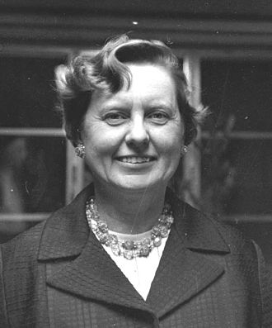
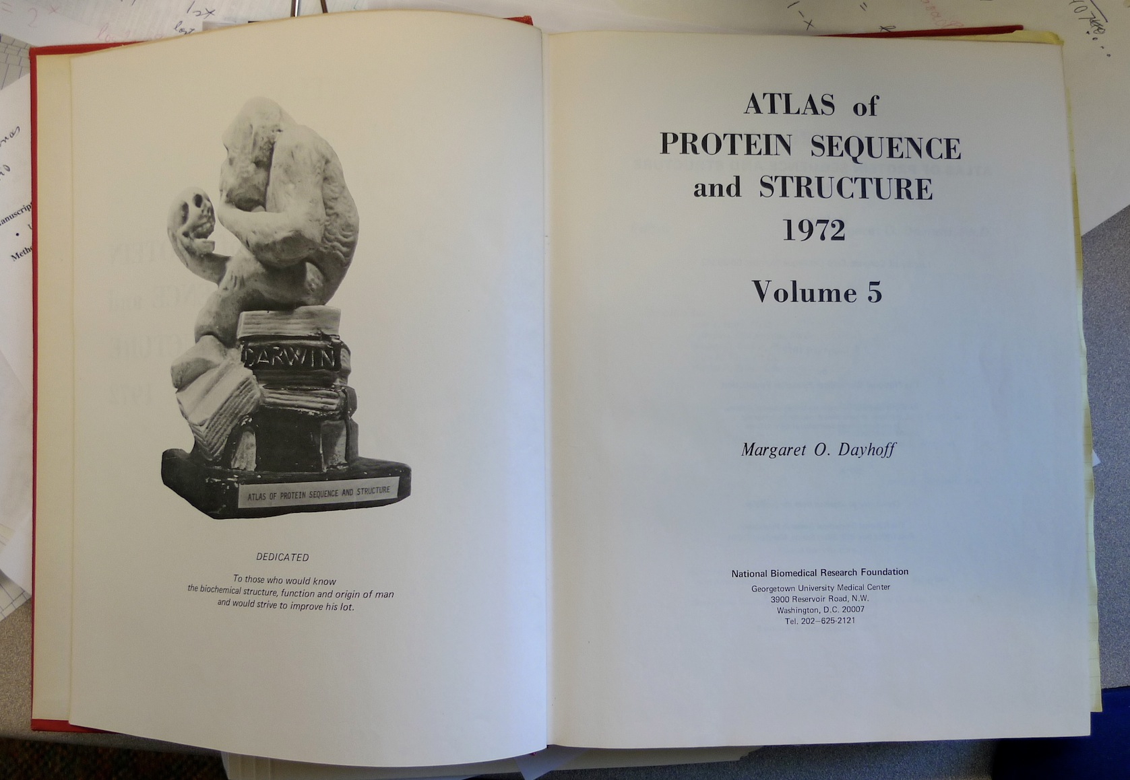
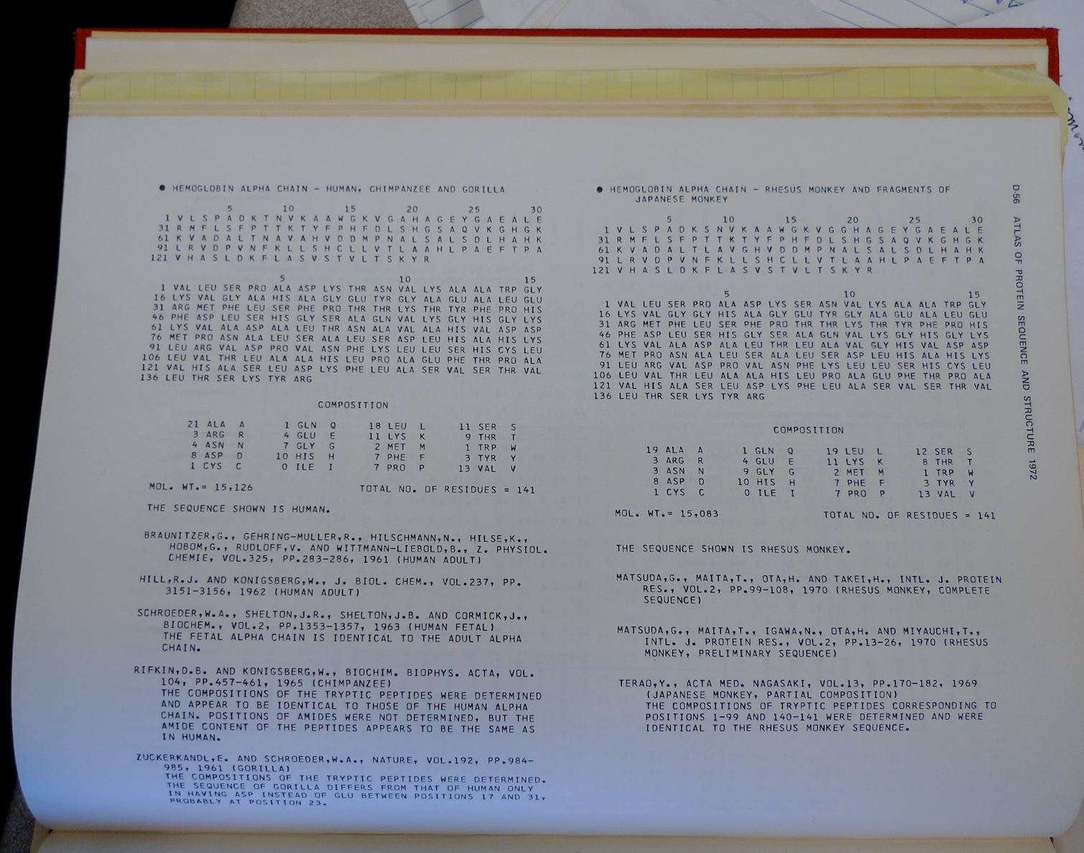
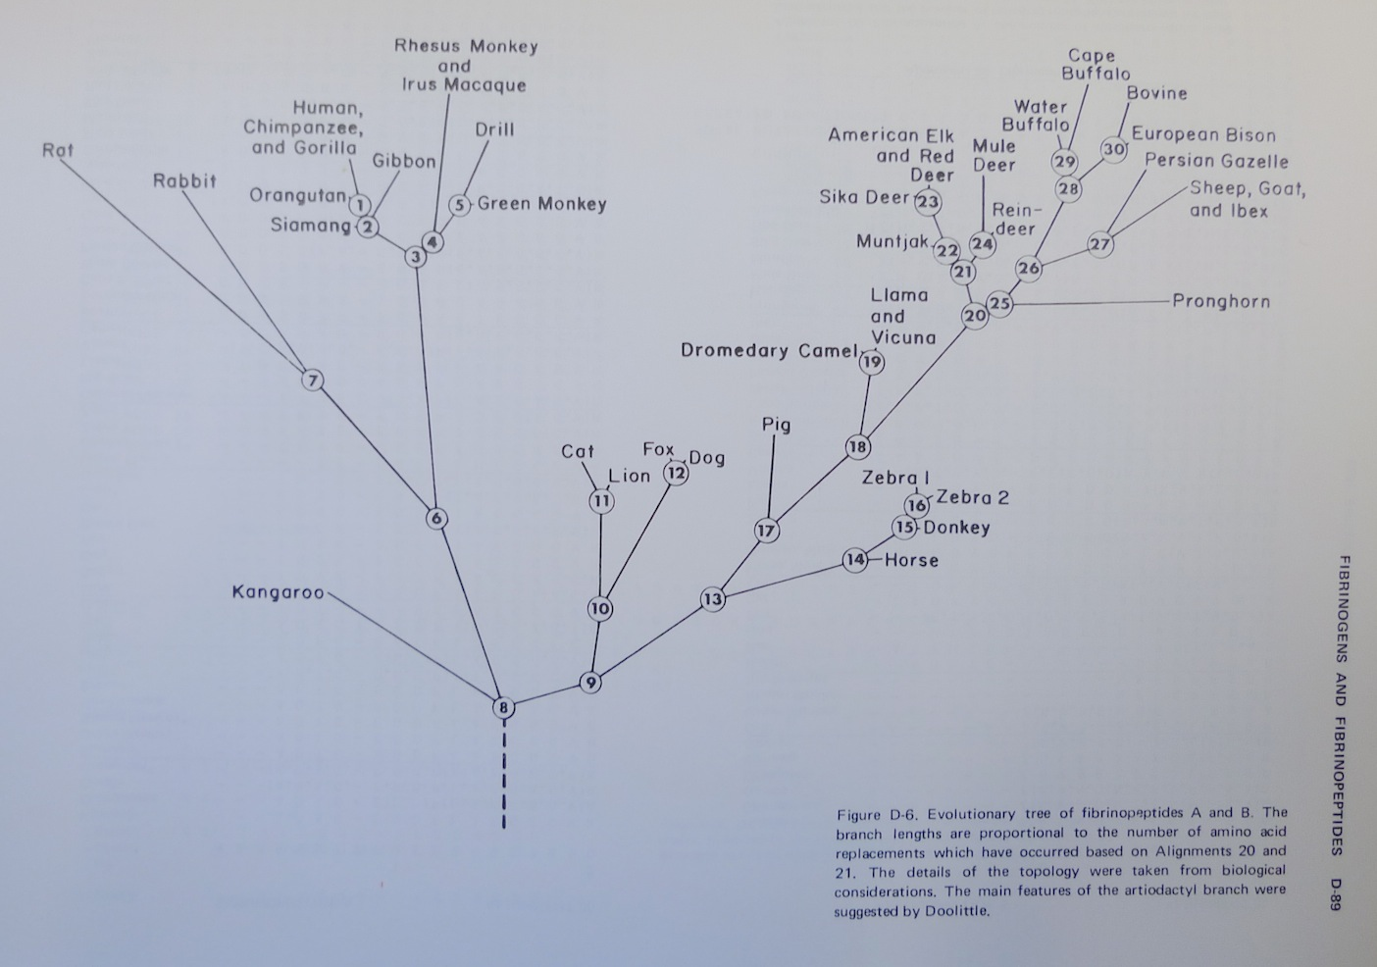
Dr. Margaret Belle (Oakley) Dayhoff
March 11, 1925 – February 5, 1983
Among other things, we owe her the first nucleotide and protein data bank, the PAM substitution matrix, and the single letter amino acid code. (Image from wikipedia)

Slide 25
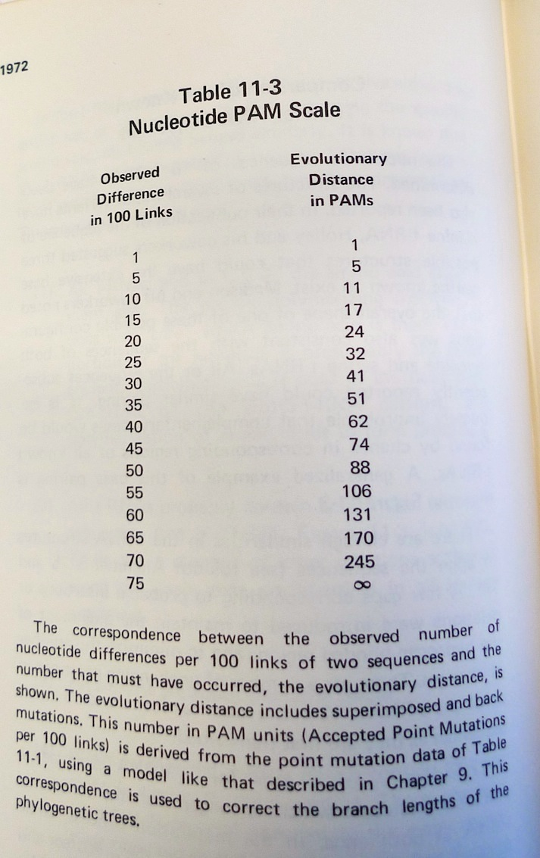
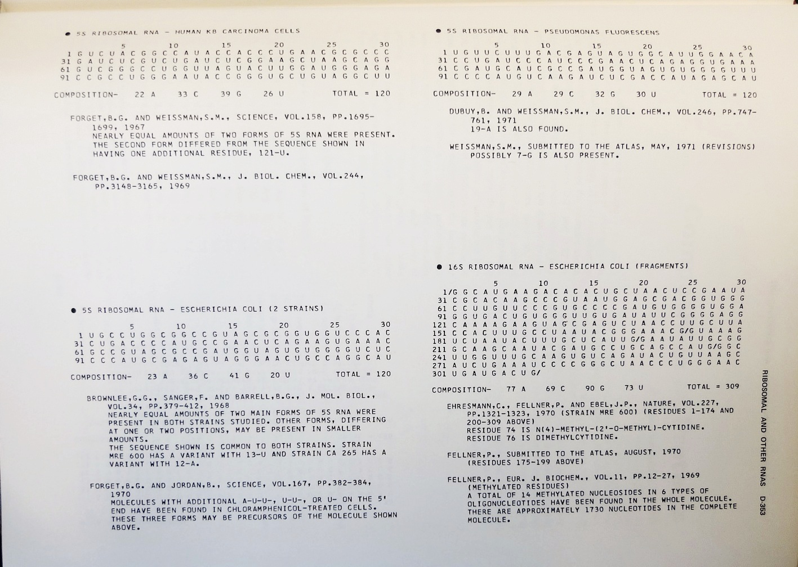
Atlas of Protein Sequences 1972 (cont)
The Atlas also contained RNA sequences, and PAM matrix for nucleotides

Slide 26
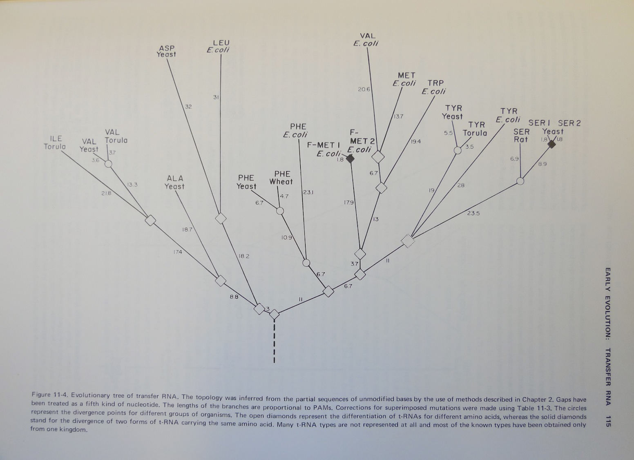
Atlas of Protein Sequences 1972 (cont)
Contained phylogenetic reconstructions that went back in time to far before the Last Universal Common Ancestor (LUCA) aka the cenancestor of all living cellular organisms alive today.
tRNA phylogeny

Slide 27
Selecting Scoring Matrices
Choose a matrix appropriate to the suspected degree of sequence identity between the query and its target sequences
PAM: empirically derived for close relatives
BLOSUM: empirically derived for distant relatives
27

Slide 28
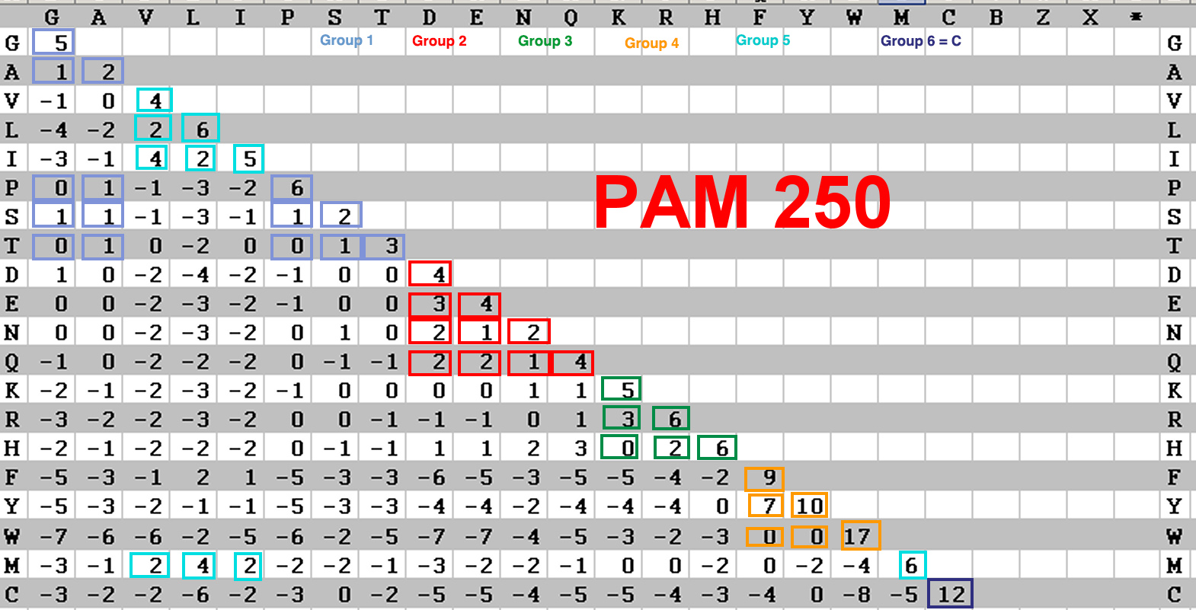
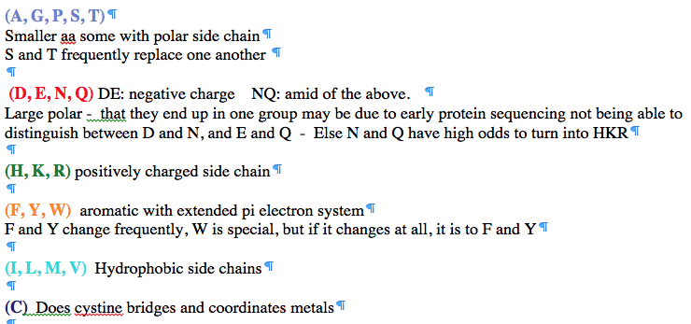
PAM 250 log (odds) matrix
Notes:
Dayhoff recoding

Slide 29
Statistics of data – bank searches

Slide 30
False Positives (probability of)
The probability of have the observed outcome under the null hypothesis
(the drug doesn’t make a difference, the sequences aren’t related, the target sites are not particularly conserved …)
Example: Sequence similarity between two sequences.
How to measure what is expected under the null hypothesis?
Possibility 1: Randomize one or both of the sequences.
Possibility 2: Compare one of the sequences against a databank. (Assuming the databank has mainly unrelated sequences)
Possibility 3: Use a formula for the distribution that is based on a model or that fit observations.

Slide 31
Distribution under null hypothesis from randomized sequences
Calculate alignment score for actual sequences
Calculate expectation under null hypothesis
randomize (scramble) one (or both) of the sequences and calculate the alignment score for the randomized sequences.
repeat the last step at least 100 times (usually 1000)
describe distribution of randomized alignment scores
Calculate the probability of the score for actual sequences under the null hypothesis, i.e., Is the score obtained for the real sequences significantly better than the score for the randomized sequences?
Lipman and Pearson (1984) Rapid and Sensitive Protein Similarity Searches, Science 227(4693):1435-41, DOI: 10.1126/science.2983426

Slide 32
z -score
MEAN
Alignment Score
Actual Sequences
z Score = 4.1
STDDEV

Slide 33
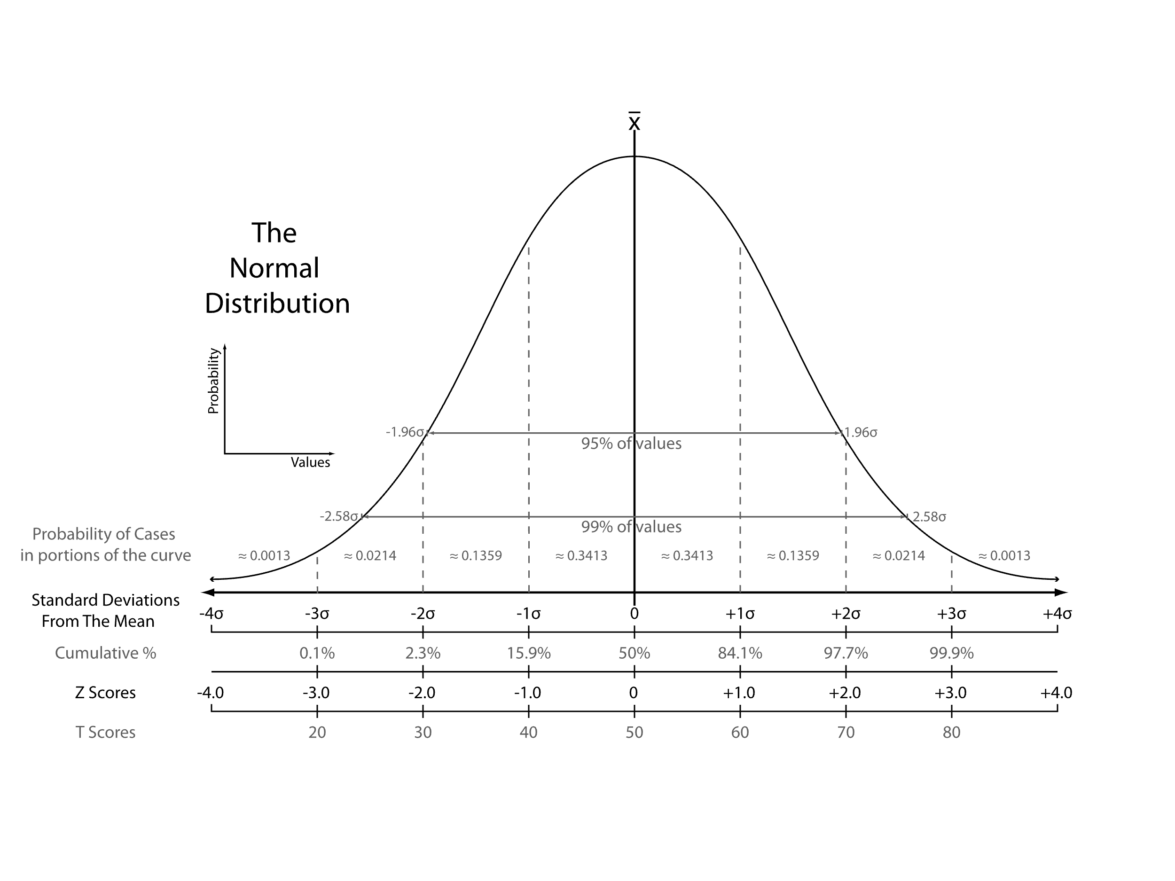
z -score
From: https://en.wikipedia.org/wiki/Standard_score
Notes:
Distinction between probability and probability density

Slide 34
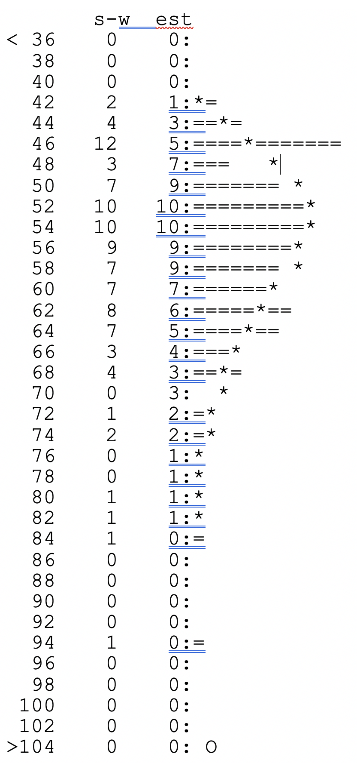
Using a probability distribution
Modern PRSS
43400 residues in 100 sequences,
BLOSUM50 matrix,
gap penalties: -12,-2
unshuffled s-w score: 269;
shuffled score range: 43 - 96
Lambda: 0.13635 K: 0.0055017;
P(269)= 1.9668e-13
For 100 sequences,
a score >=269 is expected
1.97e-11 times
Notes:
e stabds for engineering format not Eulers number!

Slide 35
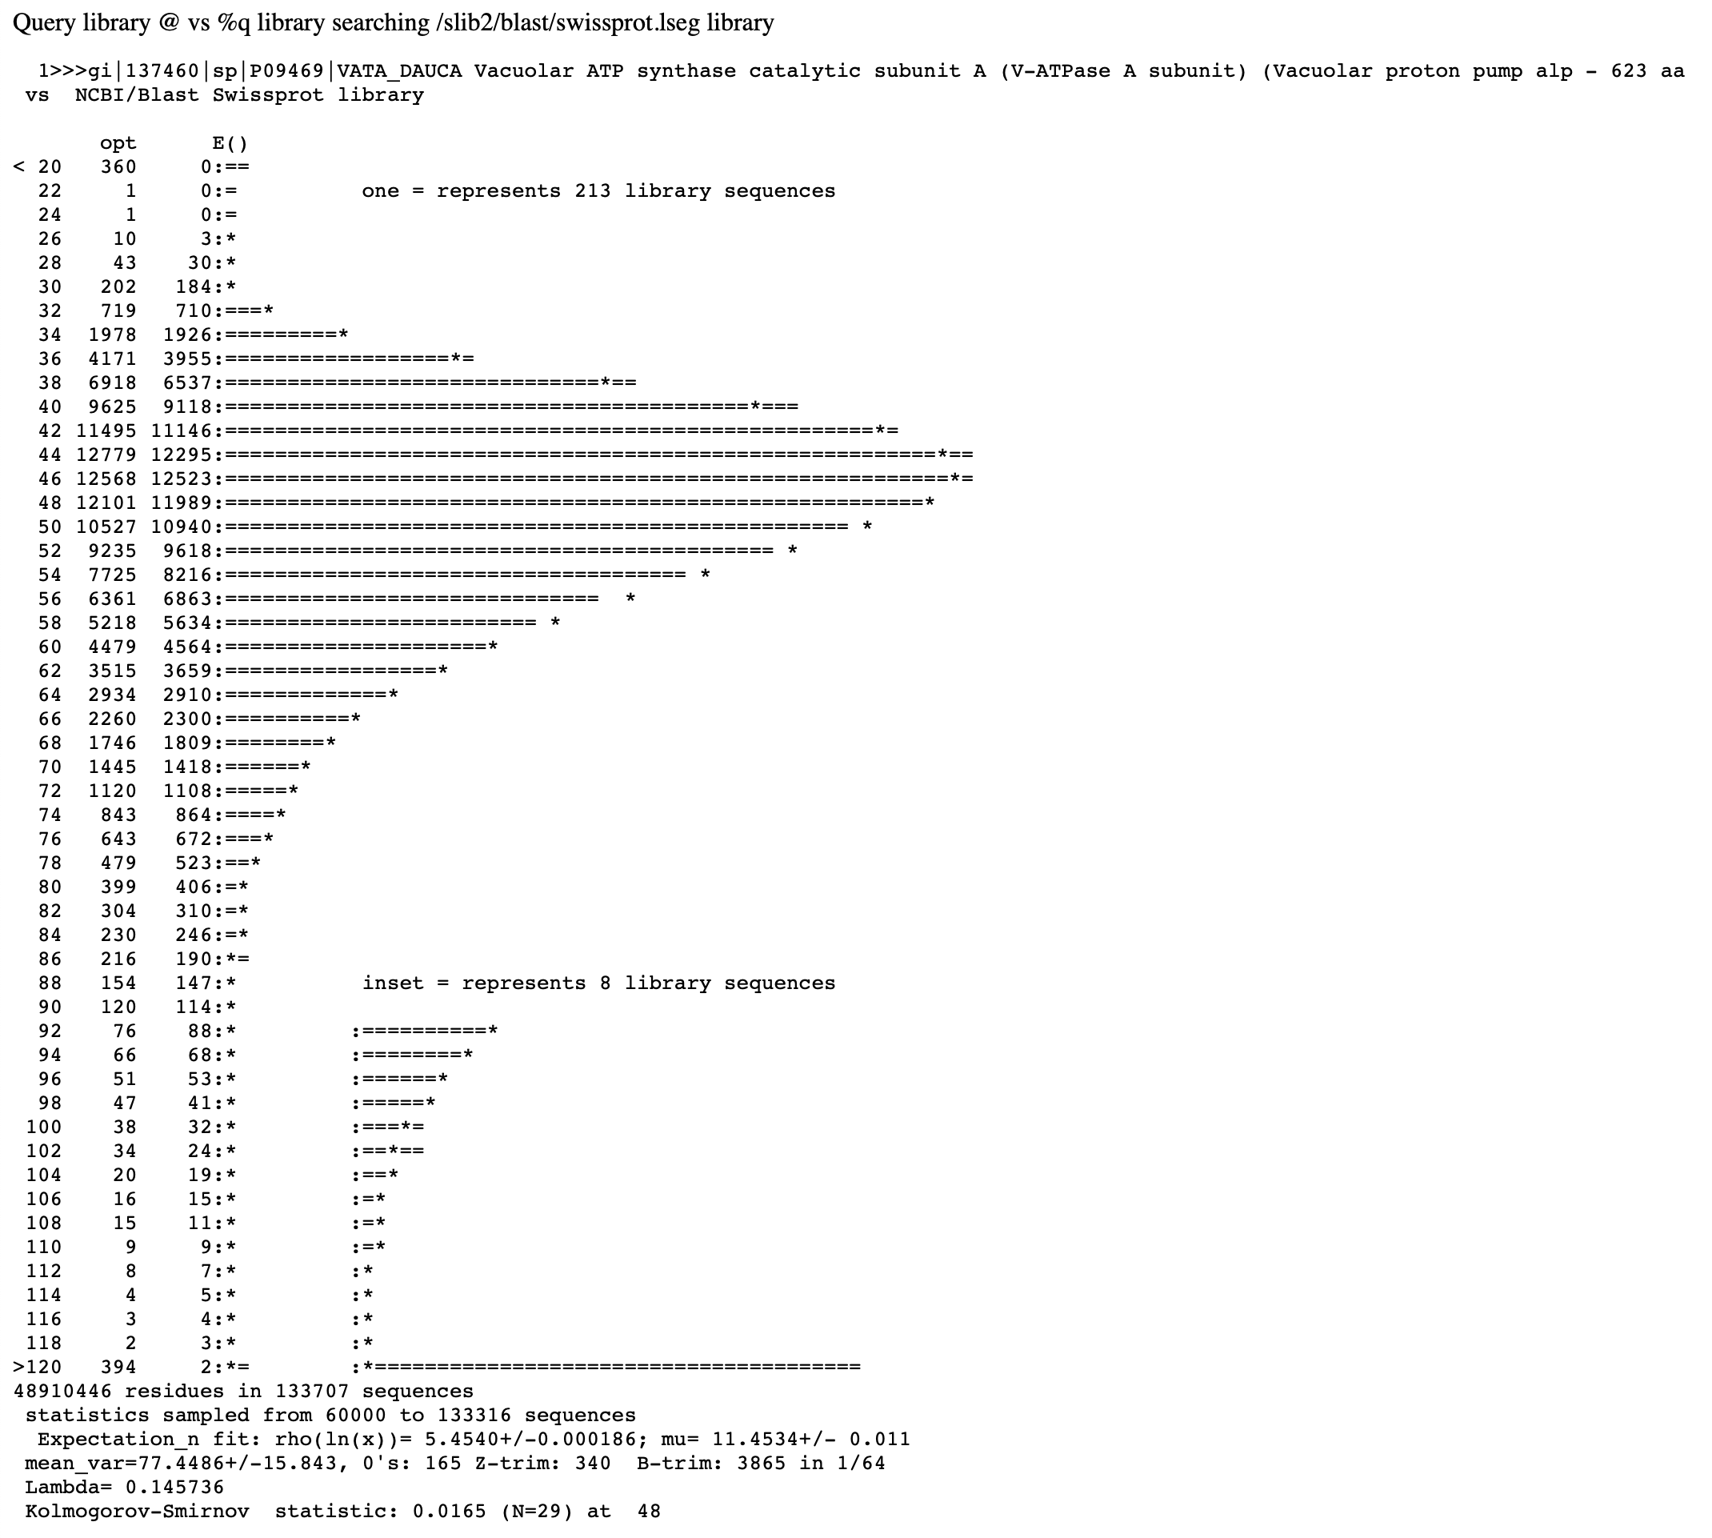
FASTA databank search
(Distribution under H₀ is estimated from the data, i.e. all scores against the databank sequences)

Slide 36
False Positives versus False Negatives
If a databank search with a sequence is considered a search a ”homology search” (significant similar complex sequence are homologs), then
False Positives: non-homologous sequences that are reported as similar (these are very well estimated by E-values)
False Negatives: homologous sequences that are not reported as similar (there are many, but the number is unknown)
Aside:
E-values give the expected number of matches with an alignment score this good or better due to chance alone (no shared ancestry, no convergent evolution)
P-values give the probability of to find a match of this quality or better due to chance alone (no shared ancestry, no convergent evolution).
The P value is equal to the probability that the null hypothesis (similarity is due to chance alone) is true. This probability is also known as the significance level at which the null hypothesis can be rejected.
P values are [0,1], E-values are [0,infinity).

Slide 37
blast searches via web interfaces
@ NCBI
@ phagesDB
@ EMBL
@ .....

Slide 38
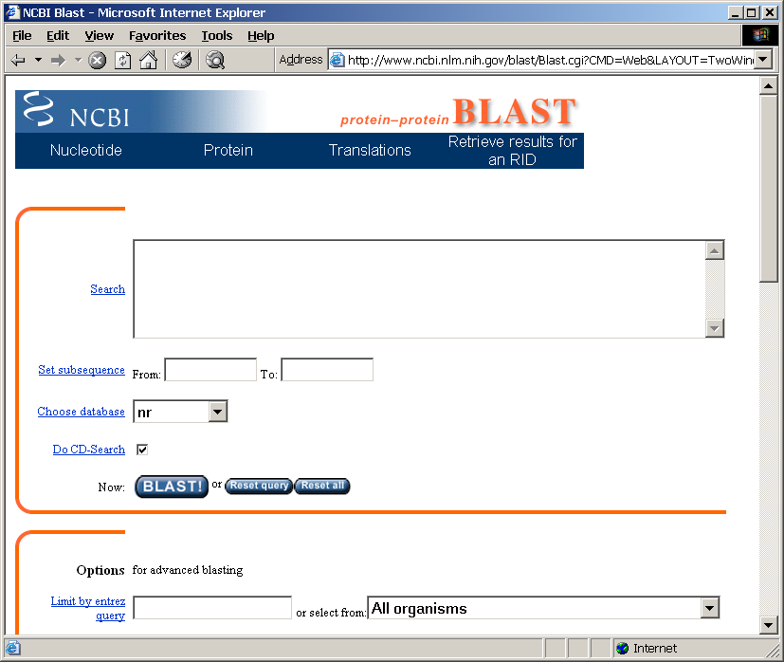
Routine BlastP search
FASTA formatted text
or Genbank ID#
Protein database
Run
by Bob Friedman

Slide 39
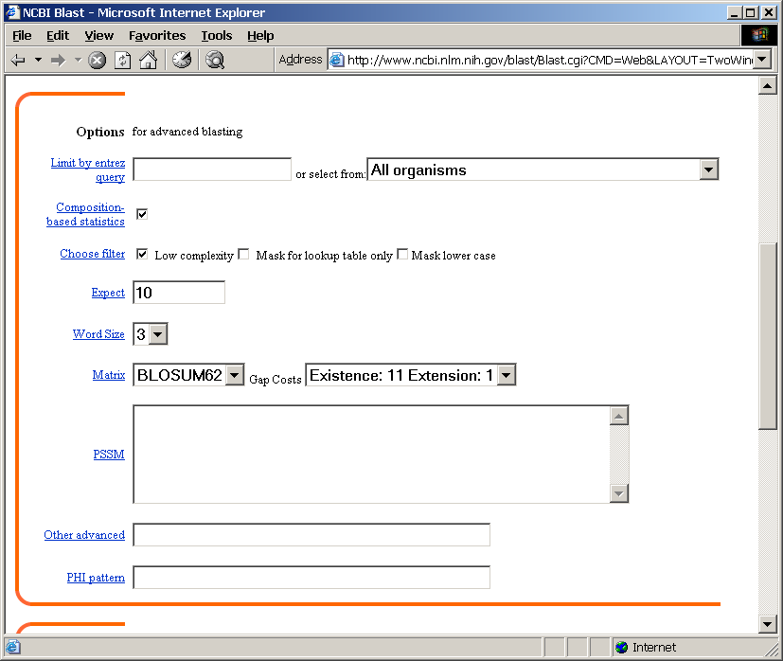
BlastP parameters
Restrict by taxonomic
group
Filter repetitive regions
Statistical cut-off
Size of words in look-up table
Similarity matrix (cost of gaps)
by Bob Friedman

Slide 40
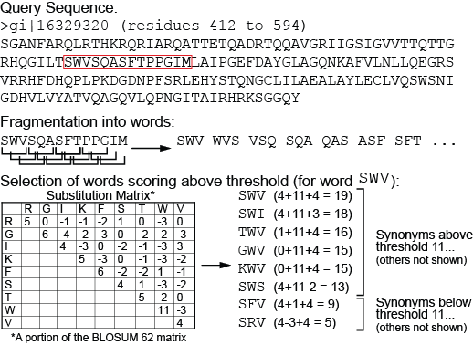
BLAST Phase 1: Segmenting the query sequence; scoring potential word matches--compile
BLAST:
  Segments the query sequence into pieces (“words”)
    Default word length: 3 amino acids or 11 nucleic acids
  Creates a list of synonyms and their scores for comparing query words to target words
    Uses scoring matrix to calculate scores for synonyms that might be found in the database
  Saves the scores (and synonyms) exceeding a given threshold T
40

Slide 41
BLAST Phase 2: Scanning the database
BLAST
  Scans the database for matches to the word list with acceptable T values
  Requires two matches (“hits”) within the target sequence
  Sets aside sequences with matches above T for further analysis
Words
SWI
PGI
…………..SWITEASFSPPGIM…..
Possible match from the database
41

Slide 42
Uses of Blast in bioinformatics
The Blast web tool at NCBI is limited:
custom and multiple databases are not available
“time-out” before long searches are completed
What if researcher wants to use tBlastn to find all olfactory receptors in the mosquito? Or, if you want to check the presence of a (pseudo)gene in a preliminary genome assembly?
Answer: Use Blast from command-line
Also: The command-line allows the user to run commands repeatedly
by Bob Friedman

Slide 43
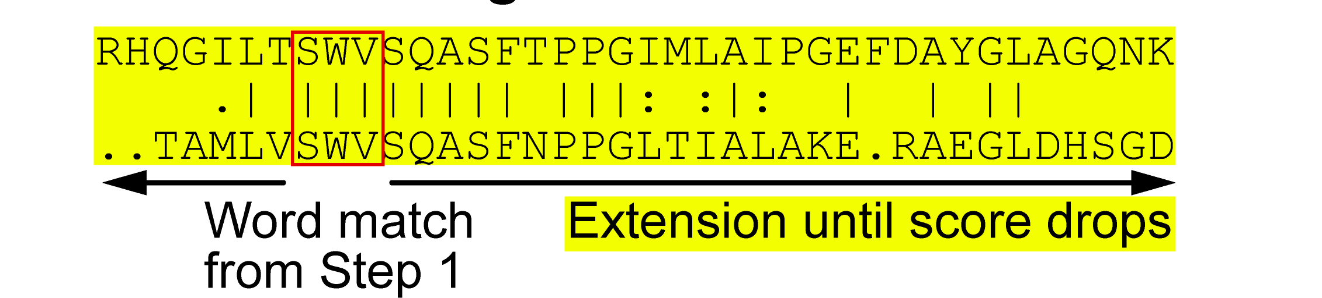
BLAST Phase 3: Extending the hits
BLAST
  Searches 5’ and 3’ of the word hit on both the query and target sequence
  Adds up the score for sequence identity or similarity until value exceeds S
  Alignment is dropped from subsequent analyses if value never exceeds S
43

Slide 44
Establishing a significant “hit”
Blast’s E-value indicates statistical significance of a sequence match
E-value is the Expected number of sequence matches in database of n number of sequences
database size is arbitrary
multiple testing problem
E-value calculated from many assumptions
E-value depends on size of data bank.
Examples:
E-value = 1 = expect the match to occur in the database by chance 1x
E-value = .01 = expect 1% chance of match occurring
E-value = 1x10⁻²⁰ = strict match between protein domains
by Bob Friedman

Slide 45
Blast databases
EST - Expression Sequence Tags; cDNA
wgs – whole genome shotgun reads
Reference genome sequences
NR - non-redundant DNA or amino acid sequence database
NT - NR database excluding EST, STS, GSS, HTGS
PDB - DNA or amino acid sequences accompanied by 3d structures
STS - Sequence Tagged Sites; short genomic markers for mapping
Swissprot - well-annotated amino-acid sequences
Refseq_select – proteins/mRNAs encoded by well characterized transcripts
env_nr - Metagenomic proteins
SRA – sequence read archive
wgs – whole genome shotgun sequences
At the EBI:
Uniref90 / Uniref50 – data base that clusters sequences more than 90 or 50 % identical and represents each cluster by a single representative sequence
Great to assemble sequences to calculate profiles.
by Bob Friedman

Slide 46
Types of Blast searching
blastp compares an amino acid query sequence against a protein sequence database
blastn compares a nucleotide query sequence against a nucleotide sequence database
blastx compares the six-frame conceptual protein translation products of a nucleotide query sequence against a protein sequence database
tblastn compares a protein query sequence against a nucleotide sequence database translated in six reading frames
tblastx compares the six-frame translations of a nucleotide query sequence against the six-frame translations of a nucleotide sequence database.
by Bob Friedman

Slide 47
blastn and blastp searches using the same gene as query
 | Nucleotide Query | Protein Query
Flowering plants | 1417 | 2055
Other green plants (minus flowering plants) | 36 | 708
Red algae | 7 | 42
Opisthokonts (animals and fungi) | 2479 | >5000
Primates | 5 | 152
Thermoplasmatales | 9 | 117
Cyanobacteria | 0 | 326
The first 6 searches target organisms that posses the vacuolar/archaeal type ATPase, the cyanobacteria only have the more divergent F-ATPase

Slide 48
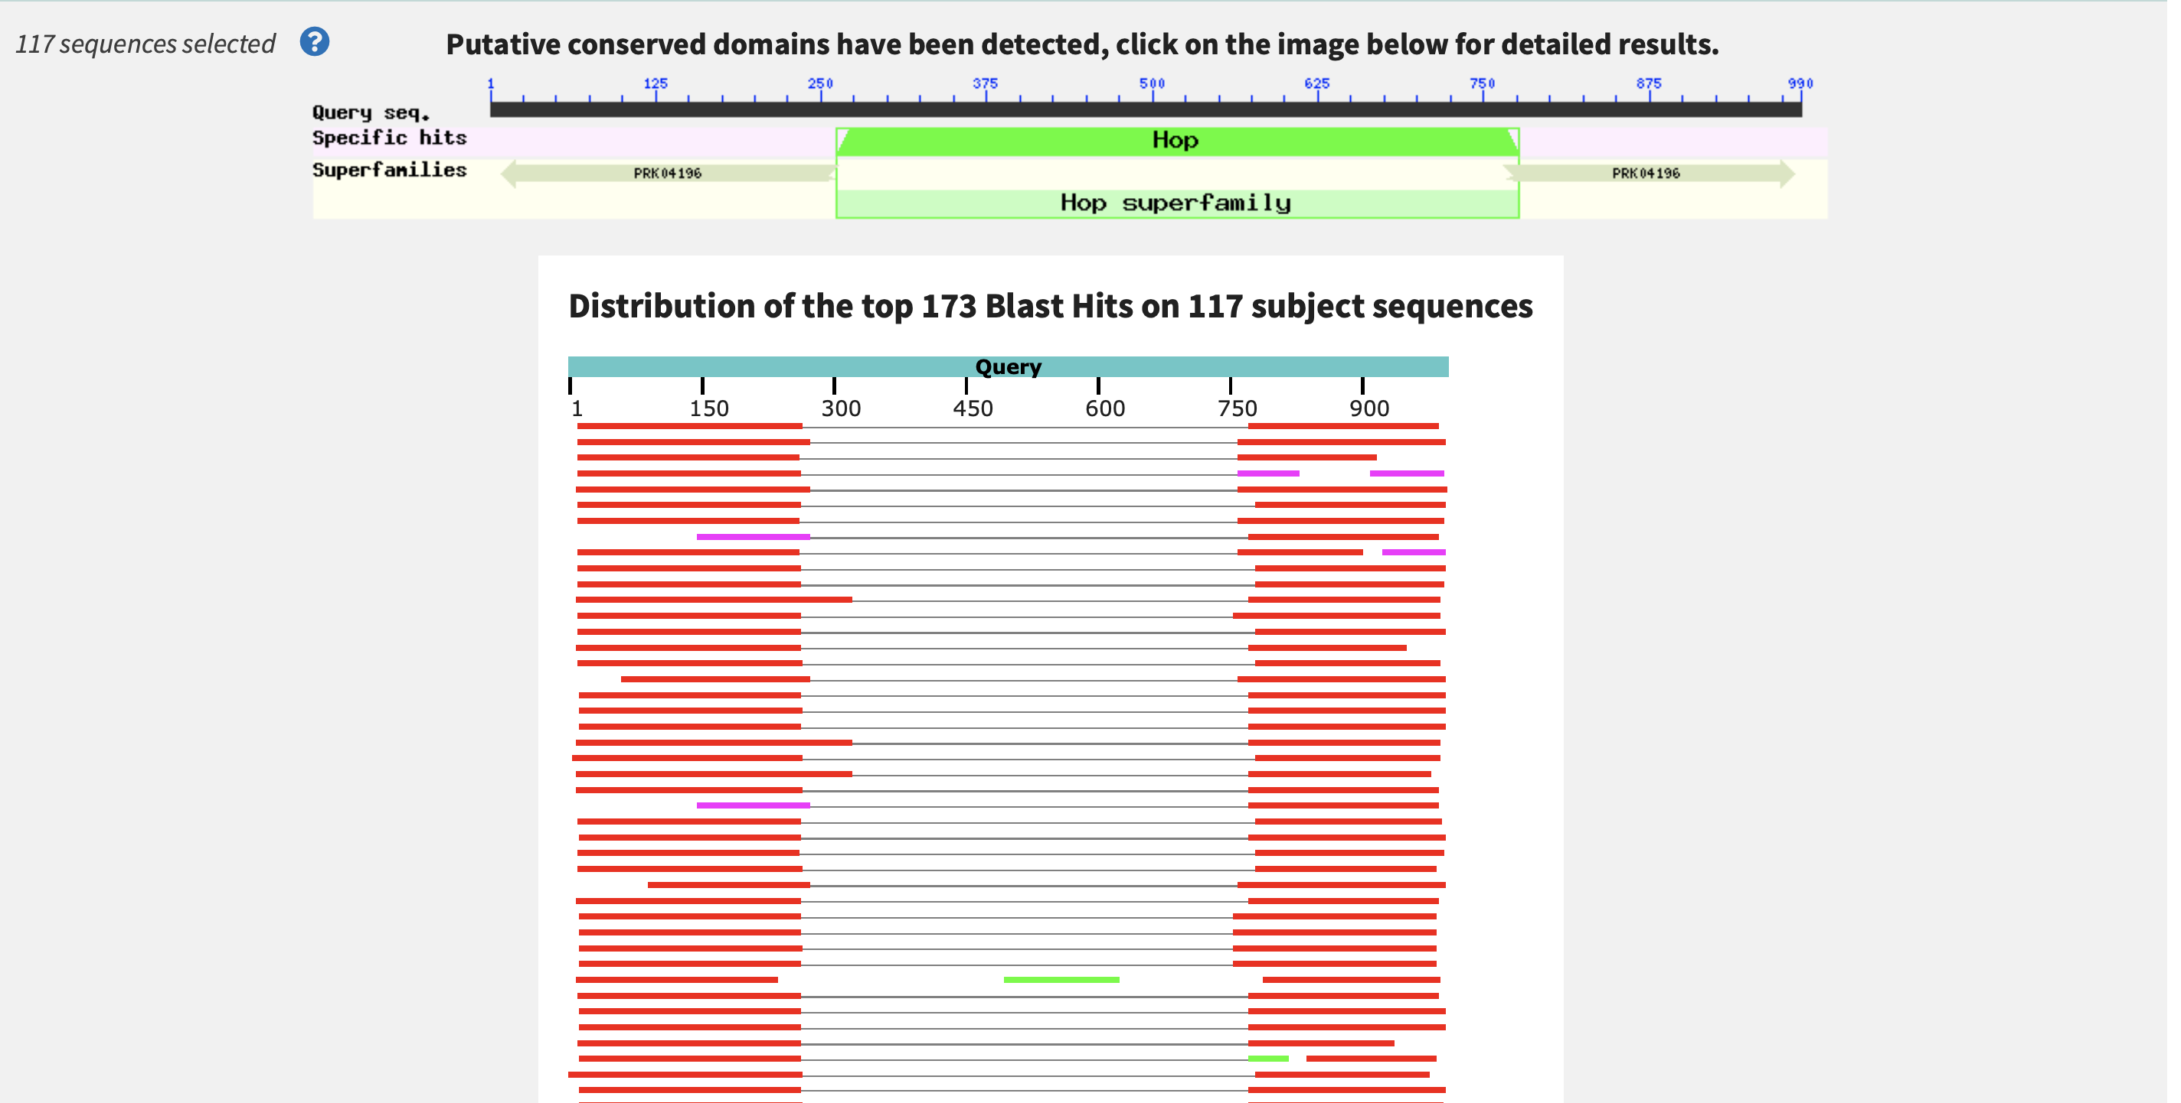
Blast search with an intein containing protein query
Extein
Intein
Extein

Slide 49
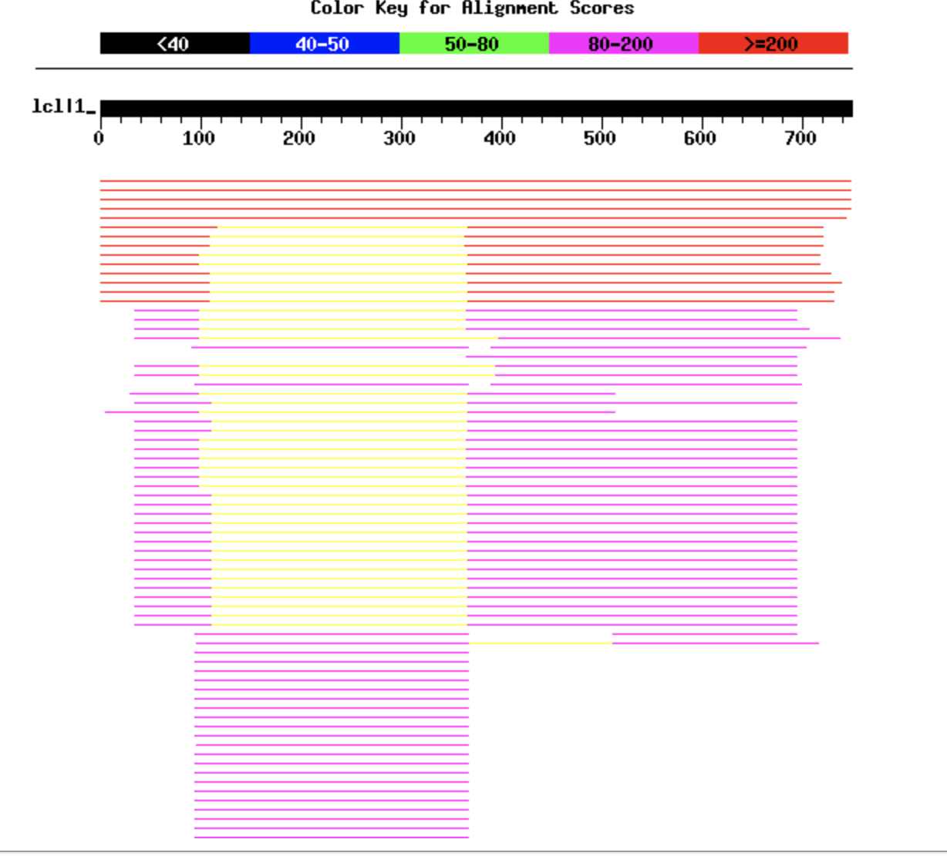
PauloDiaboli Terminase Blastp Search on PhagesDB
Extein and Intein
Extein only
Extein
Extein
Intein
More divergent Extein only
Intein only
Note: blast tries to extend the alignment. Consequently, the boundaries are not always reliable.
Notes:
Started with a blast search on the PauloDiaboli protein sequence
Each line represents a match to a phage that had significant alignment to the query phage (PauloDiaboli)
We can see from this that there are intein only matches, extein only matches, and some that are extein and intein

Slide 50
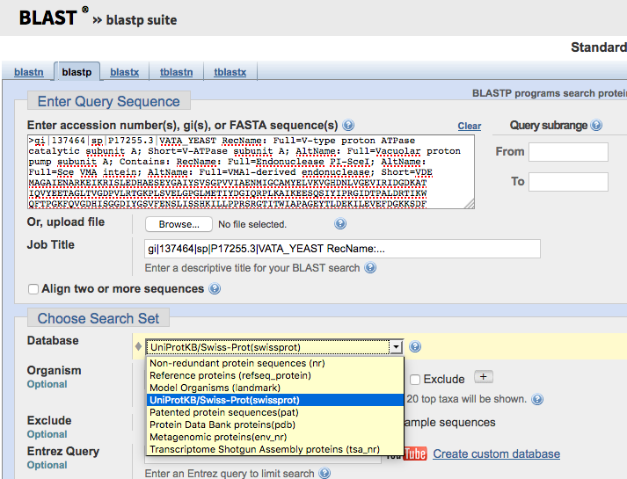

Slide 51
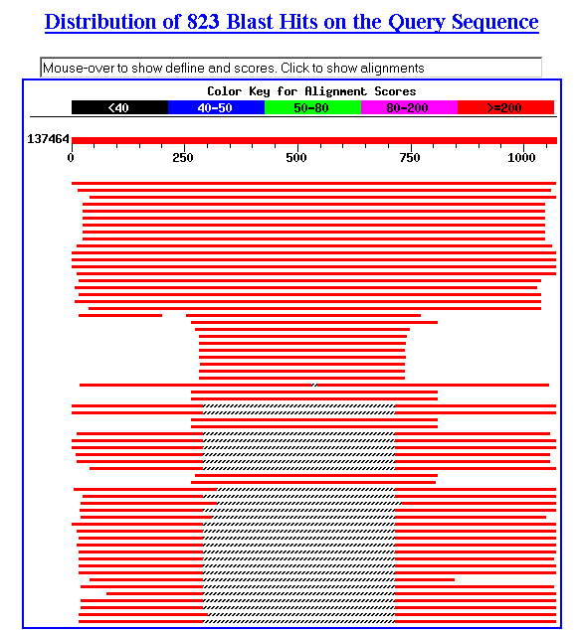
Example of web based BLAST
program: BLASTP
sequence: vma1 gi:137464

Slide 52
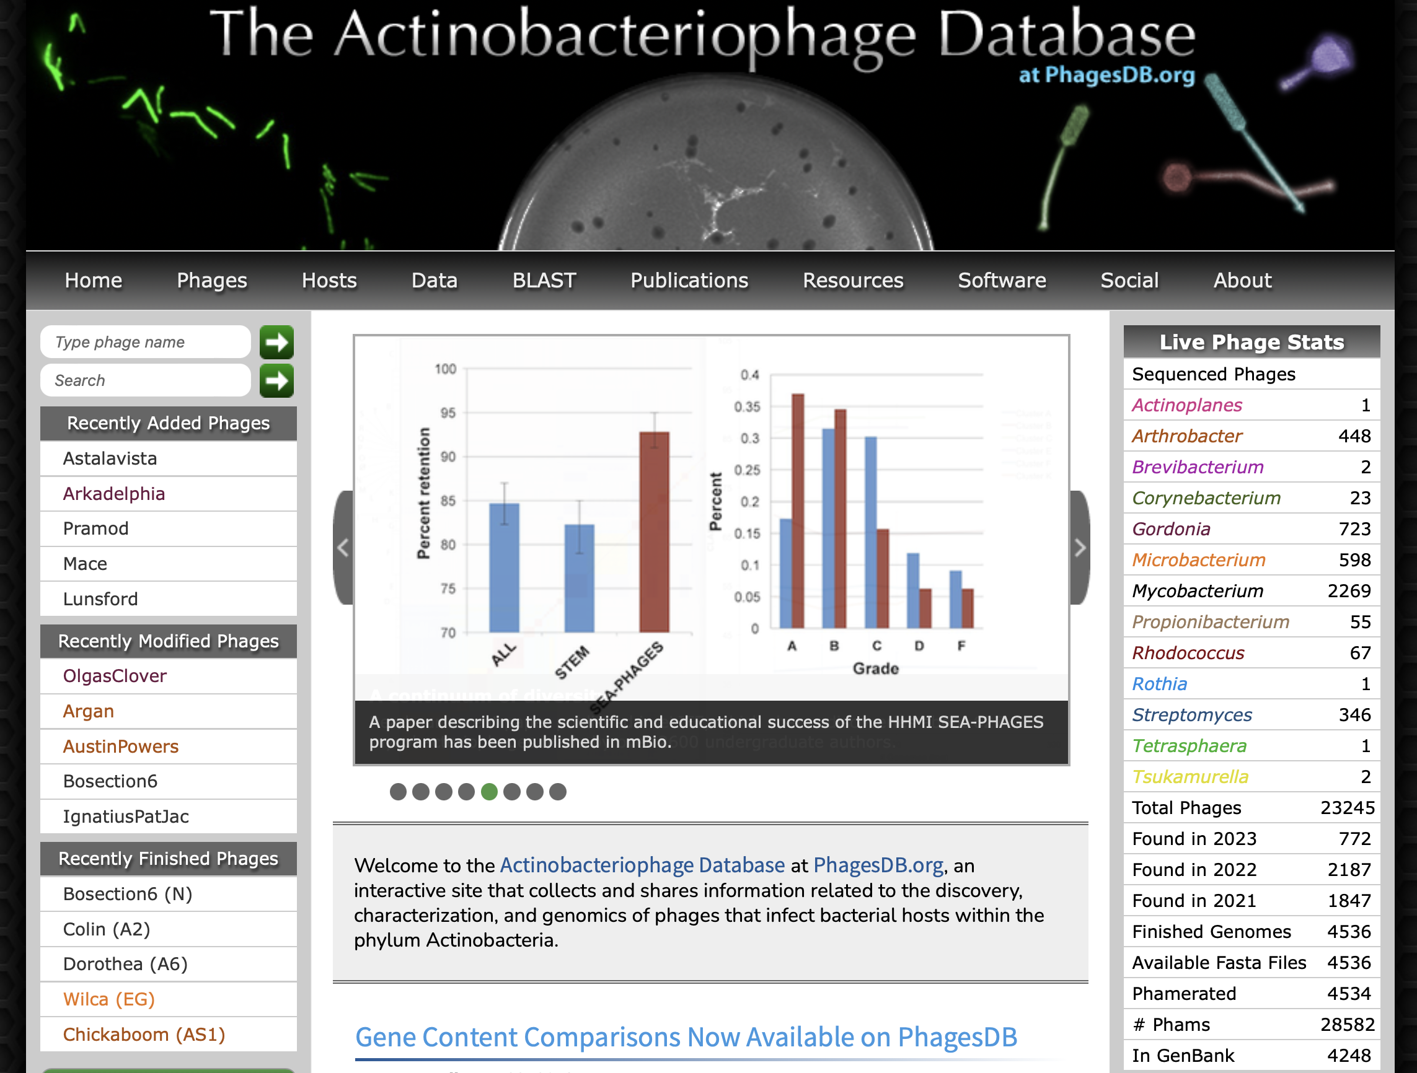
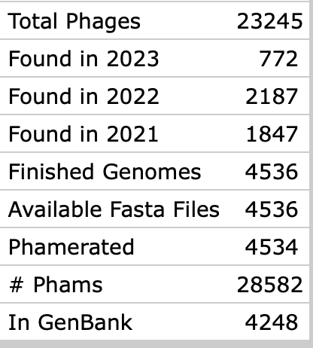
PhagesDB
Phams: Families of Phage proteins

Slide 53
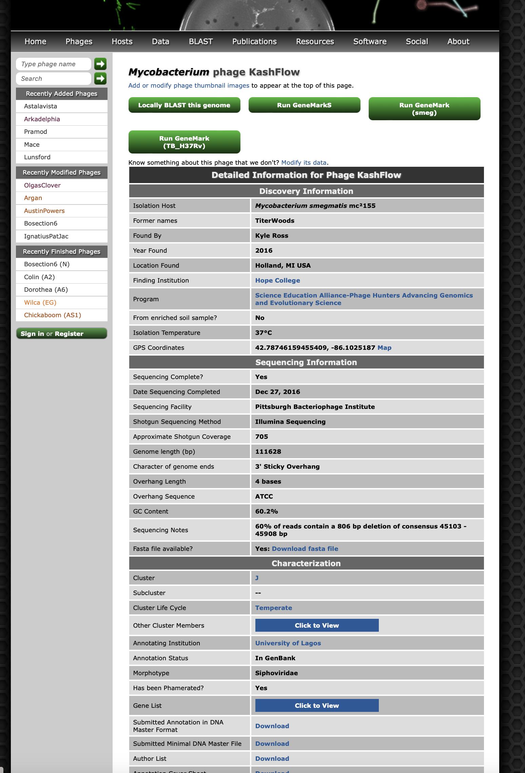
Every phage has their own page, which links to the fasta sequence of the genome,
a list of phages in the same cluster,
a Gene List of all encoded proteins,
data on who isolated the phage where and when,
an image of the plaque, and
often a negative contrast EM picture.
On top is a link to blastn the genome against the other phage genomes in phagesdb

Slide 54
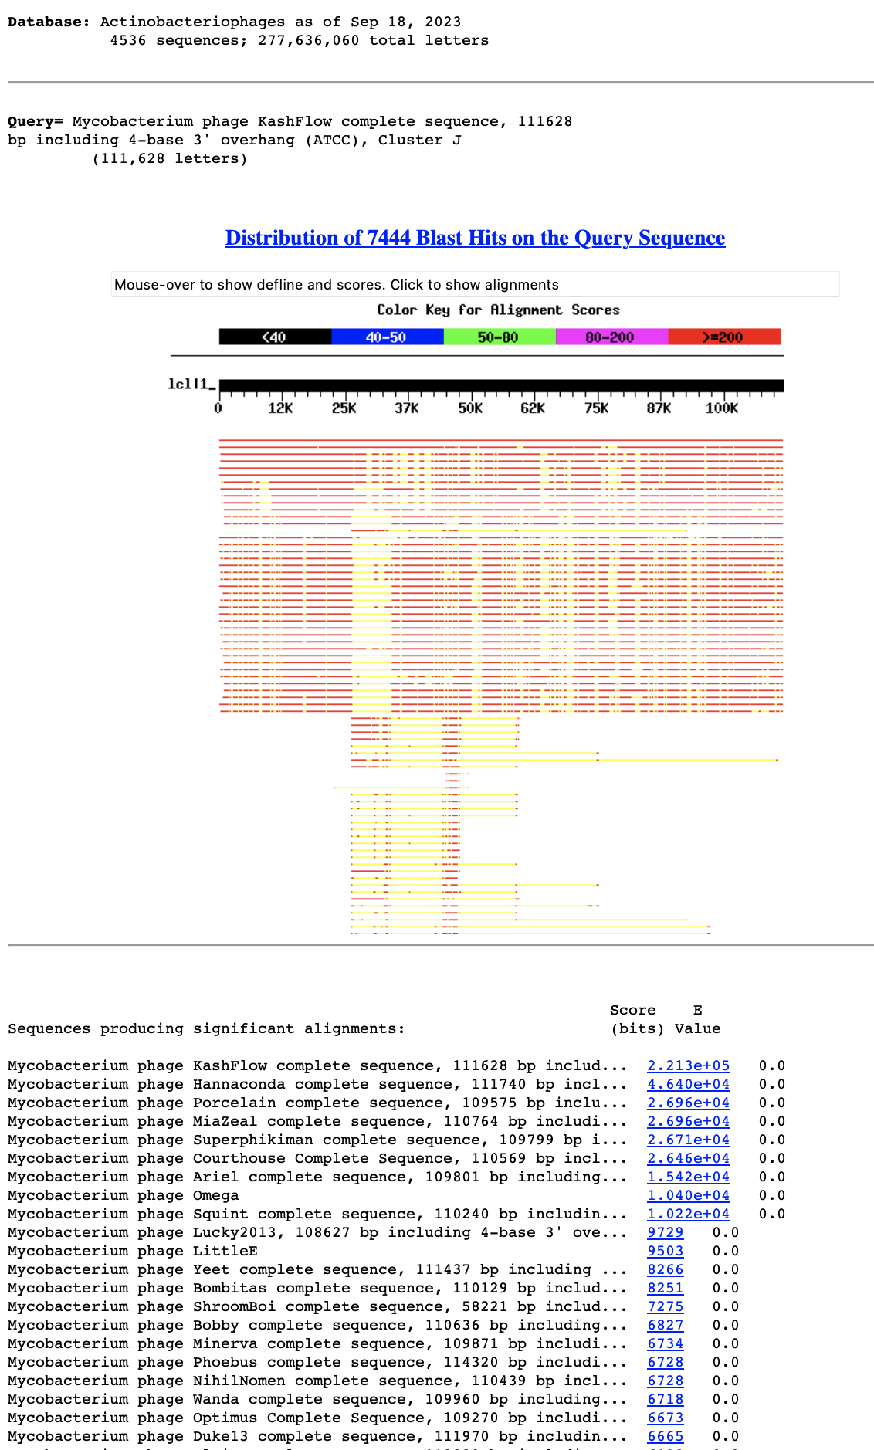

Slide 55
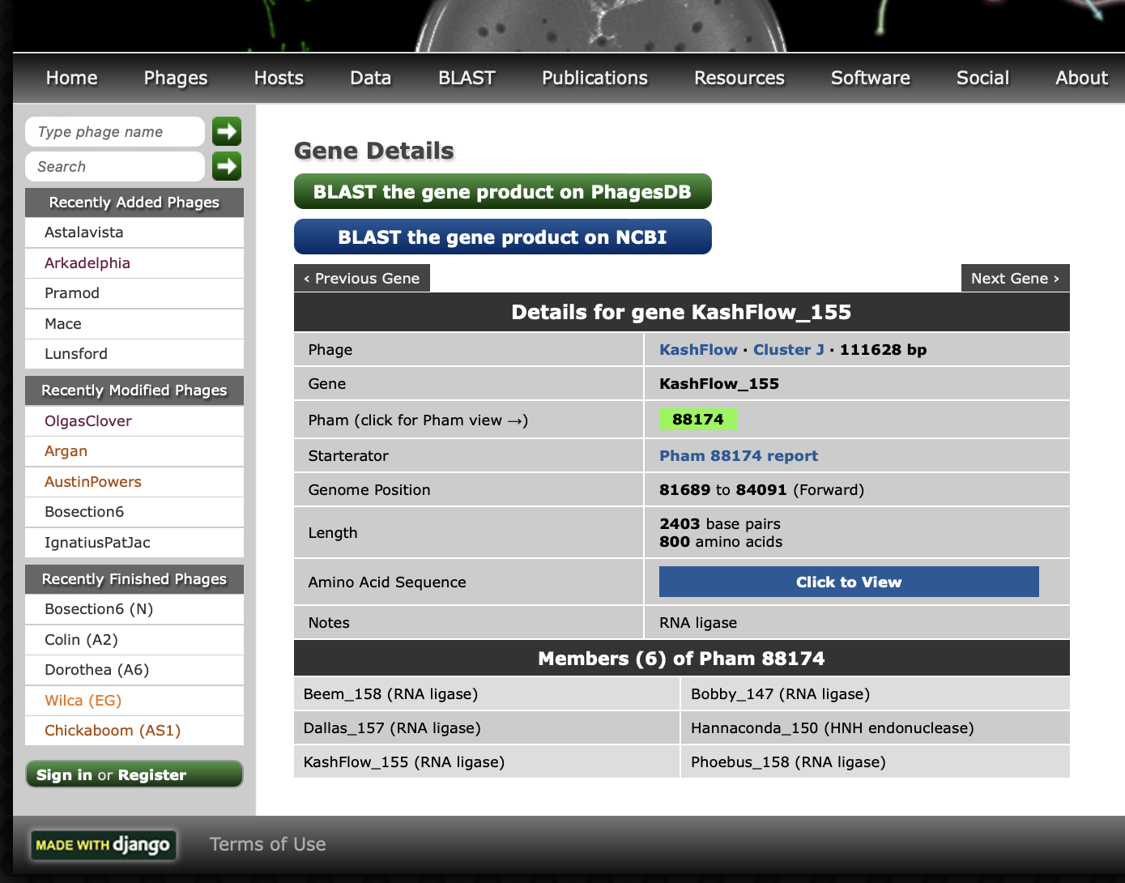
If on the gene list, one follows the link to a particular gene, one has links to amino acid sequence, other members of the protein phamily, and on top links to blast searches at NCBI and phagesDB
https://phagesdb.org/blastp/KashFlow_CDS_155/

Slide 56



Slide 57
End of lecture ?

Slide 58
Review: Types of Error in a Databank Search
False positives: The number of false positives are estimated in the E-value. The P-value or significance value gives the probability that a positive identification is made in error (same as with drug tests).
Danger: avoid fishing expeditions. If you do 100 tests on random data, you expect one to be positive at the 1% significance level.
You could apply the Bonferroni correction:
The significance level for the individual test is calculated through dividing the overall desired significance level by the number of parallel tests.
The null-hypothesis of the overall test is that None of the individual tests is significantly different from chance. (The opposite of none being "at least one")
False negatives: Homologous sequences in the databank that are not recognized as such. If there are only 12000 different protein families, on average a sequence should have (size of the databank)/12000 matches. In other words, the number of false negatives is probably very large.

Slide 59

Effect of low complexity filter
!!! the most common sequences in databases are simple repeats !!!

Slide 60
fasta: an alternative to blast
slower
better alignments between query and database sequences.
An example output is here

Slide 61
Custom databases
Custom databases can include private sequence data, non-redundant gene sets based on genomic locations, merging of genetic data from specific organisms
It’s also faster to search only the sequence data that is necessary
Can search against sequences with custom names
by Bob Friedman

Slide 62

Browsing and retrieving genomes from the NCBI

Slide 63

Genome browser at NCBI https://www.ncbi.nlm.nih.gov/genome/browse/

Slide 64


Slide 65


Slide 66
Formatting a custom database
Format sequence data into Fasta format
Example of Fasta format:
>sequence 1
AAATGCTTAAAAA
>sequence 2
AAATTGCTAAAAGA
Convert Fasta to Blast format by using makeblastdb program from command-line:
makeblastdb -in proteins.faa -dbtype prot -parse_seqids
(formatdb.log is a file where the results are logged from the formatting operation)
by Bob Friedman

Slide 67
Searching a custom database:
blastp -query query_protein.faa -db proteins.faa -out blast.txt -outfmt 6
-outfmt 6 specifies a tabular output format.
The default e-value cut-off is 10 (i.e. at the bottom of the list you expect about 10 false positives). To reduce the size of the output file you can set the e value cut-off to 0.0001 (you would probably not have any false positives).
You would add -evalue 0.0001 to the above command.
The output will be written to a text file called blast.txt.
The file query_protein.faa can contain one or many sequences in fasta format. If the file has more than one sequences a blast search will be done for every sequence. However, all the output goes into the same file.

Slide 68
How to get help: command -h
bash-4.2$ blastp -h
USAGE
blastp [-h] [-help] [-import_search_strategy filename]
[-export_search_strategy filename] [-task task_name] [-db database_name]
[-dbsize num_letters] [-gilist filename] [-seqidlist filename]
[-negative_gilist filename] [-negative_seqidlist filename]
[-entrez_query entrez_query] [-db_soft_mask filtering_algorithm]
[-db_hard_mask filtering_algorithm] [-subject subject_input_file]
[-subject_loc range] [-query input_file] [-out output_file]
[-evalue evalue] [-word_size int_value] [-gapopen open_penalty]
[-gapextend extend_penalty] [-qcov_hsp_perc float_value]
[-max_hsps int_value] [-xdrop_ungap float_value] [-xdrop_gap float_value]
[-xdrop_gap_final float_value] [-searchsp int_value]
[-sum_stats bool_value] [-seg SEG_options] [-soft_masking soft_masking]
[-matrix matrix_name] [-threshold float_value] [-culling_limit int_value]
[-best_hit_overhang float_value] [-best_hit_score_edge float_value]
[-window_size int_value] [-lcase_masking] [-query_loc range]
[-parse_deflines] [-outfmt format] [-show_gis]
[-num_descriptions int_value] [-num_alignments int_value]
[-line_length line_length] [-html] [-max_target_seqs num_sequences]
[-num_threads int_value] [-ungapped] [-remote] [-comp_based_stats compo]
[-use_sw_tback] [-version]
DESCRIPTION
Protein-Protein BLAST 2.7.1+
Use '-help' to print detailed descriptions of command line arguments

Slide 69
From blast –help: (goes over several pages)
*** Formatting options
-outfmt <String>
alignment view options:
0 = Pairwise,
1 = Query-anchored showing identities,
2 = Query-anchored no identities,
3 = Flat query-anchored showing identities,
4 = Flat query-anchored no identities,
5 = BLAST XML,
6 = Tabular,
7 = Tabular with comment lines,
8 = Seqalign (Text ASN.1),
9 = Seqalign (Binary ASN.1),
10 = Comma-separated values,
11 = BLAST archive (ASN.1),
12 = Seqalign (JSON),
13 = Multiple-file BLAST JSON,
14 = Multiple-file BLAST XML2,
15 = Single-file BLAST JSON,
16 = Single-file BLAST XML2,
18 = Organism Report

Slide 70
From blast –help: (continued)
Options 6, 7 and 10 can be additionally configured to produce
a custom format specified by space delimited format specifiers.
The supported format specifiers are:
qseqid means Query Seq-id
qgi means Query GI
qacc means Query accesion
qaccver means Query accesion.version
qlen means Query sequence length
sseqid means Subject Seq-id
sallseqid means All subject Seq-id(s), separated by a ';'
sgi means Subject GI
sallgi means All subject GIs
sacc means Subject accession
saccver means Subject accession.version
sallacc means All subject accessions
slen means Subject sequence length
qstart means Start of alignment in query
qend means End of alignment in query
sstart means Start of alignment in subject
send means End of alignment in subject
qseq means Aligned part of query sequence
sseq means Aligned part of subject sequence
evalue means Expect value
bitscore means Bit score
score means Raw score
length means Alignment length
pident means Percentage of identical matches
nident means Number of identical matches
mismatch means Number of mismatches
positive means Number of positive-scoring matches
gapopen means Number of gap openings
gaps means Total number of gaps
ppos means Percentage of positive-scoring matches
frames means Query and subject frames separated by a '/'
qframe means Query frame
sframe means Subject frame
btop means Blast traceback operations (BTOP)
staxid means Subject Taxonomy ID
ssciname means Subject Scientific Name
scomname means Subject Common Name
sblastname means Subject Blast Name
sskingdom means Subject Super Kingdom
staxids means unique Subject Taxonomy ID(s), separated by a ';'
(in numerical order)
sscinames means unique Subject Scientific Name(s), separated by a ';'
scomnames means unique Subject Common Name(s), separated by a ';'
sblastnames means unique Subject Blast Name(s), separated by a ';'
(in alphabetical order)
sskingdoms means unique Subject Super Kingdom(s), separated by a ';'
(in alphabetical order)
stitle means Subject Title
salltitles means All Subject Title(s), separated by a '<>'
sstrand means Subject Strand
qcovs means Query Coverage Per Subject
qcovhsp means Query Coverage Per HSP
qcovus means Query Coverage Per Unique Subject (blastn only)

Slide 71
When not provided, the default value is:
'qaccver saccver pident length mismatch gapopen qstart qend sstart send
evalue bitscore', which is equivalent to the keyword 'std'
Default = `0'
Query accession_number.version
Subject accession_number.version
% identity
Alignment length
Number of mismatches
Number of gap openings
Start of alignment in query
End of alignment in query
Start of alignment in subject
End of alignment in subject
Expect value
Bit score

Slide 72
How to get help: command -h
bash-4.2$ makeblastdb -h
USAGE
makeblastdb [-h] [-help] [-in input_file] [-input_type type]
-dbtype molecule_type [-title database_title] [-parse_seqids]
[-hash_index] [-mask_data mask_data_files] [-mask_id mask_algo_ids]
[-mask_desc mask_algo_descriptions] [-gi_mask]
[-gi_mask_name gi_based_mask_names] [-out database_name]
[-max_file_sz number_of_bytes] [-logfile File_Name] [-taxid TaxID]
[-taxid_map TaxIDMapFile] [-version]
DESCRIPTION
Application to create BLAST databases, version 2.7.1+
Use '-help' to print detailed descriptions of command line arguments

Slide 73
Default tabular output (–outfmt 6): (gene 10 from bacteriophage Zhengyi against actinophagedb)
Zhengyi 94287_EugeneKrabs_Draft_10 99.463 745 4 0 1 745 1 745 0.0 1544
Zhengyi 311157_Unphazed_10 85.542 747 106 1 1 745 1 747 0.0 1338
Zhengyi 325083_Xitlalli_Draft_10 85.906 745 103 1 3 745 4 748 0.0 1337
Zhengyi 15244_ArMaWen_10 85.542 747 106 1 1 745 1 747 0.0 1337
Zhengyi 169244_LilyLou_11 85.408 747 107 1 1 745 1 747 0.0 1335
Zhengyi 288178_Stormbreaker_Draft_10 85.638 745 105 1 3 745 4 748 0.0 1332
Zhengyi 35842_BlueRugrat_Draft_10 85.599 743 105 1 5 745 3 745 0.0 1330
Zhengyi 301381_TinyTimothy_10 84.688 738 105 2 8 745 4 733 0.0 1288
Zhengyi 319351_Wesak_10 84.553 738 106 2 8 745 4 733 0.0 1285
Zhengyi 233484_Phogo_10 81.392 747 129 4 1 745 1 739 0.0 1245
Zhengyi 5978_Alex44_10 81.258 747 130 4 1 745 1 739 0.0 1243
Zhengyi 219502_Pabst_Draft_11 75.963 753 165 7 3 745 4 750 0.0 1155
Zhengyi 5386_Akoni_10 60.881 772 242 11 5 745 7 749 0.0 889
Zhengyi 16330_Ashton_10 60.881 772 242 11 5 745 7 749 0.0 889
Zhengyi 6996_AloeVera_Draft_10 61.061 773 239 12 5 745 4 746 0.0 889
Zhengyi 307288_Truong_10 60.931 773 240 12 5 745 7 749 0.0 887
Zhengyi 97649_Fede_Draft_10 61.282 749 269 13 5 745 4 739 0.0 879
Zhengyi 17656_Atraxi_Draft_10 60.610 754 261 12 5 745 4 734 0.0 874
Zhengyi 184880_Mazun_Draft_10 60.898 757 248 15 7 745 6 732 0.0 870
Zhengyi 234940_PhriedRice_10 60.956 753 254 13 7 745 6 732 0.0 867
Zhengyi 234112_Phractured_10 60.956 753 254 13 7 745 6 732 0.0 867
Zhengyi 229391_Phedro_10 60.956 753 254 13 7 745 6 732 0.0 867
Zhengyi 228522_Pharky_10 60.956 753 254 13 7 745 6 732 0.0 867
Zhengyi 14465_Arete_11 37.517 757 416 19 3 745 13 726 1.30e-133 414
Zhengyi 45652_Burro_10 37.813 759 403 21 7 745 15 724 3.58e-130 405
Zhengyi 13154_Araxxi_10 36.842 760 413 21 5 745 14 725 2.12e-124 390
Zhengyi 307086_Troy_42 26.267 750 406 35 6 721 2 638 1.45e-33 139
Zhengyi 265199_SamW_42 26.267 750 406 35 6 721 2 638 1.45e-33 139
Zhengyi 164472_Lederberg_42 26.267 750 406 35 6 721 2 638 1.45e-33 139
Often looks strange, because some entries run into the next tab – making the font smaller, or loading it into excel helps.

Slide 74
Default tabular output (–outfmt 7): gene all proteins in Hfx. volcanii genome against a nanohaloarchaeal genome (strain SG9)
# Query: WP_004040797.1 hypothetical protein [Haloferax volcanii]
# Database: SG9.faa
# Fields: query acc.ver, subject acc.ver, % identity, alignment length, mismatches, gap opens, q. start, q. end, s. start, s. end, evalue, bit score
# 11 hits found
WP_004040797.1 AOV94602.1 45.000 20 11 0 66 85 1240 1259 0.14 26.6
WP_004040797.1 AOV95267.1 27.273 66 38 3 25 84 354 415 0.37 25.4
WP_004040797.1 AOV94348.1 50.000 14 7 0 104 117 44 57 2.8 22.7
WP_004040797.1 AOV94453.1 25.000 60 43 1 57 116 352 409 3.2 22.7
WP_004040797.1 AOV94962.1 27.869 61 42 2 15 73 547 607 3.2 22.3
WP_004040797.1 AOV94961.1 20.909 110 75 3 10 117 8 107 4.0 21.9
WP_004040797.1 AOV94654.1 66.667 15 5 0 82 96 314 328 6.7 21.6
WP_004040797.1 AOV94708.1 37.500 24 15 0 62 85 8 31 6.9 21.6
WP_004040797.1 AOV94738.1 41.935 31 18 0 30 60 487 517 7.9 21.2
WP_004040797.1 AOV94984.1 37.143 35 20 1 27 59 722 756 8.7 21.2
WP_004040797.1 AOV94472.1 28.235 85 57 1 6 86 142 226 9.4 21.2
# BLASTP 2.7.1+
# Query: WP_004040798.1 hypothetical protein [Haloferax volcanii]
# Database: SG9.faa
# Fields: query acc.ver, subject acc.ver, % identity, alignment length, mismatches, gap opens, q. start, q. end, s. start, s. end, evalue, bit score
# 2 hits found
WP_004040798.1 AOV95137.1 28.889 45 32 0 7 51 15 59 0.23 25.8
WP_004040798.1 AOV95296.1 50.000 14 7 0 125 138 243 256 6.7 22.3
# BLASTP 2.7.1+
# Query: WP_004040800.1 hypothetical protein [Haloferax volcanii]
# Database: SG9.faa
# Fields: query acc.ver, subject acc.ver, % identity, alignment length, mismatches, gap opens, q. start, q. end, s. start, s. end, evalue, bit score
# 13 hits found
WP_004040800.1 AOV94411.1 30.645 62 42 1 247 307 18 79 0.83 26.2
...
Continues for all ~4000 genes in the Haloferax volcanii genome.

Slide 75
Command Line
The favored operating system flavor in computational biology is UNIX/LINUX.
The command line is similar to DOS.
Some of the frequently used commands are here
pwd
ls
ls –l
chmod
chmod a+x blastall.sh
chmod 755 *.sh
cd
cd ..
cd $HOME
passwd
ps
ps aux
rm
more
cat
vi (text editor)
ps
ps aux
ssh
sftp
For windows an “ok” ssh program is putty.
UConn also has a site license for the ssh program from ssh.com

Slide 76

How to get help on unix commands: man command

Slide 77


How to get help:
man command
man often gives too much information,
google is a great alternative.

Slide 78
UNIX
Basic UNIX commands
ls, cd, chmod, cp, rm, mkdir, more (or) less, vi, ps, kill -9, man
A brief listing is here
chmod is a particular pain in the ... .
Under unix every file has an owner and the owner, his group and everyone else have permissions to read, write and/or execute the file (or they don’t). If you want to see which permissions are currently assigned to your files, type ls -l at the command prompt.
chmod a+x *.pl gives everyone execute permission for all files that end with .pl the * is a wildcard. (warning don't ever use rm in conjunction with *)
For more on chmod type ”man chmod” or see here.
(In the OSX GUI you can control click at a file, and change permissions in the info box). Most ssh clients (FUGU and SSH) allow you to use a GUI to change file permissions (in FUGU ctrl click).

Slide 79
Unix - command line interface
If you tried to execute a command, and you made a mistake, for example, you mistyped a file name, you can recall the last command using the up arrow (down arrow for more recent).
If you are tired typing long filenames, you can use the tab key to complete the line, provided there is only one way to complete the line. E.g: cd /Desktop could be replaced by cd /D<tab>
If there are two or more choices you hear a boing, if you hit <tab> again, you get a list of choices.
If you want to become more familiar with the unix command line, the code-academy has a good introduction at
https://www.codecademy.com/courses/learn-the-command-line

Slide 80
characters at the end of lines
File tranfers from Windows to UNIX and return:
End of Line characters are a problem. Under Windows DO NOT use notepad, it does not understand UNIX newline symbols ‘\n’.
Best write your programs under UNIX using vi or vim (or any other editor you are comfortable with)
2nd best is to use a text editor like bbedit (very nice and free program for UNIX). Like vi and vim it provides context dependent coloring.
3rd best is to remove end of line symbols in a UNIX editor or use sed (Stream EDitor) after you transferred the file:
sed s/.$// name_of_WINDOWS_infile > name_of_UNIX_outfile (This replaces the last non letter character before the eol ($) with nothing)
Some versions of office allow to save files as UNIX textfiles, but ...
A related problem is encountered by Mac users. Many older text editors will use MAC carriage returns at the end of the line. Most unix programs will not be able to handle these. In a terminal window you could use the following command to convert your file:
tr ’\r' ’\n' < name_of_the_Mac_file > name_of_the_unix_file
The EoL confusion is very inconvenient, but there really is no easy solution, tough luck; and you better know about this in case something goes wrong.

Slide 81
Special characters:
\n #newline
\t #tab

Slide 82
To move files between local PC and server:
For windows machines:
install Filezilla client for transfer and putty as terminal.
For Macintosh computers:
install Filezilla (client!) from https://filezilla-project.org/
To establish a command line connection via ssh (secure shell):
For windows machines:
Use PuTTY to establish an ssh connection
There are more user-friendly programs (e.g., Bitvise SSH Client); however, UConn’s bioinformatics cluster Xanadu uses different nodes for file transfer and ssh connections, thus the program with more bells and whistles that assume the same address for both doesn’t help much, and mainly creates confusion.
For Macintosh computers:
Use the terminal program that is part of the operating system (in the Applications/Utilities folder

Slide 83
P-Hacking
You should define a testable hypothesis before you select the data to analyze.
The interactive selection of which data to include or exclude is known as P-hacking – you try out different things until you det the expected result.
For example, the question if a government formed by democrats (or republicans) is significantly beneficial to the economy.
This depends on which level of government you include, and which measures for the economy you use.
An interactive P-hacking scheme on this question is at
https://projects.fivethirtyeight.com/p-hacking/
Also see https://fivethirtyeight.com/features/science-isnt-broken/#part1

Slide 84


Using all the data does not give significant results

Slide 85


But with minor modification:

Slide 86
Data Dredging aka Fishing Expeditions
If you do 100 experiments, you expect to find one experiment that is significant at the 1% level due to chance alone.
(P-value = The probability to find something under the null hypothesis or due to chance alone.)
If in 100 experiments you do not want to have a false positive with a probability of 1%, then you need to correct the P-value for the individual test.
The Bonferroni correction (often considered unreasonably harsh) divides the overall acceptable probability for a false positive by the number of parallel experiments:
Overall P<0.01, n=100, significance level for the individual test:
P=0.01/100=0.0001=10⁻⁴

Slide 87
When do you need a correction for multiple tests?
Expression studies, where you test all possible transcripts simultaneously
Test all genes in a genome against a database of pathogenicity genes

Slide 88
One Person
One Person
doing
doing
one test
N=1000 tests
Without correction
Probability for a false positive
in single test
P<0.01
Probability for a false positive
in single test
P<0.01
Overall probability
for a false positive
P<10
Overall probability
for a false positive
P<0.01
With Bonferroni correction
Probability for a false positive
in single test
P<0.01/N=0.00001
Overall probability
for a false positive
P<0.01

Slide 89
One Person
1000 People
doing
doing
one test
N=1 test each
Without correction
Probability for a false positive
in single test
P<0.01
Overall probability
for a false positive
P<10
Probability for a false positive
in single test
P<0.01
Result:
990 people have an insignificant finding and conclude this was a good idea, while it lasted.
10 people have a significant result with P < 0.01
1 person has a a significant result with P < 0.001
They conclude that this is an important and exciting result providing significant support to an important hypothesis.
=> News Headline!
Overall probability
for a false positive
P<0.01

Slide 90
Verbal overshadowing is the phenomenon where giving a verbal description of a face (or other complex stimuli) impairs recognition of that face or stimuli first reported by Schooler and Englster-Schooler (1990). The effects are observed across multiple domains of cognition that are known to rely on non-verbal knowledge and perceptual expertise, such as memory. Memory has been known to be influenced by language. Seminal work by Carmichael and collaborators (1932) demonstrated that labels attached to, or associated with, non-verbal forms during memory encoding can affect the way the forms were subsequently reproduced. Because of this, memory performance that relies on reportable aspects of memory that encode visual forms should be vulnerable to the effects of verbalization.
From Wikipedia https://en.wikipedia.org/wiki/Verbal_overshadowing
See: Article in New Yorker at https://www.newyorker.com/magazine/2010/12/13/the-truth-wears-off

Slide 91
The Decline Effect
Other examples
second generation anti-psychotic drugs
connection between symmetry and sexual preference of female birds in nature
The “truth wears off” because:
regression toward the mean
publication bias
novel drugs might have a stronger placebo effect

Slide 92
What can one do to prevent the scientific enterprise to report false results on a regular basis?

