Slide 1
Class 24
Bipartitions and embedded Quartets

Slide 2
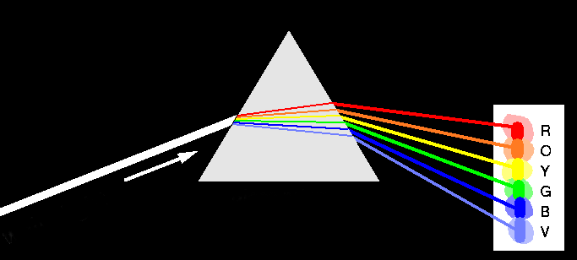
Decomposition of Phylogenetic Data
Phylogenetic information
present in genomes
Break information
into small quanta
of information
(bipartitions or
embedded quartets)
Analyze spectra to detect transferred genes and plurality consensus.

Slide 3

TOOLS TO ANALYZE PHYLOGENETIC INFORMATION FROM MULTIPLE GENES IN GENOMES:
Bipartition Spectra (Lento Plots)

Slide 4
BIPARTITION OF A PHYLOGENETIC TREE
Bipartition (or split) – a division of a phylogenetic tree into two parts that are connected by a single branch.
It divides a dataset into two groups, but it does not consider the relationships within each of the two groups.
Yellow vs Rest
* * * . . . * *
95
compatible to illustrated
bipartition
Orange vs Rest
. . * . . . . *
* * * . . . . .
incompatible to illustrated
bipartition

Slide 5
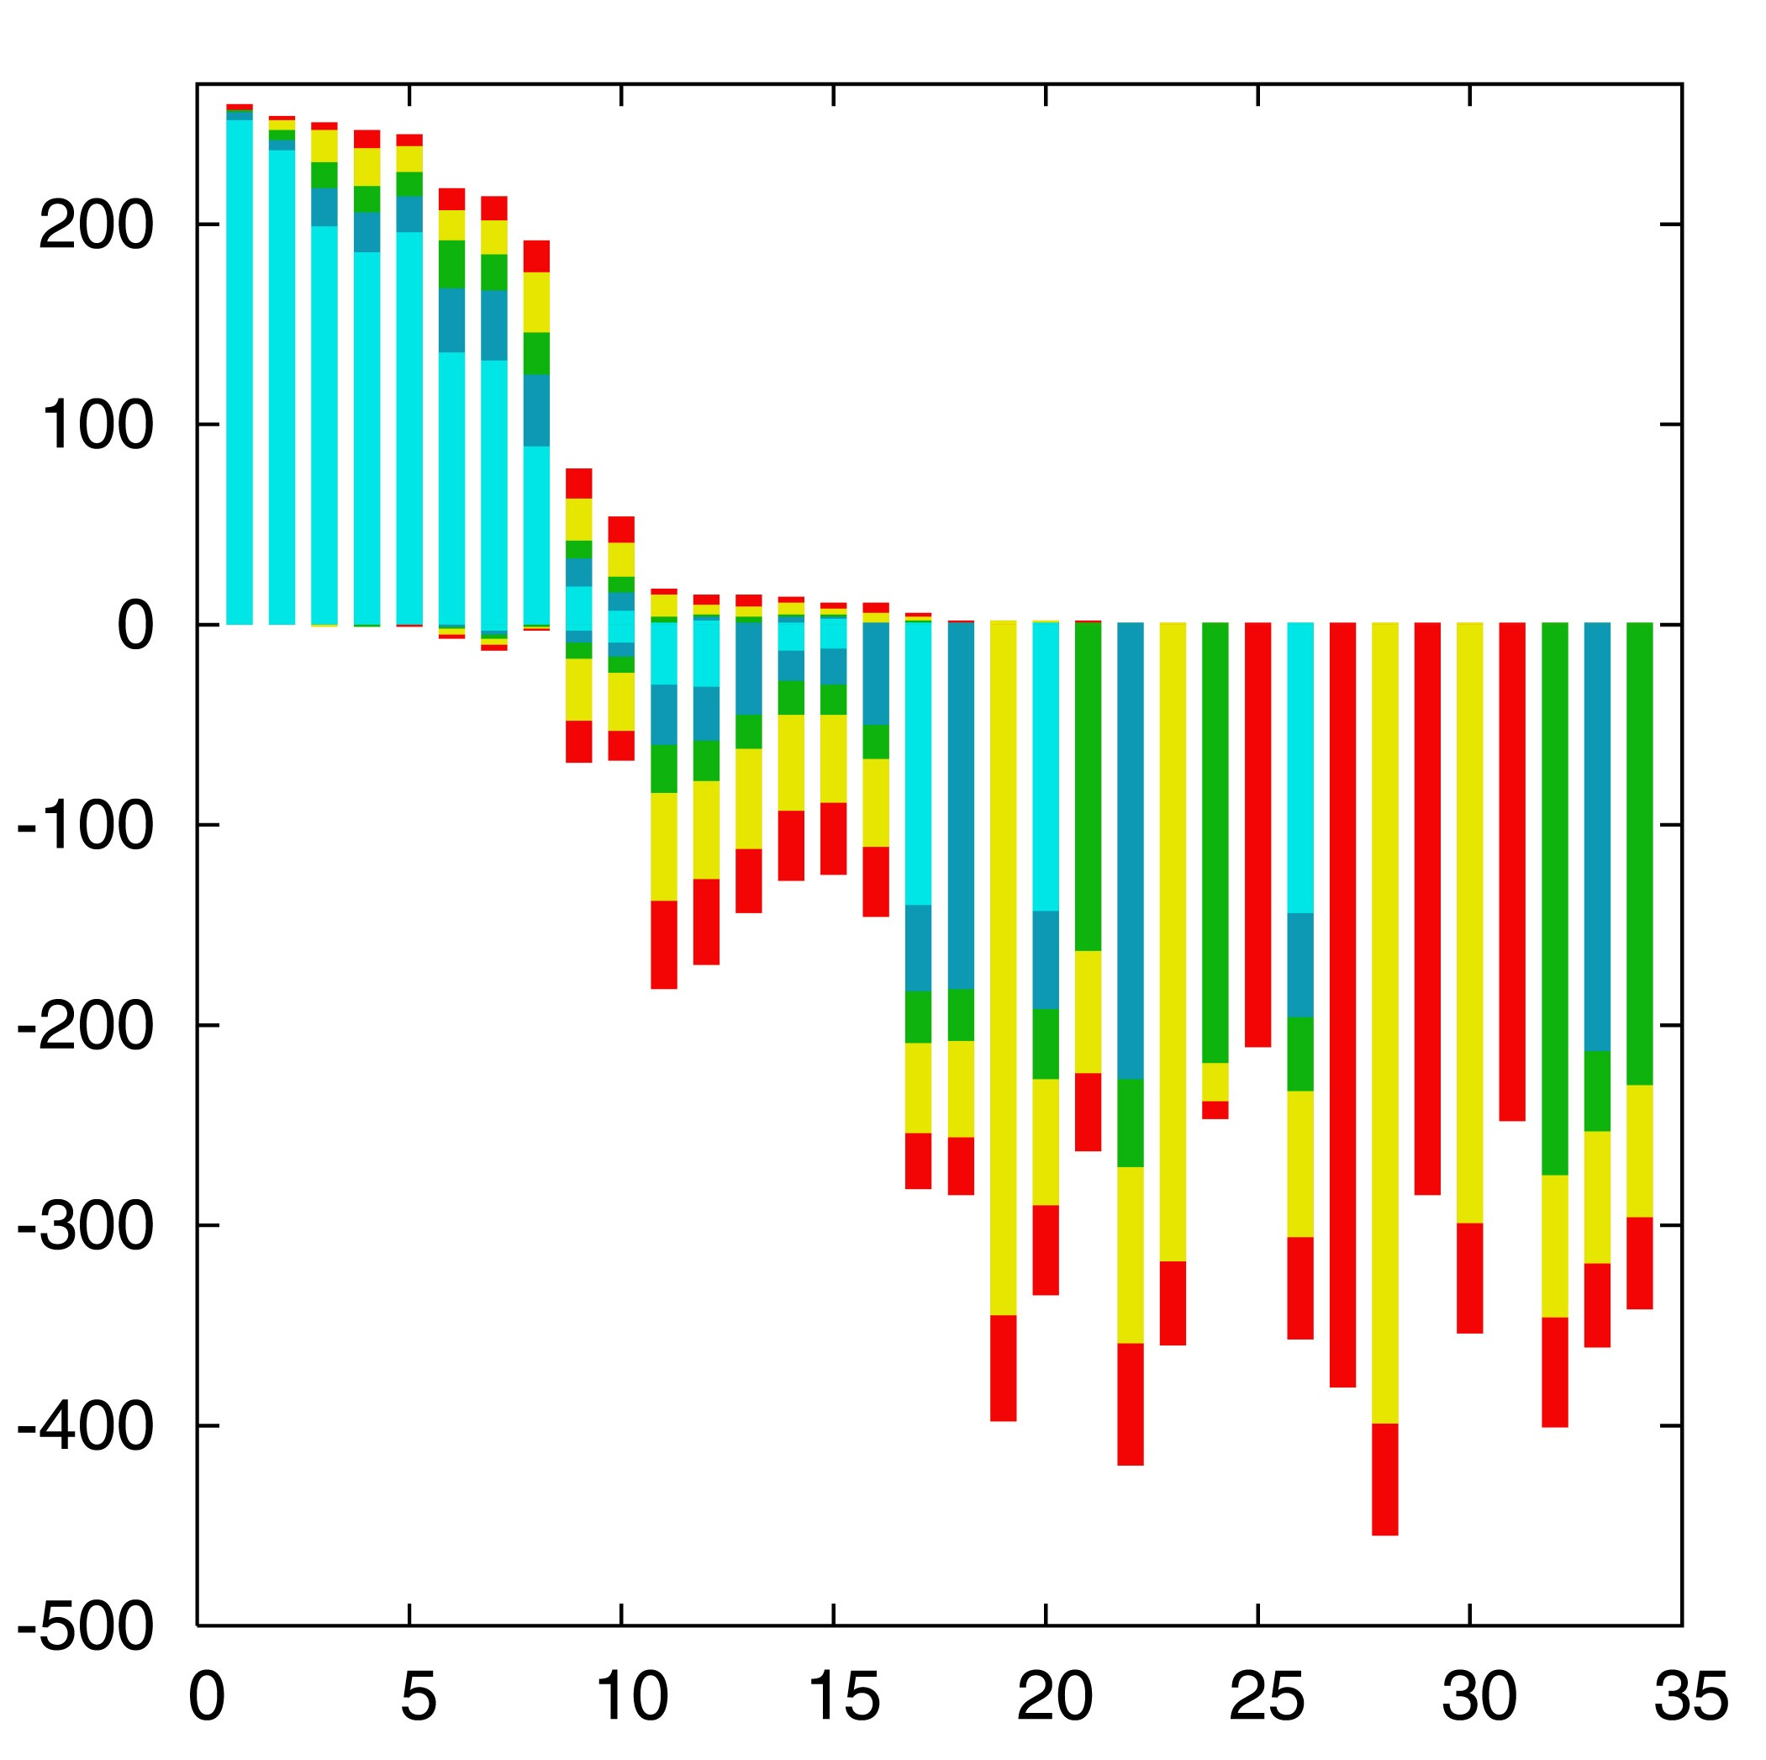

“Lento”-plot of 34 supported bipartitions (out of 4082 possible)
13 gamma-
proteobacterial
genomes
(258 putative
orthologs):
E.coli
Buchnera
Haemophilus
Pasteurella
Salmonella
Yersinia pestis
(2 strains)
Vibrio
Xanthomonas
(2 sp.)
Pseudomonas
Wigglesworthia
There are 13,749,310,575 possible unrooted tree topologies for 13 genomes

Slide 6
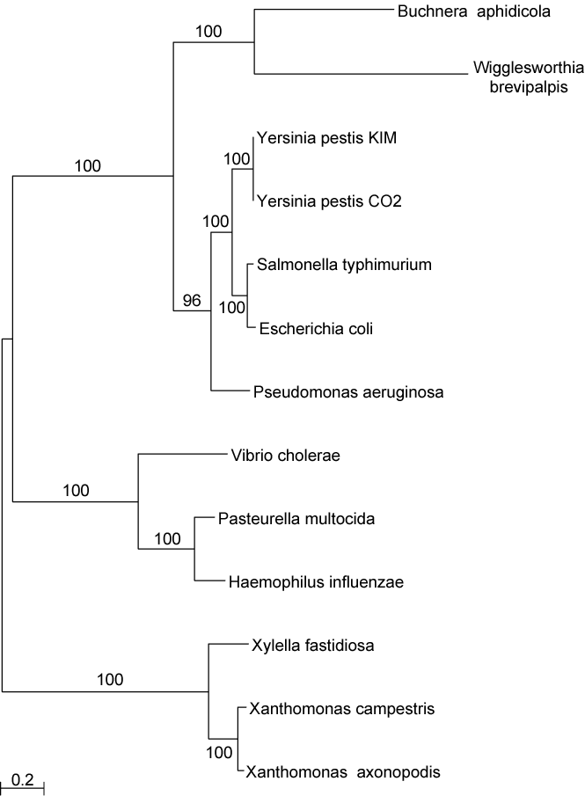
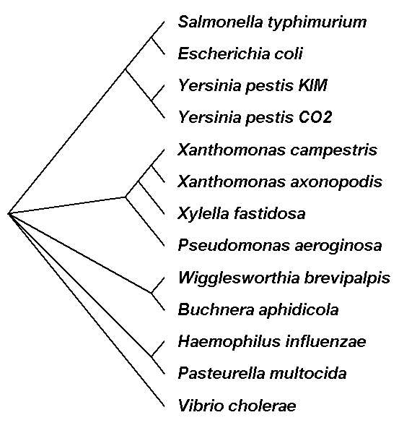
Consensus clusters of eight significantly supported bipartitions
Phylogeny of putatively transferred gene
(virulence factor homologs (mviN))
only 258 genes analyzed

Slide 7
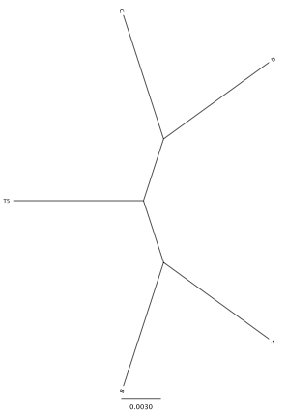
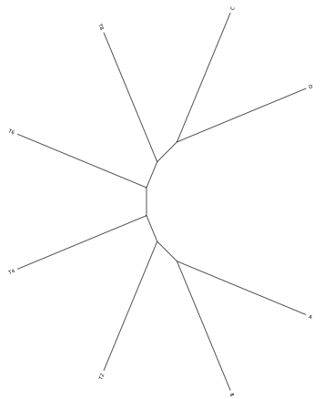
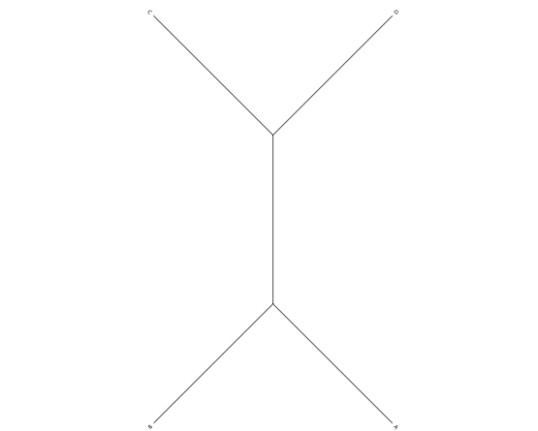
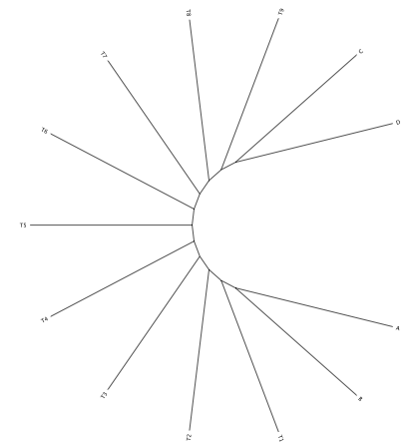
Decay of bipartition support with number of OTUs
Phylogenies used for simulation
Notes:
Same model (WAG +Gamma) used for simulation and evaluation (including alpha =1). Simulation of sequences with lenghts of 200, 500 and 1000 using seq-gen.

Slide 8
The finding that a bipartition is strongly supported by many gene families!
This might reflect a strong signal reflecting evolutionary history,
or a strong artifact biasing the analysis.
e.g., Wigglesworthia and Buchnera are both genera of endosymbiotic bacteria of insects, and both have reduced genomes with a high AT content.

Slide 9
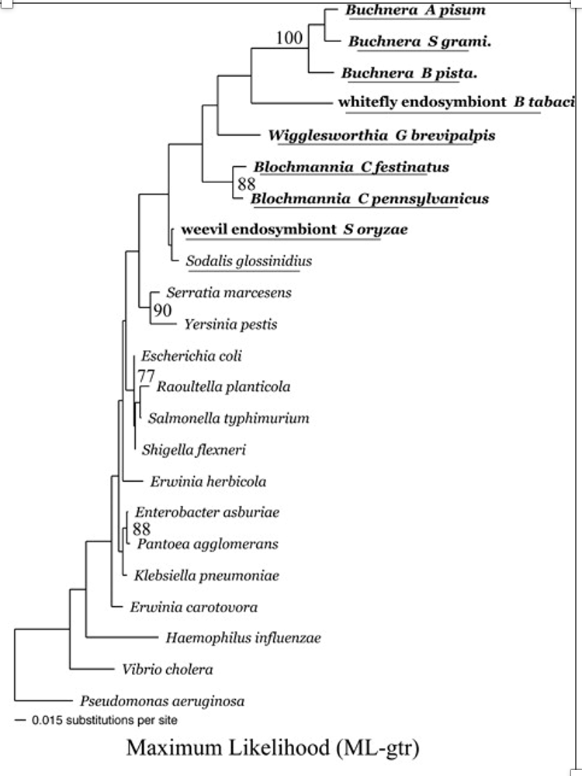
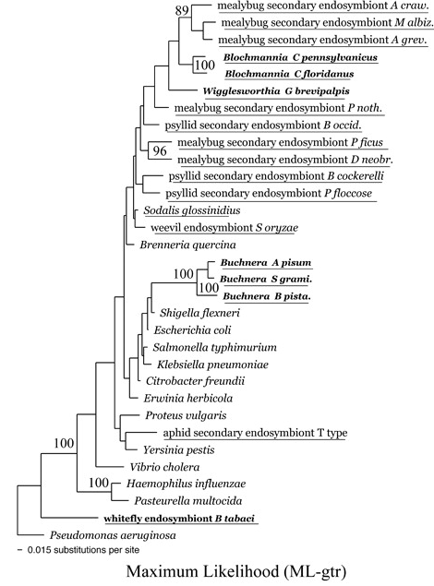
Using a homogeneous model for phylogenetic reconstruction (not general time reversable)
From: https://doi.org/10.1093/molbev/msi036
groEL
16S rRNA

Slide 10
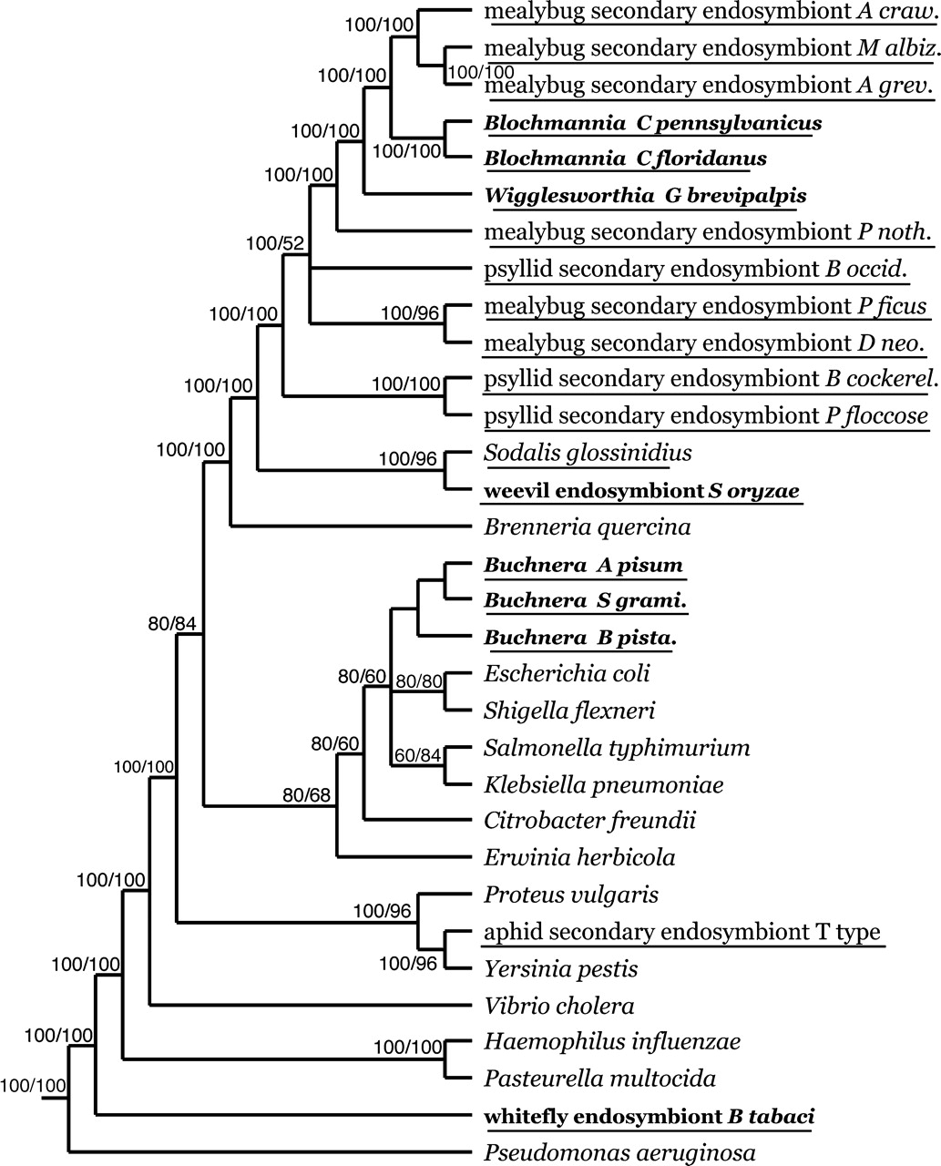
Using a non-homogeneous model for phylogenetic reconstruction (not general time reversable)
Underlined taxa are insect endosymbionts, boldface taxa are primary (obligate) endosymbionts.
The AT-bias of several primary endosymbionts within the Enterobacteriales is quite severe, at ∼26% GC (Shigenobu et al. 2000) in the aphid endosymbiont Buchnera, ∼22% GC in the tsetse fly endosymbiont Wigglesworthia (Akman et al. 2002), and 27% GC in the ant endosymbiont Blochmannia (Gil et al. 2003).
From: https://doi.org/10.1093/molbev/msi036
Mol Biol Evol, Volume 22, Issue 3, March 2005, Pages 520–532, https://doi.org/10.1093/molbev/msi036
The content of this slide may be subject to copyright: please see the slide notes for details.

Slide 11

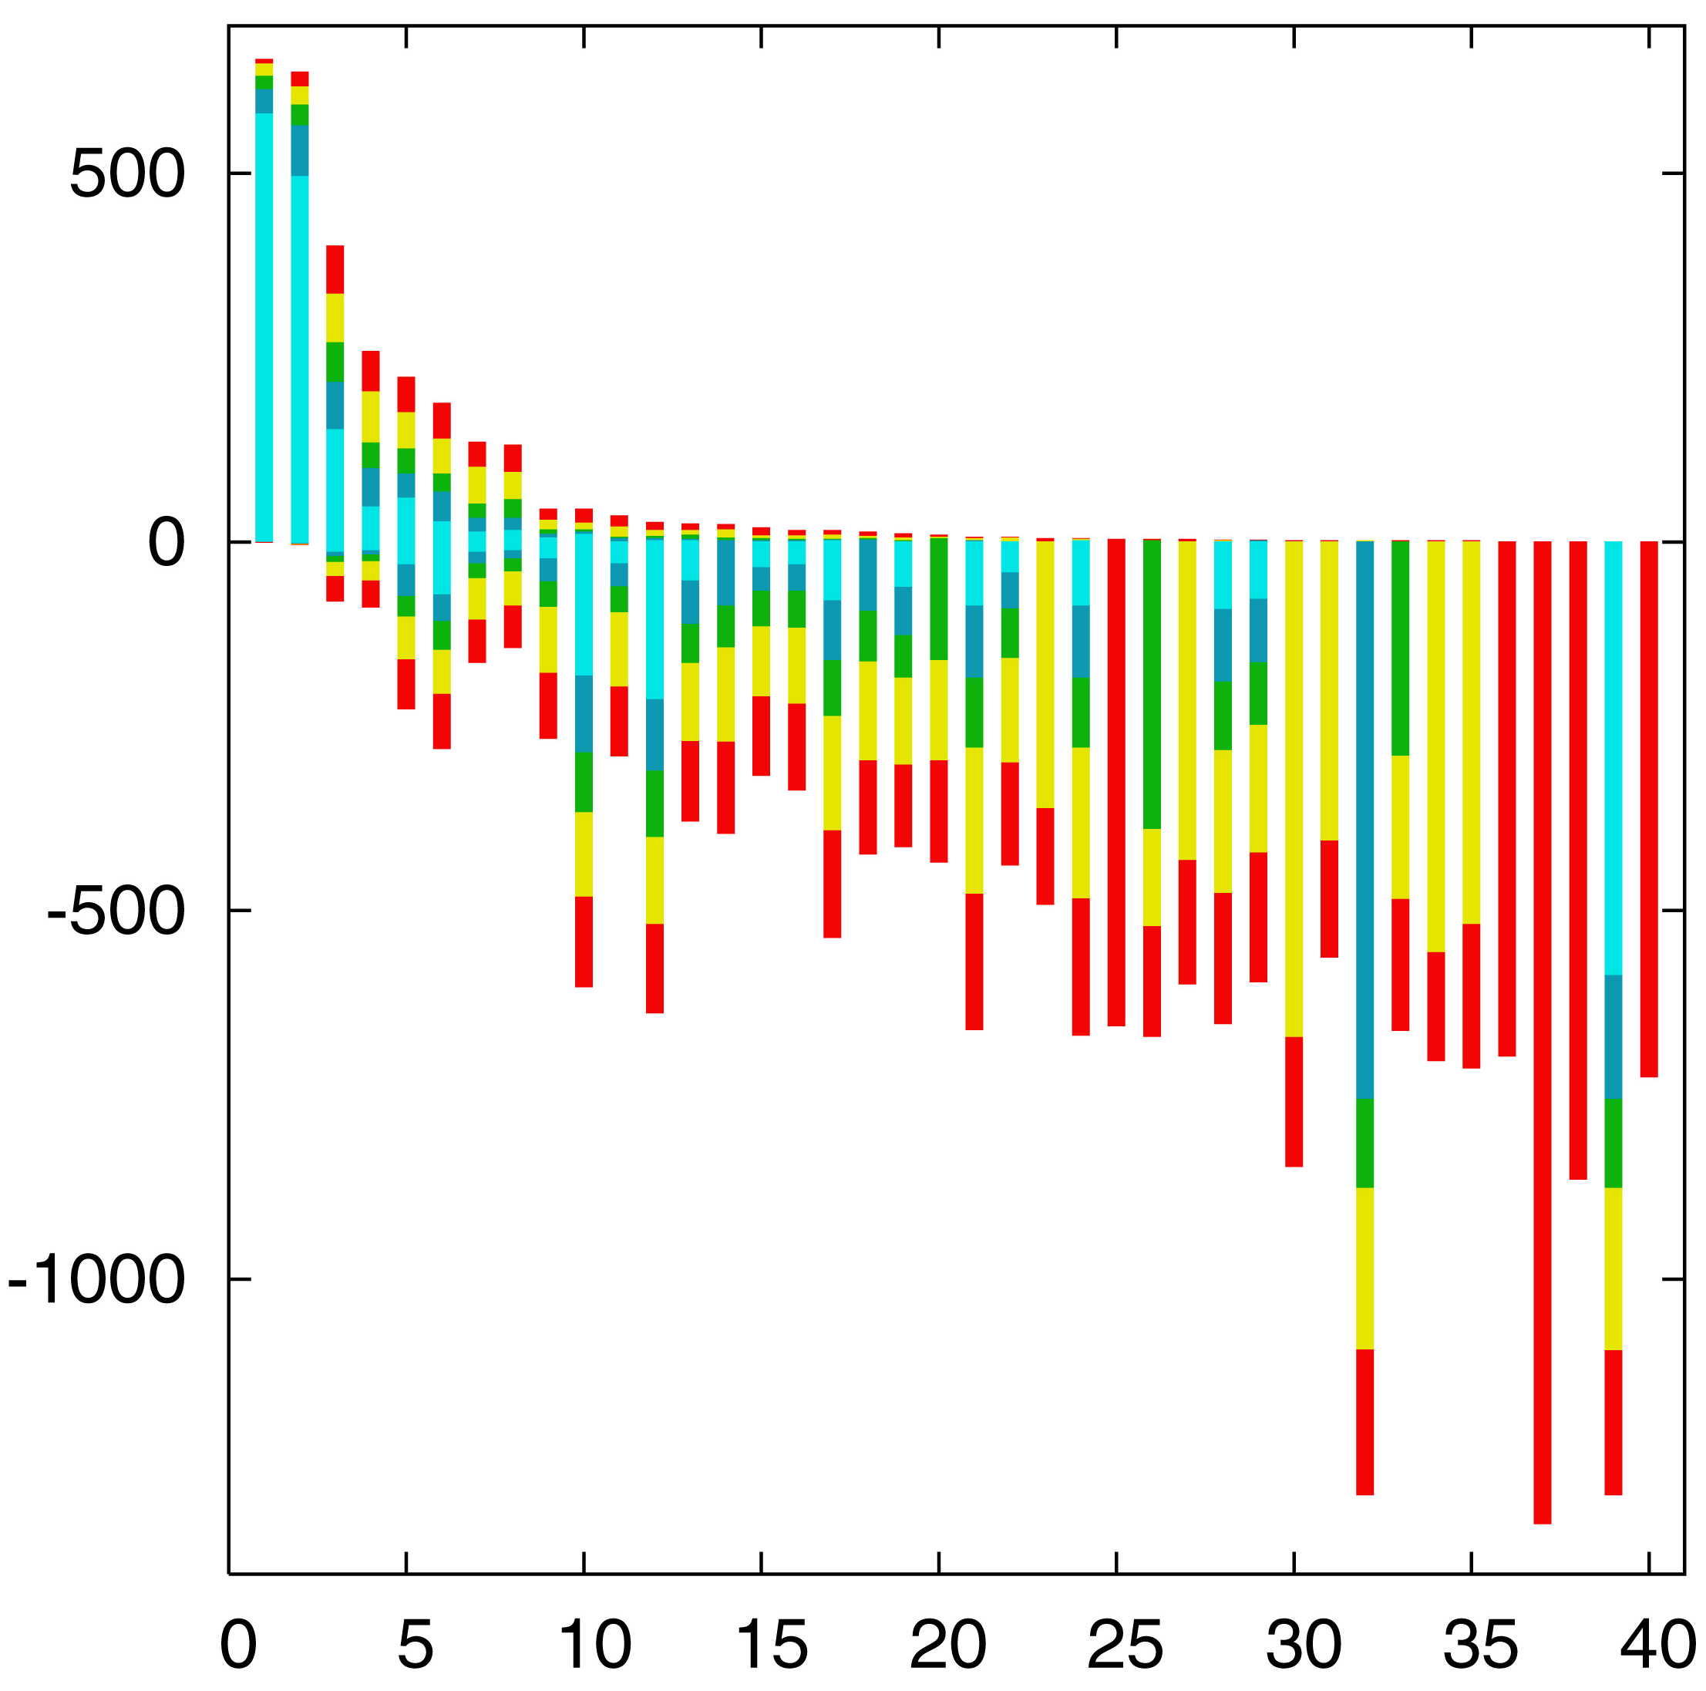
“Lento”-plot of supported bipartitions (out of 501 possible)
10 cyanobacteria:
Anabaena
Trichodesmium
Synechocystis sp.
Prochlorococcus
marinus
(3 strains)
Marine
Synechococcus
Thermo-
synechococcus
elongatus
Gloeobacter
Nostoc
punctioforme
Number of datasets
Based on 678 sets of orthologous genes
Zhaxybayeva, Lapierre and Gogarten, Trends in Genetics, 2004, 20(5): 254-260.

Slide 12
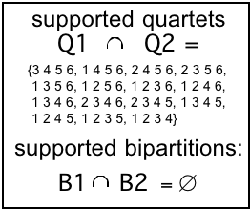
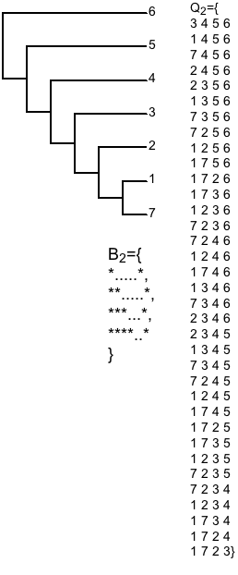
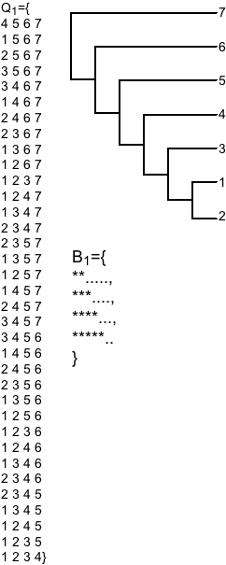
PROBLEMS WITH BIPARTITIONS (CONT.)
A single rogue sequence that moves from one end of a Hennigian comb to the other changes all bipartition
bipartitions
embedded quartets

Slide 13
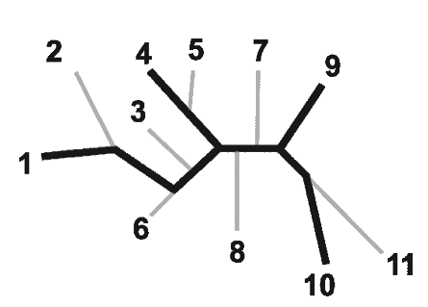
Bootstrap support values for embedded quartets
+
: tree calculated from one pseudo-sample generated by bootstraping from an alignment of one gene family present in 11 genomes
: embedded quartet for genomes
1, 4, 9, and 10 .
This bootstrap sample supports the topology ((1,4),9,10).
1
9
1
9
1
10
4
√
10
10
4
9
4
Zhaxybayeva et al. 2006, Genome Research, 16(9):1099-108
Quartet spectral analyses of genomes iterates over three loops:
Repeat for all bootstrap samples.
Repeat for all possible embedded quartets.
Repeat for all gene families.

Slide 14
Decay of bipartition support with number of OTUs
Phylogenies used for simulation
Notes:
Same model (WAG +Gamma) used for simulation and evaluation (including alpha =1). Simulation of sequences with lenghts of 200, 500 and 1000 using seq-gen.

Slide 15
Example for decay of bipartition support with number of OTUs
Sequence
lengths
C
D
C
D
C
D
C
D
200
89
74
70
A
B
A
B
A
B
A
B
C
D
C
D
C
D
C
D
500
71
86
99
94
74
100
73
92
A
B
A
B
A
B
71
A
B
C
D
C
D
C
D
C
D
72
100
90
1000
79
87
100
100
91
98
87
A
B
A
B
94
B
A
A
B
Only branches with better than 70% bootstrap support are shown
Notes:
Each row gives the result for one simulation, done with 9 additional sequences emerging equally far apart on the central branch. In the analyses on the left, all, 8 or 5 of these additional sequences were omitted.

Slide 16
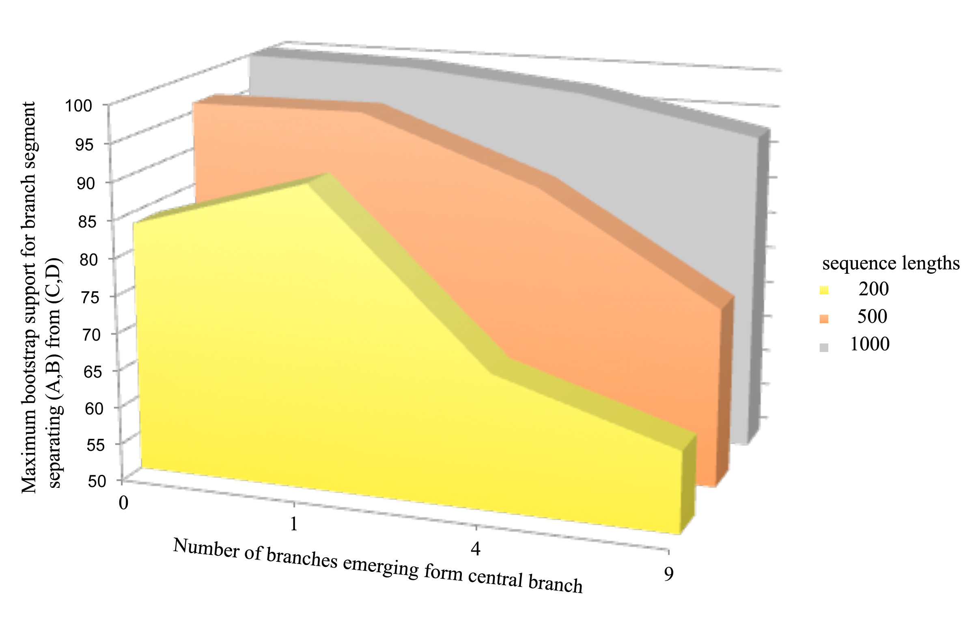
Decay of bipartition support with number of OTUs
Each value is the average of 10 simulations using seq-gen.
Simulated sequences were evaluated using PHYML.
Model for simulation and evaluation WAG + Γ(α=1, 4 rate categories)
Notes:
Can we add SE bars?
Would be good to have more simulations.
Would be good to evaluate in phylip (don’t trust phyml)

Slide 17
Bipartition Paradox:
The more sequences are added, the lower the support for bipartitions that include all sequences. The more data one uses, the lower the bootstrap support values become.
This paradox disappears when only embedded splits for 4 sequences are considered.

Slide 18

TOOLS TO ANALYZE PHYLOGENETIC INFORMATION FROM MULTIPLE GENES IN GENOMES:
QUARTET DECOMPOSITION

Slide 19
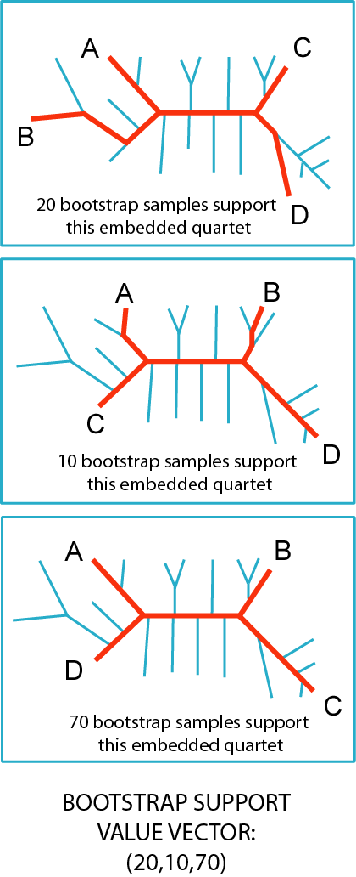
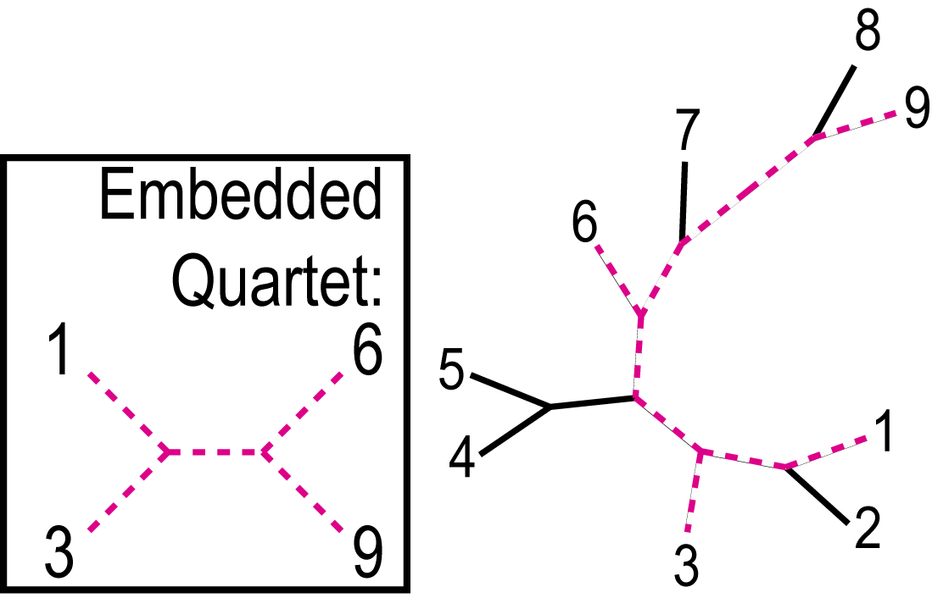
QUARTET DECOMPOSITION METHOD
15 bootstrap samples
71 bootstrap samples
Quartet is a smallest unit of phylogenetic information
Each quartet is associated with only three unrooted tree topologies
Support for different quartet topologies can be summarized for all gene families
14 bootstrap samples
(15, 71, 14)

Slide 20
Bootstrap support values for embedded quartets
+
: tree calculated from one pseudo-sample generated by bootstraping from an alignment of one gene family present in 11 genomes
: embedded quartet for genomes
1, 4, 9, and 10 .
This bootstrap sample supports the topology ((1,4),9,10).
1
9
1
9
1
10
4
√
10
10
4
9
4
Zhaxybayeva et al. 2006, Genome Research, 16(9):1099-108
Quartet spectral analyses of genomes iterates over three loops:
Repeat for all bootstrap samples.
Repeat for all possible embedded quartets.
Repeat for all gene families.

Slide 21
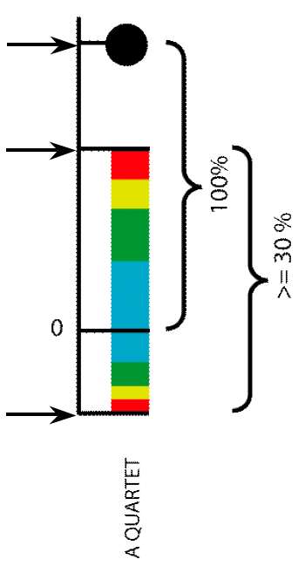
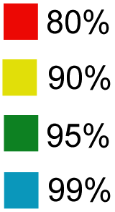
Illustration of one component of a quartet spectral analyses Summary of phylogenetic information for one genome quartet for all gene families
Total number of gene families containing the species quartet
Number of gene families supporting the same topology as the plurality
(colored according to bootstrap support level)
Number of gene families supporting one of the two alternative quartet topologies

Slide 22
N completely sequenced genomes
(a.a. sequences)
Generate Alignment
Generate 100 bootstrap samples
Detect gene families
Families with missing data are considered
Calculate shape parameter for Gamma distribution
Create distance matrix for each boot. sample
FOR EACH GENE FAMILY
QUARTET DECOMPOSITION ANALYSES: DATA FLOW
Generate list of possible embedded quartets
Trees
Visualize support for embedded quartets
Evaluate support for each possible embedded quartet
Exclude quartets that can be results of artifacts

Slide 23
Other POSITIVE THOUGHTS ABOUT THE METHOD
No assumption that all genes in a genome have the same phylogenetic history.
The total number of quartets is much smaller than number of tree topologies, which makes it possible to evaluate all quartets.
Gene families present only in few analyzed genomes can be included in the analyses
Phylogenetic signal can be divided into consensus supported by the plurality of gene families and the conflicting signal.
Allows us to partition analyzed genomes according to some scenario (e.g., grouping by ecology) and retrieve gene families that support or conflict it.

Slide 24
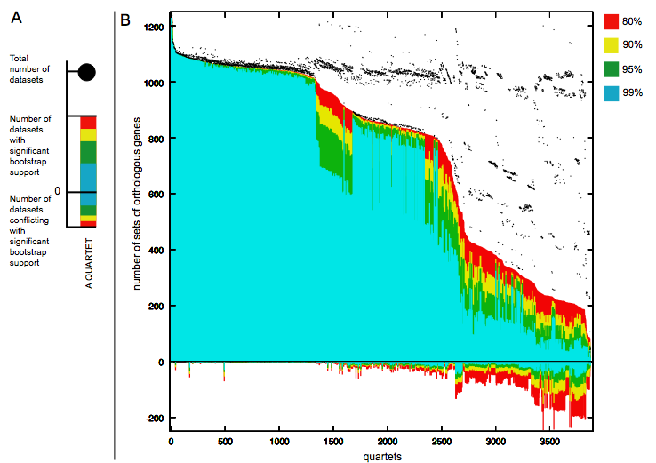
Quartet decomposition analysis of 19 Prochlorococcus and marine Synechococcus genomes. Quartets with a very short internal branch or very long external branches as well those resolved by less than 30% of gene families were excluded from the analyses to minimize artifacts of phylogenetic reconstruction.

Slide 25
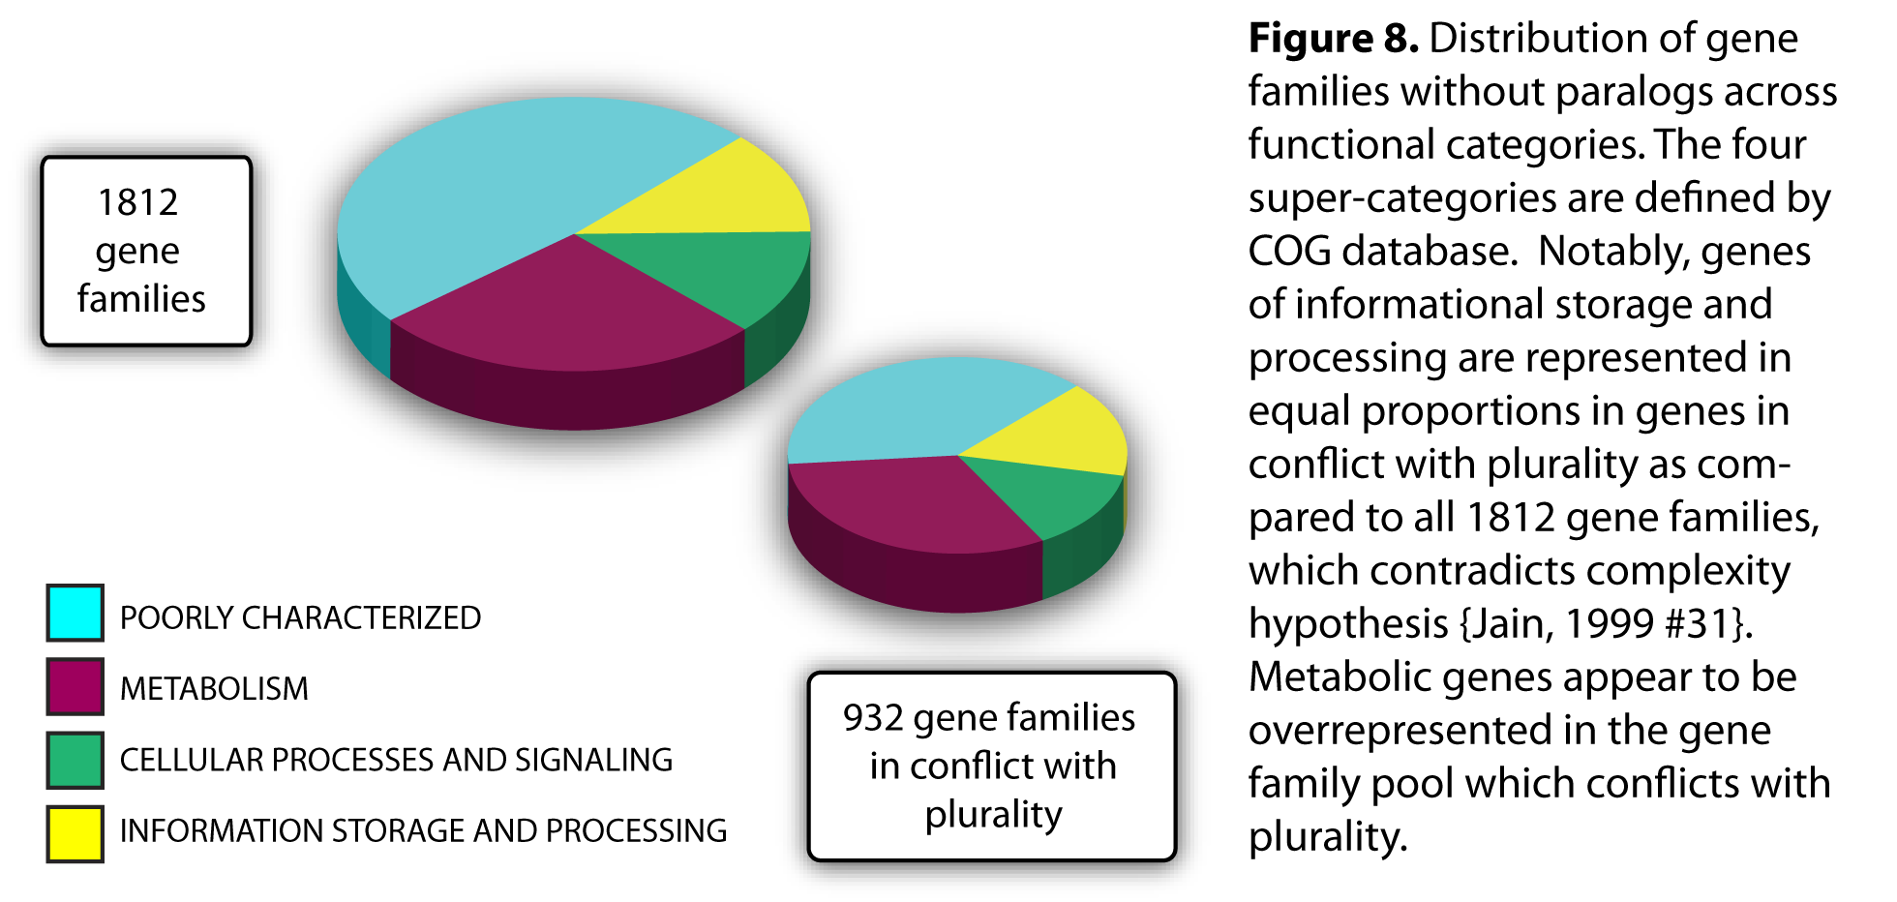

Slide 26
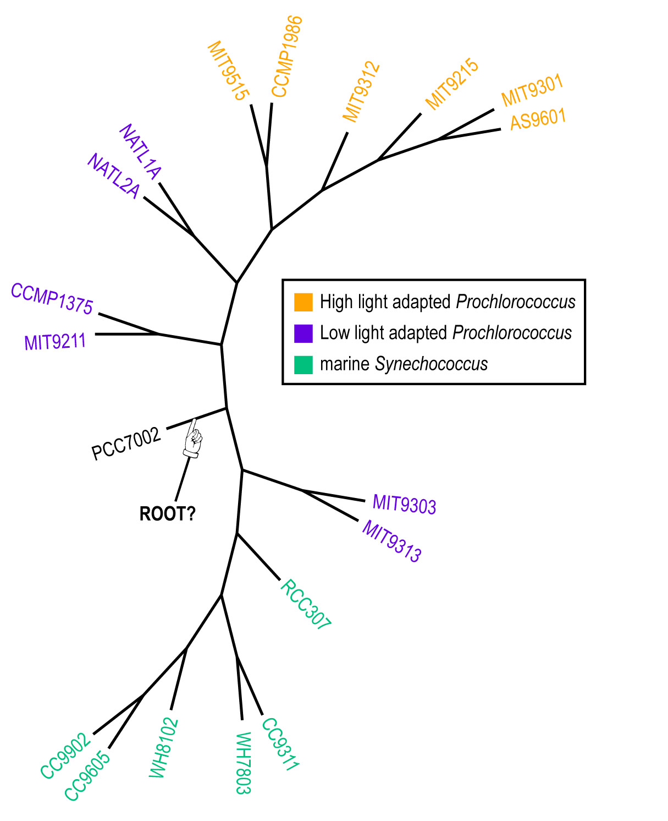
Plurality consensus calculated as supertree (MRP) from quartets in the plurality topology.

Slide 27
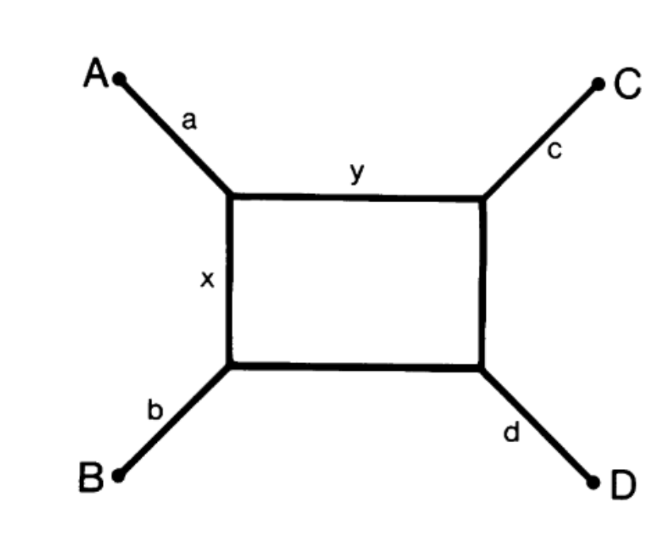
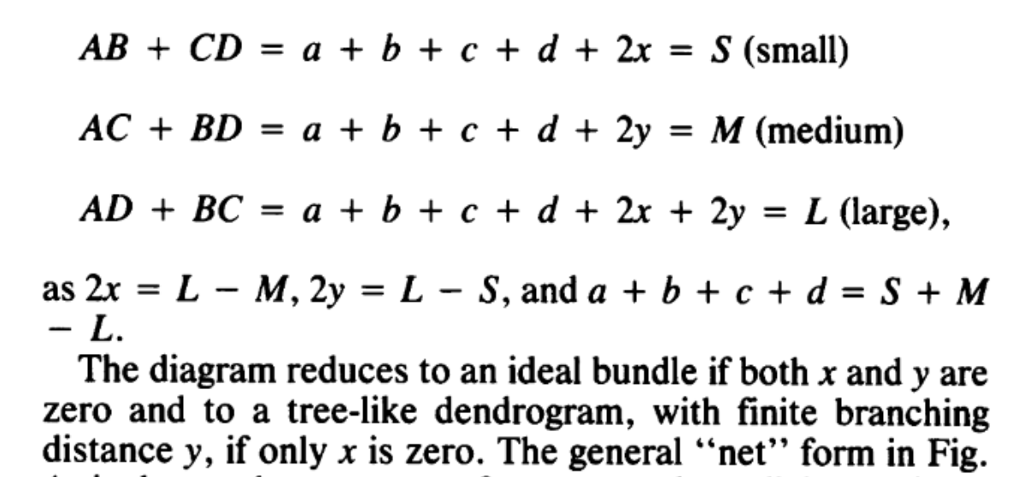
Given a distance matrix for 4 sequences:
From: M Eigen, R Winkler-Oswatitsch, and A Dress
Statistical geometry in sequence space: a method of quantitative comparative sequence analysis.
PNAS 85 (16) 5913-5917
David Bryant, Vincent Moulton: Neighbor Net:
https://academic.oup.com/mbe/article/21/2/255/1187993
Implemented in Splits Tree

Slide 28
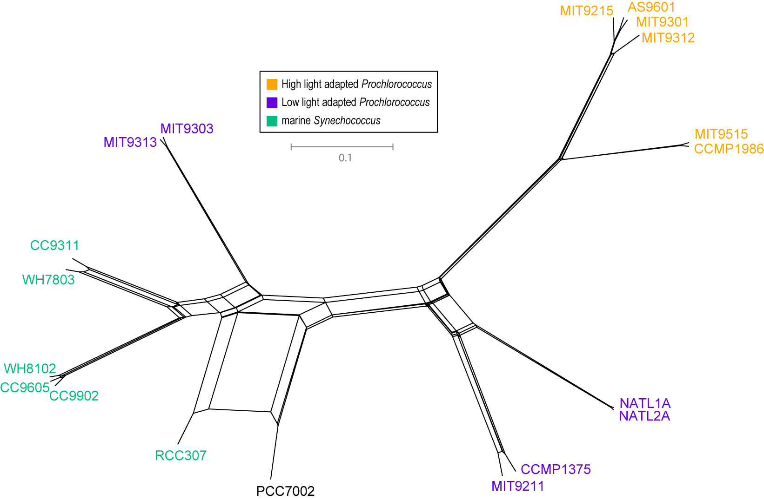
NeighborNet (calculated with SplitsTree 4.0)
Plurality neighbor-net calculated as supertree (from the MRP matrix using SplitsTree 4.0) from all quartets significantly supported by all individual gene families (1812) without in-paralogs.

