Slide 1
MCB3421
class 24
Figtree

Slide 2
Figtree developed by the same group that developed tracer
Reads trees in a variety of different formats (including Newick)
Re-root, flip branches, (subtree – not really)
color, branch and node labels
Draws trees as trees, stars, and circular diagrams

Slide 3
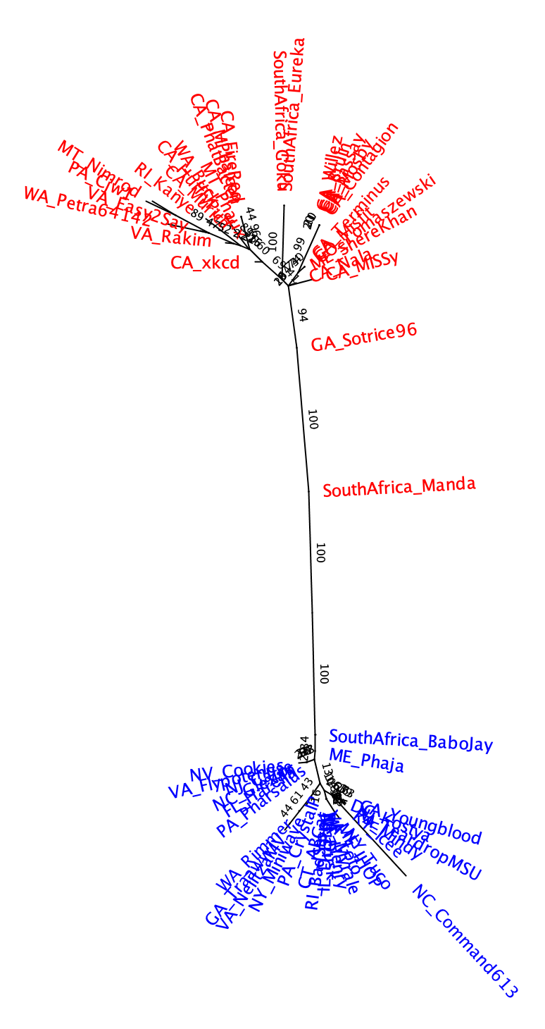
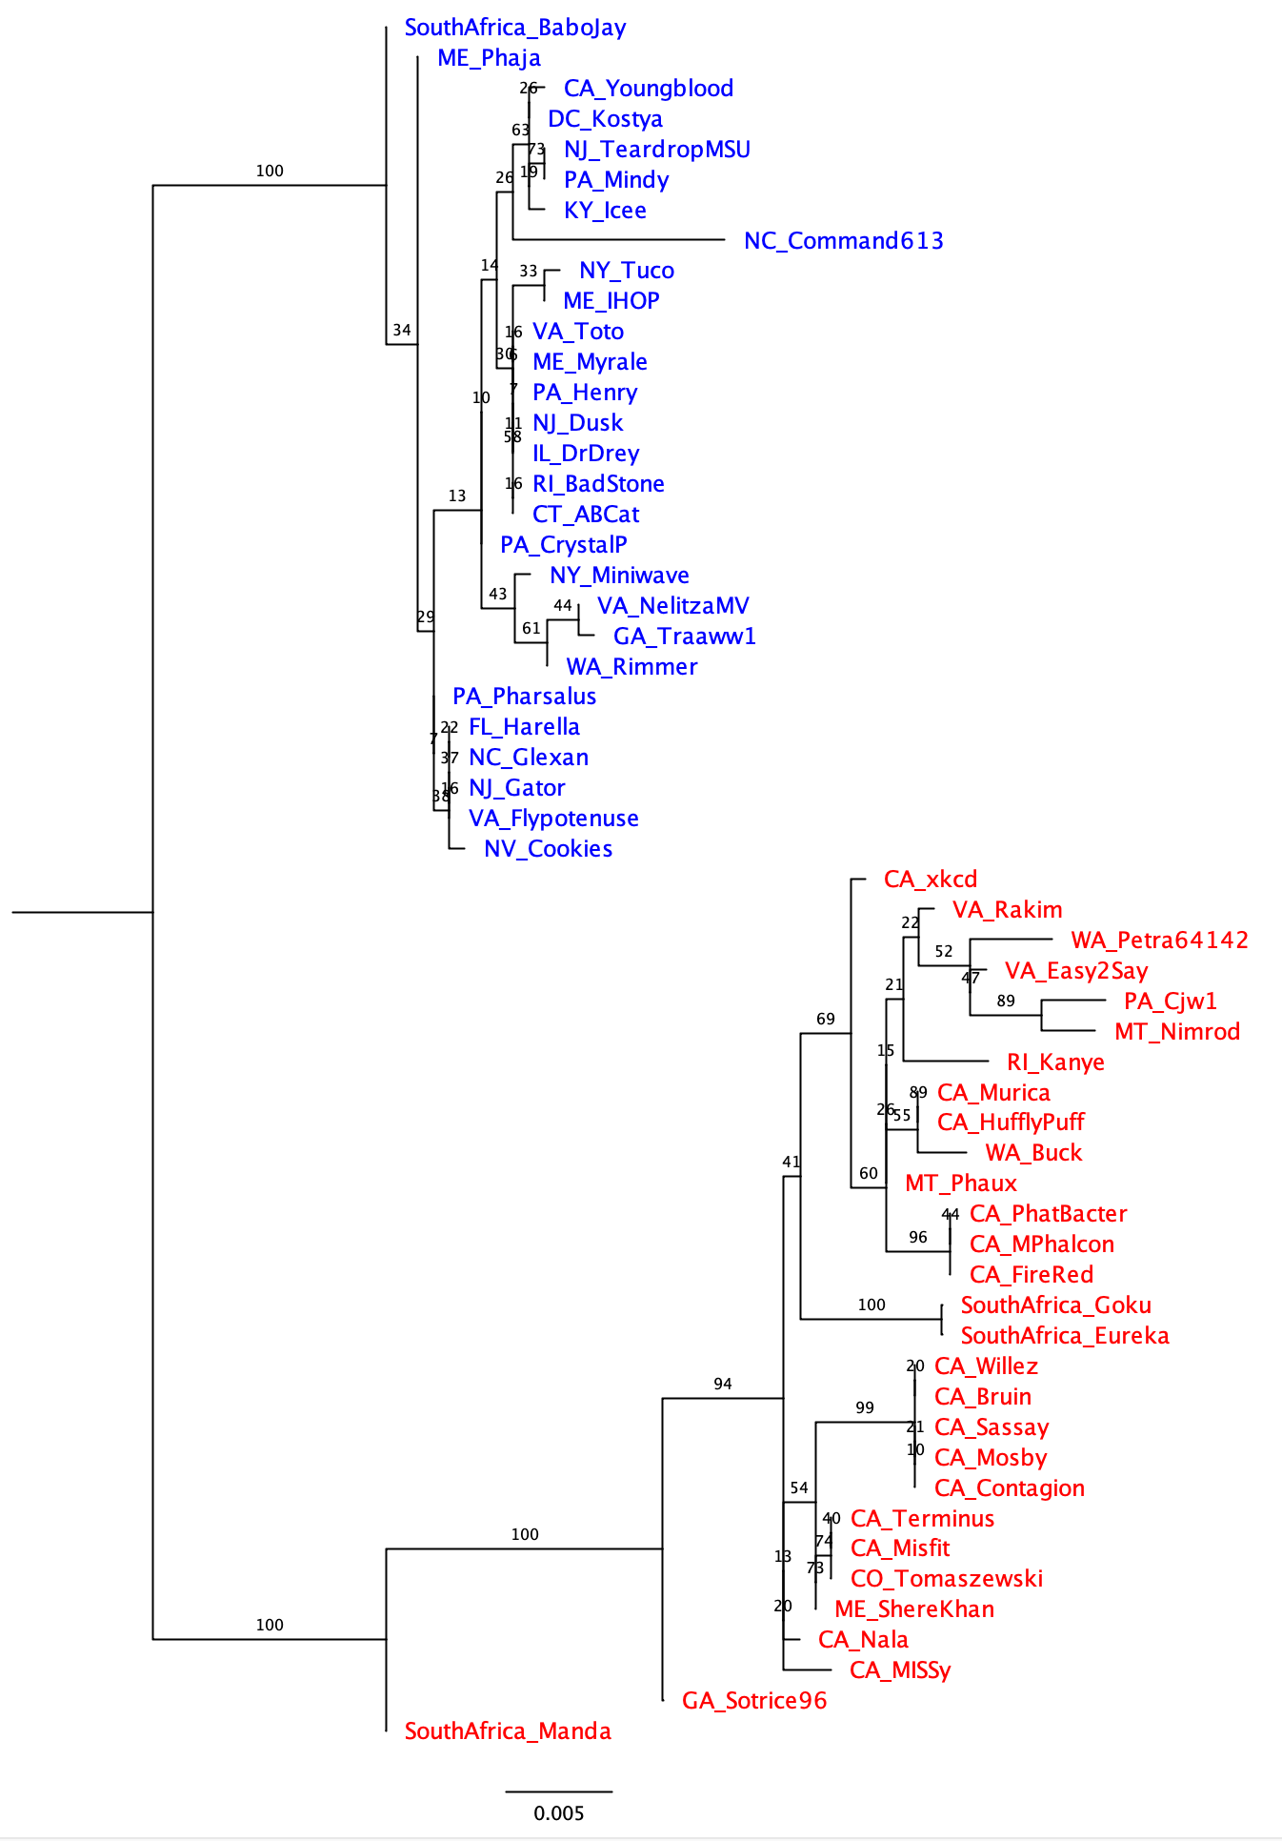
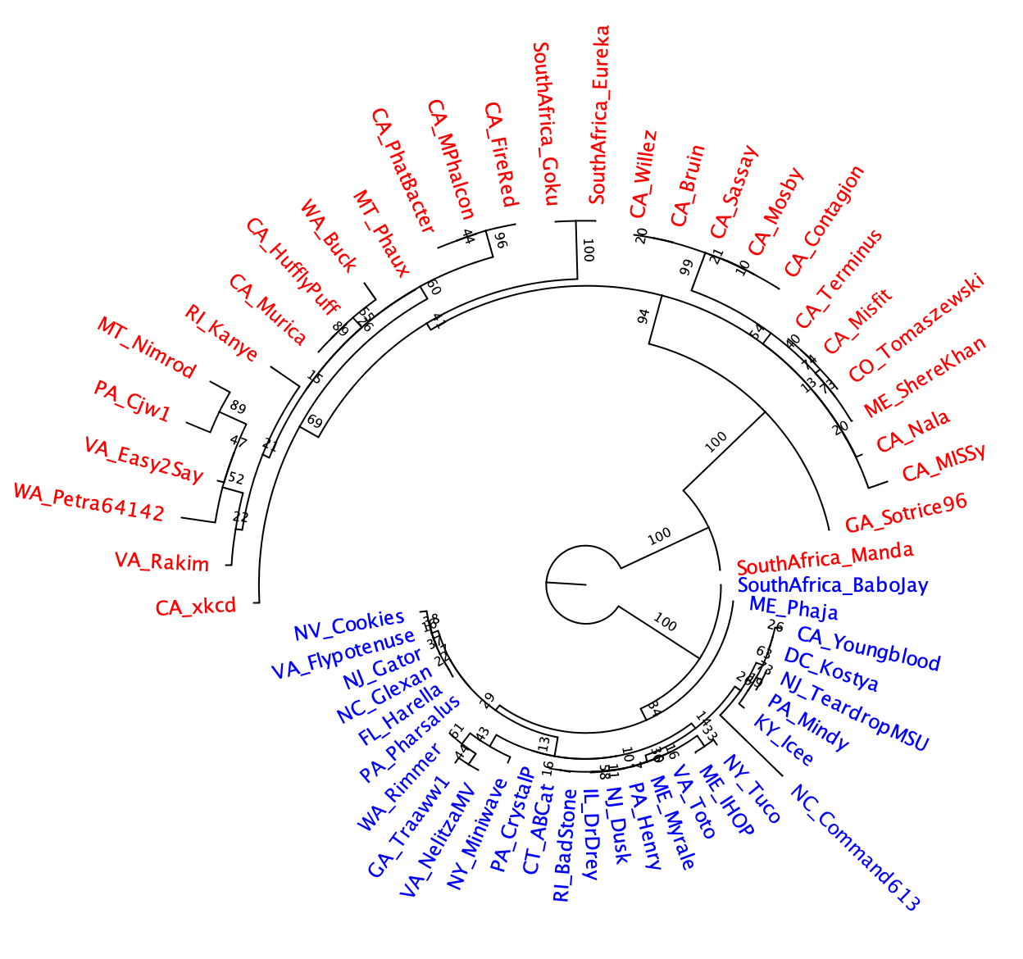
Different ways to draw the tree
Given that the tree does not have an outgroup, the branch at the root is strange!

Slide 4
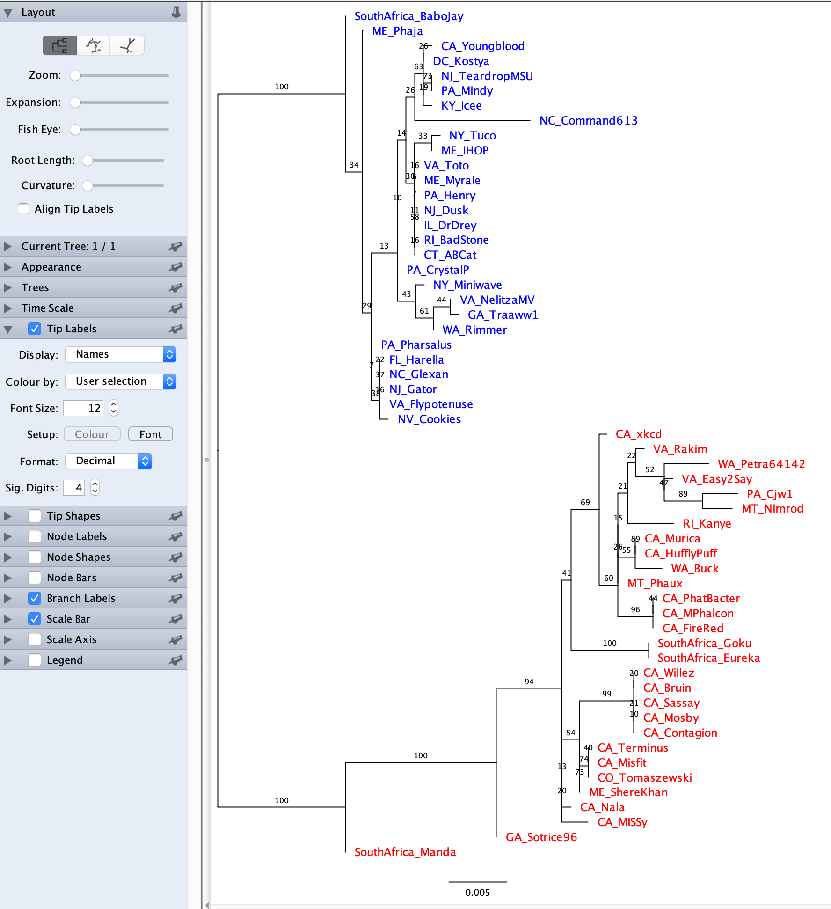
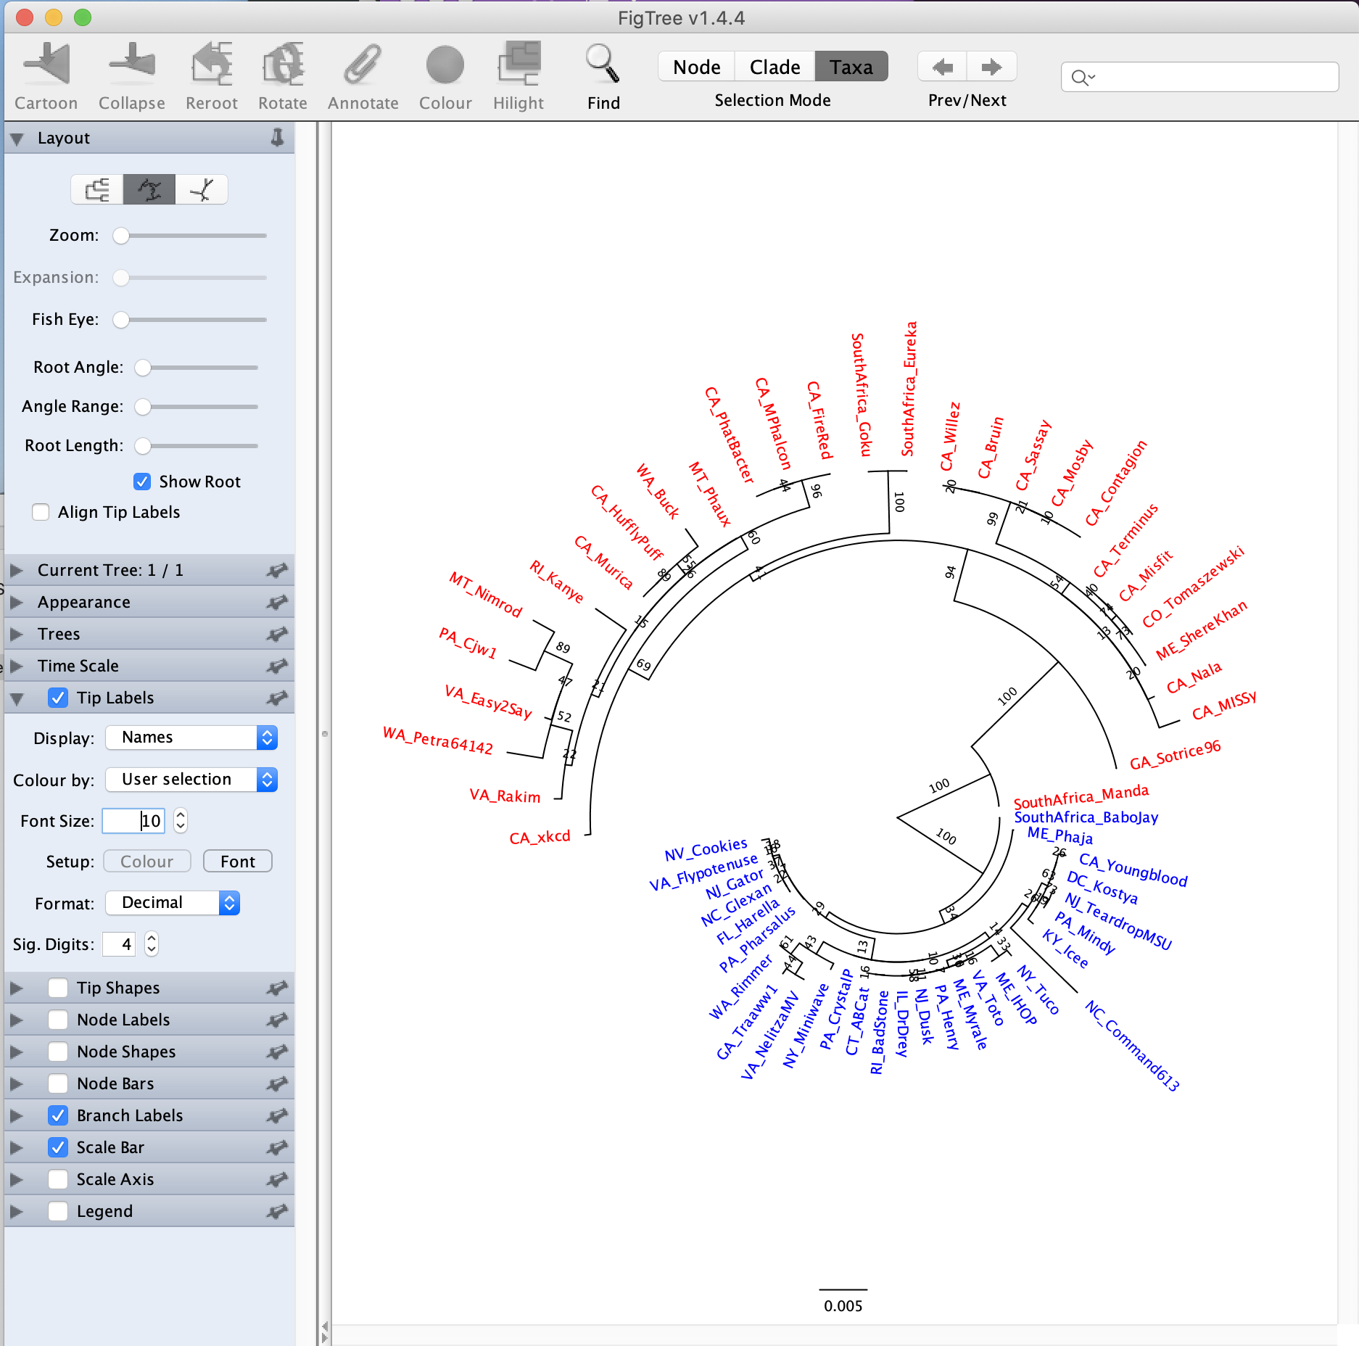
moving the toot length lever to the left helps

Slide 5
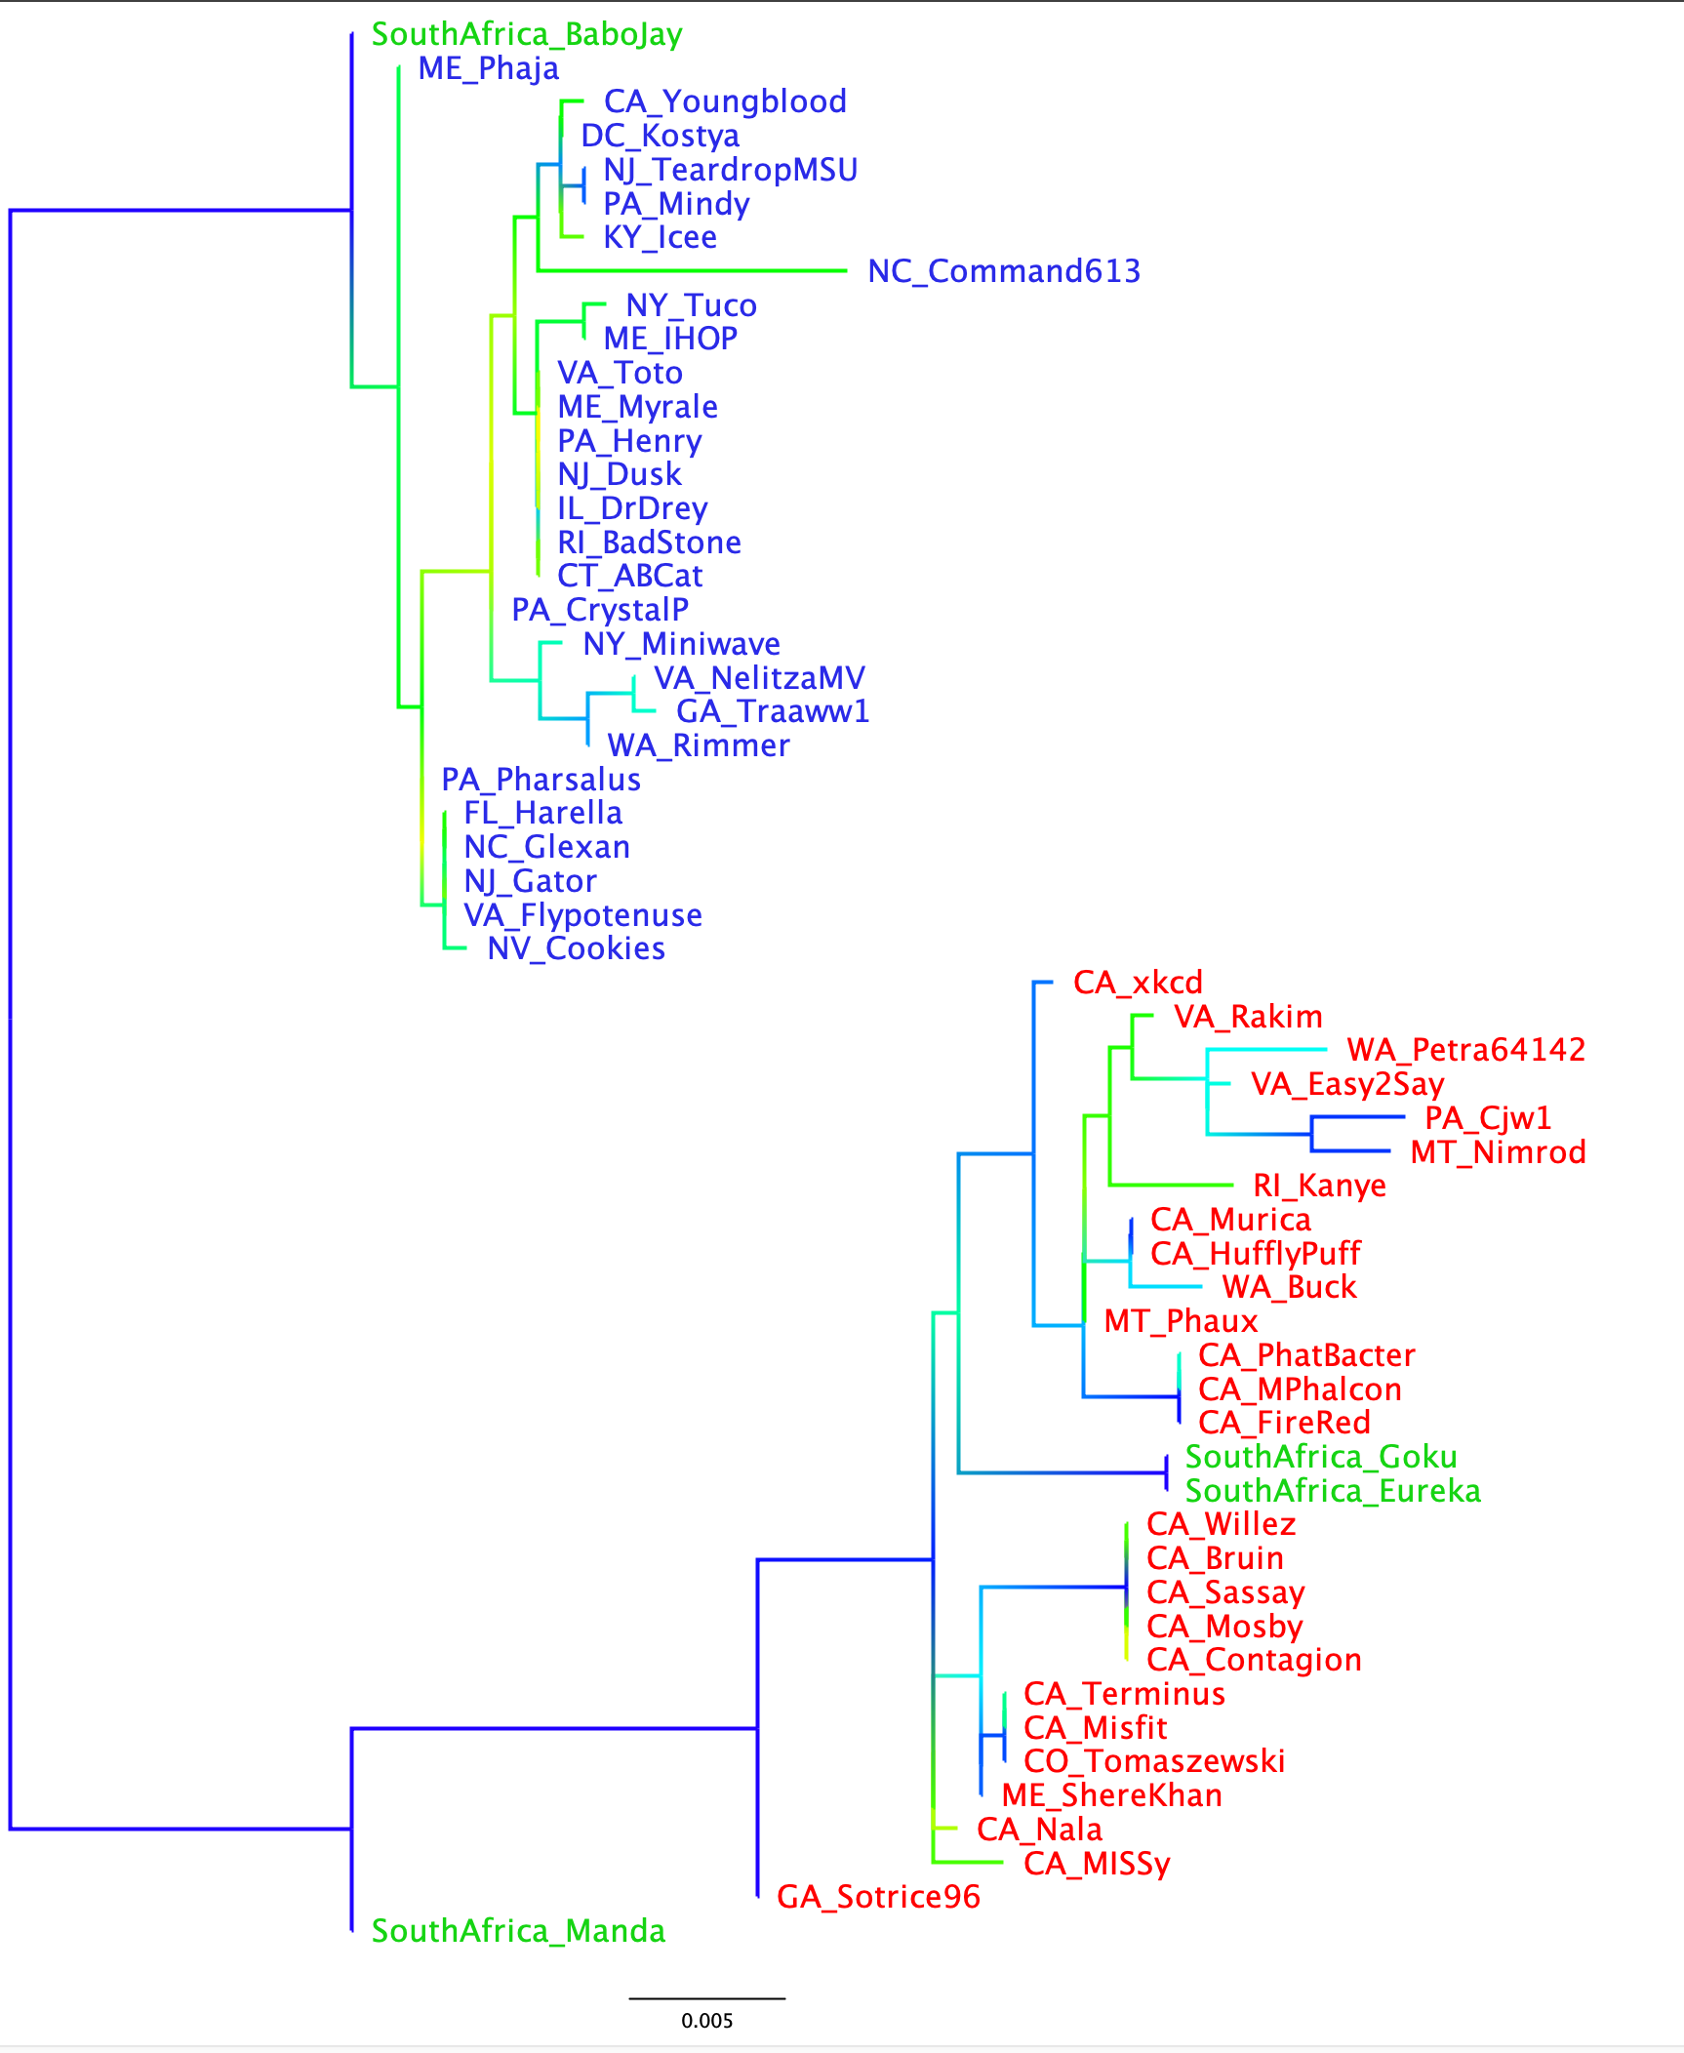
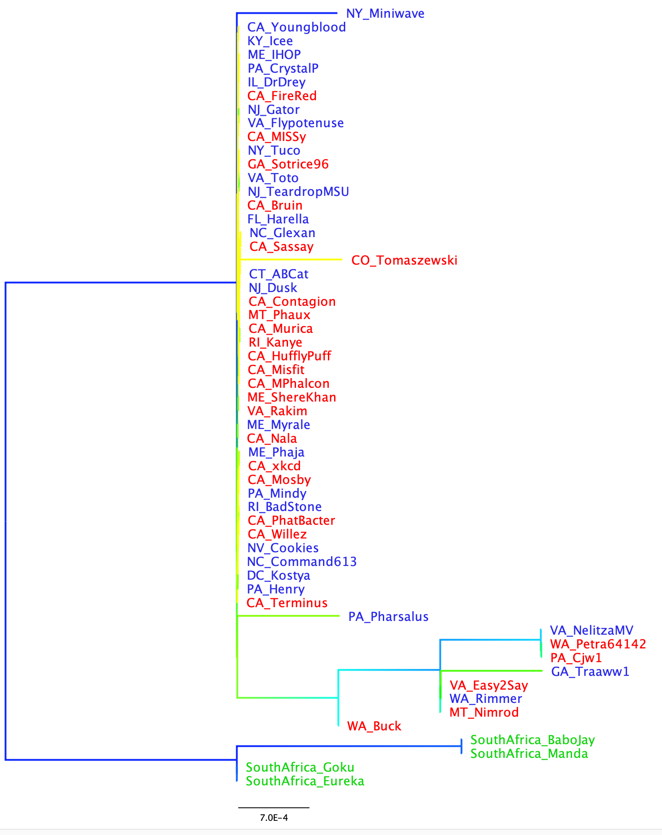
If you have multiple gene trees from the same set (or subset) of species, and the leaves have the same names, the colors carry over to the new tree you open
Branches gradient colored according to support value
Extein
-> the clans defined by the extein tree are not reflected in the intein phylogeny. The intein was transferred several times between the red and green clans. Note the nearly identical intein between red and green leaves.
Intein

Slide 6
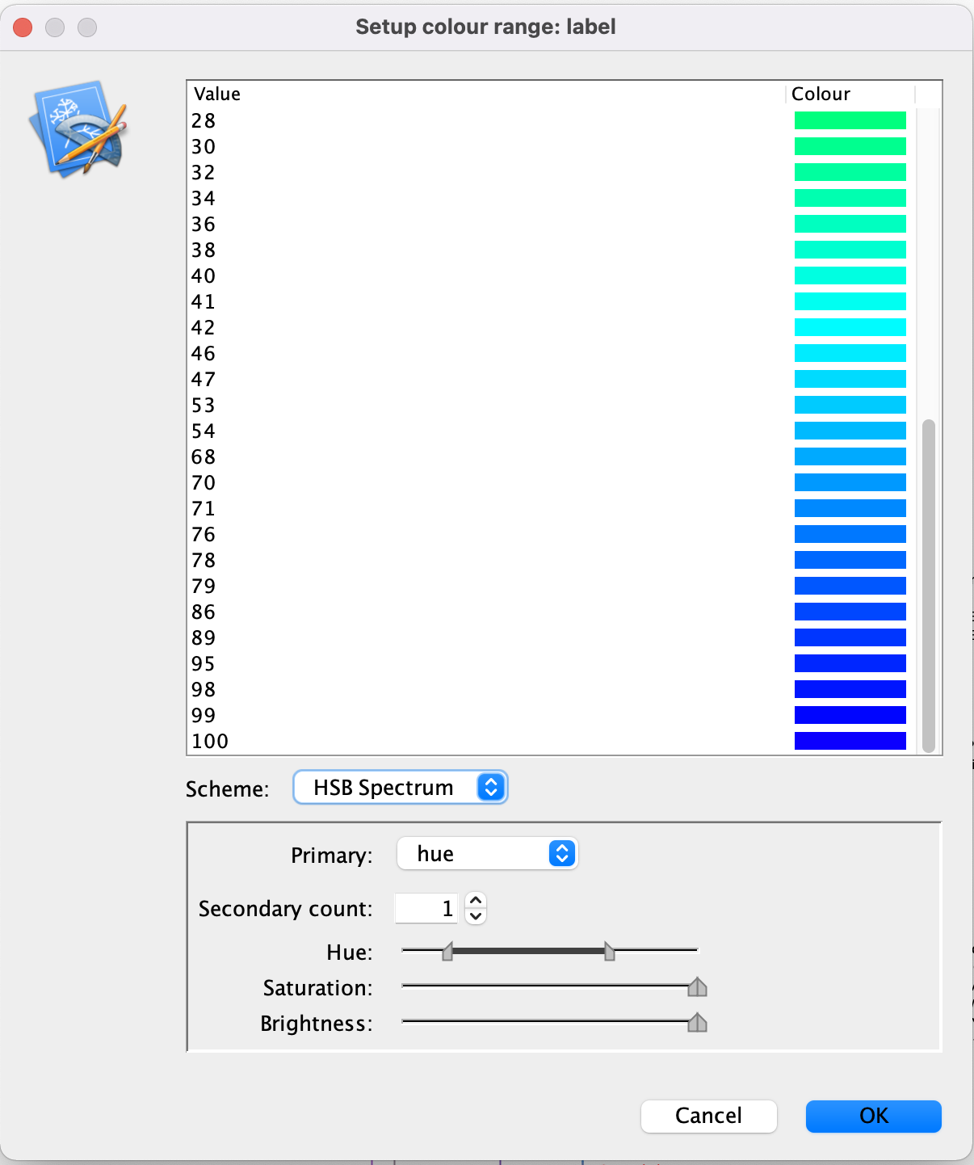

Slide 7
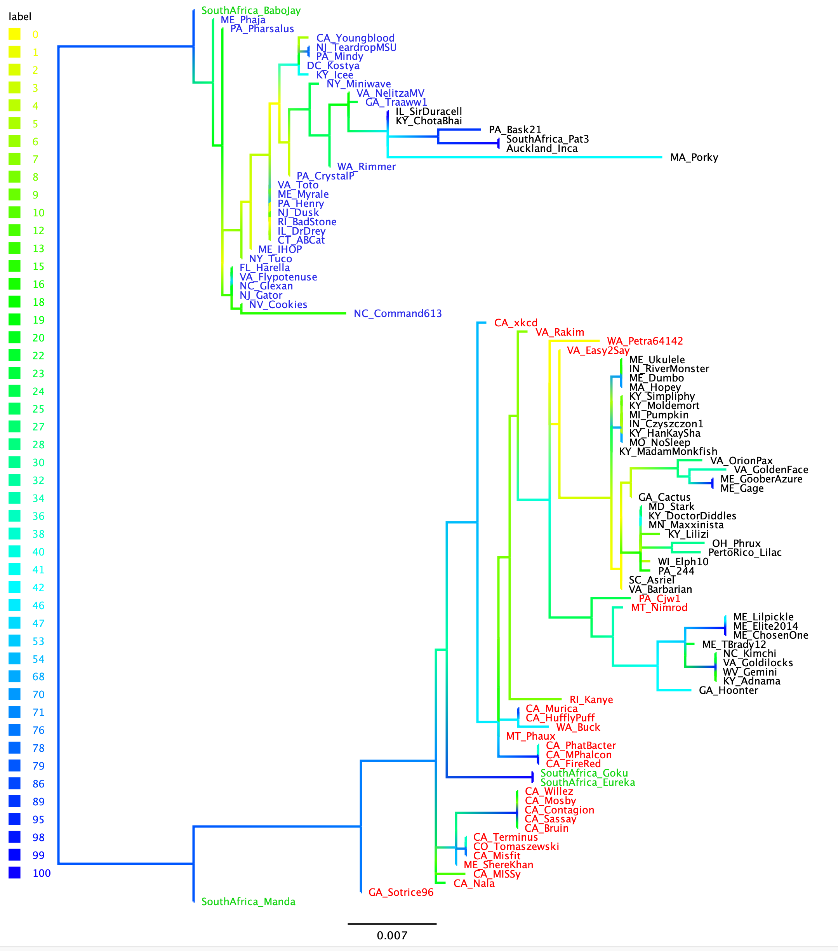
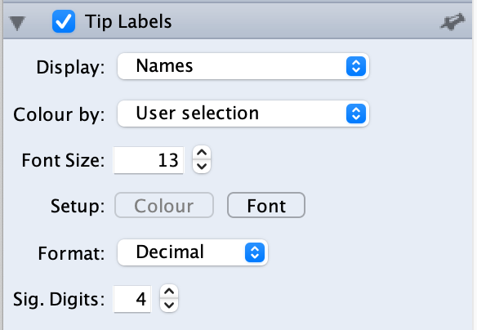
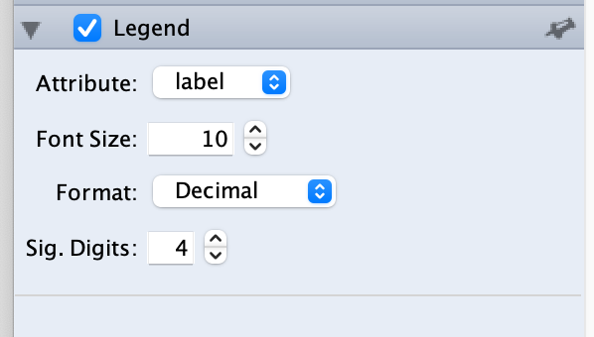
Phylogeny of Exteins in terminases of Actinophage cluster E
no Intein
clade 1
clade 2

Slide 8
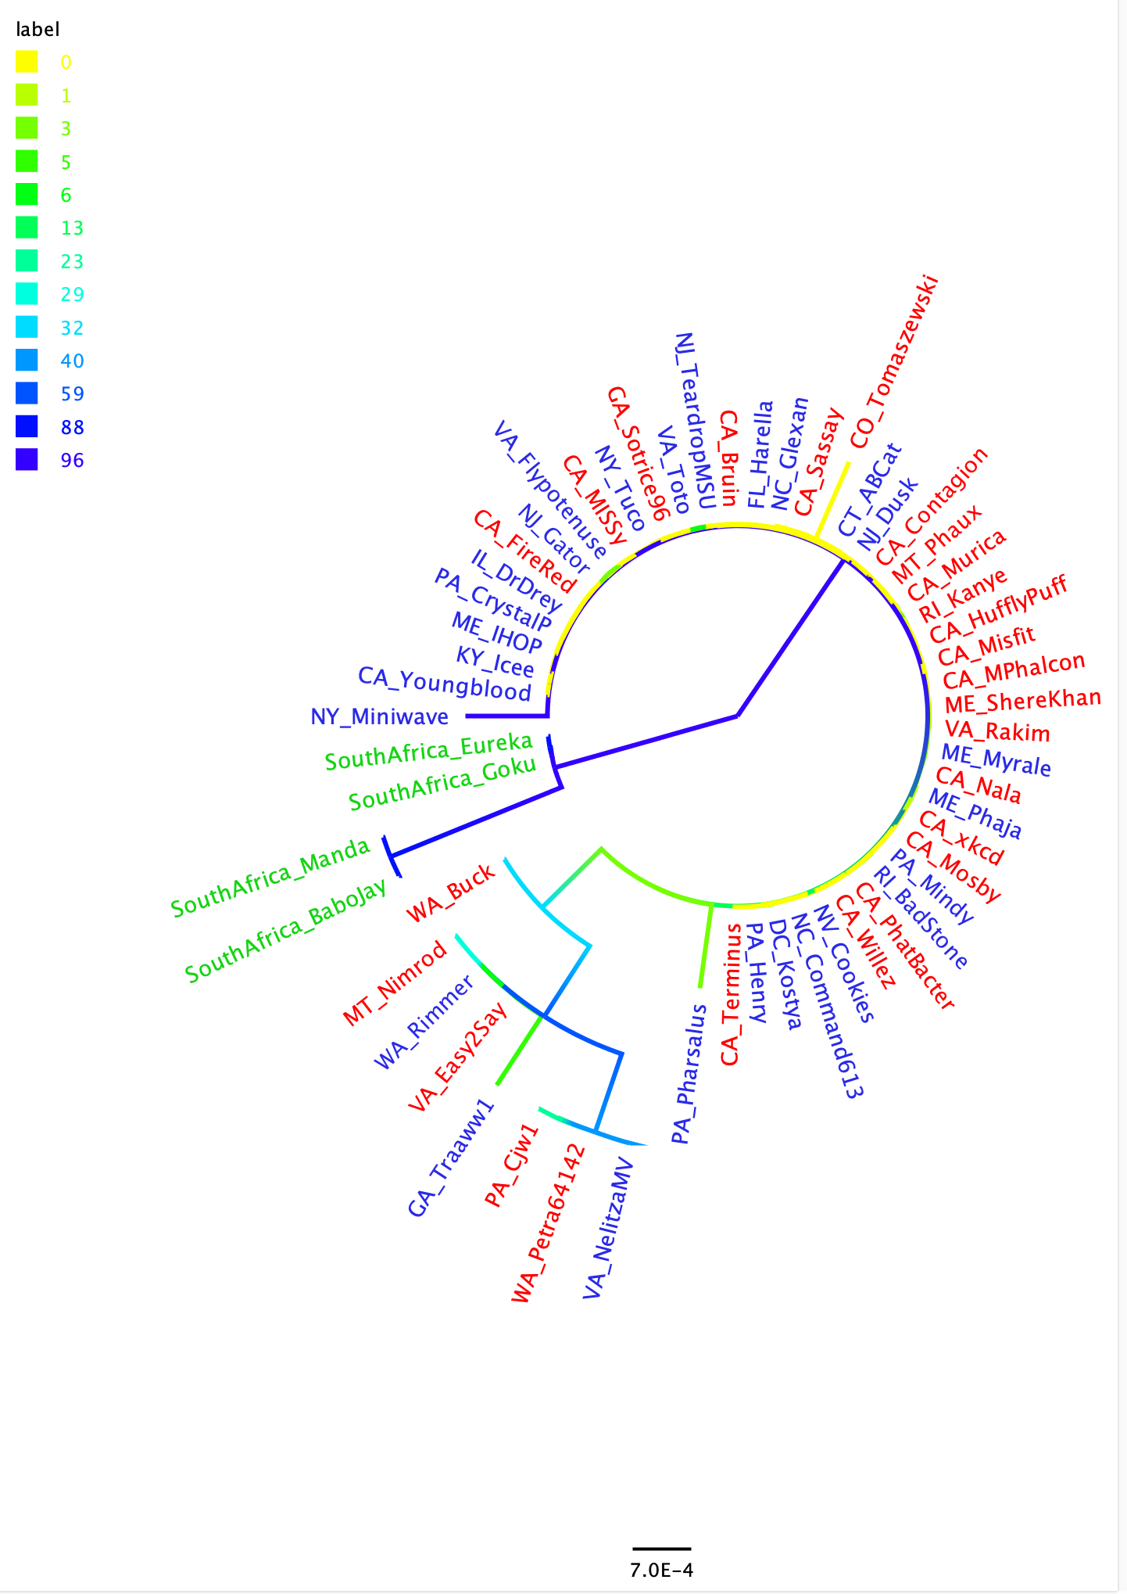

Slide 9
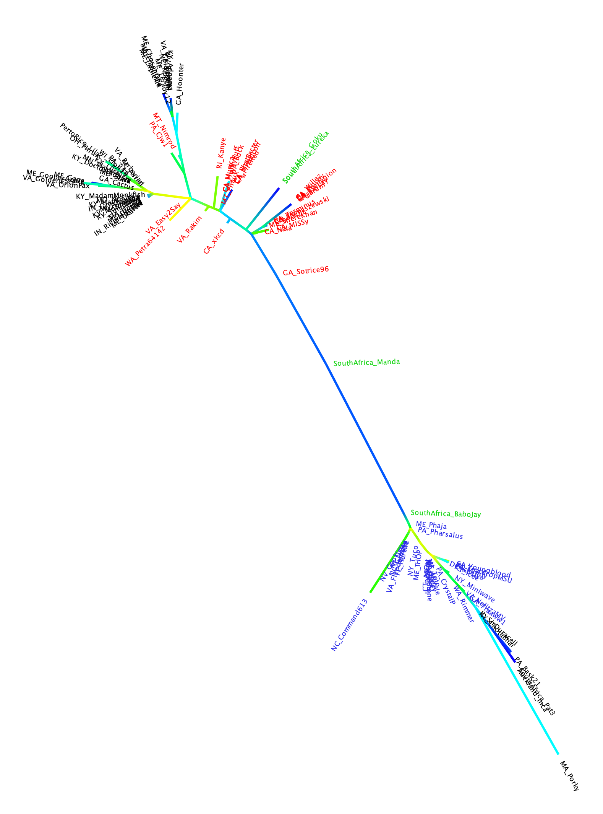
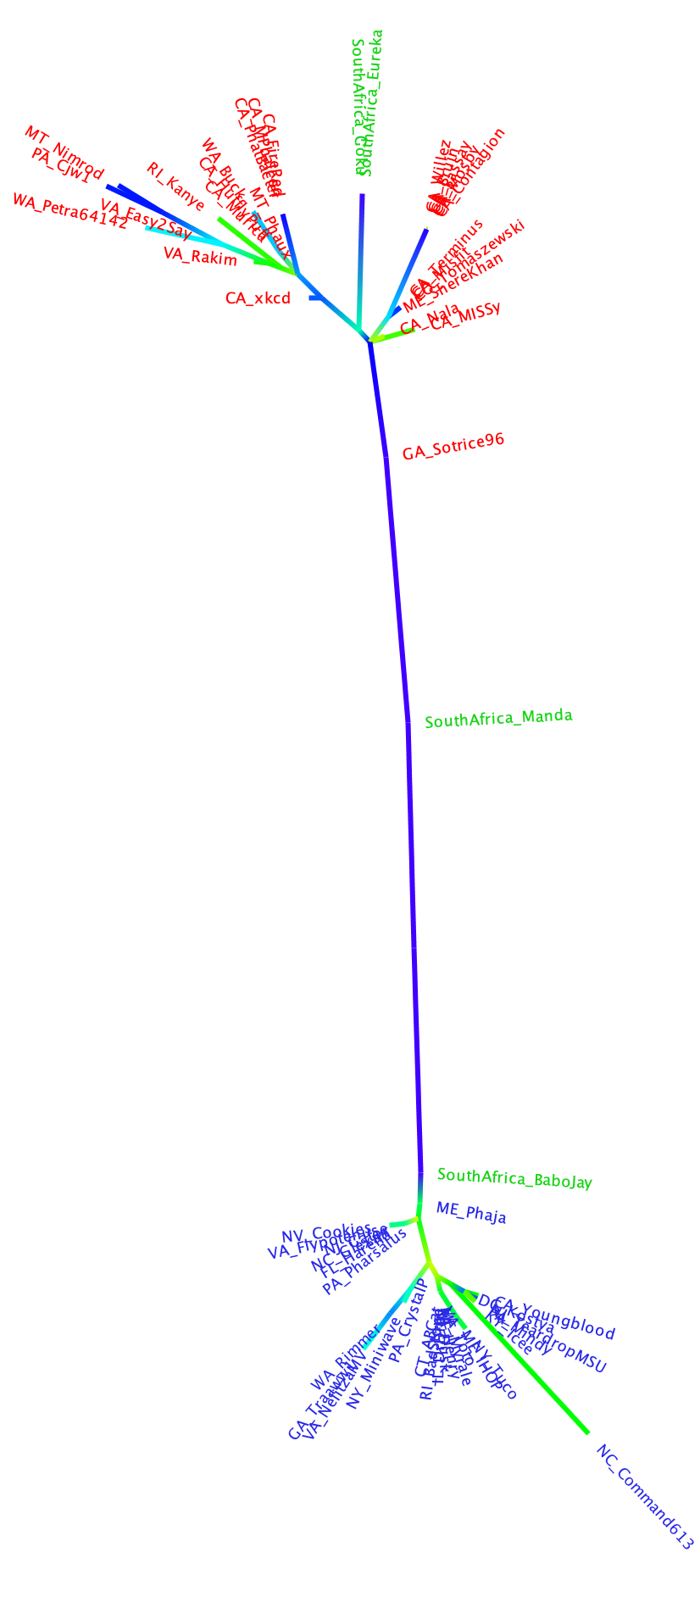
exteins
intein containing exteins

