Slide 1
MCB3421
class 24
Introns Early vs Introns late
Figtree

Slide 3
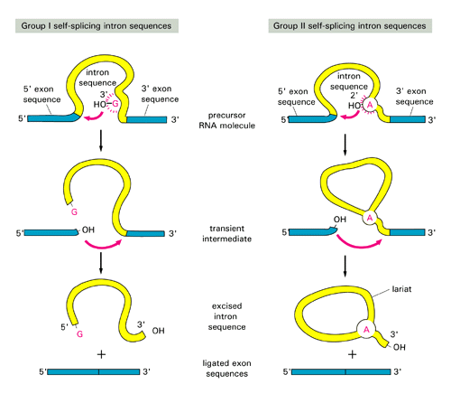

Slide 4
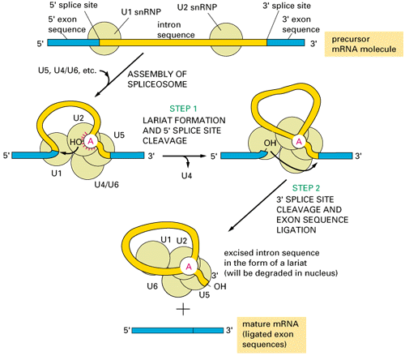

Slide 5
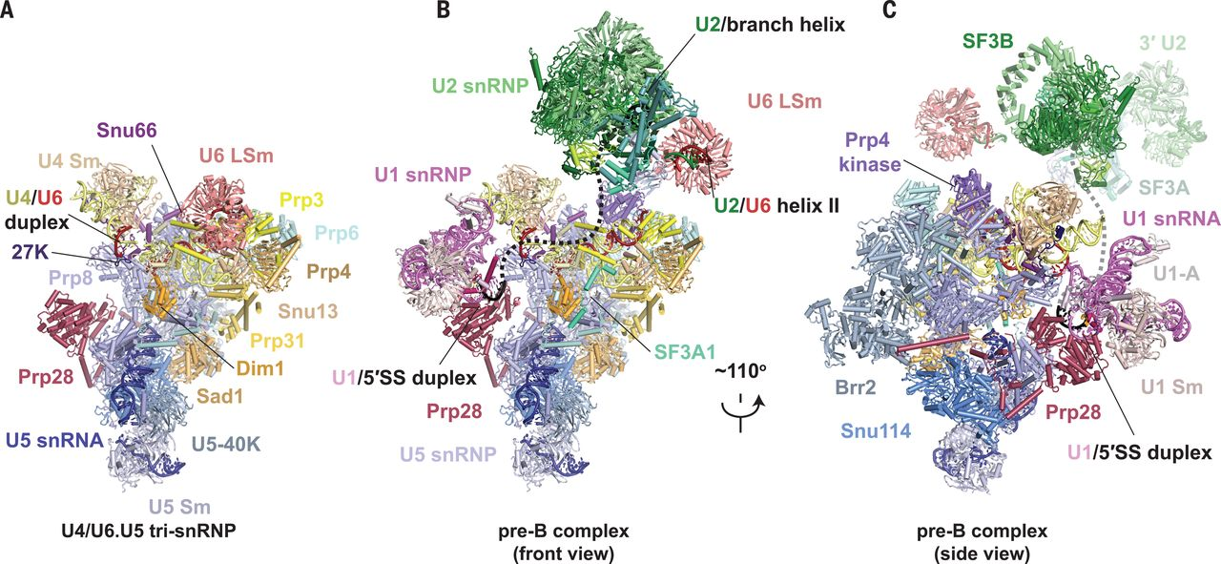
Fig. 1 Structures of human tri-snRNP and pre–B complex.
Clément Charenton et al. Science 2019;364:362-367
Copyright © 2019 The Authors, some rights reserved; exclusive licensee American Association for the Advancement of Science. No claim to original U.S. Government Works
Notes:
Structures of human tri-snRNP and pre–B complex. (A) Overview of human U4/U6.U5 tri-snRNP. (B and C) Overview of the human U1.U2.U4/U6.U5 pre–B complex in two orientations. The black dashed line represents the theoretical path of the pre-mRNA intron.

Slide 6
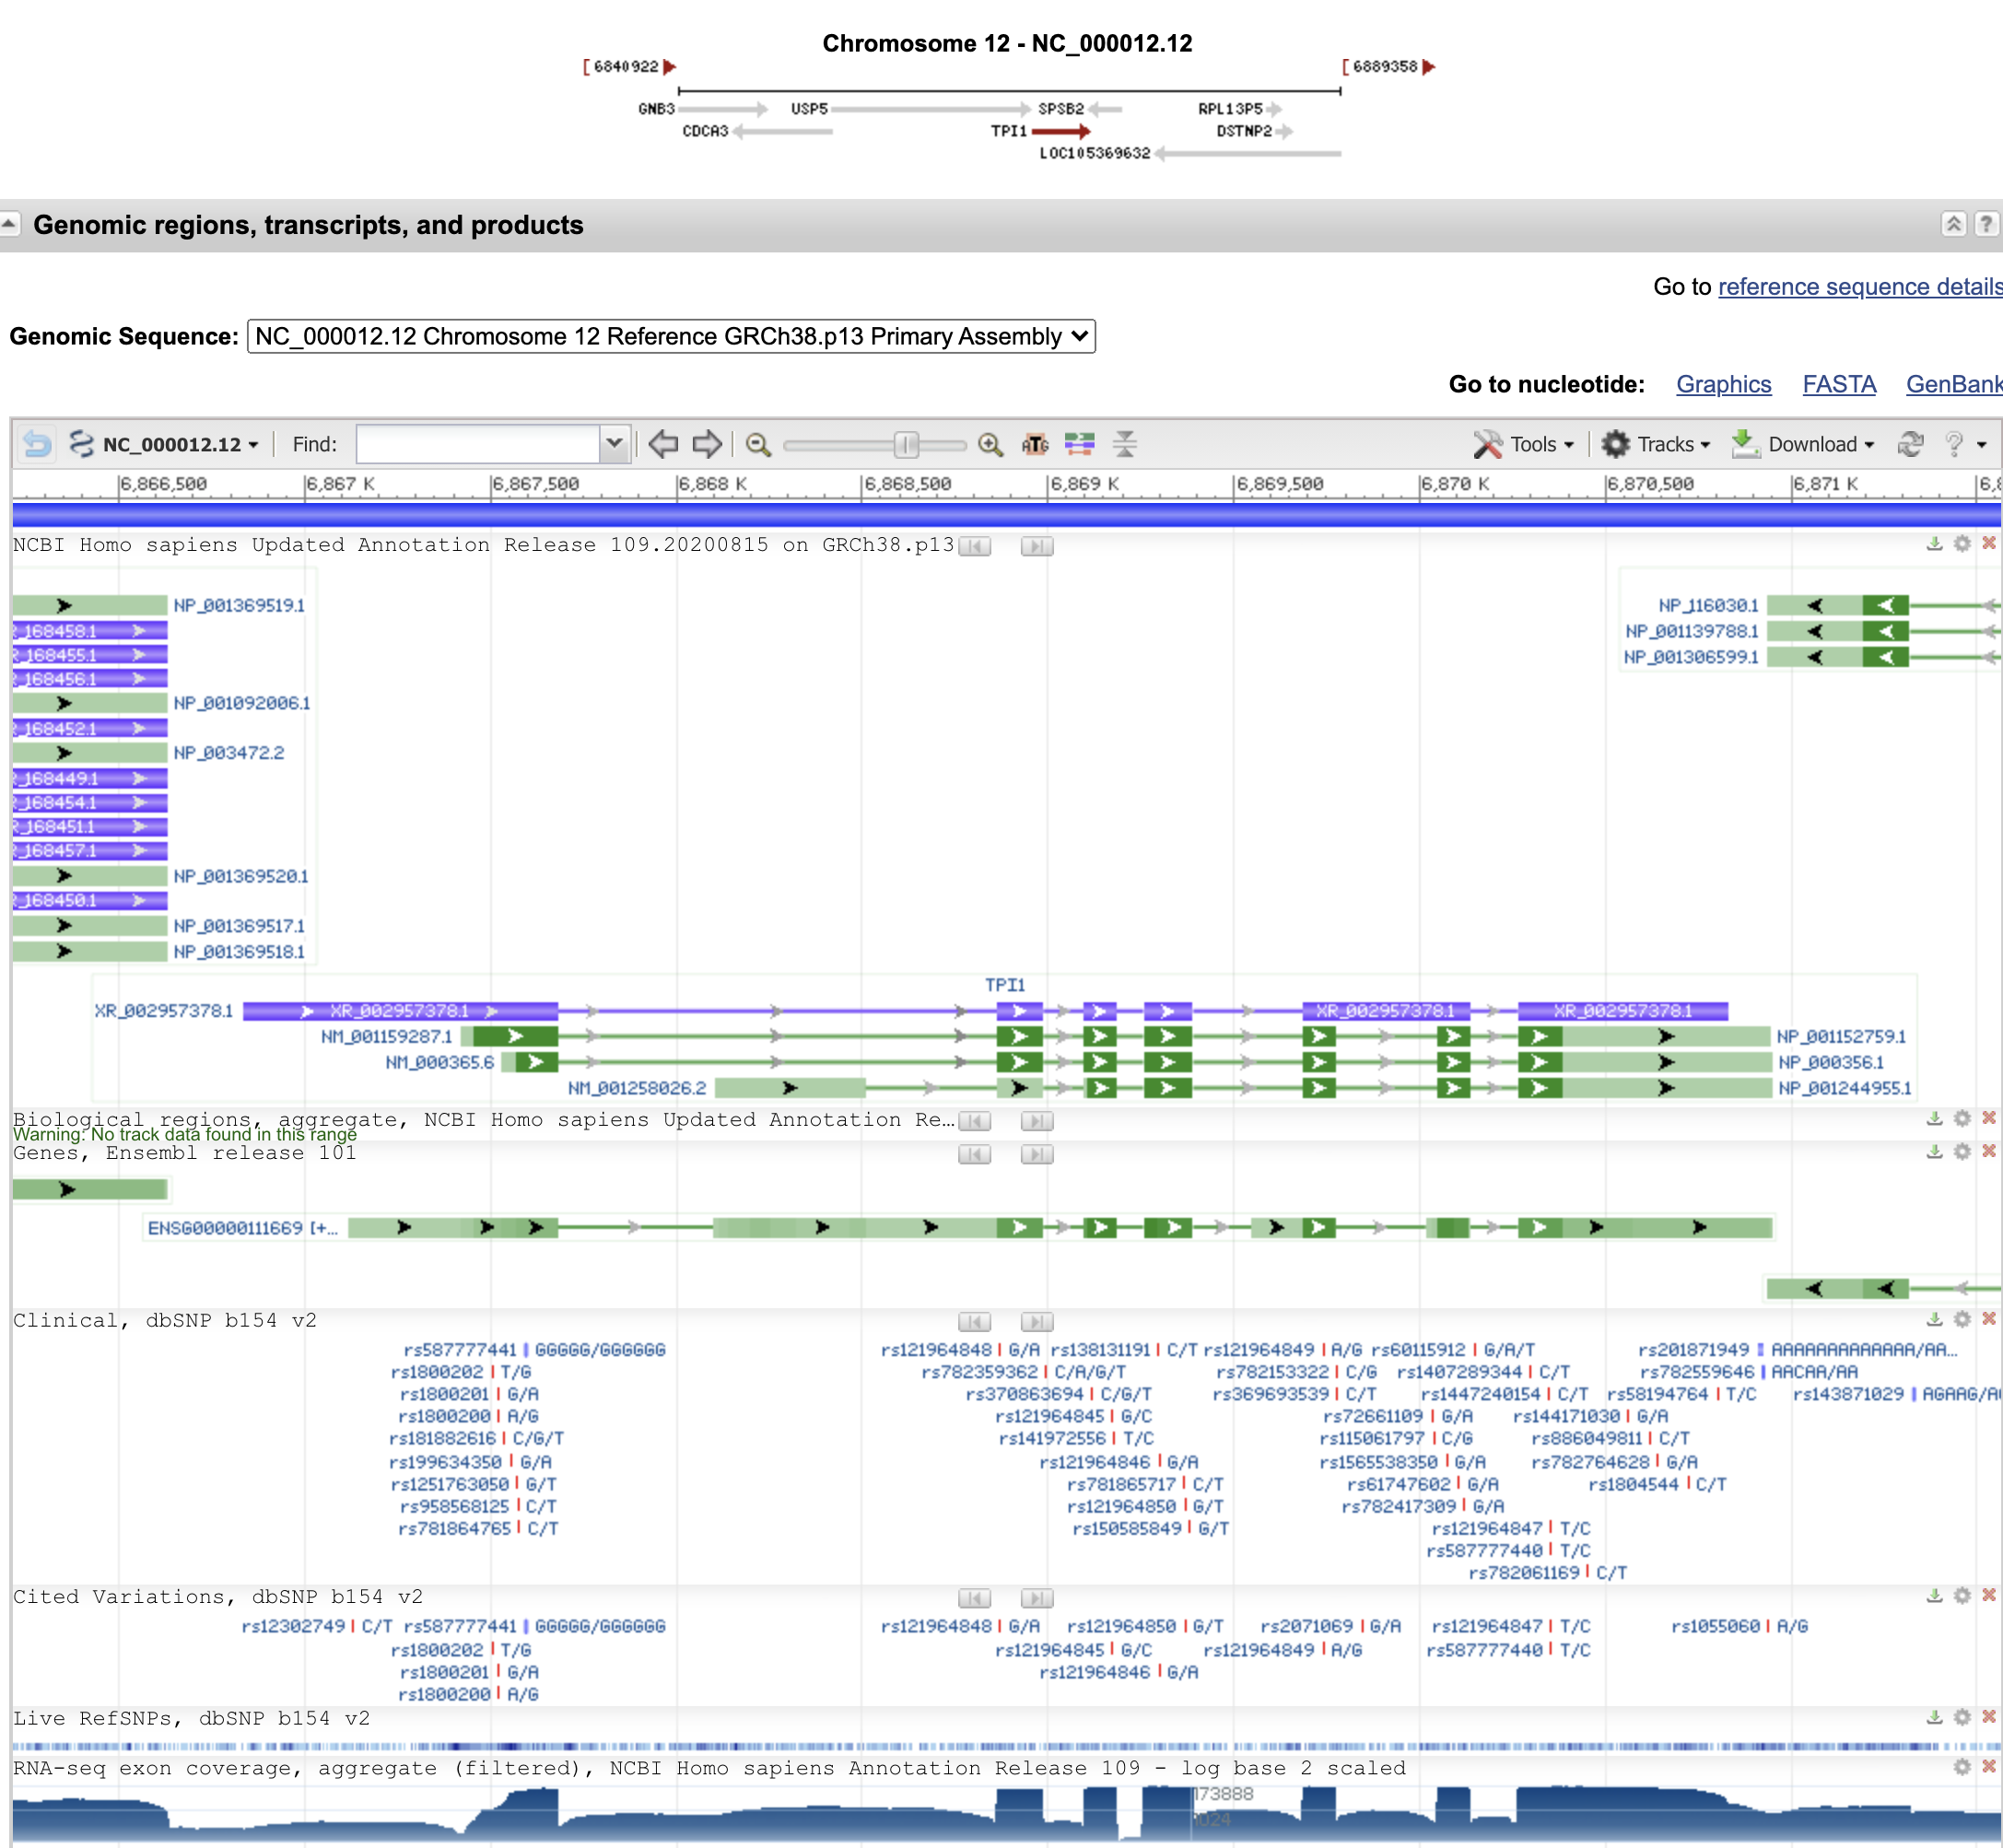
The human tpi1 gene in NCBI

Slide 7
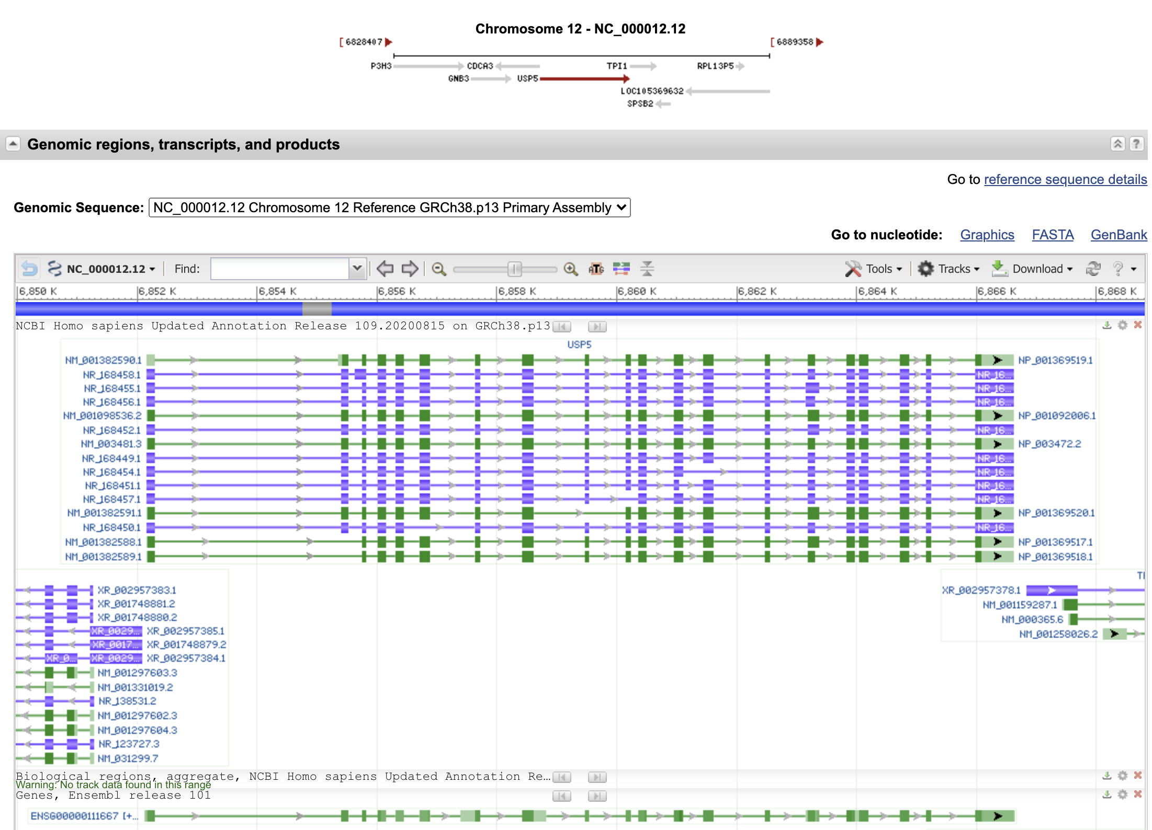
The neighboring gene, ubiquitin specific peptidase 5,
is perhaps more typical:

Slide 8
vma1 genes
Saccharomyces cerevisiae S288C
Schizosaccharomyces pombe
Xenopus laevis (African clawed frog)
(one of two paralogs)
Homo sapiens (human)

Slide 9
vma1 genes
Arabidopsis thaliana (thale cress)
Zea mays chromosome 4
Zea mays chromosome 5
Phoenix dactylifera (date palm)
Phalaenopsis equestris (orchid)

Slide 10
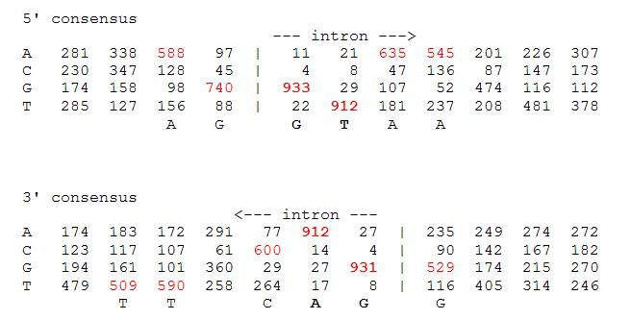
Splice site consensus in Arabidopsis thaliana

Slide 11
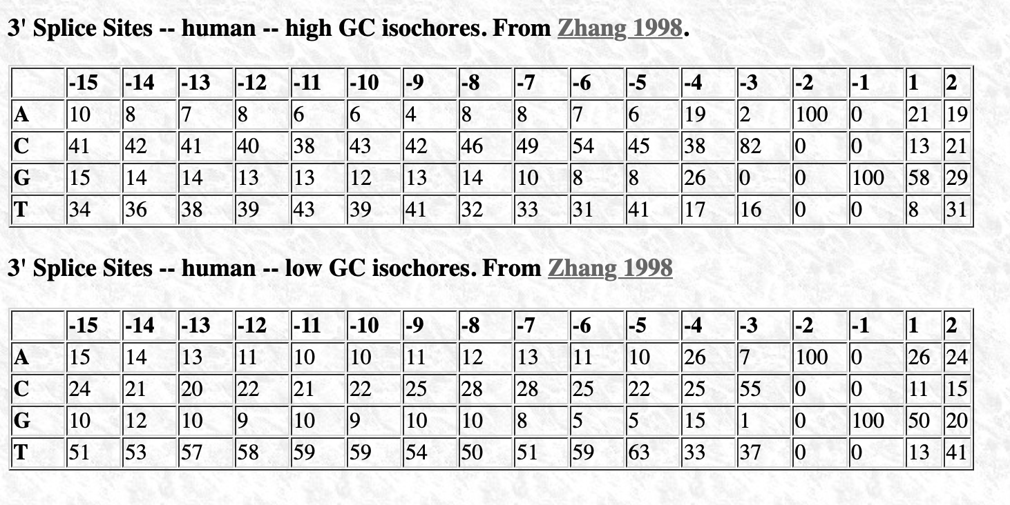
Splice site consensus humans
C A G || G T
From: http://science.umd.edu/labs/mount/RNAinfo/matrices.html https://pubmed.ncbi.nlm.nih.gov/9536098/

Slide 12
Splice site consensus humans
A G || G T
From: http://science.umd.edu/labs/mount/RNAinfo/matrices.html https://pubmed.ncbi.nlm.nih.gov/9536098/

Slide 13
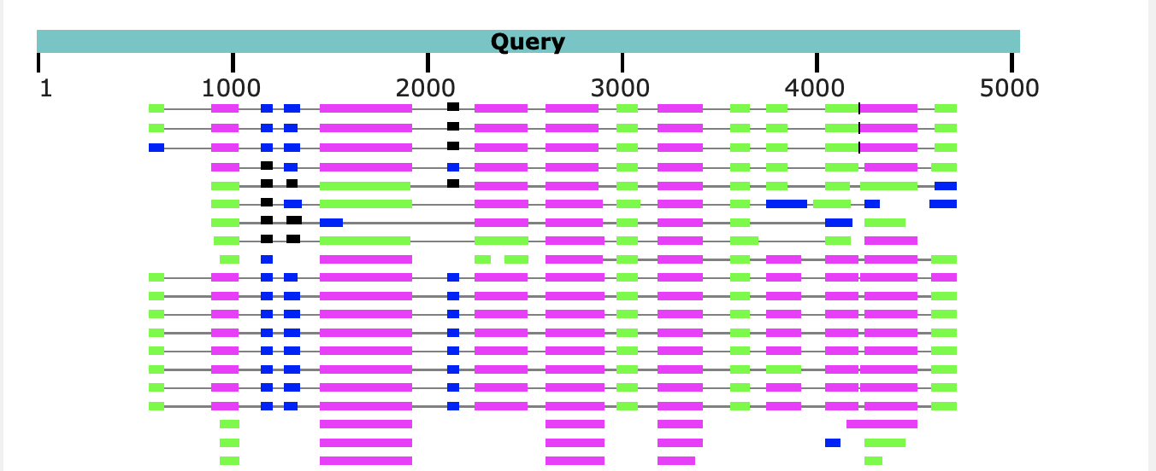
Predicting Intron and Exon sequences using computational approaches remains problematic.
The best way approach is to compare a cDNA or EST to the genome.
The second best is to compare the genome sequence to a protein databank.
The parts of the query that does not have matches corresponds to introns.
Note the large number of introns present in Arabidopsis, which is a plant with a very small genome. In other organisms the introns are even larger.

Slide 14
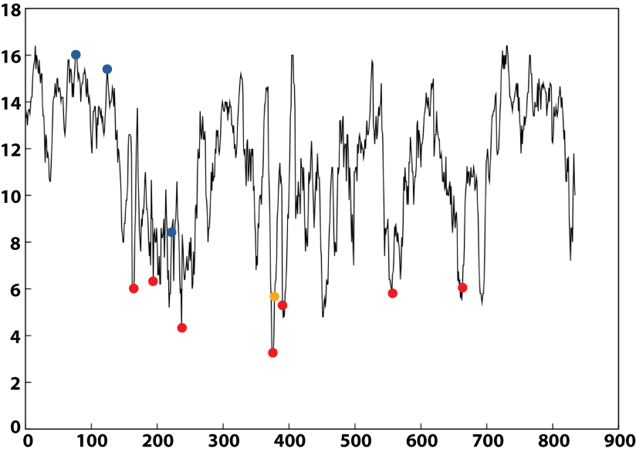
Ribonucleotide Reductase
Intein
Group I Introns
Group II Introns

Slide 15
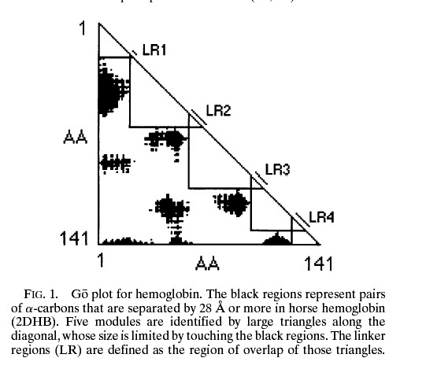
From:
Intron positions correlate with module boundaries in ancient proteins
Sandro Jose de Souza, Manyuan Long, Lloyd Schoenbach, Scott William Roy, and Walter Gilbert
https://www.pnas.org/content/93/25/14632
Named after Mitiko Gō

Slide 16
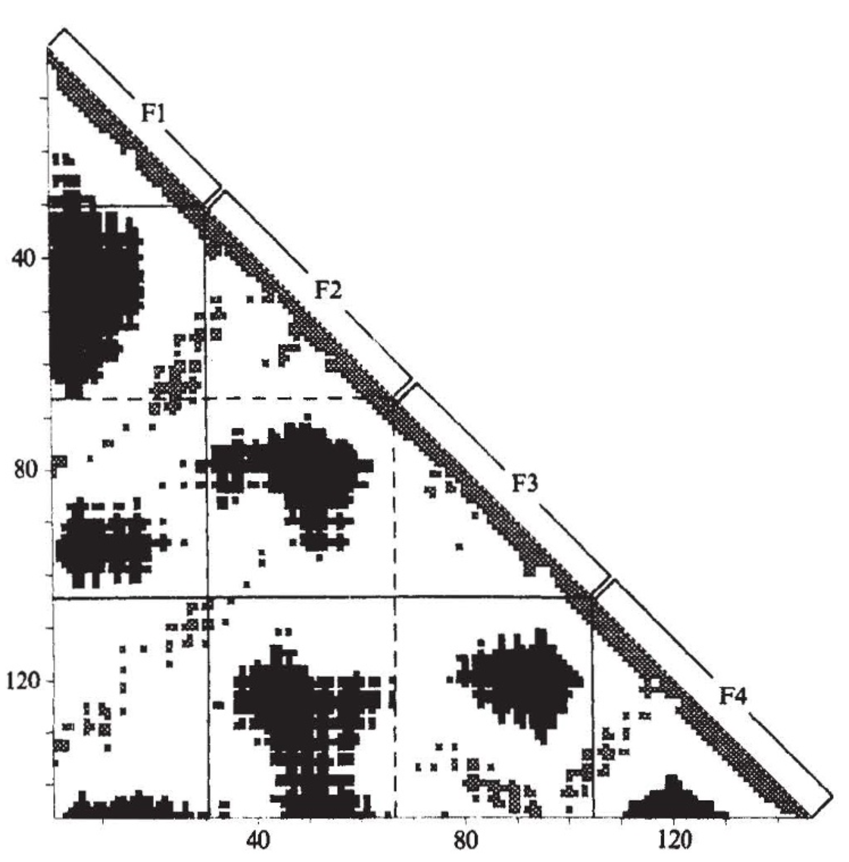
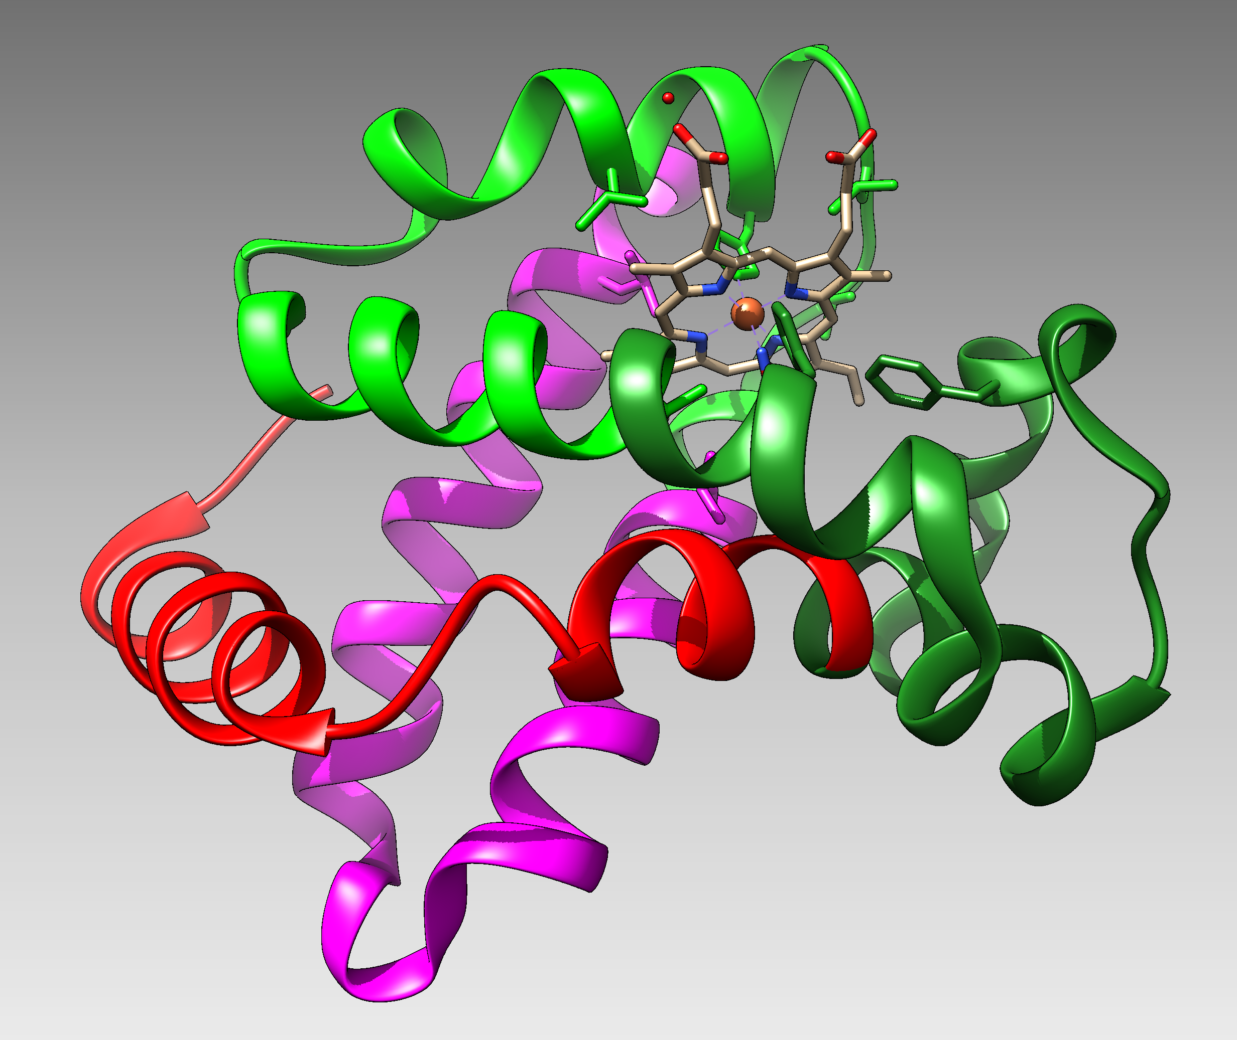
From:
Correlation of DNA exonic regions with protein structural units in haemoglobin
Mitiko Gō
Nature volume 291, pages90–92(1981)
beta SU from 4N8T Go domains colored
F1
F2
F3
F4

Slide 17
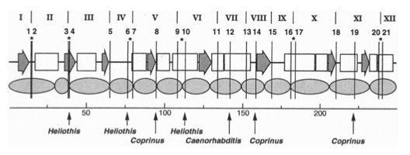

Slide 18
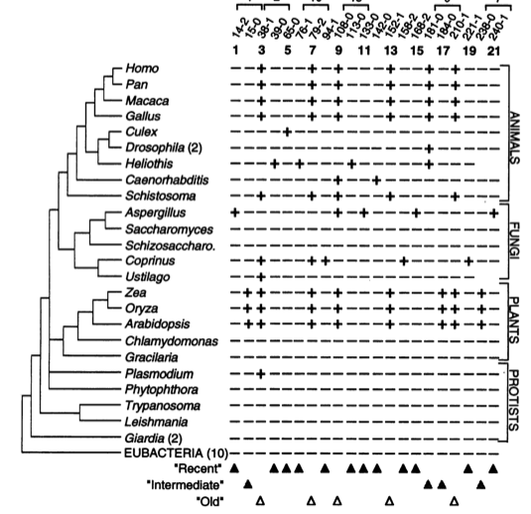

Slide 19
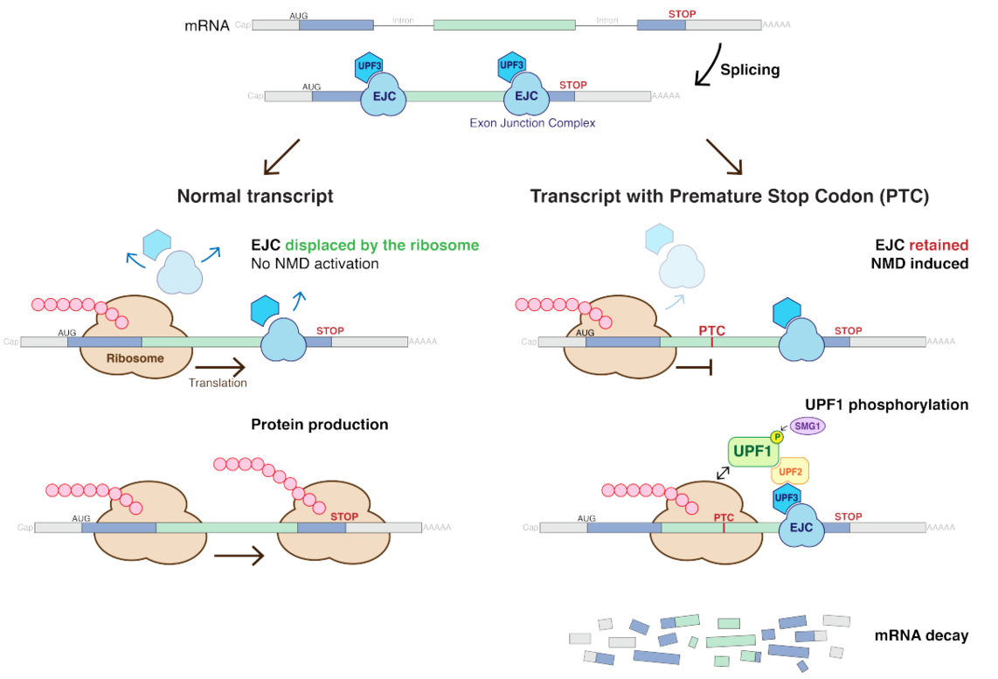
Nonsense-mediated mRNA decay (NMD) pathway
/
/
From:
https://en.wikipedia.org/wiki/Nonsense-mediated_decay
More details at https://en.wikipedia.org/wiki/MRNA_surveillance

Slide 20
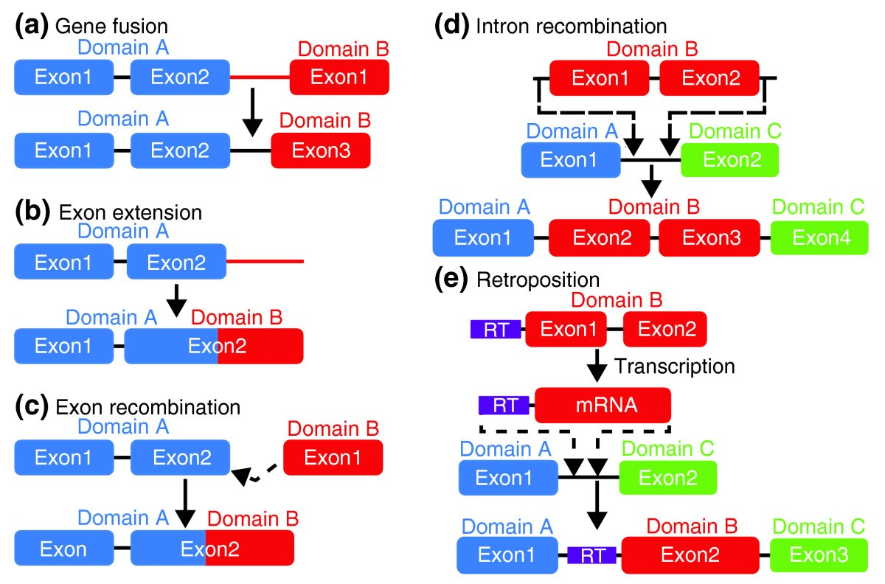
From: How do proteins gain new domains?
(a) Gene fusion. The noncoding region between two genes is modified so that the exons of the first gene become spliced with the second. (most common in animals) (b) Exon extension. The noncoding region following an exon becomes part of the exon and codes for a new domain. (c) Exon recombination. The exons of two genes become directly joined. (d) Intron recombination. An exon from one gene is inserted into the intron of another. (rare Less than 10%) (e) Retroposition. A retrotransposon sequence (RT, purple) mediates the copying of itself and a neighboring gene region via an mRNA intermediate, followed by insertion into another gene. (Rare (?) Gained domain encoded by a single exon).
/
Data from https://www.ncbi.nlm.nih.gov/pmc/articles/PMC2926785/

Slide 21
Other possible benefits of introns
Alternative Splicing
Exon shuffling
If splicing is skipped the intron sequence can become a novel exon.

Slide 22
Possible benefits of having intein
Exon shuffling
Genes for the IgG heavy chain
51x27x6x5 = 41,310 different combinations
Genes for the IgG light chain
40x 5 = 200 different combinations
If the assembly of the light and heavy chain one region V (D) J are joined together 8,262,000 different antibodies can be produced through exon shuffling. In the maturation of B cells additional mutations further increase diversity.
From: https://www.ncbi.nlm.nih.gov/books/NBK26860/

Slide 23
Introns early
Introns late
Self splicing RNAs are an example for catalytic RNA that could have been present in RNA world.
There is little reason to assume that the RNA world was not plagued by self-splicing parasites.
Neighboring Introns are more frequently in same phase than expected by chance (but not by much ☺)
Spliceosomal introns are present in deep branching eukaryotes
Introns frequently are found in linker regions (see Go plots)
Exon shuffling can create a large number of different catalytic sites (see the maturation of the immune system)
The nonsense mediated decay pathway exists in plants, animals and fungi. This pathway relies on tagging Exon Junction Complexes, i.e. the widespread presence of spliceosomal introns.
Mapping individual introns onto organismal evolutionary history shows that many introns inserted into the sites where they are found presently more recently.
Intron preference for linker region could be the result of selection (they do less harm here than in tightly packed domains.
Exon shuffling in the maturation of the adaptive immune system is a modern trait of vertebrates.
Even if some introns are ancient, this does not prove that they played a role in assembling the now existing protein families. In the recent evolution (in the presence of many large introns), recombination in introns (exon shuffling appears to be rare – gene fusions are more common)

Slide 24
Predicting Open Reading Frames
GeneMark uses hidden Markov models and can be trained using training sets -- works for pro- and eukaryotes and metagenomes
-- GenemarkS is the “standard to gene calling in viruses and prokaryotes
Glimmer was developed for prokaryotes, -- a related software (GlimmerHMM) was developed for eukaryotes
Keep in mind that ab initio approaches work less well than those based on homology.
Popular are
PROKKA (described here)
RAST
Both rely on homology and already annotated similar genomes.
The cycle of identifying essential genes (aatRNAsynthases, DNA and RNA polymerases, ATPsynthases), and using these to train gene prediction software seems to work well.

Slide 25
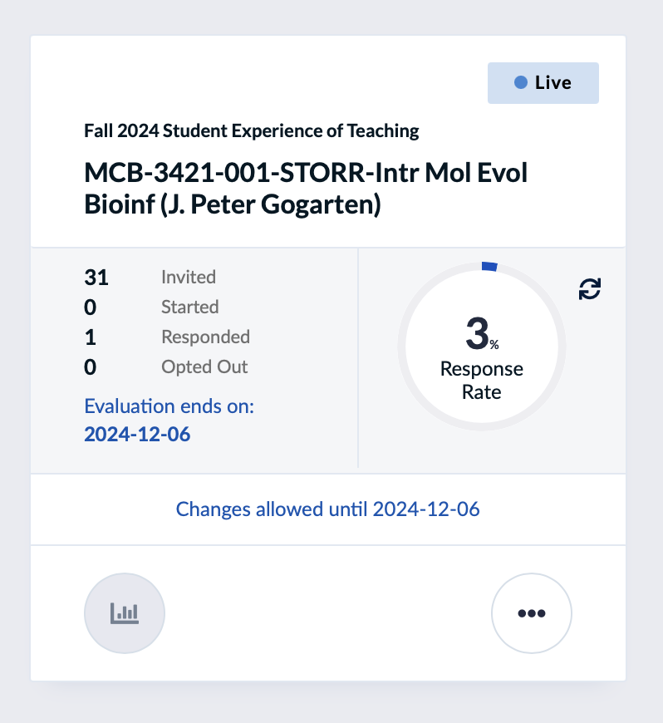

Slide 26
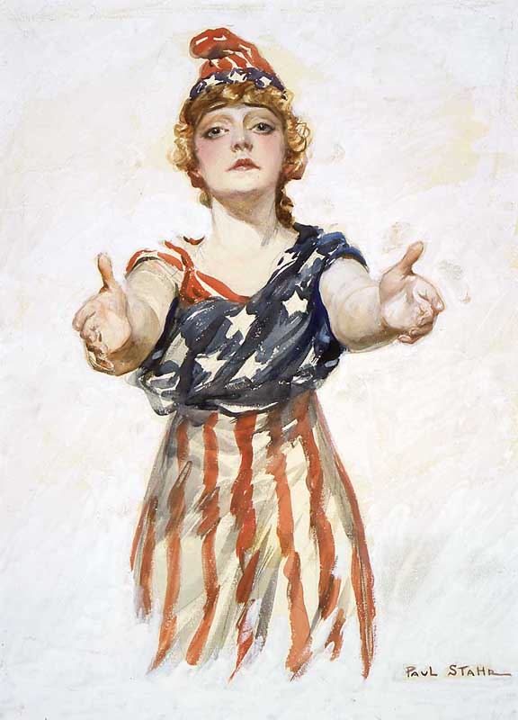
Be Nice !
Do the SETs !
Columbia from https://en.wikipedia.org/wiki/Uncle_Sam

