Slide 1
MCB 3421_2024 – class 10
The transitive property of homology
Blast searches via the commandline
The fossil record for early life
LUCA and the early heavy bombardment of Earth

Slide 2
Recommendation following the somewhat difficult use of filezilla and the absence of a decent text editor.
If you use the class laptops, always check out the same laptop.
Possibly set yourself up as a user
Then, if you use filezilla’s connection manager, filezilla will retain your settings.
Text editors that do not impose wrapping text if the line becomes to long work better in case one look at multiple sequence fasta files. I found BBEdit (there is a free version with limited but sufficient features) and the text editor in Visual Studio Code to work well

Slide 3
If A is a homolog of B & B is a homolog of C
A
B
B
C
then
A
B
C
B
C
A
A
C
B
either
or
or

Slide 4
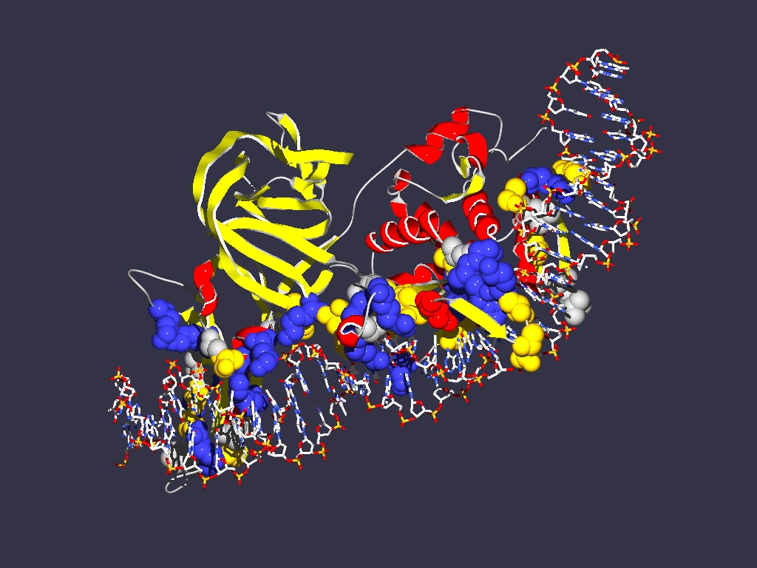
The transitive property of homology ”Exceptions”
A or B or C are not one, but several entities lumped together
Example:
Encoding
1LWS
Extein = Host Protein
Intein Splicing Domain
Homing Endonuclease (HE)
domain
Each component can have its own homologs

Slide 5
Exception to the transitive property of homology
In a pairwise blast search multiple components in the query might be revealed as follows:
Query: GI 6320016 (V-ATPase a-SU from Yeast)
6320016 (V‐ATPase A‐SU from Yeast)
GI 1303679 (V‐ATPase A‐SU from Acetabularia)
GI 1303679 (V‐ATPase A‐SU from Acetabularia)
Homolog 1:
GI 1303679 (V‐ATPase A‐SU from Acetabularia)
V-ATPase a-SU from Acetabularia
Homolog 2:
HO-endonuclease from Yeast

Slide 6
While homology is a transitive property, the parts of a protein (or DNA) that are homologous need to be the same. E.g. 6320016 (V‐ATPase A‐SU from Yeast) is homologous to 1303679 (V‐ATPase A‐SU from Acetabularia) and to 2507047 (mating type switching endonuclease from yeast), but different parts of 6320016 give rise to this homology.

Slide 7
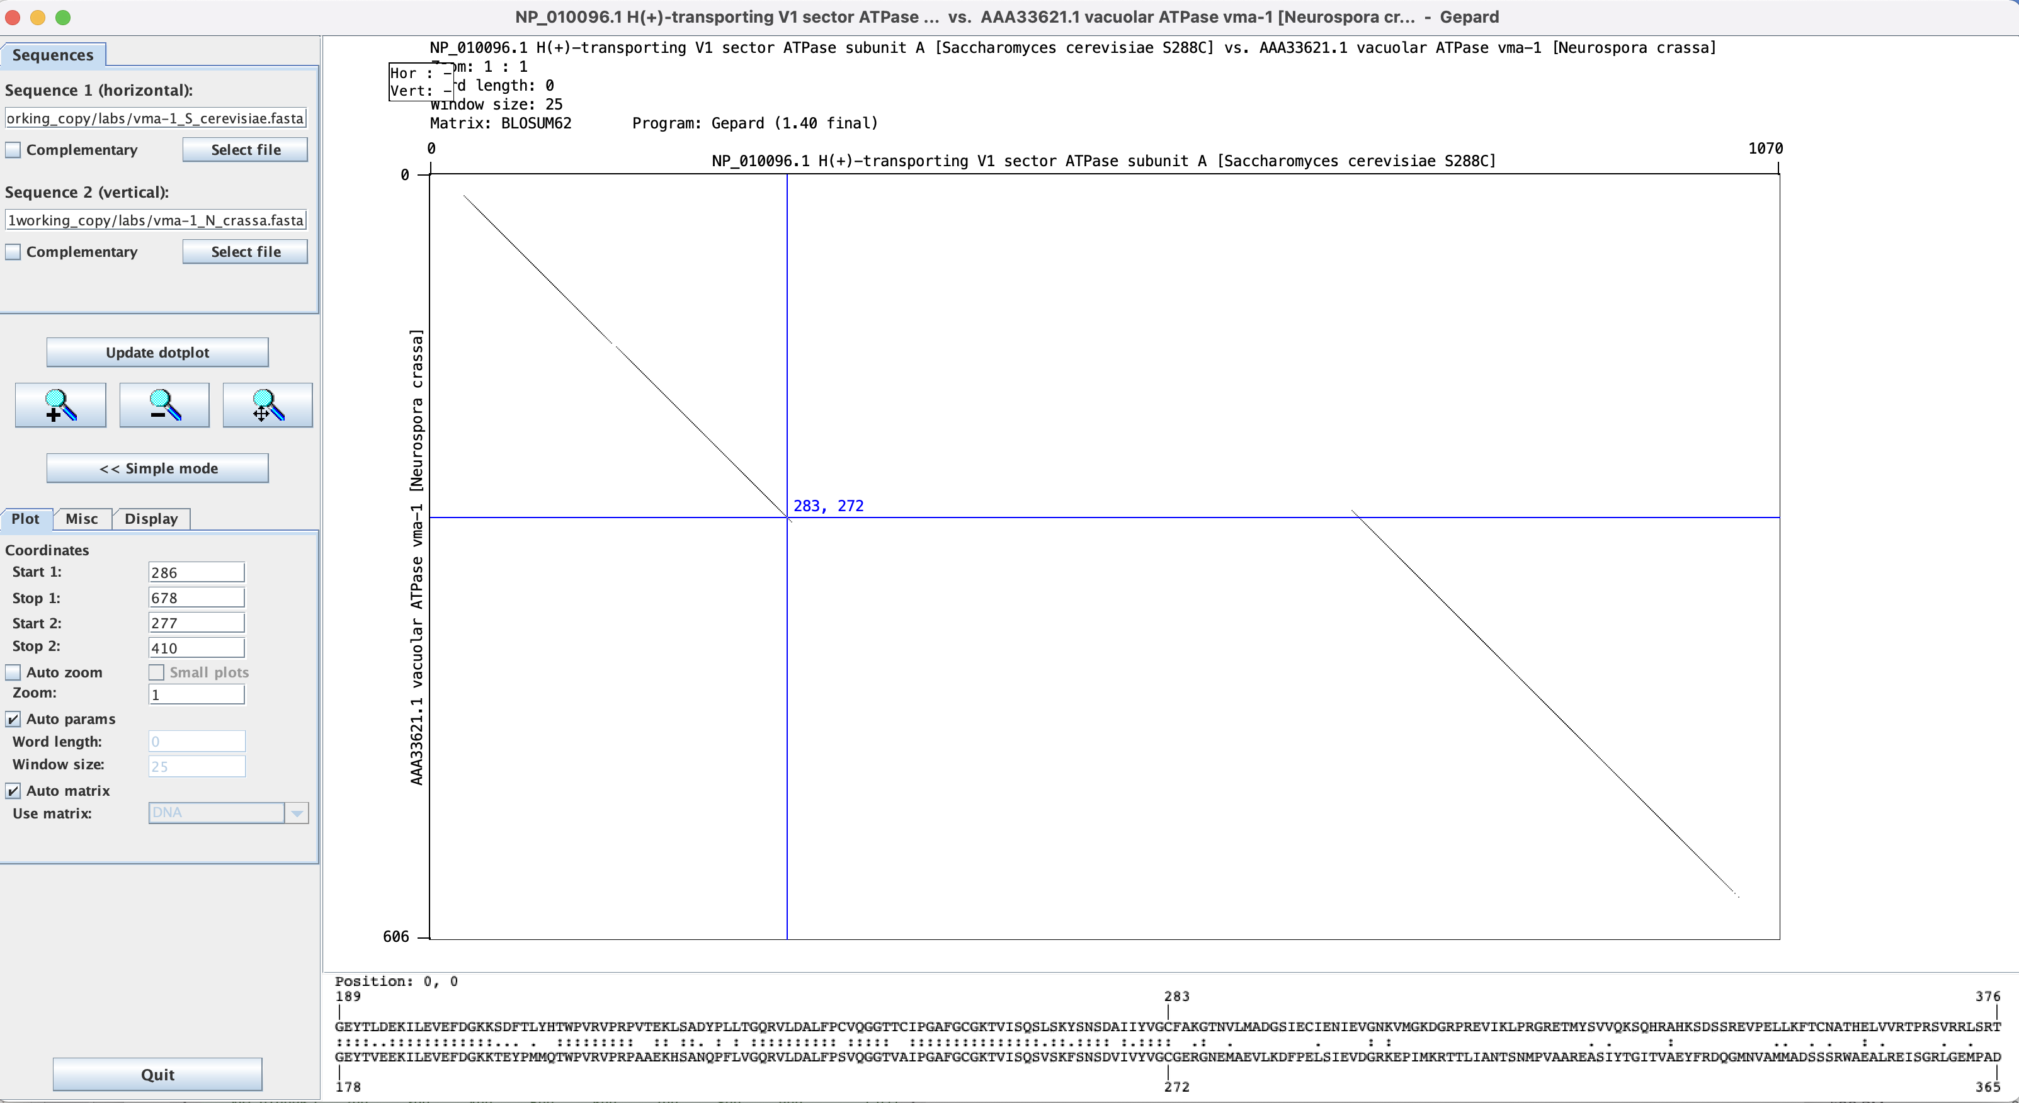
Dotplot in Gephard: Yeast vs Neurosora V-ATPase A-subunit.
Note: while the match ends at position 283, the diagonal extends a little beyond this. The first aa of the intein is the C

Slide 8
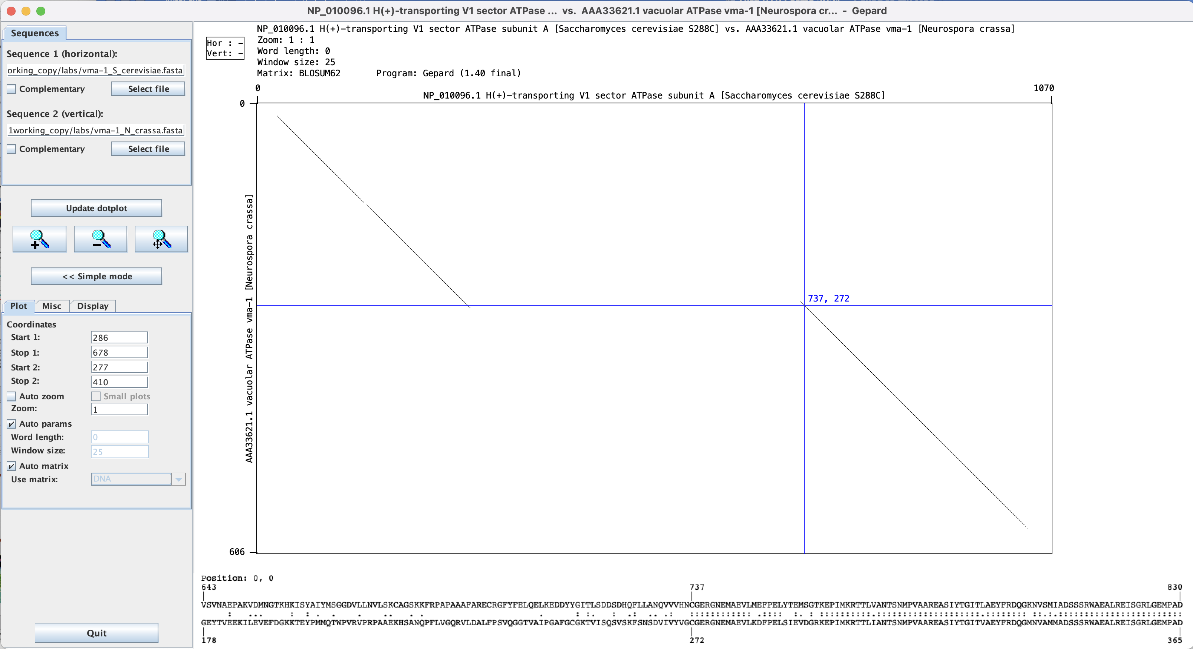
The last aa of the inteins are HN

Slide 9
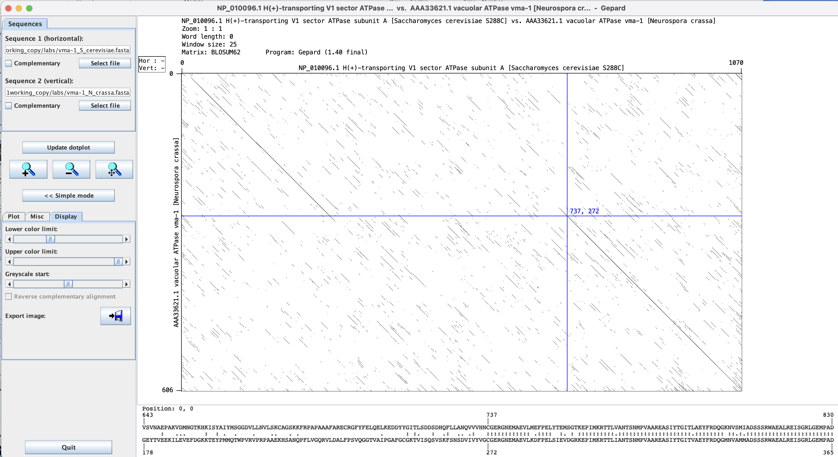
Adjusting which windows to display.

Slide 10
Hiroshige’s ‘Sudden Rain’ aka ’Sudden Shower over Shin-Ōhashi Bridge and Atake’
from: https://www.nytimes.com/interactive/2024/09/26/upshot/ten-minute-challenge-bridge.html?smid=url-share
and
https://en.wikipedia.org/wiki/Sudden_Shower_over_Shin-Ōhashi_Bridge_and_Atake

Slide 11
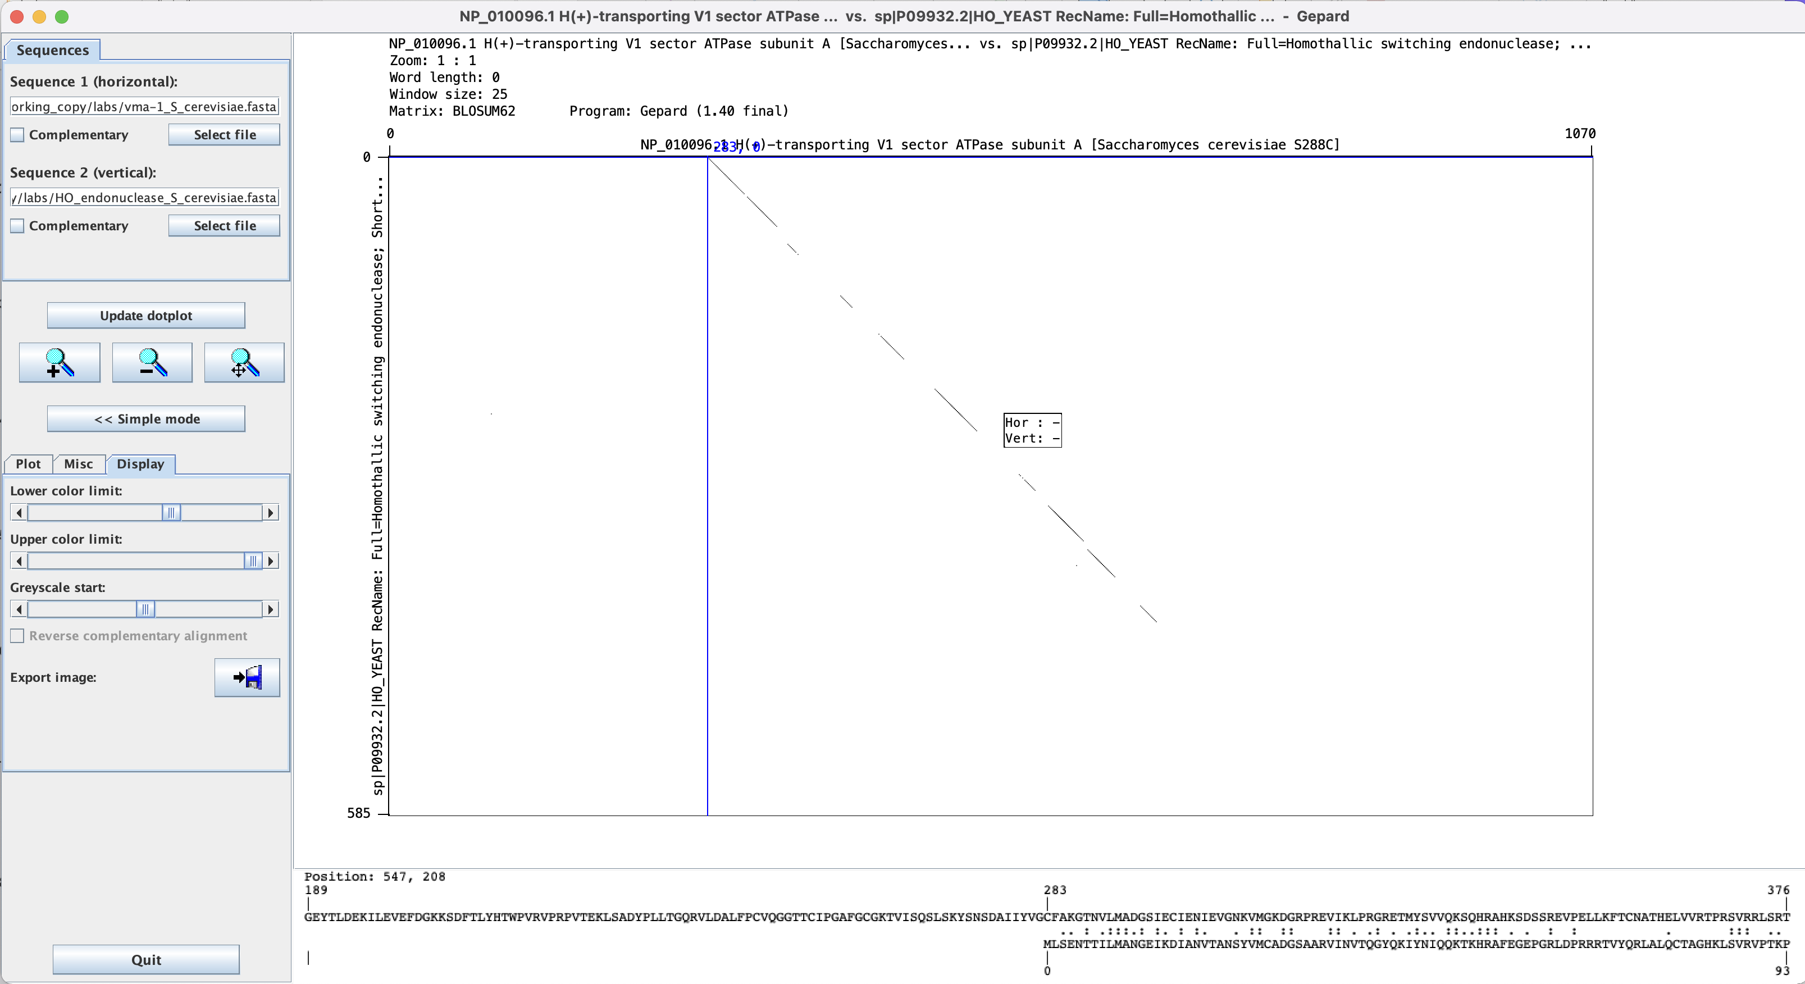
This works moderately well for divergent sequences – one could increase the window size and decrease the lower color limit

Slide 12
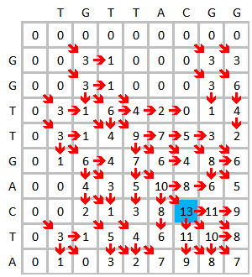
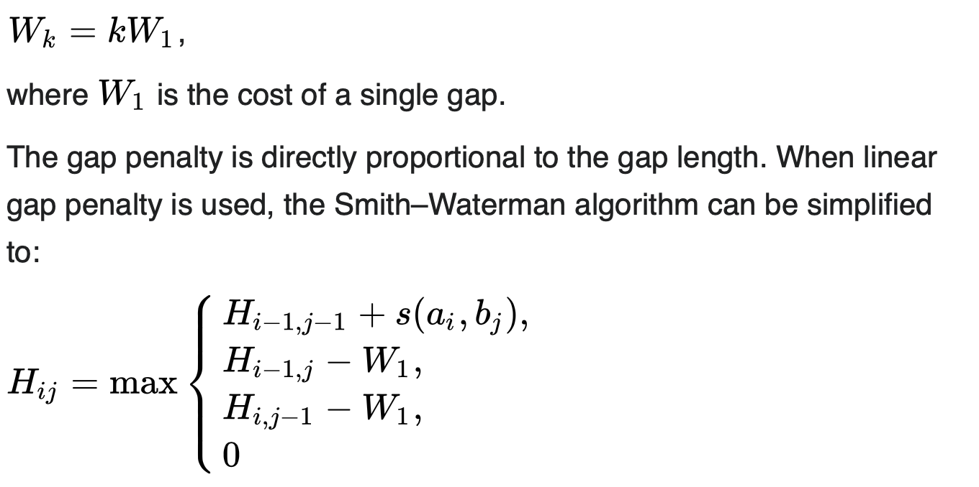
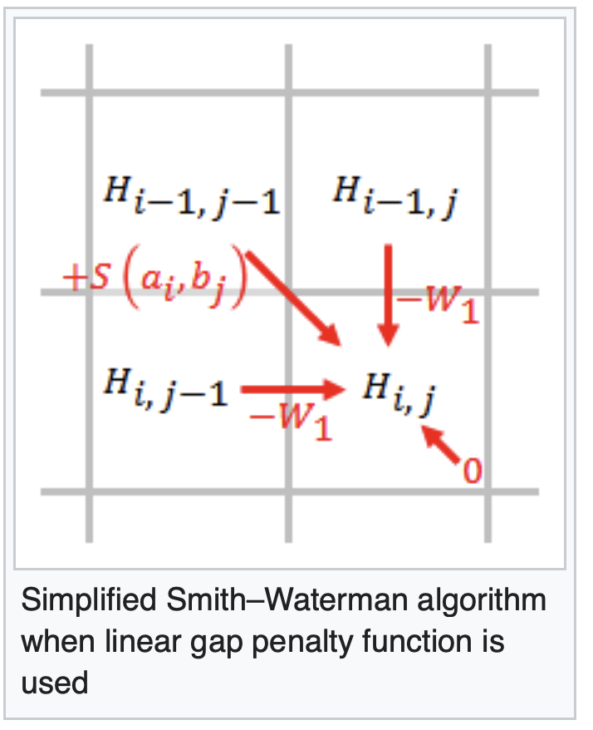
Optimal alignments
For pairwise (this has been extended to three sequences) dynamic programming algorithms have been developed that guarantee to find an optimal alignment (given a scoring matrix and gap penalties) (and you can use shuffling to assess significance of the score)
The most famous of these are the Needleman Wunsch and the Smith Waterman algorithms.
Wikipedia has a good description of the Smith–Waterman algorithm
You write down the sequences on the two axes, and starting at the upper left fill in the maximum score for each field
Assuming a linear gap penalty:

Slide 13
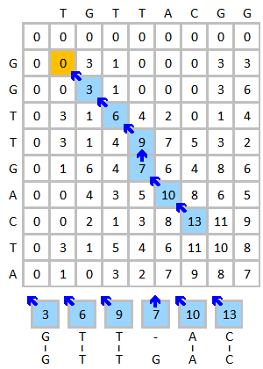
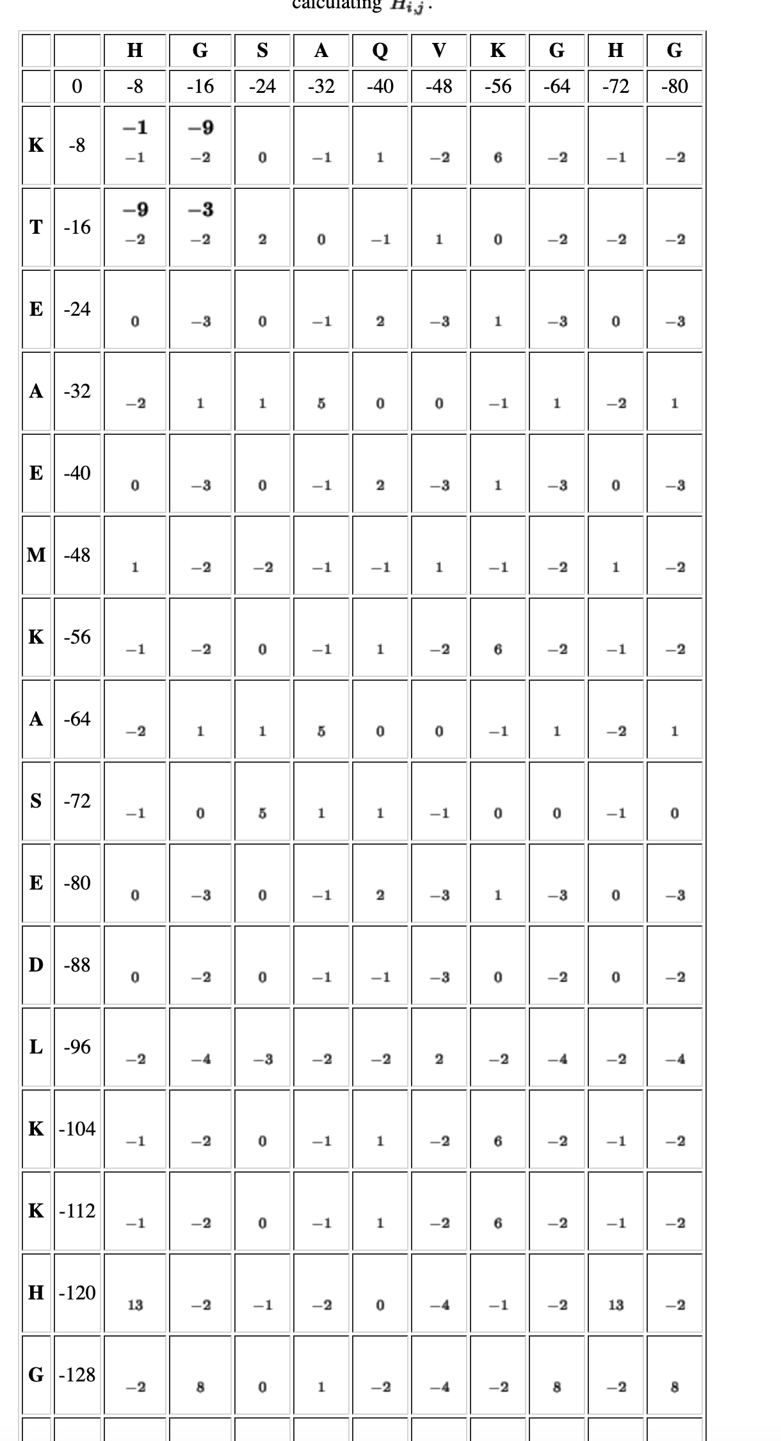
Trace back from the highest number to zero.
The Needleman-Wunsch algorithm differs in that it allows for cells to have
negative scores. A step by step version is here or more readable here

Slide 14
Both algorithms are guaranteed to give you an optimum score; however, usually the report a single alignment; however, usually there are different alignment with the same score. E.g.:
From: https://en.wikipedia.org/wiki/Needleman–Wunsch_algorithm

Slide 15
Multiple Sequence Alignments (MSAs)
clustalx (the same as clustalw with a GUI) is a frequently used progressive alignment algorithm*.
Gives excellent alignments that usually are very similar to alignments based on protein structures. It works better, the more sequences are included.
Often not acceptable as a start point to build molecular phylogenies!
* the first effective multiple sequence alignment program was developed by Feng and Doolittle

Slide 16
The second step (the clustering analysis of the sequences) is most important. The relationships found here will create a serious bias in the final alignment. The better the guide tree, the better the final alignment. One can load a guide tree into clustal. This tree will then be used instead of the neighbor joining tree calculated by clustalw as a default. (The guide tree needs to be in normal parenthesis notation WITH branch lengths).

Slide 17
Other alignment programs:
MUSCLE is the current alignment program of choice. Most think that it gives better alignments compared to clustal (clustalw or clustalo), it is faster and works with larg datasets. The program is available through a webserver at the ebi, and as a command line program to download here, and already installed on Xanadu.
Developed by gentleman scientist Robert Edgar. The paper on muscle has been citer over 47000 times
MUSCLE also is one option to use in the SEAVIEW GUI program

Slide 18
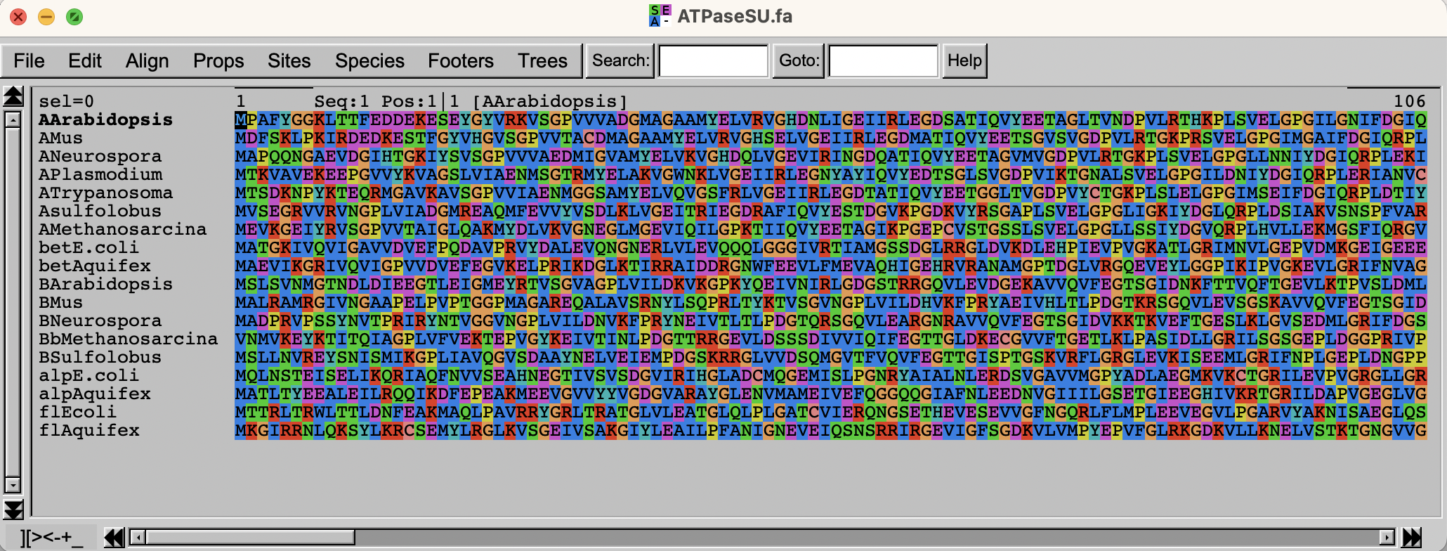
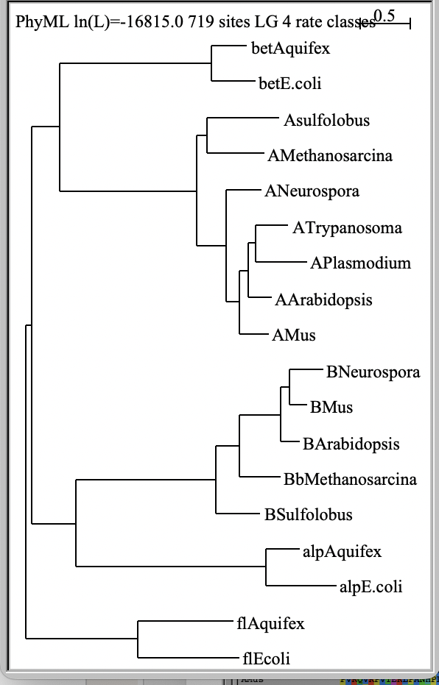
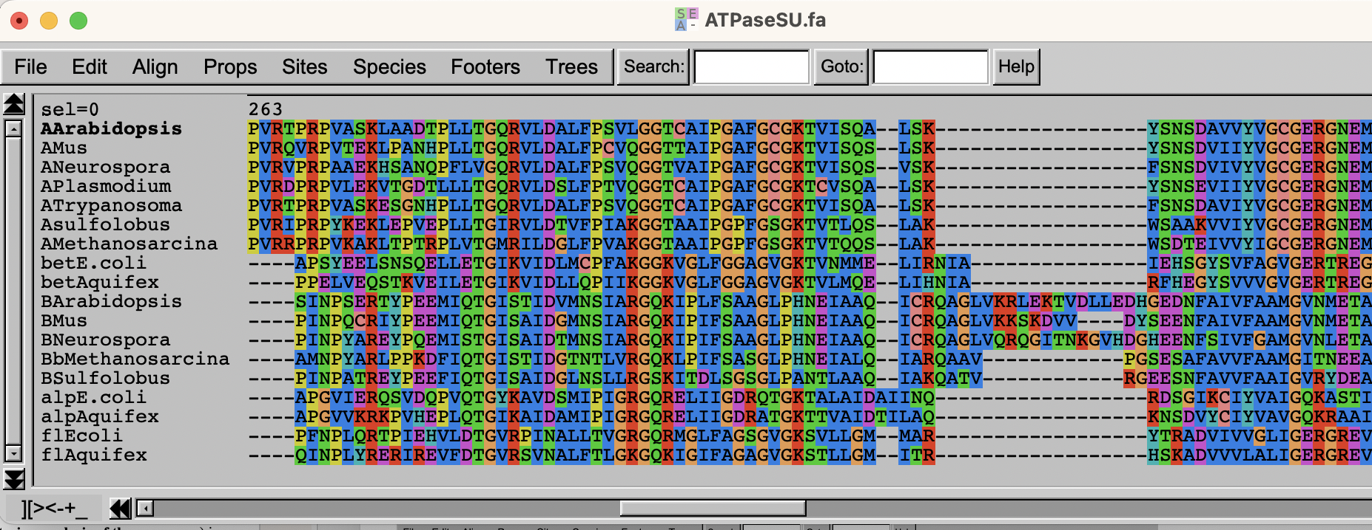
Seaview
aligns sequences
translates nucleotide sequences
reconstructs phylogenetic trees
easy to dissect alignment into domains

Slide 19
Statalign – trees without MSAs
If your sequences are not very similar, and if you are not able to generate a trustworthy multiple sequence alignment, you can calculate distance trees based on pairwise alignments only. The best program for this purpose is statalign from Jeff Thorne (Thorne JL, Kishino H (1992) Freeing phylogenies from artifacts of alignment. Mol Bio Evol 9:1148-1162). It runs under standard UNIX. It's only worth your effort if you are getting gray hairs because of a data set you cannot reliably align. Very out of fashion these days.

Slide 20
Prank
Most multiple sequence alignment programs produce alignments that are pleasing to the human eye by placing only a few large gaps into the sequences.
However, for many applications it is better to align a particular amino acid to gaps in the other sequences, if one is not certain about the homology of the position. Programs that introduce more gaps are at present underutilized. An example is PRANK (a web version of PRANK is part of the guidance 2 server to determine reliably aligned sites).

Slide 21
MAFFT
(this seems currently the best program, if one wants to align divergent sequences)
A collection of alignment programs with different options.
Options exist for sequences that are homologous over their entire length, or those that consist of multiple domains and may contain long gaps (missing domains) in some sequences.
Another option (currently in testing) is to force or not force alignment of divergent regions. An unalign level of .9 seems a good choice to avoid downstream artifacts

Slide 22
MAFFT
Available online, but only with very limited numbers of iterations. (Note the webversion also gives you the command line command that you can use to run the alignment locally.
If you use the web interface at https://mafft.cbrc.jp/alignment/server/ , it tells which command it used – you can copy this and then use it on Xanadu or your own computer from the command-line, and increase the number of iterations.
Commands might be the following:
mafft --globalpair --maxiterate 1000 all.fasta > output_alignment.fasta
mafft --globalpair --unalignlevel 0.8 --leavegappyregion --maxiterate 1000 all.fasta > more_iterations_alignlevel0.8.fasta
The manual is at https://mafft.cbrc.jp/alignment/software/manual/manual.html

Slide 23
SATè
A program that combines phylogenetic reconstruction and multiple sequence alignment: SATe.
SATé is a software package for inferring a sequence alignment and phylogenetic tree. The iterative algorithm involves repeated alignment and tree searching operations. The original data set is divided into smaller subproblems by a tree-based decomposition. These subproblems are aligned and further merged for phylogenetic tree inference.

Slide 24
Recommendations
If you need to use MSA in your work, my current recommendation is to use muscle, and test if an alignment calculated with PRANK or MAFFT gives similar results.
Note: in some instances none of the automated procedures gives satisfactory results and modifying alignments by hand is the only option.

Slide 25
Manual Alignments
In some instances, none of the automated procedures gives satisfactory results and modifying alignments by hand is the only option.
Jalview remains a popular option. Advantages are the PCA analysis of the sequence alignment, and the integration of the different display windows.
Seaview is similar, it has a nice GUI and uses has more sophisticated alignment (muscle, clustalo) and phylogenetic reconstruction programs.

Slide 26
E.g., a gene invaded by inteins inserted into different locations
Intein 2
Extein
Intein 1
Intein 2
Extein
Intein 3
Muscle aligns the 2nd intein to the 1st intein mushes part of the extein with the intein sequence :

Slide 27
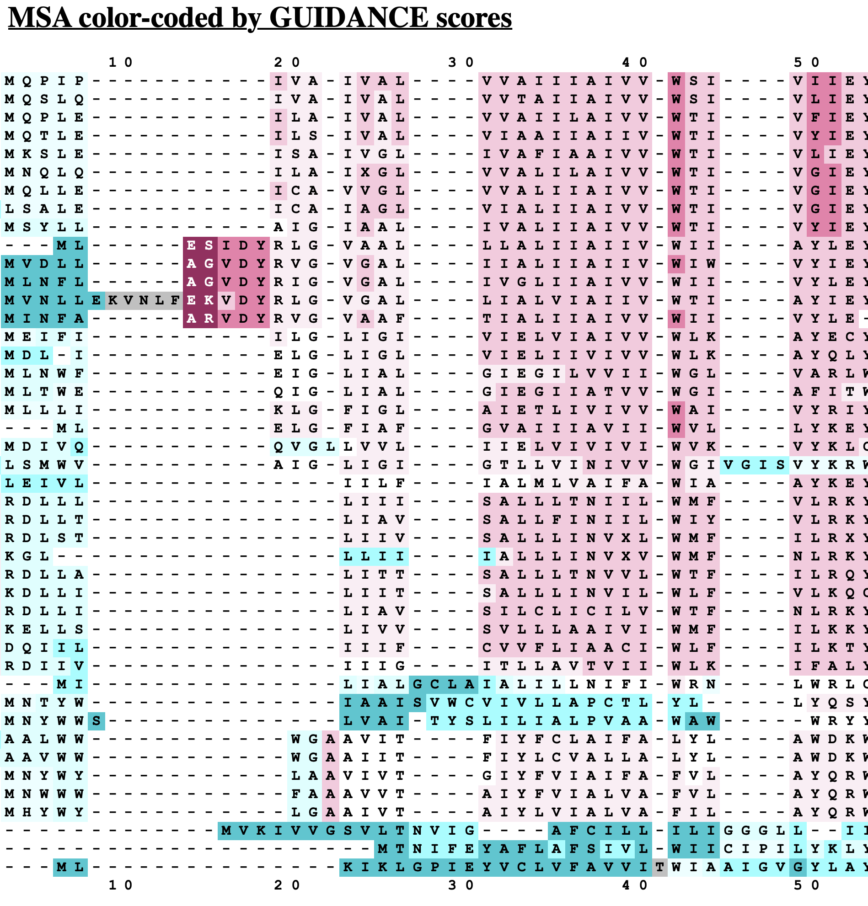
The question if one should use only reliably aligned sequences, or all sequences remains under debate. Many think that using all of the sequences will inform on substitution patterns and thus generate more reliable models.
Also, variable regions that cannot be aligned between divergent sequences, will help to resolve relationships closer to the tips.
One approach to remove ambiguous alignment positions is GBLOCK (implemented in seaview (see above, web server is here), another is guidance from Tal Pupko's lab at TAU (I like this one, because It allows to remove positions from poorly aligned individual sequences, not only complete columns).

Slide 28
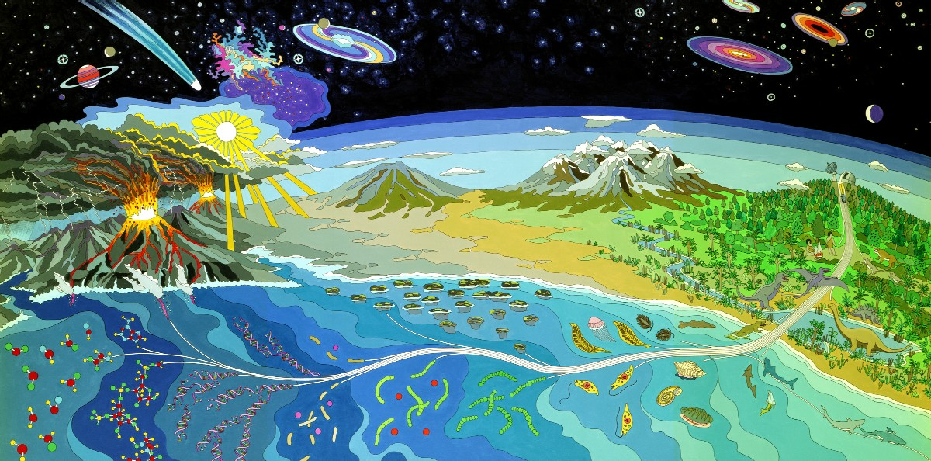
Mural at NASA Ames Research Center
The record for early life

Slide 29
With the insistence of NSF and NIH that articles reporting on funded research are accessible by the public within a year after publication, many recent articles are available to everyone. Exceptions are review articles and commentaries and particularly annoying, older articles in Science (e.g., Bill Schopf’s article on 3.5 billion-year-old* cyanobacterial fossils.
* Names and abbreviations for large numbers are a problem. Most European countries denote “10^{9”} as a milliard and “10^{12”} as billion. This is known as a the short (UK and US) and long scale respectively. From Wikipedia:
For example, Bulgarian, Catalan, Croatian, Czech, Danish, Dutch, Finnish, French, Georgian, German, Hebrew (Asia), Hungarian, Italian, Norwegian, Polish, Portuguese, Romanian, Russian, Serbian, Slovak, Slovenian, Spanish, Swedish, Turkish and Ukrainian — use milliard (or a related word) for the short scale billion, and billion (or a related word) for the long scale billion.
Giga Year Before Present as less ambiguous.

Slide 30
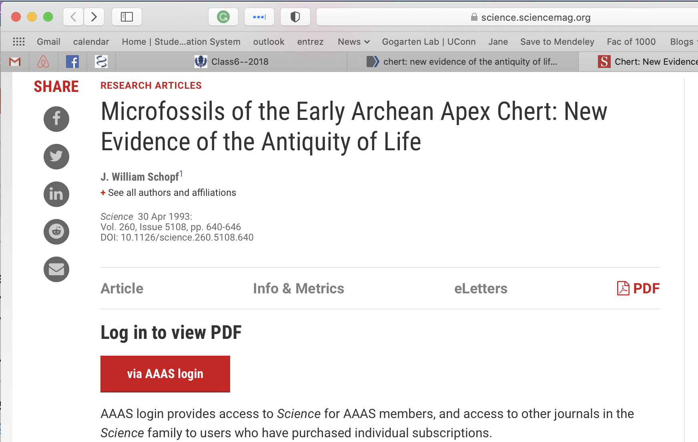

Slide 31
The web’s solution to open access:
Paste DOI here

Slide 32
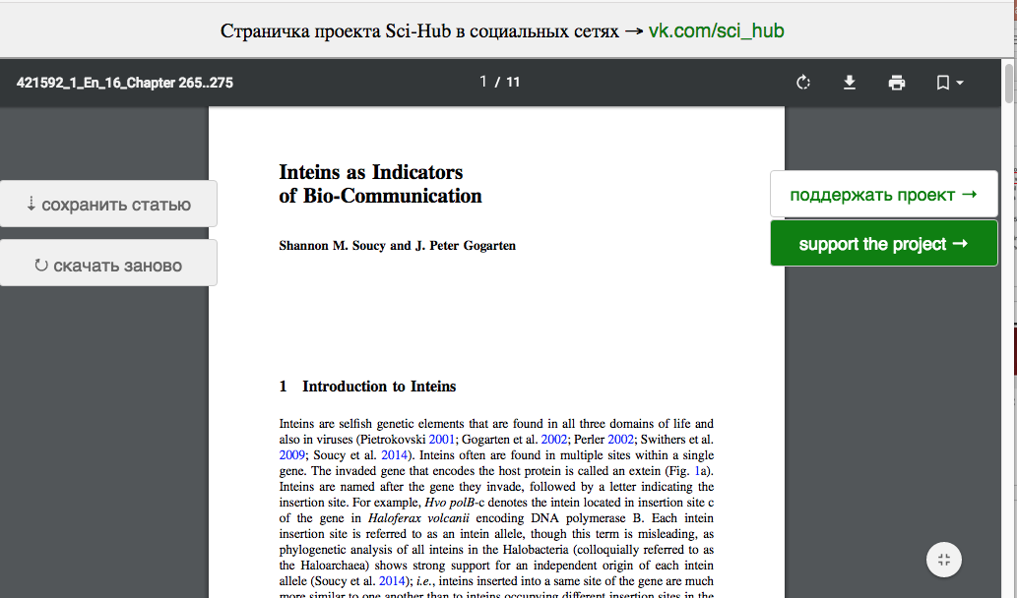
SCI-HUB
Even obscure and very recent Book Chapters are retrieved. This was posted before the authors had received their pdf!

Slide 33
Companion site to SCI-HUB

Slide 34
Jemmy Button was a native American “abducted” by Captain FitzRoy (bought for a button, hence the name) to England to be civilized. He, together with a missionary and other Fuegians were returned to Tierra del Fuego on the same trip that also brought Charles Darwin to the Galapagos.

Slide 35
to download click here

Slide 36
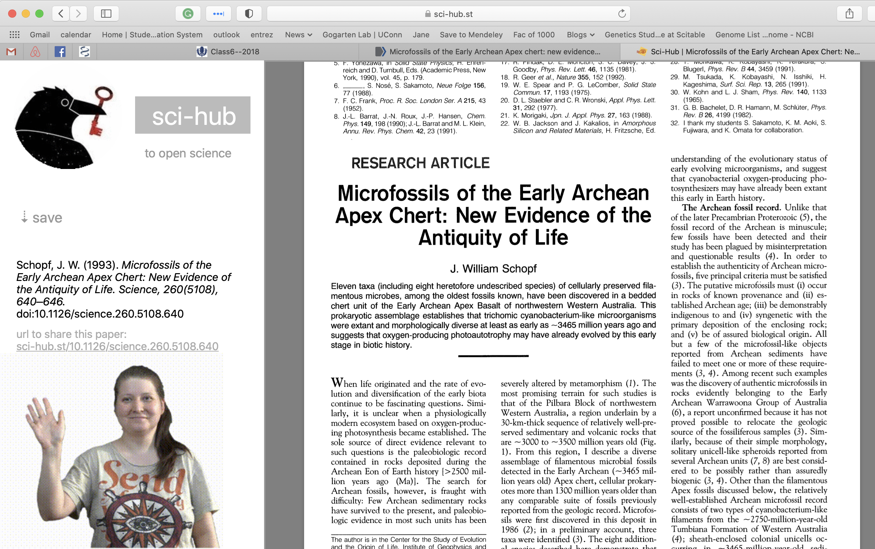

Slide 37
How old is life on Earth?
The Earth is about 4.6 Ga old, but no crustal rocks has survived from that time. The oldest rocks are no older than 4.0 Ga. But zircon crystals dated to 4.4 billion years BP are found in rocks. They are considered evidence for Earth's crust having had formed and being in contact with water already 4.4 billion years GaBP (here and here)
Biological Signature Evidence (examples): Oldest geological evidence for life - 3.8 Ga ago - is based on ¹³C discrimination (carbon derived from living systems often have lower delta ¹³C values than inorganic carbonates) [here]. The rocks are from Akilia island off the coast of Greenland, and severely altered by metamorphism. However, recently the evidence for that was reassessed.
3.7 billion year of rocks from the Isua formation in Greenland contain structures described as stromatholites. here in NYT, report in Nature
The amount of carbon in the Issua formation (and its discrimination against against 13C) is interpreted by Minik Rosing to indicate a highly productive biosphere.
3.7GA old fossils from marine hydrothermal vent systems (Dodd et al 2017)
Molecular dating from sequences usually has used microfossils (e.g., Bangia like fossils from 1.1 GaBP), and the end of the early heavy bombardment at around 3.9 GaBP and calibration points. Without the latter, dates from molecular data appear much earlier. A recent manuscript estimates that a complex LUCA has lived ~4.2 Ga (4.09–4.33 Ga) BP.

Slide 38
How old is life on Earth? (continued)
The amount of carbon in the Issua formation (and its discrimination against agains 13C) is interpreted by Minik Rosing to indicate a highly productive biosphere.
3.7GA old fossils from marine hydrothermal vent systems (Dodd et al 2017)
Morphological Fossil Evidence:
For about a decade the oldest microfossils were considered to be about 3.5 Ga old (see here). The fossils (as interpreted by Bill Schopf) look like "modern" Cyanobacteria. Compare the time to to molecular trees of life: Is this a problem? However, the evidence for these fossils was questioned. 3.2Ga old filamentous fossils, probably of thermophilic chemotrophic prokaryotes (Rasmussen, 2000) 1.8Ga old fossils from Gunflint formation: iron-loving bacteria and cyanobacteria

Slide 39
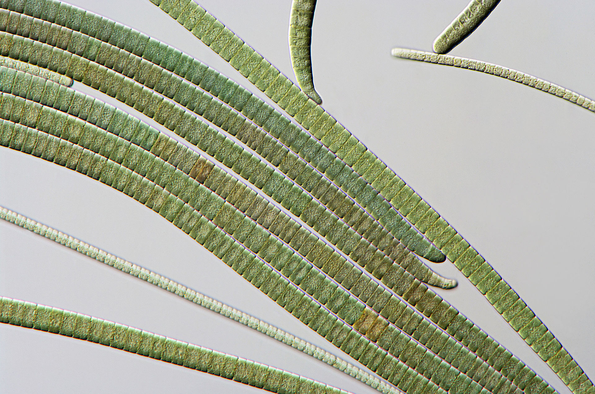
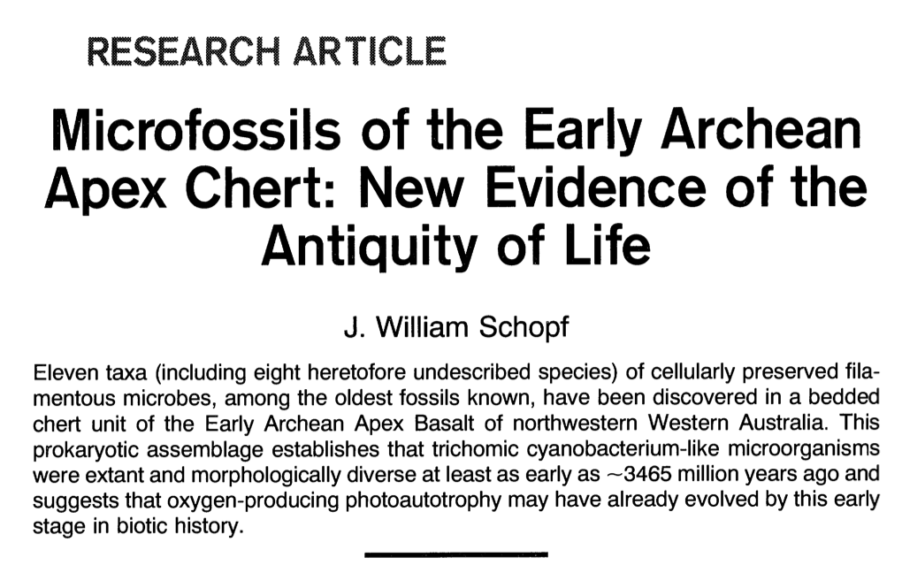
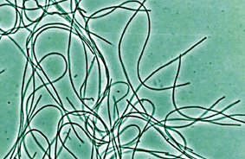
Oscillatoria (a cyanobacterium)
Chloroflexus (green non-sulfur bacteria)
Cyanobacteria-like: Bill Schopf and others most of the time considered them cyanobacteria, especially when other wrote about the finding; however, there are non-oxygen producing filamentous photosynthetic bacteria with a very similar morphology

Slide 40
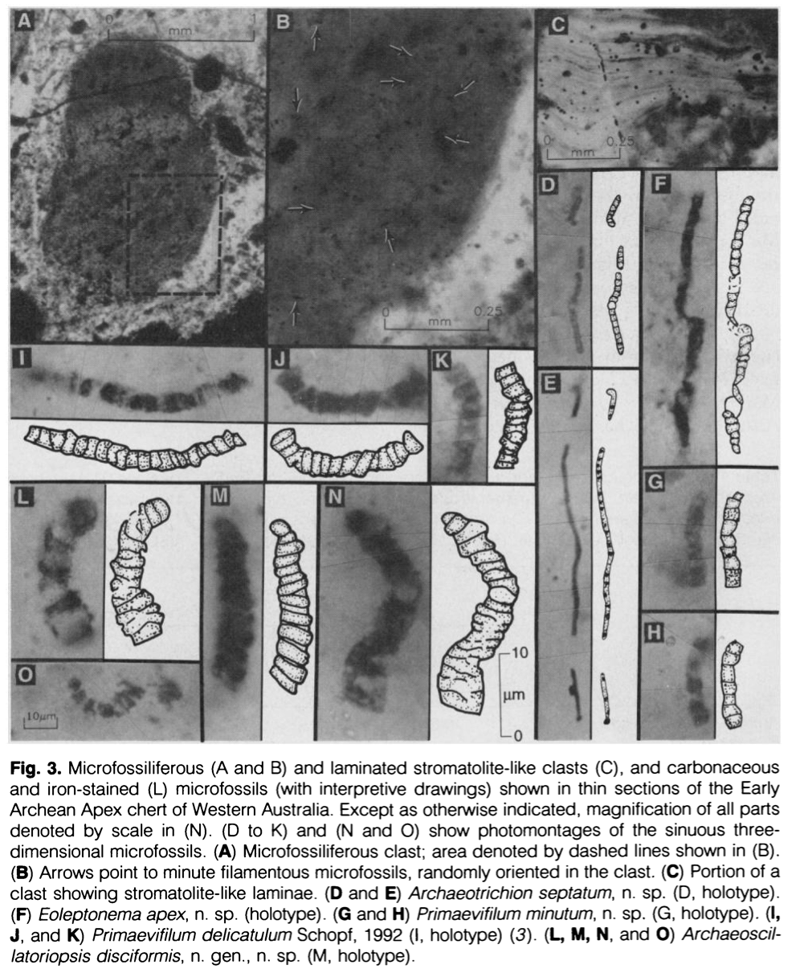
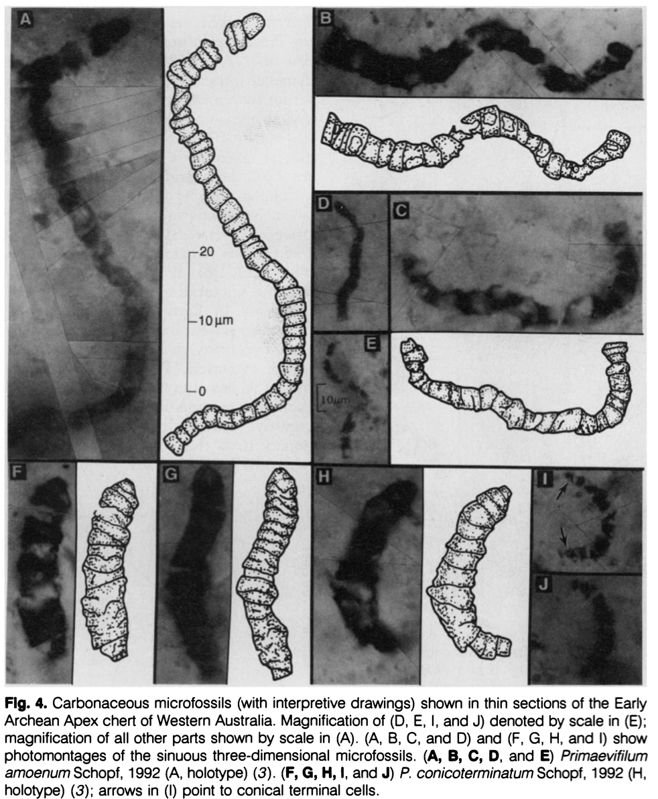

Slide 42
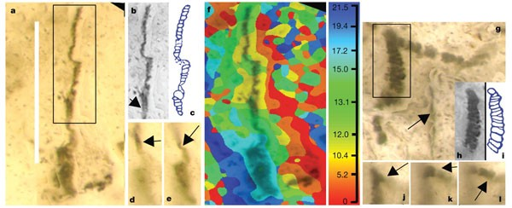
a, New image of putative beggiatoan Eoleptonema apex Holotype (ref. 3), combining the most sharply focused images from successive focal planes; b, c, digital image and interpretative sketch in the style of ref. 3 that omits the lower structure; d, e, new single image frames showing continuity of original and newly imaged structures. f, Topographic map showing computer-selected focal planes (plus scale in µm) of a; g, new image of putative cyanobacterium Archaeoscillatoriopsis disciformis Holotype (ref. 3) showing rhombic ghost (arrow); h, i, digital image and interpretative sketch in the style of ref. 3 that omits the lower structure and side branch; j, k, l, new single image frames showing continuity of original and newly imaged structure. Scale bar, 40 µm.

