Slide 1
Class 13
Notes on computer lab 7
Photosynthesis in the Tree/Net of Life
Willie Hennig and cladistics

Slide 2
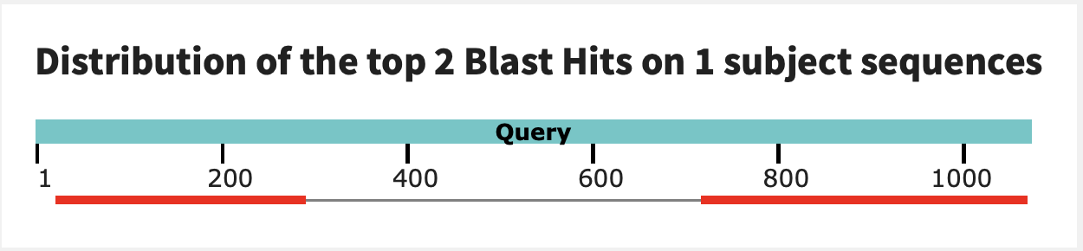
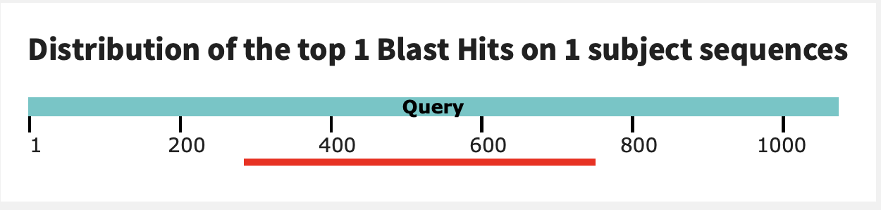
Exception to the transitive property of homology
In a pairwise blast search multiple components in the query might be revealed as follows:
Query: GI 6320016 (V-ATPase a-SU from Yeast)
6320016 (V‐ATPase A‐SU from Yeast)
GI 1303679 (V‐ATPase A‐SU from Acetabularia)
GI 1303679 (V‐ATPase A‐SU from Acetabularia)
Homolog 1:
GI 1303679 (V‐ATPase A‐SU from Acetabularia)
V-ATPase a-SU from Acetabularia
Homolog 2:
HO-endonuclease from Yeast

Slide 3
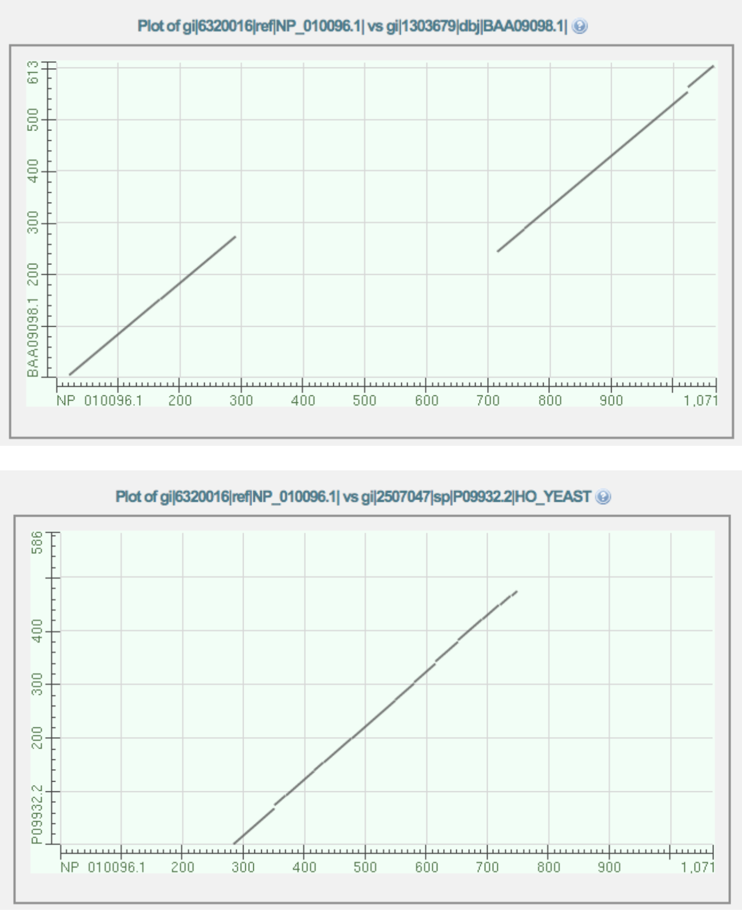
While homology is a transitive property, the parts of a protein (or DNA) that are homologous need to be the same. E.g. 6320016 (V‐ATPase A‐SU from Yeast) is homologous to 1303679 (V‐ATPase A‐SU from Acetabularia) and to 2507047 (mating type switching endonuclease from yeast), but different parts of 6320016 give rise to this homology.

Slide 4
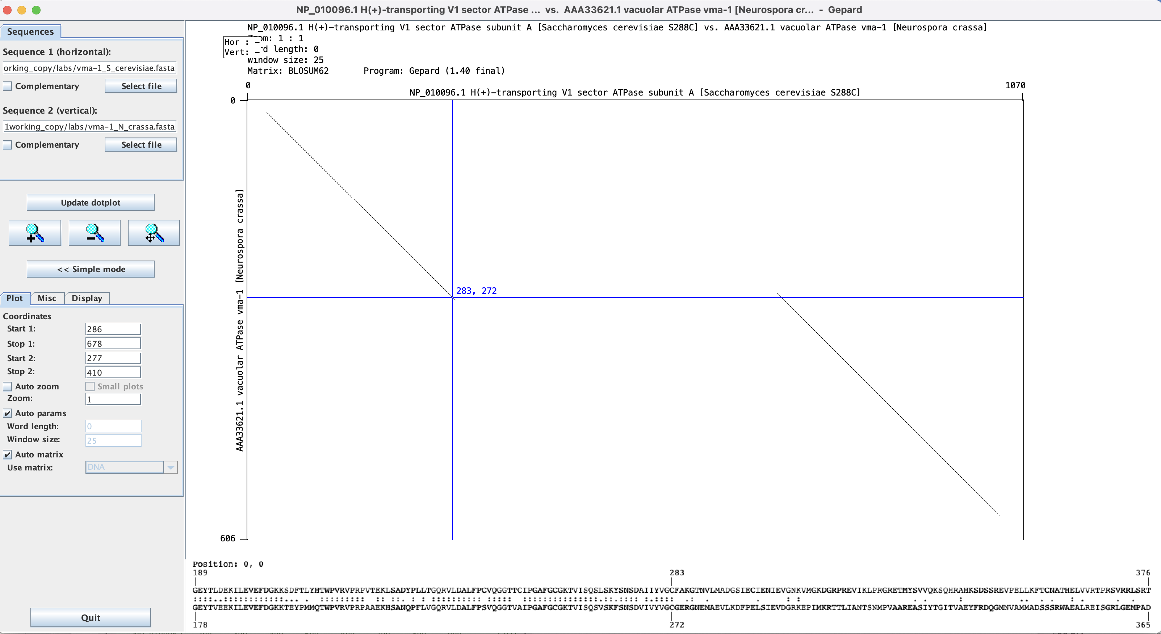
Dotplot in Gephard: Yeast vs Neurosora V-ATPase A-subunit.
Note: while the match ends at position 283, the diagonal extends a little beyond this. The first aa of the intein is the C

Slide 5
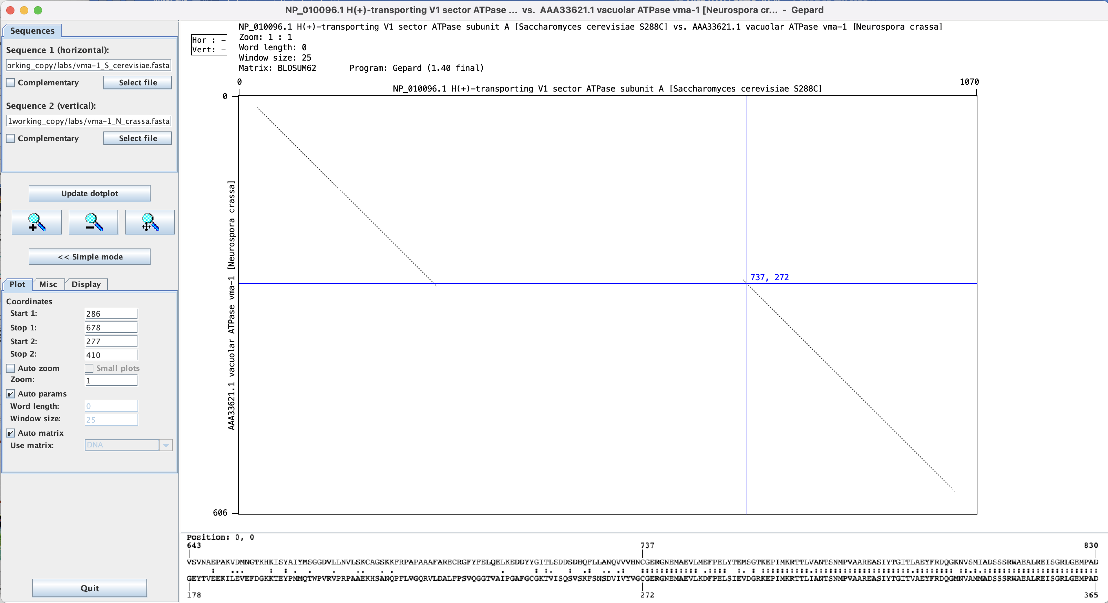
The last aa of the inteins are HN

Slide 6
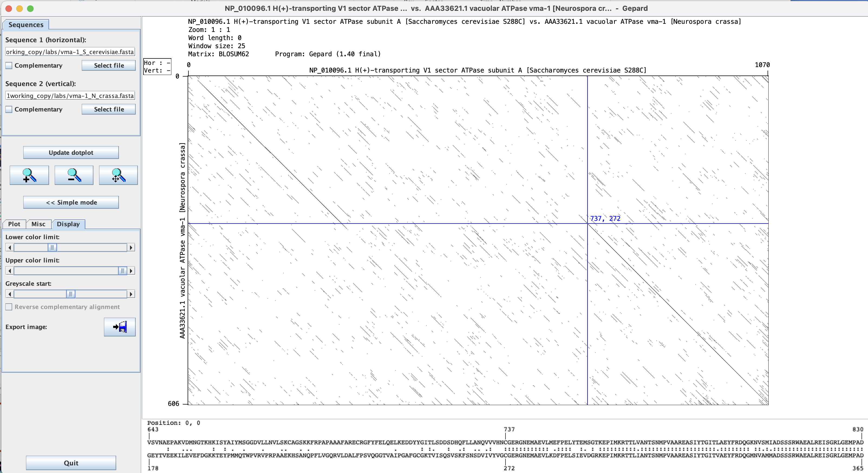
Adjusting which windows to display.

Slide 7

Distant View of Atake in Evening Shower
https://en.wikipedia.org/wiki/Sudden_Shower_over_Shin-Ōhashi_Bridge_and_Atake

Slide 8
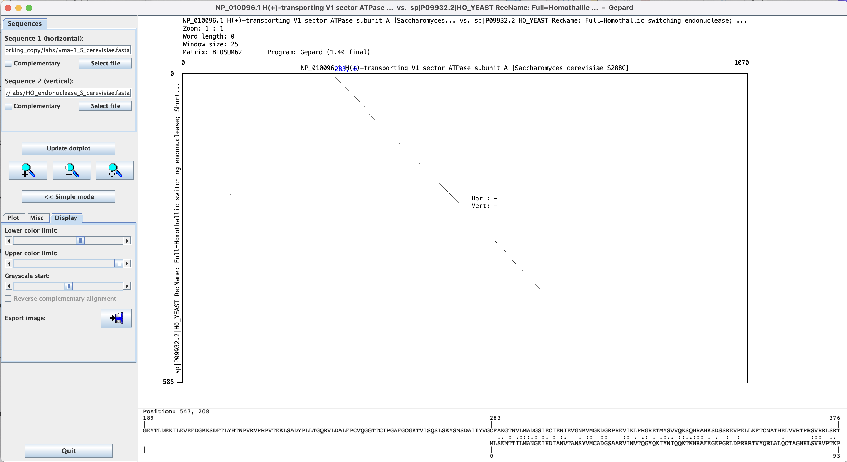
This works moderately well for divergent sequences – one could increase the window size and decrease the lower color limit

Slide 9
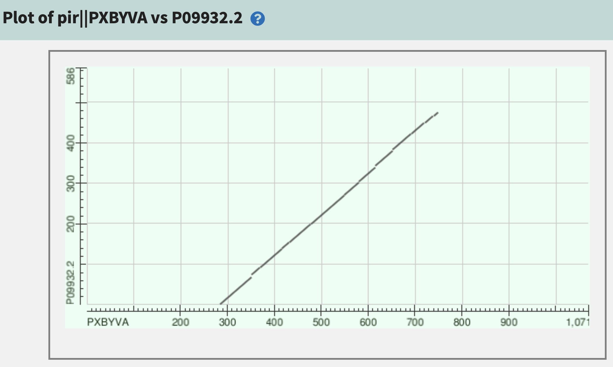
This also works well in pairwise blast
HO- mating type switching endonuclease
Yeast vma1 (with intein)

Slide 10
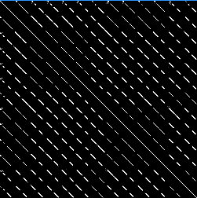
dotplot
The easiest way (provided the program runs on your computer) to align two sequences is to use a dotplot or gepard.
In realistic implementations a window of 5 to 20 nucleotides or amino acids is slid along one of the axes (i.e., sequences) and compared to every possible window on the other axis (sequence).
The dot intensity can adjusted to reflect the percent identity (or similarity) in the two windows.
Example of a dotplot comparison of a protein with 13 repeated domains compared against itself
See the slides from class 3 (slide 5) illustrating the
different ATPase quaternary structures.

Slide 11
B
A
B
V-proteolipid
From lecture 3:
A
B
A
N
C
c
A-proteolipids
V-type ATPase
A-type ATPase
N
N
C
C
α
β
α
Halobacterium
Methanococcus
Methanopyrus
β
β
α
c
F-proteolipid
N
C
F-type ATPase
Notes:
Proton pumping ATPases usually are classified as follows: P-, V- and F-type H⁺-ATPases. The F- and V-type (vacuolar) ATPases possess two major portions: the hydrophilic and the hydrophobic membrane sectors, named as F₁ or V₁ and F₀ or V₀, respectively.
The F-ATPase is present in the plasma membrane of Bacteria, inner membrane of mitochondria and thylakoid membranes of chloroplasts. This enzyme consumes the electrochemical H⁺ gradient to synthesize ATP or hydrolyzes ATP to build up a H+ gradient. The V-ATPase is present in the endomembrane systems of eukaryotes: vacuoles, Golgi apparatus and coated vesicles. The Archaea have an ATPase whose primary structure is very similar to the V-ATPase, but whose function is more similar to F-ATPases. Therefore, the archaeal counterpart of the V-ATPases is called A-ATPase.
The hydrophobic sector F0/V0 is formed by the subunits a, b and c. Subunit c, also called proteolipid, is involved in H⁺ translocation across the membrane. The vacuolar ATPases have 6 proteolipids per enzyme with a molecular weight of 16 kDa each. The V-ATPase proteolipids consist of four membrane spanning helices, while the F-ATPase proteolipids have only two membrane spanning helices.
The number of transmembrane helices of the archaeal ATPase proteolipid vary in size: 2 in Halobacterium, 3 in Sulfolobus and Thermus, and 5 in Methanococcus.
While the gene duplication that gave rise to the catalytic and non catalytic subunits occurred before the divergence of the V/F/A-ATPase, the gene duplication and fusion events that gave rise to the large V-type proteolipid occurred only in the branch leading to vacuolar type ATPase. The resulting protein has four transmembrane helices, and is twice the size of the F-proteolipid, but still possesses only one catalytic residue.

Slide 12
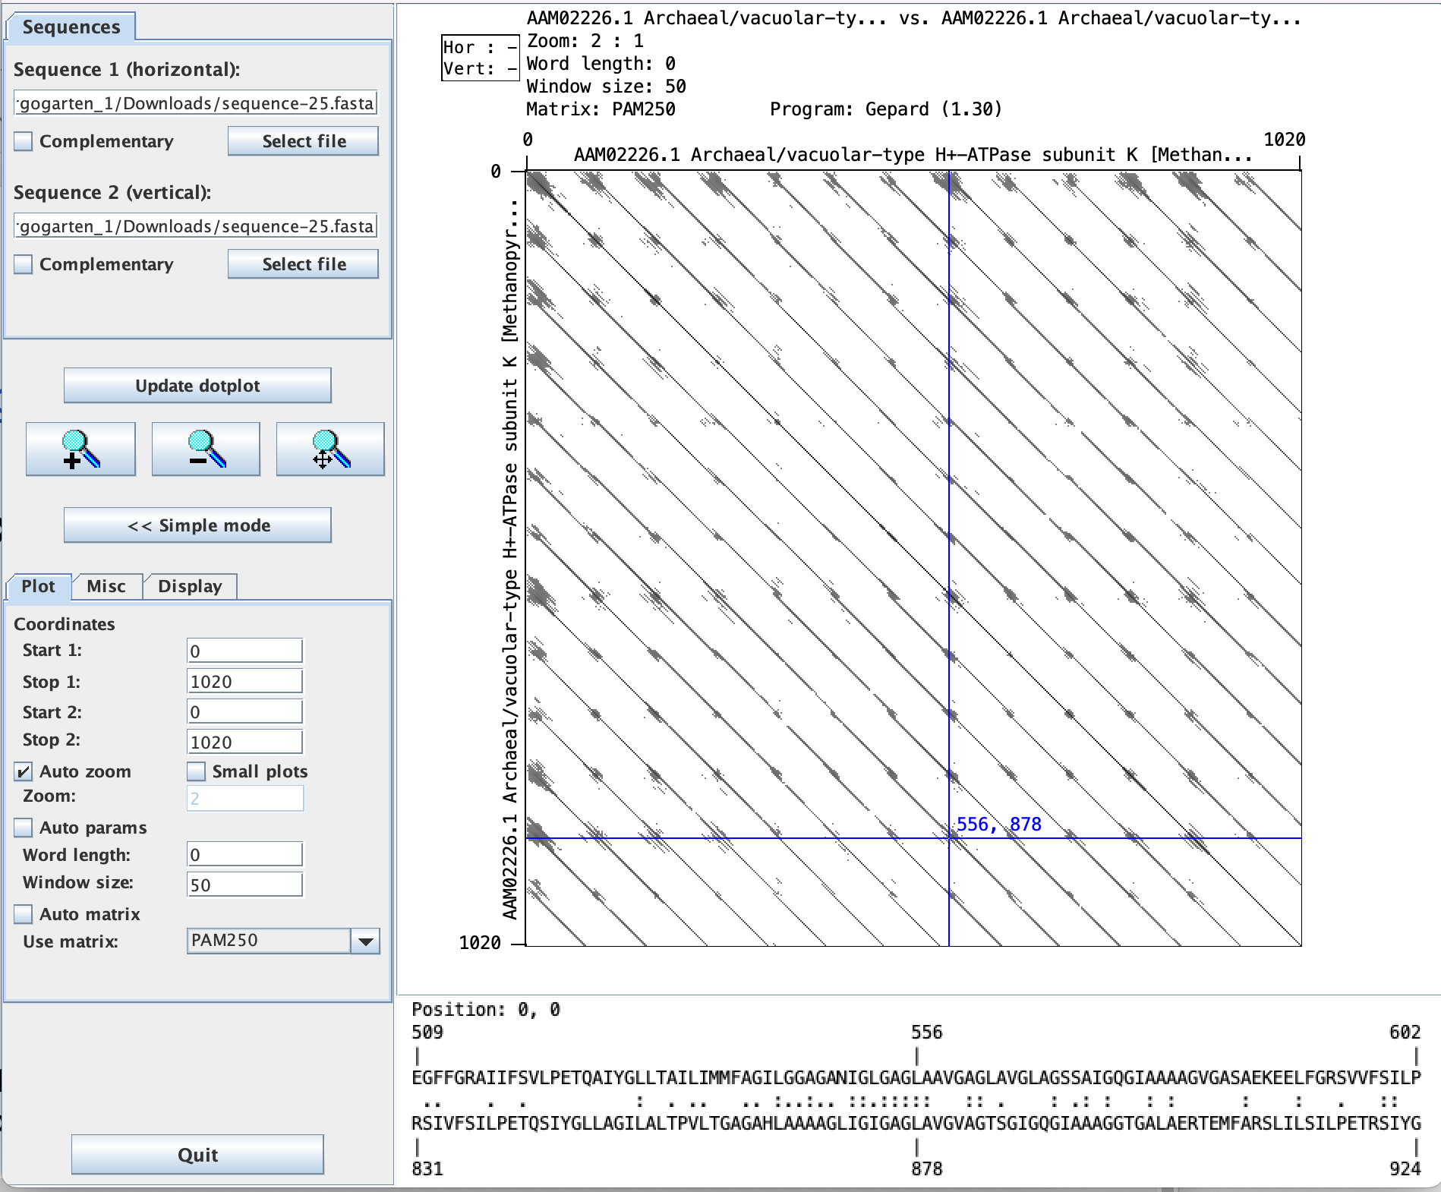
The same with less stringency:
wordsize 50
PAM 250

Slide 13
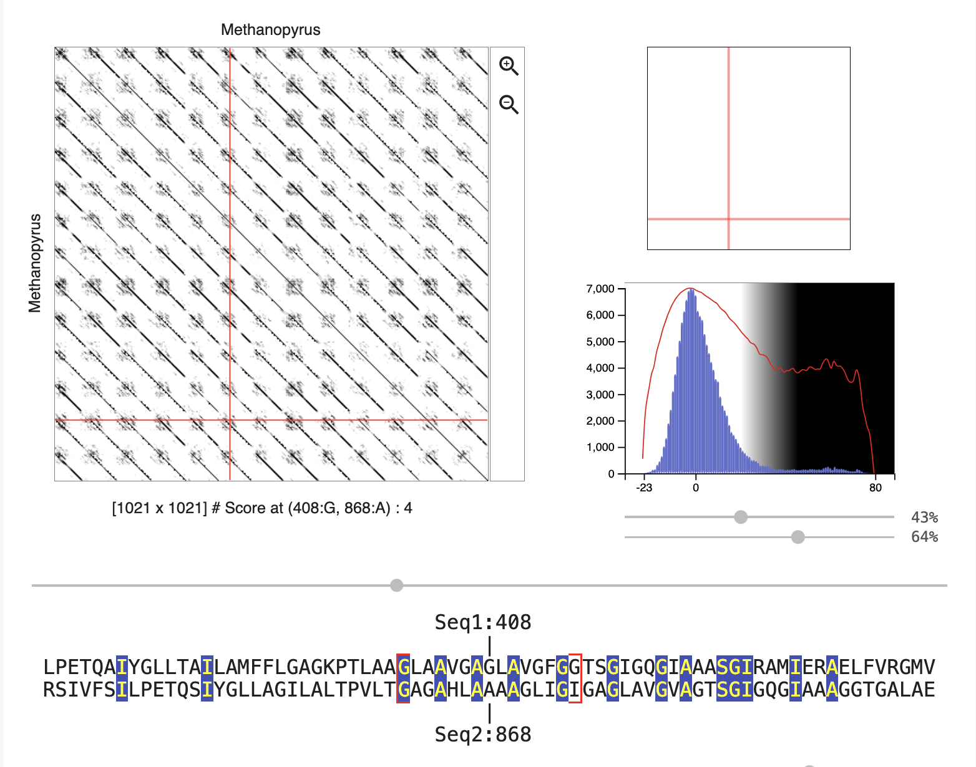
The same in dotletJS
Window size 15, Blosum 62

Slide 14
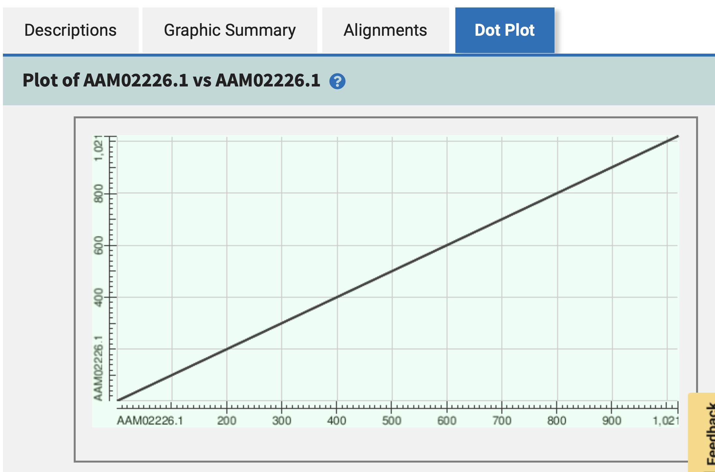
The same pairwise comparison on blastp:

Slide 15
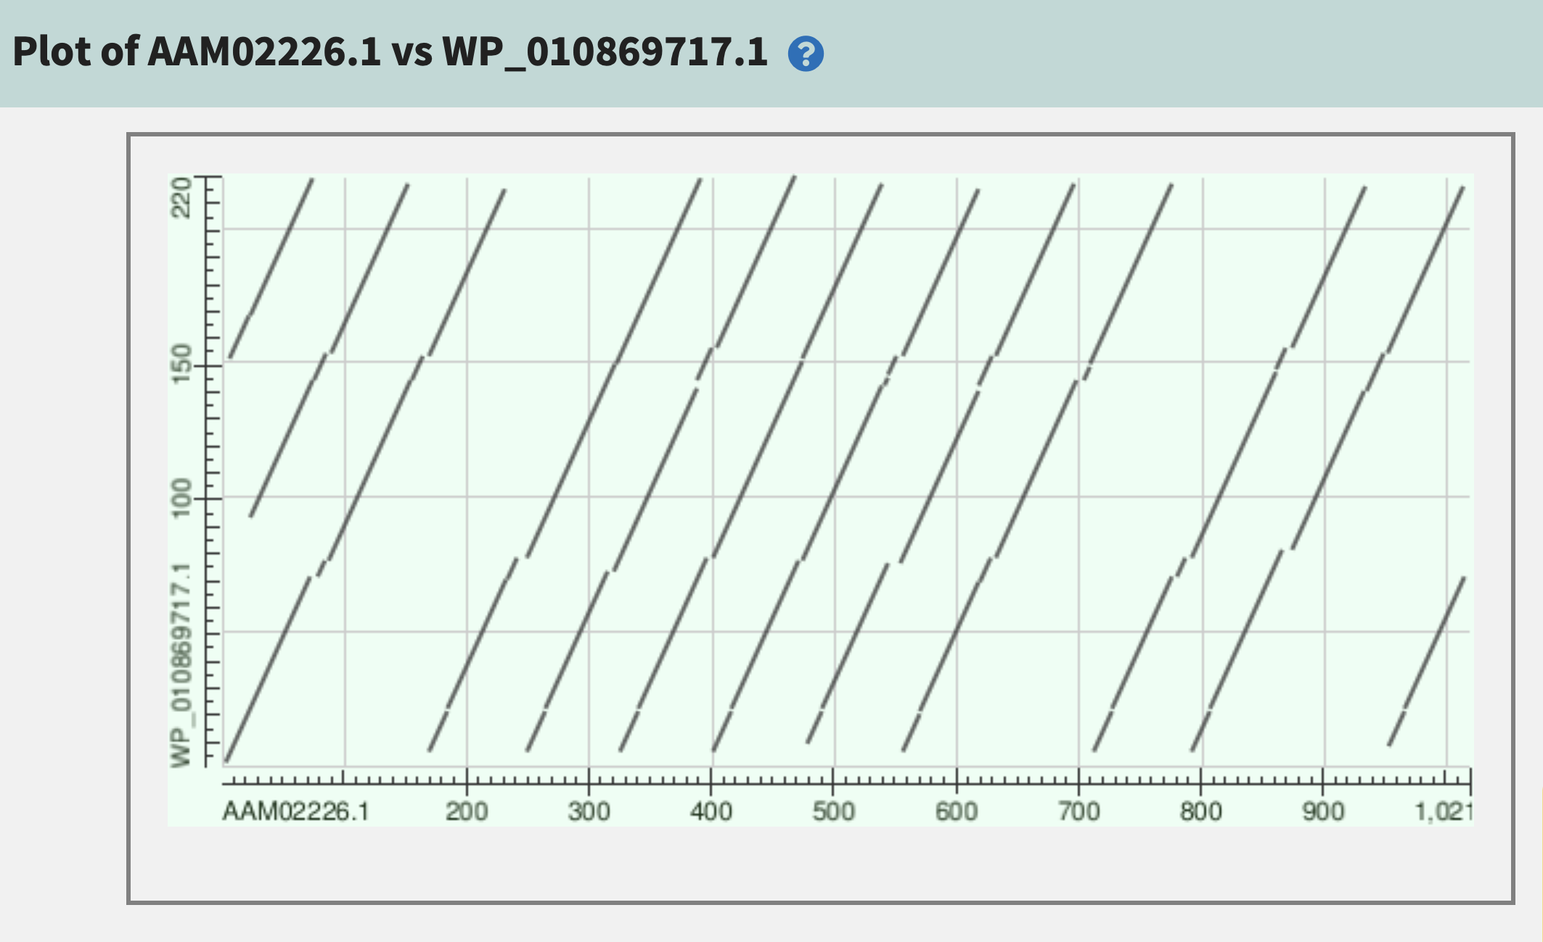
The problem persists if non-identical sequences are compared
Methanocaldococcus jannaschii proteolipid
(three repeat units
Methanopyrus kandleri proteolipid (13 repeat units)

Slide 16
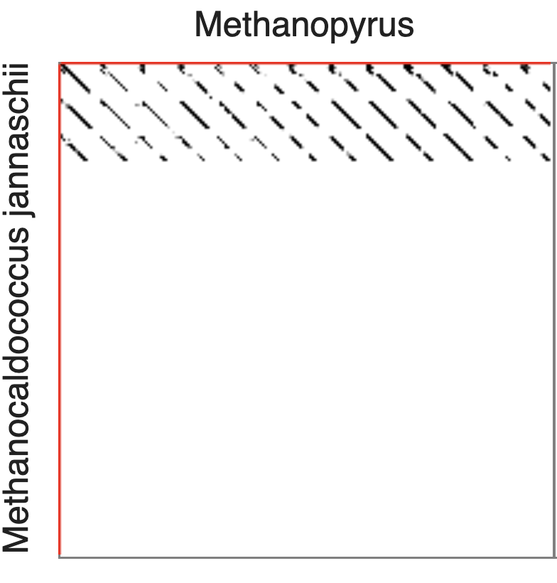
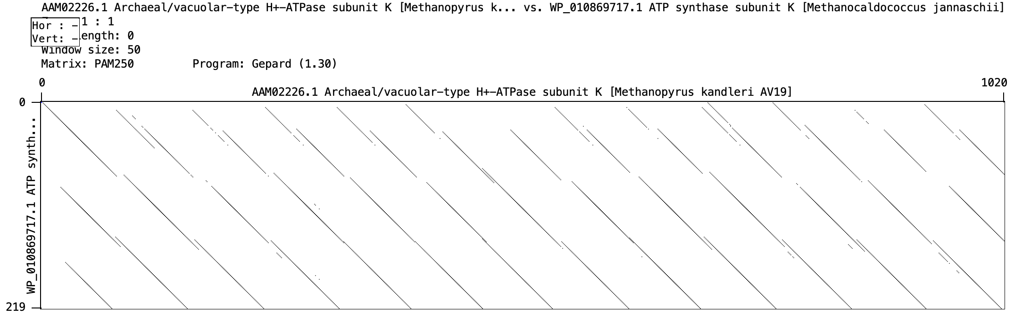
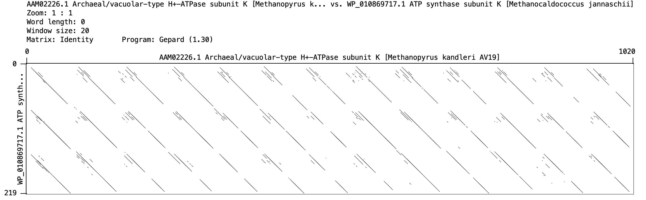
The same in dotlet and Gepard:

Slide 17
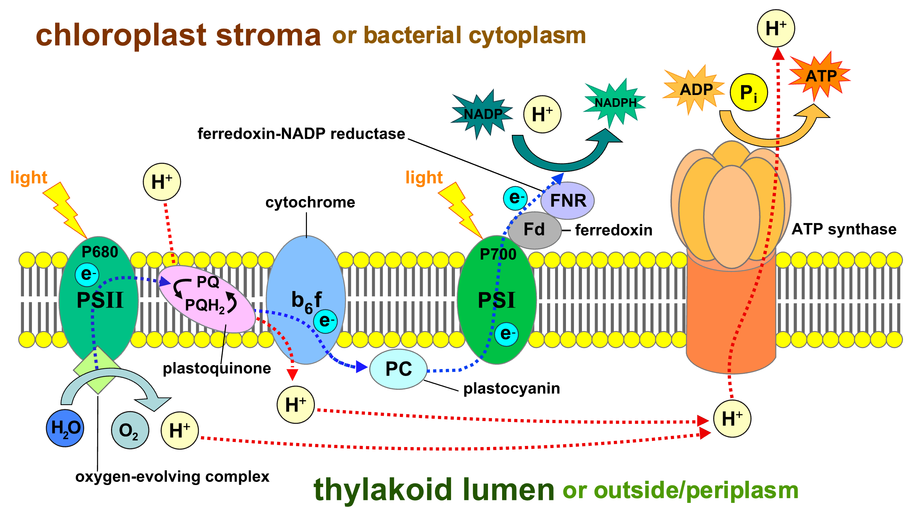

Slide 18
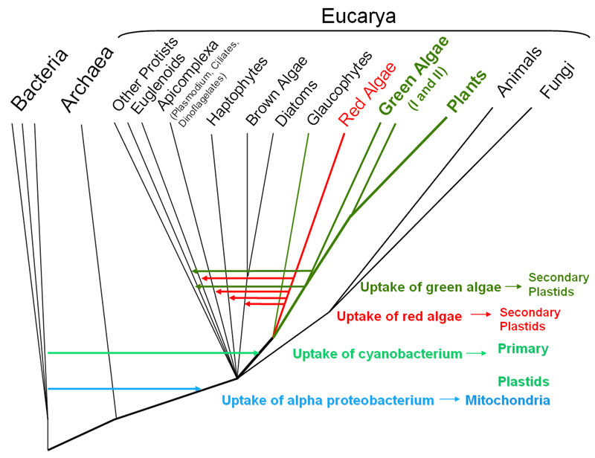
From: http://6e.plantphys.net/topic01.02.html

Slide 19
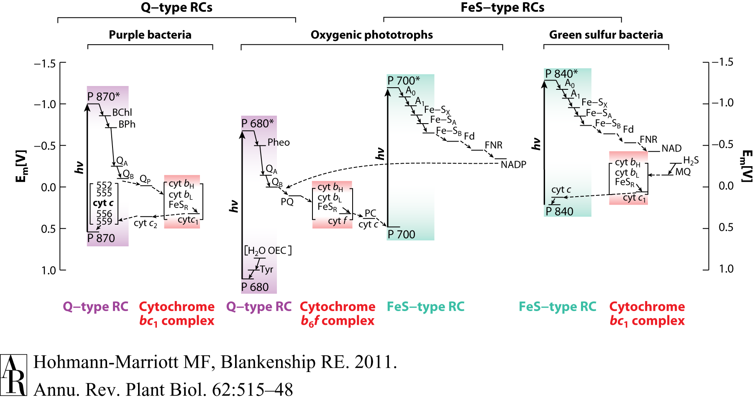
HGT as a force creating new pathways – Example 1
Oxygen producing photosynthesis

Slide 20
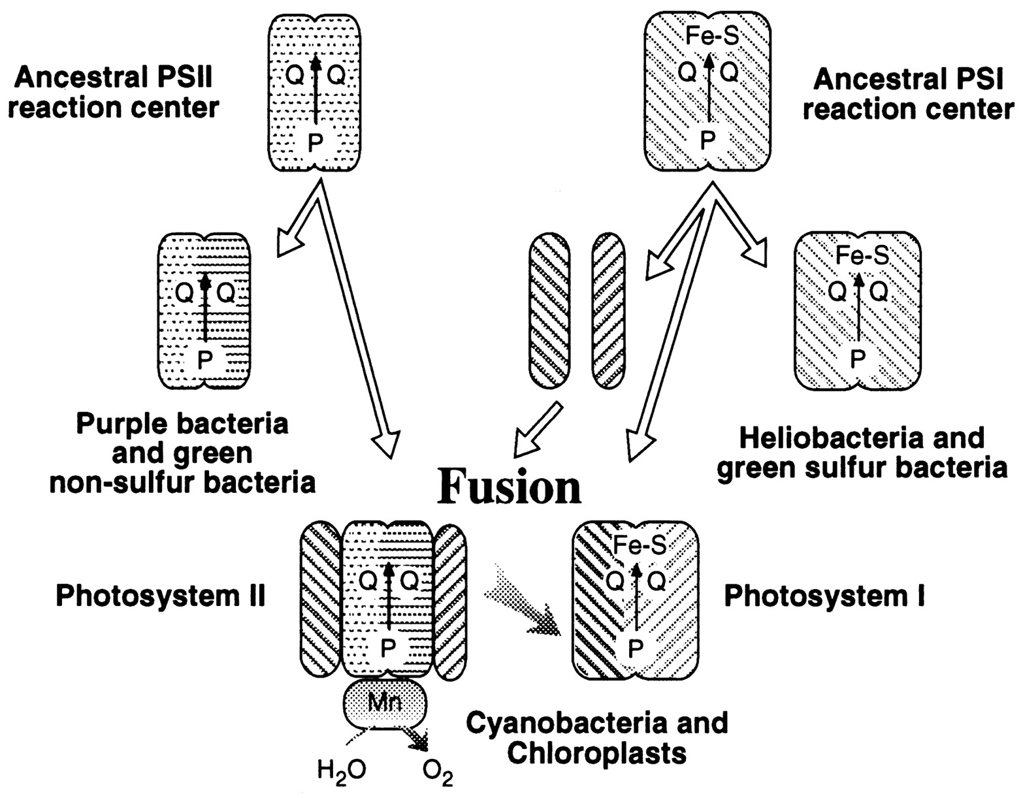
A heterologous fusion model for the evolution of oxygenic photosynthesis based on phylogenetic analysis.
Xiong J et al. PNAS 1998;95:14851-14856
©1998 by National Academy of Sciences
Notes:
A heterologous fusion model for the evolution of oxygenic photosynthesis based on phylogenetic analysis. Details of the model are provided in the text.

Slide 21
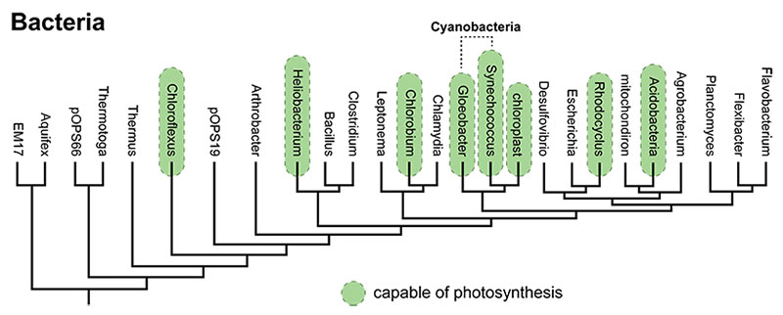
All photosynthetic pathways, including those of the Cyanobacteria, are quite similar. This suggests that they all evolved from a common ancestral pathway — in other words, that they are homologous. However, all the different bacteria that photosynthesize are rather distantly related to one another. The genes coding for photosynthetic pathways seem homologous, but the lineages bearing them are not closely related enough for a common ancestor to have passed the pathways on to all of them. What's the explanation for this apparent paradox? Horizontal transfer.
From: https://evolution.berkeley.edu/evolibrary/news/170503_cyanobacteria

Slide 22
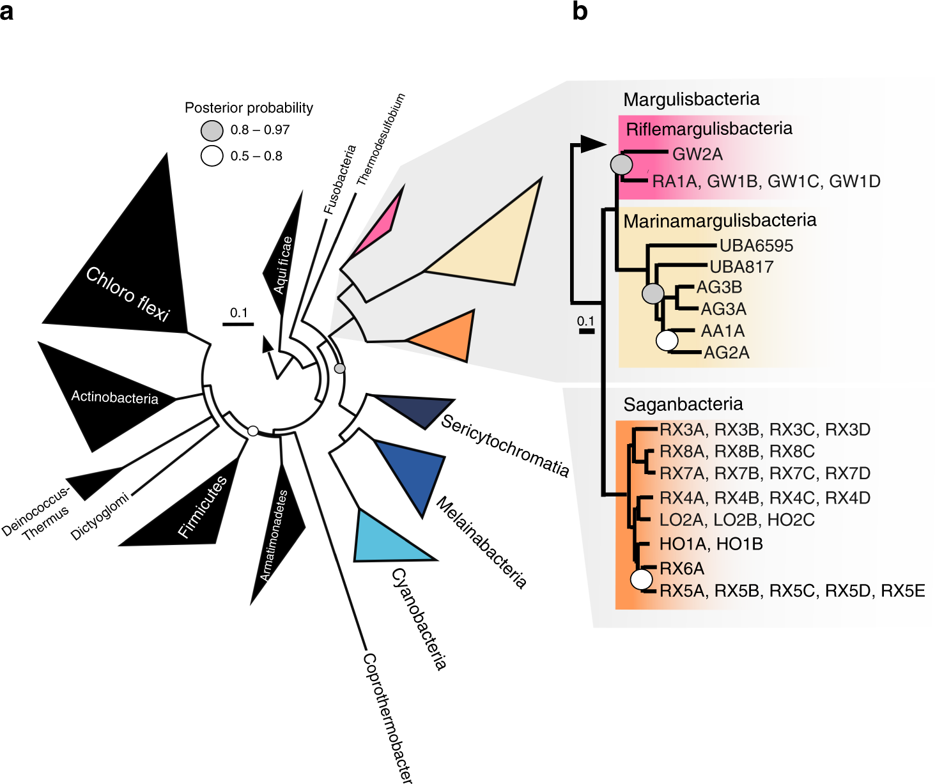
The ancestor of all these groups may have been an anaerobe in which fermentation and H₂metabolism were central metabolic features. The ability to use O₂ as a terminal electron acceptor must have been subsequently acquired by these lineages.
From: https://www.nature.com/articles/s41467-018-08246-y

Slide 23
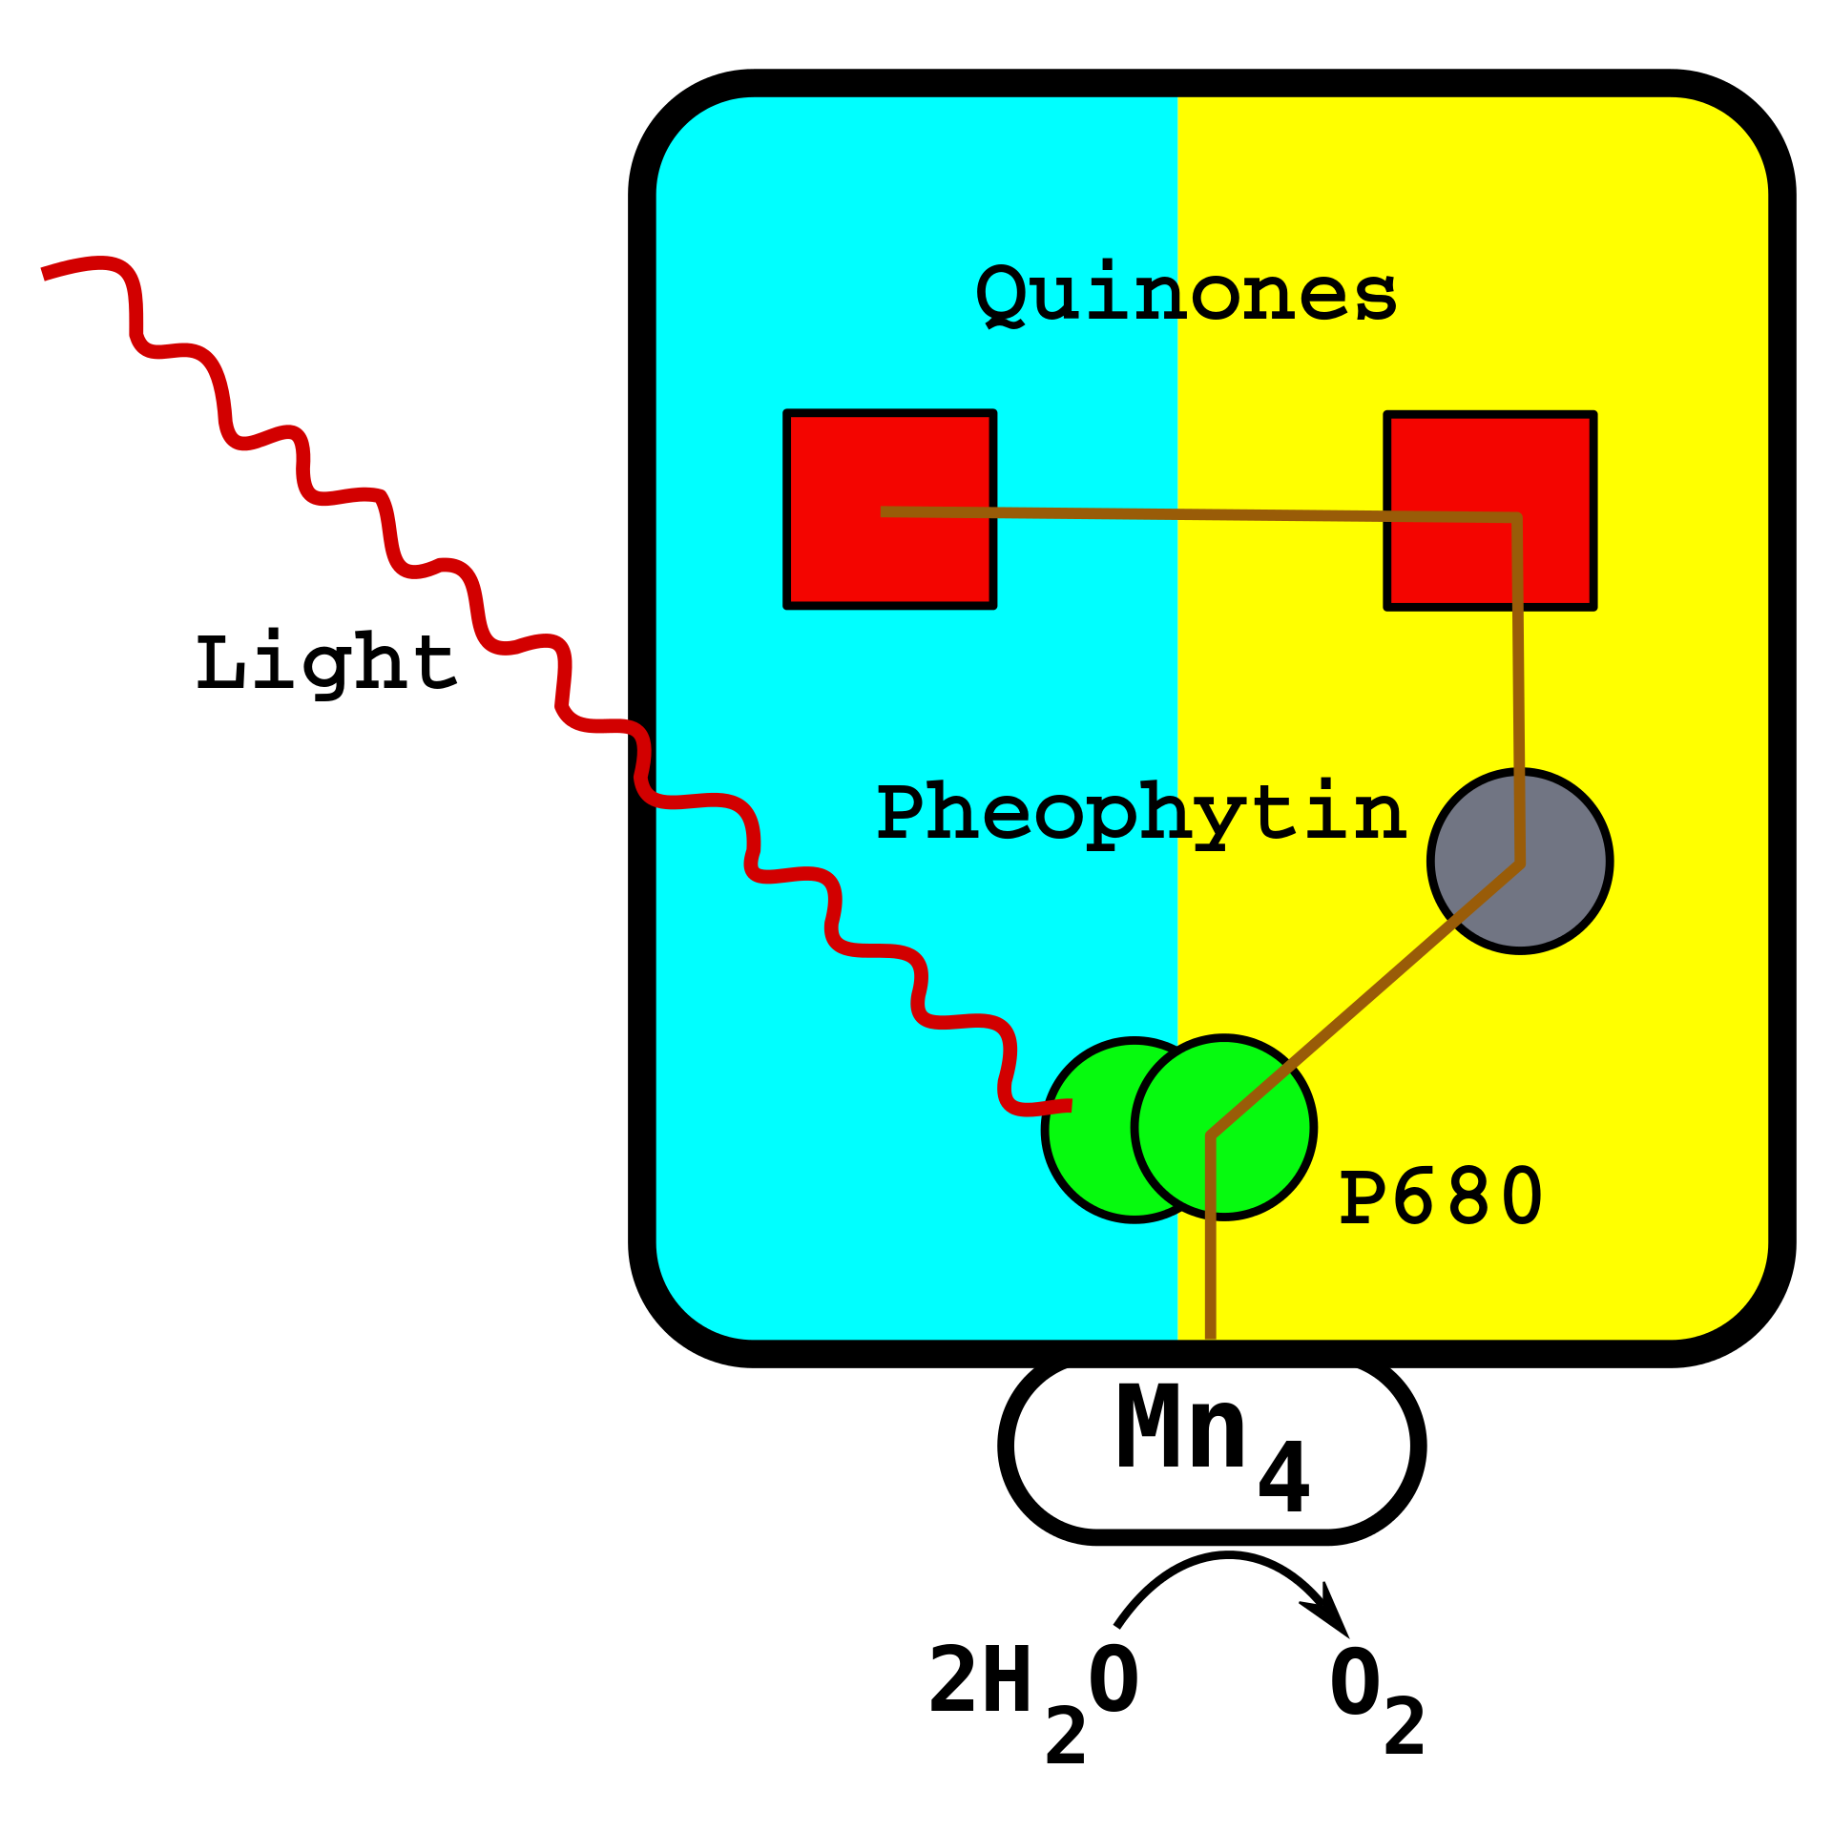
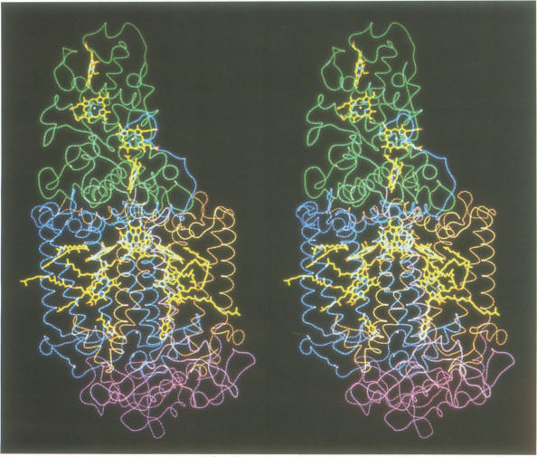
From Wikipedia (left) and J Deisenhofer and H Michel’s Nobel lecture

Slide 24
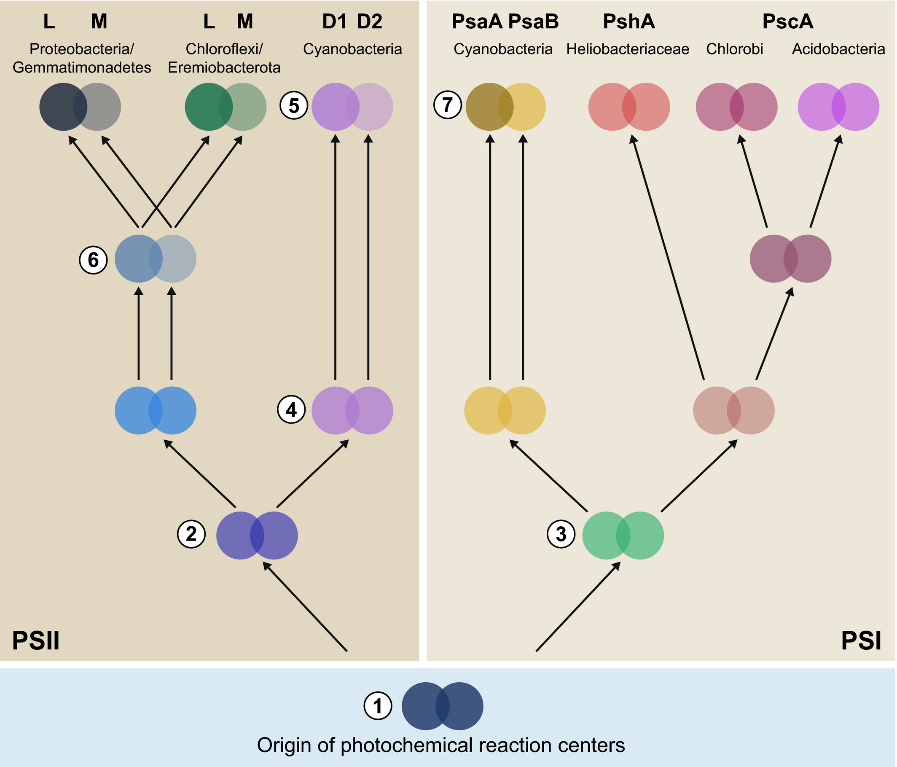
Schematic representation of the evolutionary relationships of reaction center proteins based on molecular phylogenies.
Comment: It is curious that the duplication and divergence between the two reaction center proteins is inferred to have happened three times independently. A more ancient duplication followed by gene conversion seems a more parsimonious explanation.

Slide 25
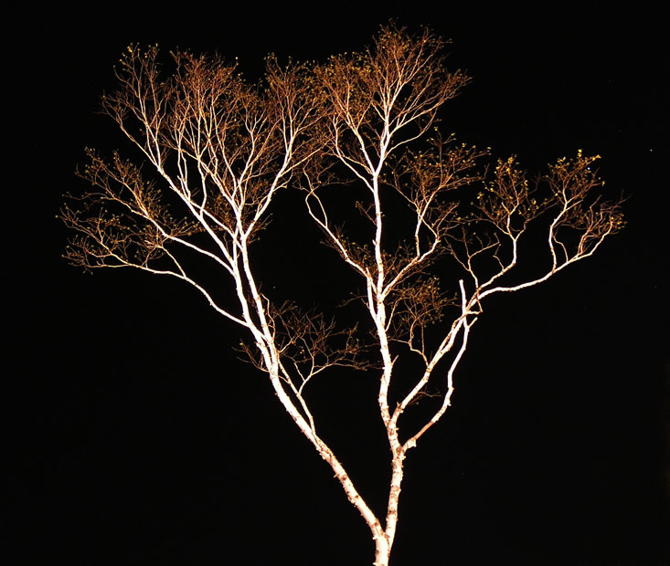
Cladistics
A Natural Taxonomy
Eukaryotes
Bacteria
Archaea
Cenancestor
(aka LUCA or MRCA)

Slide 26
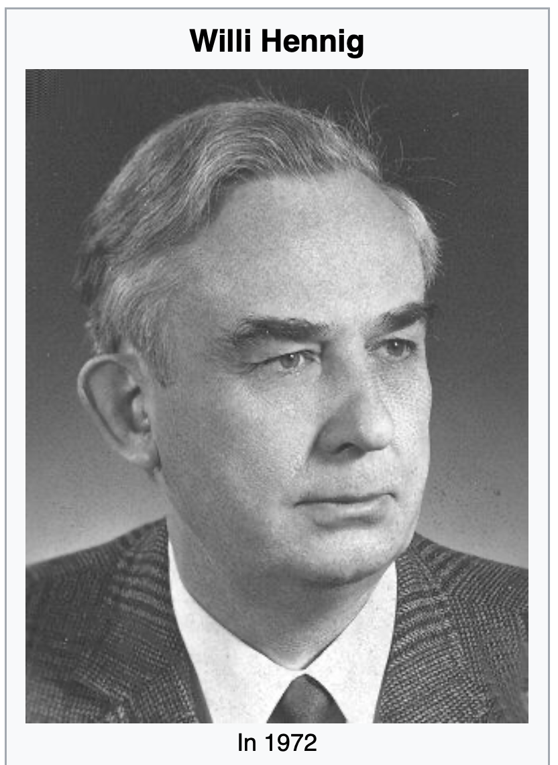
Willi Hennig was the founder of a systematic system based on shared ancestry (aka cladistics).
His area of expertise were insect.
Wings, halteres, hardened fore-wings, the ability to fold wing back, no wings, mouth parts, development includes a pupae ... are excellent characters to classify organisms.
From Wikipedia: https://en.wikipedia.org/wiki/Willi_Hennig

Slide 27
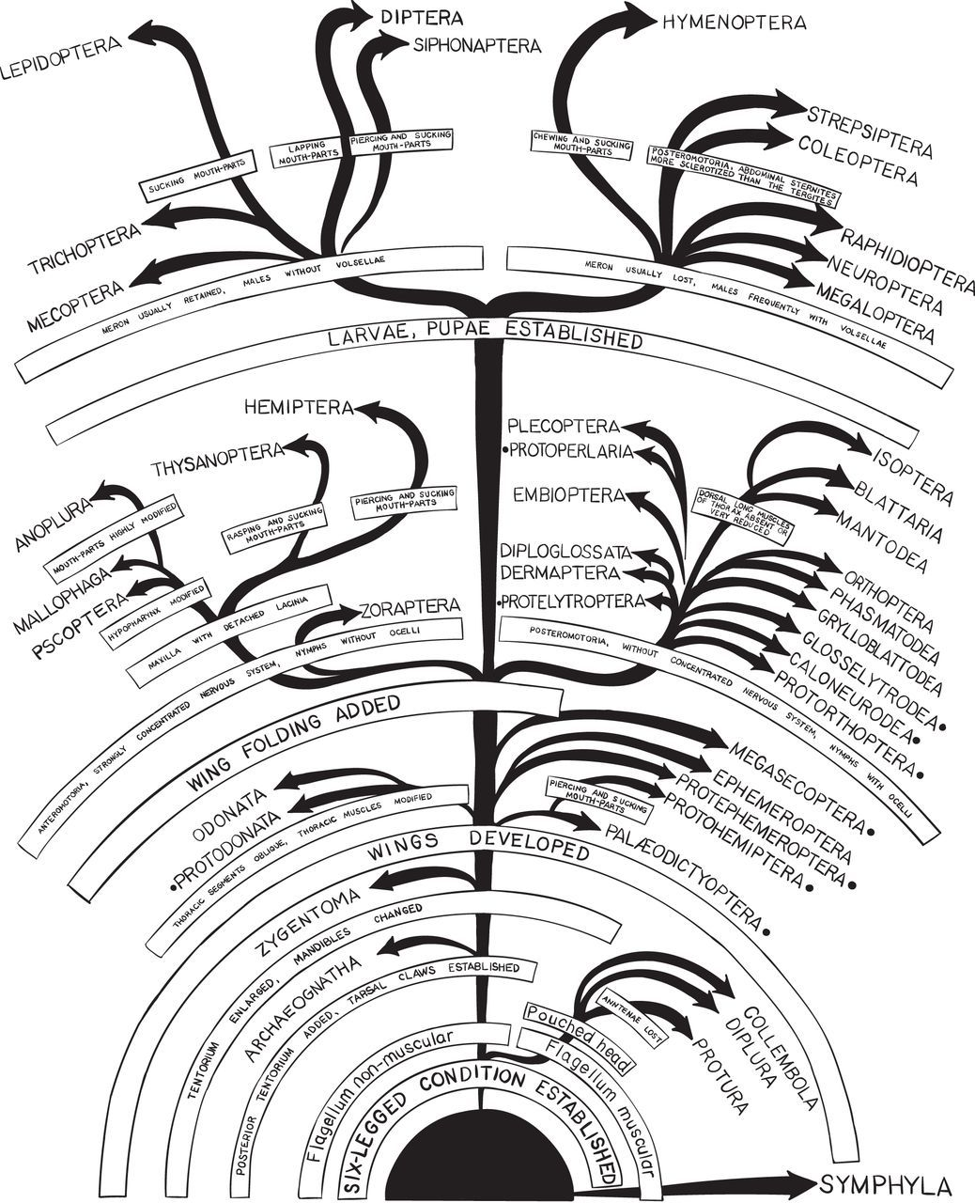
Insect taxonomy based on shared derived characters.
From: https://royalsocietypublishing.org/doi/10.1098/rsif.2016.0363

Slide 28
C C C c c
B B b b b
A a a a a
I
II
III
IV
V
D -> d
C -> c
B -> b
A -> a

Slide 29
C C C c c
B B b b b
A a a a a
I
II
III
IV
V
D -> d
Shared derived characters (aka synapomorphies) define monophyletic groups,
C -> c
B -> b
i.e. groups that have a common ancestor that is only ancestor to the members of the group and not to other organisms
A -> a

Slide 30
D D D D d
C C C c c
B B b b b
I
II
III
IV
V
D -> d
Shared primitive characters (aka symplesiomorphies) define paraphyletic groups
C -> c
B -> b
i.e., the common ancestor of this group is also the ancestor of organisms not belonging to this group
A -> a

Slide 31
D D D D d
C C C c c
B B b b b
A a a a a
I
II
III
IV
V
D -> d
Derived characters
that are not shared
(as the autapomorphy d) do not provide phylogenetic information.
C -> c
(question: If one
would know that A is primitive, would this provide useful phylogenetic information?
B -> b
A -> a

Slide 32
Terminology
The goal of cladistics is to have a natural taxonomic system that is based on shared ancestry. Every group is defined by an ancestor that only is an ancestor to this group.
In molecular phylogenies, we usually cannot distinguish between derived and primitive characters. Most phylogenetic reconstruction results in unrooted trees, as if you look at a tree from the top, and you do not know where the trunk is.
The tip of the branches often are called leaves or Operational Taxonomic Units.
In a phylogenetic tree the line connecting two nodes is know as a split or bipartition. If one removes the line, the leaves fall into two groups.
In a rooted tree, each node defines the descendants as a clade. In unrooted trees a group connected to a single node is called a clan.

Slide 33
Terminology for trees
The term cladogram refers to a strictly bifurcating diagram, where each clade is defined by a common ancestor that only gives rise to members of this clade. I.e., a clade is monophyletic (derived from one ancestor) as opposed to a polyphyletic group (derived from many ancestors). Note: you need to know where the root is! If one does not know the root, but one wants to denote a group that groups together, one can use the term clan.
Branches in cladograms are not scaled with respect to time or substation events
A clade is recognized and defined by shared derived characters (= synapomorphies). Shared primitive characters (= sympleisiomorphies , alternativie spelling is symplesiomorphies) do not define a clade. (See in example drawing ala Hennig).
To use these terms you need to have polarized characters; for most molecular characters you don't know which state is primitive and which is derived (exceptions: ?).

Slide 34
Trees often are rearranged and can become misleading to the non-expert:
The two trees are identical, the fact that one depicts humans on top does not reflect us being more advanced, it just is one of many possible ways to draw a tree.

Slide 35
Terminology
Related terms:
autapomorphy = a derived character that is only present in one group; an autapomorphic character does not tell us anything about the relationship of the group that has this character ot other groups.
homoplasy = a derived character that was derived twice independently (convergent evolution). Note that the characters in question might still be homologous (e.g. a position in a sequence alignment, frontlimbs turned into wings in birds and bats).
paraphyletic = a taxonomic group that is defined by a common ancestor, however, the common ancestor of this group also has decendants that do not belong to this taxonomic group. Many systematists despise paraphyletic groups (and consider them to be polyphyletic). Examples for paraphyletic groups are reptiles and protists. Many consider the archaea to be paraphyletic as well.
holophyletic = same as above, but the common ancestor gave rise only to members of the group.

Slide 36
Terminology
Branches, splits, bipartitions
Leaves, or OTUs (operational taxonomic units)
In a rooted tree: clades (else clans)
Mono-, Para-, polyphyletic groups, cladists and a natural taxonomy
The term cladogram refers to a strictly bifurcating diagram, where each clade is defined by a common ancestor that only gives rise to members of this clade. I.e., a clade is monophyletic (derived from one ancestor) as opposed to a polyphyletic group (derived from many ancestors). (Note: you need to know where the root is! If one does not know the root, but one wants to denote a group that groups together, one can use the term clan)
A clade is recognized and defined by shared derived characters (= synapomorphies). Shared primitive characters (= sympleisiomorphies , alternativie spelling is symplesiomorphies) do not define a clade. (See in example drawing ala Hennig).
To use these terms you need to have polarized characters; for most molecular characters you don't know which state is primitive and which is derived (exceptions:....).

Slide 37
Complications and Controversies
According to Hennig:
Shared derived characters define monophyletic groups
Shared primitive characters define paraphyletic groups
homoplasies – characters that evolved independently define polyphyletic groups
According to Ernst Ashlock (and Ernst Mayr and a few others)
Both, shared derived characters and shared primitive characters define monophyletic groups – they go back to a common ancestor, and they deserve a name (e.g., prokaryotes, reptiles)
Shared derived characters define holophyletic groups
Homoplasies - define polyphyletic groups

Slide 38
Which characters define which groups:
Shared primitive
Characters
Shared Derived
Characters
Homoplasies
According to
Hennig
Polyphyletic
Paraphyletic
Monophyletic
According to
Ashlock
Polyphyletic
Holophyletic
Monophyletic

Slide 39
Why Fish don’t exist
According to Willi Hennig (a view accepted by most taxonomist that do not need to teach undergraduate students)
  reptiles,
  fish,
  protists,
  algae,
  green algae,
  prokaryotes,
  and many others
are not proper taxonomic groups, because the ancestor of these groups was also ancestor to organisms that are not part of this group.

Slide 40

Why Fish don’t exist
Link to an npr interview
David Starr Jordan on Wikipedia
Taxonomist, eugenicist,
first president of Stanford,
and possible murderer of Jane Stanford
You tube video of virtual event with Lulu Miller
Link to book

Slide 41
Why might it be correct to say that “Fish don’t exist”?
The distinction between holophyletic and monophyletic that Mayr and Ashlock propose abandons a taxonomy based on natural groups.
Discuss the advantages and disadvantages of a strict cladistic approach that does not allow groups based on symplesiomorphies (shared primitive characters).
List a few groups of organisms that represent paraphyletic groups
Note: Willi Henning’s cladistics is at odds with Ernst Mayr’s understanding of taxonomic groups.

Slide 42
Why Fish don’t exist
According to Willi Hennig (a view accepted by most taxonomist that do not need to teach undergraduate students)
  reptiles,
  fish,
  protists,
  algae,
  green algae,
  prokaryotes,
  and many others
are not proper taxonomic groups, because the ancestor of these groups was also ancestor to organisms that are not part of this group.
Which groups derive from the same ancestors?

Slide 43
Why Fish don’t exist
According to Willi Hennig (a view accepted by most taxonomist that do not need to teach undergraduate students)
  reptiles,
  fish,
  protists,
  algae,
  green algae,
  prokaryotes,
  and many others
are not proper taxonomic groups, because the ancestor of these groups was also ancestor to organisms that are not part of this group.
Which groups derive from the same ancestors?
Fish are not a monophyletic group, because their ancestor is also ancestor to the tetrapods
Prokaryotes are not a monophyletic group, because their ancestor is also ancestor to the Eukaryotes

Slide 44
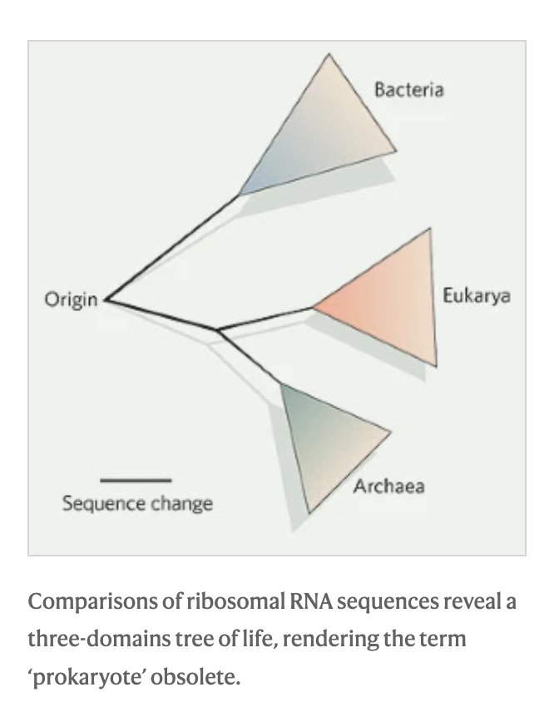
Norman R. Pace:
Time for a change, Nature volume 441, page289 (2006)
Argues that the term prokaryote is obsolete, because it denotes a paraphyletic group.
Prokaryotes
In an ironic twist, the recent discovery and sequencing of new archaeal species, reveals that the Archaea themselves likely are a paraphyletic group ->

Slide 45
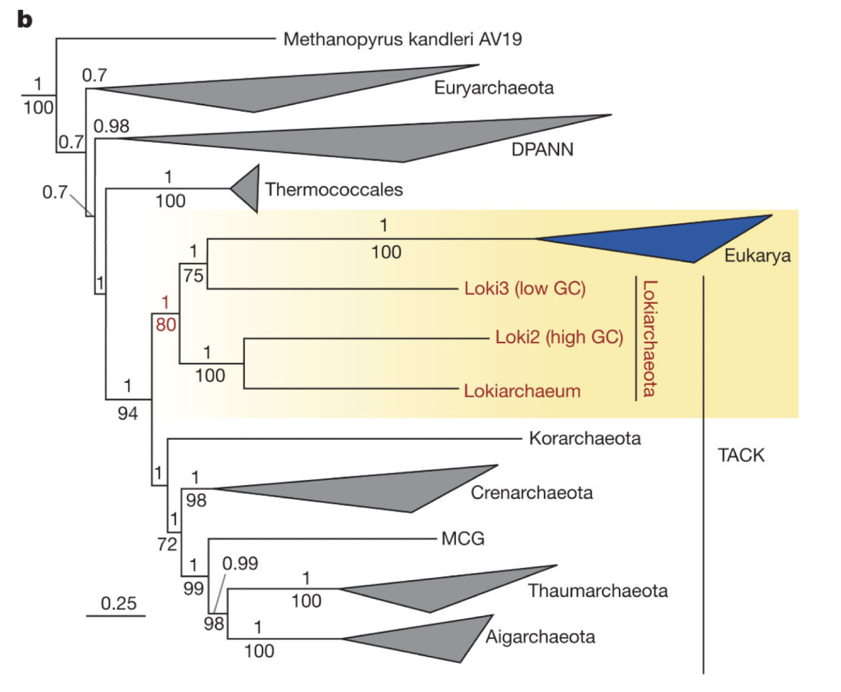
Prokaryotes
Archaea
The recent discovery and sequencing of archaeal species, reveals that the Archaea themselves likely are a paraphyletic group.
E.g., Spang et al. Complex archaea that bridge the gap between prokaryotes and eukaryotes Nature. 2015 May 14; 521(7551): 173–179. doi:10.1038/nature14447.
However, see Da Cunha et al., Asgard archaea do not close the debate about the universal tree of life topology, PLoS Genet 14(3): e1007215. https://doi.org/10.1371/ journal.pgen.1007215

Slide 46
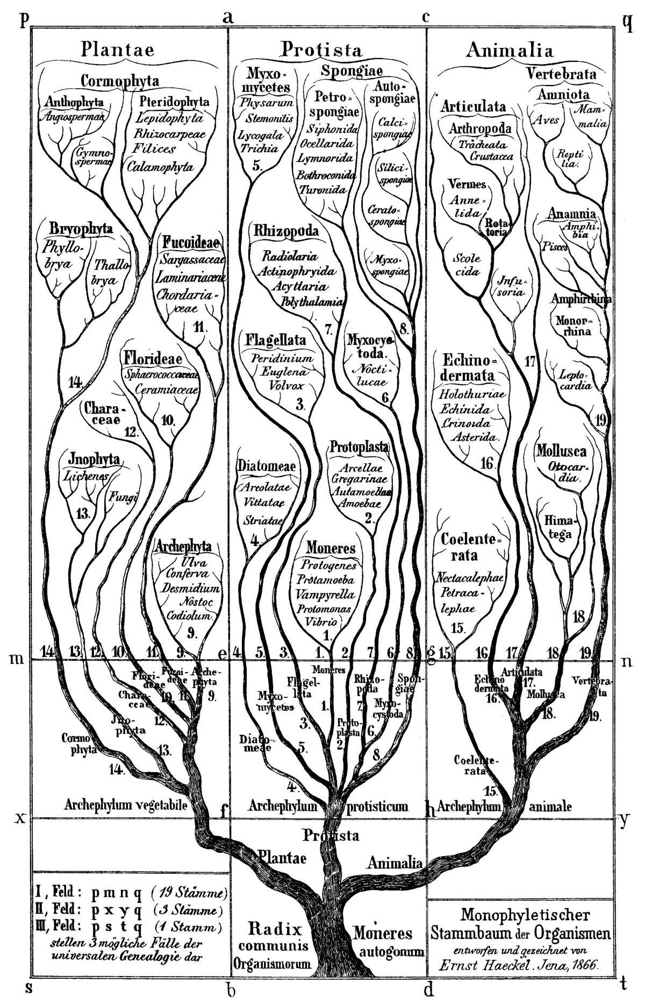
Discussion:
What might be misleading about some of the images depicting evolution?
E.g., Ernst Haeckel’s famous tree.

Slide 47
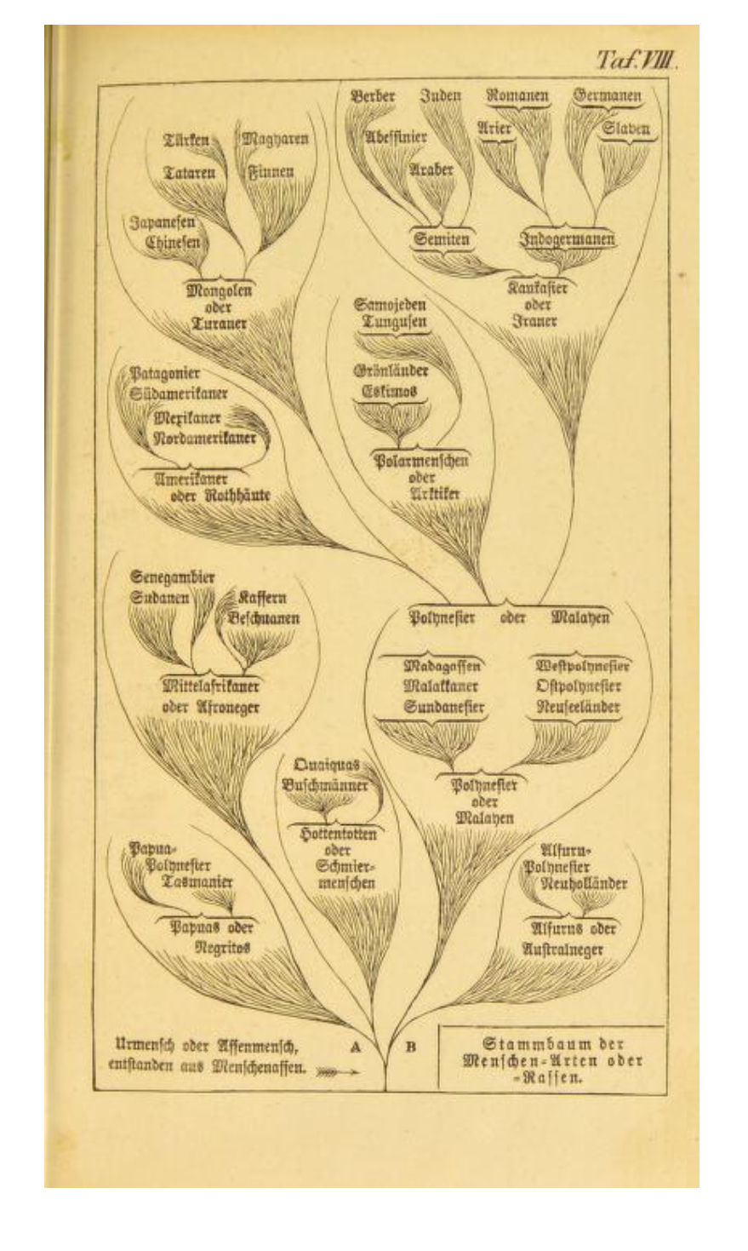
These biases become even more painfully obvious in Haeckel’s depictions of human evolution.
Ernst Haeckel 1868 Stem-tree of human species and races.
Native Americans
Japanese
Germanic
The point of this and the following slides is not that Ernst Haeckel was a racist (he was, and so were most other scientists at the time, including Charles Darwin); rather they are to illustrate the arbitrariness in which leaves sometimes are arranged in cladograms.
Adapted from: Robert J. Richards, The tragic sense of life, Ernst Haeckel and the struggle over evolutionary thought, University of Chicago Press 2008

Slide 48
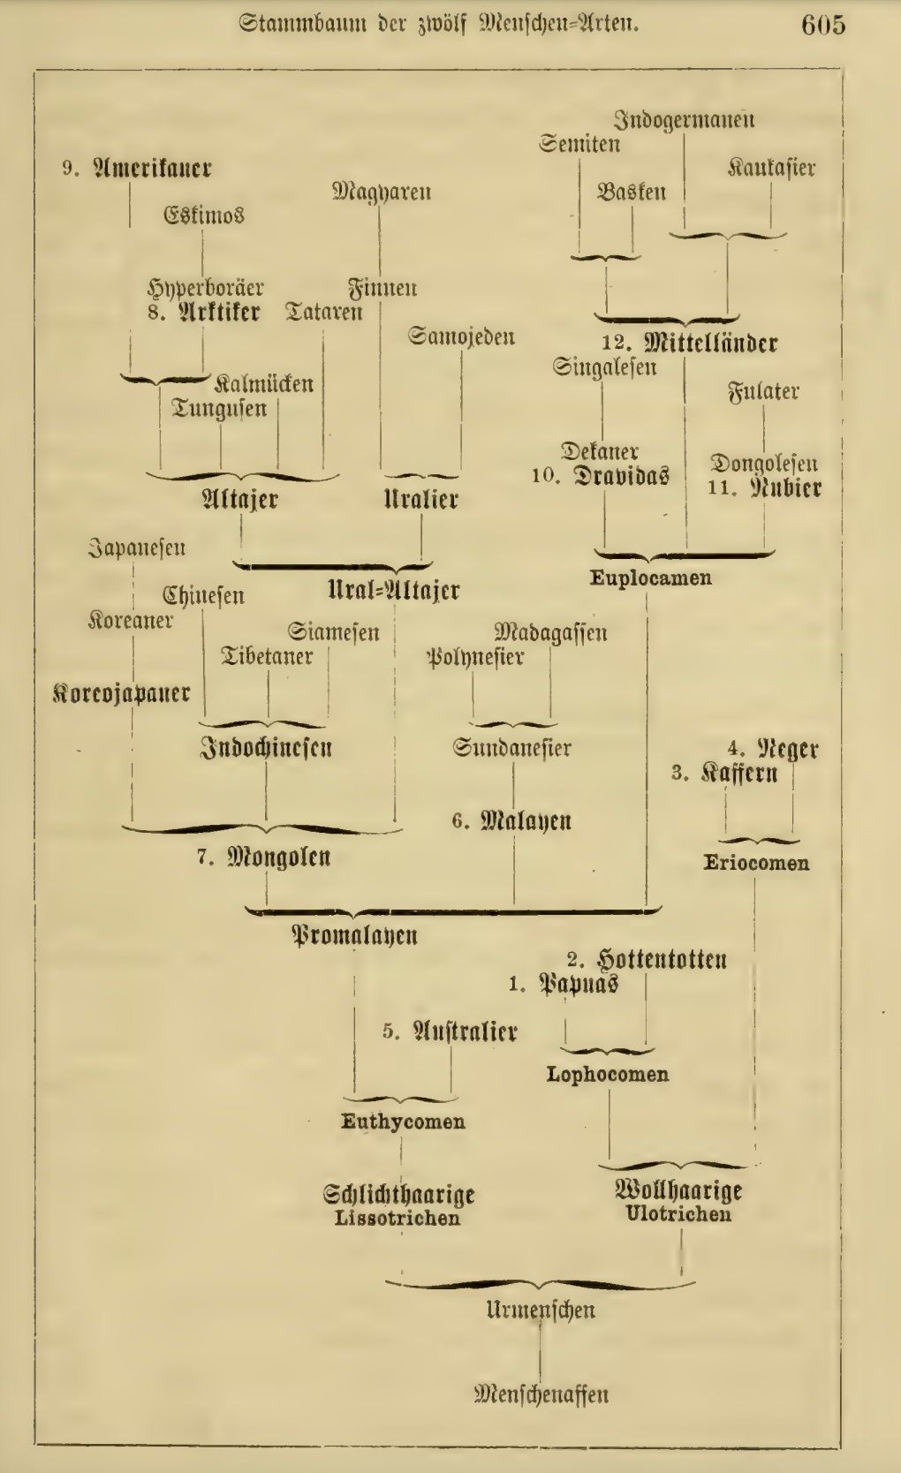
Due to Karl May (popular German author) the idea of the “noble savage” had become popular in Germany and associated mainly with native Americans.
Native Americans
Japanese
Germanic
Ernst Haeckel 1870-79: Stem-tree of human species and races. (2nd to 7th edition of Natürliche Schöpfungsgeschichte)

Slide 49
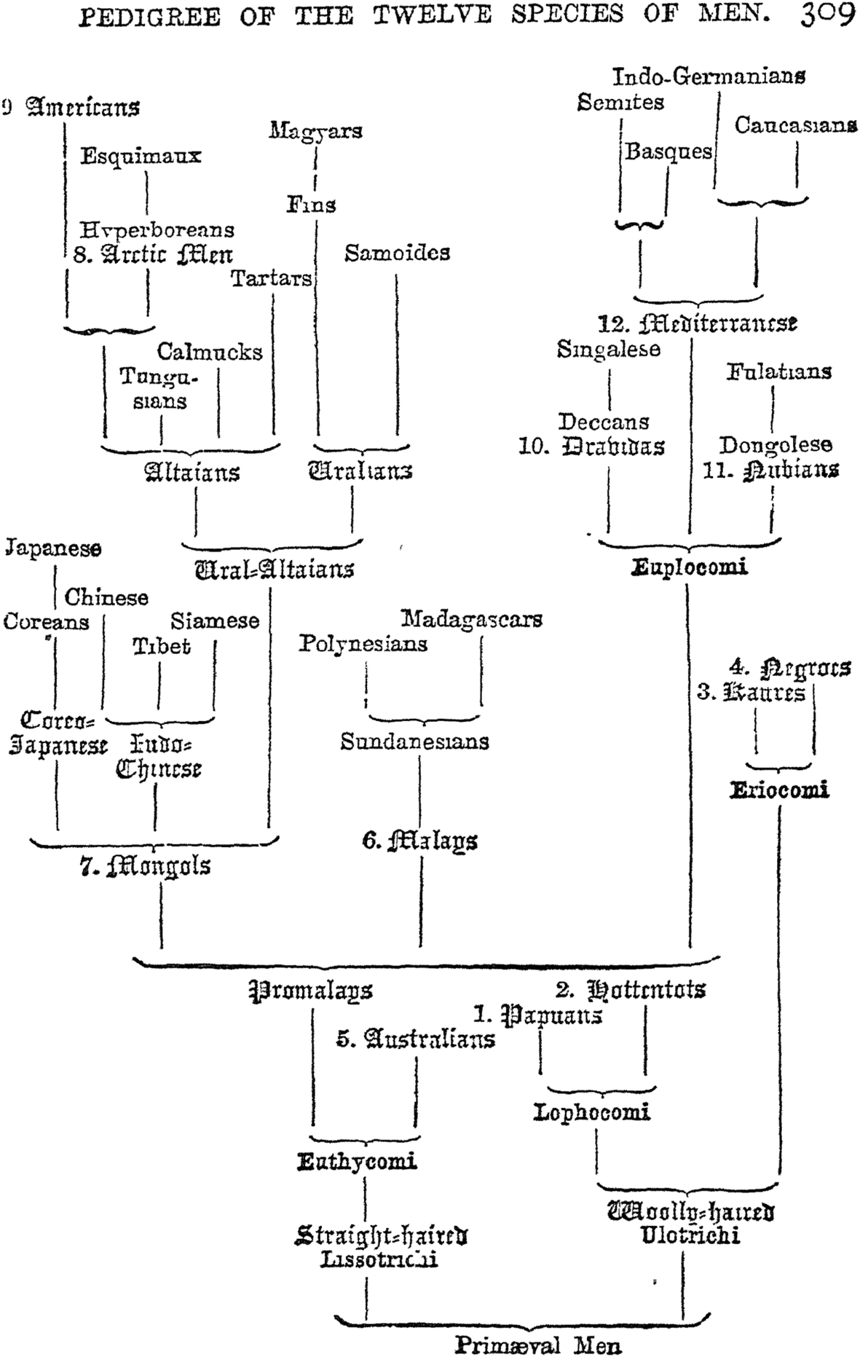
Due to Karl May the idea of the “noble savage” had become popular in Germany and associated mainly with native Americans
Ernst Haeckel 1870-79 Stem-tree of human species and races. (2nd to 7th edition of Natürliche Schöppfungsgeschichte)
Native Americans
Japanese
Germanic

Slide 50
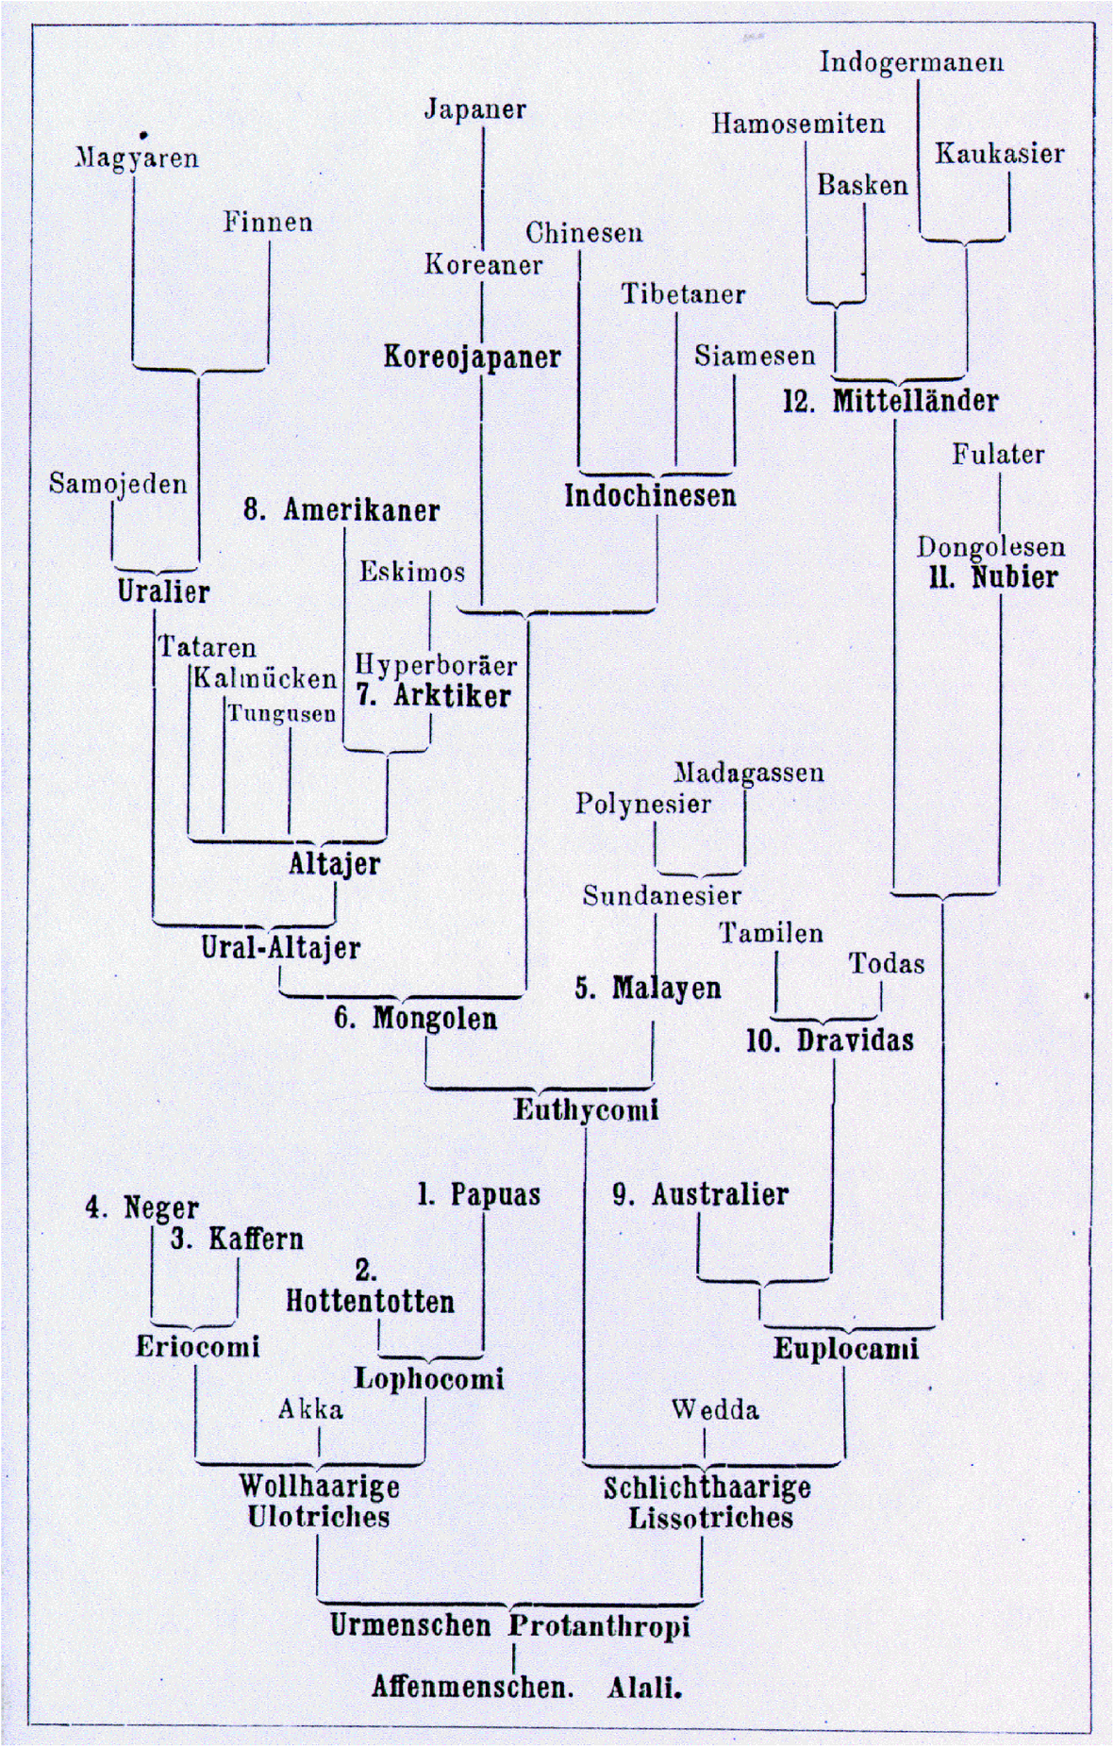
Buffalo Bill Western Shows depicted native Americans as savages killing innocent families had become popular entertainment in Europe.
Also, Haeckel’s books were translated into Japanese in 1882 and 1889.
Native Americans
Japanese
Germanic
The History of Creation, 8th (+) edition 1889-1920

Slide 51
Trees in Newick or parenthesis format
Trees rooted on a node (basal trifurcation) are usually considered as unrooted
Trees rooted on a branch are usually considered as rooted
((A, B), (C, D), E)
(((A, B), (C, D)), E)
Arbitrarily rooted in a node –
While displayed as rooted in a node, the tree should be considered as unrooted
Strictly bifurcating –
The root is located on the branch leading to E
More links here and here and here

Slide 52
What is in a tree?
Trees form molecular data are usually calculated as unrooted trees (at least they should be - if they are not this is usually a mistake).
To root a tree you either can assume a molecular clock (substitutions occur at a constant rate, again this assumption is usually not warranted and needs to be tested),
or you can use an outgroup (i.e. something that you know forms the deepest branch), or you need to be able to decide, which state of a character is primitive – this might work for wings, but usually not for A, G, T, and Cs.
For example, to root a phylogeny of birds, you could use the homologous characters from a reptile as outgroup; to find the root in a tree depicting the relations between different human mitochondria, you could use the mitochondria from chimpanzees or from Neanderthals as an outgroup; to root a phylogeny of alpha hemoglobins you could use a beta hemoglobin sequence, or a myoglobin sequence as outgroup.
What could be the outgroup for the Tree-of-Life?
Trees have a branching pattern (also called the topology), and branch lengths.
Often the branch lengths are ignored in depicting trees (these trees often are referred to as cladograms - note that cladograms should be considered rooted).
You can swap branches attached to a node, and in an unrooted you can depict the tree as rooted in any branch you like without changing the tree.

