Slide 1
Lecture 15
Mutual Aid
versus (?)
Natural Selection
More on Trees

Slide 2
Notes on Computer Lab 8

Slide 3
Histograms in Excel: use the Data Toolpak

Slide 4
To get a nice-looking histogram, that also is easy to compare to other histograms, it is a good idea to add a column to the right that lists the bins in the histogram. As we want to get a histogram of % identity values (i.e. a depiction of how often did the %id values occur in the selected data) bins of 5% are ok.

Slide 5
To get a nice histogram use the Data Analysis tool pak. It is part of the standard Excel distribution, but you might have to install it first.
Select tools, data analysis, histogram -- the default insert histogram is “ok” but you are stuch with the default bin sizes.

Slide 6
Click in the input range and select the data you want to analyze in a histogram, do the same for the bin range. (In my version, you cannot select a whole column.
select either everything, upto E-values of 1 e-7 or E-values > .5 or 1 or 10
click ok

Slide 7
If you selected to place the result into a new worksheet, a table will be inserted in a new sheet.
The easiest is to select the table, and them insert a new graphic from recommended charts:

Slide 8
Percent ID is not an appropriate measure for the quality of a blast hit. The reason is that blast is doing only local alignments, and the percent ID is expressed as a fraction of the length of the match.
If the match is 8aa long, a match 4 aa corresponds to 50% identity, but is hardly significant.

Slide 9
From the Borrelia-Haloferax comaparison
Histogram of % identity, different E-values
Logarithmic scale on Y-axis

Slide 10
Histograms of the number of matches illustrate the problem:
Add a new column to the spread sheet that gives the Number of identical aa per database match
= %ID/100 * Length [@percentID]/100*[@length]

Slide 11
How to get annotation lines for the matches:
Copy the accession numbers from the blast output:
Paste into text editor:
Replace all \n with ,

Slide 12
How to get annotation lines for the matches:
Copy paste into the blastdbcmd:
blastdbcmd -entry NP_038203.2,NP_004125.3,NP_079272.4,NP_068746.2,NP_001263409.1,NP_004981.2,NP_955472.1,NP_006286.1,NP_036255.2,NP_001263409.1,NP_006787.2,NP_002622.2,XP_054169791.1 -db Homo_sapiens_protein.faa -outfmt %t
The –outfmt %t restricts the output to only the annotation line, without it you get all the sequences. (You could use a text editor to pull out the annotation lines.)
For more on the blastdbcmd type blastdbcmd –help at the command line

Slide 13
Top hits comparing Borrelia against human (as data-bank)
Note #1: Many aa RSs -- frequently transferred, often targeted by antibiotics.
Note #2: the vacuolar or Archaeal type A ATPase should not be present in a bacterium -- HGT happens.

Slide 14
Top hits comparing Haloferax against
human (as data-bank)
Note #1: Many aa RSs -- frequently transferred, often targeted by antibiotics.

Slide 15
Gene and genome duplications

Slide 16
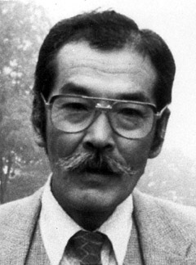
Duplications and Evolution
Ohno postulated that gene duplication plays a major role in evolution
Small scale duplications (SSD)
Whole genome duplications (WGD)
Polyploid: nucleus contains three or more copies of each chromosome
Autopolyploid: formed within a single species
Diploids AA and A’A’ Polyploid AAA’A’
Allopolyploid: formed from more than one species
Diploids AA and BB Polyploid AABB
Susumu Ohno 1970
Evolution by gene duplication
1R and 2R hypothesis
“Junk DNA” 1972
Slide from Chris Pires

Slide 17
Type of gene duplications:
tandem repeats
duplication via transposition (esp. retro transposition) (selfish genetic elements, but other genes as well; see the work from Craig Nelson’s lab)
Whole genome, chromosome, or chromosome arm duplications
In the lineage to vertebrates two whole genome duplications occurred (the exact placement is uncertain, because other duplications occurred as well). As a consequence, many regulatory genes (e.g. the hox gene cluster) are now present in at least 4 copies per genome. Many think that this allowed for a more differentiated development)
In fish* three rounds of whole genome duplications occurred
(*Teleostei = bony fish; the largest group of fish, but it does not include the sistergroup to the tetrapods (Lungfish or Dipnoe)
Most crop plants are polyploid (auto- or allopolyploid) => can lead to instant speciation in a hybridzone.

Slide 18
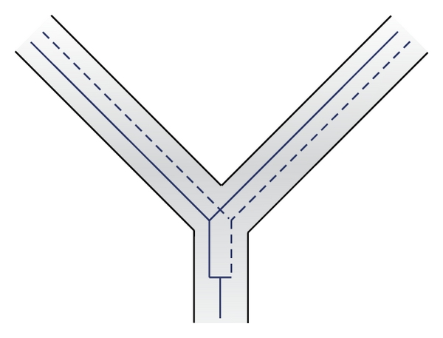
Autochtonous gene duplication.
Can occur through duplication of part of a chromosome, or through an mRNA intermediate (the new gene loses its introns)

Slide 19
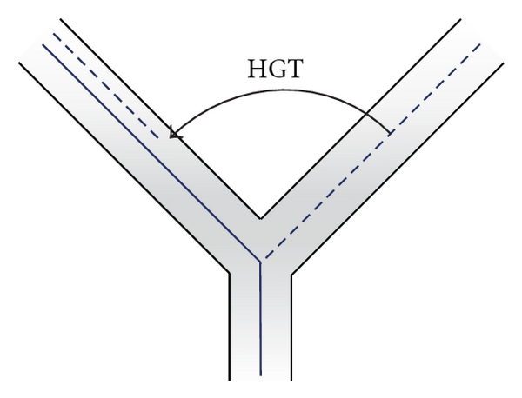
Gene family expansion through gene transfer. In one lineage the gene might have acquired a slightly different function, e.g., a malic acid dehydrogenase might have acquired reactivity toward lactic acid.
The recipient lineage than has both, a lactic and a malic acid dehydrogenase.
Most common in bacteria

Slide 20
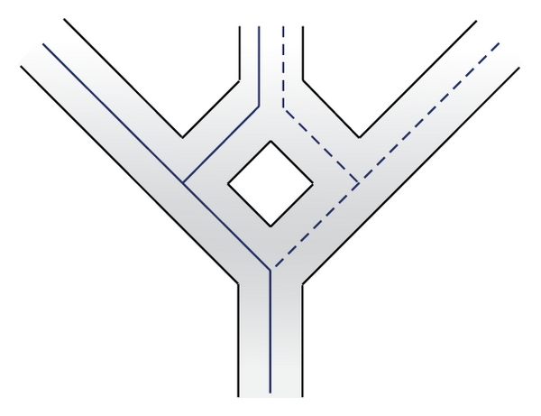
Aneupolyploidization.
Genomes from two related lineages fuse, all genes are duplicated. Occurs frequently in plants (instant speciation, the hybrids can not cross with the parents, because they have different sets of chromosomes.

Slide 21
Gene and genome duplication versus
Horizontal Gene Transfer
Gene family expansion through horizontal gene transfer –
the most common process in prokaryotes
Gene duplication through lineage fusion
Very common in plants, but also in animals
Autochtonous gene/genome
duplication are rare
in prokaryotes

Slide 22
Fate of Duplicated genes

Slide 23
Fate of Duplicated genes
gene silencing -> decay -- the most common fate, loss of function
Pseudogenization
gene paralog 1
one paralog keep the original function
gene duplication
gene 1
gene paralog 2
one paralog accumulates mutations and looses function
Occurs most frequently

Slide 24
Fate of Duplicated genes
gene silencing -> decay -- the most common fate, loss of function
subfunctionalization -- the two daughter genes from the duplication divide the functions of the parent gene, for example, via tissue specific expression – in plants many genes for proton pumps targeted to the plasma membrane exist, they all have the same function, but they are expressed in root hairs, in stamen, ..., in human the mitochondrial F-ATPase alpha subunit (encoded in the nucleus) has an isoform that is only expressed in the liver; this is the most common way for a gene to be maintained in a genome following a duplication.

Slide 25
The Fate of Duplicated Genes
Subfunctionalization
gene paralog 1
gene duplication
gene 1
gene paralog 2
The gene has a a function
(e.g., an ATP synthase subunit expressed in all organs, or in all organs of a plant)
The two paralogs divide the functional space
(e.g. one paralog is expressed in liver cells, the other in all other organs, or in case of plants one expressed only in anthers, the other in roots, the third in stomata)
Occurs often, This is the main pathway paralogs are maintained in a genome.

Slide 26
Fate of Duplicated genes
gene silencing -> decay -- the most common fate, loss of function
subfunctionalization -- the two daughter genes from the duplication divide the functions of the parent gene, for example, via tissue specific expression – in plants many genes for proton pumps targeted to the plasma membrane exist, they all have the same function, but they are expressed in root hairs, in stamen, ..., in human the mitochondrial F-ATPase alpha subunit (encoded in the nucleus) has an isoform that is only expressed in the liver; this is the most common way for a gene to be maintained in a genome following a duplication.
neofunctionalization -- one of the genes picks up a new function that the parent gene did not have.

Slide 27
The Fate of Duplicated Genes
Neofunctionalization
gene paralog 1
gene duplication
gene 1
gene paralog 2
paralog two picks up new function
Does happen only very rarely, it at all.

Slide 28
Question:
It seems that gene duplications followed by gene loss play not a big role in evolution. Conway and Lynch suggest that these duplications play a major role in biodiversity in erecting post mating hybridization barriers. How does this work?

Slide 29



Post mating hybridization barrier (hybrid infertility) through duplication followed by loss of function
Parent Populations
Subpopulation a
In 50% of the cases
the two sub populations
will lose the function in different copies
duplicated gene
before loss of function
Subpopulation b

Slide 30


F1
F2
Chr1+
Chr1 -
Chr2+
2+
1+
Chr2-
1+
0 +
Hybrid will have two functional genes in different locations
In 25% the F2 will not have a functional gene.
In case 100 genes were initially duplicated.
50 will be differentially fixed, and for each of
these the chance of being completely lost is 25%.
The chance the none of the 50 genes is lost is 0.75⁵⁰= 6x10⁻⁷

Slide 31
Natural Selection and Mutual Aid

Slide 32
Darwinian Evolution – Natural Selection
…., if there be, owing to the high geometrical powers of increase of each species, at some age, season, or year, a severe struggle for life, and this certainly cannot be disputed; then, considering the infinite complexity of the relations of all organic beings to each other and to their conditions of existence, causing an infinite diversity in structure, constitution, and habits, to be advantageous to them, I think it would be a most extraordinary fact if no variation ever had occurred useful to each being's own welfare, in the same way as so many variations have occurred useful to man. But if variations useful to any organic being do occur, assuredly individuals thus characterised will have the best chance of being preserved in the struggle for life; and from the strong principle of inheritance they will tend to produce offspring similarly characterised. This principle of preservation, I have called, for the sake of brevity, Natural Selection.
Charles Darwin
Photo by J. Cameron, 1869

Slide 33
Nature, red in tooth and claw
Are God and Nature then at strife,
That Nature lends such evil dreams?
So careful of the type she seems,
So careless of the single life;
That I, considering everywhere
Her secret meaning in her deeds,
And finding that of fifty seeds
She often brings but one to bear,
Canto 56
Who trusted God was love indeed
And love Creation's final law
Tho' Nature, red in tooth and claw
With ravine, shriek'd against his creed
From: Alfred Lord Tennyson's In Memoriam A. H. H., 1850 (published before Darwin's Origin of species)

Slide 34
Social Darwinism and Eugenics
(Spencer, Malthus, Galton)
Herbert Spencer in his Principles of Biology of 1864 wrote: 'This survival of the fittest, which I have here sought to express in mechanical terms, is that which Mr. Darwin has called "natural selection", or the preservation of favoured races in the struggle for life.'
Charles Darwin in The Descent of Man, and Selection in Relation to Sex (1882): 'Thus the weak members of civilized societies propagate their kind. No one who has attended to the breeding of domestic animals will doubt that this must be highly injurious to the race of man. It is surprising how soon a want of care, or care wrongly directed, leads to the degeneration of a domestic race; but excepting in the case of man himself, hardly any one is so ignorant as to allow his worst animals to breed. … but there appears to be at least one check in steady action, namely that the weaker and inferior members of society do not marry so freely as the sound …
Charles Robert Darwin, aged 45 in 1854
Images from Wikipedia

Slide 35
From: http://darwin-online.org.uk/content/frameset?pageseq=157&itemID=F955&viewtype=side

Slide 36
Darwin was an ardent abolitionist, (e.g. here) but …
From: http://darwin-online.org.uk/content/frameset?pageseq=229&itemID=F937.1&viewtype=side

Slide 37
Aside on Jemmy Button:
Darwin was on the beagle when Captain Fitzroy returned Jemmy Button to his native Tierra del Fuego (or Fireland).
Jemmy Button had been abducted to England on the previous voyage of the Beagle under Captain Fitzroy, and under Fitzroy’s tutelage received education in England.
Two views of Jemmy Button from FitzRoy's Narrative (1839)
via Wikipedia
See the reading assignment for this week.

Slide 38
Some of the early Darwinists were worse racists.
For example, Ernst Haeckel writes in his HISTORY OF CREATION
At the lowest stage of human mental development are the Australians, some tribes of the Polynesians, and the Bushmen, Hottentots, and some of the Negro tribes … Nothing, however, is perhaps more remarkable in this respect, than that some of the wildest tribes in southern Asia and eastern Africa have no trace whatever of the first foundations of all human civilization, of family life, and marriage. They live together in herds, like apes, generally climbing on trees and eating fruits; they do not know of fire, and use stones and clubs as weapons, just like the higher apes. All attempts to introduce civilization among these, and many of the other tribes of the lowest human species, have hitherto been of no avail; it is impossible to implant human culture where the requisite soil, namely, the perfecting of the brain, is wanting. Not one of these tribes has ever been ennobled by civilization; it rather accelerates their extinction. They have barely risen above the lowest stage of transition from man-like apes to ape-like men, a stage which the progenitors of the higher human species had already passed through thousands of years ago.

Slide 39
Prince Pyotr Alexeyevich Kropotkin
Mutual Aid: A Factor of Evolution
Russian Anarchist; organized geographical survey expedition to Siberia and Manchuria; spent most of his life in Switzerland, France (Paris commune), and England; returned to Russia after the 1917 revolution, but did not like the Bolsheviks and spoke out against authoritarian socialism.
Chapters written 1890-96
Critique of the "Struggle for Existence".
Raises the question
"Who are the fittest?"

Slide 40
From Mutual aid: a factor of evolution - Peter Kropotkin
… I saw animal life struggling in Northern Asia. They made me realize at an early date the overwhelming importance in Nature of what Darwin described as "the natural checks to over-multiplication," in comparison to the struggle between individuals of the same species for the means of subsistence, which may go on here and there, to some limited extent, but never attains the importance of the former. Paucity of life, under-population -- not over-population -- being the distinctive feature …
… besides the law of Mutual Struggle there is in Nature the law of Mutual Aid, which, for the success of the struggle for life, and especially for the progressive evolution of the species, is far more important than the law of mutual contest.
... Darwin himself was not fully aware of the generality of the factor … And at the very beginning of his memorable work he insisted upon the term being taken in its "large and metaphorical sense including dependence of one being on another, and including (which is more important) not only the life of the individual, but success in leaving progeny."1

Slide 41
From Mutual aid: a factor of evolution - Peter Kropotkin
… Nay, on the very pages just mentioned, amidst data disproving the narrow Malthusian conception of struggle, the old Malthusian leaven reappeared -- namely, in Darwin's remarks as to the alleged inconveniences of maintaining the "weak in mind and body" in our civilized societies (ch. v). As if thousands of weak-bodied and infirm poets, scientists, inventors, and reformers, together with other thousands of so-called "fools" and "weak-minded enthusiasts," were not the most precious weapons used by humanity in its struggle for existence by intellectual and moral arms, which Darwin himself emphasized in those same chapters of Descent of Man.

Slide 42
Symbiogenesis
Konstantin Mereschkowski:
The nature and origins of chromatophores in the plant kingdom (1905)
The Theory of Two Plasms as the Basis of Symbiogenesis (1909)
Natural selection cannot create novelty.
→ Acquisition and inheritance of microbes
(see also Lynn Margulis' theory of serial endosybiosis)

Slide 43
Gaia Hypothesis
Lynn Margulis, James Lovelock
Ecosystems (including the whole biosphere) can be seen as super organisms with their own homeostatic mechanisms.
Problems:
A single organisms cannot evolve by natural selection.
Both positive and negative feed back loops exist in the biosphere.
John Maynard Smith in Connie Barlow's "From Gaia to Selfish gene":
Images from Wikipedia

Slide 44
Holobiont and Evolution
Holobiont = Host plus all its Symbionts
In science symbiont is usually defined as living together, i.e. the term includes mutualistic, commensal and parasitic interactions.
The fitness of the Holobiont is the arbiter of selection.
The Hologenome Theory of Evolution
Image: BODY MICROBES, by Bruno Vergauwen.

Slide 45
Mutual aid
Discussion
Is the concept of mutual aid in conflict with Darwin’s theory of evolution by natural selection?
Or only in conflict with social Darwinists?
Is it the result of seeing the struggle for survival as a struggle with the environment, and not with members of the same species? (=> Group Selection)

Slide 46
Follow up questions on mutual aid
Discussion
mutual aid in the bacterial world – rule or exception?
Example: distributed metabolic pathways ammonium to nitrite to nitrate
Is there a difference between cooperation, mutualism and cheating?

Slide 47
The Black Queen Hypothesis
doi: 10.1128/mBio.00036-12
23 March 2012
mBio vol. 3 no. 2 e00036-12
explains the emergence of collaboration between microbes through the loss of genes encoding common goods (leaky products). E.g.:
Start - After selection for small streamlined genomes
Cells with identical genomes Cells are mutually dependent
The name refers to the game of Hearts, where the usual strategy is to avoid hearts and the queen of spades (in analogy to get rid of as many genes encoding leaky functions as possible - cheating).
The alternative is to get all hearts and the Black Queen (corresponding to the maintaining the keystone genome).

Slide 48
What is in a tree?
Trees form molecular data are usually calculated as unrooted trees (at least they should be - if they are not, this is usually a mistake).
Trees have a branching pattern (also called the topology), and branch (split) lengths.
Often the branch lengths are ignored in depicting trees (these trees often are referred to as cladograms - note that cladograms should be considered rooted).
You can swap branches attached to a node, and in an unrooted you can depict the tree as rooted in any branch you like without changing the tree.

Slide 49
Orientation and branch length I
In case of a cladogram the leaves representing extant organisms should be at the same level,
i.e., not as in Haeckel’s trees.

Slide 50
Orientation and branch length II
If you have branches scaled with the amount of change,
use them!

Slide 51
Trees can be depicted in many ways

Slide 52
If you must break a long branch, provide information on how long this branch is (long branches are a problem).
Ciccarelli FD et al., Science. 2006 Mar 3;311(5765):1283-7.
doi: 10.1126/science.1123061.
Wikimedia commons

Slide 53
Test: Which of these trees is different when considering their unrooted topology?
More tests here

Slide 54
If you like tests on trees:
Science had an article on a
“The Tree-Thinking Challenge”, with a supplement that contained two quizzes on trees (with answers). We will do some of these in next week’s TBL class
E.g.:
On the basis of the tree on the left, is the frog more closely related to the fish or the human?
Does the tree on the right change your mind?

Slide 55
Trees in Newick or parenthesis format
Trees rooted on a node are usually considered as unrooted
Trees rooted on a branch are usually considered as rooted
((A, B), (C, D), E)
(((A, B), (C, D)), E)
Arbitrarily rooted in a node –
While displayed as rooted in a node, the tree should be considered as unrooted
Strictly bifurcating –
The root is located on the branch leading to E
More links here and here and here

Slide 56
Phylogenetic Reconstruction – Why?
A) Systematic classification of organisms
e.g.: Who were the first angiosperms? (i.e. where are the first angiosperms located relative to present day angiosperms?) Where in the tree of life is the last common ancestor located?
B) Evolution of molecules
e.g.: domain shuffling, reassignment of function, gene duplications, horizontal gene transfer, drug targets,
detection of genes that drive evolution of a species/population
(e.g. influenca virus)
C) Identification of organisms
e.g., phylotyping in microbiome samples,
origin of genes and viruses (e.g., HIV virus, recent ebola outbreak)

Slide 57
Steps of the phylogenetic analysis
Phylogenetic analysis is an inference of evolutionary relationships between organisms.
Phylogenetics tries to answer the question
“How did groups of organisms come into existence?”
Those relationships are usually represented by tree-like diagrams.
Note: the equation of biological evolution with a tree like process has limited validity at best.

Slide 58
Phylogenetic reconstruction - How
Distance analyses
  calculate pairwise distances
  (different distance measures, correction for multiple hits, correction for codon bias)
  make distance matrix (table of pairwise corrected distances)
  calculate tree from distance matrix
    i) using optimality criterion
    (e.g.: smallest error between distance matrix and distances in tree (very popular in people with a physics background),
    or use
    ii) algorithmic approaches (UPGMA or neighbor joining) – very fast, popular with students of Masatoshi Nei

Slide 59
Algorithmic approaches (no global optimality criterion)
Principle of Neighbor Joining
From Wikipedia
UPGMA from Richard Edwards (here)
Wikipedia also has a good work through.

Slide 60
Phylogenetic reconstruction - How
Parsimony: Find the tree (or trees) that explains data with the smallest number of substitutions (aka as Occam’s razor).
Note: parsimony does poorly in the presence of short and long branches
Maximum Likelihood: Find the tree and model that make the dataset most probable.
Note: the probability of an individual data set is tiny. Usually a 0, followed by several 10000 zeros. -LogL values of 90000 are common.
Bayesian Approach: Find the tree and model that are most probable given the data and prior information.
Note: The Bayesian analysis and the biased random walk in parameter space use the likelihood (but not the maximum likelihood) associated with the points in in parameter space.

Slide 61
Else:
spectral analyses, like evolutionary parsimony, look only at patterns of substitutions,
Another way to categorize methods of phylogenetic reconstruction is to ask if they are using
an optimality criterion (e.g.: smallest error between distance matrix and distances in tree, least number of steps, highest probability), or
algorithmic approaches (UPGMA or neighbor joining)
Packages and programs available:
iqtree, MrBayes, PAUP*, phyml, raxml, PHYLIP, PAML, Tree-Puzzle, clustalw, PhyloGenie, HyPhy, seaview (GUI for PHYLIP and phyml)

Slide 62
Ockham’s Razor or the Parsimony Principle
In the words of Sir Isaac Newton:
“We are to admit no more causes of natural things than such as are both true and sufficient to explain their appearances.”
We prefer the phylogeny or cladogram that explains the observed characters (sequence or others) with the fewest number of changes.

