Slide 1
Lecture 16
Reconstructing Evolutionary History Part I

Slide 2
What is in a tree?
Trees form molecular data are usually calculated as unrooted trees (at least they should be - if they are not, this is usually a mistake).
Trees have a branching pattern (also called the topology), and branch (split) lengths.
Often the branch lengths are ignored in depicting trees (these trees often are referred to as cladograms - note that cladograms should be considered rooted).
You can swap branches attached to a node, and in an unrooted you can depict the tree as rooted in any branch you like without changing the tree.

Slide 3
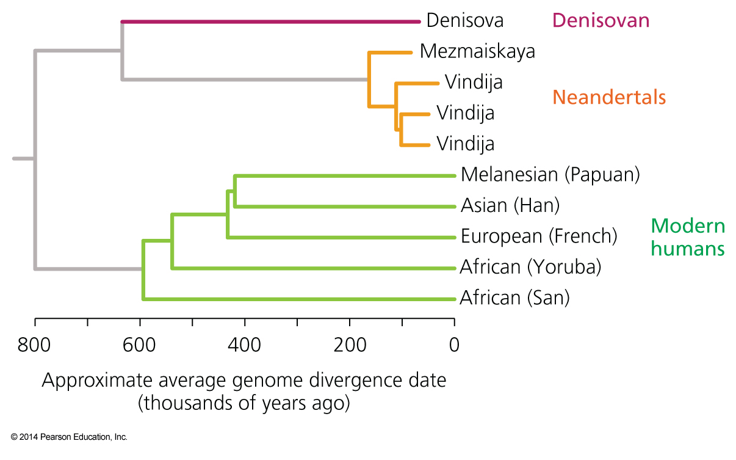
Orientation and branch length I
In case of a cladogram the leaves representing extant organisms should be at the same level, i.e., not as in Haeckel’s trees.

Slide 4
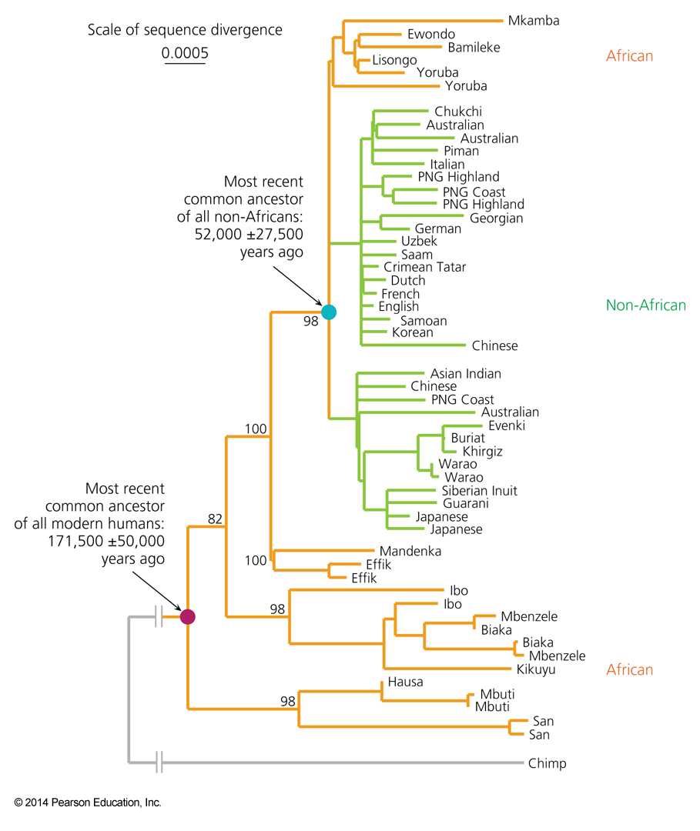
Orientation and branch length II
If you have branches scaled with the amount of change, use them!

Slide 5
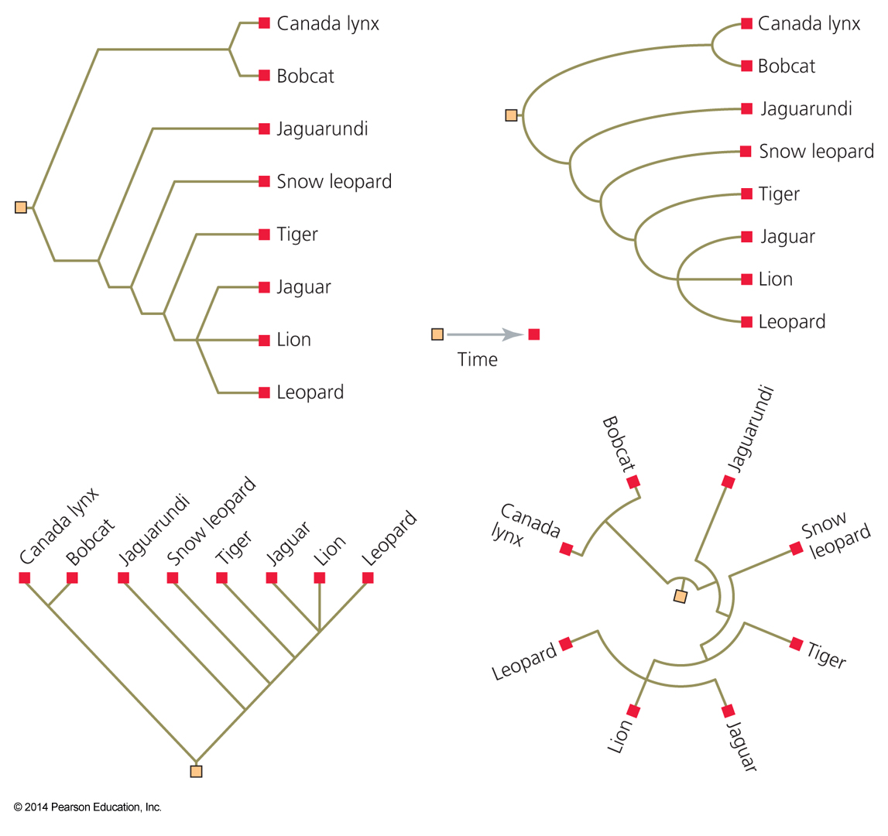
Trees can be depicted in many ways

Slide 6
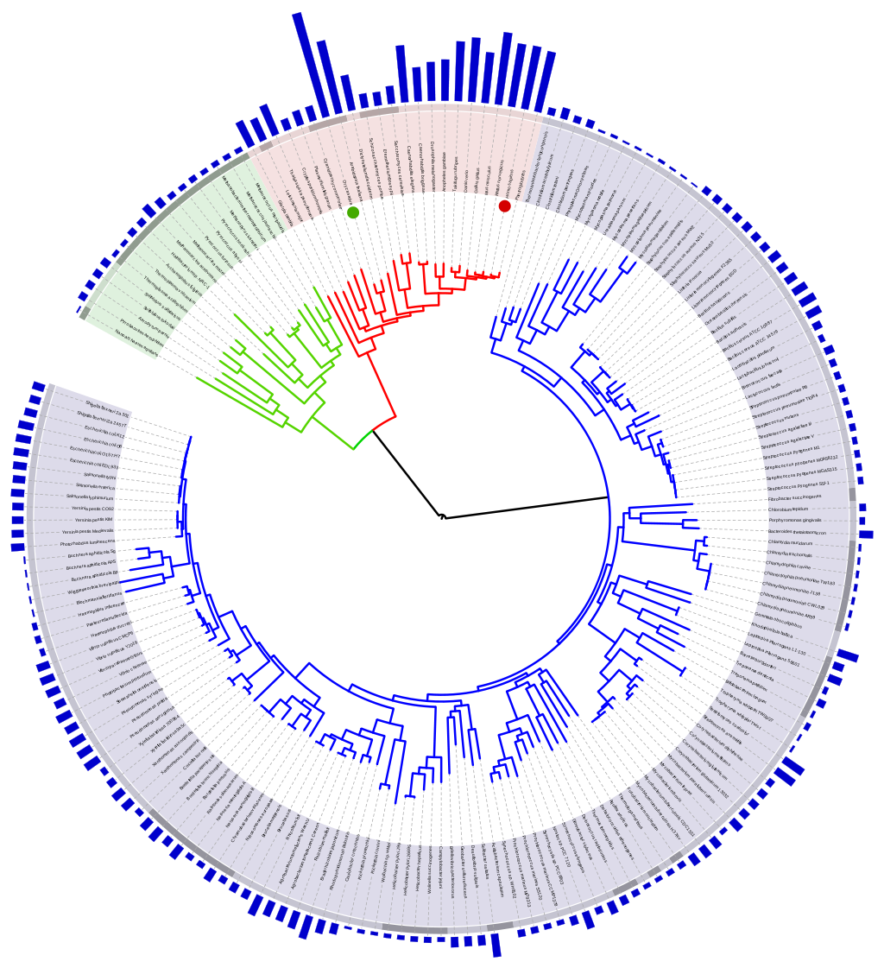
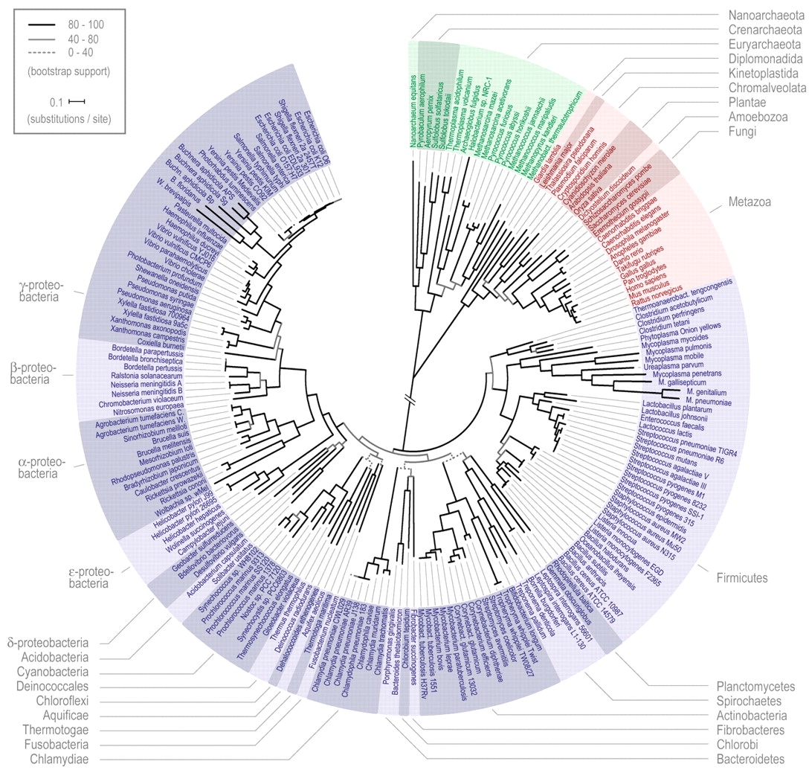
If you must break a long branch, provide information on how long this branch is (long branches are a problem).
Ciccarelli FD et al., Science. 2006 Mar 3;311(5765):1283-7. doi: 10.1126/science.1123061.
Wikimedia commons

Slide 7
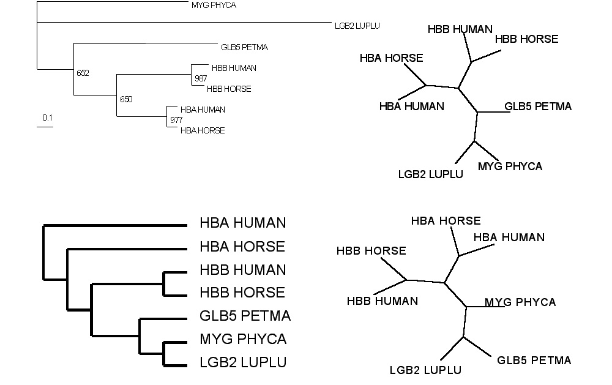
Test: Which of these trees is different when considering their unrooted topology?
More tests here

Slide 8
If you like tests on trees:
Science had an article on a
“The Tree-Thinking Challenge”, with a supplement that contained two quizzes on trees (with answers). We will do some of these in next week’s TBL class
E.g.:
On the basis of the tree on the left, is the frog more closely related to the fish or the human? Does the tree on the right change your mind?

Slide 9
Trees in Newick or parenthesis format
Trees rooted on a node are usually considered as unrooted
Trees rooted on a branch are usually considered as rooted
((A, B), (C, D), E)
(((A, B), (C, D)), E)
Arbitrarily rooted in a node –
While displayed as rooted in a node, the tree should be considered as unrooted
Strictly bifurcating – The root is located on the branch leading to E
More links here and here and here

Slide 10
Phylogenetic Reconstruction – Why?
A) Systematic classification of organisms
e.g.: Who were the first angiosperms? (i.e. where are the first angiosperms located relative to present day angiosperms?) Where in the tree of life is the last common ancestor located?
B) Evolution of molecules
e.g.: domain shuffling, reassignment of function, gene duplications, horizontal gene transfer, drug targets, detection of genes that drive evolution of a species/population (e.g. influenca virus)
C) Identification of organisms
e.g., phylotyping in microbiome samples, origin of genes and viruses (e.g., HIV virus, recent ebola outbreak)

Slide 11
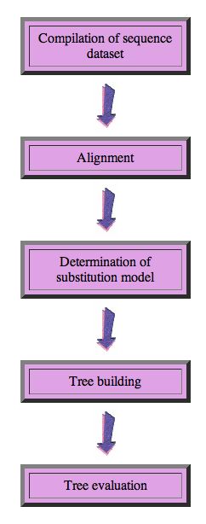
Steps of the phylogenetic analysis
Phylogenetic analysis is an inference of evolutionary relationships between organisms.
Phylogenetics tries to answer the question “How did groups of organisms come into existence?”
Those relationships are usually represented by tree-like diagrams.
Note: the equation of biological evolution with a tree like process has limited validity at best.

Slide 12
Phylogenetic reconstruction - How
Distance analyses
calculate pairwise distances
(different distance measures, correction for multiple hits, correction for codon bias)
make distance matrix (table of pairwise corrected distances)
calculate tree from distance matrix
i) using optimality criterion
(e.g.: smallest error between distance matrix and distances in tree (very popular in people with a physics background), or use
ii) algorithmic approaches (UPGMA or neighbor joining) – very fast, popular with students of Masatoshi Nei

Slide 13
Algorithmic approaches (no global optimality criterion)
Principle of Neighbor Joining
From Wikipedia
UPGMA from Richard Edwards (here)
Wikipedia also has a good work through.

Slide 14
Phylogenetic reconstruction - How
Parsimony: Find the tree (or trees) that explains data with the smallest number of substitutions (aka as Occam’s razor).
Note: parsimony does poorly in the presence of short and long branches
Maximum Likelihood: Find the tree and model that make the dataset most probable. Note: the probability of an individual data set is tiny. Usually a 0, followed by several 10000 zeros. -LogL values of 90000 are common.
Bayesian Approach: Find the tree and model that are most probable given the data and prior information. Note: The Bayesian analysis and the biased random walk in parameter space use the likelihood (but not the maximum likelihood) associated with the points in in parameter space.

Slide 15
Else:
spectral analyses, like evolutionary parsimony, look only at patterns of substitutions,
Another way to categorize methods of phylogenetic reconstruction is to ask if they are using
an optimality criterion (e.g.: smallest error between distance matrix and distances in tree, least number of steps, highest probability), or
algorithmic approaches (UPGMA or neighbor joining)
Packages and programs available: iqtree, MrBayes, PAUP*, phyml, raxml, PHYLIP, PAML, Tree-Puzzle, clustalw, PhyloGenie, HyPhy, seaview (GUI for PHYLIP and phyml)

Slide 16
Ockham’s Razor or the Parsimony Principle
In the words of Sir Isaac Newton:
“We are to admit no more causes of natural things than such as are both true and sufficient to explain their appearances.”
We prefer the phylogeny or cladogram that explains the observed characters (sequence or others) with the fewest number of changes.

Slide 17
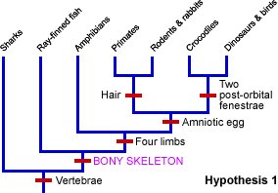
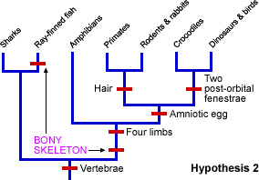
The parsimony approach also works for other characters. See below for the relation between sharks and bony fish:
From https://evolution.berkeley.edu/evolibrary/teach/index.php
This is pretty much equal to Willi Hennig’s cladistics. (The only difference is that parsimony does not insist on distinguishing between primitive and derived characters.)
Note, one can use ML for morphological characters!

Slide 18
Heuristic Searches
The most parsimonious tree or the maximum likely hood tree or the distance tree that fulfills some optimality criterion cannot be calculated directly from the data matrix (in contrast to the algorithmic approaches).
Given a tree the branch length (or number of steps) that optimize the criterion can be calculated.
To find the overall best tree, the enormous tree spaced need to be explored.

Slide 19
Number of different trees and number of splits
Number of genomes [n] | Number of trees [2n-5]! / [2(n-3)(n-3)!] | Number of bipartitions [2^{(n-1)}-n-1]
4 | 3 | 3
6 | 105 | 25
8 | 10,395 | 119
10 | 2,075,025 | 501
13 | 1.37E + 10 | 4,082
20 | 2.22E + 20 | 5.24E + 05
50 | 2.84E + 74 | 5.63E + 14
This is for unrooted trees. A rooted tree with n-leaves has the same number of different topologies as an unrooted tree with (n-1) leaves.

Slide 20
Maximum Likelihood

Slide 21
Estimating Models and Model Parameters.
Likelihood: Probability of a dataset given a model and a set of parameter.
Maximum likelihood: maximum probability of drawing the sample actually obtained using the model parameters as variable. (This usually is a tiny number, thus usually one uses the negative logarithm).
This works great for finding the best fitting parameters, AND Maximum Likelihood Estimation (MLE) can be used to test if assuming a more complicated model is justified by the data

Slide 22
Example: Regression using Polynomials
When has one added too many parameters?
The fit undoubted increases with each parameter, but does this increase justify the additional parameter?
Notes:
The fit undoubted increases with each parameter, but does this increase justify the additional parameter?

Slide 23
One could use the maximum likelihood ratio test
Let L1 be the maximum value of the likelihood of the data without the additional assumption. In other words, L1 is the likelihood of the data with all the parameters unrestricted and maximum likelihood estimates substituted for these parameters.
Let L0 be the maximum value of the likelihood when the parameters are restricted (and reduced in number) based on the assumption. Assume k parameters were lost (i.e., L0 has k less parameters than L1).
Form the ratio λ=L0/L1. This ratio is always between 0 and 1 and the less likely the assumption is, the smaller λ will be. This can be quantified at a given confidence level as follows:
Calculate χ2=−2 ln λ. The smaller λ is, the larger χ2 will be.
We can tell when χ2 is significantly large by comparing it to the 100(1−α) percentile point of a Chi-Square distribution with degrees of freedom. χ2has an approximate Chi-Square distribution with k degrees of freedom and the approximation is usually good, even for small sample sizes.
The likelihood ratio test computes χ2 and rejects the assumption if χ2 is larger than a Chi-Square percentile with k degrees of freedom, where the percentile corresponds to the confidence level chosen by the analyst.
From: https://www.itl.nist.gov/div898/handbook/apr/section2/apr233.htm
Alternatives to the MLRT are the use of the Akaike information criterion or the Bayesian information criterion

Slide 24
Aside:
MLE is a sophisticated version of Ockham razor.
Ockham razor favors the explanation that can explain an observation with the fewest assumptions (the parsimony principle).
MLE favors the explanation under which the observation is most probable. (MLE becomes equivalent to parsimony, if all events are equally probable. Note: you can also apply different weights to the events that are counted in parsimony, or ignore some altogether, e.g., transversion parsimony.)

Slide 25
Model parameters frequently used in maximum likelihood phylogenetic reconstruction
branch lengths
probabilities for for the different substitutions (most models are General Time Reversible, which often is not realistic)
frequency of aa or nucleotide types
probability that some sites experience more change then others
percent invariant sites

Slide 26
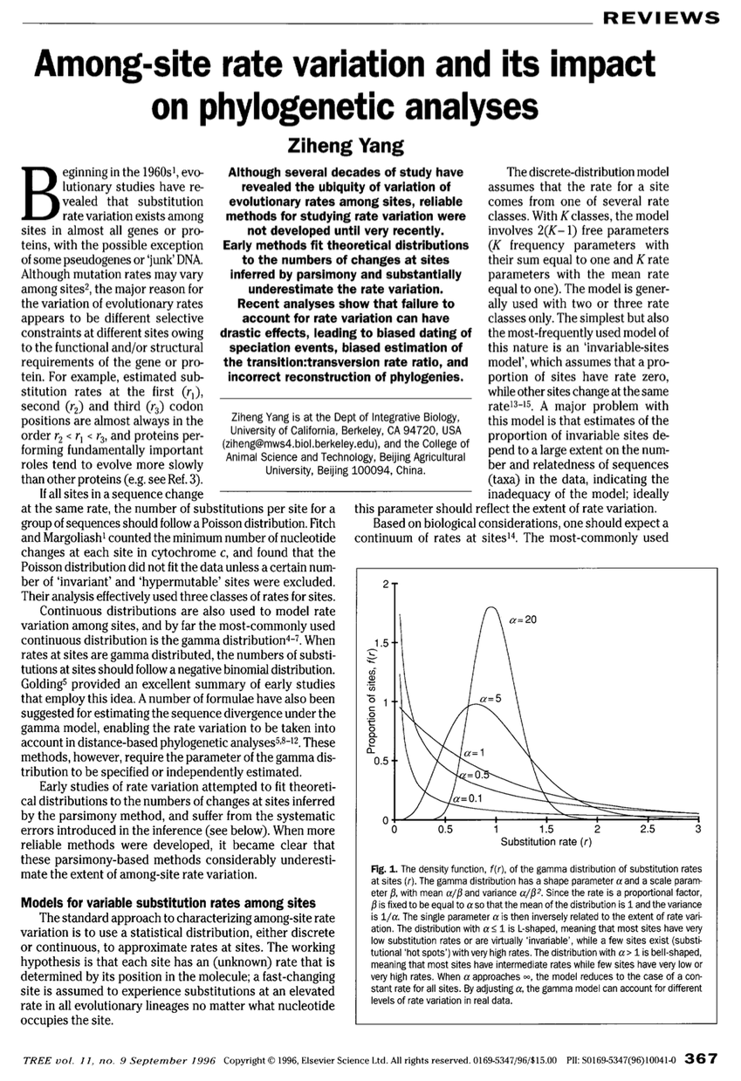
all sites in an alignment are not created equal.
https://www.sciencedirect.com/science/article/pii/0169534796100410?via%3Dihub

Slide 27
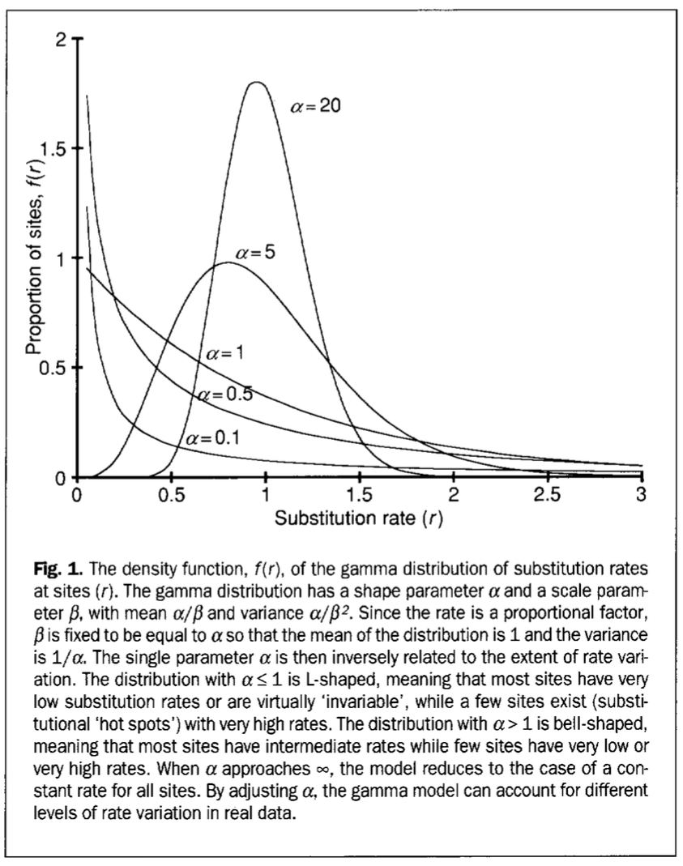
Aside on Correcting Distances
all sites in an alignment are not created equal.

