Slide 1
MCB 3421 – lecture 20
Intro to population genetics
Detecting types of selection

Slide 2
Population Genetics
Drift versus Selection
A) In a population of infinite size in which allele frequencies follow a differential equation a mutation with a selective advantage will be fixed

Slide 3
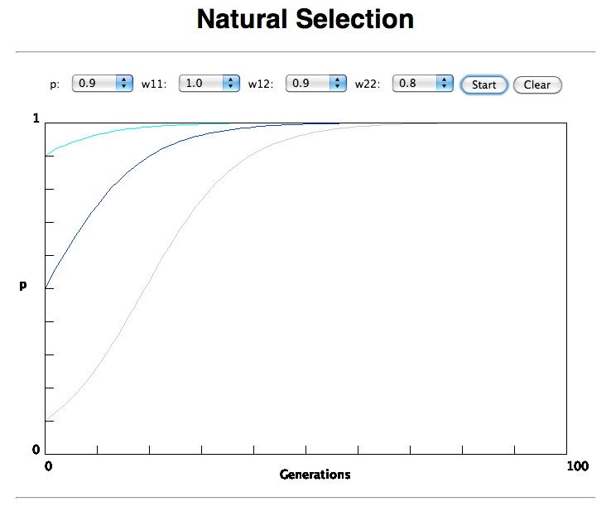

Slide 4
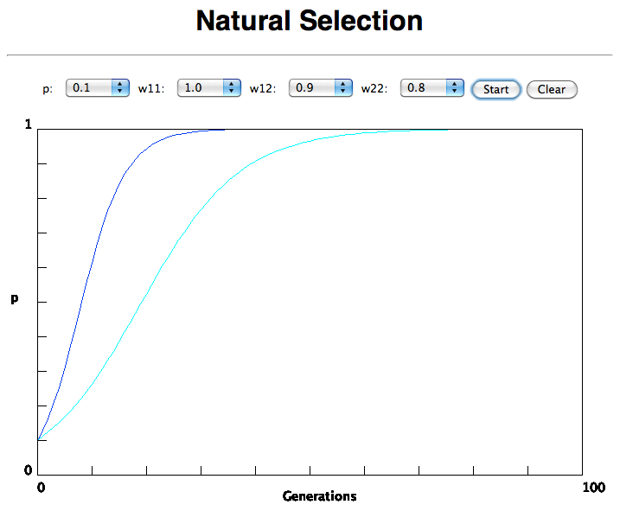
In the deterministic model, the time till fixation depends on the selective advantage, but fixation is guaranteed.

Slide 5
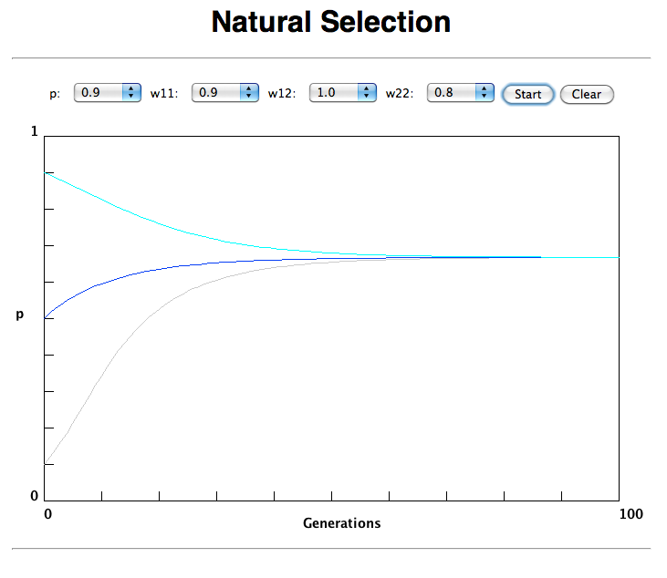
Only in case the heterozygote has an advantage (=balancing
selection) do both alleles coexist in a population.

Slide 6
(Kimura’s) Neutral theory:
The vast majority of observed sequence differences between members of a population are neutral (or close to neutral). These differences can be fixed in the population through random genetic drift. Some mutations are strongly counter selected (this is why there are patterns of conserved residues). Only very seldom is a mutation under positive selection.
The neutral theory does not say that all evolution is neutral and everything is only due to to genetic drift.

Slide 7
Modern synthesis:
Evolution occurs within populations where the fittest organisms have a selective advantage. Over time the advantageous genes become fixed in a population and the population gradually changes.
Why is this not a contradiction to the theory of neutral evolution. (which says what ?)

Slide 8
Nearly Neutral theory:
Even synonymous mutations do not lead to random composition but to codon bias.
Small negative selection might be sufficient to produce the observed codon usage bias.

Slide 9
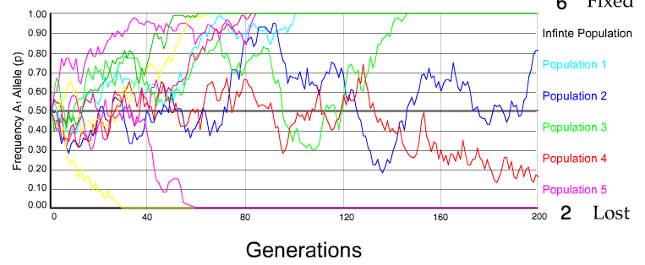
Genetic Drift:
The law of the Gutter:
N=50 s=0
10 replicates

Slide 10
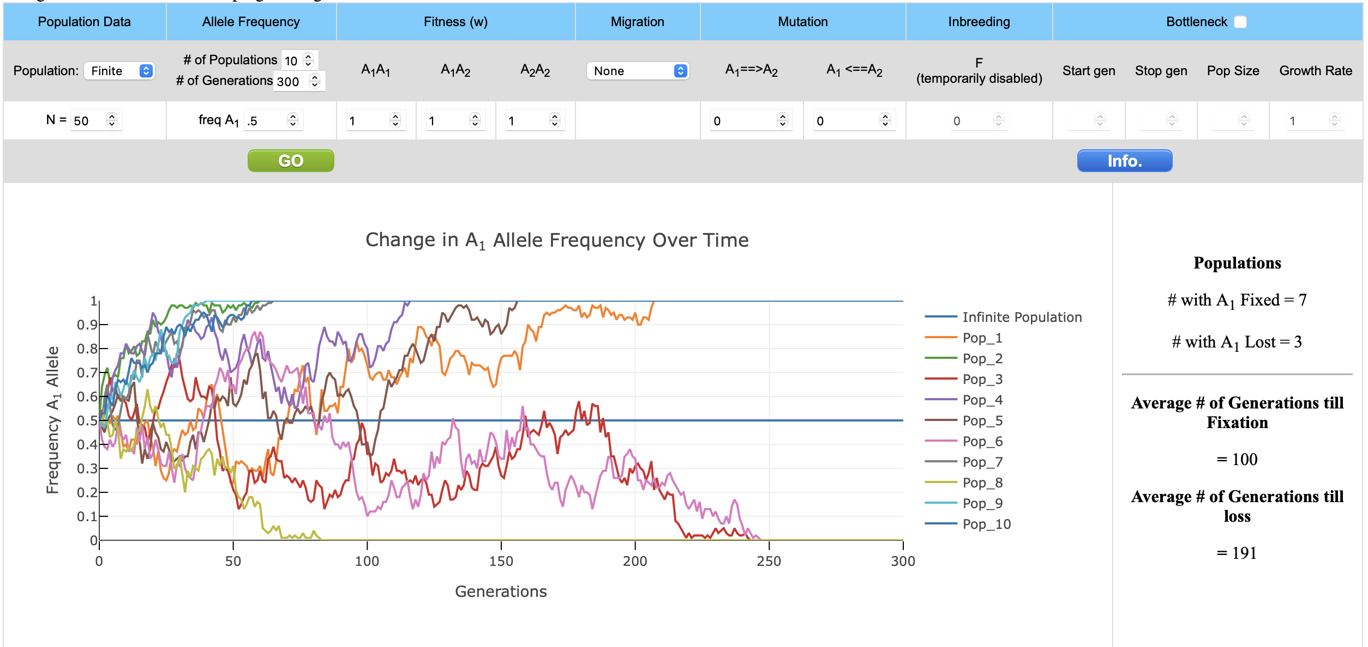

Slide 11
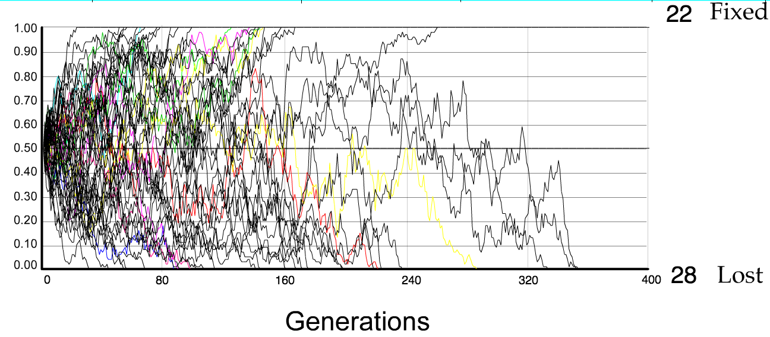
N=50 s=0
50 replicates

Slide 12
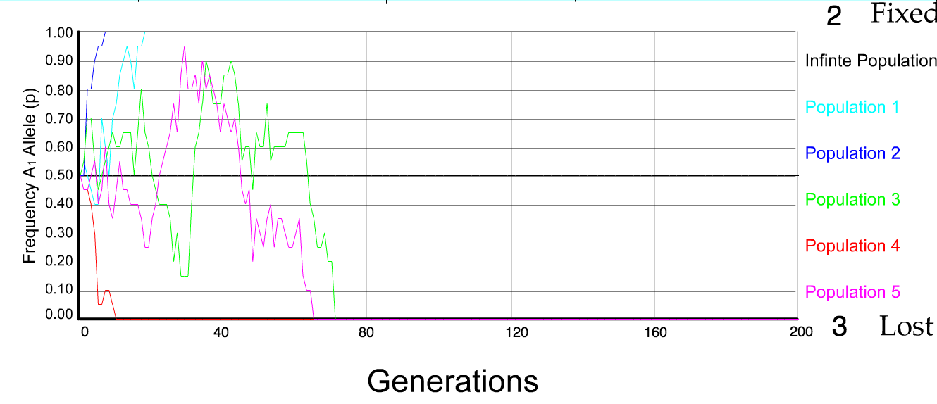
N=10 s=0
5 replicates

Slide 13
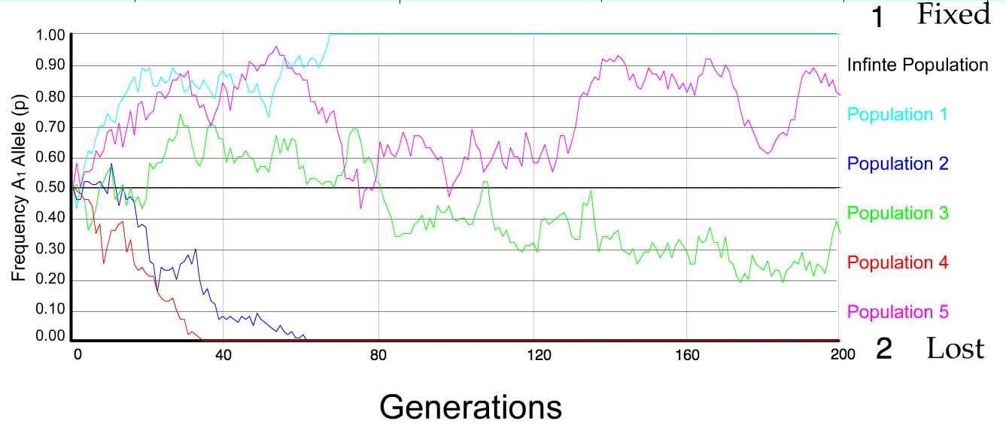
N=50 s=0
5 replicates

Slide 14
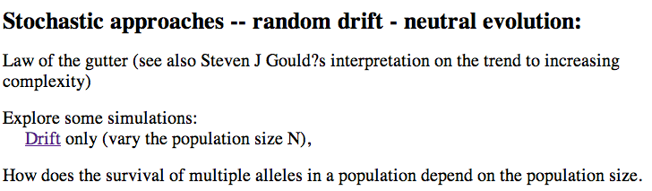
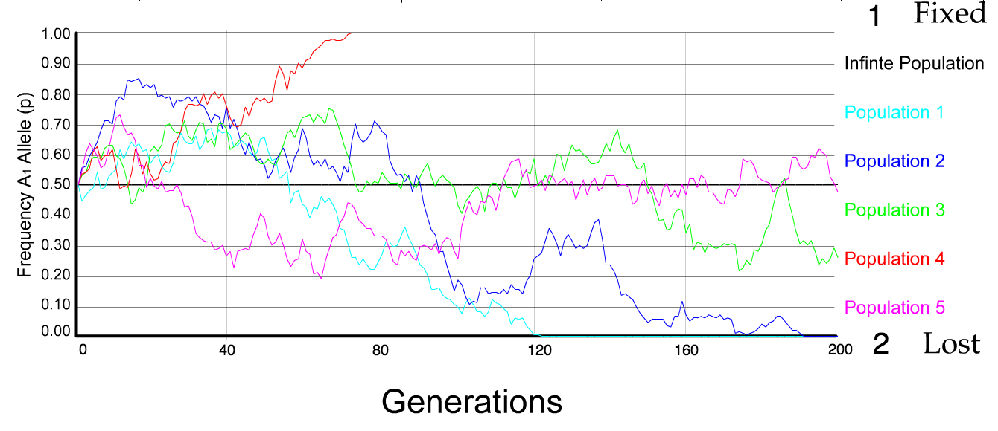
N=100 s=0
5 replicates

Slide 15
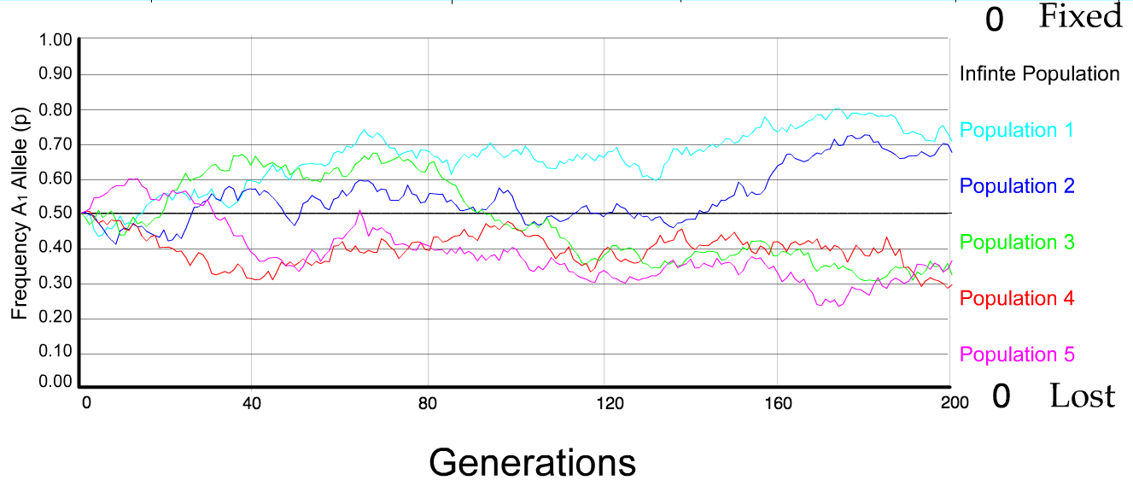
N=500 s=0
5 replicates

Slide 16
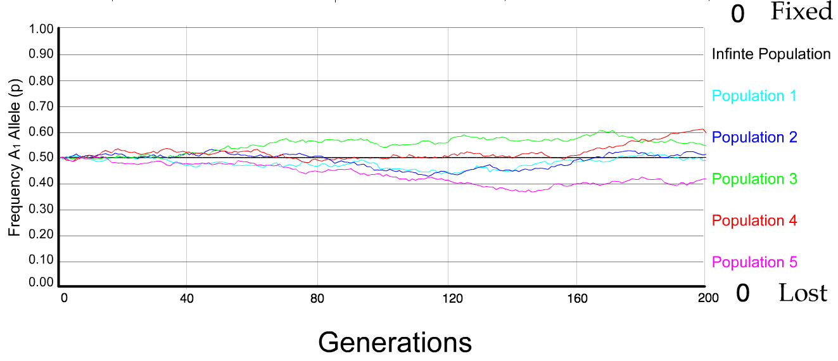
N=5000 s=0
5 replicates

Slide 17
s=0 -- neutral mutation
– no selective advantage or disadvantage
The probability of fixation, P, is equal to frequency of allele in population.
Mutation rate (per gene/per unit of time) = u ;
freq. with which allele is generated in diploid population size N =u*2N
Probability of fixation for each allele = 1/(2N)
Substitution rate =
frequency with which new alleles are generated * Probability of fixation= u*2N *1/(2N) = u = Mutation rate
Therefore:
If f s=0, the substitution rate is independent of population size, and equal to the mutation rate !!!! (NOTE: Mutation unequal Substitution! )
This is the reason that there is hope that the molecular clock might sometimes work.
Fixation time due to drift alone:
t_{av}=4*N_{e} generations
(N_{e}=effective population size; For n discrete generations
N_{e}= n/(1/N₁+1/N₂+…..1/N_{n}) or (1/N₁+1/N₂+…..1/N_{n}) = n/N_{e}

Slide 18
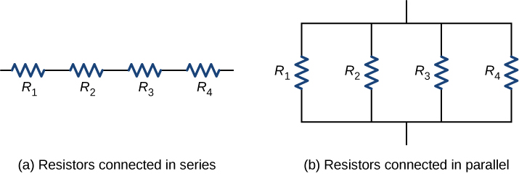
(1/N₁+1/N₂+…..1/N_{n}) = n/N_{e}
(1/N₁+1/N₂+…..1/N_{n})/n = 1/N_{e}
(1/R₁+1/R₂+1/R₃+1/R₄)/n = 1/R
The effective population size is dominated by the size of the population
bottle neck
(in analogy to the smallest resistance)

Slide 19
s>0
Time till fixation on average:
t_{av}= (2/s) ln (2N) generations
N=10⁴,
s=0: average time to fixation: 40.000 generations
s=0.01: average time to fixation: 1.900 generations
N=10⁶,
s=0: average time to fixation: 4*10⁶ generations
s=0.01: average time to fixation: 2900 generations
N=10¹¹ (100 billion – size of the Prochlorococcus population),
s=0: average time to fixation: 2*10¹¹ generations (about .5 billion years)
s=0.01: average time to fixation: 5200 generations (about 14 years)
Probability of fixation, P, is approximately equal to 2s;
e.g., if selective advantage s = 1% then P = 2%

Slide 20
s>0
Time till fixation on average:
t_{av}= (2/s) ln (2N) generations
(how come that this is also true for mutations with negative “s” ! discuss among yourselves)
N=10⁴,
s=0: average time to fixation: 40.000 generations
s=0.01: average time to fixation: 1.900 generations
N=10⁶,
s=0: average time to fixation: 4*10⁶ generations
s=0.01: average time to fixation: 2900 generations
N=10¹¹ (100 billion – size of the Prochlorococcus population),
s=0: average time to fixation: 2*10¹¹ generations (about .5 billion years)
s=0.01: average time to fixation: 5200 generations (about 14 years)
Probability of fixation, P, is approximately equal to 2s;
e.g., if selective advantage s = 1% then P = 2%

Slide 21
Positive selection (s>0)
A new allele (mutant) confers some increase in the fitness of the organism
Selection acts to favour this allele
Also called adaptive selection or Darwinian selection.
NOTE: Fitness = ability to survive and reproduce
Modified from from www.tcd.ie/Genetics/staff/Aoife/GE3026/GE3026_1+2.ppt

Slide 22
Random Genetic Drift
Selection
100
advantageous
Allele frequency
disadvantageous
0
Modified from from www.tcd.ie/Genetics/staff/Aoife/GE3026/GE3026_1+2.ppt

Slide 23
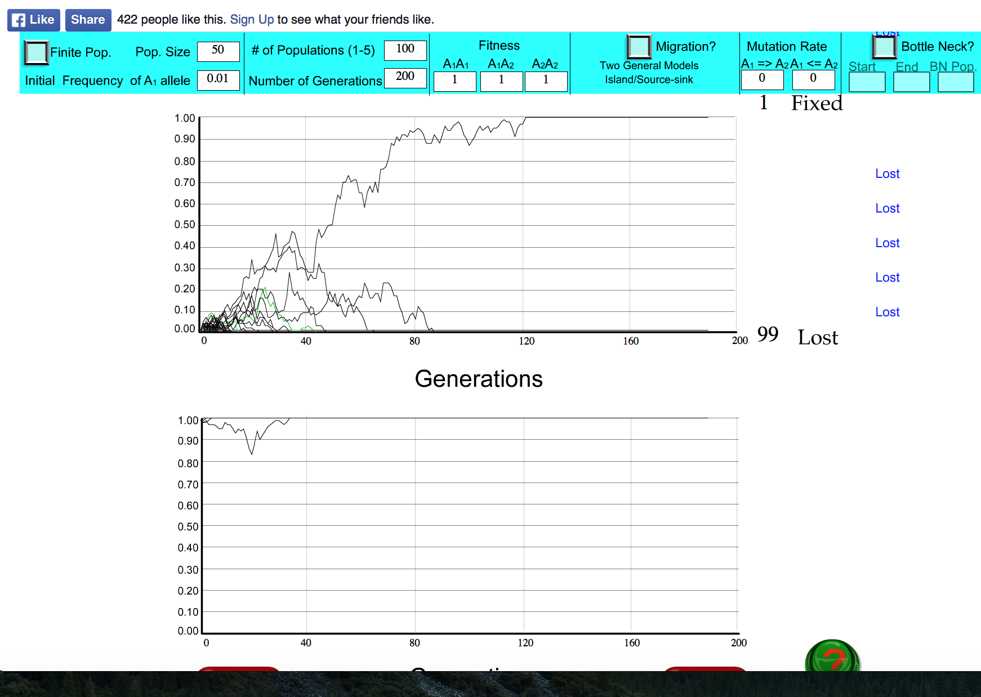
s=0

Slide 24
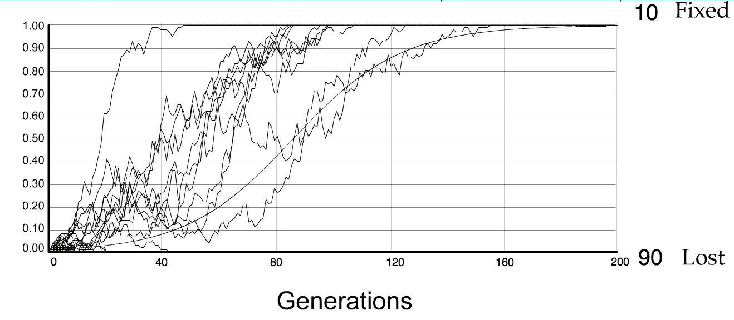
For advantageous mutations:
Probability of fixation, P, is approximately equal to 2s;
e.g., if selective advantage s = 5% then P = 10%
tav=2/s*log2N generations = 40*log100= 80

Slide 25
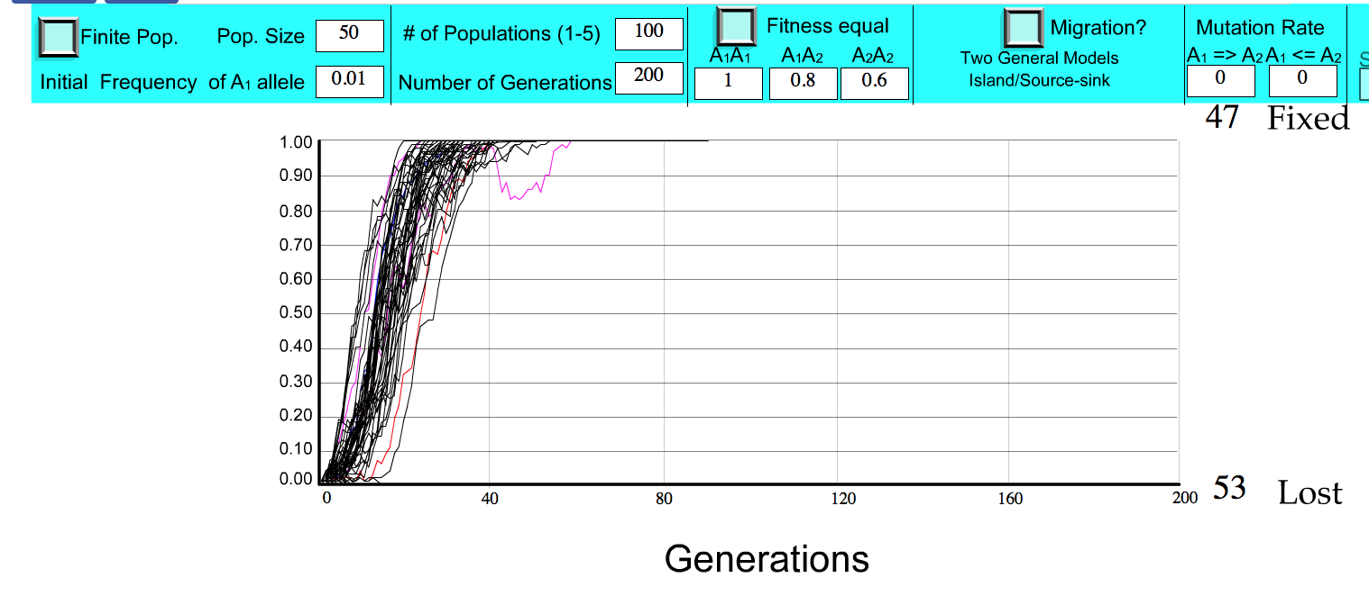
S=.2 => shorter fixation time.

Slide 26
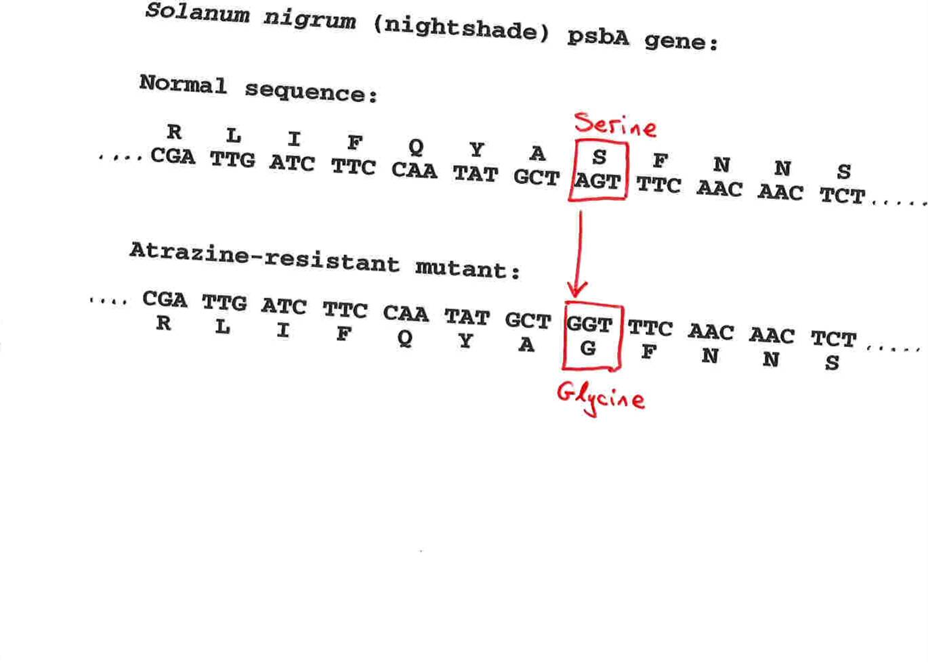
Advantageous allele
Herbicide resistance gene in nightshade plant
Modified from from www.tcd.ie/Genetics/staff/Aoife/GE3026/GE3026_1+2.ppt

Slide 27
selection versus drift
The larger the population the longer it takes for an allele to become fixed.
Note: Even though an allele conveys a strong selective advantage of 10%, the allele has a rather large chance to go extinct.
Note#2: Fixation is faster under selection than under drift.
Question: Can you think of genes that have a higher fixation probability? (Hint: HGT)

Slide 28
Negative selection (s<0)
A new allele (mutant) confers some decrease in the fitness of the organism
Selection acts to remove this allele
Also called purifying selection
Modified from from www.tcd.ie/Genetics/staff/Aoife/GE3026/GE3026_1+2.ppt

Slide 29
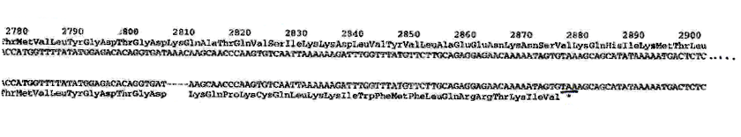
Deleterious allele
Human breast cancer gene, BRCA2
5% of breast cancer cases are familial
Mutations in BRCA2 account for 20% of familial cases
Normal (wild type) allele
Mutant allele
(Montreal 440
Family)
Stop codon
4 base pair deletion
Causes frameshift
Modified from from www.tcd.ie/Genetics/staff/Aoife/GE3026/GE3026_1+2.ppt

Slide 30
Neutral mutations
Neither advantageous nor disadvantageous
Invisible to selection (no selection)
Frequency subject to ‘drift’ in the population
Random drift – random changes of allele frequency in small populations

Slide 31
Types of Mutation-Substitution
Replacement of one nucleotide by another
Synonymous (Doesn’t change amino acid)
  Rate sometimes indicated by Ks
  Rate sometimes indicated by d_{s}
Non-Synonymous (Changes Amino Acid)
  Rate sometimes indicated by Ka
  Rate sometimes indicated by d_{n}
(this and the following 4 slides are from
mentor.lscf.ucsb.edu/course/ spring/eemb102/lecture/Lecture7.ppt)

Slide 32
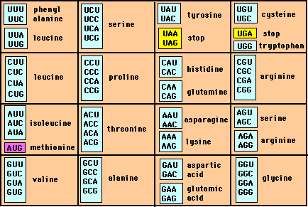
Genetic Code – Note degeneracy of 1st vs 2nd vs 3rd position sites

Slide 33
Genetic Code
Four-fold degenerate site – Any substitution is synonymous
From: mentor.lscf.ucsb.edu/course/spring/eemb102/lecture/Lecture7.ppt

Slide 34
Genetic Code
Two-fold degenerate site – Some substitutions synonymous, some
non-synonymous
From: mentor.lscf.ucsb.edu/course/spring/eemb102/lecture/Lecture7.ppt

Slide 35
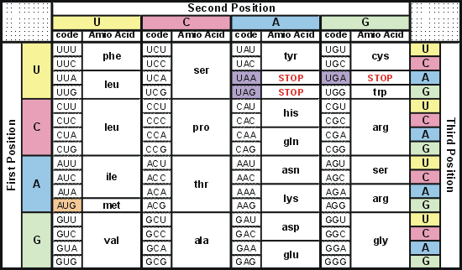
Degeneracy of 1st vs 2nd vs 3rd position sites results in 25.5% synonymous changes and 74.5% non synonymous changes (Yang&Nielsen,1998).
Genetic Code
Notes:
An inspection of the genetic code table suggests most changes at the first position are nonsynonymous, all changes at the second codon position are nonsynonymous and only some changes at the third position are synonymous. As a result we do not expect to see equal proportions of synonymous and nonsynonymous mutations even if there is no selection at protein level. Indeed, if mutations from any one nucleotide to any other occur at the same rate , we expect 25.5% of mutations to be synonymous and 74.5% mutations to be nonsynonymous.

Slide 36
Measuring Selection on Genes
Null hypothesis = neutral evolution
Under neutral evolution, synonymous changes should accumulate at a rate equal to mutation rate
Under neutral evolution, amino acid substitutions should also accumulate at a rate equal to the mutation rate
From: mentor.lscf.ucsb.edu/course/spring/eemb102/lecture/Lecture7.ppt

Slide 37
Counting #s/#a
Ser Ser Ser Ser Ser
Species1 TGA TGC TGT TGT TGT
Ser Ser Ser Ser Ala
Species2 TGT TGT TGT TGT GGT
#s = 2 sites
#a = 1 site
#a/#s=0.5
To assess selection pressures one needs to calculate the rates (Ka, Ks), i.e. the occurring substitutions as a fraction of the possible syn. and nonsyn. substitutions.
Things get more complicated, if one wants to take transition transversion ratios and codon bias into account. See
chapter 4 in Nei and Kumar, Molecular Evolution and Phylogenetics.
Modified from: mentor.lscf.ucsb.edu/course/spring/eemb102/lecture/Lecture7.ppt

Slide 38
Testing for selection using dN/dS ratio
dN/dS ratio (aka Ka/Ks or ω (omega) ratio) where
dN = number of non-synonymous substitutions / number of all possible non-synonymous substitutions
dS =number of synonymous substitutions / number of all possible synonymous substitutions
dN/dS >1 positive, Darwinian selection
dN/dS =1 neutral evolution This usually is the null hypothesis!
dN/dS <1 negative, purifying selection
Notes:
The synonymous and non-synonymous rates dN and dS are defined as the numbers of synonymous and nonsynonymous substitutions per site. The ratio of the two rates omega=dN/dS then measures selective pressure at the protein level. If selection level has no effect on fitness, nonsynonymous mutations will be fixed at the same rate as synonymous mutations so that dN=dS and omega=1. If nonsynonymous mutations are deleterious purifying selection will reduce their fixation rate so that dN<dS and omega<1. If nonsynonymous mutations are favored by Darwinian selection, they will be fixed at a higher rate than synonymous mutations resulting in dN>dS and omega>1.

Slide 39
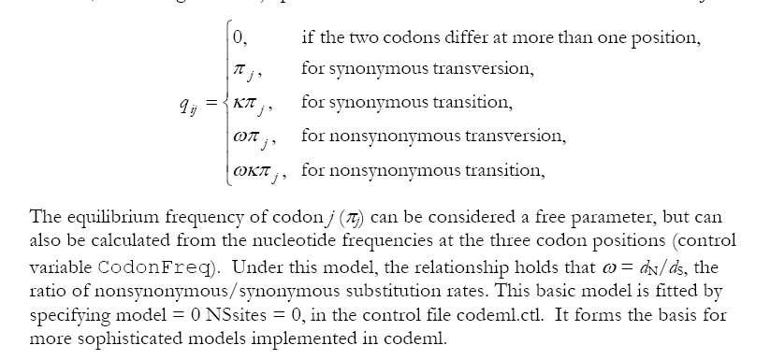
PAML (codeml) the basic model

Slide 40
dambe
Two programs worked well for me to align nucleotide sequences based on the amino acid alignment,
One is DAMBE (only for windows). This is a handy program for a lot of things, including reading a lot of different formats, calculating phylogenies, it even runs codeml (from PAML) for you.
The procedure is not straight forward, but is well described on the help pages. After installing DAMBE go to HELP -> general HELP -> sequences -> align nucleotide sequences based on …->
If you follow the instructions to the letter, it works fine.
DAMBE also calculates Ka and Ks distances from codon based aligned sequences.

Slide 41
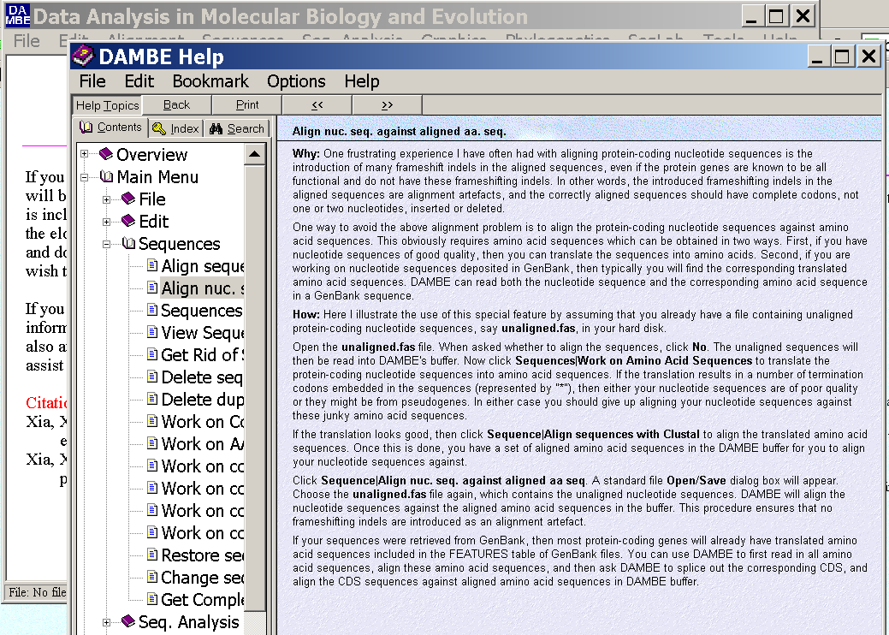
dambe (cont)

Slide 42
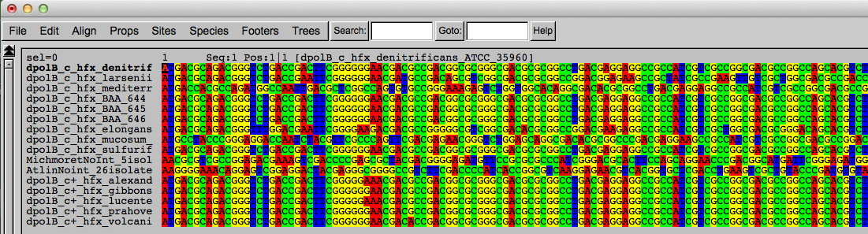
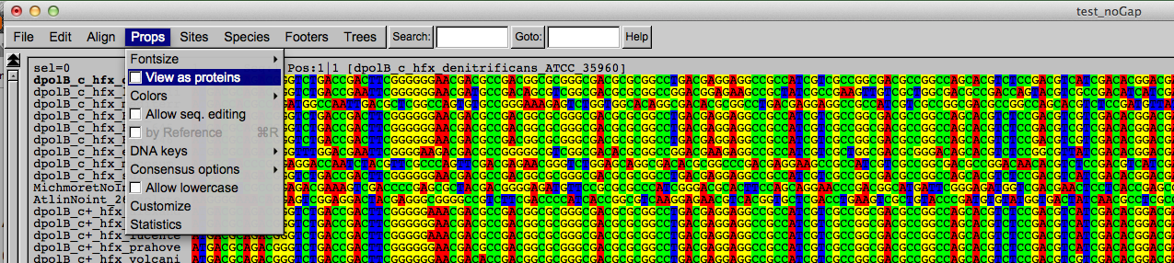
Codon based alignments in Seaview
Load nucleotide sequences (no gaps in sequences, sequence starts with nucleotide corresponding to 1st codon position)
Select view as proteins

Slide 43
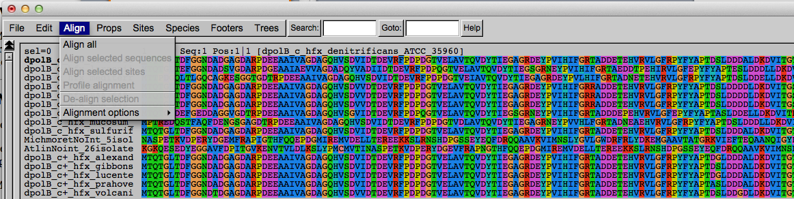
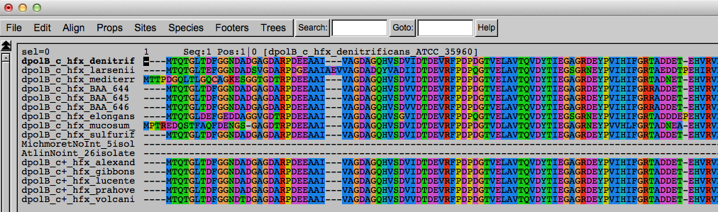
Codon based alignments in Seaview
With the protein sequences displayed, align sequences
Select view as nucleotides

Slide 44
PAML (codeml) the basic model

Slide 45

sites versus branches
You can determine omega for the whole dataset; however, usually not all sites in a sequence are under selection all the time.
PAML (and other programs) allow to either determine omega for each site over the whole tree, ,
or determine omega for each branch for the whole sequence,
.
It would be great to do both, i.e., conclude codon 176 in the vacuolar ATPases was under positive selection during the evolution of modern humans – alas, a single site often does not provide much statistics. PAML does provide a branch site model.

Slide 46
Sites model(s)
have been shown to work great in few instances.
The most celebrated case is the influenza virus HA gene.
A talk by Walter Fitch (slides and sound) on the evolution of
this molecule is here .
This article by Yang et al, 2000 gives more background on ml approaches to measure omega.
The dataset used by Yang et al is here: flu_data.paup .
On the other hand, if sequences are difficult to align and contain pseudogenes, diversifying selection can be inferred erroneously. Misaligned regions, often surrounding gaps, result in higher rates of non-synonymous substitutions.
pro: https://pmc.ncbi.nlm.nih.gov/articles/PMC1180675/
critical: https://www.pnas.org/doi/10.1073/pnas.0401566101

Slide 47
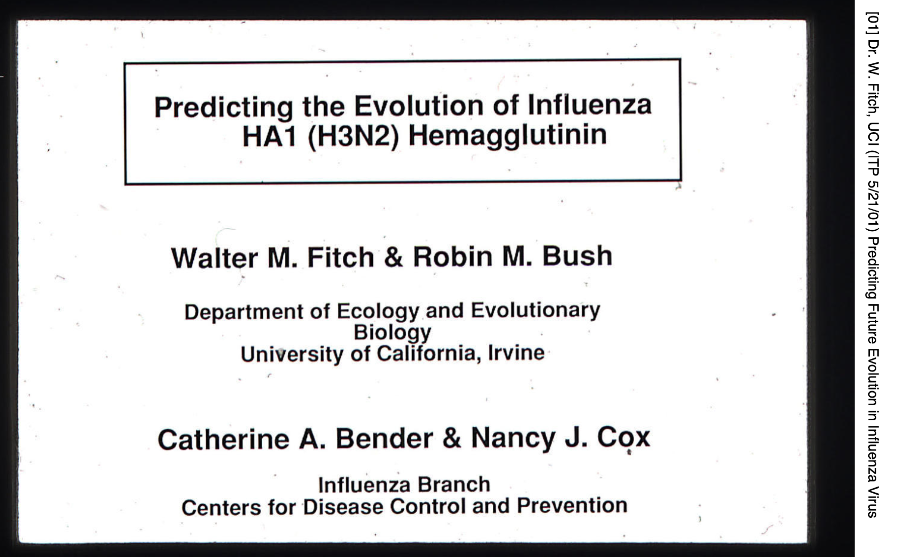
Slides from Walter Fitch’s talk

Slide 48
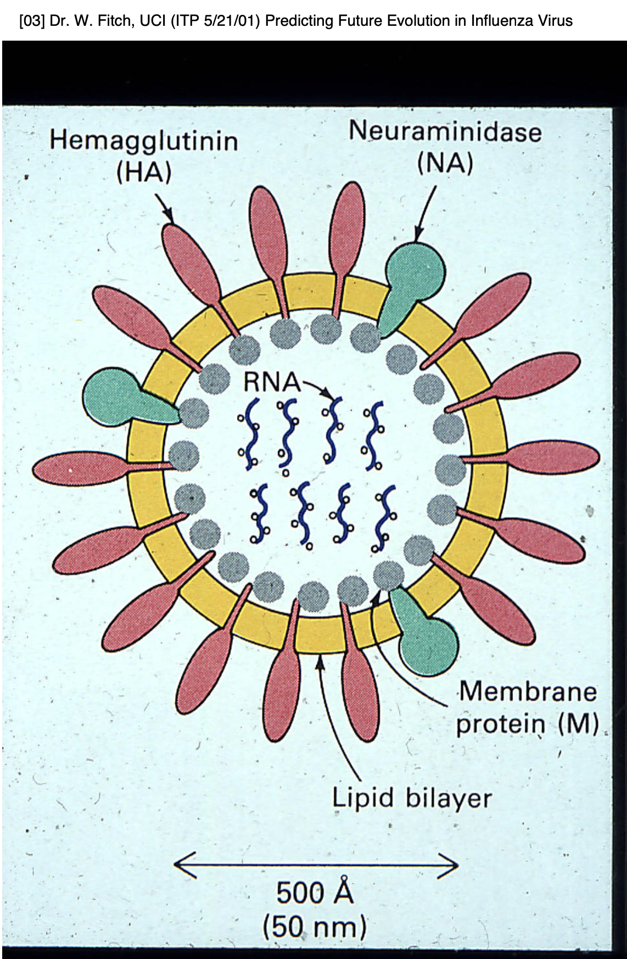
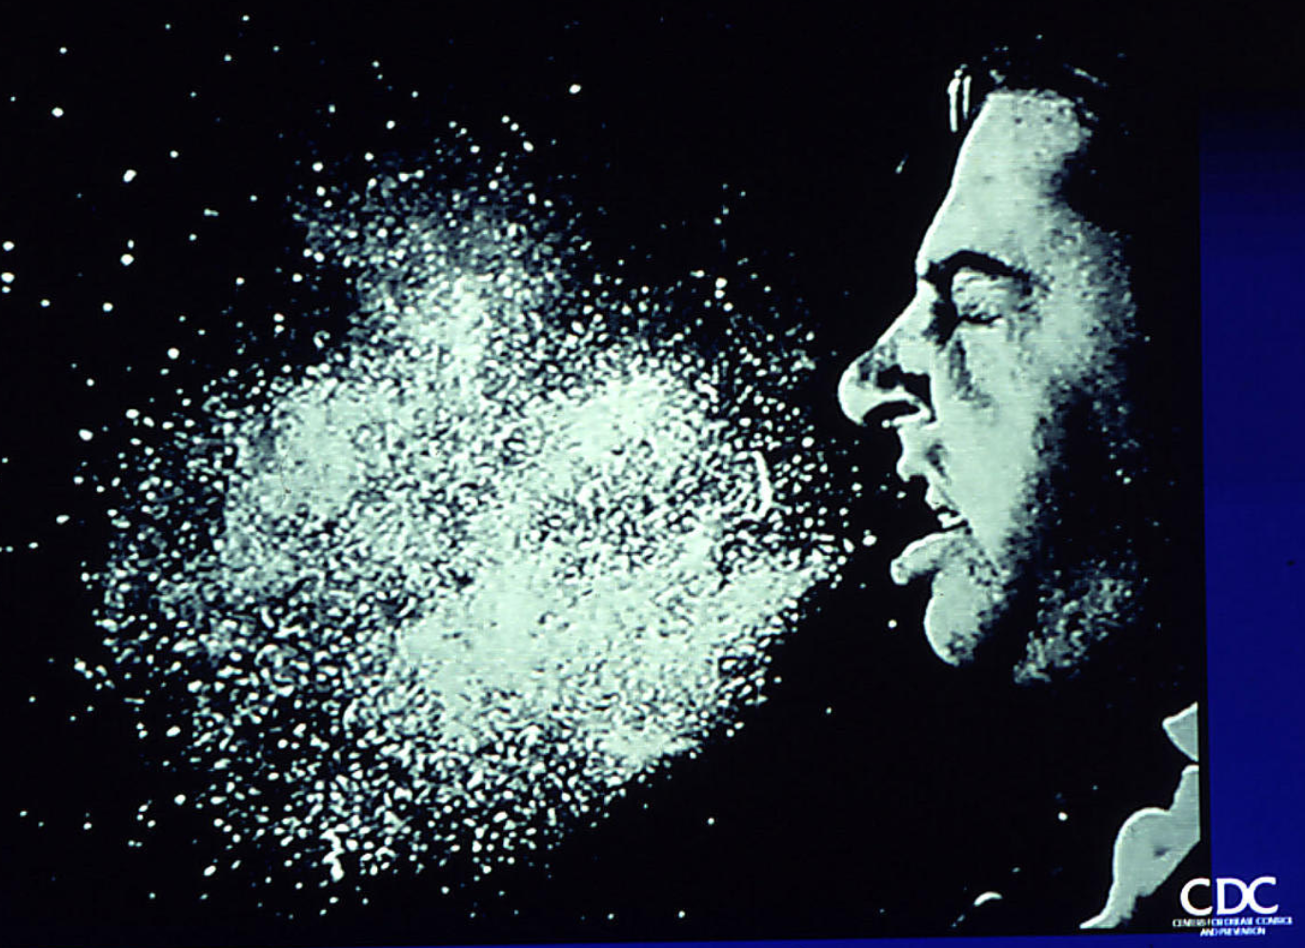

Slide 49
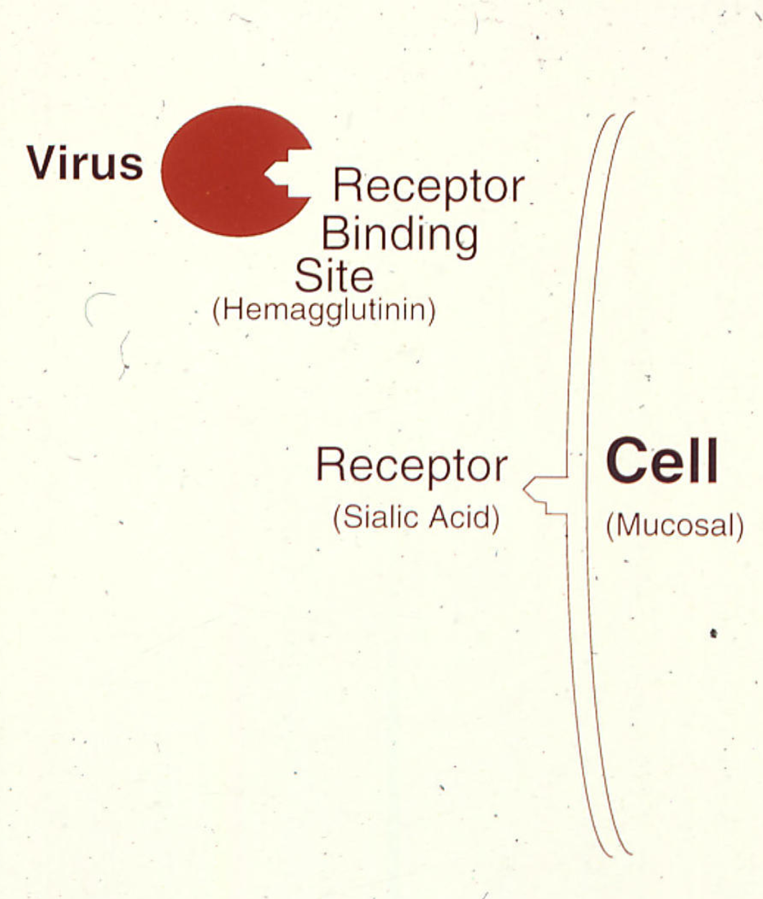
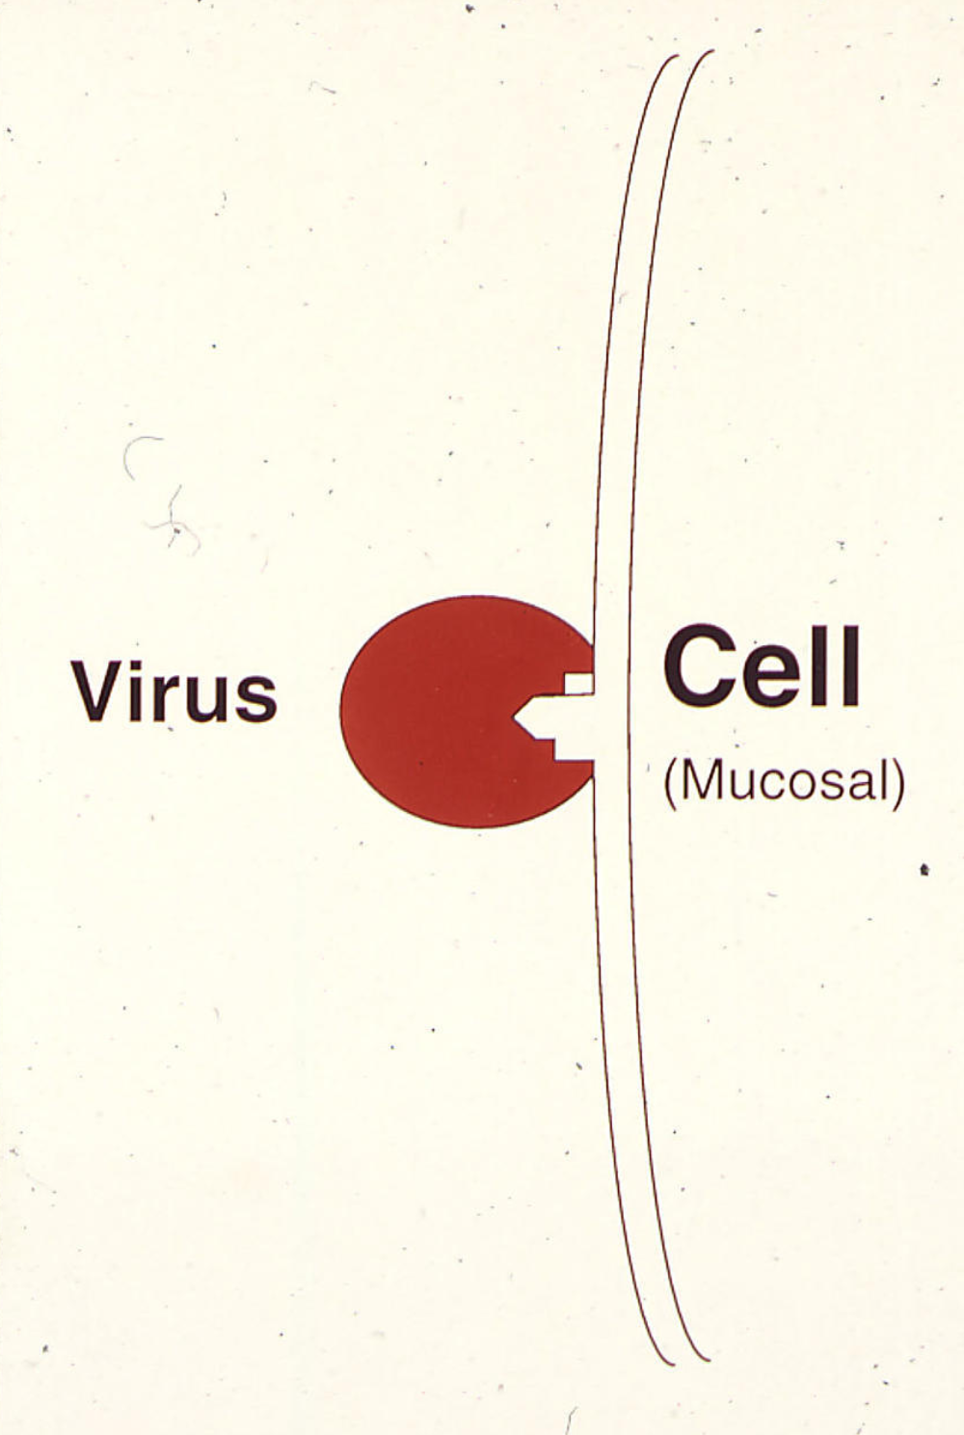

Slide 51
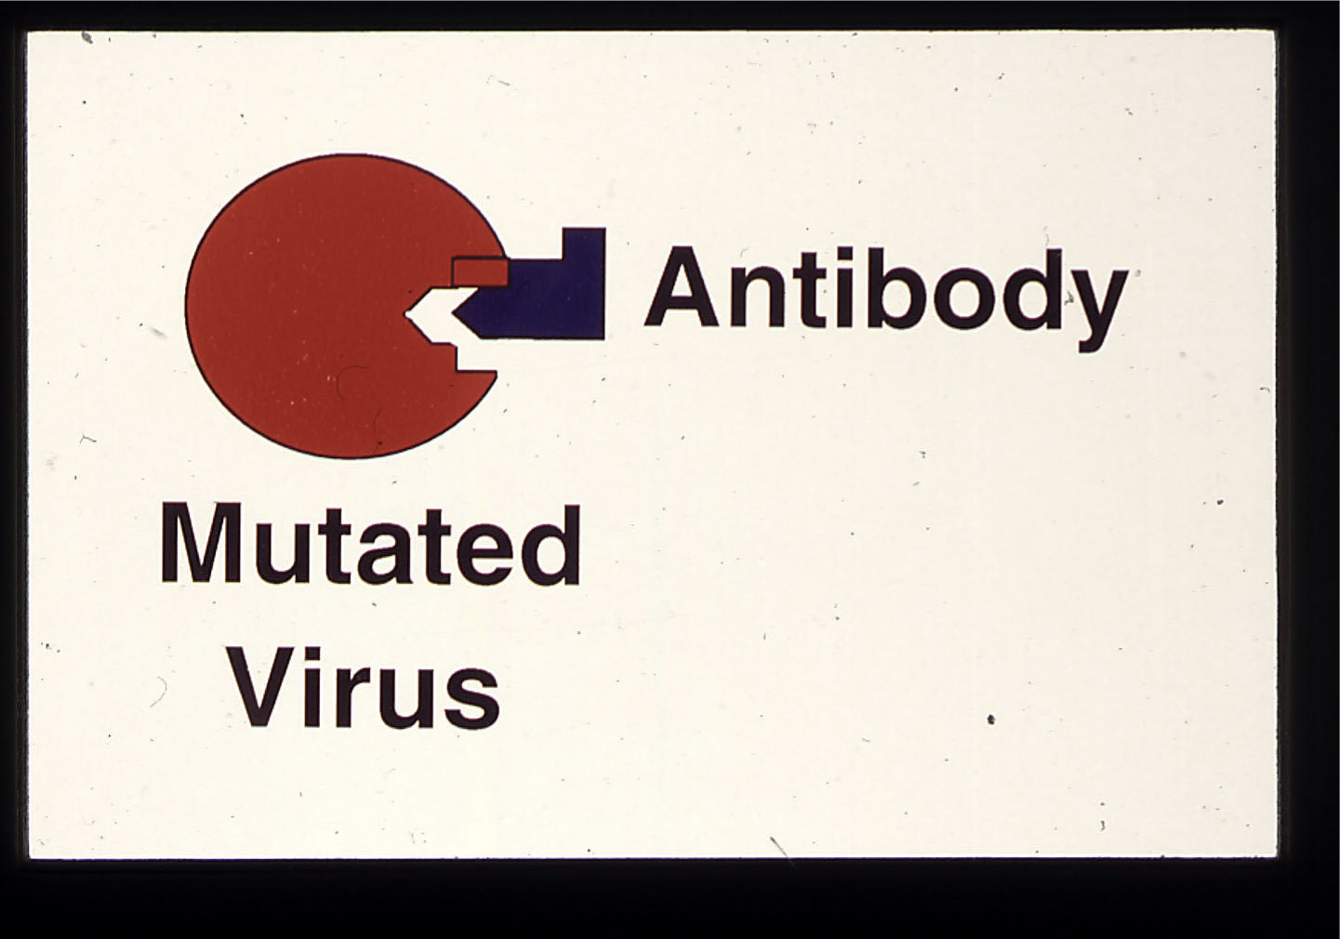

Slide 52
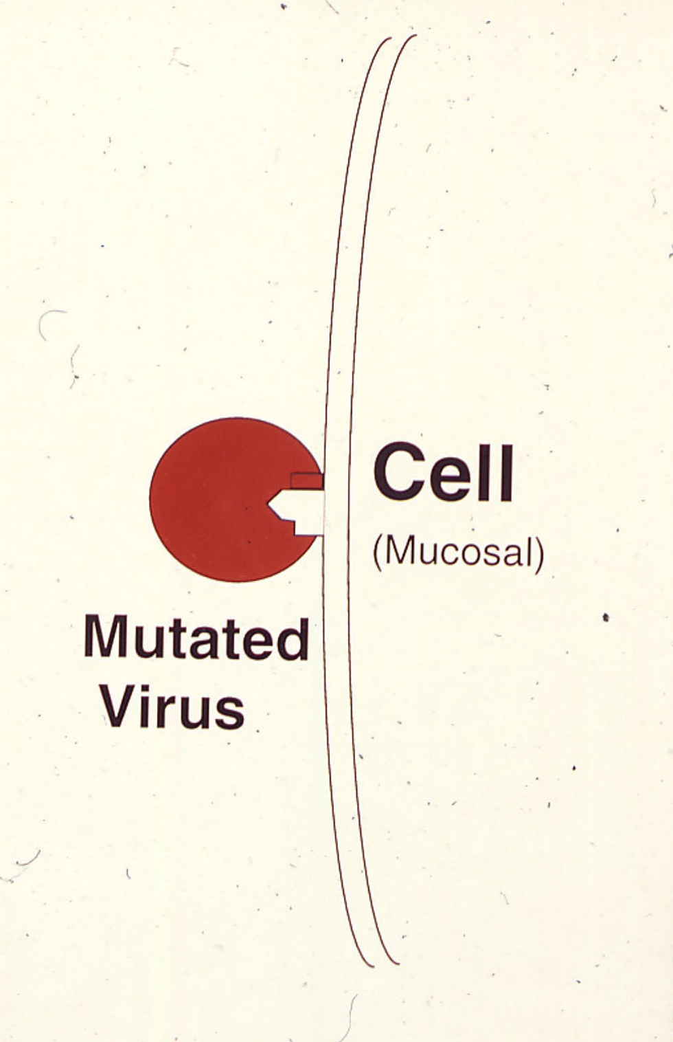
Positive or
Darwinian or
diversifying selection
of the mutated virus

Slide 53
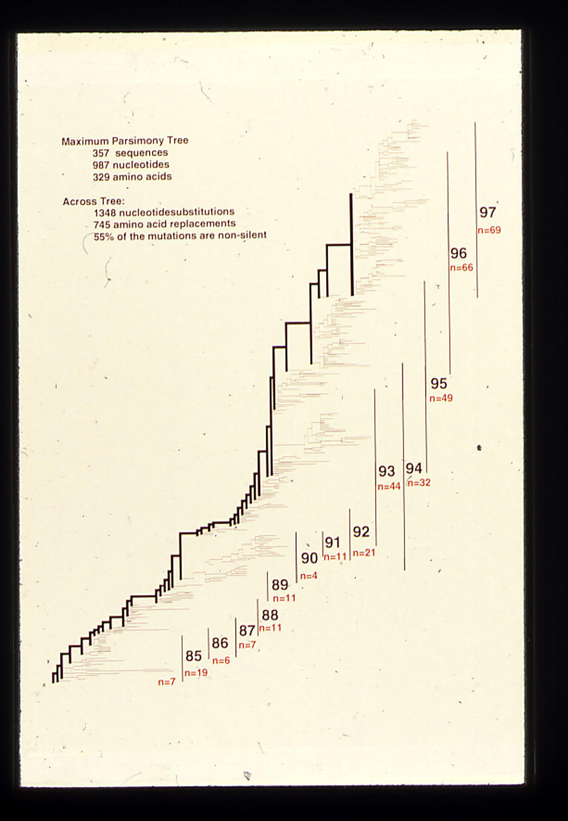
Parsimony phylogeny of influenza HA gene

Slide 54
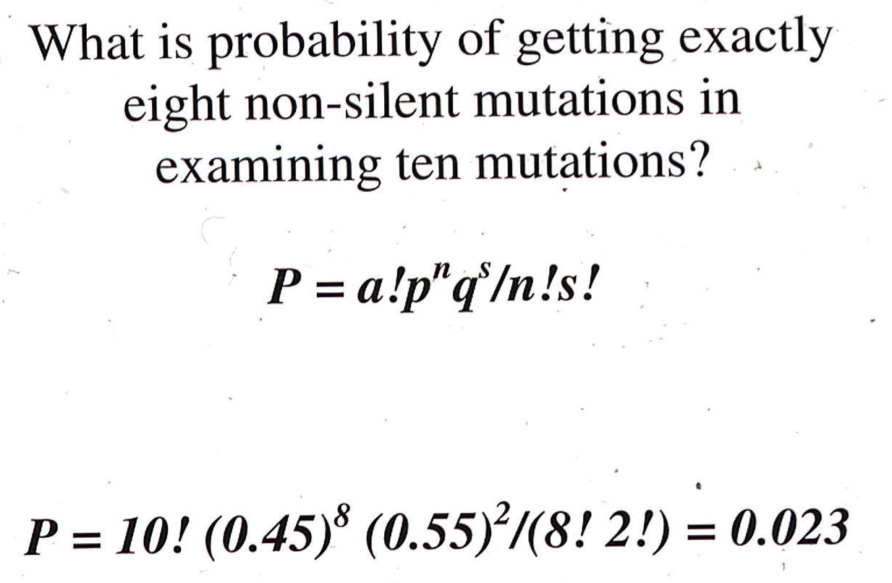
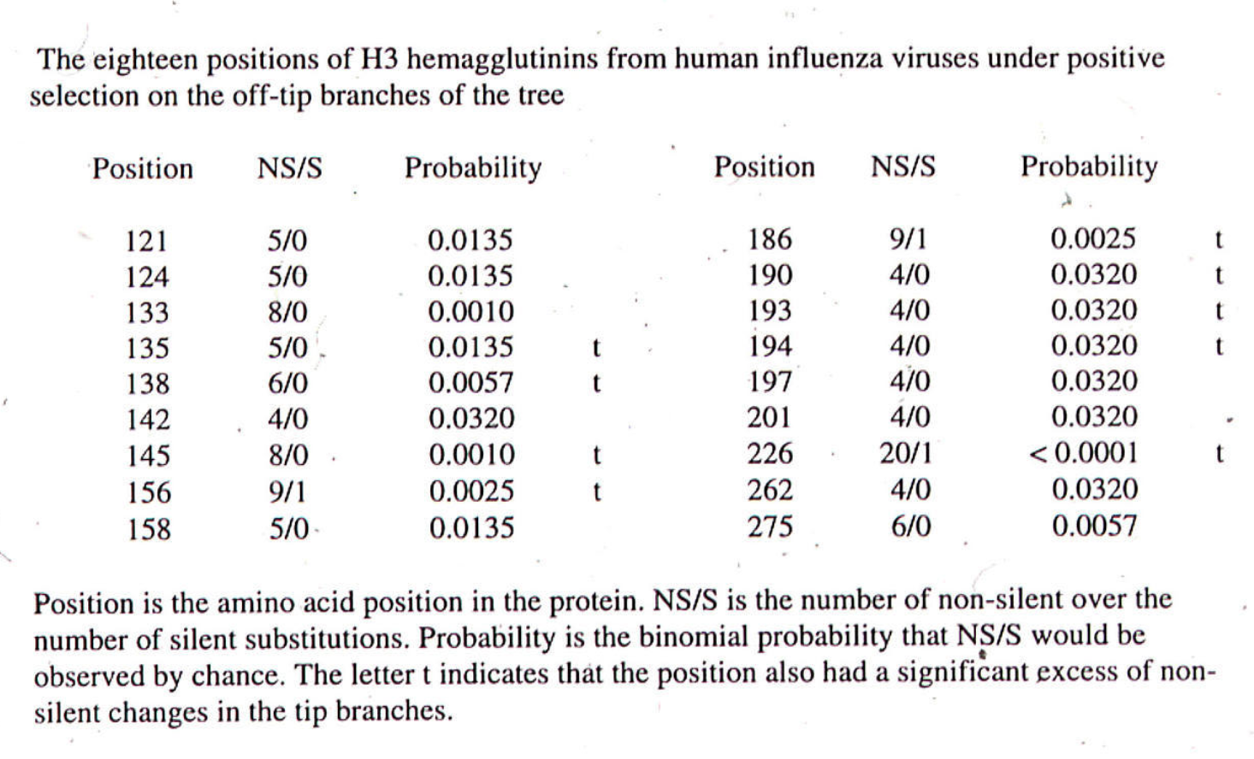

Slide 55
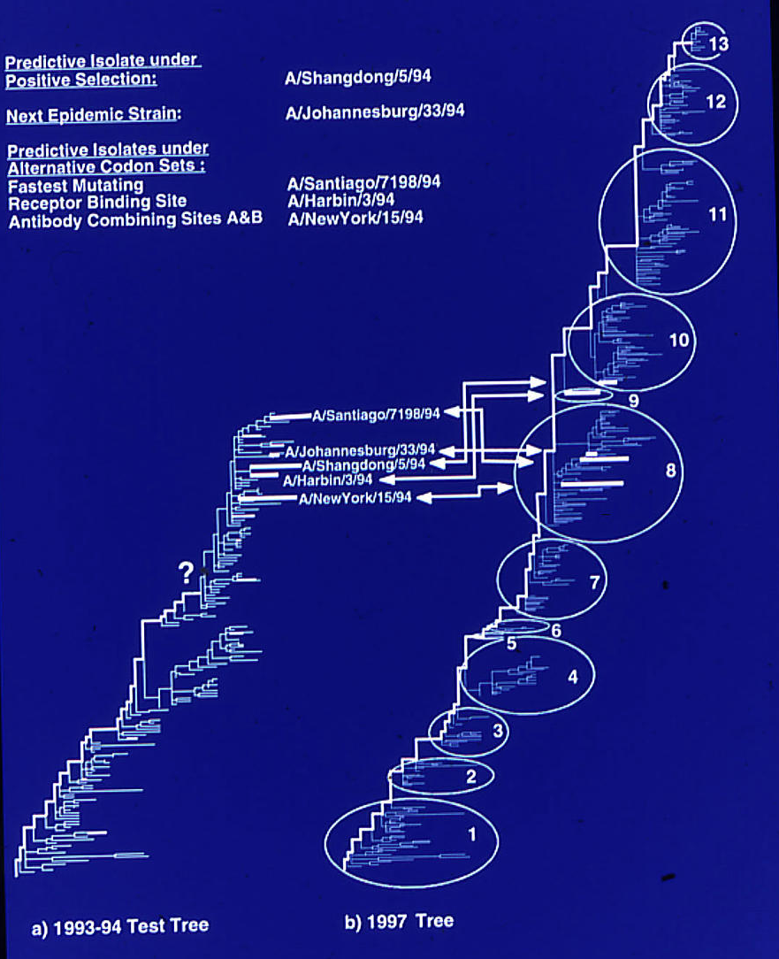

Slide 56
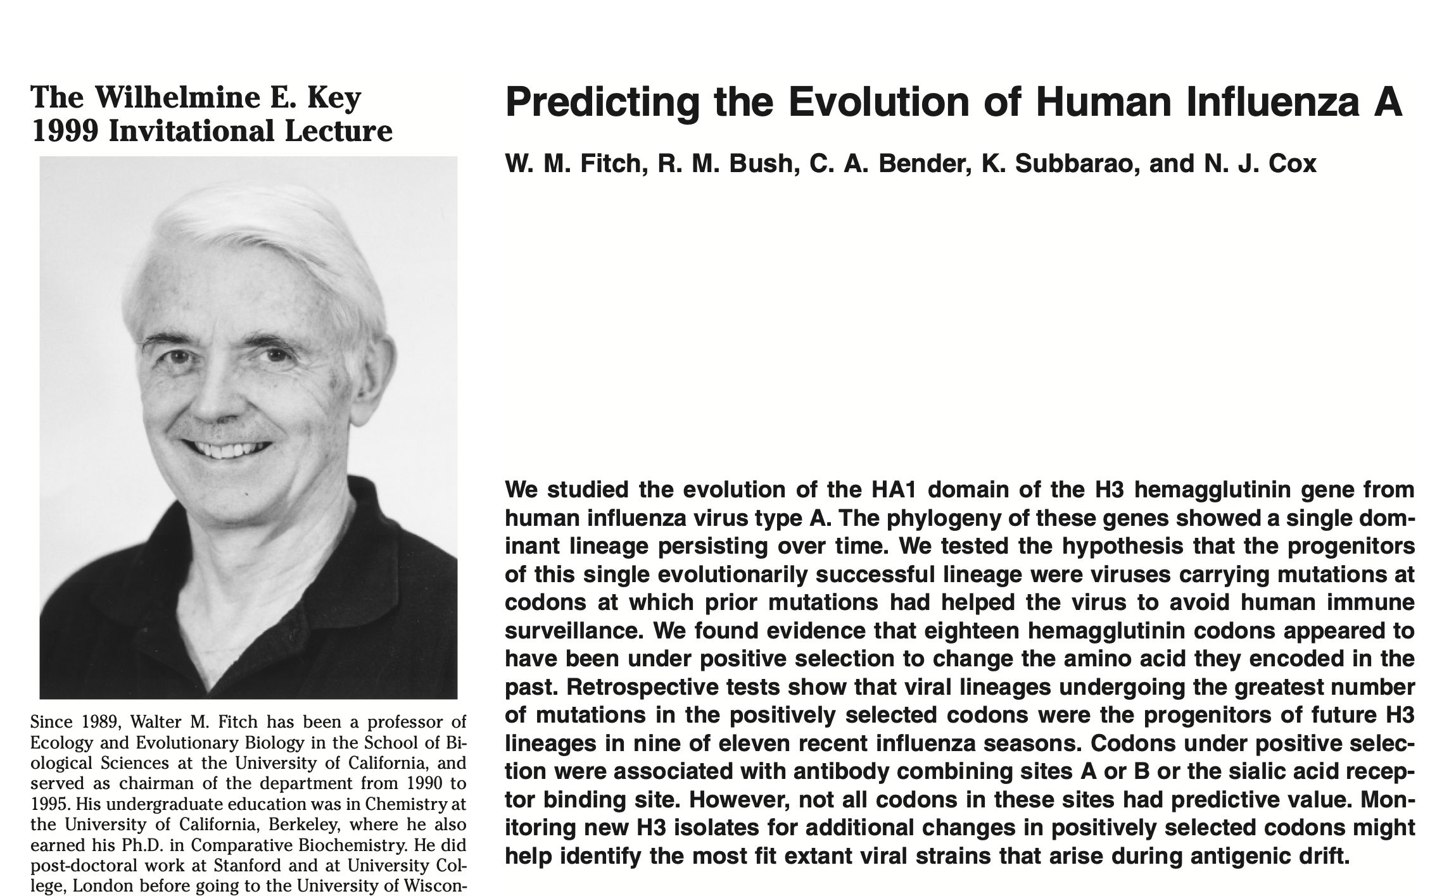
More here:

Slide 57
sites model in MrBayes
The MrBayes block in a nexus file might look something like this:
begin mrbayes;
set autoclose=yes;
lset nst=2 rates=gamma nucmodel=codon omegavar=Ny98;
mcmcp samplefreq=500 printfreq=500;
mcmc ngen=500000;
sump burnin=500;
sumt burnin=500;
end;
This article by Yang et al, 2000 gives more background on ml approaches to measure omega.
The dataset used by Yang et al is here: flu_data.paup .

Slide 58
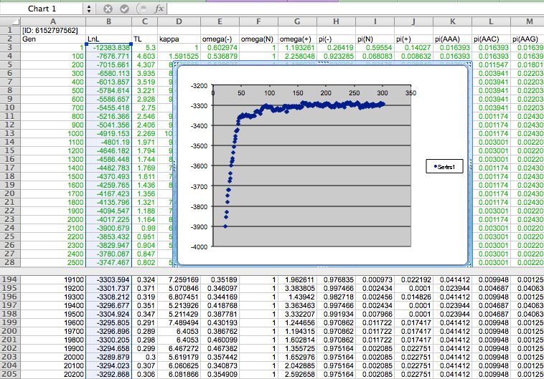

Slide 59
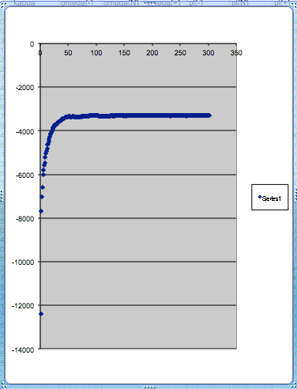
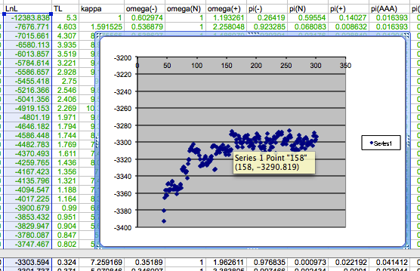
plot LogL to determine which samples to ignore
the same after rescaling the y-axis

Slide 60
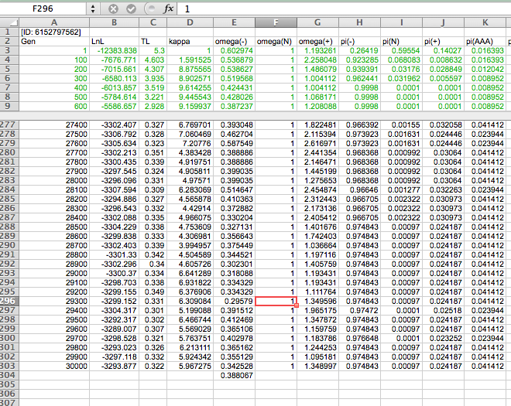

Slide 61
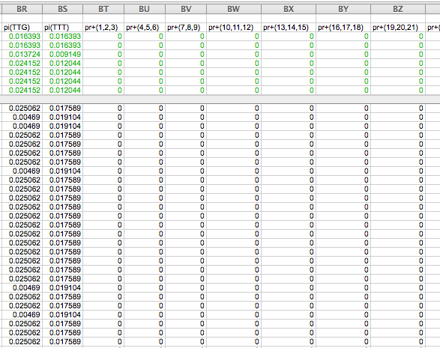

Slide 62
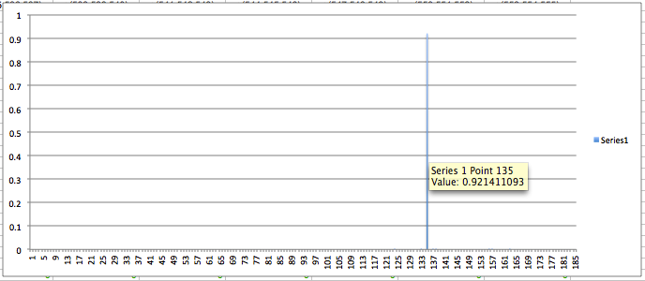
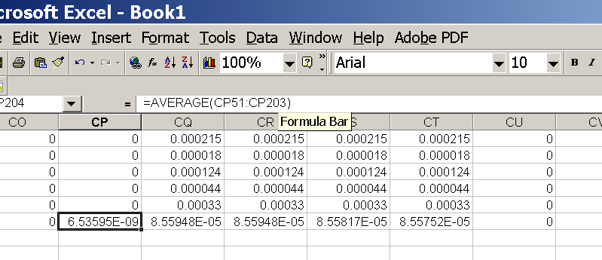
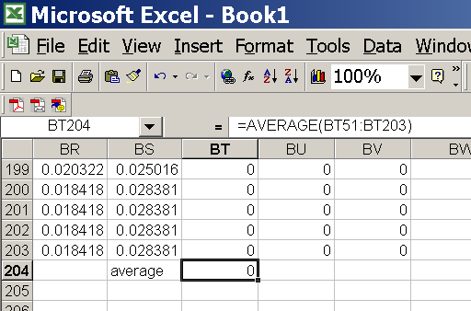
for each codon calculate the the average probability
copy paste formula
plot row
enter formula

Slide 63
Other ways to detect positive selection
Selective sweeps -> fewer alleles present in population (lower heterogeneity between alleles)
-> neighboring genes sweeped along (linkage disequilibrium)
(see below for possible contributions from archaic Humans for example)
Repeated episodes of positive selection -> high dN
(works well for repeated positive – aka diversifying – selection; e.g. virus interaction with the immune system)
A COMMON PROBLEM IS DUE TO UNRELIABLY ALIGNED SEQUENCES, which result in high dN.
Genes that are decaying, or that are pseudogenes already, have a dN/dS close to 1. Adding questionable alignments to this, one can easily arrive at dN/dS > 1.
Olfactory Receptors in humans?

Slide 64
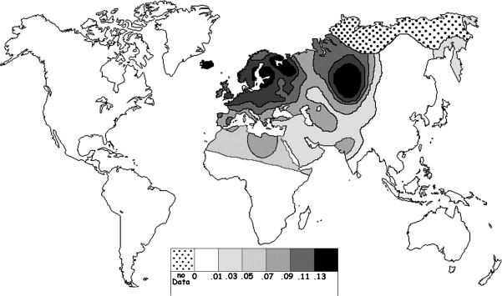
Fig. 1 Current world-wide frequency distribution of CCR5-Δ32 allele frequencies. Only the frequencies of Native populations have been evidenced in Americas, Asia, Africa and Oceania. Map redrawn and modified principally from <ce:cross-ref refid="bib5"> B...
Eric Faure , Manuela Royer-Carenzi
Is the European spatial distribution of the HIV-1-resistant CCR5-Δ32 allele formed by a breakdown of the pathocenosis due to the historical Roman expansion?
Infection, Genetics and Evolution, Volume 8, Issue 6, 2008, 864 - 874
http://dx.doi.org/10.1016/j.meegid.2008.08.007

Slide 65
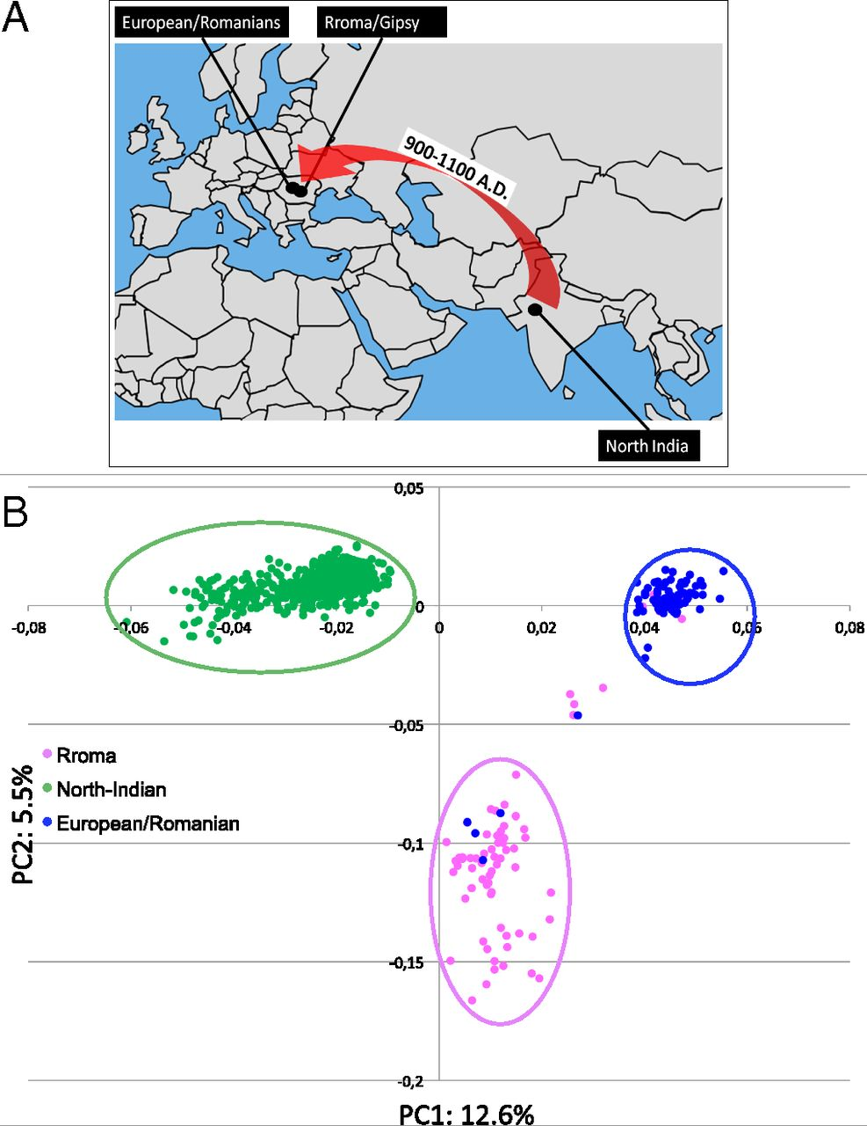
Geographic origin of the three populations studied.
196,524 SNPs
-> PCA
Hafid Laayouni et al. PNAS 2014;111:2668-2673
©2014 by National Academy of Sciences
Notes:
Geographic origin of the three populations studied. (A) European/Romanians and Rroma/Gipsy share the same location, even if the origin of the latter is in North India. (B) Plot of the populations under analysis according to the coordinates to the two main eigenvectors of smartpca (Eigensoft) analysis, in which each dot represents an individual. Individuals within the circles and the same color have been considered for the study; those of different colors represent false population allocation and those intermediate represent admixed individuals. ROM, nongypsy Romanians; INDI, individuals from North India; GYP, Rroma/Gypsies living in Romania.

Slide 66
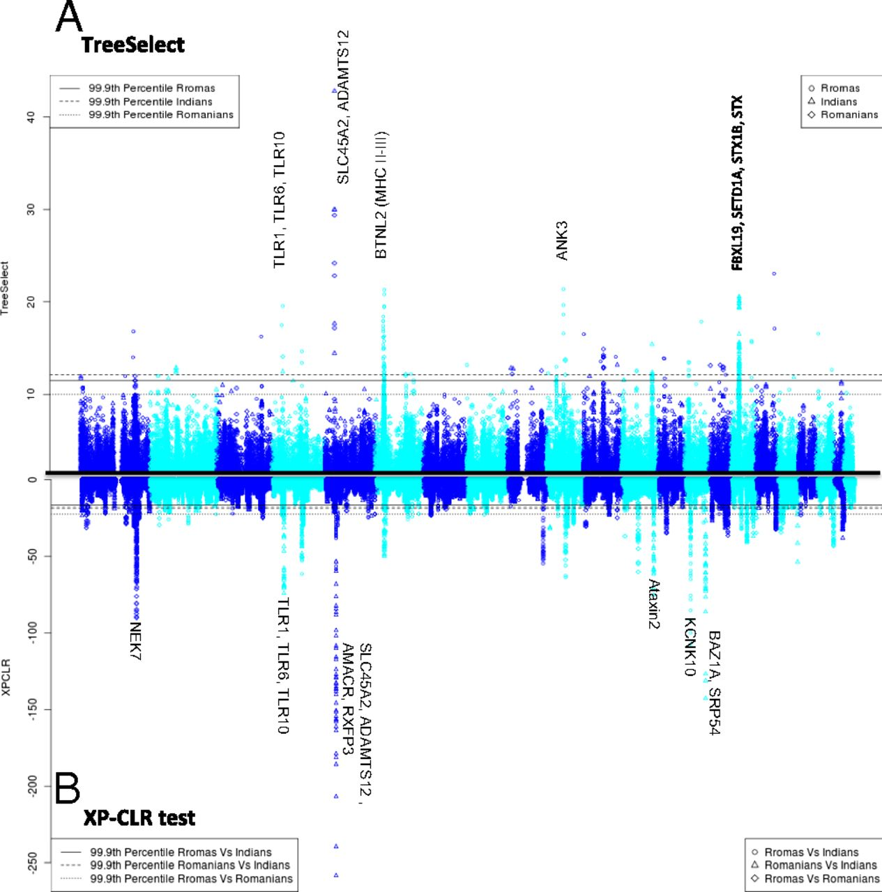
Manhattan plot of results of selection tests in Rroma, Romanians, and Indians using TreeSelect statistic (A) and XP-CLR statistic (B).
SNP frequencies within and between populations
selective sweeps detected through linkage disequilibrium
Laayouni H et al. PNAS 2014;111:2668-2673
Convergent evolution in European and Rroma populations reveals pressure exerted by plague on Toll-like receptors.
©2014 by National Academy of Sciences
Notes:
Manhattan plot of results of selection tests in Rroma, Romanians, and Indians using TreeSelect statistic (A) and XP-CLR statistic (B). Chromosomes ordered from chromosome 1 to chromosome 22.

Slide 67
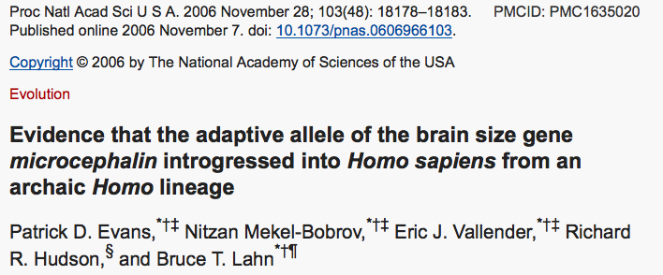
Genes involved in brain development (mutations lead to microencephaly).
Divergent version (alleles) of the wildtype allele exist, with rather uneven frequencies in different human populations.

Slide 68

https://science.sciencemag.org/content/309/5741/1720.long
Variant arose about
5800 years ago

Slide 69

https://science.sciencemag.org/content/309/5741/1717.long
The age of haplogroup D was found to be ~37,000 years

Slide 70


Slide 71


Schematic depiction of two demographic scenarios compatible with the observed genealogy of the microcephalin locus.
Patrick D. Evans et al. PNAS 2006;103:48:18178-18183
©2006 by National Academy of Sciences
Notes:
Schematic depiction of two demographic scenarios compatible with the observed genealogy of the microcephalin locus. In both scenarios, an ancestral population, depicted in green, was subdivided into two reproductively isolated populations. One population, depicted in red, fixes the non-D allele, whereas the other population, depicted in blue, fixes the D allele. (A) In the first scenario, the blue population went through a severe bottleneck that dramatically reduced genetic diversity. It then expanded and merged with the other population. (B) In the second scenario, a rare interbreeding event occurred between the two populations, bringing a copy of the D allele from the blue into the red population. This copy subsequently amplified to high frequency under positive selective pressure. The first scenario depends on demography only and does not require selection. This scenario should therefore affect all sites in the genome. The second scenario requires the action of positive selection on the introgressed allele and is therefore not expected to have a genome-wide effect. The observation that the genealogy of microcephalin is not representative of the genome is consistent with the second scenario.

Slide 72


From the WSJ
... told his audience was that genetic changes over the past several thousand years might be linked to brain size and intelligence. He flashed maps that showed the changes had taken hold and spread widely in Europe, Asia and the Americas, but weren't common in sub-Saharan Africa.
Web sites and magazines promoting white "racialism" quickly seized on Dr. Lahn's suggestive scientific snapshot.
The university's patent office is also having second thoughts. Its director, Alan Thomas, says his office is dropping a patent application filed last year that would cover using Dr. Lahn's work as a DNA-based intelligence test. "We really don't want to end up on the front page...for doing eugenics," Mr. Thomas says.
More recently, Dr. Lahn says he was moved when a student asked him whether some knowledge might not be worth having. It is a notion to which he has been warming.
https://www.wsj.com/articles/SB115040765329081636

Slide 73
More on gene flow in human populations

Slide 74


Lineage sorting and extended/complex speciation
Fig. 20.6
For a large fraction of genes, the human sequences are not closer to the chimpanzee homologues. The fraction is smaller for the X chromosome.
https://upload.wikimedia.org/wikipedia/commons/3/3e/Hominini_lineage.svg

Slide 75


Lineage sorting and extended/complex speciation (cont.)
Patterson Net al., Nature. 2006 441(7097):1103-8. doi: 10.1038/nature04789.

Slide 76

The traditional (pre-genomics) multiregional hypothesis
From http://en.wikipedia.org/wiki/Multiregional_Evolution

Slide 77

Out of Africa Hypothesis (supported by mitochondrial DNA)
From https://en.wikipedia.org/wiki/Recent_African_origin_of_modern_humans

Slide 78

From: http://www.nytimes.com/2012/01/31/science/gains-in-dna-are-speeding-research-into-human-origins.html?_r=1

Slide 79

The Denisovan genome was sequenced from the distal manual phalanx fragment (replica depicted) found in the Denisova cave.^{[16]}
Thilo Parg / Wikimedia Commons
„Lizenz: CC BY-SA 3.0“

Slide 80

From Wikipedia
Dbachmann CC BY-SA 4.0
A model of the phylogeny of H. sapiens over the last 600,000 years (vertical axis). The horizontal axis represents geographic location; the vertical axis represents time in thousands of years ago.^{[1]} Homo heidelbergensis is shown as diverging into Neanderthals, Denisovans and H. sapiens. With the expansion of H. sapiens after 200 kya, Neanderthals, Denisovans and unspecified archaic African hominins are displayed as again subsumed into the H. sapiens lineage. Possible admixture events involving certain modern populations in Africa are also shown.

Slide 81


Fig. 1 A population network including four episodes of gene flow, with an embedded gene genealogy.
Alan R. Rogers et al. Sci Adv 2020;6:eaay5483
Copyright © 2020 The Authors, some rights reserved; exclusive licensee American Association for the Advancement of Science. No claim to original U.S. Government Works. Distributed under a Creative Commons Attribution NonCommercial License 4.0 (CC BY-NC).
Notes:
A population network including four episodes of gene flow, with an embedded gene genealogy. Upper case letters (X, Y, N, D, and S) represent populations (Africa, Europe, Neanderthal, Denisovan, and superarchaic). Greek letters label episodes of admixture. d and xyn illustrate two nucleotide site patterns, in which 0 and 1 represent the ancestral and derived alleles. A mutation on the red branch would generate site pattern d. One on the blue branch would generate xyn. For simplicity, this figure refers to Neanderthals with a single letter. Elsewhere, we use two letters to distinguish between the Altai and Vindija Neanderthals.

Slide 82
From Wikipedia: https://en.wikipedia.org/wiki/Denisovan

Slide 83


From Wikipedia: https://en.wikipedia.org/wiki/Denisovan

Slide 84



Slide 85

Did the Denisovans Cross Wallace's Line?
Science 18 October 2013:
vol. 342 no. 6156 321-323
Ancient migrations.
The proportions of Denisovan DNA in modern human populations are shown as red in pie charts, relative to New Guinea and Australian Aborigines (3). Wallace's Line (8) is formed by the powerful Indonesian flow-through current (blue arrows) and marks the limit of the Sunda shelf and Eurasian placental mammals.

