Slide 1
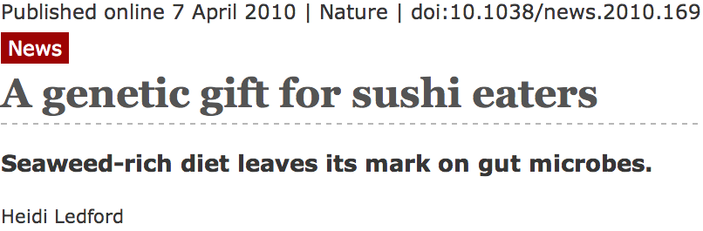
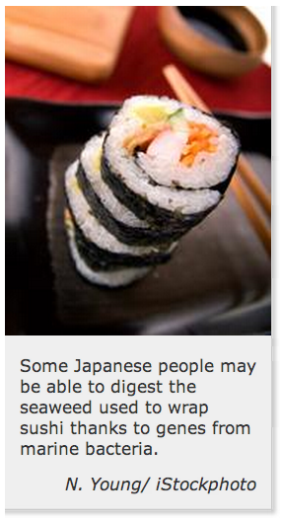
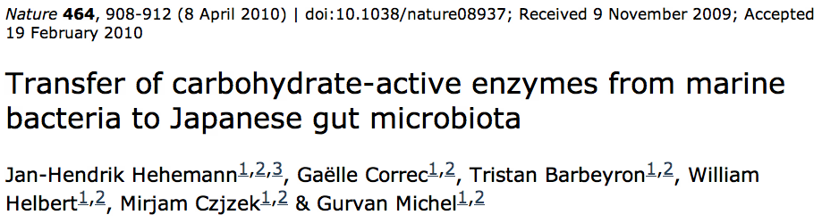
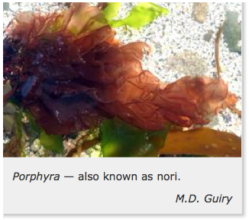

Gene Transfer in Eukaryotes
Bacterial parasites on seaweed
HGT
Human gut symbiont

Slide 2
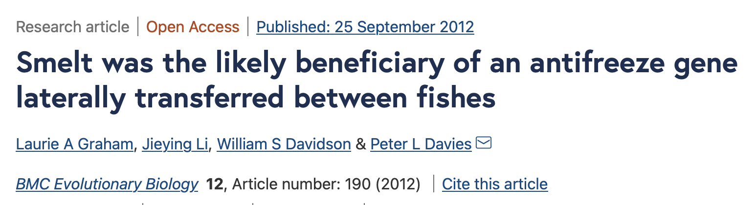
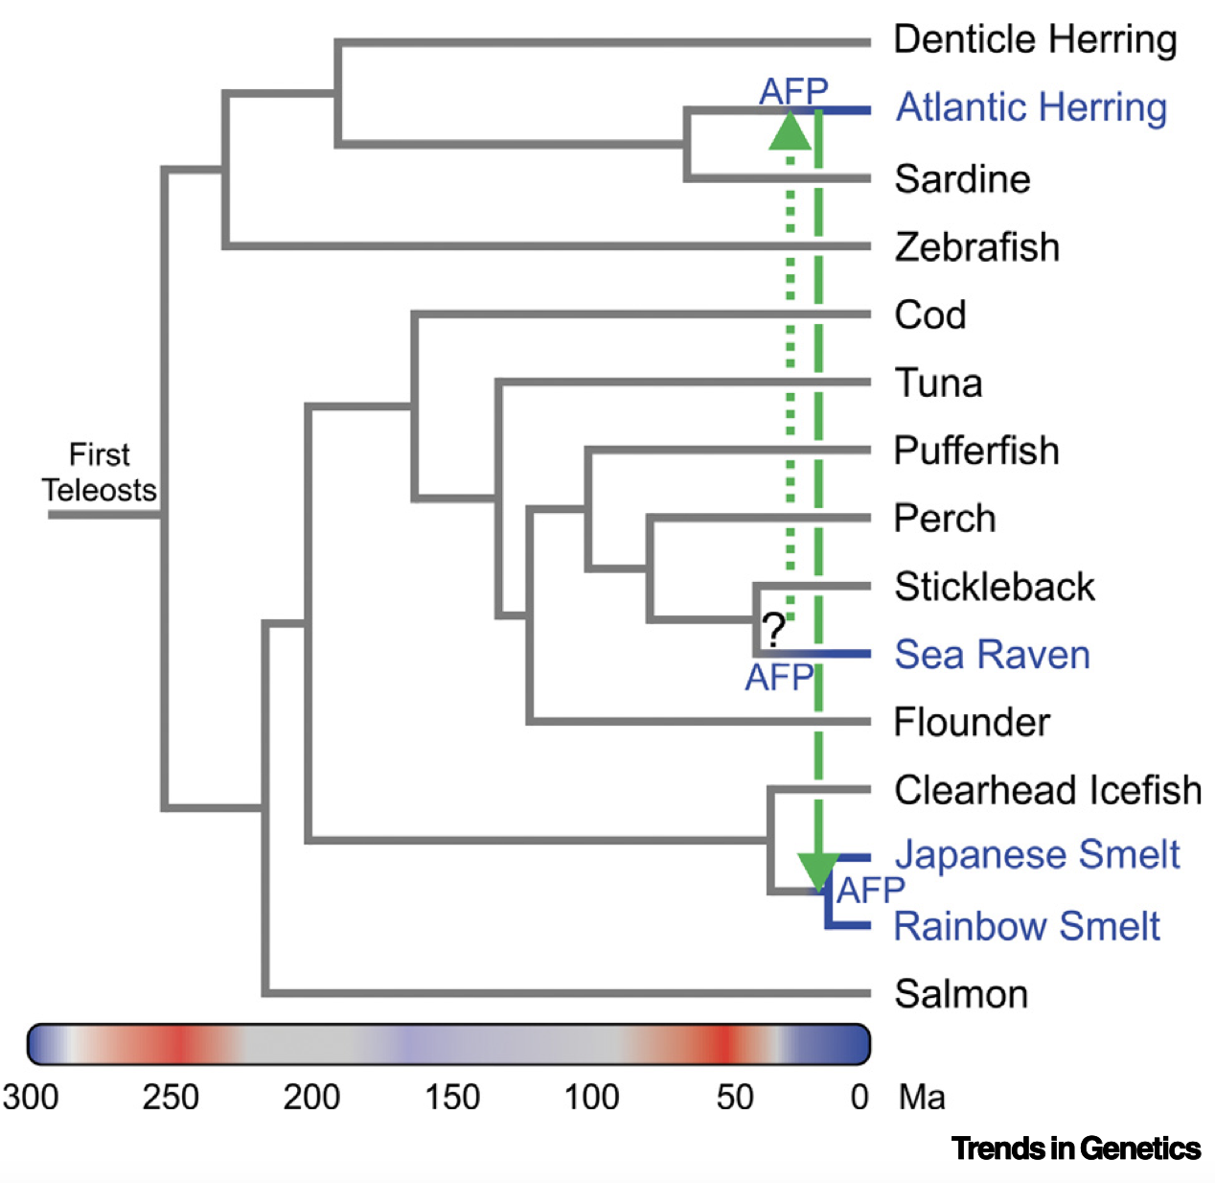
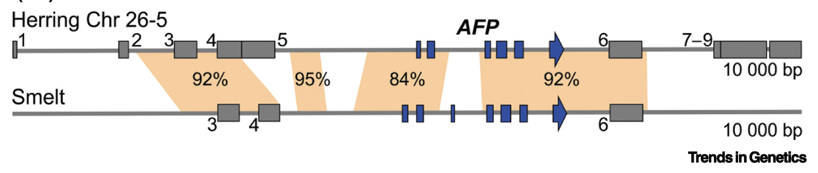
The recent assembly of the herring genome suggests this fish acquired its antifreeze protein gene by horizontal transfer and then passed a copy on to the smelt. The direction of gene transfer is confirmed by some accompanying transposable elements and by the breakage of gene synteny…
Transposable elements
Exons
Images and text from: https://www.cell.com/trends/genetics/pdf/S0168-9525(21)00051-2.pdf

Slide 3
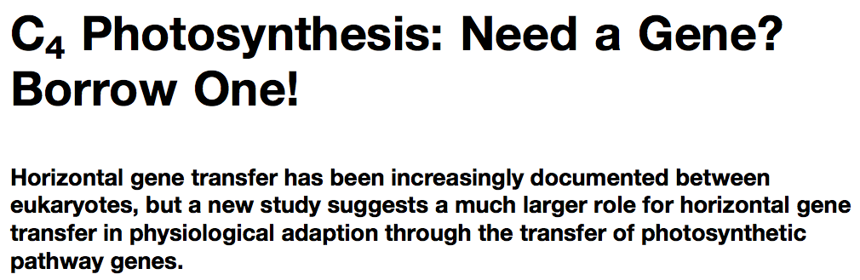
Gene Transfer in Eukaryotes – Example 2
Highlights
Key genes for C₄ photosynthesis were transmitted between distantly related grasses
These genes contributed to the adaptation of the primary metabolism
Their transmission was independent from most of the genome
Curr Biol. 2012 Mar 6;22(5):445-9. Epub 2012 Feb 16.
Adaptive Evolution of C(4) Photosynthesis
through Recurrent Lateral Gene Transfer.
Christin PA, Edwards EJ, Besnard G, Boxall SF, Gregory R, Kellogg EA, Hartwell J, Osborne CP.
Eric H. Roalson Current Biology Vol 22 No 5 R162

Slide 4
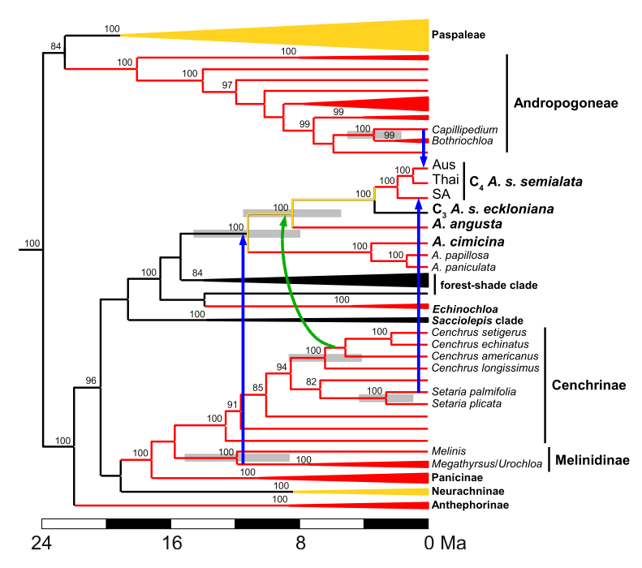
Gene Transfer in Eukaryotes – Example 2
From: Christin PA, Edwards EJ, Besnard G, Boxall SF, Gregory R, Kellogg EA, Hartwell J, Osborne CP.
Adaptive Evolution of C(4) Photosynthesis
through Recurrent Lateral Gene Transfer. Curr Biol. 2012 Mar 6;22(5):445-9. Epub 2012 Feb 16.

Slide 5
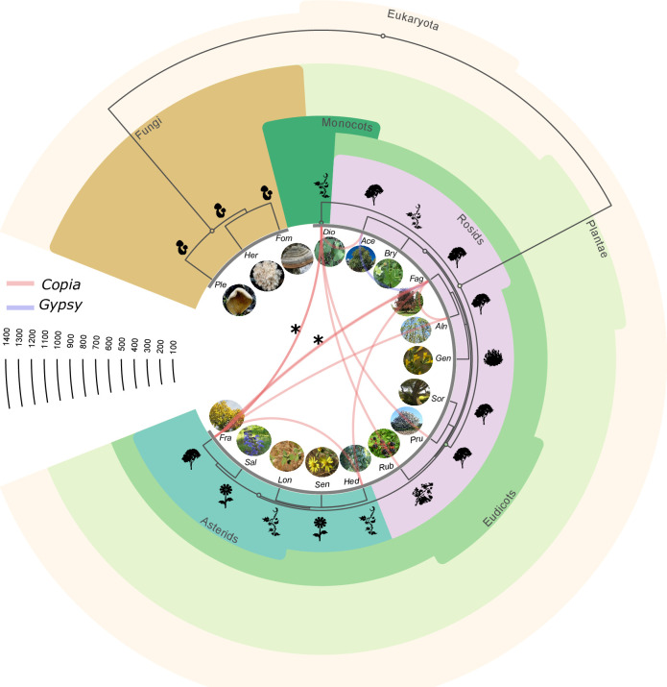
Transfer of LTR retrotransposons between plant species.
From:
Aubin E et al. Genome-wide analysis of horizontal transfer in non-model wild species from a natural ecosystem reveals new insights into genetic exchange in plants. PLoS Genet. 2023 Oct 19;19(10):e1010964. doi: 10.1371/journal.pgen.1010964.
LINE retrotransposons transferred from predator (snakes) to prey (frogs)
https://academic.oup.com/mbe/article/39/4/msac052/6563207
Early report of TE transfer between species: Daniels SB, Peterson KR, Strausbaugh LD, Kidwell MG, Chovnick A. Evidence for Horizontal Transmission of the P Transposable Element between Drosophila Species. Genetics. 1990;124:339–55.

Slide 6
Niche adapting genes
Observations support a gene centered view of ecology
Genes and operons are adapted to ecological niches, not species

Slide 7
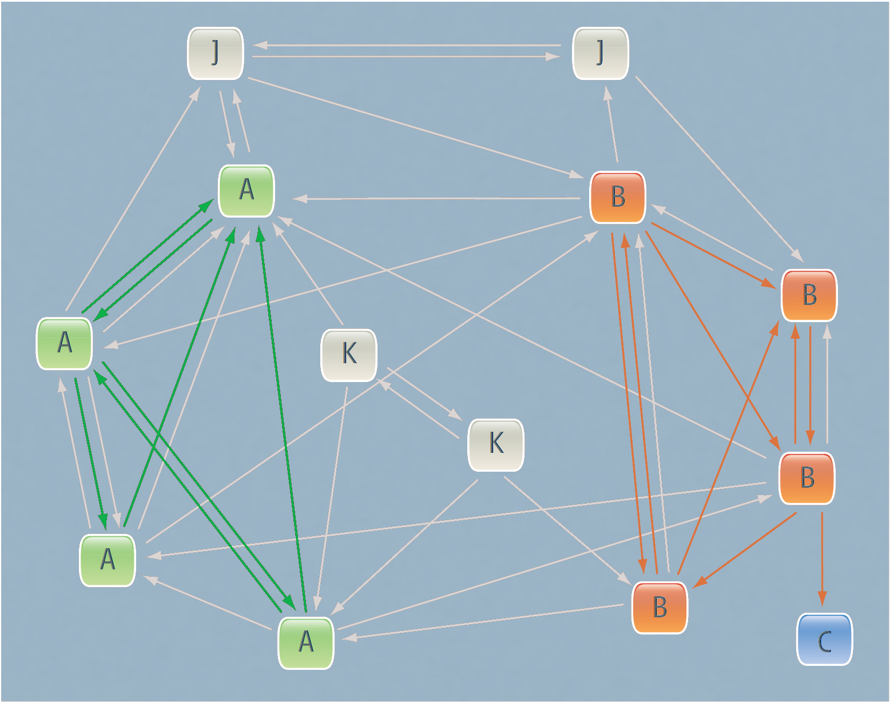
A structured exchange community. Niche defining genes.
Modified from Papke RT, Gogarten JP (2012) How Bacterial Lineages Emerge. Science 336: 45-46
Members of two distinct niches are shown as green and orange squares;
gray squares are relatives occupying different niches. Genes that adapt their hosts to these niches are mostly exchanged or recombined between members of the same niche (green and orange arrows), but they might also be shared with recent niche invaders (blue square), accelerating their adaptation to a new habitat.

Slide 8
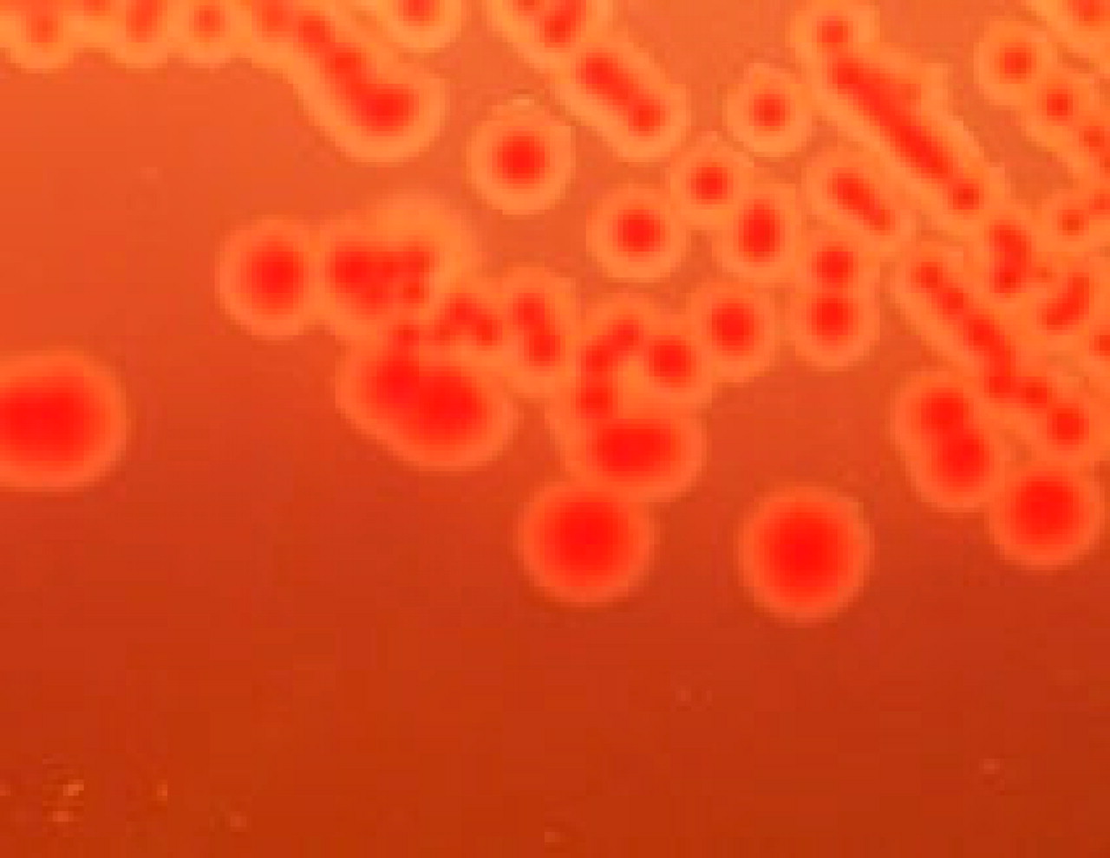
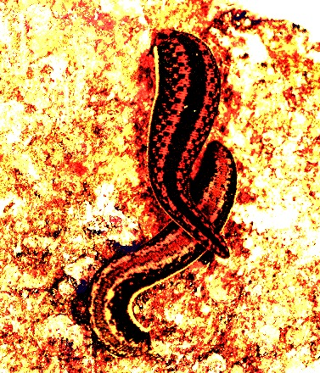
Aeromonas
Genus of γ-proteobacteria.
(Divergence between Escherichia and Aeromonas
about 700 million years BP)
Common in freshwater environments.
Forms symbioses with many animals.
(parasitic, commensal, mutualistic)
Some strains can cause disease in humans
wound infection,
Bacteremia,
diarrhea (Traveler’s Diarrhea)
.
Janda J M , and Abbott S L Clin. Microbiol. Rev. 2010;23:35-73 Clinical Microbiology Reviews
http://jb.asm.org/content/189/19.cover-expansion

Slide 9
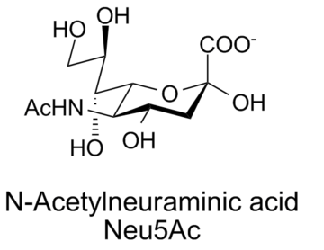
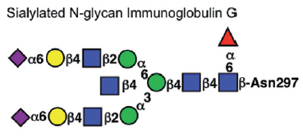
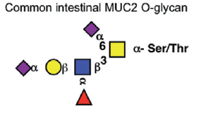
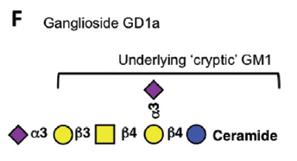
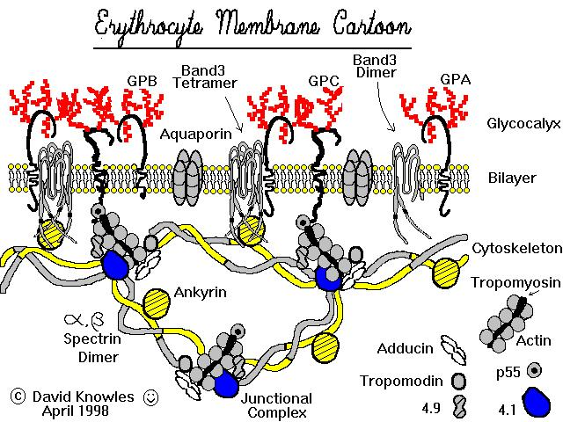
Sialic Acid
α-keto sugar
Neuraminic acid
Cell-to-cell signaling
Bacteria can utilize sialic acid in:
  Nutrition
  Structural incorporation
  Adhesion factor
  Unmasking
David Knowles
Lewis and Kewis, 2012

Slide 10
Sialic acid catabolism pathway
Sialoglyconjugate
Sialidase, (NanH)
N-acetylneuraminic acid
Extracellular
Uptake into cell via general porins/specific transporters (NanT)
Intracellular
N-acetylneuraminic acid
N-acetylneuraminic acid lyase (NanA)
N-acetylmannosamine
N-acetylmannosamine kinase (NanK)
N-acetylmannosamine-6P
N-acetylmannosamine- 6P epimerase (NanE)
N-acetylglucosamine-6P

Slide 11
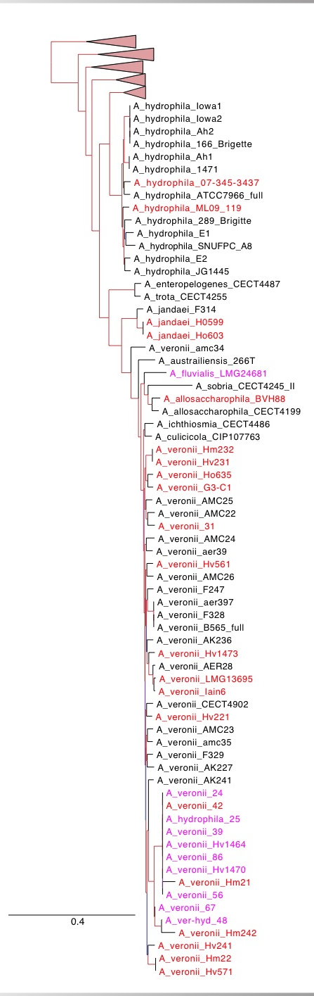
Aeromonas MLSA supermatrix colored according to presence of sialic acid utilization enzymes
Red: N-acetylneuraminate lyase
transcriptional regulator
N -acetylmannosamine-6-phosphate 2-epimerase
N-acetylmannosamine kinase
sodium-glucose/galactose cotransporter
(hypothetical protein)
Sialidase absent

Slide 12
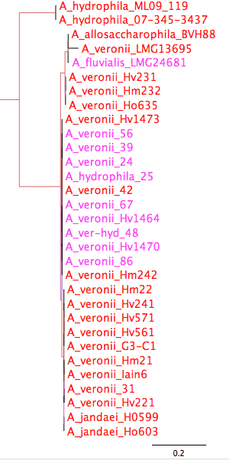
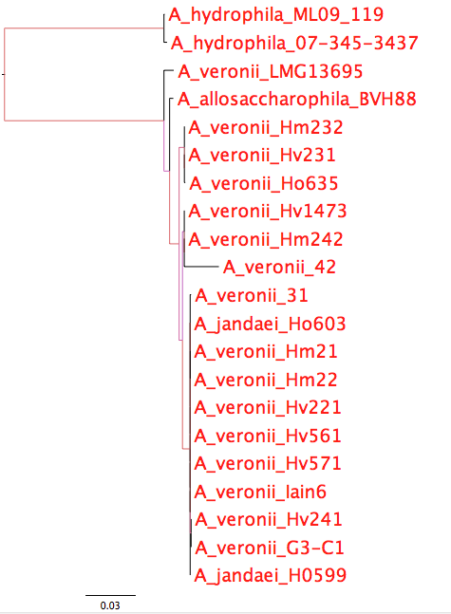
Phylogeny of sialic acid catabolism enzymes
Sialidase
ORFs 1,2,3,4,5
red: contains sialidase, branches colored by aLRT

Slide 13
A structured exchange community. Niche defining genes.
Modified from Papke RT, Gogarten JP (2012) How Bacterial Lineages Emerge. Science 336: 45-46
Members of two distinct niches are shown as green and orange squares;
gray squares are relatives occupying different niches. Genes that adapt their hosts to these niches are mostly exchanged or recombined between members of the same niche (green and orange arrows), but they might also be shared with recent niche invaders (blue square), accelerating their adaptation to a new habitat.

Slide 14
Homeoalleles
Variants that have the same general function, but can have distinct characteristics.
Gene pool contains different homeoalleles, but individual strains and species usually contain only one of the alleles.
Can be brought together temporarily in a lineage through HGT
Andam, Williams, Gogarten 2010 PNAS
Notes:
The two TyrRS enzymes can be seen as variants similar to alleles in a population. Individual lines of descent possess one or the other of these variants, and in rare instances, they can possess both. We propose to call these variants homeoalleles. Like alleles, they have the same general function, but can have distinct characteristics. As is the case for homeologs in polypoids, homeoalleles cannot be considered orthologs, even though they are homologs with the same function. The line of descent has access to a gene pool that contains both TyrRS homeoalleles, whereas individual strains and species usually contain only one of the alleles. Genes in the accessible gene pool have different propensity to be swapped into an individual line of decent. Genes present in members of the same strain in the same environment likely have the highest propensity of being acquired, genes from organisms with similar regulatory promoter sequences and similar composition will be more frequently acquired than genes with less similar composition and promoters. Genes from divergent organisms will frequently fall in the latter category, and may contain sequence motifs incompatible with the genome organization of the recipient (36).
The two TyrRS types are so divergent (approximately 28 % identity between the two Pseudomonas TyrRS types) that the possibility of homologous recombination between the TyrRS homeoalleles is unlikely. Consequently, in case of TyrRS homeoalleles we expect that the unit of successful horizontal gene transfer includes at least the complete tyrRS gene. Homeoalelles can then be brought together temporarily in a lineage following horizontal transfer, but due to largely overlapping function, only one of the alleles is likely to survive in a lineage on the long run. The surviving allele may be selected due to an adaptive advantage under prevailing conditions.

Slide 15
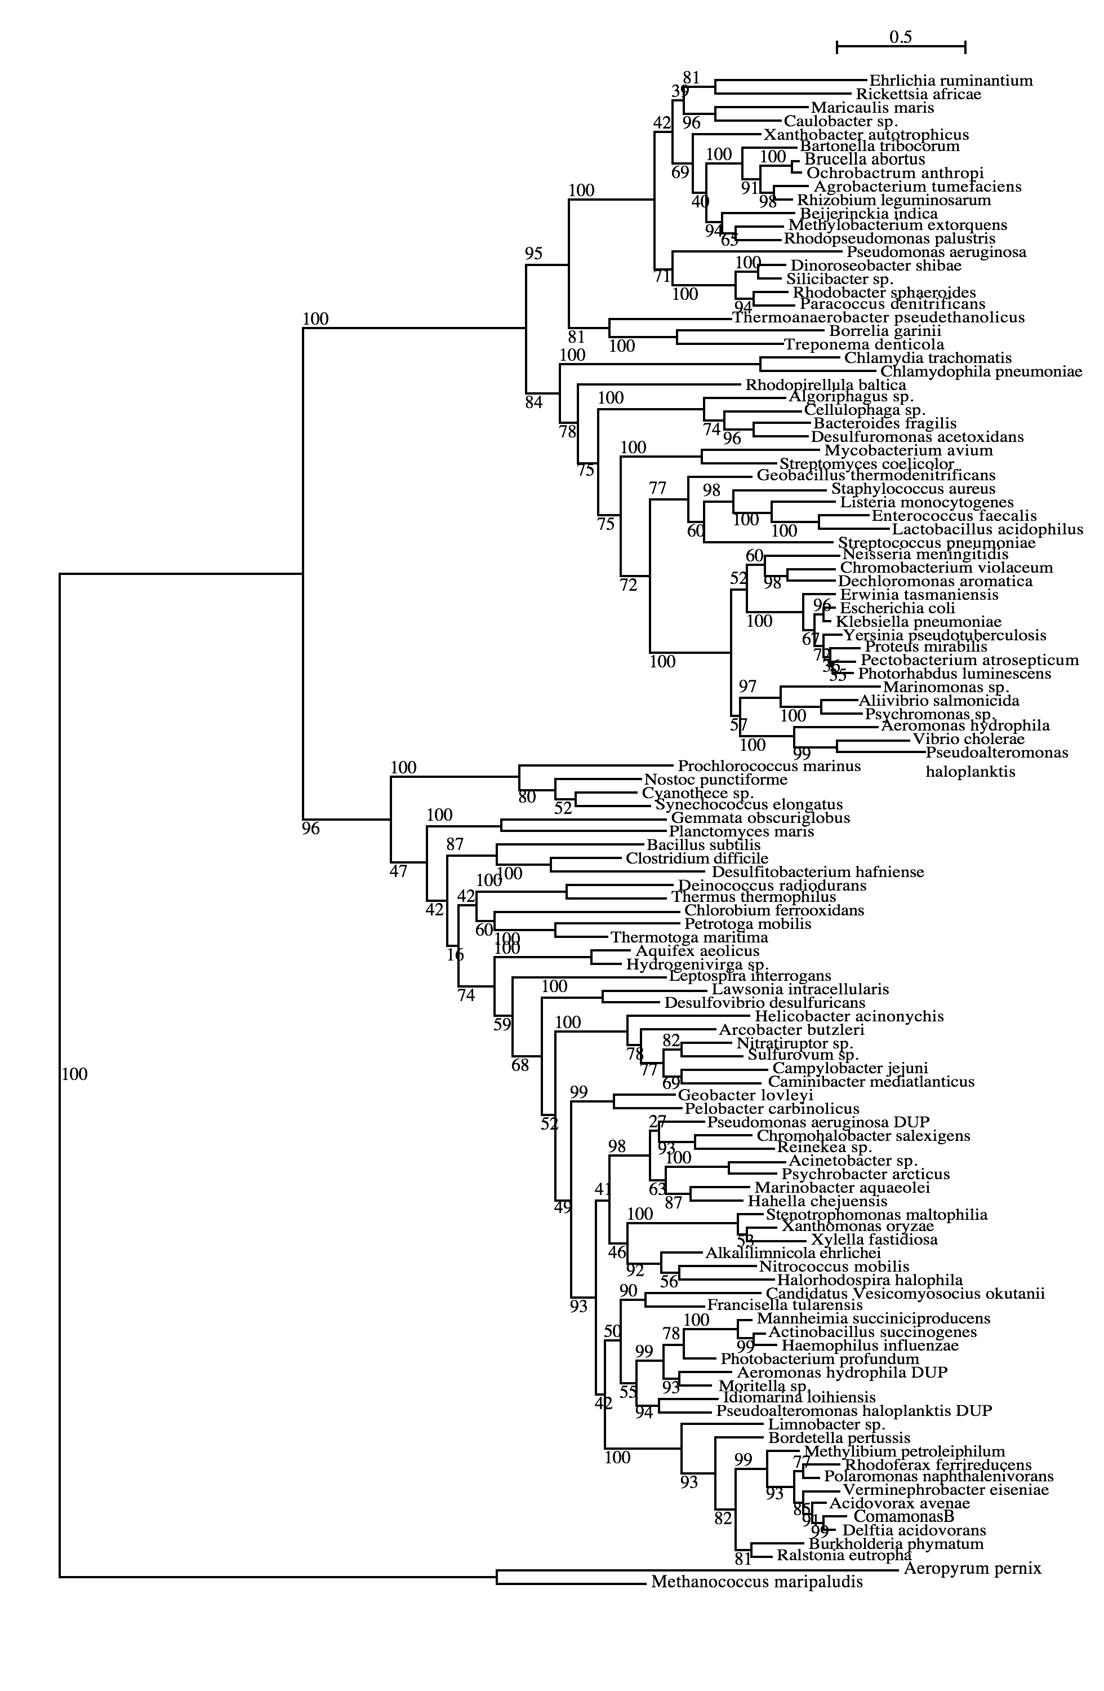
Tyrosyl-tRNA synthetase
Planctomycetes
Firmicutes
Spirochetes
δ-Proteobacteria
γ-Proteobacteria
β-Proteobacteria
Andam, Williams, Gogarten 2010 PNAS
Notes:
There are 3 species (same strain) here that have duplicates found in both subtrees – Pseudomonas aeruginosa PA01, Aeromonas hydrophila ATCC7966 and Pseudoalteromonas haloplanktis TAC125. All three are from complete genome sequences and I checked the papers that published the description of each genome. For Pseudomonas PA01 genome, the authors stated that its large genome size (6.3M bp) was a result of gene duplication, with 50% more paralogous groups than predicted (Stover et al. 2000). However, they didn’t say anything about which genes might have been duplicated. Aeromonas ATCC7966 has more tRNAs (128) than other sequenced genomes and many of these were a result of tandem duplication (Seshadri et al 2006). So does this suggest that their synthetases might have been duplicated as well? They have also found many protein-coding genes that are paralogous. Lastly, the Pseudoaltermonas TAC125 has two chromosomes but all tRNAs are found in only one of them (Medigue et al. 2005). They also found a high number of tRNA genes (106), similar to other vibrios. What I found interesting in their paper is that when they compared its genes with homologs with other related bacteria, the authors found high similarity with Shewanella and Vibrio (which are found in the top part of our tree) and also with Idiomarina and Photobacterium (found in bottom part of our tree). I wonder if some other genes of Pseudoalteromonas also show the same pattern like this? That is, if its other genes that were duplicated also split into two groups?

Slide 16
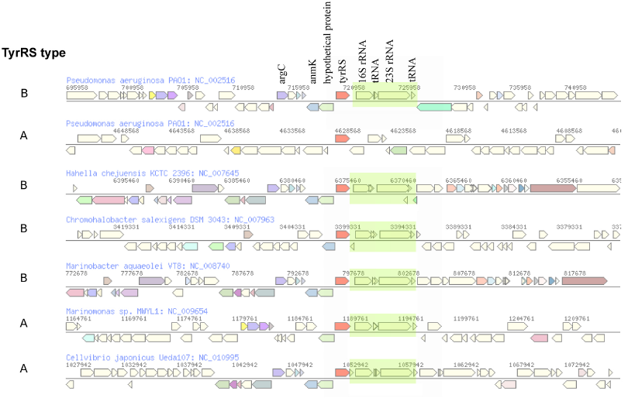
The genomic neighborhood of tyrRS in γ-proteobacteria
Andam, Williams, Gogarten 2010 PNAS
Notes:
similar neighboring gene identity and order for both tyrRS types A and B
The similarities in tyrRS region but differences in tyrRS type imply that transfer of tyrRS types among these genomes followed by homologous recombination. Although the two tyrRS types have low identity, homologous replacement with breakpoints in the neighboring genes may have facilitated the switching between TyrRS types. P. aeruginosa also carries tyrRS type A, but the genomic neighborhood of this gene does not show synteny with that of the tyrRS type A of other closely related taxa.
The finding of similar tyrRS gene neighborhoods in close relatives carrying either type A or type B provides evidence for the replacement of one form of tyrRS with another. Significantly, this rejects the differential loss hypothesis for these organisms. If the last common ancestor possessed both types of enzymes, we would expect the genes coding for each type of tyrRS to possess dissimilar genes flanking them.
The two TyrRS types are so divergent (approximately 28 % identity between the two Pseudomonas TyrRS types) that the possibility of homologous recombination within the TyrRS homeoalleles is unlikely. Consequently, in case of TyrRS homeoalleles, we expect that the unit of successful horizontal gene transfer includes at least the complete tyrRS gene.

Slide 17
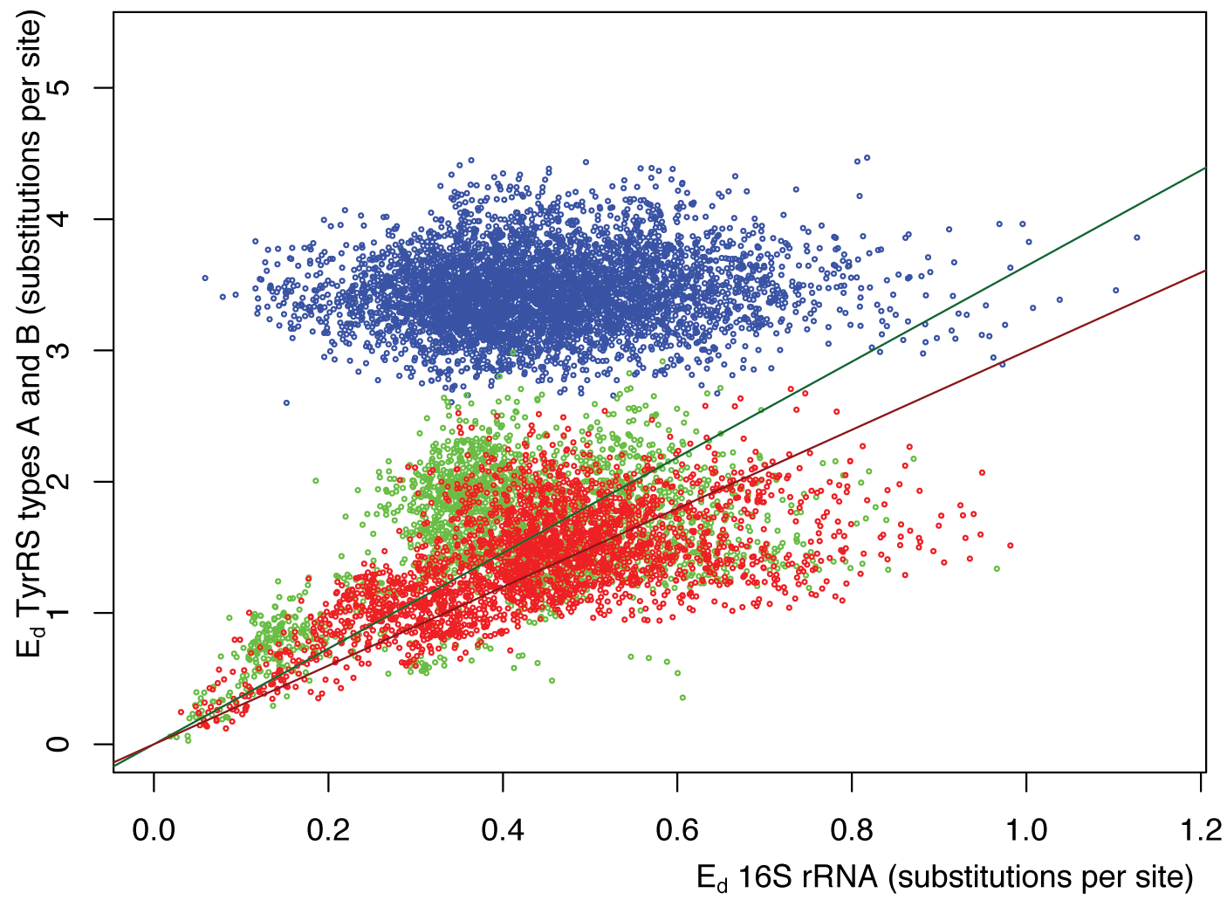
Pairwise distance between tyrRSs versus
pairwise distance of 16S rRNAs from the same genomes
Green -Type A tyrRS
Red - Type B tyrRS
Blue - Between the two types of tyrRS
Andam, Williams, Gogarten 2010 PNAS

Slide 18
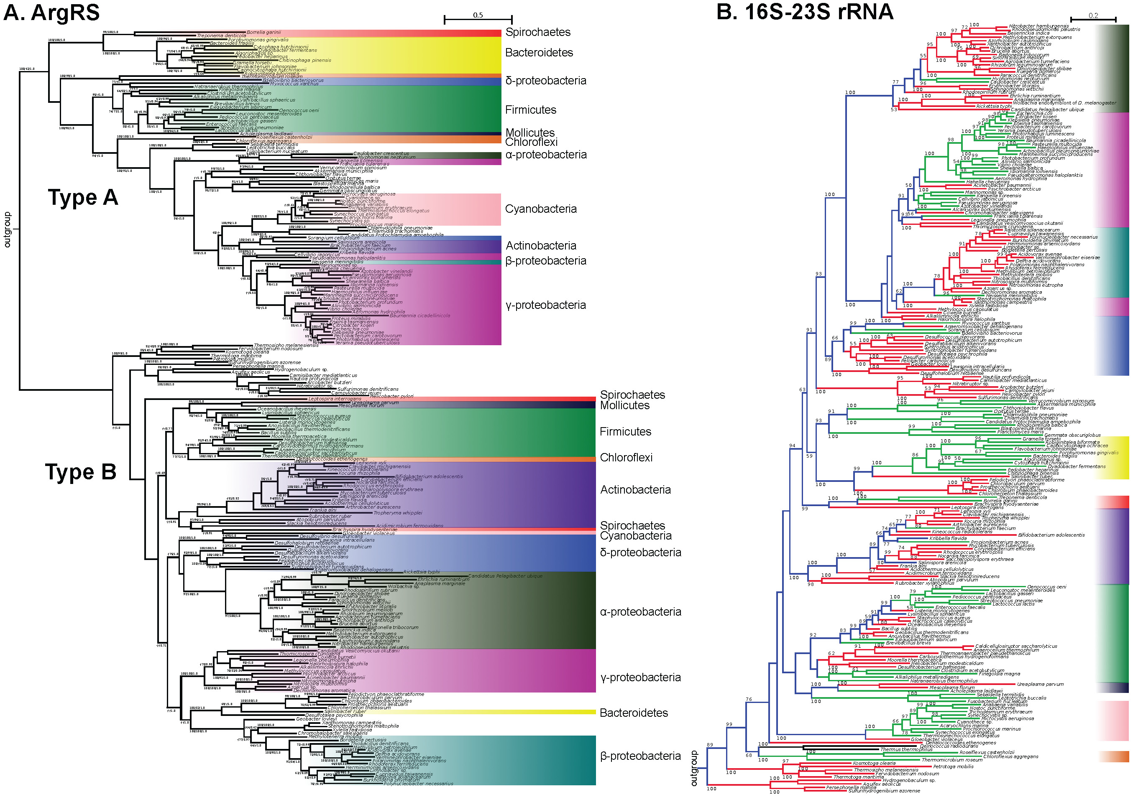

Slide 19
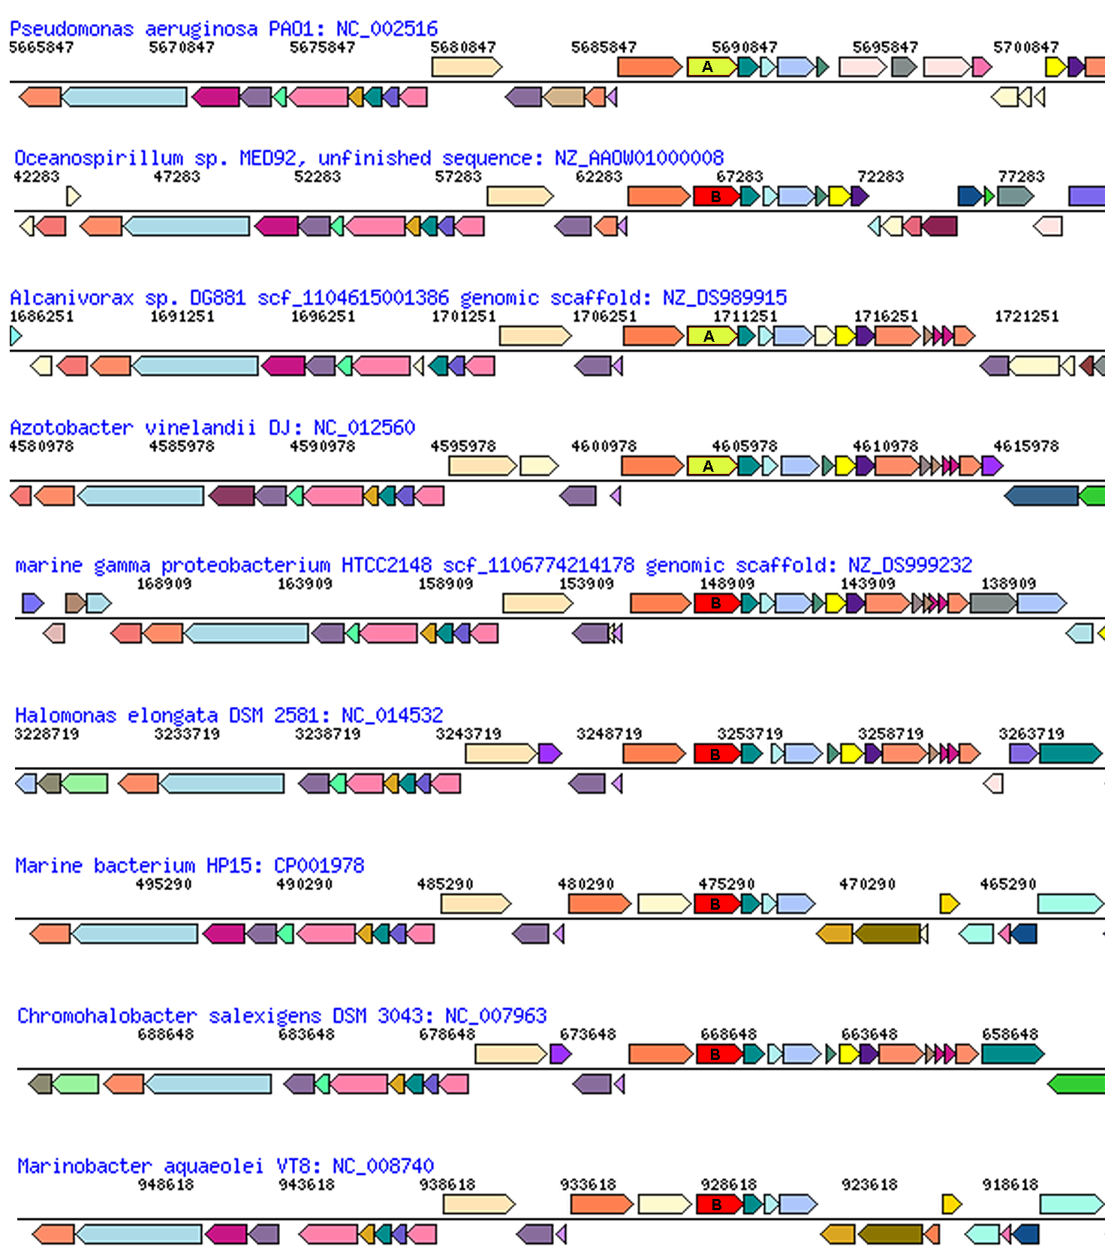
glutamate
synthase
penicillin-bp
ArgRS synteny
between types in Pseudomonadales and Oceanospirillales
aroB
malic enz
ArgRS A&B
PilQ
PriA
HsIU
Pseudomonadales

Slide 20
Terminology
Typically, the term pangenome is used to describe the gene content of a related taxonomic group, like a species or genus, family or phylum.
Sometimes it refers to a broader set like the entire contents of a gut,
but this is usually referred to (and should be referred to) as a meta-genome and considered a separate phenomenon.
Edwards-Venn cogwheel
A.W.F. Edwards 1998

Slide 21
Aside on disputes in terminology:
Two definitions for the term microbiome:
Micro-biome: a biome occupied by microorganisms (the skin can be considered a biome, for large organisms, the tundra is an example for a biome)
Microb-i-ome: the summary of -omics information obtained for a microbial community.
It seems #1 has won, see Jonathan Eisen’s discussion here.
Bottomline: The characterization of a micro-biome goes beyond a catalog of species (the microbiota), and certainly beyond the enumerations of 16S rRNA OTUs present in an environment; it includes the interactions between organisms, defining guilds (groups of organisms with similar roles in a biome), placing organisms into guilds, and characterizing the ecological parameters that define the niche. In addition, the microbiome is also populated by phages, other viruses, and eukaryotes. Catalogs of 16S rRNA OTUs and metagenome sequencing are an important first step, but alone they are insufficient to define of fully describe a microbiome.

Slide 22
The pangenome as a shared genetic resource
The homeoalleles provide an example for the pangenome providing a shared genetic recourse. (The different aaRS types provide resistance to antibiotics produced by competitors – switching to another type can provide a selective advantage.)
Another example are weakly selected functions (wsf) – genes or gene clusters that are only used under some conditions, e.g. a complex sugar in the environment. In the absence of the sugar, the genes will decay and may be lost from most genomes, only to be shared between members if the sugar becomes available again.
Jeffrey Lawrence and John Roth suggested that this sharing can drive operon formation (here and here)!
Edwards-Venn cogwheel
A.W.F. Edwards 1998

Slide 23
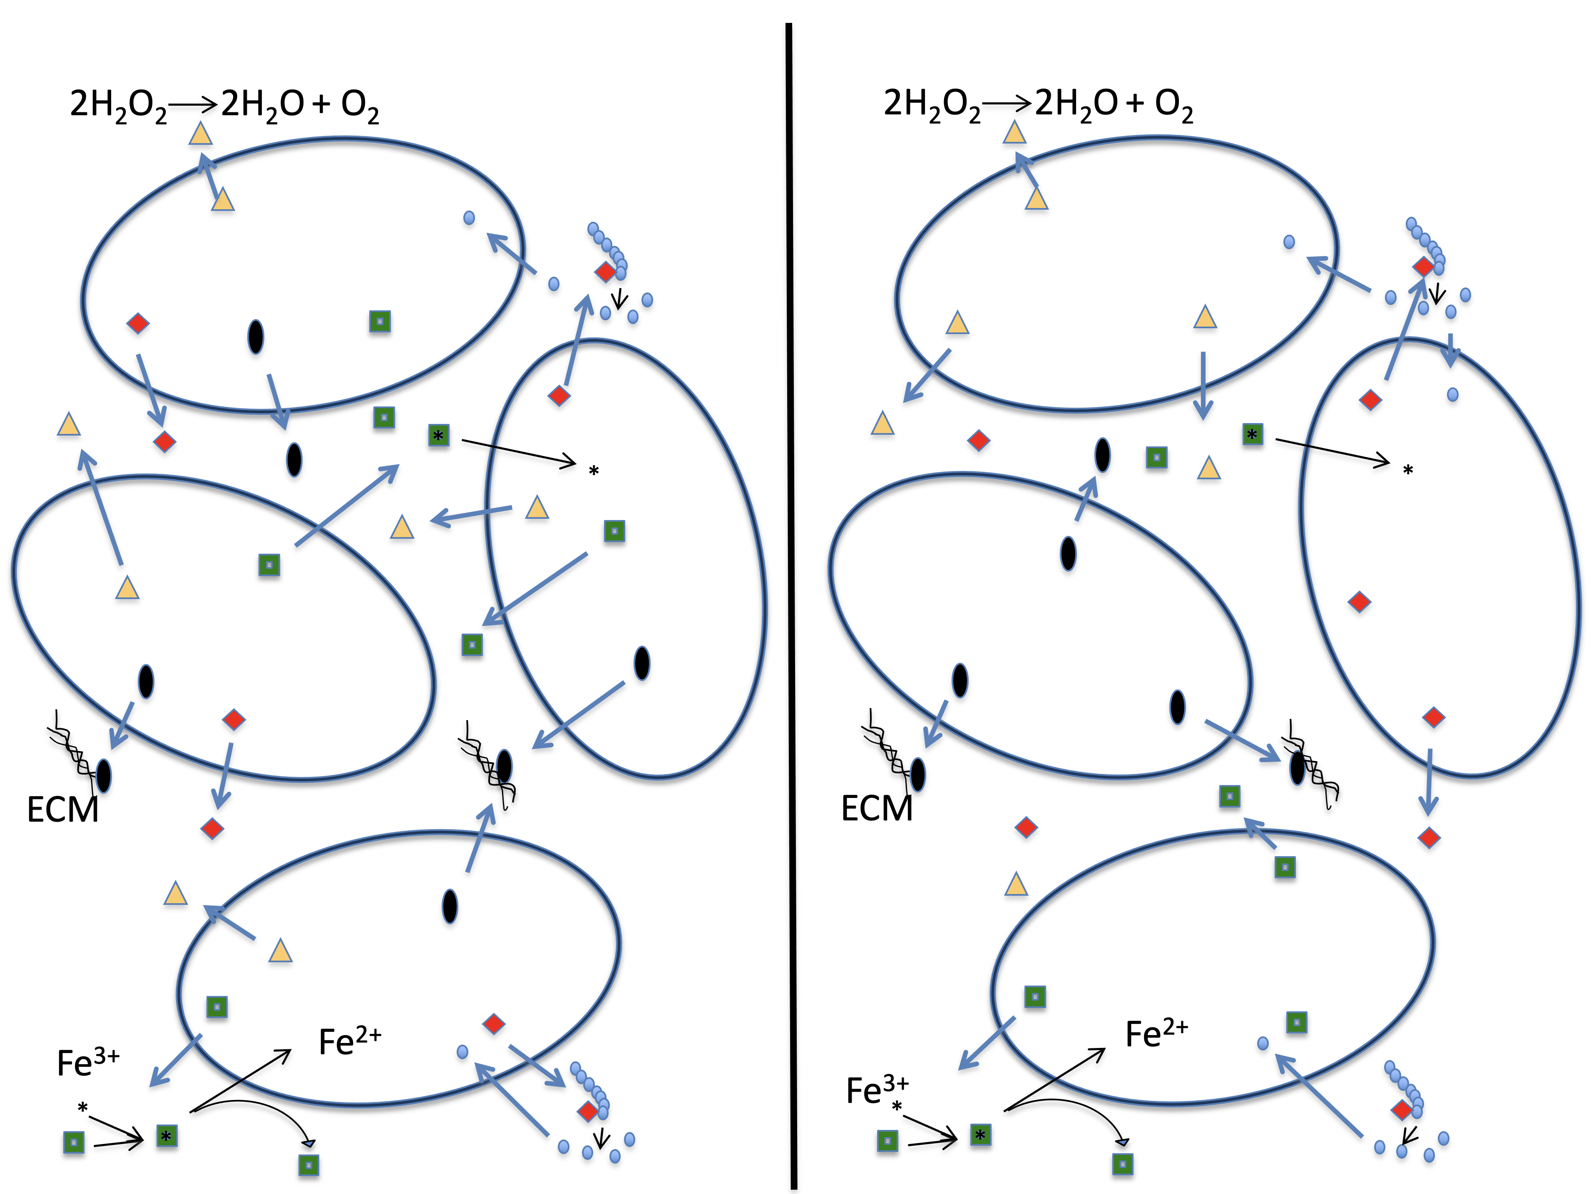
The pangenome as a shared genetic resource
Another important group of genes among the accessory pool are genes that are involved in cheating (an individual relies on its neighbors to provide the function), or the division of labor (aka mutual cheating). This is the subject of the Strong Black Queen Hypothesis.
A.W.F. Edwards 1998
Edwards-Venn cogwheel

Slide 24
HGT as a force creating new pathways

Slide 25
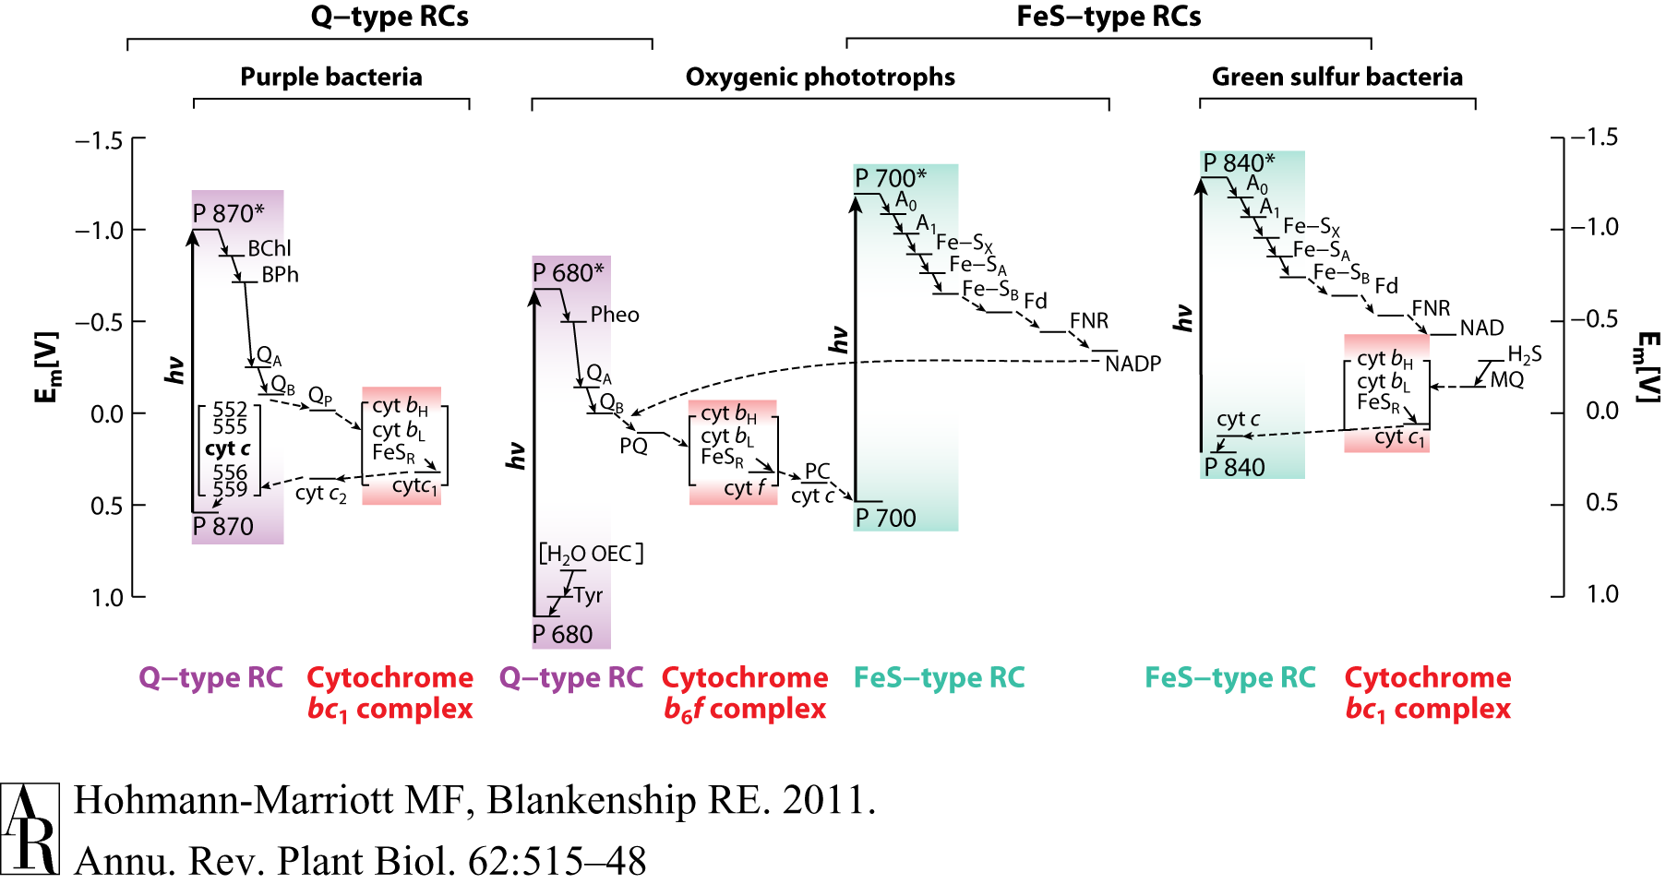
HGT as a force creating new pathways – Example 2
Oxygen producing photosynthesis

Slide 26
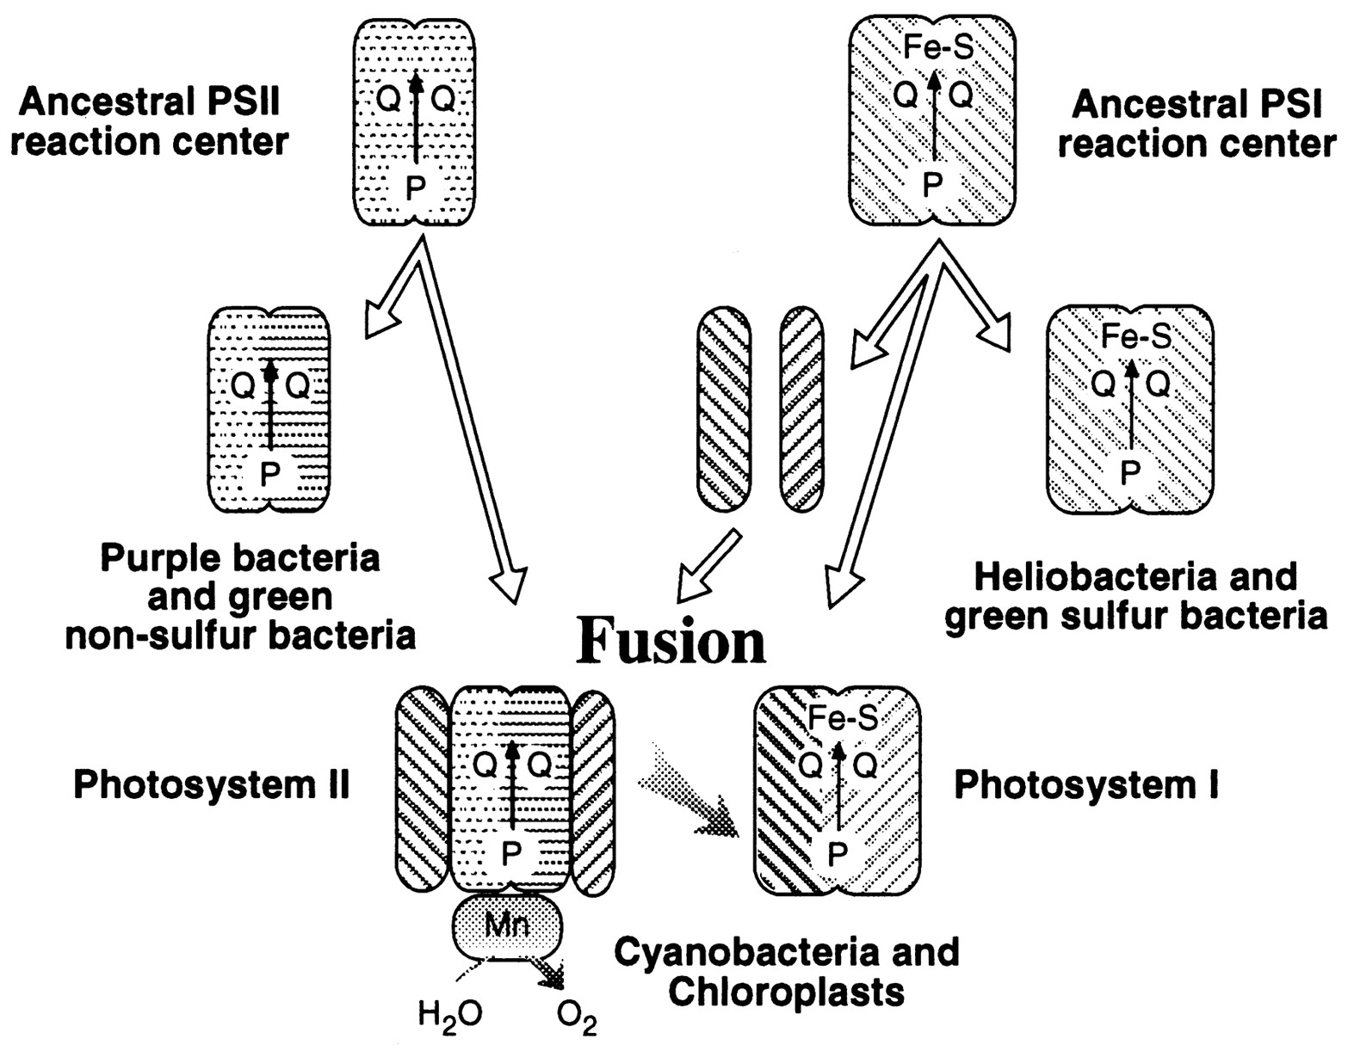
A heterologous fusion model for the evolution of oxygenic photosynthesis based on phylogenetic analysis.
Xiong J et al. PNAS 1998;95:14851-14856
©1998 by National Academy of Sciences
Notes:
A heterologous fusion model for the evolution of oxygenic photosynthesis based on phylogenetic analysis. Details of the model are provided in the text.

Slide 27
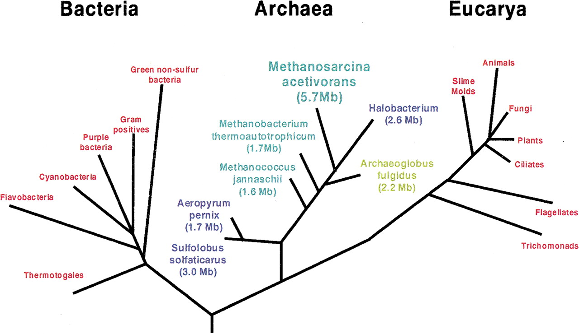
HGT as a force creating new pathways – Example I
Acetoclastic Methanogenesis
Thermo-
plasmatales
Pyrococci
Modified from: Galagan et al., 2002

Slide 28
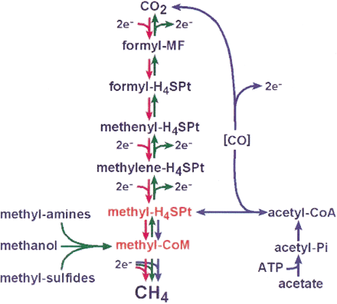
Methanogenesis
Unique to subset of Archaea
Energy production via reduction of multiple carbon substrates to CH₄
900 Million metric tons of biogenic methane produced annually.
Over 66% of biogenic methane is produced from acetate, mostly by Methanosarcina genera.
From: Galagan et al., 2002
Fournier and Gogarten (2008) Evolution of Acetoclastic Methanogenesis in Methanosarcina via Horizontal Gene Transfer from Cellulolytic Clostridia. J. Bacteriol. 190(3):1124-7

Slide 29
Methanogenesis
CODH complex:
reversible Acetyl-CoA synthesis
Acetoclastic methanogenesis-
specific pathway:
acetate kinase (AckA) and
phosphotransacetylase (Pta)
From: Galagan et al., 2002

Slide 30
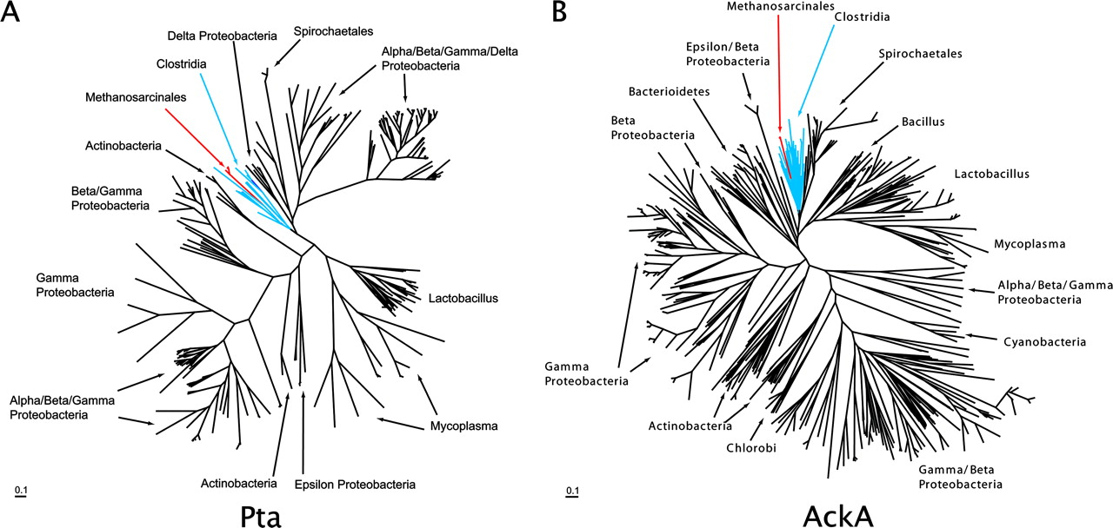
Maximum likelihood phylogenetic trees of Pta and AckA homologs. Homologs found in Methanosarcina are red and in both cases are found in a monophyletic group corresponding to the Clostridia (blue) ... .

Slide 31
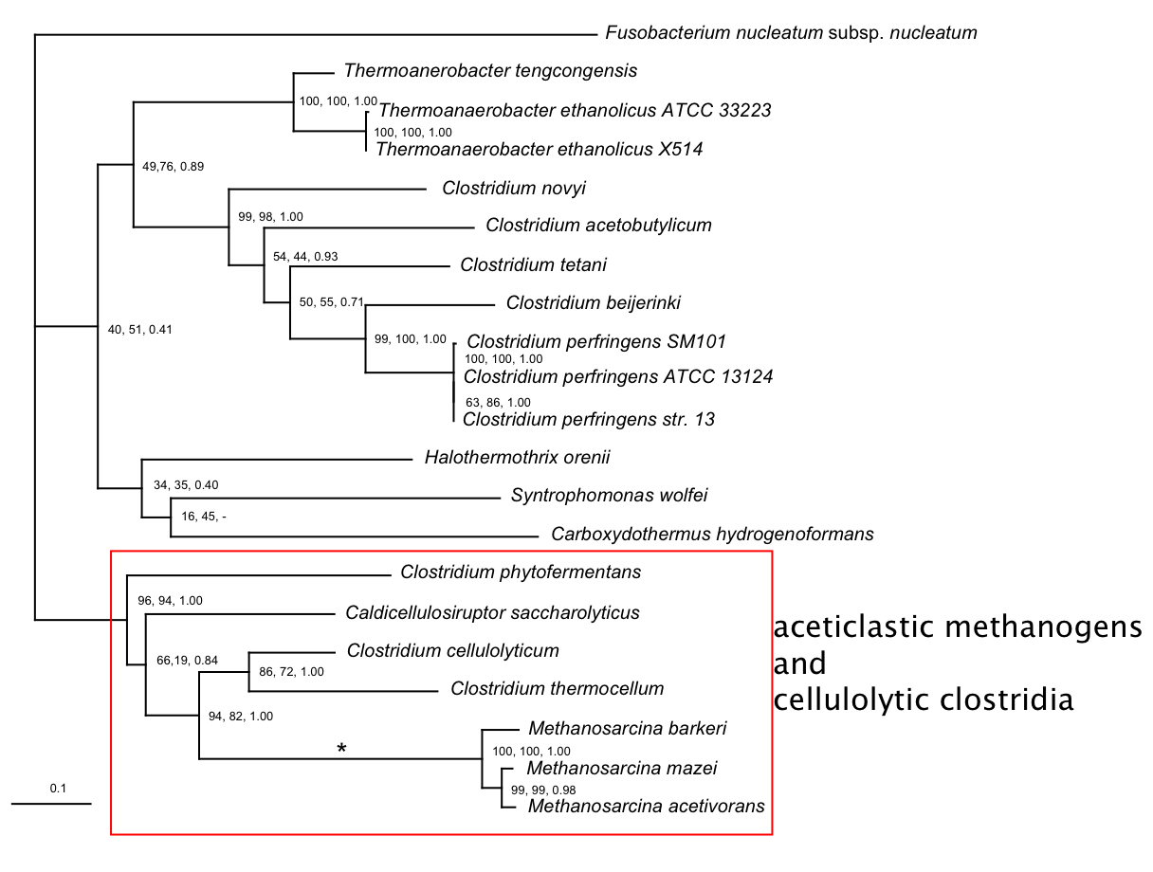
Phosphotransacetylase (Pta)
Modified form Fournier and Gogarten (2008) Evolution of Acetoclastic Methanogenesis in Methanosarcina via Horizontal Gene Transfer from Cellulolytic Clostridia. J. Bacteriol. 190(3):1124-7
acetoclastic Methanosarcina and cellulolytic clostridia

Slide 32
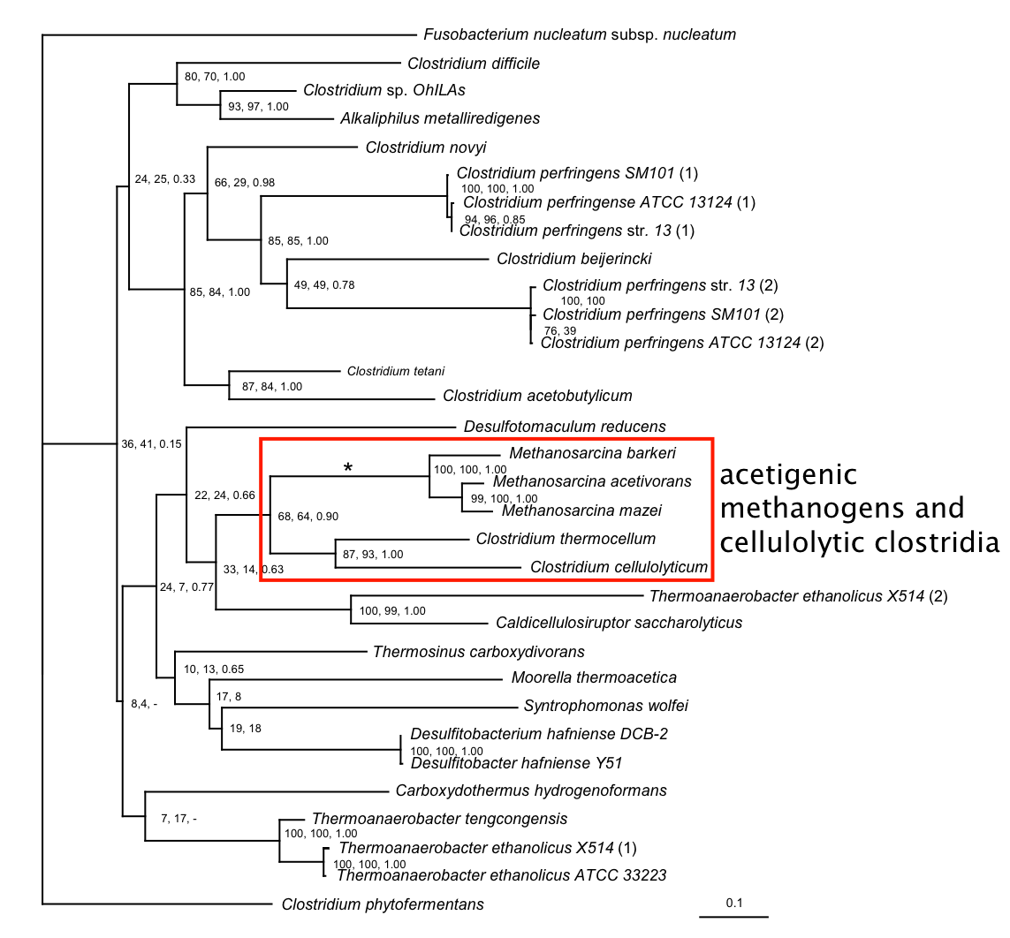
acetate kinase (AckA)
acetoclastic methonogens and cellulolytic clostridia
Modified form Fournier and Gogarten (2008) Evolution of Acetoclastic Methanogenesis in Methanosarcina via Horizontal Gene Transfer from Cellulolytic Clostridia. J. Bacteriol. 190(3):1124-7

Slide 33
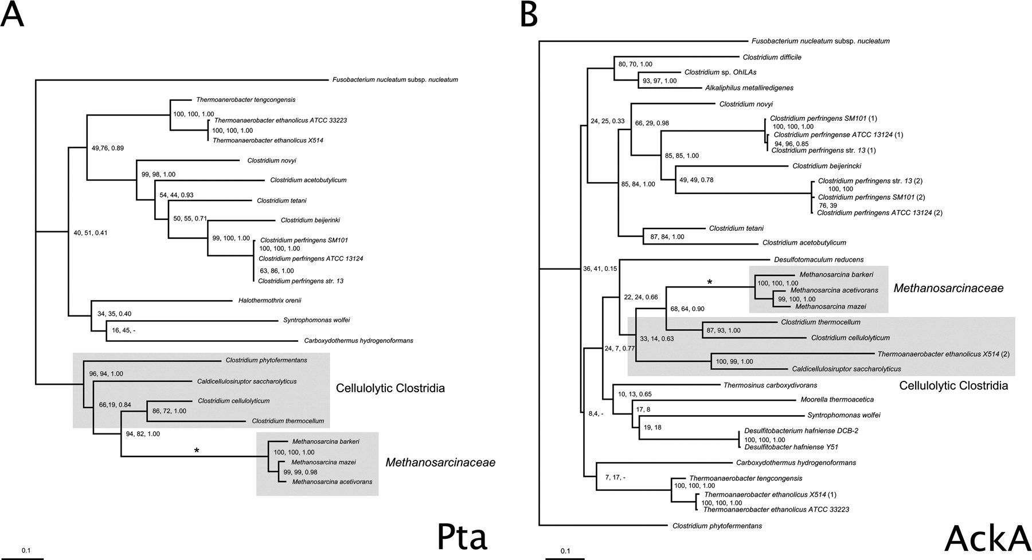
Consensus trees of Pta and AckA homologs within the Clostridia. Branches in which there were postulated horizontal gene transfers to Methanosarcina are indicated by an asterisk. Homologs from the firmicute F. nucleatum were used as outgroups to root the trees. The numbers associated with each clade indicate bootstrap values for maximum likelihood and neighbor joining and the posterior probability from Bayesian inference, respectively. Sequence alignment was ...

Slide 34
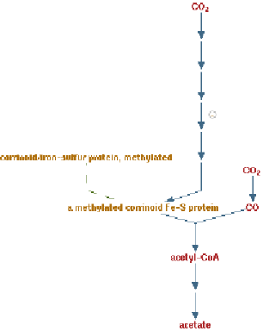
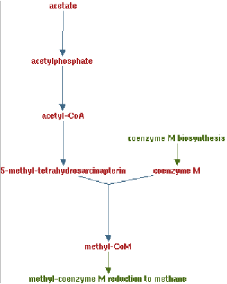
Clostridia acetigenic pathway
Methanosarcina
acetoclastic pathway
AckA
HGT
PtaA
PtaA
AckA
Figures drawn with Metacyc (www.metacyc.org)

Slide 35
HGT as a force creating new pathways – Example 3
Acetyl-CoA Assimilation: Methylaspartate Cycle
Acetate
Alcohols
Polyhydroxybutyrate
Fatty acids
acetyl-CoA
Lysine, leucine
oxaloacetate
citrate
malate
isocitrate
CO
2
fumarate
acetyl-CoA
2-oxoglutarate
Poly-γ -glutamate
succinate
glutamate
Proteins
glyoxylate
γ-Glutamylcystein
succinyl-CoA
methylaspartate
CO
Osmoadaptation
2
propionyl-CoA
mesaconate
3-methylmalyl-CoA
mesaconyl-CoA
Khomyakova, Bükmez, Thomas, Erb, Berg, Science, 2011

Slide 36
Comparison of different anaplerotic pathways
acetyl-CoA
acetyl-CoA
acetyl-CoA
acetyl-CoA
crotonyl-CoA
oxaloacetate
citrate
oxaloacetate
citrate
CO
2
malate
isocitrate
acetyl-CoA
ethylmalonyl-CoA
CO
2
fumarate
acetyl-CoA
2-oxoglutarate
malate
isocitrate
methylsuccinyl-CoA
glyoxylate
succinate
glutamate
CO
2
mesaconyl-CoA
glyoxylate
2-oxoglutarate
3-methylmalyl-CoA
succinyl-CoA
methylaspartate
fumarate
CO
propionyl-CoA
glyoxylate
2
propionyl-CoA
mesaconate
CO
2
CO
2
acetyl-CoA
succinate
succinyl-CoA
3-methylmalyl-CoA
mesaconyl-CoA
succinyl-CoA
malate
Citric acid cycle and
Glyoxylate cycle
Ethylmalonyl-CoA
pathway
Methylaspartate cycle
Bacteria, Eukarya and some Archaea
α-Proteobacteria, streptomycetes
haloarchaea

Slide 37
HGT as a force creating new pathways – Example 3
Acetyl-CoA Assimilation: methylaspartate cycle
Haloarchaea
Haloarcula marismortui,
Natrialba magadii
Glutamate fermentation,
Bacteria
Propionate assimilation
Acetate
assimilation, Bacteria
Khomyakova, Bükmez, Thomas, Erb, Berg, Science, 2011

