Slide 1
MCB 3421 - 2024
Class 1
Introduction

Slide 2
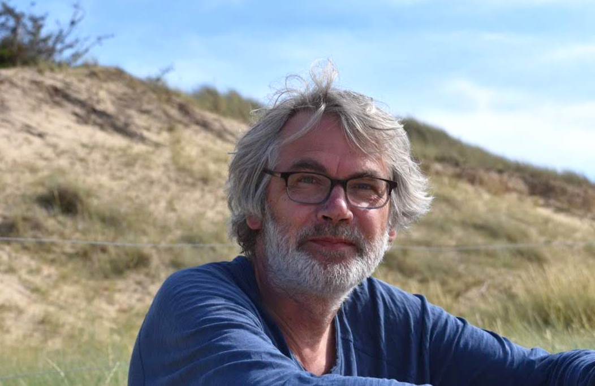
Instructor:
Johann Peter Gogarten
Dept. Molecular and Cell Biology
BP404
University of Connecticut
Storrs, CT 06269-3125
Phone: 486-4061
Email: gogarten@uconn.edu
Biology Diploma 1982 Univ. of Tübingen - Plant Physiology / Biomathematics
Sugar transport in liverworts
PhD (scl) 1986 Univ. of Gießen – Biophysics / Plant Physiology
Membrane and long-distance transport in plants
Postdoctoral Fellow -1989 University of California Santa Cruz
Molecular biology and evolution; Energization of the endomembrane system,
Origin of the eukaryotic cell
Since 1989 at UConn – adopted by microbiologists
Early evolution of life, genomics, horizontal gene transfer, symbiotic
relationships between genes, molecular parasites

Slide 3

Instructor:
J. Peter Gogarten
Dept. Molecular and Cell Biology
BP404
University of Connecticut
Storrs, CT 06269-3125
Phone: 486-4061
Email: gogarten@uconn.edu
Else:
Married with three children.
  The oldest, my daughter, teaches genetics of epidemiology at the University of Washington in Seattle
  The second oldest is a researcher at the Helmholtz Inst for One
  Health in Germany, and works on environmental DNA,
  microbiomes, viromes, and phageomes in monkeys.
  The third one is in Physician in Potsdam, Germany.
Six Grand children ...
A motorcycle (Royal Enfield)
House next to the Mount Hope river.

Slide 4

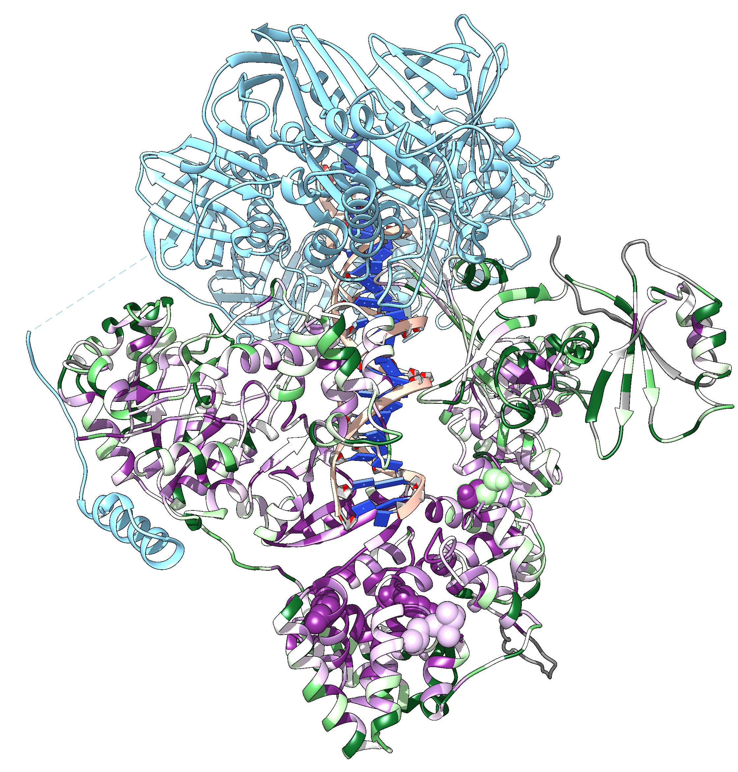
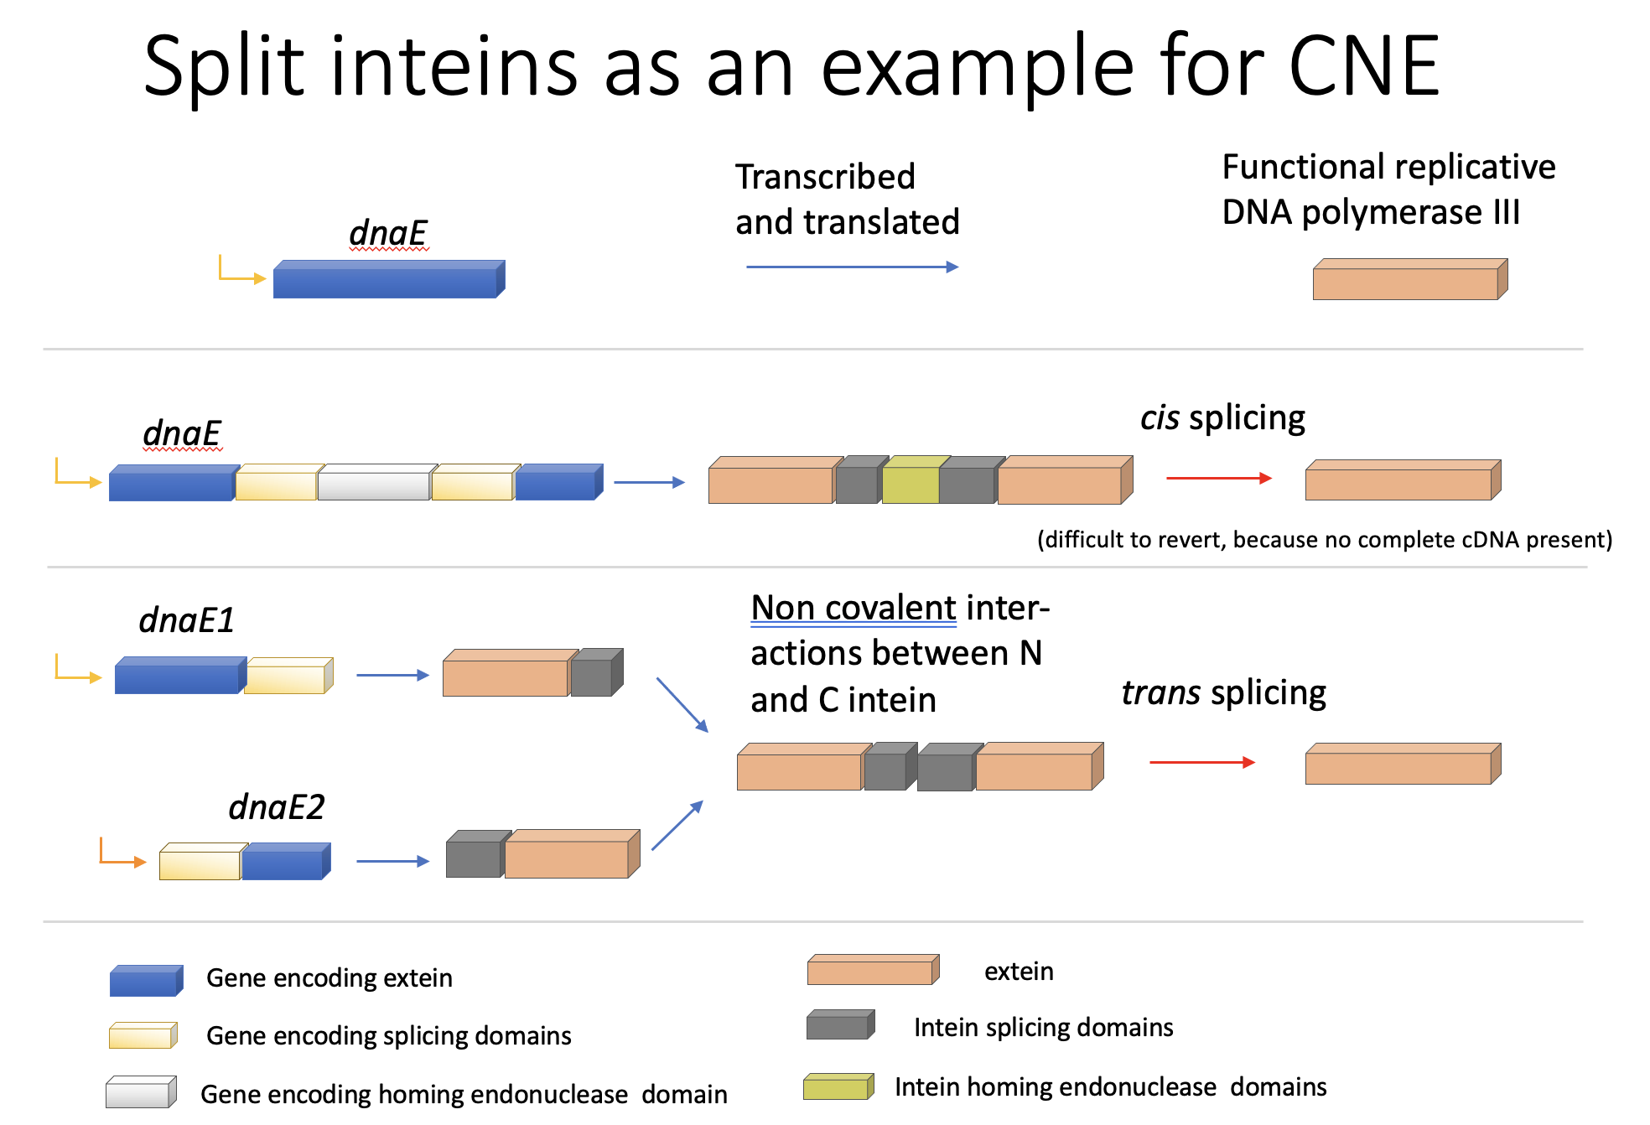
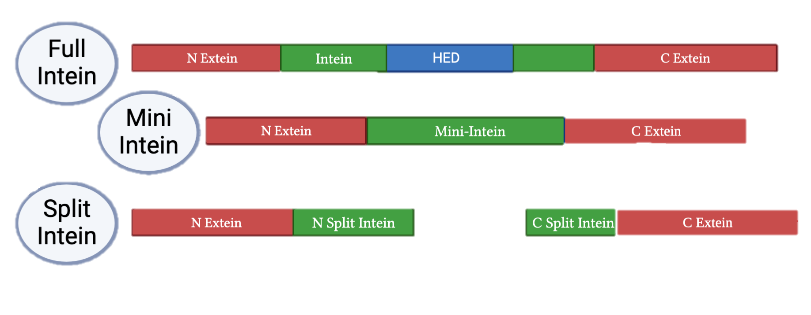

Teaching Assistant:
Daniel S Phillips
Dept. Molecular and Cell Biology
University of Connecticut
Storrs, CT 06269-3125
daniel.s.phillips@uconn.edu
PhD student in Molecular and Cell Biology
Research on inteins and split inteins in
Cyanobacteria.
Pan-genome analyses of Microcystis aeruginosa

Slide 5
Read the Syllabus!
https://j.p.gogarten.uconn.edu/mcb3421_2024/Syllabus_for_Fall_2024.pdf
The following items are important:
Basis for grading
Classroom Etiquette (cell phone use and mask wearing)
Learning objectives
Academic Honesty (!! plagiarism !! “collaborations” for writing assignments and
take-home exams will not be tolerated! If, to answer a question on a take-home
exam, you use information from a website (either verbatim or paraphrased)
put in a reference to the website). If you use chatGPT or similar to write a section of an essay, mark the section and put the AI program and your query into the references. Communicating with AIs is an artform that might get you a job as AI-handler, but you need to declare the use of AI systems.

Slide 6
Topics
Evolution of biomolecules and application to molecular data analysis and the design of new molecules
Early evolution of life
Neutral pathways towards increasing complexity
Selfish genes, molecular innovations
Data bank searches
Alignment of sequences and 3-D protein structures
See the syllabus and the homepage for more details!
Frequent examples will be ATP synthases, Inteins, Aeromonas (due to collaboration with Joerg Graf), Thermotoga (Ken Noll) , Haloarchaea (Thane Papke).
The next two slides (hidden) have a more detailed listing. Read through them, and let me know, if you would like to hear more on one of these topics, or if you would like to see another topic covered.

Slide 7
Topics (in more detail)
inspection and comparison of protein structures, convergence versus common ancestry
alignment of protein structures
What is life? (phages and viruses as part of a living system)
evolution as algorithm
sequence space
data bank searches
Entrez at the NCBI
evolution of the universe
prebiotic evolution, the origin of life
self-replicating biopolymers, the RNA-world,
in vitro selection, experimental evolution
from single genes to metabolic networks and hypercycles
exon/domain shuffling
What is the unit of selection? Genes, individuals, populations?
gene duplications versus gene transfer
biochemical innovation
alignment of nucleotide and amino acid sequences (pairwise and multiple; global and local)
detecting divergent homologs using PSI blast
molecular trees (phylogenetic reconstructions)
species concepts
introns, inteins, molecular parasites, homing
continued on next slide

Slide 8
Topics (in more detail - continued)
selfish genes, selfish operons
rare genes in microbial population
cooperation between genes - ecology of the genome
analyses of complete genomes
comparative genome analyses
horizontal gene transfer
Is there an organismal tree of life?
co-evolution
emergence of cooperation
evolution of the holobiont / the hologenome
What is the genome of an organism? Pan-genomes of population and species.
black and red queen hypotheses
Does a division of labor arise within microbial populations?
neutral evolution
evolution of complexity (non-adaptive pathways towards complexity, constructive neutral evolution)
networks (small world networks, interaction networks, hubs, the rich get richer)

Slide 9
You are required to maintain a electronic notebook
You need to have an entry for every lecture, describing the most interesting thing you learned in the lecture, or any interesting thought that were triggered by the lecture!
You need to keep detailed descriptions of what you did in the computer labs. E.g., which files you worked, which commands you used.
You will email a copy or share your notebook with the instructors on in the middle of the semester (October 6th) and after the last day of classes.
Choice 1: use One Note
Choice 2: use Joplin
(A problem with Joplin is that Daniel and I do not have continuous access to your
notebook, Advantage are that is uses markup language and can be exported to html)

Slide 10
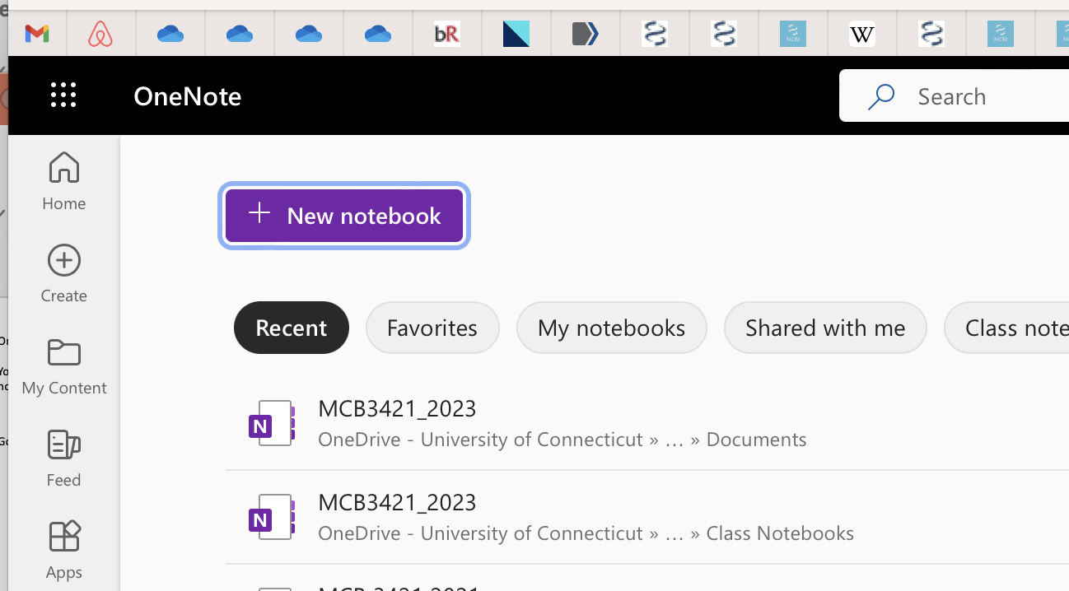
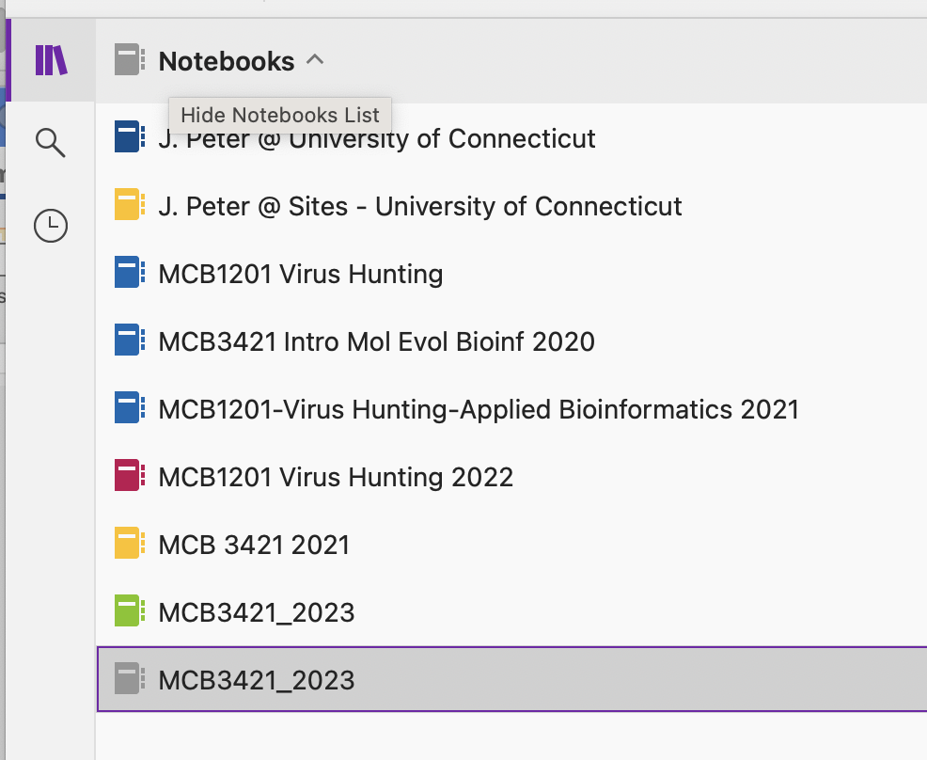
One Note is part of Microsoft office and available to all students.
You should have received a notification from Microsoft that you have access to a class notebook.
If not, Go to OneNote (in the Application folder or online at Office 365 Applications)
Log in, and look for the MCB3421_2024 class notebook.
The 9 dots on the web interface open the menu bar

Slide 11
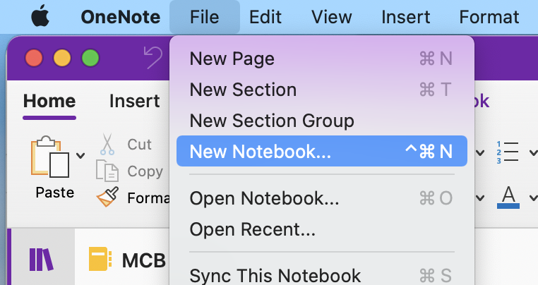
One Note should be part of Microsoft office and available to all students.
You should have received a notification from Microsoft that you have access to a class notebook.

Slide 12
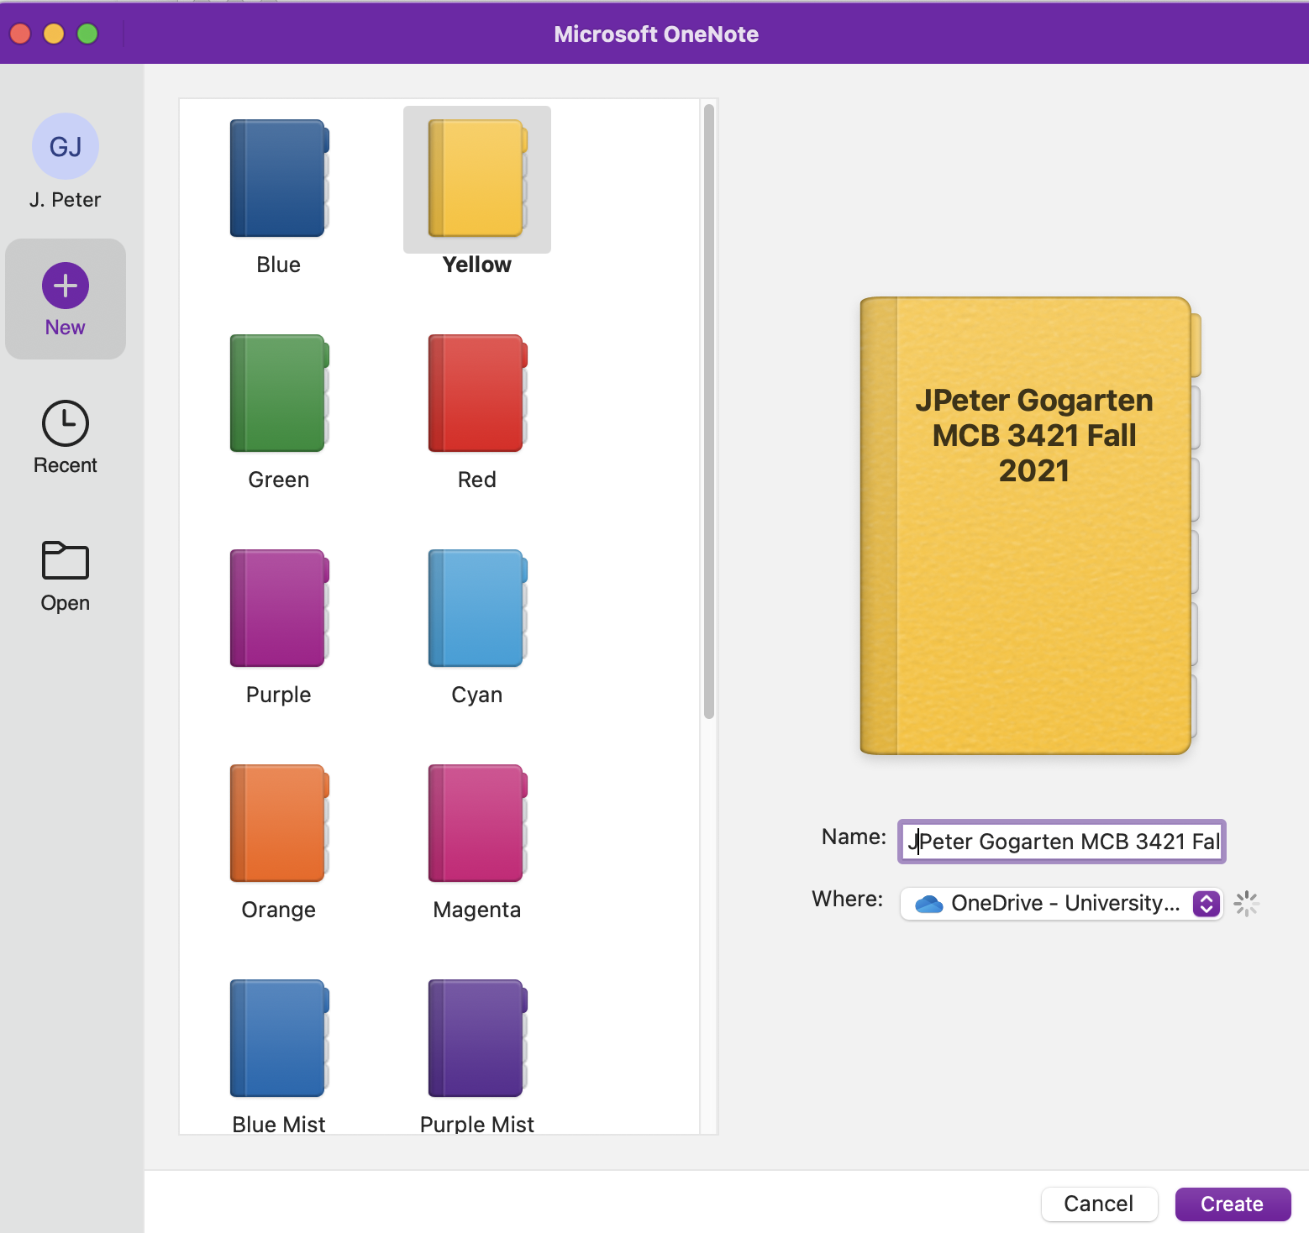
Pick a name and
click create

Slide 13
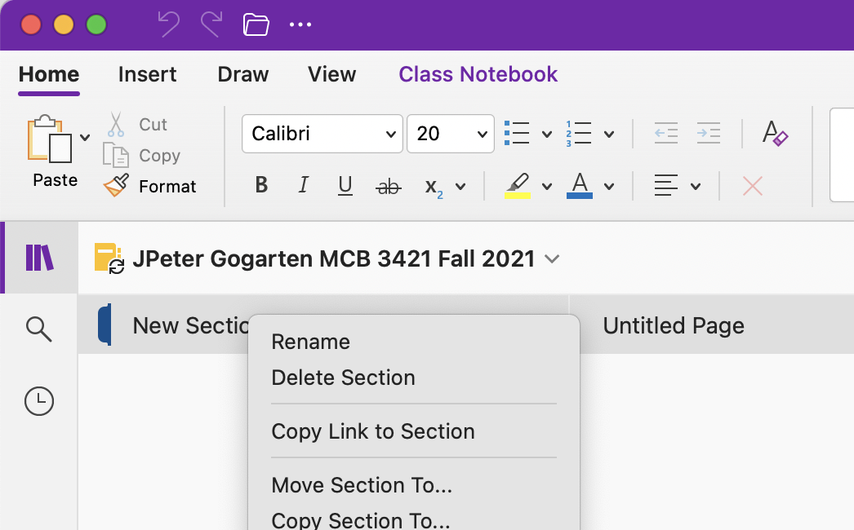
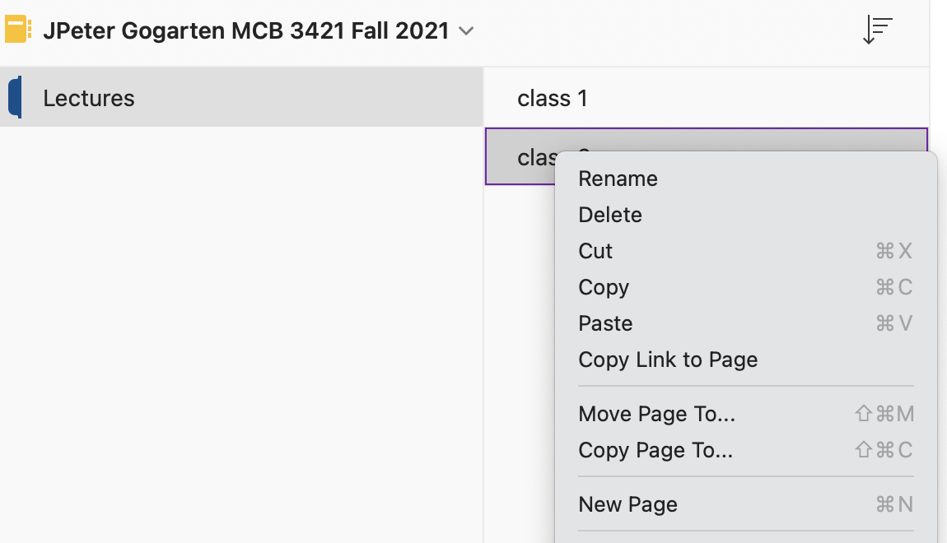
Rename New Section to
Lectures (right click)
Add more pages - right click on the page name
(call them class 1,
class 2 ...
Add a new section (right click on the existing section name) and call it Computer Labs

Slide 14
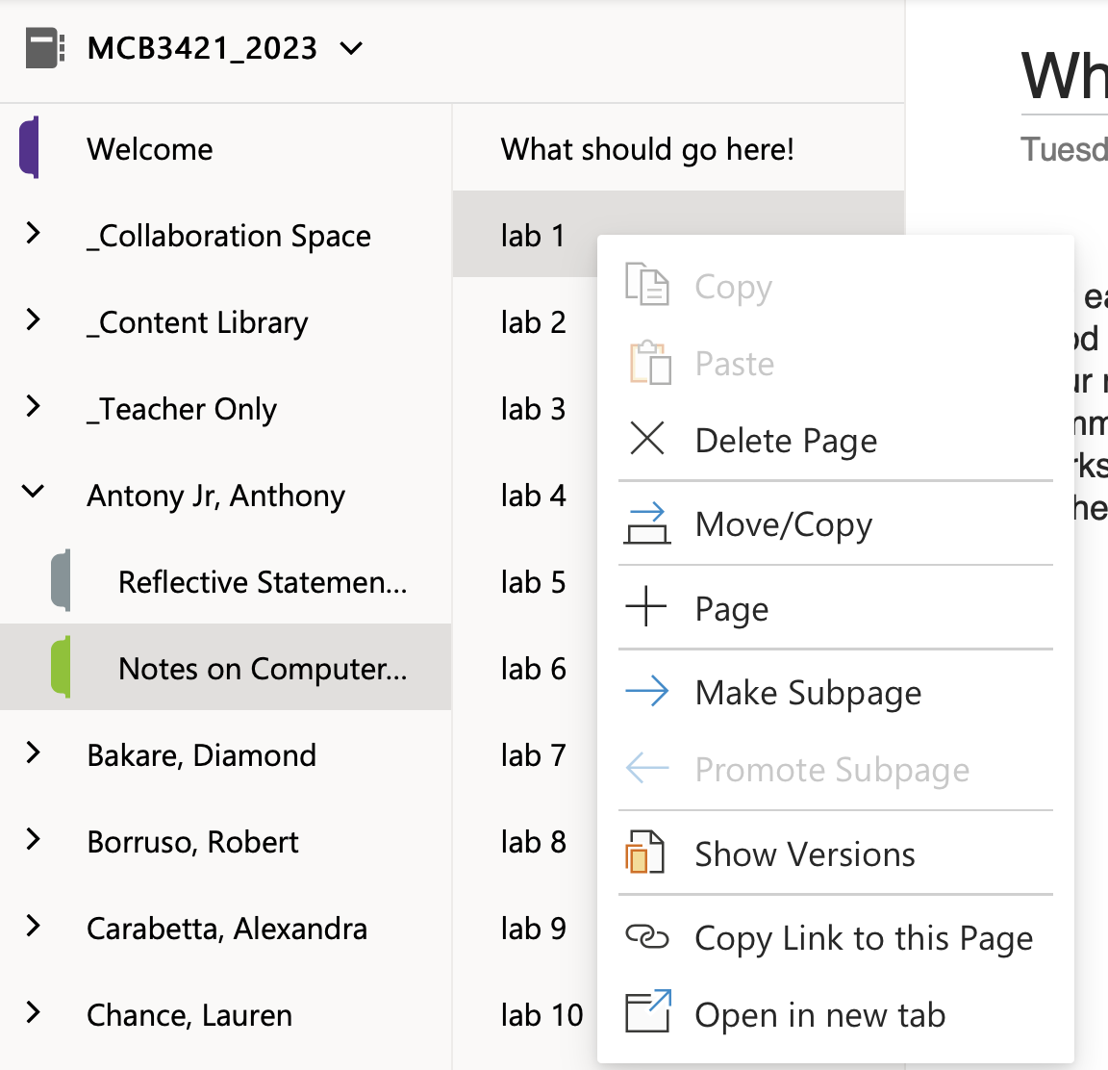
Right click to add pages

Slide 15
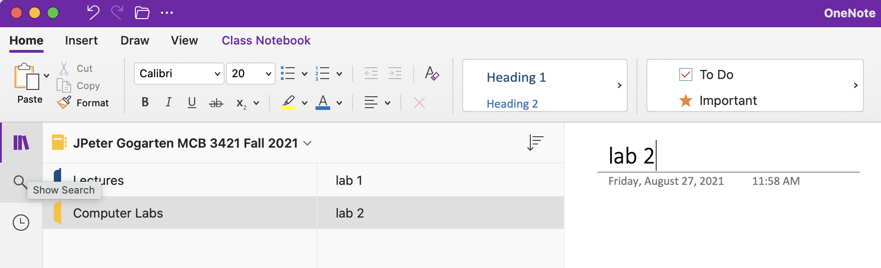
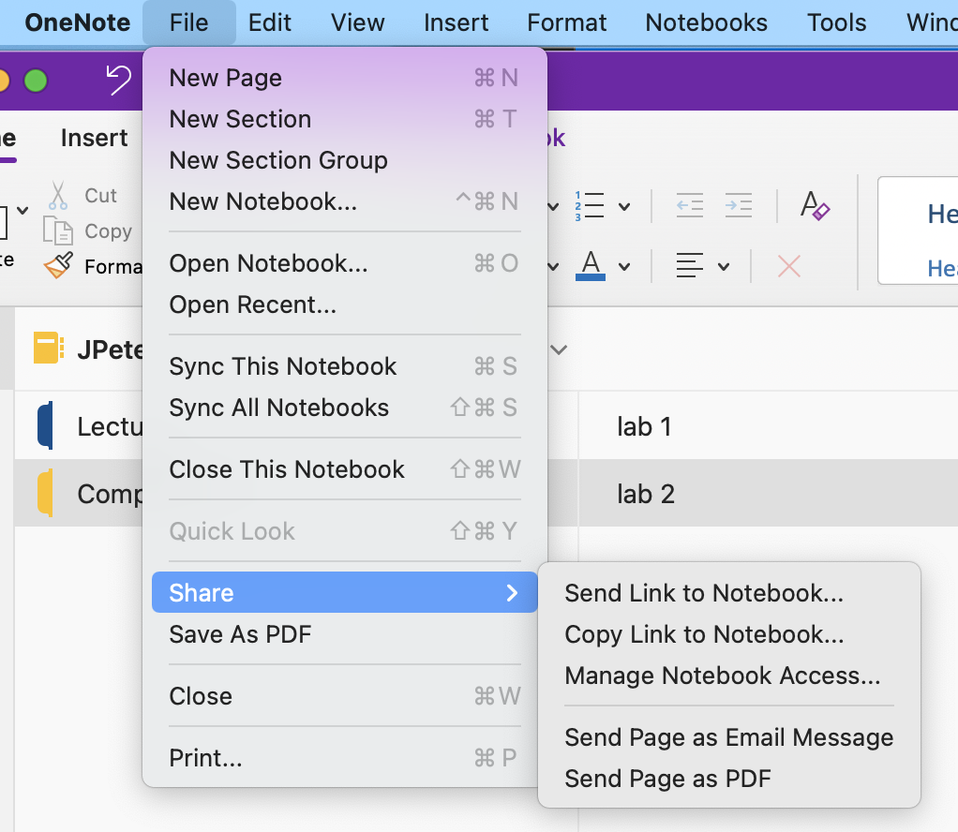
The result should look something like this
An advantage over handwritten notes is that you can copy/paste items from your screen or from a file directly into the notebook.
To share a OneNote notebook, go to
File > Share > Send Link to Notebook.
If you use the class notebook, your instructors already have access ☺

Slide 16

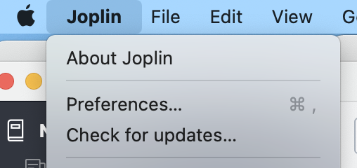
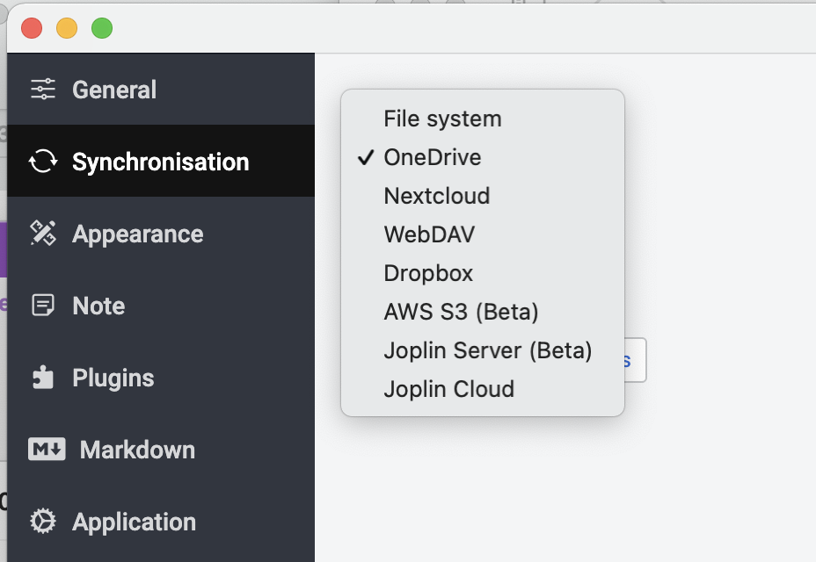
For those who have struggled with Microsoft OneNote before, Joplin is worthwhile alternative. An added advantage is that you learn and get familiar with Markdown language (many programming and scripting languages use markdown (e.g.: Rstudio)
To install Joplin go to https://joplinapp.org/download/
Start the Joplin App
under Joplin > Preferences
select synchronization
Select the synchronization service
of your choice.

Slide 17
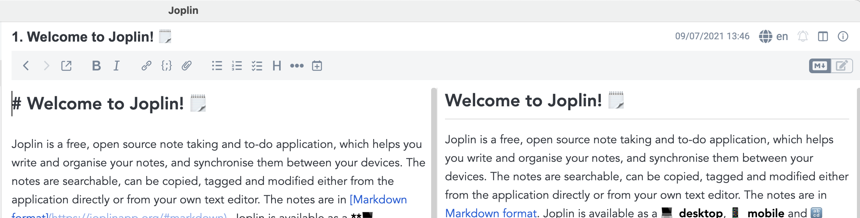
In the upper right hand is two-page symbol that allows to move from one type of editor window to the next.
One display is markdown (on the left above).
This is the place where to can drop in pictures or files.
You also can use
#, ##, to format text as headers,
- to create bullets,
`to create text in monospace font`,
*** to create a separator,
**to display text in bold**.
Repeated clicking moves to the rendered text and to the side-by-side view.

Slide 18
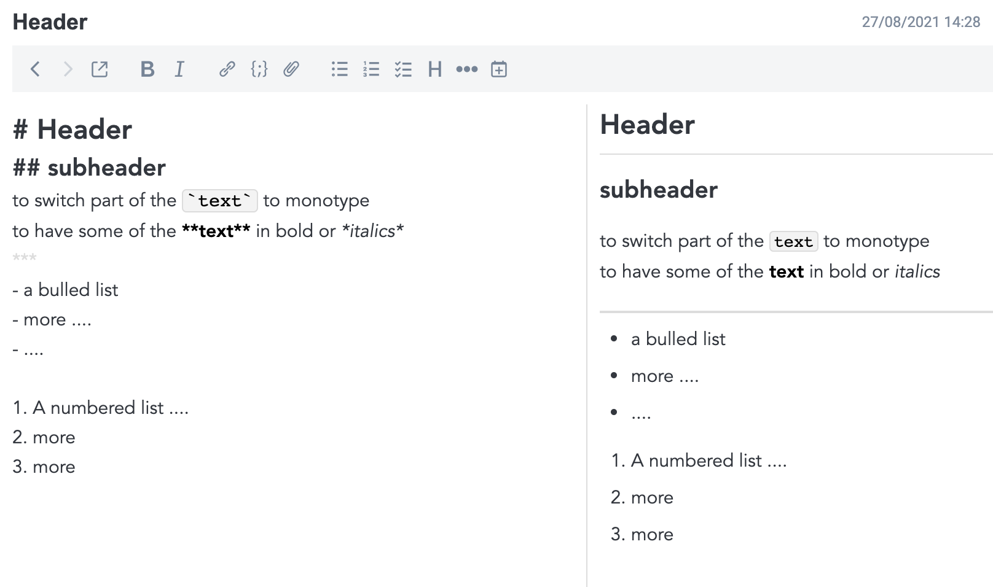
One can export text to pdf or html

Slide 19
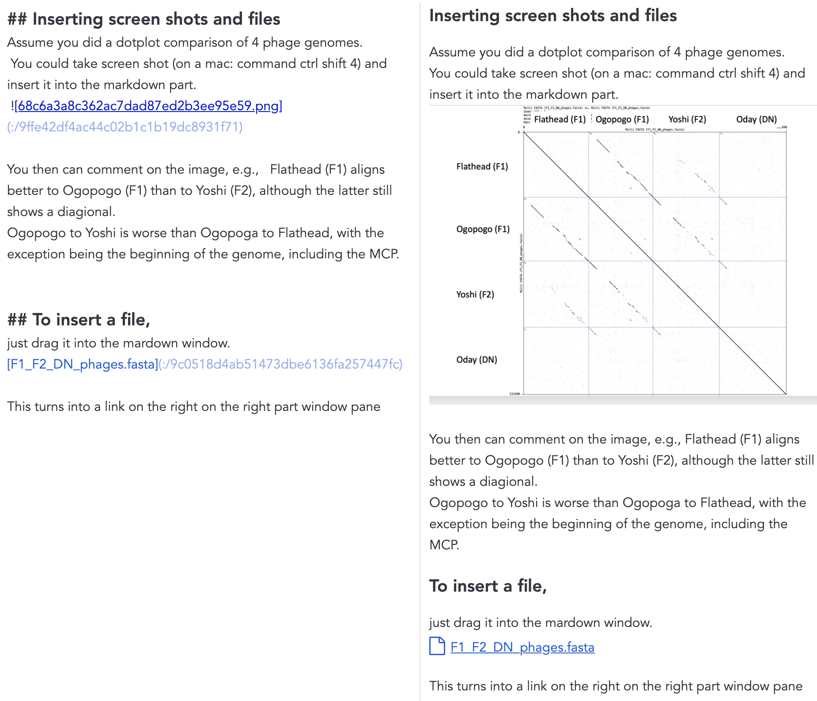

Slide 20
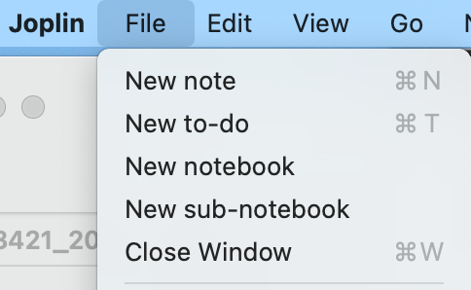
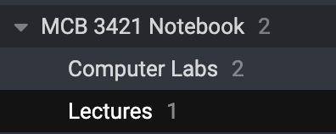
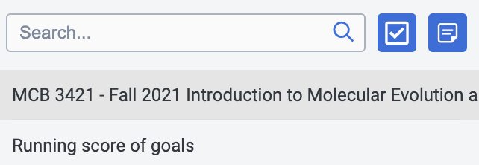
Create a MCB 3421 notebook.
Create two sub-notebooks in the MCB 3421 notebook
One for lectures and one for the computer labs
Within each you can add pages for individual computer labs and the lectures.
Or for the latter, you could add entries for the lectures to a growing page (put the newest lecture on top)

Slide 21
HuskyCT
Videos of lectures (if it works)
Take-home exams
Discussion board
Reading material
For everything else go to the
class’s homepage
and the
running list of goals and assignments.

Slide 22
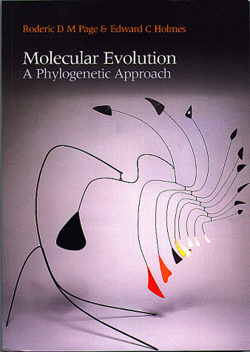
No Textbook Required!
We will not use a printed book for reading assignments! Reading assignments will use texts available on the www, including Wikipedia, and through WebCT. In case you are interested, the following might be worth while to consider reading in case you get lost in trees depicting evolution.
Molecular Evolution : A Phylogenetic Approach
by Roderic D. M. Page, Edward C. Holmes Price: $63.95 Paperback - 352 pages (October 1998)
Blackwell Science Inc; ISBN: 0865428891
This book gives an excellent introduction to terms, methods, and problems in molecular evolution. It does not contain too many details on individual algorithm, but it provides a readable overview.
Rather expensive, but UConn provides access to an online version

Slide 23

Textbooks: (continued)
Inferring Phylogenies
by Joe Felsenstein
ISBN: 0-87893-177-5; $61.95 paper
Excellent book on phylogenetics and many aspects of population genetics (e.g., gene coalescence in populations, a topic that is rather relevant to species phylogenies in microorganisms :)).
This is not exactly bedtime reading, but if you need a well-founded thorough explanation, this is a good book to consult.
Link to the UConn Library

Slide 24
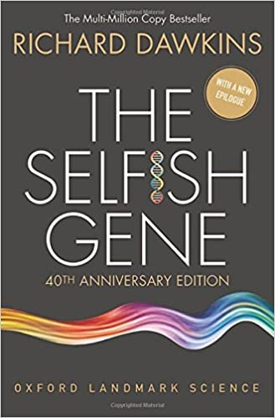
Interesting Reading Materials
Richard Dawkins: The Selfish Gene
This book considers evolution from the gene’s point of view.
Many of today’s molecular biologists consider this the most influential book they read.
UConn’s library has a link to an online version, but it is really slow.

Slide 25
What is Bioinformatics?

Slide 26
What is Bioinformatics?
General definition:
Area between Computer Sciences and Biology
(or application of the tools of informatics to biology)
Bioinformatics took off only with the availability of large amounts of genome information, thus a narrower and practical delineation is:
Area between Informatics and Genomics
(and other omics, such as transcriptomics, proteomics, metabolomics ...)
Related areas:
Computational biology, Cybernetics
Typically, bioinformatics is considered to include:
management of biological databanks,
access to biological data, and
extracting useful information from biological data.
See the assignment for Wednesday.

Slide 27
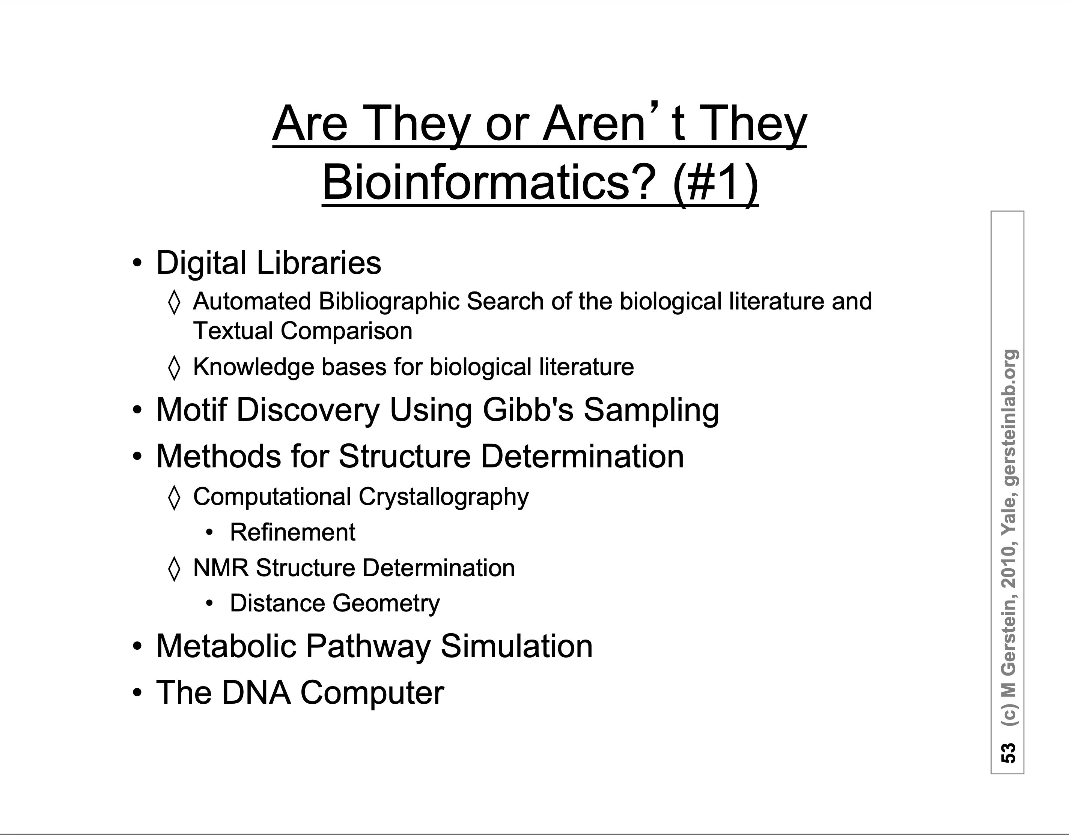
AI systems such as alphafold

Slide 28
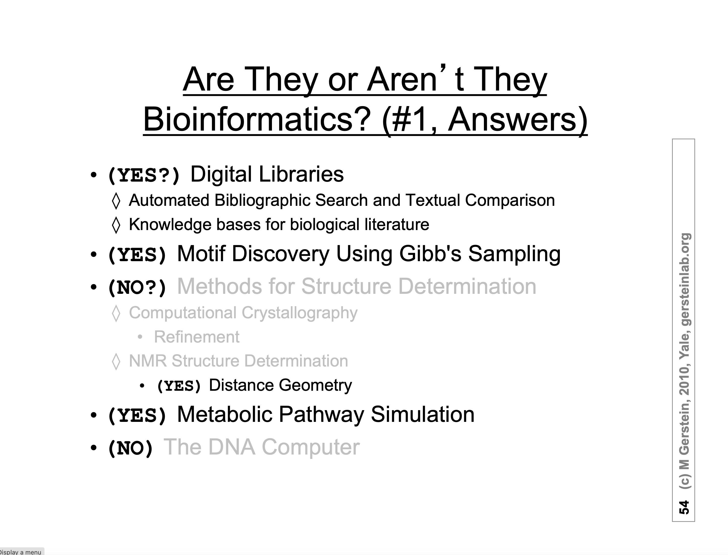
(YES) AI systems such as alphafold

Slide 29
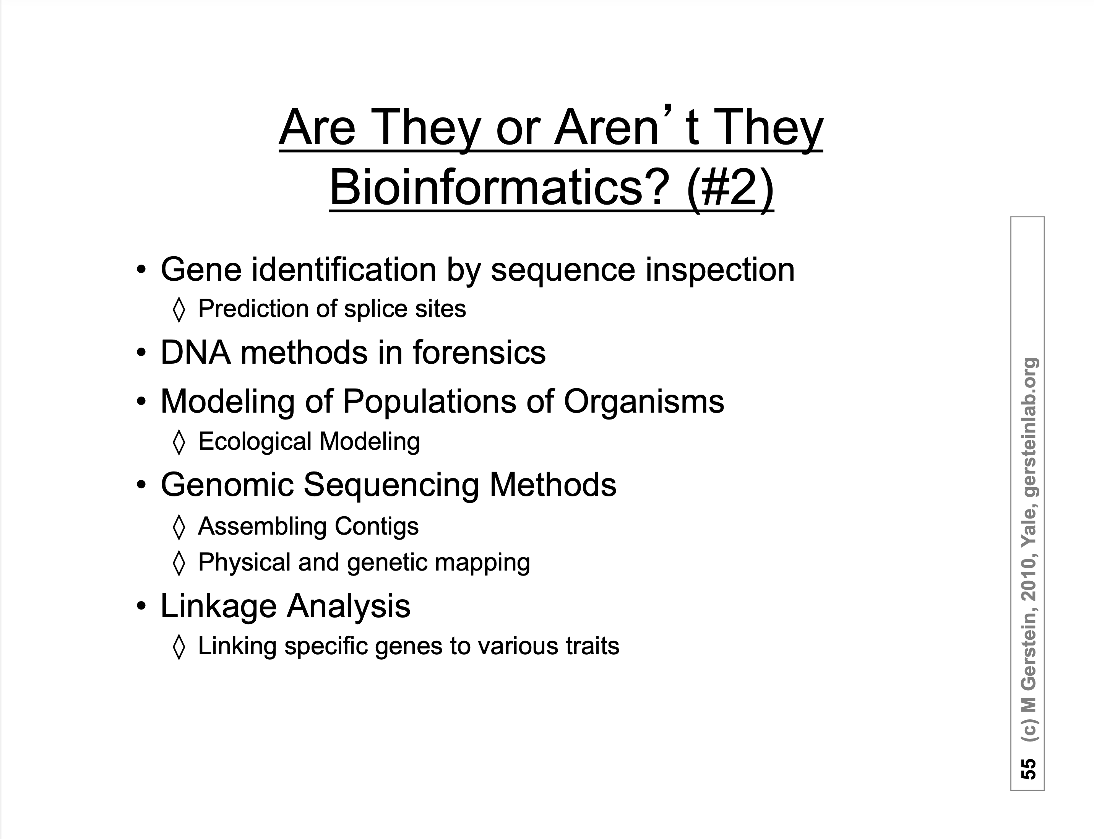

Slide 30
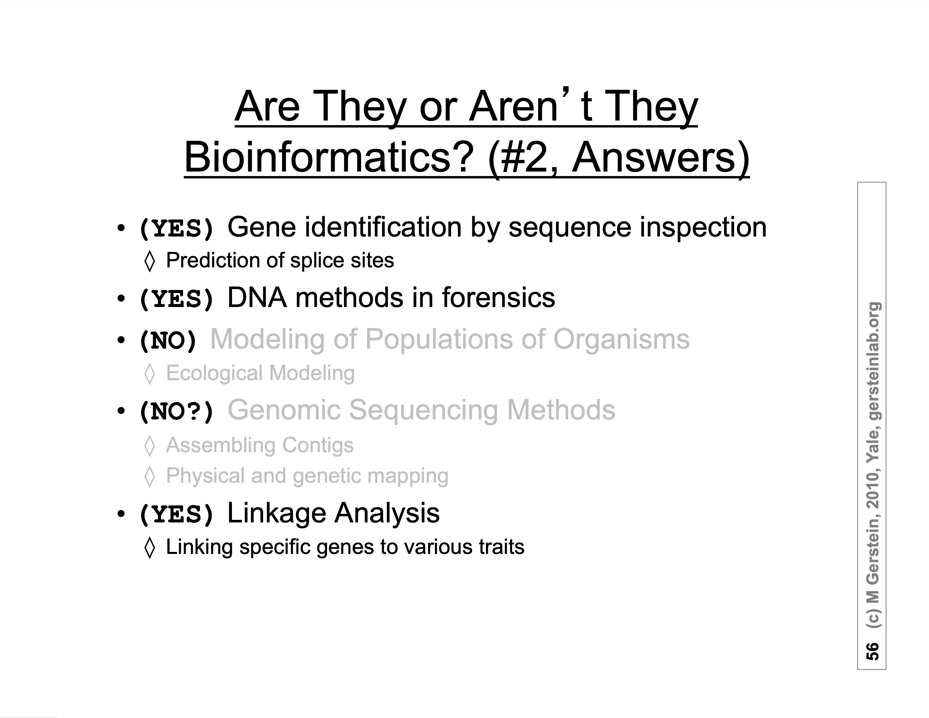

Slide 31
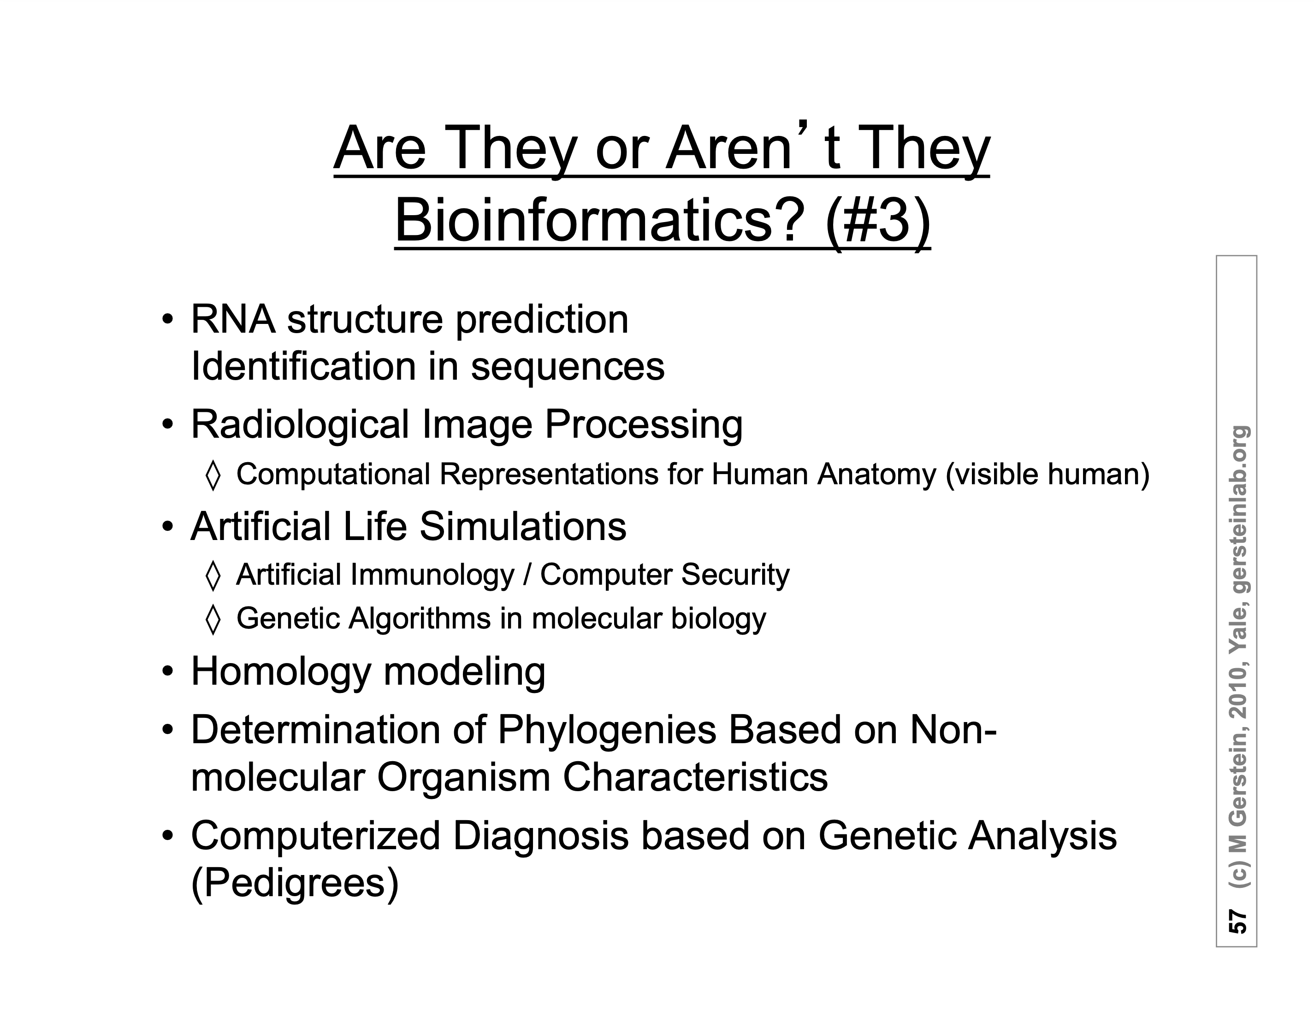

Slide 32
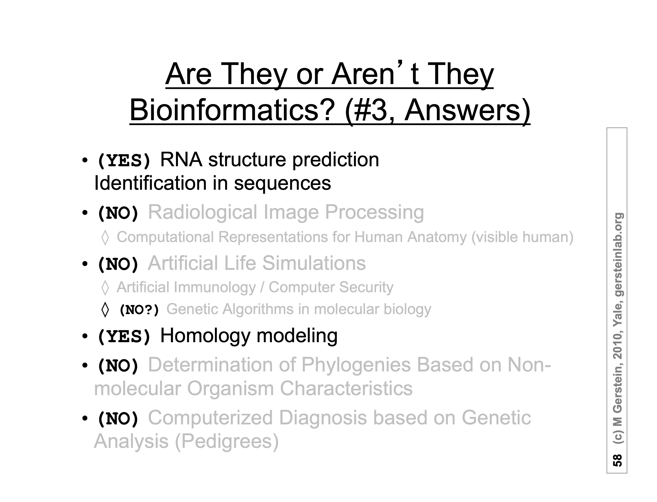

Slide 33
What does Bioinformatics have to do with Molecular Evolution?
DNA sequence -> transcription -> translation -> protein folding ->
protein function (catalytic and other properties) ->
properties of the organism(s) -> properties of the population and community
-> ecology (taking also the non biological environment into account)
Most scientists believe that the principle of reductionism (plus new laws and relations emerging on each level); however, at several steps along the way from DNA to function our understanding of the chemical and physical processes involved is so incomplete that prediction of protein function based on only a single DNA sequence and first principles is at present impossible for proteins of reasonable size.
Solution:
Use evolutionary context:
"Nothing in biology makes sense except in the light of evolution" (Theodosius Dobzhansky)
Present day proteins evolved through substitution and selection from ancestral proteins. Related proteins have similar sequence AND similar structure AND similar function.

