Slide 1
MCB3421 2024
Class 2
Basics of Molecular Biology Intro to Protein Structure

Slide 2
For Honors Conversion and/or CURE
Please let us know ASAP, if you are interested in research accompanying MCB3421. We are in the collecting interesting genes for CURE projects.
The honors conversion request form now resides in a new place. See https://honors.uconn.edu/honors-course-conversions/ for details

Slide 3
For the CURE Research Project
You will be assigned a gene that has been invaded by an intein (a type of self splicing selfish genetic element).
You will characterize the invaded gene and the intein using tools we will also use in the computer lab sessions (data bank searches to find homologs, aligning invaded and uninvaded host genes, reconstructing the evolutionary history of host gene and intein).
Questions that will be addressed: Between which organisms was the intein transferred? Is the intein invasion occurring in a geographically local environment? Was the intein frequently lost and gained?
Progress will be discussed with the instructors via email, and during and after the weekly computer lab sessions.

Slide 4
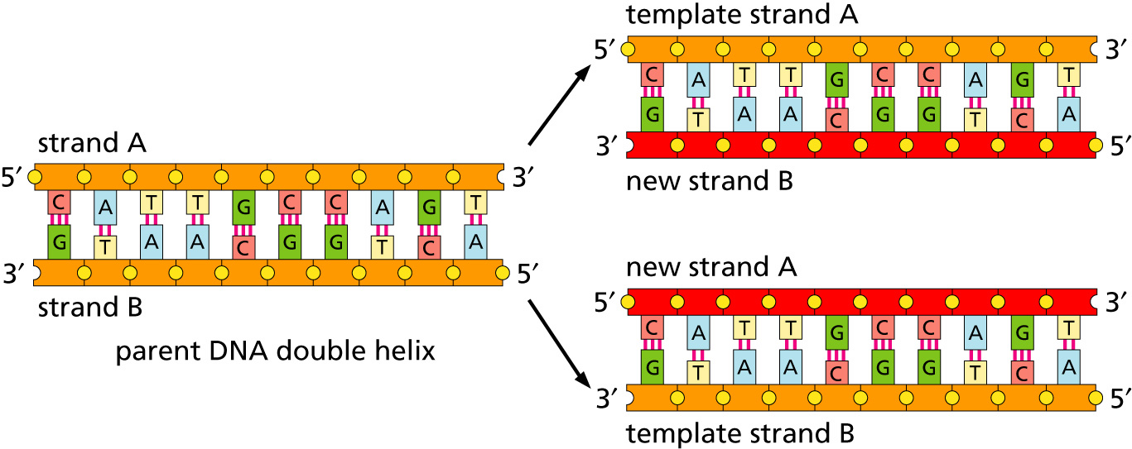
Replication
lagging and leading strand - strand bias see Drew Barry’s animation at https://www.youtube.com/watch?v=7Hk9jct2ozY at 2.30 minutes

Slide 5
Replication
https://www.youtube.com/embed/X_tYrnv_o6A?start=60
Start at 1 minute stop at 2 minutes
Drew Berry

Slide 6
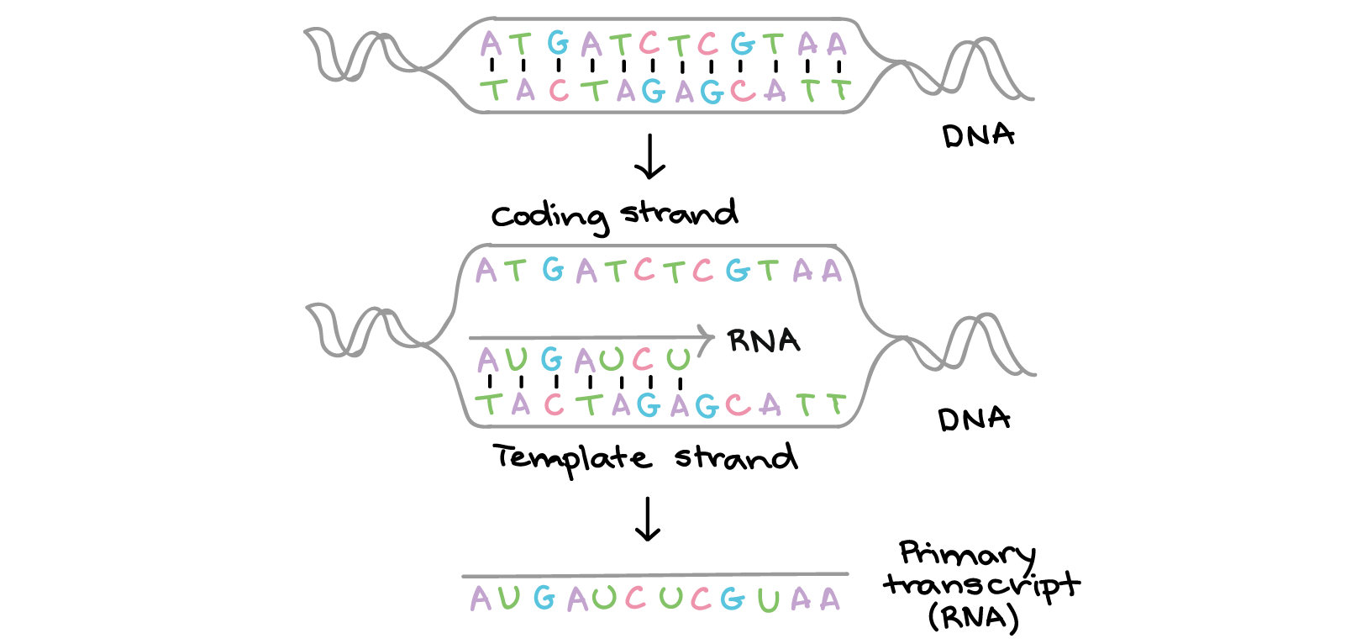
Transcription
Khan Academy, www.khanacademy.org

Slide 7
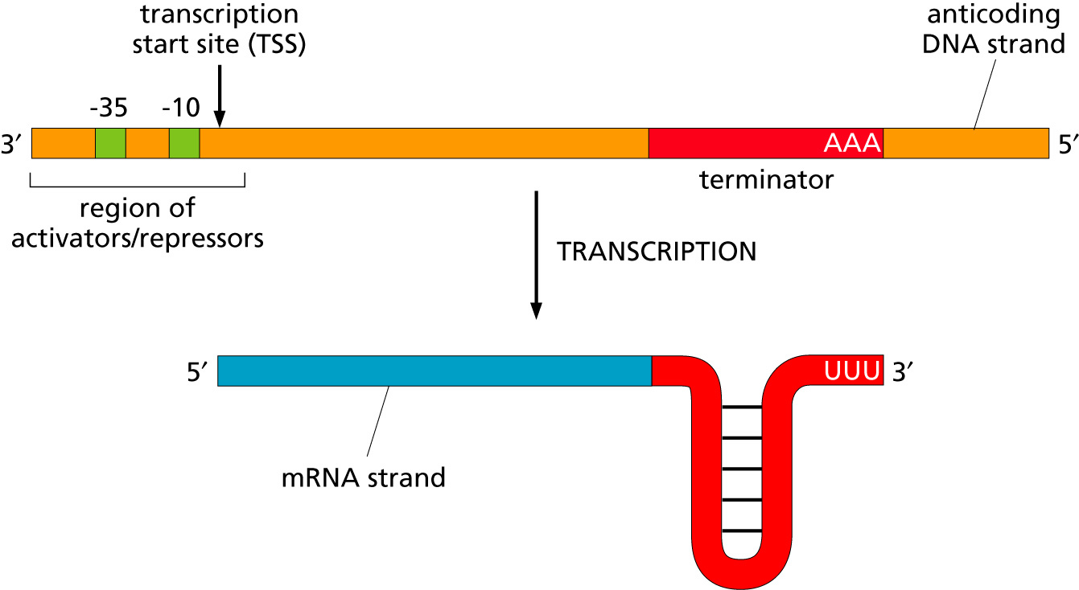
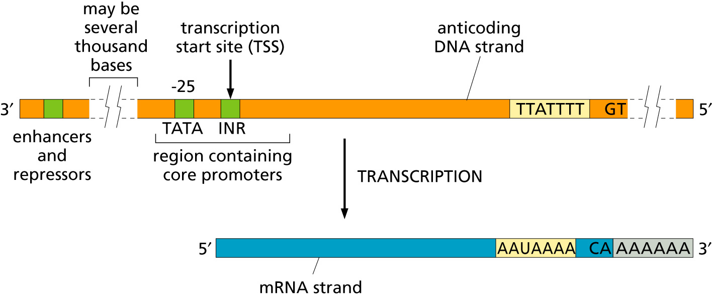
Transcription
Bacteria
Eukaryotes

Slide 8
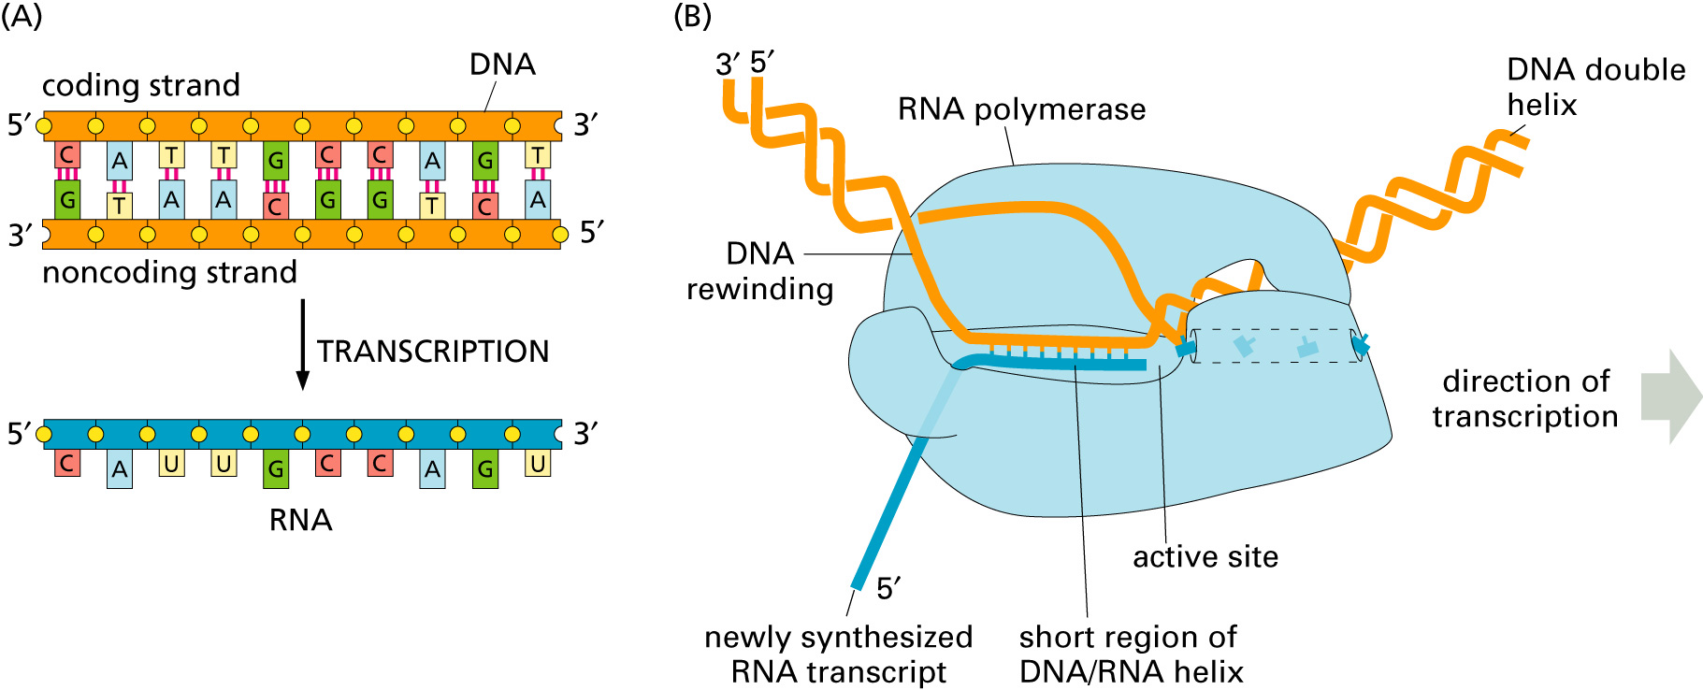
Transcription

Slide 9
https://www.youtube.com/watch?v=xSQybiea2AA
Drew Berry

Slide 10
RNA processing
Simple illustration of a pre-mRNA, with introns (top). After the introns have been removed via splicing, the mature mRNA sequence is ready for translation (bottom).
Intron types
RNA can be the catalyst

Slide 11
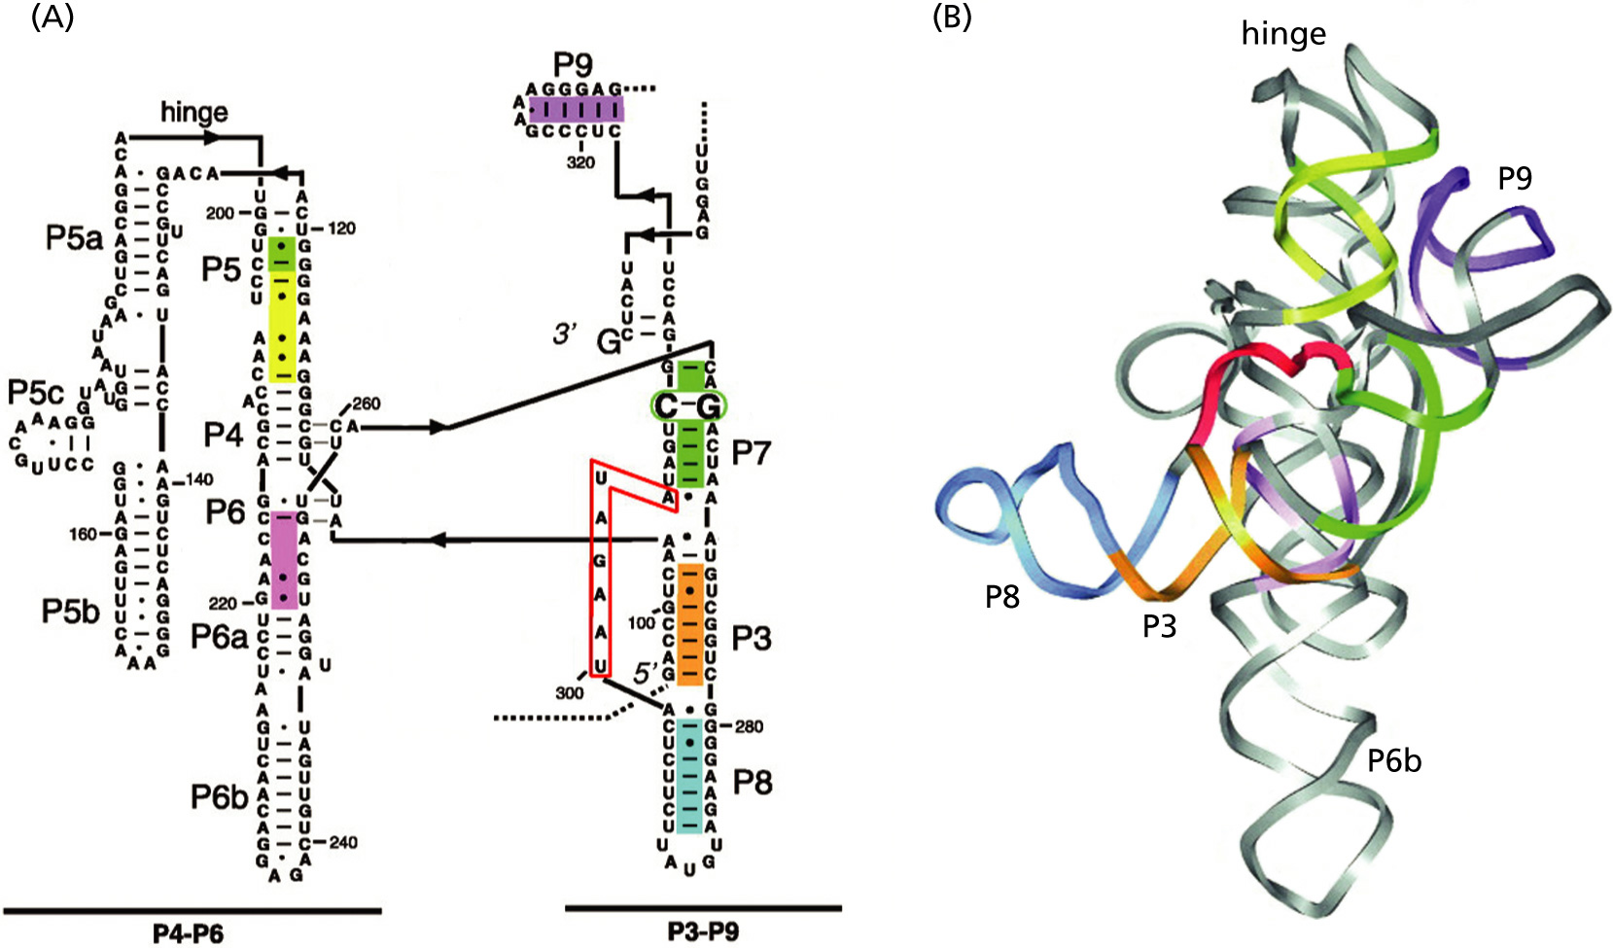
Self-splicing introns

Slide 12
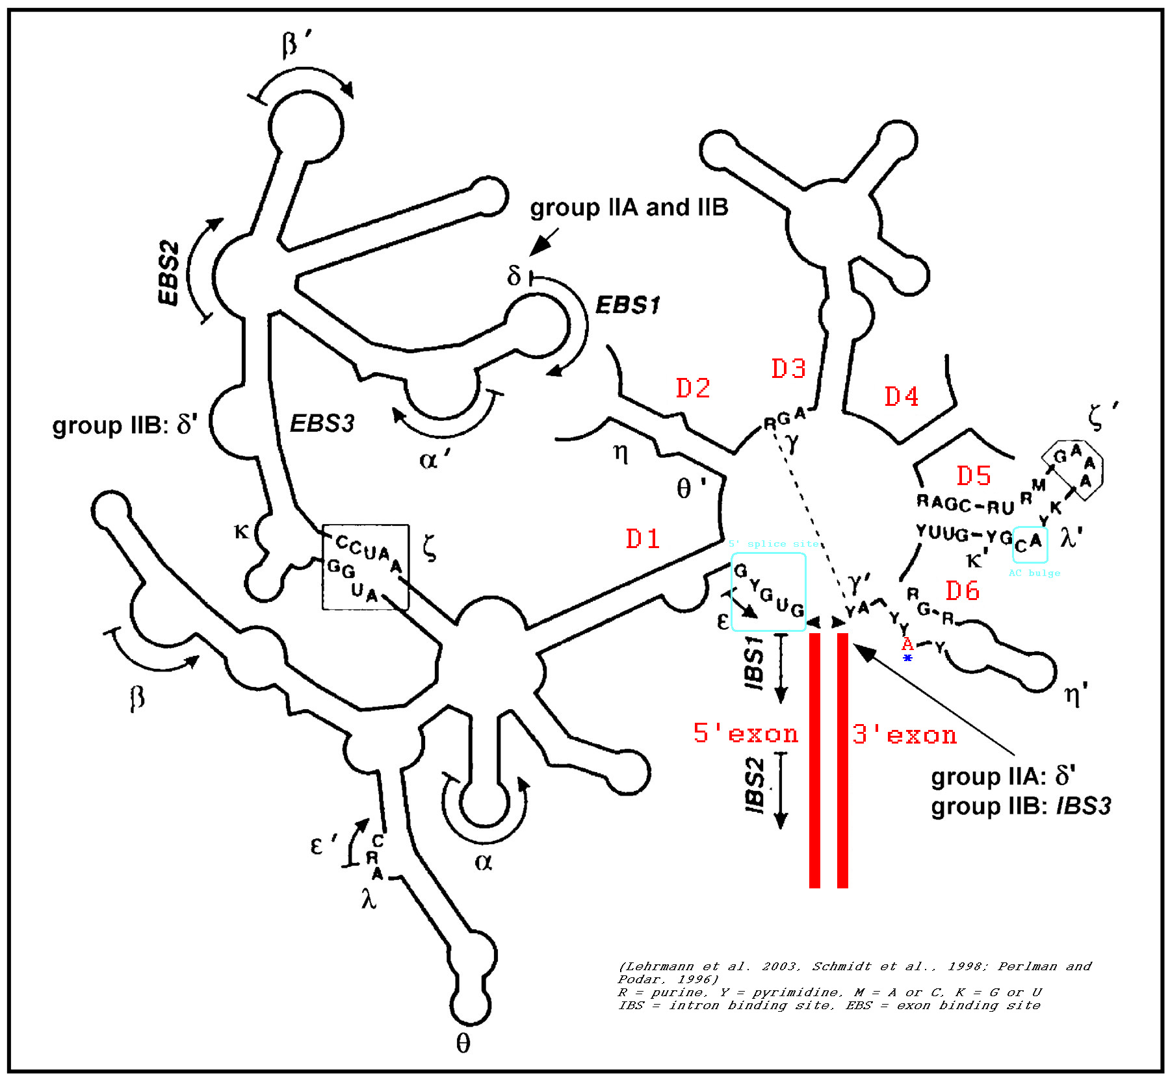
Group II intron

Slide 13
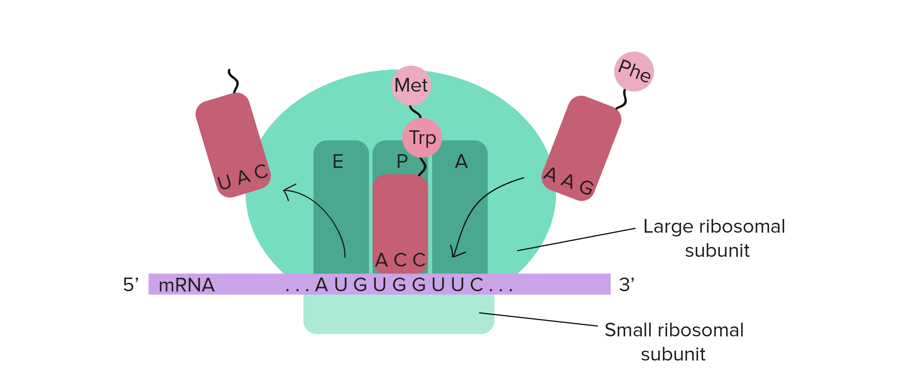
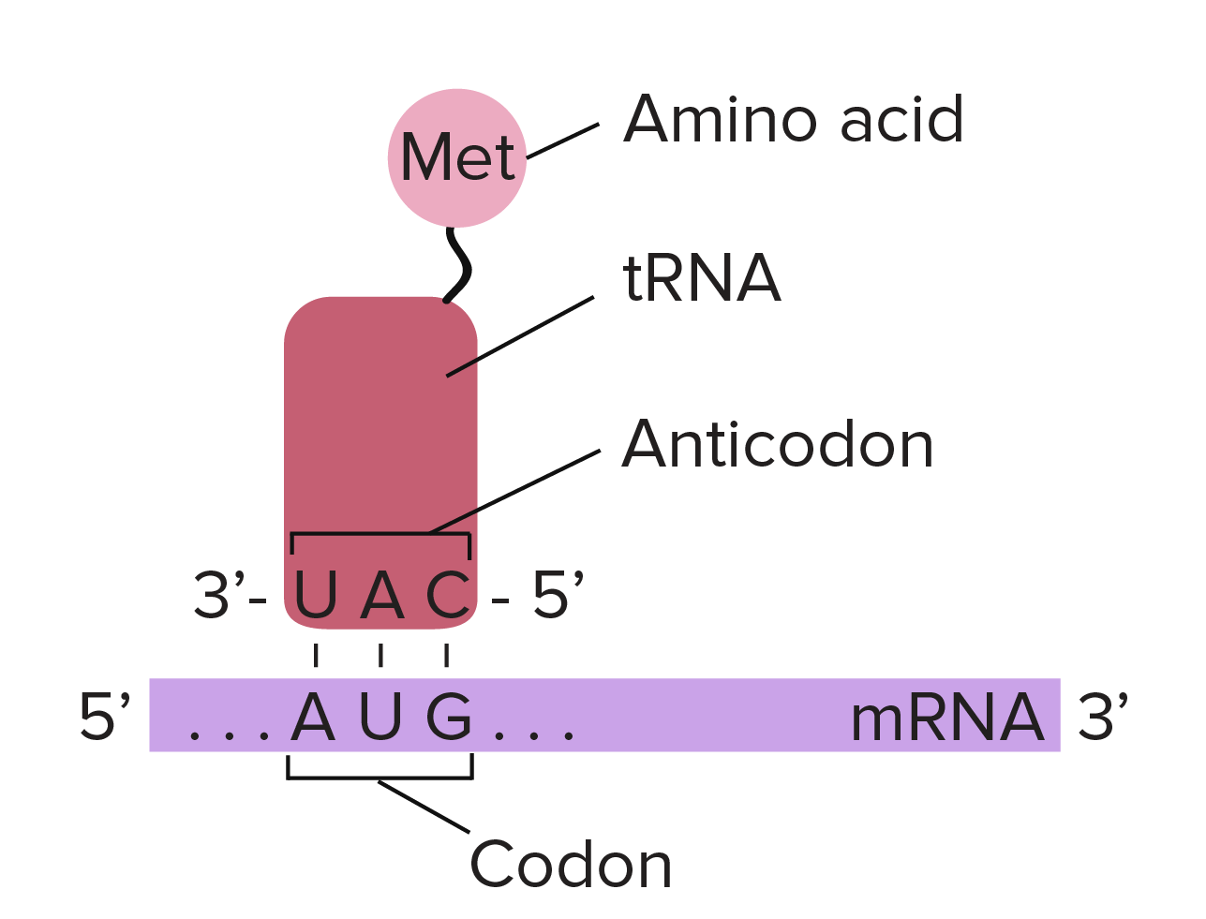
Translation

Slide 14
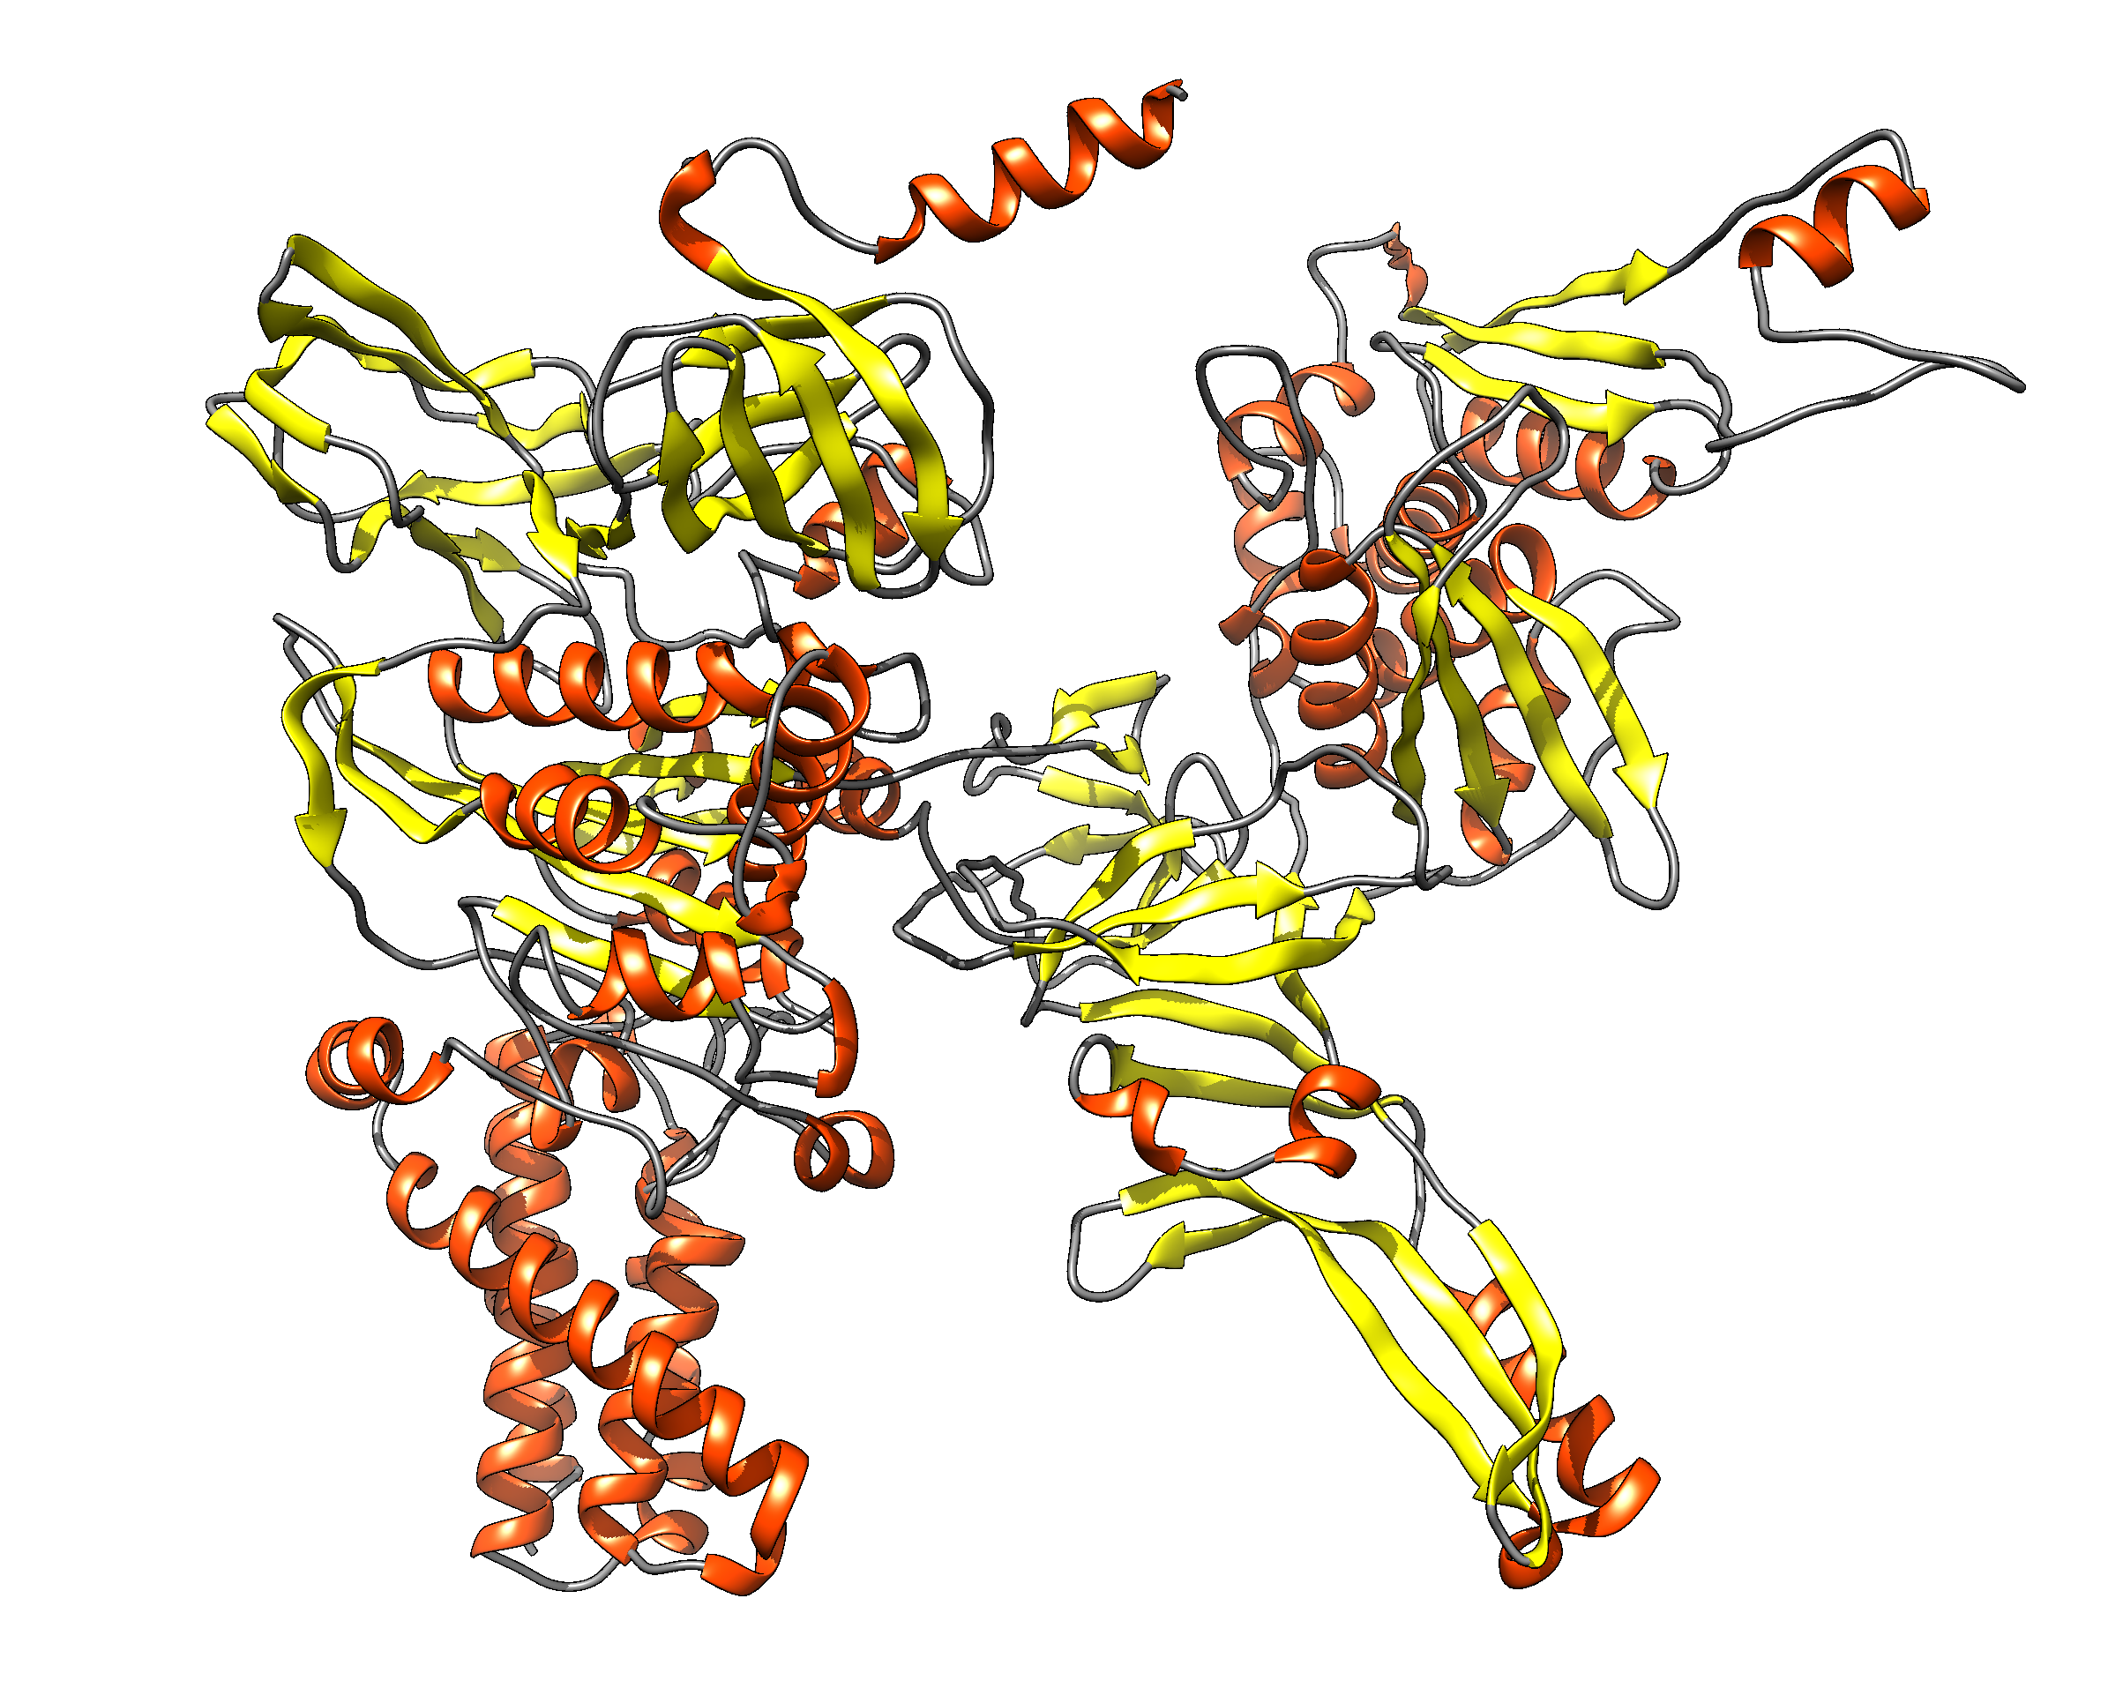
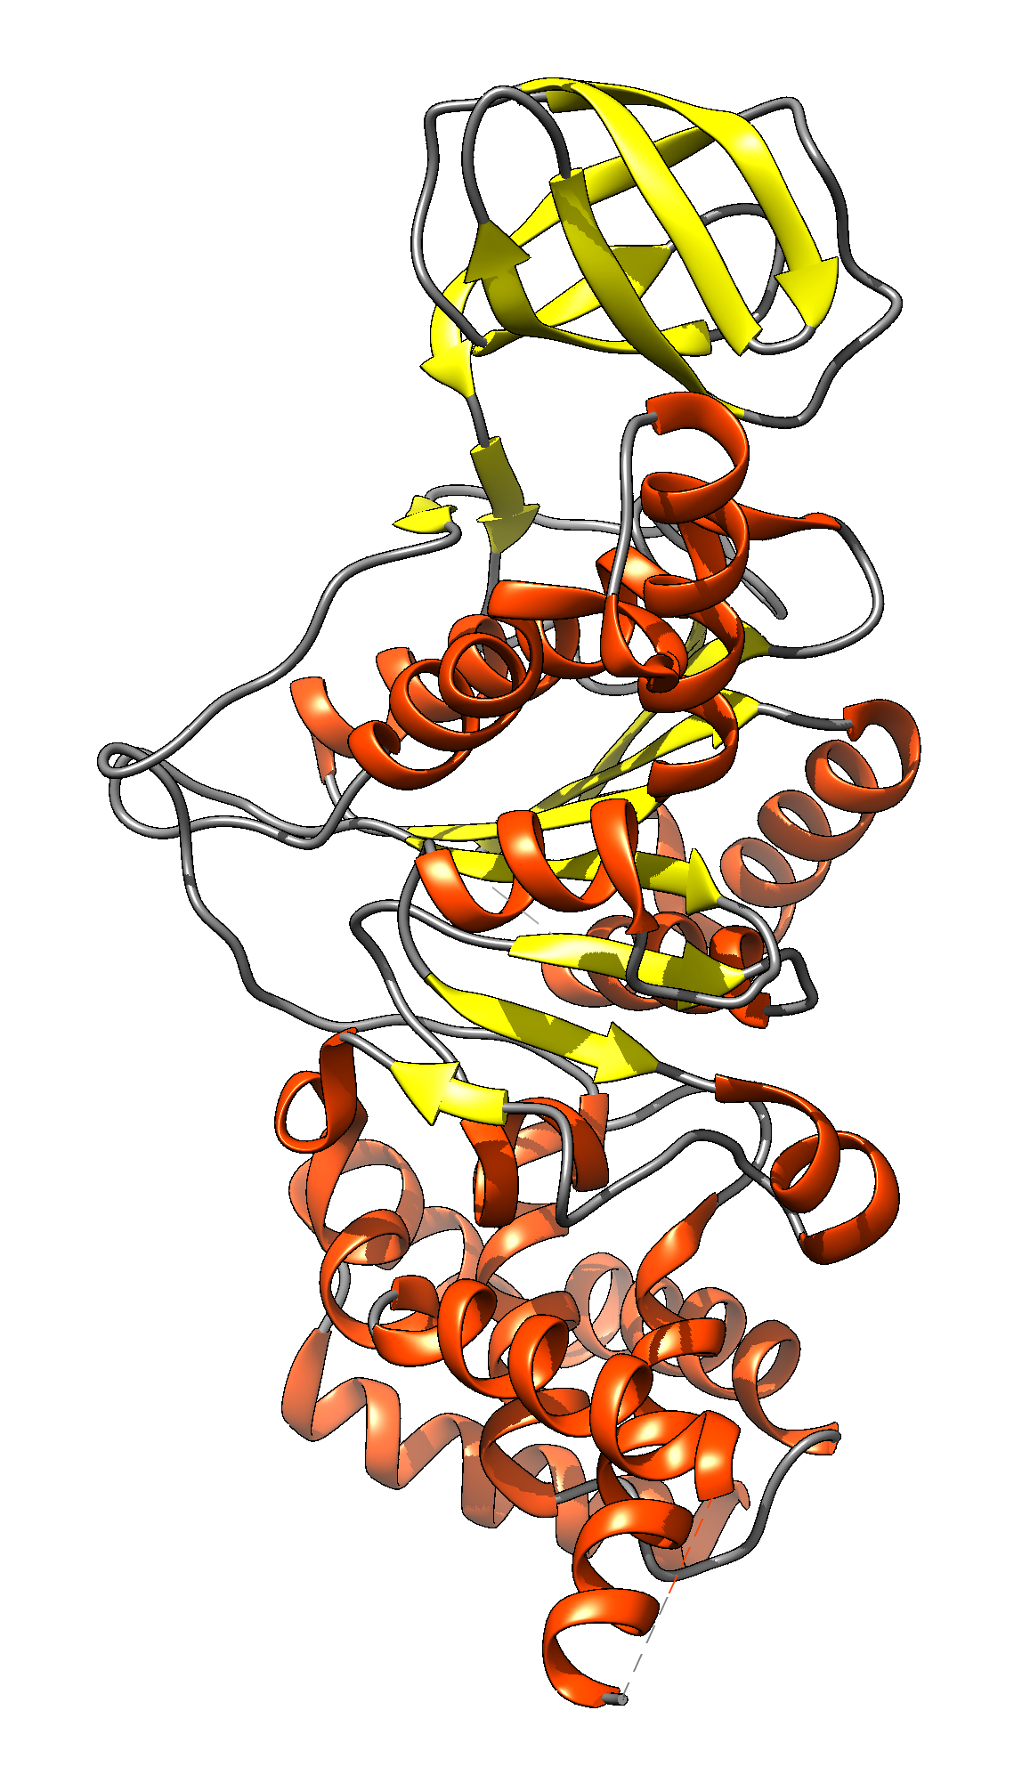
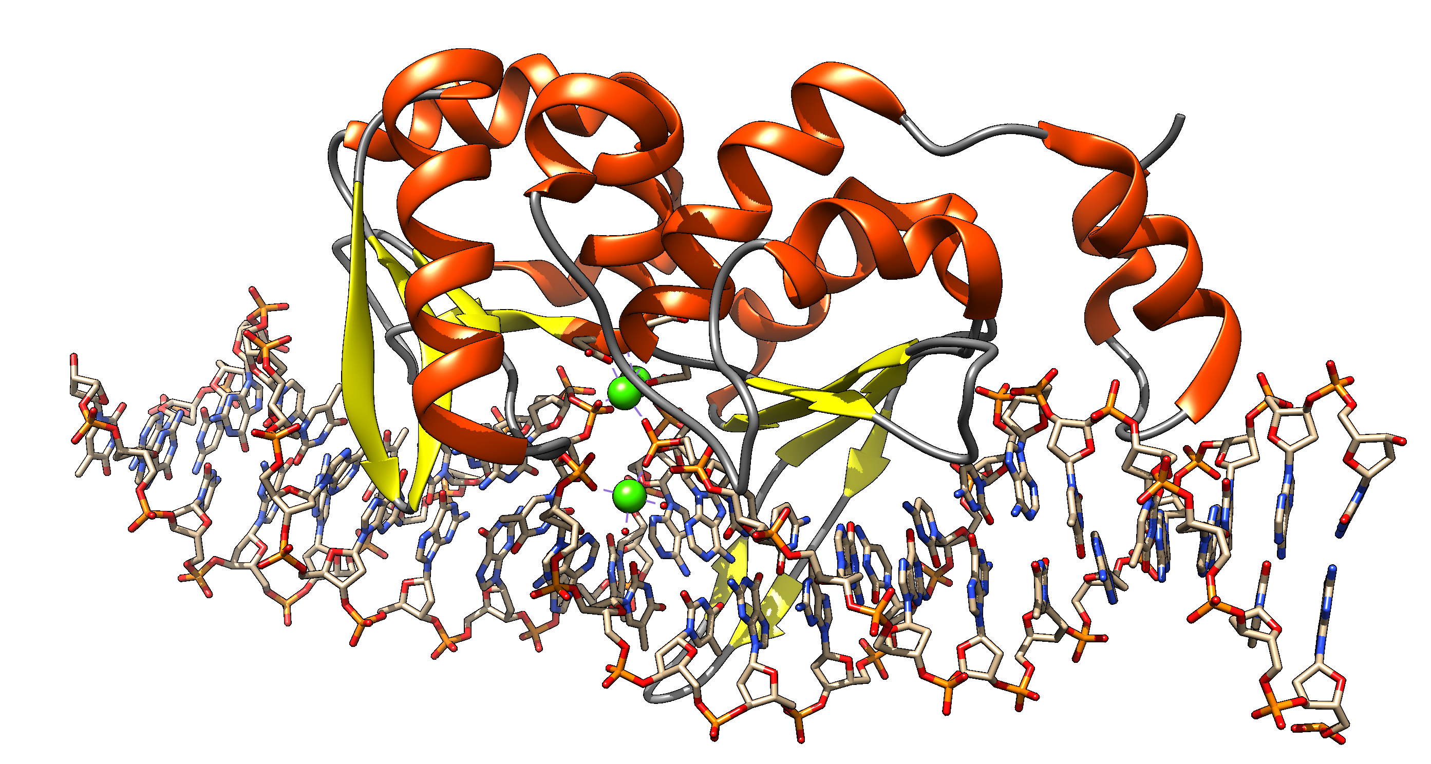
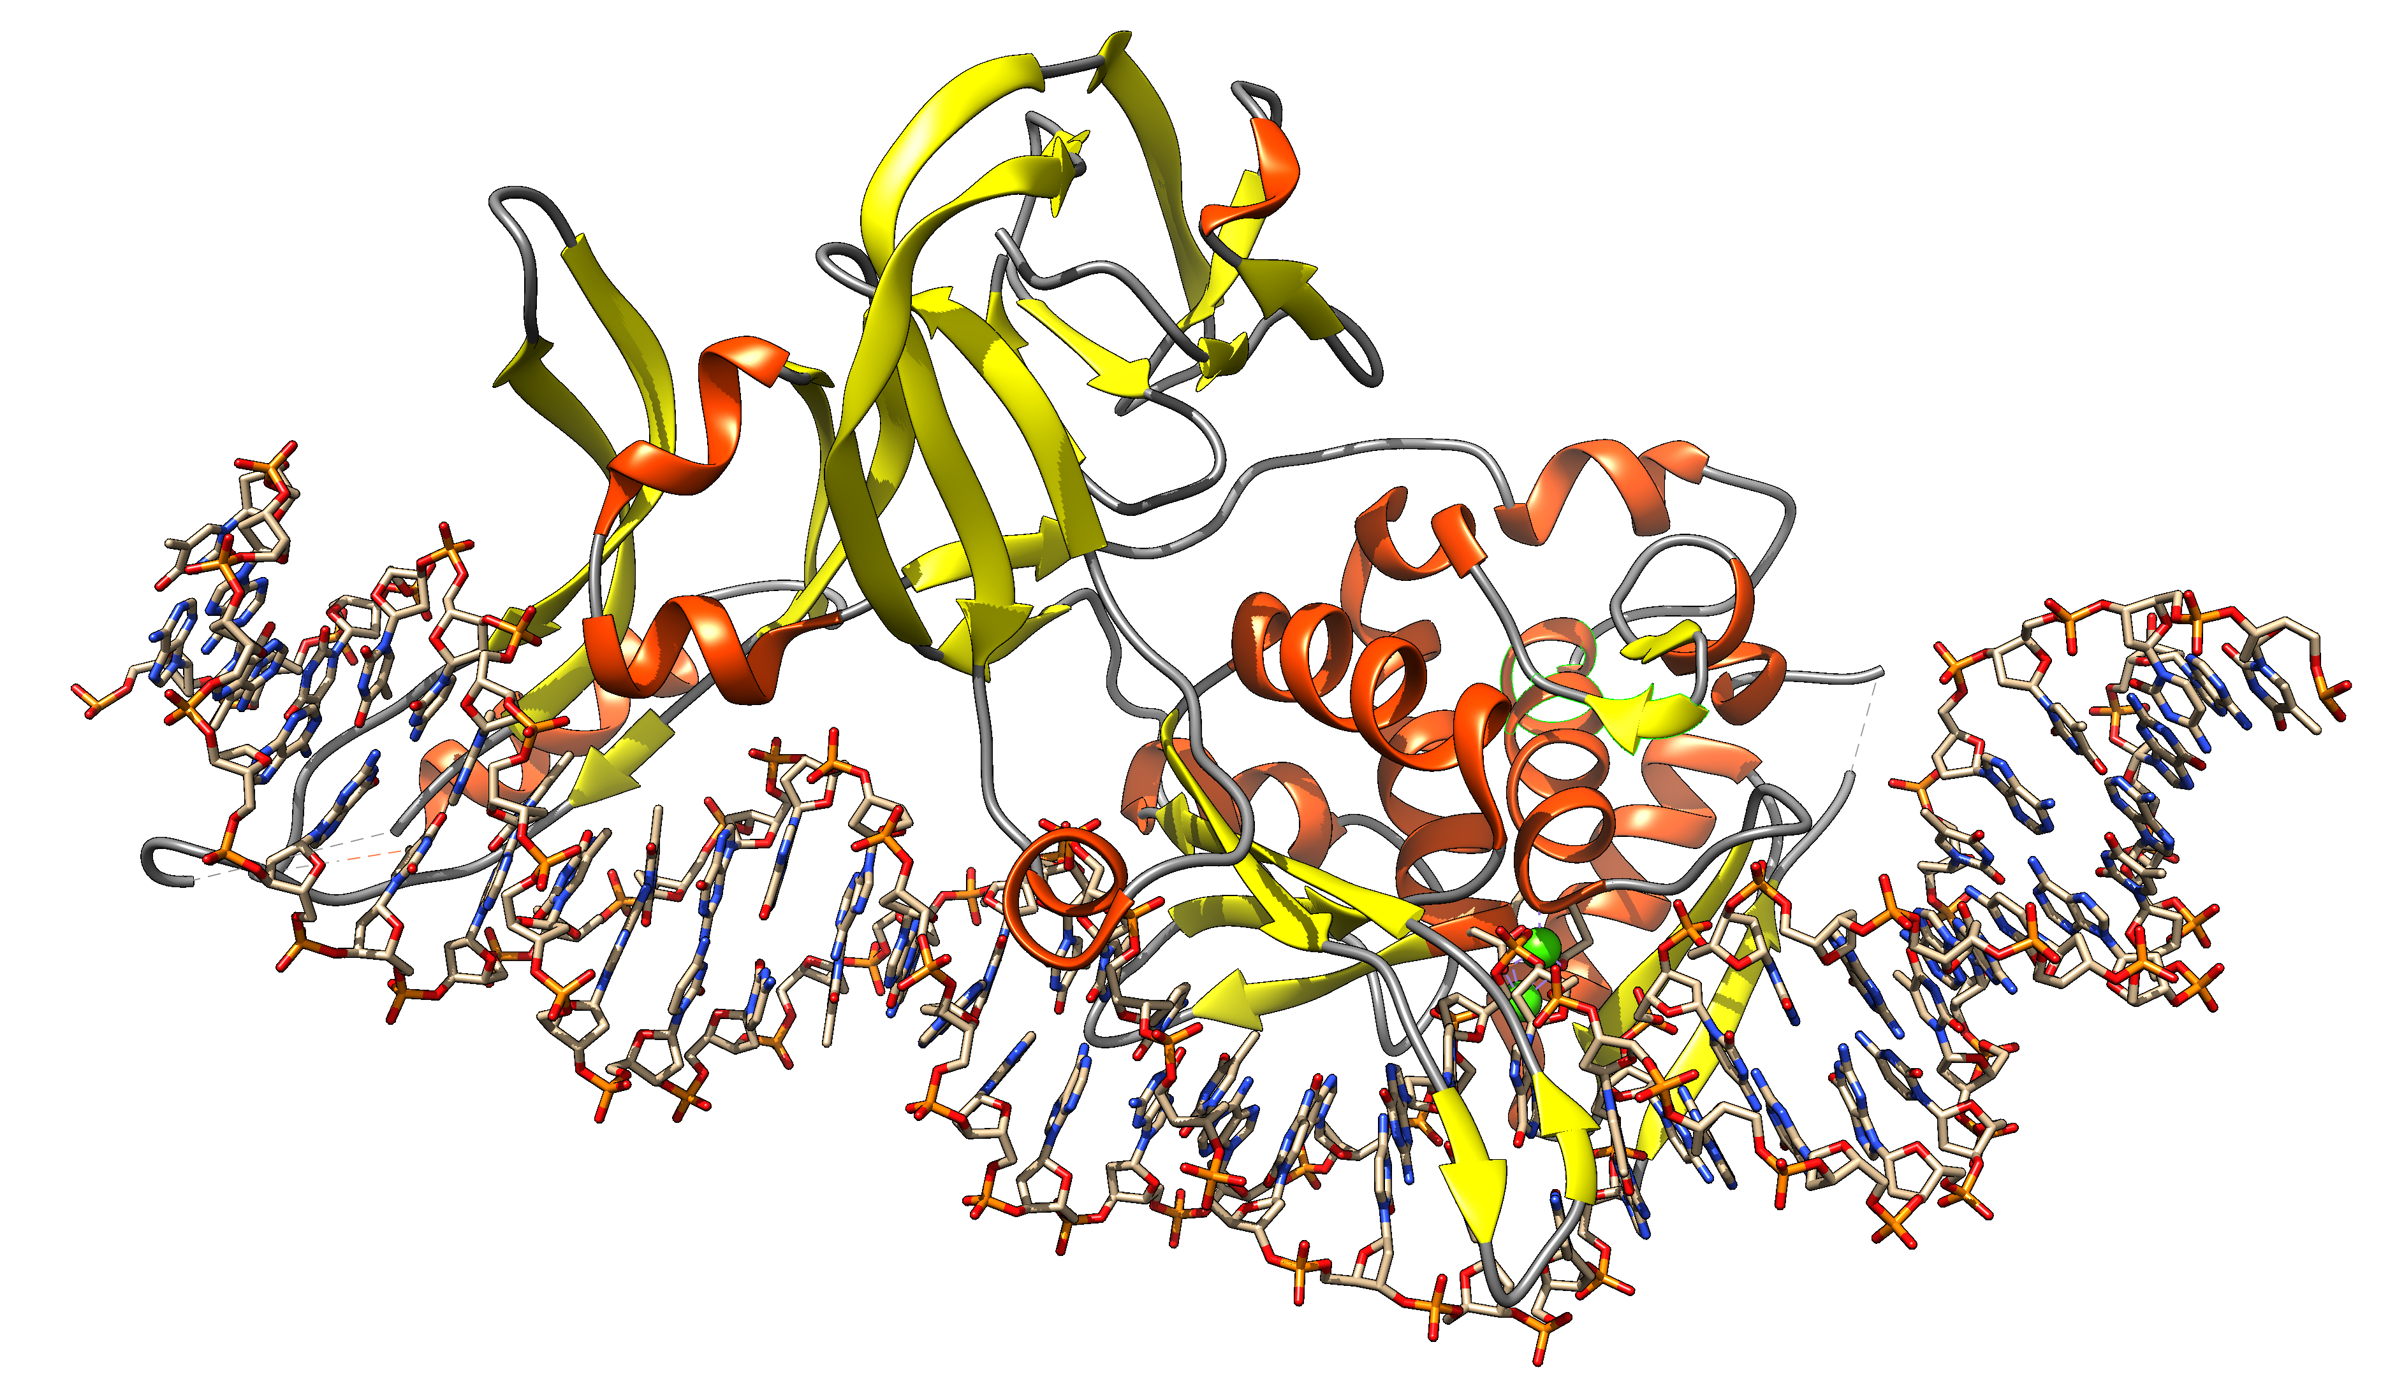
Group I Intron
Intein
Exon: Intron: ORF on Intron
Extein: Intein Splicing Domain: HE domain:
DNA
transcription
transcription
mRNA
or rRNA
translation
splicing
Exon
Intron with ORF
translation
alpha fold prediction of Sce vma1 gene product
splicing
Protein
Homing Endonuclease
1LWS.pdb
functional protein
functional protein
Intein with HE and
Splicing domain
Notes:
Structures F-ATPase chain A, SceI, https://alphafold.ebi.ac.uk/entry/P38078 and 1LWS

Slide 15
https://www.youtube.com/watch?v=WkI_Vbwn14g
Drew Berry

Slide 16
Prokarotic Gene Organization

Slide 17
Operon Organization

Slide 18
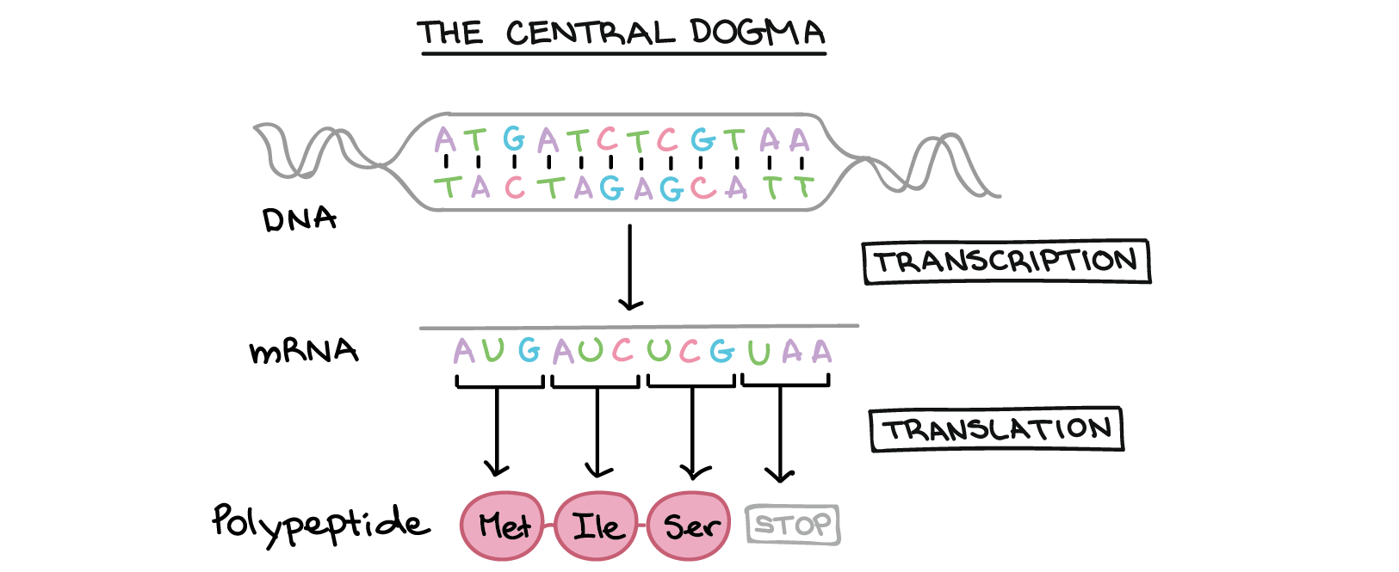
The central dogma
Why might this be wrong or incomplete
Khan Academy, www.khanacademy.org

Slide 19
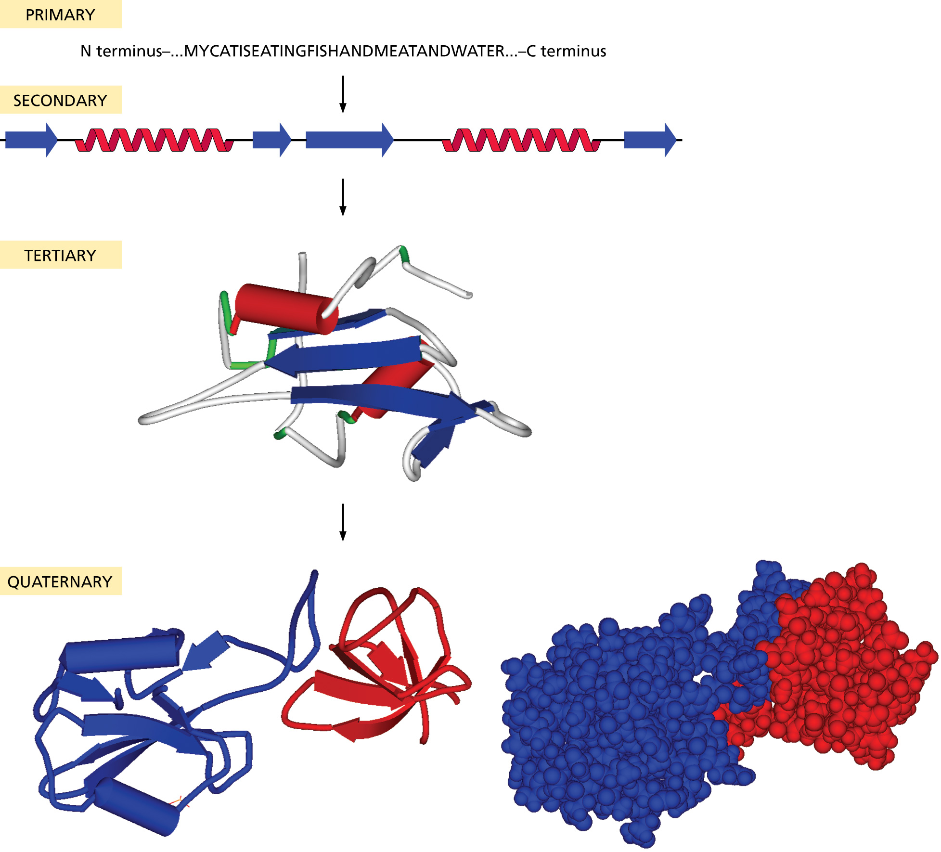
Protein structure:

Slide 20
Primary structure
20 typical amino acids from the primary sequence of a protein:
The sequence is written from the amino to the carboxy terminal

Slide 21
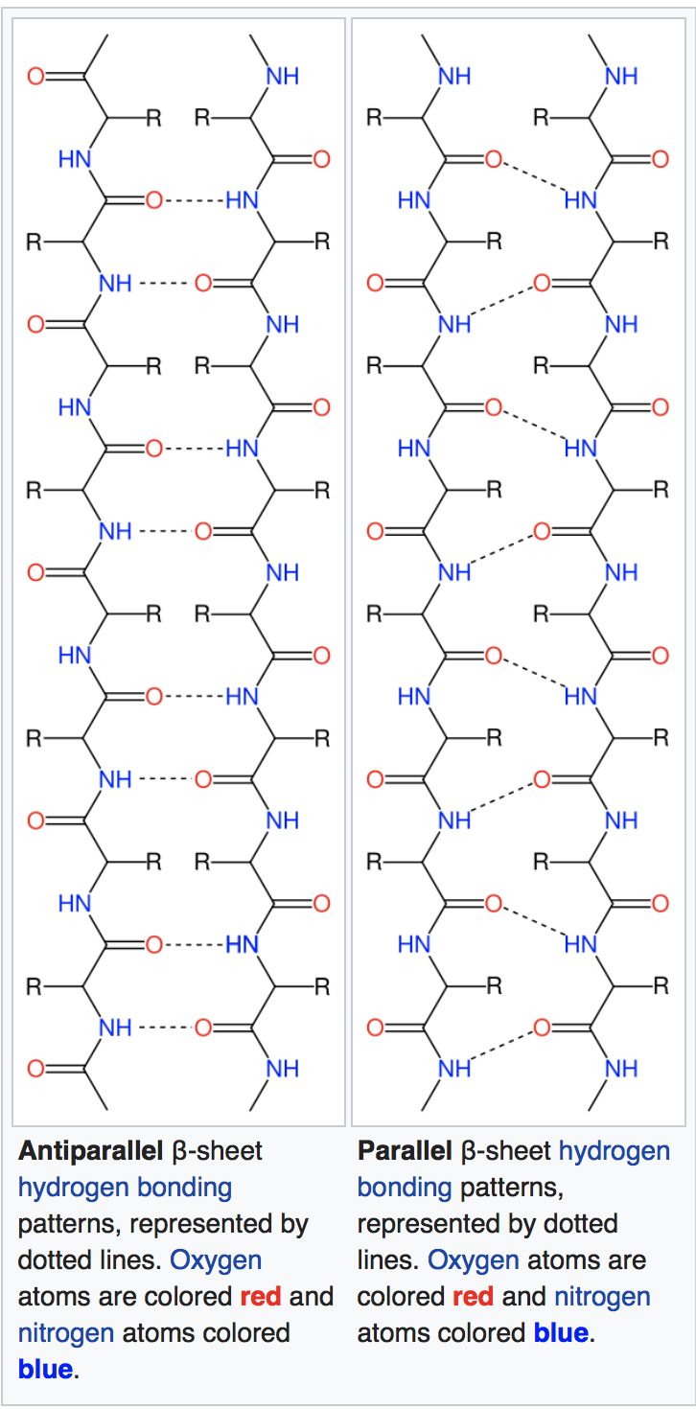
Important secondary structure elements (local folds)
Beta sheets
Often depicted as yellow arrows
From Wikipedia
https://en.wikipedia.org/wiki/Beta_sheet https://en.wikipedia.org/wiki/Beta_barrel

Slide 22
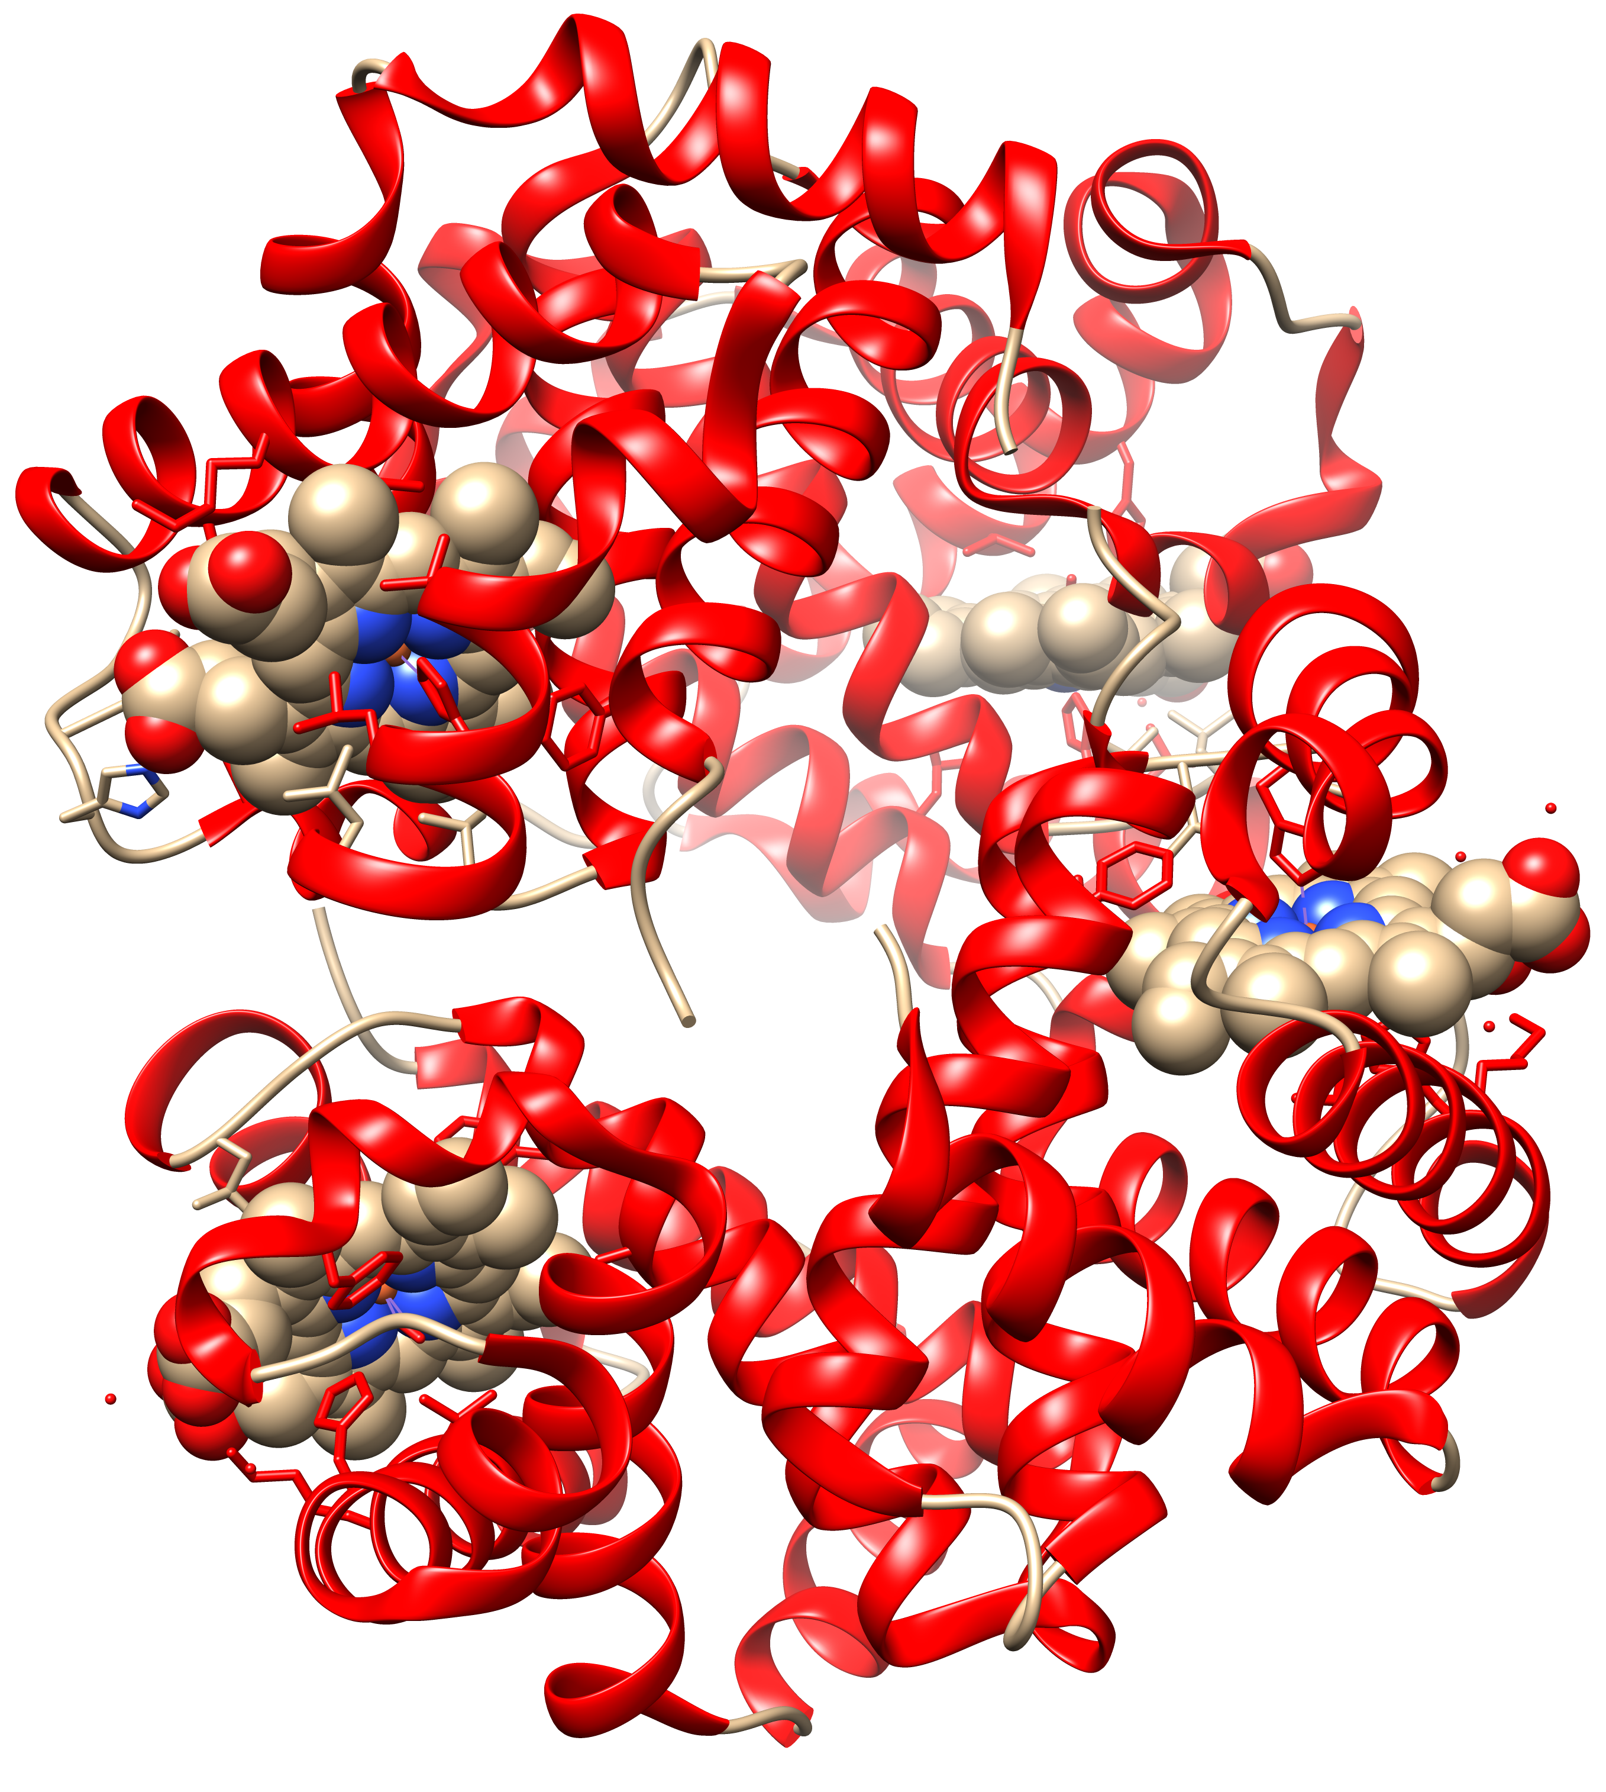
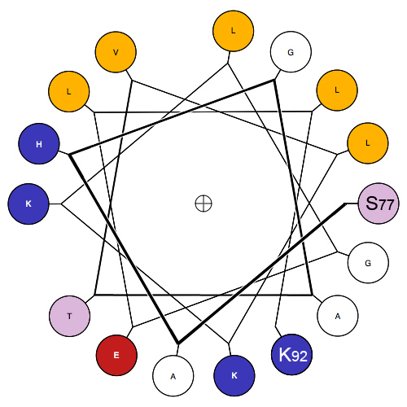
Important secondary structure elements (local folds)
Alpha Helices
Often depicted as red spirals
1GZX.pdb
Modified from Wikipedia
https://en.wikipedia.org/wiki/Alpha_helix https://en.wikipedia.org/wiki/Hemoglobin

Slide 23
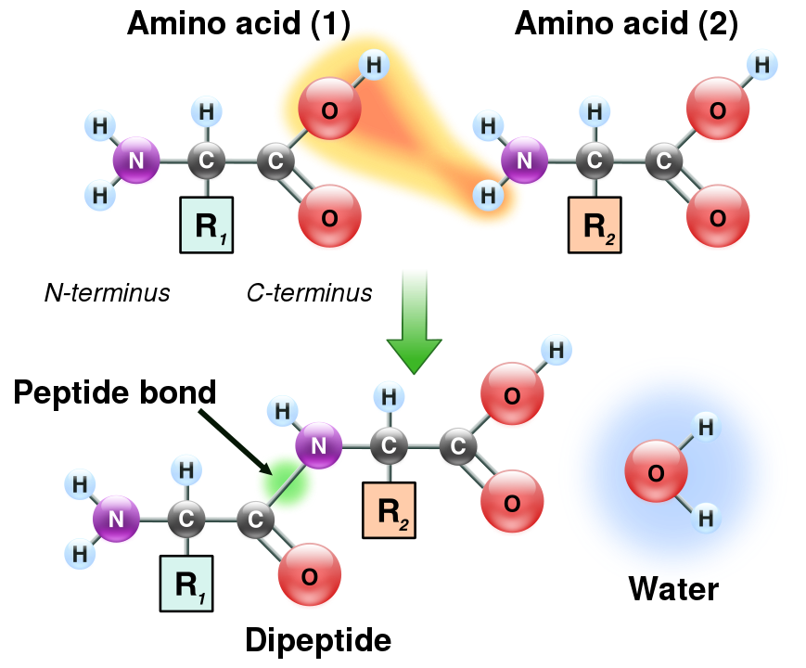
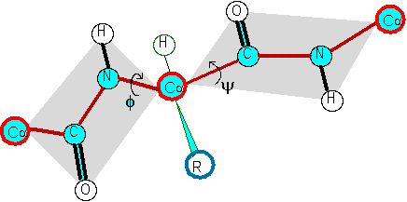
The Phi and Psi angles associated with each alpha carbon along the peptide chain
Formation of a peptide bond
φ
ψ
Illustration of the peptide plane (gray area) and φ-ψ angles. The red line formed by the repeating -Cα-C-N-Cα- is the backbone of the peptide chain.
From: https://en.wikipedia.org/wiki/Peptide_bond

Slide 24
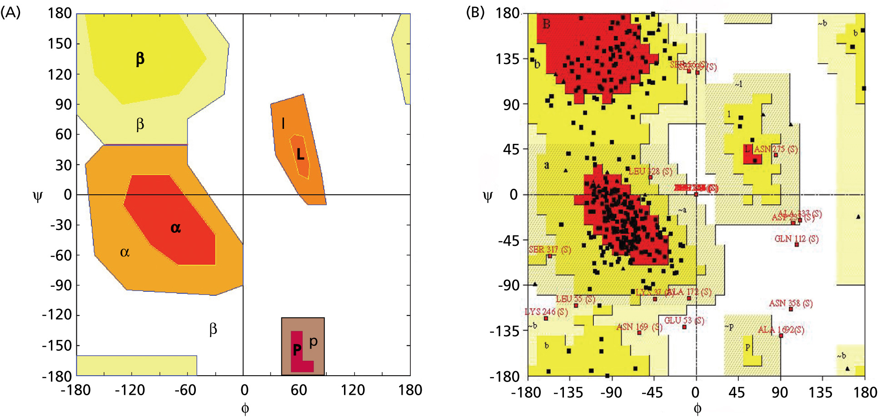
Angles in the protein backbone

Slide 25
UCSF’s Chimera
Free and powerful program to work with protein structures
Steep and long learning curve (command line and/or menu driven)
Available for free at http://www.rbvi.ucsf.edu/chimera/ and https://www.rbvi.ucsf.edu/chimerax/
Chimera is a little easier to use than chimerax, but the latter has an interface to alphafold.
Many tutorials are available on the program’s webpage and on youtube.
We will use chimeraX in the first few computer labs. If you want to use your own laptop download and install chimeraX

Slide 26
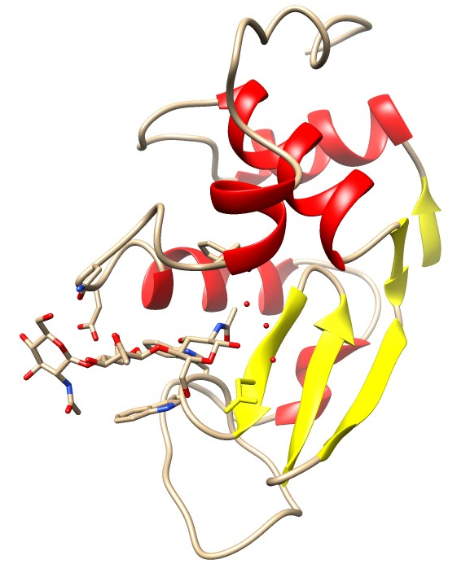
Lysozyme
Cleaves the sugar backbone on the cell wall of bacteria (which leads to exploding bacteria).
Present in tears, salvia, egg white, …
The N-acetylglucosamine (NAG) trimer is an inhibitor that binds to the catalytic site

