Slide 1
MCB3421 - 2024
Class 2

Slide 2
What does Bioinformatics have to do with Molecular Evolution?
DNA sequence -> transcription -> translation -> protein folding ->
protein function (catalytic and other properties) ->
properties of the organism(s) -> properties of the population and community
-> ecology (taking also the non biological environment into account)
Most scientists believe that the principle of reductionism (plus new laws and relations emerging on each level); however, at several steps along the way from DNA to function our understanding of the chemical and physical processes involved is so incomplete that prediction of protein function based on only a single DNA sequence and first principles is at present impossible for proteins of reasonable size.
Solution:
Use evolutionary context:
"Nothing in biology makes sense except in the light of evolution" (Theodosius Dobzhansky)
Present day proteins evolved through substitution and selection from ancestral proteins. Related proteins have similar sequence AND similar structure AND similar function.

Slide 3
"Nothing in biology makes sense except in the light of evolution"
Theodosius Dobzhansky

Slide 4
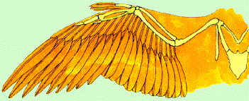
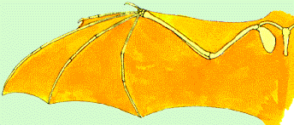
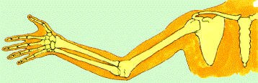
Homology
bird wing
bat wing
human arm
by Bob Friedman
homology is similarity due to shared ancestry

Slide 5
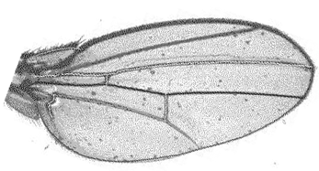
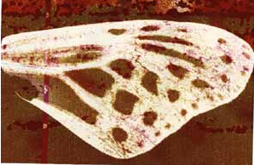
homology vs analogy
A priori sequences could be similar due to convergent evolution
Homology (shared ancestry) versus Analogy (convergent evolution)
bird wing
butterfly wing
bat wing
fly wing

Slide 6
Related proteins
Present day proteins evolved through substitution and selection from ancestral proteins.
Related proteins have similar sequence AND similar structure AND similar function (at least if they did not diverge too much).
In the above mantra "similar function" can refer to:
  identical function,
  similar function, e.g.:
    identical reactions catalyzed in different organisms; or
    same catalytic mechanism but different substrate (malic and lactic acid dehydrogenases);
    similar subunits and domains that are brought together through a (hypothetical) process called domain shuffling, e.g. nucleotide binding domains in hexokinse, myosin, HSP70, and ATPsynthases.

Slide 7
homology
Two sequences are homologous, if there existed an ancestral molecule in the past that is ancestral to both of the extant sequences
Homology is a "yes" or "no" character (don't know is also possible as is very likely).
Either sequences (or characters) share ancestry or they don't (like pregnancy). Molecular biologist often use homology as synonymous to similarity or percent identity. One often reads: sequence A and B are 70% homologous.
To an evolutionary biologist this sounds as wrong as 70% pregnant.
Important types of Homology
Orthology: bifurcation in molecular tree reflects speciation
Paralogy: bifurcation in molecular tree reflects gene duplication
other types of homology that are often distinguished are
synology (due to genome fusion) and xenology (due to gene transfer)
Notes:
See the article from Walter Fitch on Homology. Available in reading materials on HuskyCT.

Slide 8
Sequence Similarity vs Homology
The following is based on observation and not on an a priori truth:
If two (complex) sequences show significant similarity in their primary sequence, they have shared ancestry (i.e. they are homologs), and probably similar function (although some proteins acquired radically new functional assignments, lense crystalline).

Slide 9
The Size of Protein Sequence Space
(back of the envelope calculation)
Consider a protein of 600 amino acids.
Assume that for every position there could be any of the twenty possible amino acid.
Then the total number of possibilities is 20 choices for the first position times 20 for the second position times 20 to the third .... = 20 to the 600 = 4*10⁷⁸⁰ different proteins possible with lengths of 600 amino acids.
For comparison: the universe contains only about 10⁸⁹ protons and has an age of about 5*10¹⁷ seconds or 5*10²⁹ picoseconds.
If every proton in the universe were a super-computer that explored one possible protein sequence per picosecond, we only would have explored 5*10¹¹⁸ sequences, i.e. a negligible fraction of the possible sequences with length 600 (one in about 10⁶⁶²).

Slide 10
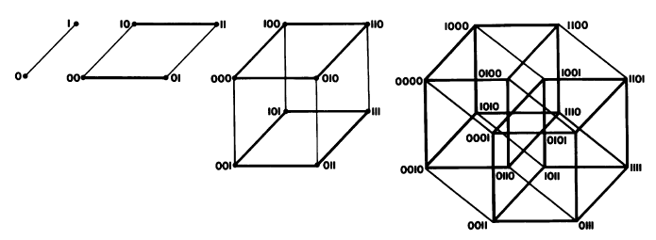
Ways to construct sequence Space
Figure from Eigen et al. 1988 illustrating the construction of a high dimensional sequence space. Each additional sequence position adds another dimension, doubling the diagram for the shorter sequence. Shown is the progression from a single sequence position (line) to a tetramer (hypercube). A four (or twenty) letter code can be accommodated either through allowing four (or twenty) values for each dimension (Rechenberg 1973; Casari et al. 1995), or through additional dimensions (Eigen and Winkler-Oswatitsch 1992).
Eigen, M. and R. Winkler-Oswatitsch (1992). Steps Towards Life: A Perspective on Evolution. Oxford; New York, Oxford University Press.
Eigen, M., R. Winkler-Oswatitsch and A. Dress (1988). "Statistical geometry in sequence space: a method of quantitative comparative sequence analysis." Proc Natl Acad Sci U S A 85(16): 5913-7
Casari, G., C. Sander and A. Valencia (1995). "A method to predict functional residues in proteins." Nat Struct Biol 2(2): 171-8
Rechenberg, I. (1973). Evolutionsstrategie; Optimierung technischer Systeme nach Prinzipien der biologischen Evolution. Stuttgart-Bad Cannstatt, Frommann-Holzboog.
Notes:
SEQUENCE EVOLUTION CAN BE CONSIDERED A WALK THROUGH THE SPARSLY POPULATED SEQUENCE SPACE

Slide 11
Size of protein space versus connectivity:
While the size of the combinatoric space for proteins is unimaginable (for 600 amino acid long proteins this space has 4*10⁷⁸⁰ vertices),
this space is also highly connected, that is, it takes less than 600 steps (counting a muatation of an amino acid in the sequence as a step)
to get from an arbitrary point in this space to any other arbitrary point.

Slide 12
no similarity vs no homology
If two (complex) sequences show significant similarity in their primary sequence, they have shared ancestry, and probably similar function.
>>> THE REVERSE IS NOT TRUE !! <<<
PROTEINS WITH THE SAME OR SIMILAR FUNCTION DO NOT ALWAYS SHOW SIGNIFICANT SEQUENCE SIMILARITY
for one of two reasons:
a) they evolved independently (e.g. different types of nucleotide binding sites), i.e. they are not homologous;
or
b) they underwent so many substitution events that there is no readily detectable similarity remaining; i.e. they are homologous, but the homology can no longer be inferred from the similarity of the primary sequence (too many substitutions;
Corollary: PROTEINS WITH SHARED ANCESTRY DO NOT ALWAYS SHOW SIGNIFICANT SIMILARITY.

Slide 13
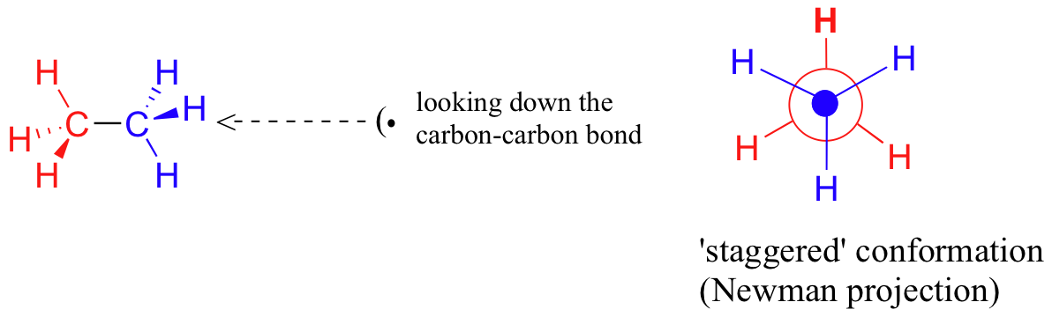
The space of of possible protein folds
According to the rules of combinatorics, an astronomical number of possible different amino acid sequences exists sequences.
Levinthal estimated the possible number of conformations for a given protein sequence also is astronomical.
He calculated that a protein with 100 amino acids has 99 peptide bonds, each with a phi and psi angles, resulting in a total of 198 angles around which the peptide backbone can rotate. If each of these can exist in three possible energetic minima (the sidechains are staggered), one arrives at 3¹⁹⁸ = 3•10⁹⁴ possible conformations.
Levinthal's paradox says: If a protein would randomly explore all possible conformations, it would require a time longer than the age of the universe to arrive at its correct native conformation.

Slide 14
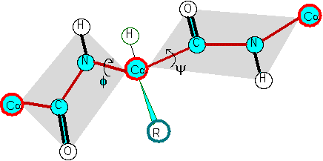
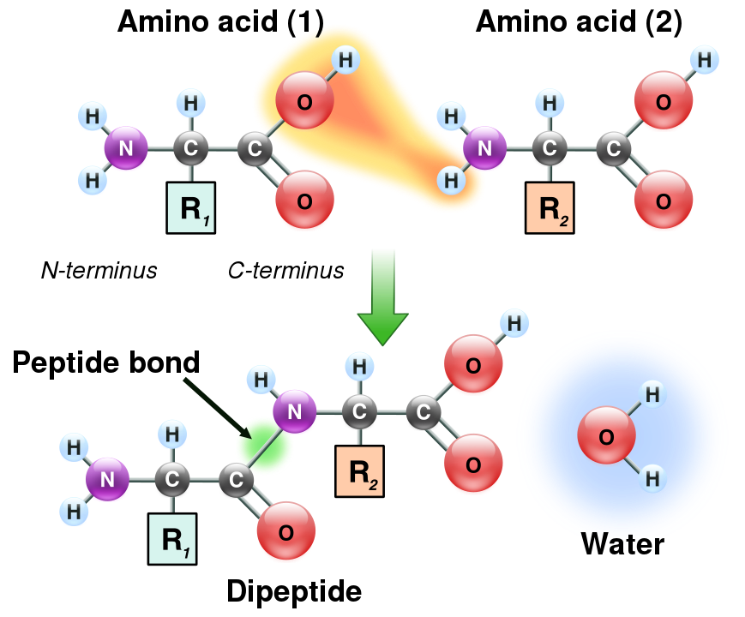
The Phi and Psi angles associated with each alpha carbon along the peptide chain
Formation of a peptide bond
φ
ψ
Illustration of the peptide plane (gray area) and φ-ψ angles. The red line formed by the repeating -Cα-C-N-Cα- is the backbone of the peptide chain.
From:
https://en.wikipedia.org/wiki/Peptide_bond

Slide 15
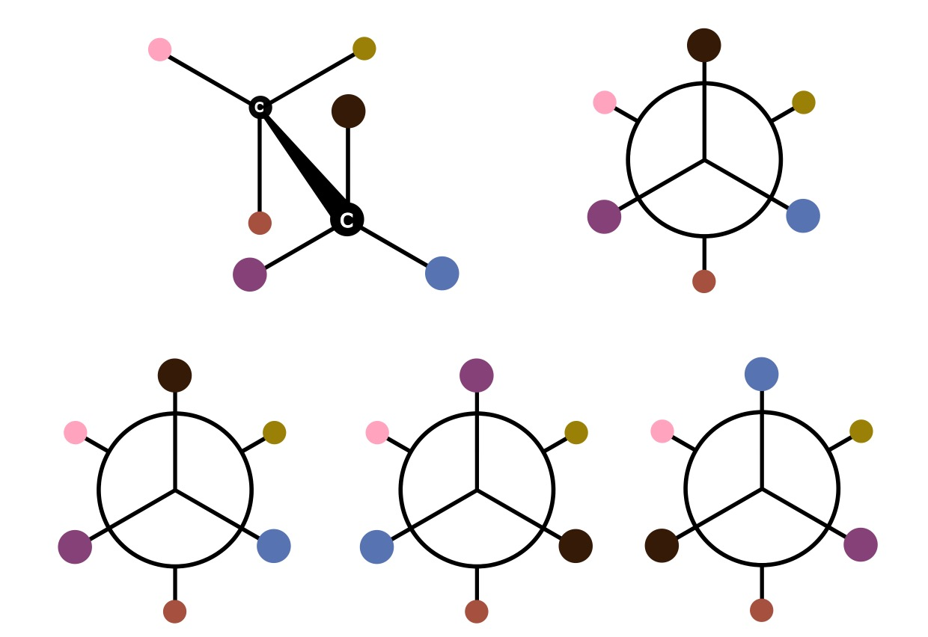
The three staggered conformations of a C-C bond. The 6 residues are indicated by different colors.

