Slide 1
MCB 3421 2024
Class 3
Discussion of Computer lab #1
and
Assignments

Slide 2
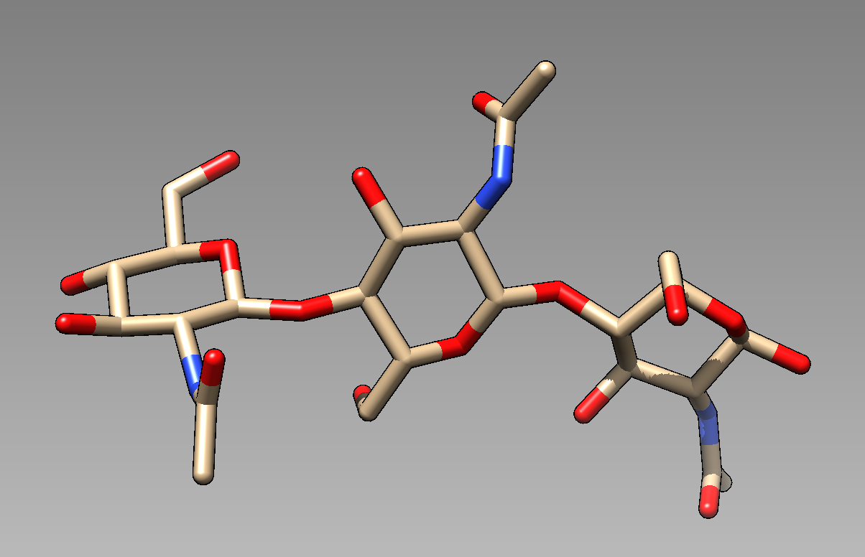
Which is the central /middle NAG?

Slide 3
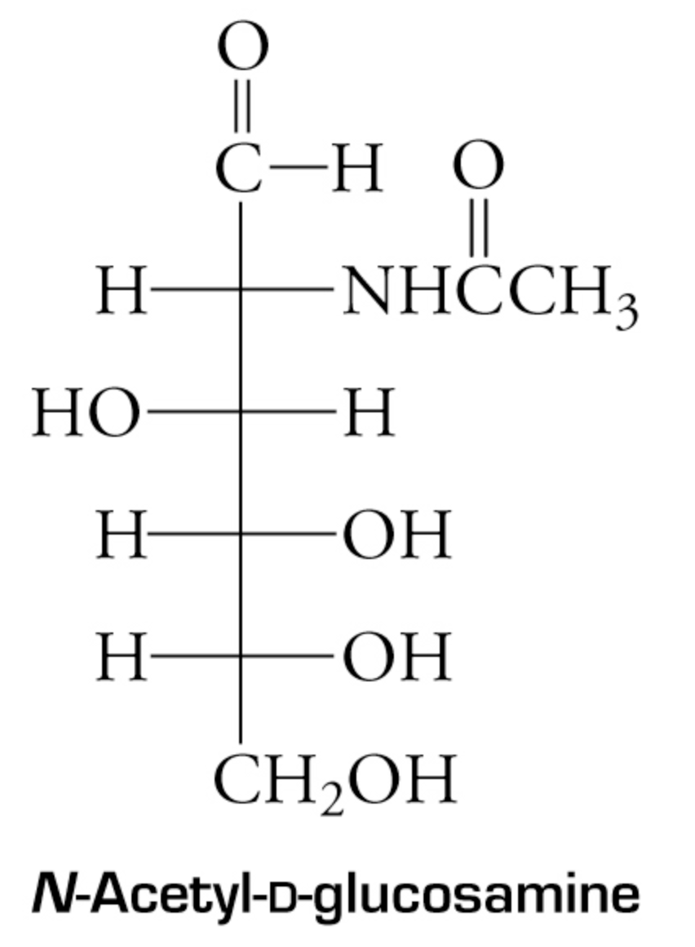
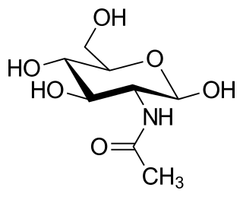
3
2
4
1
5
6
Fisher projection
beta 1-4 glycosidic bonds

Slide 4
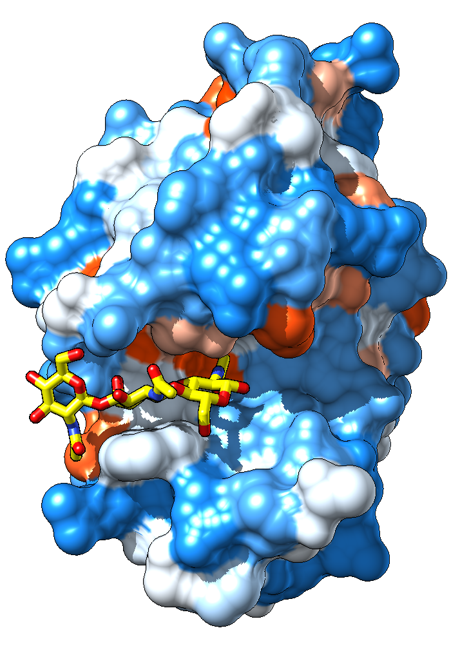
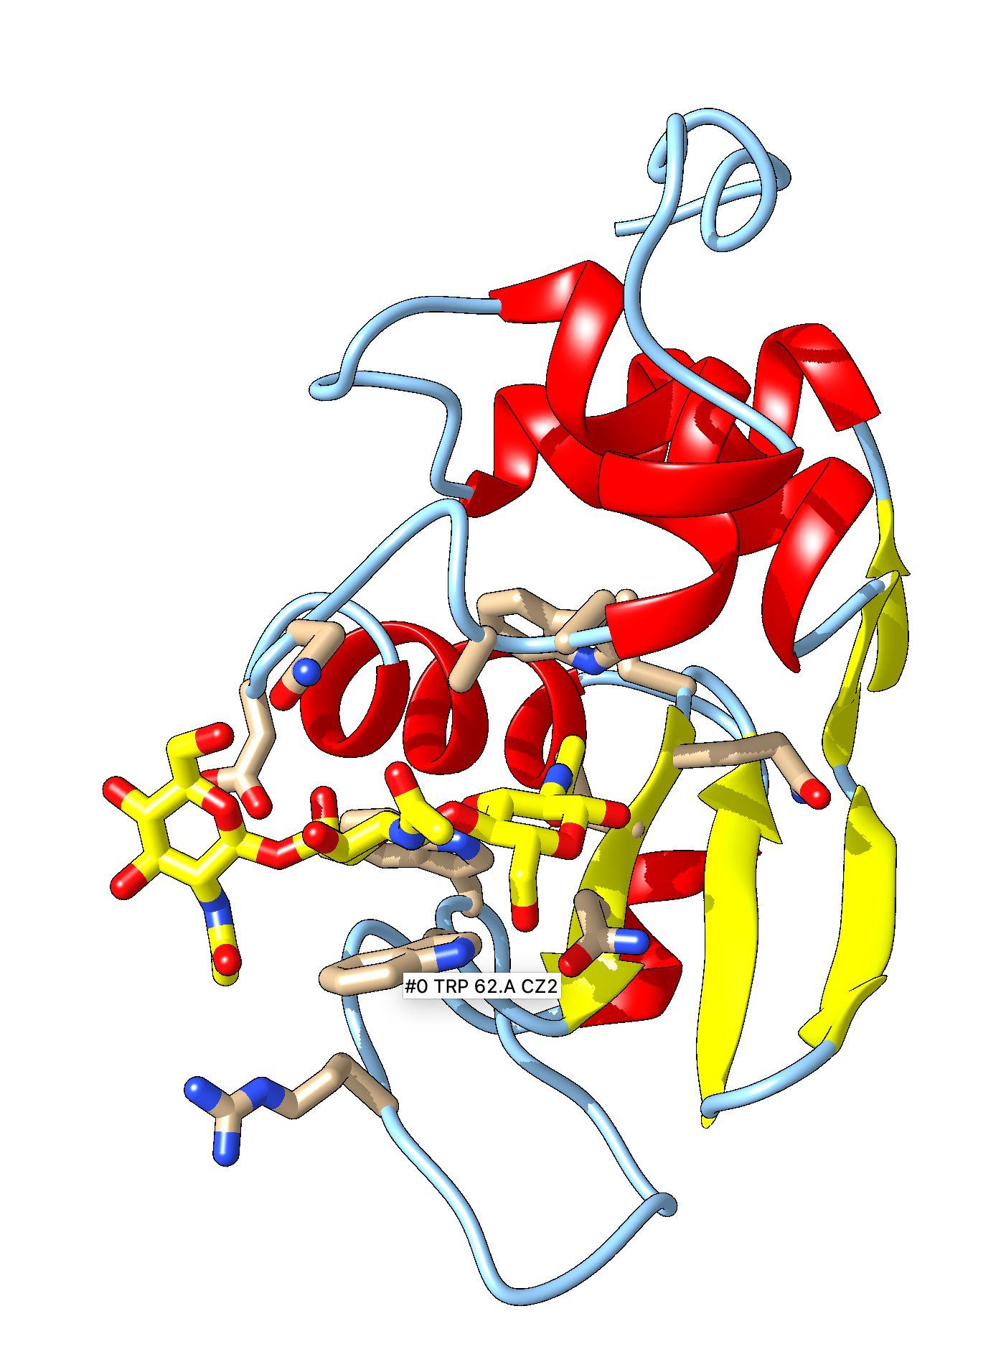
1HEW Colomb surface with NAG
blue: negative, red: positive

Slide 5
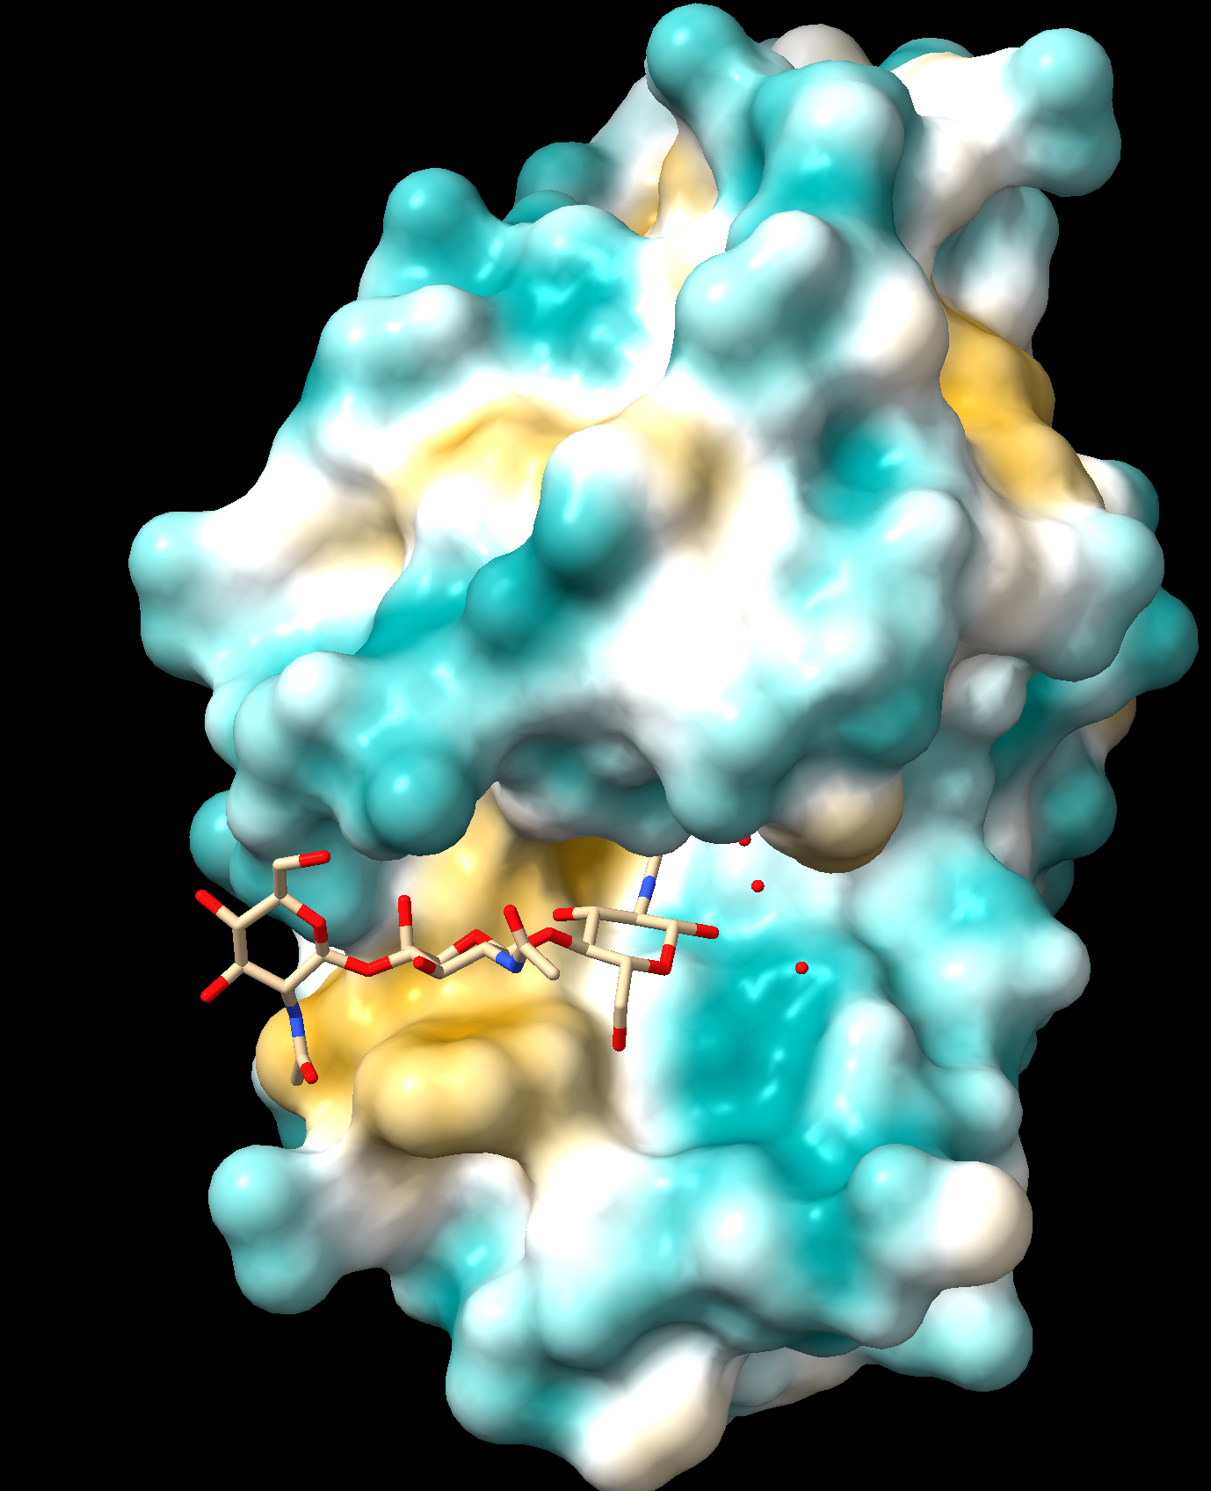
1HEW hydrophilicity surface with NAG
brown: hydicrophob, turquoise: hydrophilic

Slide 6
The Ramachandran Plot

Slide 7
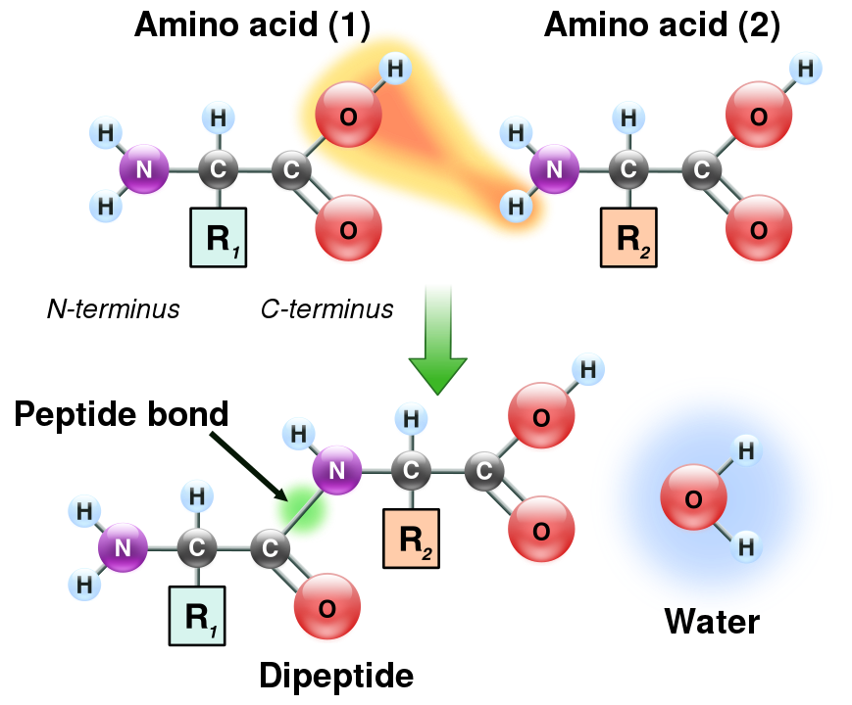
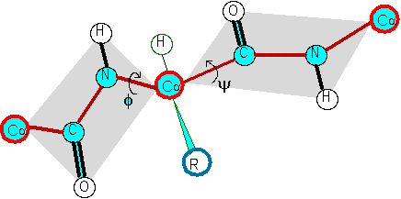
Formation of a peptide bond
The Phi and Psi angles associated with each alpha carbon along the peptide chain
φ
ψ
Illustration of the peptide plane (gray area) and φ-ψ angles. The red line formed by the repeating -Cα-C-N-Cα- is the backbone of the peptide chain.
From: https://en.wikipedia.org/wiki/Peptide_bond

Slide 8
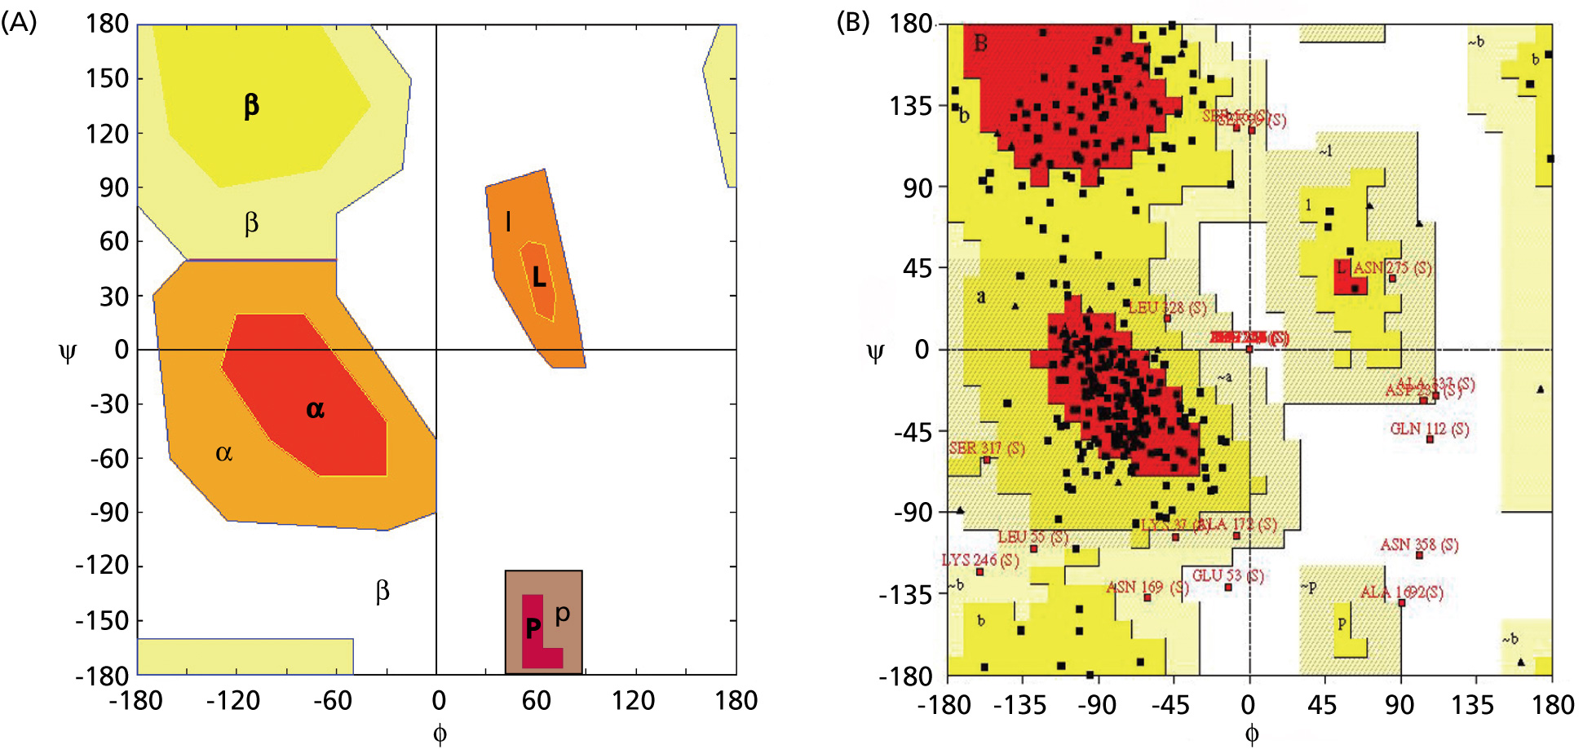
Angles in the protein backbone
Each axis really is a circle -180 is the same angle as +180

Slide 9
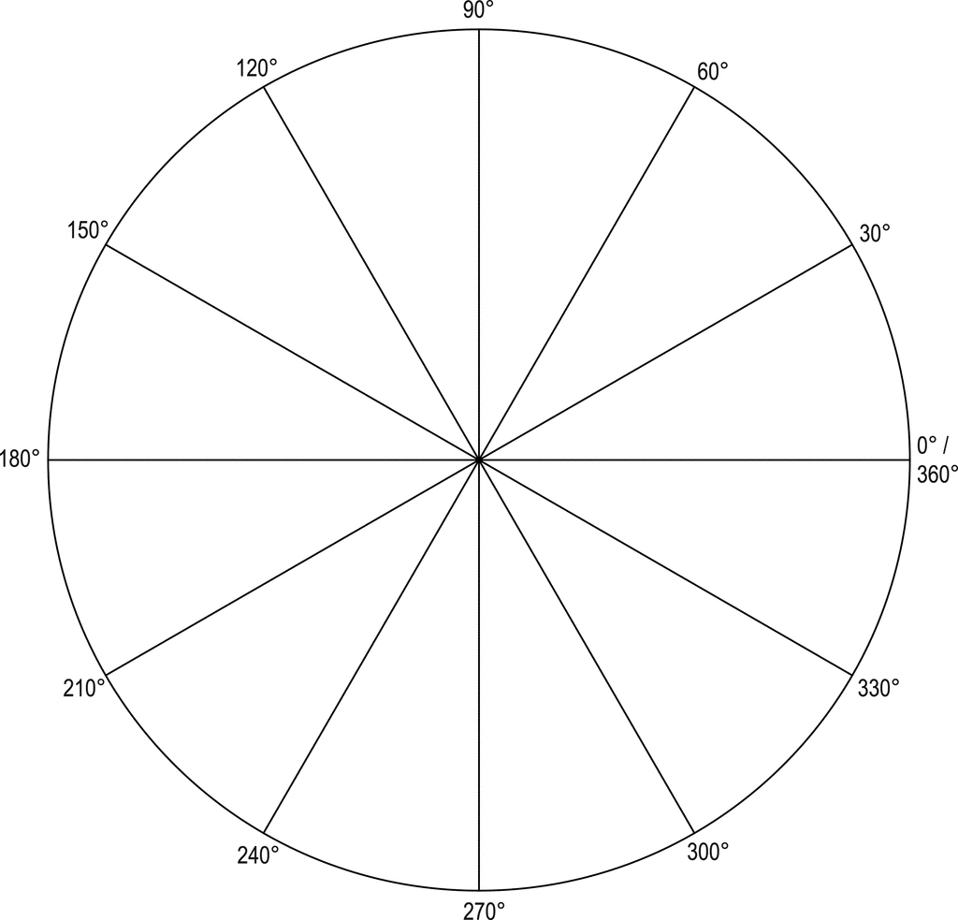
-270º
-240º
-300º
-210º
-330º
-180º
0º
-30º
-150º
-120º
-60º
-90º

Slide 10
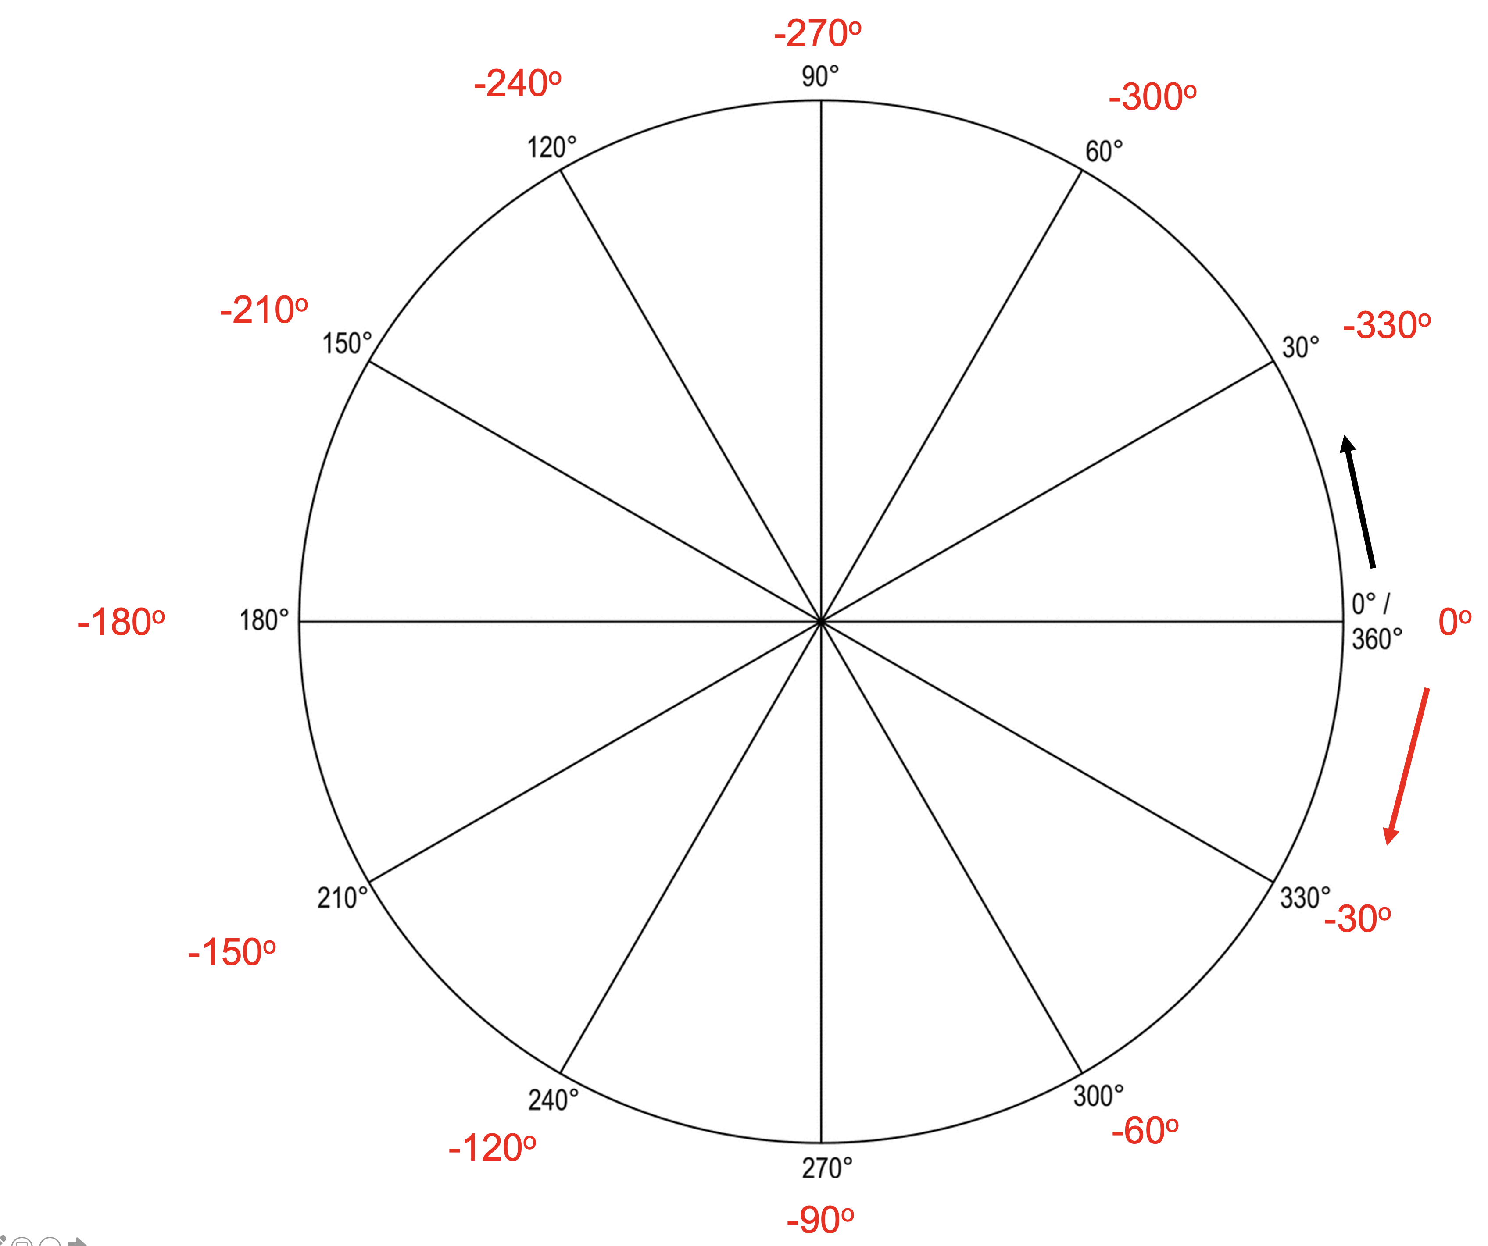
Where would an alpha carbon with angles of +200 (Phi) degree and +220 degree (Psi) plot?
The sum of the angle measured in the positive and the angle measured in the negative direction is equal to 360
Phi -90 or 360 - 90 = 270
Psi: -60 or 360 - 60 = 300

Slide 11
Questions to contemplate
Would in your opinion maintaining a database on beetles that contains data on where an individual beetle was collected, its morphology, and where is it stored in the collection fall under bioinformatics?
Would your assessment change, if partial sequences of the mitochondrial cytochrome C oxidase were included for each beetle?
Would in your opinion determining the 3D structure of a protein using X-ray crystallography fall under bioinformatics?
Would in your opinion the development of a new approach to next generation sequencing (NGS) fall under bioinformatics?

Slide 12
Questions to contemplate
Would in your opinion maintaining a database on beetles that contains data on where an individual beetle was collected, its morphology, and where is it stored in the collection fall under bioinformatics? No, as long as the databank would not contain a link to some -omics information
Would your assessment change, if partial sequences of the mitochondrial cytochrome C oxidase were included for each beetle? Yes
Would in your opinion determining the 3D structure of a protein using X-ray crystallography fall under bioinformatics? No, as long as it is for a single protein. A project that aims to determine all structure encoded in a genome, maybe.
Would in your opinion the development of a new approach to next generation sequencing (NGS) fall under bioinformatics? No, but you need to know about the different approaches to understand the errors that might be included in your data. E.g. 454 pyrosequencing has difficulties with determining the lengths of mononucleotide tracks.

Slide 13
Questions to contemplate
Are most proteins with similar function homologous?
Are all proteins with similar function homologous?
Are most proteins with significant sequence similarity homologous?
Do most homologous proteins have significant sequence similarity?
Do most homologous proteins have similar structure?

Slide 14
Questions to contemplate
Are most proteins with similar function homologous? Certainly not all, but most probably yes.
Are all proteins with similar function homologous? Definitely “no”. Convergent evolution can result in proteins with similar functions multiple times. Sometimes it is not clear, if homology exists, e.g., the DNA replication machinery in Bacteria on one side and Archaea and Eukaryotes on the other. At present scientists think that most proteins in that machinery are not homologous. A systematic collection of non-homologous isofunctional enzymes (NISE) was described in https://pubmed.ncbi.nlm.nih.gov/20433725/ .
Are most proteins with significant sequence similarity homologous? Yes!
Do most homologous proteins have significant sequence similarity? No! In many (most?) cases substitution events continued to occur in evolution erasing easily recognizable similarity in the primary sequence. Ford Doolittle once said jokingly (?), that if proteins evolved by gene duplication and divergence, then all proteins would be homologous to one another.
Do most homologous proteins have similar structure? Yes!

Slide 15
The RNA World and the Central Dogma

Slide 16
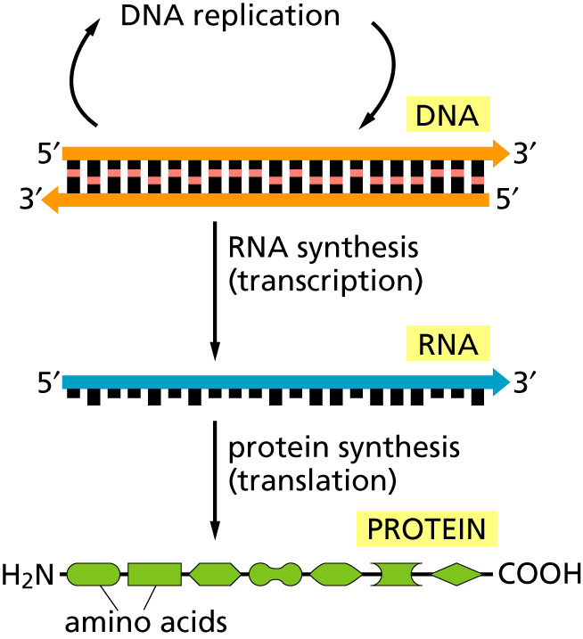
The central dogma
Why might this be wrong or incomplete
Notes:
Reverse transcriptase
Also, proteins can modify a DNA sequence – however, they never back translate a protein into RNA or DNA

Slide 17
Why might the central dogma as depicted in the last slide be wrong or incomplete

Slide 18
Why might the central dogma as depicted in the last slide be wrong or incomplete
Many viruses (e.g., HIV, HERVs) possess a reverse transcriptase that can transcript RNA back into DNA. HIV: Human Immunodeficiency Virus HERV: Human endogenous retroviruses (For SciFi on HERVs see Darwin’s Radio)
In Eukaryotes, many gene duplications occur through an RNA intermediate (see work from Craig Nelson’s lab (here and here)

Slide 19
Why might the central dogma as depicted in the last slide be wrong or incomplete
Proteins can modify DNA sequences, e.g., homing endonucleases, mismatch repair enzymes; however, these do not back translate a protein sequence into a nucleotide sequence.

Slide 20
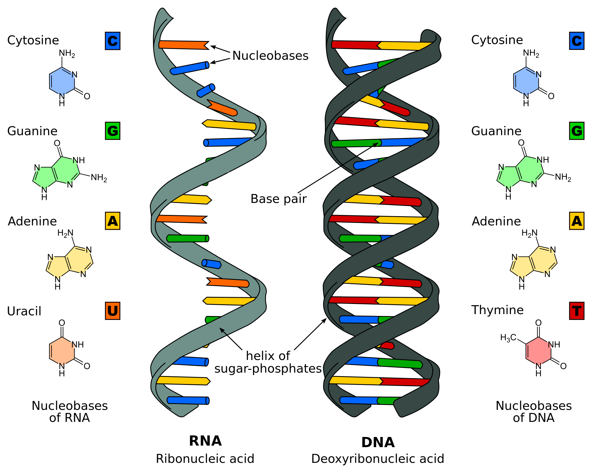
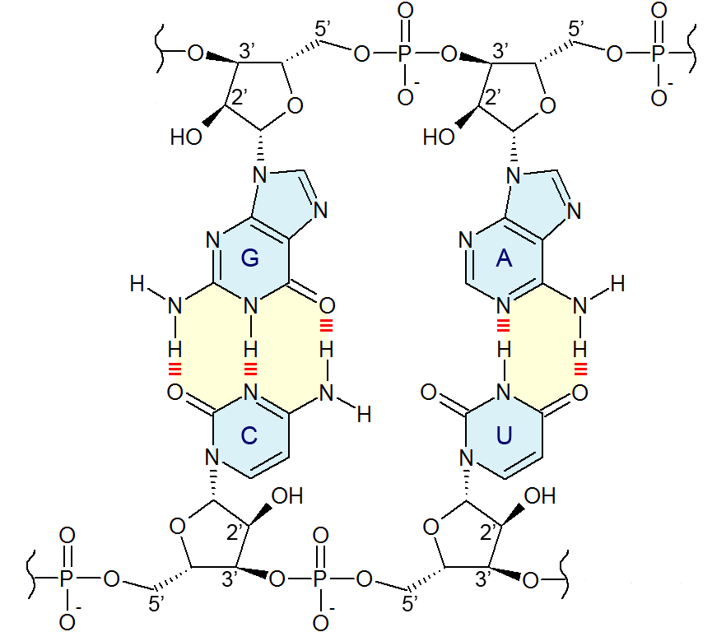
Base pairing in RNA Note the OH group at C2of the ribose
A comparison of RNA (left) with DNA (right), showing the helices and nucleobases each employs
From Wikipedia

Slide 21
The RNA world concept
Today RNA usually is an intermediate between information storage (DNA) and catalytic action/structures (protein)
The RNA world hypothesis says that early in life RNA was fulfilling both functions: information storage (as in today’s RNA viruses – SARS1&2, HIV) and catalytic activity.

Slide 22
RNA enzymes:

Slide 23
Ribosome

Slide 24
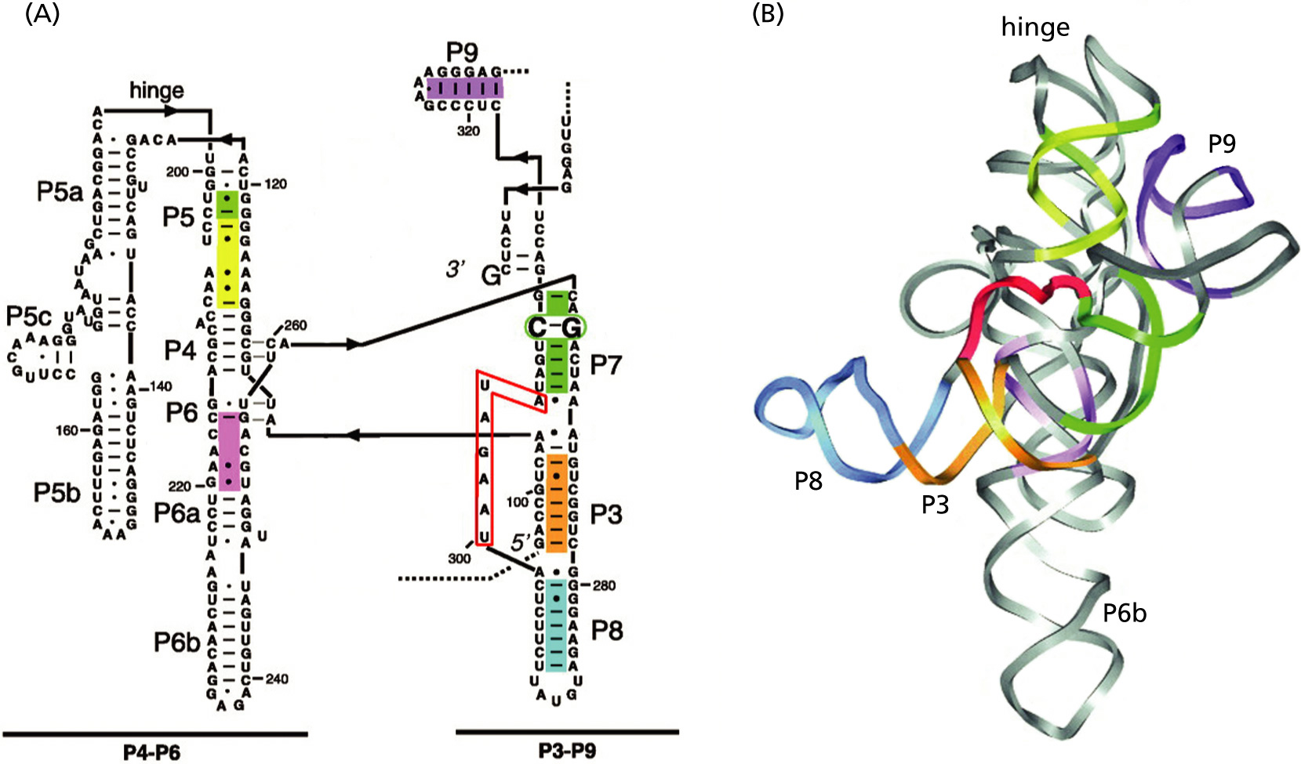
Self-splicing introns

Slide 25
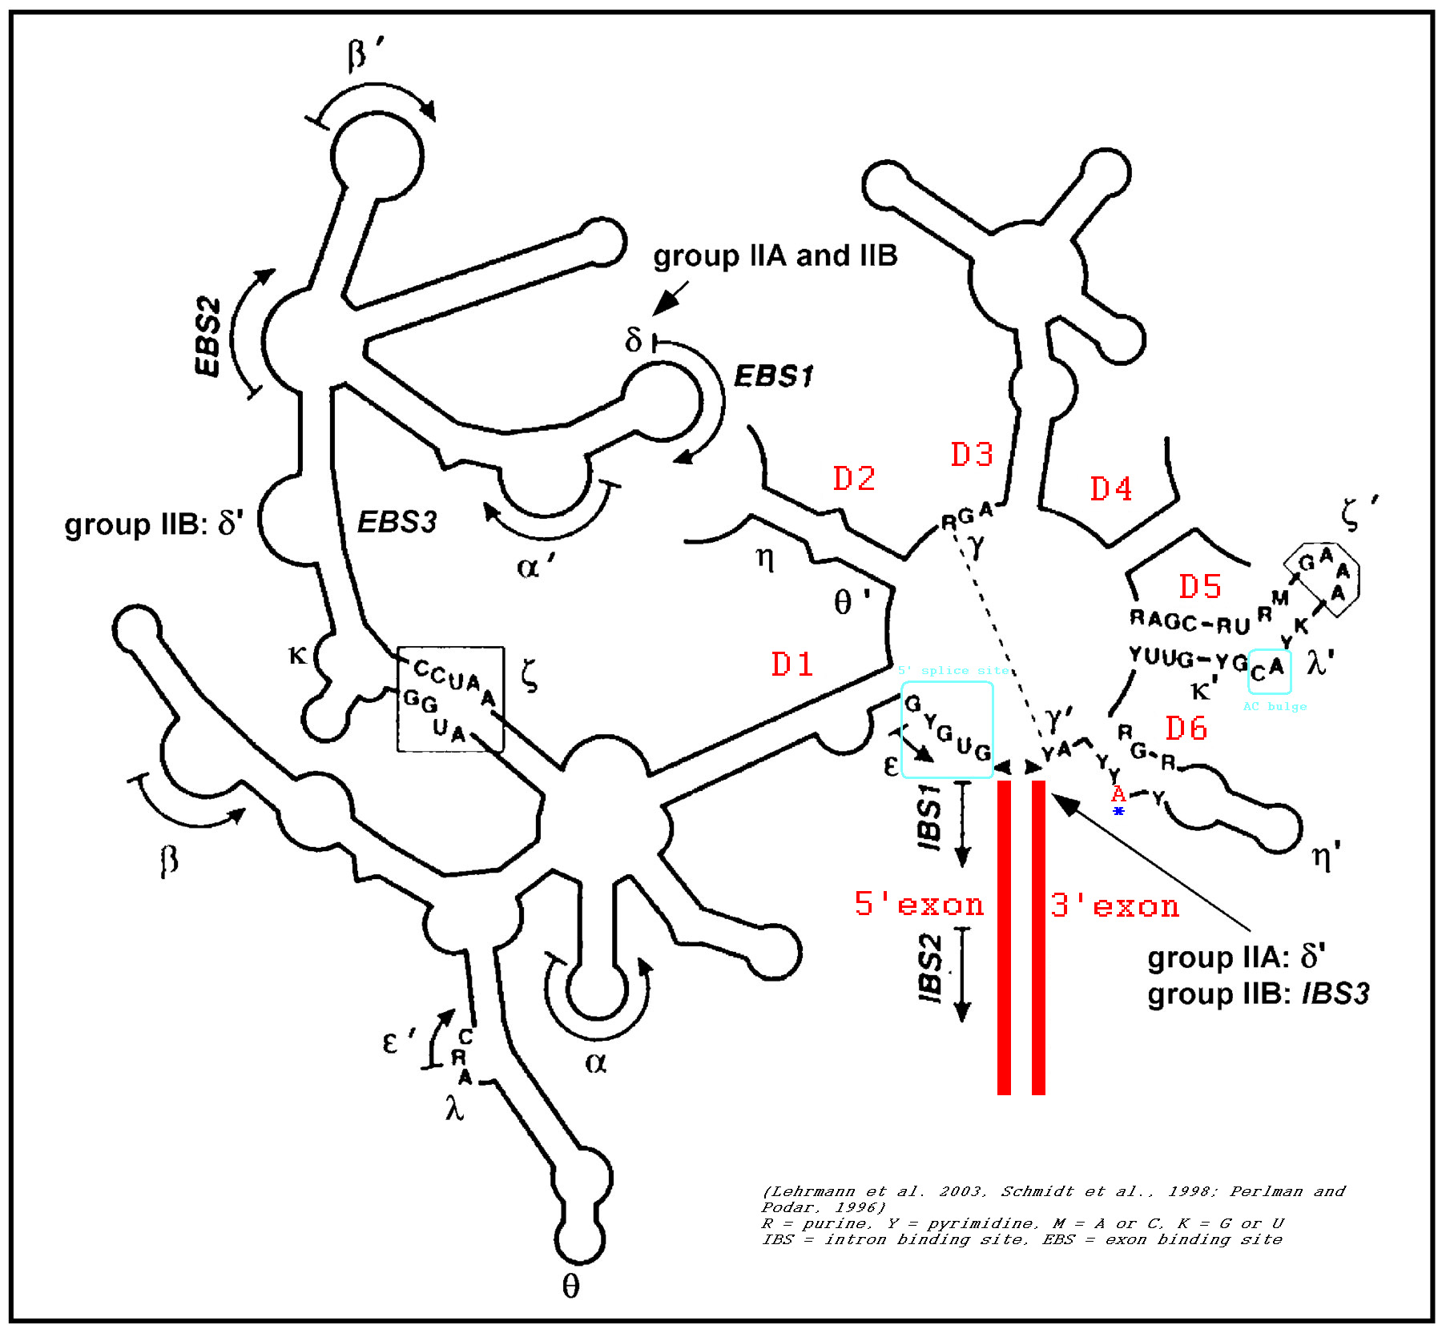
Group II intron

Slide 26
Pro-RNA world
RNA connects Information Storage (DNA) and catalysis (Protein) One could envision the DNA and protein polymers added to the RNA world
RNA can be genetic material
RNA can be an enzyme
Many cofactors are ribonucleotides, which has been interpreted as a remnant from the RNA world

Slide 27
Can you name some cofactors that might be remnants from the RNA world?

Slide 28
Can you name some cofactors that might be remnants from the RNA world?
ATP
Nicotinamide adenine dinucleotide phosphate (NADP⁺)
NAD⁺
Flavin Mono Nucleotide
acetyl-CoA
FADH
coenzyme F420 (in methanogenesis)

Slide 29
Contra-RNA world
RNA is reactive and instable (DNA is more stable – the OH group on C2 is rather reactive)
RNA catalysts are slow
RNA is not a likely product of prebiotic synthesis The first self replicating RNA would need plenty of activated nucleotides. Even small contaminations with the stereoisomer kills replication.
The primordial soup would have been too diluted -> primordial pizza (sandwich) reactants bound to surface

Slide 30
