Slide 1
MCB 3421 2024
Class 3
ATP synthase and ancient paralogs

Slide 2
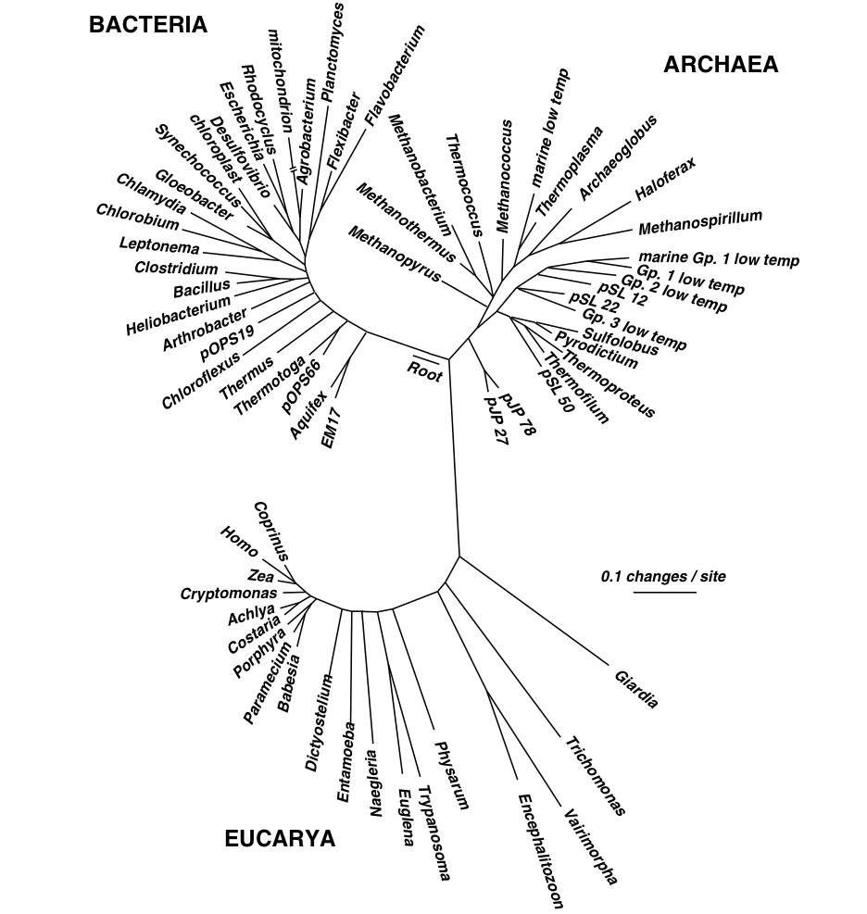
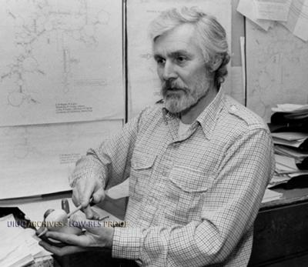
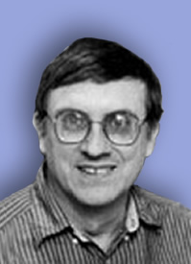
Small Subunit Ribosomal RNA based Tree of Life.
Carl Woese
George Fox
Notes:
1977

Slide 3
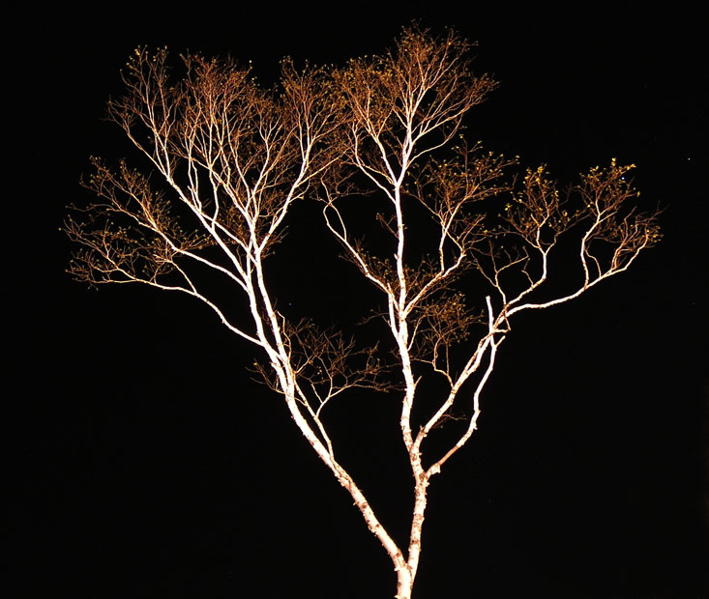
The Ribosomal “Tree of Life”
Eukaryotes
Bacteria
Archaea
Cenancestor
(aka LUCA or MRCA)
can be placed using ancient paralogs or the echo remaining from the early expansion of the genetic code.
Notes:
ribosome not transferred between divergent organisms
using a large co-adapted cellular component is better than averaging over many different components with different histories

Slide 4
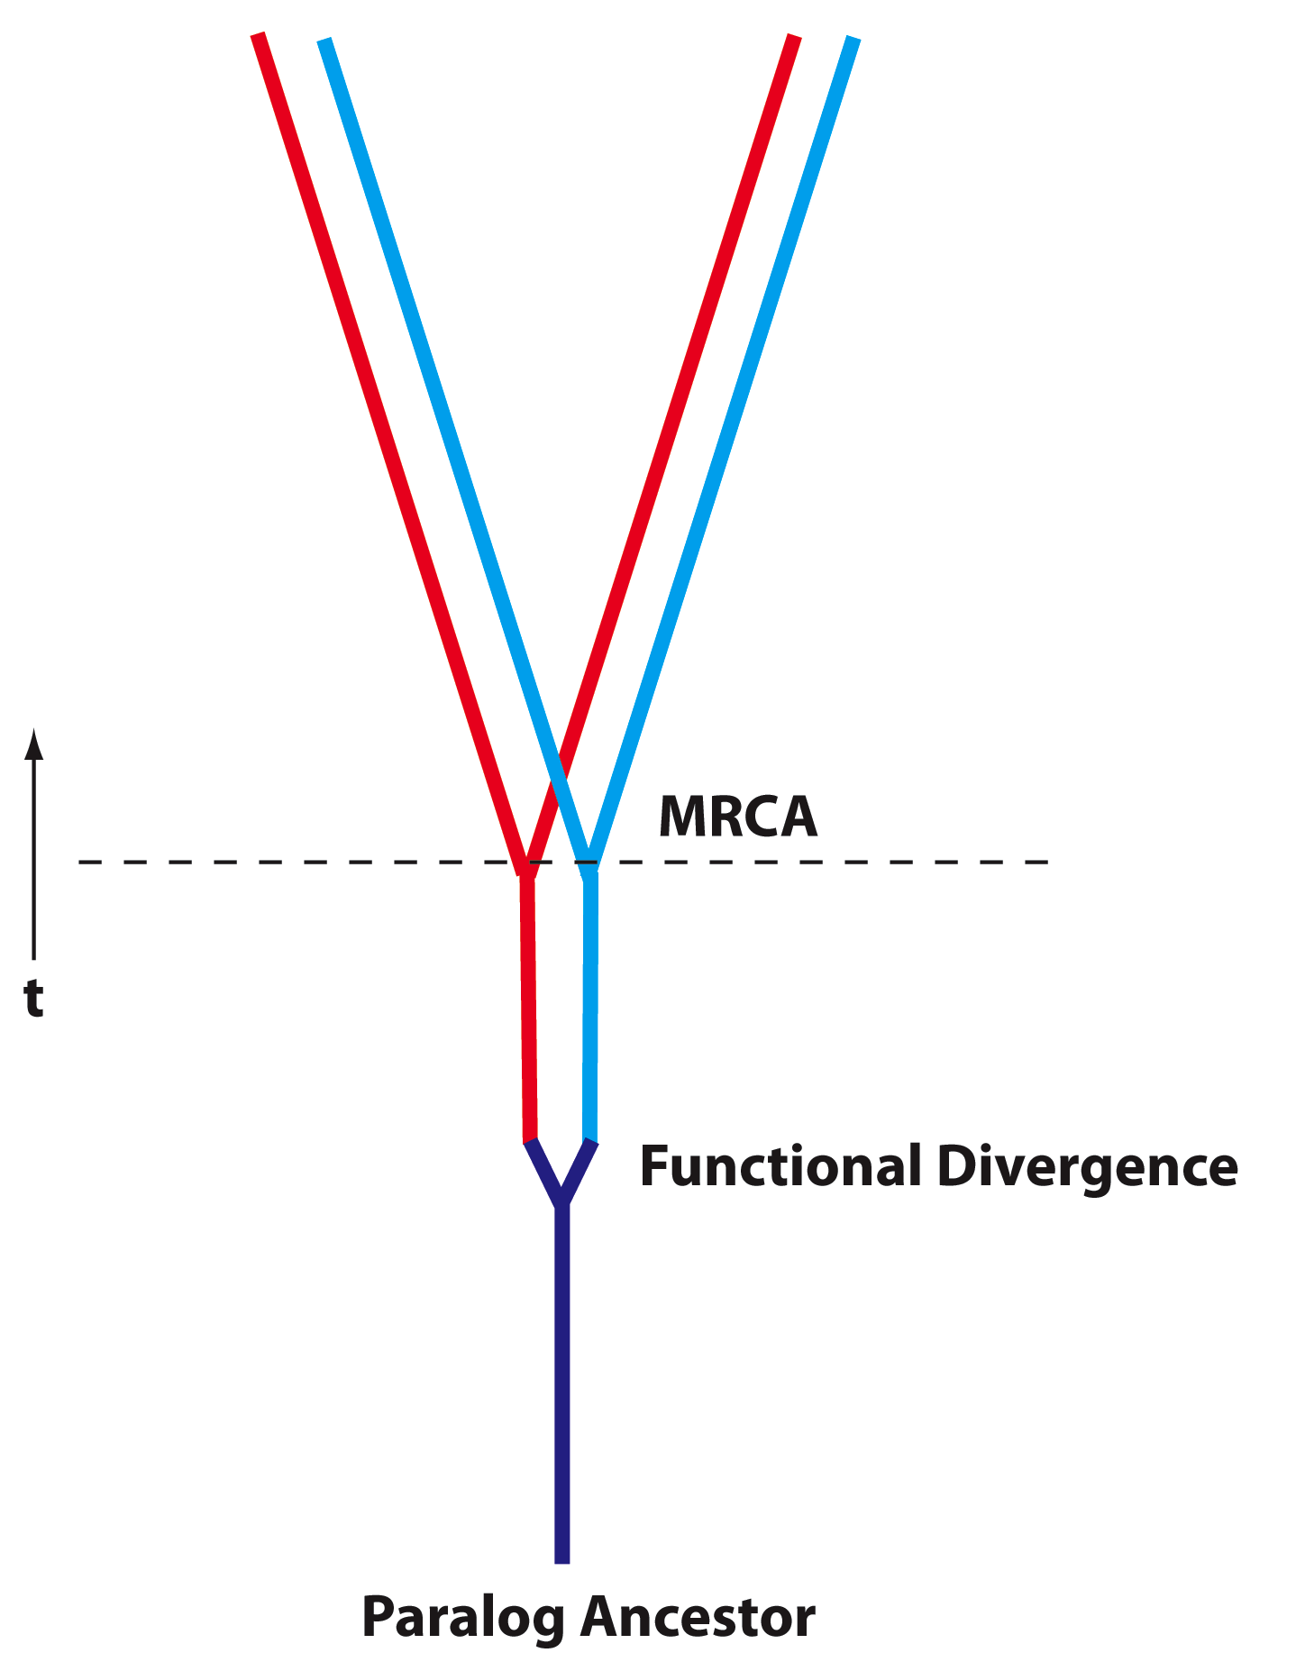
Deep Paralogs
Gene families evolve by duplication, gene transfer and divergence
For ancient proteins, some of these divergences occurred before the divergence of the three domains of life (MRCA);
Determining function of paralog ancestors could elucidate primordial physiology… however, lack of time machine prevents direct experimental observation.
In some special cases, can be inferred using amino acid composition…
Examples for ancient duplicated genes?

Slide 5
B
A
B
V-proteolipid
A
A
B
N
C
c
A-proteolipids
V-type ATPase
A-type ATPase
N
N
C
C
α
β
α
Halobacterium
Methanococcus
Methanopyrus
β
β
α
c
F-proteolipid
N
C
F-type ATPase
Notes:
Proton pumping ATPases usually are classified as follows: P-, V- and F-type H⁺-ATPases. The F- and V-type (vacuolar) ATPases possess two major portions: the hydrophilic and the hydrophobic membrane sectors, named as F₁ or V₁ and F₀ or V₀, respectively.
The F-ATPase is present in the plasma membrane of Bacteria, inner membrane of mitochondria and thylakoid membranes of chloroplasts. This enzyme consumes the electrochemical H⁺ gradient to synthesize ATP or hydrolyzes ATP to build up a H+ gradient. The V-ATPase is present in the endomembrane systems of eukaryotes: vacuoles, Golgi apparatus and coated vesicles. The Archaea have an ATPase whose primary structure is very similar to the V-ATPase, but whose function is more similar to F-ATPases. Therefore, the archaeal counterpart of the V-ATPases is called A-ATPase.
The hydrophobic sector F0/V0 is formed by the subunits a, b and c. Subunit c, also called proteolipid, is involved in H⁺ translocation across the membrane. The vacuolar ATPases have 6 proteolipids per enzyme with a molecular weight of 16 kDa each. The V-ATPase proteolipids consist of four membrane spanning helices, while the F-ATPase proteolipids have only two membrane spanning helices.
The number of transmembrane helices of the archaeal ATPase proteolipid vary in size: 2 in Halobacterium, 3 in Sulfolobus and Thermus, and 5 in Methanococcus.
While the gene duplication that gave rise to the catalytic and non catalytic subunits occurred before the divergence of the V/F/A-ATPase, the gene duplication and fusion events that gave rise to the large V-type proteolipid occurred only in the branch leading to vacuolar type ATPase. The resulting protein has four transmembrane helices, and is twice the size of the F-proteolipid, but still possesses only one catalytic residue.

Slide 6
F-ATPase: In bacteria, mitochondria and plastids (i.e., in those organelles that evolved from bacterial endosymbionts).
Makes ATP or energizes the membrane.
V-ATPase: vacuolar type ATPases found on the eukaryotic endomembrane system (lysosomes, endosomes, vacuolar membranes, trans Golgi network)
In vivo this enzyme never synthesizes ATP, rather it energizes the respective membrane, and it provides a signal (intra vesicular acidification) for receptors to let go of their substrate.
A-ATPase: With respect to function these are very similar to the F-ATPase but found in the membranes surrounding archaeal cells. With respect to structure the A and V ATPases are so similar that often the A-ATPases are labelled as V-ATPases.

Slide 7
Catalytic subunits
Non catalytic subunits
Archaea
Eukarya
Bacteria
Bacteria
Archaea
Eukarya
speciation
time
gene duplication
Gogarten et al, 1989, PNAS 86, 17, 6661–6665
http://www.pnas.org/content/113/32/E4654.full.pdf?with-ds=yes
Notes:
Rooting the Tree of Life by an ancient Gene Duplicaiton

Slide 8
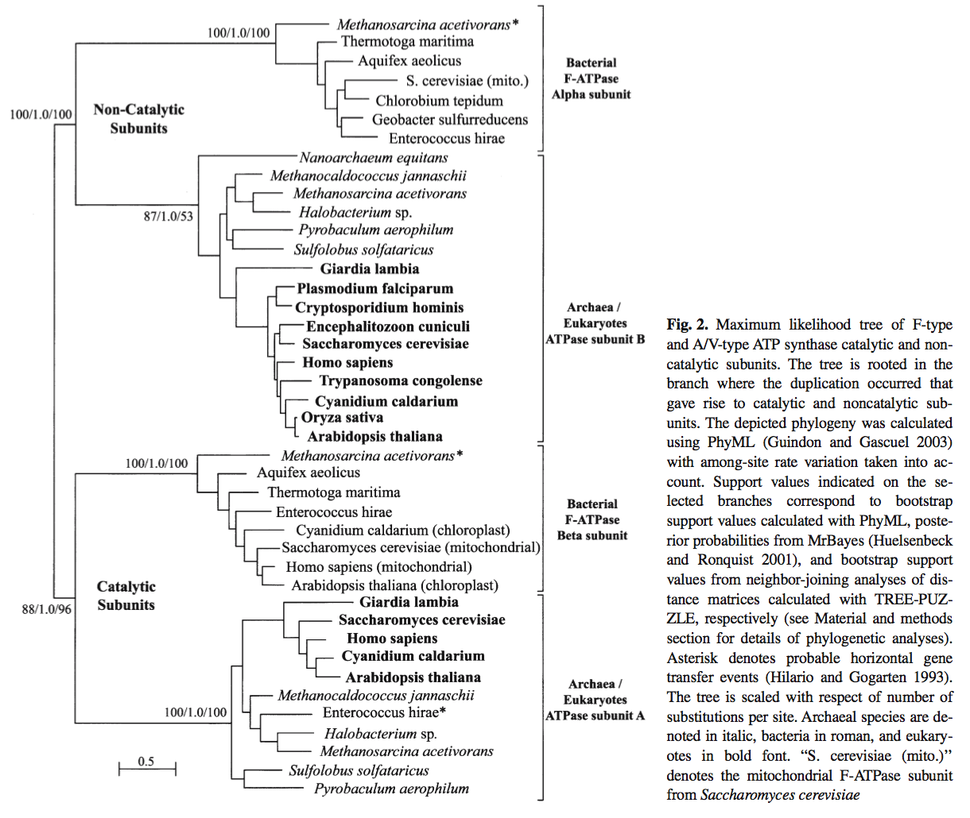

ATPase / ATPsynthase
ATP binding Subunits
Notes:
Zhaxybayeva, O., Lapierre, P., & Gogarten, J. P. (2005). Ancient gene duplications and the root(s) of the tree of life. Protoplasma, 227(1), 53–64. doi:10.1007/s00709-005-0135-1

Slide 9
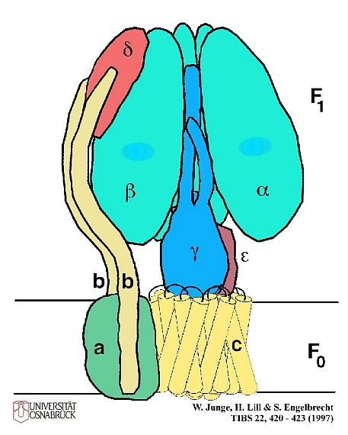

Slide 10
Nobel prizes awarded for ATP synthases
Peter D Mitchell, recipient of the Nobel Prize in Chemistry 1978, developed the hypothesis that the transmembrane gradient of protons is the intermediate between electron transport and ATP synthesis. Initially, his idea was not accepted; to publish it, he founded his own publishing house.

Slide 11
Nobel prizes awarded for ATP synthases
Paul D. Boyer, recipient of the Nobel Prize in Chemistry 1997, studied the catalytic mechanism of ATP synthesis. He concluded that the different catalytic subunits are in different phases of the catalytic cycle (similar to the engines in a motor).
John E. Walker, recipient of the Nobel Prize in Chemistry 1997, determined the structure of the F1 ATPases from beef heart mitochondria. In the determined structure the subunits are frozen in different parts of the catalytic cycle.

Slide 12
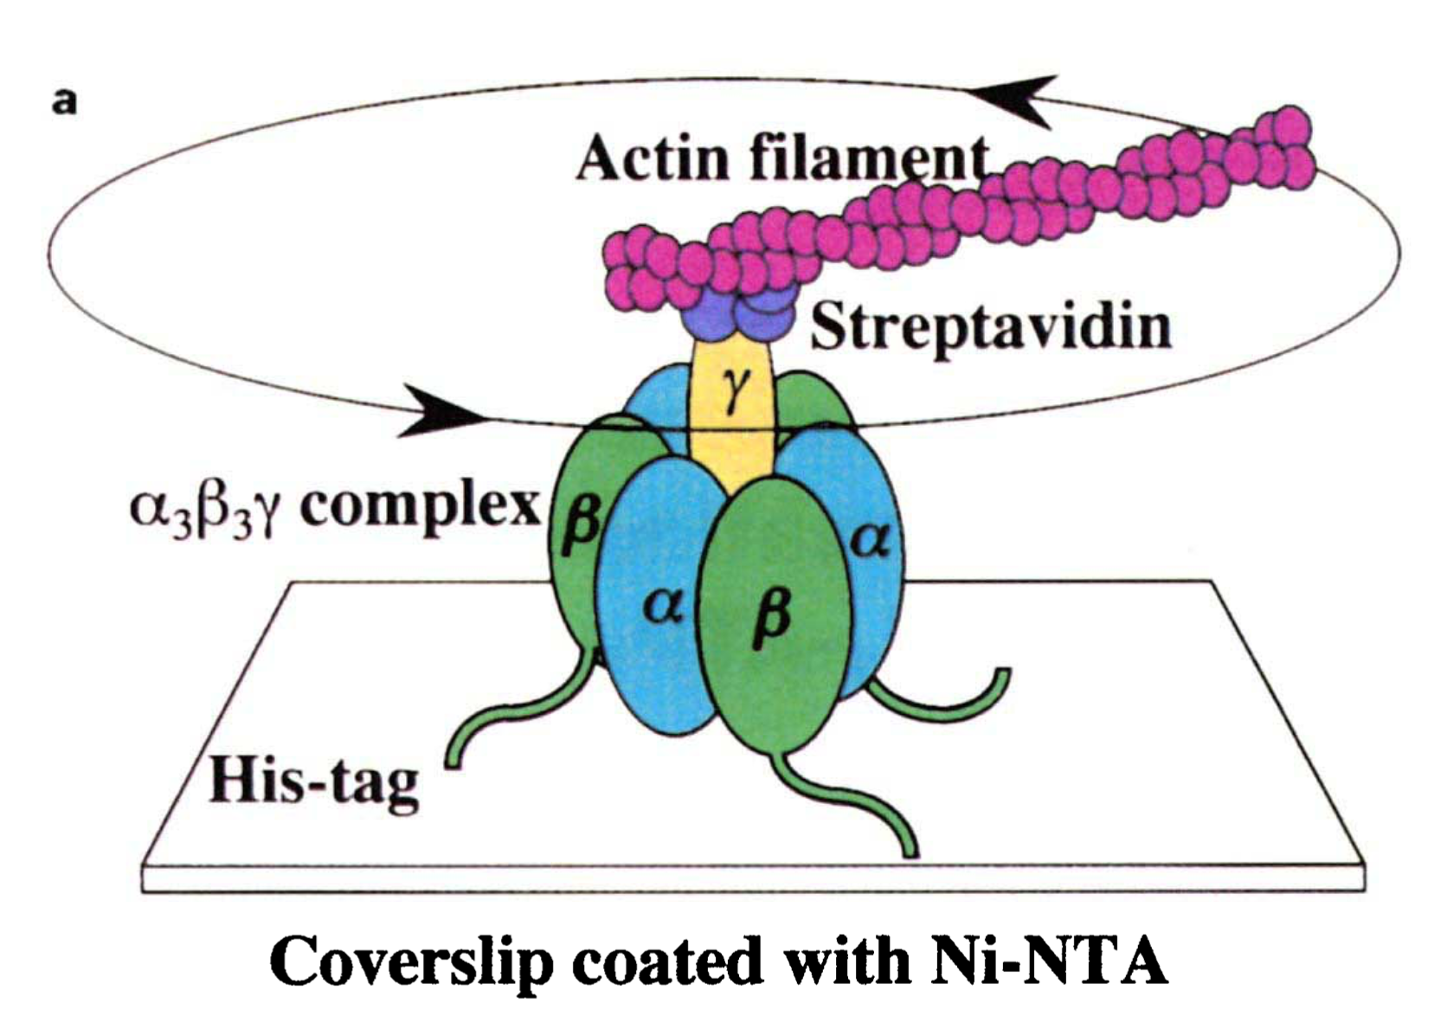
Seeing is believing
Watch the movie here
https://www.youtube.com/watch?v=0y7n-vK1AJE
A reasonably realistic
animation is at
https://www.youtube.com/watch?v=_GPDsQnnvrA
Experiment from Noji et al.
A very schematic
animation is at
https://www.youtube.com/watch?v=k_DQ1FjFuYM

Slide 13
