Slide 1
MCB 3421 Class 4 2023
Discussion of Lab
Review of Lab 2
ATP binding sites –
Shared Ancestry versus Convergent Evolution
Handwaving argument as to why convergent evolution does not result in parallel invention of similar primary sequences

Slide 2
Some answered the questions: Can you determine which chain, via (Select > chain), does not have an ATP or ATP analog bound?
with chain G (the gamma subunit) -- this is technically correct. However, we were studying the 6 subunits in the head group, and one of the three beta subunits has an empty ATP binding site.
The expected answer was
CHAIN E: BETA(E) (E for Empty)
(one could have obtained this answer by hovering the mouse pointer over the subunit without the ATP (which at this point might have been visible as space filling balls). The label that pops up gives the aa one points at followed by the chain. Or one could look at the pdb file (or you could have consulted the answer you gave to the previous question).

Slide 3
"Make a guess as to how much ATP are synthesized in the human body per day". The answers on the web and in the literature are slightly different, But all in the range of about the bodyweight.
or:
or from Wikipedia:

Slide 4
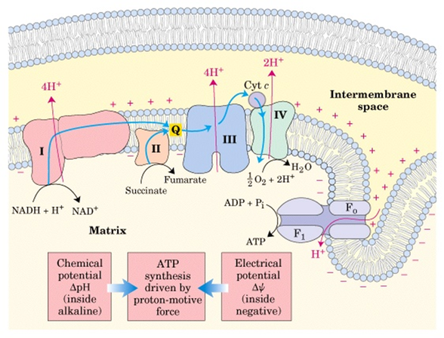
Chemiosmotic coupling
https://microbiochem.weebly.com/uploads/2/8/8/2/28824147/9076073.png?588
From:
https://microbiochem.weebly.com/chemiosmotic-coupling-hypothesis.html

Slide 5
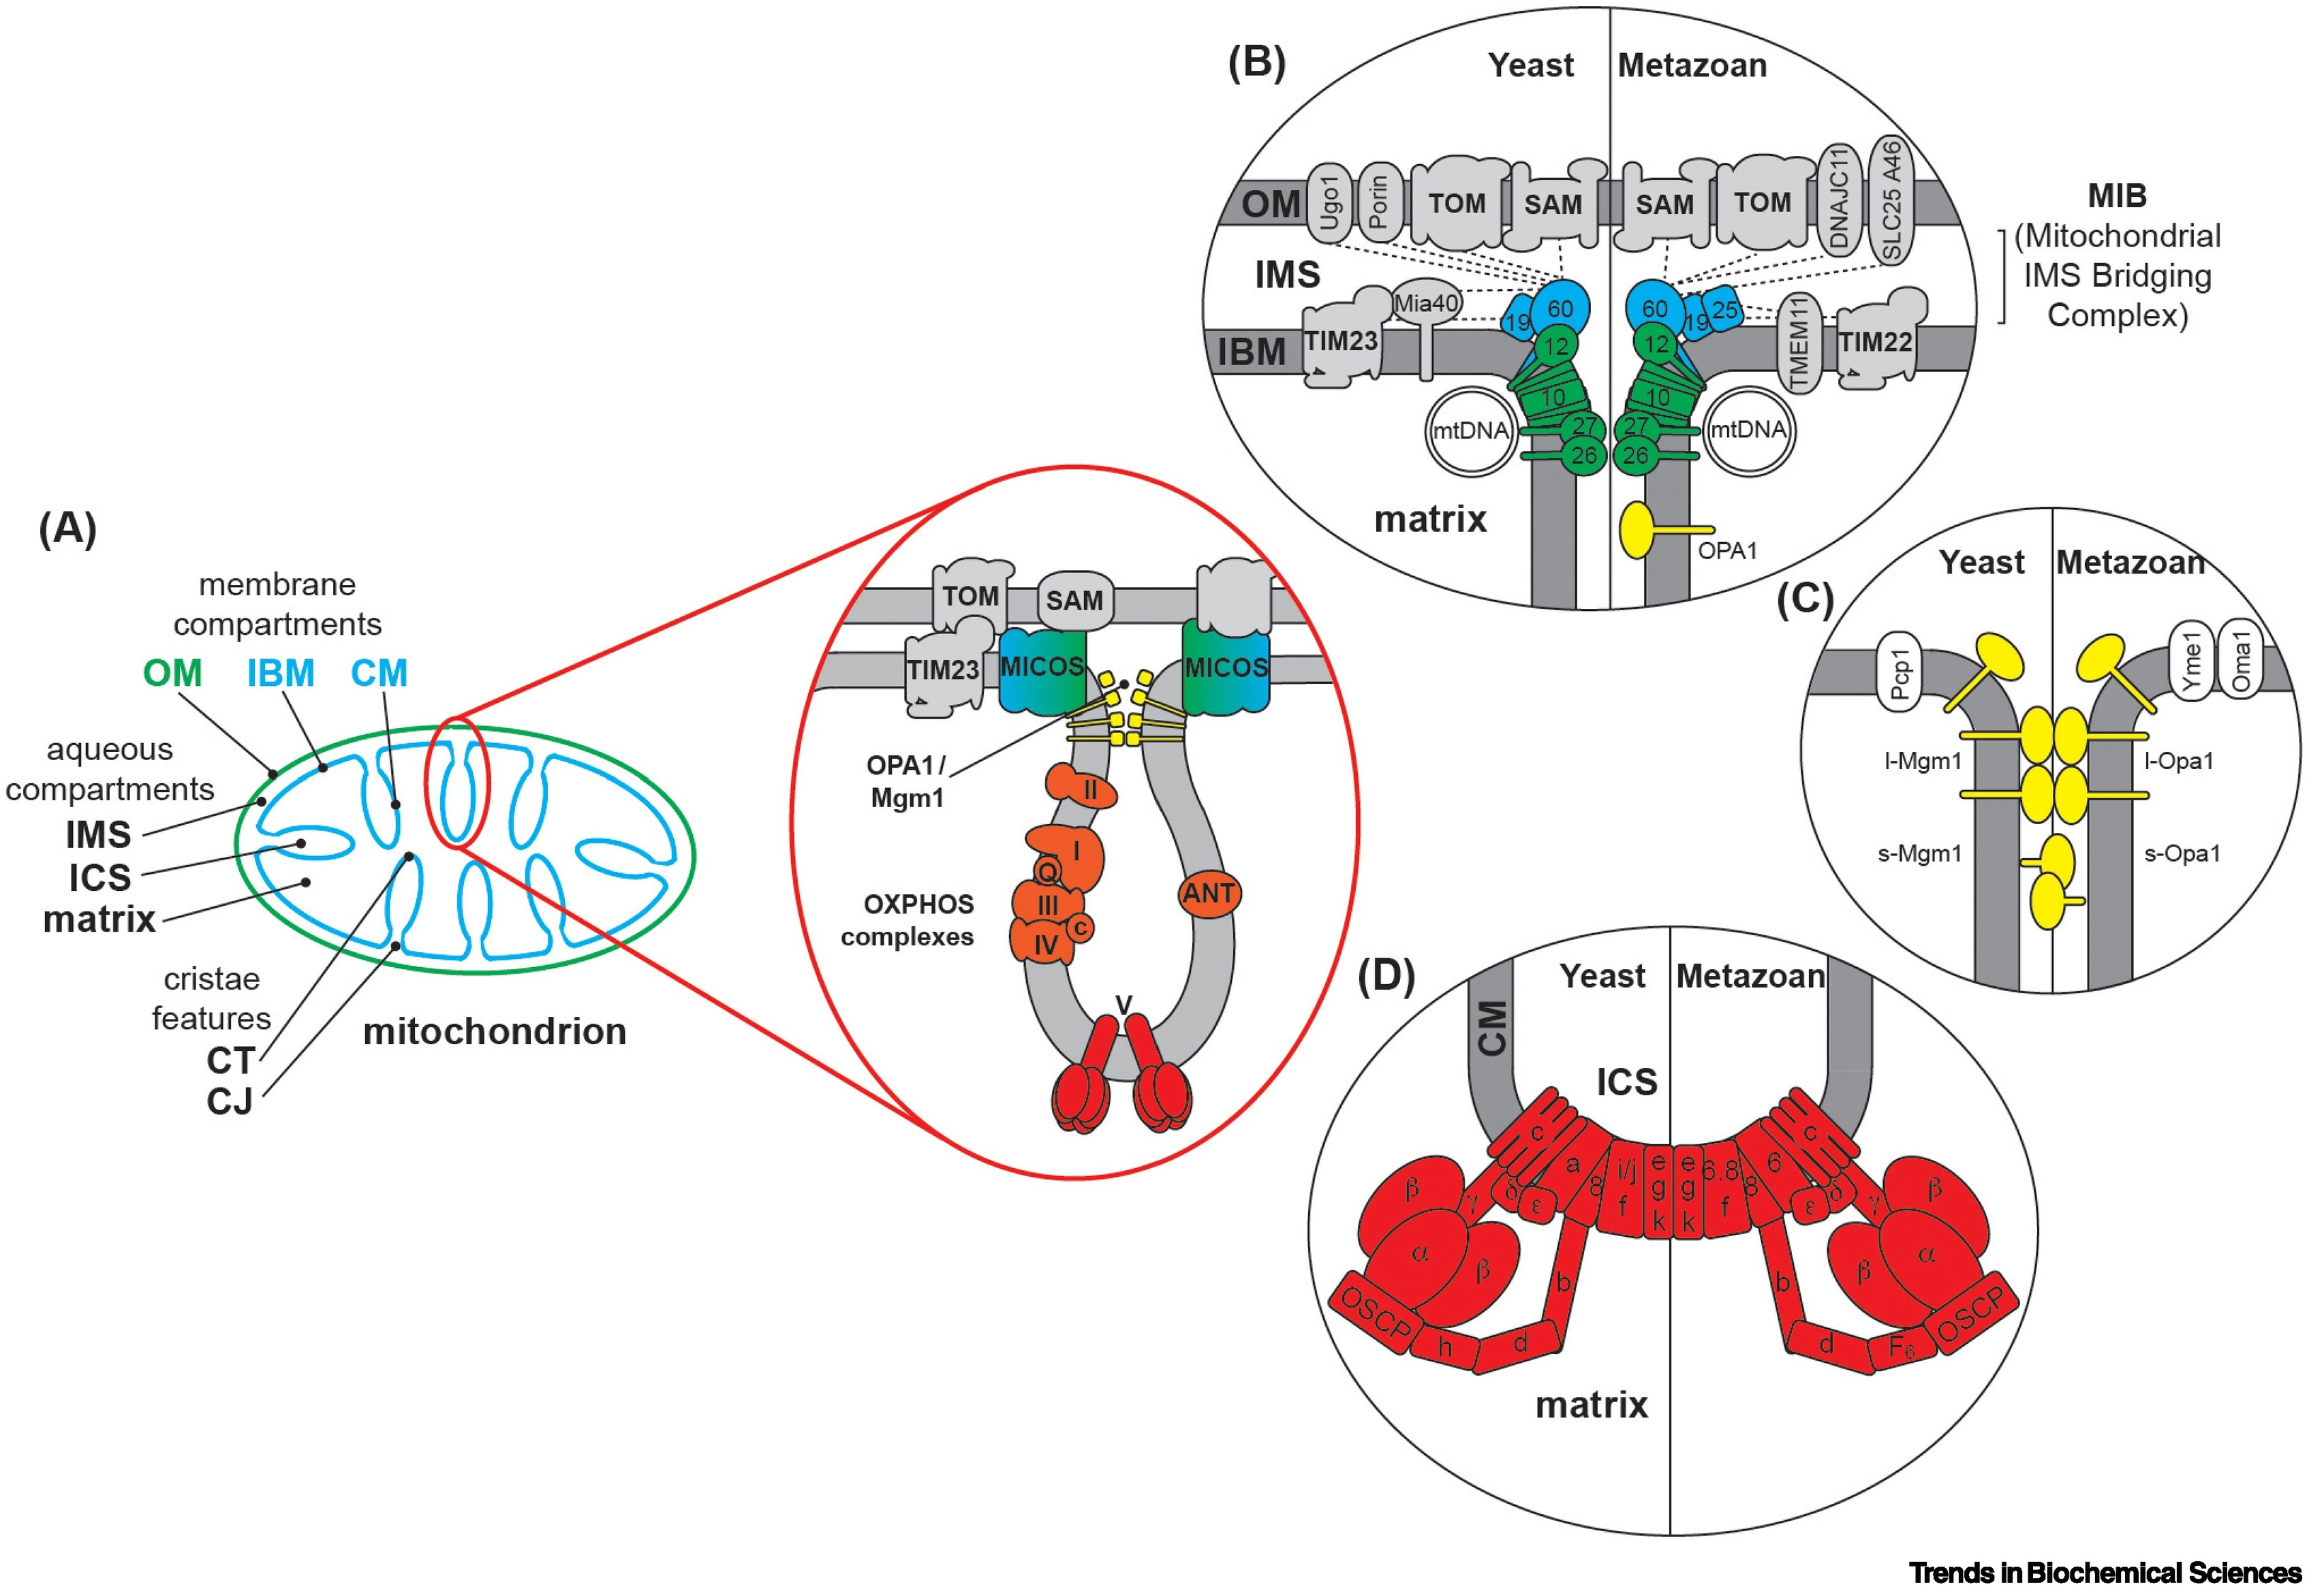
From: Mitochondrial compartmentalization: emerging themes in structure and function.
Joseph C. Iovine, Steven M. Claypool, Nathan N. Alder
Trends in Biochemical Sciences
DOI: 10.1016/j.tibs.2021.06.003

Slide 6
BetaTP and alphaTP from 1bmf.pdb

Slide 7
The most common fold in proteins is the Rossmann fold occurring in most nucleotide binding proteins. Examples are the V-/F-/A-ATPases, helicases, P-type ATPases, myosin ….
At the core of the fold is a beta alpha beta fold, and the presence of the so-called Walker motifs.
(From http://proteopedia.org/wiki/index.php/Rossmann_fold)

Slide 8
It is conceivable that all the Rossmann fold domains are homologous, but the beta alpha beta arrangement is rather simple, and one cannot exclude the possibility of convergent evolution (i.e., the Rossmann fold in ATP synthases, might not have common shared ancestry with the Rossmann fold in P-type ATPases, ABC transporters, or the NADH binding 3-phosphoglycerate dehydrogenase)
“The basic nucleus of the βαβ fold is about 30 residues. In many proteins that do not share any significant sequence homology, there exists an extensive tertiary structural homology beyond this 30 residue segment, particularly in specific domains that bind dinucleotides. Therefore, the probability that this type of extensive structural homology evolved independently is very low. Thus, most likely βαβ fold represents an ancient structure that left its vestige in numerous proteins. Certainly, this conclusion does not exclude the possibility of independent convergent evolution.” From http://proteopedia.org/wiki/index.php/Rossmann_fold

Slide 9
GRASP ATP binding site
A second unrelated ATP binding domain is the GRASP domain. Examples are D alanin – D-Alanin ligase, glutathione synthetase, carbamoyl phosphate synthetase and many other enzymes that use the energy from ATP to ligate two substrates.

Slide 10
GRASP ATP binding sites

Slide 11
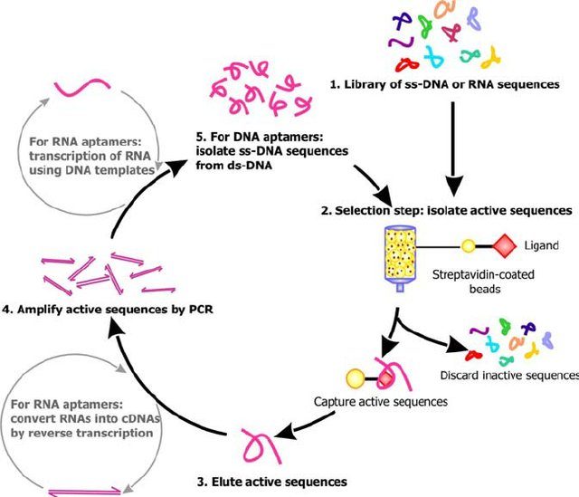
SELEX

Slide 12
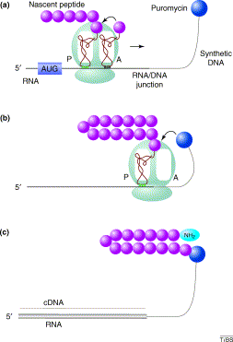
RNA display
from https://www.sciencedirect.com/science/article/pii/S0968000403000367

Slide 13
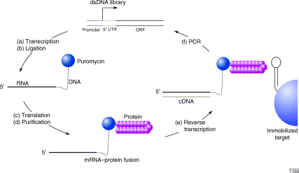
from https://www.sciencedirect.com/science/article/pii/S0968000403000367

Slide 14
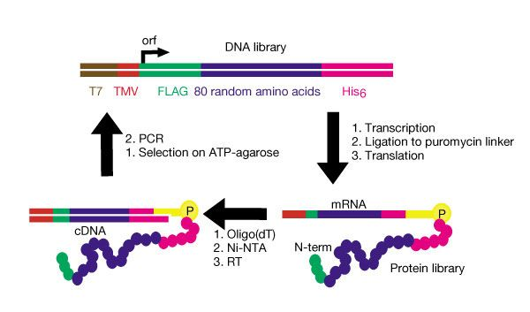
Keefe and Szostak’s description
Four distinct ATP binding peptides isolated.
”estimate that roughly 1 in 10¹¹ of all random-sequence proteins have ATP-binding activity comparable to the proteins isolated in this study”
from https://www.nature.com/articles/35070613

Slide 15
One of these in vitro selected peptides was crystalized by Lo Surdo, P., Walsh, M.A., Sollazzo, M.
From: https://www.nature.com/articles/nsmb745

Slide 16
GRASP ATP from the D-alanin D-alanine ligase

Slide 17
Rossman fold
ATPase beta SU
1BMF.pdb

Slide 18
In vitro selected peptide
1UW1.pdb

Slide 19
Convergent evolution of ATP binding sites did not lead to a similar arrangement of secondary structures building blocks.
ATP GRASP Rossmann fold In vitro evolved peptide

Slide 20
Rossmann, ATP GRASP, in vitro evolution
The Rossmann and GRASP domains evolved through natural selection.
Using an approach similar to the selection of substrate binding aptamers (RNA) in the selex approach (co-invented by former UConn undergraduate Larry Gold), Keefe and Szostak used Puromycin to link the synthesized protein to the encoding DNA. (aka RNA display)

Slide 21
Related proteins
Present day proteins evolved through substitution and selection from ancestral proteins.
Related proteins have similar sequence AND similar structure AND similar function (at least if they did not diverge too much).
In the above mantra "similar function" can refer to:
identical function,
similar function, e.g.:
identical reactions catalyzed in different organisms; or
same catalytic mechanism but different substrate (malic and lactic acid dehydrogenases);
similar subunits and domains that are brought together through a (hypothetical) process called domain shuffling, e.g. nucleotide binding domains in hexokinse, myosin, HSP70, and ATPsynthases.

Slide 22
homology
Two sequences are homologous, if there existed an ancestral molecule in the past that is ancestral to both of the extant sequences
Homology is a "yes" or "no" character (don't know is also possible as is very likely). Either sequences (or characters) share ancestry or they don't (like pregnancy). Molecular biologist often use homology as synonymous to similarity or percent identity. One often reads: sequence A and B are 70% homologous. To an evolutionary biologist this sounds as wrong as 70% pregnant.
Important types of Homology
Orthology: bifurcation in molecular tree reflects speciation Paralogy: bifurcation in molecular tree reflects gene duplication other types of homology that are often distinguished are synology (due to genome fusion) and xenology (due to gene transfer)
Notes:
See the article from Walter Fitch on Homology. Available in reading materials on HuskyCT.

Slide 23
Sequence Similarity vs Homology
The following is based on observation and not on an a priori truth:
If two (complex) sequences show significant similarity in their primary sequence, they have shared ancestry (i.e., they are homologs), and probably similar function (although some proteins acquired radically new functional assignments).

Slide 24
The Size of Protein Sequence Space (back of the envelope calculation)
Consider a protein of 600 amino acids. Assume that for every position there could be any of the twenty possible amino acid. Then the total number of possibilities is 20 choices for the first position times 20 for the second position times 20 to the third .... = 20 to the 600 = 4*10⁷⁸⁰ different proteins possible with lengths of 600 amino acids.
For comparison the universe contains only about 10⁸⁹ protons and has an age of about 5*10¹⁷ seconds or 5*10²⁹ picoseconds.
If every proton in the universe were a super-computer that explored one possible protein sequence per picosecond, we only would have explored 5*10¹¹⁸ sequences, i.e. a negligible fraction of the possible sequences with length 600 (one in about 10⁶⁶²).

Slide 25
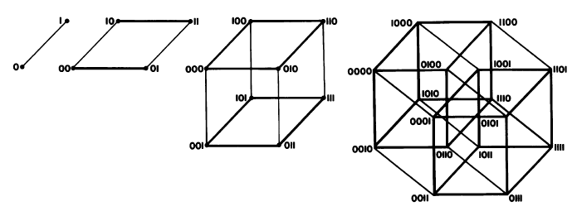
Ways to construct sequence Space
Figure from Eigen et al. 1988 illustrating the construction of a high dimensional sequence space. Each additional sequence position adds another dimension, doubling the diagram for the shorter sequence. Shown is the progression from a single sequence position (line) to a tetramer (hypercube). A four (or twenty) letter code can be accommodated either through allowing four (or twenty) values for each dimension (Rechenberg 1973; Casari et al. 1995), or through additional dimensions (Eigen and Winkler-Oswatitsch 1992).
Eigen, M. and R. Winkler-Oswatitsch (1992). Steps Towards Life: A Perspective on Evolution. Oxford; New York, Oxford University Press.
Eigen, M., R. Winkler-Oswatitsch and A. Dress (1988). "Statistical geometry in sequence space: a method of quantitative comparative sequence analysis." Proc Natl Acad Sci U S A 85(16): 5913-7
Casari, G., C. Sander and A. Valencia (1995). "A method to predict functional residues in proteins." Nat Struct Biol 2(2): 171-8
Rechenberg, I. (1973). Evolutionsstrategie; Optimierung technischer Systeme nach Prinzipien der biologischen Evolution. Stuttgart-Bad Cannstatt, Frommann-Holzboog.

Slide 26
Size of protein space versus connectivity:
While the size of the combinatoric space for proteins is unimaginable (for 600 amino acid long proteins this space has 4*10⁷⁸⁰ vertices), this space is also highly connected, that is, it takes less than 600 steps (counting a mutation of an amino acid in the sequence as a step) to get from an arbitrary point in this space to any other arbitrary point.

Slide 27
no similarity vs no homology
If two (complex) sequences show significant similarity in their primary sequence, they have shared ancestry, and probably similar function. >>> THE REVERSE IS NOT TRUE !! <<<
PROTEINS WITH THE SAME OR SIMILAR FUNCTION DO NOT ALWAYS SHOW SIGNIFICANT SEQUENCE SIMILARITY for one of two reasons:
a) they evolved independently (e.g., different types of nucleotide binding sites), i.e. they are not homologous;
or
b) they underwent so many substitution events that there is no readily detectable similarity remaining; i.e. they are homologous, but the homology can no longer be inferred from the similarity of the primary sequence (too many substitutions;
Corollary: PROTEINS WITH SHARED ANCESTRY DO NOT ALWAYS SHOW SIGNIFICANT SIMILARITY.

Slide 28
The space of of possible protein folds
According to the rules of combinatorics, an astronomical number of possible different amino acid sequences exists sequences.
Levinthal estimated the possible number of conformations for a given protein sequence also is astronomical.
He calculated that a protein with 100 amino acids has 99 peptide bonds, each with a phi and psi angles, resulting in a total of 198 angles around which the peptide backbone can rotate. If each of these can exist in three possible energetic minima (the sidechains are staggered), one arrives at 3¹⁹⁸ = 3•10⁹⁴ possible conformations.
Levinthal's paradox says: If a protein would randomly explore all possible conformations, it would require a time longer than the age of the universe to arrive at its correct native conformation.

Slide 29
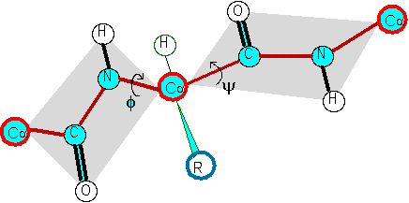
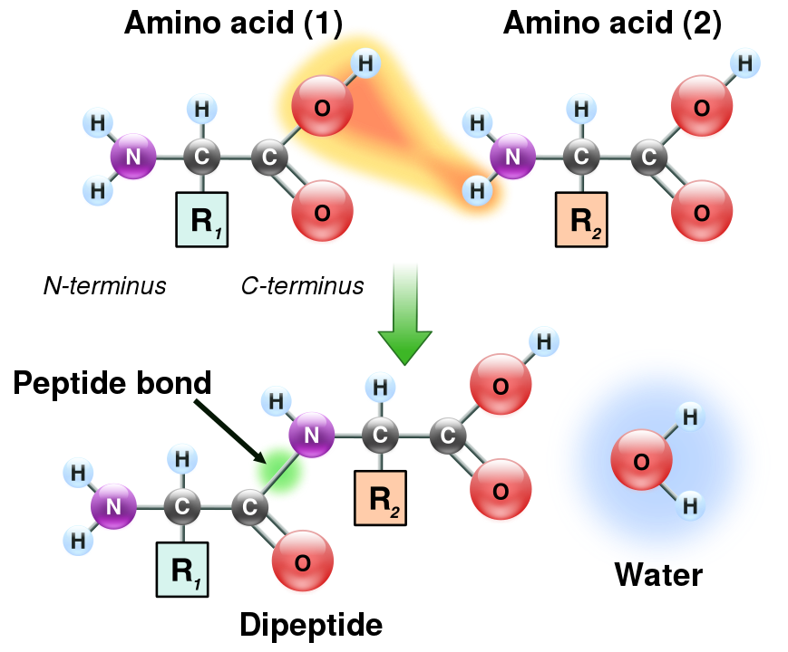
The Phi and Psi angles associated with each alpha carbon along the peptide chain
Formation of a peptide bond
φ
ψ
Illustration of the peptide plane (gray area) and φ-ψ angles. The red line formed by the repeating -Cα-C-N-Cα- is the backbone of the peptide chain.
From: https://en.wikipedia.org/wiki/Peptide_bond

Slide 30
The space of of possible protein folds
According to the rules of combinatorics, an astronomical number of possible different amino acid sequences exists sequences.
Levinthal estimated the possible number of conformations for a given protein sequence also is astronomical.
He calculated that a protein with 100 amino acids has 99 peptide bonds, each with a phi and psi angles, resulting in a total of 198 angles around which the peptide backbone can rotate. If each of these can exist in three possible energetic minima (the sidechains are staggered), one arrives at 3¹⁹⁸ = 3•10⁹⁴ possible conformations.
Levinthal's paradox says: If a protein would randomly explore all possible conformations, it would require a time longer than the age of the universe to arrive at its correct native conformation.

Slide 31
The three staggered conformations of a C-C bond. The 6 residues are indicated by different colors.

