Slide 1
Class 12
MCB 3421_2024
Your questions regarding the midterm
More on inteins and other SGE
insertion sequences

Slide 2
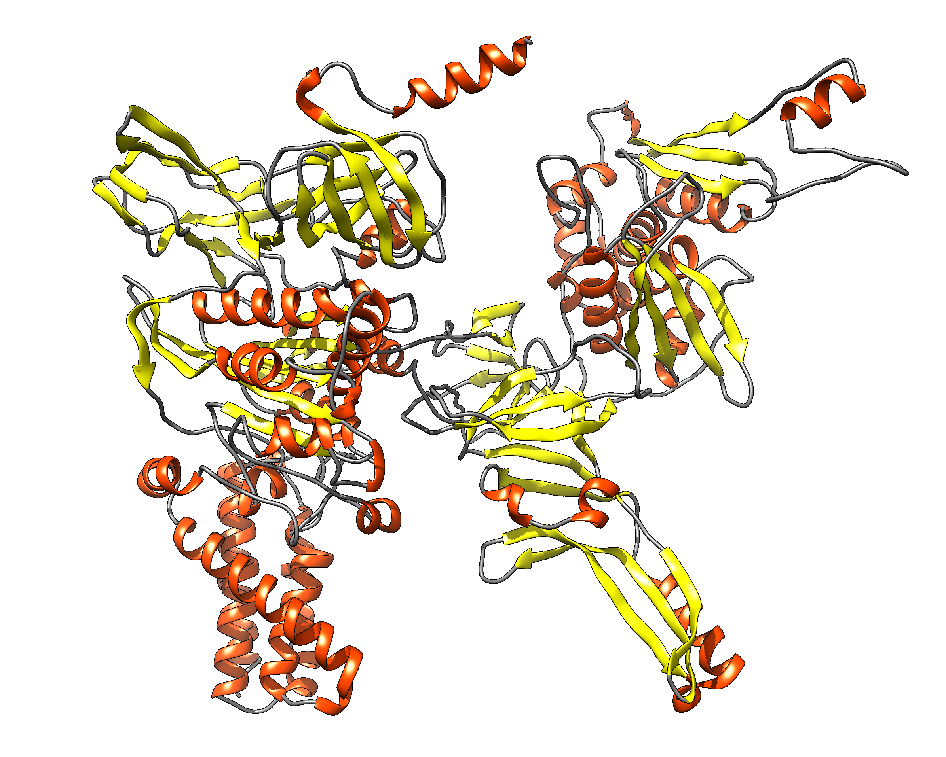
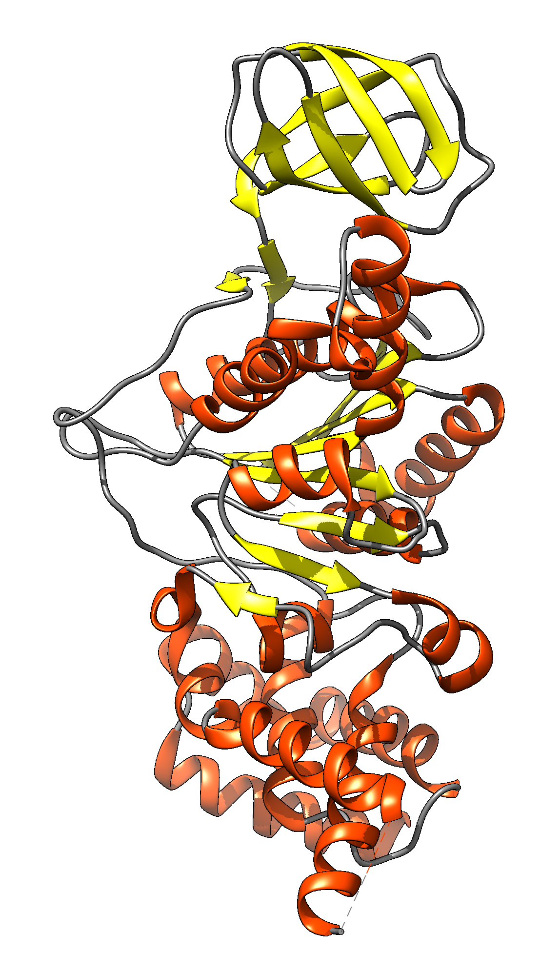
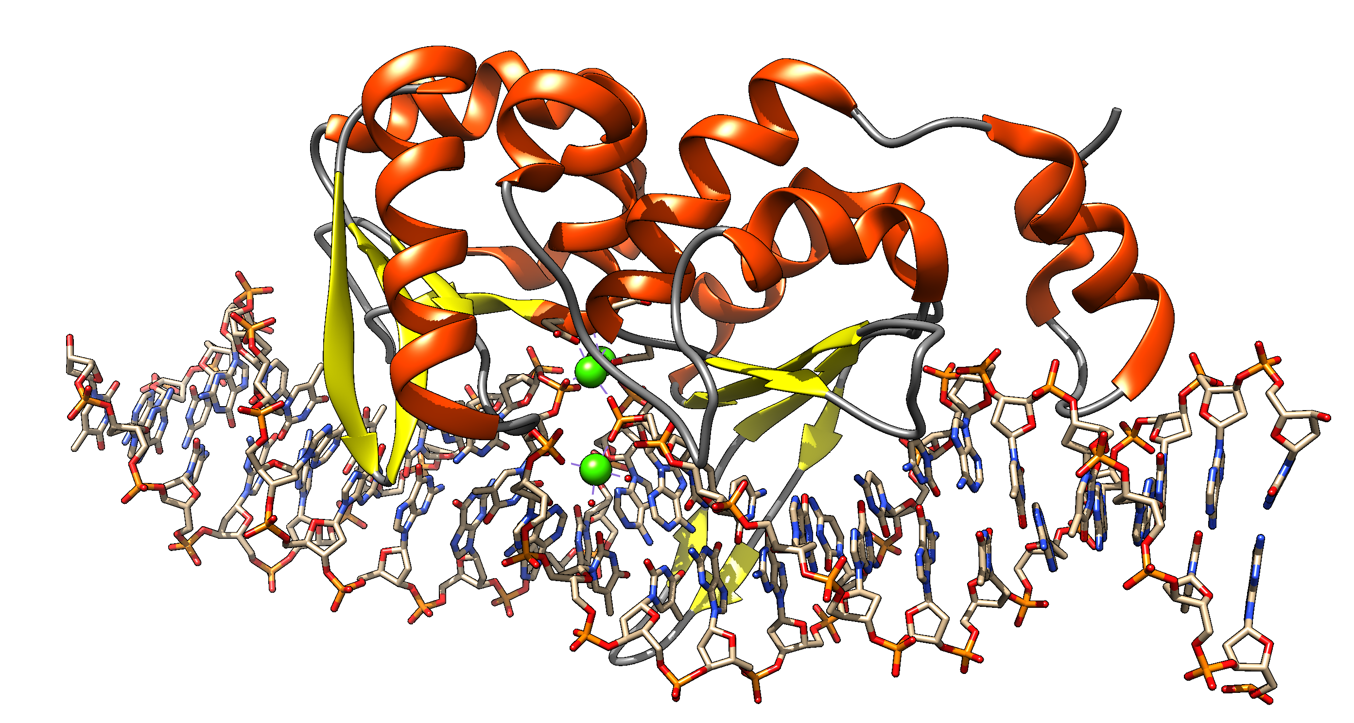
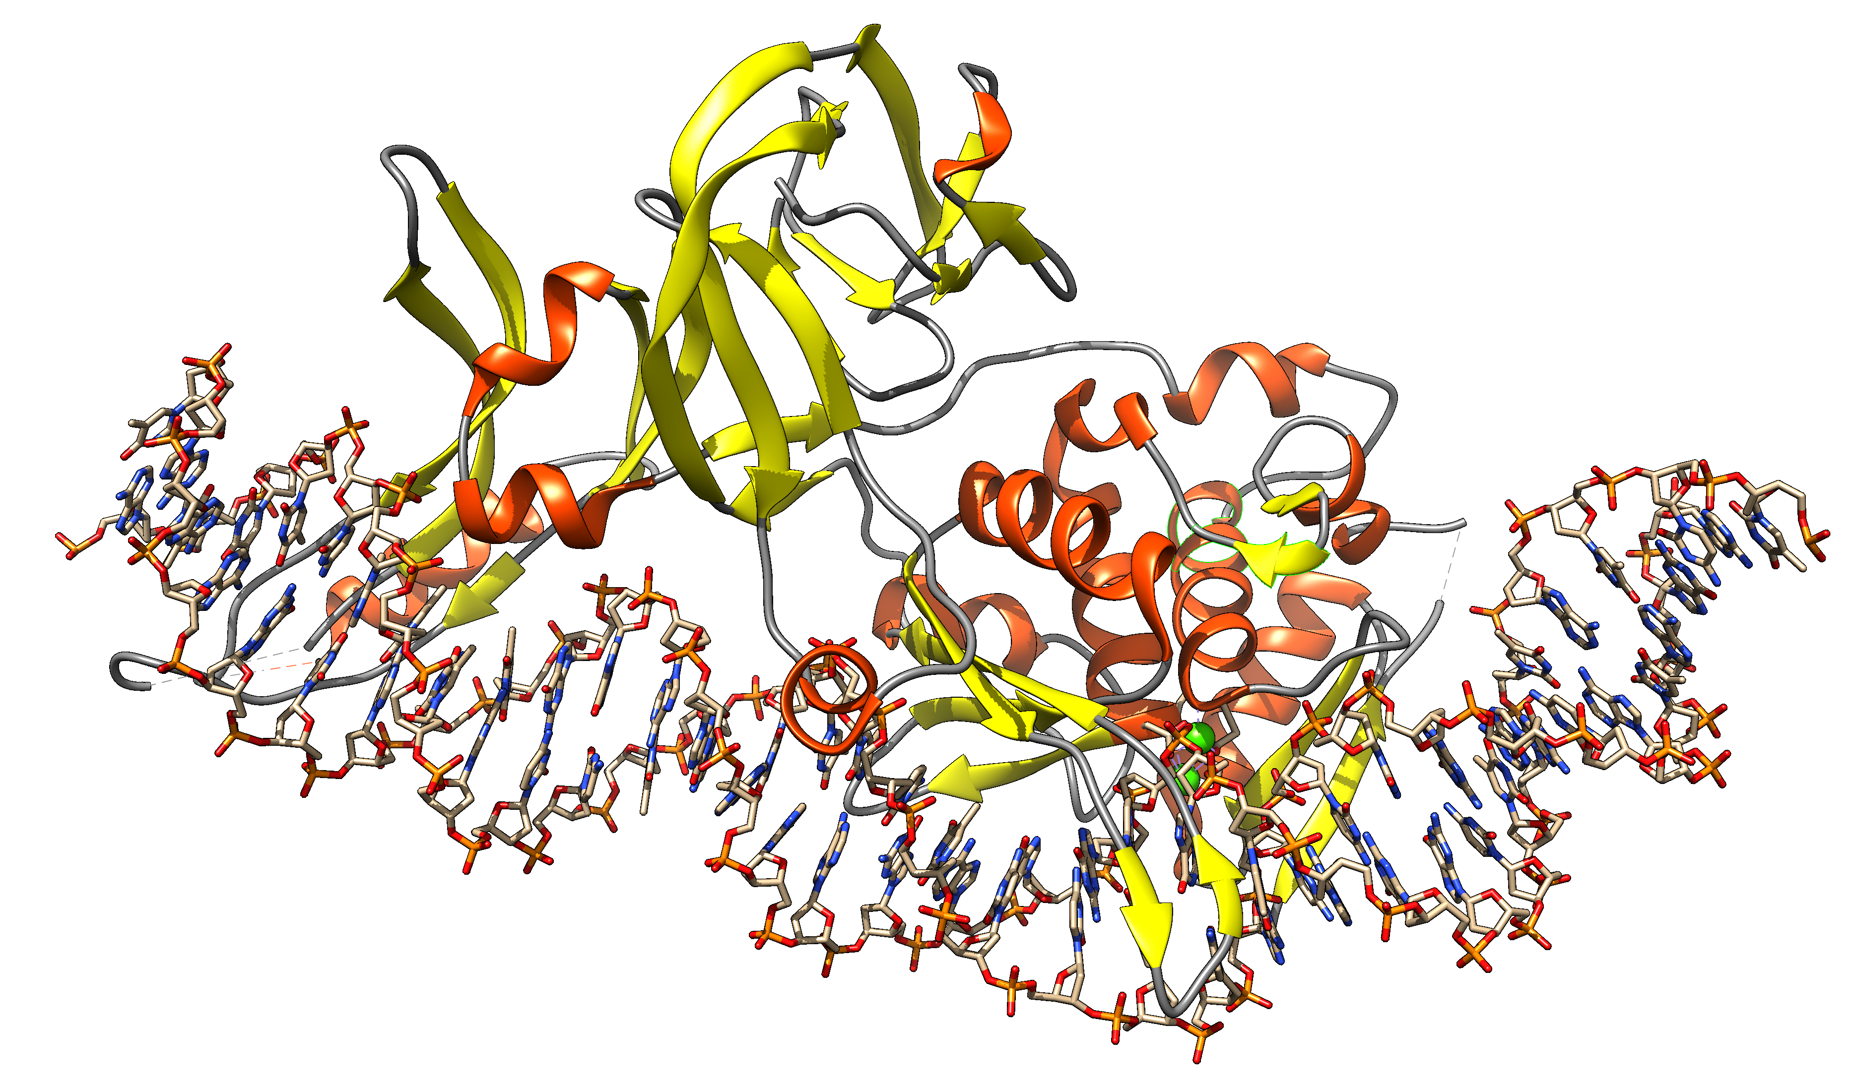
Group I Intron
Intein
Exon: Intron: ORF on Intron
Extein: Intein Splicing Domain: HE domain:
DNA
transcription
transcription
mRNA
or
rRNA
translation
splicing
Exon
Intron with ORF
translation
alpha fold prediction
of Sce vma1 gene product
splicing
Protein
Homing Endonuclease
1LWS.pdb
functional protein
functional protein
Intein with HE and
Splicing domain
Notes:
Structures F-ATPase chain A, SceI, https://alphafold.ebi.ac.uk/entry/P38078 and 1LWS

Slide 3
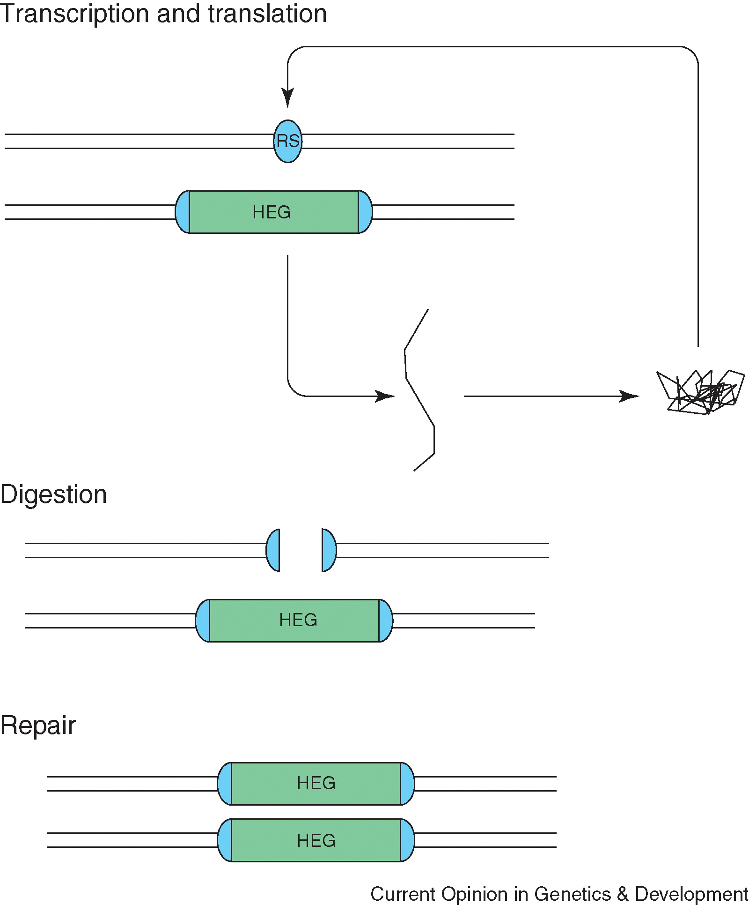


Intein Homing
Intein = Intervening Protein sequence
= “protein intron”
Modified from
Self Splicing
Domain
Homing Endonuclaease
Domain

Slide 4
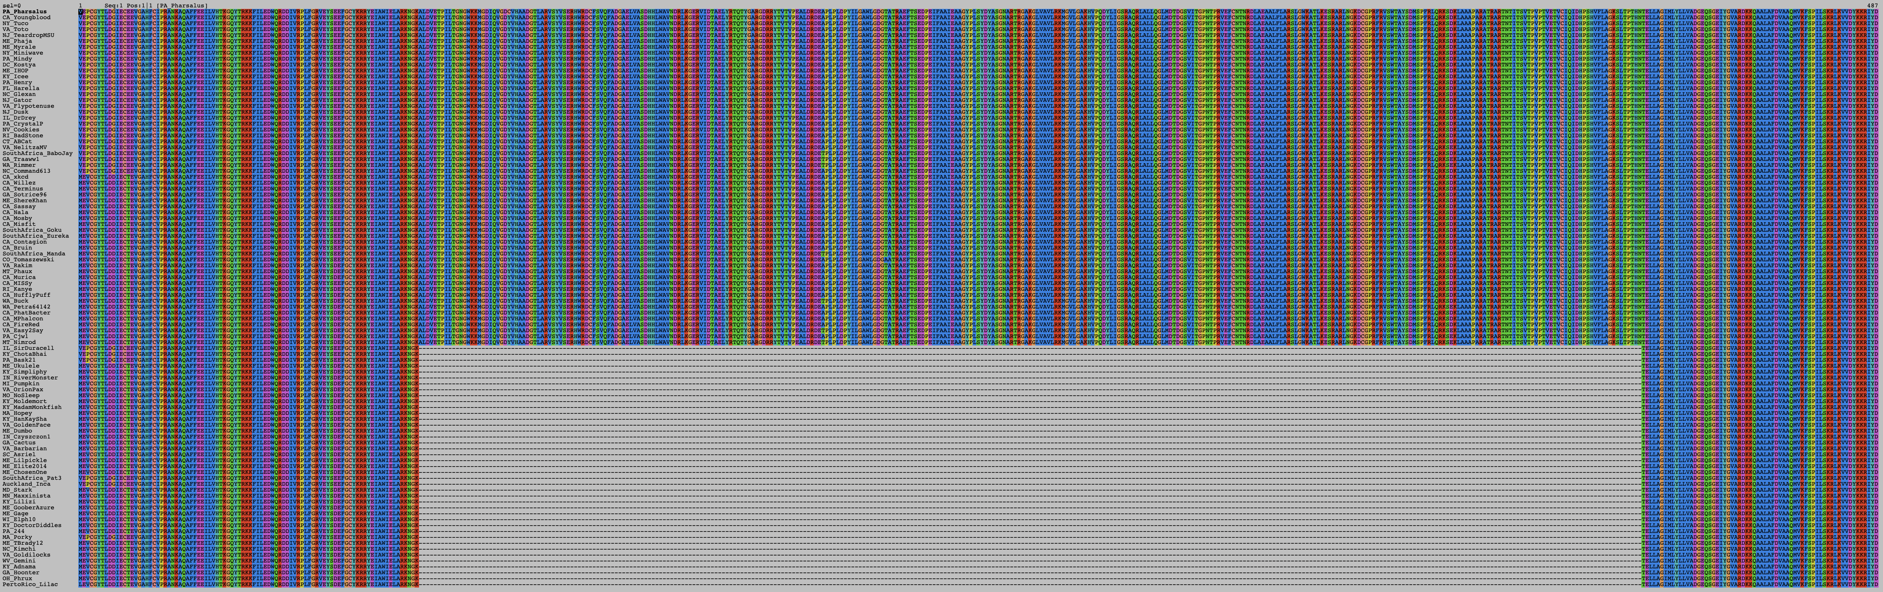
Terminase (Intein) in Actinobacteriophages Cluster E
N-Extein
Intein
C-Extein

Slide 5
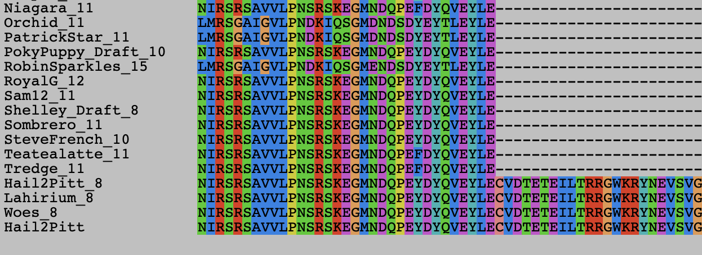
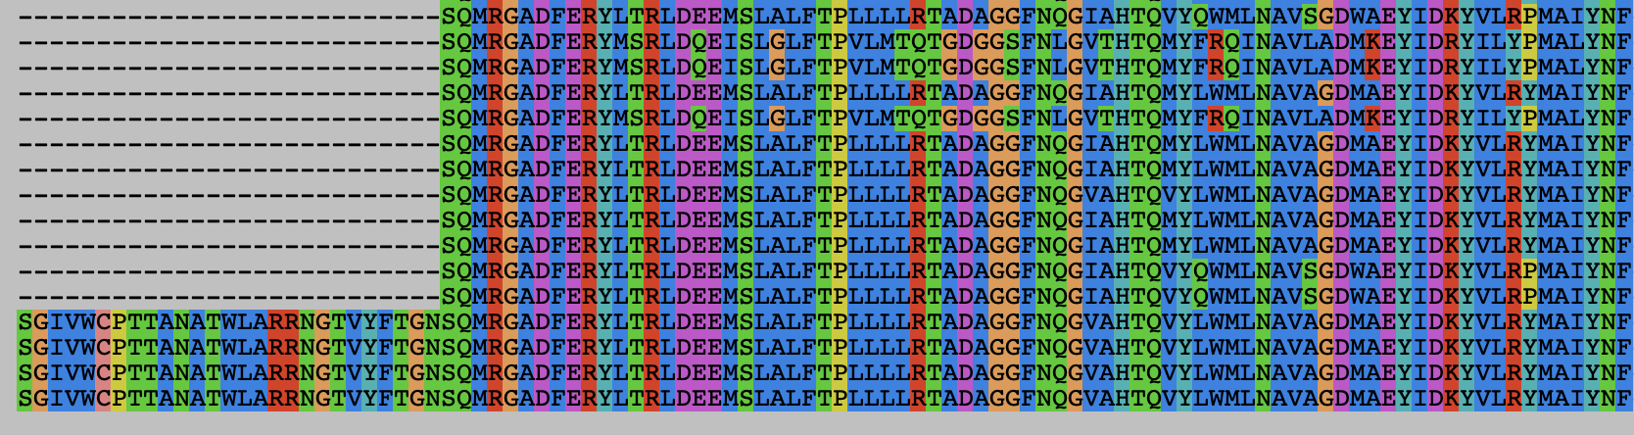
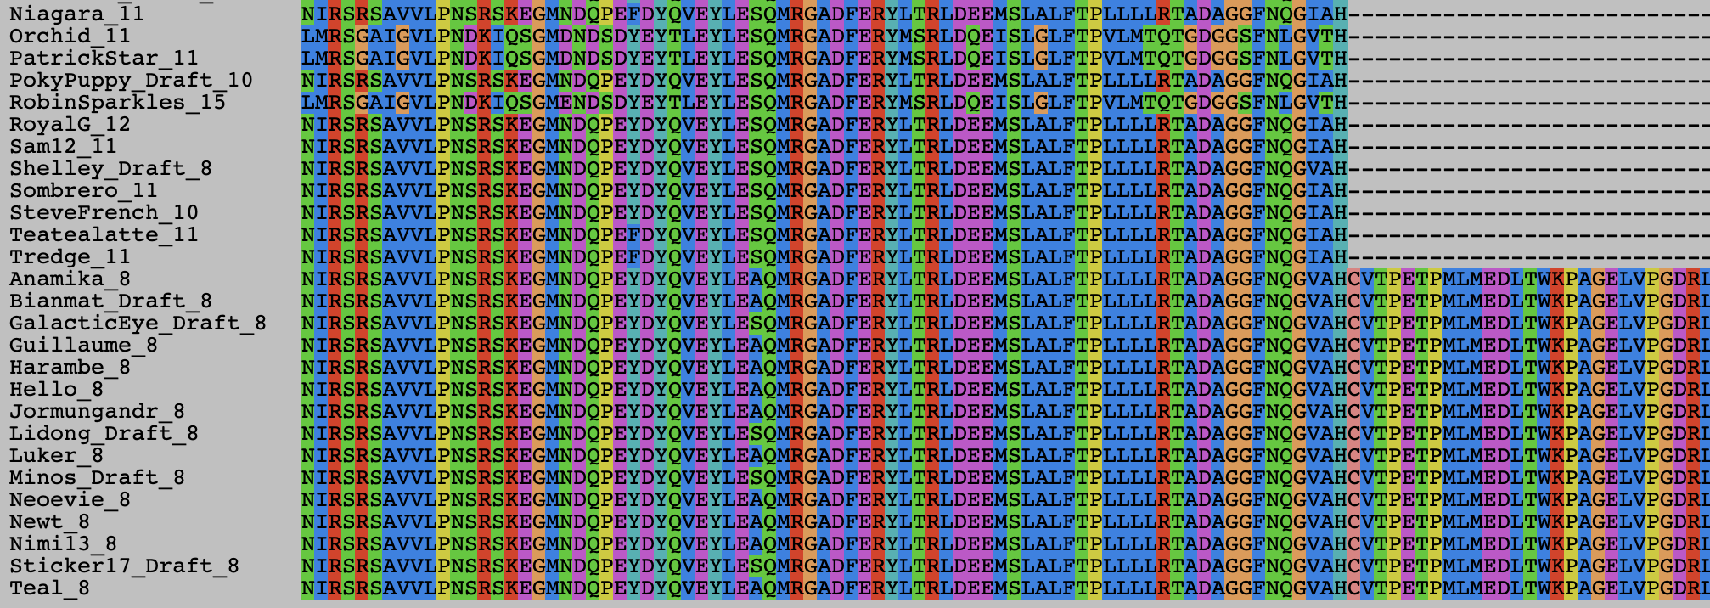
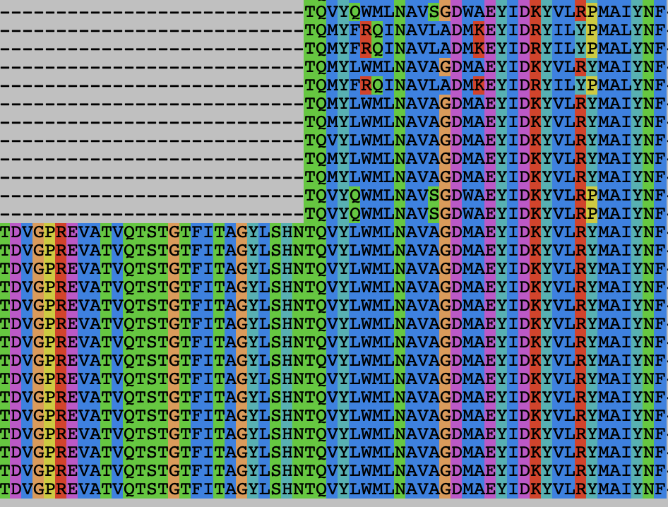
Multiple Inteins: Portal protein in Actinophage cluster CS
Intein a
Intein b

Slide 6
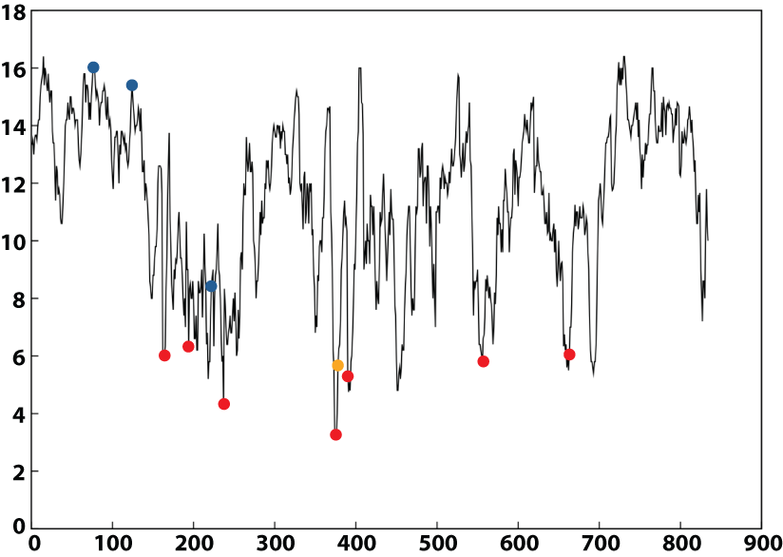
Ribonucleotide Reductase
Intein
Group I Introns
Group II Introns

Slide 7
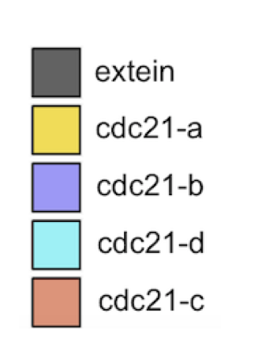
Haloquadratum walsbyi DSM 16790 is quadruply invaded
>WP_011572831.1 ATP-dependent DNA helicase [Haloquadratum walsbyi]
MAQAPQDPQDLTDRFIQFYRKYYRDDIGTLAQQFPHEKRSLYIDYHDLYAFDVELAEDYRREPDQLREYA
EEALRLYDLPADVKLGRAHVRMRSLPDTVDIRNIRVHDDHIGHLIAVQGIVRKATDVRPKITEAAFECQR
CGTMTYIPQSDSGFQEPHECQGCERQGPFDVDFDQSEFIDAQKVRVQESPEGLRGGETPQSIDVDLEDDA
TGAVTAGDHVTTTGVLHIEQQTSGNEKTPIFDIYMDGRSVEIEDEEFDDMDITDEDVAEIVELSNDPDIY
EKMVESVAPSIYGYDEEKLAMILQLFSGVTKHLPDGSRIRGDLHMLLIGDPGTGKCVSGETDIALVEGKT
ATIGELVESALTDPKPVDDGVWDTADFTVTSAIETGELIERDVTRVWKRQSPETMRQIQIAGGRSVTVTP
SHPVFVEHNGSYTARRADSLSAGESVAIADDVADSHPISVDNTANTLNPRSMSTPGITTDGGLYRTGSDG
GIVHAEVGKEDVTDCLTTDRITAVKTVTPTAEWVYDLEVEGTHAYLTNGVLSHNSAMLQYIRNIAPRSVY
TSGKGSSSAGLCVTGETRIHTTDGFVPLKQLATQHHPKKVTTETAAAYERELYTVDPTTQSAEVTQSKSS
HVWRMPEKHCRRIRTASGKQLEASVNTPVLTVDDAEIKWKPISAIESNDSVVIPQYNNVERSSVSITDIF
EFTQEQLKLTEKSITILRTEIVSQYQNIAAAADALNIDVNSVEALITGQPVVSDVIDRVCDAISVSSEDI
TIHHVIGPTGTAIELPEVLNDDLLYLLGAAFACGNIMTGETCEERWIQFHAPEESIRSHIIDAAVATFGS
ESIQTDTEQANTVQVISATVTRLFETLGLEQITDAAPREIHPRLTAVSGADAFIRGLFDTGGRIDNKNTP
QIAIGTASEPLAEQIQLLLETYGIGSCRDTGDQSHTGTSTTQGQYLTLTGSDAQAYRTTIGTRTDSGSSW
DRQVSSSHADSEPSVRSTTTDTRKRTDMHEHEIISAGDVSTVSSVESDGGTPQMPRSNIEPQSIGYDYES
SRVNEIQTETVVEAVNTGKKEVFDLTVPNTQNFIGGGIVTHNTAAAVRDDFGDGQQWTLEAGALVLADKG
IAAVDELDKMRCVTGETLVSLADGRHVPIASLATDASKTGTIESKPDGVGRTIRGIDDLTVWTMTENKQL
TGRPVTAIHQYDSPDTLWQITLSDGSEVTTTADHPFIIINRDGVHECPAKHLSENDEVYTPADGYTASTS
DITPDSETSSDSLPDGGITQTRTNQYSSHRCDADLSDDELLDITTKTIKSIETVHPSDGTDVYDLTVSGT
HNFVANGMIVHNSEDRSAMHEALEQQSYHPRSEVLLADGQRIDIGTFVDSRIEKNNANVIDGINCEILPV
DDIDVYTVDTDTGSASTVSIDRVSRHPAPSEFIRVKFSNGRSVLVTPEHPMFIDDGSETKTVQANALSGG
EFVPAPHHLPGVNTDASSVSDDINDVSTIRTHVRSRARAKAEVEVRATDGEFKLIDAAQTLGIITAVGKV
SVDAPERGIIVDMDRTVDSSKDSINNVLGSVIPSNDNDSITRVQDTGSTGNQWRWSVNTFIERMIEIAPA
VTADRPNRRVPDAVLGGSEAVVQQFLTGVIIAAGRILDETIRIYASSNELACDYADAFLRLGITASVEDG
PAEIAAQTVIKCDSDYERACGMFDISSSRTTPSDTSSQNNQSSVTAQNEDTHQTTSHEILPSGIADELQS
IRQLLNIPASEQLASITAGDDGIALSIARAEINLLRDHIETLRMDTENVSIGRDDCVTPTISSSSKYKYA
KNSITSDENLQLFGQSQAQLSERTKTTESSSISASTDLVSIPANISENRLVAATQRLDEVETRCNRRYHR
VIAVDTVSNAGPHACEWVYDITVEPTNTFISSGVVLHNSISVSKAGINATLKSRCSLLGAANPKYGRFDQ
YEPIGEQIDLEPALISRFDLIFTVTDEPDPDADAKLADHIINTNYAGELHTQKANIPNSEFTDGEVESAT
AEVTPTIDAELLRKYVAYARRNCYPTMTDDAQDVIRKFYVDFRAKGADDDAPVPVTARKLEALVRLSEAS
ARLRLSDTVEQEDAKRVTSIVESCLRDIGMDPETGEFDADIVETGTSKNQRDRIKNLKHLIENIEADYDD
GAPVDEVIEQAISELGLSESKAEGEIENLRAKGEVYEPRTGSLRTT
H. walsbyi DSM 16790 (NC_008212.1) is one of few quadruply invaded strains.
Mini inteins are present at sites cdc21-a and cdc21-d. Full inteins are present at sites cdc21-b and cdc21-c.

Slide 8
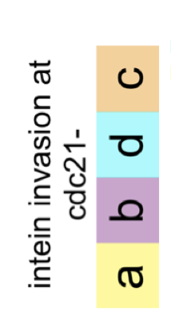
cdc21 extein (aka mcm2) phylogeny in Haloarchaea -
intein presence at the four insertion sites is color coded
large inteins and small inteins are indicated by upper and lower case characters
Notes:
Inteins have a very disjunct distribution, indicating frequent intein loss and gain

Slide 9
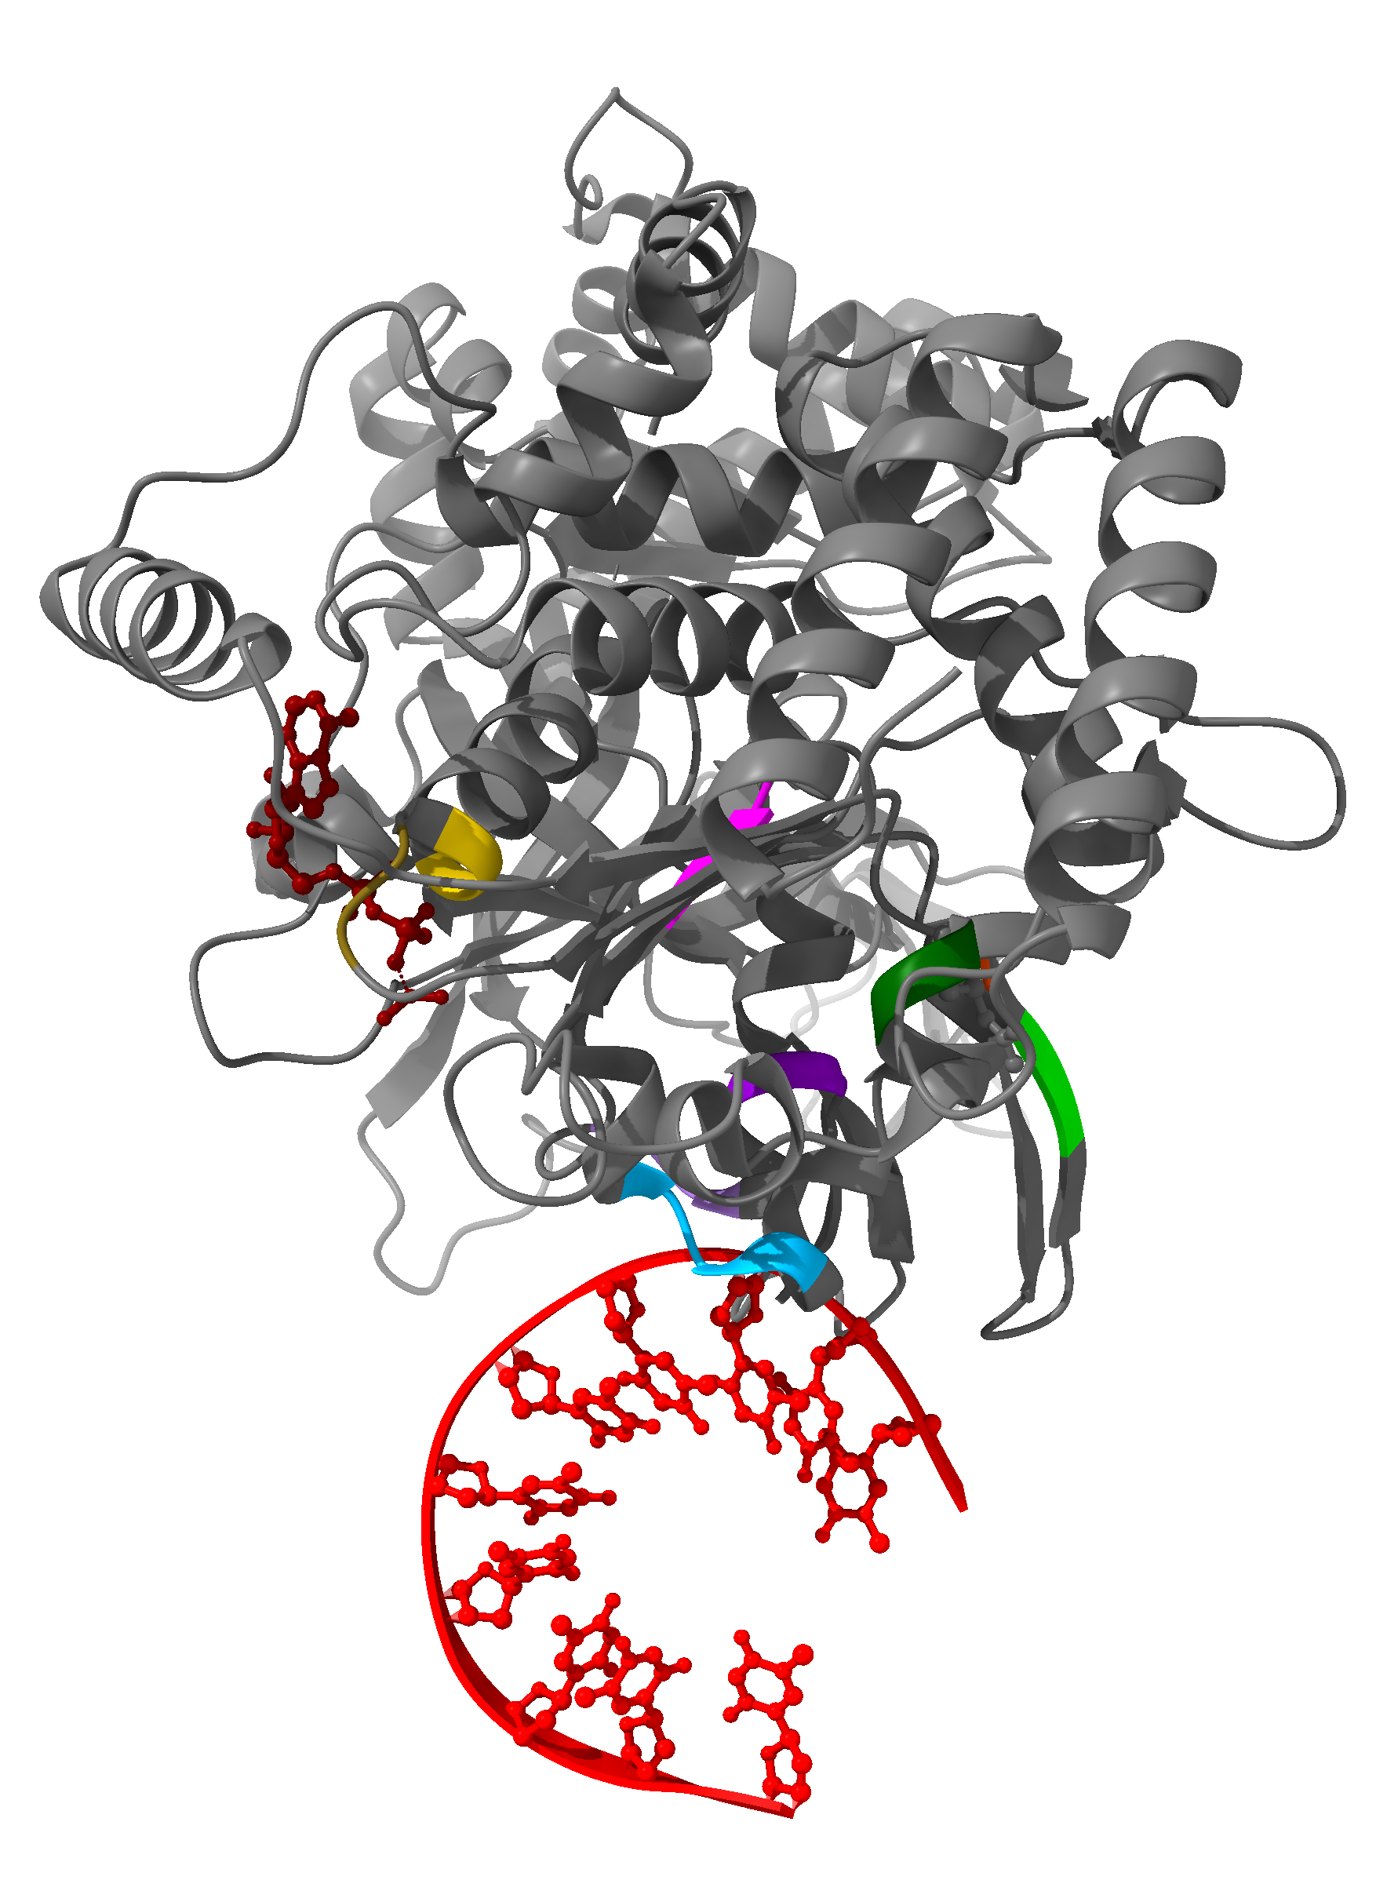
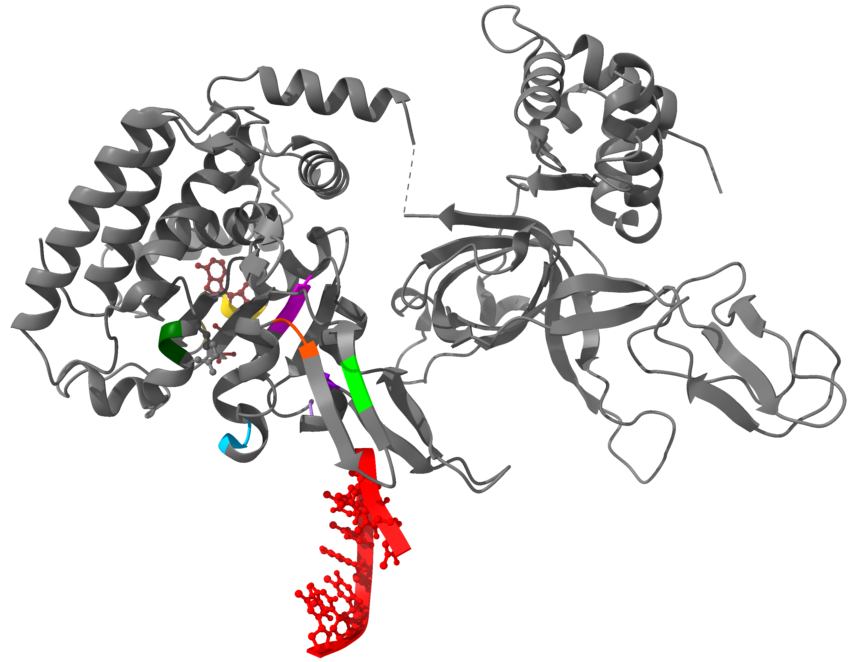
Eleven intein insertion sites fall within the catalytic domain
“front” view
“side” view
90°

Slide 10
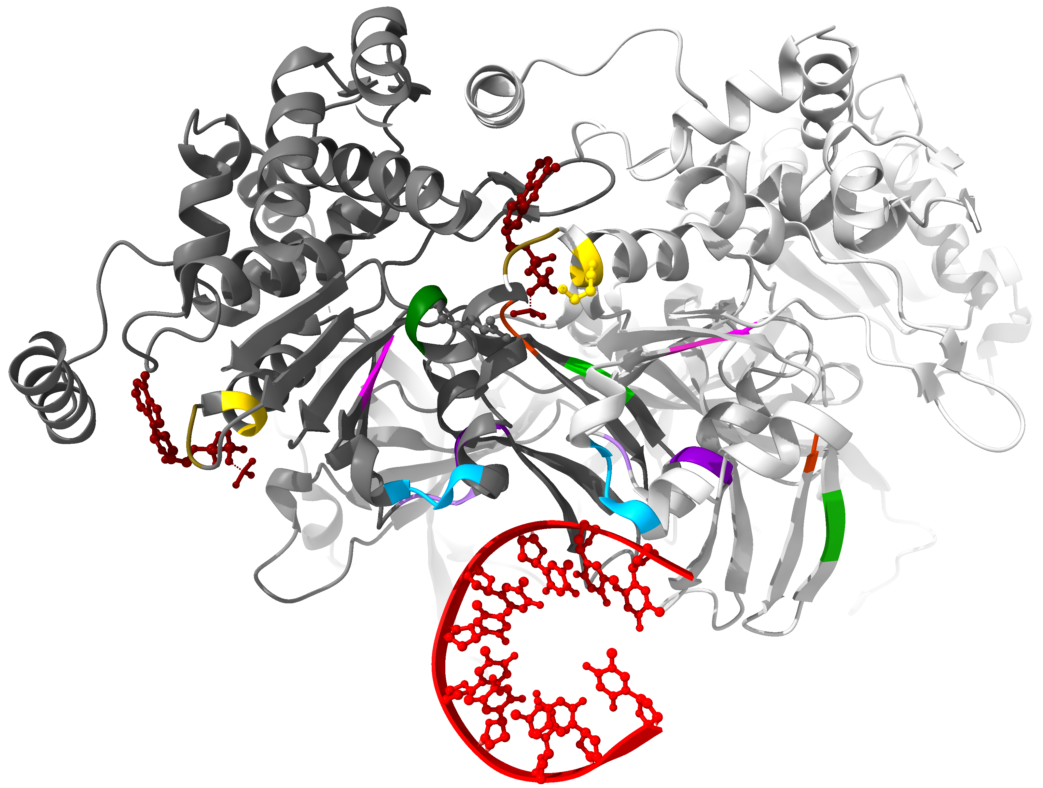
2/6 subunits of MCM homohexamer shown to visualize ATP-binding site at interface

Slide 11
Terminases Cluster E
Extein phylogeny
Black: No intein
Red: Intein present
Notes:
Note: deep divergence between two groups

Slide 12
Terminases ClusterE -- only intein containing terminases included
Leaves have the same color in both trees

Slide 13
How do inteins persist in evolution?
Homing cycle
(similar to Goddard and Burt, Recurrent invasion and extinction of a selfish gene PNAS 1999 doi: 10.1073/pnas.96.24.13880)
Intransitive fitness relationships
Environment with different niches that favor the different alleles (with and without intein)

Slide 14
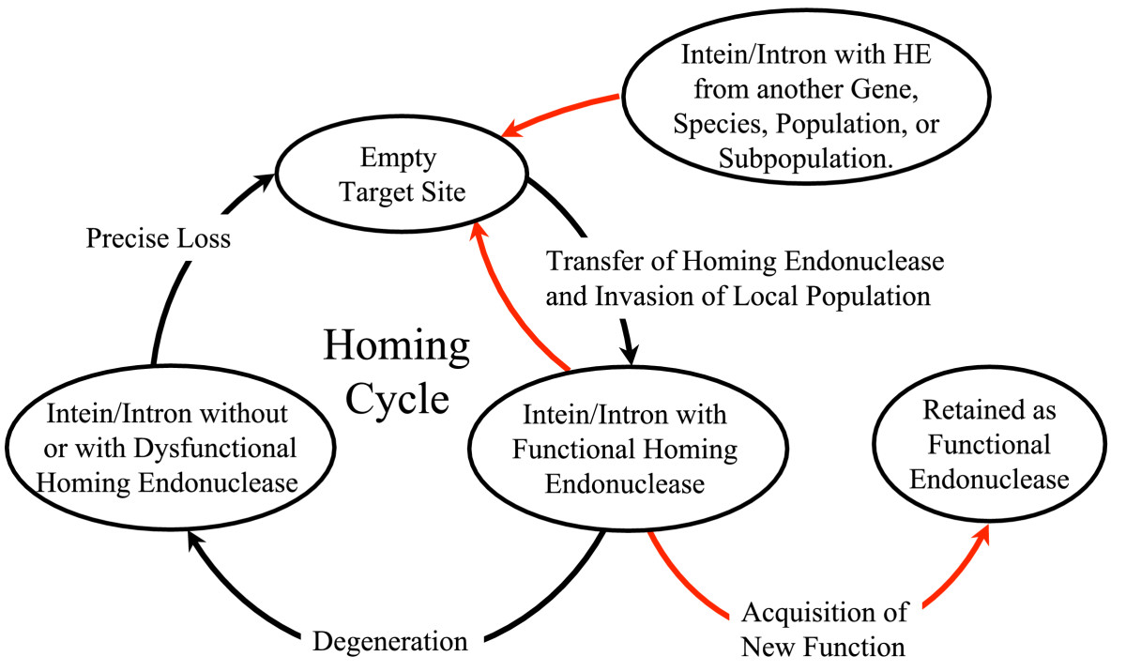
Homing cycle of a parasitic genetic element (modified from [3, 13]). Recent findings suggest that due to complex population structure the cycle might not operate in synchrony in different subpopulations. The red arrows indicate the trajectory of the functioning HE and the black arrows the fate of the host gene. The precise loss can occur through recombination with an intein or intron free allele, or, in case of introns, through recombination with a reverse transcript of the spliced mRNA [39, 40].

Slide 15
How do inteins persist in evolution?
Homing cycle
(similar to Goddard and Burt, Recurrent invasion and extinction of a selfish gene PNAS 1999 doi: 10.1073/pnas.96.24.13880)
Intransitive fitness relationships
Environment with different niches that favor the different alleles (with and without intein)

Slide 16
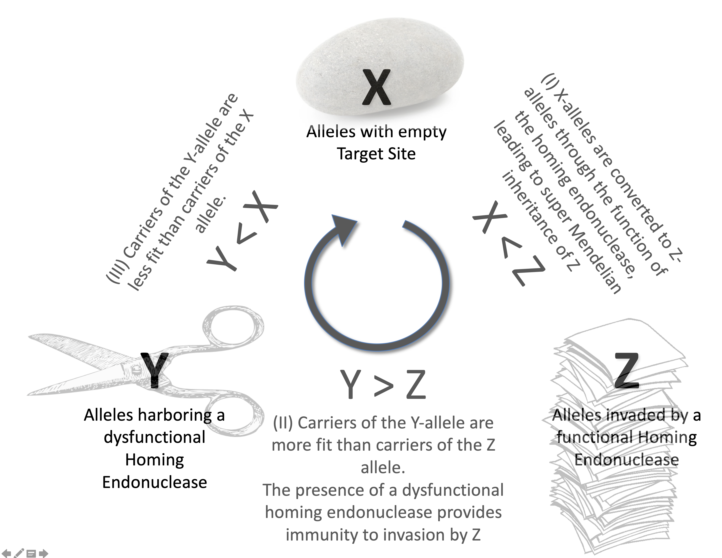
Coexistence of the three forms
A Molecular Rock-Paper-Scissors game
Simulations using difference-equations in
populations of limited size
Barzel et al. BMC Evolutionary Biology 2011 11:324 doi:10.1186/1471-2148-11-324

Slide 17
How do inteins persist in evolution?
Homing cycle
(similar to Goddard and Burt, Recurrent invasion and extinction of a selfish gene PNAS 1999 doi: 10.1073/pnas.96.24.13880)
Intransitive fitness relationships
Environment with different niches that favor the different alleles (with and without intein)

Slide 18
Co-existence in a heterogenous population
Arguments in favor for a co-existence in a heterogenous population
the intein can have a strong negative effect on organismal fitness
Due to the large fitness cost, the intein + and intein – alleles dominate during different parts of the growth curve
Co-existence of the intein with homing endonuclease (P+)
and the allele with an empty target site (P-) in a heterogenous
environment.
Intein containing and intein free alleles have been isolated from the same populations.
(See Shannon Soucy and Yutian Feng)

Slide 19
Some inteins have a large fitness cost
Fitness cost due to
the intein: 7%
From: Naor A, Altman-Price N, Soucy SM, Green AG, Mitiagin Y, Turgeman I, Davidovich N, Gogarten JP*, Gophna U* (2016)
The impact of a homing intein on recombination frequency and organismal fitness.
PNAS 113 (32): E4654–E4661 doi:10.1073/pnas.1606416113

Slide 20
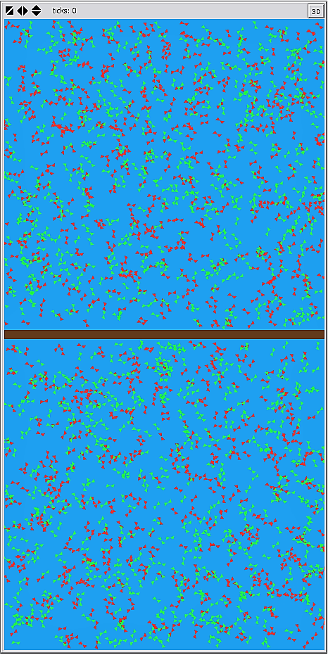
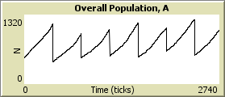
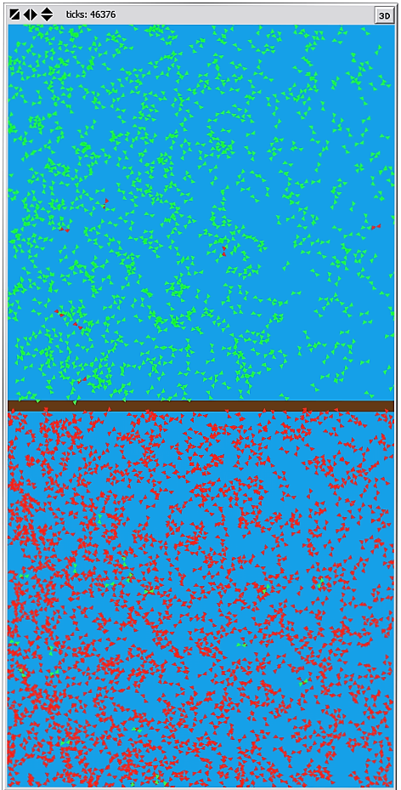
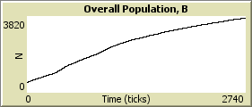
Agent-Based Modeling of Microbial Communities
The agent-based modeling platform NetLogo was used to assess the population dynamics of molecular parasites known as inteins
Simulated microbial agents independently move, acquire resources, replicate, mate, and die
User-defined parameters influence cellular movement, mating frequency, and community growth state
The ultimate distribution of inteins was dependent on whether the community spent more time in exponential or stationary phase
Limited transfer between sub-environments promoted limited allele coexistence
A
A
Population held in exponential phase
B
B
Population enters stationary phase

Slide 21
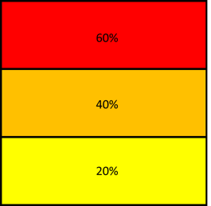
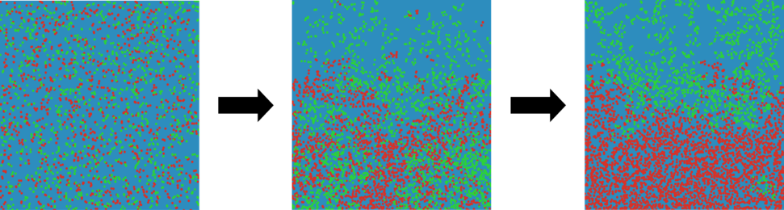
One environment with a gradient in efficiency of local extinction events
Extinction efficiency
Development over time
Close to stationary phase: Inteins transmission continues,
increasing the frequency of the invaded allele
During active growth: Due to fitness cost of the intein, the
frequency of the noninvaded allele increases

Slide 22
The trajectories after disturbances plotted as vectors --
0 (immediately after the disturbance) -> 4 generations later

Slide 23
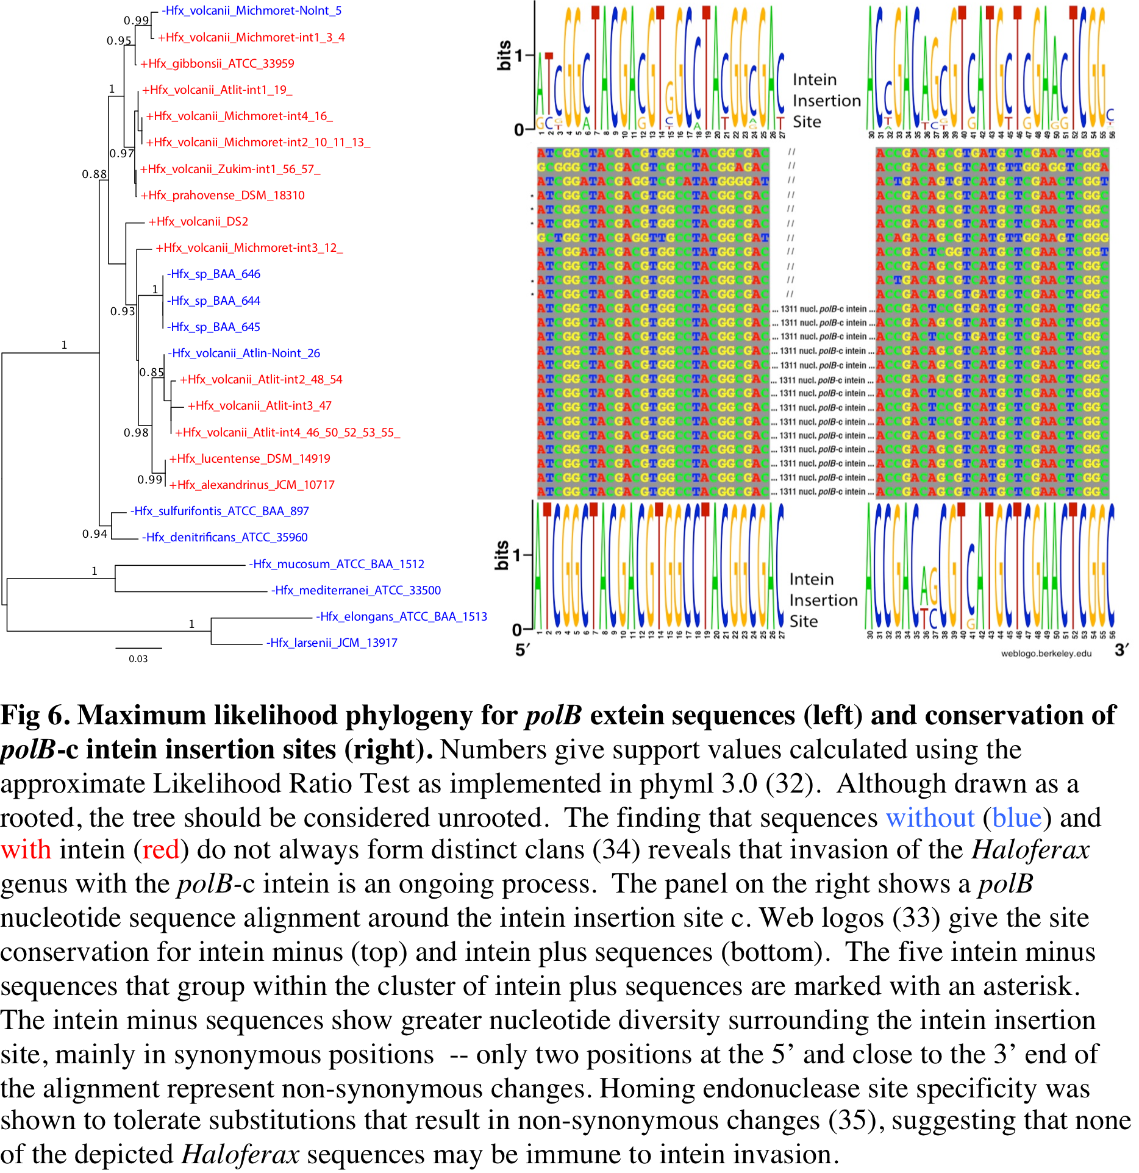
Notes:
From: Naor A, Altman-Price N, Soucy SM, Green AG, Mitiagin Y, Turgeman I, |
Davidovich N, Gogarten JP*, Gophna U* (2016)
The impact of a homing intein on recombination frequency and organismal fitness.
PNAS 113 (32): E4654–E4661 doi:10.1073/pnas.1606416113

Slide 24
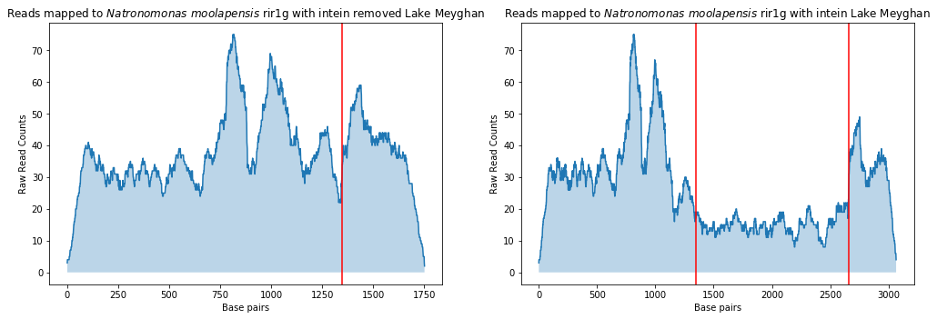
Frequency of reads mapped to Natronomonas moolapensis rir1g
Metagenomic reads from Lake Meyghan* mapped back to reference sequences with and without the intein.
Intein was artificially removed, to intact insertion site.
Red lines indicate intein boundaries, sharp decrease in coverage when intein removed.
*Naghoni, A. et al. Microbial diversity in the hypersaline Lake Meyghan, Iran. Sci. Rep. 7, (2017).

Slide 25
Do inteins have a function beneficial to the organisms?

Slide 26
Inteins with homing endonuclease certainly started out as selfish genetic elements.
Current Controversy:
Did inteins acquire a function that is beneficial to the host?
Yes, in case of the mating type switching endonuclease in yeast that evolved from an intein.
Maybe in case of phages, where in case of a double infection with two phages, one with, one without an intein.
Maybe in case intein splicing is sensitive to environmental conditions, inteins could an emergency shut-off preventing the synthesis of new functional proteins.

Slide 27
Inteins with homing endonuclease certainly started out as selfish genetic elements.
Current Controversy:
Did inteins acquire a function that is beneficial to the host?
Yes, in case of the mating type switching endonuclease in yeast that evolved from an intein.
Maybe in case of phages, where in case of a double infection with two phages, one with, one without an intein.
Analysis support inteins as parasites, that are frequently gained and lost.
Maybe in case intein splicing is sensitive to environmental conditions, inteins could an emergency shut-off preventing the synthesis of new functional proteins.
Lack of vertical inheritance and the intein’s fitness cost make this unlikely for most inteins

Slide 28
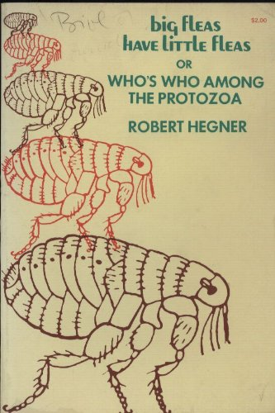
Siphonaptera
Great fleas have little fleas upon their backs to bite 'em,
And little fleas have lesser fleas, and so ad infinitum.
And the great fleas themselves, in turn, have greater fleas to go on ;
While these again have greater still, and greater still, and so on.
From: Augustus De Morgan’s poem Siphonaptera (1872)
via https://en.wikipedia.org/wiki/Siphonaptera_(poem)

Slide 29
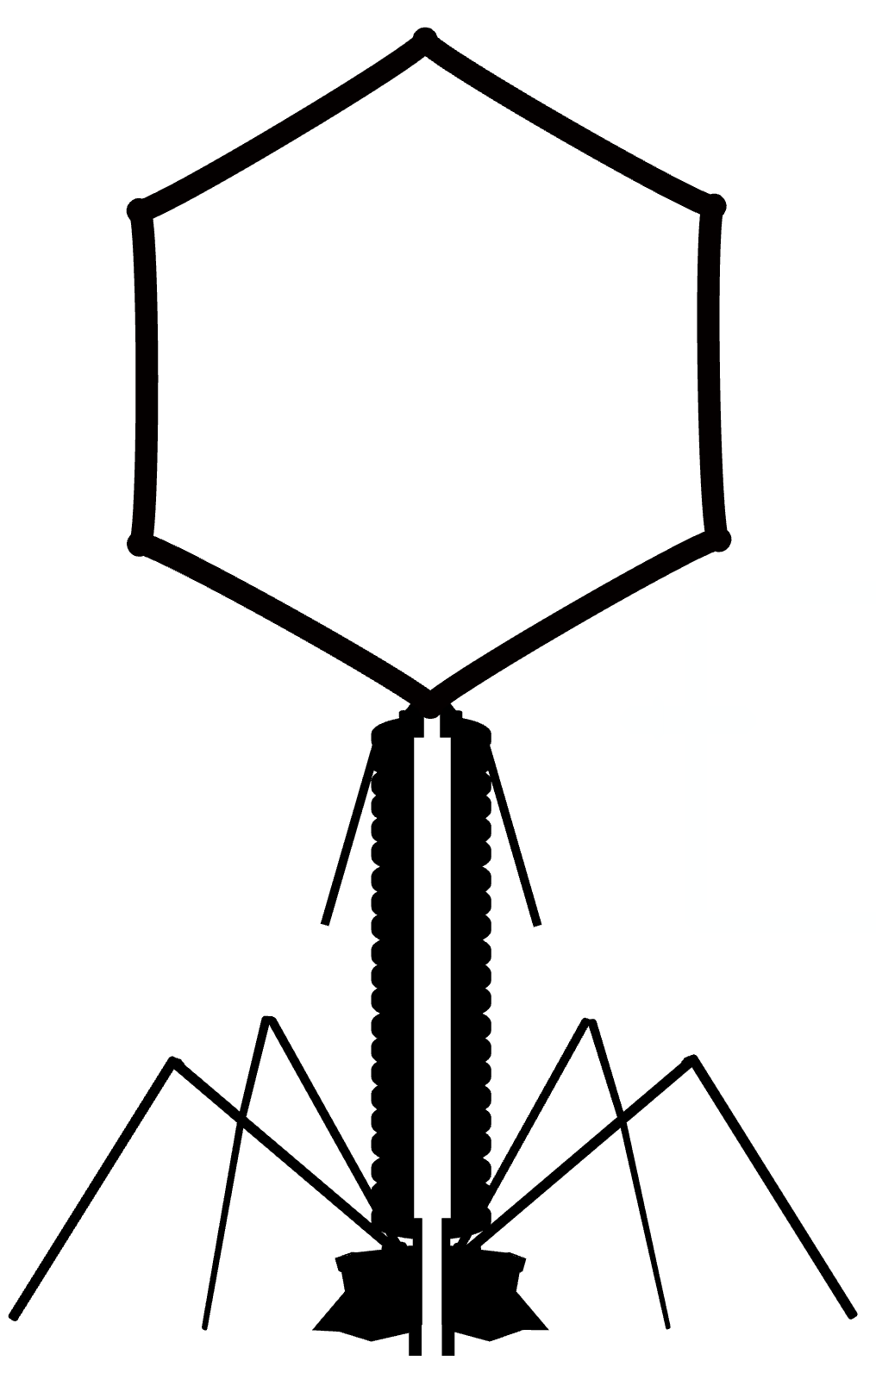

Phage with Intein
Phage w/o Intein
Bacterial Cell
x
Intein

Slide 30
Phage Assembly
From: Corynne L. Dedeo, Gino Cingolani, and Carolyn M. Teschke:
Portal Protein: The Orchestrator of Capsid Assembly for the dsDNA Tailed Bacteriophages and Herpesviruses
Annual Review of Virology 2019
Notes:
Terminase plays a crucial role in packaging DNA into the phage head. It’s subunits form a complex with the Portal proteins, it provides energy to pump DNA into the head, and contains a nuclease the cleaves the DNA, when the head is full – communicated through conformation changes of the portal protein and interaction with the ATP driven DNA pump.
.

Slide 31
Exteins and their inteins from homologous terminase subunits in the A1 cluster
Extein

Slide 32
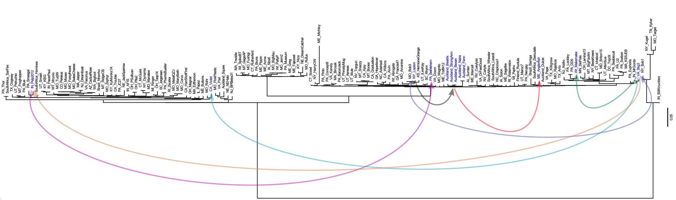
Reconciliation between extein and intein trees
This is one of many equally parsimonious reconciliations (allowing for transfer, duplication and loss).
Note that the Auckland cluster requires only one intein acquisition at the base.

Slide 33
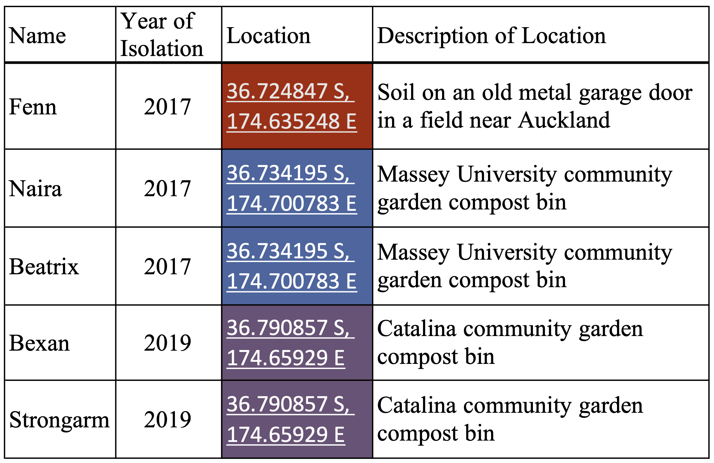
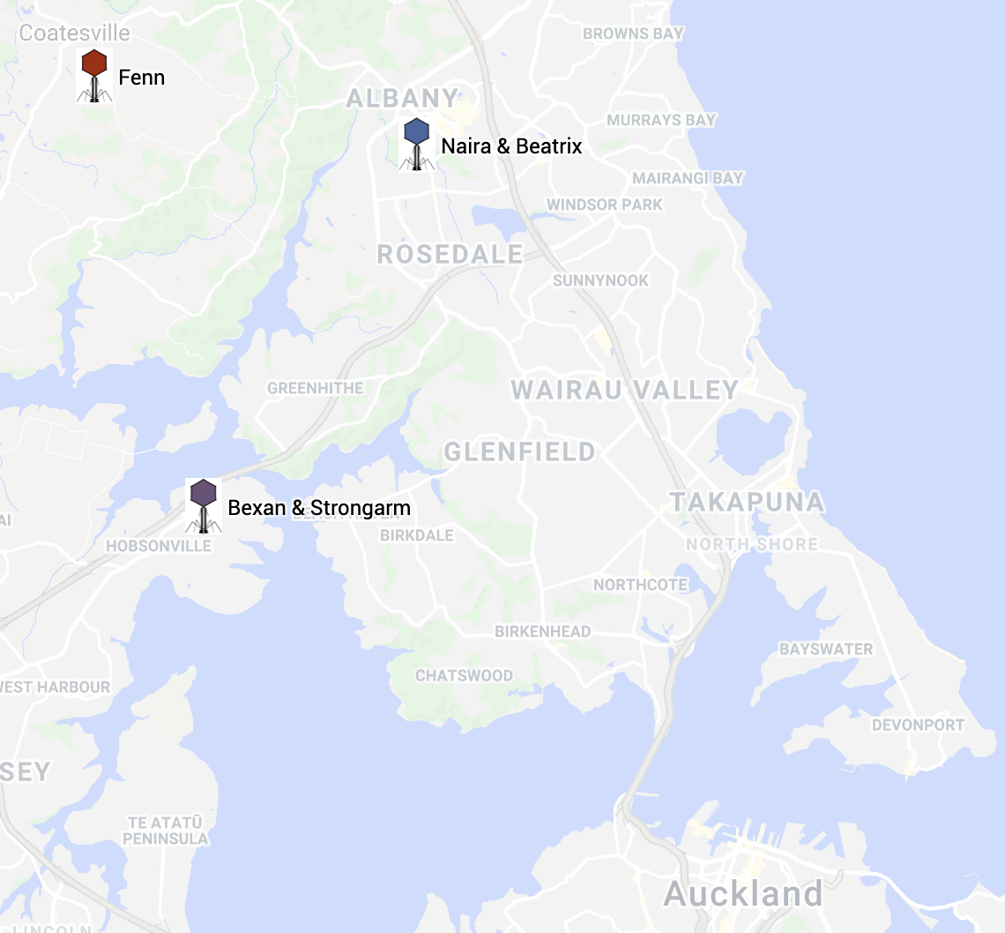
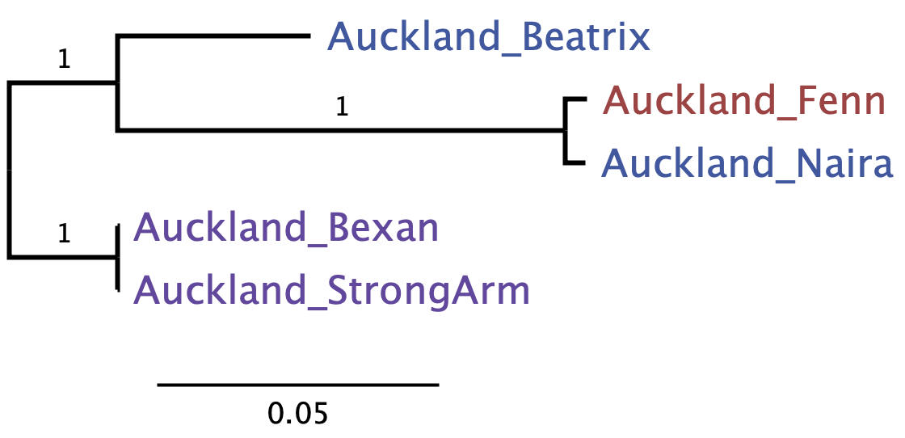
The A1 Phages from the Auckland area
Phylogeny based on genome sequences (topology is the same if the extein is used):
Notes:
Bexan and Strongarm differ by one nucleotide and a 128 nucleotide indel (Bexan has a deletion that fuses two neighboring minor tail proteins into a single larger ORF)

Slide 34
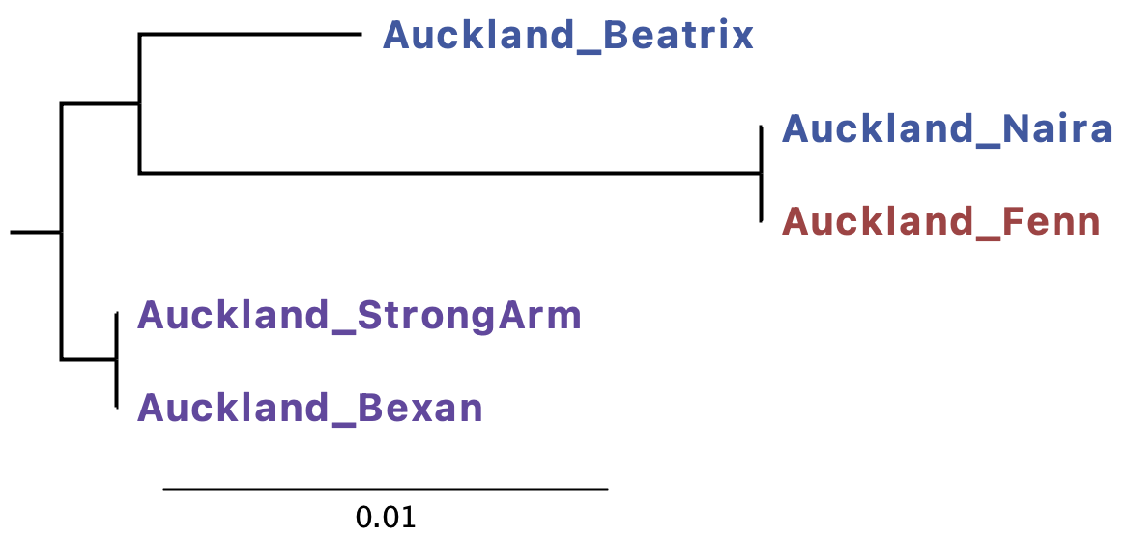
The A1 Phages from the Auckland area
 | Number of sites | Number of sequences | Number of Polymorphic sites (only SNPs) | Watterson’s Theta
Extein | 1689 | 5 | 31 | 0.0088
Intein | 1023 | 5 | 0 | 0
Phylogeny based on extein sequences (topology is the same if the whole genomes are used):
Notes:
Bexan and Strongarm differ by one nucleotide and a 128 nucleotide indel (Bexan has a deletion that fuses two neighboring minor tail proteins into a single larger ORF)

Slide 35
Terminases ClusterE -- only intein containing terminases included
Leaves have the same color in both trees

Slide 36
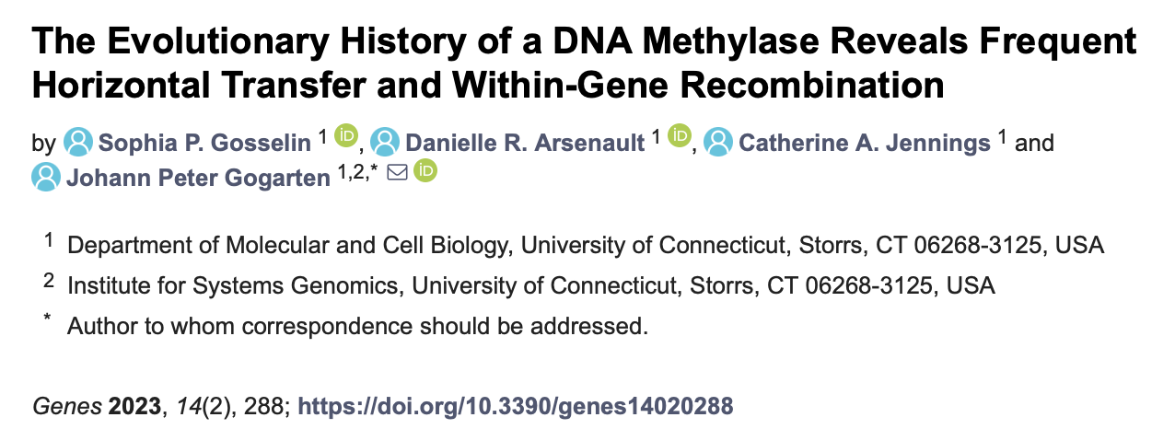

Slide 37
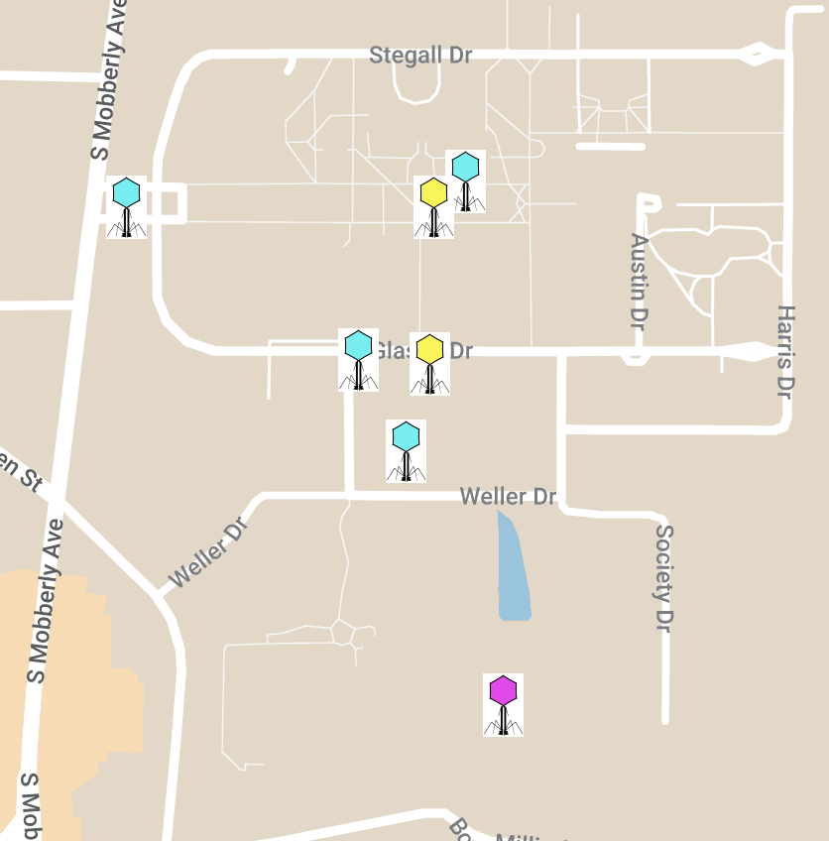
Methylase Extein Phylogeny
Notes:
Cactusjack LeTourneau University 2018 32.4654 N,94.7273 W
Glaske LeTourneau University 2017 32.46555 N,94.72777 W
Phalm LeTourneau University 2018 32.466944 N,94.730278 W
StressBall LeTourneau University 2018 32.464719 N,94.727251 W
Megiddo LeTourneau University 2018 32.4624 N,94.7262 W
KilKor LeTourneau University 2018 32.4655 N,94.727 W
Willsammy LeTourneau University 2016 32.466944 N,94.726944 W

Slide 38
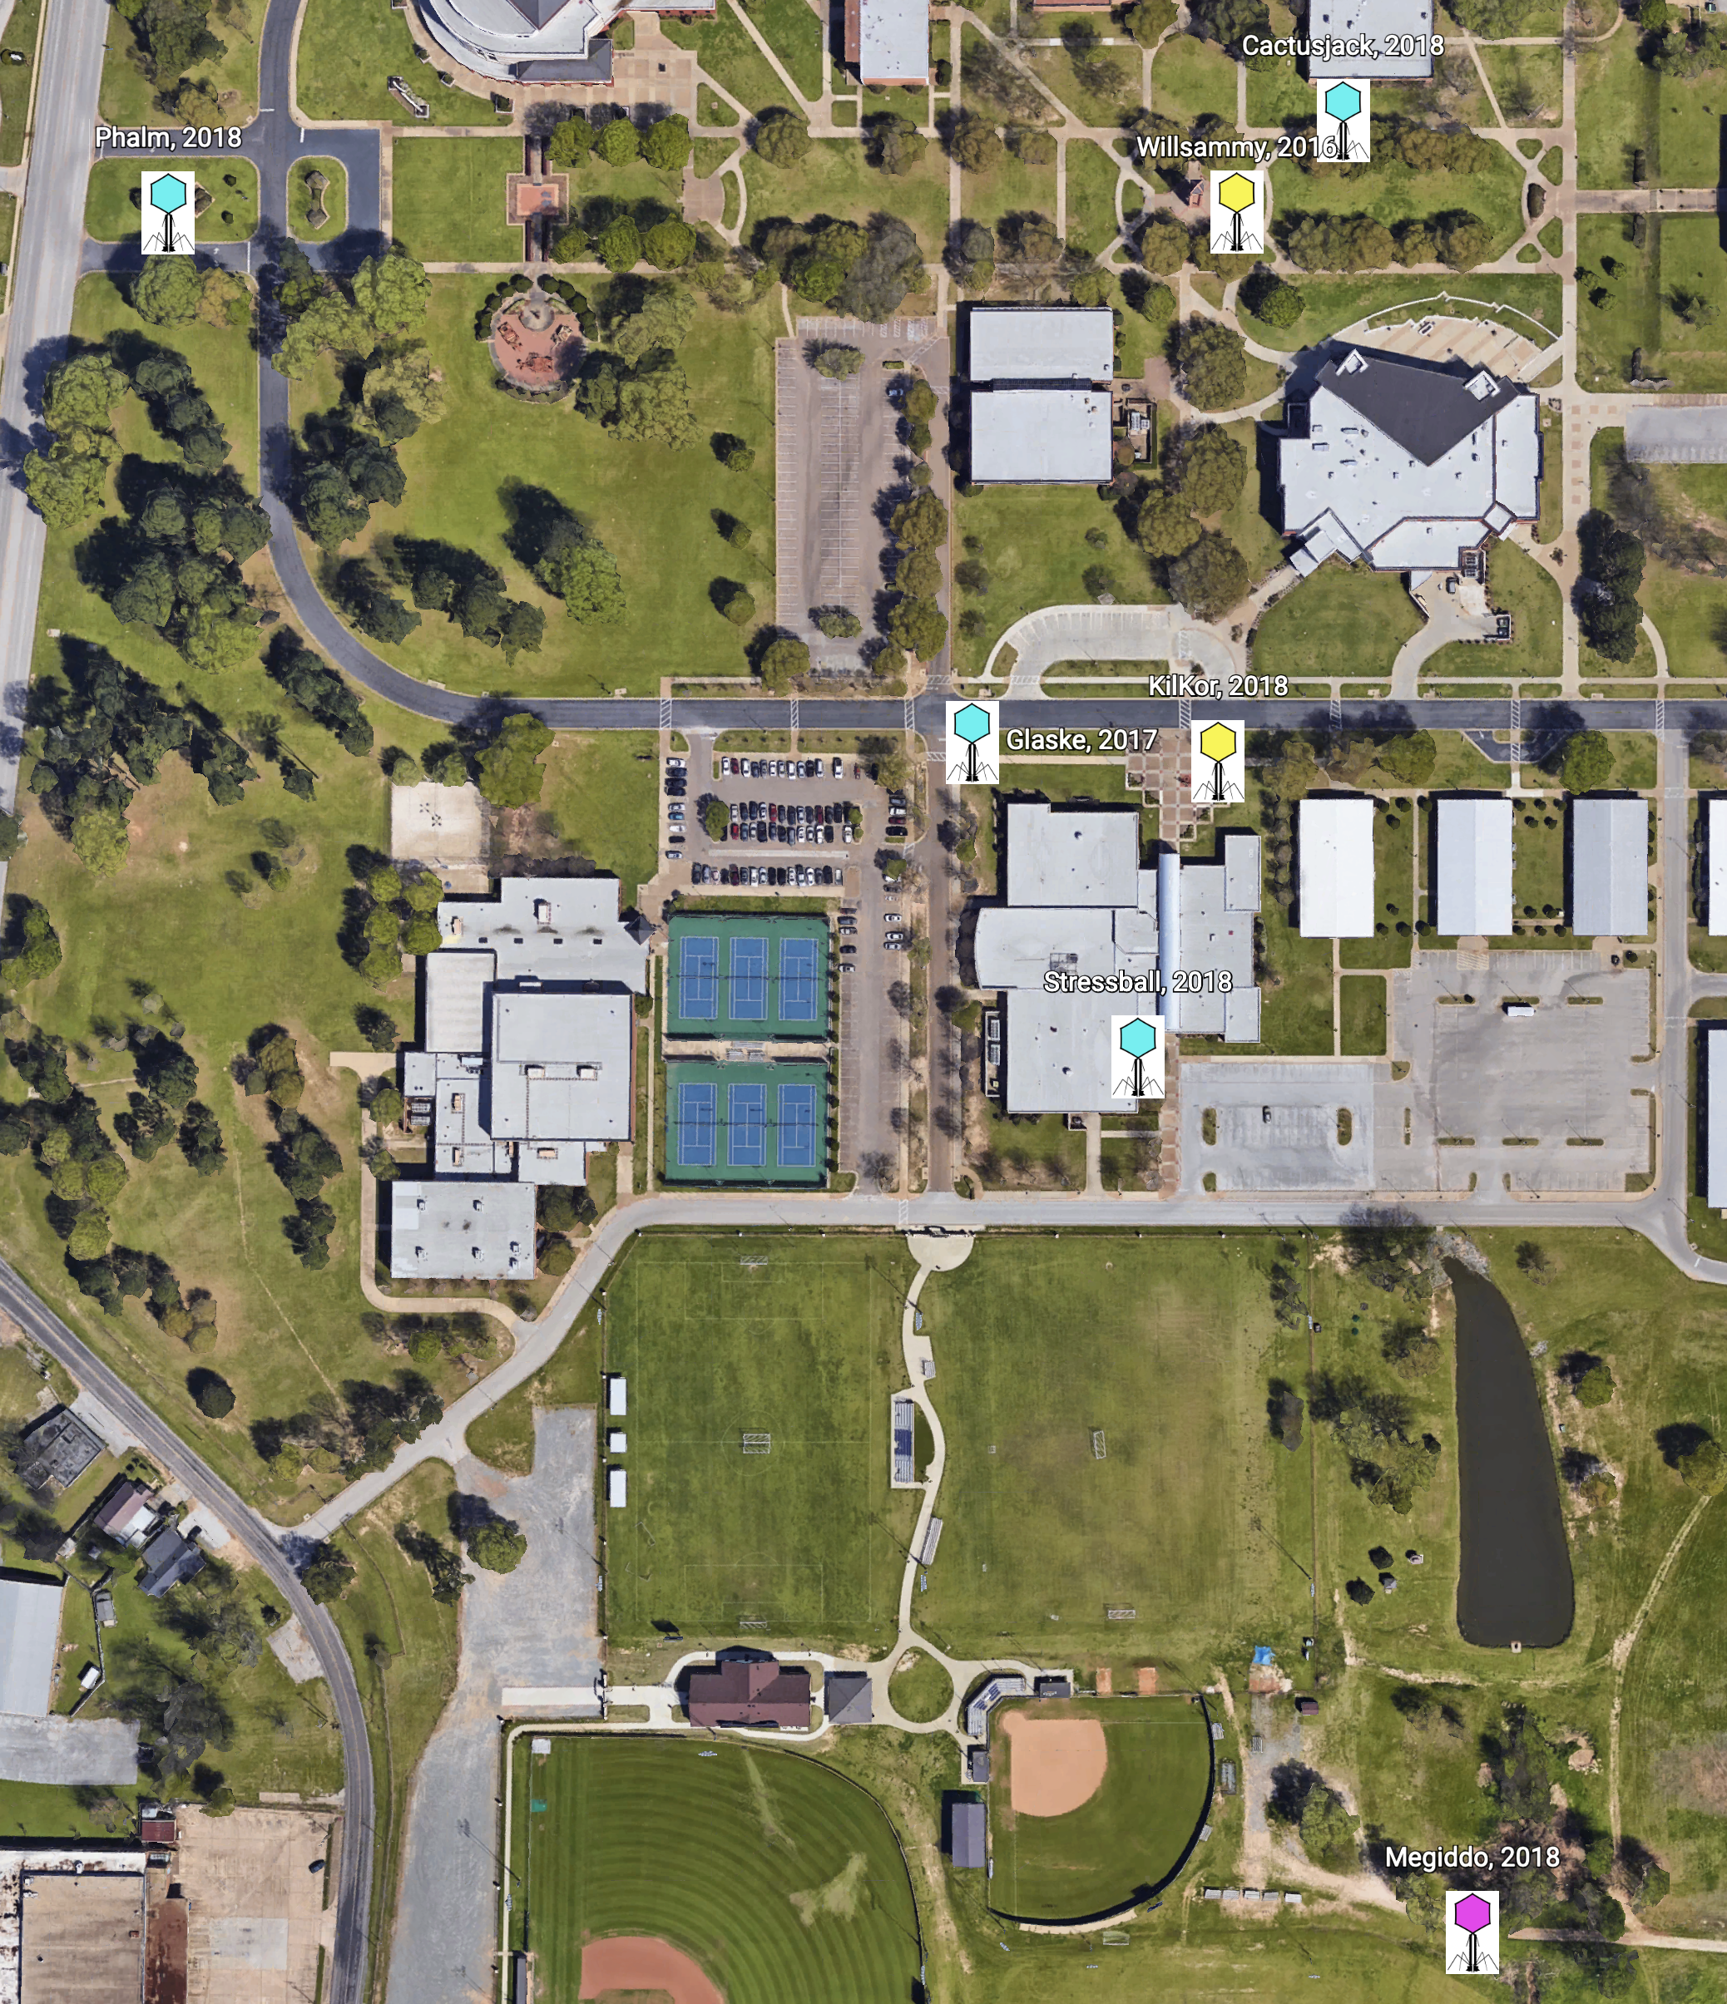
Name | Year | Location | Coordinates
Cactusjack | 2018 | planter outside of science lab | 32.4654 N,94.7273 W
Glaske | 2017 | soil beteen tree roots | 32.46555 N,94.72777 W
Phalm | 2018 | well-mulched flower bed | 32.466944 N,94.730278 W
StressBall | 2018 | flower bed behind our science building | 32.464719 N,94.727251 W
Megiddo | 2018 | soil at base of a bush in the wooded area | 32.4624 N,94.7262 W
KilKor | 2018 | soil below a tree in a flower bed outside of Glaske Center. | 32.4655 N,94.727 W
Willsammy | 2016 | below a tree between library and education building. | 32.466944 N,94.726944 W
Notes:
Cactusjack LeTourneau University 2018 32.4654 N,94.7273 W
Glaske LeTourneau University 2017 32.46555 N,94.72777 W
Phalm LeTourneau University 2018 32.466944 N,94.730278 W
StressBall LeTourneau University 2018 32.464719 N,94.727251 W
Megiddo LeTourneau University 2018 32.4624 N,94.7262 W
KilKor LeTourneau University 2018 32.4655 N,94.727 W
Willsammy LeTourneau University 2016 32.466944 N,94.726944 W

Slide 39
Methylase Extein Phylogeny
Exteins
(intein containing)
All isolated at
LeTourneau University
Texas in 2016-2018
Max 13% sequence divergence
Inteins
(intein containing)
Max 0% sequence divergence
Notes:
Cactusjack LeTourneau University 2018 32.4654 N,94.7273 W
Glaske LeTourneau University 2017 32.46555 N,94.72777 W
Phalm LeTourneau University 2018 32.466944 N,94.730278 W
StressBall LeTourneau University 2018 32.464719 N,94.727251 W
Megiddo LeTourneau University 2018 32.4624 N,94.7262 W
KilKor LeTourneau University 2018 32.4655 N,94.727 W
Willsammy LeTourneau University 2016 32.466944 N,94.726944 W

Slide 40
Phylogeny of an Actinophage Methylase Family
Exteins
Inteins
Max 13% sequence divergence
Max 0% sequence divergence
Notes:
Cactusjack LeTourneau University 2018 32.4654 N,94.7273 W
Glaske LeTourneau University 2017 32.46555 N,94.72777 W
Phalm LeTourneau University 2018 32.466944 N,94.730278 W
StressBall LeTourneau University 2018 32.464719 N,94.727251 W
Megiddo LeTourneau University 2018 32.4624 N,94.7262 W
KilKor LeTourneau University 2018 32.4655 N,94.727 W
Willsammy LeTourneau University 2016 32.466944 N,94.726944 W

Slide 41
Notes:
"24_08_14_cali_and_sa_nuctransferase.pdf" This figure shows the spread of the inteins invading nucleotidyltransferases.
(A) is the extein phylogeny. The colored circles indicate the presence of an intein, and the color designates which of our internal similarity clusters that intein belongs to. There are two clusters (orange and purple) the rest of this figure focuses on the orange ones. Note that the dotted lines flow to the location of isolation for the phage that contains this intein containing nucleotidyl transferase.
(B) A map of california showing sampling locations for these phages with inteins. Note the divergence of the extein sequences despite the highly similar intein sequences which is shown in (C).
(C) the intein phylogeny for the orange circle inteins. Everyone except Daffodil is practically identical.
(D) A map of Natal South Africa, showing the sampling locations for a seperate subset of these intein sequences
(E) Zoom in from (D) of the city of Durban.
(F) Overall global distribution of this intein. Note that this may be heavily biased by our sampling.

Slide 42
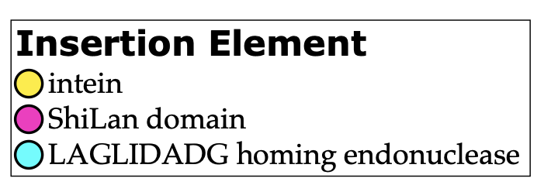
The Shilan Domain
Methylase Extein
Phylogeny
A new type of insertion sequence with disjunct distribution

Slide 43
Shilan domain
No self-splicing domain
Insertion sequence has a second ORF that creates a transcript encoding an HNH endonuclease

Slide 44
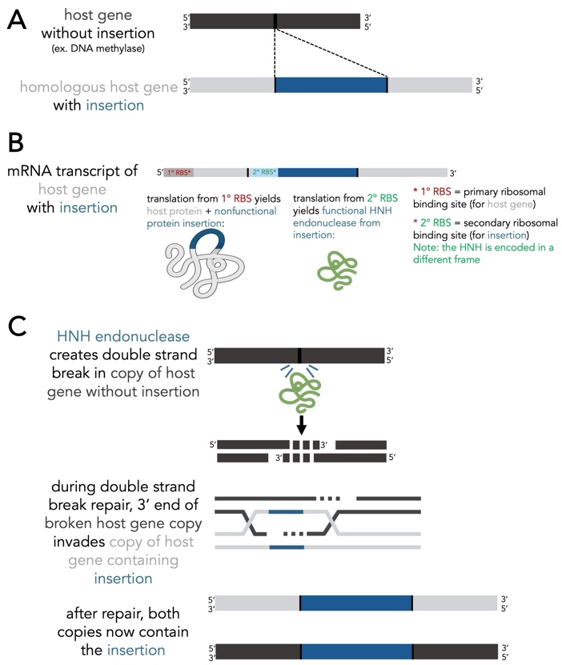
Host genes with and without insertion sequence.
(B) Depiction of second overlapping reading frame encoding an HNH endonuclease.
(C) Homing through double strand
break repair.

Slide 45
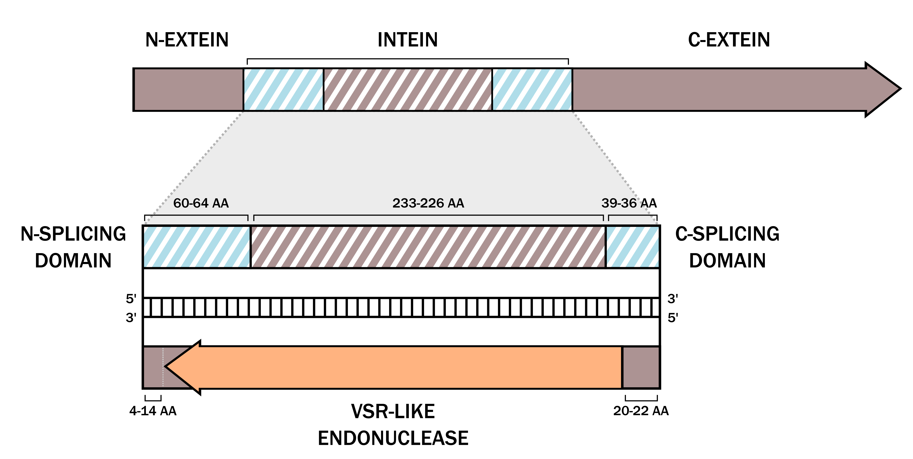
Unexpected Variations in Inteins
The homing endonuclease is encoded on the other strand with its own transcription and translation start site.

Slide 47
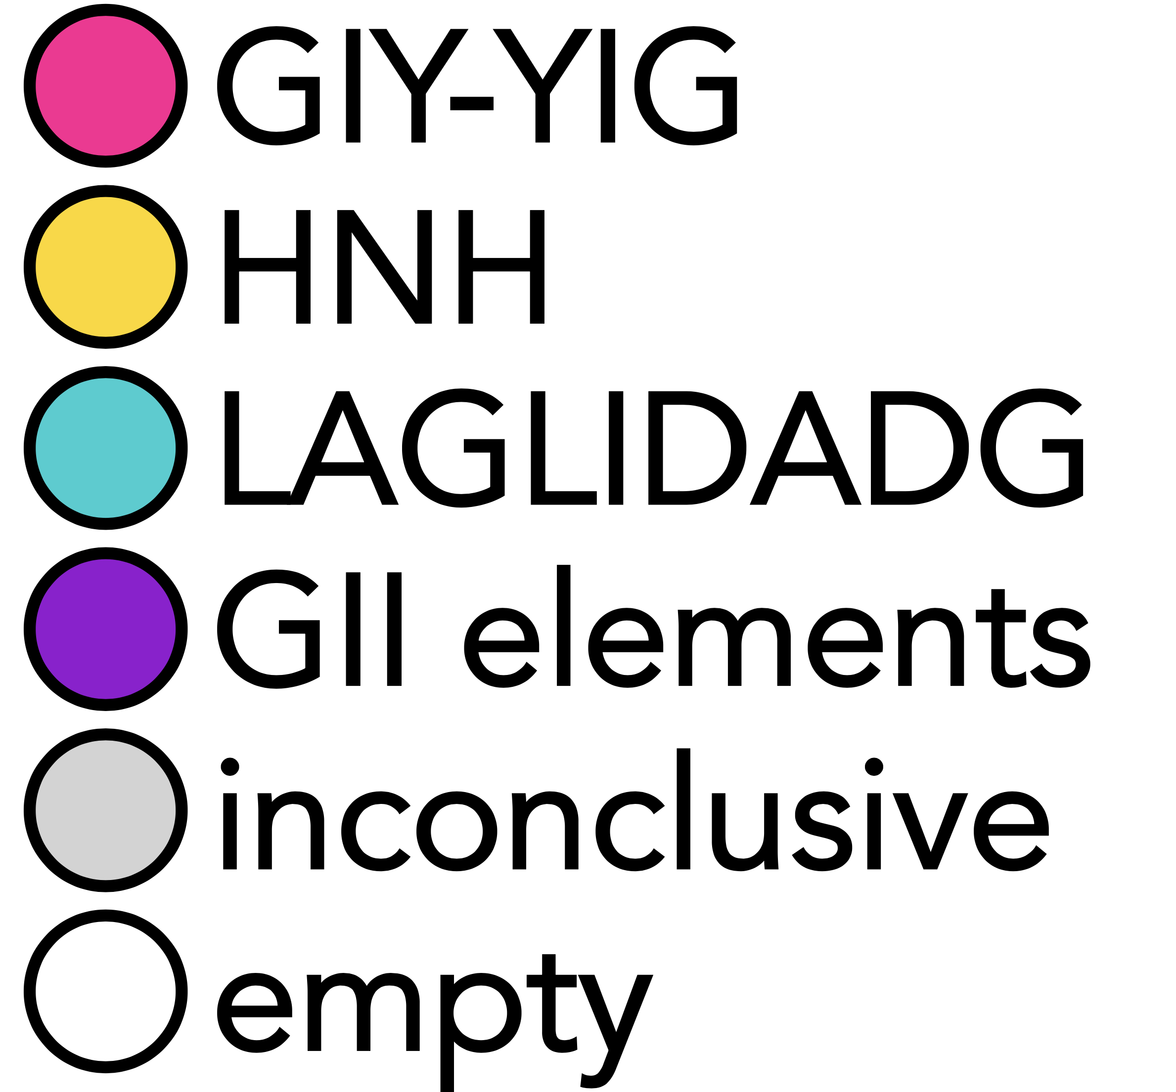
bootstrap
support
3
intronic orf
100
amino acid phylogeny of psbA exons
0.04

Slide 48
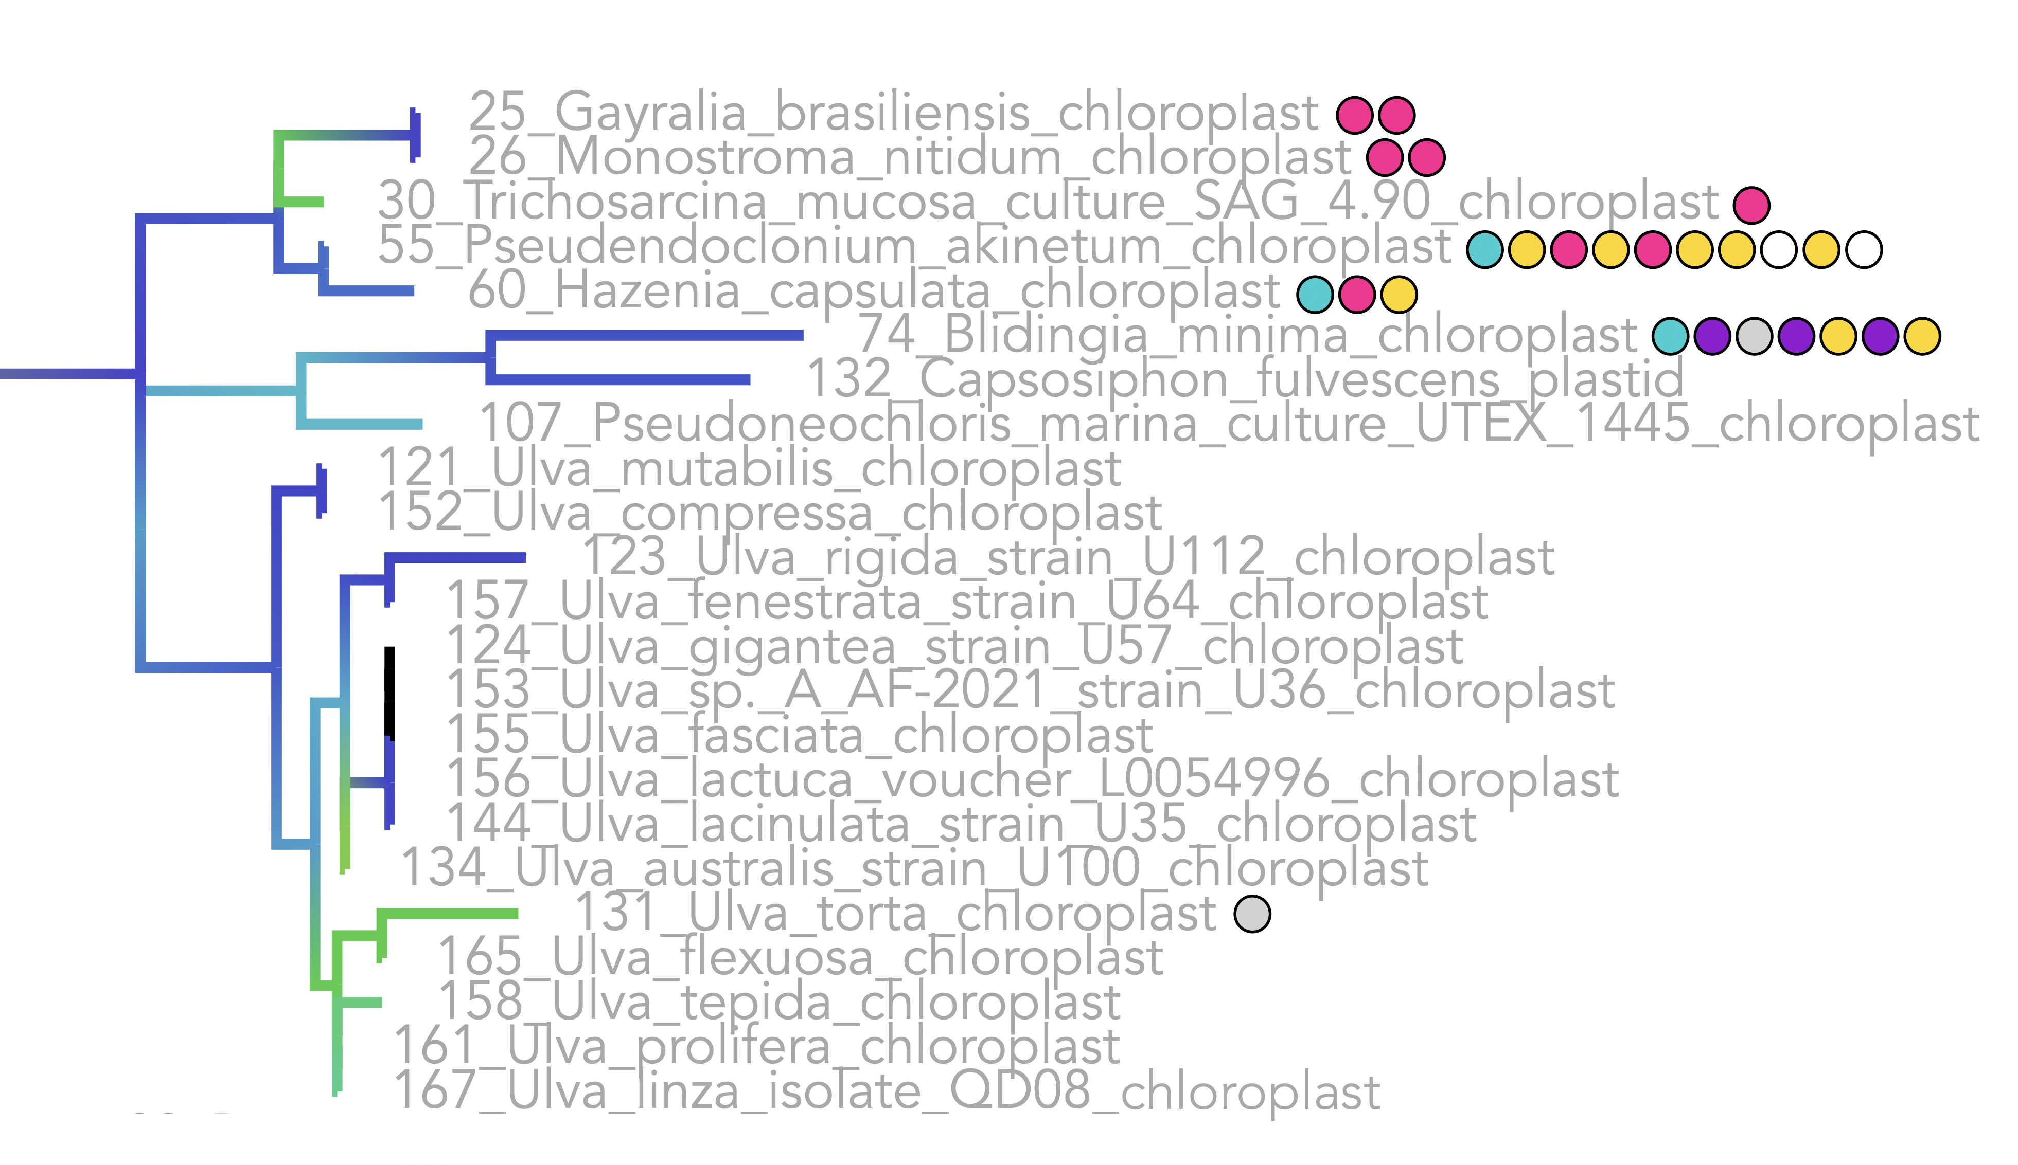
intronic orf

Slide 49
Inferring Recombination Events from Dot -, Gene, or Mummer Plots

Slide 50
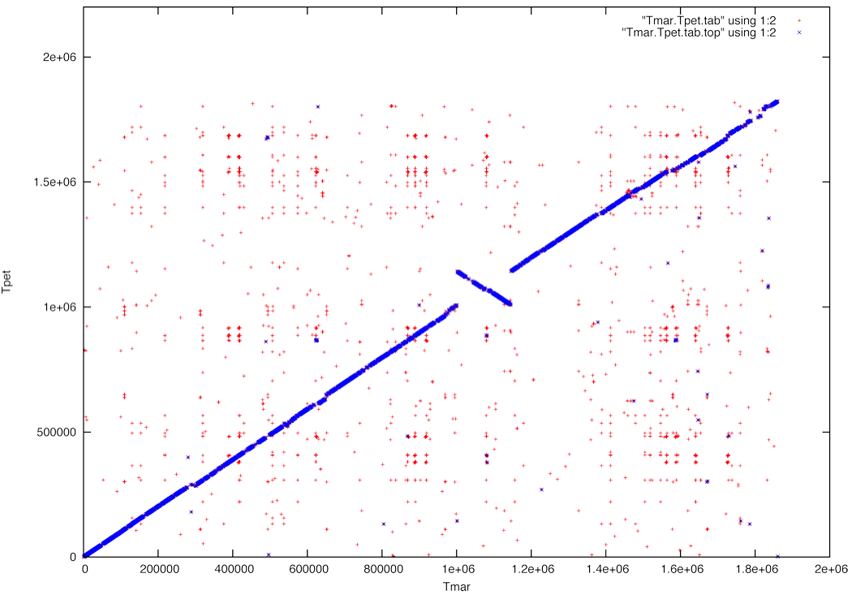
2
3
X axis
1
#3
3
2
2
#2
#1
1
y axis
1
3
1
2
3
#1 Identify and label syntenic fragments and their direction in the axes. For each axis draw a circular representation.

Slide 51
2
3
X axis
1
#3
3
2
2
#2
#1
1
X axis
1
3
1
2
3
#2 Draw in the recombination events that convert the genome on the X-axis into the one on the Y axis.

Slide 52
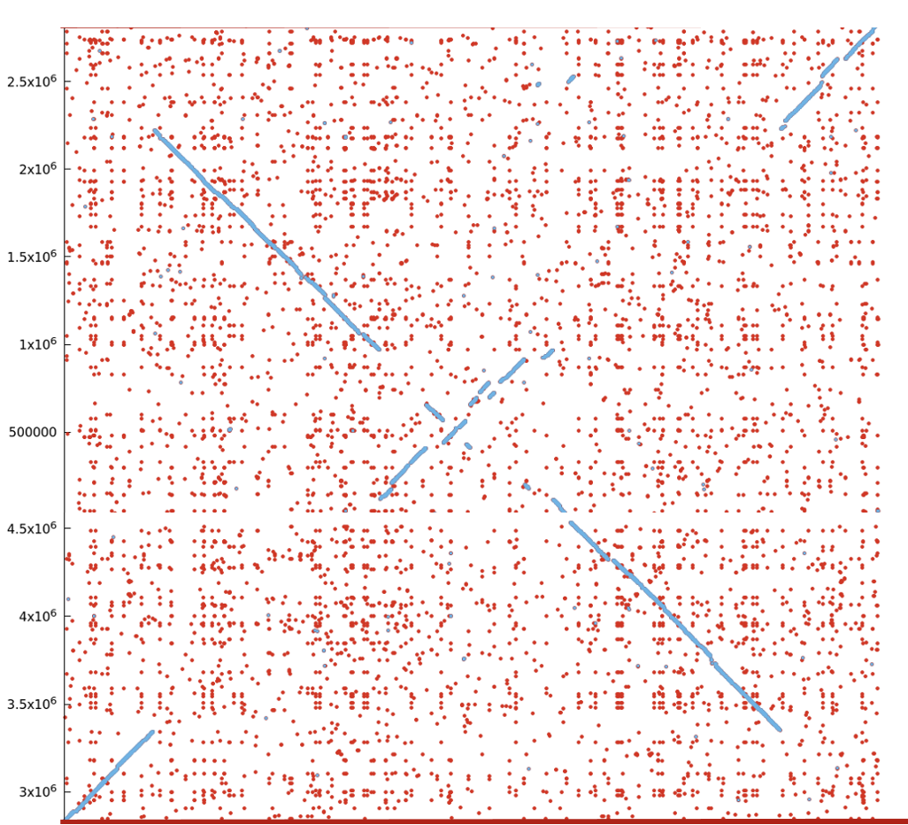
3
5
2
4
X axis
2
1
5
3
3
4
2
4
Y axis
1
1
5
1
3
4
5
2

Slide 53
3
5
2
4
X axis
2
1
5
3
3
4
2
4
Y axis
1
1
5
1
3
4
5
2

Slide 54
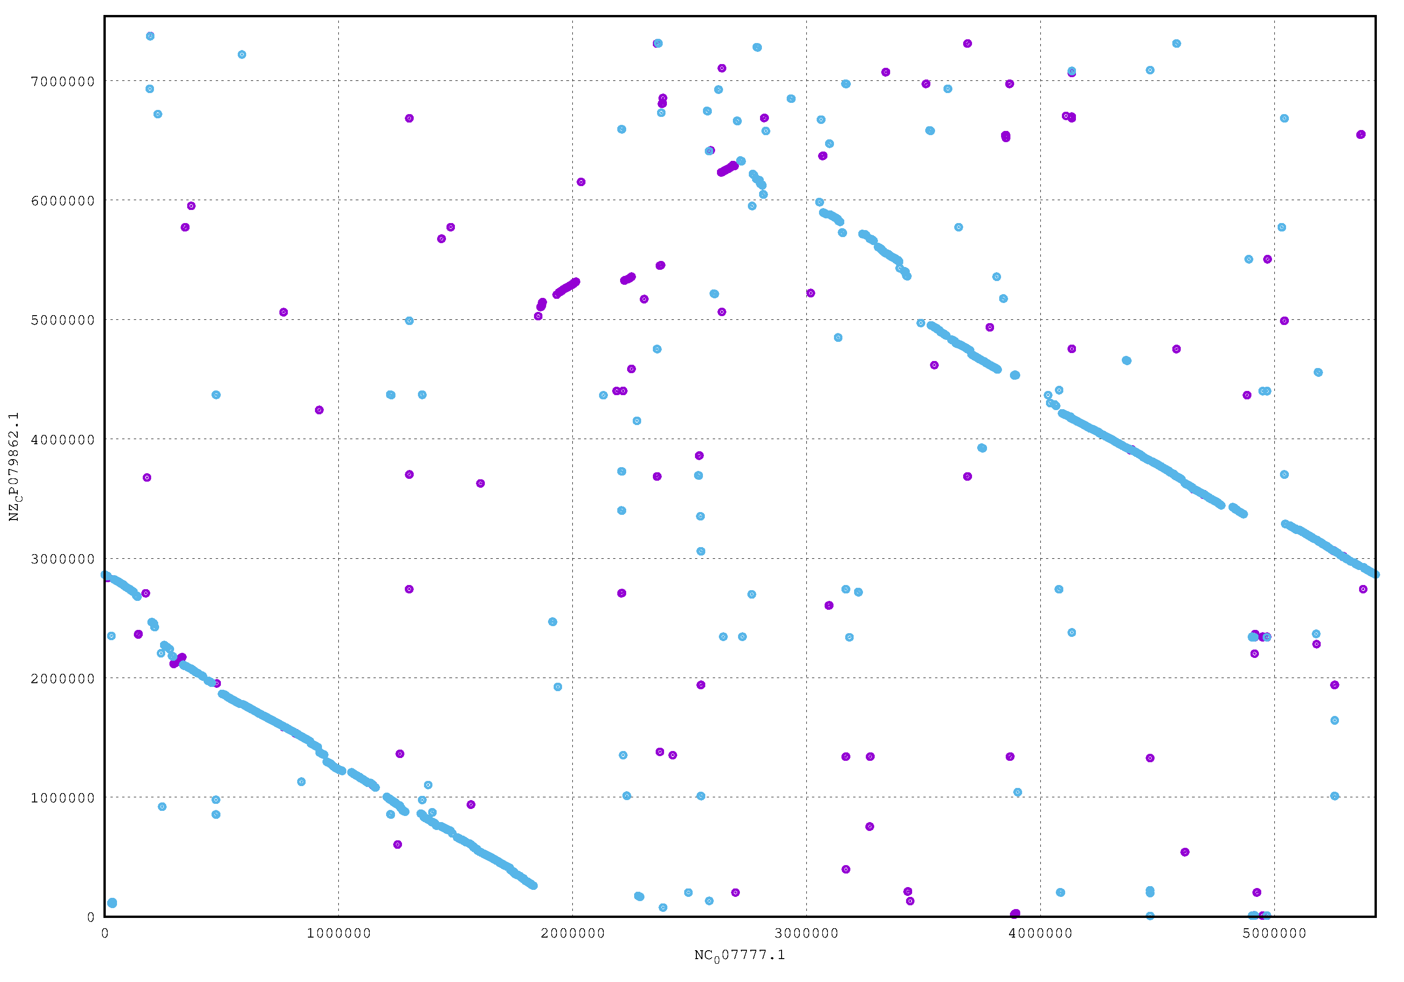
Nucmer plot, one sequence has ori at 28601000
Frankia_sp_ArI3
(dnaA at 2861770-2863377 - strand)
Frankia_casuarinae

Slide 55
Frankia_sp_ArI3
(dnaA at 2861770-2863377 - strand)
Frankia_casuarinae

Slide 56
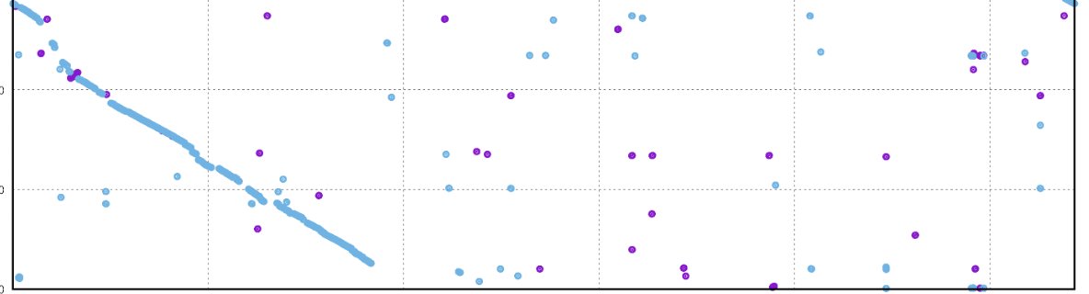
Frankia_sp_ArI3
(dnaA at 2861770-2863377 - strand)
Frankia_casuarinae

Slide 57
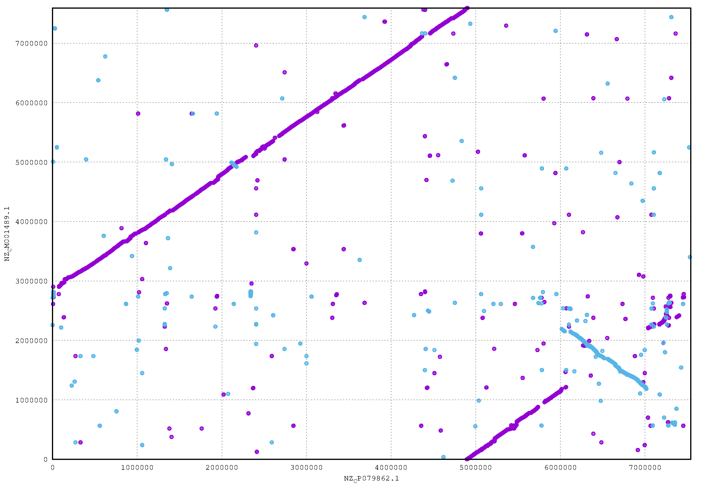
Frankia_sp_QA3_chromosome
dnaA at 5628471 5630093 -
Frankia_sp_ArI3
(dnaA at 2861770-2863377 - strand)

Slide 58
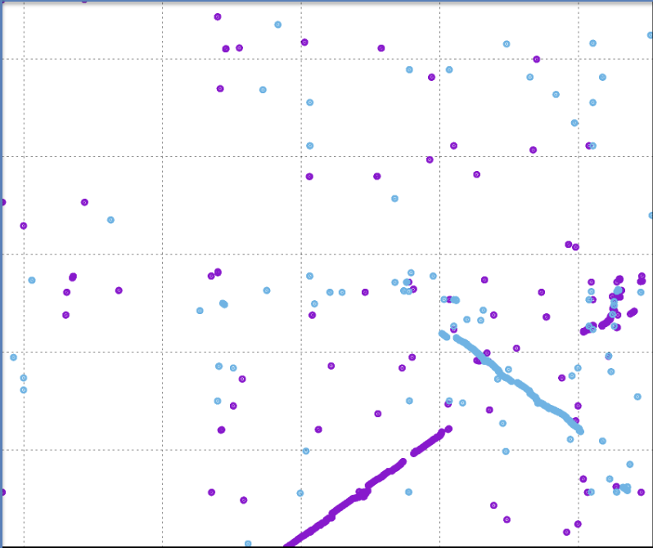
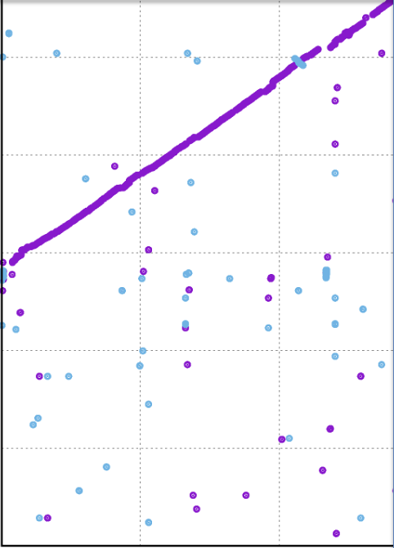
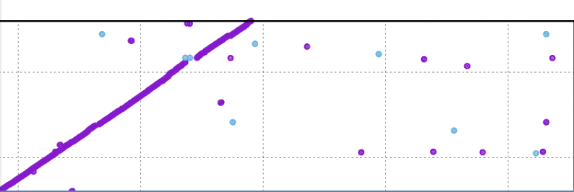
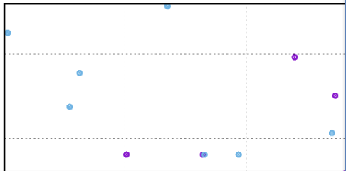
Frankia_sp_QA3 - strand
Frankia_sp_ArI3 - strand)

