Slide 1
MCB 5472
Intro to Trees
Peter Gogarten
Office: BSP 404
phone: 860 486-4061,
Email: gogarten@uconn.edu

Slide 2
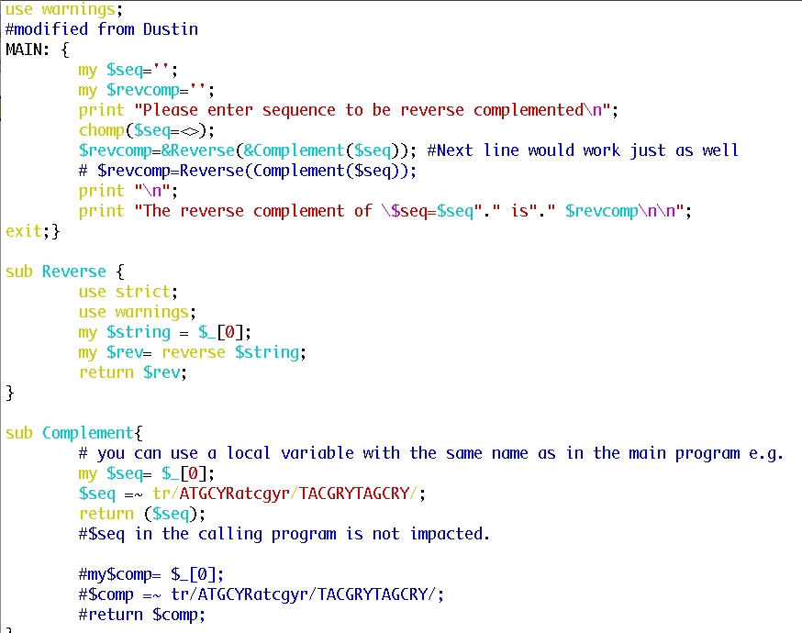
OLD ASSIGNMENTS
Turn your script that calculates the reverse complement of a sequence into a subroutine

Slide 3
OLD ASSIGNMENTS
Write a script that takes all files with the extension .fa (containing a single fasta formated sequence) and writes their contents in a single multiple sequence file.
Solution 1:
use warnings;
system ("cat *.fa > all_fa_files.faa");

Slide 4
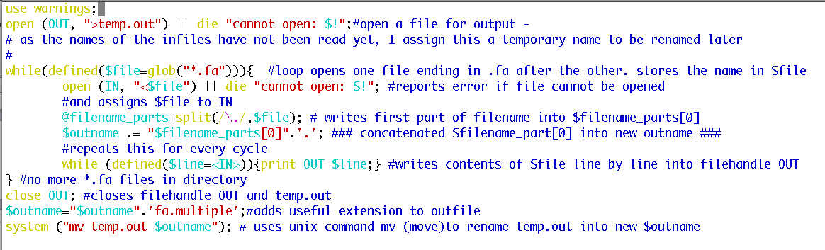
OLD ASSIGNMENTS
Solution 2:

Slide 5
assignments continued (use class 5 as sample)
Assume that you have the following non-aligned multiple sequence files in a directory:
A.fa : vacuolar/archaeal ATPase catalytic subunits ;
B.fa : vacuolar/archaeal ATPase non-catalytic subunits;
alpha.fa : F-ATPases non-catalytic subunits,
beta.fa : F-ATPases catalytic subunits,
F.fa : ATPase involved in the assembly of the bacterial flagella.
Write a perl script that executes muscle or clustalw and
1) aligns the sequences within each file
2) successively calculates profile alignments between all aligned sequences.
Hints:
system (command);# executes “command” as if you had typed command in the command line

Slide 6
challenge:
Often one wants to build families of homologous proteins extracted from genomes. One way to do so is to find reciprocal best hits.
Tools:
The script blastall.pl takes the genomes indicted in the first line and calculates all possible genome against genome searches.
This script simple_rbh_pairs.pl takes two blastall searches (genome A versus genome B) in -m8 format and listing only the top scoring blast hit for each query) and writes the GI numbers of reciprocal best hits into a table.
The script run_pairs.pl runs all possible pairwise extractions of RBHs
Task: write a script that combines the pairwise tables keeping only those families that have a strict reciprocal best blast hit relationship in all genomes.

Slide 7
New assignment
Check chapter U40 in the Unix/Perl primer – sad ☹
Read chapters P17 and P18 on regular expressions
(these are really useful, if you repeatedly run a program that generates complex output, and you want to extract a single value into a table, e.g. a program that calculates theoretical isoelectric points … )

Slide 8
New assignment
Write a script that takes a genome (fna file) and calculates the GC content.
Modify the script to count tetra- and penta-nucleotide frequencies.
Modify the script so that it creates a table that gives the GC, tetra- and penta-nucleotide content in a sliding window moving through the genome.

Slide 9
New assignment
Write a script that takes a genome (fna file) and calculates the GC content.
Modify the script to count tetra- and penta-nucleotide frequencies.
Modify the script so that it creates a table that gives the GC, tetra- and penta-nucleotide content in a sliding window moving through the genome.
(For which of these programs, and for which problems might you want to consider, or correct for strand bias?)

Slide 10
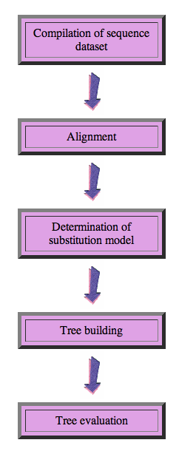
Steps of the phylogenetic analysis
Phylogenetic analysis is an inference of evolutionary relationships between organisms.
Phylogenetics tries to answer the question
“How did groups of organisms come into existence?”
Those relationships are usually represented by tree-like diagrams.
Note: the assumption of a tree-like process of evolution is controversial!

Slide 11
Phylogenetic reconstruction - How
Distance analyses
  calculate pairwise distances
  (different distance measures, correction for multiple hits, correction for codon bias)
  make distance matrix (table of pairwise corrected distances)
  calculate tree from distance matrix
    i) using optimality criterion
    (e.g.: smallest error between distance matrix
    and distances in tree, or use
    ii) algorithmic approaches (UPGMA or neighbor joining) B)

Slide 12
Phylogenetic reconstruction - How
Parsimony analyses
  find that tree that explains sequence data with minimum number of substitutions
  (tree includes hypothesis of sequence at each of the nodes)
Maximum Likelihood analyses
  given a model for sequence evolution, find the tree that has the highest probability under this model.
  This approach can also be used to successively refine the model.
Bayesian statistics use ML analyses to calculate posterior probabilities for trees, clades and evolutionary parameters. Especially MCMC approaches have become very popular in the last year, because they allow to estimate evolutionary parameters (e.g., which site in a virus protein is under positive selection), without assuming that one actually knows the "true" phylogeny.

Slide 13
What is in a tree?
Trees form molecular data are usually calculated as unrooted trees (at least they should be - if they are not this is usually a mistake).
To root a tree you either can assume a molecular clock (substitutions occur at a constant rate, again this assumption is usually not warranted and needs to be tested),
or you can use an outgroup (i.e. something that you know forms the deepest branch).
  For example, to root a phylogeny of birds, you could use the homologous characters from a reptile as outgroup; to find the root in a tree depicting the relations between different human mitochondria, you could use the mitochondria from chimpanzees or from Neanderthals as an outgroup; to root a phylogeny of alpha hemoglobins you could use a beta hemoglobin sequence, or a myoglobin sequence as outgroup.
Trees have a branching pattern (also called the topology), and branch lengths.
Often the branch lengths are ignored in depicting trees (these trees often are referred to as cladograms - note that cladograms should be considered rooted).
You can swap branches attached to a node, and in an unrooted you can depict the tree as rooted in any branch you like without changing the tree.

Slide 14
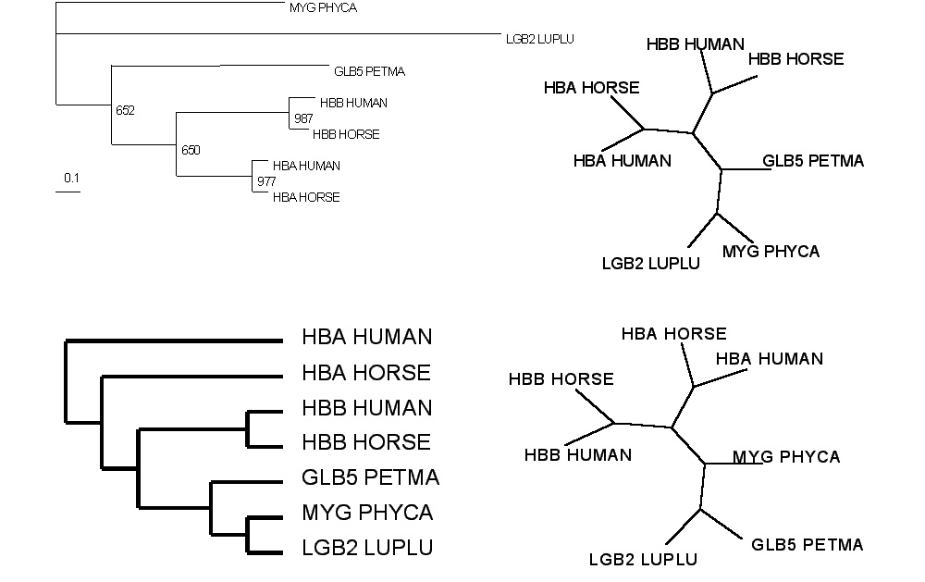
Test:Which of these trees is different?
More tests here

Slide 15
Terminology
Branches, splits, bipartitions
In a rooted tree: clades (for urooted trees sometimes the term clann is used)
Mono-, Para-, polyphyletic groups, cladists and a natural taxonomy
The term cladogram refers to a strictly bifurcating diagram, where each clade is defined by a common ancestor that only gives rise to members of this clade. I.e., a clade is monophyletic (derived from one ancestor) as opposed to polyphyletic (derived from many ancestors). (Note: you do need to know where the root is!)
A clade is recognized and defined by shared derived characters (= synapomorphies). Shared primitive characters (= sympleisiomorphies , aternativie spelling is symplesiomorphies) do not define a clade. (see in class example drawing ala Hennig).
To use these terms you need to have polarized characters; for most molecular characters you don't know which state is primitive and which is derived (exceptions:....).

Slide 16
Terminology
Related terms:
autapomorphy = a derived character that is only present in one group; an autapomorphic character does not tell us anything about the relationship of the group that has this character ot other groups.
homoplasy = a derived character that was derived twice independently (convergent evolution). Note that the characters in question might still be homologous (e.g. a position in a sequence alignment, frontlimbs turned into wings in birds and bats).
paraphyletic = a taxonomic group that is defined by a common ancestor, however, the common ancestor of this group also has decendants that do not belong to this taxonomic group. Many systematists despise paraphyletic groups (and consider them to be polyphyletic). Examples for paraphyletic groups are reptiles and protists. Many consider the archaea to be paraphyletic as well.
holophyletic = same as above, but the common ancestor gave rise only to members of the group.

Slide 17
homology
Two sequences are homologous, if there existed an ancestral molecule in the past that is ancestral to both of the sequences
Types of Homology
Orthologs: “deepest” bifurcation in molecular tree reflects speciation.
These are the molecules people interested in the taxonomic classification of organisms want to study.
Paralogs: “deepest” bifurcation in molecular tree reflects gene duplication. The study of paralogs and their distribution in genomes provides clues on the way genomes evolved.
Gen and genome duplication have emerged as the most important pathway to molecular innovation, including the evolution of developmental pathways.
Xenologs: gene was obtained by organism through horizontal transfer. The classic example for Xenologs are antibiotic resistance genes, but the history of many other molecules also fits into this category: inteins, selfsplicing introns, transposable elements, ion pumps, other transporters,
Synologs: genes ended up in one organism through fusion of lineages. The paradigm are genes that were transferred into the eukaryotic cell together with the endosymbionts that evolved into mitochondria and plastids
(the -logs are often spelled with "ue" like in orthologues)
see Fitch's article in TIG 2000 for more discussion.

Slide 18
Trees – what might they mean?
Calculating a tree is comparatively easy, figuring out what it might mean is much more difficult.
If this is the probable organismal tree:
species A
species B
species C
species D
what could be the reason for obtaining this gene tree:
seq. from A
seq. from D
seq. from C
seq. from B

Slide 19
lack of resolution
seq. from A
seq. from D
seq. from C
seq. from B
e.g., 60% bootstrap support for bipartition (AD)(CB)

Slide 20
long branch attraction artifact
the two longest branches join together
seq. from A
seq. from D
seq. from C
seq. from B
e.g., 100% bootstrap support for bipartition (AD)(CB)
What could you do to investigate if this is a possible explanation?
use only slow positions,
use an algorithm that corrects for ASRV

Slide 21
Gene transfer
Organismal tree:
species A
species B
Gene Transfer
species C
species D
molecular tree:
seq. from A
seq. from D
seq. from C
speciation
seq. from B
gene transfer

Slide 22
Gene duplication
Organismal tree:
species A
species B
species C
gene duplication
species D
molecular tree:
molecular tree:
molecular tree:
seq. from A
seq. from A
seq. from A
seq. from B
seq. from B
seq. from C
seq. from C
seq. from D
seq. from D
seq. from D
seq.’ from B
seq.’ from B
seq.’ from C
seq.’ from C
seq.’ from C
gene duplication
gene duplication
gene duplication
seq.’ from D
seq.’ from D
seq.’ from D

Slide 23
Gene duplication and gene transfer are equivalent explanations.
The more relatives of C are found that do not have the blue type of gene, the less likely is the duplication loss scenario
Ancient duplication followed by gene loss
Horizontal or lateral Gene
Note that scenario B involves many more individual events than A
1 HGT with
orthologous replacement
1 gene duplication followed by 4 independent gene loss events

Slide 24
What is it good for?
Gene duplication events can provide an outgroup that allows rooting a molecular phylogeny.
Most famously this principle was applied in case of the tree of life – the only outgroup available in this case are ancient paralogs (see http://gogarten.uconn.edu/cvs/Publ_Pres.htm for more info).
However, the same principle also is applicable to any group of organisms, where a duplication preceded the radiation (example).
Lineage specific duplications also provide insights into which traits were important during evolution of a lineage.

Slide 25
Function, ortho- and paralogy
molecular tree:
seq. from A
seq.’ from B
seq.’ from C
seq.’ from D
gene duplication
seq. from B
seq. from C
seq. from D
The presence of the duplication is a taxonomic character (shared derived character in species B C D).
The phylogeny suggests that seq’ and seq have similar function, and that this function was important in the evolution of the clade BCD.
seq’ in B and seq’in C and D are orthologs and probably have the same function, whereas seq and seq’ in BCD probably have different function (the difference might be in subfunctionalization of functions that seq had in A. – e.g. organ specific expression)

Slide 26
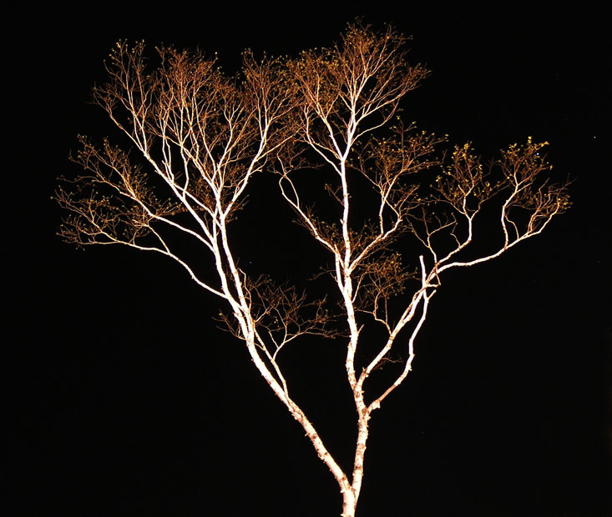
The Ribosomal “Tree of Life”
Eukaryotes
Bacteria
Archaea
Cenancestor
(aka MRCA or LUCA)
as placed by ancient duplicated genes (ATPases, Signal recognition particles, EF), or by signal remaining from genetic code expansion.
based on a single cellular component
no reticulation
only extant lineages
branch length is not proportional to time

Slide 27
SSU-rRNA Tree of Life
Haloferax
Riftia
E.coli
mitochondria
A
RCHAEA
Chromatium
B
ACTERIA
Methanospirillum
Agrobacterium
Sulfolobus
Methanosarcina
Chlorobium
Methanobacterium
Cytophaga
Thermoproteus
Epulopiscium
Thermofilum
Methanococcus
Bacillus
pSL 50
Thermococcus
chloroplast
pSL 4
Methanopyrus
Synechococcus
pSL 22
Treponema
Thermus
pSL 12
Deinococcus
ORIGIN
Thermotoga
Aquifex
Marine
pJP 27
EM 17
group 1
pJP 78
0.1 changes per nt
CPS
V/A-ATPase
Prolyl RS
Lysyl RS
Mitochondria
Plastids
E
UCARYA
Tritrichomonas
Zea
Homo
Coprinus
Giardia
Paramecium
Hexamita
Porphyra
Vairimorpha
Dictyostelium
Physarum
Naegleria
Euglena
Entamoeba
Fig. modified from Norman Pace
Encephalitozoon
Trypanosoma

Slide 28
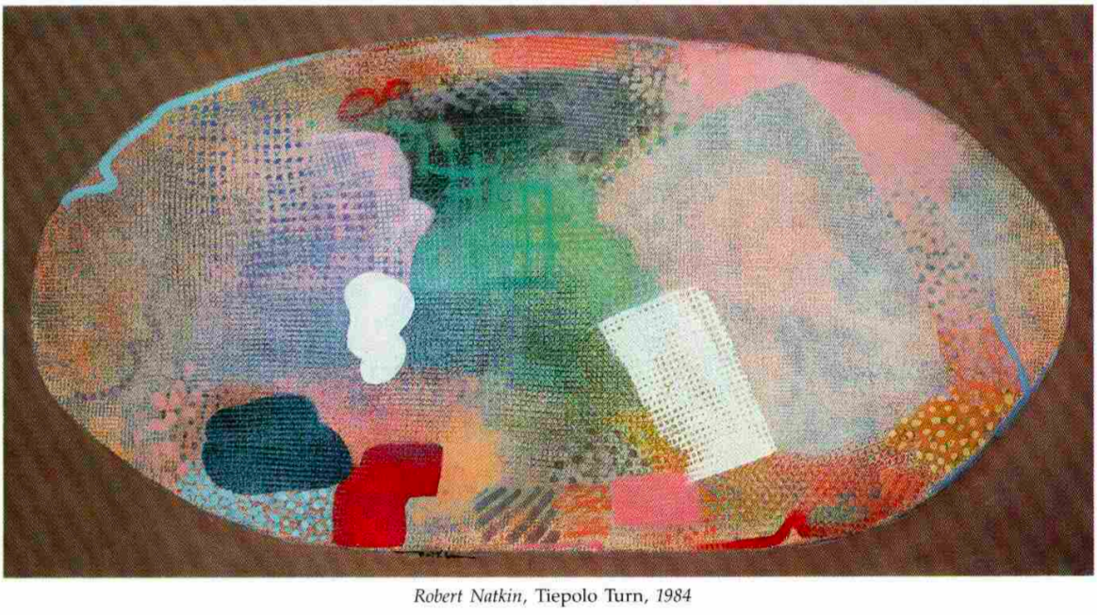
Ochiai, K., Yamanaka, T., Kimura, K., and Sawada, O. (1959)
Inheritance of drug resistance (and its tranfer) between Shigella strains and Between Shigella and E.coli strains.
Hihon Iji Shimpor 1861: 34 (in Japanese)
Gray GS, Fitch WM (1983):
Evolution of antibiotic resistance genes: the DNA sequence of a kanamycin resistance gene from Staphylococcus aureus.
Mol Biol Evol 1983, 1(1):57-66.
Sorin Sonea (1988):
The global organism:
A new view of bacteria.
The Sciences, 28:38-45.

Slide 29
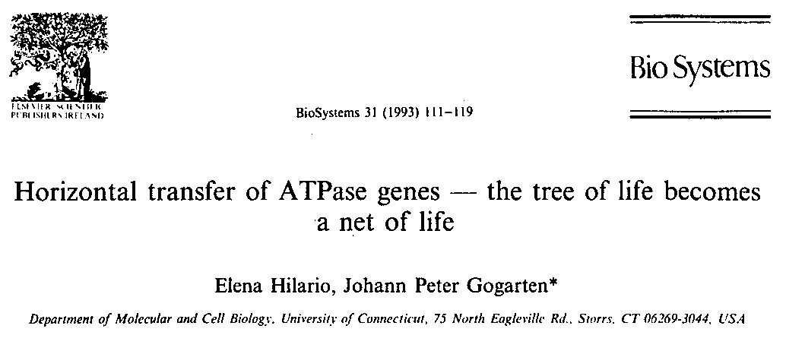
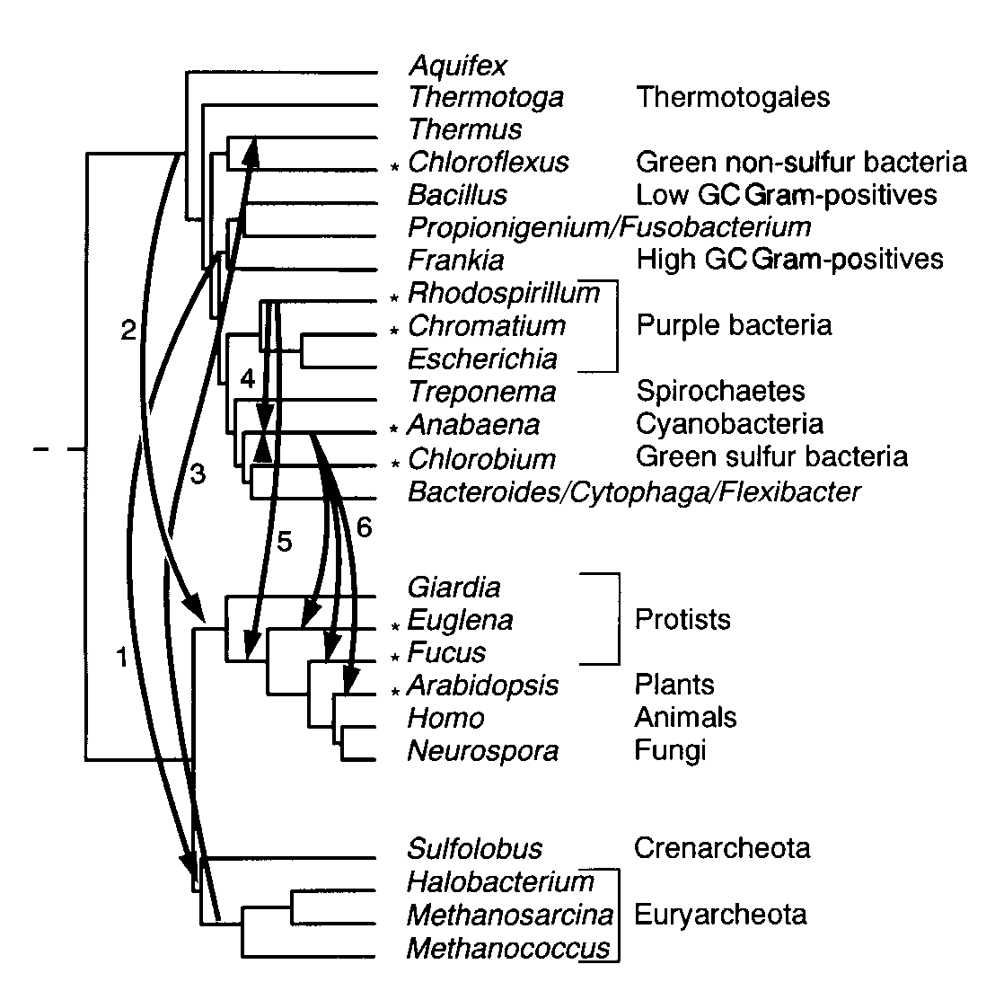
1993:
1995:
GOGARTEN, J.P. (1995): The early evolution of cellular life, Trends in Ecology and Evolution, 10, 147-151.

Slide 30
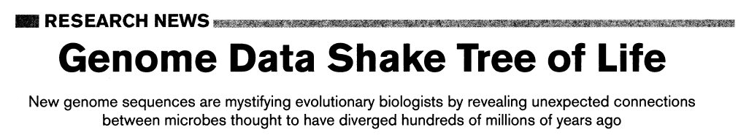
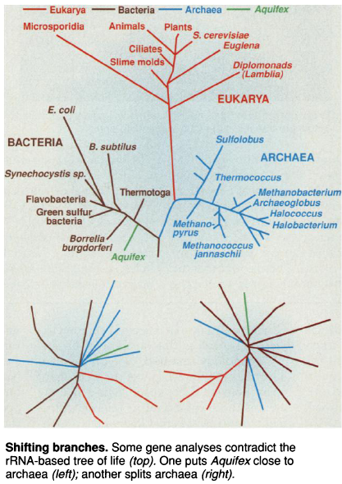
1998:
Science, 280, p.672ff (1998)

Slide 31
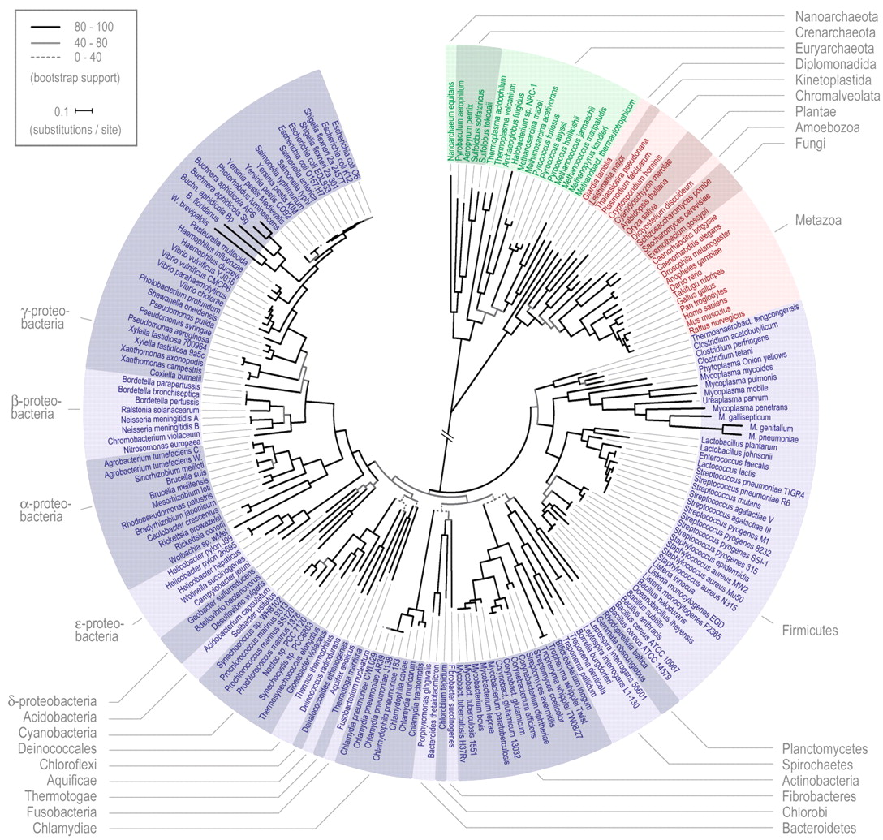
31 orthologous protein sequences present in 191 genomes each, concatenated, 8,089 sites
Ciccarelli et al. 2006
Toward automatic reconstruction of a highly resolved tree of life.
The tree of one percent*
*Dagan and Martin,Genome Biology, 2006

Slide 32
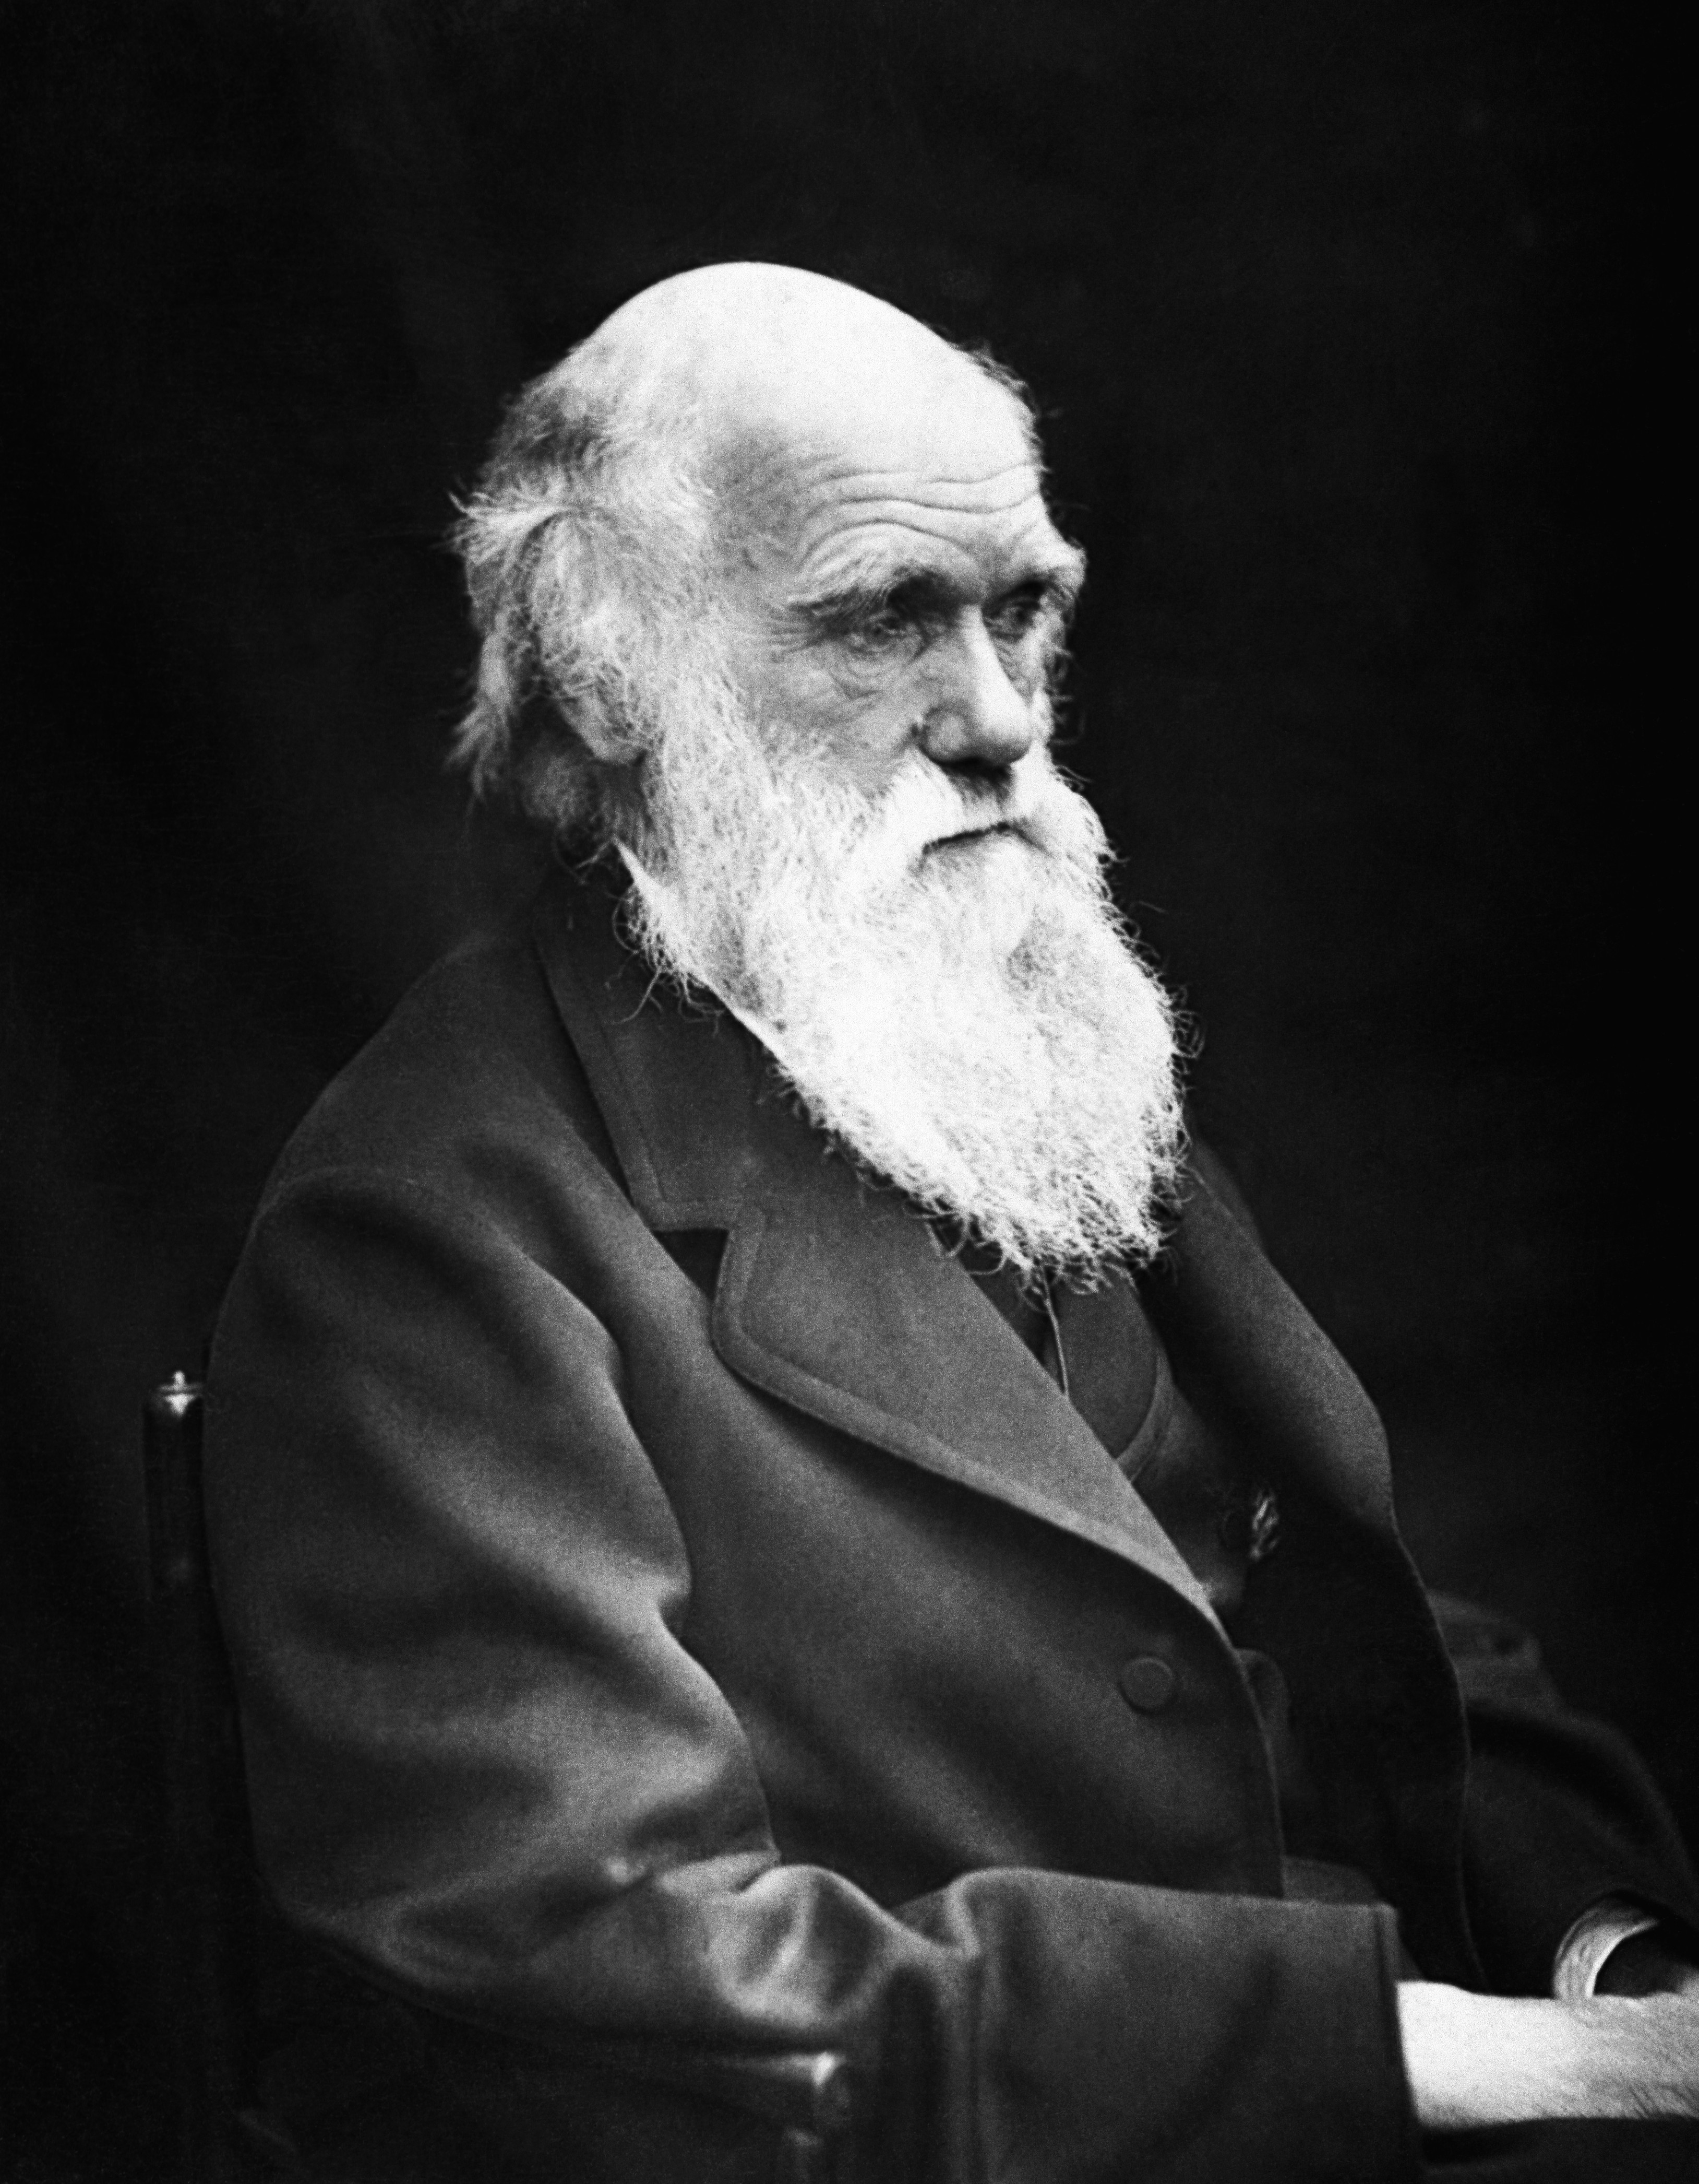
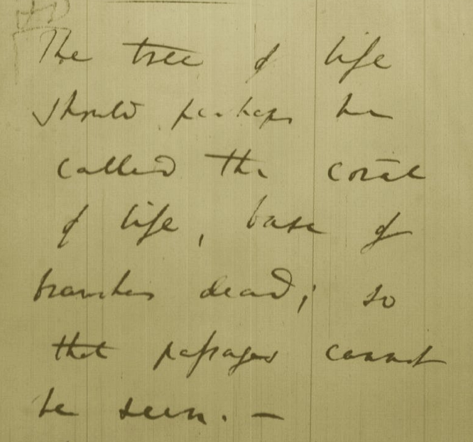
Tree, Web, or Coral of Life?
“The tree of life should perhaps be called the coral of life, base of branches dead”
Charles Darwin
Photo by J. Cameron, 1869
Page B26 from Charles Darwin’s (1809-1882) notebook (1837/38)

Slide 33
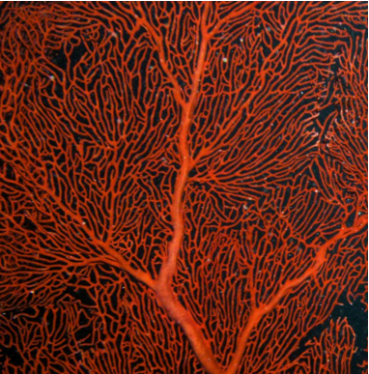
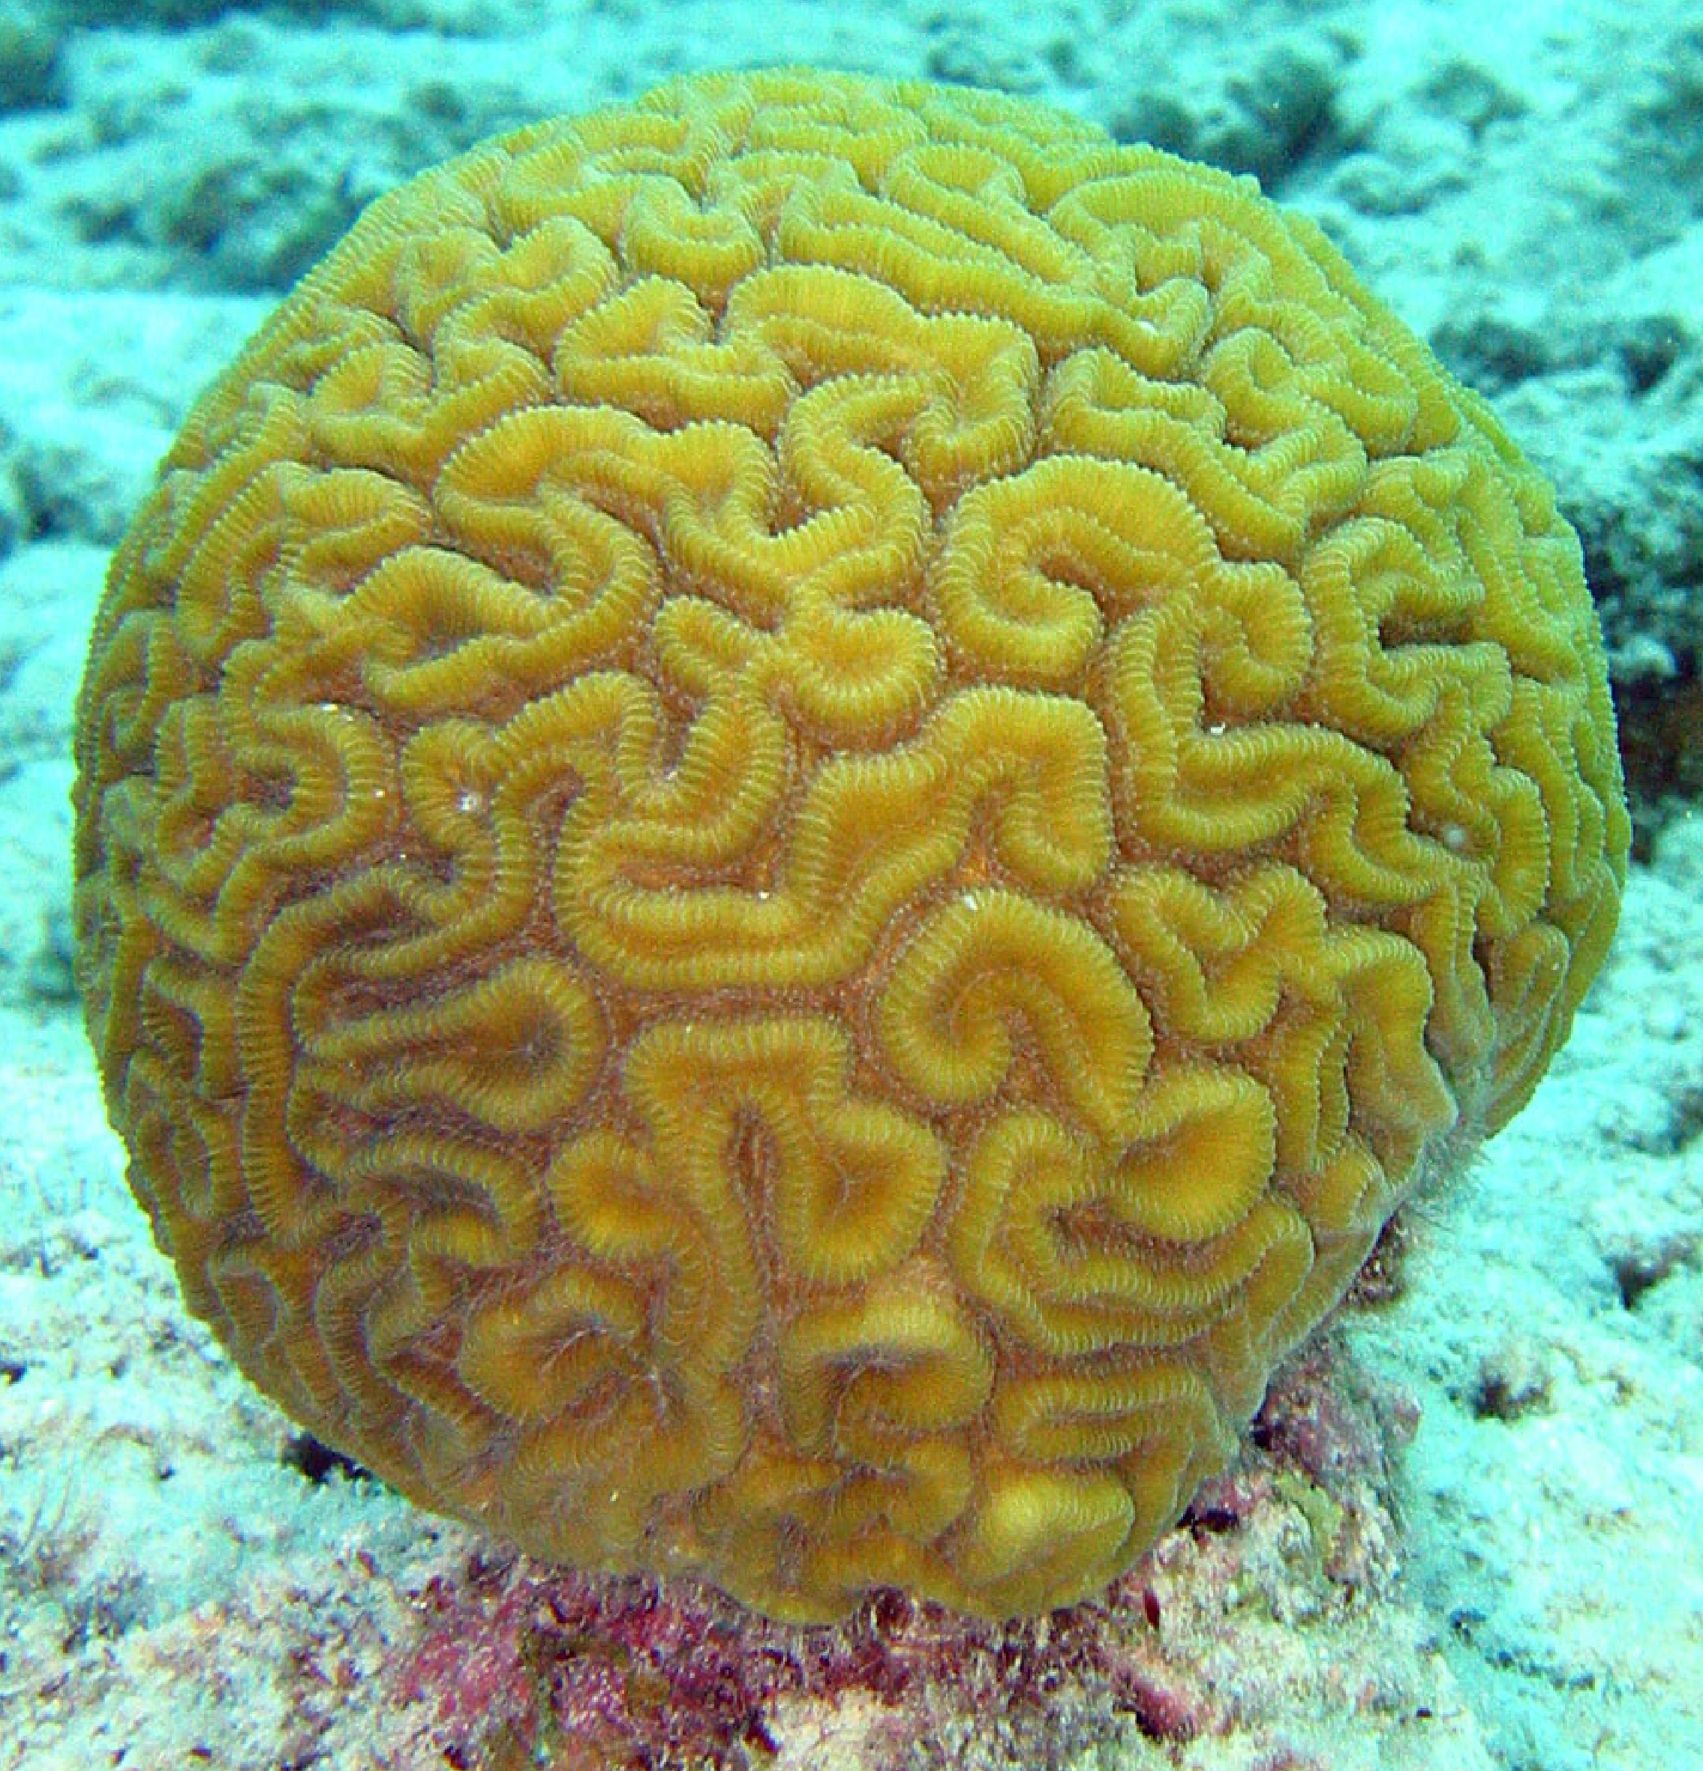
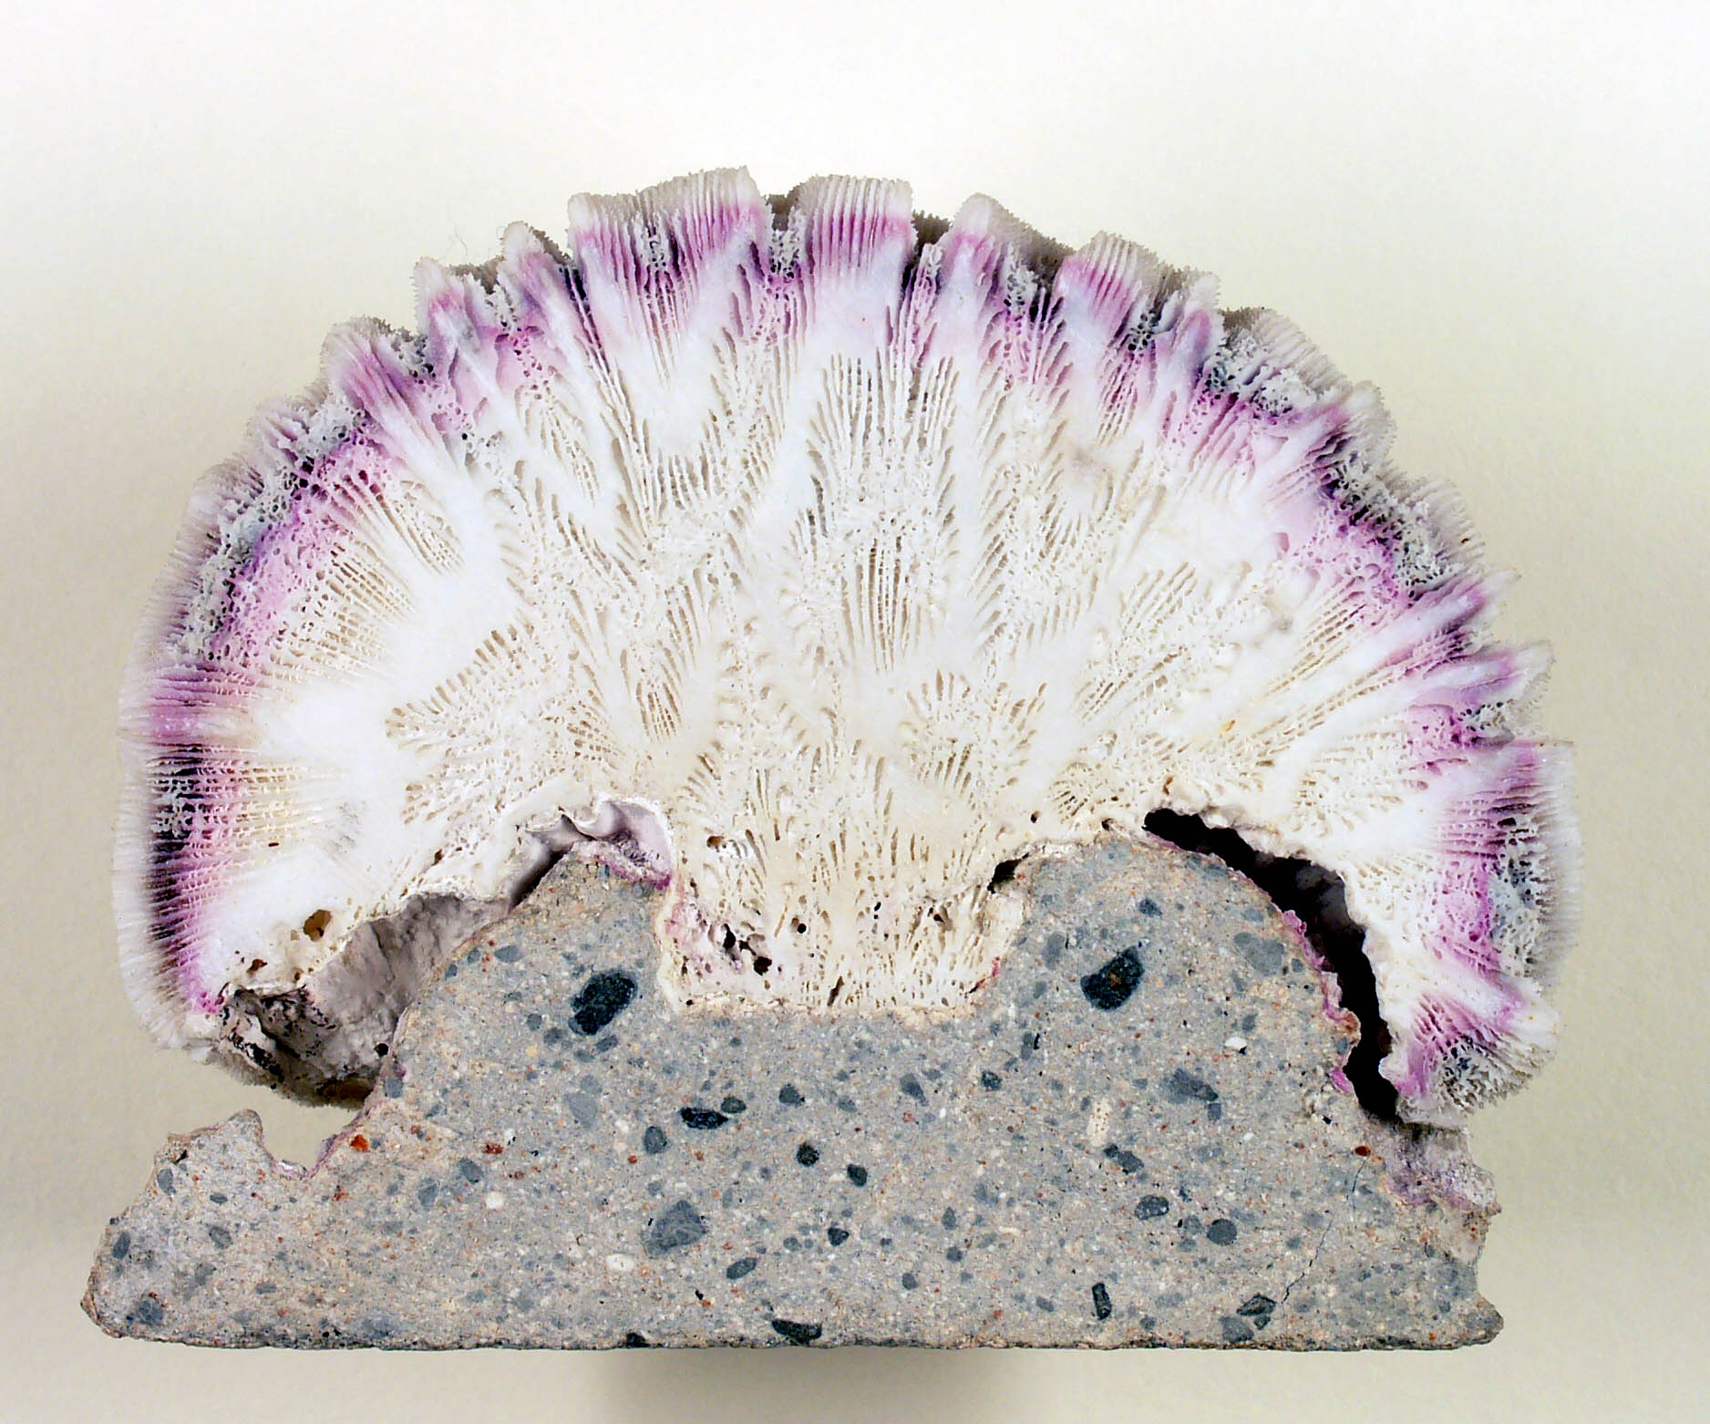
Which Type of Coral ?

Slide 34
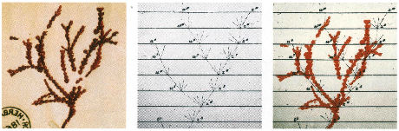
Darwin’s Coral a Red Algae?
(Bossea orbignyana)
According to Horst Bredekamp, parts of the diagram in Darwin's origin of species (center) may reflect the branching properties of a specimen Darwin collected himself.
From Florian Maderspacher:
“The captivating coral--the origins of early evolutionary imagery.”
Current Biology 16: R476-8 2006

Slide 35
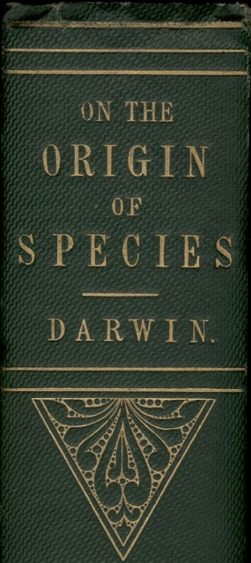
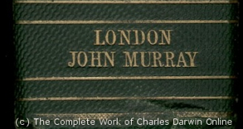
“As buds give rise by growth to fresh buds, and these, if vigorous, branch out and overtop on all sides many a feebler branch, so by generation I believe it has been with the great Tree of Life, which fills with its dead and broken branches the crust of the earth, and covers the surface with its ever-branching and beautiful ramifications.”
Charles Darwin in
“On the Origin of Species by Means of Natural Selection or the Preservation of Favoured Races in the Struggle for Life”,
p 162 ff, London, John Murray, 1859

Slide 36
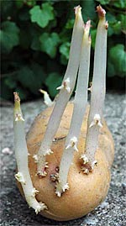
THE POTATO OF LIFE
Bacteria
Archaea
Eukaryotes
Successive independent crystallization of the three domains of life from a population of pre-cells
extinct
lineage
Glansdorff N, Xu Y, Labedan B: The Last Universal Common Ancestor: emergence, constitution and genetic legacy of an elusive forerunner.
Biol Direct 2008, 3:29.
Kandler O (1994) The early diversification of life. In Early Life on Earth, Nobel Symposium, vol. 84, pp. 152-509: Columbia Univ. Press.
Woese CR (2002) On the evolution of cells. PNAS 99: 8742-7
photo from www.sonnentaler.net

Slide 37
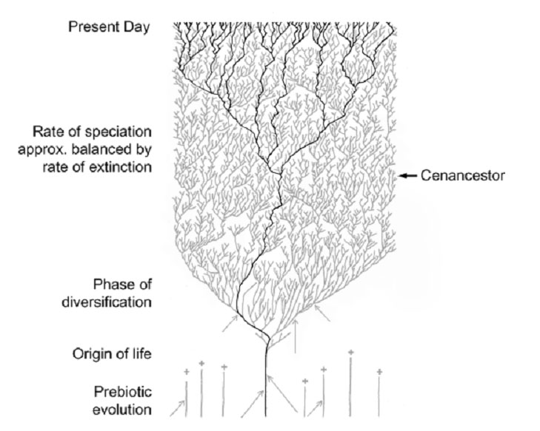
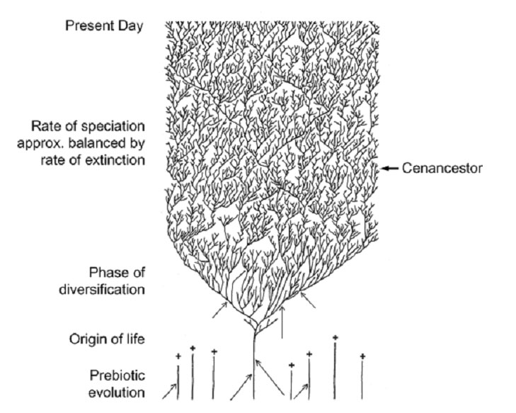
The Coral of Life (Darwin)
Notes:
The “Coral of Life” and the transfer of characters from now extinct into surviving lineages

Slide 38
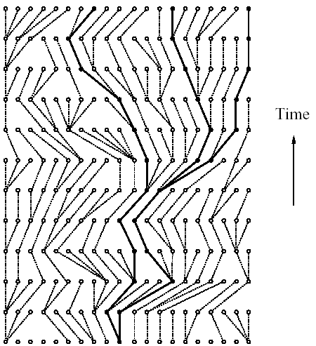
Coalescence – the process of tracing lineages backwards in time to their common ancestors. Every two extant lineages coalesce to their most recent common ancestor. Eventually, all lineages coalesce to the cenancestor.
t/2
(Kingman,
1982)
Illustration is from J. Felsenstein, “Inferring Phylogenies”, Sinauer, 2003

Slide 39
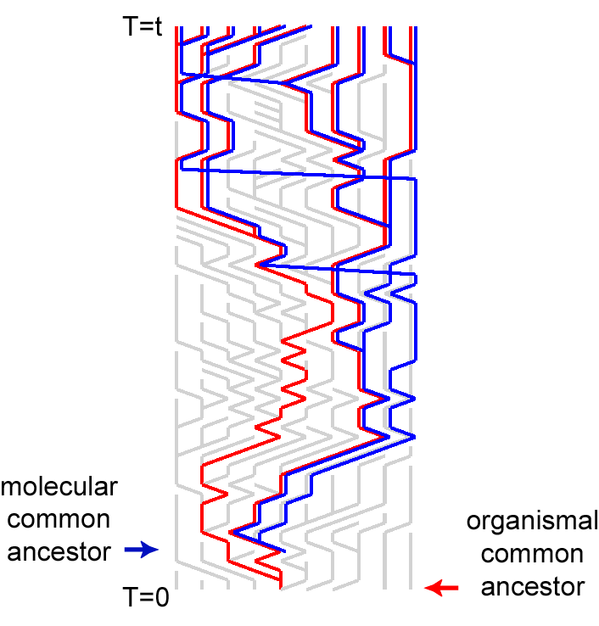
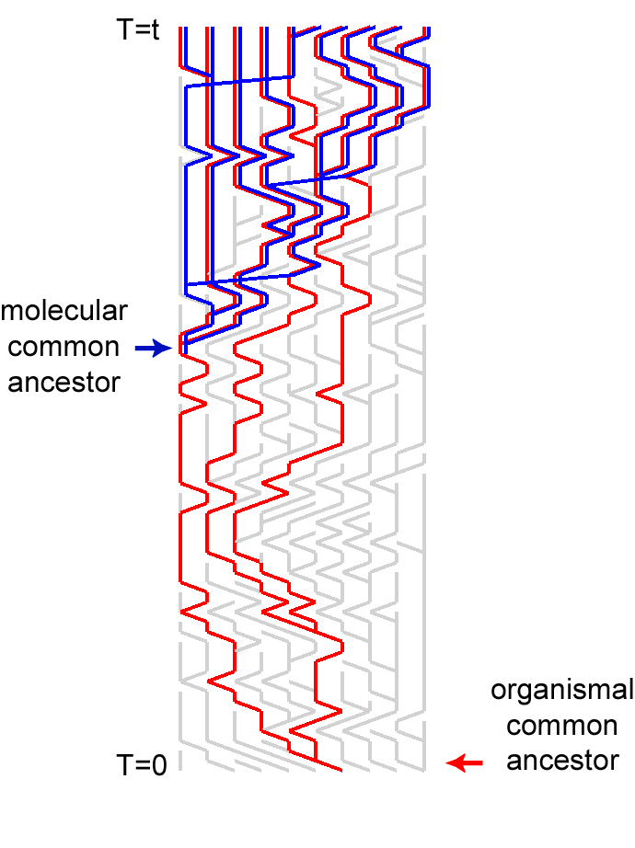
Simulations of organismal evolution by coalescence
One extinction and one speciation event per generation
Horizontal transfer event once in 10 generations
RED: organismal lineages (no HGT)
BLUE: molecular lineages (with HGT)
GRAY: extinct lineages
RESULTS:
Most recent common ancestors are different for organismal and molecular phylogenies
Different coalescence times
Long coalescence of the last two lineages

Slide 40
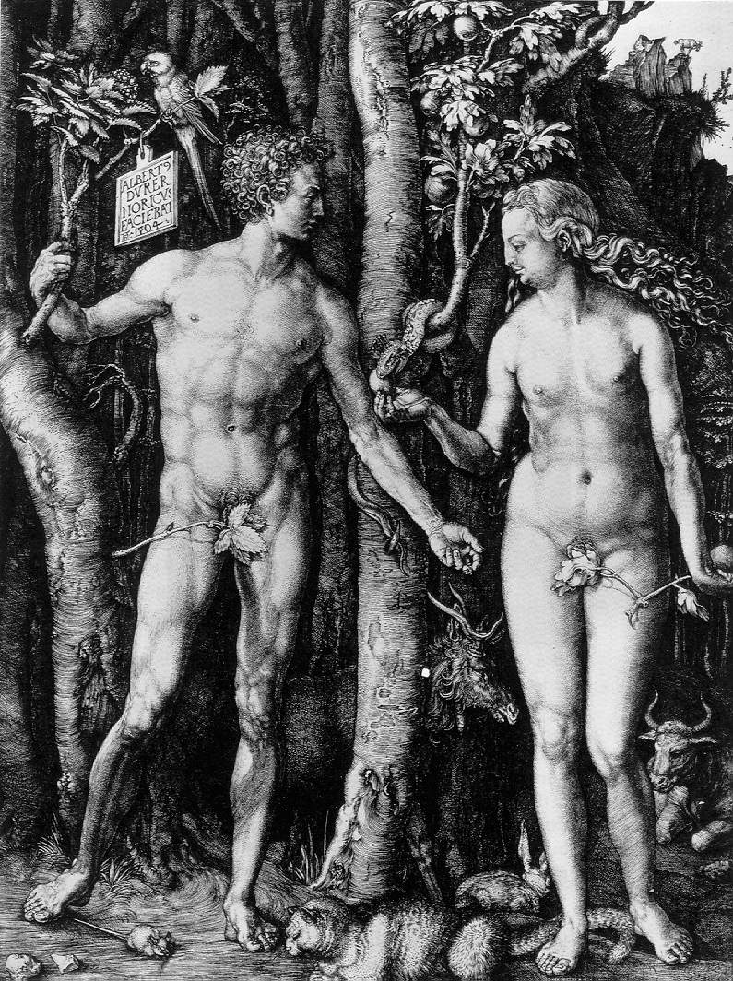
Y chromosome
Adam
Mitochondrial
Eve
Lived
approximately
50,000 years ago
Lived
166,000-249,000
years ago
Thomson, R. et al. (2000) Proc Natl Acad Sci U S A 97, 7360-5
Underhill, P.A. et al. (2000) Nat Genet 26, 358-61
Cann, R.L. et al. (1987) Nature 325, 31-6
Vigilant, L. et al. (1991) Science 253, 1503-7
Albrecht Dürer, The Fall of Man, 1504
Adam and Eve never met ☹
The same is true for ancestral rRNAs, EF, ATPases!

Slide 41
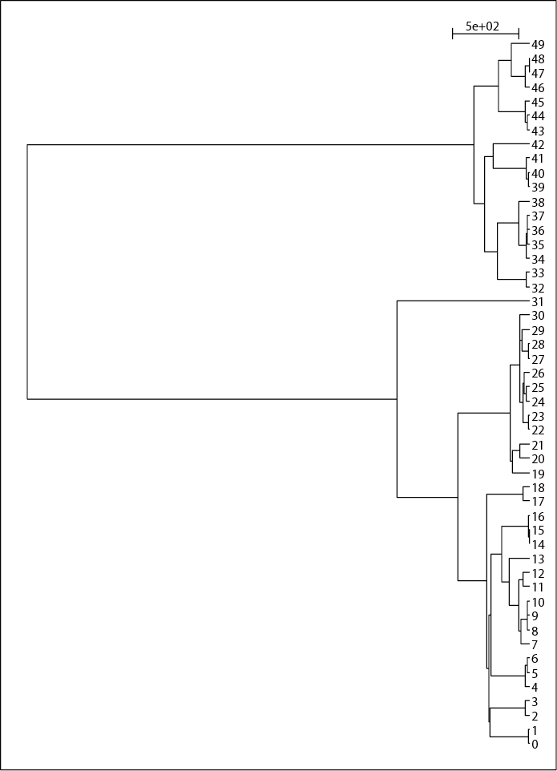
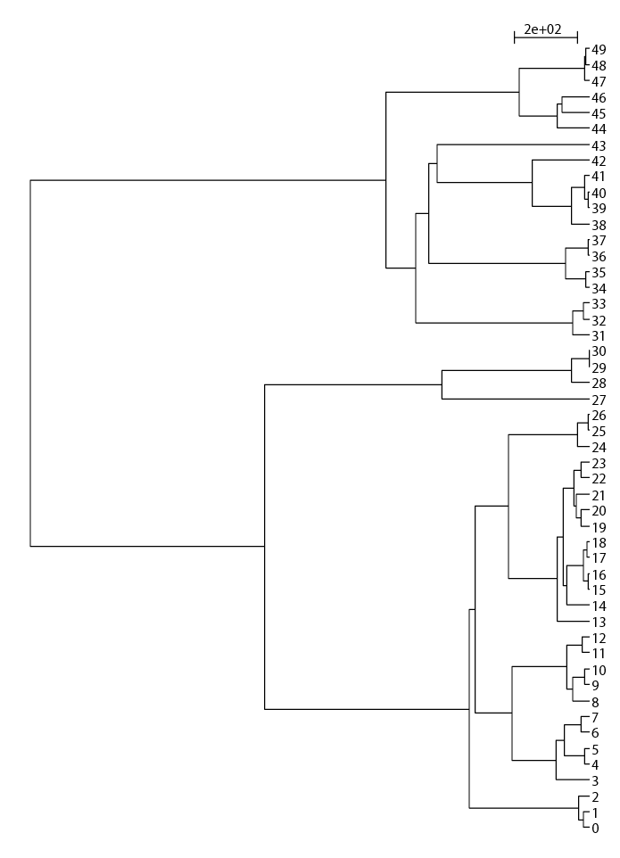
EXTANT LINEAGES FOR THE SIMULATIONS OF 50 LINEAGES

Slide 42
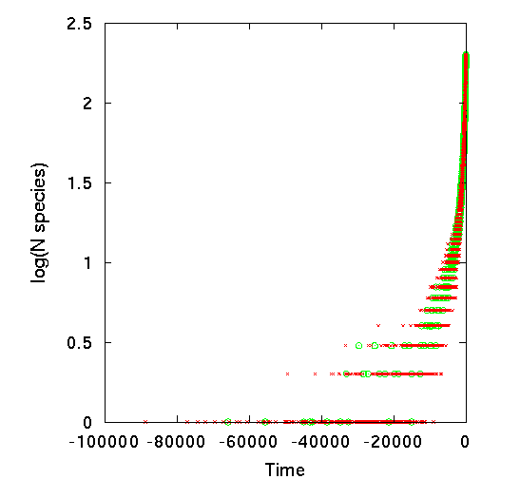
Lineages Through Time Plot
10 simulations of organismal evolution assuming
a constant number of species (200) throughout the simulation;
1 speciation and 1 extinction per time step.
(green O)
25 gene histories simulated
for each organismal history assuming
1 HGT per 10 speciation events (red x)
log (number of surviving lineages)
green: organismal lineages ;
red: molecular lineages (with gene transfer)

Slide 43
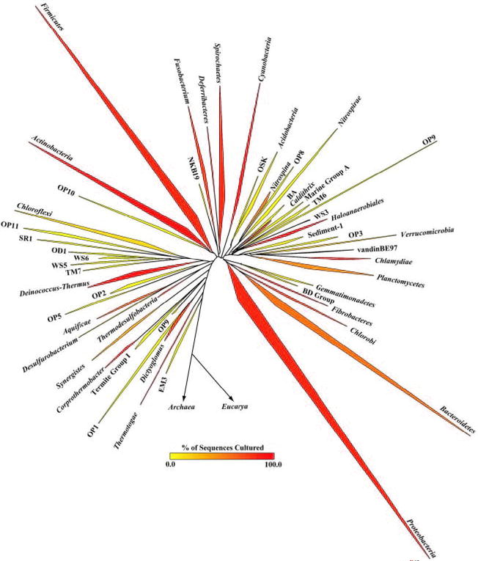
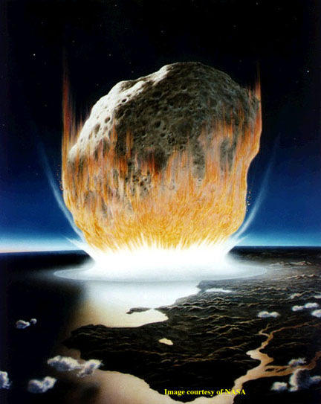
The deviation from the “long branches at the base” pattern could be due to
under sampling
an actual radiation
  due to an invention that was not transferred
  following a mass extinction
Bacterial 16SrRNA based phylogeny (from P. D. Schloss and J. Handelsman, Microbiology and Molecular Biology Reviews, December 2004.)

Slide 44
Sequence editors and viewers
Jalview Homepage, Description
Jalview as Java Web Start Application
(other JAVA applications are here)
Jalview is easy to install and run.
Test file is here (ATPase subunits)
(Intro to ATPases: 1bmf in spdbv)
(gif of rotation here, movies of the rotation are here and here)
(Load all.txt into Jalview,
colour options,
mouse use,
PID tree,
Principle component analysis -> sequence space)
More on sequence space here

