Slide 1
MCB 5472
Phylogenetic reconstruction likelihood and posterior probability
Peter Gogarten
Office: BSP 404
phone: 860 486-4061,
Email: gogarten@uconn.edu

Slide 2
phyml
PHYML - A simple, fast, and accurate algorithm to estimate large phylogenies by maximum likelihood
An online interface is here ;
there is a command line version that is described here (not as straight forward as in clustalw);
a phylip like interface is automatically invoked, if you type
“phyml” – the manual is here.
Phyml is installed on bbcxsrv1.
Do example on atp_all.phy
Note data type, bootstrap option within program, models for ASRV (pinvar and gamma), by default the starting tree is calculated via neighbor joining.

Slide 3
phyml - comments
The old version of phyml, under some circumstances calculated the consensus tree wrong. One solution was to save all the individual trees and to also evaluate them with consense from the phylip package.
Note: phyml allows longer names, but consense allows only 10 characters!
phyml is fast enough to analyze dataset with hundreds of sequences (in 1990, a maximum likelihood analyses with 12 sequences (no ASRV) took several days).
For moderately sized datasets you can estimate branch support through a bootstrap analysis (it still might run several hours, but compared to protml or PAUP, this is extremely fast).
The paper describing phyml is here,
a brief interview with the authors is here

Slide 4
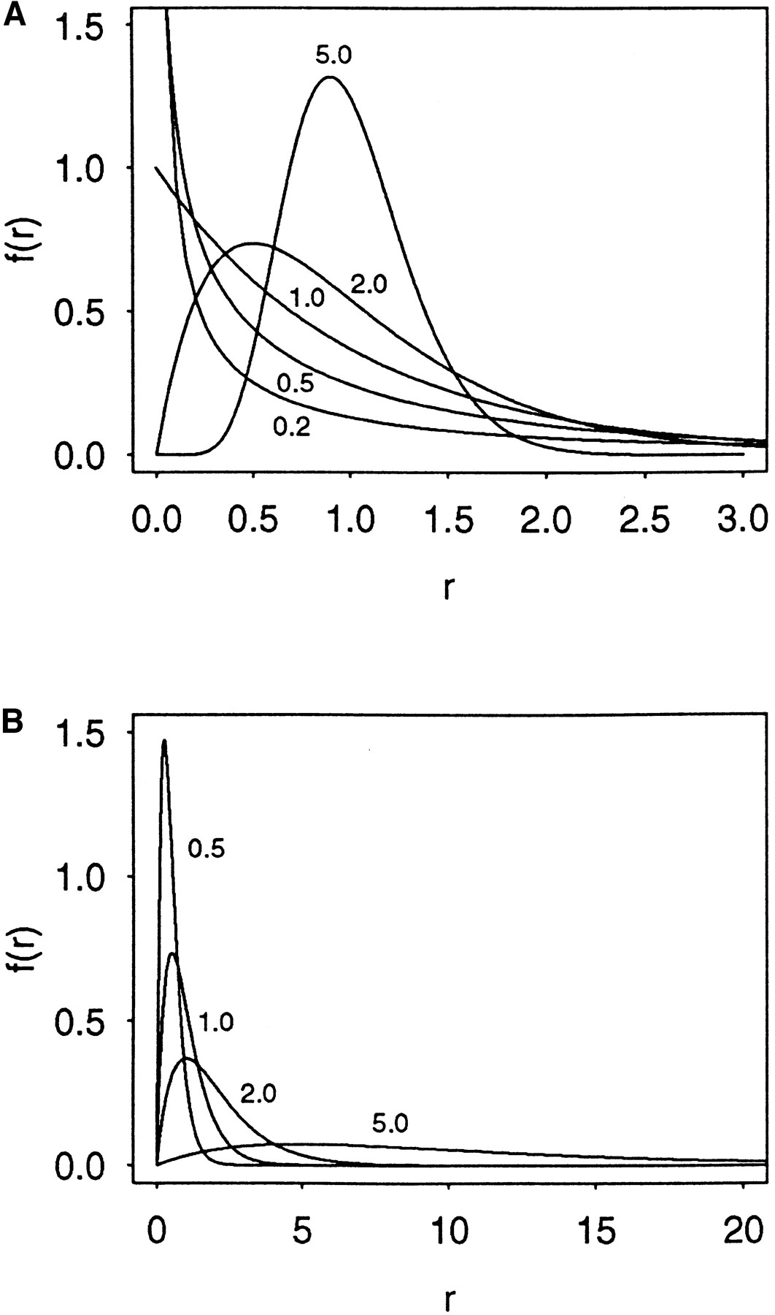

Figure 1. The probability density functions of gamma distributions
Zhang, J. et al. Genetics 1998;149:1615-1625
Copyright © 2007 by the Genetics Society of America

Slide 5
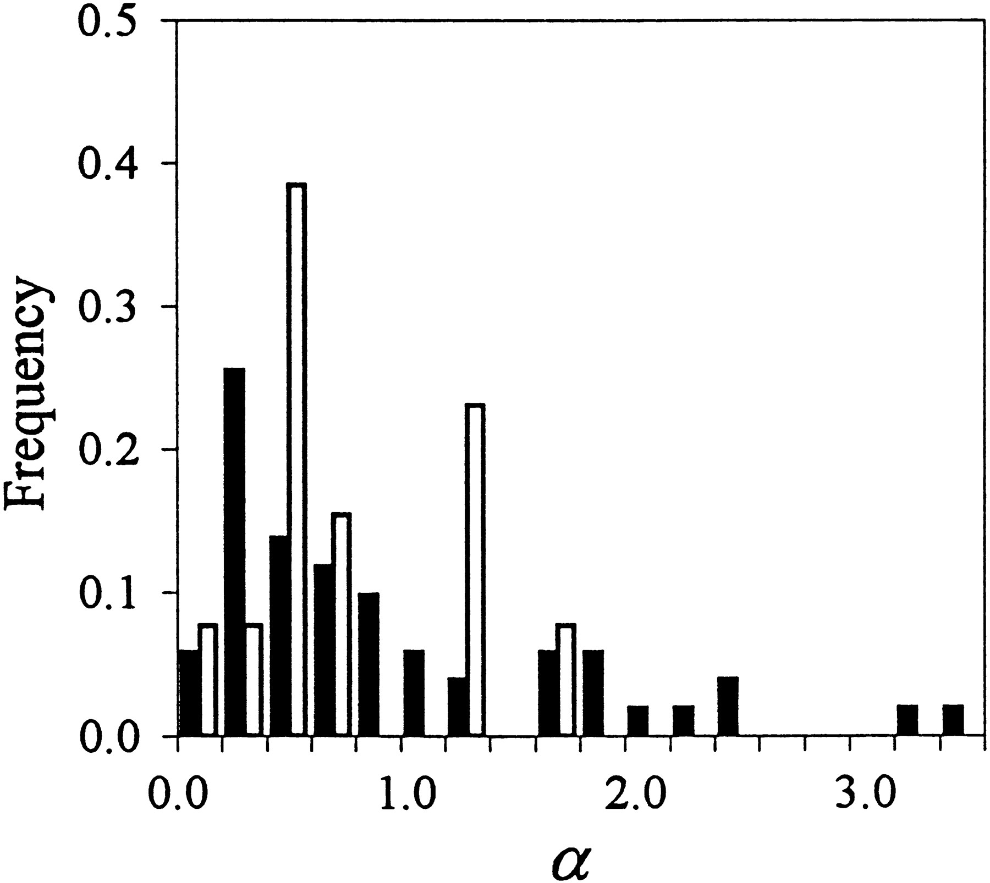
Figure 4. Distributions of the {alpha} values of 51 nuclear (solid histograms) and 13 mitochondrial (open histograms) genes
Zhang, J. et al. Genetics 1998;149:1615-1625
Copyright © 2007 by the Genetics Society of America

Slide 6
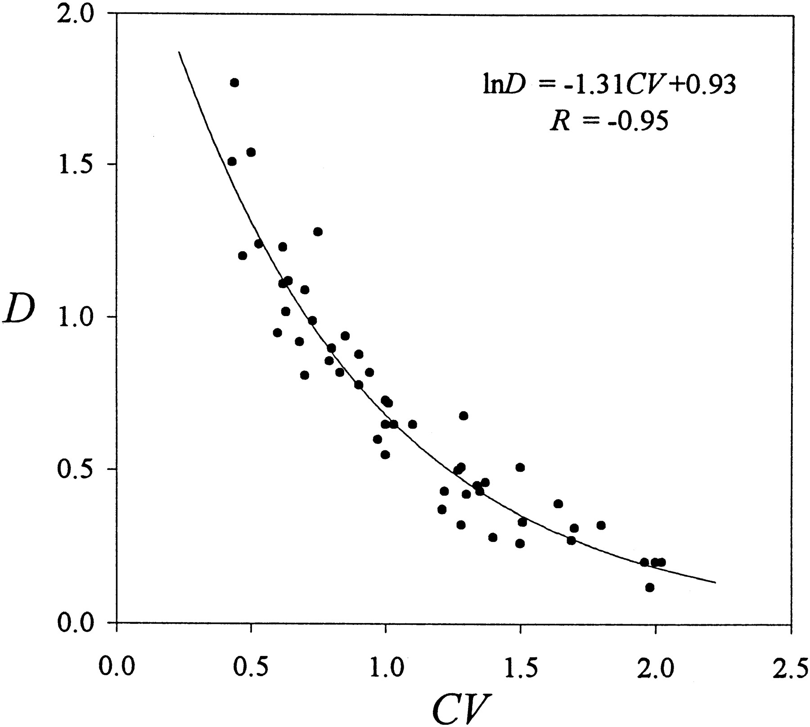
Figure 3. Correlation between the extent of among-site rate variation CV and the mean substitution rate D (={micro}T) in 51 nuclear genes
Zhang, J. et al. Genetics 1998;149:1615-1625
Copyright © 2008 by the Genetics Society of America

Slide 7

TreePuzzle ne PUZZLE
TREE-PUZZLE is a very versatile maximum likelihood program that is particularly useful to analyze protein sequences. The program was developed by Korbian Strimmer and Arnd von Haseler (then at the Univ. of Munich) and is maintained by von Haseler, Heiko A. Schmidt, and Martin Vingron
(contacts see http://www.tree-puzzle.de/).

Slide 8
TREE-PUZZLE
allows fast and accurate estimation of ASRV (through estimating the shape parameter alpha) for both nucleotide and amino acid sequences,
It has a “fast” algorithm to calculate trees through quartet puzzling (calculating ml trees for quartets of species and building the multispecies tree from the quartets).
The program provides confidence numbers (puzzle support values), which tend to be smaller than bootstrap values (i.e. provide a more conservative estimate),
the program calculates branch lengths and likelihood for user defined trees, which is great if you want to compare different tree topologies, or different models using the maximum likelihood ratio test.
Branches which are not significantly supported are collapsed.
TREE-PUZZLE runs on "all" platforms
TREE-PUZZLE reads PHYLIP format, and communicates with the user in a way similar to the PHYLIP programs.

Slide 9
Maximum likelihood ratio test
If you want to compare two models of evolution (this includes the tree) given a data set, you can utilize the so-called maximum likelihood ratio test.
If L₁ and L₂ are the likelihoods of the two models, d =2(logL₁-logL₂) approximately follows a Chi square distribution with n degrees of freedom. Usually n is the difference in model parameters. I.e., how many parameters are used to describe the substitution process and the tree. In particular n can be the difference in branches between two trees (one tree is more resolved than the other).
In principle, this test can only be applied if on model is a more refined version of the other. In the particular case, when you compare two trees, one calculated without assuming a clock, the other assuming a clock, the degrees of freedom are the number of OTUs – 2 (as all sequences end up in the present at the same level, their branches cannot be freely chosen) .
To calculate the probability you can use the CHISQUARE calculator for windows available from Paul Lewis.

Slide 10
TREE-PUZZLE allows (cont)
TREEPUZZLE calculates distance matrices using the ml specified model. These can be used in FITCH or Neighbor.
PUZZLEBOOT automates this approach to do bootstrap analyses –
WARNING: this is a distance matrix analyses!
The official script for PUZZLEBOOT is here – you need to create a command file (puzzle.cmds), and puzzle needs to be envocable through the command puzzle.
Your input file needs to be the renamed outfile from seqboot
A slightly modified working version of puzzleboot_mod.sh is here, and here is an example for puzzle.cmds . Read the instructions before you run this!
Maximum likelihood mapping is an excellent way to
assess the phylogenetic information contained in a dataset.
ML mapping can be used to calculate the support around one branch.
@@@ Puzzle is cool, don't leave home without it! @@@

Slide 11
TREE-PUZZLE – PROBLEMS/DRAWBACKS
The more species you add the lower the support for individual branches. While this is true for all algorithms, in TREE-PUZZLE this can lead to completely unresolved trees with only a few handful of sequences.
Trees calculated via quartet puzzling are usually not completely resolved, and they do not correspond to the ML-tree:
The determined multi-species tree is not the tree with the highest likelihood, rather it is the tree whose topology is supported through ml-quartets, and the lengths of the resolved branches is determined through maximum likelihood.

Slide 12
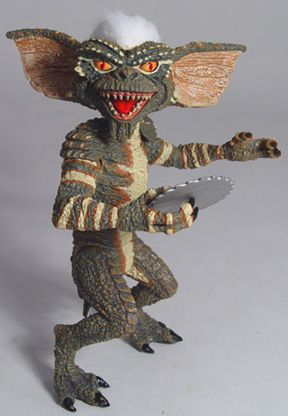
Elliot Sober’s Gremlins
Observation: Loud noise in the attic
?
Hypothesis: gremlins in the attic playing bowling
Likelihood =
P(noise|gremlins in the attic)
P(gremlins in the attic|noise)
?
?

Slide 13
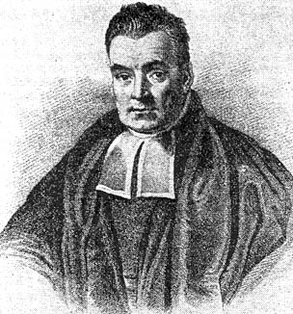
Bayes’ Theorem
Likelihood
describes how well the model predicts the data
P(data|model, I)
P(model|data, I) = P(model, I)
P(data,I)
Posterior
Probability
represents the degree
to which we believe a given model accurately describes the situation
given the available data and all of our prior information I
Prior
Probability
describes the degree to which we believe the model accurately describes reality
based on all of our prior information.
Normalizing
constant
Reverend Thomas Bayes (1702-1761)

Slide 14
Likelihood estimates do not take prior information into consideration:
e.g., if the result of three coin tosses is 3 times head, then the likelihood estimate for the frequency of having a head is 1 (3 out of 3 events) and the estimate for the frequency of having a head is zero.
The probability that both events (A and B) occur
Both sides expressed as conditional probability
If A is the model and B is the data, then
P(B|A) is the likelihood of model A
P(A|B) is the posterior probability of the model given the data.
P(A) is the considered the prior probability of the model.
P(B) often is treated as a normalizing constant.

Slide 15
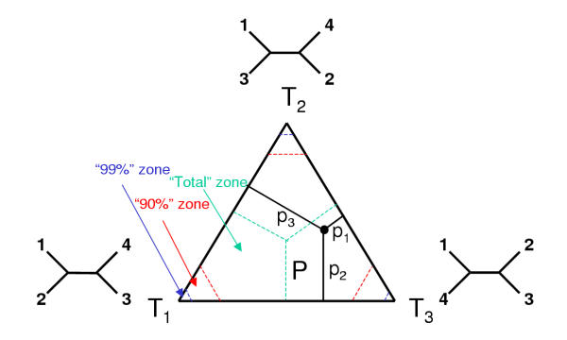
ml mapping
From: Olga Zhaxybayeva and J Peter Gogarten BMC Genomics 2002, 3:4

Slide 16
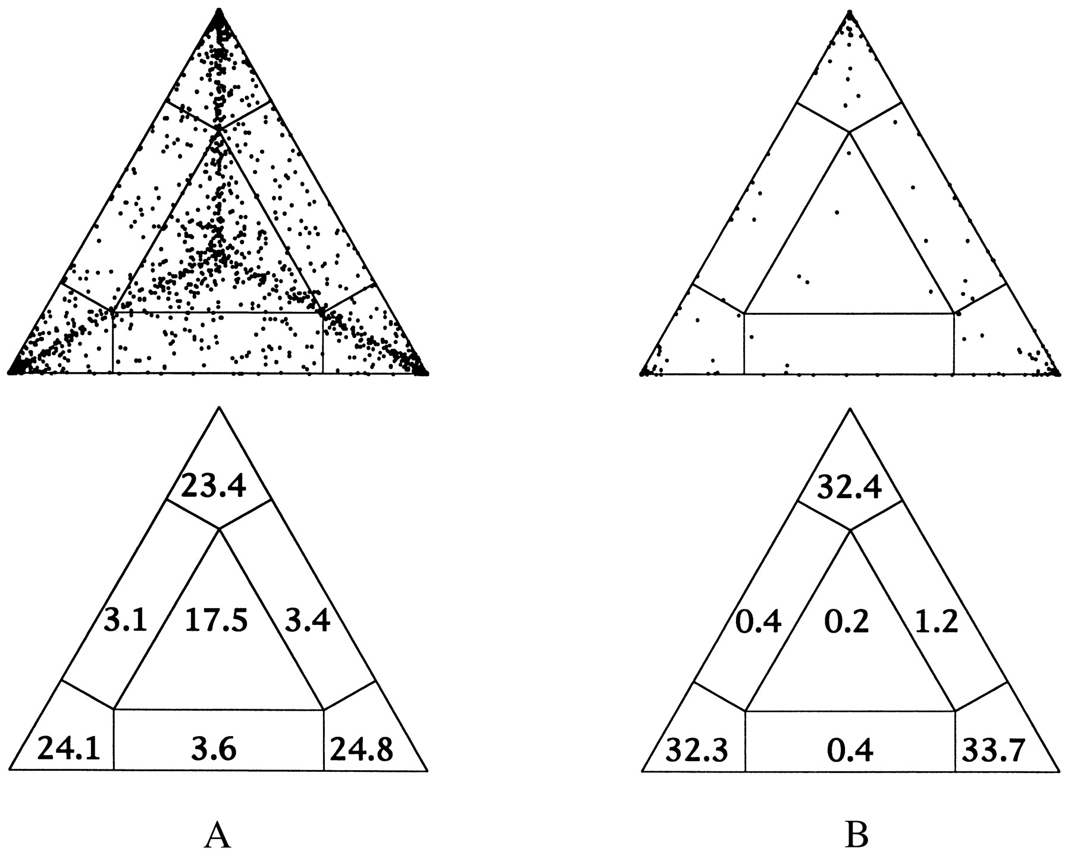
ml mapping
Figure 5. Likelihood-mapping analysis for two biological data sets. (Upper) The distribution patterns. (Lower) The occupancies (in percent) for the seven areas of attraction.
(A) Cytochrome-b data from ref. 14. (B) Ribosomal DNA of major arthropod groups (15).
From: Korbinian Strimmer and Arndt von Haeseler Proc. Natl. Acad. Sci. USA
Vol. 94, pp. 6815-6819, June 1997

Slide 17
(a,b)-(c,d)
/\
/ \
/ \
/ 1 \
/ \ / \
/ \ / \
/ \/ \
/ 3 : 2 \
/ : \
/__________________\
(a,d)-(b,c) (a,c)-(b,d)
Number of quartets in region 1: 68 (= 24.3%)
Number of quartets in region 2: 21 (= 7.5%)
Number of quartets in region 3: 191 (= 68.2%)
Occupancies of the seven areas 1, 2, 3, 4, 5, 6, 7:
(a,b)-(c,d)
/\
/ \
/ 1 \
/ \ / \
/ /\ \
/ 6 / \ 4 \
/ / 7 \ \
/ \ /______\ / \
/ 3 : 5 : 2 \
/__________________\
(a,d)-(b,c) (a,c)-(b,d)
Number of quartets in region 1: 53 (= 18.9%)
Number of quartets in region 2: 15 (= 5.4%)
Number of quartets in region 3: 173 (= 61.8%)
Number of quartets in region 4: 3 (= 1.1%)
Number of quartets in region 5: 0 (= 0.0%)
Number of quartets in region 6: 26 (= 9.3%)
Number of quartets in region 7: 10 (= 3.6%)
Cluster a: 14 sequences
outgroup (prokaryotes)
Cluster b: 20 sequences
other Eukaryotes
Cluster c: 1 sequences
Plasmodium
Cluster d: 1 sequences
Giardia

Slide 18
Alternative Approaches to Estimate
Posterior Probabilities
Bayesian Posterior Probability Mapping with MrBayes
(Huelsenbeck and Ronquist, 2001)
Problem:
Strimmer’s formula
L_{i}
p_{i}=
only considers 3 trees
(those that maximize the likelihood for
the three topologies)
L₁+L₂+L₃
Solution:
Exploration of the tree space by sampling trees using a biased random walk
(Implemented in MrBayes program)
Trees with higher likelihoods will be sampled more often
N_{i}
p_{i}≈
N_{total}
,where N_{i} - number of sampled trees of topology i, i=1,2,3
N_{total} – total number of sampled trees (has to be large)

Slide 19
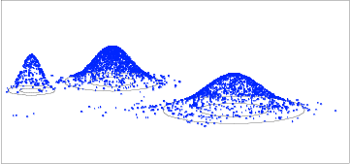
Illustration of a biased random walk
Image generated with Paul Lewis's MCRobot
Figure generated using MCRobot program (Paul Lewis, 2001)

Slide 20
Nexus files:
This is the file format used by many popular programs like MacClade, Mesquite, ModelTest, MrBayes and PAUP*. Nexus file names often have a .nxs or .nex extension.
A formal description of the NEXUS format can be found in Maddison et al. (1997).
Conversion of an interleaved NEXUS file to a non-interleaved NEXUS file: execute the file in PAUP*, and export the file as non-interleaved NEXUS file. You can also type the commands:
export file=yourfile.nex format=nexus interleaved=no;
clustalw saves and reads Nexus sequence and tree files
(check on gap treatment and label as DNA or aa)

Slide 21
sample DNA file
#nexus
begin data;
dimensions ntax=10 nchar=705;
format datatype=dna interleave=yes gap=- missing=?;
matrix
Cow ATGGCATATCCCATACAACTAGGATTCCAAGATGCAACATCACCAATCATAGAAGAACTA
Carp ATGGCACACCCAACGCAACTAGGTTTCAAGGACGCGGCCATACCCGTTATAGAGGAACTT
Chicken ATGGCCAACCACTCCCAACTAGGCTTTCAAGACGCCTCATCCCCCATCATAGAAGAGCTC
Human ATGGCACATGCAGCGCAAGTAGGTCTACAAGACGCTACTTCCCCTATCATAGAAGAGCTT
Loach ATGGCACATCCCACACAATTAGGATTCCAAGACGCGGCCTCACCCGTAATAGAAGAACTT
Mouse ATGGCCTACCCATTCCAACTTGGTCTACAAGACGCCACATCCCCTATTATAGAAGAGCTA
Rat ATGGCTTACCCATTTCAACTTGGCTTACAAGACGCTACATCACCTATCATAGAAGAACTT
Seal ATGGCATACCCCCTACAAATAGGCCTACAAGATGCAACCTCTCCCATTATAGAGGAGTTA
Whale ATGGCATATCCATTCCAACTAGGTTTCCAAGATGCAGCATCACCCATCATAGAAGAGCTC
Frog ATGGCACACCCATCACAATTAGGTTTTCAAGACGCAGCCTCTCCAATTATAGAAGAATTA
Cow CTTCACTTTCATGACCACACGCTAATAATTGTCTTCTTAATTAGCTCATTAGTACTTTAC
Carp CTTCACTTCCACGACCACGCATTAATAATTGTGCTCCTAATTAGCACTTTAGTTTTATAT
Chicken GTTGAATTCCACGACCACGCCCTGATAGTCGCACTAGCAATTTGCAGCTTAGTACTCTAC
Human ATCACCTTTCATGATCACGCCCTCATAATCATTTTCCTTATCTGCTTCCTAGTCCTGTAT
Loach CTTCACTTCCATGACCATGCCCTAATAATTGTATTTTTGATTAGCGCCCTAGTACTTTAT
Mouse ATAAATTTCCATGATCACACACTAATAATTGTTTTCCTAATTAGCTCCTTAGTCCTCTAT
Rat ACAAACTTTCATGACCACACCCTAATAATTGTATTCCTCATCAGCTCCCTAGTACTTTAT
Seal CTACACTTCCATGACCACACATTAATAATTGTGTTCCTAATTAGCTCATTAGTACTCTAC
Whale CTACACTTTCACGATCATACACTAATAATCGTTTTTCTAATTAGCTCTTTAGTTCTCTAC
Frog CTTCACTTCCACGACCATACCCTCATAGCCGTTTTTCTTATTAGTACGCTAGTTCTTTAC
//
Frog AACTGATCTTCATCAATACTA---GAAGCATCACTA------AGA
;
end;

Slide 22
sample aa file
#NEXUS
Begin data;
Dimensions ntax=10 nchar=234;
Format datatype=protein gap=- interleave;
Matrix
Cow MAYPMQLGFQDATSPIMEELLHFHDHTLMIVFLISSLVLYIISLMLTTKLTHTSTMDAQE
Carp MAHPTQLGFKDAAMPVMEELLHFHDHALMIVLLISTLVLYIITAMVSTKLTNKYILDSQE
Chicken MANHSQLGFQDASSPIMEELVEFHDHALMVALAICSLVLYLLTLMLMEKLS-SNTVDAQE
Human MAHAAQVGLQDATSPIMEELITFHDHALMIIFLICFLVLYALFLTLTTKLTNTNISDAQE
Loach MAHPTQLGFQDAASPVMEELLHFHDHALMIVFLISALVLYVIITTVSTKLTNMYILDSQE
Mouse MAYPFQLGLQDATSPIMEELMNFHDHTLMIVFLISSLVLYIISLMLTTKLTHTSTMDAQE
Rat MAYPFQLGLQDATSPIMEELTNFHDHTLMIVFLISSLVLYIISLMLTTKLTHTSTMDAQE
Seal MAYPLQMGLQDATSPIMEELLHFHDHTLMIVFLISSLVLYIISLMLTTKLTHTSTMDAQE
Whale MAYPFQLGFQDAASPIMEELLHFHDHTLMIVFLISSLVLYIITLMLTTKLTHTSTMDAQE
Frog MAHPSQLGFQDAASPIMEELLHFHDHTLMAVFLISTLVLYIITIMMTTKLTNTNLMDAQE
//
Loach QTAFIASRPGVFYGQCSEICGANHSFMPIVVEAVPLSHFENWSTLMLKDASLGS
Mouse QATVTSNRPGLFYGQCSEICGSNHSFMPIVLEMVPLKYFENWSASMI-------
Rat QATVTSNRPGLFYGQCSEICGSNHSFMPIVLEMVPLKYFENWSASMI-------
Seal QTTLMTMRPGLYYGQCSEICGSNHSFMPIVLELVPLSHFEKWSTSML-------
Whale QTTLMSTRPGLFYGQCSEICGSNHSFMPIVLELVPLEVFEKWSVSML-------
Frog QTSFIATRPGVFYGQCSEICGANHSFMPIVVEAVPLTDFENWSSSML-EASL--
;
End;
Another example is here

Slide 23
More information on Nexus files and PAUP and MrBayes commands are in the respective manuals:
http://paup.csit.fsu.edu/, manual here, tutorial here
http://mrbayes.csit.fsu.edu/, manual here Wikki

Slide 24
sites model in MrBayes
The MrBayes block in a nexus file might look something like this:
begin mrbayes;
set autoclose=yes;
lset nst=2 rates=gamma nucmodel=codon omegavar=Ny98;
mcmcp samplefreq=500 printfreq=500;
mcmc ngen=500000;
sump burnin=50;
sumt burnin=50;
end;

Slide 25
Often in phylogenetic analysis the model and the prior information is very complex. For example, if you attempt to calculate a dated molecular phylogeny with a clock whose rate changes over the tree, and with some soft calibration points thrown in.
To get an idea what the outcome of the model and constraints is without the data, run the chain without any data.

Slide 26
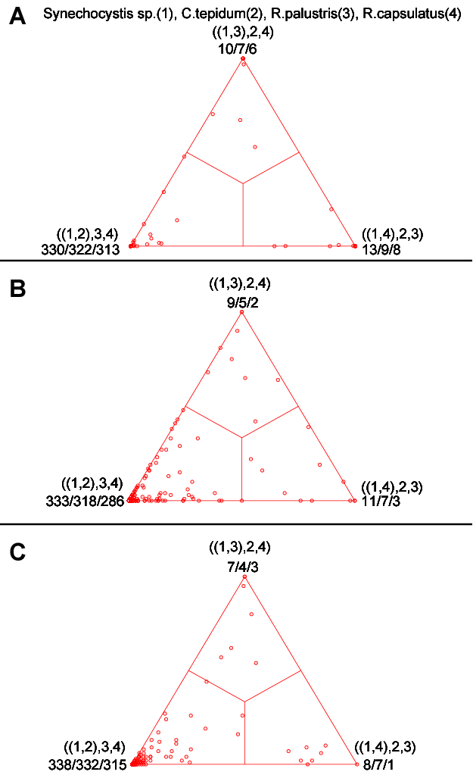
COMPARISON OF DIFFERENT SUPPORT MEASURES
A: mapping of posterior probabilities according to Strimmer and von Haeseler
B: mapping of bootstrap support values
C: mapping of bootstrap support values from extended datasets
Zhaxybayeva and Gogarten, BMC Genomics 2003 4: 37

Slide 27
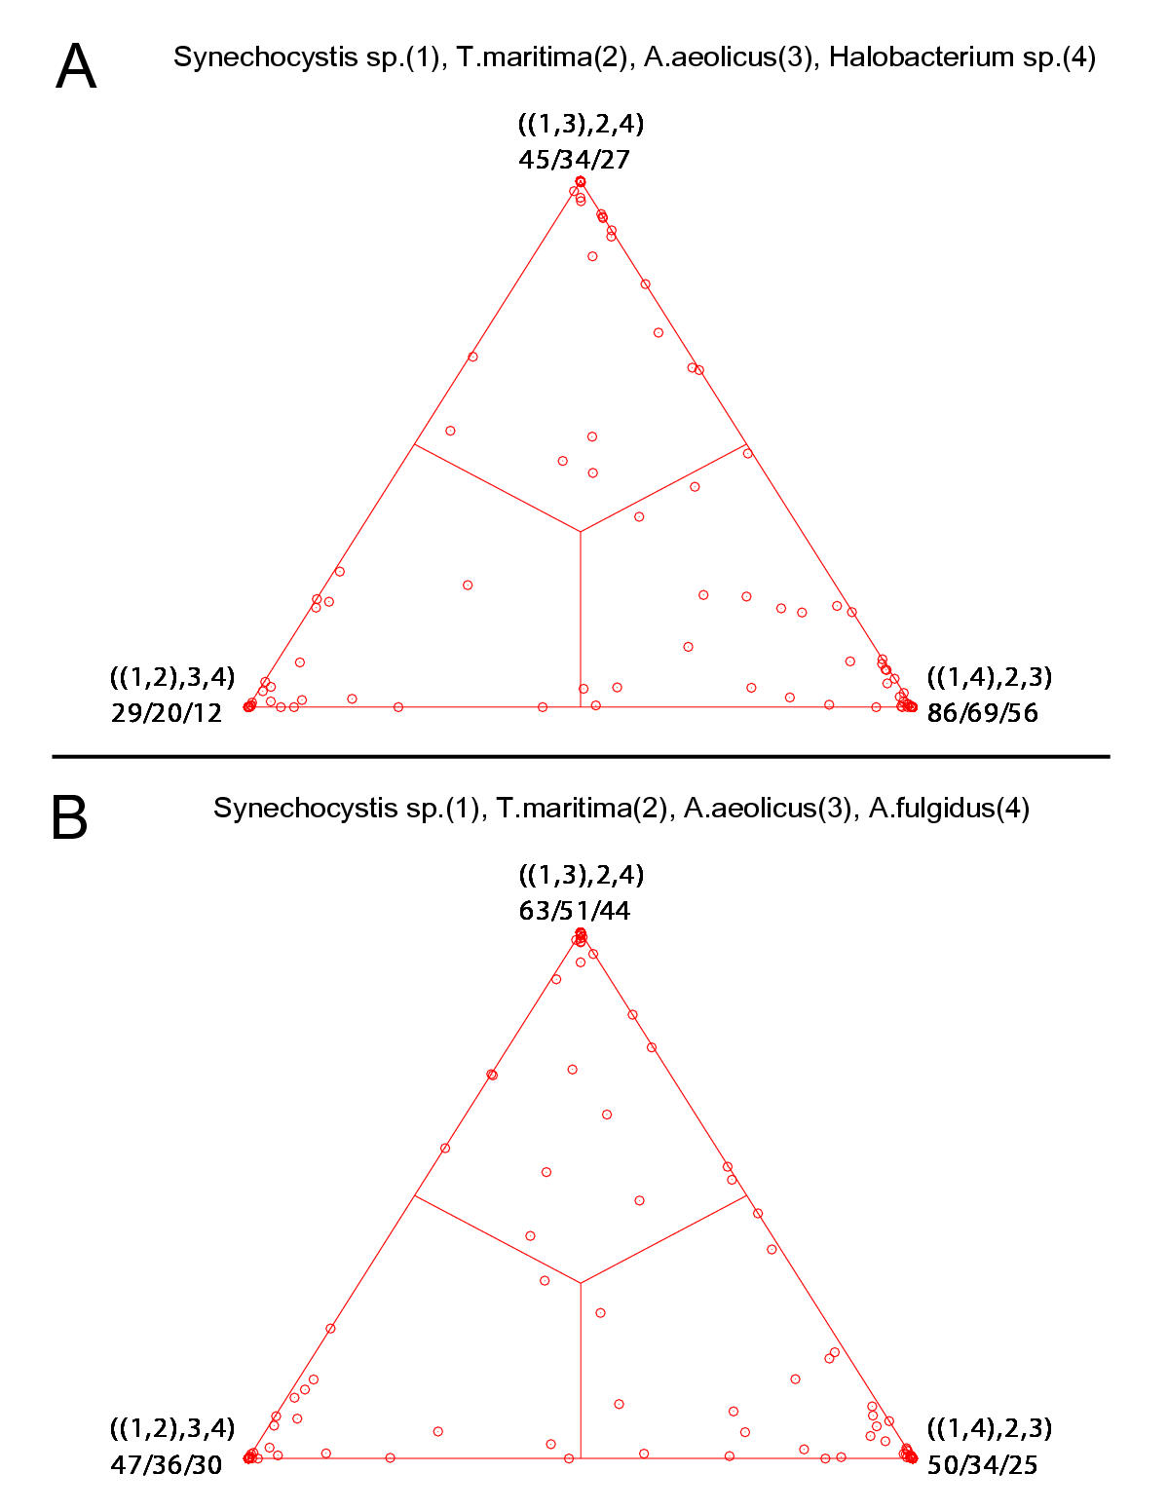
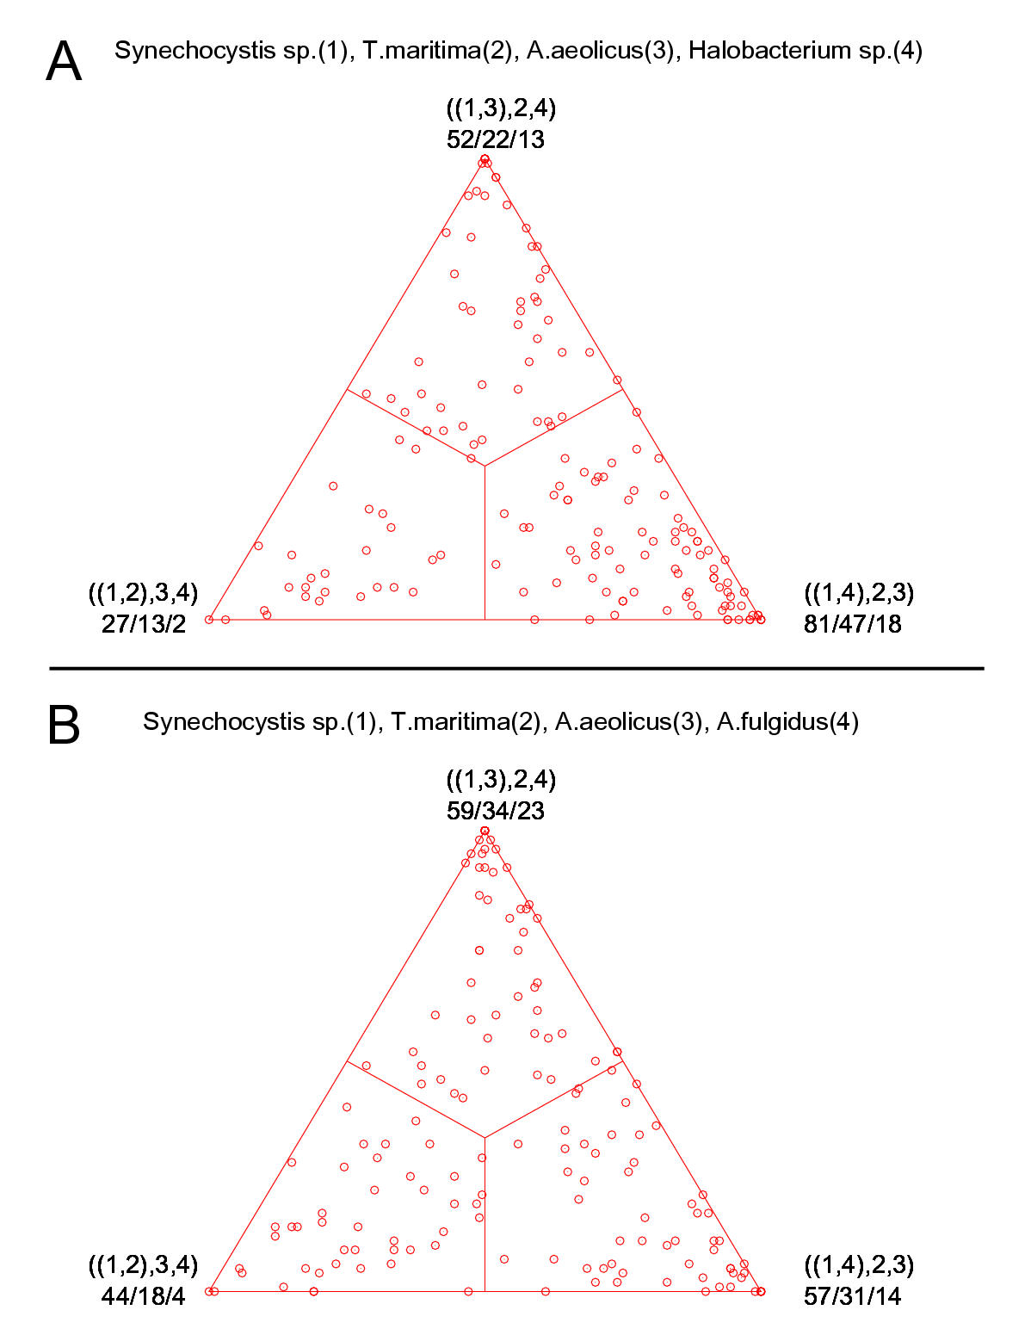
bootstrap values from extended datasets
ml-mapping
versus
More gene families group species according to environment than according to 16SrRNA phylogeny
In contrast, a themophilic archaeon has more genes grouping with the thermophilic bacteria

Slide 28
Sequence alignment:
CLUSTALW
MUSCLE
Removing ambiguous positions:
T-COFFEE
FORBACK
Generation of pseudosamples:
SEQBOOT
PROTDIST
TREE-PUZZLE
Calculating and evaluating phylogenies:
PROTPARS
PHYML
NEIGHBOR
FITCH
Comparing phylogenies:
CONSENSE
SH-TEST in TREE-PUZZLE
Comparing models:
Maximum Likelihood Ratio Test
Visualizing trees:
ATV, njplot, or treeview
Phylip programs can be combined in many different ways with one another and with programs that use the same file formats.

Slide 29
the gradualist point of view
Evolution occurs within populations where the fittest organisms have a selective advantage. Over time the advantagous genes become fixed in a population and the population gradually changes.
Note: this is not in contradiction to the the theory of neutral evolution. (which says what ?)
Processes that MIGHT go beyond inheritance with variation and selection?
  Horizontal gene transfer and recombination
  Polyploidization (botany, vertebrate evolution) see here
  Fusion and cooperation of organisms (Kefir, lichen, also the eukaryotic cell)
  Targeted mutations (?), genetic memory (?) (see Foster's and Hall's reviews on directed/adaptive mutations; see here for a counterpoint)
  Random genetic drift (i.e. traits are fixed even though they do not provide an advantage)
  Gratuitous complexity (introns, split intein)
  Selfish genes (who/what is the subject of evolution??)
  Parasitism, altruism, Morons (Gene Transfer Agents)

Slide 30
Old exercises:
Write a script that determines the number of elements in %ash.
@keys = keys(%ash); #assigns keys to an array
$number =@keys; # determines number of different keys (uses array in scalar context).
print "$number \n";
Write a script that prints out a hash sorted on the keys in alphabetical order.
@gi_names = sort(keys(%gi_hash)); # sorts key and assigns keys to an array
foreach (@gi_names){
print "$_ occurred $gi_hash{$_} times\n";
}
Remove an entry in a hash (key and value):
delete $gi_hash{$varaible_denoting_some_key};
Write a program that it uses hashes to calculates mono-, di-, tri-, and quartet-nucleotide frequencies in a genome.
Carries over to next week

Slide 31
Assignments:
Re-read chapter P16-P18 in the primer
Given a multiple fasta sequence file*, write a script that for each sequence extract the gi number and the species name. and rewrites the file so that the annotation line starts with the gi number, followed by the species/strain name, followed by a space. (The gi number and the species name should not be separated by or contain any spaces – replace them by _. This is useful, because clustalw will recognize the number and name as handle for the sequence.)
Work on your student project
Assume that the annotation line follows the NCBI convention and begins with the > followed by the gi number, and ends with the species and strain designation given in []
Example:
>gi|229240723|ref|ZP_04365119.1| primary replicative DNA helicase; intein [Cellulomonas flavigena DSM 20109]
Example multiple sequence file is here.

