Slide 1
MCB 5472
The Queue,
Phylogenetic Reconstruction and Selection
Peter Gogarten
Office: BSP 404
phone: 860 486-4061,
Email: gogarten@uconn.edu

Slide 2
Old exercises:
Write a program that it uses hashes to calculates mono-, di-, tri-, and quartet-nucleotide frequencies in a genome.
Go over tetraA.pl
New exercises:
modify tetraA.pl so that the user (or another program) can assign the size of the nmer as a variable!

Slide 3
Old Assignments:
Re-read chapter P16-P18 in the primer
Given a multiple fasta sequence file*, write a script that for each sequence extract the gi number and the species name. and rewrites the file so that the annotation line starts with the gi number, followed by the species/strain name, followed by a space. (The gi number and the species name should not be separated by or contain any spaces – replace them by _. This is useful, because clustalw will recognize the number and name as handle for the sequence.)
Work on your student project
Assume that the annotation line follows the NCBI convention and begins with the > followed by the gi number, and ends with the species and strain designation given in []
Example:
>gi|229240723|ref|ZP_04365119.1| primary replicative DNA helicase; intein [Cellulomonas flavigena DSM 20109]
Example multiple sequence file is here.

Slide 4
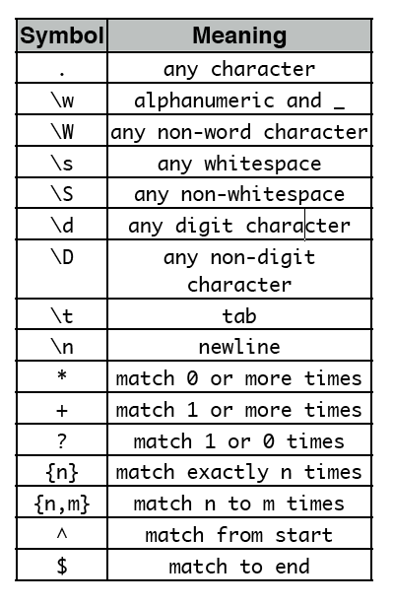
an error prone solution is at convertannotationline.pl
Rewrite this script so that is uses the $&
variable to extract the gi number and
the species name.
New Assignment:

Slide 5
Bioinformatics Facility of the Biotechnology
The Do and Don’t of the Xserve Cluster
Pascal Lapierre, Facility Scientist
Biotech Center, G05
486-8742
The next ten slides were provided Pascal Lapierre

Slide 6
Head
Node
Xserve Cluster Physical Organization
2 x 2.3GHz G5 processors
2 GB of memories per node
(8 GB on node 17)
2.3 TeraBytes of Storage on
the head node.
- 2 other mini clusters assigned for special projects
Node001
To
Node017

Slide 7
Basic Rules
For research purpose only. Not a place to put your favorite MP3 or backup your HD.
Do not overload the systems. It is ok to use ~6 nodes in period of low activities but when it gets busy, limit yourself to only 2-3 nodes if absolutely necessary.
Always keep track of your jobs. Don’t let things running unattended for months.
Use the queue system whenever you can.
Do not run jobs on the Head node.

Slide 8
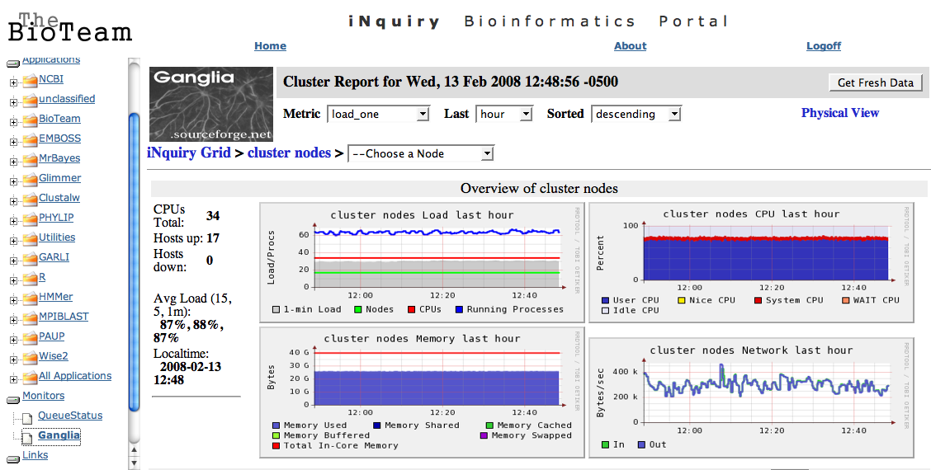
Remote Access
- Via SSH or Web Interface
ssh your_name@bbcxsrv1.biotech.uconn.edu
http://www.biotech.uconn.edu/bf/

Slide 9
Useful Commands
(Help page available at : http://137.99.46.188/wiki/index.php/Main_Page)
qstat : Shows the current status of the available Grid Engine queues and the jobs associated with the queues.
ls : List directory contents
ps : Display the process status. Allow to get process ID.
      ps ux : Displays your process only
      ps aux : displays all the process running on the node
du : display disk usage statistics. Use du -h for a readable output (df for disk space)

Slide 10
Useful Commands (cont)
mkdir and rmdir : create and remove directories
cp : copy files
mv : moved files (can be used to rename files)
rm : remove files. rm -r to remove files and sub-directories
kill : to kill a running process. Kill -9 ‘proc_id’

Slide 11
The queue system
“Managing Workload by Managing Resources and Policies”
qstat : Display the queue status.
qrsh : Queue remote shell. Automatically select an available node to log on.
qsub : Queue submit. Automatically submit a job to an available node. Used in conjuncture with a shell script (see next slide).
qdel : Delete a job running in the queue.
    qdel - process_ID

Slide 12
How to submit a job using qsub?
A shell script is just a small text file pointing to what you want to run in the queue.
For example, if I want to submit a perl script (phyml_trees1.pl), I will create a text file name phyml.sh :
#!/bin/sh
cd /Users/nucleus/evolver
perl phyml_trees1.pl
#end of script
To submit the shell :
qsub phyml.sh

Slide 13
Things to be cautious :
While highly reliable, the cluster might sometimes run into problems and needed to be rebooted. This will cause to loose all the processes that were running at the time. Try to think of ways to break up or save at different stage of your analyses.
The NFS (Network File System) have temporary amnesia. When overwhelm, the system will forget to write part of the output files. A workaround is to save to the scratch drive of the individual nodes (cd /scratch).
- blastall -p blastp -d nr -o /scratch/pascal/blast.out -a 2 -F F -m 9

Slide 14
Tricks that I have learned
In Perl, Array of Arrays are useful for grid-like manipulations of data :
Seq.txt =
MRRAIATNQQ
MRLAIISRQD
MRRLSISRQQ
MRLAIIIRQQ
##!/usr/bin/perl -w
$infile = ”seq.txt";
open (FILE,$infile);
while ($in = <FILE>) { #go infile line by line
chomp $in;
@data = split ('',$in); #split using ‘’
push @matrix,[@data]; # put the array @data
into @matrix
}
0123456789
0
1
2
3
MRRAIATNQQ
MRLAIISRQD
MRRLSISRQQ
MRLAIIIRQQ
Print $matrix[2][4];
S

Slide 15
the gradualist point of view
Evolution occurs within populations where the fittest organisms have a selective advantage. Over time the advantages genes become fixed in a population and the population gradually changes.
Note: this is not in contradiction to the the theory of neutral evolution. (which says what ?)
Processes that MIGHT go beyond inheritance with variation and selection?
  Horizontal gene transfer and recombination
  Polyploidization (botany, vertebrate evolution) see here
  Fusion and cooperation of organisms (Kefir, lichen, also the eukaryotic cell)
  Targeted mutations (?), genetic memory (?) (see Foster's and Hall's reviews on directed/adaptive mutations; see here for a counterpoint)
  Random genetic drift
  Gratuitous complexity
  Selfish genes (who/what is the subject of evolution??)
  Parasitism, altruism, Morons

Slide 16
selection versus drift
see Kent Holsinger’s java simulations at
http://darwin.eeb.uconn.edu/simulations/simulations.html
The law of the gutter.
compare drift versus select + drift
The larger the population the longer it takes for an allele to become fixed.
Note: Even though an allele conveys a strong selective advantage of 10%, the allele has a rather large chance to go extinct.
Note#2: Fixation is faster under selection than under drift.
BUT

Slide 17
s=0
Probability of fixation, P, is equal to frequency of allele in population. Mutation rate (per gene/per unit of time) = u ;
freq. with which allele is generated in diploid population size N =u*2N
Probability of fixation for each allele = 1/(2N)
Substitution rate =
frequency with which new alleles are generated * Probability of fixation= u*2N *1/(2N) = u
Therefore:
If f s=0, the substitution rate is independent of population size, and equal to the mutation rate !!!! (NOTE: Mutation unequal Substitution! )
This is the reason that there is hope that the molecular clock might sometimes work.
Fixation time due to drift alone:
t_{av}=4*N_{e} generations
(N_{e}=effective population size; For n discrete generations
N_{e}= n/(1/N₁+1/N₂+…..1/N_{n})

Slide 18
s>0
Time till fixation on average:
t_{av}= (2/s) ln (2N) generations
(also true for mutations with negative “s” ! discuss among yourselves)
E.g.: N=10⁶,
s=0: average time to fixation: 4*10⁶ generations
s=0.01: average time to fixation: 2900 generations
N=10⁴,
s=0: average time to fixation: 40.000 generations
s=0.01: average time to fixation: 1.900 generations
=> substitution rate of mutation under positive selection is larger than the rate wite which neutral mutations are fixed.

Slide 19
Random Genetic Drift
Selection
100
advantageous
Allele frequency
disadvantageous
0
Modified from from www.tcd.ie/Genetics/staff/Aoife/GE3026/GE3026_1+2.ppt

Slide 20
Positive selection
A new allele (mutant) confers some increase in the fitness of the organism
Selection acts to favour this allele
Also called adaptive selection or Darwinian selection.
NOTE: Fitness = ability to survive and reproduce
Modified from from www.tcd.ie/Genetics/staff/Aoife/GE3026/GE3026_1+2.ppt

Slide 21
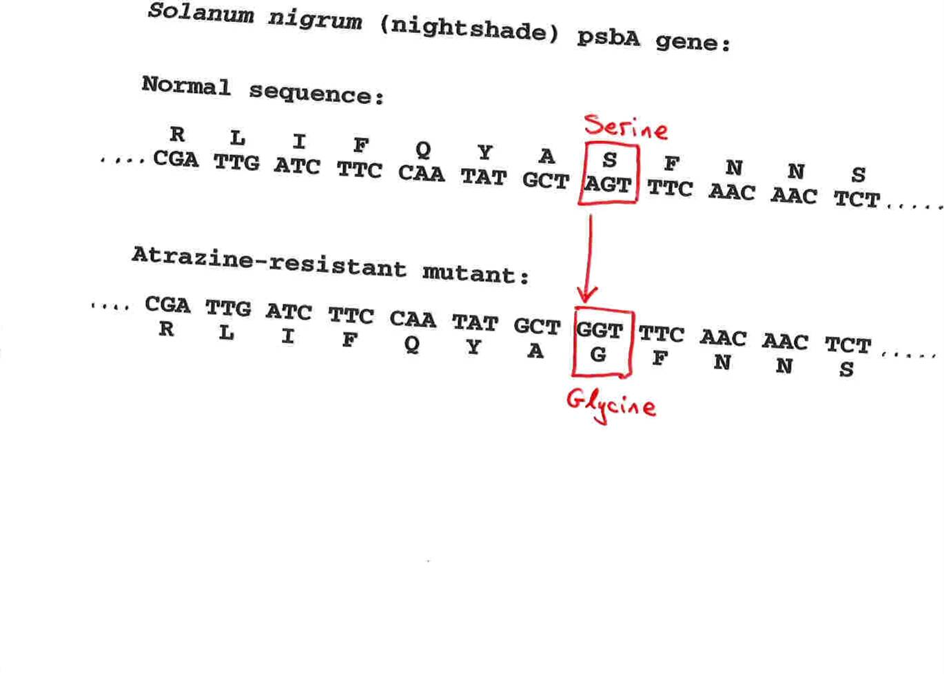
Advantageous allele
Herbicide resistance gene in nightshade plant
Modified from from www.tcd.ie/Genetics/staff/Aoife/GE3026/GE3026_1+2.ppt

Slide 22
Negative selection
A new allele (mutant) confers some decrease in the fitness of the organism
Selection acts to remove this allele
Also called purifying selection
Modified from from www.tcd.ie/Genetics/staff/Aoife/GE3026/GE3026_1+2.ppt

Slide 23
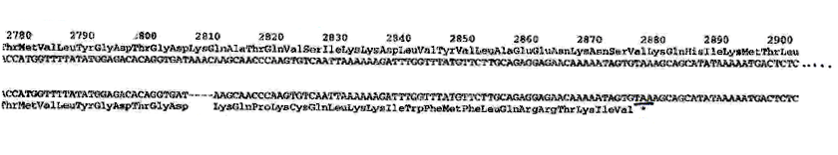
Deleterious allele
Human breast cancer gene, BRCA2
5% of breast cancer cases are familial
Mutations in BRCA2 account for 20% of familial cases
Normal (wild type) allele
Mutant allele
(Montreal 440
Family)
Stop codon
4 base pair deletion
Causes frameshift
Modified from from www.tcd.ie/Genetics/staff/Aoife/GE3026/GE3026_1+2.ppt

Slide 24
Neutral mutations
Neither advantageous nor disadvantageous
Invisible to selection (no selection)
Frequency subject to ‘drift’ in the population
Random drift – random changes in small populations

Slide 25
Types of Mutation-Substitution
Replacement of one nucleotide by another
Synonymous (Doesn’t change amino acid)
  Rate sometimes indicated by Ks
  Rate sometimes indicated by d_{s}
Non-Synonymous (Changes Amino Acid)
  Rate sometimes indicated by Ka
  Rate sometimes indicated by d_{n}
(this and the following 4 slides are from
mentor.lscf.ucsb.edu/course/ spring/eemb102/lecture/Lecture7.ppt)

Slide 26
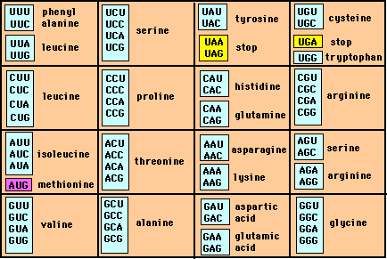
Genetic Code – Note degeneracy of 1st vs 2nd vs 3rd position sites

Slide 27
Genetic Code
Four-fold degenerate site – Any substitution is synonymous
From: mentor.lscf.ucsb.edu/course/spring/eemb102/lecture/Lecture7.ppt

Slide 28
Genetic Code
Two-fold degenerate site – Some substitutions synonymous, some
non-synonymous
From: mentor.lscf.ucsb.edu/course/spring/eemb102/lecture/Lecture7.ppt

Slide 29
Measuring Selection on Genes
Null hypothesis = neutral evolution
Under neutral evolution, synonymous changes should accumulate at a rate equal to mutation rate
Under neutral evolution, amino acid substitutions should also accumulate at a rate equal to the mutation rate
From: mentor.lscf.ucsb.edu/course/spring/eemb102/lecture/Lecture7.ppt

Slide 30
Counting #s/#a
Ser Ser Ser Ser Ser
Species1 TGA TGC TGT TGT TGT
Ser Ser Ser Ser Ala
Species2 TGT TGT TGT TGT GGT
#s = 2 sites
#a = 1 site
#a/#s=0.5
To assess selection pressures one needs to calculate the rates (Ka, Ks), i.e. the occurring substitutions as a fraction of the possible syn. and nonsyn. substitutions.
Things get more complicated, if one wants to take transition transversion ratios and codon bias into account. See chapter 4 in Nei and Kumar, Molecular Evolution and Phylogenetics.
Modified from: mentor.lscf.ucsb.edu/course/spring/eemb102/lecture/Lecture7.ppt

Slide 31
dambe
Two programs worked well for me to align nucleotide sequences based on the amino acid alignment,
One is DAMBE (only for windows). This is a handy program for a lot of things, including reading a lot of different formats, calculating phylogenies, it even runs codeml (from PAML) for you.
The procedure is not straight forward, but is well described on the help pages. After installing DAMBE go to HELP -> general HELP -> sequences -> align nucleotide sequences based on …->
If you follow the instructions to the letter, it works fine.
DAMBE also calculates Ka and Ks distances from codon based aligned sequences.

Slide 32
dambe (cont)

Slide 33
aa based nucleotide alignments (cont)
An alternative is the tranalign program that is part of the emboss package. On bbcxsrv1 you can invoke the program by typing tranalign.
Instructions and program description are here .
If you want to use your own dataset in the lab on Monday, generate a codon based alignment with either dambe or tranalign and save it as a nexus file and as a phylip formated multiple sequence file (using either clustalw, PAUP (export or tonexus), dambe, or readseq on the web)

Slide 34
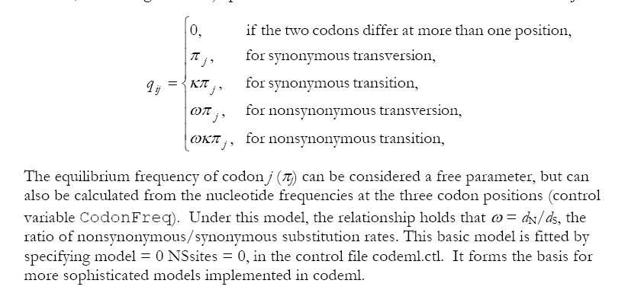
PAML (codeml) the basic model

Slide 35

sites versus branches
You can determine omega for the whole dataset; however, usually not all sites in a sequence are under selection all the time.
PAML (and other programs) allow to either determine omega for each site over the whole tree, ,
or determine omega for each branch for the whole sequence,
.
It would be great to do both, i.e., conclude codon 176 in the vacuolar ATPases was under positive selection during the evolution of modern humans – alas, a single site does not provide any statistics ….

Slide 36
Sites model(s)
work great have been shown to work great in few instances.
The most celebrated case is the influenza virus HA gene.
A talk by Walter Fitch (slides and sound) on the evolution of
this molecule is here .
This article by Yang et al, 2000 gives more background on ml aproaches to measure omega. The dataset used by Yang et al is here: flu_data.paup .

Slide 37
sites model in MrBayes
The MrBayes block in a nexus file might look something like this:
begin mrbayes;
set autoclose=yes;
lset nst=2 rates=gamma nucmodel=codon omegavar=Ny98;
mcmcp samplefreq=500 printfreq=500;
mcmc ngen=500000;
sump burnin=50;
sumt burnin=50;
end;

Slide 38
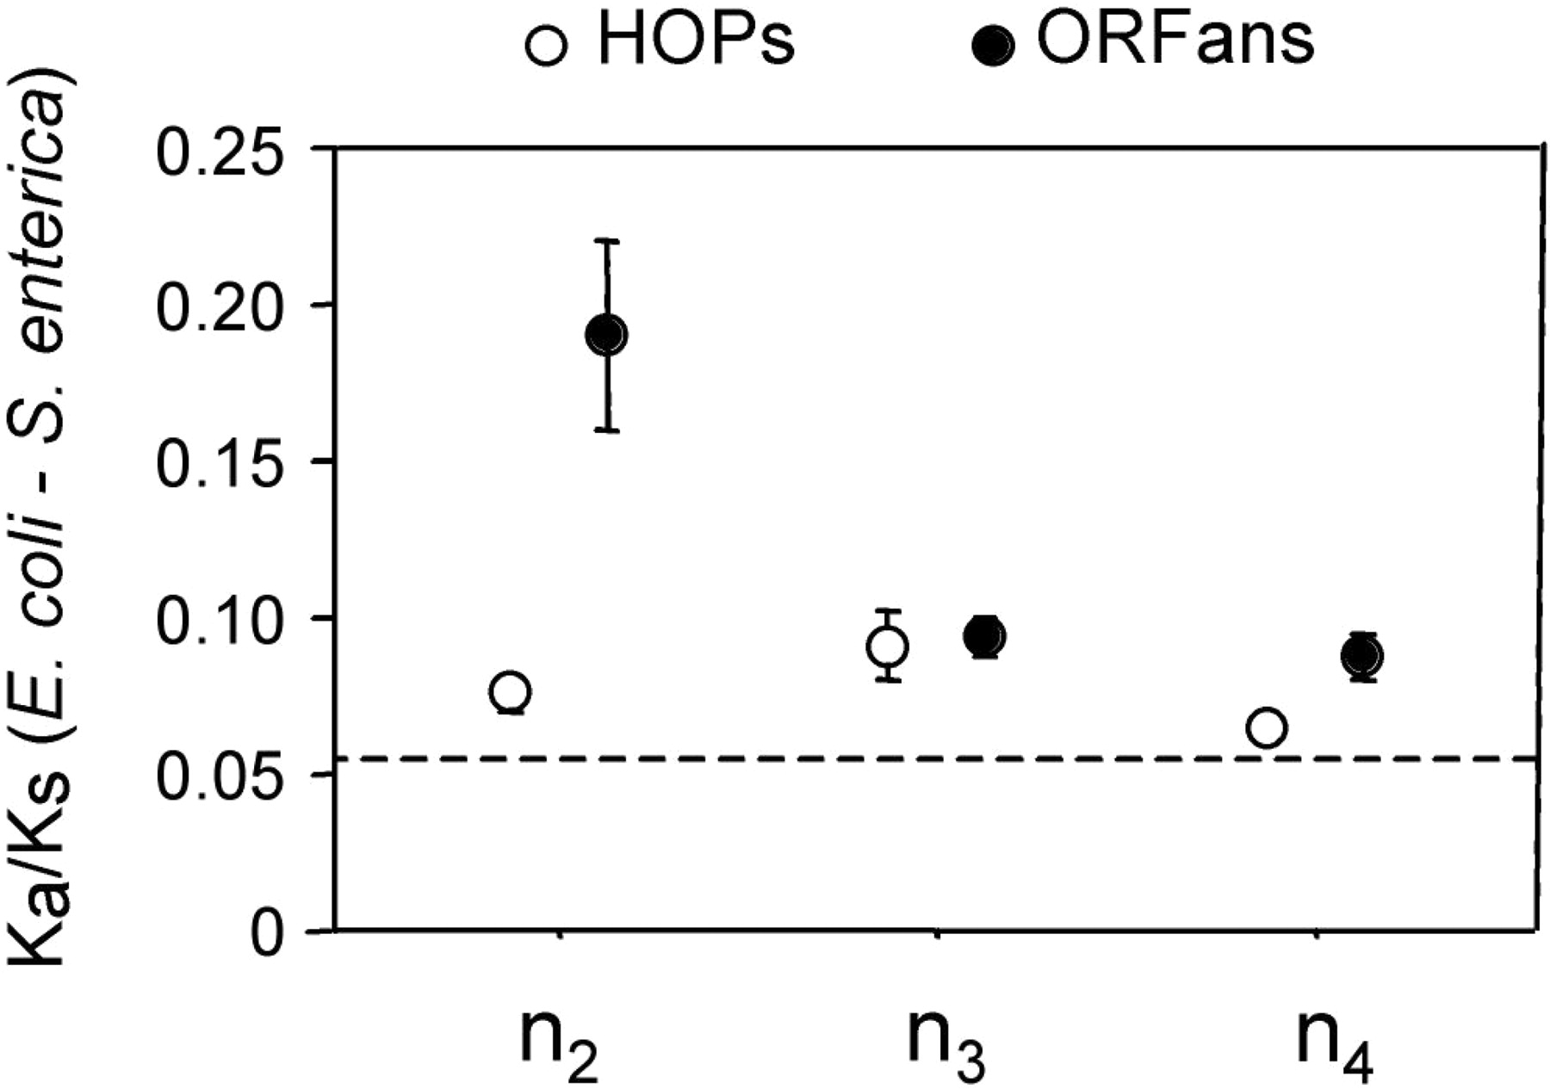
Vincent Daubin and Howard Ochman: Bacterial Genomes as New Gene Homes: The Genealogy of ORFans in E. coli. Genome Research 14:1036-1042, 2004
The ratio of non-synonymous to synonymous substitutions for genes found only in the E.coli - Salmonella clade is lower than 1, but larger than for more widely distributed genes.
Fig. 3 from Vincent Daubin and Howard Ochman, Genome Research 14:1036-1042, 2004

Slide 39

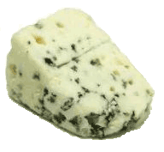
Trunk-of-my-car analogy: Hardly anything in there is the is the result of providing a selective advantage. Some items are removed quickly (purifying selection), some are useful under some conditions, but most things do not alter the fitness.
Could some of the inferred purifying selection be due to the acquisition of novel detrimental characteristics (e.g., protein toxicity)?

Slide 40
where to get help
read the manuals and help files
check out the discussion boards at http://www.rannala.org/phpBB2/
else
there is a new program on the block called hy-phy
(=hypothesis testing using phylogenetics).
The easiest is probably to run the analyses on the authors datamonkey.

Slide 41
hy-phy
Results of an anaylsis using the SLAC approach
more output might still be here

Slide 42
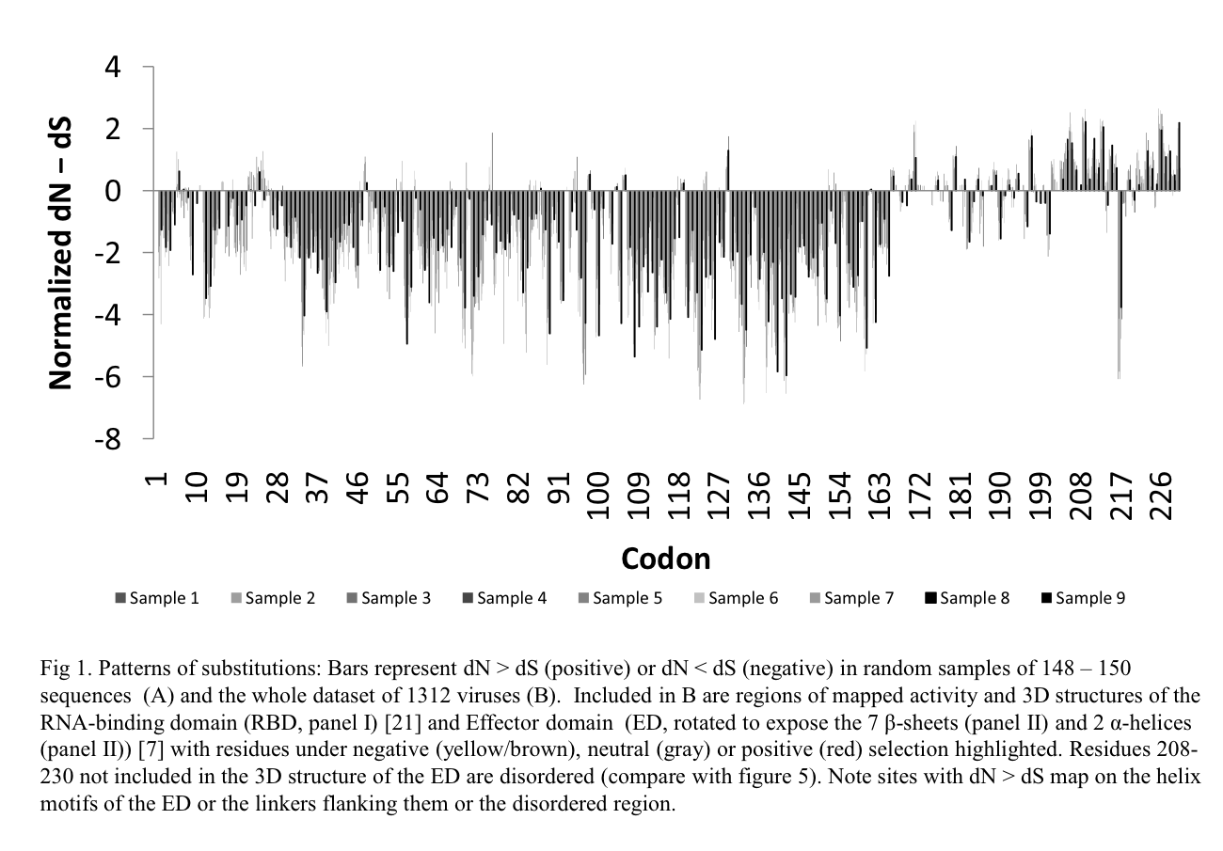

Slide 43

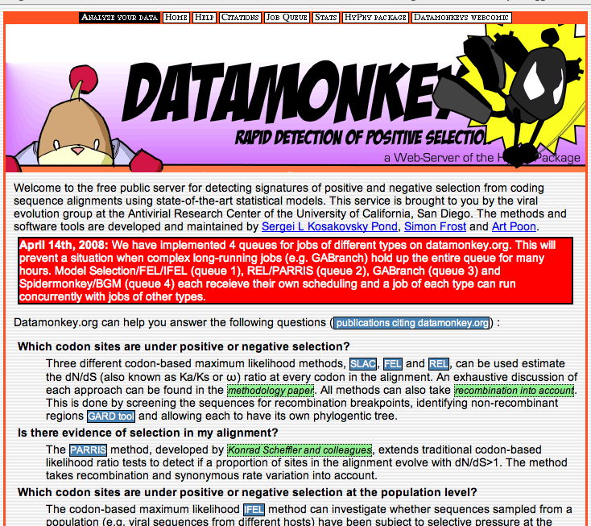
Hy-Phy -
Hypothesis Testing using Phylogenies.
Using Batchfiles or GUI
Information at http://www.hyphy.org/
Selected analyses also can be
performed online at
http://www.datamonkey.org/

Slide 44
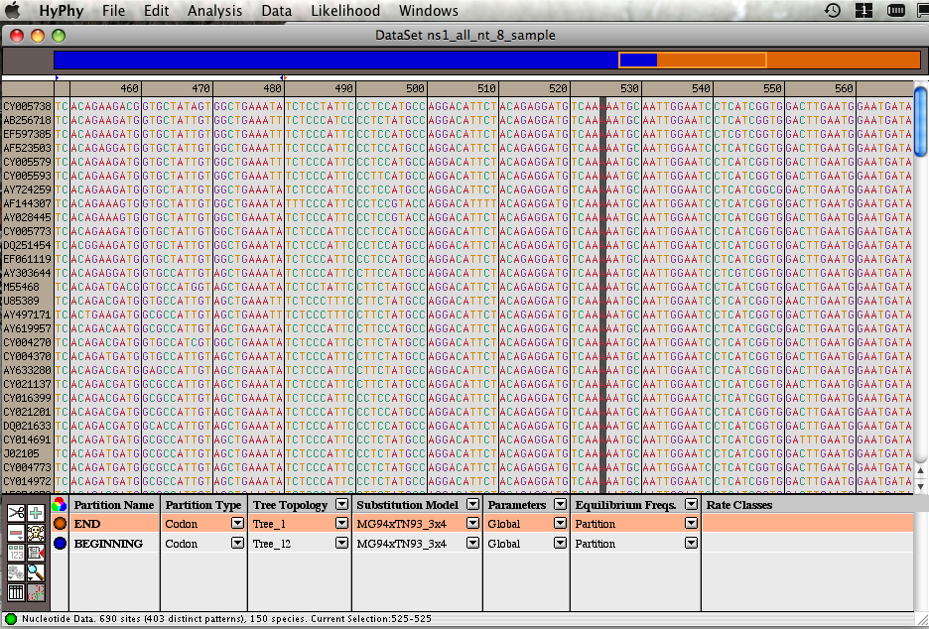
Example testing for dN/dS in two partitions of the data --
John’s dataset
Set up two partitions, define model for each, optimize likelihood

Slide 45
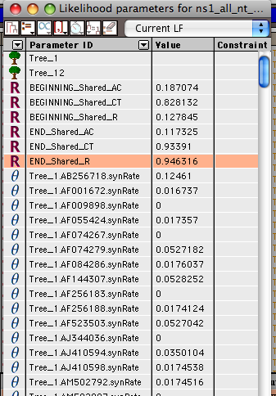
Example testing for dN/dS in two partitions of the data --
John’s dataset
Safe Likelihood Function
then
select as alternative
The dN/dS ratios for the two partitions are different.

Slide 46
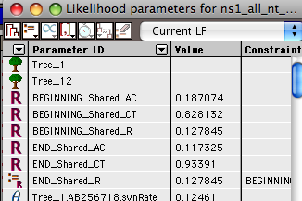
Example testing for dN/dS in two partitions of the data --
John’s dataset
Set up null hypothesis, i.e.:
The two dN/dS are equal
(to do, select both rows and then click the define as equal button on top)

Slide 47
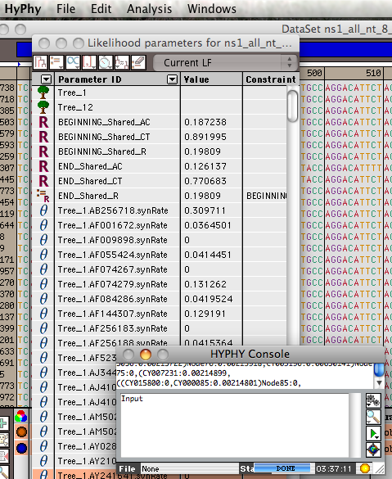
Example testing for dN/dS in two partitions of the data --
John’s dataset

Slide 48
Example testing for dN/dS in two partitions of the data --
John’s dataset
Name and save as
Null-
hyp.

Slide 49
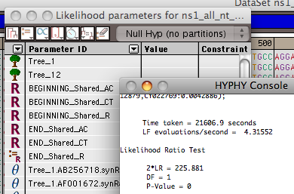
Example testing for dN/dS in two partitions of the data --
John’s dataset
After selecting LRT (= Likelihood Ratio test), the console displays the result, i.e., the beginning and end of the sequence alignment have significantly different dN/dS ratios.

Slide 50
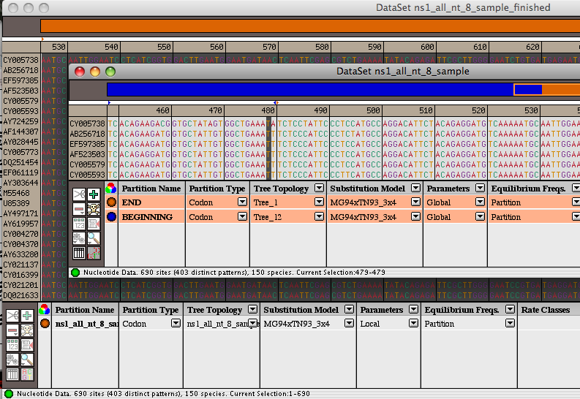
Example testing for dN/dS in two partitions of the data --
John’s dataset
Alternatively, especially if the the two models are not nested, one can set up two different windows with the same dataset:
Model 1
Model 2

Slide 51
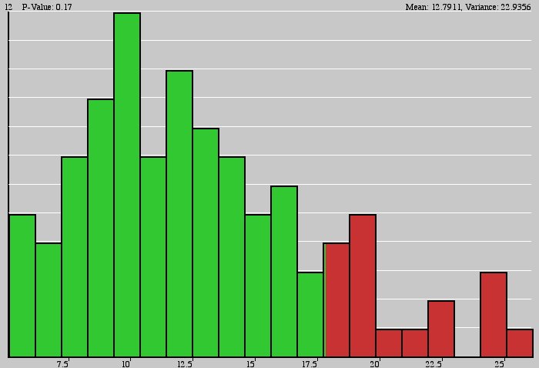
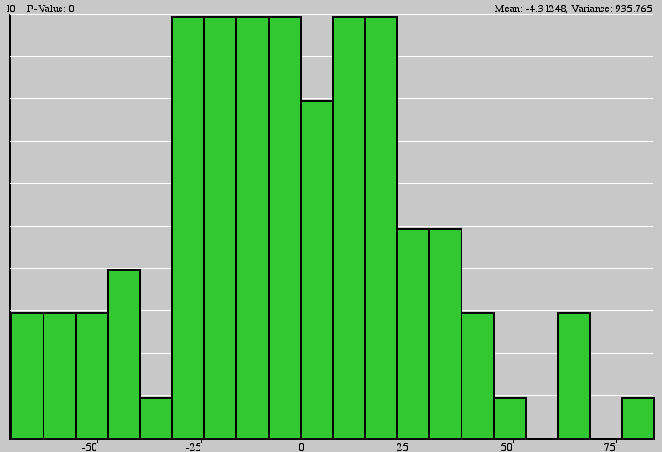
Example testing for dN/dS in two partitions of the data --
John’s dataset
Simulation under model 1, evalutation under model 2, calculate LR
Compare real LR to distribution from simulated LR values. The result might look something like this or this

