Slide 1
MCB 5472
Gene Families,
Super Trees and Super Matrices
Peter Gogarten
Office: BSP 404
phone: 860 486-4061,
Email: gogarten@uconn.edu

Slide 2
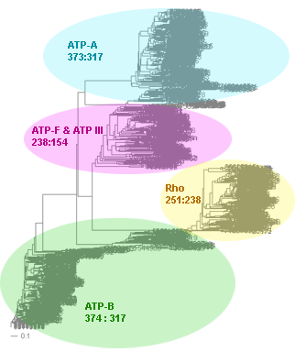
Automated Assembly of Gene Families
Using BranchClust
J. Peter Gogarten
University of Connecticut
Dept. of Molecular and Cell Biol.
Collaborators:
Maria Poptsova (UConn)
Fenglou Mao (UGA)
Funded through the
Edmond J. Safra Bioinformatics Program.
Fulbright Fellowship,
NASA Exobiology Program,
NSF Assembling the Tree of Life Programm and
NASA Applied Information Systems Research Program
Workshop at Te Aviv University, November 29th, 2009.
Notes:
Title / content
Coauthors
Funding agencies

Slide 3
to use other genomes:
The easiest source for other genomes is via anonymous ftp from ftp.ncbi.nlm.nih.gov
Genomes are in the subfolder genomes.
Bacterial and Archaeal genomes are in the subfolder Bacteria
For use with BranchClust you want to retrieve the .faa files from the folders of the individual organisms (in case there are multiple .faa files, download them all and copy them into a single file).
Copy the genomes into the fasta folder in directory where the branchclust scripts are.
To create a table that links GI numbers to genomes run perl extract_gi_numbers.pl or
qsub extract_gi_numbers.sh

Slide 4
If you use other genomes you will need to generate a file that contains assignments between name of the ORF and the name of the genome. This file should be called gi_numbers.out
If your genomes follow the JGI convention, every ORF starts with a four letters designating the species followed by 4 numbers identifying the particular ORF. In this case the file
gi_numbers.out should look as follows. It should be straight forward to create this file by hand ☺
Thermotoga maritima | Tmar.....
Thermotoga naphthophila | Tnap.....
Thermotoga neapolitana | Tnea.....
Thermotoga petrophila | Tpet.....
Thermotoga sp. RQ2 | TRQ2.....

Slide 5
If your genomes conform to the NCBI *.faa convention, put the genomes into a subdirectory called fasta, and run the script extract_gi_numbers.pl in the parent directory. (Best is probably
~/workshop/test.)
The script should generate a log file and an output file called gi_numbers.out
Burkholderia phage Bcep781 | 2375.... 4783.... 1179.....
Enterobacteria phage K1F | 7711....
Enterobacteria phage N4 | 1199.....
Enterobacteria phage P22 | 5123.... 9635... 1271.... 193433..
Enterobacteria phage RB43 | 6639....
Enterobacteria phage T1 | 4568....
Enterobacteria phage T3 | 1757....
Enterobacteria phage T5 | 4640....
Enterobacteria phage T7 | 9627...
Kluyvera phage Kvp1 | 2126.....
Lactobacillus phage phiAT3 | 4869....
Lactobacillus prophage Lj965 | 4117....
Lactococcus phage r1t | 2345....
Lactococcus phage sk1 | 9629... 193434..
Mycobacterium phage Bxz2 | 29566...

Slide 6
IF YOU USE GENOMES WITH NCBI ANNOTATION LINES, YOU NEED TO USE THE SCRIPTS CALLED BY do_all_GI.sh !!
(Sorry, in its present form this version does not allow to filter the E-values in the parsing of the blast searches. This means that you need to select a reasonable E-value in your initial blast searches.
If you want to use an E-value cut-off of 10^-20, you need to edit the do_blast.pl script!
If you use the JGI format, you can use the parse_blast_cutoff_Thermotoga.pl script to change the E-value, i.e, you don't have to re-run all of the blast searches.).

Slide 7
Create super families, alignments and trees
vi do_blast.pl
# to see what the parameters are doing type blastall or
# bastall | more at the commandline.
# If you move this to a different computer you might need to change a 2 to a 1
vi parse_blast_cutoff_thermotoga.pl
# change bioperl directory; change cutoff E-value
# the script as written uses the bioperl library in my home directory
# Note: if using closely related genomes, you can cut back on the
# size of the superfamilies by using a smaller E-value
# (if you genomes have normal GI numbers, use
# vi parse_blast_cutoff1.pl)
# check output:
more parsed/all_vs_all.parsed ### type q to leave more
more parsed/all_vs_all.parsed | wc -l
# checks for number of lines=super famiies output

Slide 8
Super Families to Trees
perl parse_superfamilies_singlelink.pl 1
# 1 gives the minimum size of the superfamily
perl prepare_fa_thermotoga.pl parsed/all_vs_all.fam
Creates a multiple fasta file for each superfamily
perl do_clustalw_aln.pl
aligns sequences using clustalw
perl do_clustalw_dist_kimura.pl
calcualtes trees using Kimura distances for all families in fa
#trees stored in trees Check #1, 106, 1027, 111
perl prepare_trees.pl
reformats trees

Slide 9
Branchclust
perl branchclust_all_thermotoga.pl 2
# Parameter 2 (MANY) says that a family needs to have
# at least 2 members.
make_clusterlist.sh
# runs perl make_fam_list_inpar.pl 5 4 0
# results in test called families_inpar_5_4_0.list
# 5: number of genomes;
# 4: number of genomes in cluster ;
# 0: number of inparalogs
# (a 1 returns all the families with exactly 1 inparalog)
# you could add additional lines to the shell script:
# perl make_fam_list_inpar.pl 5 4 1

Slide 10
Process Branchclust output
perl names_for_cluster_all.pl
# (Parses clusters and attaches names.
# Results in sub directory clusters. List in test)
perl summary.pl
# (makes list of number of complete and incomplete families
# file is stored in test)
perl detailed_summary_dashes.pl
# (result in test: detailed_summary.out - can be used in Excel)
perl prepare_bcfam_thermotoga.pl families_inpar_5_4_0.list #(writes multiple fasta files into bcfam subdirectory.
# Can be used for alignment and phylogenetic reconstruction)

Slide 11
Summary Output
done with many = 3 and
E-value cut-off of 10⁻²⁵
complete: 1564
incomplete: 248
total: 1812
------ details -------
incomplete 4: 87
incomplete 3: 53
incomplete 2: 66
incomplete 1: 42

Slide 12
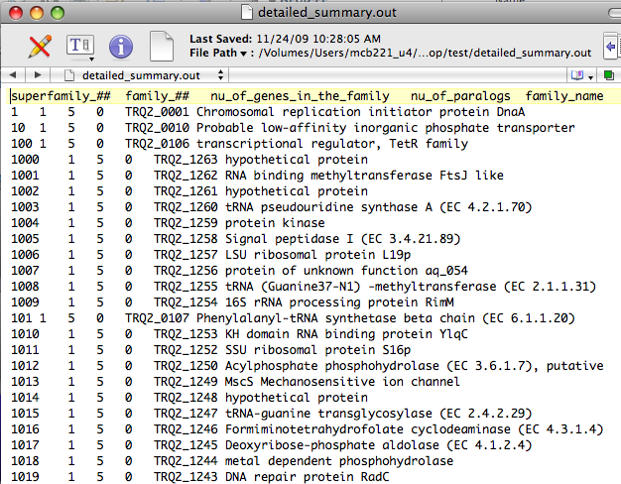
Detailed Summary in Text Wrangler

Slide 13
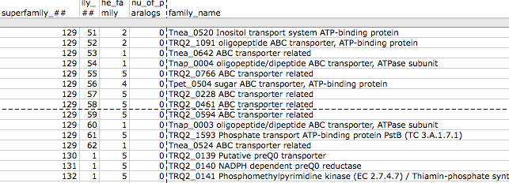
Detailed Summary in Excel
copy detailed summary out onto your computer
In EXEL Menu: Data -> get external data -> import text file ->
in English version use defaults for other options.
In EXEL Menu: Data -> sort -> sort by “superfamily number”-> if asked, check expand selection
Scrolling down the list, search for a superfamily that was broken down into many families.
Do the families that were part of a superfamily have similar annotation lines?
How many of the families were complete?
Do any have inparalogs? Take note of a few super families.

Slide 14
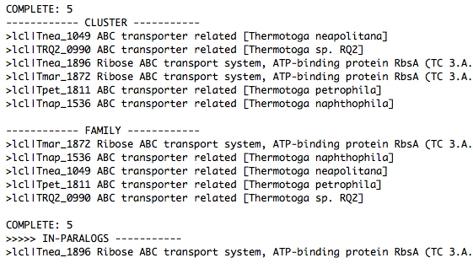
clusters/clusters_NNN.out.names
Check a superfamily of your choice.
Within a family, are all the annotation lines uniform?
Within this report, if there are inparalogs, one is listed as a family member, the other one as inparalog. This is an arbitrary choice, both inparalogs from the same genome should be considered as being part of of the family.
Out of cluster paralogs are paralogs that did not make it into a cluster with “many” genomes.

Slide 15
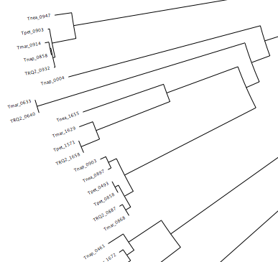
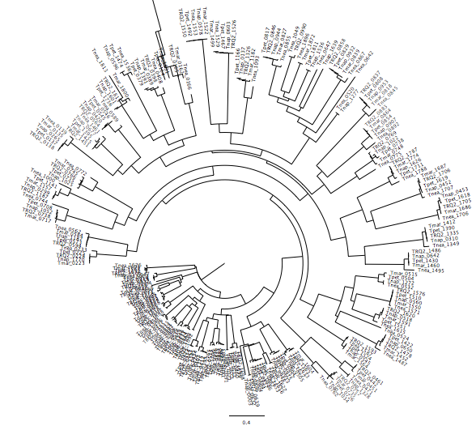
trees/fam_XYZ.tre
Check the tree for a superfamily of your choice. Copy the file to your computer and open it in TreeView, NJPLOT, or FigTree (check with your neighbor on which program works).
For at least one cluster, in the tree, check if branchclust came to the same conclusion you would have reached.

Slide 16
prepare_bcfam_thermotoga.pl families_inpar_5_4_0.list
The script prepare_bcfam_thermotoga.pl takes a list of families (created by make_fam_list_inpar.pl) and for each family retrieves the fasta sequences from the combined genome databank and stores the sequences in the BCfam folder, one multiple sequence file per family.
One possibility for further evaluation is to take multiple sequence files, align the sequences and perform a phylogenetic reconstruction (including boostrap analysis) using programs like phyml or Raxml.
The resulting trees can be analyzed by decomposition and supertree approaches.

Slide 17
Decomposition of Phylogenetic Data
Phylogenetic information
present in genomes
Break information
into small quanta
of information
(bipartitions or
embedded quartets)
Analyze spectra to detect transferred genes and plurality consensus.

Slide 18

TOOLS TO ANALYZE PHYLOGENETIC INFORMATION FROM MULTIPLE GENES IN GENOMES:
Bipartition Spectra (Lento Plots)

Slide 19
BIPARTITION OF A PHYLOGENETIC TREE
Bipartition (or split) – a division of a phylogenetic tree into two parts that are connected by a single branch.
It divides a dataset into two groups, but it does not consider the relationships within each of the two groups.
Yellow vs Rest
* * * . . . * *
95
compatible to illustrated
bipartition
Orange vs Rest
. . * . . . . *
* * * . . . . .
incompatible to illustrated
bipartition

Slide 20
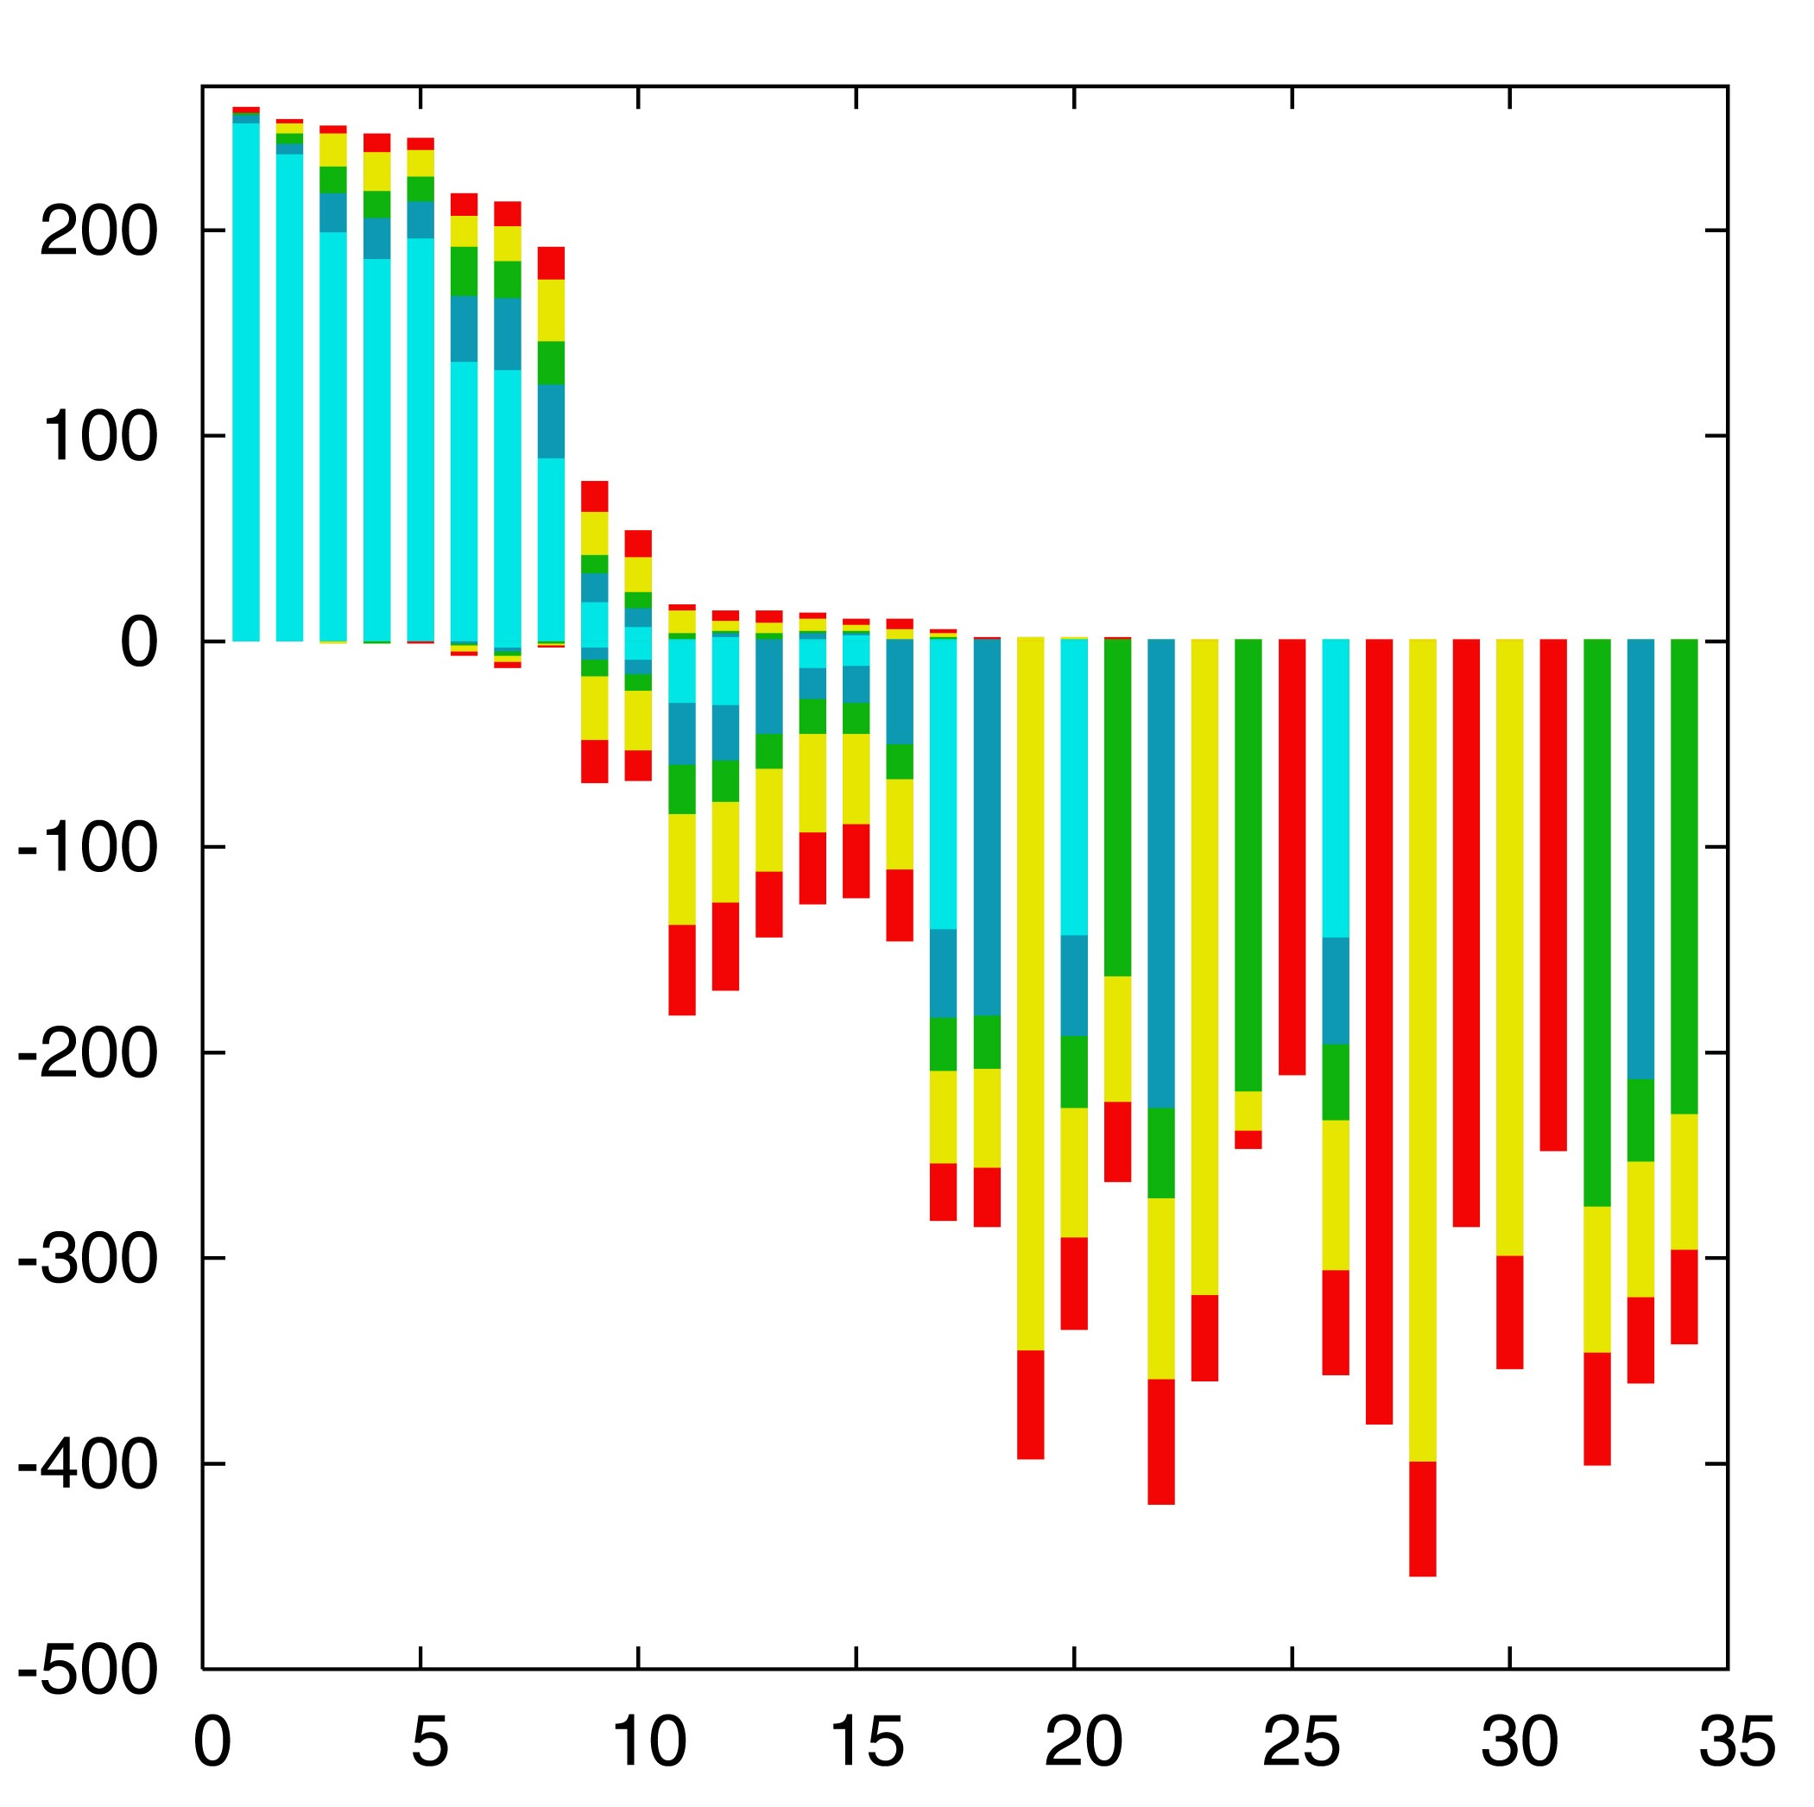
“Lento”-plot of 34 supported bipartitions (out of 4082 possible)
13 gamma-
proteobacterial
genomes
(258 putative
orthologs):
E.coli
Buchnera
Haemophilus
Pasteurella
Salmonella
Yersinia pestis
(2 strains)
Vibrio
Xanthomonas
(2 sp.)
Pseudomonas
Wigglesworthia
There are 13,749,310,575 possible unrooted tree topologies for 13 genomes

Slide 21
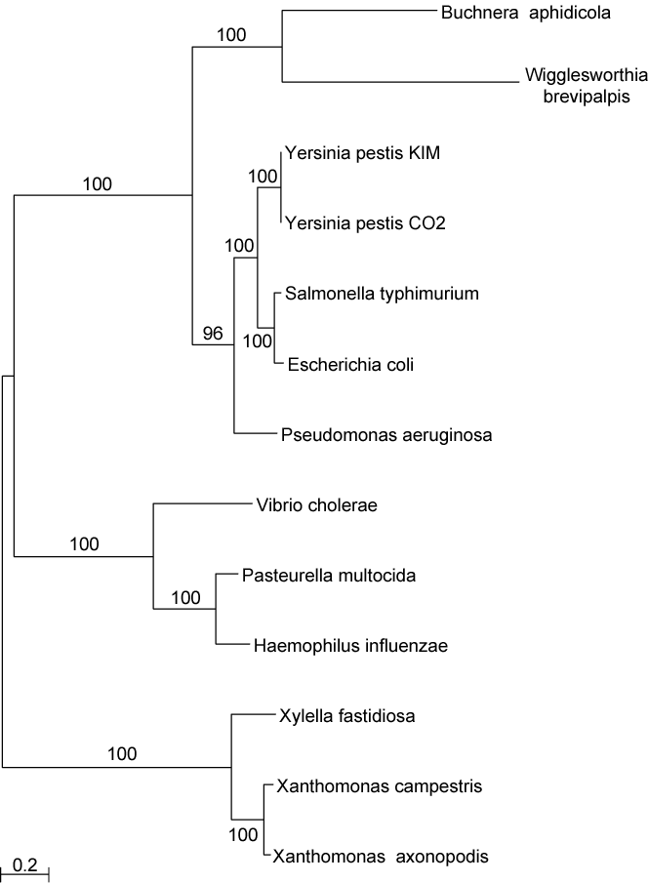
Consensus clusters of eight significantly supported bipartitions
Phylogeny of putatively transferred gene
(virulence factor homologs (mviN))
only 258 genes analyzed

Slide 22
“Lento”-plot of supported bipartitions (out of 501 possible)
10 cyanobacteria:
Anabaena
Trichodesmium
Synechocystis sp.
Prochlorococcus
marinus
(3 strains)
Marine
Synechococcus
Thermo-
synechococcus
elongatus
Gloeobacter
Nostoc
punctioforme
Number of datasets
Based on 678 sets of orthologous genes
Zhaxybayeva, Lapierre and Gogarten, Trends in Genetics, 2004, 20(5): 254-260.

Slide 23
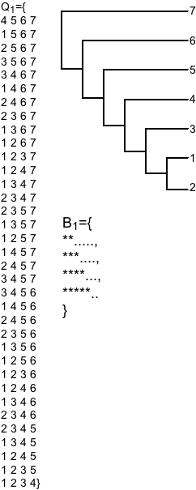
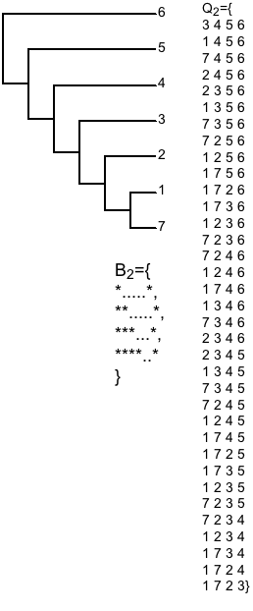
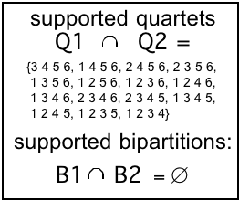
PROBLEMS WITH BIPARTITIONS (CONT.)
A single rogue sequence that moves from one end of a Hennigian comb to the other changes all bipartition
bipartitions
embedded quartets

Slide 24
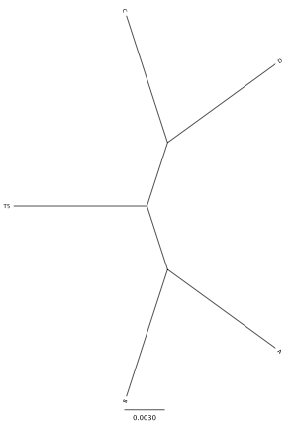
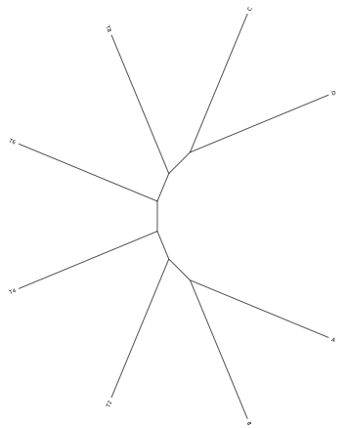
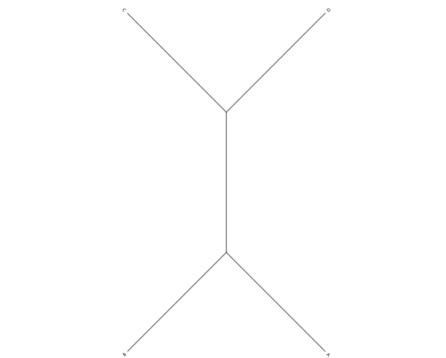
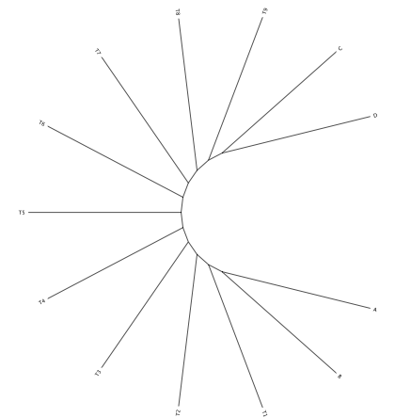
Decay of bipartition support with number of OTUs
Phylogenies used for simulation
Notes:
Same model (WAG +Gamma) used for simulation and evaluation (including alpha =1). Simulation of sequences with lenghts of 200, 500 and 1000 using seq-gen.

Slide 25
Example for decay of bipartition support with number of OTUs
Sequence
lengths
C
D
C
D
C
D
C
D
200
89
74
70
A
B
A
B
A
B
A
B
C
D
C
D
C
D
C
D
500
71
86
99
94
74
100
73
92
A
B
A
B
A
B
71
A
B
C
D
C
D
C
D
C
D
72
100
90
1000
79
87
100
100
91
98
87
A
B
A
B
94
B
A
A
B
Only branches with better than 70% bootstrap support are shown
Notes:
Each row gives the result for one simulation, done with 9 additional sequences emerging equally far apart on the central branch. In the analyses on the left, all, 8 or 5 of these additional sequences were omitted.

Slide 26
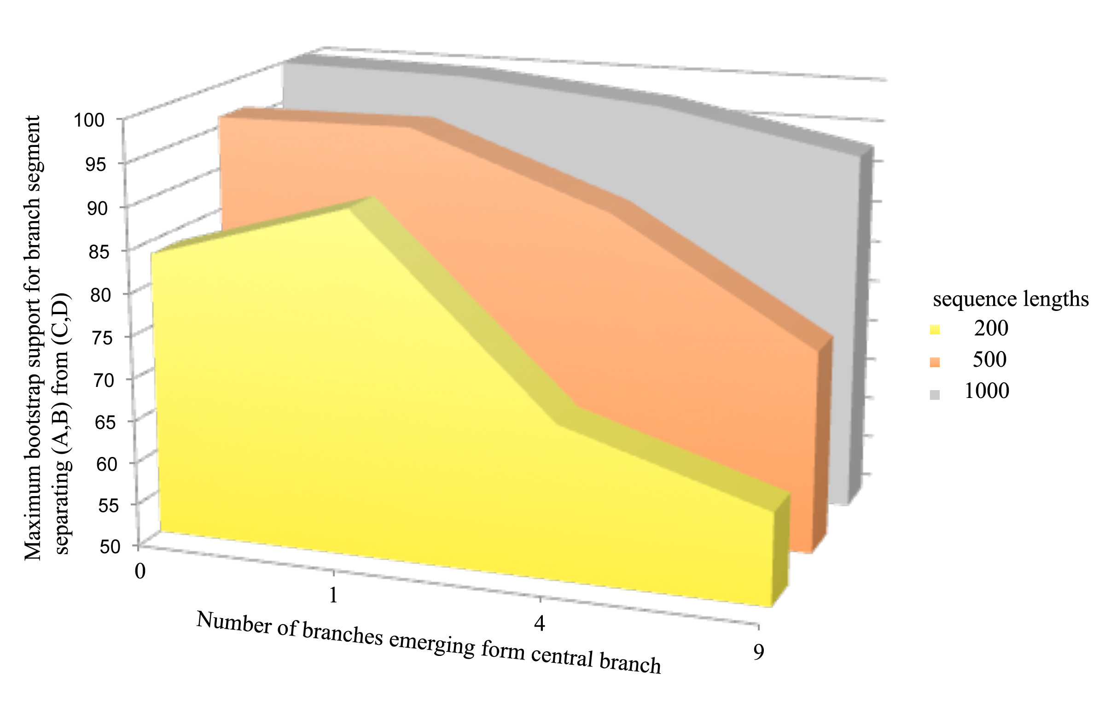
Decay of bipartition support with number of OTUs
Each value is the average of 10 simulations using seq-gen.
Simulated sequences were evaluated using PHYML.
Model for simulation and evaluation WAG + Γ(α=1, 4 rate categories)
Notes:
Can we add SE bars?
Would be good to have more simulations.
Would be good to evaluate in phylip (don’t trust phyml)

Slide 27
Bipartition Paradox:
The more sequences are added, the lower the support for bipartitions that include all sequences. The more data one uses, the lower the bootstrap support values become.
This paradox disappears when only embedded splits for 4 sequences are considered.

Slide 28

TOOLS TO ANALYZE PHYLOGENETIC INFORMATION FROM MULTIPLE GENES IN GENOMES:
QUARTET DECOMPOSITION

Slide 29
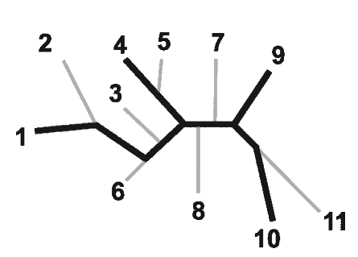
Bootstrap support values for embedded quartets
+
: tree calculated from one pseudo-sample generated by bootstraping from an alignment of one gene family present in 11 genomes
: embedded quartet for genomes
1, 4, 9, and 10 .
This bootstrap sample supports the topology ((1,4),9,10).
1
9
1
9
1
10
4
√
10
10
4
9
4
Zhaxybayeva et al. 2006, Genome Research, 16(9):1099-108
Quartet spectral analyses of genomes iterates over three loops:
Repeat for all bootstrap samples.
Repeat for all possible embedded quartets.
Repeat for all gene families.

Slide 30
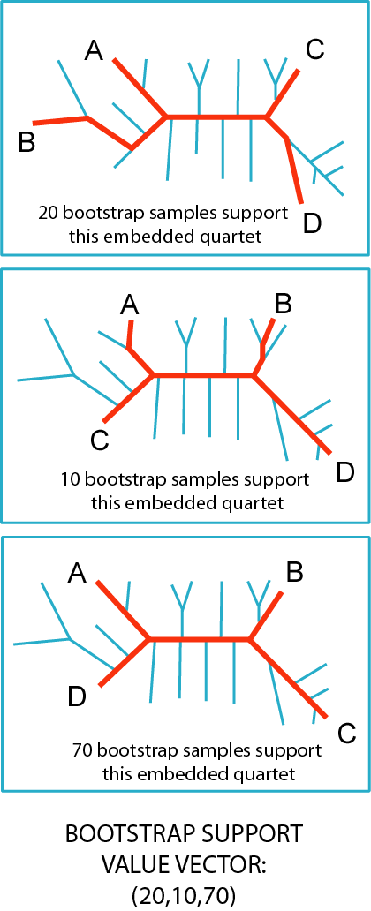
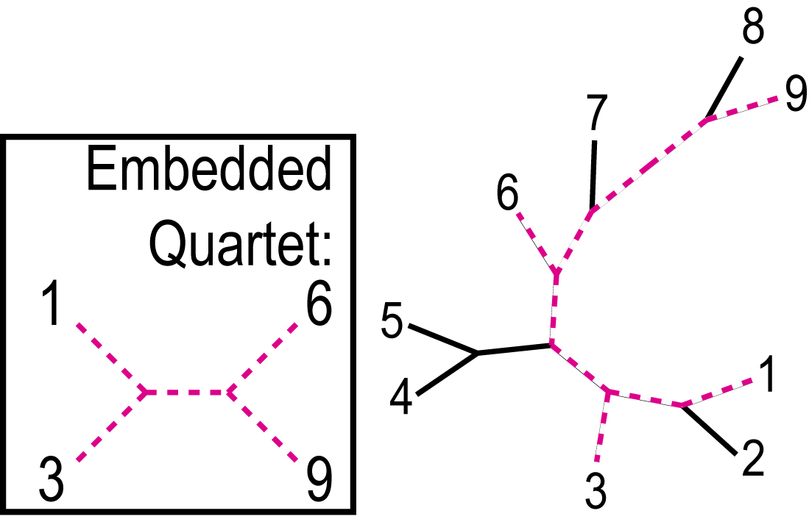
QUARTET DECOMPOSITION METHOD
15 bootstrap samples
71 bootstrap samples
Quartet is a smallest unit of phylogenetic information
Each quartet is associated with only three unrooted tree topologies
Support for different quartet topologies can be summarized for all gene families
14 bootstrap samples
(15, 71, 14)

Slide 31
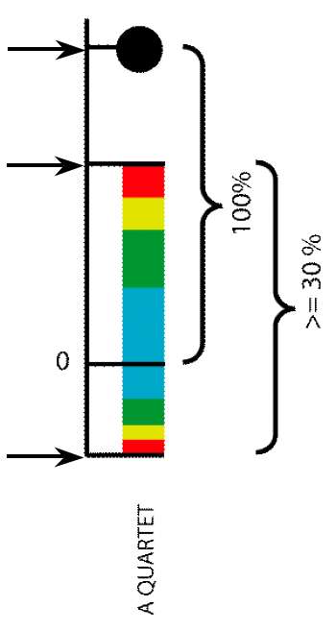
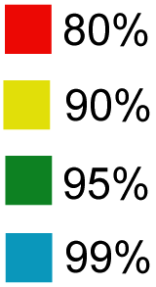
Illustration of one component of a quartet spectral analyses Summary of phylogenetic information for one genome quartet for all gene families
Total number of gene families containing the species quartet
Number of gene families supporting the same topology as the plurality
(colored according to bootstrap support level)
Number of gene families supporting one of the two alternative quartet topologies

Slide 32
N completely sequenced genomes
(a.a. sequences)
Generate Alignment
Generate 100 bootstrap samples
Detect gene families
Families with missing data are considered
Calculate shape parameter for Gamma distribution
Create distance matrix for each boot. sample
FOR EACH GENE FAMILY
QUARTET DECOMPOSITION ANALYSES: DATA FLOW
Generate list of possible embedded quartets
Trees
Visualize support for embedded quartets
Evaluate support for each possible embedded quartet
Exclude quartets that can be results of artifacts

Slide 33
Other POSITIVE THOUGHTS ABOUT THE METHOD
No assumption that all genes in a genome have the same phylogenetic history.
The total number of quartets is much smaller than number of tree topologies, which makes it possible to evaluate all quartets.
Gene families present only in few analyzed genomes can be included in the analyses
Phylogenetic signal can be divided into consensus supported by the plurality of gene families and the conflicting signal.
Allows us to partition analyzed genomes according to some scenario (e.g., grouping by ecology) and retrieve gene families that support or conflict it.

Slide 34
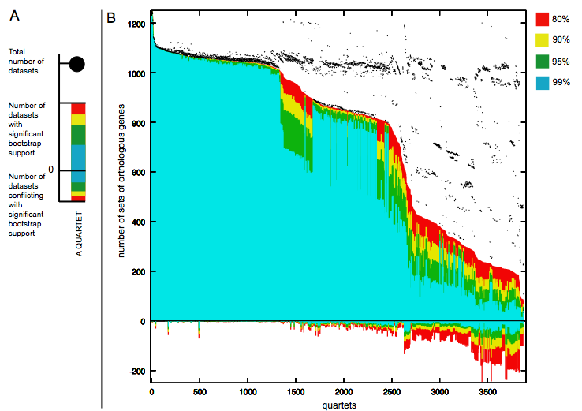
Quartet decomposition analysis of 19 Prochlorococcus and marine Synechococcus genomes. Quartets with a very short internal branch or very long external branches as well those resolved by less than 30% of gene families were excluded from the analyses to minimize artifacts of phylogenetic reconstruction.

Slide 35
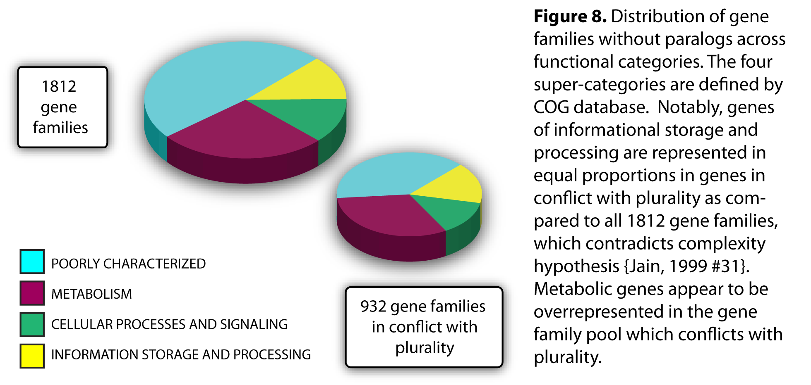

Slide 36
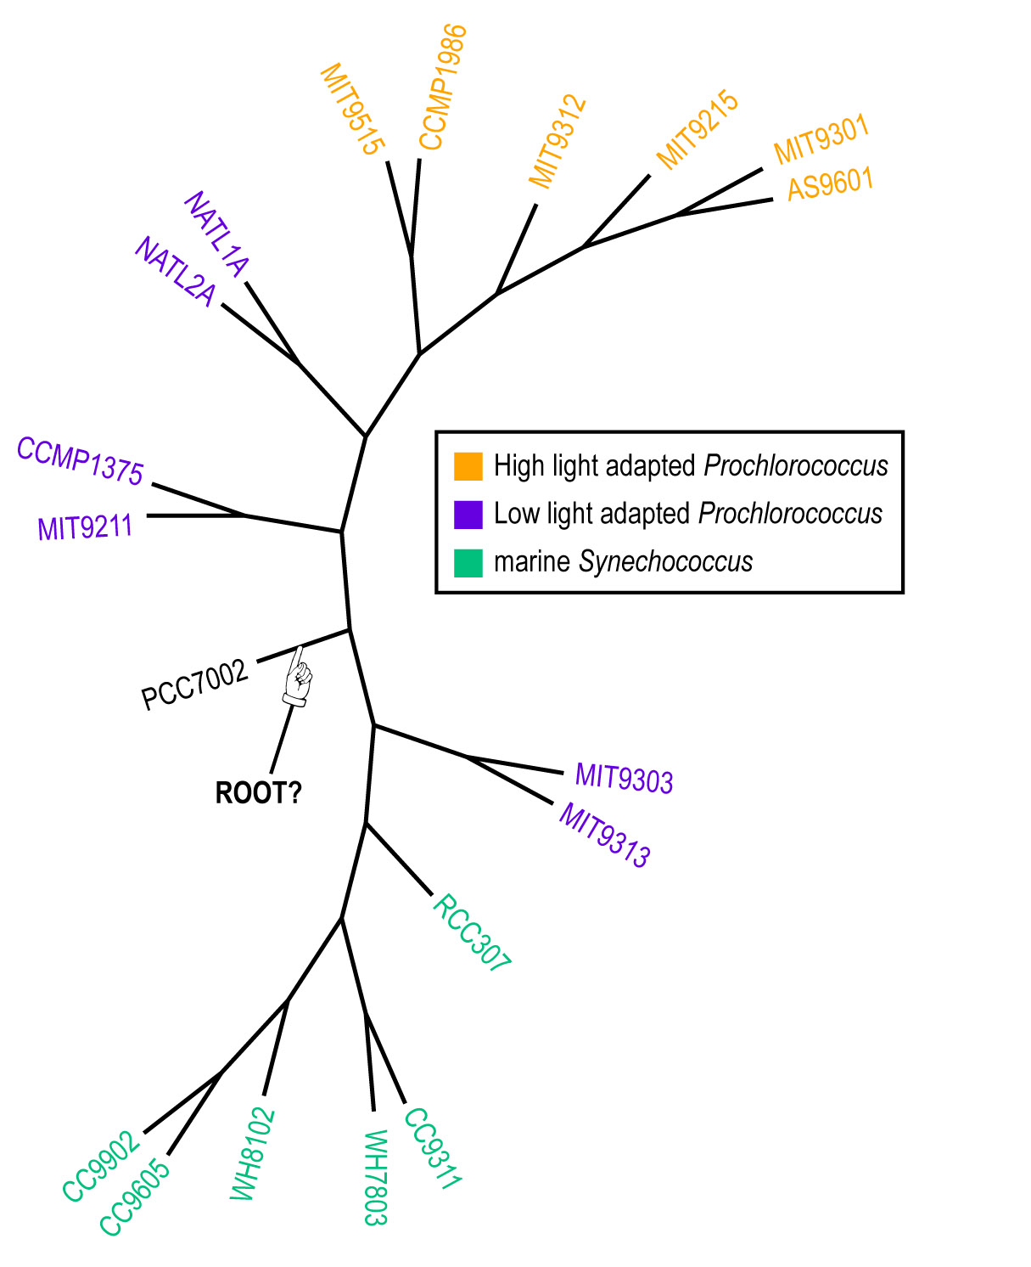
Plurality consensus calculated as supertree (MRP) from quartets in the plurality topology.

Slide 37
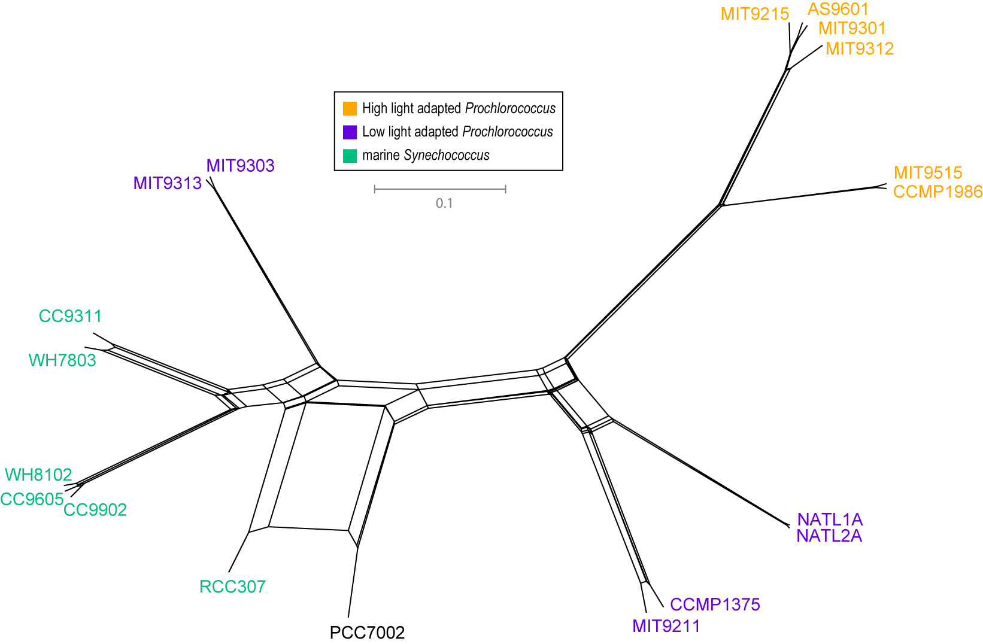
NeighborNet (calculated with SplitsTree 4.0)
Plurality neighbor-net calculated as supertree (from the MRP matrix using SplitsTree 4.0) from all quartets significantly supported by all individual gene families (1812) without in-paralogs.

Slide 38
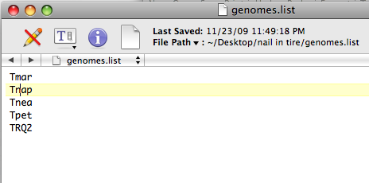
The Quartet Decomposition Server
http://csbl1.bmb.uga.edu/QD/phytree.php
Input A):
a file listing the names of genomes: E.g.:

Slide 39
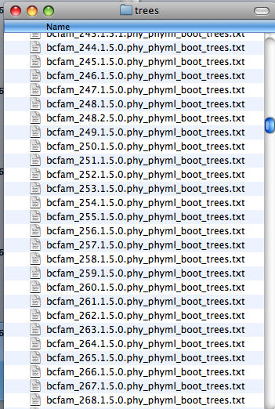
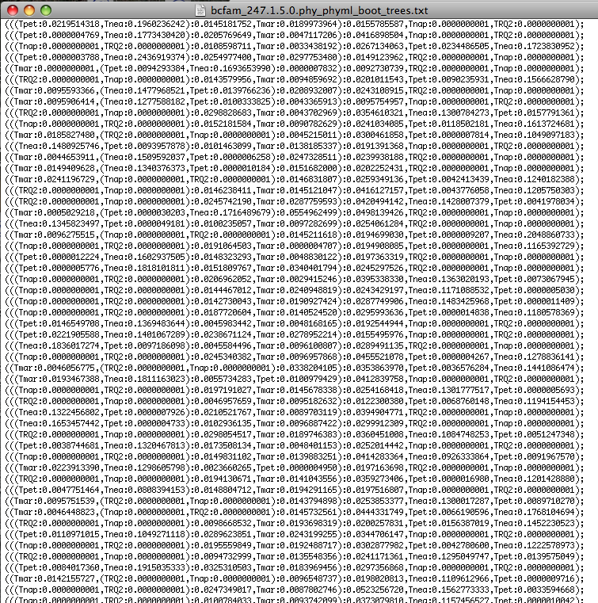
The Quartet Decomposition Server
http://csbl1.bmb.uga.edu/QD/phytree.php
Input B):
An Archive of files where every file contains all the trees that resulted from a bootstrap analysis of one gene family:
One file per family
100 trees per file

Slide 40
The Quartet Decomposition Server
http://csbl1.bmb.uga.edu/QD/phytree.php
Trees from the bootstrap samples should contain branch lengths, but the name for each sequence should be translated to the genome name, using the names in the genome list.
See the following three trees in Newick notation for an example:
(((Tnea:0.1559823230,Tpet:0.0072068797):0.0287486818,Tmar:0.0046676053):0.0407339037,Tnap:0.0000000001,TRQ2:0.0000000001);
(((Tpet:0.0219514318,Tnea:0.1960236242):0.0145181752,Tmar:0.0189973964):0.0155785587,Tnap:0.0000000001,TRQ2:0.0000000001);
(((Tpet:0.0000004769,Tnea:0.1773430420):0.0205769649,Tmar:0.0047117206):0.0416898504,Tnap:0.0000000001,TRQ2:0.0000000001);

Slide 41
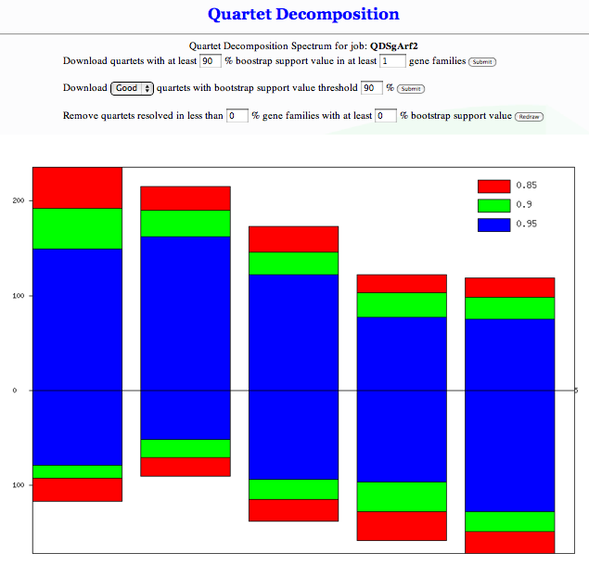
The spectrum http://csbl1.bmb.uga.edu/QD/jobstatus.php?jobid=QDSgArf2&source=0&resolve=0&support=0

Slide 42
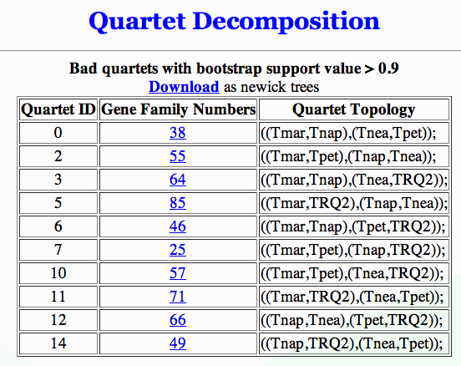
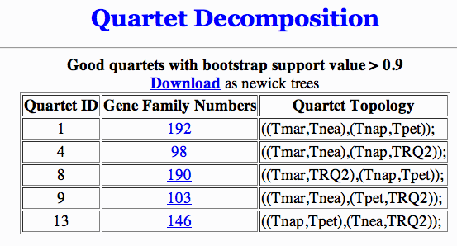
good and bad quartets

Slide 43

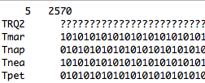

Quartets -> Matrix Representation Using Parsimony
Tmar
Tnea
Tpet
Tnap
…

Slide 44
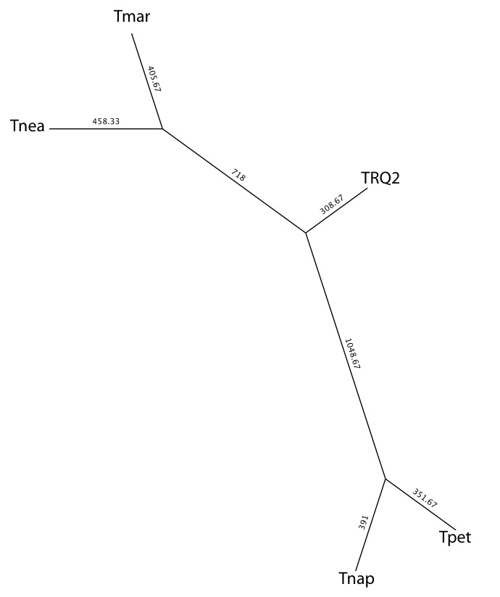
Most Parsimonious Tree (MRP)
Using all Quartets from all Gene Families that have more than 90% bootstrap support

Slide 45
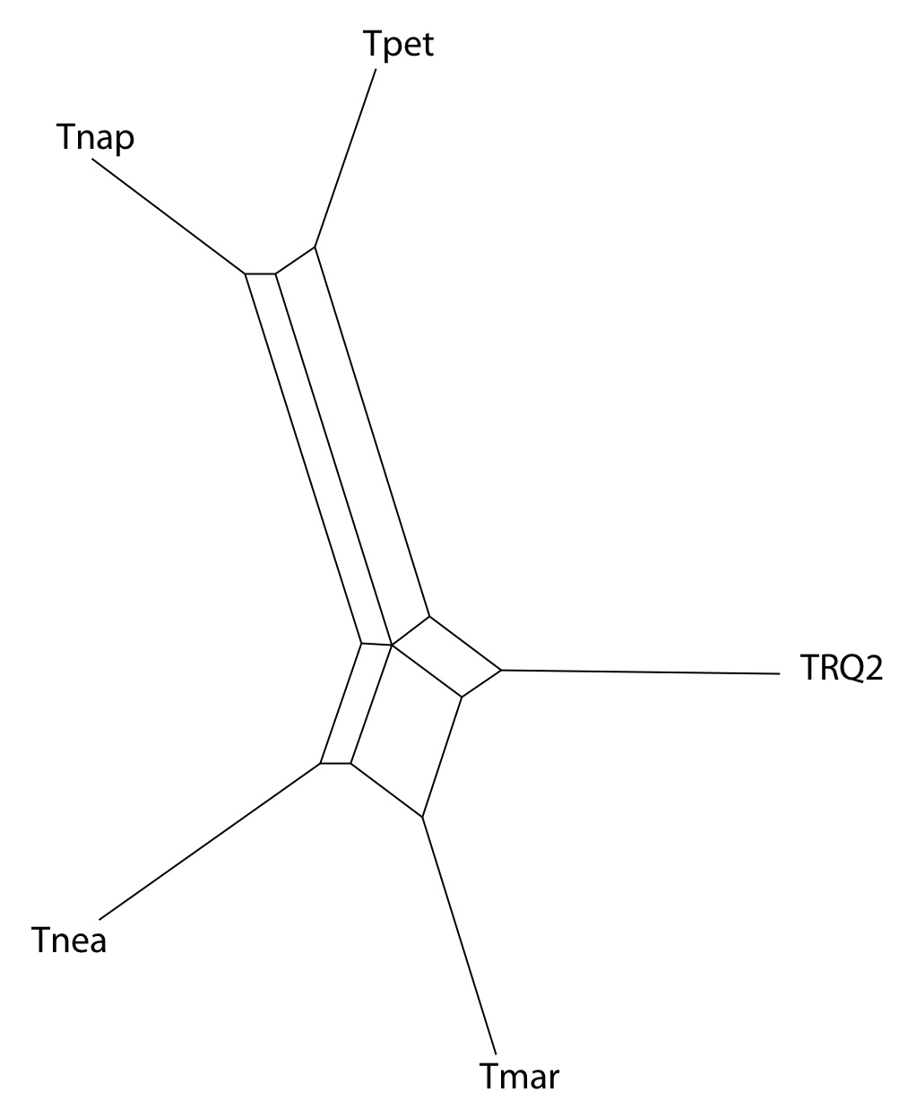
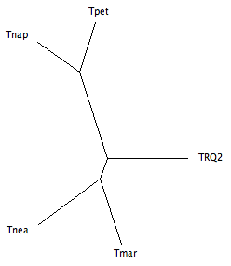
Splits Tree Representation
Using all Quartets from all Gene Families that have more than 90% bootstrap support
Split Decomposition tree
from uncorrected P distances
NJ tree
from uncorrected P distances

Slide 46
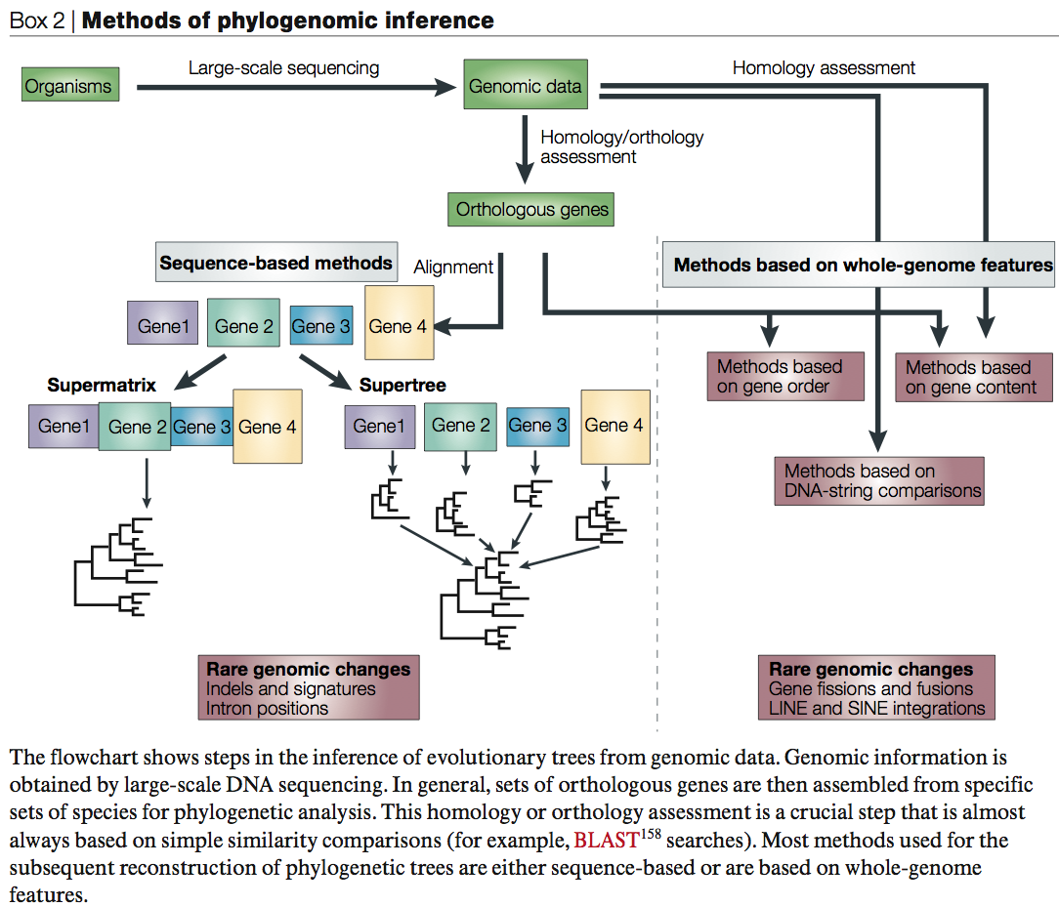
From:
Delsuc F, Brinkmann H, Philippe H.
Phylogenomics and the reconstruction of the tree of life.
Nat Rev Genet. 2005 May;6(5):361-75.

Slide 47
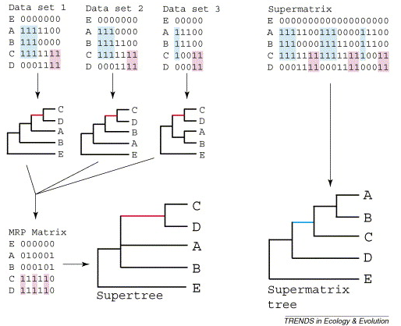
Supertree vs. Supermatrix
From:
Alan de Queiroz John Gatesy:
The supermatrix approach to systematics
Trends Ecol Evol. 2007 Jan;22(1):34-41
Schematic of MRP supertree (left) and parsimony supermatrix (right) approaches to the analysis of three data sets. Clade C+D is supported by all three separate data sets, but not by the supermatrix. Synapomorphies for clade C+D are highlighted in pink. Clade A+B+C is not supported by separate analyses of the three data sets, but is supported by the supermatrix. Synapomorphies for clade A+B+C are highlighted in blue. E is the outgroup used to root the tree.

Slide 48
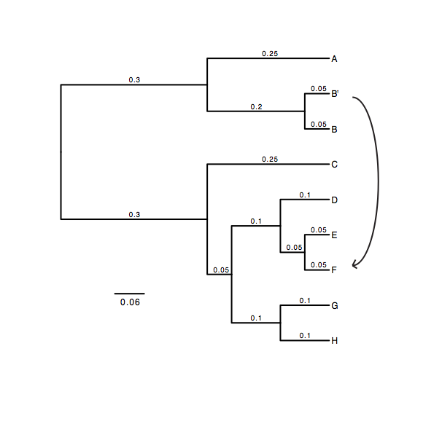
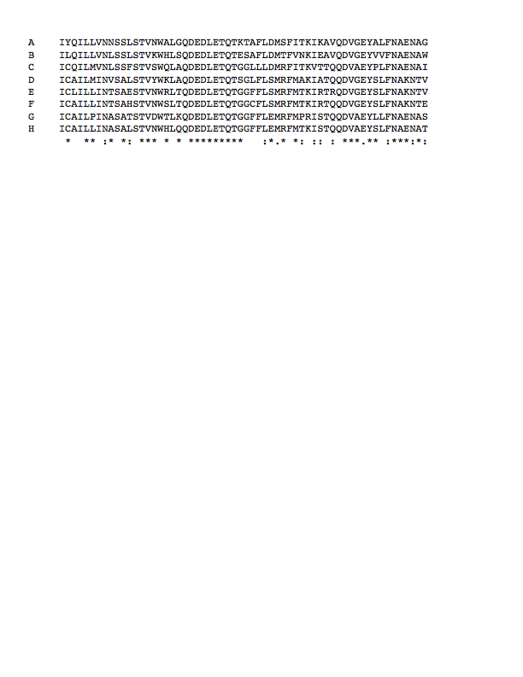
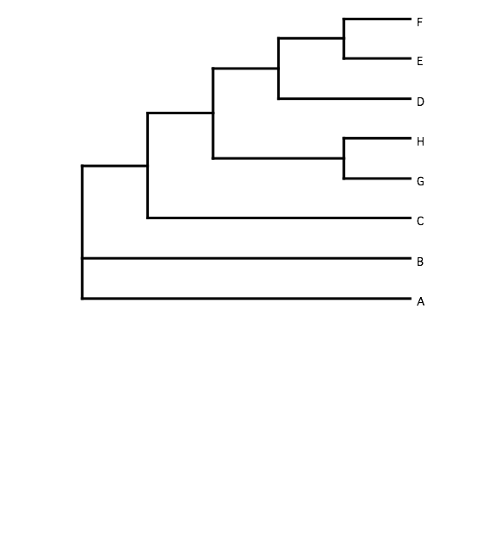
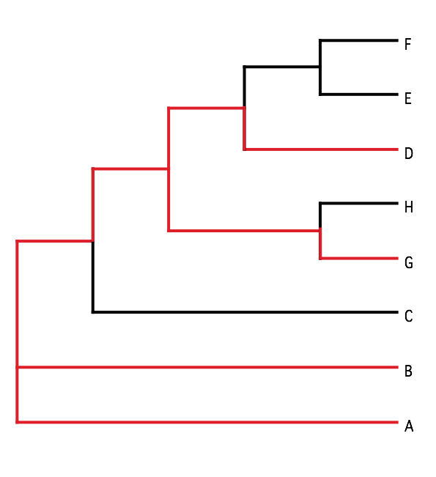
B) Generate 100 datasets using Evolver with certain amount of HGTs
A) Template tree
C) Calculate 1 tree using the concatenated dataset or 100 individual trees
D) Calculate Quartet based tree using Quartet Suite
Repeated 100 times…

Slide 49
Supermatrix versus
Quartet based Supertree
inset: simulated phylogeny

Slide 50
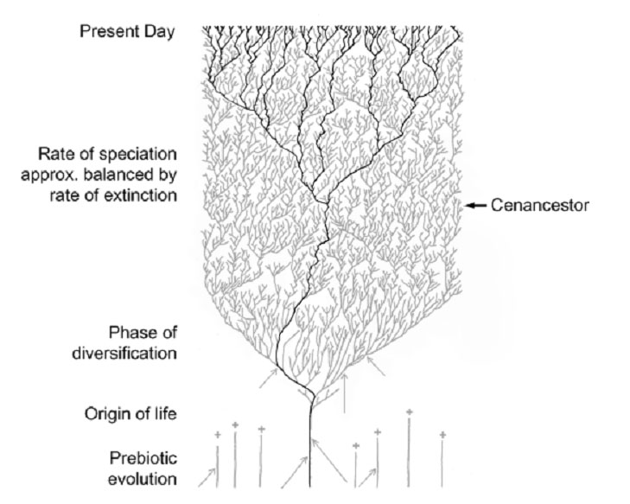
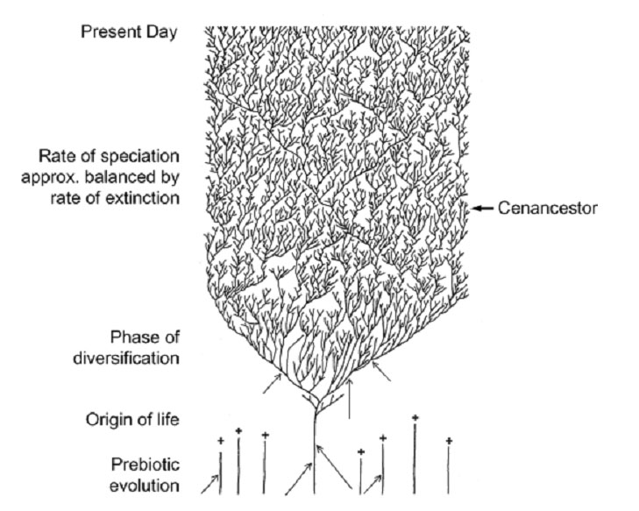
The Coral of Life (Darwin)
Notes:
The “Coral of Life” and the transfer of characters from now extinct into surviving lineages

Slide 51
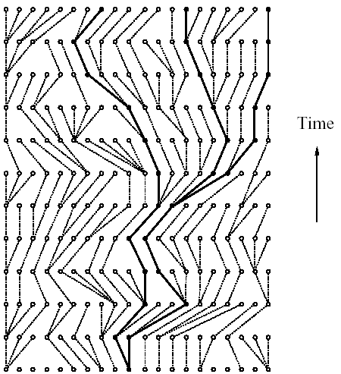
Coalescence – the process of tracing lineages backwards in time to their common ancestors. Every two extant lineages coalesce to their most recent common ancestor. Eventually, all lineages coalesce to the cenancestor.
t/2
(Kingman,
1982)
Illustration is from J. Felsenstein, “Inferring Phylogenies”, Sinauer, 2003

Slide 52
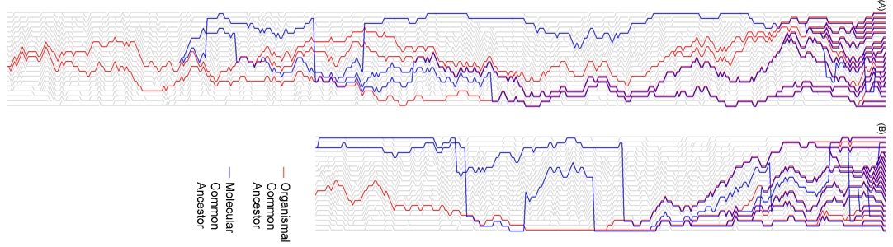
Coalescence of ORGANISMAL and MOLECULAR Lineages
Time
20 lineages
One extinction and one speciation event per generation
One horizontal transfer event once in 10 generations (I.e., speciation events)
RED: organismal lineages (no HGT)
BLUE: molecular lineages (with HGT)
GRAY: extinct lineages
RESULTS:
Most recent common ancestors are different for organismal and molecular phylogenies
Different coalescence times
Long coalescence time for the last two lineages

Slide 53
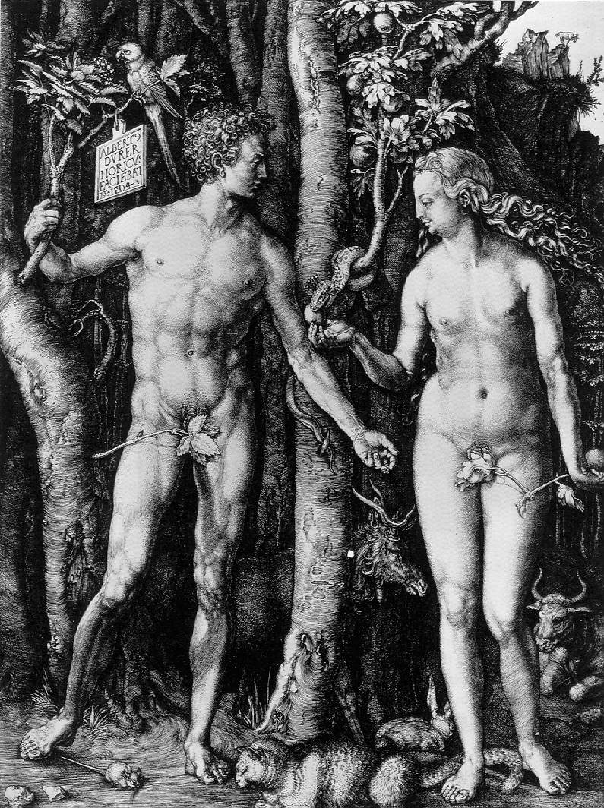
Y chromosome
Adam
Mitochondrial
Eve
Lived
approximately
50,000 years ago
Lived
166,000-249,000
years ago
Thomson, R. et al. (2000) Proc Natl Acad Sci U S A 97, 7360-5
Underhill, P.A. et al. (2000) Nat Genet 26, 358-61
Cann, R.L. et al. (1987) Nature 325, 31-6
Vigilant, L. et al. (1991) Science 253, 1503-7
Albrecht Dürer, The Fall of Man, 1504
Adam and Eve never met ☹
The same is true for ancestral rRNAs, EF, SRP, ATPases!

Slide 54
The most recent common ancestor in pedigrees:
(aside the most recent common ancestor of all humans, i.e. the person found in all pedigrees of now existing human was estimated to have lived only a few thousand years ago. (About 4500 years BP under a realistic model for migration and non random mating)
see D.L. Rohde, S. Olson, J.T. Chang, Nature 431(7008), 562–566 (2004)
Did this genealogical MRCA contribute any genes to your genome?
(Provide a back of the envelope calculation on how many nucleotides in your genome were contributed by this MRCA).

Slide 55
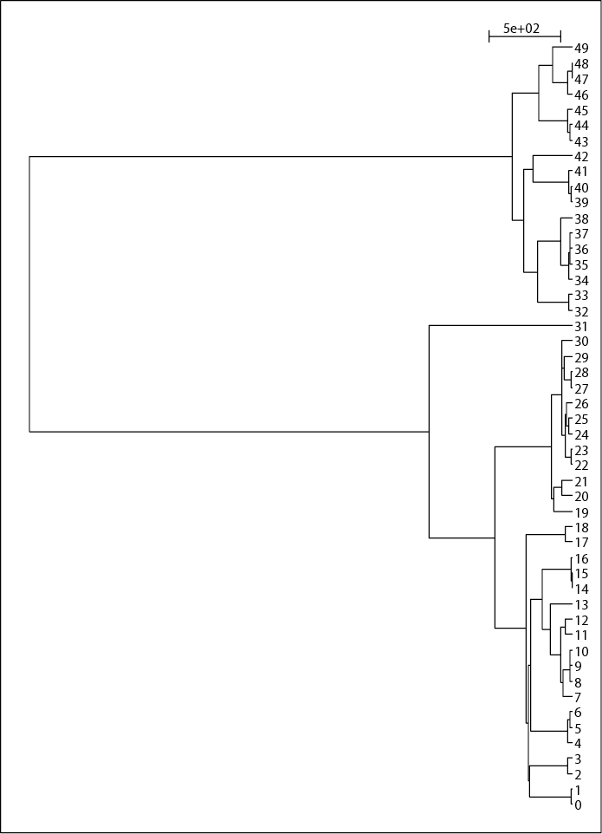
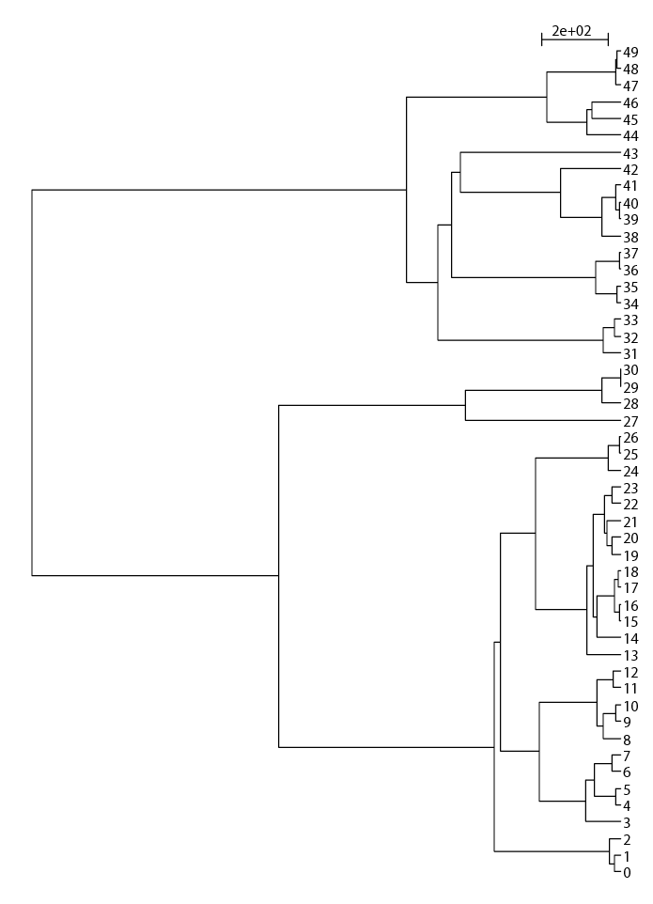
EXTANT LINEAGES FOR THE SIMULATIONS OF 50 LINEAGES
Modified from Zhaxybayeva and Gogarten (2004), TIGs 20, 182-187
Notes:
First describe than discuss

Slide 56
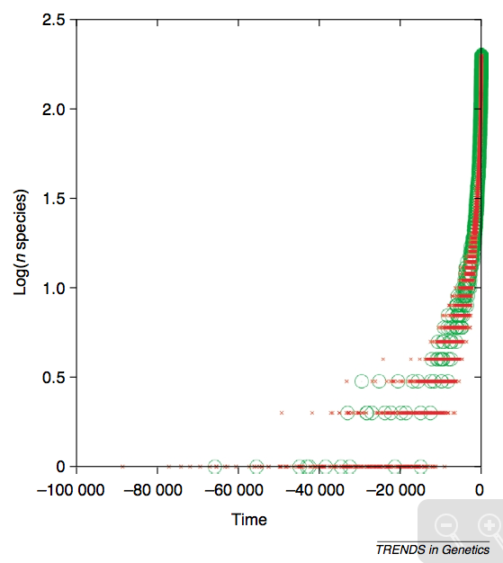
Lineages through time plot for simulated data, 200 species per generation. Data from 10 independent simulations of organismal evolution are shown in green, and for each organismal simulation 25 simulations of gene evolution were performed [one horizontal gene transfer (HGT) event per 10 generations] and are shown in red.
Modified from Zhaxybayeva and Gogarten (2004), TIGs 20, 182-187
Notes:
First describe than discuss

Slide 57
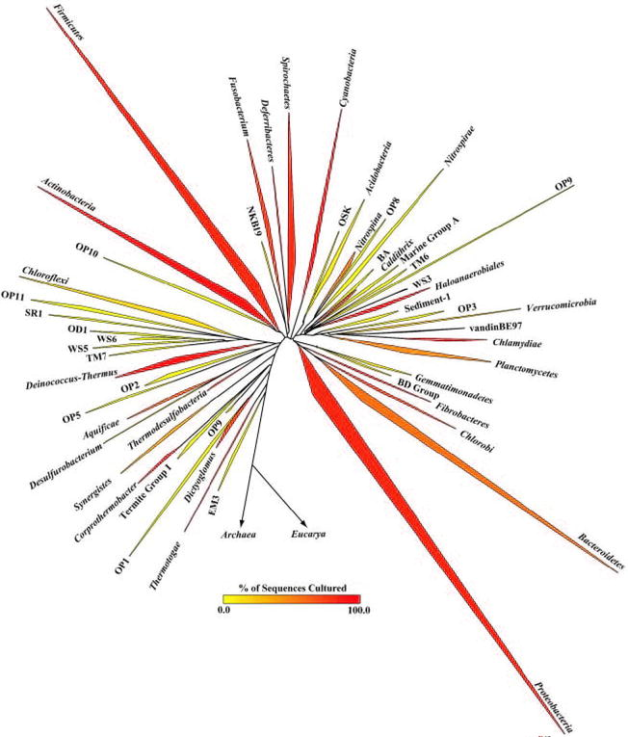

The deviation from the “long branches at the base” pattern could be due to
under sampling
an actual radiation
  due to an invention that was not transferred
  following a mass extinction
Bacterial 16SrRNA based phylogeny (from P. D. Schloss and J. Handelsman, Microbiology and Molecular Biology Reviews, December 2004.)

