Slide 1
MCB 5472
Psi BLAST,
Perl: Arrays, Loops
J. Peter Gogarten
Office: BPB 404
phone: 860 486-4061,
Email: gogarten@uconn.edu

Slide 2
Psi-Blast: Detecting structural homologs
Psi-Blast was designed to detect homology for highly divergent amino acid sequences
Psi = position-specific iterated
Psi-Blast is a good technique to find “potential candidate” genes
Example: Search for Olfactory Receptor genes in Mosquito genome
Hill CA, Fox AN, Pitts RJ, Kent LB, Tan PL, Chrystal MA, Cravchik A, Collins FH, Robertson HM, Zwiebel LJ (2002) G protein-coupled receptors in Anopheles gambiae. Science 298:176-8
by Bob Friedman

Slide 3
Psi-Blast Model
Model of Psi-Blast:
1. Use results of gapped BlastP query to construct a multiple sequence alignment
2. Construct a position-specific scoring matrix from the alignment
3. Search database with alignment instead of query sequence
4. Add matches to alignment and repeat
Similar to Blast, the E-value in Psi-Blast is important in establishing matches
E-value defaults to 0.001 & Blosom62
Psi-Blast can use existing multiple alignment - particularly powerful when the gene functions are known (prior knowledge) or use RPS-Blast database
by Bob Friedman

Slide 4
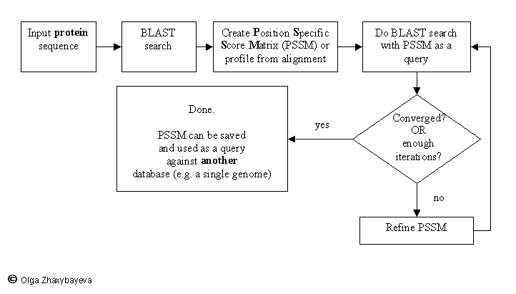
PSI BLAST scheme

Slide 5
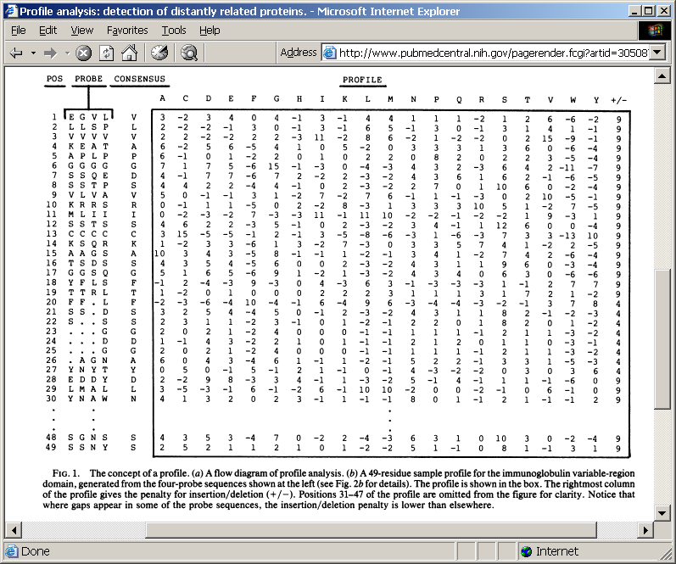
Position-specific Matrix
by Bob Friedman
M Gribskov, A D McLachlan, and D Eisenberg (1987) Profile analysis: detection of distantly related proteins. PNAS 84:4355-8.

Slide 6
Psi-Blast Results
Query: 55670331 (intein)
link to sequence here, check BLink ☺

Slide 7
PSI BLAST and E-values!
Psi-Blast is for finding matches among divergent sequences (position-specific information)
WARNING: For the nth iteration of a PSI BLAST search, the E-value gives the number of matches to the profile NOT to the initial query sequence! The danger is that the profile was corrupted in an earlier iteration.

Slide 8
PSI Blast from the command line
Often you want to run a PSIBLAST search with two different databanks -
one to create the PSSM, the other to get sequences:
To create the PSSM:
blastpgp -d nr -i subI -j 5 -C subI.ckp -a 2 -o subI.out -h 0.00001 -F f
blastpgp -d swissprot -i gamma -j 5 -C gamma.ckp -a 2 -o gamma.out -h 0.00001 -F f
Runs a 4 iterations of a PSIblast
the -h option tells the program to use matches with E <10^-5 for the next iteration,
(the default is 10⁻³ )
-C creates a checkpoint (called subI.ckp),
-o writes the output to subI.out,
-i option specifies input as using subI as input (a fasta formated aa sequence).
The nr databank used is stored in /common/data/
-a 2 use two processors
(It might help to use the node with more memory (017)
(command is ssh node017)

Slide 9
To use the PSSM:
blastpgp -d /Users/jpgogarten/genomes/msb8.faa -i subI -a 2 -R subI.ckp -o subI.out3 -F f
blastpgp -d /Users/jpgogarten/genomes/msb8.faa -i gamma -a 2 -R gamma.ckp -o gamma.out3 -F f
Runs another iteration of the same blast search, but uses the databank /Users/jpgogarten/genomes/msb8.faa
-R tells the program where to resume
-d specifies a different databank
-i input file - same sequence as before
-o output_filename
-a 2 use two processors

Slide 10
PSI Blast and finding gene families within genomes
use PSSM to search genome:
Use protein sequences encoded in genome as target:
blastpgp -d target_genome.faa -i query.name -a 2 -R query.ckp -o query.out3 -F f
B) Use nucleotide sequence and tblastn. This is an advantage if you are also interested in pseudogenes, and/or if you don’t trust the genome annotation:
blastall -i query.name -d target_genome_nucl.ffn -p psitblastn -R query.ckp

Slide 11
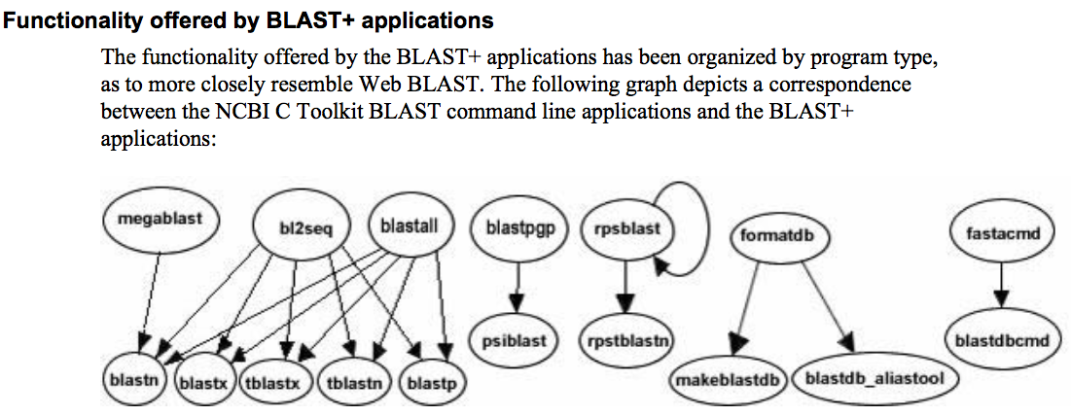
The NCBI has released a new version of blast. The command line version is blast+ .
The new version is faster and allows for more flexibility, but at present we still have problems with running it on the cluster.
The new commands are equivalent to the blastall commmands:

Slide 12
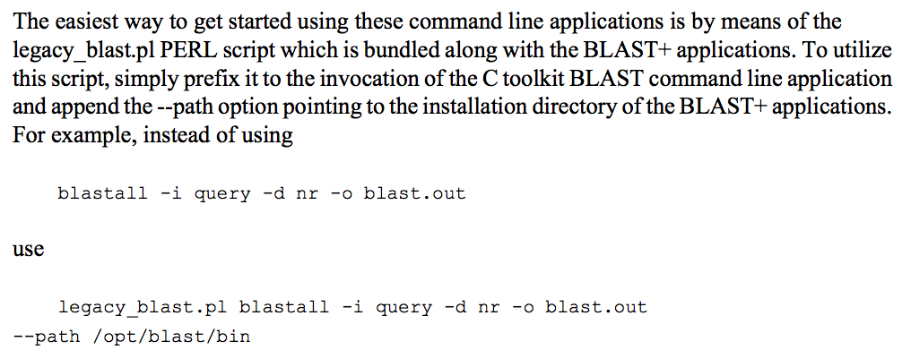
The legacy_blast.pl script that is part of blast+ translates blastall commands into the blast+ syntax. E.g.:
$ ./legacy_blast.pl megablast -i query.fsa -d nt -o mb.out --print_only
/opt/ncbi/blast/bin/blastn -query query.fsa -db "nt" -out mb.out
$
From the blast+ manual:

Slide 13
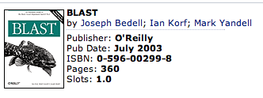
More on blastall:
available at safari books online
http://proquestcombo.safaribooksonline.com/
Installation instructions and info on parameters at the NCBI:
http://www.ncbi.nlm.nih.gov/staff/tao/URLAPI/blastall/
ftp://ftp.ncbi.nlm.nih.gov/blast/documents/formatdb.html
ftp://ftp.ncbi.nlm.nih.gov/blast/documents/blast.html
ftp://ftp.ncbi.nlm.nih.gov/blast/documents/blastpgp.html
ftp://ftp.ncbi.nlm.nih.gov/blast/documents/fastacmd.html
ftp://ftp.ncbi.nlm.nih.gov/blast/documents/
http://www.bioinformatics.ubc.ca/resources/tools/blastall
http://en.wikipedia.org/wiki/BLAST

Slide 14
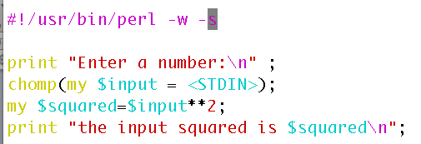
Example (~/perl/class2/demo.pl)
Go through class2.pl http://gogarten.uconn.edu/mcb5472_2010/class2.pl

Slide 15
Old assignments:
What is the difference between a compiler and an interpreter?
A compiler takes program and translates it in low level executable language/code.
An interpreter goes through a program line by line and executes commands.
The traditional distinction between compiled and interpreted languages is being blurred.
2) When is it useful to make a script executable, when not?
You save a little bit of typing when you make it executable, but else it is pretty equivalent. (If you start the program with $ perl script_name.pl, you don’t need the shebang line. But the –w flag to use warnings is recognized.
Comment on use strict; and use warnings,.

Slide 16
Old assignments:
3) What is the value of $i after each of the following operations?
$i=1;
$i++;
$i *= $i;
$i .= $i;
$i = $i/11;
$i = $i . “score and” . $i+3;
First make a guess, then test your prediction using a script.

Slide 17
#!/usr/bin/perl #-w
my $i='';
print "\$i= $i\n";
$i = 1;
print "\$i= $i\n";
$i++;
print "\$i= $i\n";
$i *= $i;
print "\$i= $i\n";
$i .= $i;
print "\$i= $i\n";
$i = $i/11;
print "\$i= $i\n";
$i = $i . "score and" . $i+3 ;
print "\$i= $i\n";
$i = $i+3 . "score and" . $i;
print "\$i= $i\n";
$i=
$i= 1
$i= 2
$i= 4
$i= 44
$i= 4
$i= 7
$i= 10score and7
discuss and run test.pl with and without –w flag

Slide 18
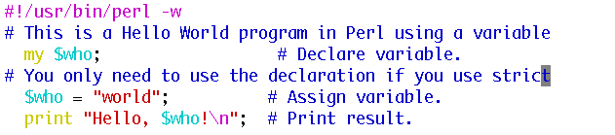
Discuss and run the hello_world script with variable and input
hello_world_variable.pl

Slide 19
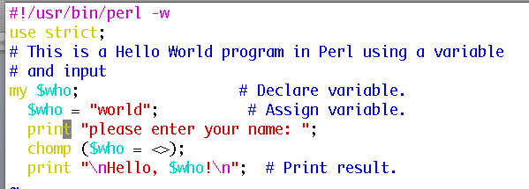
Discuss and run the hello_world script with variable and input
hello_world_variable_input.pl
The best way to find which module to use is google. You can search core modules at http://perldoc.perl.org/search.html?

Slide 20
Old assignments:
4) If $a = 2 and $b=3, what is the type and values of the scalar stored in $c after each of the following statements:
$c = $a + $b;
$c = $a / $b;
$c = $a . $b;
$c = "$a + $b";
$c = '$a + $b';
First make a guess, then test your prediction using a script.

Slide 21
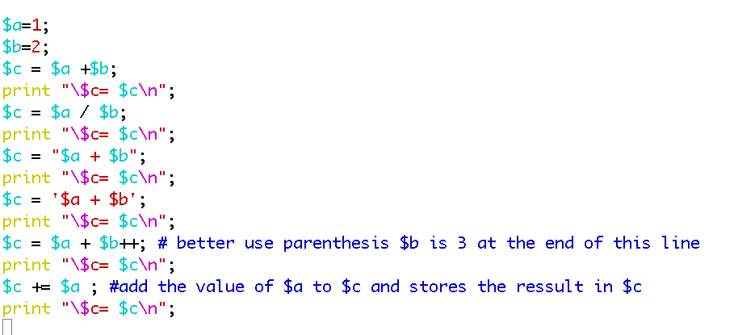
$c= 3
$c= 0.5
$c= 1 + 2
$c= $a + $b
$c= 3
$c= 4
Run and discuss test2.pl

Slide 22
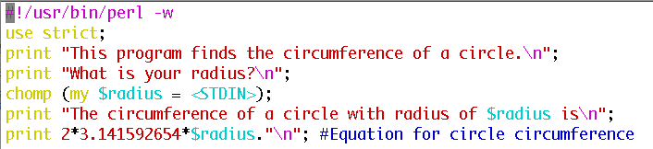
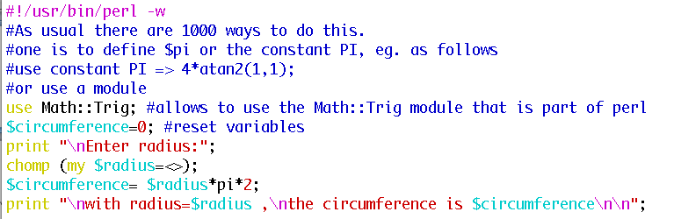
2) Why does the first of these get along without chomp ($line);
(chomp is a built-in command in Perl to remove a trailing newline, if any, from a string).
3) Write a short Perl script that calculates the circumference of a circle given a radius provided by the user.

Slide 23
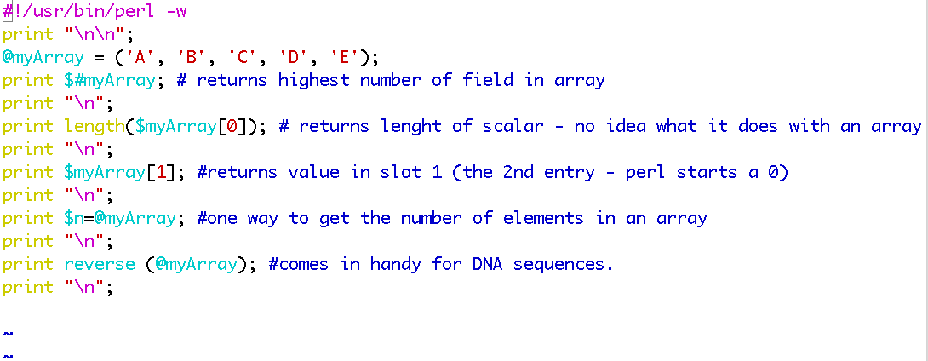
From Wednesday:
For the following array declaration @myArray = ('A', 'B', 'C', 'D', 'E'); what is the value of the following expressions:
$#myArray length(@myArray) $myArray[1] $n=@myArray reverse (@myArray)
4
1
B
5
EDCBA
Run and discuss myArray.pl

Slide 24
Assignment for Monday (class 4)
Write a 2 sentence outline for your student project
Read chapter P5 and P12 conditional statements and on “for, foreach, and while” loops.
http://korflab.ucdavis.edu/Unix_and_Perl/unix_and_perl_v2.3.3.pdf
Background:
@a=(0..50);
# This assigns numbers from 0 to 50 to an array,
# so that $a[0] =0; $a[1] =1; $a[50] =50
3) Write perl scripts that add all numbers from 1 to 50. Try to do this using at least two different control structures.
4) Create a program that reads in a sequence stored in a file handed to the program on the command line and determines GC content of a sequence. Use class3.pl as a starting point.

Slide 25
Go through class3.pl script.
If time go through Olga’s search for distant homologs webpage at http://www.mta.ca/~ozhaxybayeva/bioinf2010/class10.html

