Slide 1
MCB 5472
Psi BLAST,
Perl: Arrays, Loops
J. Peter Gogarten
Office: BPB 404
phone: 860 486-4061,
Email: gogarten@uconn.edu

Slide 2
Psi-Blast Results
Query: 55670331 (intein)
link to sequence here, check BLink ☺

Slide 3
PSI BLAST and E-values!
Psi-Blast is for finding matches among divergent sequences (position-specific information)
WARNING: For the nth iteration of a PSI BLAST search, the E-value gives the number of matches to the profile NOT to the initial query sequence! The danger is that the profile was corrupted in an earlier iteration.

Slide 4
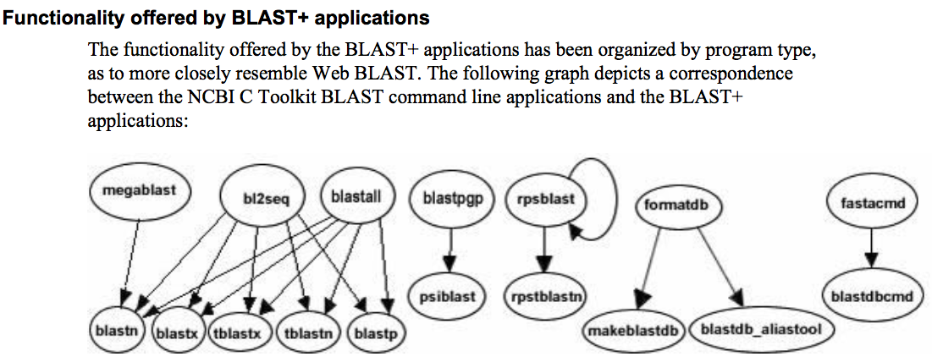
The NCBI has released a new version of blast. The command line version is blast+ .
The new version is faster and allows for more flexibility, but at present we still have problems with running it on the cluster.
The new commands are equivalent to the blastall commmands:

Slide 5
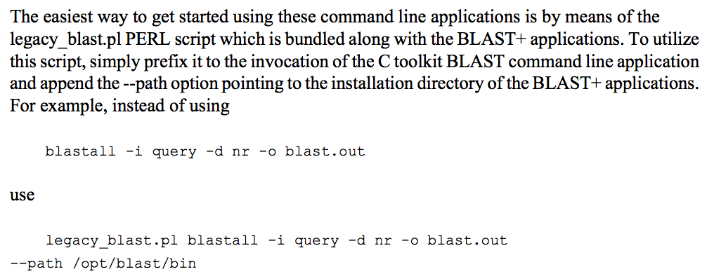
The legacy_blast.pl script that is part of blast+ translates blastall commands into the blast+ syntax. E.g.:
$ ./legacy_blast.pl megablast -i query.fsa -d nt -o mb.out --print_only
/opt/ncbi/blast/bin/blastn -query query.fsa -db "nt" -out mb.out
$
From the blast+ manual:

Slide 6
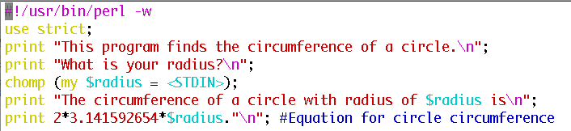
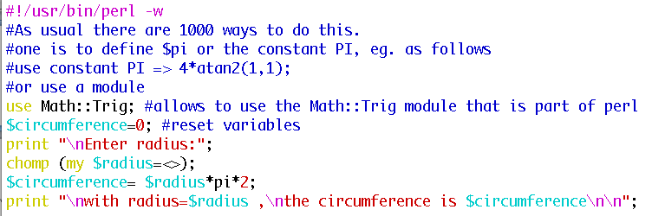
3) Write a short Perl script that calculates the circumference of a circle given a radius provided by the user.
The best way to find which module to use is google. You can search core modules at http://perldoc.perl.org/search.html?

Slide 7
Old Assignment for Monday
Write a 2 sentence outline for your student project
Read chapter P5 and P12 conditional statements and on “for, foreach, and while” loops.
http://korflab.ucdavis.edu/Unix_and_Perl/unix_and_perl_v2.3.3.pdf
Background:
@a=(0..50);
# This assigns numbers from 0 to 50 to an array,
# so that $a[0] =0; $a[1] =1; $a[50] =50
3) Write perl scripts that add all numbers from 1 to 50. Try to do this using at least two different control structures.
4) Create a program that reads in a sequence stored in a file handed to the program on the command line and determines GC content of a sequence. Use class3.pl as a starting point.

Slide 8
Go through class3.pl script
(http://gogarten.uconn.edu/mcb5472_2010/class3.pl).
If time go through Olga’s search for distant homologs webpage at (use cd00081for PSSM viewer) http://www.mta.ca/~ozhaxybayeva/bioinf2010/class10.html

Slide 9
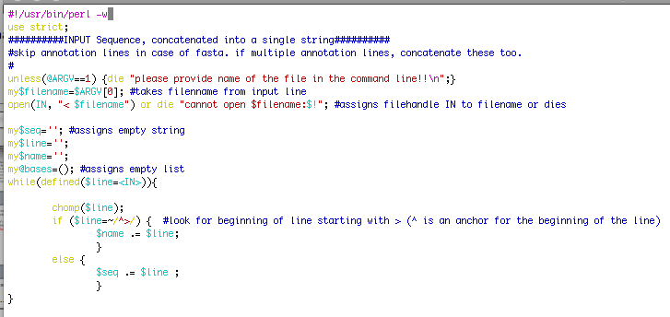
%GC counter, part A: read in seqs

Slide 10
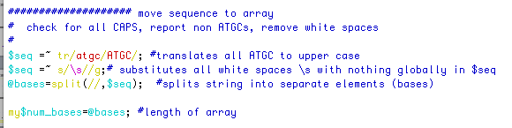
%GC counter, part B: move seqs to array

Slide 11
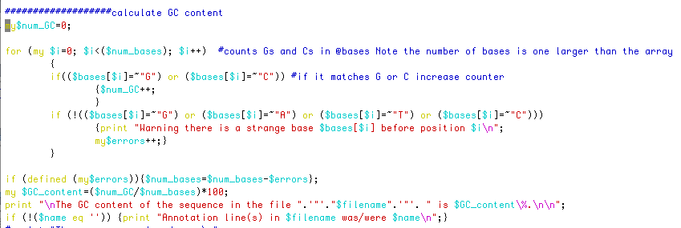
%GC counter, part B: calculate %GC

Slide 12
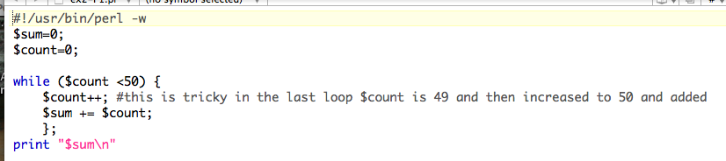
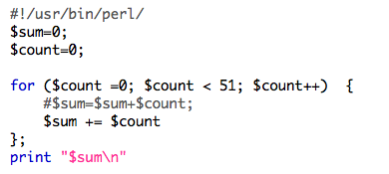
Control structures: Sum 1..50
while ( ) { }
for ( , , ) { }

Slide 13
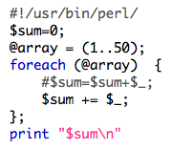
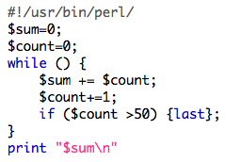
Control structures: Sum 1..50
foreach ( ) { };
Infinite loop with last:
while () {
if( ) {last};
};

Slide 14
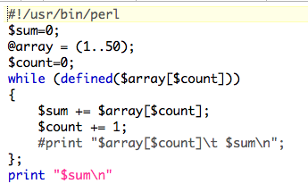
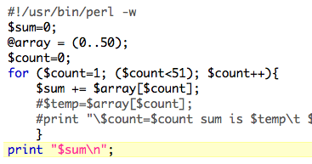
Control structures: Sum 1..50
while (defined ( )) { };
for ( , , ) { }
Counting elements of an array
Could have started at 0

Slide 15
For Monday
Write a script that reads in a sequence and prints out the reverse complement.
Modify your script to that it can handle a sequence that goes over several lines.
Background: $comp =~ tr/ATGC/TACG/;
#translates every A in $comp into a T; every T into an A; every G into a C and every C into a G
Read P 14 on hashes, write the program suggested in the chapter.

Slide 16
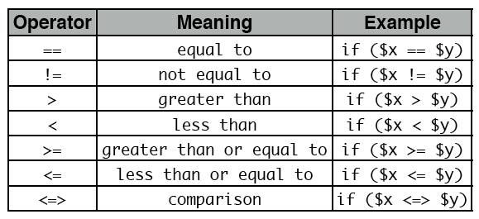
For Monday
Do the following statements evaluate to true or false? (Check P5)
1
0 && 1
0||1
45
45-45
45/45
45==45
45<=>45
45<=50 from http://korflab.ucdavis.edu/Unix_and_Perl/unix_and_perl_v2.3.3.pdf
55>=50
50<=>70
45!=45
45!=50

Slide 17
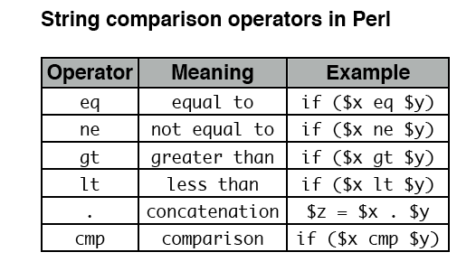
from http://korflab.ucdavis.edu/Unix_and_Perl/unix_and_perl_v2.3.3.pdf

Slide 18
Most of the smaller assignments should be solvable within half an hour. Using the notes, the text book and the internet try to solve one problem for not more than one hour. Then ask me or Tim for help.
In total, the assignments for one week might take a few hours, but if it goes beyond 6 hours total, ask for help, or hand in the latest version of your attempt to solve the assignment. Sometimes, a little help can go a long way. The main reason for the assignments is to make you actually write code and to learn form the mistakes you make.

Slide 19
Hashes are tables that relate keys and values.
(in the array the number of the field could be considered the key:
@a=(1..51) => $a[0]=1, $a[50]=51 )
In a %ash the entry for the key is the address where the value is stored.
E.g., you could have a hash where the students age is stores as value and the student ID is the key.
But you also could use the students name as key and the ID or age or …. as value. This works very economically, especially if the table is sparse.
my (%studentID, %student_first_name, %studentGPA);$studentID{gogarten}=9999;
$student_first_name{gogarten}=‘Johann Peter’;
$studentGPA{gogarten}=3.2;
In many instances you need to make sure that the key you want to uses has not yet been assigned. If (exists ($studentID{gogarten}) {};
Go through class 4.pl
http://gogarten.uconn.edu/mcb5472_2010/class4.pl
http://gogarten.uconn.edu/mcb5472_2010/gi_list.txt

