Slide 1
MCB 5472
Phylogenetic reconstruction #2
Peter Gogarten
Office: BSP 404
phone: 860 486-4061,
Email: gogarten@uconn.edu

Slide 2
OldAssignments:
Write a script that determines the number of elements in a %ash.
Write a script (or subroutine) that prints out a hash sorted on the keys in alphabetical order.
How can you remove an entry in a hash (key and value)?
Write a program that it uses hashes to calculates mono-, di-, tri-, and quartet-nucleotide frequencies in a genome.

Slide 3
exercises:
Write a script that determines the number of elements in %ash.
@keys = keys(%ash); #assigns keys to an array
$number =@keys; # determines number of different keys (uses array in scalar context).
print "$number \n";
Write a script that prints out a hash sorted on the keys in alphabetical order.
@gi_names = sort(keys(%gi_hash)); # sorts key and assigns keys to an array
foreach (@gi_names){
print "$_ occurred $gi_hash{$_} times\n";
}
Remove an entry in a hash (key and value):
delete $gi_hash{$varaible_denoting_some_key};

Slide 4
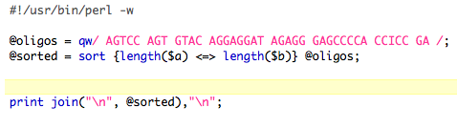
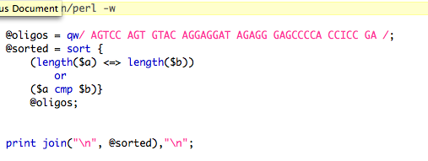
Sort based on code {}
or

Slide 5
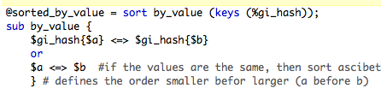
To sort Keys by their value (See class 4 &5):
or

Slide 6
Old Perl assignments
Write a script that takes all phylip formated aligned multiple sequence files present in a directory, and performes a bootstrap analyses using maximum parsimony.
Files you might want to use are A.fa, B.fa, alpha.fa, beta.fa, and atp_all.phy. BUT you first have to convert them to phylip format AND you should replace some or all gaps with ?
(In the end you would be able to answer the question “does the resolution increase if a more related subgroup is analyzed independent from an outgroup?)

Slide 7
hints
Rather than typing commands at the menu, you can write the responses that you would need to give via the keyboard into a file (e.g. your_input.txt)
You could start and execute the program protpars by typing
protpars < your_input.txt
your input.txt might contain the following lines:
  infile1.txt
  r
  t
  10
  y
  r
  r
in the script you could use the line
system (“protpars < your_input.txt”);
The main problem are the owerwrite commands if the oufile and outtree files are already existing. You can either create these beforehand, or erase them by moving (mv) their contents somewhere else.

Slide 8
create *.phy files
the easiest (probably) is to run clustalw with the phylip option:
For example (here):
#!/usr/bin/perl -w
print "# This program aligns all multiple sequence files with names *.fa \n
# found in its directory using clustalw, and saves them in phyip format.\n“;
while(defined($file=glob("*.fa"))){
@parts=split(/\./,$file);
$file=$parts[0];
system("clustalw -infile=$file.fa -align -output=PHYLIP");
};
# cleanup:
system ("rm *.dnd");
exit;
Alternatively, you could use a web version of readseq – this one worked great for me ☺

Slide 9
Alternative for entering the commands for the menu:
#!/usr/bin/perl -w
system ("cp A.phy infile");
system ("echo -e 'y\n9\n'|seqboot");
exit;
echo returns the string in ‘ ‘, i.e., y\n9\n.
The –e options allows the use of \n
The | symbol pipes the output from echo to seqboot

Slide 10
Very Old Assignment
Write a script that takes a genome (fna file) and calculates the GC content.
Modify the script to count tetra- and penta-nucleotide frequencies.
Modify the script so that it creates a table that gives the GC, tetra- and penta-nucleotide content in a sliding window moving through the genome.
(For which of these programs, and for which problems might you want to consider, or correct for strand bias?)

Slide 11
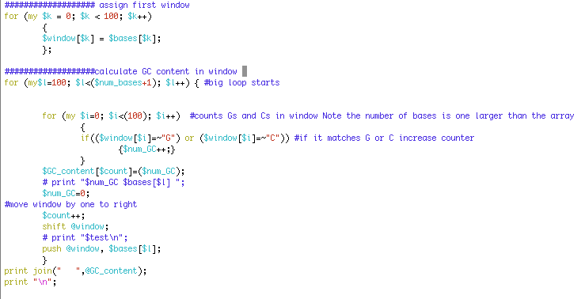
Rolling window example from GC rolling.pl

Slide 12
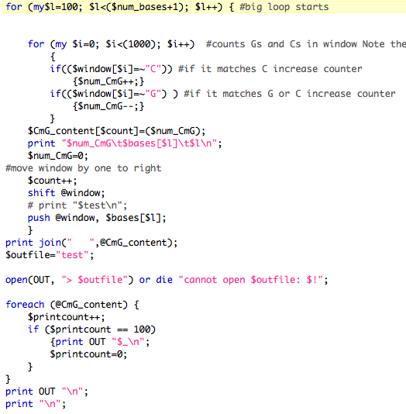

Slide 13
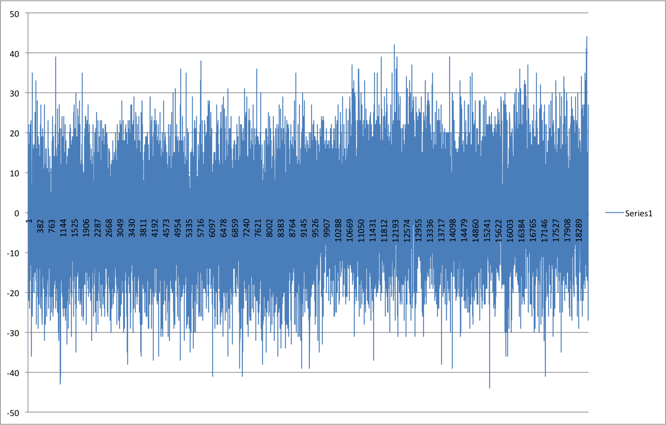
Window=100 , printed every 100

Slide 14
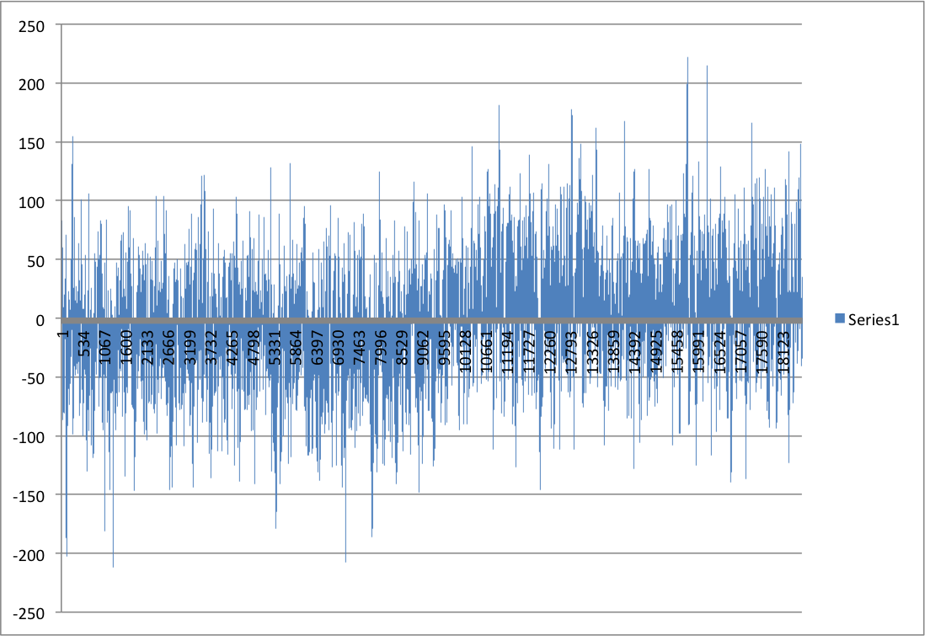
Window=1000 , printed every 100

Slide 15
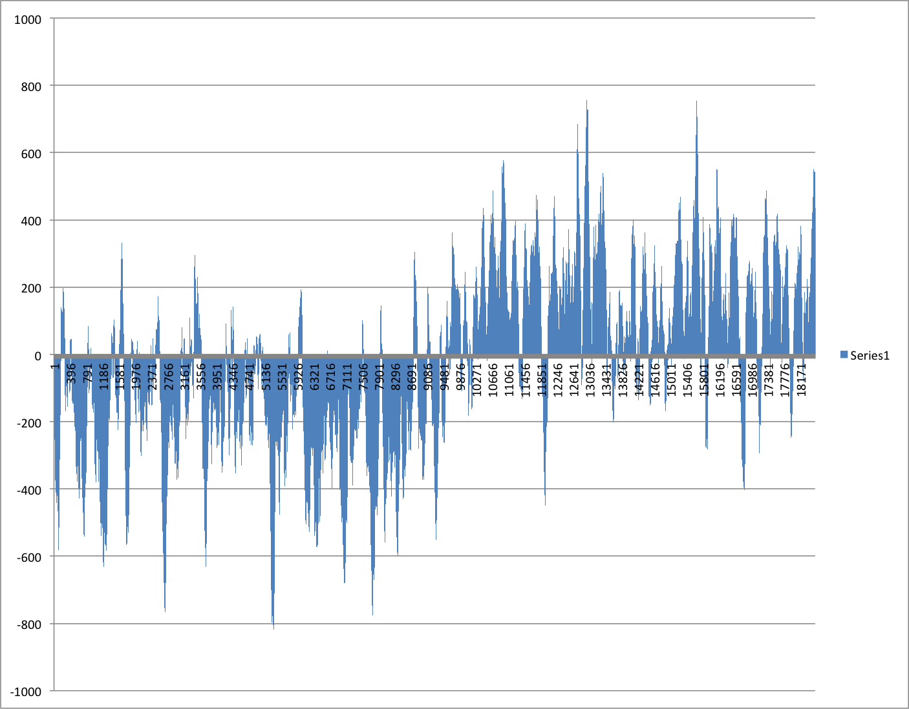
Window=10000 , printed every 100

Slide 16
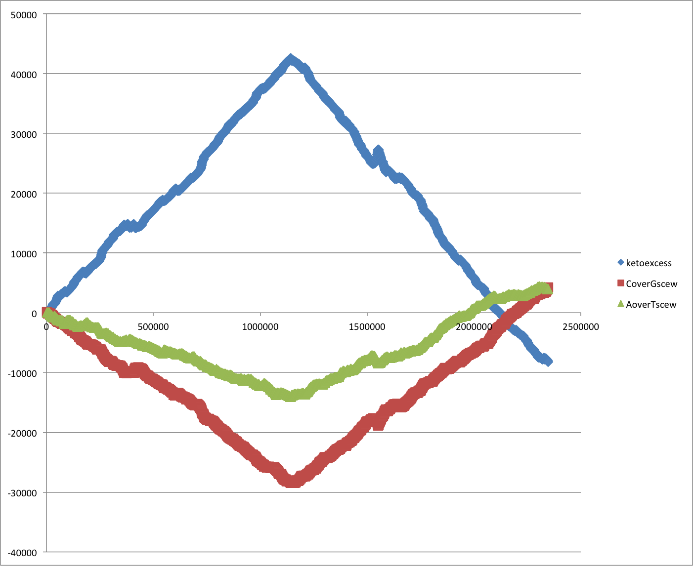
Cumulative Strand Bias SG0

Slide 17
New Assignment
Given a multiple fasta sequence file*, write a script that for each sequence extract the gi number and the species name. and rewrites the file so that the annotation line starts with the gi number, followed by the species/strain name, followed by a space. (The gi number and the species name should not be separated by or contain any spaces – replace them by _. This is useful, because clustalw will recognize the number and name as handle for the sequence.)
Assume that the annotation line follows the NCBI convention and begins with the
> followed by the gi number, and ends with the species and strain designation given in []
Example:
>gi|229240723|ref|ZP_04365119.1| primary replicative DNA helicase; intein [Cellulomonas flavigena DSM 20109]
Example multiple sequence file is here.
Work on your student project

Slide 18
Trees – possible reasons for conflict
If this is the probable organismal tree:
species A
species B
species C
species D
what could be the reason for obtaining this gene tree:
seq. from A
seq. from D
seq. from C
seq. from B

Slide 19
lack of resolution
seq. from A
seq. from D
seq. from C
seq. from B
e.g., 60% bootstrap support for bipartition (AD)(CB)

Slide 20
long branch attraction artifact
the two longest branches join together
seq. from A
seq. from D
seq. from C
seq. from B
e.g., 100% bootstrap support for bipartition (AD)(CB)
What could you do to investigate if this is a possible explanation?
use only slow positions,
use an algorithm that corrects for ASRV
add sequences that break-up the long branches

Slide 21
Gene transfer
Organismal tree:
species A
species B
Gene Transfer
species C
species D
molecular tree:
seq. from A
seq. from D
seq. from C
speciation
seq. from B
gene transfer

Slide 22
Lineage Sorting
Organismal tree:
species A
species B
species C
Genes diverge and coexist in the
organismal lineage
species D
molecular tree:
seq. from A
seq. from D
seq. from C
seq. from B

Slide 23
Gene duplication
Organismal tree:
species A
species B
species C
gene duplication
species D
molecular tree:
molecular tree:
molecular tree:
seq. from A
seq. from A
seq. from A
seq. from B
seq. from B
seq. from C
seq. from C
seq. from D
seq. from D
seq. from D
seq.’ from B
seq.’ from B
seq.’ from C
seq.’ from C
seq.’ from C
gene duplication
gene duplication
gene duplication
seq.’ from D
seq.’ from D
seq.’ from D

Slide 24
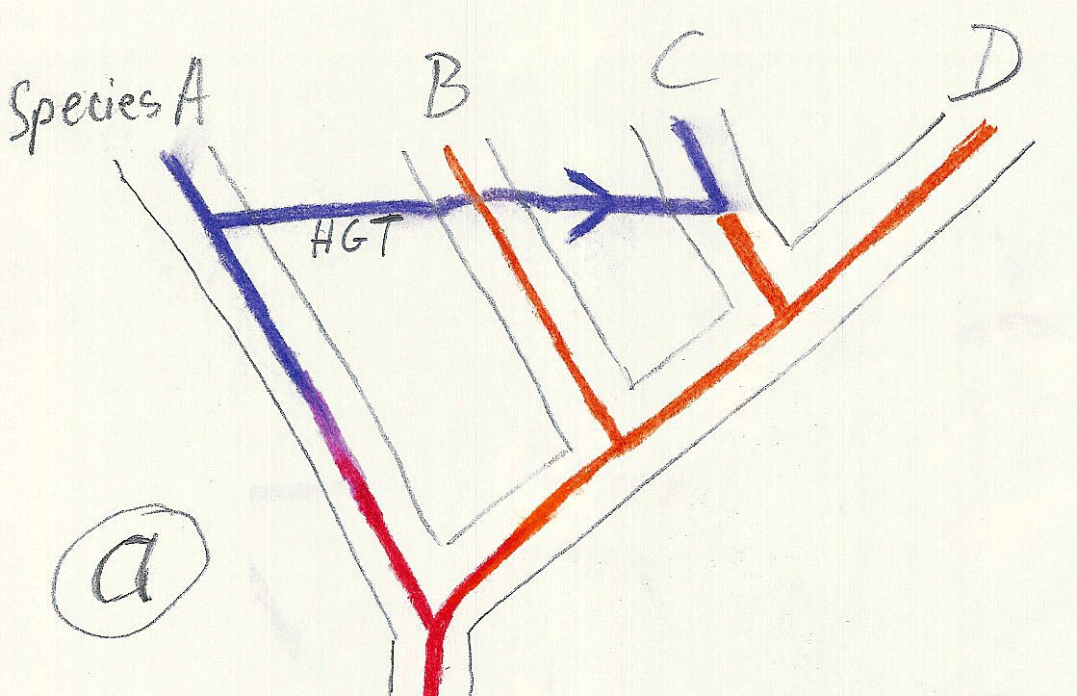
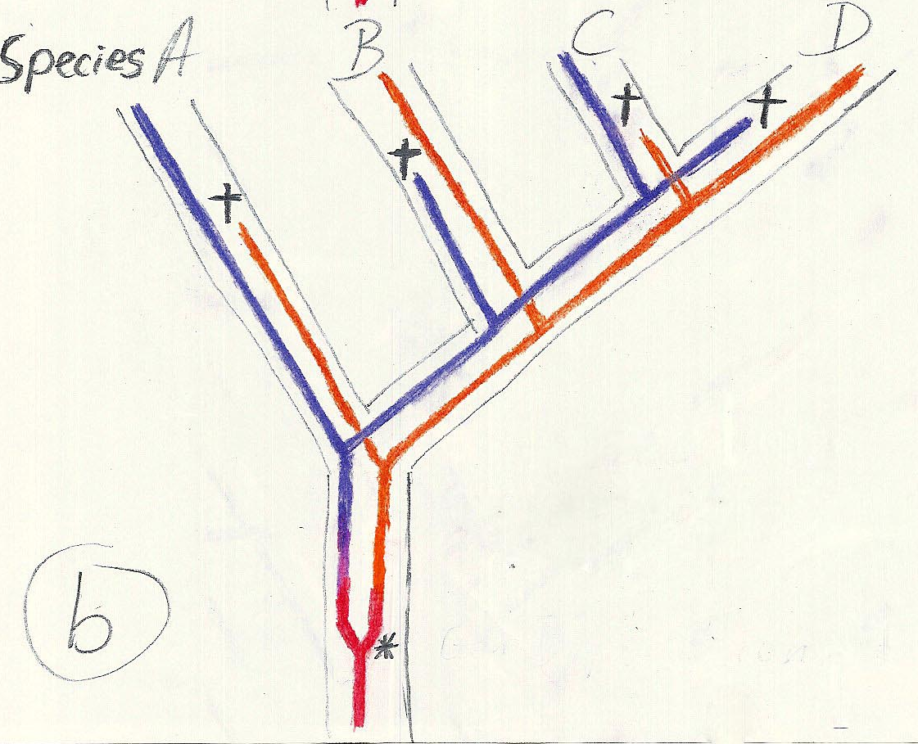
Gene duplication and gene transfer are equivalent explanations.
The more relatives of C are found that do not have the blue type of gene, the less likely is the duplication loss scenario
Ancient duplication followed by gene loss
Horizontal or lateral Gene
Note that scenario B involves many more individual events than A
1 HGT with
orthologous replacement
1 gene duplication followed by 4 independent gene loss events

Slide 25
Phylip
written and distributed by Joe Felsenstein and collaborators (some of the following is copied from the PHYLIP homepage)
PHYLIP (the PHYLogeny Inference Package) is a package of programs for inferring phylogenies (evolutionary trees).
PHYLIP is the most widely-distributed phylogeny package, and competes with PAUP* to be the one responsible for the largest number of published trees. PHYLIP has been in distribution since 1980, and has over 15,000 registered users.
Output is written onto special files with names like "outfile" and "outtree". Trees written onto "outtree" are in the Newick format, an informal standard agreed to in 1986 by authors of a number of major phylogeny packages.
Input is either provided via a file called “infile” or in response to a prompt.

Slide 26
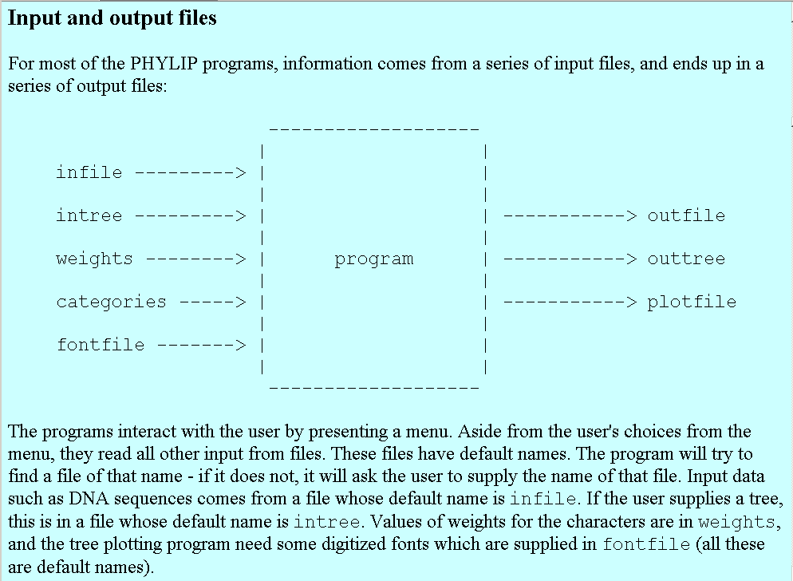
input and output

Slide 27
What’s in PHYLIP
Programs in PHYLIP allow to do parsimony, distance matrix, and likelihood methods, including bootstrapping and consensus trees. Data types that can be handled include molecular sequences, gene frequencies, restriction sites and fragments, distance matrices, and discrete characters.
Phylip works well with protein and nucleotide sequences
Many other programs mimic the style of PHYLIP programs.
(e.g. TREEPUZZLE, phyml, protml)
Many other packages use PHYIP programs in their inner workings (e.g., PHYLO_WIN)
PHYLIP runs under all operating systems
Web interfaces are available

Slide 28
Programs in PHYLIP are Modular
For example:
SEQBOOT take one set of aligned sequences and writes out a file containing bootstrap samples.
PROTDIST takes a aligned sequences (one or many sets) and calculates distance matices (one or many)
FITCH (or NEIGHBOR) calculate best fitting or neighbor joining trees from one or many distance matrices
CONSENSE takes many trees and returns a consensus tree
…. modules are available to draw trees as well, but often people use treeview or njplot

Slide 29
The Phylip Manual
is an excellent source of information.
Brief one line descriptions of the programs are here
The easiest way to run PHYLIP programs is via a command
line menu (similar to clustalw). The program is invoked through clicking on an icon, or by typing the program name at the command line.
> seqboot
> protpars
> fitch
If there is no file called infile the program responds with:
[gogarten@carrot gogarten]$ seqboot
seqboot: can't find input file "infile"
Please enter a new file name>

Slide 30
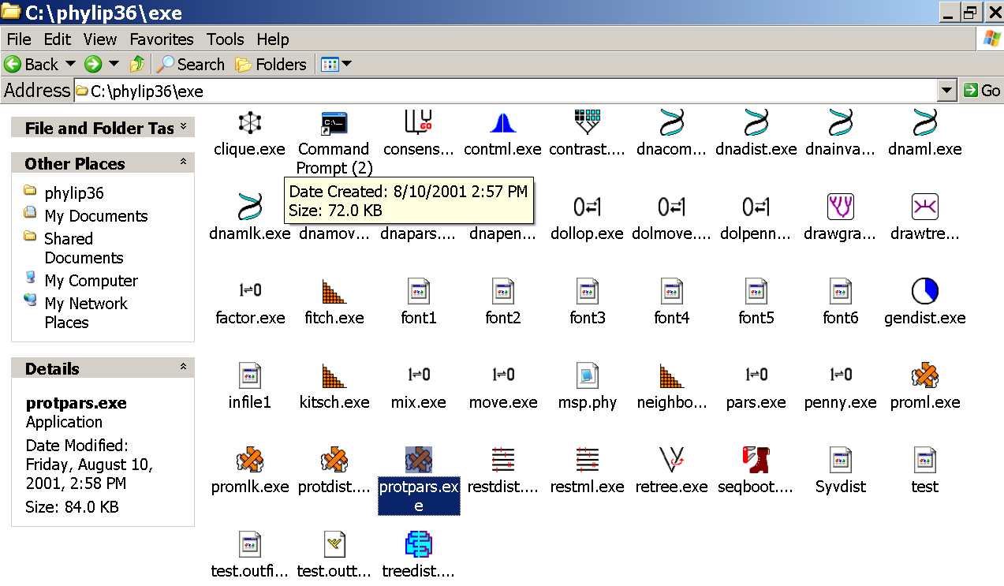
program folder

Slide 31
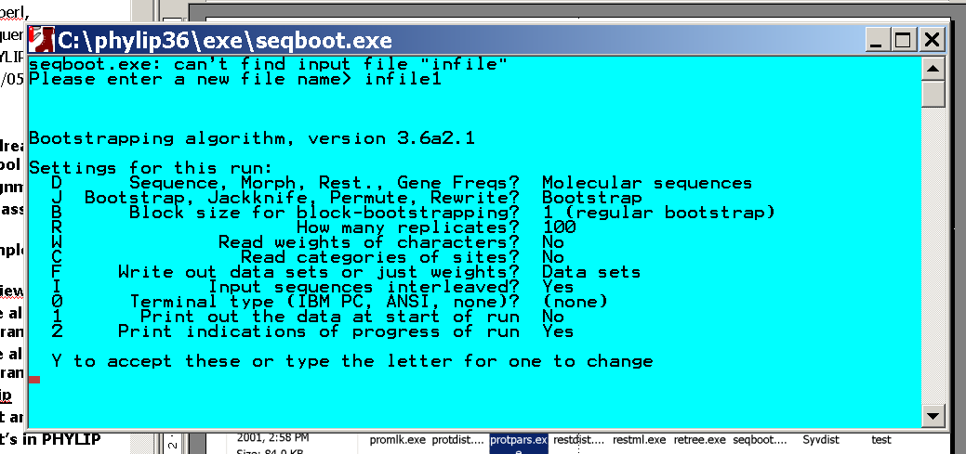
menu interface
example: seqboot and protpars on infile1

Slide 32
Sequence alignment:
CLUSTALW
MUSCLE
Removing ambiguous positions:
T-COFFEE
FORBACK
Generation of pseudosamples:
SEQBOOT
PROTDIST
TREE-PUZZLE
Calculating and evaluating phylogenies:
PROTPARS
PHYML
NEIGHBOR
FITCH
Comparing phylogenies:
CONSENSE
SH-TEST in TREE-PUZZLE
Comparing models:
Maximum Likelihood Ratio Test
Visualizing trees:
ATV, njplot, or treeview
Phylip programs can be combined in many different ways with one another and with programs that use the same file formats.

Slide 33
Example 1 Protpars
example: seqboot, protpars, consense on infile1
NOTE the bootstrap majority consensus tree does not necessarily have the same topology as the “best tree” from the original data!
threshold parsimony,
gap symbols - versus ?
(in vi you could use :%s/-/?/g to replace all – ?)
outfile
outtree compare to distance matrix analysis

Slide 34
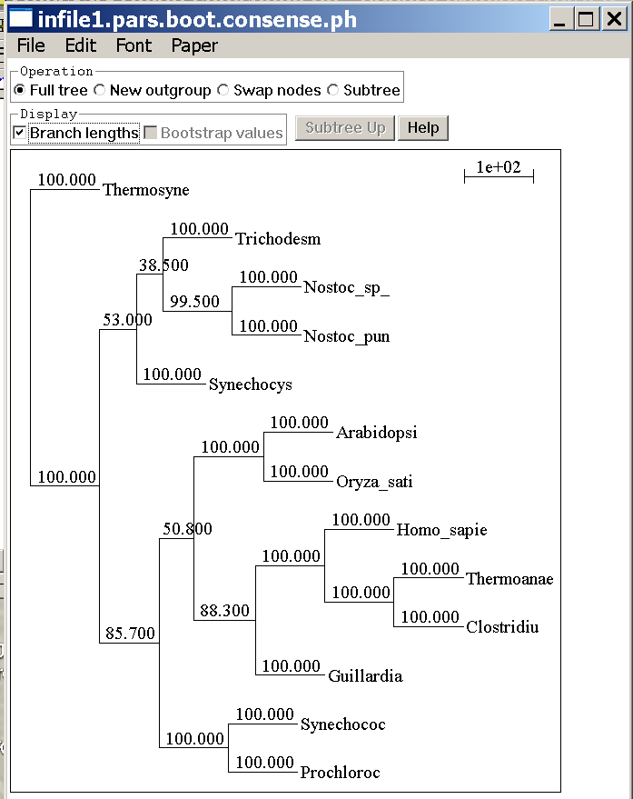
protpars (versus distance/FM)
Extended majority rule consensus tree
CONSENSUS TREE:
the numbers on the branches indicate the number
of times the partition of the species into the two sets
which are separated by that branch occurred
among the trees, out of 100.00 trees
+------Prochloroc
+----------------------100.-|
| +------Synechococ
|
| +--------------------Guillardia
+-85.7-| |
| | +-88.3-| +------Clostridiu
| | | | +-100.-|
| | | +-100.-| +------Thermoanae
| +-50.8-| |
| | +-------------Homo sapie
+------| |
| | | +------Oryza sati
| | +---------------100.0-|
| | +------Arabidopsi
| |
| | +--------------------Synechocys
| | |
| +---------------53.0-| +------Nostoc pun
| | +-99.5-|
| +-38.5-| +------Nostoc sp
| |
| +-------------Trichodesm
|
+------------------------------------------------Thermosyne
remember: this is an unrooted tree!
branches are scaled with respect to bootstrap support values, the number for the deepest branch is handeled incorrectly by njplot and treeview

Slide 35
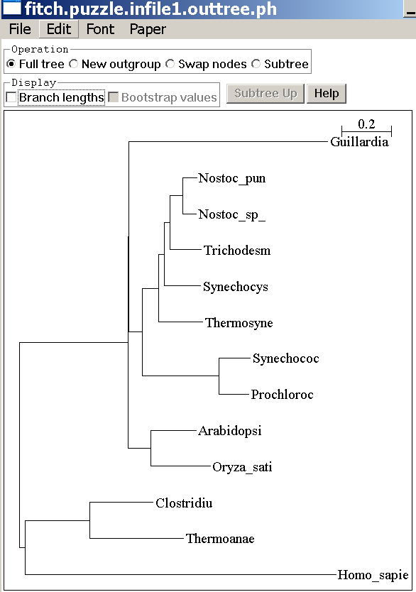
(protpars versus) distance/FM
Tree is scaled with respect to
the estimated number of
substitutions.
what might be the explanation for the red algae not grouping with the plants?
If time: demo of njplot

Slide 36
protdist
PROTdist
Settings for this run:
P Use JTT, PMB, PAM, Kimura, categories model? Jones-Taylor-Thornton matrix
G Gamma distribution of rates among positions? No
C One category of substitution rates? Yes
W Use weights for positions? No
M Analyze multiple data sets? No
I Input sequences interleaved? Yes
0 Terminal type (IBM PC, ANSI)? ANSI
1 Print out the data at start of run No
2 Print indications of progress of run Yes

Slide 37
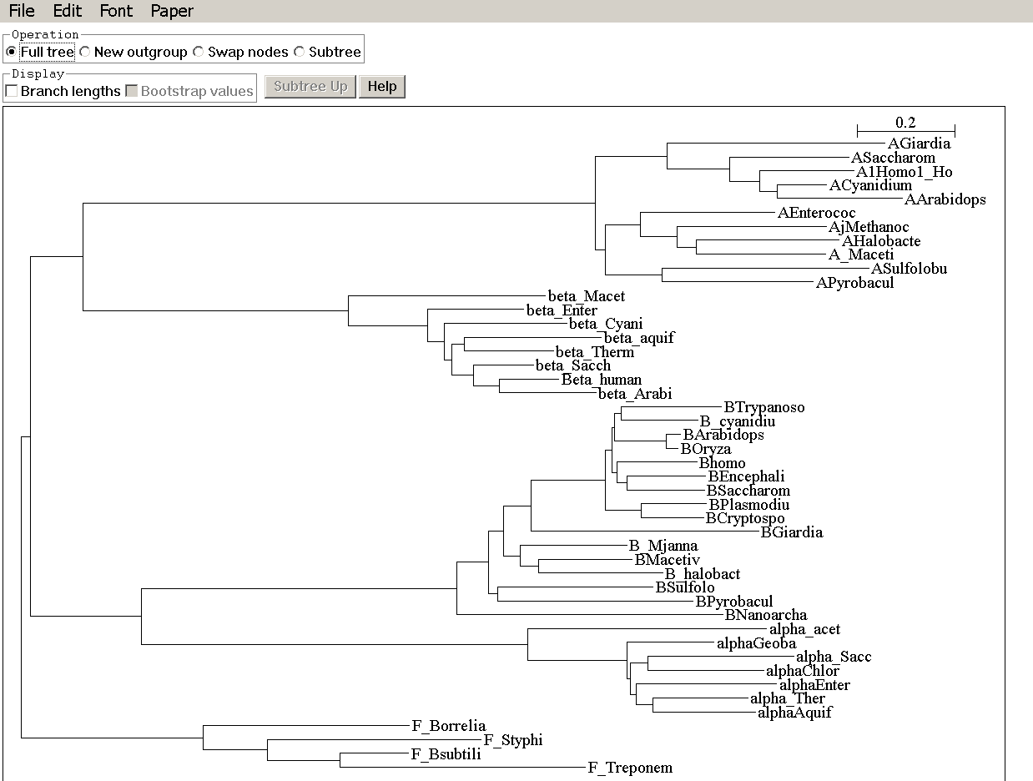
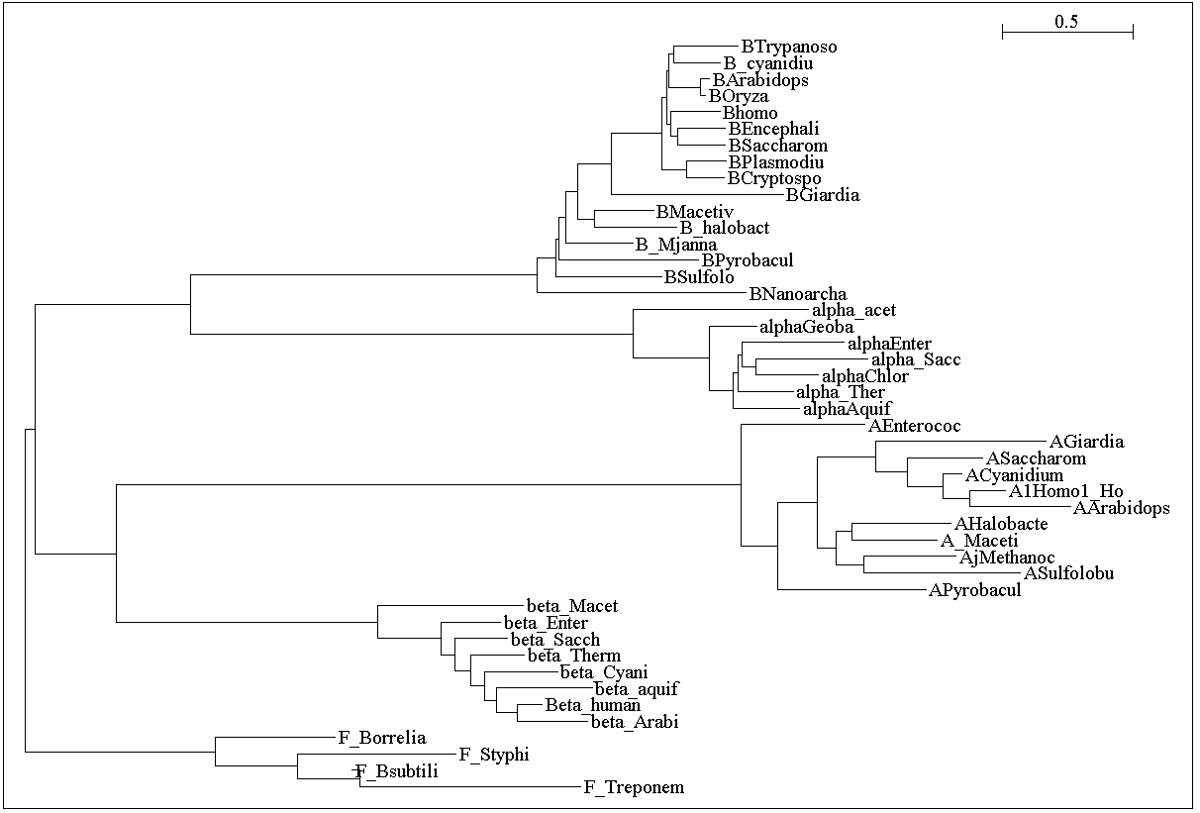
without and with correction for ASRV

Slide 38
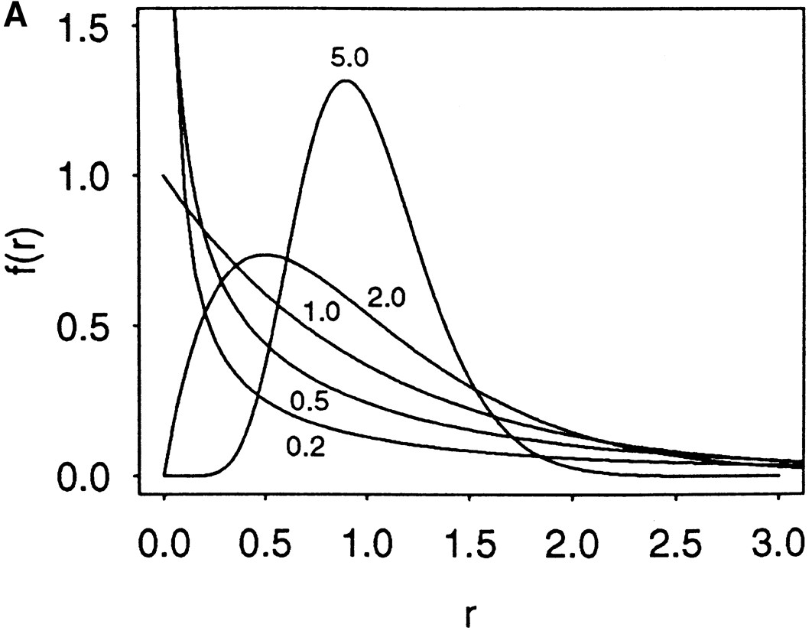

Figure 1. The probability density functions of gamma distributions
Zhang, J. et al. Genetics 1998;149:1615-1625
Copyright © 2007 by the Genetics Society of America

Slide 39
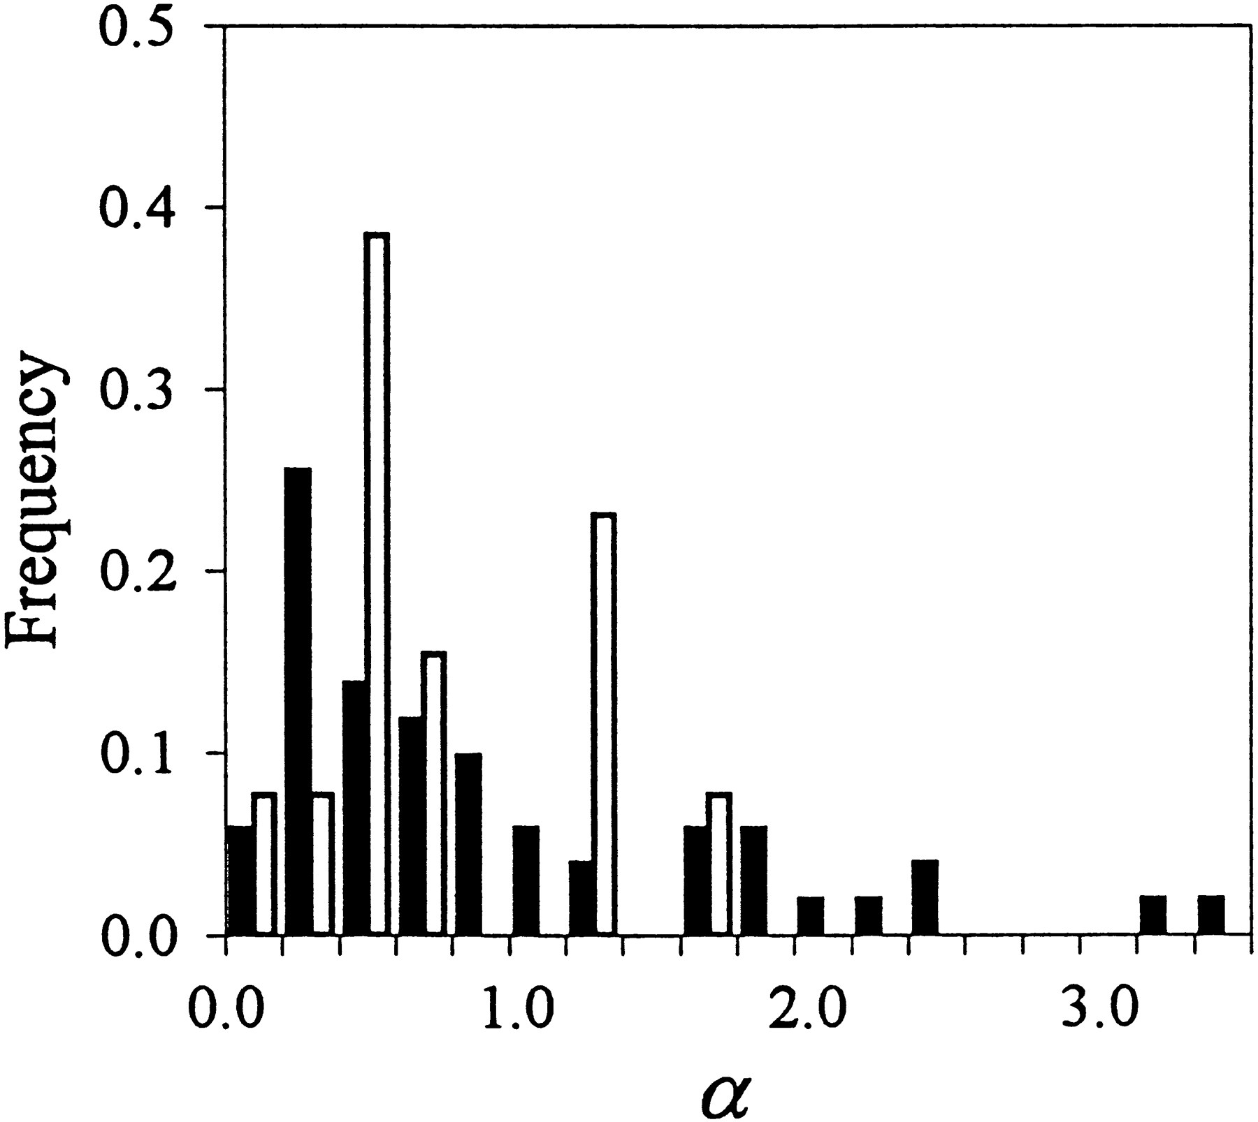
Figure 4. Distributions of the {alpha} values of 51 nuclear (solid histograms) and 13
mitochondrial (open histograms) genes
Zhang, J. et al. Genetics 1998;149:1615-1625
Copyright © 2007 by the Genetics Society of America

Slide 40
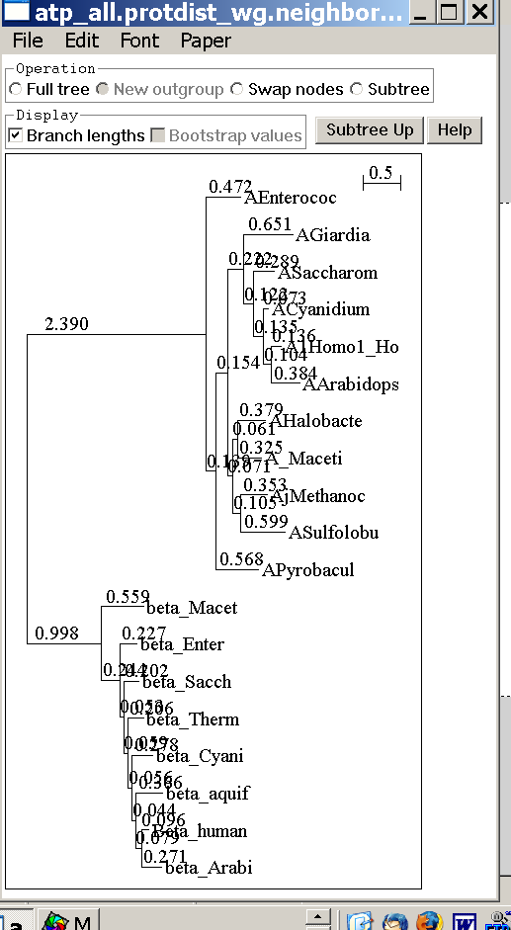
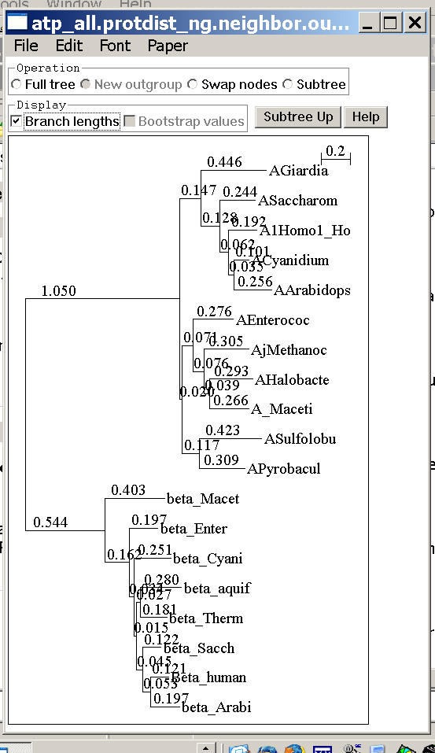
subtree with branch lengths without and with correction for ASRV

Slide 41
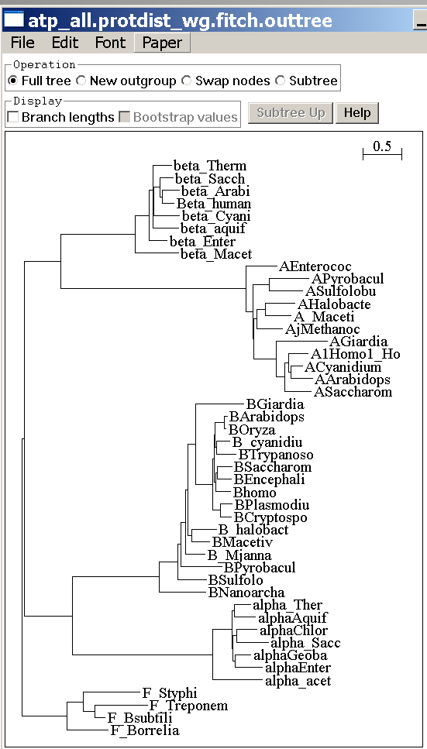
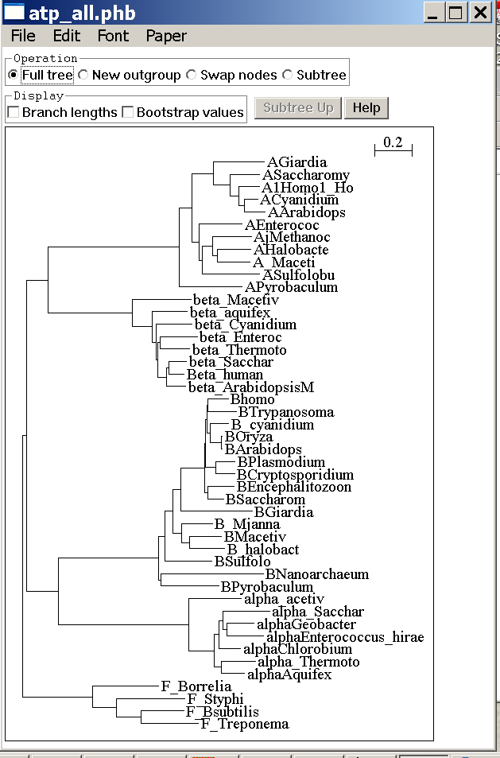
compare to trees with FITCH and clustalw – same dataset

Slide 42
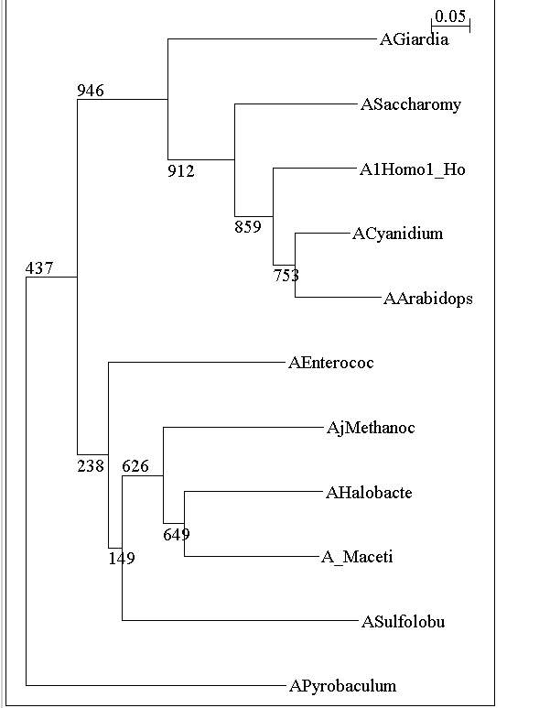
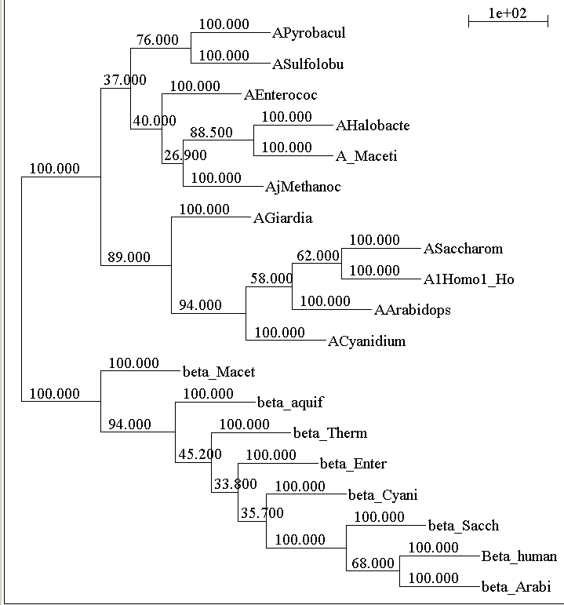
bootstrap support ala clustal protpars (gaps as ?)

Slide 43
phyml
PHYML - A simple, fast, and accurate algorithm to estimate large phylogenies by maximum likelihood
An online interface is here ;
there is a command line version that is described here (not as straight forward as in clustalw);
a phylip like interface is automatically invoked, if you type
“phyml” – the manual is here.
Phyml is installed on bbcxsrv1.
Phyml is part of seaview4

Slide 44

TreePuzzle ne PUZZLE
TREE-PUZZLE is a very versatile maximum likelihood program that is particularly useful to analyze protein sequences. The program was developed by Korbian Strimmer and Arnd von Haseler (then at the Univ. of Munich) and is maintained by von Haseler, Heiko A. Schmidt, and Martin Vingron
(contacts see http://www.tree-puzzle.de/).

Slide 45
TREE-PUZZLE
allows fast and accurate estimation of ASRV (through estimating the shape parameter alpha) for both nucleotide and amino acid sequences,
It has a “fast” algorithm to calculate trees through quartet puzzling (calculating ml trees for quartets of species and building the multispecies tree from the quartets).
The program provides confidence numbers (puzzle support values), which tend to be smaller than bootstrap values (i.e. provide a more conservative estimate),
the program calculates branch lengths and likelihood for user defined trees, which is great if you want to compare different tree topologies, or different models using the maximum likelihood ratio test.
Branches which are not significantly supported are collapsed.
TREE-PUZZLE runs on "all" platforms
TREE-PUZZLE reads PHYLIP format, and communicates with the user in a way similar to the PHYLIP programs.

Slide 46
Maximum likelihood ratio test
If you want to compare two models of evolution (this includes the tree) given a data set, you can utilize the so-called maximum likelihood ratio test.
If L₁ and L₂ are the likelihoods of the two models, d =2(logL₁-logL₂) approximately follows a Chi square distribution with n degrees of freedom. Usually n is the difference in model parameters. I.e., how many parameters are used to describe the substitution process and the tree. In particular n can be the difference in branches between two trees (one tree is more resolved than the other).
In principle, this test can only be applied if on model is a more refined version of the other. In the particular case, when you compare two trees, one calculated without assuming a clock, the other assuming a clock, the degrees of freedom are the number of OTUs – 2 (as all sequences end up in the present at the same level, their branches cannot be freely chosen) .
To calculate the probability you can use the CHISQUARE calculator for windows available from Paul Lewis.

Slide 47
TREE-PUZZLE allows (cont)
TREEPUZZLE calculates distance matrices using the ml specified model. These can be used in FITCH or Neighbor.
PUZZLEBOOT automates this approach to do bootstrap analyses –
WARNING: this is a distance matrix analyses!
The official script for PUZZLEBOOT is here – you need to create a command file (puzzle.cmds), and puzzle needs to be envocable through the command puzzle.
Your input file needs to be the renamed outfile from seqboot
A slightly modified working version of puzzleboot_mod.sh is here, and here is an example for puzzle.cmds . Read the instructions before you run this!
Maximum likelihood mapping is an excellent way to
assess the phylogenetic information contained in a dataset.
ML mapping can be used to calculate the support around one branch.
@@@ Puzzle is cool, don't leave home without it! @@@

Slide 48
TREE-PUZZLE – PROBLEMS/DRAWBACKS
The more species you add the lower the support for individual branches. While this is true for all algorithms, in TREE-PUZZLE this can lead to completely unresolved trees with only a few handful of sequences.
Trees calculated via quartet puzzling are usually not completely resolved, and they do not correspond to the ML-tree:
The determined multi-species tree is not the tree with the highest likelihood, rather it is the tree whose topology is supported through ml-quartets, and the lengths of the resolved branches is determined through maximum likelihood.

Slide 49
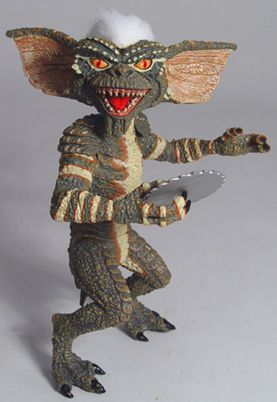
Elliot Sober’s Gremlins
Observation: Loud noise in the attic
?
Hypothesis: gremlins in the attic playing bowling
Likelihood =
P(noise|gremlins in the attic)
P(gremlins in the attic|noise)
?
?

Slide 50

Bayes’ Theorem
Likelihood
describes how well the model predicts the data
P(data|model, I)
P(model|data, I) = P(model, I)
P(data,I)
Posterior
Probability
represents the degree
to which we believe a given model accurately describes the situation
given the available data and all of our prior information I
Prior
Probability
describes the degree to which we believe the model accurately describes reality
based on all of our prior information.
Normalizing
constant
Reverend Thomas Bayes (1702-1761)

Slide 51
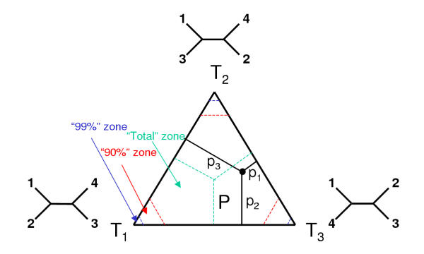
ml mapping
From: Olga Zhaxybayeva and J Peter Gogarten BMC Genomics 2002, 3:4

Slide 52
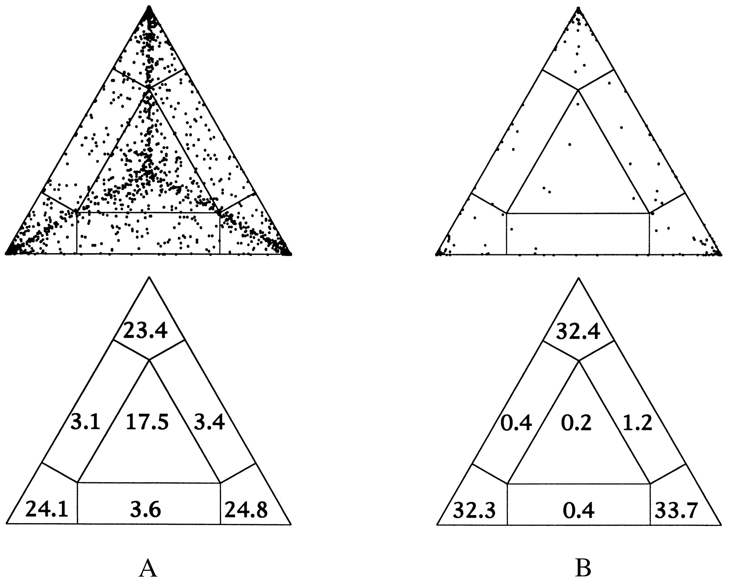
ml mapping
Figure 5. Likelihood-mapping analysis for two biological data sets. (Upper) The distribution patterns. (Lower) The occupancies (in percent) for the seven areas of attraction.
(A) Cytochrome-b data from ref. 14. (B) Ribosomal DNA of major arthropod groups (15).
From: Korbinian Strimmer and Arndt von Haeseler Proc. Natl. Acad. Sci. USA
Vol. 94, pp. 6815-6819, June 1997

Slide 53
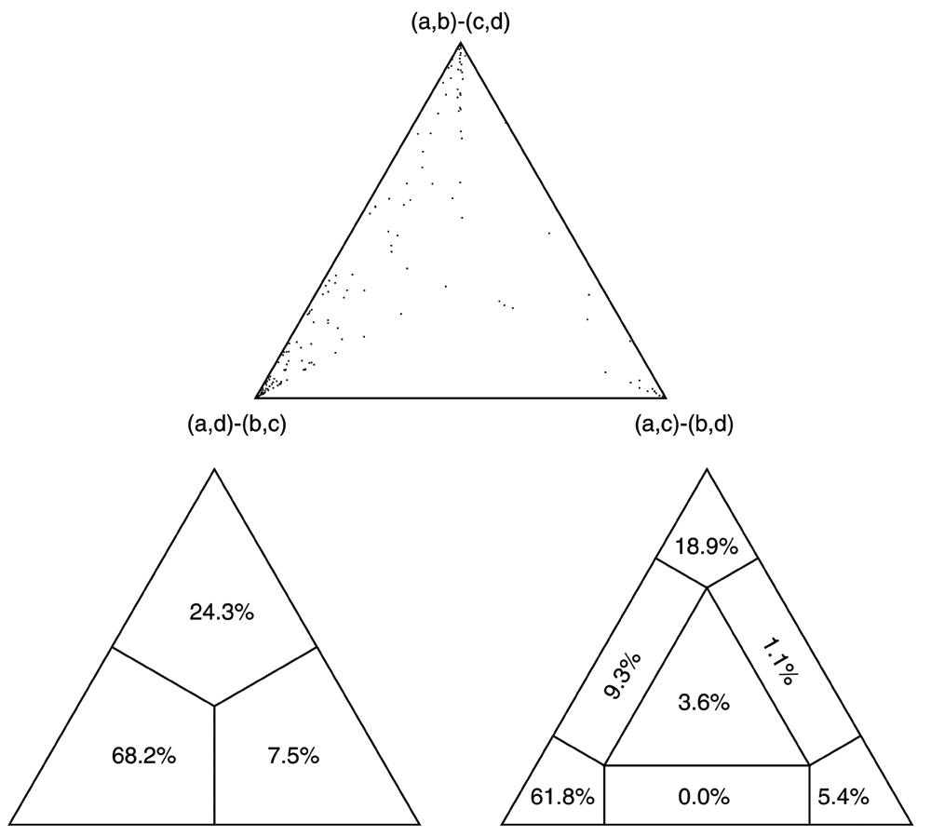
(a,b)-(c,d)
/\
/ \
/ \
/ 1 \
/ \ / \
/ \ / \
/ \/ \
/ 3 : 2 \
/ : \
/__________________\
(a,d)-(b,c) (a,c)-(b,d)
Number of quartets in region 1: 68 (= 24.3%)
Number of quartets in region 2: 21 (= 7.5%)
Number of quartets in region 3: 191 (= 68.2%)
Occupancies of the seven areas 1, 2, 3, 4, 5, 6, 7:
(a,b)-(c,d)
/\
/ \
/ 1 \
/ \ / \
/ /\ \
/ 6 / \ 4 \
/ / 7 \ \
/ \ /______\ / \
/ 3 : 5 : 2 \
/__________________\
(a,d)-(b,c) (a,c)-(b,d)
Number of quartets in region 1: 53 (= 18.9%)
Number of quartets in region 2: 15 (= 5.4%)
Number of quartets in region 3: 173 (= 61.8%)
Number of quartets in region 4: 3 (= 1.1%)
Number of quartets in region 5: 0 (= 0.0%)
Number of quartets in region 6: 26 (= 9.3%)
Number of quartets in region 7: 10 (= 3.6%)
Cluster a: 14 sequences
outgroup (prokaryotes)
Cluster b: 20 sequences
other Eukaryotes
Cluster c: 1 sequences
Plasmodium
Cluster d: 1 sequences
Giardia

Slide 54
Alternative Approaches to Estimate
Posterior Probabilities
Bayesian Posterior Probability Mapping with MrBayes
(Huelsenbeck and Ronquist, 2001)
Problem:
Strimmer’s formula
L_{i}
p_{i}=
only considers 3 trees
(those that maximize the likelihood for
the three topologies)
L₁+L₂+L₃
Solution:
Exploration of the tree space by sampling trees using a biased random walk
(Implemented in MrBayes program)
Trees with higher likelihoods will be sampled more often
N_{i}
p_{i}≈
N_{total}
,where N_{i} - number of sampled trees of topology i, i=1,2,3
N_{total} – total number of sampled trees (has to be large)

Slide 55
Illustration of a biased random walk
Figure generated using MCRobot program (Paul Lewis, 2001)

Slide 56
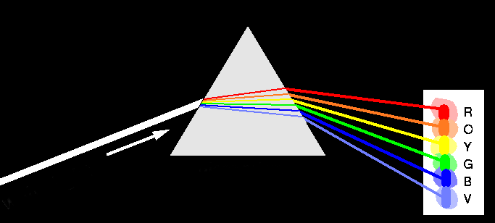
Decomposition of Phylogenetic Data
Phylogenetic information
present in genomes
Break information
into small quanta
of information
(bipartitions or
embedded quartets)
Analyze spectra to detect transferred genes and plurality consensus.

Slide 57

TOOLS TO ANALYZE PHYLOGENETIC INFORMATION FROM MULTIPLE GENES IN GENOMES:
Bipartition Spectra (Lento Plots)

Slide 58
BIPARTITION OF A PHYLOGENETIC TREE
Bipartition (or split) – a division of a phylogenetic tree into two parts that are connected by a single branch.
It divides a dataset into two groups, but it does not consider the relationships within each of the two groups.
Yellow vs Rest
* * * . . . * *
95
compatible to illustrated
bipartition
Orange vs Rest
. . * . . . . *
* * * . . . . .
incompatible to illustrated
bipartition

Slide 59
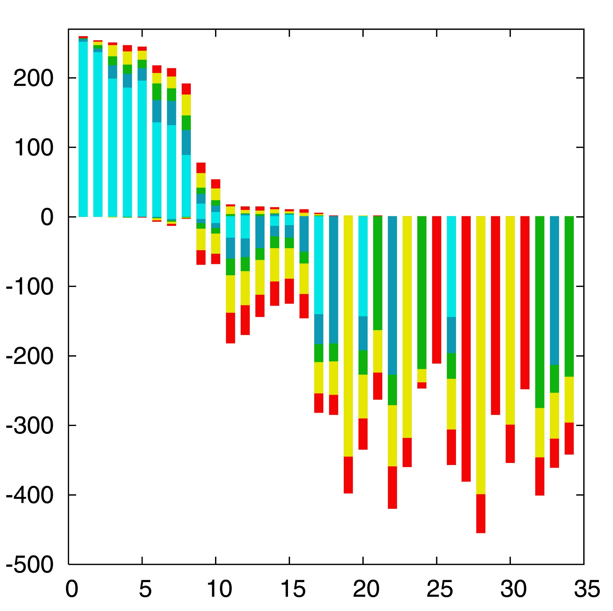

“Lento”-plot of 34 supported bipartitions (out of 4082 possible)
13 gamma-
proteobacterial
genomes
(258 putative
orthologs):
E.coli
Buchnera
Haemophilus
Pasteurella
Salmonella
Yersinia pestis
(2 strains)
Vibrio
Xanthomonas
(2 sp.)
Pseudomonas
Wigglesworthia
There are 13,749,310,575 possible unrooted tree topologies for 13 genomes

Slide 60
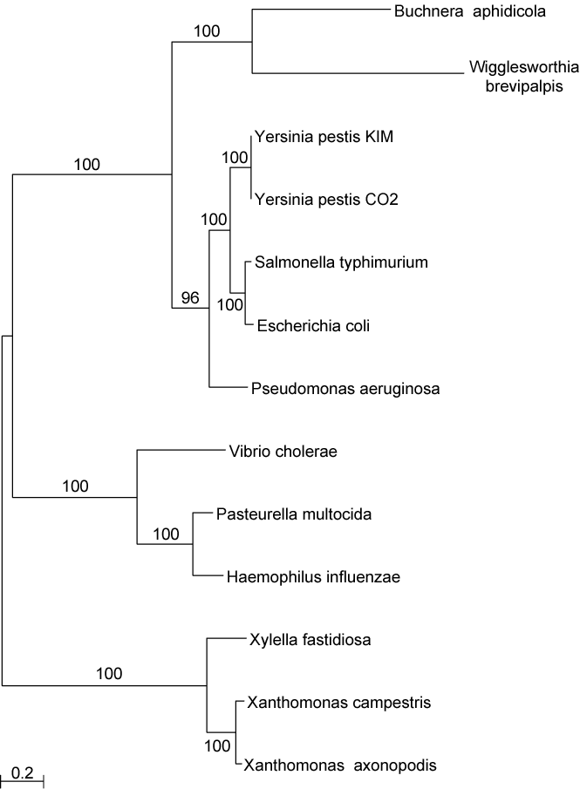
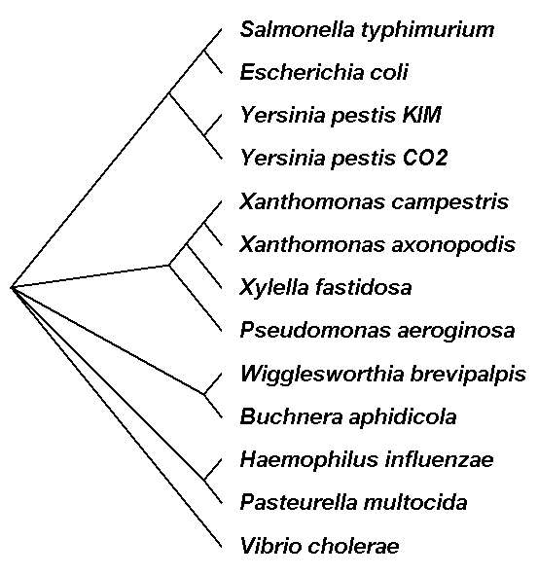
Consensus clusters of eight significantly supported bipartitions
Phylogeny of putatively transferred gene
(virulence factor homologs (mviN))
only 258 genes analyzed

Slide 61
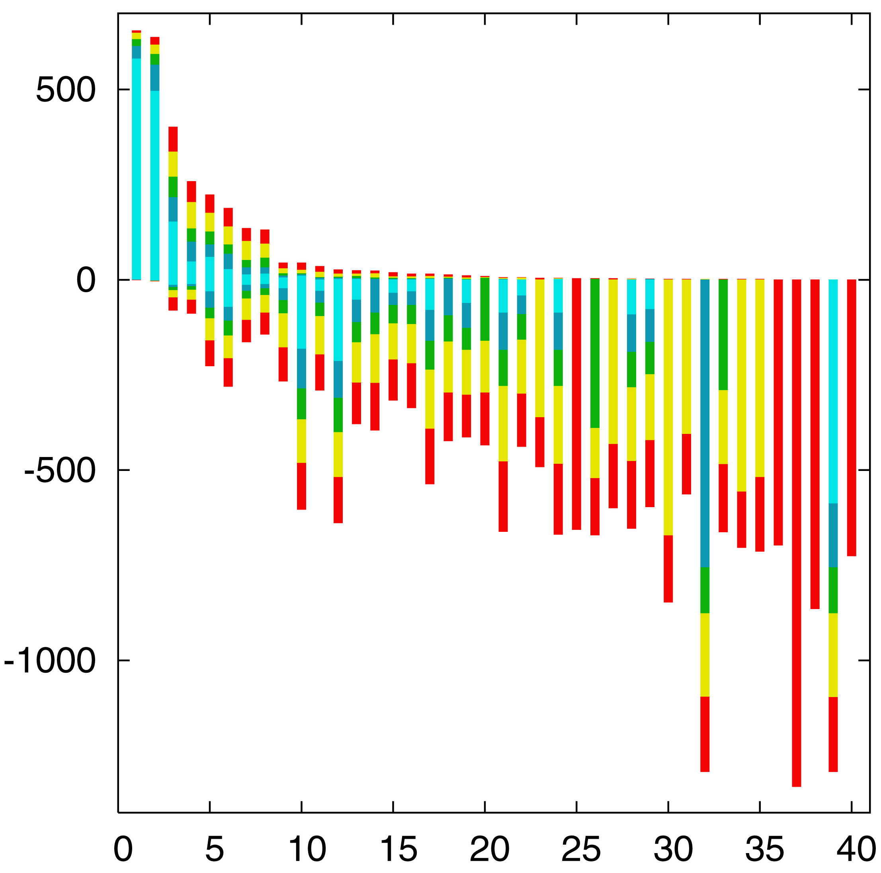

“Lento”-plot of supported bipartitions (out of 501 possible)
10 cyanobacteria:
Anabaena
Trichodesmium
Synechocystis sp.
Prochlorococcus
marinus
(3 strains)
Marine
Synechococcus
Thermo-
synechococcus
elongatus
Gloeobacter
Nostoc
punctioforme
Number of datasets
Based on 678 sets of orthologous genes
Zhaxybayeva, Lapierre and Gogarten, Trends in Genetics, 2004, 20(5): 254-260.

Slide 62
PROBLEMS WITH BIPARTITIONS (A)
A single rogue sequence that moves from one end of a Hennigian comb to the other changes all bipartition
bipartitions
embedded quartets

Slide 63
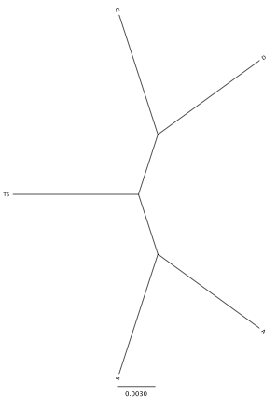
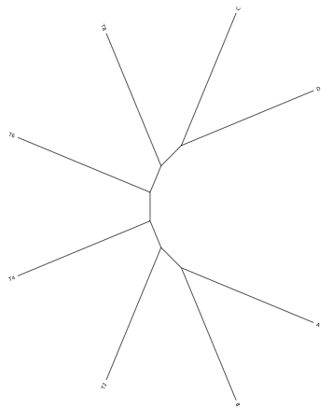
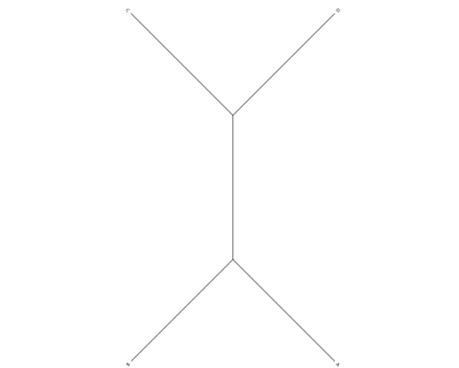
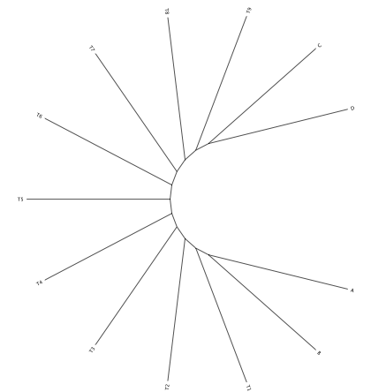
Decay of bipartition support with number of OTUs
Phylogenies used for simulation
Notes:
Same model (WAG +Gamma) used for simulation and evaluation (including alpha =1). Simulation of sequences with lenghts of 200, 500 and 1000 using seq-gen.

Slide 64
Example for decay of bipartition support with number of OTUs
Sequence
lengths
C
D
C
D
C
D
C
D
200
89
74
70
A
B
A
B
A
B
A
B
C
D
C
D
C
D
C
D
500
71
86
99
94
74
100
73
92
A
B
A
B
A
B
71
A
B
C
D
C
D
C
D
C
D
72
100
90
1000
79
87
100
100
91
98
87
A
B
A
B
94
B
A
A
B
Only branches with better than 70% bootstrap support are shown
Notes:
Each row gives the result for one simulation, done with 9 additional sequences emerging equally far apart on the central branch. In the analyses on the left, all, 8 or 5 of these additional sequences were omitted.

Slide 65
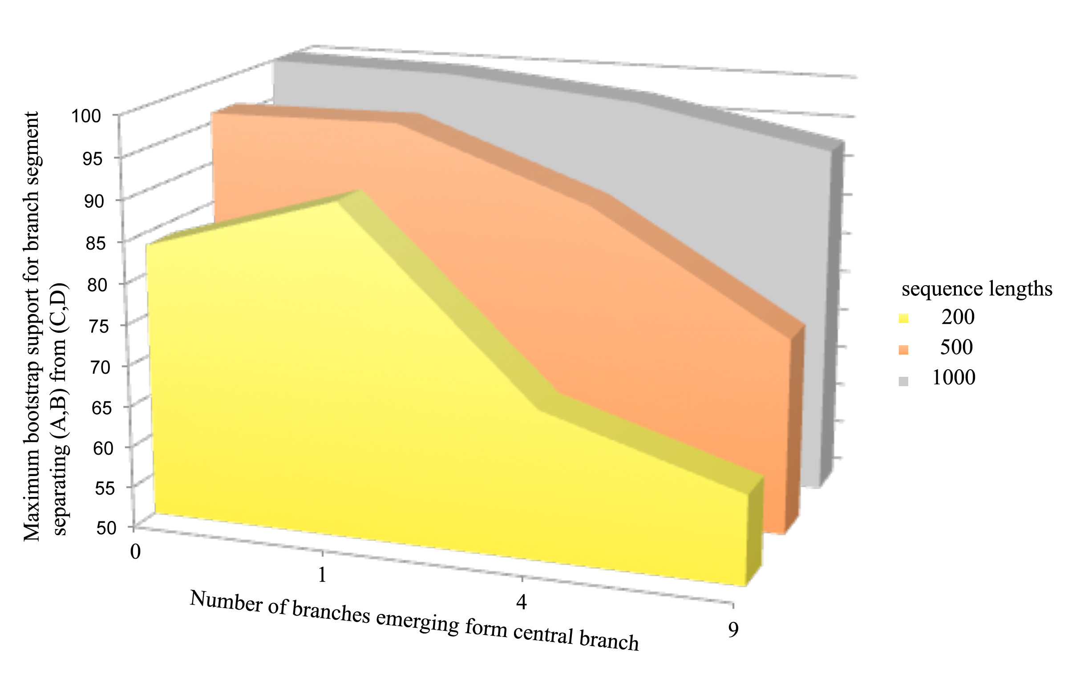
Decay of bipartition support with number of OTUs
Each value is the average of 10 simulations using seq-gen.
Simulated sequences were evaluated using PHYML.
Model for simulation and evaluation WAG + Γ(α=1, 4 rate categories)
Notes:
Can we add SE bars?
Would be good to have more simulations.
Would be good to evaluate in phylip (don’t trust phyml)

Slide 66
Bipartition Paradox:
The more sequences are added, the lower the support for bipartitions that include all sequences. The more data one uses, the lower the bootstrap support values become.
This paradox disappears when only embedded splits for 4 sequences are considered.

Slide 67
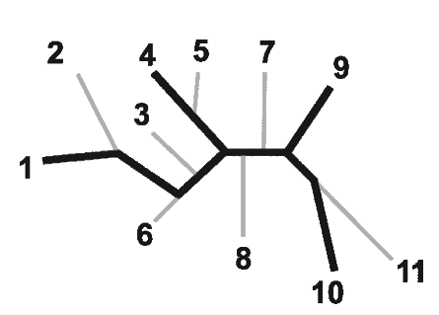
Bootstrap support values for embedded quartets
+
: tree calculated from one pseudo-sample generated by bootstraping from an alignment of one gene family present in 11 genomes
: embedded quartet for genomes
1, 4, 9, and 10 .
This bootstrap sample supports the topology ((1,4),9,10).
1
9
1
9
1
10
4
√
10
10
4
9
4
Zhaxybayeva et al. 2006, Genome Research, 16(9):1099-108
Quartet spectral analyses of genomes iterates over three loops:
Repeat for all bootstrap samples.
Repeat for all possible embedded quartets.
Repeat for all gene families.

Slide 68
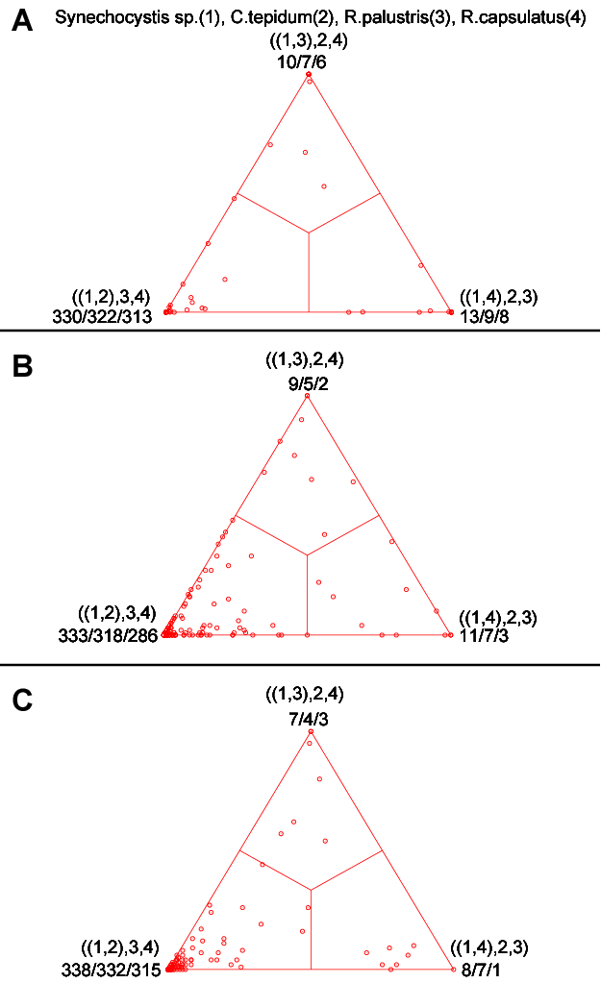
COMPARISON OF DIFFERENT SUPPORT MEASURES
A: mapping of posterior probabilities according to Strimmer and von Haeseler
B: mapping of bootstrap support values
C: mapping of bootstrap support values from extended datasets
Zhaxybayeva and Gogarten, BMC Genomics 2003 4: 37

Slide 69
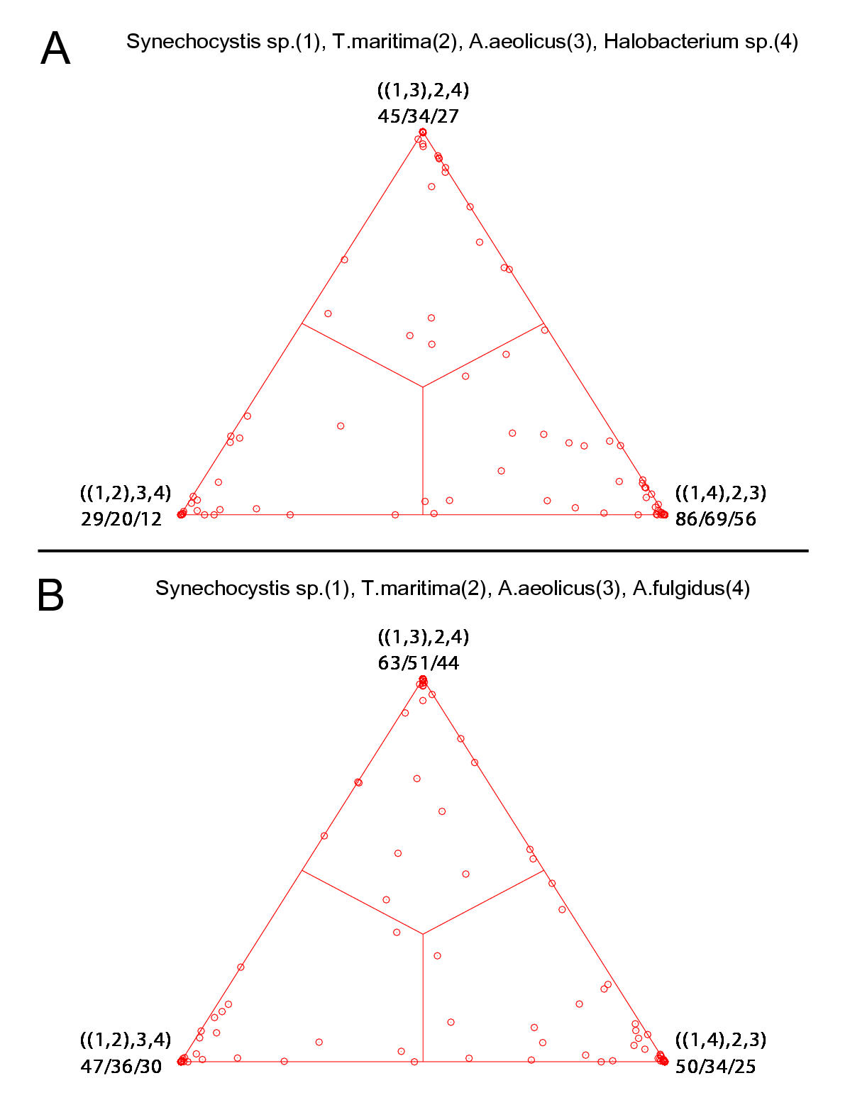
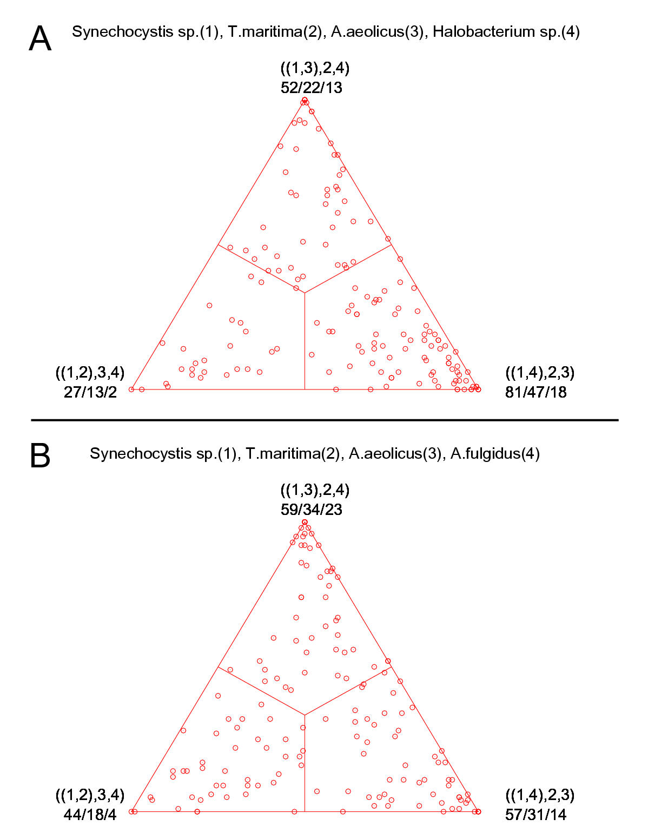
bootstrap values from extended datasets
ml-mapping
versus
More gene families group species according to environment than according to 16SrRNA phylogeny
In contrast, a themophilic archaeon has more genes grouping with the thermophilic bacteria

Slide 70
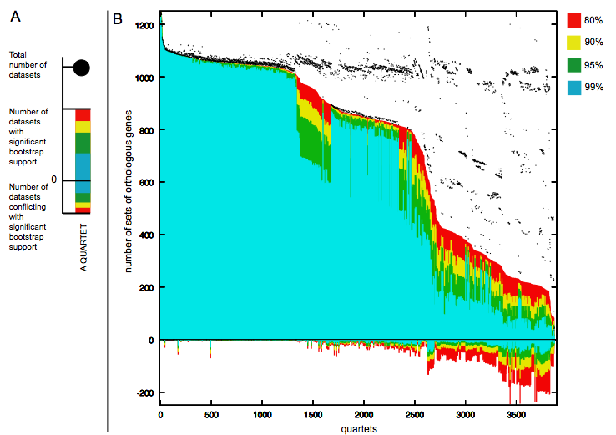
Quartet decomposition analysis of 19 Prochlorococcus and marine Synechococcus genomes. Quartets with a very short internal branch or very long external branches as well those resolved by less than 30% of gene families were excluded from the analyses to minimize artifacts of phylogenetic reconstruction.

