Slide 1
MCB 5472
Types of selection
Peter Gogarten
Office: BSP 404
phone: 860 486-4061,
Email: gogarten@uconn.edu

Slide 2
Old assignment
Write script from exam
Work of Student project

Slide 3
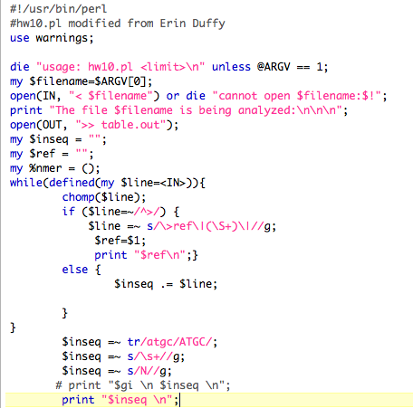
Simple: dinucleotide sequence from single nucleotide sequence
Part I: Reading data

Slide 4
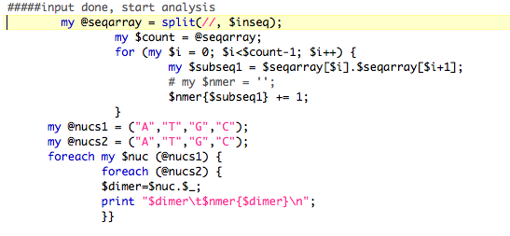
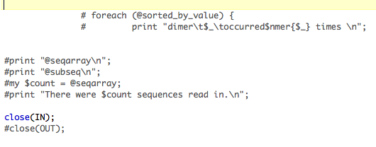
Simple: dinucleotide sequence from single nucleotide sequence
Part 2: Analyzing data

Slide 5
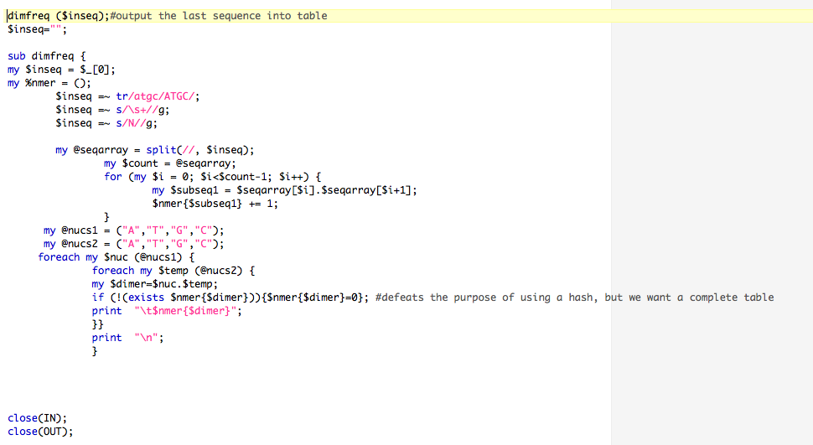
Subroutine: dinucleotide sequence from single nucleotide sequence

Slide 6
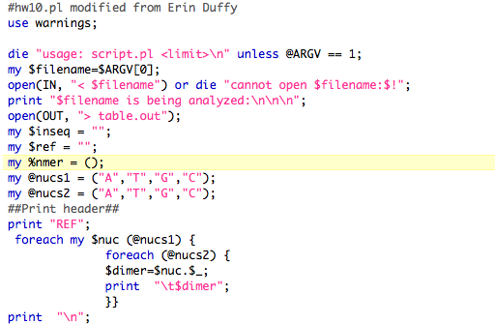
Analyze file with multiple ORFs
Part 1: Open file and print header
Add OUT to print to file

Slide 7
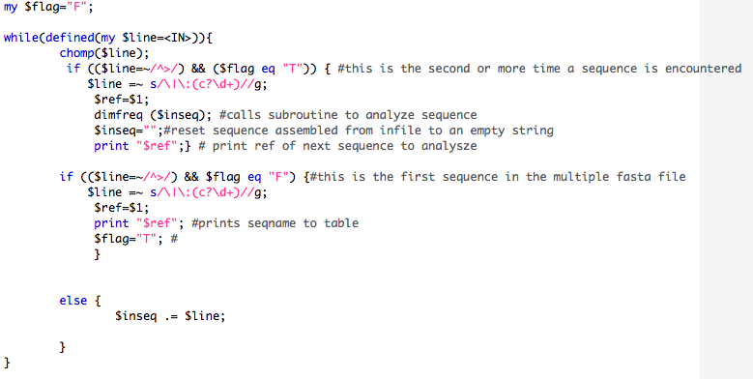
Analyze file with multiple ORFs
Part 2: Program Flow
dimfreq also prints to OUT

Slide 8
Subroutine: dinucleotide sequence from single nucleotide sequence

Slide 9
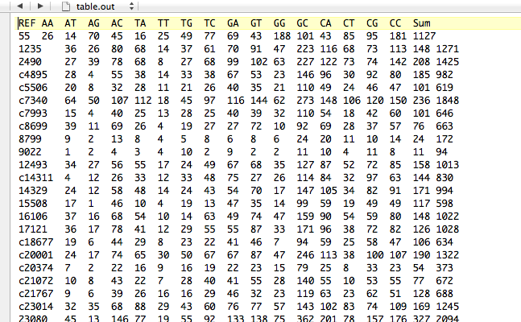
Table.out in text editor

Slide 10
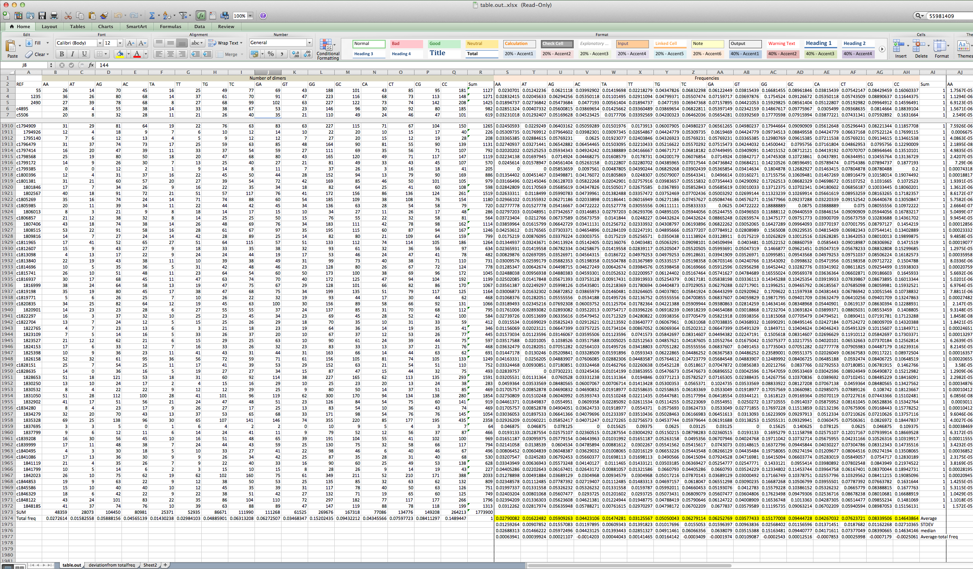
Table.out in excel

Slide 11
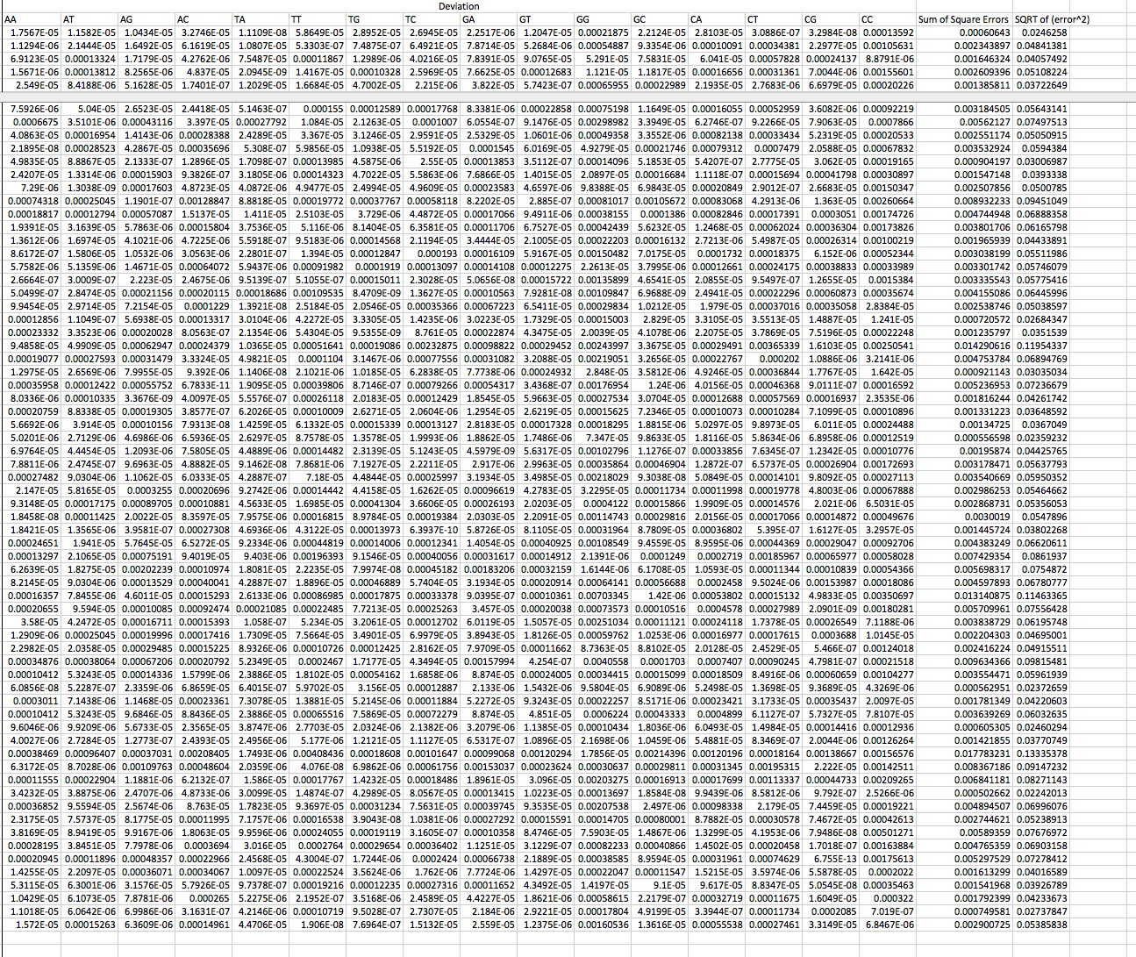
Table.out in excel

Slide 12
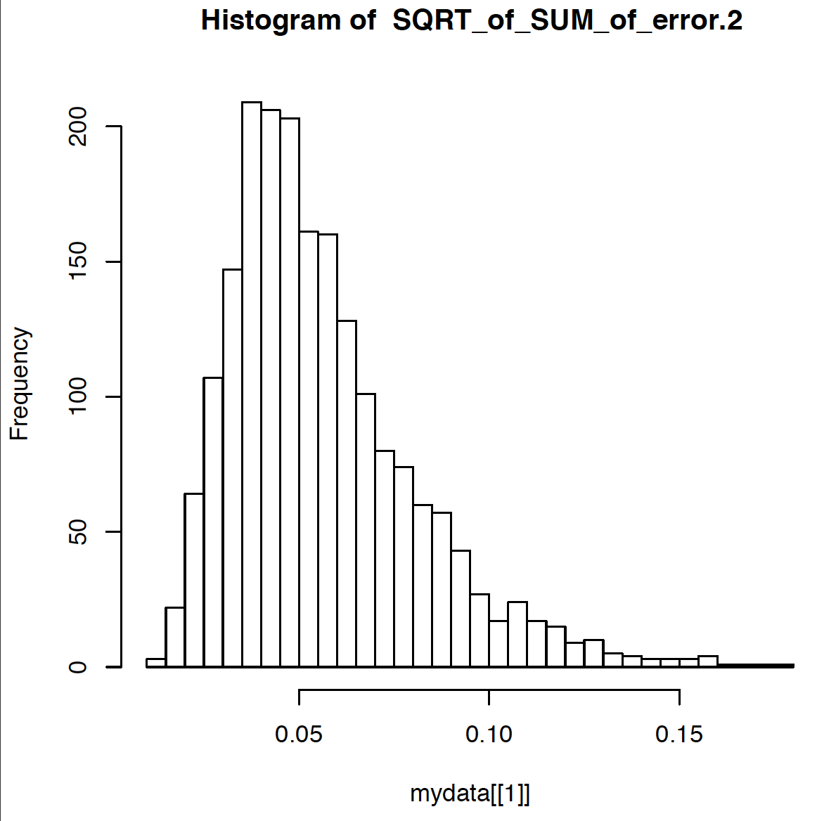

Slide 13
Illustration of a biased random walk
Figure generated using MCRobot program (Paul Lewis, 2001)

Slide 14
the gradualist point of view
Evolution occurs within populations where the fittest organisms have a selective advantage. Over time the advantages genes become fixed in a population and the population gradually changes.
This reasoning (with many more details) is known as the modern synthesis.
Note: this is not in contradiction to the the theory of neutral evolution. (which says what ?)
Processes that MIGHT go beyond inheritance with variation and selection?
  Horizontal gene transfer and recombination
  Polyploidization (botany, vertebrate evolution) see here
  Fusion and cooperation of organisms (Kefir, lichen, also the eukaryotic cell)
  Targeted mutations (?), genetic memory (?) (see Foster's and Hall's reviews on directed/adaptive mutations; see here for a counterpoint)
  Random genetic drift
  Gratuitous complexity
  Selfish genes (who/what is the subject of evolution??)
  Parasitism, altruism, Morons
  Mutationism, hopeful monsters (see here for a critical discussion by Arlin Stolzfus)

Slide 15
selection versus drift
see Kent Holsinger’s java simulations at
http://darwin.eeb.uconn.edu/simulations/simulations.html
The law of the gutter.
compare drift versus select + drift
The larger the population the longer it takes for an allele to become fixed.
Note: Even though an allele conveys a strong selective advantage of 10%, the allele has a rather large chance to go extinct.
Note#2: Fixation is faster under selection than under drift.

Slide 16
s=0
Probability of fixation, P, is equal to frequency of allele in population. Mutation rate (per gene/per unit of time) = u ;
freq. with which allele is generated in diploid population size N: u*2N
Probability of fixation for each allele = 1/(2N)
Substitution rate (the rate with which mutations are fixed in a lineage) =
frequency with which new alleles are generated * Probability of fixation= u*2N *1/(2N) = u
Therefore:
If f s=0, the substitution rate is independent of population size, and equal to the mutation rate !!!!
This is the reason that there is hope that the molecular clock might sometimes work.
Fixation time due to drift alone:
t_{av}=4*N_{e} generations
(N_{e}=effective population size; For n discrete generations
N_{e}= n/(1/N₁+1/N₂+…..1/N_{n})

Slide 17
s>0
Time till fixation on average:
t_{av}= (2/s) ln (2N) generations
(also true for mutations with negative “s” ! discuss among yourselves)
E.g.: N=10⁶,
s=0: average time to fixation: 4*10⁶ generations
s=0.01: average time to fixation: 2900 generations
N=10⁴,
s=0: average time to fixation: 40.000 generations
s=0.01: average time to fixation: 1.900 generations
=> substitution rate of mutation under positive selection is larger than the rate wite which neutral mutations are fixed.

Slide 18
Random Genetic Drift
Selection
100
advantageous
Allele frequency
disadvantageous
0
Modified from from www.tcd.ie/Genetics/staff/Aoife/GE3026/GE3026_1+2.ppt

Slide 19
Positive selection
A new allele (mutant) confers some increase in the fitness of the organism
Selection acts to favour this allele
Also called adaptive selection or Darwinian selection.
NOTE: Fitness = ability to survive and reproduce
Modified from from www.tcd.ie/Genetics/staff/Aoife/GE3026/GE3026_1+2.ppt

Slide 20
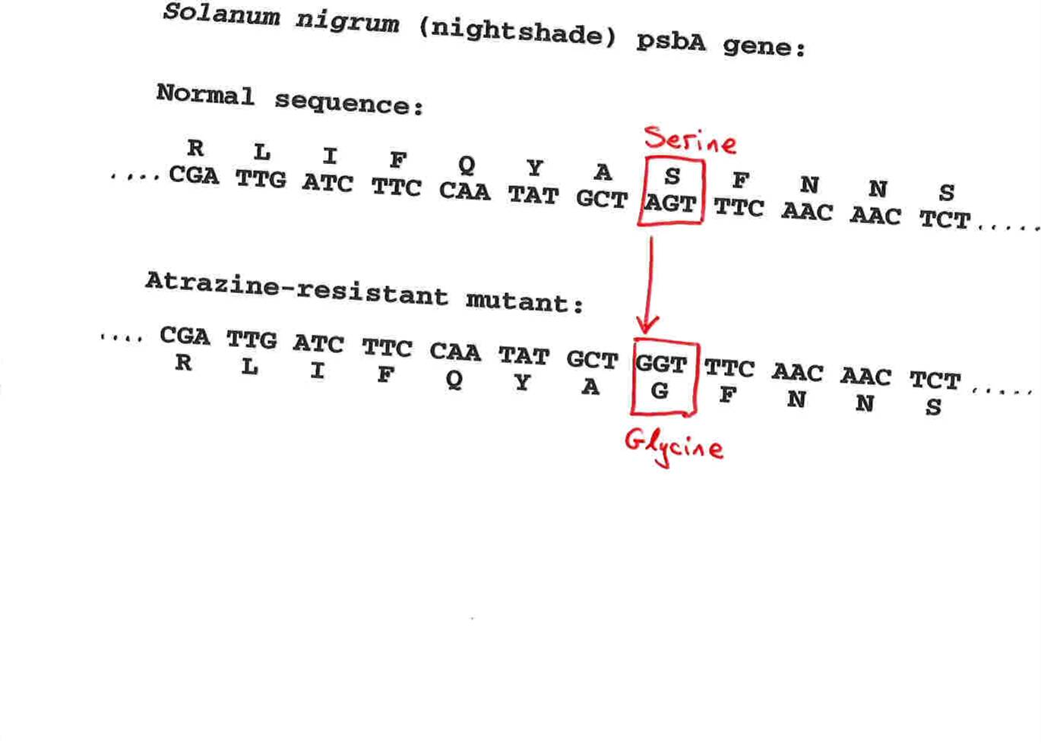
Advantageous allele
Herbicide resistance gene in nightshade plant
Modified from from www.tcd.ie/Genetics/staff/Aoife/GE3026/GE3026_1+2.ppt

Slide 21
Negative selection
A new allele (mutant) confers some decrease in the fitness of the organism
Selection acts to remove this allele
Also called purifying selection
Modified from from www.tcd.ie/Genetics/staff/Aoife/GE3026/GE3026_1+2.ppt

Slide 22
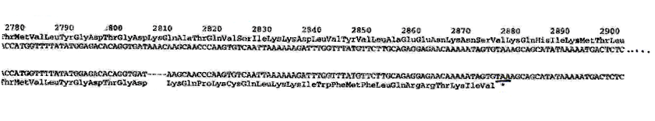
Deleterious allele
Human breast cancer gene, BRCA2
5% of breast cancer cases are familial
Mutations in BRCA2 account for 20% of familial cases
Normal (wild type) allele
Mutant allele
(Montreal 440
Family)
Stop codon
4 base pair deletion
Causes frameshift
Modified from from www.tcd.ie/Genetics/staff/Aoife/GE3026/GE3026_1+2.ppt

Slide 23
Neutral mutations
Neither advantageous nor disadvantageous
Invisible to selection (no selection)
Frequency subject to ‘drift’ in the population
Random drift – random changes in small populations

Slide 24
Types of Mutation-Substitution
Replacement of one nucleotide by another
Synonymous (Doesn’t change amino acid)
  Rate sometimes indicated by Ks
  Rate sometimes indicated by d_{s}
Non-Synonymous (Changes Amino Acid)
  Rate sometimes indicated by Ka
  Rate sometimes indicated by d_{n}
(this and the following 4 slides are from
mentor.lscf.ucsb.edu/course/ spring/eemb102/lecture/Lecture7.ppt)

Slide 25
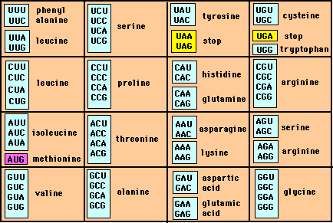
Genetic Code – Note degeneracy of 1st vs 2nd vs 3rd position sites

Slide 26
Genetic Code
Four-fold degenerate site – Any substitution is synonymous
From: mentor.lscf.ucsb.edu/course/spring/eemb102/lecture/Lecture7.ppt

Slide 27
Genetic Code
Two-fold degenerate site – Some substitutions synonymous, some
non-synonymous
From: mentor.lscf.ucsb.edu/course/spring/eemb102/lecture/Lecture7.ppt

Slide 28
Measuring Selection on Genes
Null hypothesis = neutral evolution
Under neutral evolution, synonymous changes should accumulate at a rate equal to mutation rate
Under neutral evolution, amino acid substitutions should also accumulate at a rate equal to the mutation rate
From: mentor.lscf.ucsb.edu/course/spring/eemb102/lecture/Lecture7.ppt

Slide 29
Counting #s/#a
Ser Ser Ser Ser Ser
Species1 TGA TGC TGT TGT TGT
Ser Ser Ser Ser Ala
Species2 TGT TGT TGT TGT GGT
#s = 2 sites
#a = 1 site
#a/#s=0.5
To assess selection pressures one needs to calculate the rates (Ka, Ks), i.e. the occurring substitutions as a fraction of the possible syn. and nonsyn. substitutions.
Things get more complicated, if one wants to take transition transversion ratios and codon bias into account. See chapter 4 in Nei and Kumar, Molecular Evolution and Phylogenetics.
Modified from: mentor.lscf.ucsb.edu/course/spring/eemb102/lecture/Lecture7.ppt

Slide 30
dambe
Two programs worked well for me to align nucleotide sequences based on the amino acid alignment,
One is DAMBE (only for windows). This is a handy program for a lot of things, including reading a lot of different formats, calculating phylogenies, it even runs codeml (from PAML) for you.
The procedure is not straight forward, but is well described on the help pages. After installing DAMBE go to HELP -> general HELP -> sequences -> align nucleotide sequences based on …->
If you follow the instructions to the letter, it works fine.
DAMBE also calculates Ka and Ks distances from codon based aligned sequences.

Slide 31
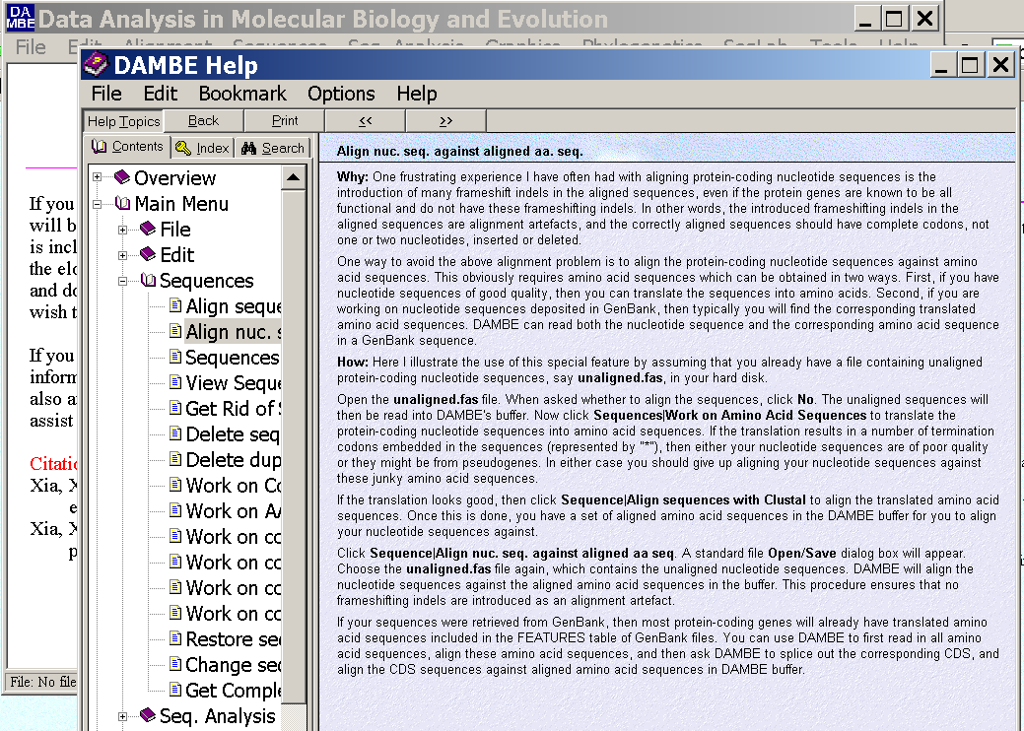
dambe (cont)

Slide 32
aa based nucleotide alignments (cont)
An alternative is the tranalign program that is part of the emboss package. On bbcxsrv1 you can invoke the program by typing tranalign.
Instructions and program description are here .
If you want to use your own dataset in the lab on Monday, generate a codon based alignment with either dambe or tranalign and save it as a nexus file and as a phylip formated multiple sequence file (using either clustalw, PAUP (export or tonexus), dambe, or readseq on the web)

Slide 33
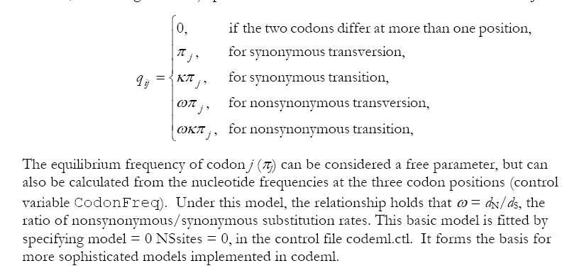
PAML (codeml) the basic model

Slide 34

sites versus branches
You can determine omega for the whole dataset; however, usually not all sites in a sequence are under selection all the time.
PAML (and other programs) allow to either determine omega for each site over the whole tree, ,
or determine omega for each branch for the whole sequence,
.
It would be great to do both, i.e., conclude codon 176 in the vacuolar ATPases was under positive selection during the evolution of modern humans – alas, a single site does not provide any statistics ….

Slide 35
Sites model(s)
work great have been shown to work great in few instances.
The most celebrated case is the influenza virus HA gene.
A talk by Walter Fitch (slides and sound) on the evolution of
this molecule is here .
This article by Yang et al, 2000 gives more background on ml aproaches to measure omega. The dataset used by Yang et al is here: flu_data.paup .

Slide 36
sites model in MrBayes
The MrBayes block in a nexus file might look something like this:
begin mrbayes;
set autoclose=yes;
lset nst=2 rates=gamma nucmodel=codon omegavar=Ny98;
mcmcp samplefreq=500 printfreq=500;
mcmc ngen=500000;
sump burnin=50;
sumt burnin=50;
end;

Slide 37
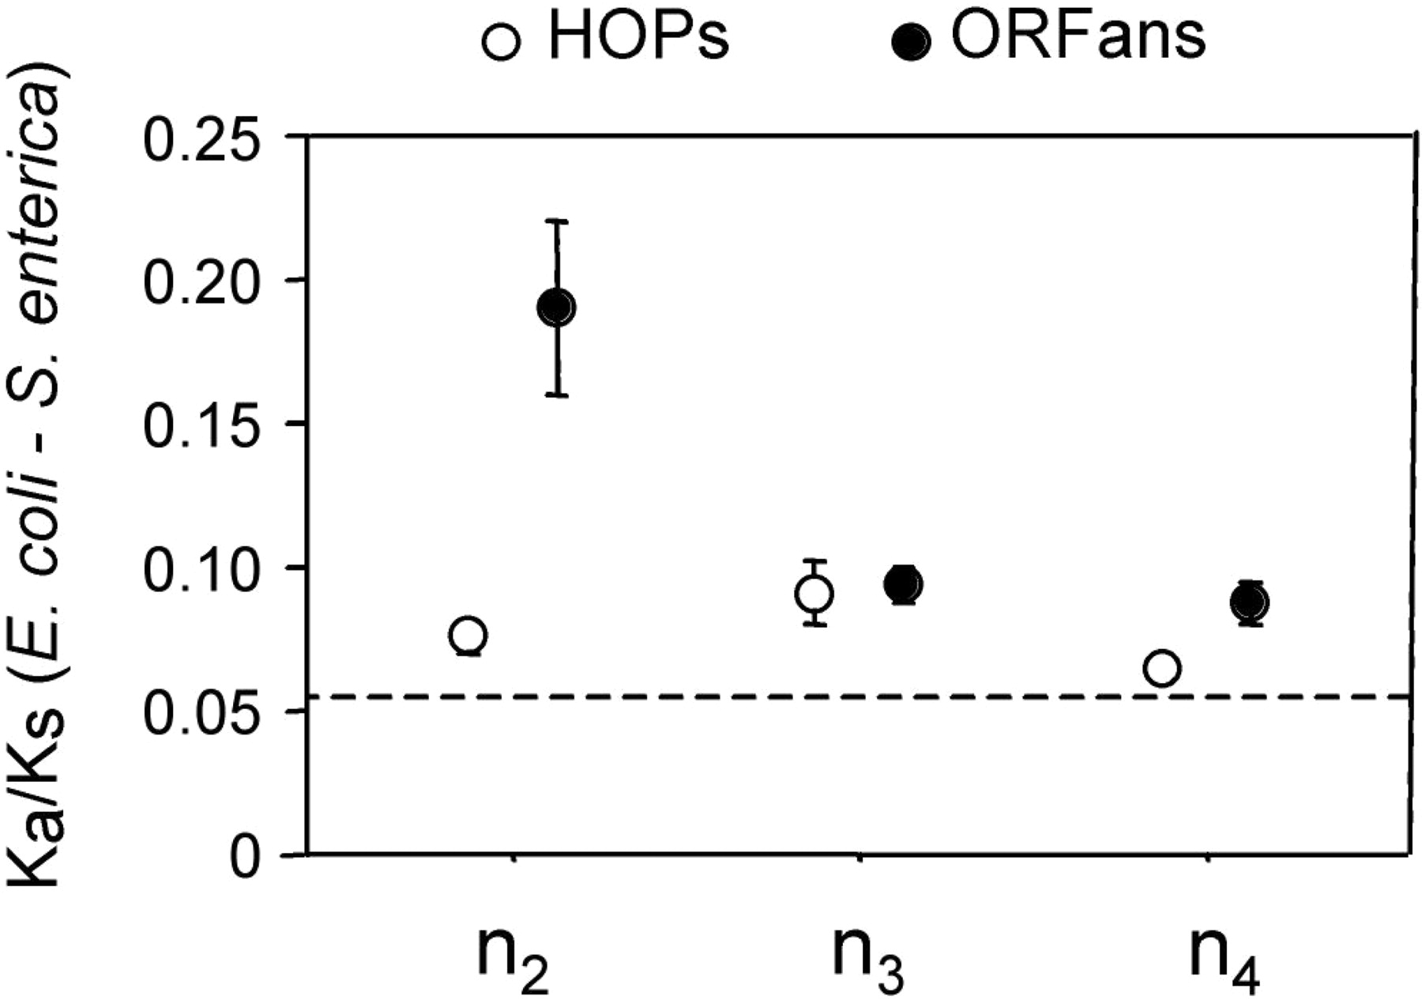
Vincent Daubin and Howard Ochman: Bacterial Genomes as New Gene Homes: The Genealogy of ORFans in E. coli. Genome Research 14:1036-1042, 2004
The ratio of non-synonymous to synonymous substitutions for genes found only in the E.coli - Salmonella clade is lower than 1, but larger than for more widely distributed genes.
Fig. 3 from Vincent Daubin and Howard Ochman, Genome Research 14:1036-1042, 2004

Slide 38

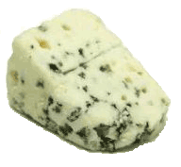
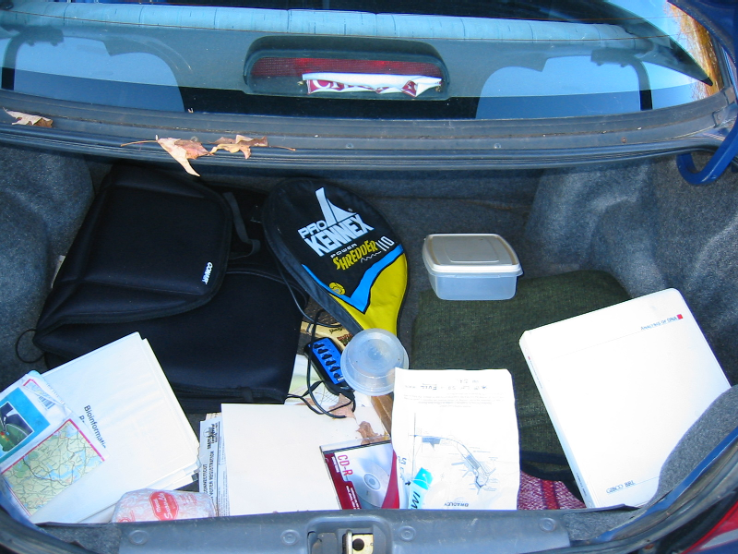
Trunk-of-my-car analogy: Hardly anything in there is the is the result of providing a selective advantage. Some items are removed quickly (purifying selection), some are useful under some conditions, but most things do not alter the fitness.
Could some of the inferred purifying selection be due to the acquisition of novel detrimental characteristics (e.g., protein toxicity)?

Slide 39
MrBayes analyzing the *.nex.p file
The easiest is to load the file into excel (if your alignment is too long, you need to load the data into separate spreadsheets – see here execise 2 item 2 for more info)
plot LogL to determine which samples to ignore
for each codon calculate the the average probability (from the samples you do not ignore) that the codon belongs to the group of codons with omega>1.
plot this quantity using a bar graph.

Slide 40
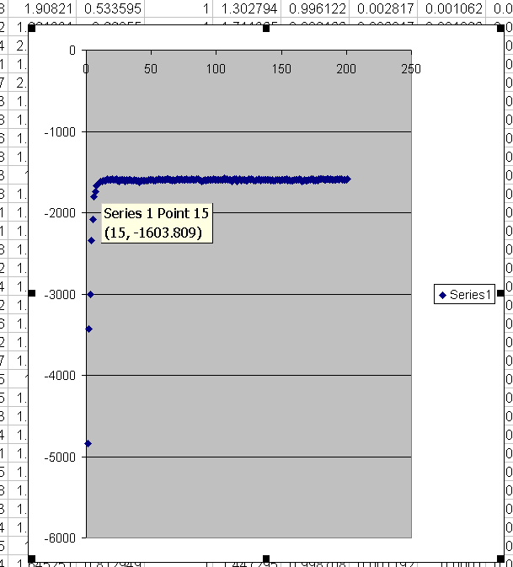
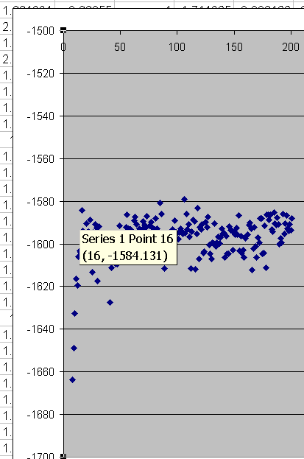
plot LogL to determine which samples to ignore
the same after rescaling the y-axis

Slide 41
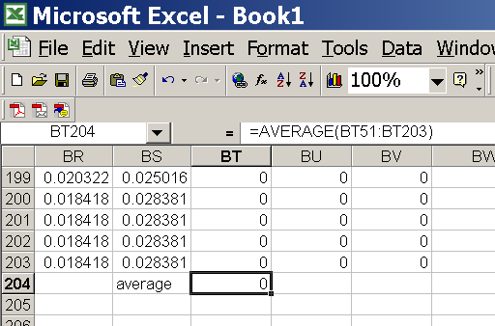
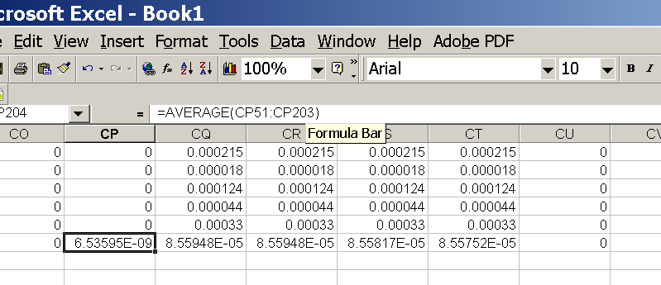
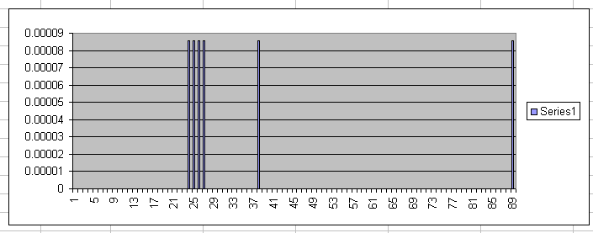
for each codon calculate the the average probability
copy paste formula
plot row
enter formula

Slide 42
MrBayes on bbcxrv1
If you do this for your own data,
run the procedure first for only 50000 generations (takes about 30 minutes) to check that everthing works as expected,
then run the program overnight for at least 500 000 generations.
Especially, if you have a large dataset, do the latter twice and compare the results for consistency. ( I prefer two runs over 500000 generations each over one run over a million generations.)
The preferred wa to run mrbayes is to use the command line:
>mb
Do example on threonlyRS

Slide 43
PAML – codeml – sites model
the paml package contains several distinct programs for nucleotides (baseml) protein coding sequences and amino acid sequences (codeml) and to simulate sequences evolution.
The input file needs to be in phylip format.
By default it assumes a sequential format (e.g. here).
If the sequences are interleaved, you need to add an “I” to the first line, as in these example headers:
6 467 I
gi|1613157 ---------- MSDNDTIVAQ ATPPGRGGVG ILRISGFKAR EVAETVLGKL
gi|2212798 ---------- MSTTDTIVAQ ATPPGRGGVG ILRVSGRAAS EVAHAVLGKL
gi|1564003 MALIQSCSGN TMTTDTIVAQ ATAPGRGGVG IIRVSGPLAA HVAQTVTGRT
gi|1560076 ---------M QAATETIVAI ATAQGRGGVG IVRVSGPLAG QMAVAVSGRQ
gi|2123365 -----MN--- -ALPSTIVAI ATAAGTGGIG IVRLSGPQSV QIAAALGIAG
gi|1583936 -----MSQRS TKMGDTIAAI ATASGAAGIG IIRLSGSLIK TIATGLGMTT
PKPRYADYLP FKDADGSVLD QGIALWFPGP NSFTGEDVLE LQGHGGPVIL
PKPRYADYLP FKDVDGSTLD QGIALYFPGP NSFTGEDVLE LQGHGGPVIL
LRPRYAEYLP FTDEDGQQLD QGIALFFPNP HSFTGEDVLE LQGHGGPVVM
LKARHAHYGP FLDAGGQVID EGLSLYFPGP NSFTGEDVLE LQGHGGPVVL
LQSRHARYAR FRDAQGEVID DGIAVWFPAP HSFTGEEVVE LQGHGSPVLL
LRPRYAHYTR FLDVQDEVID DGLALWFPAP HSFTGEDVLE LQGHGSPLLL
5 855 I
human
goat-cow
rabbit
rat
marsupial
1
GTG CTG TCT CCT GCC GAC AAG ACC AAC GTC AAG GCC GCC TGG GGC AAG GTT GGC GCG CAC
... ... ... G.C ... ... ... T.. ..T ... ... ... ... ... ... ... ... ... .GC A..
... ... ... ..C ..T ... ... ... ... A.. ... A.T ... ... .AA ... A.C ... AGC ...
... ..C ... G.A .AT ... ..A ... ... A.. ... AA. TG. ... ..G ... A.. ..T .GC ..T
... ..C ..G GA. ..T ... ... ..T C.. ..G ..A ... AT. ... ..T ... ..G ..A .GC ...
61
GCT GGC GAG TAT GGT GCG GAG GCC CTG GAG AGG ATG TTC CTG TCC TTC CCC ACC ACC AAG
... ..A .CT ... ..C ..A ... ..T ... ... ... ... ... ... AG. ... ... ... ... ...
.G. ... ... ... ..C ..C ... ... G.. ... ... ... ... T.. GG. ... ... ... ... ...
.G. ..T ..A ... ..C .A. ... ... ..A C.. ... ... ... GCT G.. ... ... ... ... ...
..C ..T .CC ..C .CA ..T ..A ..T ..T .CC ..A .CC ... ..C ... ... ... ..T ... ..A

Slide 44
PAML – codeml – sites model (cont.)
the program is invoked by typing codeml followed by the name of a control file that tells the program what to do.
paml can be used to find the maximum likelihood tree, however, the program is rather slow. Phyml is a better choice to find the tree, which then can be used as a user tree.
An example for a codeml.ctl file is codeml.hv1.sites.ctl
This file directs codeml to run three different models:
one with an omega fixed at 1, a second where each site can be either have an omega between 0 and 1, or an omega of 1, and third a model that uses three omegas as described before for MrBayes.
The output is written into a file called Hv1.sites.codeml_out (as directed by the control file).
Point out log likelihoods and estimated parameter line (kappa and omegas)
Additional useful information is in the rst file generated by the codeml
Discuss overall result.

Slide 45
PAML – codeml – branch model
For the same dataset to estimate the dN/dS ratios for individual
branches, you could use this file codeml.hv1.branches.ctl as control file.
The output is written, as directed by the control file, into a file called Hv1.branch.codeml_out
A good way to check for episodes with plenty of non-synonymous substitutions is to compare the dn and ds trees.
Also, it might be a good idea to repeat the analyses on parts of the sequence (using the same tree). In this case the sequences encode a family of spider toxins that include the mature toxin, a propeptide and a signal sequence (see here for more information).
Bottom line: one needs plenty of sequences to detect positive selection.

Slide 46
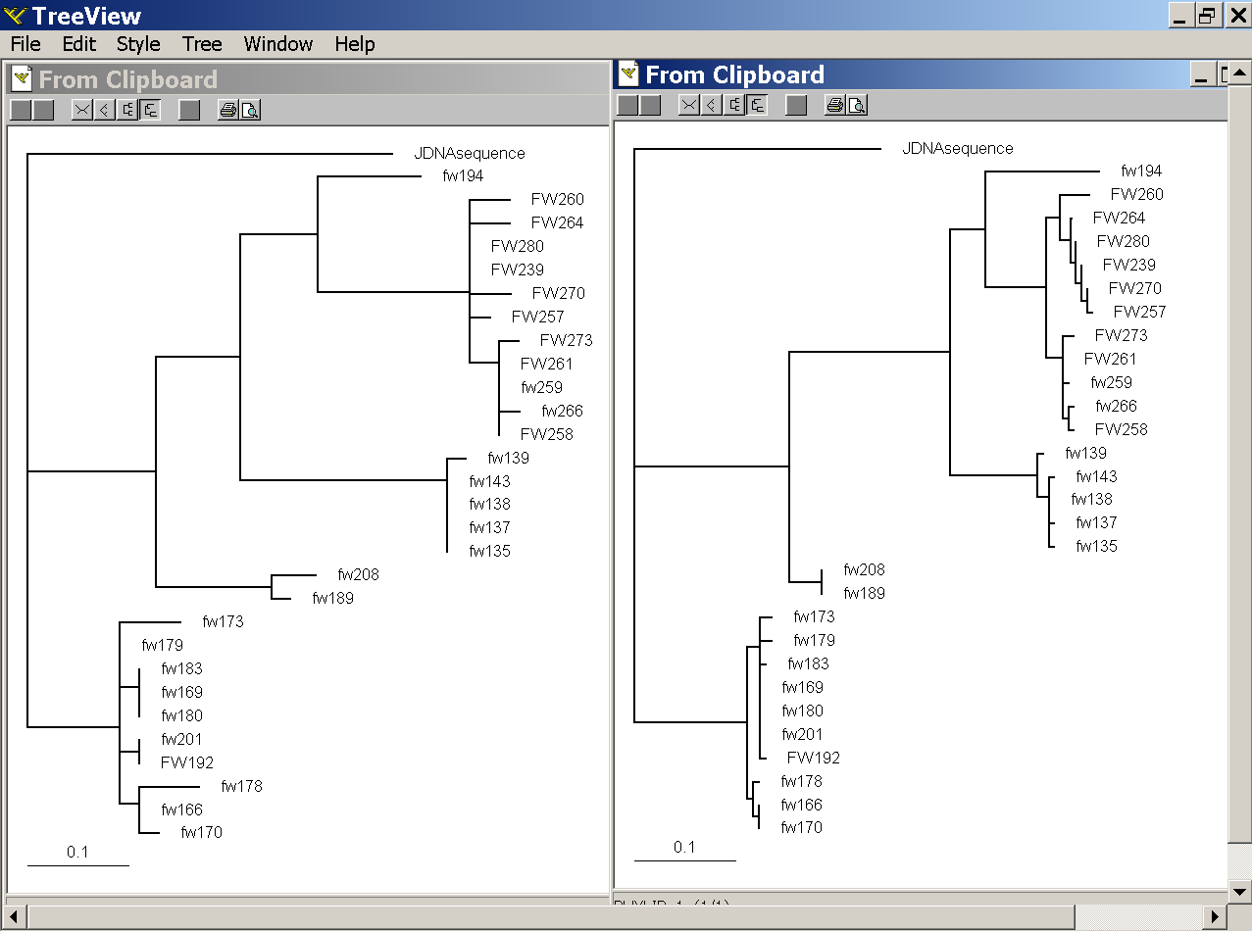
PAML – codeml – branch model
dS -tree
dN -tree

Slide 47
where to get help
read the manuals and help files
check out the discussion boards at http://www.rannala.org/phpBB2/
else
there is a new program on the block called hy-phy
(=hypothesis testing using phylogenetics).
The easiest is probably to run the analyses on the authors datamonkey.

Slide 48
Discussion: Other ways to detect positive selection?
Selective sweep -> fewer alleles present in population
Repeated episodes of positive selection -> high dN
If time discuss http://online.itp.ucsb.edu/online/infobio01/fitch1/

Slide 49
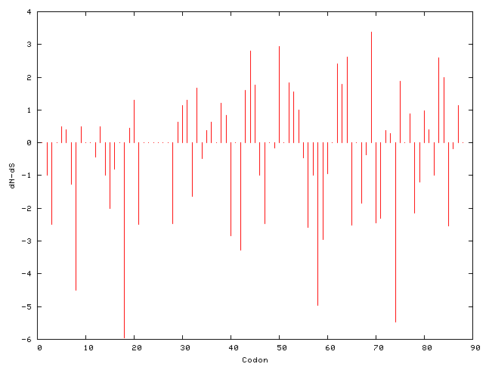
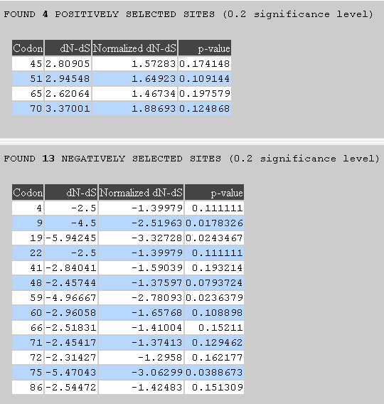
hy-phy
Results of an anaylsis using the SLAC approach
more output might still be here

Slide 50
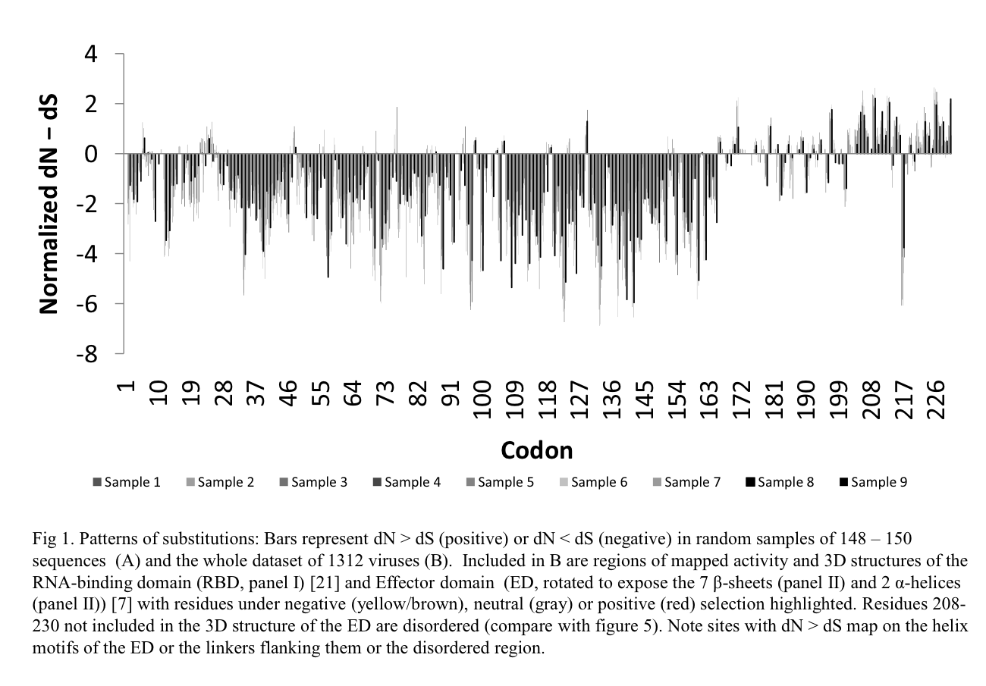

Slide 51

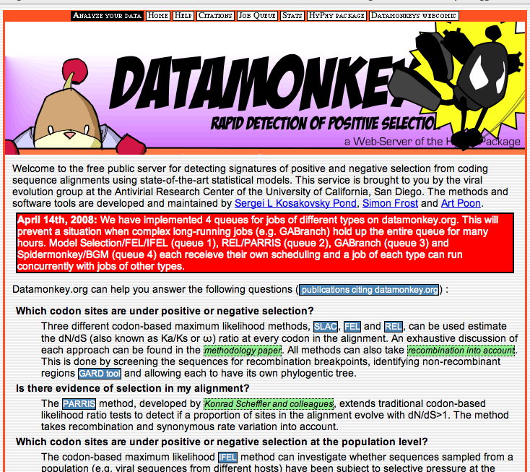
Hy-Phy -
Hypothesis Testing using Phylogenies.
Using Batchfiles or GUI
Information at http://www.hyphy.org/
Selected analyses also can be
performed online at
http://www.datamonkey.org/

Slide 52
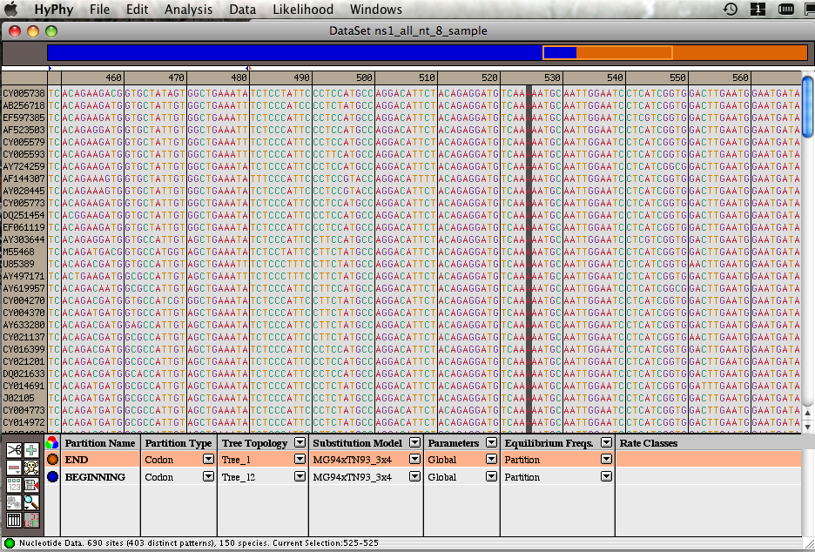
Example testing for dN/dS in two partitions of the data --
John’s dataset
Set up two partitions, define model for each, optimize likelihood

Slide 53
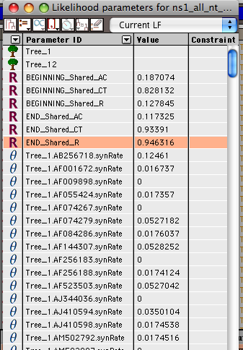
Example testing for dN/dS in two partitions of the data --
John’s dataset
Save Likelihood Function
then
select as alternative
The dN/dS ratios for the two partitions are different.

Slide 54
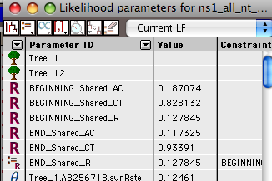
Example testing for dN/dS in two partitions of the data --
John’s dataset
Set up null hypothesis, i.e.:
The two dN/dS are equal
(to do, select both rows and then click the define as equal button on top)

Slide 55
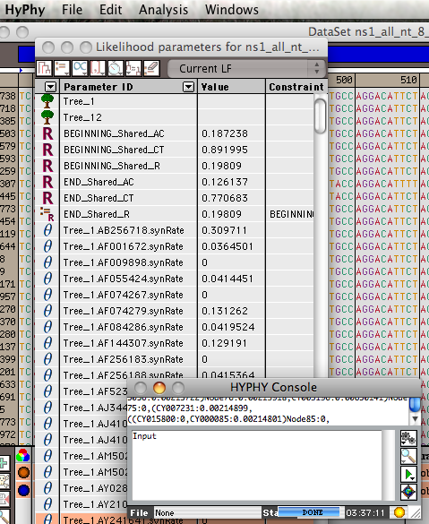
Example testing for dN/dS in two partitions of the data --
John’s dataset

Slide 56
Example testing for dN/dS in two partitions of the data --
John’s dataset
Name and save as
Null-
hyp.

Slide 57
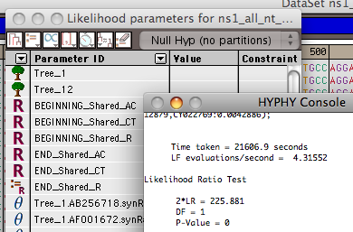
Example testing for dN/dS in two partitions of the data --
John’s dataset
After selecting LRT (= Likelihood Ratio test), the console displays the result, i.e., the beginning and end of the sequence alignment have significantly different dN/dS ratios.

Slide 58
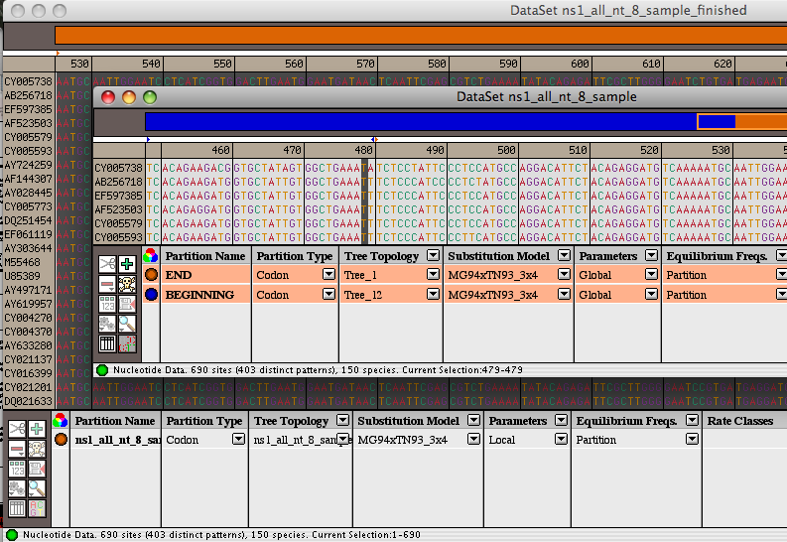
Example testing for dN/dS in two partitions of the data --
John’s dataset
Alternatively, especially if the the two models are not nested, one can set up two different windows with the same dataset:
Model 1
Model 2

Slide 59
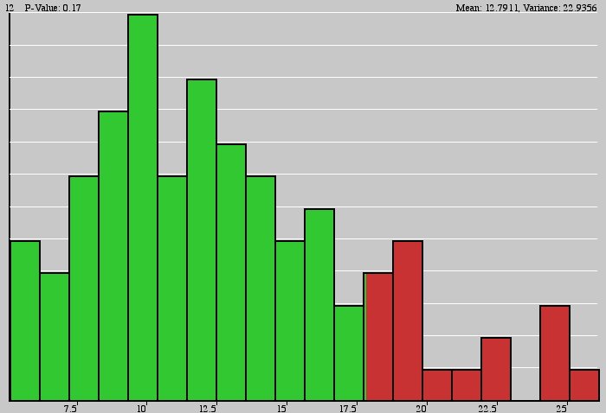
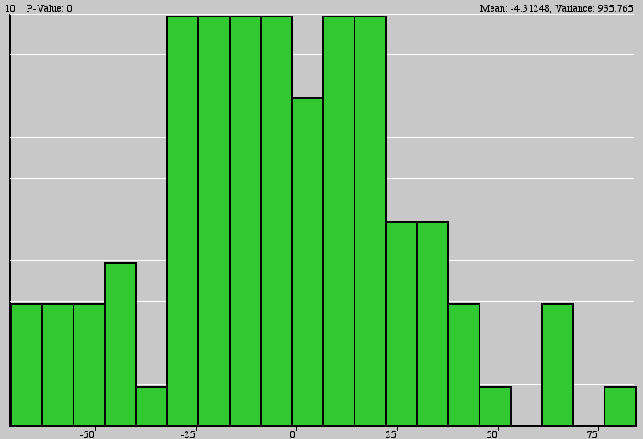
Example testing for dN/dS in two partitions of the data --
John’s dataset
Simulation under model 1, evalutation under model 2, calculate LR
Compare real LR to distribution from simulated LR values. The result might look something like this or this

