Slide 1
MCB 5472
Supertrees vs Supermatrix
Assembly of Gene Families
Peter Gogarten
Office: BSP 404
phone: 860 486-4061,
Email: gogarten@uconn.edu

Slide 2
Next Monday: Class meets in 201
Lab this Wednesday:
dN/dS, or assembly of gene families, or …
Presentations (less than 12 minutes each)
Monday 4/23:
    Shannon Soucy, Ajay Obla, Terrence Shin,
    Allison Kerwin, Jacquelynn Benjamino, Matthew Fullmer
Wednesday 4/25:
    Ursula King, Erin Duffy, Kunica Asija, Corey Bunce,
    Matt Ouellette, Emre Aksoy, Seila Omer,

Slide 3
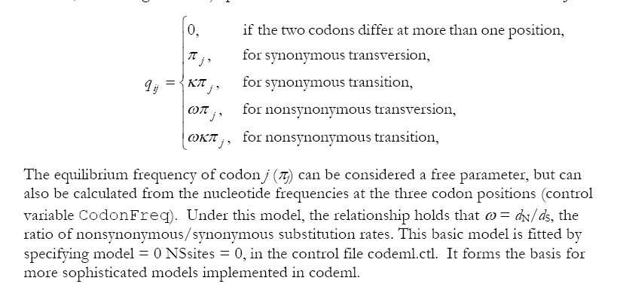
PAML (codeml) the basic model
Paml is available from the author at
http://abacus.gene.ucl.ac.uk/software/paml.html

Slide 4

sites versus branches
You can determine omega for the whole dataset; however, usually not all sites in a sequence are under selection all the time.
PAML (and other programs) allow to either determine omega for each site over the whole tree, ,
or determine omega for each branch for the whole sequence,
.
It would be great to do both, i.e., conclude codon 176 in the vacuolar ATPases was under positive selection during the evolution of modern humans – alas, a single site does not provide any statistics ….

Slide 5
PAML – codeml – sites model (cont.)
the program is invoked by typing codeml followed by the name of a control file that tells the program what to do.
paml can be used to find the maximum likelihood tree, however, the program is rather slow. Phyml is a better choice to find the tree, which then can be used as a user tree.
An example for a codeml.ctl file is codeml.hv1.sites.ctl
This file directs codeml to run three different models:
one with an omega fixed at 1, a second where each site can be either have an omega between 0 and 1, or an omega of 1, and third a model that uses three omegas as described before for MrBayes.
The output is written into a file called Hv1.sites.codeml_out (as directed by the control file).
Point out log likelihoods and estimated parameter line (kappa and omegas)
Additional useful information is in the rst file generated by the codeml
Discuss overall result.

Slide 6
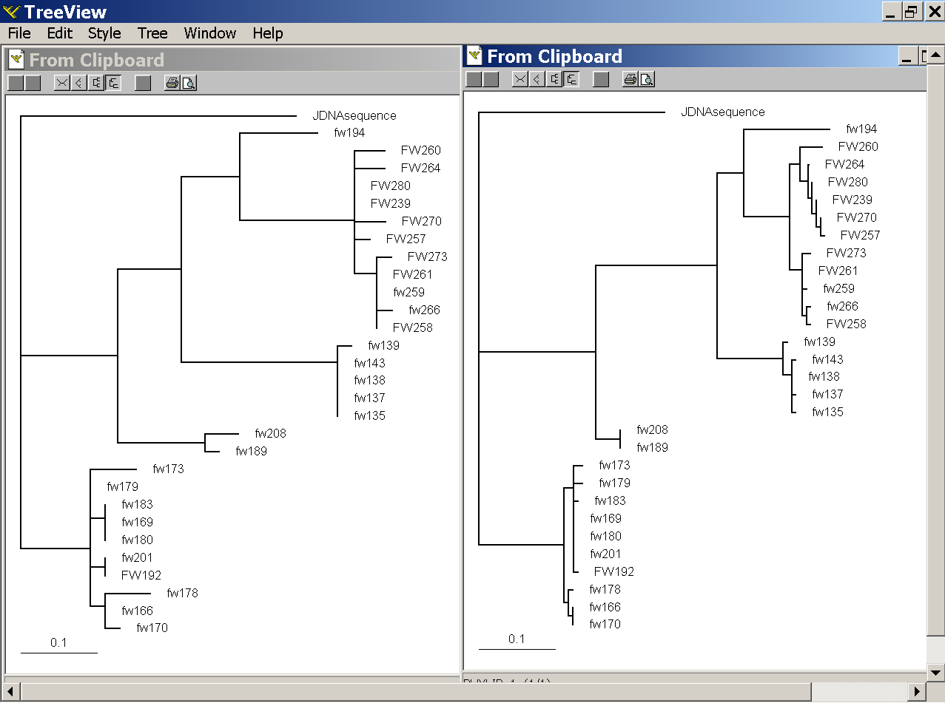
PAML – codeml – branch model
dS -tree
dN -tree

Slide 7
where to get help
read the manuals and help files
check out the discussion board at
https://www.ucl.ac.uk/discussions/viewforum.php?f=54
pal2nal: http://www.bork.embl.de/pal2nal/
else
there is a new program on the block called hy-phy
(=hypothesis testing using phylogenetics).
The easiest is probably to run the analyses on the authors datamonkey.

Slide 8
Discussion: Other ways to detect positive selection?
Selective sweep -> fewer alleles present in population
Repeated episodes of positive selection -> high dN

Slide 9
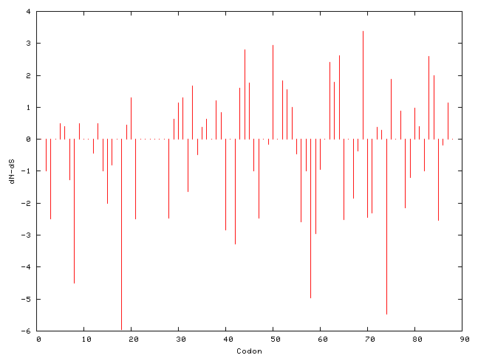
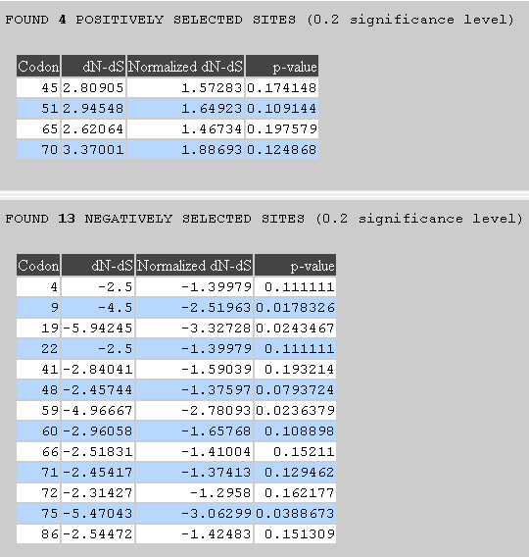
hy-phy
Results of an anaylsis using the SLAC approach

Slide 10
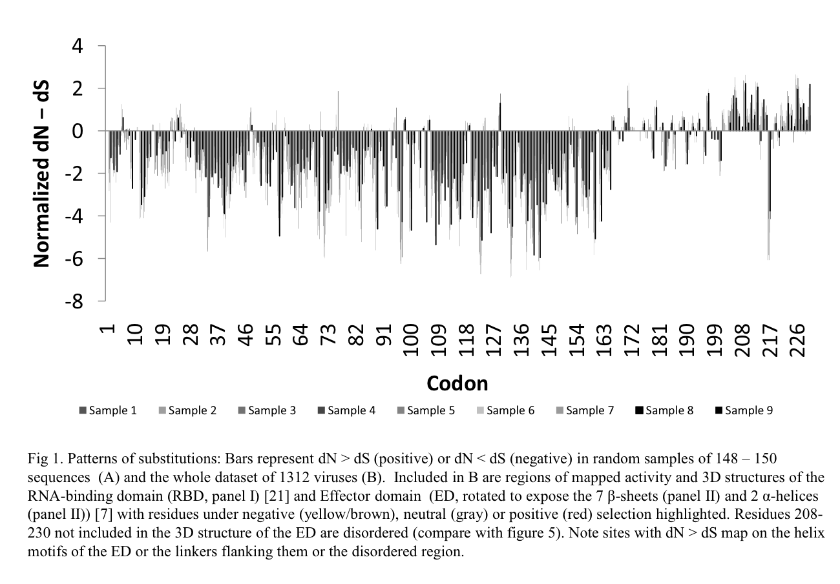

Slide 11

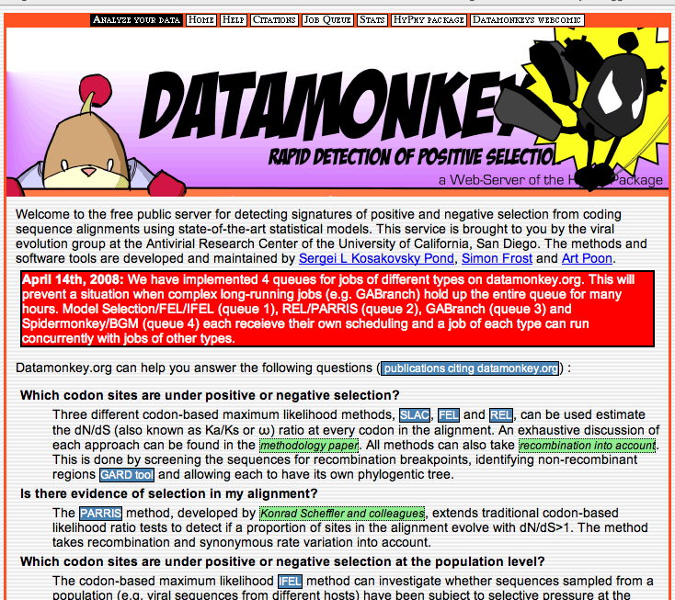
Hy-Phy -
Hypothesis Testing using Phylogenies.
Using Batchfiles or GUI
Information at http://www.hyphy.org/
Selected analyses also can be
performed online at
http://www.datamonkey.org/

Slide 12
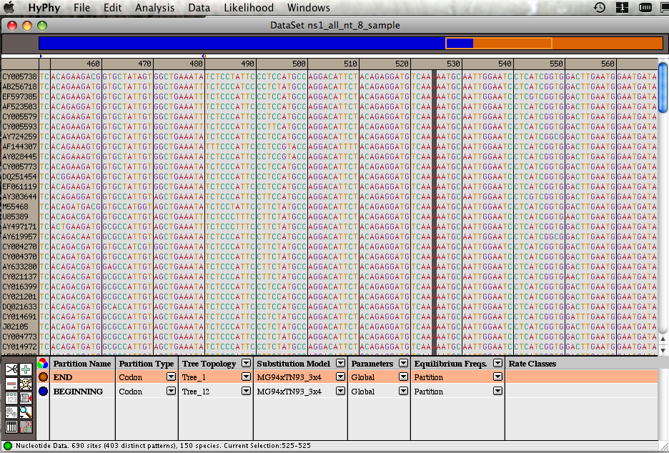
Example testing for dN/dS in two partitions of the data --
John’s dataset
Set up two partitions, define model for each, optimize likelihood

Slide 13
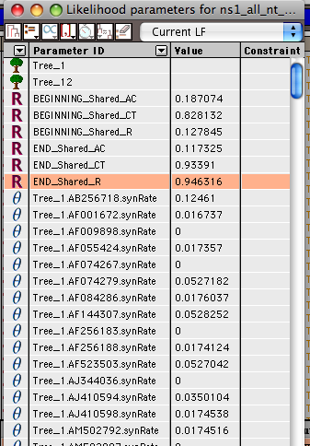
Example testing for dN/dS in two partitions of the data --
John’s dataset
Save Likelihood Function
then
select as alternative
The dN/dS ratios for the two partitions are different.

Slide 14
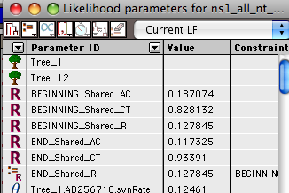
Example testing for dN/dS in two partitions of the data --
John’s dataset
Set up null hypothesis, i.e.:
The two dN/dS are equal
(to do, select both rows and then click the define as equal button on top)

Slide 15
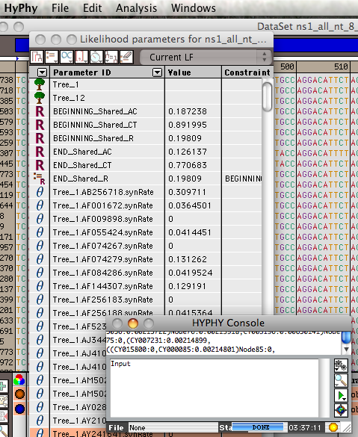
Example testing for dN/dS in two partitions of the data --
John’s dataset

Slide 16
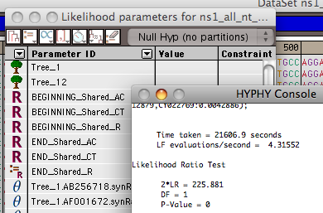
Example testing for dN/dS in two partitions of the data --
John’s dataset
After selecting LRT (= Likelihood Ratio test), the console displays the result, i.e., the beginning and end of the sequence alignment have significantly different dN/dS ratios.

Slide 17
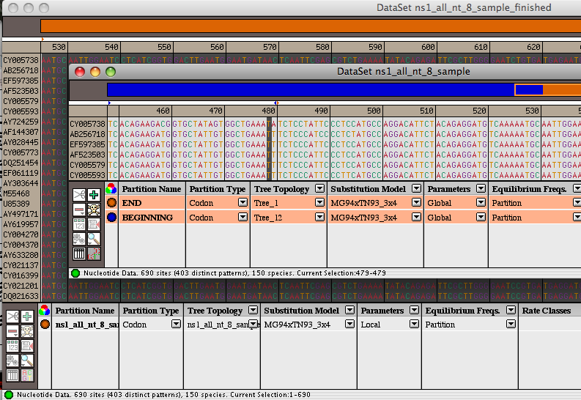
Example testing for dN/dS in two partitions of the data --
John’s dataset
Alternatively, especially if the the two models are not nested, one can set up two different windows with the same dataset:
Model 1
Model 2

Slide 18
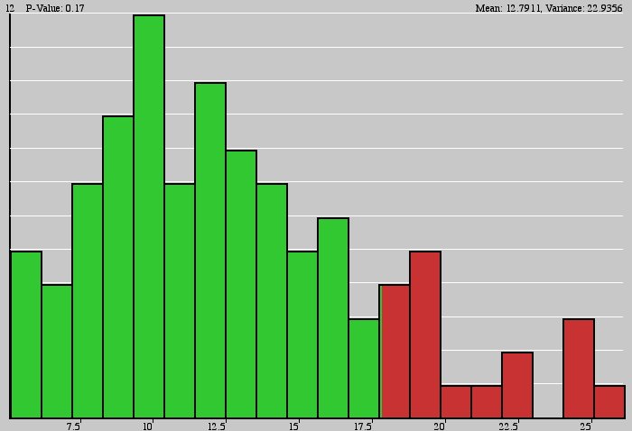
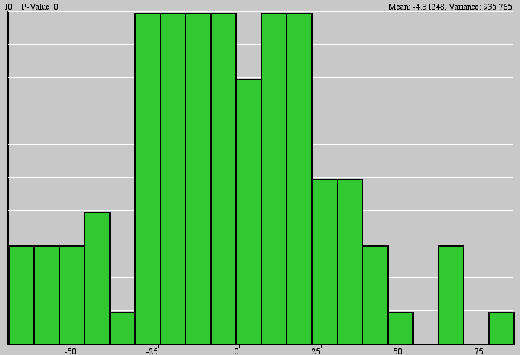
Example testing for dN/dS in two partitions of the data --
John’s dataset
Simulation under model 2, evalutation under model 1, calculate LR
Compare real LR to distribution from simulated LR values. The result might look something like this or this

Slide 19
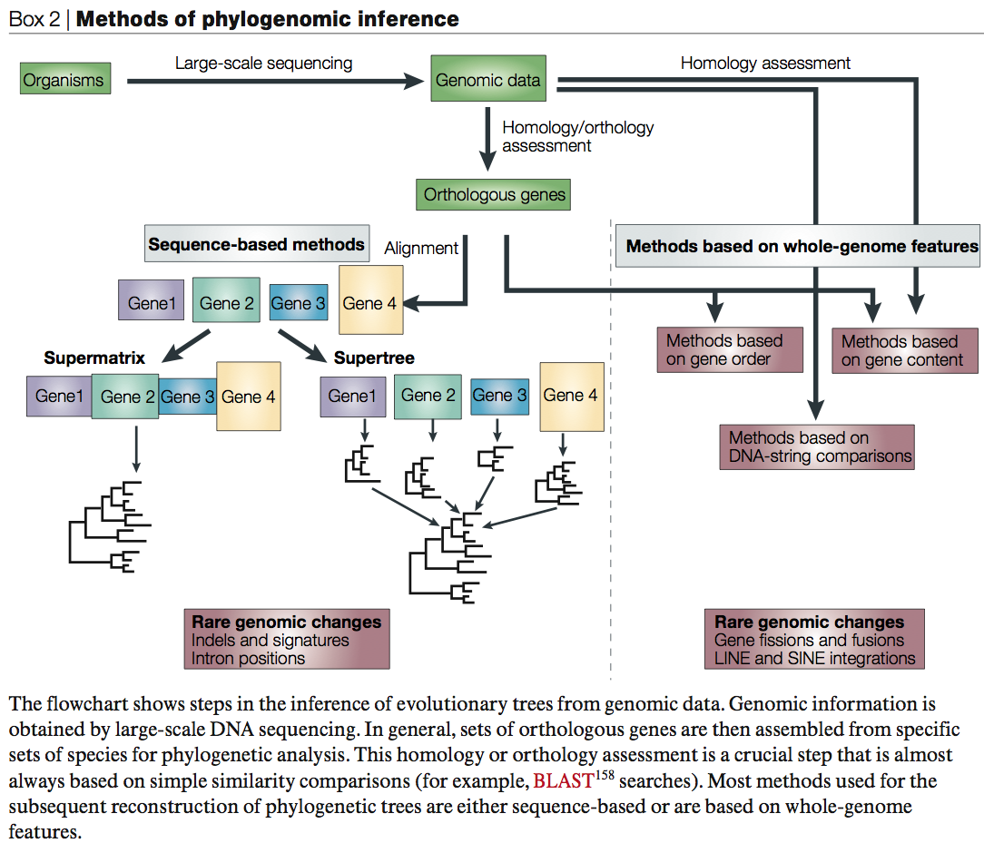
From:
Delsuc F, Brinkmann H, Philippe H.
Phylogenomics and the reconstruction of the tree of life.
Nat Rev Genet. 2005 May;6(5):361-75.

Slide 20
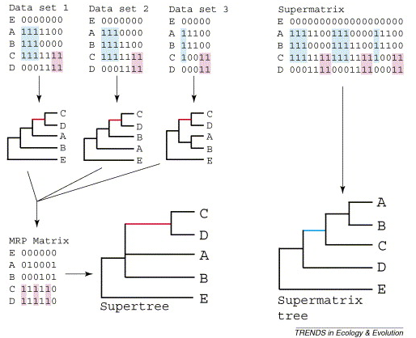
Supertree vs. Supermatrix
From:
Alan de Queiroz John Gatesy:
The supermatrix approach to systematics
Trends Ecol Evol. 2007 Jan;22(1):34-41
Schematic of MRP supertree (left) and parsimony supermatrix (right) approaches to the analysis of three data sets. Clade C+D is supported by all three separate data sets, but not by the supermatrix. Synapomorphies for clade C+D are highlighted in pink. Clade A+B+C is not supported by separate analyses of the three data sets, but is supported by the supermatrix. Synapomorphies for clade A+B+C are highlighted in blue. E is the outgroup used to root the tree.

Slide 21
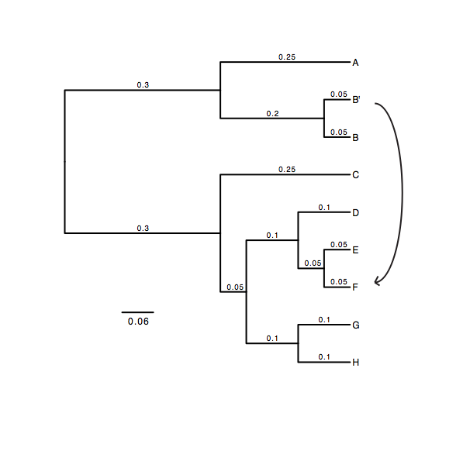
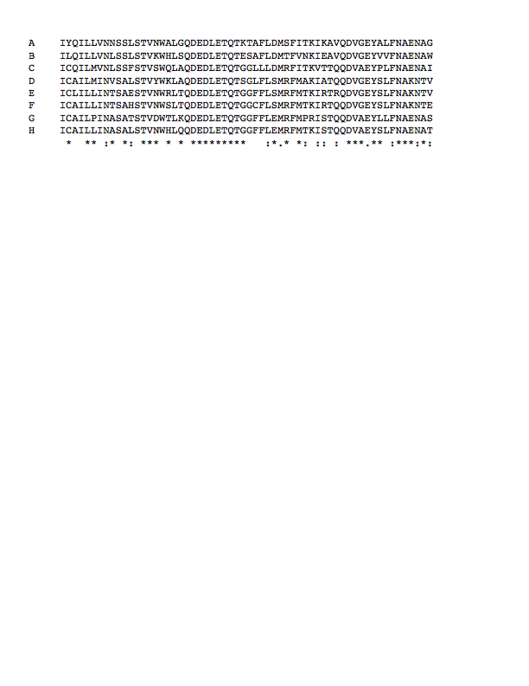
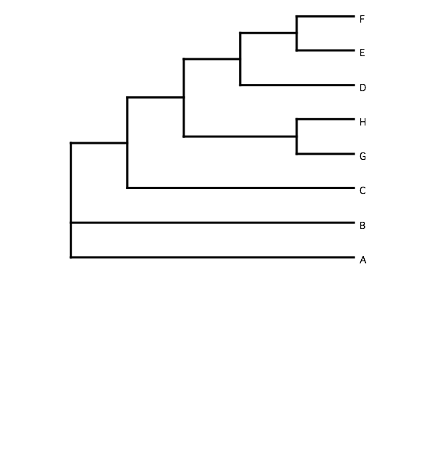
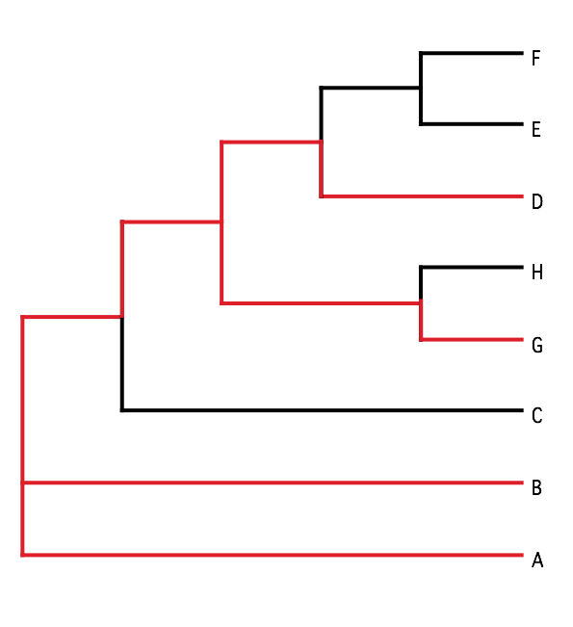
B) Generate 100 datasets using Evolver with certain amount of HGTs
A) Template tree
C) Calculate 1 tree using the concatenated dataset or 100 individual trees
D) Calculate Quartet based tree using Quartet Suite
Repeated 100 times…

Slide 22
Supermatrix versus
Quartet based Supertree
inset: simulated phylogeny

Slide 23
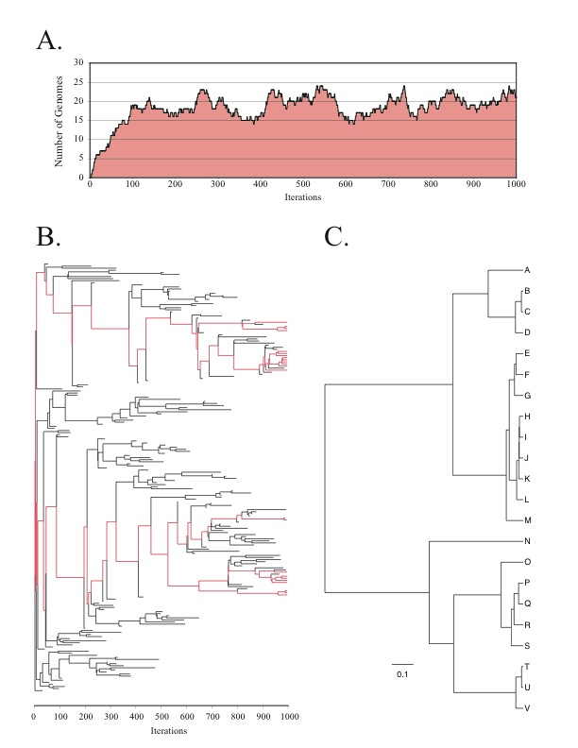
Note : Using same genome seed random number will reproduce same genome history

Slide 24
HGT EvolSimulator Results

Slide 26
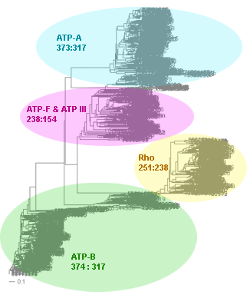
Automated Assembly of Gene Families
Using BranchClust
J. Peter Gogarten
University of Connecticut
Dept. of Molecular and Cell Biol.
Collaborators:
Maria Poptsova (UConn)
Fenglou Mao (UGA)
Funded through the
Edmond J. Safra Bioinformatics Program.
Fulbright Fellowship,
NASA Exobiology Program,
NSF Assembling the Tree of Life Programm and
NASA Applied Information Systems Research Program
Notes:
Title / content
Coauthors
Funding agencies

Slide 27
Why do we need gene families?
Which genes are common between
different species?
Which genes were duplicated in which species?
(Lineage specific gene family expansions)
Do all the common genes share a
common history?
Reconstruct (parts of) the tree/net of life / Detect horizontally transferred genes.

Slide 28
Why do we need gene families?
Help in genome annotation.
Genes in a family should have same annotation across species (usually).
Genes present in almost all genomes of a group of closely related organisms, but absent in one or tow members, might represent genome annotation artifacts.

Slide 29
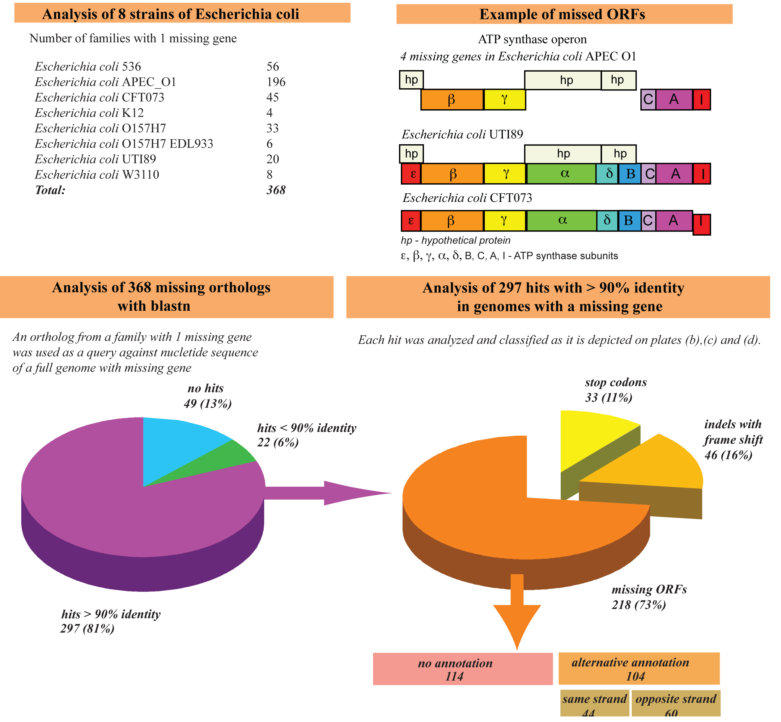
Detecting Errors in Genome Annotation

Slide 30
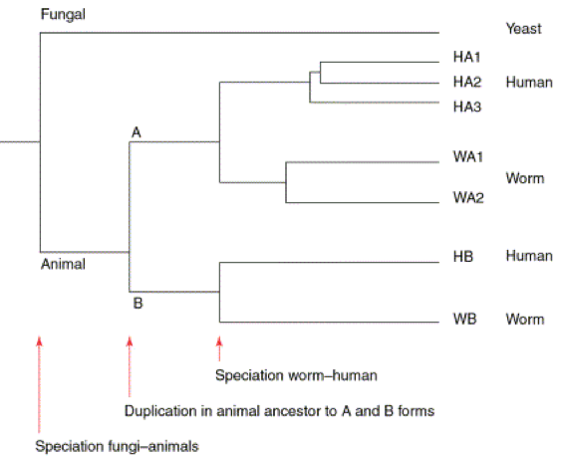
Types of Paralogs: In- and Outparalogs
…. all genes in the HA* set are co-orthologous to all genes in the WA* set. The genes HA* are hence ‘inparalogs’ to each other when comparing human to worm. By contrast, the genes HB and HA* are ‘outparalogs’ when comparing human with worm. However, HB and HA*, and WB and WA* are inparalogs when comparing with yeast, because the animal–yeast split pre-dates the
HA*–HB duplication.
From: Sonnhammer and Koonin: Orthology, paralogy and proposed classification for paralog TIG 18 (12) 2002, 619-620

Slide 31
Selection of Orthologous Gene Families
All automated methods for assembling sets of orthologous genes are based on sequence similarities.
BLAST hits
Triangular circular BLAST significant hits
(COG, or Cluster of Orthologous Groups)
Sequence identity of 30% and greater
(SCOP database)
Similarity complemented by HMM-profile analysis
Pfam database
Reciprocal BLAST hit method

Slide 32
Strict Reciprocal BLAST Hit Method
2’
1
2
1
2
3
4
3
4
1 gene family
0 gene family
often fails in the presence of paralogs

Slide 33
Families of ATP-synthases
Case of 2 bacteria and 2 archaea species
ATP-A (catalytic subunit)
ATP-B (non-catalytic subunit)
Escherichia coli
ATP-A
Escherichia coli
ATP-A
ATP-B
Methanosarcina
mazei
ATP-B
Methanosarcina
mazei
ATP-F
ATP-A
ATP-A
ATP-A
ATP-A
ATP-B
ATP-B
ATP-B
ATP-B
Sulfolobus
solfataricus
Sulfolobus
solfataricus
ATP-A
ATP-A
ATP-B
Bacillus subtilis
ATP-B
ATP-F
Bacillus subtilis
Neither ATP-A nor ATB-B is selected by RBH method

Slide 34
Families of ATP-synthases
Phylogenetic Tree
Family of ATP-A
Sulfolobus solfataricus
ATP-A
Methanosarcina
mazei
Bacillus subtilis
ATP-A
ATP-A
ATP-A
Escherichia coli
Bacillus subtilis
ATP-F
ATP-B
Escherichia coli
ATP-F
Escherichia coli
ATP-B
ATP-B
Bacillus subtilis
ATP-B
Sulfolobus
solfataricus
Family of ATP-F
Methanosarcina
mazei
Family of ATP-B

Slide 35

BranchClust Algorithm
genome 1
genome i
genome 2
BLAST
hits
genome 3
genome N
dataset of N genomes
superfamily
tree
www.bioinformatics.org/branchclust

Slide 36
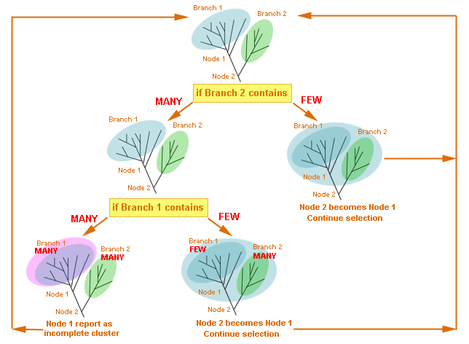
BranchClust Algorithm
www.bioinformatics.org/branchclust

Slide 37
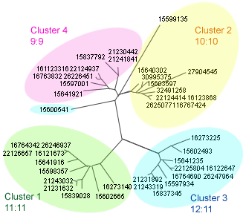
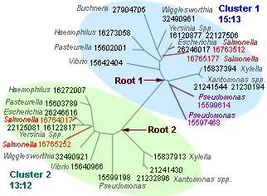
BranchClust Algorithm
Root positions
Superfamily of penicillin-binding protein
Superfamily of DNA-binding protein
13 gamma proteo bacteria
13 gamma proteo bacteria
www.bioinformatics.org/branchclust

Slide 38
BranchClust Algorithm
Comparison of the best BLAST hit method and BranchClust algorithm
Number of taxa - A: Archaea B: Bacteria | Number of selected families:
 | Reciprocal best BLAST hit | BranchClust
2A 2B | 80 | 414 (all complete)
13B | 236 | 409 (263 complete, 409 with n≥8 )
16B 14A | 12 | 126 (60 complete, 126 with n≥24).
www.bioinformatics.org/branchclust

Slide 39
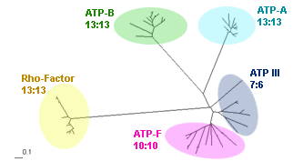
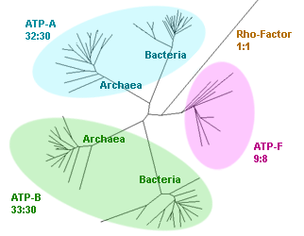
BranchClust Algorithm
ATP-synthases: Examples of Clustering
13 gamma proteobacteria
317 bacteria and archaea
30 taxa: 16 bacteria and 14 archaea
www.bioinformatics.org/branchclust

Slide 40
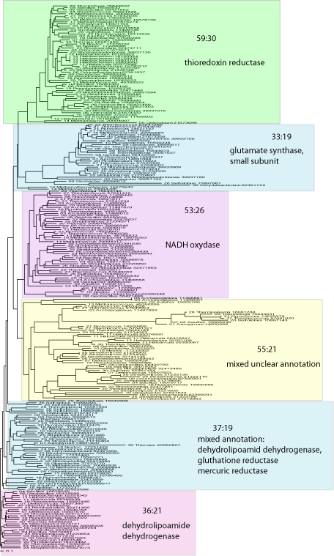
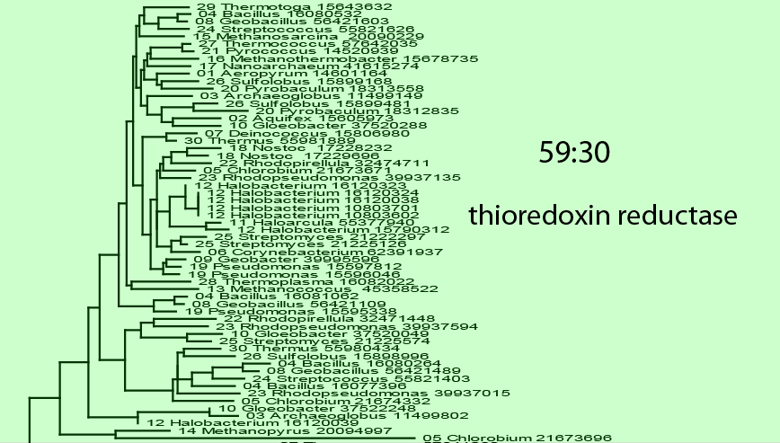
BranchClust Algorithm
Typical Superfamily for 30 taxa (16 bacteria and 14 archaea)
59:30
33:19
53:26
55:21
37:19
36:21
www.bioinformatics.org/branchclust

Slide 41
BranchClust Algorithm
Data Flow
Download n complete genomes (ftp://ftp.ncbi.nlm.nih.gov/genomes/Bacteria)
In fasta format (*.faa)
Align with ClustalW
Reconstruct superfamily tree
ClustalW –quick distance method
Phyml – Maximum Likelihood
Put all n genomes in one database
Search all ORF against database, consisting of n genomes
Parse with BranchClust
Gene families
Parse BLAST-output with the requirement that all members of a superfamily should have an E-value better than a cut-off
Superfamilies
www.bioinformatics.org/branchclust

Slide 42
BranchClust Algorithm
Implementation and Usage
The BranchClust algorithm is implemented in Perl with the use of the BioPerl module for
parsing trees and is freely available at http://bioinformatics.org/branchclust
Required:
1.Bioperl module for parsing trees Bio::TreeIO
2. Taxa recognition file gi_numbers.out must be present in the current directory.
For information on how to create this file, read the Taxa recognition file section on the web-site.
3. Blastall from NCB needs to be installed.
www.bioinformatics.org/branchclust

Slide 43
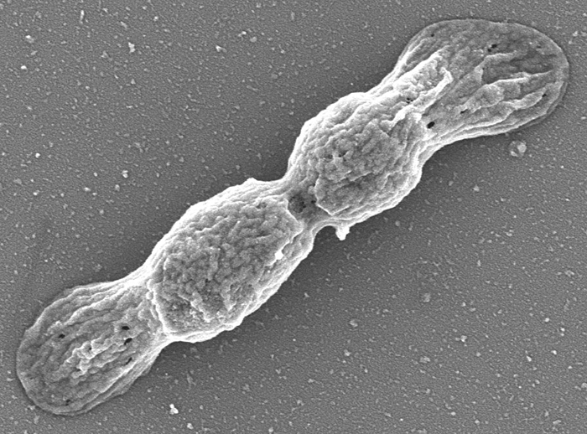
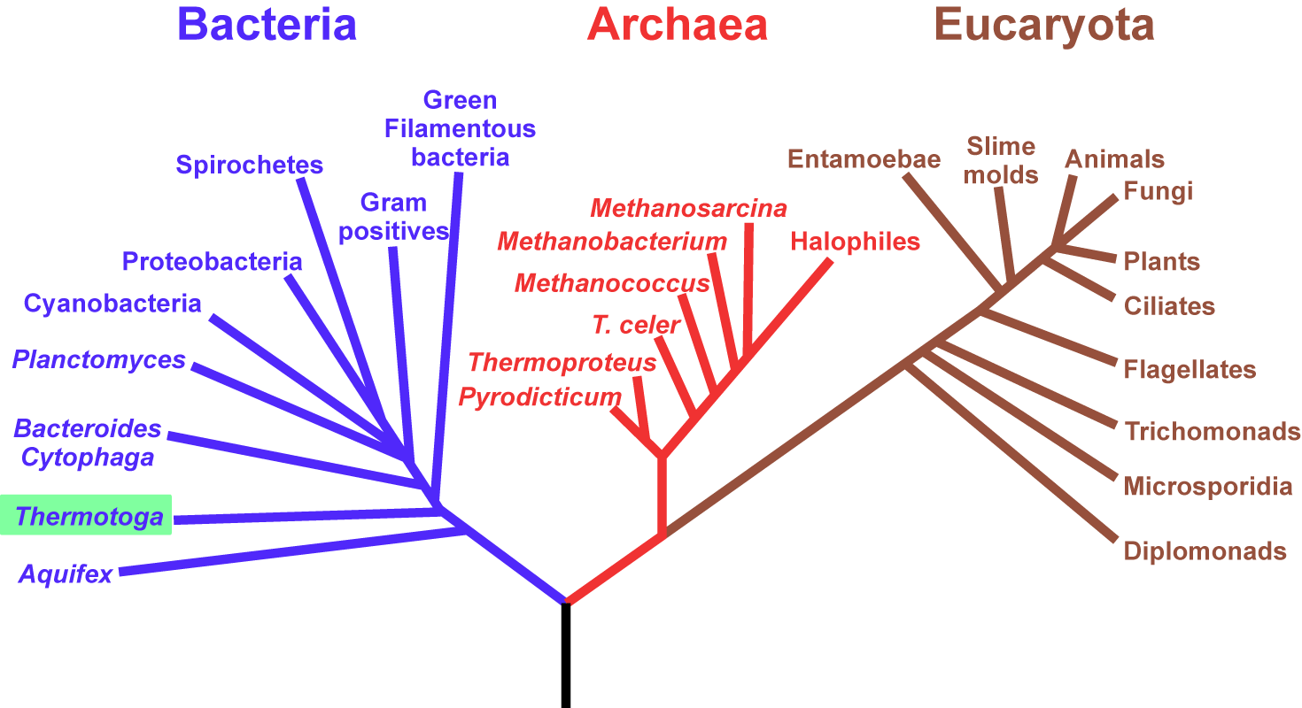
Thermotoga petrophila
Thermotoga maritima
Thermotoga sp. strain RQ2
Thermotoga neapolitana
Thermotoga naphthophila
Kosmotoga olearia. Courtesy of Kenneth Noll, UConn
16S rRNA tree
Source: Wikipedia
Olga Zhaxybayeva, Kristen S. Swithers, Pascal Lapierre, Gregory P. Fournier, Derek M. Bickhart, Robert T. DeBoy, Karen E. Nelson, Camilla L. Nesbø, W. Ford Doolittle, J. Peter Gogarten, and Kenneth M. Noll.
“On the Chimeric Nature, Thermophilic Origin and Phylogenetic Placement of the Thermotogales”, Proc Natl Acad Sci U S A., Online Early, March 23, 2009.

Slide 44
to use other genomes:
The easiest source for other genomes is via anonymous ftp from ftp.ncbi.nlm.nih.gov
Genomes are in the subfolder genomes.
Bacterial and Archaeal genomes are in the subfolder Bacteria
For use with BranchClust you want to retrieve the .faa files from the folders of the individual organisms (in case there are multiple .faa files, download them all and copy them into a single file).
Copy the genomes into the fasta folder in directory where the branchclust scripts are.
To create a table that links GI numbers to genomes run perl extract_gi_numbers.pl or
qsub extract_gi_numbers.sh

Slide 45
to copy files and scripts into your folder
mkdir workshop
cd workshop
mkdir test
cp -R /Users/jpgogarten/workshop/test/* /Users/mcb221_unnn/workshop/test/
This should be one line, and mcb221_u1nnn should be replaced with the name of your home directory.
The –R tells UNIX to copy recursively (including subdirectories)
This command also copies a directory called fasta that contains 5 genomes to work on. If you want to work on different genomes, delete the 5 *.faa files that contain the genomes from the Thermotogales and replace them with the genomes of your choice. (“genomes” really means all the proteins encoded by ORFs present in the genome).

Slide 46
If you use other genomes you will need to generate a file that contains assignments between name of the ORF and the name of the genome. This file should be called gi_numbers.out
If your genomes follow the JGI convention, every ORF starts with a four letters designating the species folloed by 4 numbers identifying the particular ORF. In this case the file
gi_numbers.out should look as follows. It should be straight forward to create this file by hand ☺
Thermotoga maritima | Tmar.....
Thermotoga naphthophila | Tnap.....
Thermotoga neapolitana | Tnea.....
Thermotoga petrophila | Tpet.....
Thermotoga sp. RQ2 | TRQ2.....

Slide 47
If your genomes conform to the NCBI *.faa convention, put the genomes into a subdirectory called fasta, and run the script extract_gi_numbers.pl in the parent directory. (Best is probably
~/workshop/test.)
The script should generate a log file and an output file called gi_numbers.out
Burkholderia phage Bcep781 | 2375.... 4783.... 1179.....
Enterobacteria phage K1F | 7711....
Enterobacteria phage N4 | 1199.....
Enterobacteria phage P22 | 5123.... 9635... 1271.... 193433..
Enterobacteria phage RB43 | 6639....
Enterobacteria phage T1 | 4568....
Enterobacteria phage T3 | 1757....
Enterobacteria phage T5 | 4640....
Enterobacteria phage T7 | 9627...
Kluyvera phage Kvp1 | 2126.....
Lactobacillus phage phiAT3 | 4869....
Lactobacillus prophage Lj965 | 4117....
Lactococcus phage r1t | 2345....
Lactococcus phage sk1 | 9629... 193434..
Mycobacterium phage Bxz2 | 29566...

Slide 48
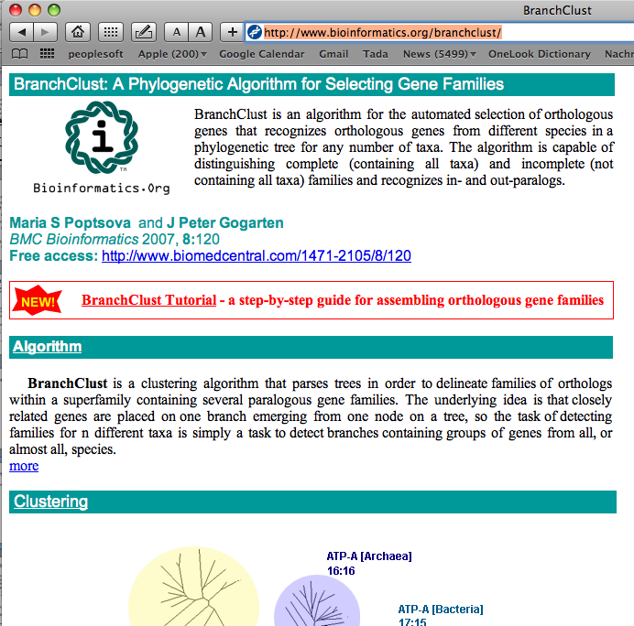
the branchclust scripts
are available at http://www.bioinformatics.org/branchclust/
A copy of the tutorial is
in the folder you copied
into your folder:
BranchClustTutorial.pdf
Consult the tutorial, if
you want to use
branchclust on other
genomes.
The commands we use
today are in a file in the
test folder called
commands workshop tau one script
This is a text file that you can open with any text editor.
(I use textwrangler on my mac, but you might want to use crimson)

Slide 49
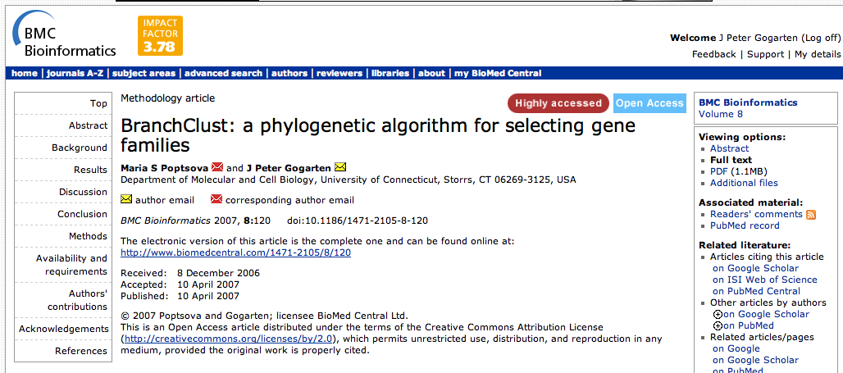
BranchClust Article
is available at
http://www.biomedcentral.com/1471-2105/8/120

Slide 50
Create super families, alignments and trees
vi do_blast.pl
# to see what the parameters are doing type blastall or
# bastall | more at the commandline.
# If you move this to a different computer you might need to change a 2 to a 1
vi parse_blast_cutoff_thermotoga.pl
# change bioperl directory; change cutoff E-value
# the script as written uses the bioperl library in my home directory
# Note: if using closely related genomes, you can cut back on the
# size of the superfamilies by using a smaller E-value
# (if you genomes have normal GI numbers, use
# vi parse_blast_cutoff1.pl)
# check output:
more parsed/all_vs_all.parsed ### type q to leave more
more parsed/all_vs_all.parsed | wc -l
# checks for number of lines=super famiies output

Slide 51
Super Families to Trees
perl parse_superfamilies_singlelink.pl 1
# 1 gives the minimum size of the superfamily
perl prepare_fa_thermotoga.pl parsed/all_vs_all.fam
Creates a multiple fasta file for each superfamily
perl do_clustalw_aln.pl
aligns sequences using clustalw
perl do_clustalw_dist_kimura.pl
calcualtes trees using Kimura distances for all families in fa
#trees stored in trees Check #1, 106, 1027, 111
perl prepare_trees.pl
reformats trees

Slide 52
Branchclust
perl branchclust_all_thermotoga.pl 2
# Parameter 2 (MANY) says that a family needs to have
# at least 2 members.
make_clusterlist.sh
# runs perl make_fam_list_inpar.pl 5 4 0
# results in test called families_inpar_5_4_0.list
# 5: number of genomes;
# 4: number of genomes in cluster ;
# 0: number of inparalogs
# (a 1 returns all the families with exactly 1 inparalog)
# you could add additional lines to the shell script:
# perl make_fam_list_inpar.pl 5 4 1

Slide 53
Process Branchclust output
perl names_for_cluster_all.pl
# (Parses clusters and attaches names.
# Results in sub directory clusters. List in test)
perl summary.pl
# (makes list of number of complete and incomplete families
# file is stored in test)
perl detailed_summary_dashes.pl
# (result in test: detailed_summary.out - can be used in Excel)
perl prepare_bcfam_thermotoga.pl families_inpar_5_4_0.list #(writes multiple fasta files into bcfam subdirectory.
# Can be used for alignment and phylogenetic reconstruction)

Slide 54
Summary Output
done with many = 3 and
E-value cut-off of 10⁻²⁵
complete: 1564
incomplete: 248
total: 1812
------ details -------
incomplete 4: 87
incomplete 3: 53
incomplete 2: 66
incomplete 1: 42

Slide 55
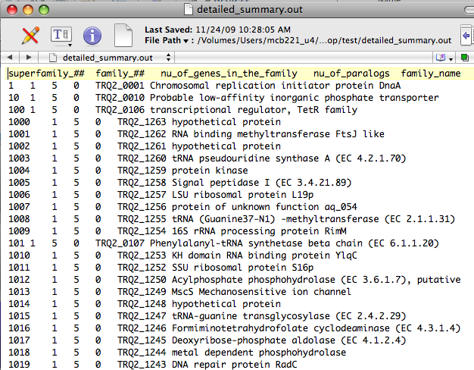
Detailed Summary in Text Wrangler

Slide 56
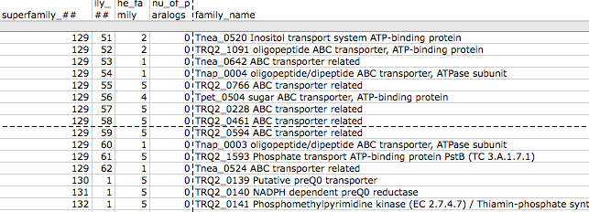
Detailed Summary in Excel
copy detailed summary out onto your computer
In EXEL Menu: Data -> get external data -> import text file ->
in English version use defaults for other options.
In EXEL Menu: Data -> sort -> sort by “superfamily number”-> if asked, check expand selection
Scrolling down the list, search for a superfamily that was broken down into many families.
Do the families that were part of a superfamily have similar annotation lines?
How many of the families were complete?
Do any have inparalogs? Take note of a few super families.

Slide 57
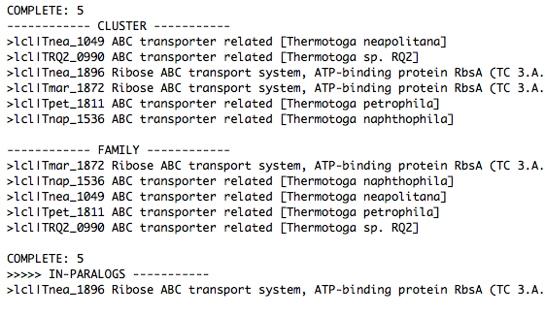
clusters/clusters_NNN.out.names
Check a superfamily of your choice.
Within a family, are all the annotation lines uniform?
Within this report, if there are inparalogs, one is listed as a family member, the other one as inparalog. This is an arbitrary choice, both inparalogs from the same genome should be considered as being part of of the family.
Out of cluster paralogs are paralogs that did not make it into a cluster with “many” genomes.

Slide 58
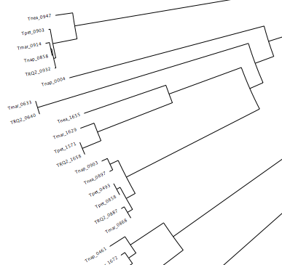
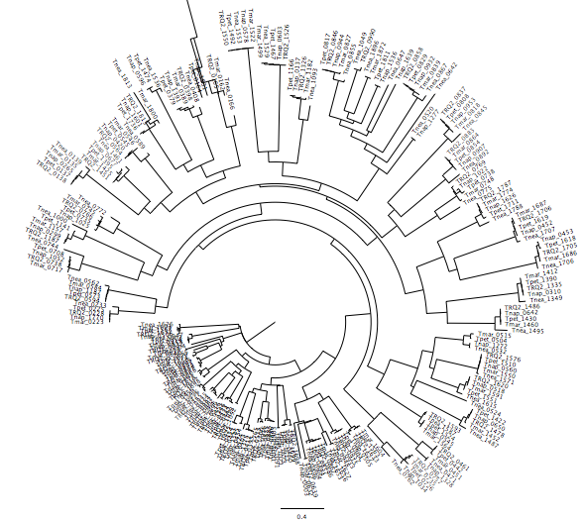
trees/fam_XYZ.tre
Check the tree for a superfamily of your choice. Copy the file to your computer and open it in TreeView, NJPLOT, or FigTree (check with your neighbor on which program works).
For at least one cluster, in the tree, check if branchclust came to the same conclusion you would have reached.

Slide 59
prepare_bcfam_thermotoga.pl families_inpar_5_4_0.list
The script prepare_bcfam_thermotoga.pl takes a list of families (created by make_fam_list_inpar.pl) and for each family retrieves the fasta sequences from the combined genome databank and stores the sequences in the BCfam folder, one multiple sequence file per family.
One possibility for further evaluation is to take multiple sequence files, align the sequences and perform a phylogenetic reconstruction (including boostrap analysis) using programs like phyml or Raxml.
The resulting trees can be analyzed by decomposition and supertree approaches.

Slide 60
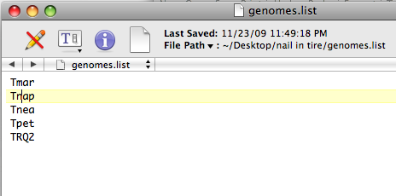
The Quartet Decomposition Server
http://csbl1.bmb.uga.edu/QD/phytree.php
Input A):
a file listing the names of genomes: E.g.:

Slide 61
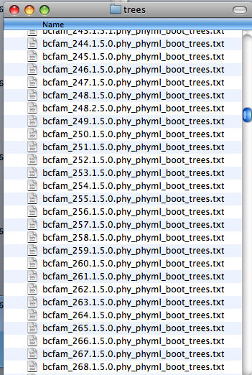
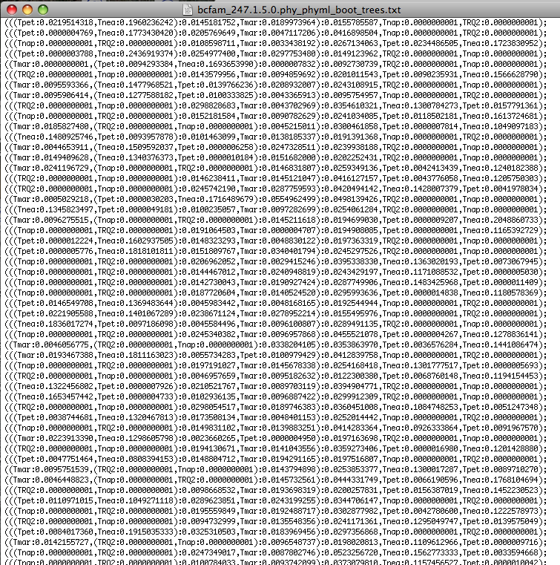
The Quartet Decomposition Server
http://csbl1.bmb.uga.edu/QD/phytree.php
Input B):
An Archive of files where every file contains all the trees that resulted from a bootstrap analysis of one gene family:
One file per family
100 trees per file

Slide 62
The Quartet Decomposition Server
http://csbl1.bmb.uga.edu/QD/phytree.php
Trees from the bootstrap samples should contain branch lengths, but the name for each sequence should be translated to the genome name, using the names in the genome list.
See the following three trees in Newick notation for an example:
(((Tnea:0.1559823230,Tpet:0.0072068797):0.0287486818,Tmar:0.0046676053):0.0407339037,Tnap:0.0000000001,TRQ2:0.0000000001);
(((Tpet:0.0219514318,Tnea:0.1960236242):0.0145181752,Tmar:0.0189973964):0.0155785587,Tnap:0.0000000001,TRQ2:0.0000000001);
(((Tpet:0.0000004769,Tnea:0.1773430420):0.0205769649,Tmar:0.0047117206):0.0416898504,Tnap:0.0000000001,TRQ2:0.0000000001);

Slide 63
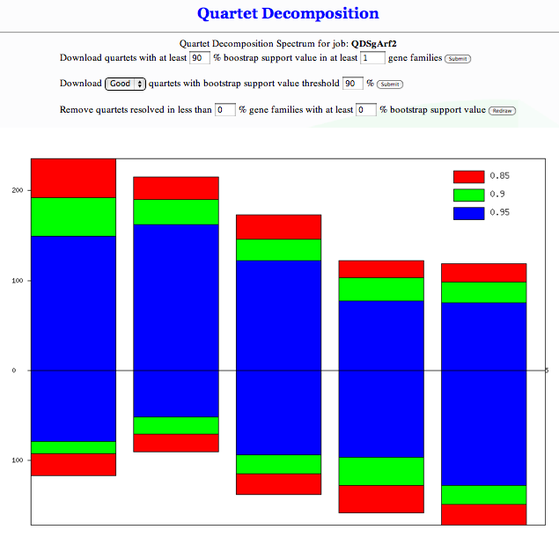
The spectrum http://csbl1.bmb.uga.edu/QD/jobstatus.php?jobid=QDSgArf2&source=0&resolve=0&support=0

Slide 64
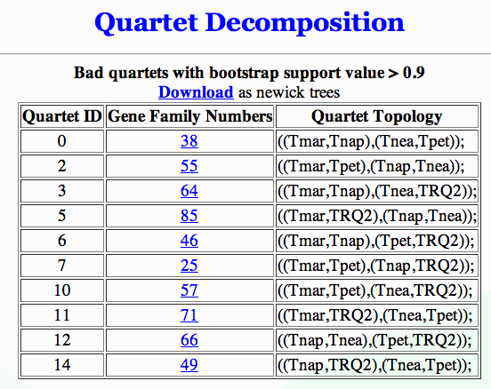
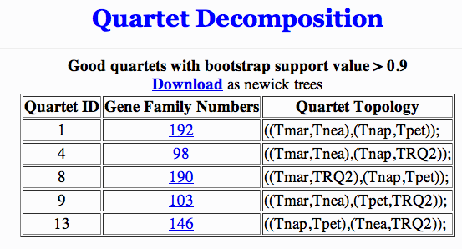
good and bad quartets

Slide 65

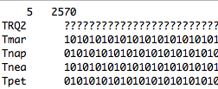

Quartets -> Matrix Representation Using Parsimony
Tmar
Tnea
Tpet
Tnap
…

Slide 66
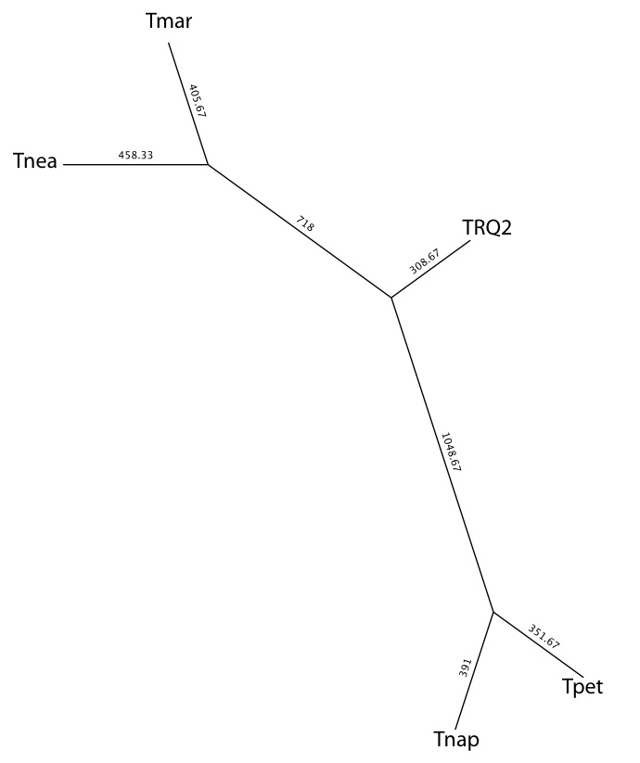
Most Parsimonious Tree (MRP)
Using all Quartets from all Gene Families that have more than 90% bootstrap support

Slide 67
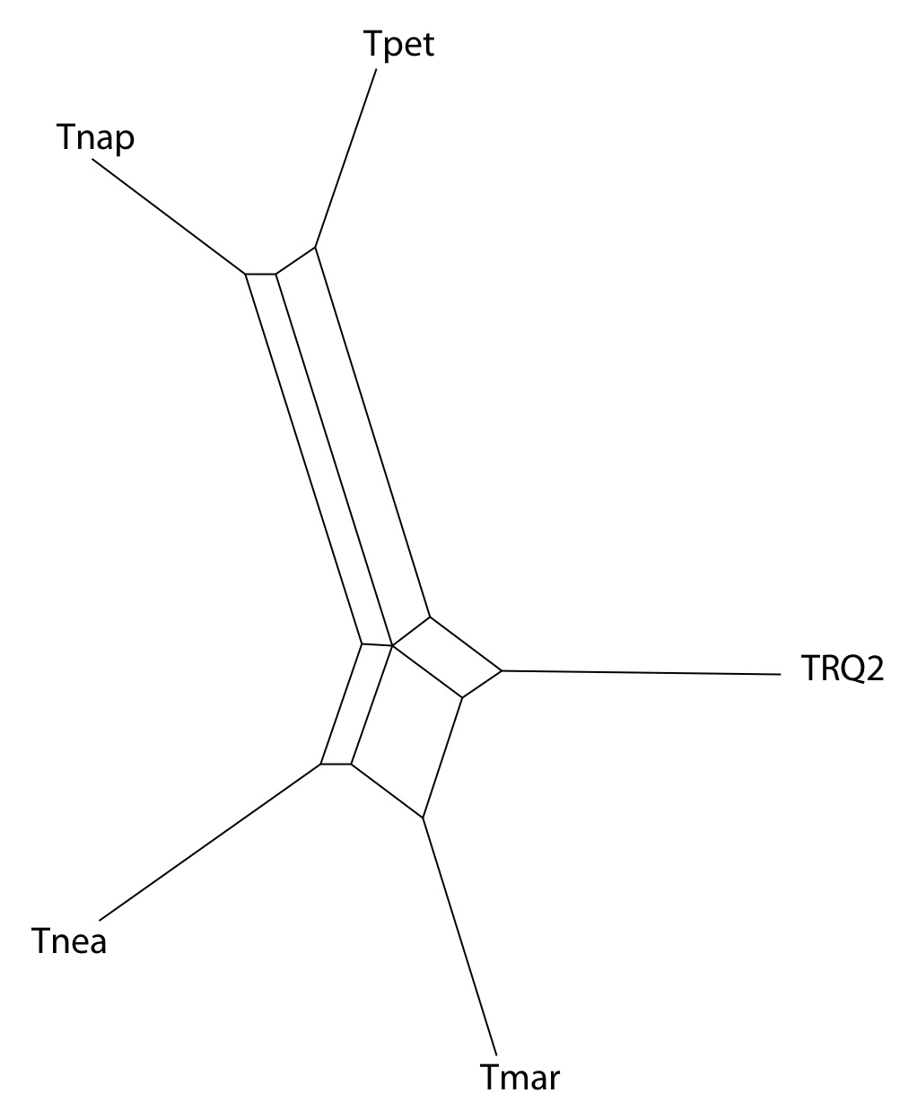
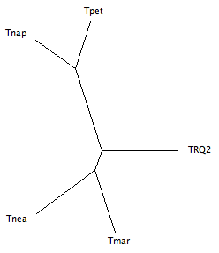
Splits Tree Representation
Using all Quartets from all Gene Families that have more than 90% bootstrap support
Split Decomposition tree
from uncorrected P distances
NJ tree
from uncorrected P distances

