Slide 1
MCB 5472
Blast, Psi BLAST, Perl: Arrays, Loops
J. Peter Gogarten
Office: BPB 404
phone: 860 486-4061,
Email: gogarten@uconn.edu

Slide 2
homology
Two sequences are homologous, if there existed an ancestral molecule in the past that is ancestral to both of the sequences
Types of Homology
Orthologs: “deepest” bifurcation in molecular tree reflects speciation. These are the molecules people interested in the taxonomic classification of organisms want to study.
Paralogs: “deepest” bifurcation in molecular tree reflects gene duplication. The study of paralogs and their distribution in genomes provides clues on the way genomes evolved. Gen and genome duplication have emerged as the most important pathway to molecular innovation, including the evolution of developmental pathways.
Xenologs: gene was obtained by organism through horizontal transfer. The classic example for Xenologs are antibiotic resistance genes, but the history of many other molecules also fits into this category: inteins, selfsplicing introns, transposable elements, ion pumps, other transporters,
Synologs: genes ended up in one organism through fusion of lineages. The paradigm are genes that were transferred into the eukaryotic cell together with the endosymbionts that evolved into mitochondria and plastids (the -logs are often spelled with "ue" like in orthologues)
see Fitch's article in TIG 2000 for more discussion.

Slide 3
Homologs, orthologs, and paralogs
Homologous structures or characters evolved from the same ancestral structure or character that existed in some organism in the past.
Orthologous characters present in two organism (A and B) are homologs that are derived from a structure that existed in the most recent common ancestor (MRCA) of A and B (orthologs often have the same function, but this is NOT part of the definition; e.g. human arms, wings or birds and bats).
Paralogous characters in the same or in two different organisms are homologs that are not derived from the same character in the MRCA, rather they are related (at their deepest node) by a gene duplication event.

Slide 4
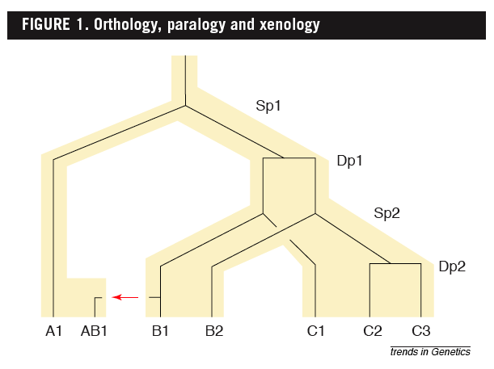
Examples
B1 is an ortholog to C1 and to A1
C2 is a paralog to C3 and to B1;
BUT
A1 is an ortholog to both B1, B2,and to C1, C2, and C3
From: Walter Fitch (2000): Homology: a personal view on some of the problems, TIG 16 (5) 227-231

Slide 5
Uses of Blast in bioinformatics
The Blast web tool at NCBI is limited:
custom and multiple databases are not available
tBlastN (gene prediction) not available
“time-out” before long searches are completed
What if researcher wants to use tBlastN to find all olfactory receptors in the mosquito? Or, if you want to check the presence of a (pseudo)gene in a preliminary genome assembly?
Answer: Use Blast from command-line
Also: The command-line allows the user to run commands repeatedly
by Bob Friedman

Slide 6
Types of Blast searching
blastp compares an amino acid query sequence against a protein sequence database
blastn compares a nucleotide query sequence against a nucleotide sequence database
blastx compares the six-frame conceptual protein translation products of a nucleotide query sequence against a protein sequence database
tblastn compares a protein query sequence against a nucleotide sequence database translated in six reading frames
tblastx compares the six-frame translations of a nucleotide query sequence against the six-frame translations of a nucleotide sequence database.
by Bob Friedman

Slide 7
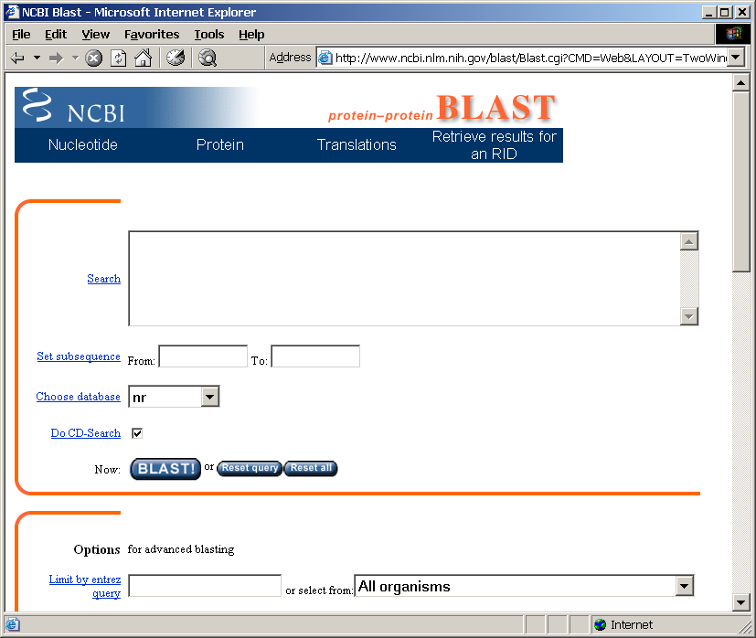
Routine BlastP search
FASTA formatted text
or Genbank ID#
Protein database
Run
by Bob Friedman

Slide 8
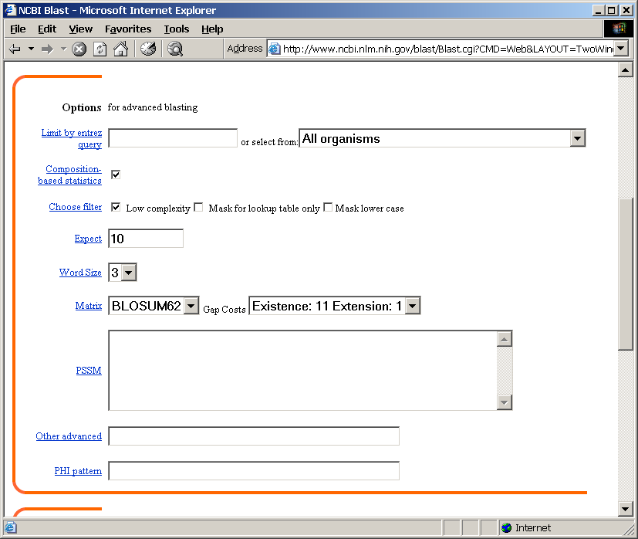
BlastP parameters
Restrict by taxonomic
group
Filter repetitive regions
Statistical cut-off
Size of words in look-up table
Similarity matrix (cost of gaps)
by Bob Friedman

Slide 9
Establishing a significant “hit”
Blast’s E-value indicates statistical significance of a sequence match
Karlin S, Altschul SF (1990) Methods for assessing the statistical significance of molecular sequence features by using general scoring schemes. PNAS 87:2264-8
E-value is the Expected number of sequence (HSPs) matches in database of n number of sequences
database size is arbitrary
multiple testing problem
E-value calculated from many assumptions
so, E-value is not easily compared between searches of different databases
Examples:
E-value = 1 = expect the match to occur in the database by chance 1x
E-value = .05 = expect 5% chance of match occurring
E-value = 1x10⁻²⁰ = strict match between protein domains
by Bob Friedman

Slide 10
When are two sequences significantly similar? PRSS
One way to quantify the similarity between two sequences is to
1. compare the actual sequences and calculate an alignment score
2. randomize (scramble) one (or both) of the sequences and calculate the alignment score for the randomized sequences.
3. repeat step 2 at least 100 times
4. describe distribution of randomized alignment scores
5. do a statistical test to determine if the score obtained for the real sequences is significantly better than the score for the randomized sequences
z-values give the distance between the actual alignment score and the mean of the scores for the randomized sequences expressed as multiples of the standard deviation calculated for the randomized scores. For example: a z-value of 3 means that the actual alignment score is 3 standard deviations better than the average for the randomized sequences. z-values > 3 are usually considered as suggestive of homology, z-values > 5 are considered as sufficient demonstration.

Slide 11
E-values and significance
Usually E values larger than 0.0001 are not considered as demonstration of homology.
For small values the E value gives the probability to find a match of this quality in a search of a databank of the same size by chance alone.
E-values give the expected number of matches with an alignment score this good or better, P-values give the probability of to find a match of this quality or better. P values are [0,1], E-values are [0,infinity). For small values E=P
Problem: If you do 1000 blast searches, you expect one match due to chance with a P-value of 0.0001
“One should” use a correction for multiple tests, like the Bonferroni correction.

Slide 12
Psi-Blast: Detecting structural homologs
Psi-Blast was designed to detect homology for highly divergent amino acid sequences
Psi = position-specific iterated
Psi-Blast is a good technique to find “potential candidate” genes
Example: Search for Olfactory Receptor genes in Mosquito genome
Hill CA, Fox AN, Pitts RJ, Kent LB, Tan PL, Chrystal MA, Cravchik A, Collins FH, Robertson HM, Zwiebel LJ (2002) G protein-coupled receptors in Anopheles gambiae. Science 298:176-8
by Bob Friedman

Slide 13
Psi-Blast Model
Model of Psi-Blast:
1. Use results of gapped BlastP query to construct a multiple sequence alignment
2. Construct a position-specific scoring matrix from the alignment
3. Search database with alignment instead of query sequence
4. Add matches to alignment and repeat
Similar to Blast, the E-value in Psi-Blast is important in establishing matches
E-value defaults to 0.001 & Blosom62
Psi-Blast can use existing multiple alignment - particularly powerful when the gene functions are known (prior knowledge) or use RPS-Blast database
by Bob Friedman

Slide 14
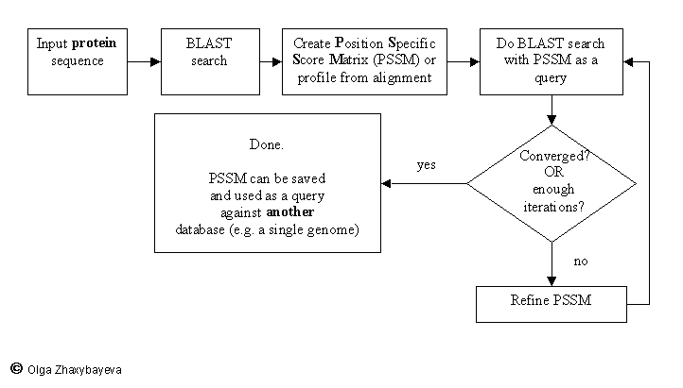
PSI BLAST scheme

Slide 15
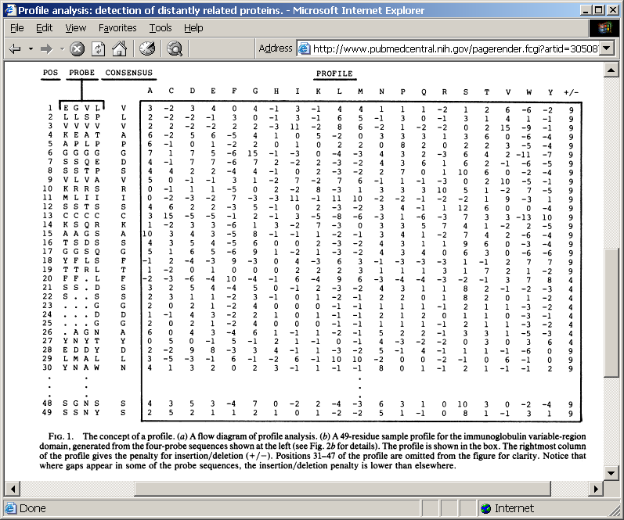
Position-specific Matrix
by Bob Friedman
M Gribskov, A D McLachlan, and D Eisenberg (1987) Profile analysis: detection of distantly related proteins. PNAS 84:4355-8.

Slide 16
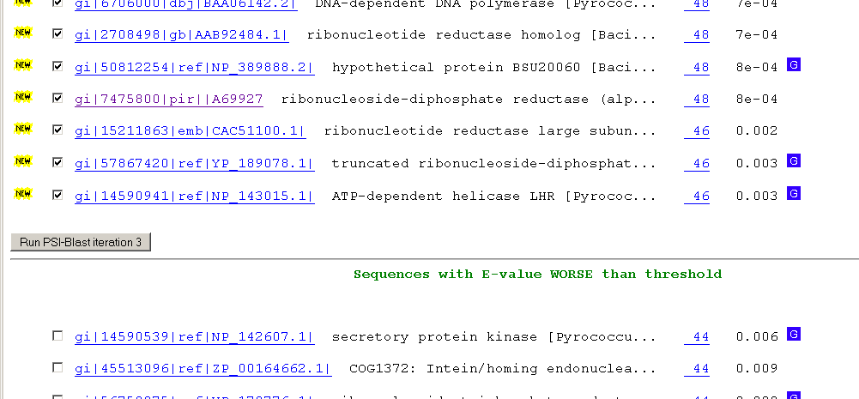
Psi-Blast Results
Query: 55670331 (intein)
link to sequence here, check BLink ☺

Slide 17
PSI BLAST and E-values!
Psi-Blast is for finding matches among divergent sequences (position-specific information) WARNING: For the nth iteration of a PSI BLAST search, the E-value gives the number of matches to the profile NOT to the initial query sequence! The danger is that the profile was corrupted in an earlier iteration.

Slide 18
PSI Blast from the command line
Often you want to run a PSIBLAST search with two different databanks - one to create the PSSM, the other to get sequences: To create the PSSM:
blastpgp -d nr -i subI -j 5 -C subI.ckp -a 2 -o subI.out -h 0.00001 -F f
blastpgp -d swissprot -i gamma -j 5 -C gamma.ckp -a 2 -o gamma.out -h 0.00001 -F f
Runs a 4 iterations of a PSIblast
the -h option tells the program to use matches with E <10^-5 for the next iteration, (the default is 10⁻³ )
-C creates a checkpoint (called subI.ckp),
-o writes the output to subI.out,
-i option specifies input as using subI as input (a fasta formated aa sequence).
The nr databank used is stored in /common/data/
-a 2 use two processors
(It might help to use the node with more memory (017)
(command is ssh node017)

Slide 19
To use the PSSM:
blastpgp -d /Users/jpgogarten/genomes/msb8.faa -i subI -a 2 -R subI.ckp -o subI.out3 -F f
blastpgp -d /Users/jpgogarten/genomes/msb8.faa -i gamma -a 2 -R gamma.ckp -o gamma.out3 -F f
Runs another iteration of the same blast search, but uses the databank /Users/jpgogarten/genomes/msb8.faa
-R tells the program where to resume
-d specifies a different databank
-i input file - same sequence as before
-o output_filename
-a 2 use two processors

Slide 20
PSI Blast and finding gene families within genomes
use PSSM to search genome:
Use protein sequences encoded in genome as target:
blastpgp -d target_genome.faa -i query.name -a 2 -R query.ckp -o query.out3 -F f
B) Use nucleotide sequence and tblastn. This is an advantage if you are also interested in pseudogenes, and/or if you don’t trust the genome annotation:
blastall -i query.name -d target_genome_nucl.ffn -p psitblastn -R query.ckp

Slide 21
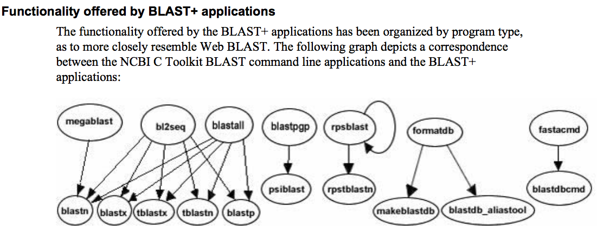
The NCBI has released a new version of blast. The command line version is blast+ .
The new version is faster and allows for more flexibility, both versions should be running it on the cluster.
The new commands are equivalent to the blastall commmands:

Slide 22
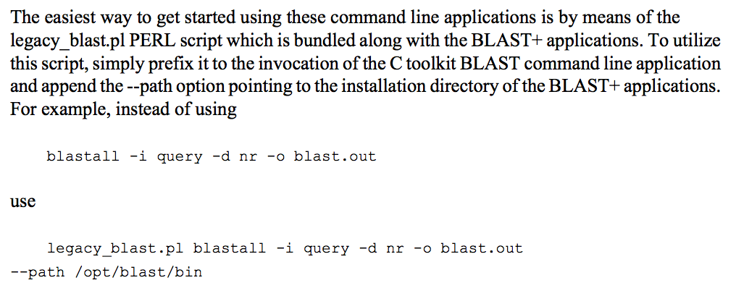
The legacy_blast.pl script that is part of blast+ translates blastall commands into the blast+ syntax. E.g.:
$ ./legacy_blast.pl megablast -i query.fsa -d nt -o mb.out --print_only
/opt/ncbi/blast/bin/blastn -query query.fsa -db "nt" -out mb.out $
From the blast+ manual:

Slide 23
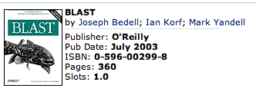
More on blastall:
available at safari books online
http://proquestcombo.safaribooksonline.com/
Installation instructions and info on parameters at the NCBI:
http://www.ncbi.nlm.nih.gov/staff/tao/URLAPI/blastall/
ftp://ftp.ncbi.nlm.nih.gov/blast/documents/formatdb.html
ftp://ftp.ncbi.nlm.nih.gov/blast/documents/blast.html
ftp://ftp.ncbi.nlm.nih.gov/blast/documents/blastpgp.html
ftp://ftp.ncbi.nlm.nih.gov/blast/documents/fastacmd.html
ftp://ftp.ncbi.nlm.nih.gov/blast/documents/
http://en.wikipedia.org/wiki/BLAST

Slide 24
Old assignments:
What is the difference between a compiler and an interpreter?
A compiler takes program and translates it in low level executable language/code.
An interpreter goes through a program line by line and executes commands.
The traditional distinction between compiled and interpreted languages is being blurred.
2) When is it useful to make a script executable, when not?
You save a little bit of typing when you make it executable, but else it is pretty equivalent. (If you start the program with $ perl script_name.pl, you don’t need the shebang line. But the –w flag to use warnings is recognized.
Comments on use strict; and use warnings,.

Slide 25
Old assignments:
3) What is the value of $i after each of the following operations?
$i=1;
$i++;
$i *= $i;
$i .= $i;
$i = $i/11;
$i = $i . “score and” . $i+3;
First make a guess, then test your prediction using a script.

Slide 26
#!/usr/bin/perl #-w
my $i='';
print "\$i= $i\n";
$i = 1;
print "\$i= $i\n";
$i++;
print "\$i= $i\n";
$i *= $i;
print "\$i= $i\n";
$i .= $i;
print "\$i= $i\n";
$i = $i/11;
print "\$i= $i\n";
$i = $i . "score and" . $i+3 ;
print "\$i= $i\n";
$i = $i+3 . "score and" . $i;
print "\$i= $i\n";
$i=
$i= 1
$i= 2
$i= 4
$i= 44
$i= 4
$i= 7
$i= 10score and7
discuss and run test.pl with and without –w flag

Slide 27
Discuss and run the hello_world script with variable and input
hello_world_variable.pl

Slide 28
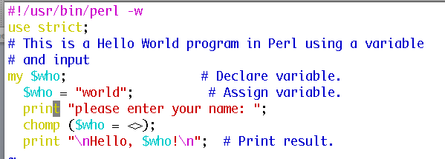
Discuss and run the hello_world script with variable and input
hello_world_variable_input.pl

Slide 29
Old assignments:
4) If $a = 2 and $b=3, what is the type and values of the scalar stored in $c after each of the following statements:
$c = $a + $b;
$c = $a / $b;
$c = $a . $b;
$c = "$a + $b";
$c = '$a + $b';
First make a guess, then test your prediction using a script.

Slide 30
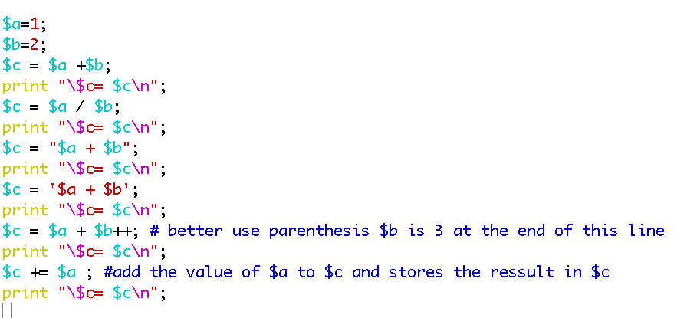
$c= 3
$c= 0.5
$c= 1 + 2
$c= $a + $b
$c= 3
$c= 4
Run and discuss test2.pl

Slide 31
2) Why does the first of these get along without chomp ($line); (chomp is a built-in command in Perl to remove a trailing newline, if any, from a string).
3) Write a short Perl script that calculates the circumference of a circle given a radius provided by the user.

Slide 32
2) Why does the first of these get along without chomp ($line); (chomp is a built-in command in Perl to remove a trailing newline, if any, from a string).
3) Write a short Perl script that calculates the circumference of a circle given a radius provided by the user.
The best way to find which module to use is google. You can search core modules at http://perldoc.perl.org/search.html?

Slide 33
From Wednesday: For the following array declaration @myArray = ('A', 'B', 'C', 'D', 'E'); what is the value of the following expressions: $#myArray length(@myArray) $myArray[1] $n=@myArray reverse (@myArray)
4
1
B
5
EDCBA
Run and discuss myArray.pl

Slide 34
Assignment for Monday (class 4)
Write a 2 sentence outline for your student project
Read chapter P5 and P12 conditional statements and on “for, foreach, and while” loops. http://korflab.ucdavis.edu/Unix_and_Perl/unix_and_perl_v2.3.3.pdf
Background: @a=(0..50); # This assigns numbers from 0 to 50 to an array, # so that $a[0] =0; $a[1] =1; $a[50] =50
3) Write perl scripts that add all numbers from 1 to 50. Try to do this using at least two different control structures.
4) Create a program that reads in a sequence stored in a file handed to the program on the command line and determines GC content of a sequence. Use class3.pl as a starting point.

Slide 35
5)
For the following array declaration @myArray = ('A', 'B', 'C', 'D', 'E');
what is the value of the following expressions: $#myArray length(@myArray) $myArray[1] $n=@myArray reverse (@myArray)
6)
Create a program that reads in a sequence stored in a file handed to the program on the command line and determines GC content of a sequence.
Details in class3.pl. See the challenge!

Slide 36
Go through class3.pl script.
Coding sequences example:
http://www.ncbi.nlm.nih.gov/protein/AEE95833.1
Ctrl click open CDS in new window.
If time do
chomp_example.pl (also in scripts)

